Slide 1
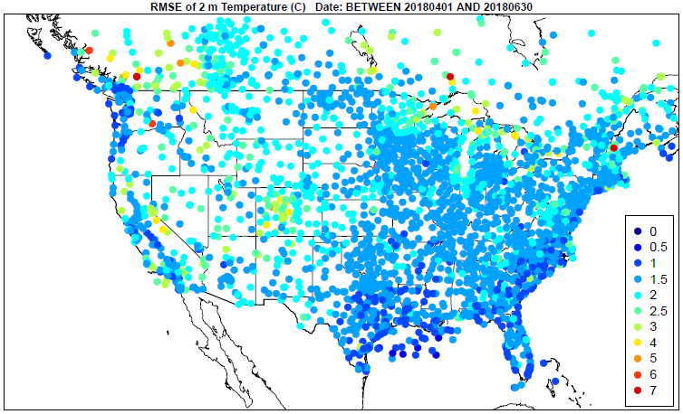
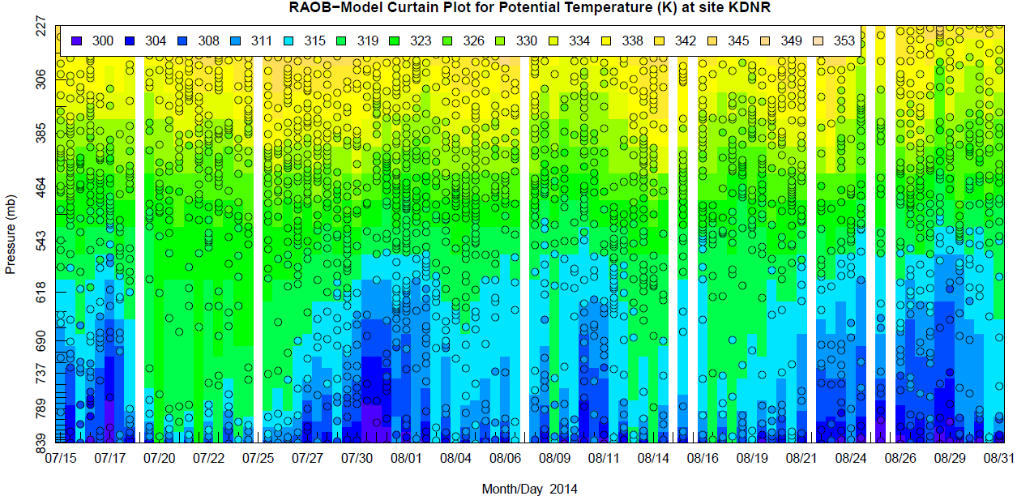
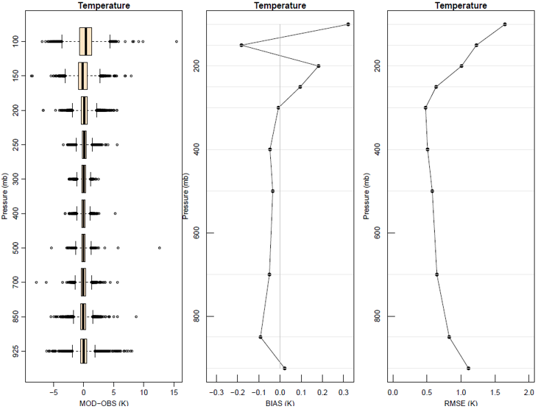
The Atmospheric Model Evaluation Tool (AMET) Amazon Machine Image
A Turn-Key AMET Distribution Method
Robert Gilliam, Michael Morton and Wyat Appel
US EPA, ORD, CEMM
Center Environmental Measurements and Modeling, Atmospheric & Environmental Systems Modeling Division
CMAS Conference, October 21, 2024

Slide 2


Outline
The Atmospheric Model Evaluation Tool (AMET)
  AQ Module + examples
  MET Module + examples (surface, upper-air, radiation & precipitation)
  AMET GUI
The AMET AWS Server Image
  Advantages
  Getting started
  Configuration
Concluding remarks

Slide 3
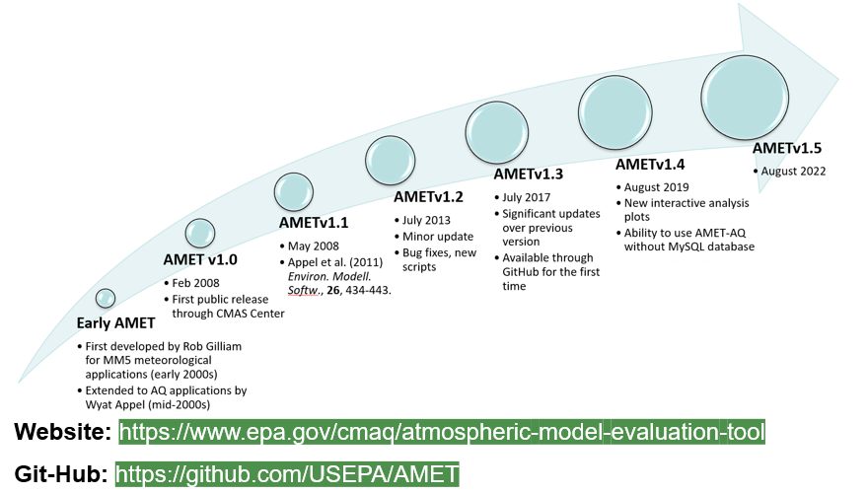
Chronology

Slide 4
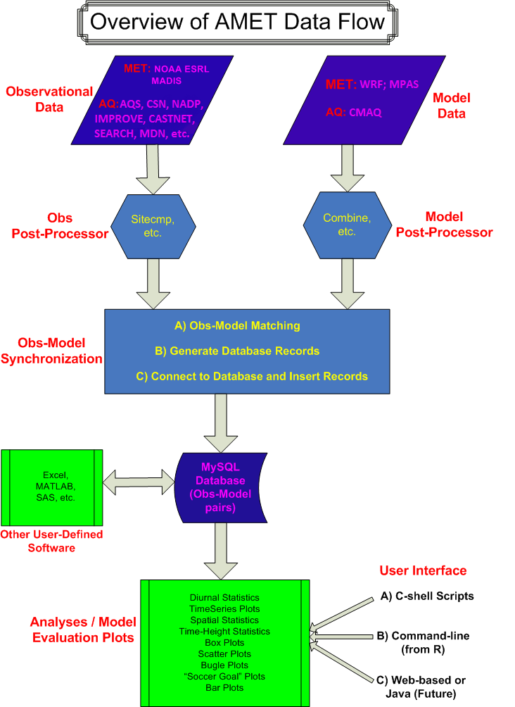
Overview of the AMET-AQ Module
Designed to work directly with CMAQ output
  could theoretically be modified to work with many different data though (e.g. water measurements)
Directly supports data from a most routine AQ networks
  North America: AQS, IMPROVE, CSN, CASTNET, NADP, MDN, SEARCH, AMON, AIRMON, FLUXNET
  Europe: AIRBASE, AURN, EMEP, AGANET, ADMN, NAMN (limited years available)
  global: TOAR, TOAR2, NOAA ESRL
Stores each network separately for more robust analysis
Utilizes Site Compare to do the model/observation matching
  Fortran based utility that is provided with CMAQ and AMET
  requires properly formatted observation files
    These files are stored on ATMOS and are also available for download
    https://www.cmascenter.org/amet/

Slide 5
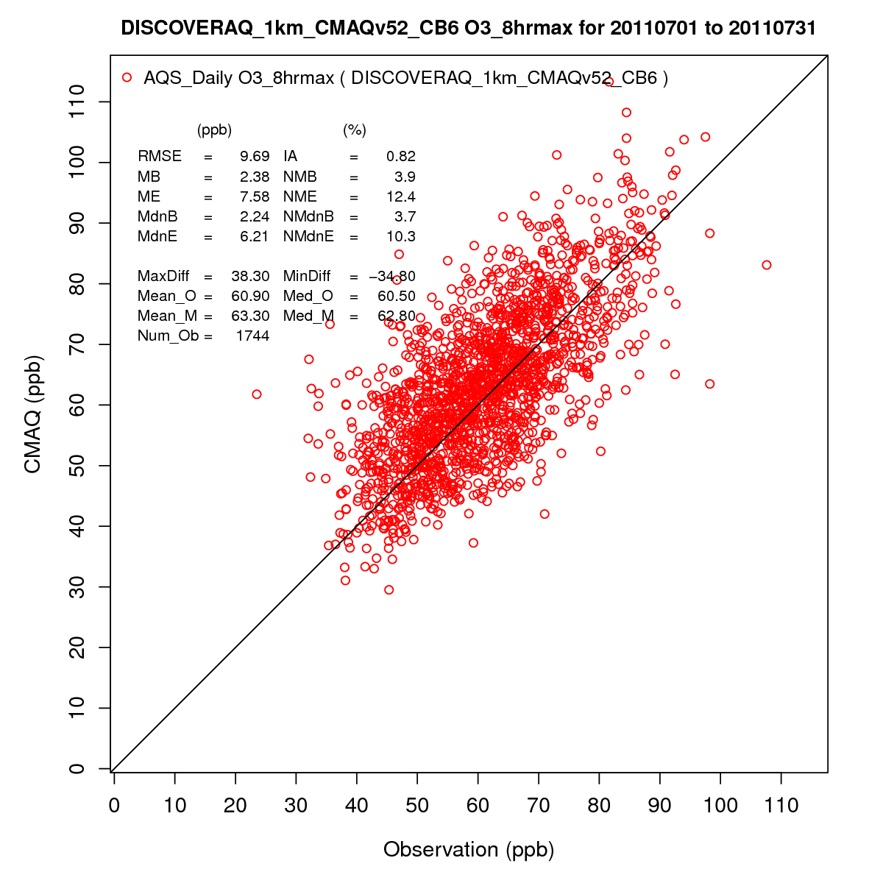
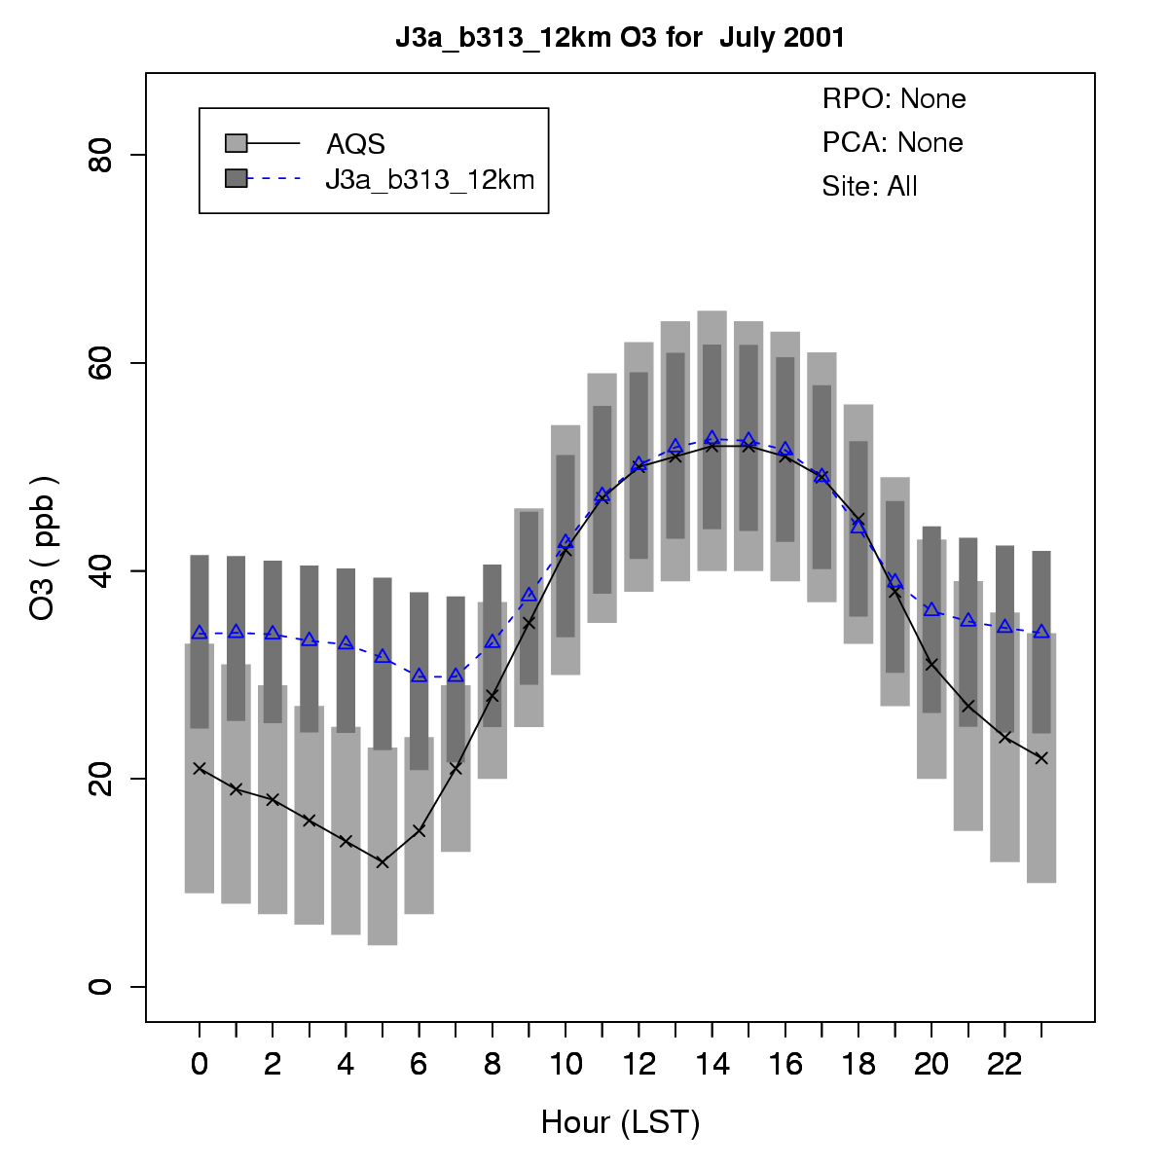
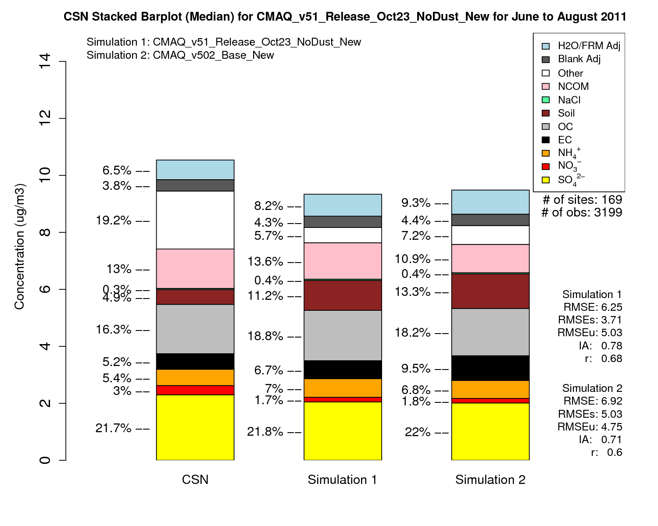
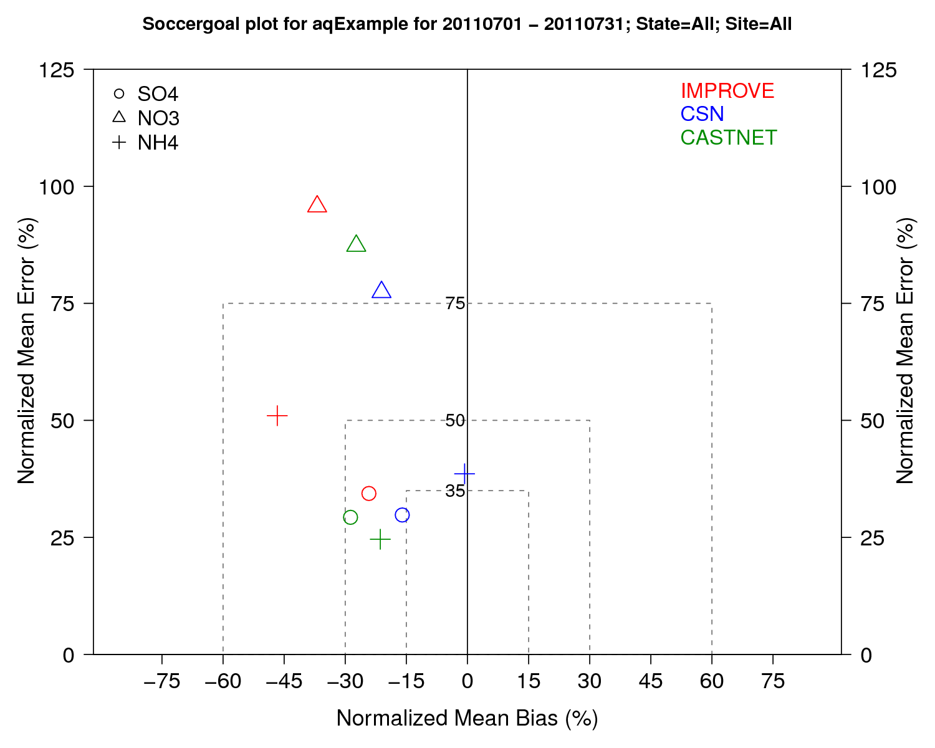
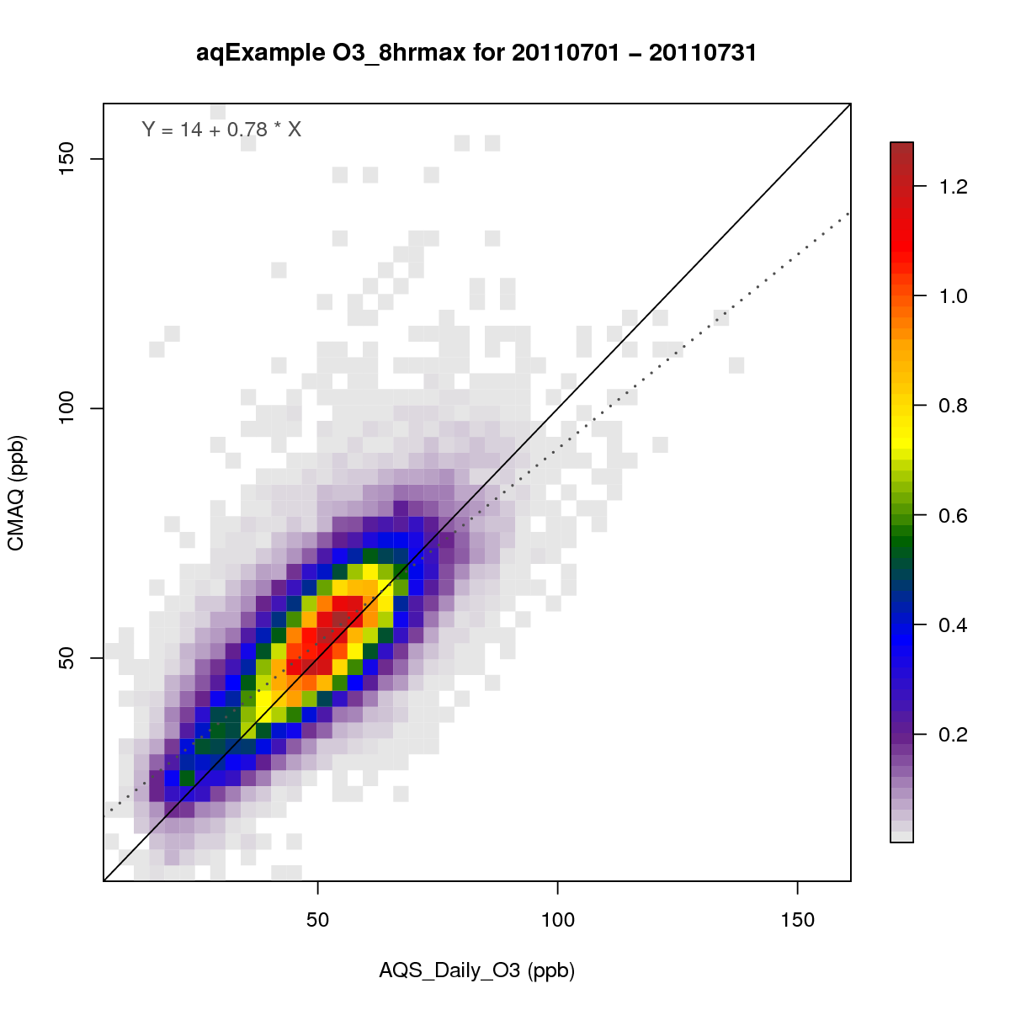
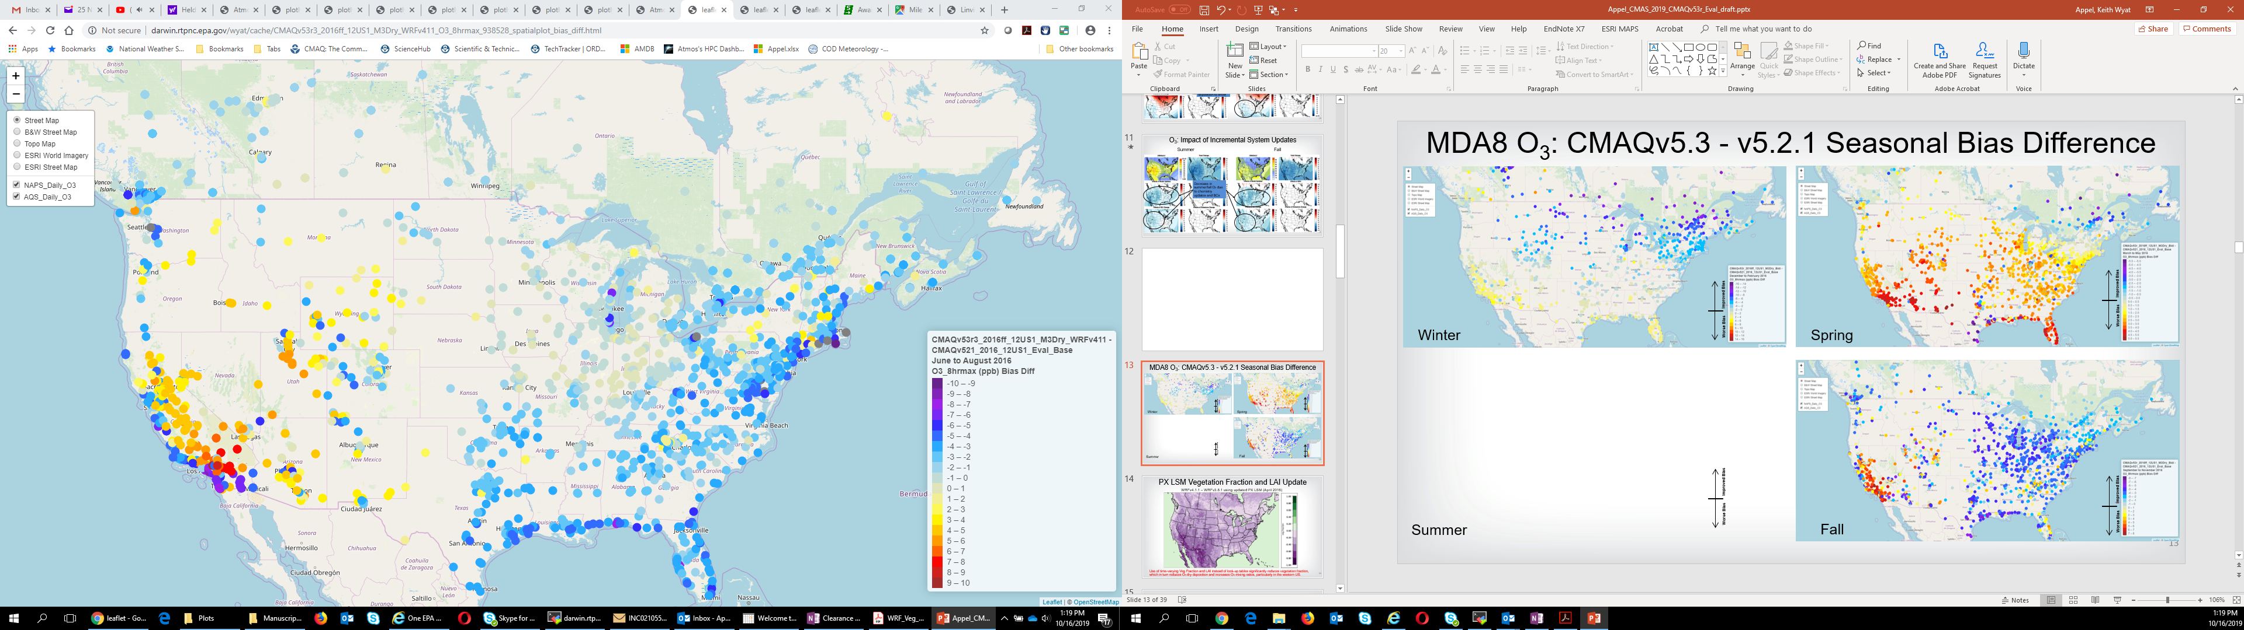
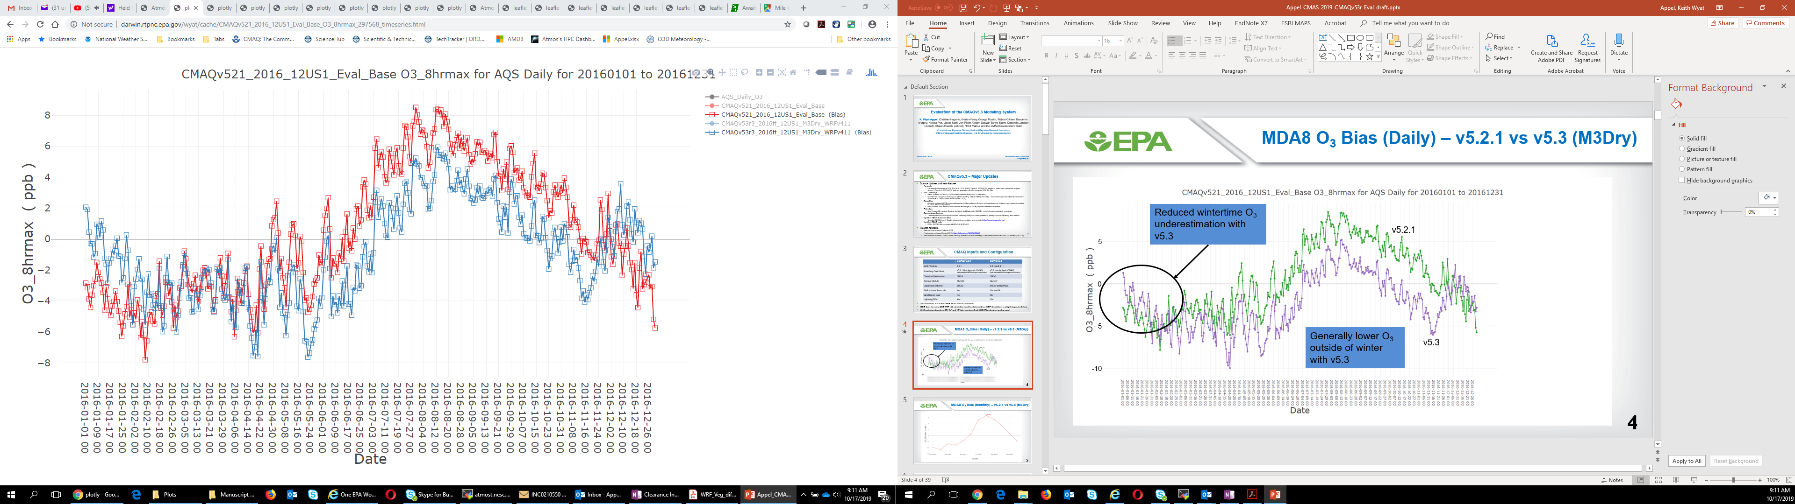
Examples of AMET-AQ Module Plots

Slide 6
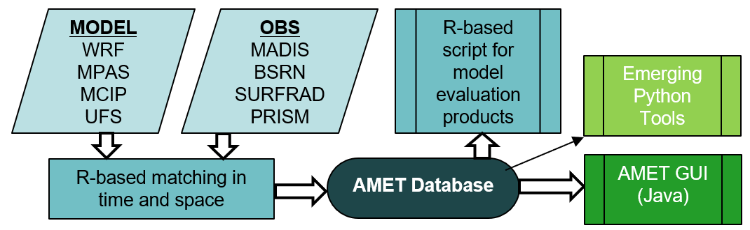
Overview of the AMET-MET Module
Designed to work directly with WRF, MPAS, MCIP and NOAA UFS
  Define model output location+prefix and AMET matches with all available observations using auto FTP
Leverages MADIS observation archive, PRISM, SurfRAD and BSRN (AutoFTP)
  Global standard surface meteorology obs networks (e.g., NOAA), Mesonets & option for simple text obs
  Global Upper-air RAOB
  Global Radiation
  CONUS precipitation via PRISM R module (auto download now)

Slide 7
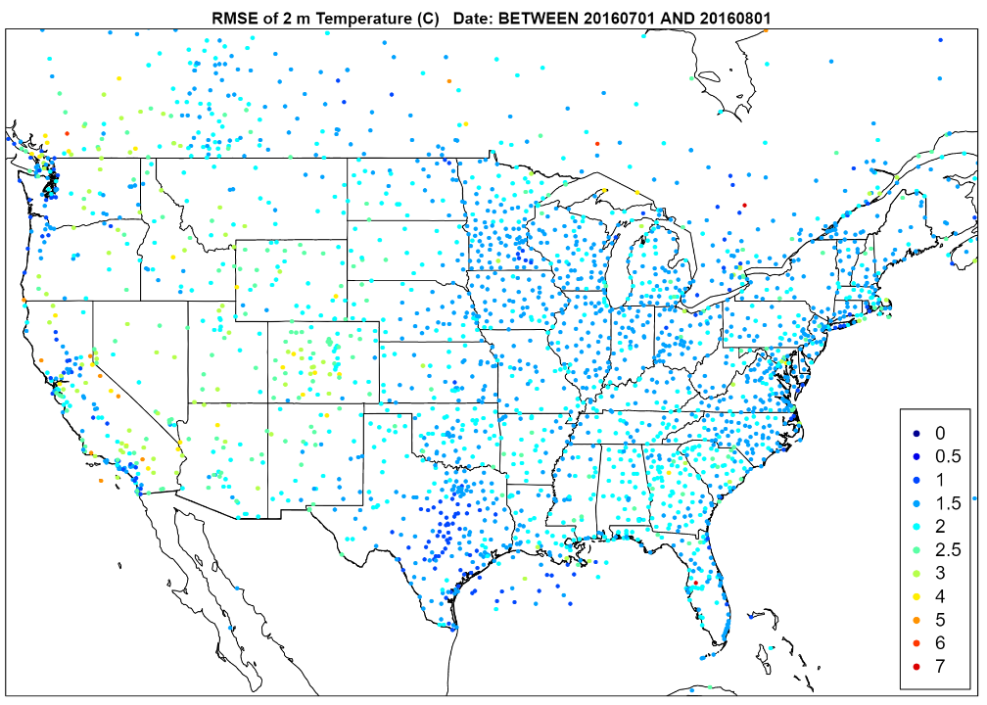
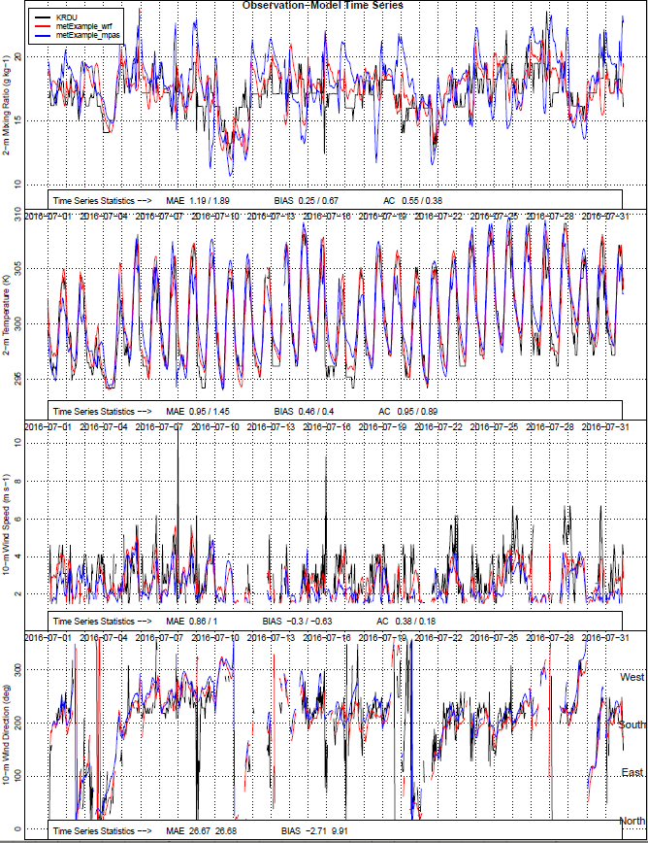
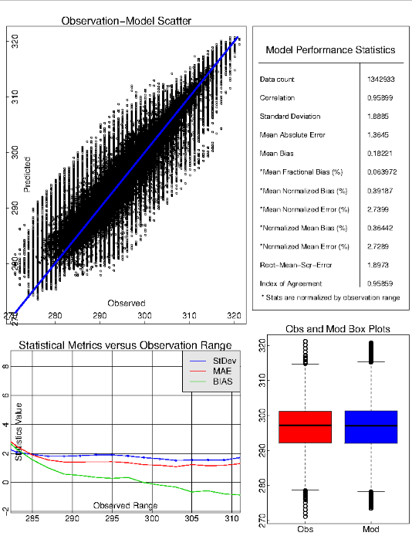
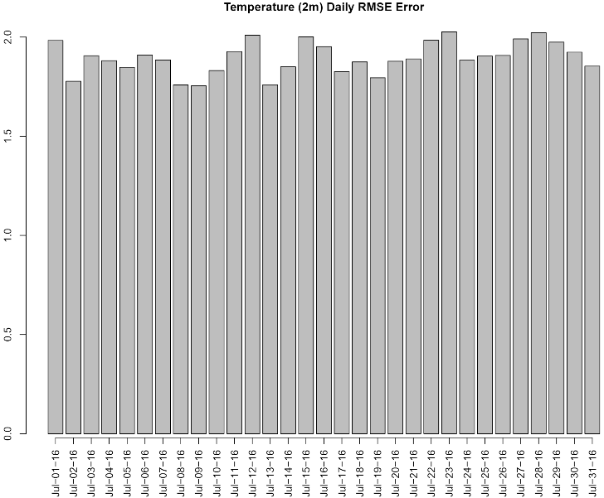
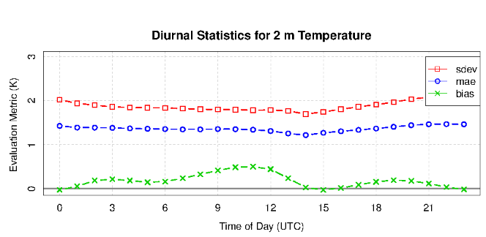
Examples: Evaluation Surface Meteorology
Outputs:
2-m temp, moisture & 10-m winds
Spatial, Time series, daily and summary statistics
run_spatial_surface.csh
run_timeseries.csh
run_daily_barplot.csh
run_summary.csh
Summary
Spatial
Timeseries
Daily
Diurnal

Slide 8
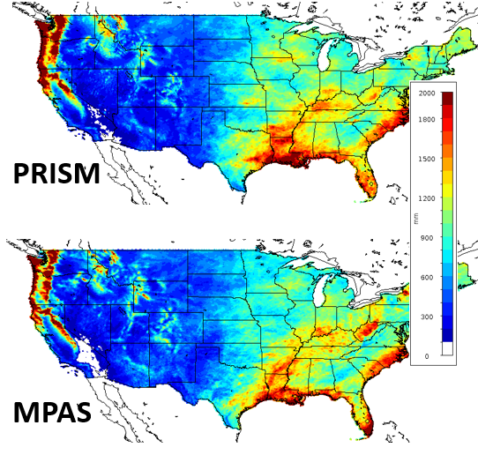
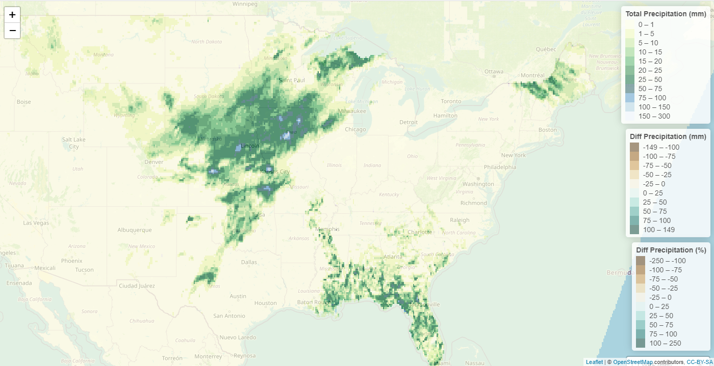

Examples: Precipitation
Currently 4km PRISM for CONUS via R Package
  daily, monthly or annual temporal options
  wrapper script can generate daily and monthly comparisons for a long model run in one execution step
  Outputs: NetCDF file in model format with PRISM & Model totals
  Outputs: Text grid statistics file for model domain
  Outputs: Leaflets HTML interactive file

Slide 9
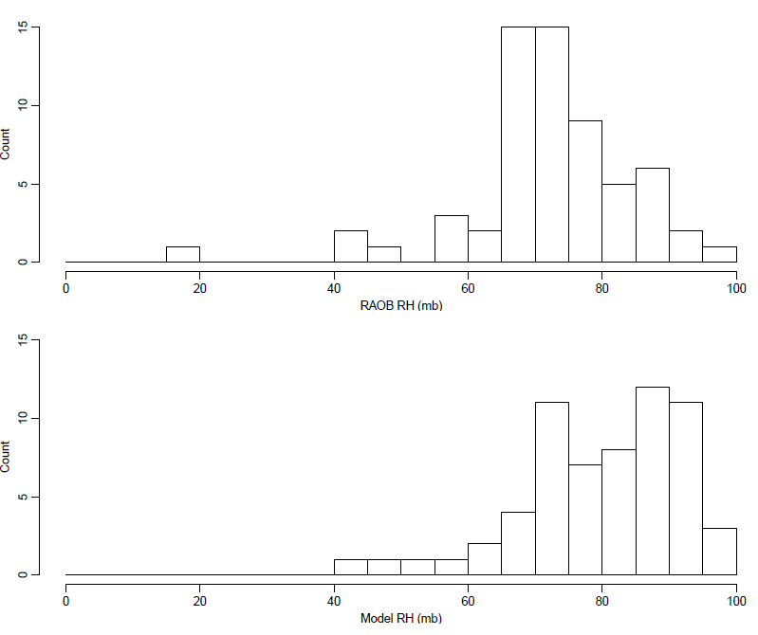
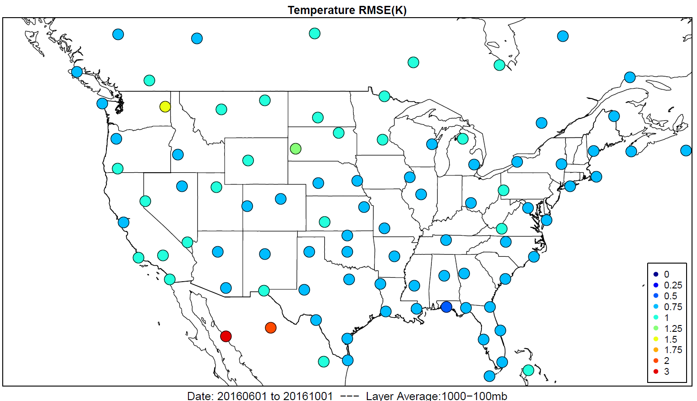
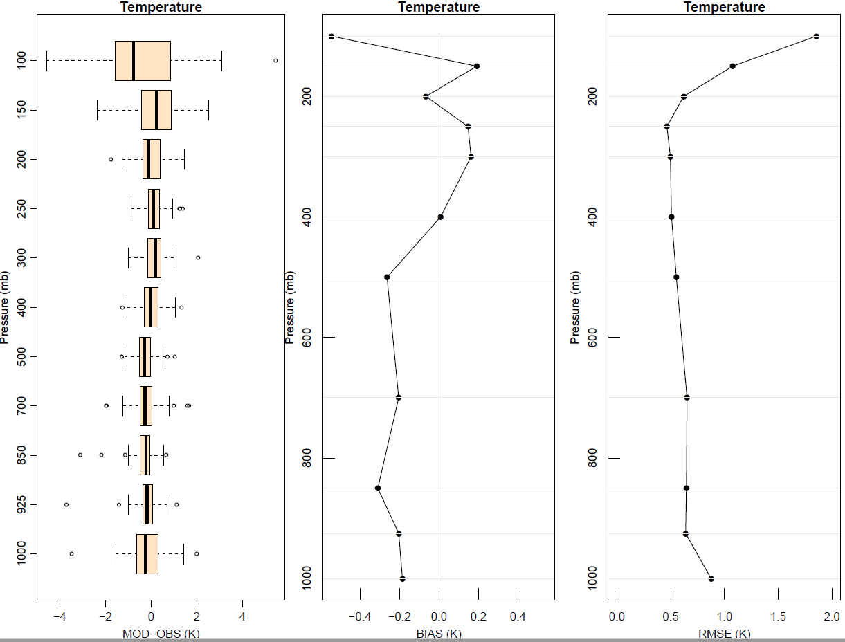
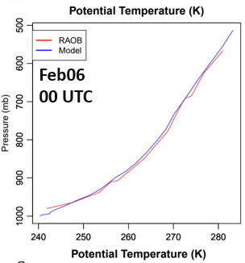
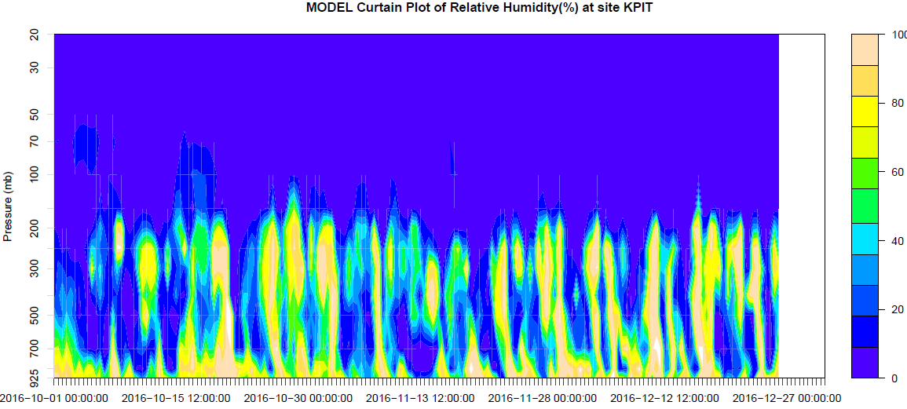
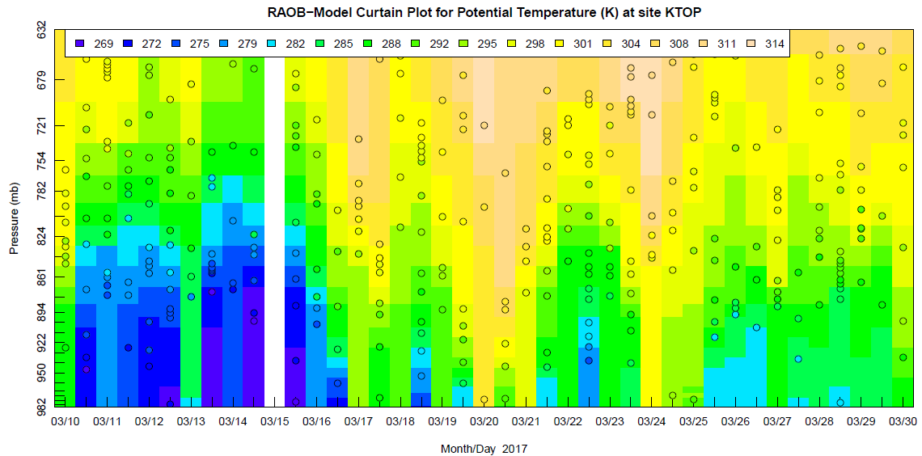
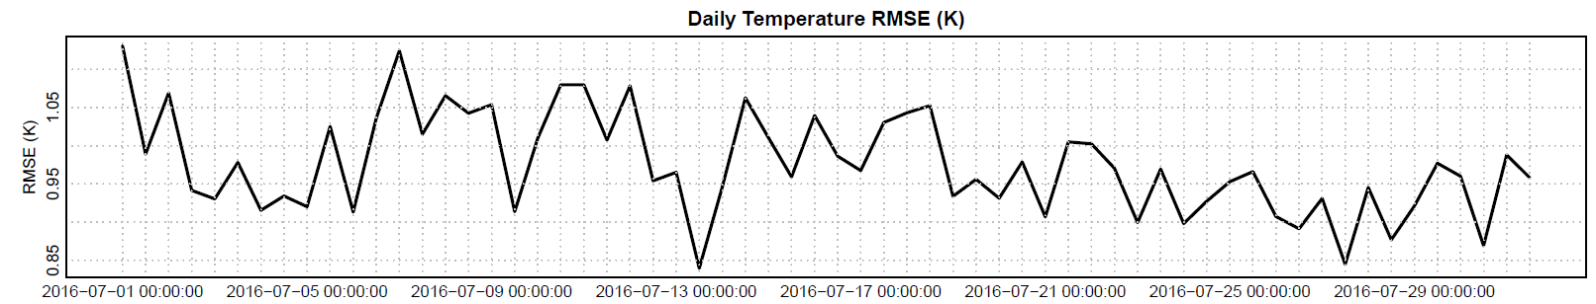
Examples: Evaluation of Upper-Air Meteorology
Outputs:
Temperature, Theta, RH and Winds
Spatial, profile, curtain, histogram, timeseries
Text (csv) of spatial and profile timeseries statistics
run_raob.csh
./input_files/raob.input
RH Histograms
Profile
Spatial
Curtain
Timeseries
Curtain

Slide 10
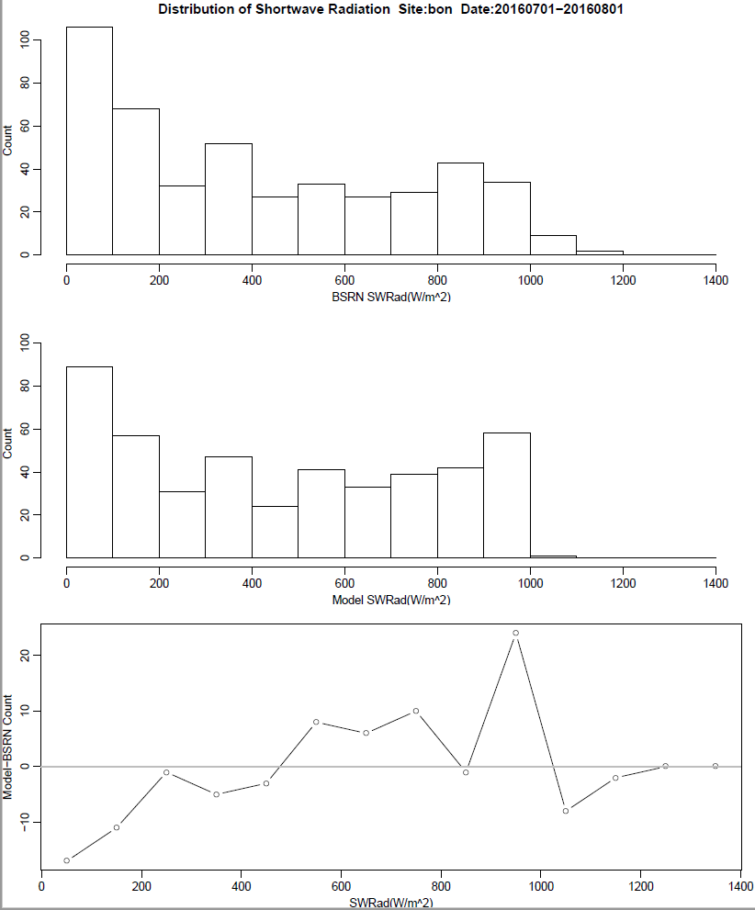
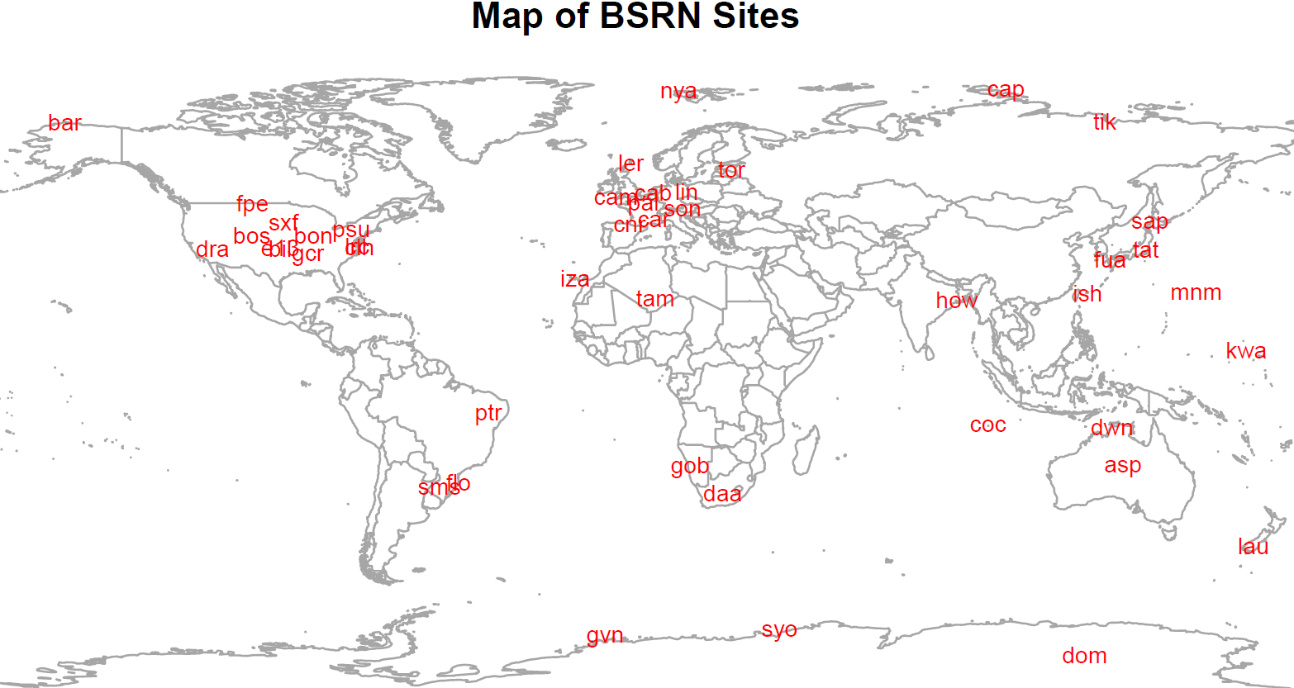
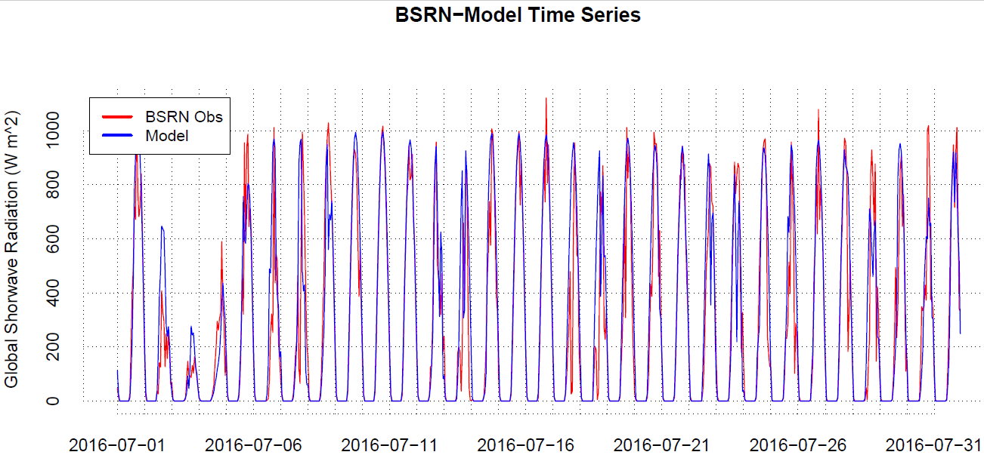
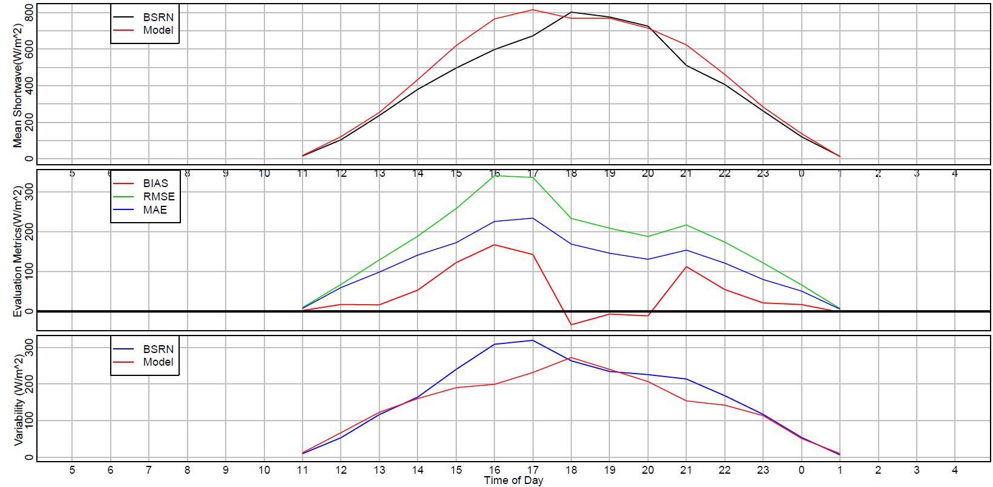
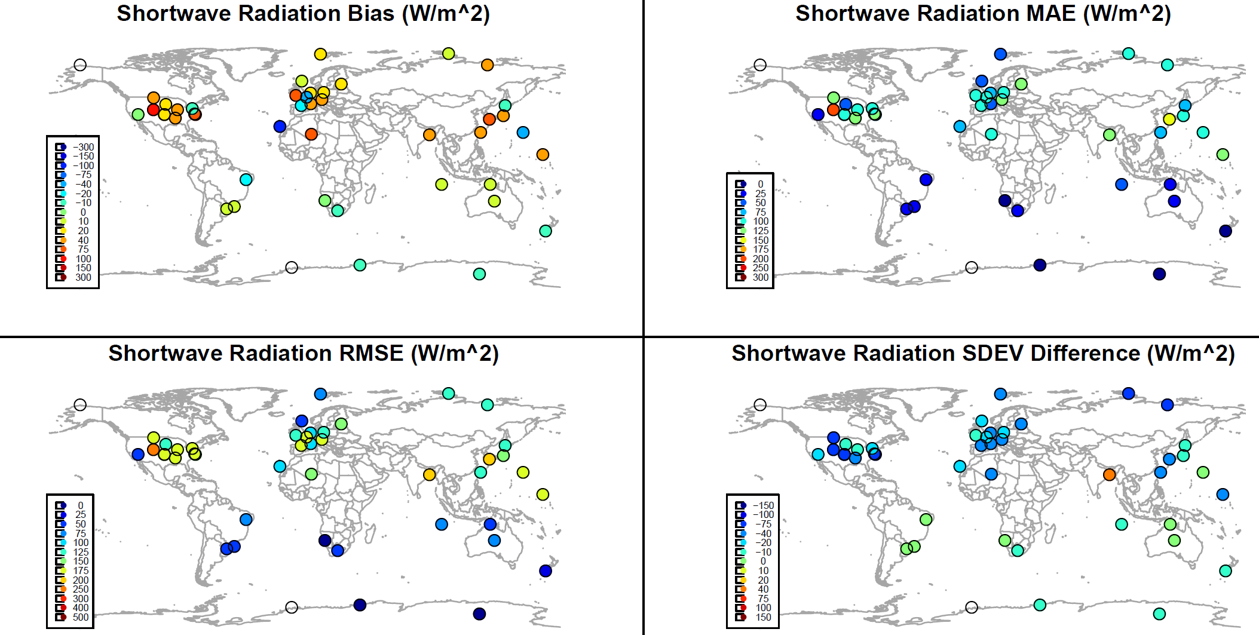
Examples: Evaluation of Shortwave Radiation
Outputs:
Shortwave radiation for the evaluation of clouds
Spatial, diurnal, histogram, timeseries
Text (csv) of spatial and profile timeseries statistics
Histograms
run_plot_srad.csh
./input_files/plot_srad.input
Timeseries
Diurnal
Spatial

Slide 11
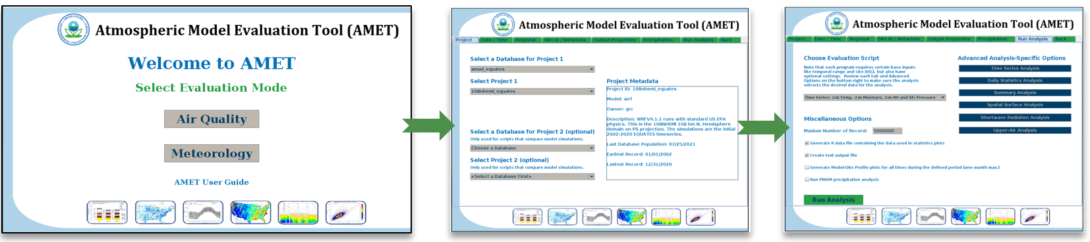
AMET Graphical User Interface
Beta version now available for external testing (AWS and local versions)
Point-and-click evaluation of models
Simplifies analysis for less experienced Unix users
Remote X11-based evaluation method on AWS server instances
Organize evaluation products

Slide 12
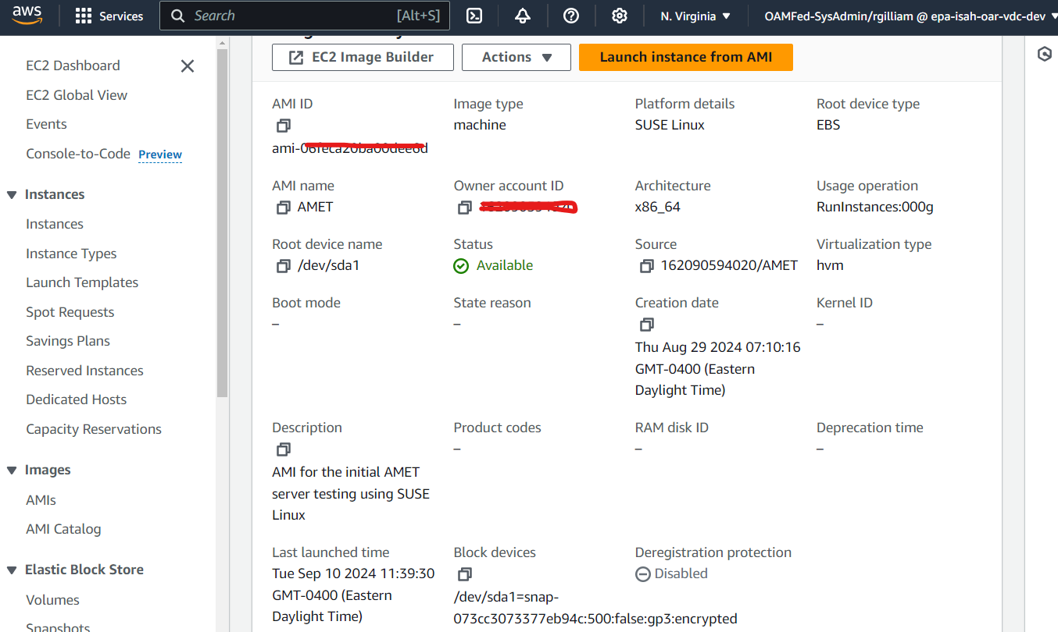

Using Amazon Web Services as a distribution method for the Atmospheric Model Evaluation Tool

Slide 13
AMET AWS: Advantages
Beta-level… looking for external partners
Turn-key vs. more complex local installs of supporting software/apps
Lightweight/Barebones Linux (SUSE)
A guide for configuring or replication on local servers or other cloud services
Or, locally as Virtual Machine image exported from AWS
Share model performance databases via the cloud
Reproducibility, Security & Storage
Modular: mount drives/volumes of model output or modeling-based instances

Slide 14
AMET AWS: Getting Started
Request access to the AMI & KMS permissions for the attached volume
Launch an AMET server instance under your AMS account
Reference AMET documentation for specific guidance& examples (https://github.com/USEPA/AMET)
Reference “working” scripts for WRF/MPAS/MCIP for pairing model output with observations and analysis (i.e., rerun pairing and analyses)
Mount organization drive(s) that have model outputs & perform pairing and analysis of user’s modeling
The AMET GUI: launch using “ametgui” for point-and-click evaluation, or copy example scripts for User’s model runs

Slide 15
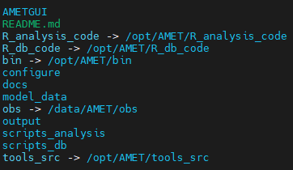
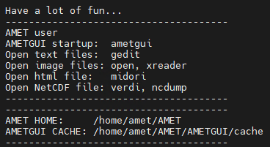
AMET AWS: Configuration
/home/amet/AMET
AMET codes, sample model data and observation
Non-root user ID is simply “amet”
  /home/amet
  Home has /home/amet/AMET distribution directory (env var “AMETBASE”)
  Main codes are linked from AMET software directory (/opt/AMET)
  User configurable matching and analysis scripts are in the local home directory for copy and modification.
CSHELL environment configured with minimal applications
  Image viewing (png, pdf, jpeg)
  Web browser (Leaflets, online documentation, Git-Hub)
  Text editor (modifying matching and analysis scripts, etc)
  NetCDF tools including US EPA’s Verdi
/home/amet

Slide 16
Concluding Remarks
This AMET AWS AMI is beta mode and testers are needed
AQ matching & some AQ analysis is less tested than the meteorology
Expect AMI updates as we improve this method
  Faster processing & more memory (currently free tier)
  Amazon 2023 or other Linux
  More software options for viewing various file formats
  Archives of last decade of AQ & MET observation data
  PAMS PBL datasets for 2020-present
  More examples of US EPA modeling results in released AMI database
    EQUATES 2002-2020, 2018 & 2022 12US1 & 108NHEMI, 12-4-1.33 LMOS
Git-Hub remains official distribution method

Slide 17

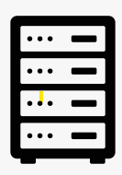


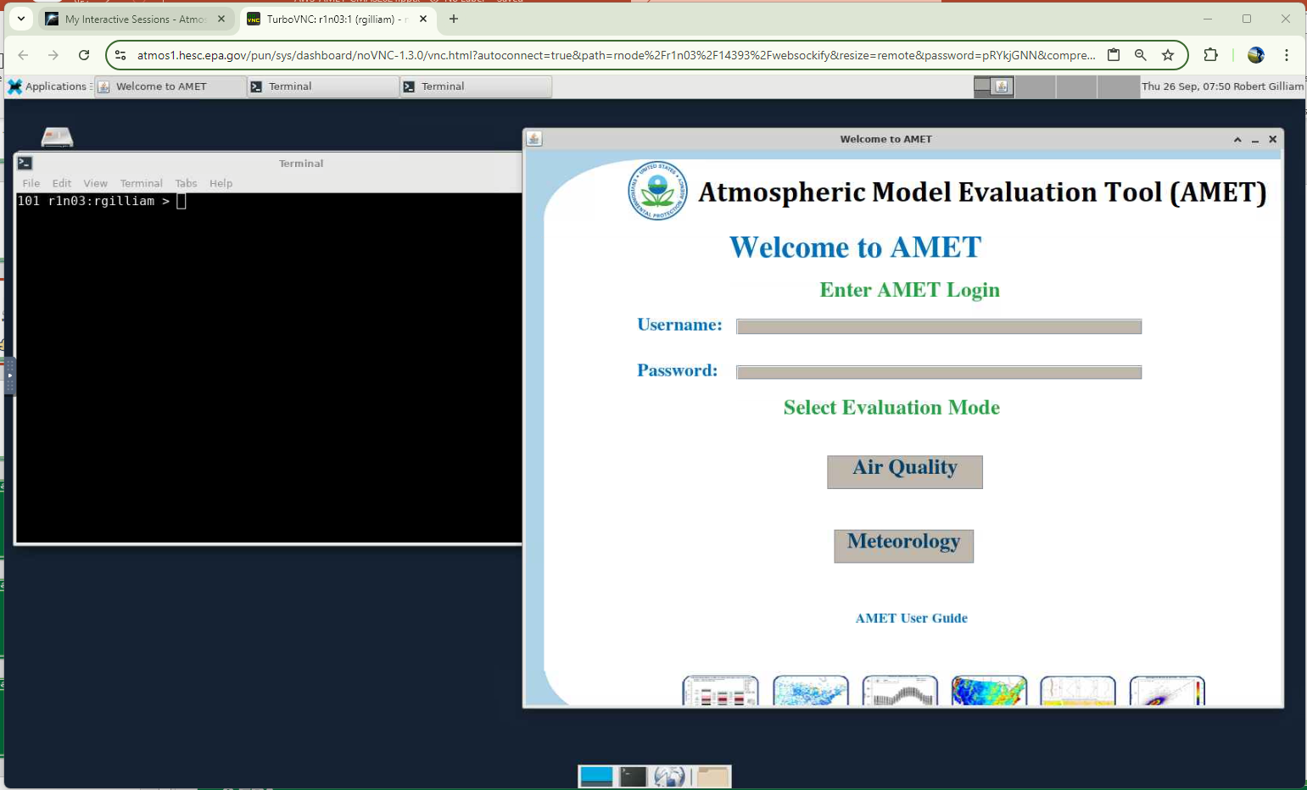
AMET AWS: Potential
A multi-organization shared database for evaluating meteorological and air quality model
AWS AMET GreenWave Environmental
AWS AMET MySQL Server
OKI University Local AMET
WRF
CMAQ
Remote Desktop Brower
AWS AMET WaveMetrics
MPAS

