Slide 1
Inter-model spatial and seasonal variability in wet deposition using the 2016 AQMEII4 simulations
Colleen Baublitz, Christian Hogrefe, Olivia E. Clifton, Paul Makar, Jesse O. Bash, Kathleen Fahey, Rohit Mathur, John T. Walker, Philip Cheung, Stefano Galmarini, Alma Hodzic, Aurelia Lupascu, Jon Pleim, Young-Hee Ryu, Roberto San Jose
October 21, 2024
Disclaimer: The views expressed in this presentation are those of the authors and do not necessarily reflect the views or policies of the U.S. EPA.

Slide 2

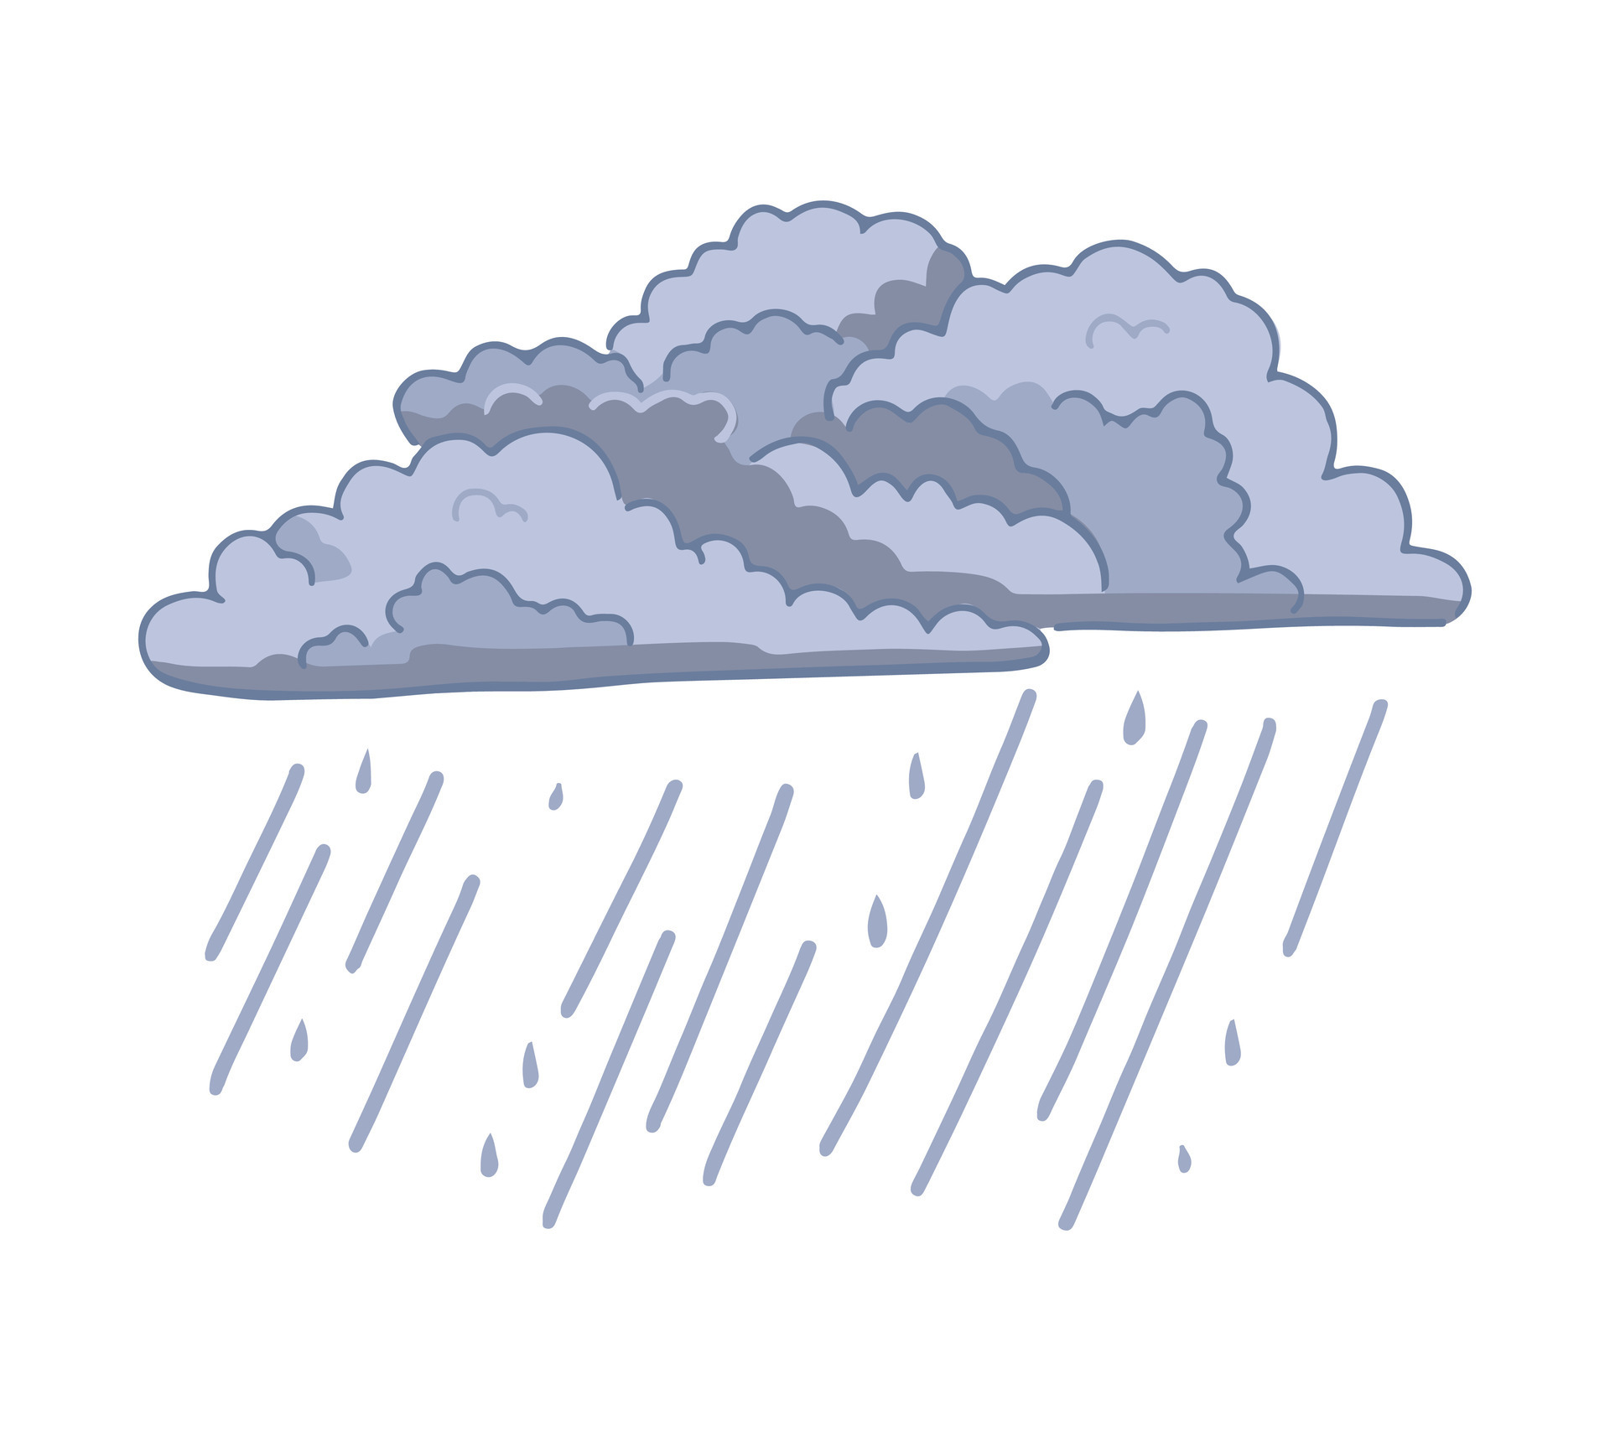
Air pollution deposition affects ecosystem welfare
Wet deposition
PM formation
Aquatic impacts (e.g., acidification)
NO_{x}
O₃
NH_{x}
Dry deposition
Soil, vegetation impacts
(e.g., increased fire risk)
Notes:
Better to have something more technical

Slide 3
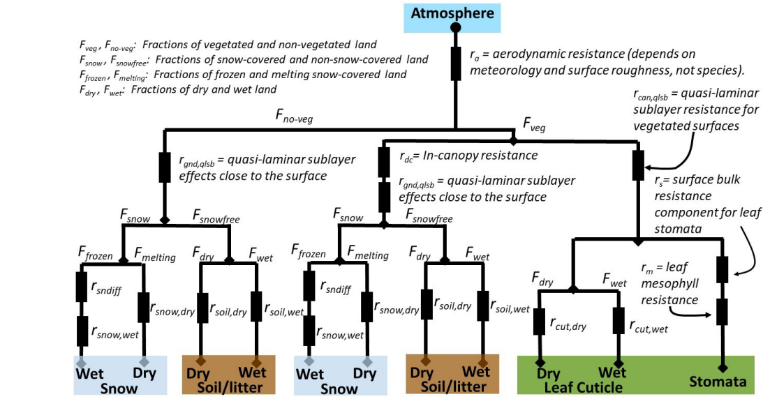
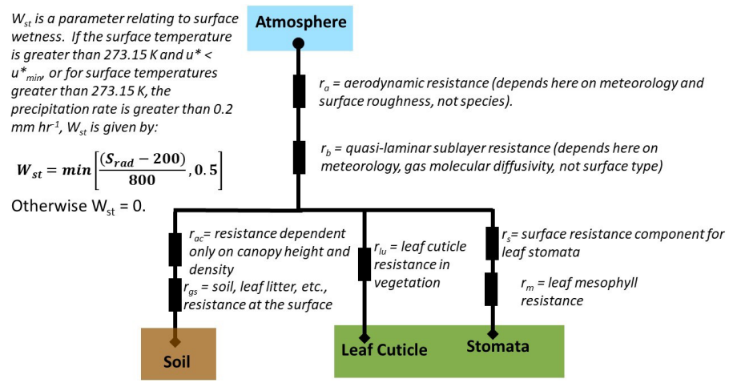
Deposition parameterizations vary among models
CMAQ-STAGE
≠
GEM/MACH
How does this structural uncertainty affect deposition estimates?
Galmarini et al., 2021

Slide 4
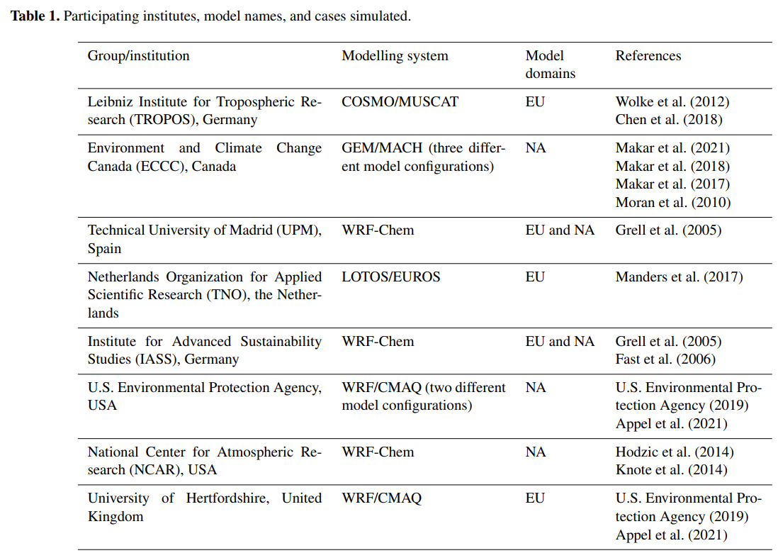
The fourth round of the Air Quality Modeling Evaluation International Initiative (AQMEII4) focuses on deposition
Emissions and boundary conditions are held constant across models, but not meteorology or landcover
Comparing across models in North American domain shows the potential range of deposition estimates
Notes:
model = 10700 for EPA WRF/CMAQ M3Dry, 10701 for EPA WRF/CMAQ STAGE, 10702 for IASS WRF/Chem, 10703 for ECCC GEM-MACH (research) w/ Wesely drydep, 10704 for ECCC GEM-MACH (research) w/ Zhang drydep, 10705 for ECCC GEM-MACH (operational) w/ Wesely drydep, 10708 for UPM WRF/Chem, and 10709 for NCAR WRF/Chem.

Slide 5
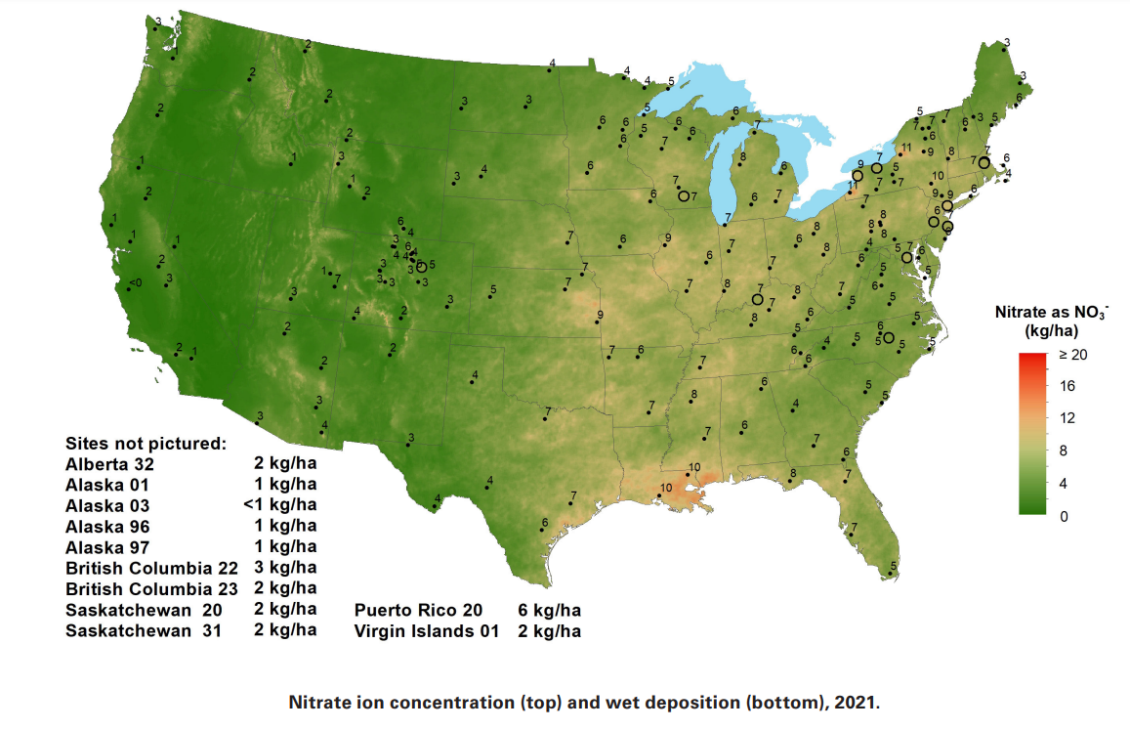
We focus on wet deposition to leverage a long-term measurement network available for model evaluation and interpretation
NADP, 2022
Notes:
Including a trends plot – ‘things have improved but still are areas for improvement’

Slide 6
Guiding questions
Where and when is there the greatest spread among the AQMEII4 models?
Is the spread associated with a particular process?
Do observations point to important and/or missing processes?
In this talk, I’ll focus on sulfate (SO₄) wet deposition.
For this project, we have also considered nitrate and ammonium.

Slide 7
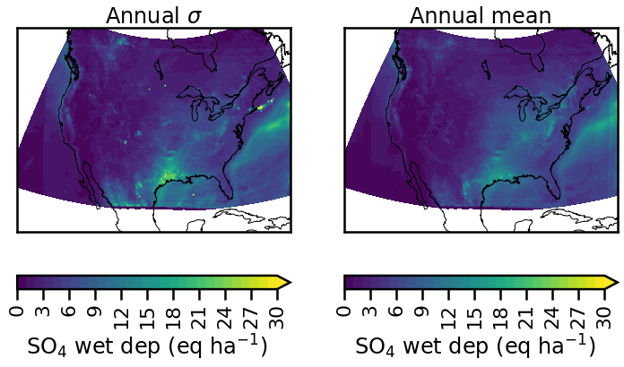
Highest deposition and spread among models near the gulf for SO₄ wet deposition
Spread is defined as the standard deviation across models (for a particular grid cell, time period, etc)
Notes:
Need to update figures for 2016

Slide 8
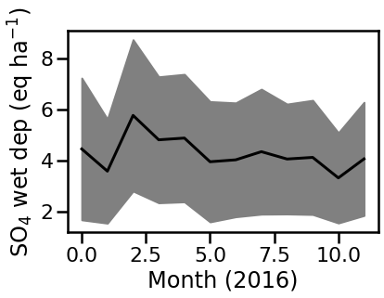
SO₄ dominates total S wet deposition, with the largest spread among models in the spring

Slide 9
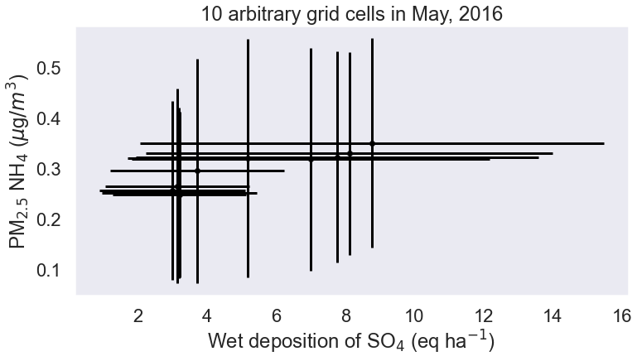
For which concentration or meteorology variables is the inter-model spread (σ) associated with the inter-model spread in wet deposition?*
Introduction to correlation plots
Spread in x or y indicates the standard deviation across the models with available simulations
*This doesn’t indicate the driver of the spread among models, but it may suggest where to take a closer look.
Notes:
Update to SO4

Slide 10
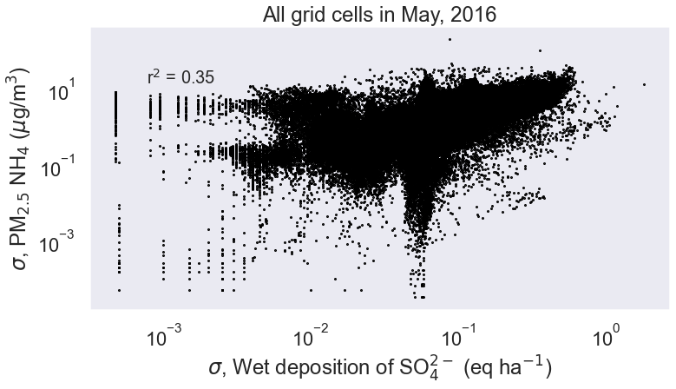
For which concentration or meteorology variables is the inter-model spread (σ) associated with the inter-model spread in wet deposition?*
Introduction to correlation plots
Next, I correlate the spread in x and y across all grid cells
Done for each wet deposition, concentration and meteorology variable
*This doesn’t indicate the driver of the spread among models, but it may suggest where to take a closer look.
Notes:
Take more time

Slide 11
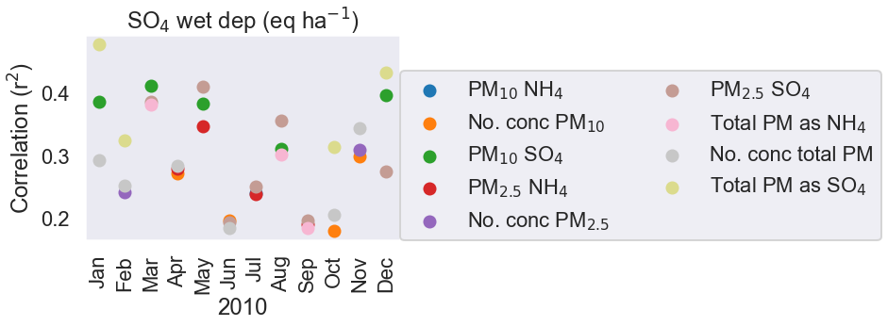
Unsurprisingly, the model spread (σ) in SO₄ wet deposition correlates with the σ of PM components for NH₄ (summer) and SO₄ (annual)
*Only the 3 variables with highest correlation are shown for each month

Slide 12
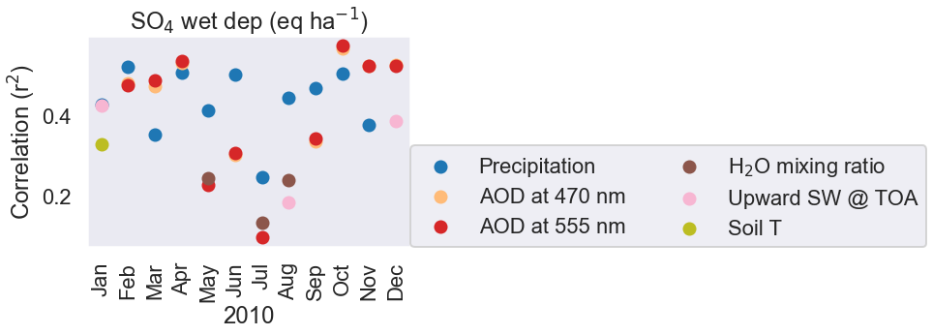
Among meteorological variables, precipitation has the strongest association with the spread in SO₄ wet deposition
Other variables, such as the aerosol optical depth (AOD), are likely affected by (rather than a driver of) the spread in wet deposition
Notes:
Title is too complicated

Slide 13
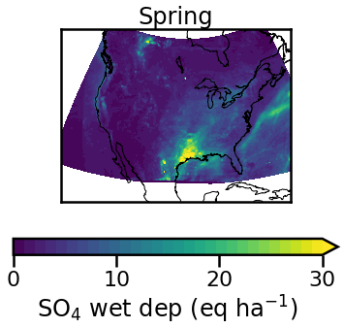
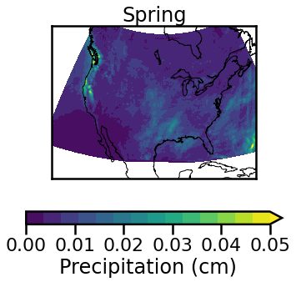
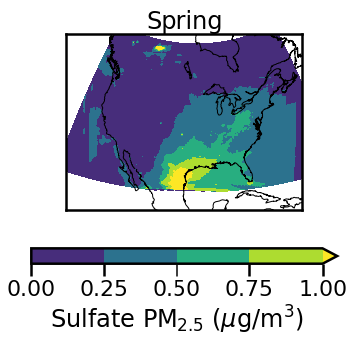
Intermodel spread in sulfate wet deposition is associated with the spread in sulfate PM and precipitation
Spatially segregated regions offer an opportunity to characterize
the processes underlying these differences, in conjunction with measurements

Slide 14
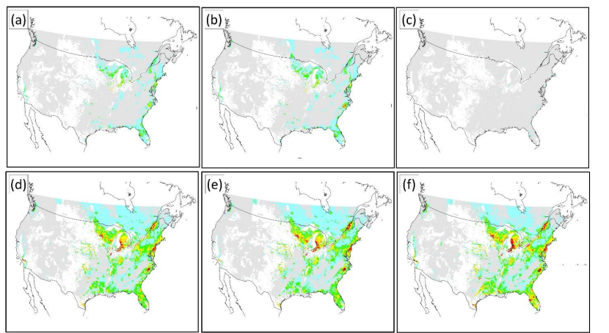
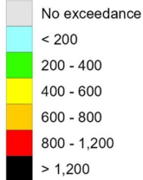
A large intermodel spread in deposition could contribute to differences when assessing ecological impacts
Critical load exceedances (a threshold for ecological harm) for forest soils among AQMEII4 models for 2016
Makar et al., in review

Slide 15
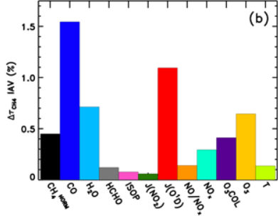
Future work includes bias correcting the precipitation; building on association analysis, potentially using machine learning
Nicely et al., 2020
An ML approach such as a neural network, previously applied to attribute intermodel differences in the hydroxyl radical for CCMI, could improve upon our correlation analysis
Notes:
How does this relate back to ecosystem impacts

