Slide 1
Ending the half century monopoly of similarity functions in the boundary layer modeling
Kiran Alapaty¹ , Jesse Bash¹ , Rob Gilliam¹, Christian Hogrefe¹, Barron Henderson², Daiwen Kang¹, Alan Vette¹, Chris Nolte¹, and Sarav Arunachalam³
¹Center for Environmental Measurement and Modeling, Office of Research and Development,
U.S. Environmental Protection Agency, RTP, NC
²Office of Air Quality Planning and Standards, U.S. Environmental Protection Agency, RTP, NC
³Institute for the Environment, The University of North Carolina at Chapel Hill, Chapel Hill, NC
October 21, 2024
Office of Research and Development
Center for Environmental Measurement and Modeling
Disclaimer: The views expressed in this presentation are those of the authors and do not necessarily reflect the views or policies of the U.S. EPA.
Notes:
I am a part-time researcher . Pretty much every coauthor has contributed to this work and without their valuable contributions, I could not have pulled this work to this shape. Thanks to all coauthors…

Slide 2
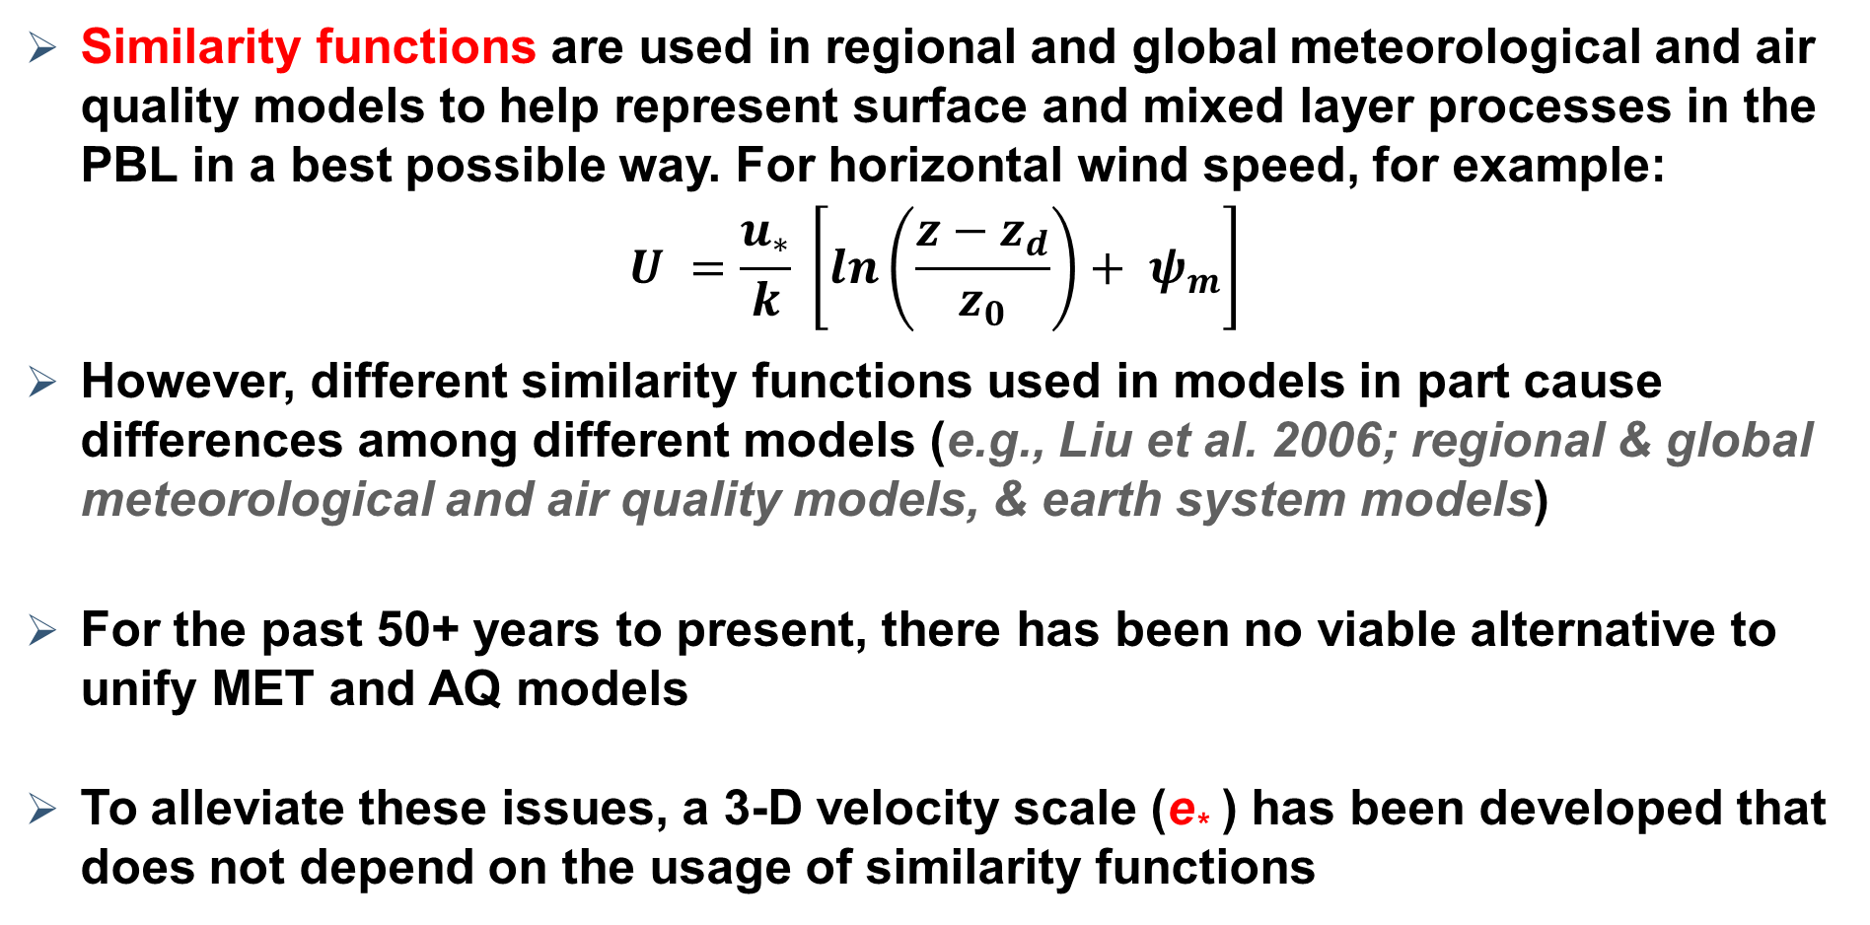
Background
  Similarity functions are used in regional and global meteorological and air quality models to help represent surface and mixed layer processes in the PBL in a best possible way. For horizontal wind speed, for example:
  $$U =\frac{u_{∗}}{k} \left[\ln\left(\frac{z−z_{d}}{z_{0}}\right)+ ψ_{m}\right]$$
  However, different similarity functions used in models in part cause differences among different models (e.g., Liu et al. 2006; regional & global meteorological and air quality models, & earth system models)
  For the past 50+ years to present, there has been no viable alternative to unify MET and AQ models
  To alleviate these issues, a 3-D velocity scale (e* ) has been developed that does not depend on the usage of similarity functions
Notes:
Point (1) When we look at the literature, we will find numerous different stability correction functions for similarity profiles across regional and global meteorological (MET) and air quality (AQ) models as well as earth system models. This is one source of model-2-model outcome differences, and this can be potentially avoided by NOT using similarity functions at all… For over half century similarity functions are ruling these models. (2) turbulence strength is underrepresented in some of the formulations and thus there is a room for improvement; (3) our new 3D turbulence velocity scale provides an opportunity to avoid these issues and can be a source of community formulations representing turbulence effects in a best possible way in MET and AQ models.; (4) this new velocity scale was evaluated and validated using measured velocity variances and a dry dep box model and these results were documented in Alapaty et al. 2022 which showed that there is no need to use similarity functions in PBL modeling. But it was done using a single-point (box) model but not a 3D MET or AQ model.

Slide 3

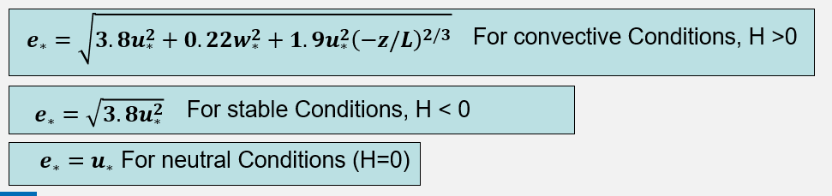

T$he new \text{3−}\text{D} turbulence velocity scale: e_{∗}$
In Alapaty et al., 2022, $e_{∗}$was estimated as:
Notes:
The new velocity scale (e*) is a function of friction velocity, convection velocity, and Obukhov length for convective conditions in PBL; and for stable conditions it is proportional to friction velocity and for neutral conditions as well along with mean wind speed. Thus, in that study we proved that aerodynamic resistance can be expressed without using similarity functions by using the e* and it becomes a seamless formulations for all models (box, 1D, 2D, and 3D MET and AQ models) since it does not depend on similarity functions.

Slide 4
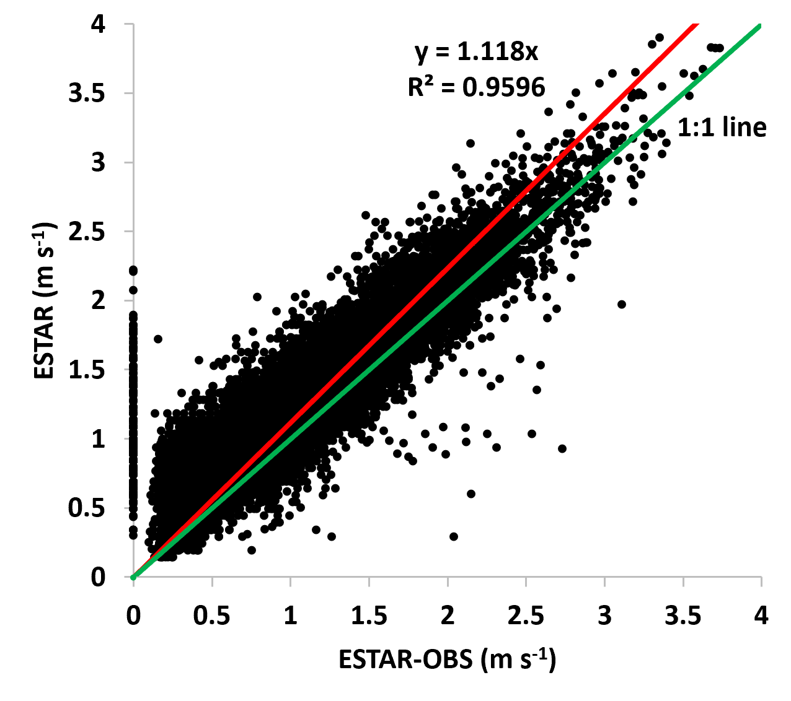
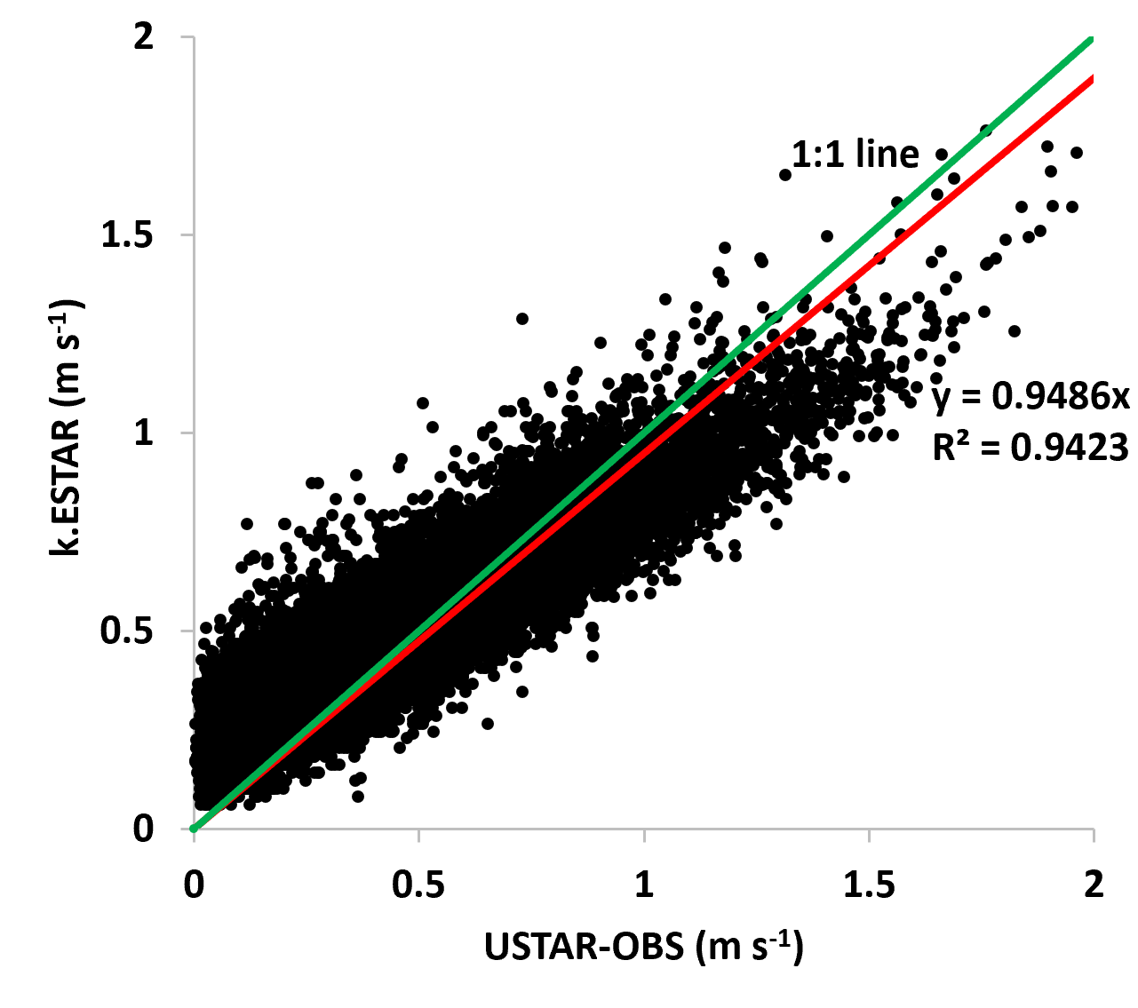

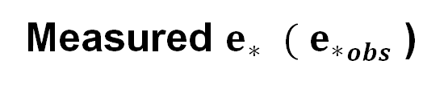
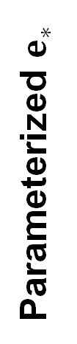
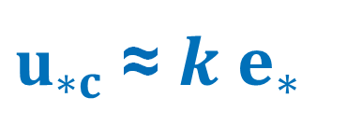
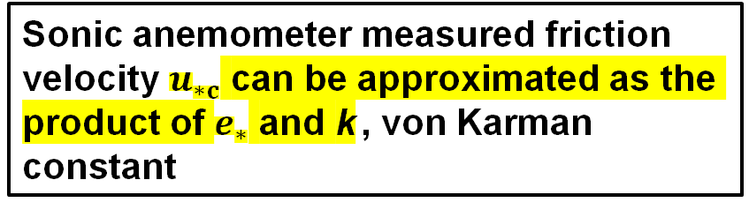
$u_{∗c}$ ≈ ${k e}_{∗}$
Validation of e* Estimation Using 3-D Sonic Anemometer Micrometeorological Variance Data (1991-2000) at Harvard Forest Site
Alapaty et al., 2022
Parameterized $e_{∗}$
Measured $e_{∗}$ ${ ( e}_{∗}obs$ )
Sonic anemometer measured friction velocity $u_{∗c}$ can be approximated as the product of $e_{∗}$ and k., von Karman constant
Notes:
To the best of our knowledge, no one has used measured velocity variances from the 3D sonic anemometer for turbulence modeling and thus we are the first ones to use such data that was collecting dust…. The 3D sonic anemometer data are used to validate the parameterized e* and results are very apparent. Further we showed that the measured friction velocity can be replaced by the product of von Karman constant and parameterized e*. This is the key result that helped us to get rid of all similarity functions in pbl modeling.

Slide 5

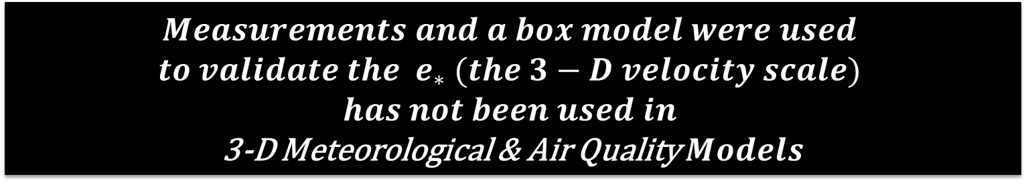
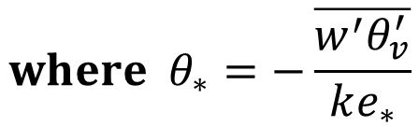
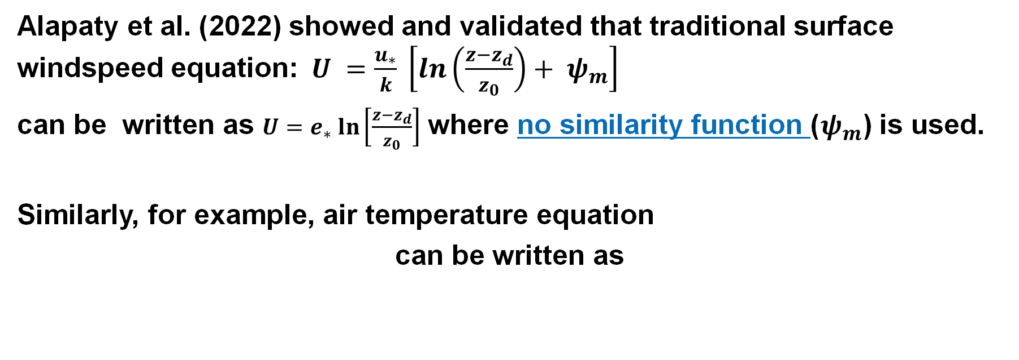
How e* dodges 50+ years-old similarity functions?
  Alapaty et al. (2022) showed and validated that traditional surface windspeed equation:$U =\frac{u_{∗}}{k} \left[\ln\left(\frac{z−z_{d}}{z_{0}}\right)+ ψ_{m}\right]$
  can be written as $U=e_{∗} ln\left[\frac{z−z_{d}}{z_{0}}\right]$ where no similarity function ($ψ_{m}$) is used.
  Similarly, for example, air temperature equation
  can be written as
$${where θ}_{∗}=−\frac{\overline{w^{′}θ_{v}^{′}}}{ke_{∗}}$$
$$Measurements and a box model were used$$
$$to validate the e_{∗} (the 3−D velocity scale)$$
$$has not been used in$$
3-D Meteorological & Air Quality $Models$

Slide 6
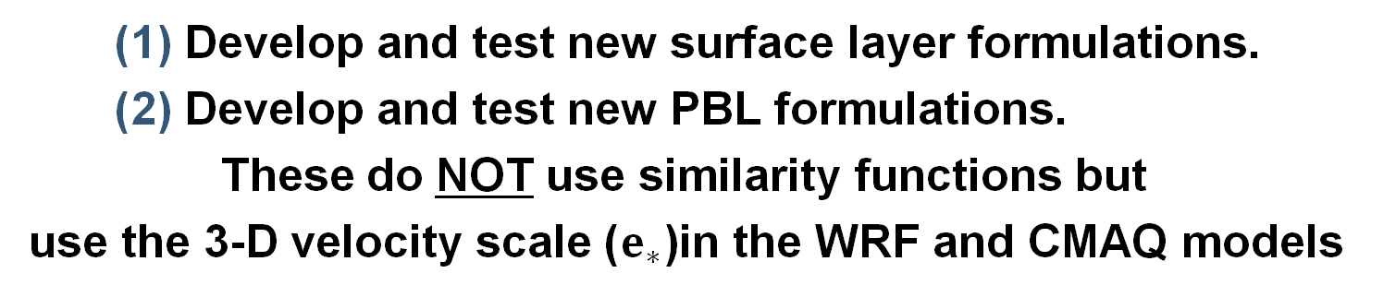
What we want to do…
(objectives)
  Using WRF model (MET model) and the CMAQ model (AQ model):
  Is it possible to perform model simulations without using similarity functions in PBL formulations?
  If so, then what is the performance of such models that do not use similarity functions in PBL?
How we want to do…
(methodology for both WRF and CMAQ models)
      Develop and test new surface layer formulations.
      Develop and test new PBL formulations.
  These do NOT use similarity functions but
  use the 3-D velocity scale ($e_{∗}$)in the WRF and CMAQ models

Slide 7
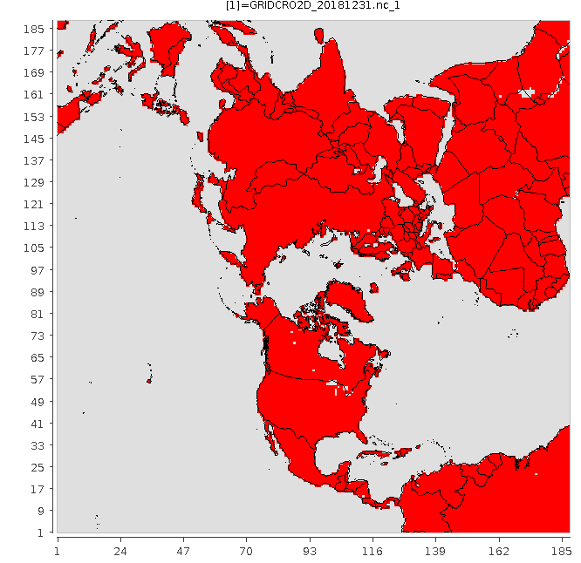
Models and Simulations
WRF model v4.3.3
CMAQ model v5.4
Modeling domain
Entire year 2018 (2 weeks spin up into 2017 December)
108 km grid, N. Hemisphere
Two simulations: (ACM2, STAGE)
SFM (Similarity Function Method)
TVM (Turbulence Velocity Method)
In the TVM, because it uses the 3-D turbulence velocity scale, there is no need to use similarity functions in: surface layer, PBL (ACM2), dry deposition (STAGE) schemes of WRF & CMAQ models.
OLD
NEW
Notes:
Since this is a part-time unfunded research , we picked modeling cases from on-going projects. Now, it is an exciting time to find out whether we can really avoid the 50+ year old practice of using similarity functions!!!

Slide 8
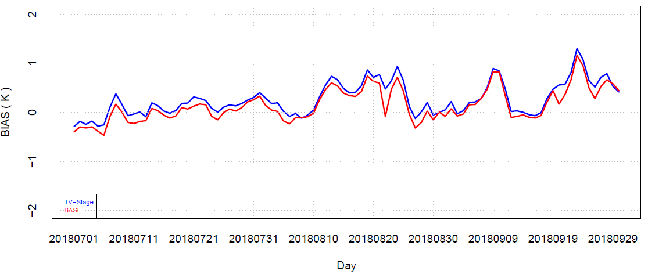
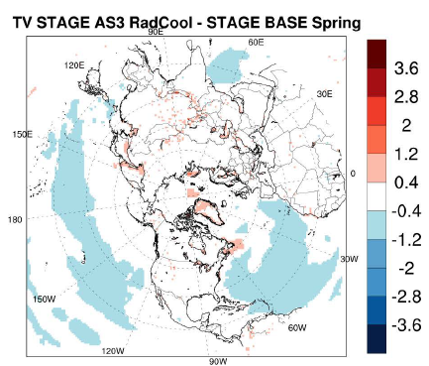
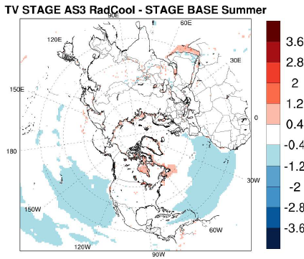
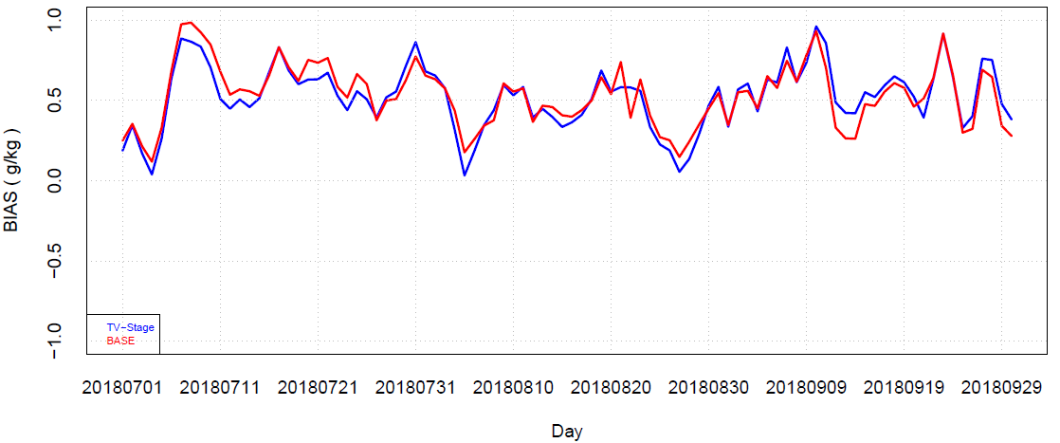
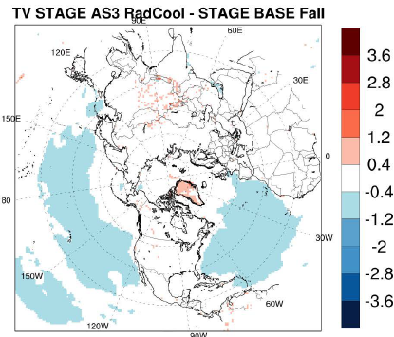
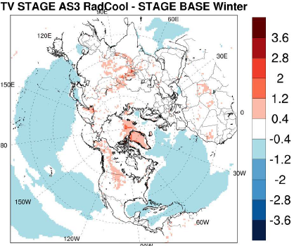
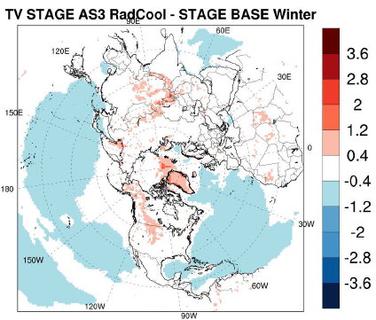
2018 WRF modeling results
2 m AGL seasonal air temperature differences (K)
SFM
TVM
2 m AGL daily air temperature bias (K) for JAS 2018
SFM
TVM
2 m AGL daily water vapor mixing ratio bias (g/kg) for JAS 2018
Notes:
(Left panel) Time series statistical measures indicate that there is an insignificant warm bias with TVM for T2, and an insignificant reduction in Q2 bias when compared to SFM. Also, bias differences are well within accuracy of measurements. Insignificant warm bias in TVM time series plot on left side indicates that the Kz in TVM is always tiny bit higher than the Kh SFM. And also, there is no Km & Kh concept in TVM.
(right panel) In general, spatial difference results are very similar between the two simulations that use (TVM) and don’t use (SFM) similarity functions with minor heterogeneous differences. With seasons, there are small differences between simulations with exception to Winter over open waters and snow covered regions. For all seasons, oceans have relatively cooler air temperatures in TVM. Most likely, turbulence maybe stronger during stable conditions. Most likely, soil moisture nudging over land may be a key player for muted response while over water there is no surface nudging. Thus, differences over water are mostly related to differences in formulations in the SFM and TVM. Interesting to note that Kzmin is used in the SFM while no such thing was used in the TVM.

Slide 9
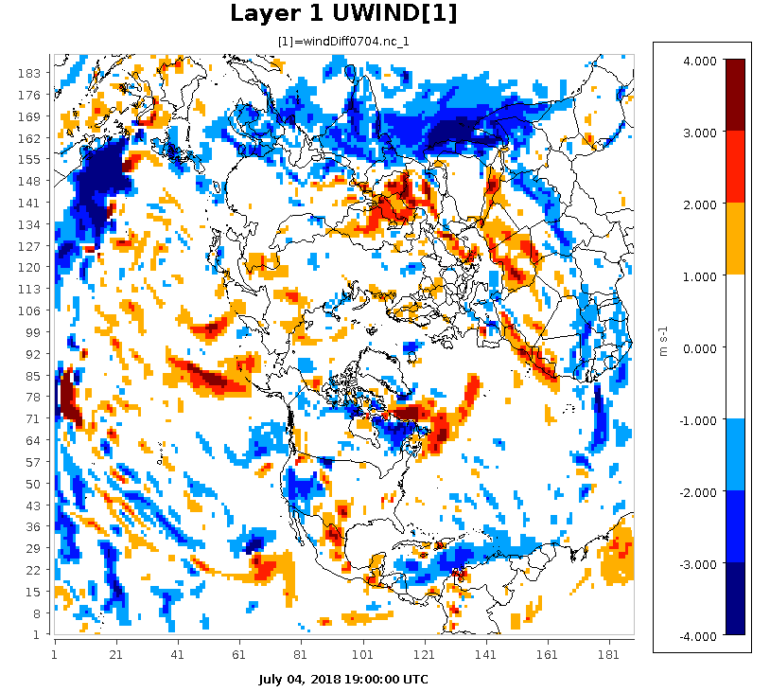
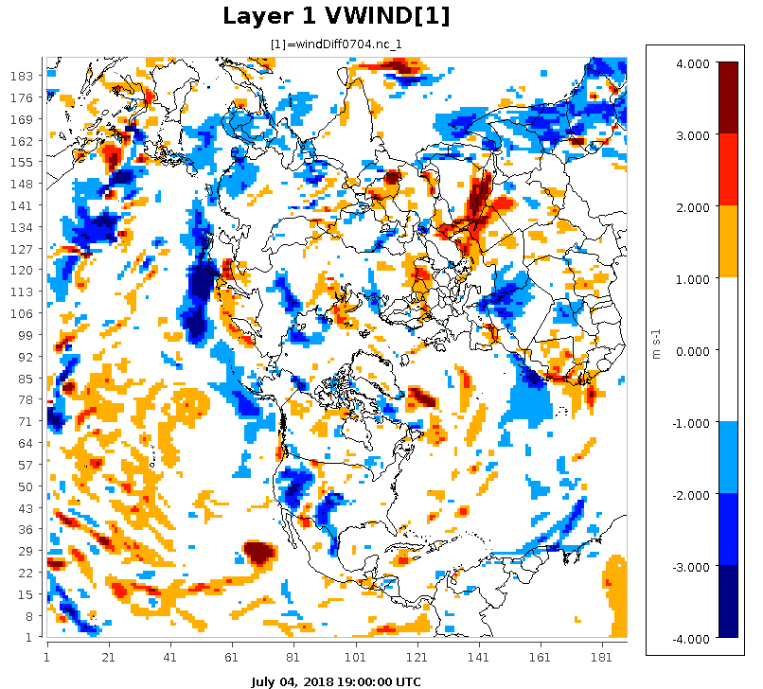
Layer 1 horizontal wind differences (m/s)
(TVM-SFM)
Zonal Wind differences
Meridional Wind differences
1900 UTC July 04, 2018
Notes:
There are no systematic patterns in the differences except that the u-wind differences are clearly present over the ITCZ regions because easterlies dominate in the tropics. In other areas, differences in clouds and radiation can contribute to differences in the surface winds. Also, note that momentum fields at the surface are not nudged and thus differences are directly due to formulation types used in SFM and TVM. Since TVM explicitly uses surface momentum and sensible heat fluxes, and since over the oceans sensible heat flux is weekly either +ve or –ve over oceans, momentum fields can be different between SFM and TVM. This result has direct bearing on the precipitation intensity, in particular over the ITCZ areas. Again, there is only one Kz in the TVM while Km is used in the SFM with a minimum Km value which could be another source for u-wind differences over the ITCZ

Slide 10
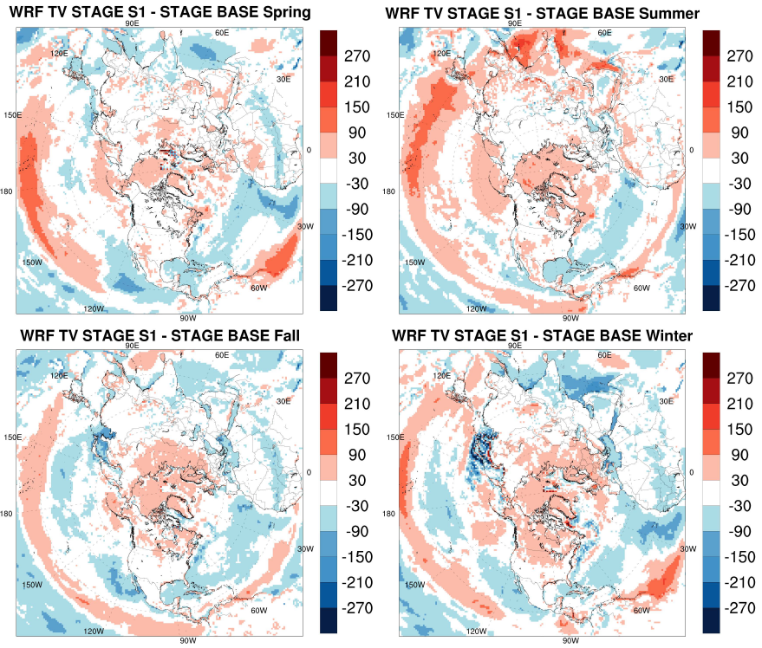
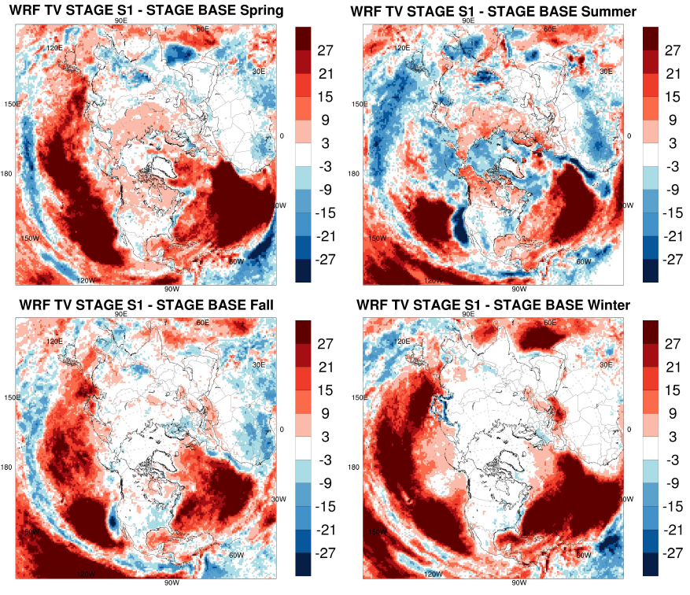
PBL depth differences (m) (TVM-SFM)
SSWR differences (W/m2)
(TVM-SFM)
9
SSWR = surface short wave radiation
Notes:
(left panel) Again, over oceans, PBL depth differences are more pronounced and over India (summer); elsewhere PBL depth differences are about 100 m in most land areas during all seasons. Impact of soil moisture nudging is felt even in the PBL depth simulations over the land areas.
(right panel) Differences in cloud simulation resulted in differences in surface shortwave radiation. This is a clear example as to how PBL processes can influence the cloud formation and hence radiation.

Slide 11
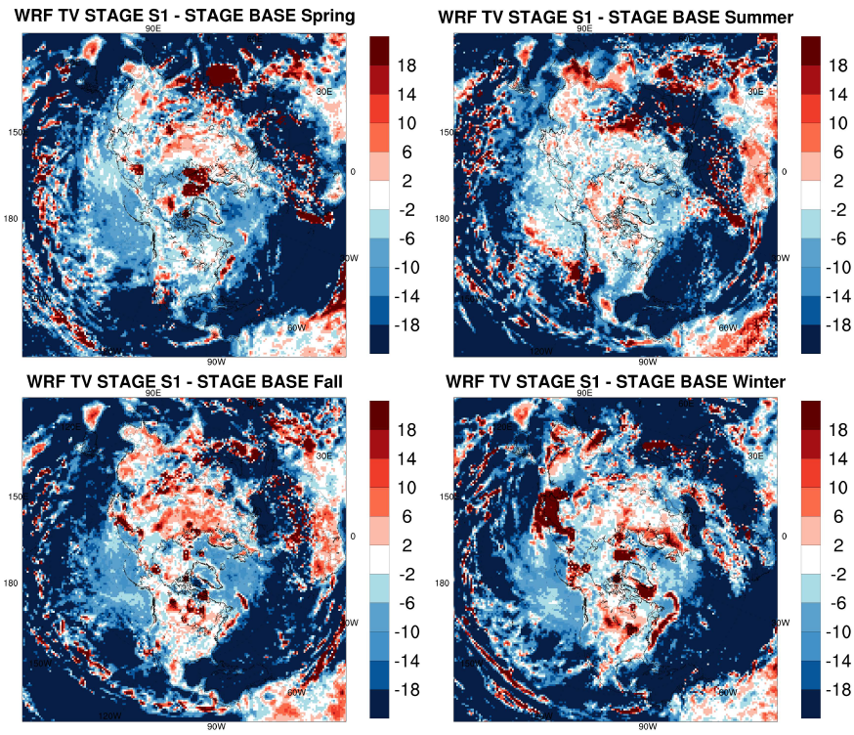
Total surface precipitation difference (%)
(TVM-SFM) for each season
Notes:
Large reduction of total surface precip can be seen over the oceans and in particular tropical oceans where ITCZ is present. With the WRF configuration used, we know that it rains too much over the waters. We will acquire global precip data for further evaluation in our further analysis.

Slide 12


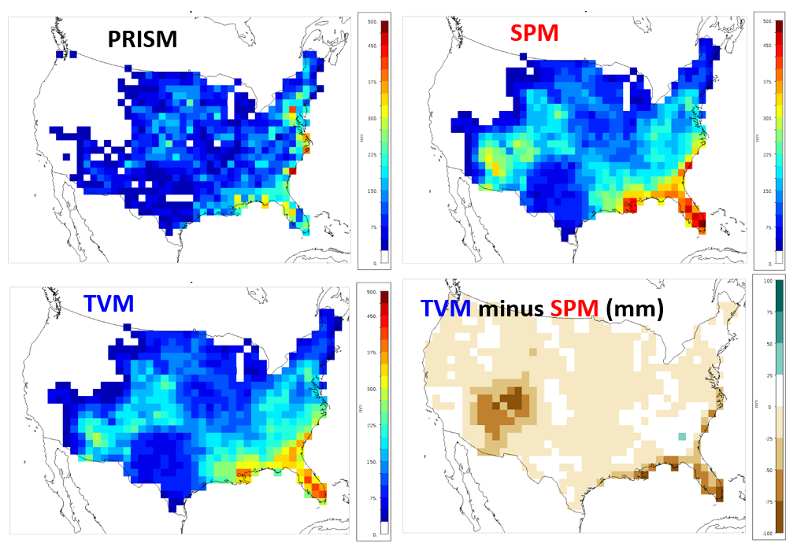
Total surface precipitation for USA for July 2018
SFM
SFM
Notes:
Top left panel is for the precip accumulated obtained from PRISM data and both simulations (SFM & TVM) overpredict surface precip when compared to PRISM data. Precip in TVM has reduced wet bias as compared to SFM. Right bottom panel also indicate that, in general precip wet bias is reduced in particular eastern coastal areas and southwestern regions. Definitely, TVM produced better precip estimates.

Slide 13
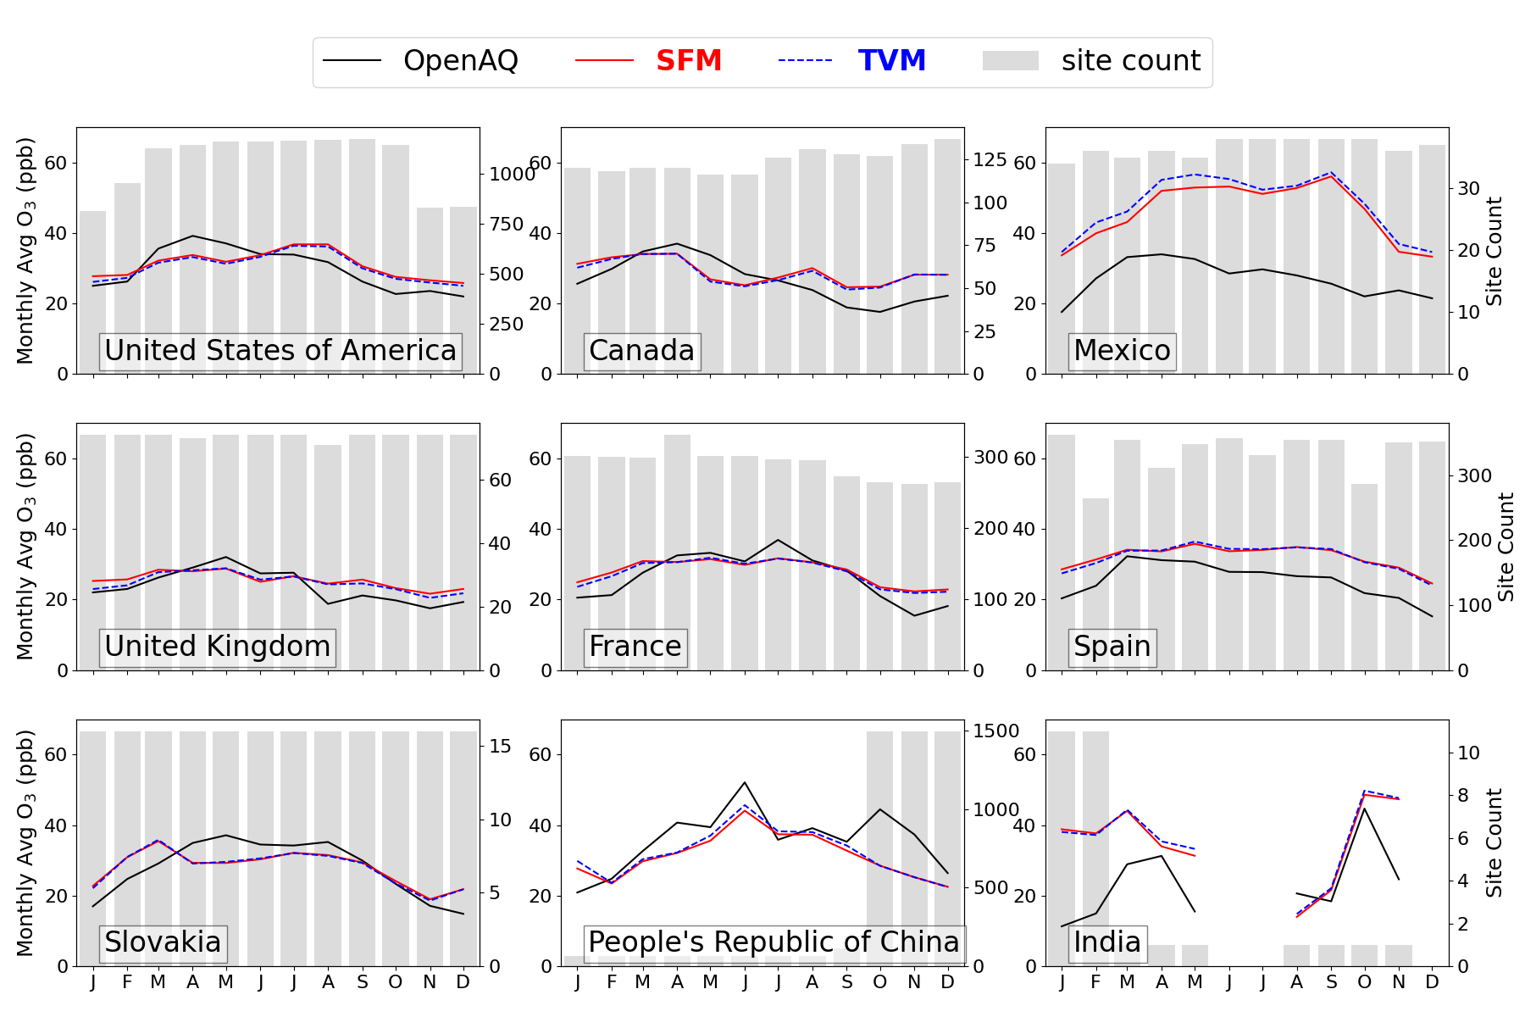
2018 CMAQ modeling results
Monthly Averaged surface ozone variation
Notes:
Seasonal variation of monthly averaged sfc ozone for different countries sow that at a gross level, both SFM and TVM produce very similar trends and magnitudes. Its hard to pick the winner here. This confirms that on average the TVM was able to successfully simulated sfc ozone. These are exciting results since we did not use any similarity functions in CMAQ (these functions are used in models for over 50+ years partially contributing to model-2-model differences)

Slide 14
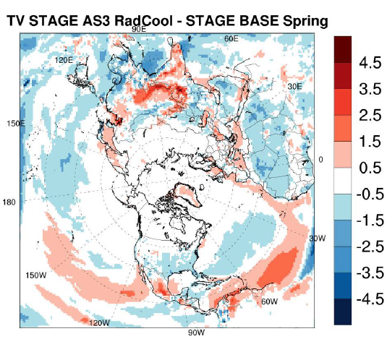
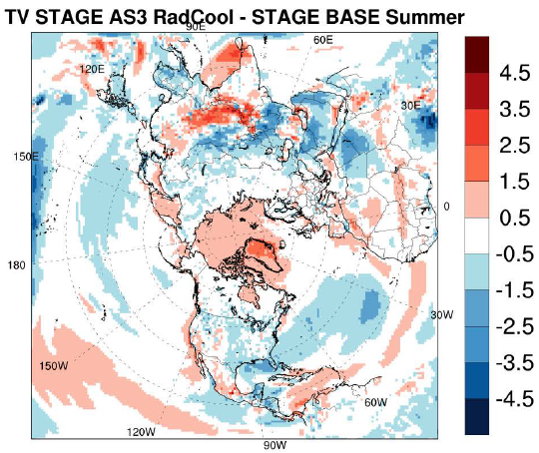
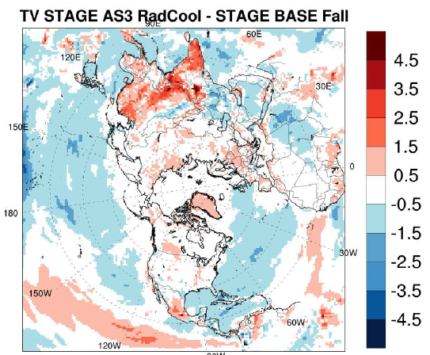
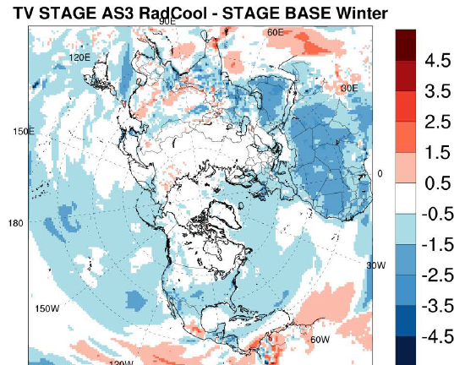
2018 CMAQ modeling results…
SPRING
SUMMER
Surface ozone differences (ppb) (TVM-SFM) for each season
FALL
WINTER
Notes:
on average TVM produces lower or higher surface ozone over many land areas during all seasons as compared to SFM. Usually, cmaq has high ozone bias in summer and TVM reduces that +ve bias; however cmaq has –ve bias in spring and TVM enhances such bias. Winter bias is also reduced in TVM.

Slide 15
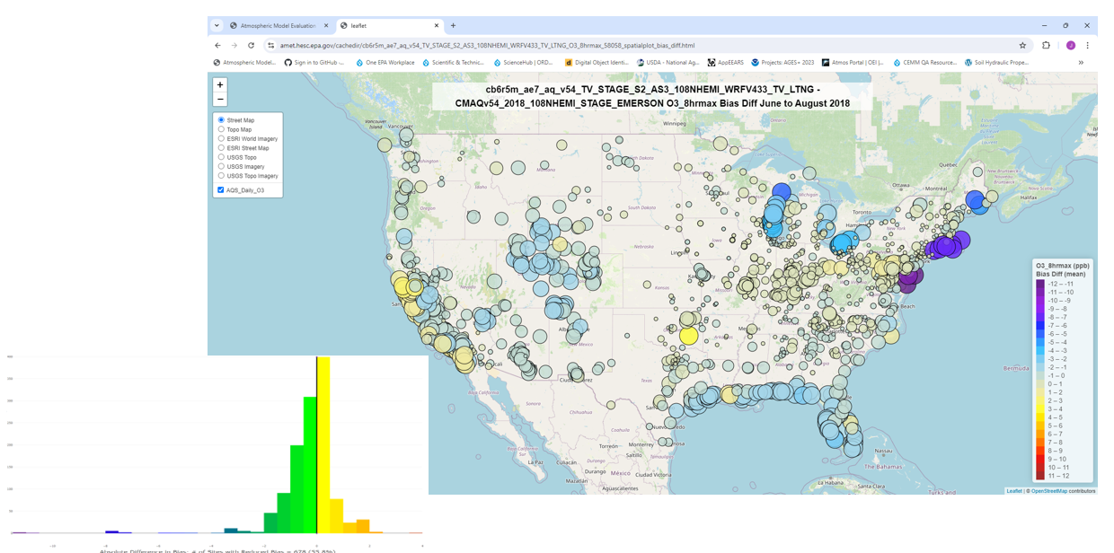
JJA bias differences (TVM bias minus SFM bias) for MDA8 Ozone
Histogram of
bias differences
14
# of sites with reduced bias = 678 (56%)
Notes:
Difference in absolute bias: warm colors = increase in bias, cool colors = decrease in bias; size of the circle = small circle of same color indicates lower bound value of the conc range and bigger circle of same color indicates upper bound value of the range. interestingly for the western US almost all of the sites TVM has significant reduction in bias (except few over CA) while for the eastern US bias differences, almost all sites show minor to moderate reductions in bias in TVM. Coastal and lake areas have large reductions in bias in TVM.
MDA8 definition: The daily maximum 8-hour concentration for a given calendar day is the highest of the 24 possible 8-hour average concentrations computed for that day. This process is repeated, yielding a daily maximum 8-hour average ozone concentration for each calendar day with ambient ozone monitoring data.

Slide 16
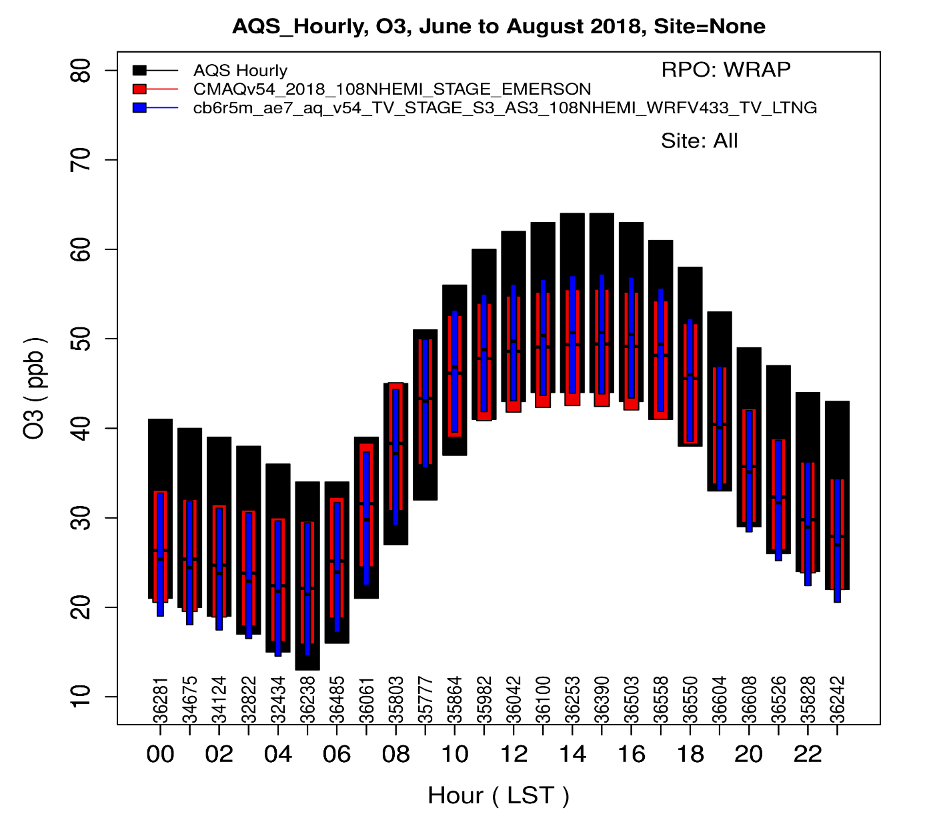
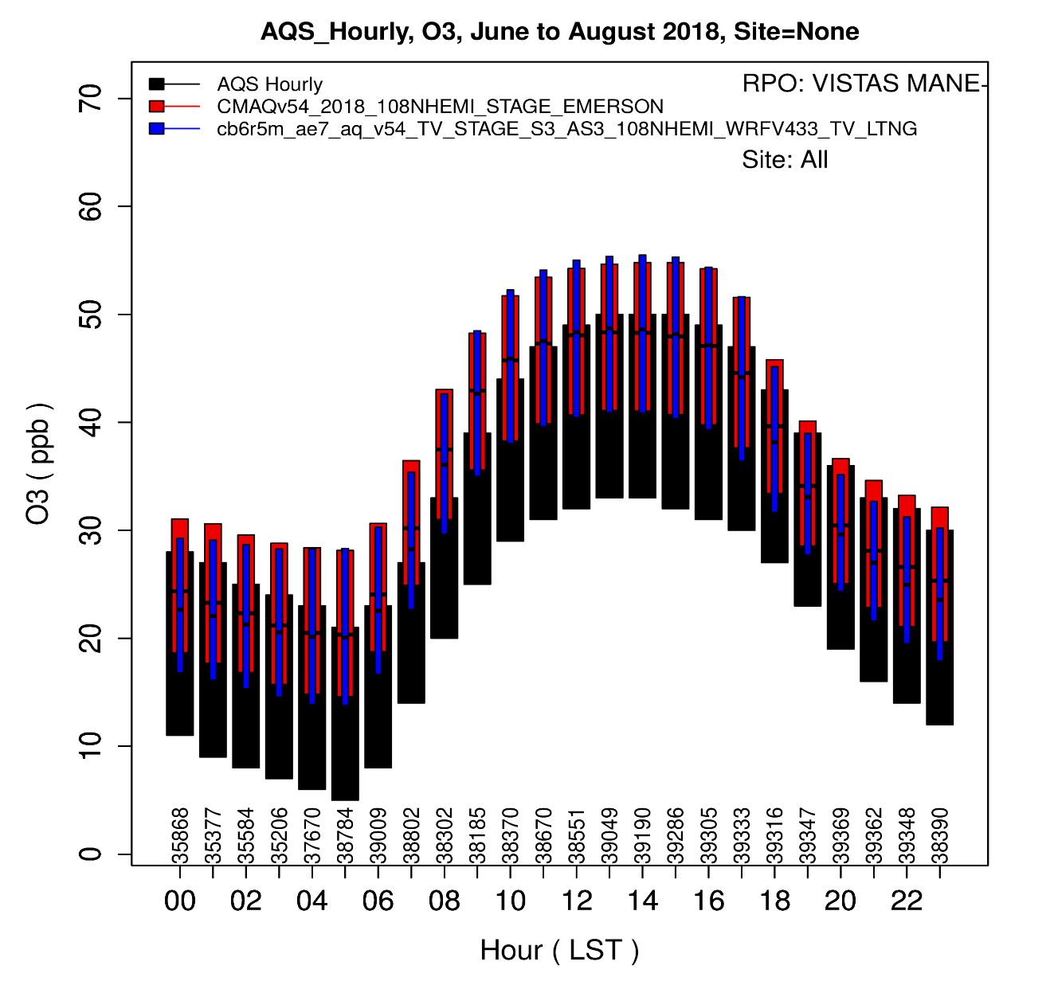
Diurnal variation of ozone (JJA averages)
Western US
Northeast and Southeast US
AQS Daily
SFM
TVM
AQS Daily
SFM
TVM
Notes:
Left panel: With TVM (blue), average minimum values during stable conditions are slightly low biased while during daytime warm conditions TVM does better than SFM (red). Both SFM and TVM underpredict max sfc ozone during daytime hours.
Right panel: during entire 24 hours max and min sfc ozone was over-predicted by both SFM and TVM, indicating fundamental issue with the CMAQ beyond PBL processes.

Slide 17
SUMMARY
Preliminary results from WRF and CMAQ models’ simulations indicate that:
For the first time (after 50+ years), both the WRF and CMAQ models didn’t use similarity functions at the hemispheric scale.
The new 3-D velocity scale is found to be functional in WRF and CMAQ models over different landuse and weather/climate regimes.
New TV scaling (TVM) produced better precipitation estimates, one of the strongest performances by TVM.
For 56% observational sites, TVM has reduced bias in surface ozone existed in the SFM simulations.
We are currently analyzing PM2.5 performance by TVM and SFM.

Slide 18
Thank you for your attention !

