Slide 1
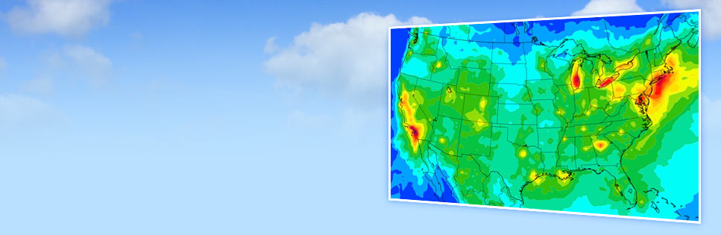

Evaluating updated secondary organic aerosol (SOA) formation schemes in CAMx
Katie Tuite¹, Chris Emery¹, Ling Huang^{1,2}, Pradeepa Vennam¹, Greg Yarwood¹
¹Ramboll
²School of Environmental and Chemical Engineering, Shanghai University
CMAS Conference 2024
Funding from:

Slide 2
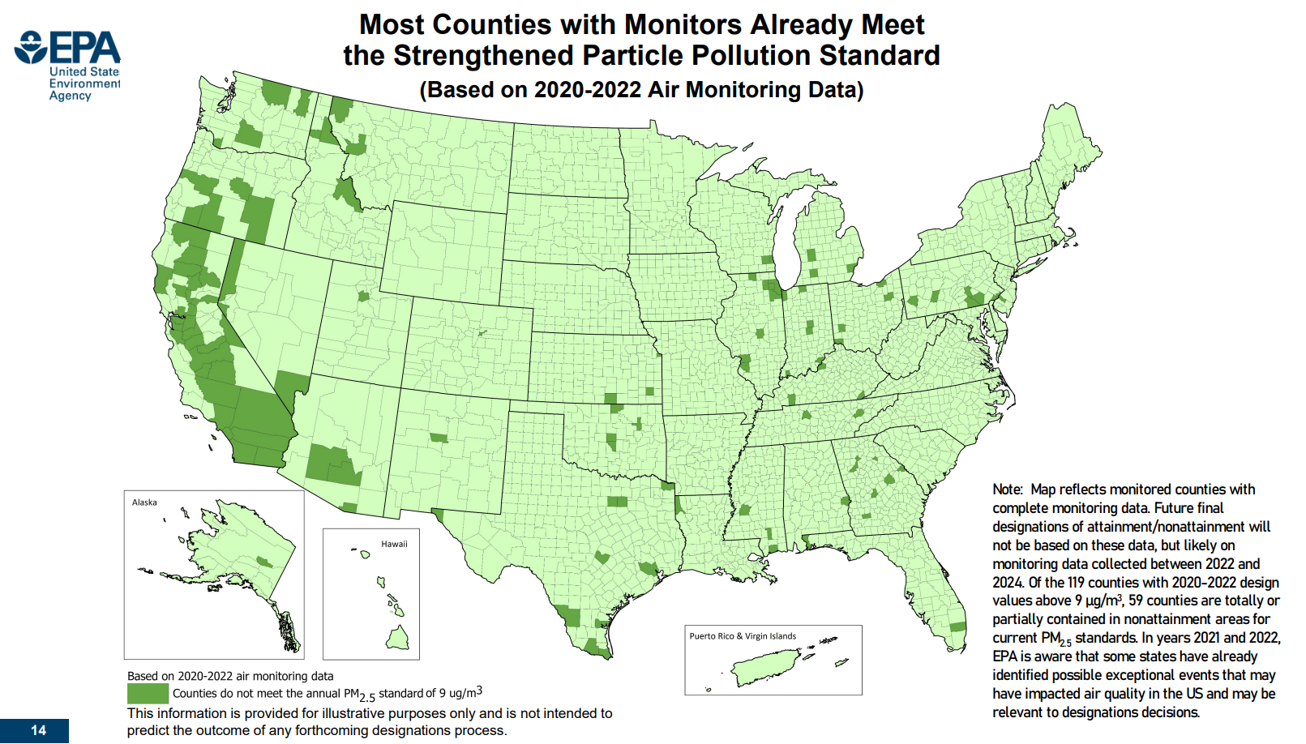
Motivation
Annual PM_{2.5} National Ambient Air Quality Standard (NAAQS) reduced from 12 μg/m³ to 9 μg/m³
PM modeling needed for State Implementation Plans (SIP)
Secondary organic aerosol (SOA) is a major component of PM_{2.5} in many regions
Differing SOA schemes can affect air quality forecasts and assessments
Purpose: Review and update the CAMx SOA treatment to better guide effective PM_{2.5} SIP strategies
Source: Final Reconsideration of the National Ambient Air Quality Standards for Particulate Matter (PM) | US EPA
Tuite CMAS2024

Slide 3
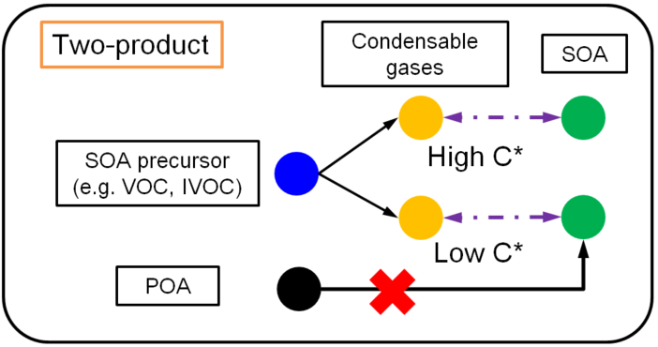
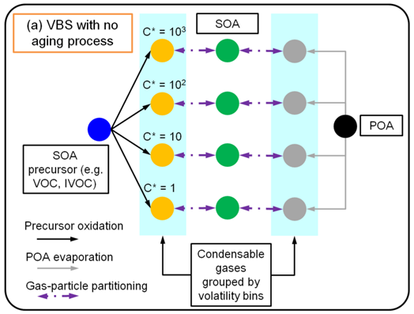
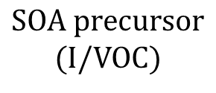
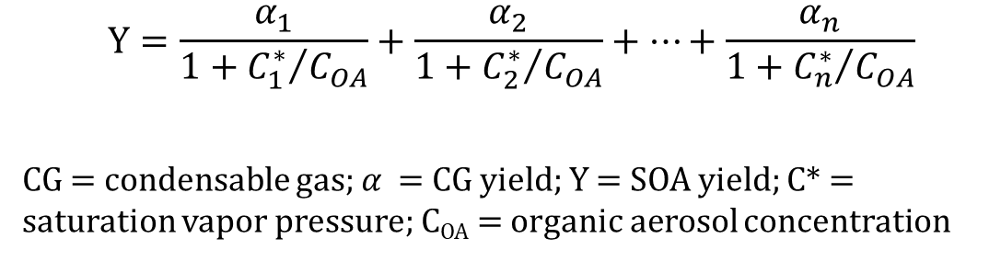
SOA treatment in models
Two-product scheme and Volatility Basis Set (VBS) are common approaches
$SOA precursor$ (I/VOC)
$$+ oxidant=α_{1}{CG}_{1}+α_{2}{CG}_{2}+…+α_{n}{CG}_{n}$$
$$Y=\frac{α_{1}}{1+{C_{1}^{∗}}/{C_{OA}}}+\frac{α_{2}}{1+{C_{2}^{∗}}/{C_{OA}}}+…+\frac{α_{n}}{1+{C_{n}^{∗}}/{C_{OA}}}$$
CG = condensable gas; $α$ = CG yield; Y = SOA yield; C* = saturation vapor pressure; C_{OA} = organic aerosol concentration
CAMx SOAP is a modified two-product scheme: high, low, and non-volatile products
Tuite CMAS2024

Slide 4
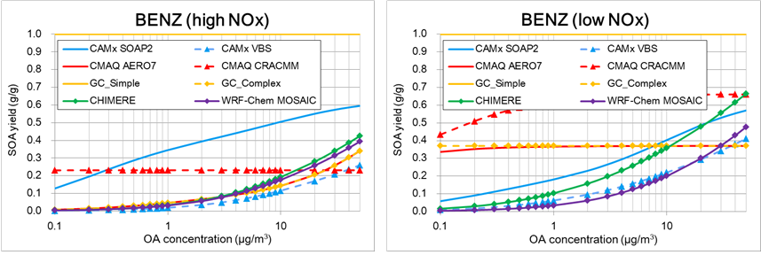
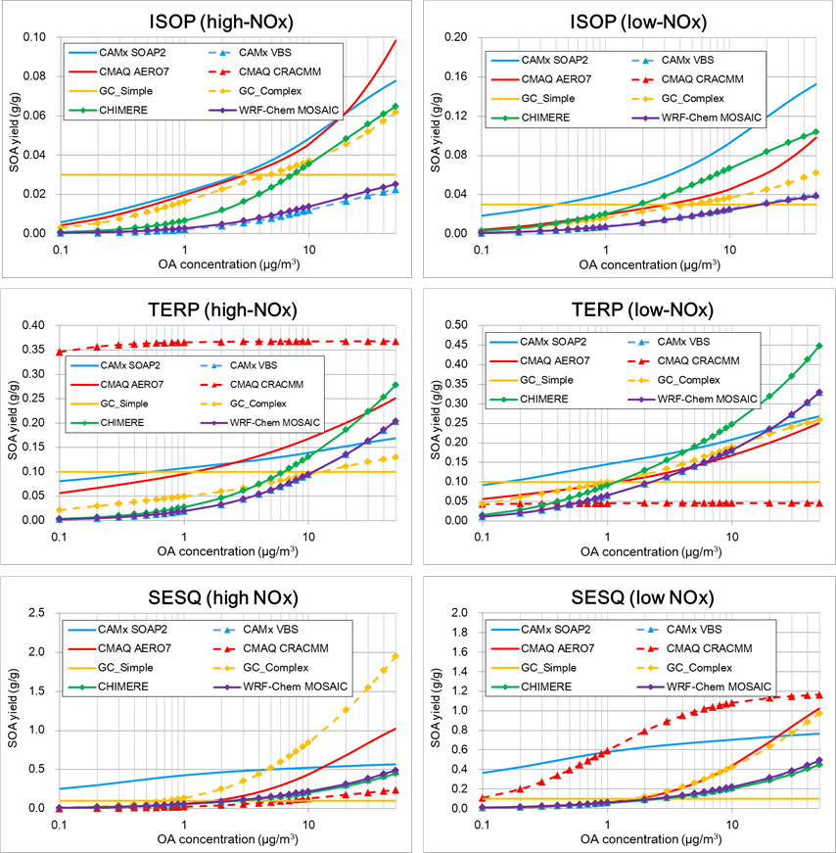
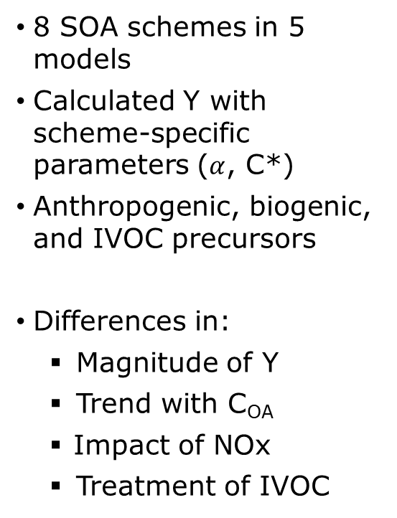
Comparison of instantaneous (nonaged) SOA yields at 298 K
8 SOA schemes in 5 models
Calculated Y with scheme-specific parameters ($α$, C*)
Anthropogenic, biogenic, and IVOC precursors
Differences in:
    Magnitude of Y
    Trend with C_{OA}
    Impact of NOx
    Treatment of IVOC
Tuite CMAS2024

Slide 5
Updated CAMx SOA schemes tested using box models
Structure of SOAP maintained but SOA yield parameters updated in 3 test schemes
    Parameters that emulate
    CMAQ AERO7
    (“E-AERO7”)
    Parameters that emulate
    CMAQ CRACMM
    (“E-CRACMM”)
    Parameters that emulate a
    “SIMPLE”-style scheme
Curves fit to AERO7/CRACMM SOA yield data using SOAP C* values
Assumes all SOA formed is non-volatile; parameters based on multi-model averages and work by Seltzer et al., 2021
Tuite CMAS2024

Slide 6
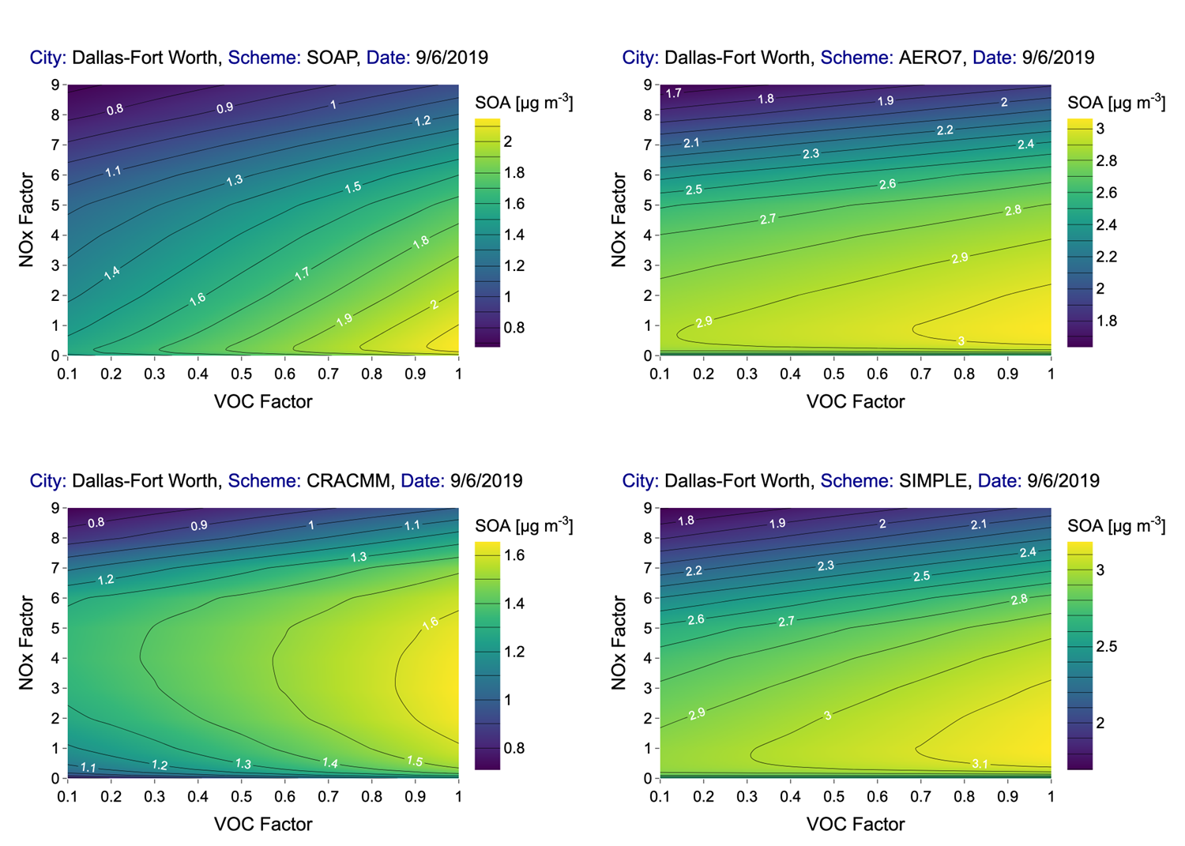
CAMx box model tests – scaled emissions runs
Dallas-Fort Worth: SOAP
Dallas-Fort Worth: E-AERO7
SOA response to varying anthropogenic VOC and NOx emissions
Similar response for SOAP, AERO7, SIMPLE
    SOA decreases as NOx increases
CRACMM behaves differently from others
    ‘Ridgeline’ is at higher NOx factor (SOA increases before it decreases)
Dallas-Fort Worth: E-CRACMM
Dallas-Fort Worth: SIMPLE
Base case (1,1)
Tuite CMAS2024

Slide 7
CAMx box model tests – reduced NOx runs
Difference in average SOA concentration (μg/m³) between base run and 50% NOx emission reduction run
 | SOAP | E-AERO7* | E-CRACMM* | SIMPLE
 | Base - 50% NOx | Base - 50% NOx | Base - 50% NOx | Base - 50% NOx
Dallas-Fort Worth
ASOA | 9.6% | 1.9% | 3.5% | 0.6%
BSOA | 12.2% | 0.4% | -10.7% | 2.4%
Total SOA | 10.3% | 1.6% | -2.5% | 0.9%
San Antonio
ASOA | 3.7% | 2.1% | 2.3% | 1.0%
BSOA | 3.7% | 0.3% | -10.0% | 1.8%
Total SOA | 3.7% | 1.8% | -3.2% | 1.1%
Tyler/Northeast Texas
ASOA | 4.4% | 9.9% | 1.0% | 8.5%
BSOA | -4.1% | -6.2% | -12.6% | -4.4%
Total SOA | -2.5% | -1.8% | -11.0% | -1.5%
Unique CRACMM behavior due terpene yield
ASOA = anthropogenic SOA; BSOA = biogenic SOA
*E-AERO7 and E-CRACMM have limited aging representation

Slide 8
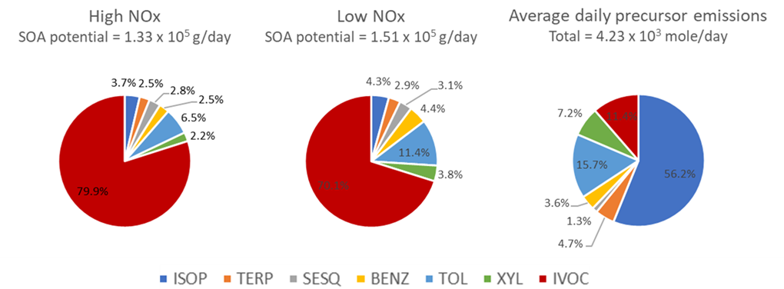
Advantages of SIMPLE scheme
Straightforward to implement
Potential to improve computational efficiency (especially with CAMx’s source apportionment probing tools)
Behaves more predictably without nonlinearities present in other schemes
Ability to calculate emission-weighted SOA potential of precursors
Dallas- Fort Worth
Tuite CMAS2024

Slide 9
CAMx SOAP updates
SOAP3 released with CAMx v7.3 (June 2024)
Two options for SOA yield parameters
    COMPLEX – based on E-AERO7 implementation
    SIMPLE – non-volatile SOA
Additional updates (not discussed in this presentation)
    POA evaporation
    SOA from heterogeneous uptake of glyoxal and methylglyoxal
Details provided in User’s Guide at www.camx.com
Tuite CMAS2024

Slide 10
Next steps
Update CAMx’s Particle Source Apportionment Technology (PSAT) probing tool for use with SIMPLE scheme
Update IVOC emission speciation to differentiate between Volatile Chemical Products (VCP) and IVOC
Thank you!
ktuite@ramboll.com
www.camx.com
Tuite CMAS2024

Slide 11
Extra slides

Slide 12
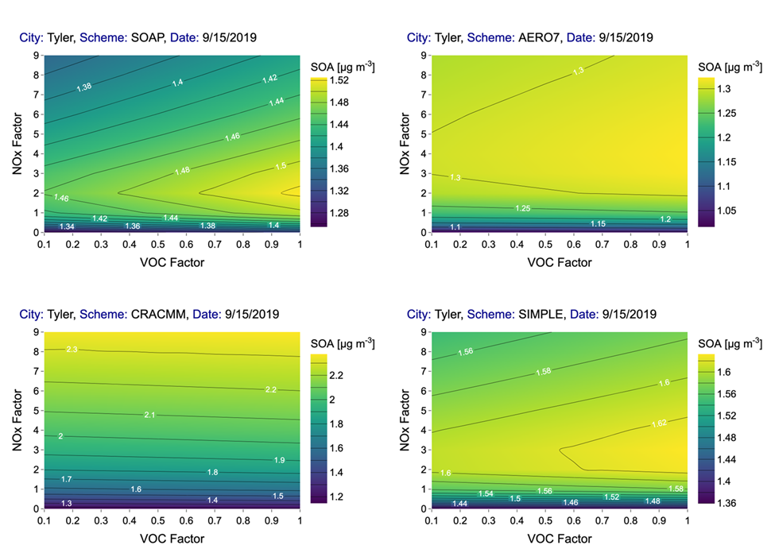
CAMx box model tests – scaled emissions runs

Slide 13
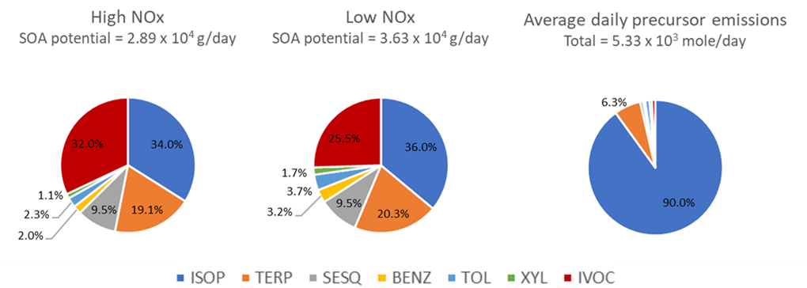
Emission-weighted SOA potential
Dallas
Tyler

