Slide 1
Future year Source Apportionment PM_{2.5} modeling in Continental US
Lakshmi Pradeepa Vennam¹, Prakash Karamchandani¹, Tejas Shah¹, Ralph Morris¹, Karim Hamza², Fred Turrati², Yamada Taiga² and Toru Kidokoro²
¹Ramboll Americas Engineering Solutions, Novato, CA
²Toyota Motor Corporation
CMAS Conference
October 21, 2024

Slide 2
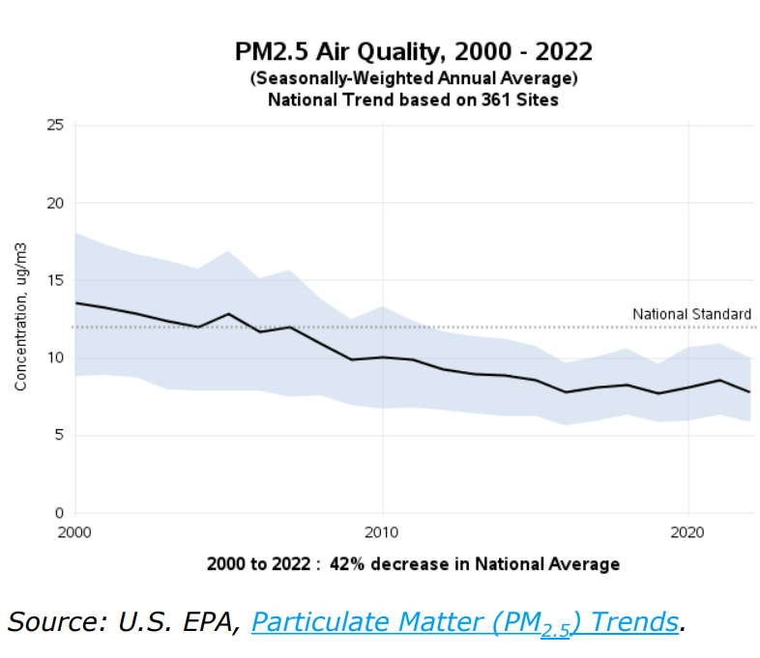
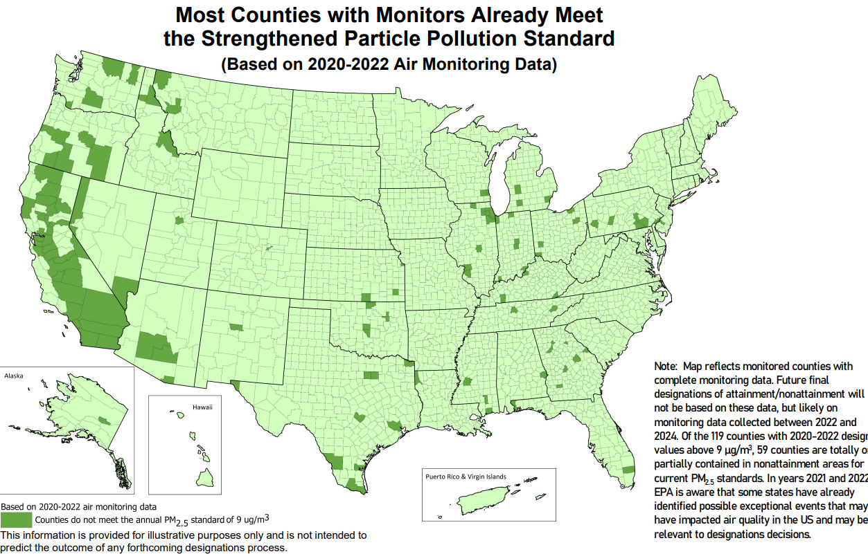
PM2.5 NAAQS standard
The annual, primary (health-based) NAAQS standard for fine particles is now 9.0 μg/m³, a 25% reduction from the previous standard 12 μg/m³
119 counties fail to achieve NAAQS based on 2020-2022 air monitoring data
Source: Final Reconsideration of the National Ambient Air Quality Standards for Particulate Matter (PM) | US EPA

Slide 3
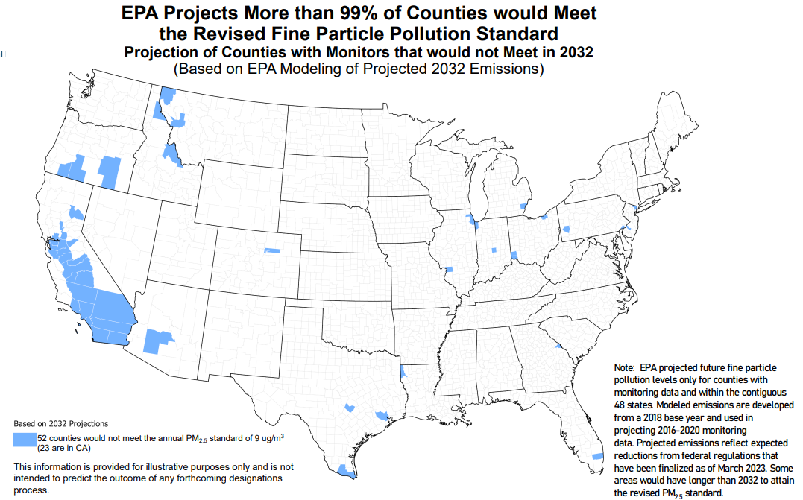
Future Projections
Source: Final Reconsideration of the National Ambient Air Quality Standards for Particulate Matter (PM) | US EPA

Slide 4
PM_{2.5} Modeling
Increasing needs in PM_{2.5} State Implementation Modeling
Implementation of effective strategies to attain the new PM_{2.5} standards
Increases the interest in understanding contributions of specific source categories to PM_{2.5}
Influence of upwind states contributions to PM_{2.5} nonattainment in a downwind state
The key focus of this study is to understand the emission sources contributions on the future year PM_{2.5} predictions, additionally studied the source specific attribution of primary and secondary PM to the total PM_{2.5}
Notes:
Recent reductions in the annual fine particulate matter (PM_{2.5}) standards from 12 to 9 µg/m³ have created interest in understanding the contributions of specific source categories to PM_{2.5}, particularly in areas in the US that are already in non-attainment or may potentially become nonattainment areas due to the new regulations.

Slide 5
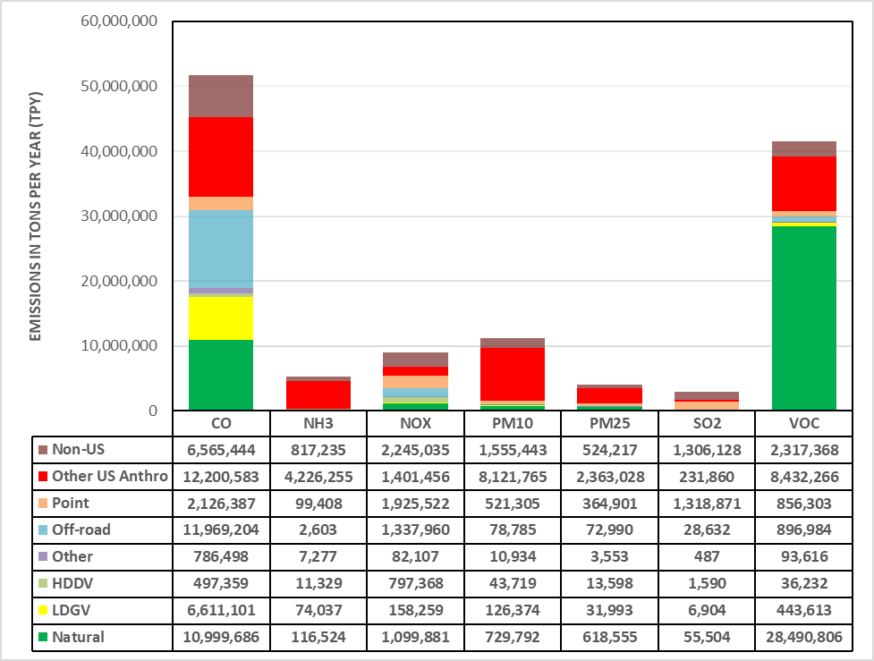
PSAT Configuration and Emissions Processing
Mobile source LDGV emissions
Mobile source HDDV emissions
Other mobile source emissions
Off-road emissions
Point source emissions
Other Anthropogenic sources (includes other area sources, prescribed and agricultural fires)
Non-US (Can-Mex) sources
Natural
Notes:
We developed future-year emission inputs by source category for the CAMx PSAT simulations. For the on-road mobile emissions, the 2032 inventory was split into three vehicle groups: (1) Light Duty Gasoline Vehicles (LDGV); (2) Heavy Duty Diesel Vehicles (HDDV); and (3) Other mobile sources (Other). The 2032 on-road activities by vehicle group were processed through the SMOKE-MOVES tool in separate processing streams to generate gridded, hourly, model-species emissions inputs for CAMx.
Vehicle exhaust emissions have been decreasing due to stricter regulations and advancements in control strategies. However, non-exhaust emissions from brake and tire wear have not been extensively regulated in the past, and their relative contribution to PM in urban areas is increasing. The split between the exhaust and non-exhaust emissions varies by vehicle type. For HDDV vehicles, exhaust PM2.5 emissions are higher than non-exhaust emissions because diesel engines (61%) generate higher PM2.5 emissions than brake and tire wear. In contrast, for LDGV vehicles, non-exhaust emissions make up a higher percentage of total PM2.5 than gasoline-fueled engine exhaust (40%).
Figure on the right shows stacked bar chart summaries of 2032 emissions by PSAT source category and pollutants for the contiguous US. Point sources are the highest emitter of NOx, followed by offroad sources. For primary PM2.5, the Other US Anthro emission category, which includes anthropogenic fugitive dust sources, dominates the total national PM2.5 inventory. The anthropogenic fugitive dust sources include road dust, construction dust, ag dust, etc. The VOC inventory is dominated by biogenic VOC (BVOC), followed by the Other US Anthro category, which includes O&G and solvent emissions.

Slide 6
Modeling Configuration
Description | Science Option
Horizontal Advection Solver | Piece wise parabolic (PPM)
Vertical Advection Solver | Implicit
Gas-Phase Mechanism | Carbon Bond (CB6r5)
Chemistry Solver | Euler Backward Iterative (EBI)
Dry Deposition | Zhang et al. (2001; 2003)
Wet Deposition | True
Diffusion | K-theory
Inline Iodine Emissions | True
Probing tool | SA (Source Apportionment)
CAMx v7.2
2016v2 and 2032 EPA Platform
12US2 Domain
PSAT source apportionment
Annual Simulation

Slide 7
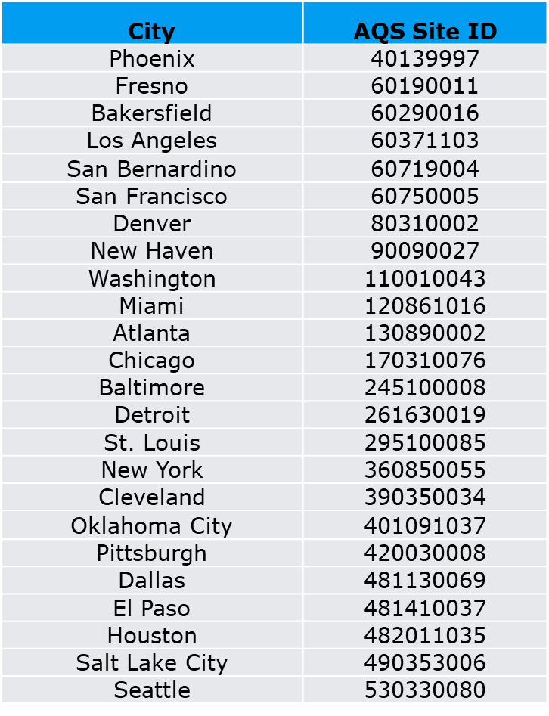
Modeling Results and Analysis
SMAT Analysis between 2016 and 2032
2032 Future year PSAT source contributions
Focused on 24 key cities, monitor grid cell analysis
Secondary and primary PM_{2.5} source contribution factors are applied to the Design Value

Slide 8
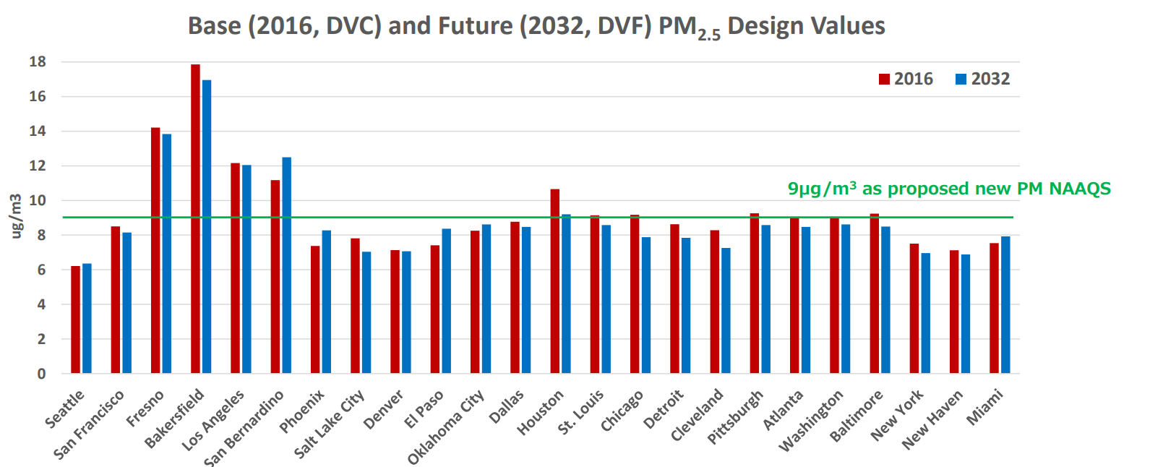
PM_{2.5} Design Values
NAAQS is expected to be achieved in many regions except California
Notes:
Figure compares the 2016 design values from observations with projected 2032 design values from SMAT. The future year design values are lower than the 2016 design values at most of the selected cities with differences ranging from 0.06 ug/m3 (at Denver) to 1.46 ug/m3 (at Houston). However, at a few cities such as Phoenix, El Paso, San Bernadino, Oklahoma, Miami and Seattle, the 2032 design values are higher (by 1.32 ug/m3 at San Bernadino) than the 2016 design values. Increases in the design values at these locations are likely associated with increase in future year emissions.

Slide 9
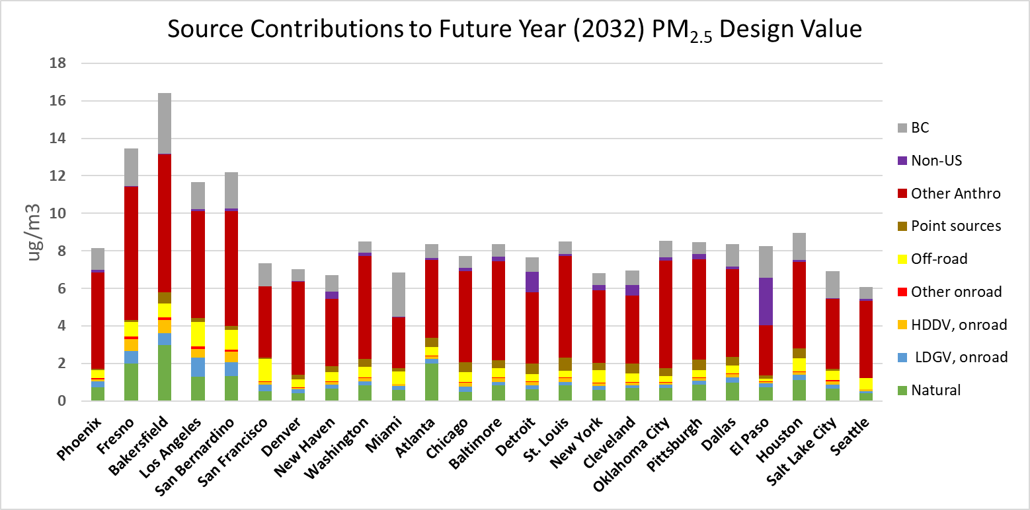
Source sectors contributions to future year total PM_{2.5} design values
Notes:
Other Anthro is the dominant source pretty much at all monitor grid cells considered at these key cities. The cities (like El paso, Detroit) that are closer to the US border shows influence from non-US sources, control strategies need to keep this in mind. Some of the cities that are closer to the ports show relatively higher contribution from off-road than some of in-land cities.

Slide 10
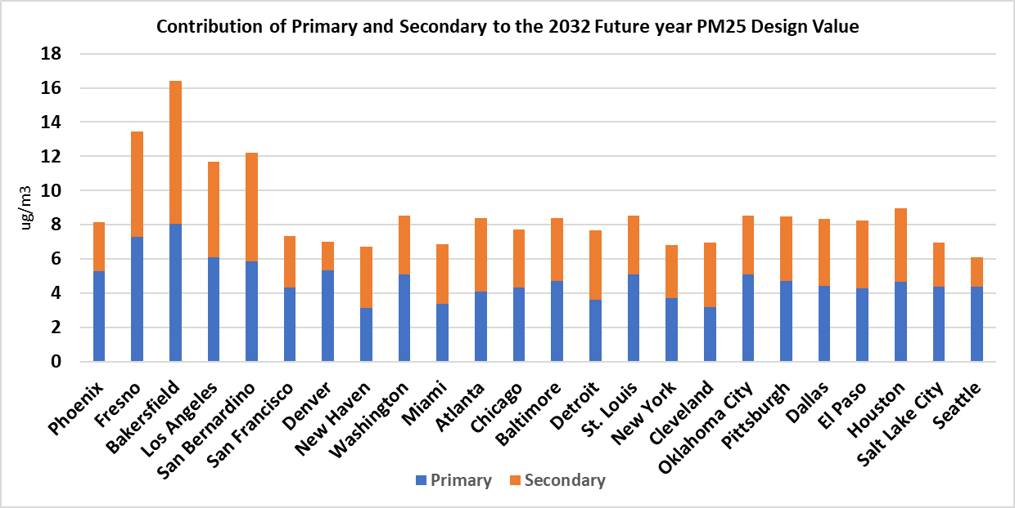
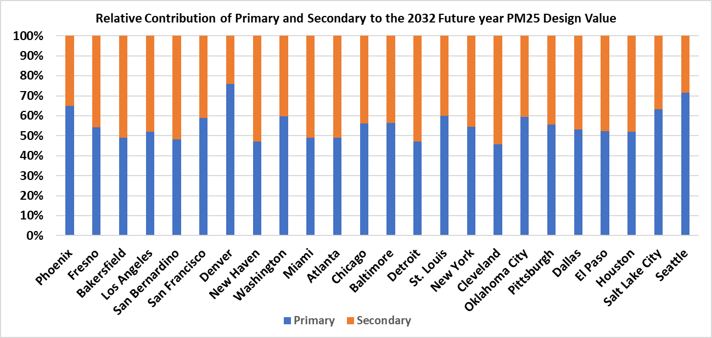
Primary vs Secondary Contribution
Notes:
The Particulate Source Apportionment Technology (PSAT) probing tool tracks primary and secondary particulate matter by apportioning the sulfur, nitrogen, secondary organic aerosol (SOA) and primary PM classes of CAMx PM species. At most of the cities significant contribution is coming from primary, but however we can see that secondary contribution is equally important
Phoenix , Denver – more primary, than secondary
Detroit , Cleveland --- slightly more secondary

Slide 11
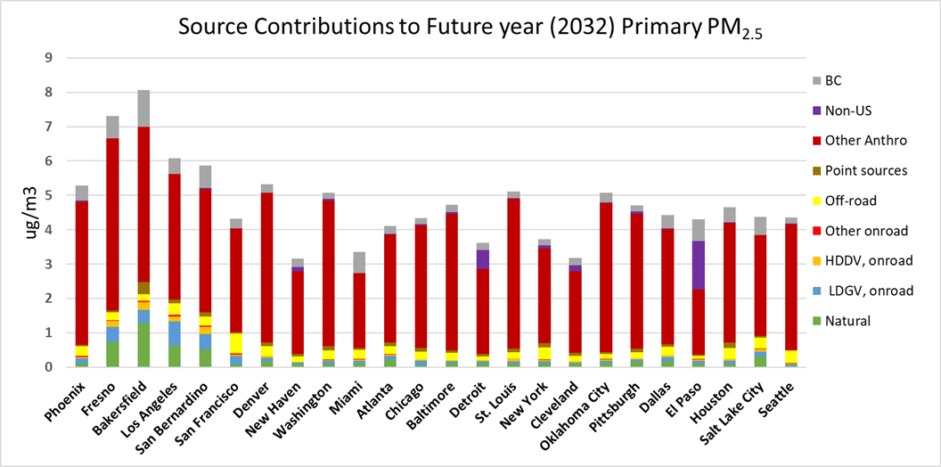
Source sectors contributions to future year primary PM_{2.5} design values

Slide 12
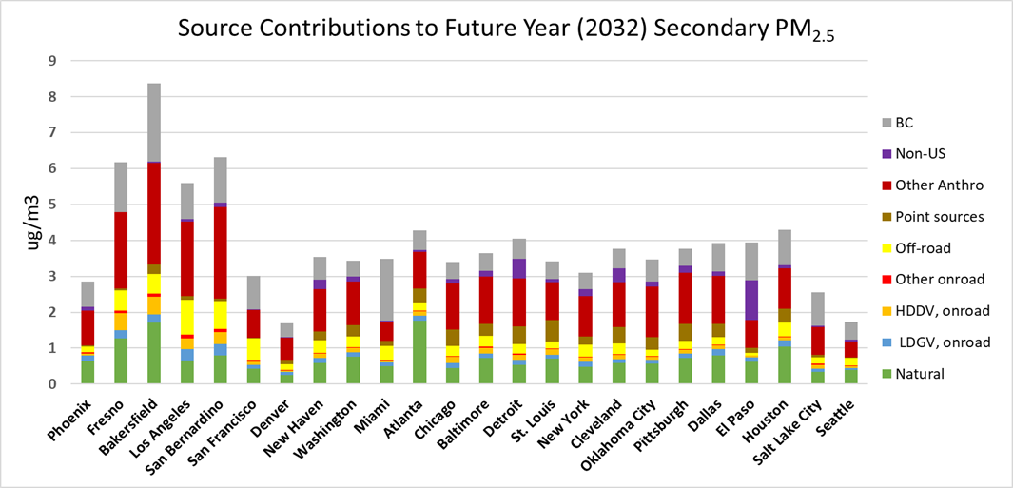
Source sectors contributions to future year secondary PM_{2.5} design values

Slide 13
Conclusions
“Other anthropogenic” source : largest contributor at all 24 locations, contributions ranging from 32% in El Paso to 70% in Denver.
Natural source category contributions are the second largest in most locations, with contributions of 23% in Atlanta and 18% in Bakersfield.
LDGV and HDDV contributions : <10% (LDGV: 2% in Seattle to 9% in Los Angeles; HDDV: 1% in El Paso to 5% in Fresno).
LDGV contributions are higher than HDDV contributions partly due to higher LDGV primary PM_{2.5} emissions as compared to HDDV emissions
“Other anthropogenic” is the dominant contributor to primary PM_{2.5}, indicating the influence of primary anthropogenic fugitive dust and agricultural/prescribed fires emissions to the total PM_{2.5}.

Slide 14
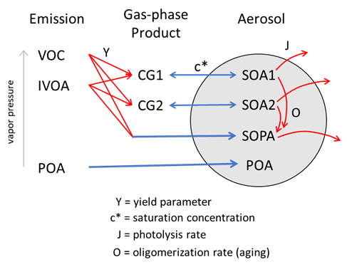
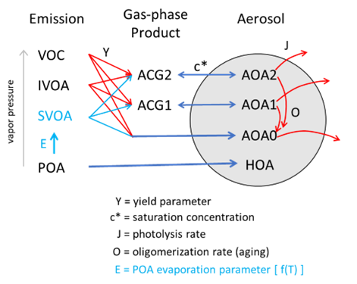
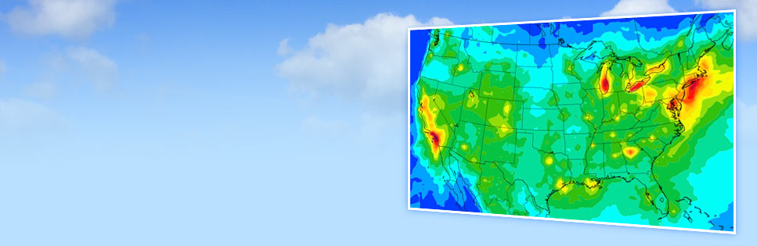
Future Recommendations for the PSAT modeling
SOAP2
SOAP3
Emission categories in SOAP3:
POA_GV: On-road gasoline exhaust
POA_DV: On-road diesel exhaust
POA_IC: General internal combustion engine exhaust, assumed 50:50 gasoline/diesel
POA_MC: Meat cooking
POA_BB: Biomass burning
POA_OP: Other Anthro sources, especially low temp combustion
POA_AV: Overall average (POA_AV).
Updating CAMx PSAT with SOAP3
Source: User’s Guide at www.camx.com
Notes:
The SOAP2 scheme recognizes a single species named POA, which represents POA emissions from all sources. To model temperature-dependent evaporation of POA, the SOAP3 scheme recognizes seven different POA species names with format POA_XX. The COMPLX option involves all volatile and non-volatile OA production and is designed to behave similarly to the AERO7 SOA scheme in the Community Multiscale Air Quality (CMAQ) model (Appel et al., 2021). The SIMPLE option assumes VOC oxidation only produces non-volatile products (AOA0 or BOA0)

