Slide 1





Evaluating NOx Emission Inventories for Houston at Source-Sector Level Using Airborne Measurements and CAMx
Co-PI: Jeremiah Johnson
Team members:
M. Omar Nawaz
Benjamin de Foy
Laura Judd
Greg Yarwood
PI: Dan Goldberg
Nawaz et al., 2024 (ACP)
Goldberg et al., 2024 (ES&T Air; Oct 15)
University of Texas Air Quality Research Program (AQRP) Project 22-023
This research presentation was supported by funding from the Texas Commission on Environmental Quality (TCEQ). The findings, opinions, or conclusions expressed do not necessarily represent those of the TCEQ.
ESA: TROPOMI on the Sentinel 5 Precursor Satellite

Slide 2
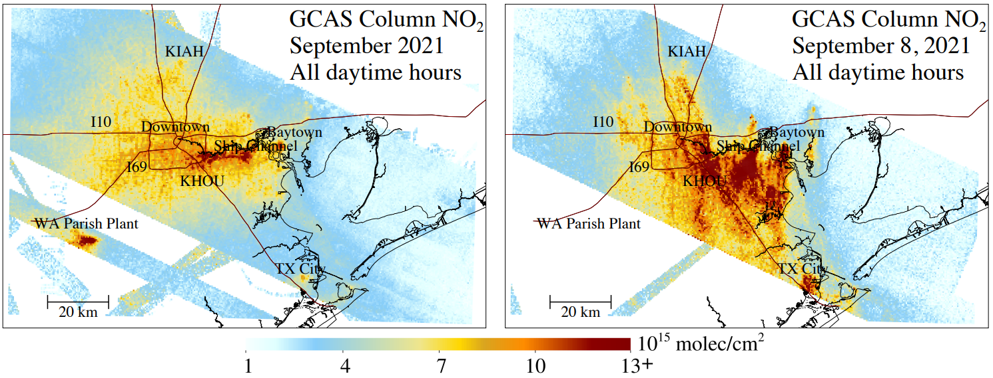
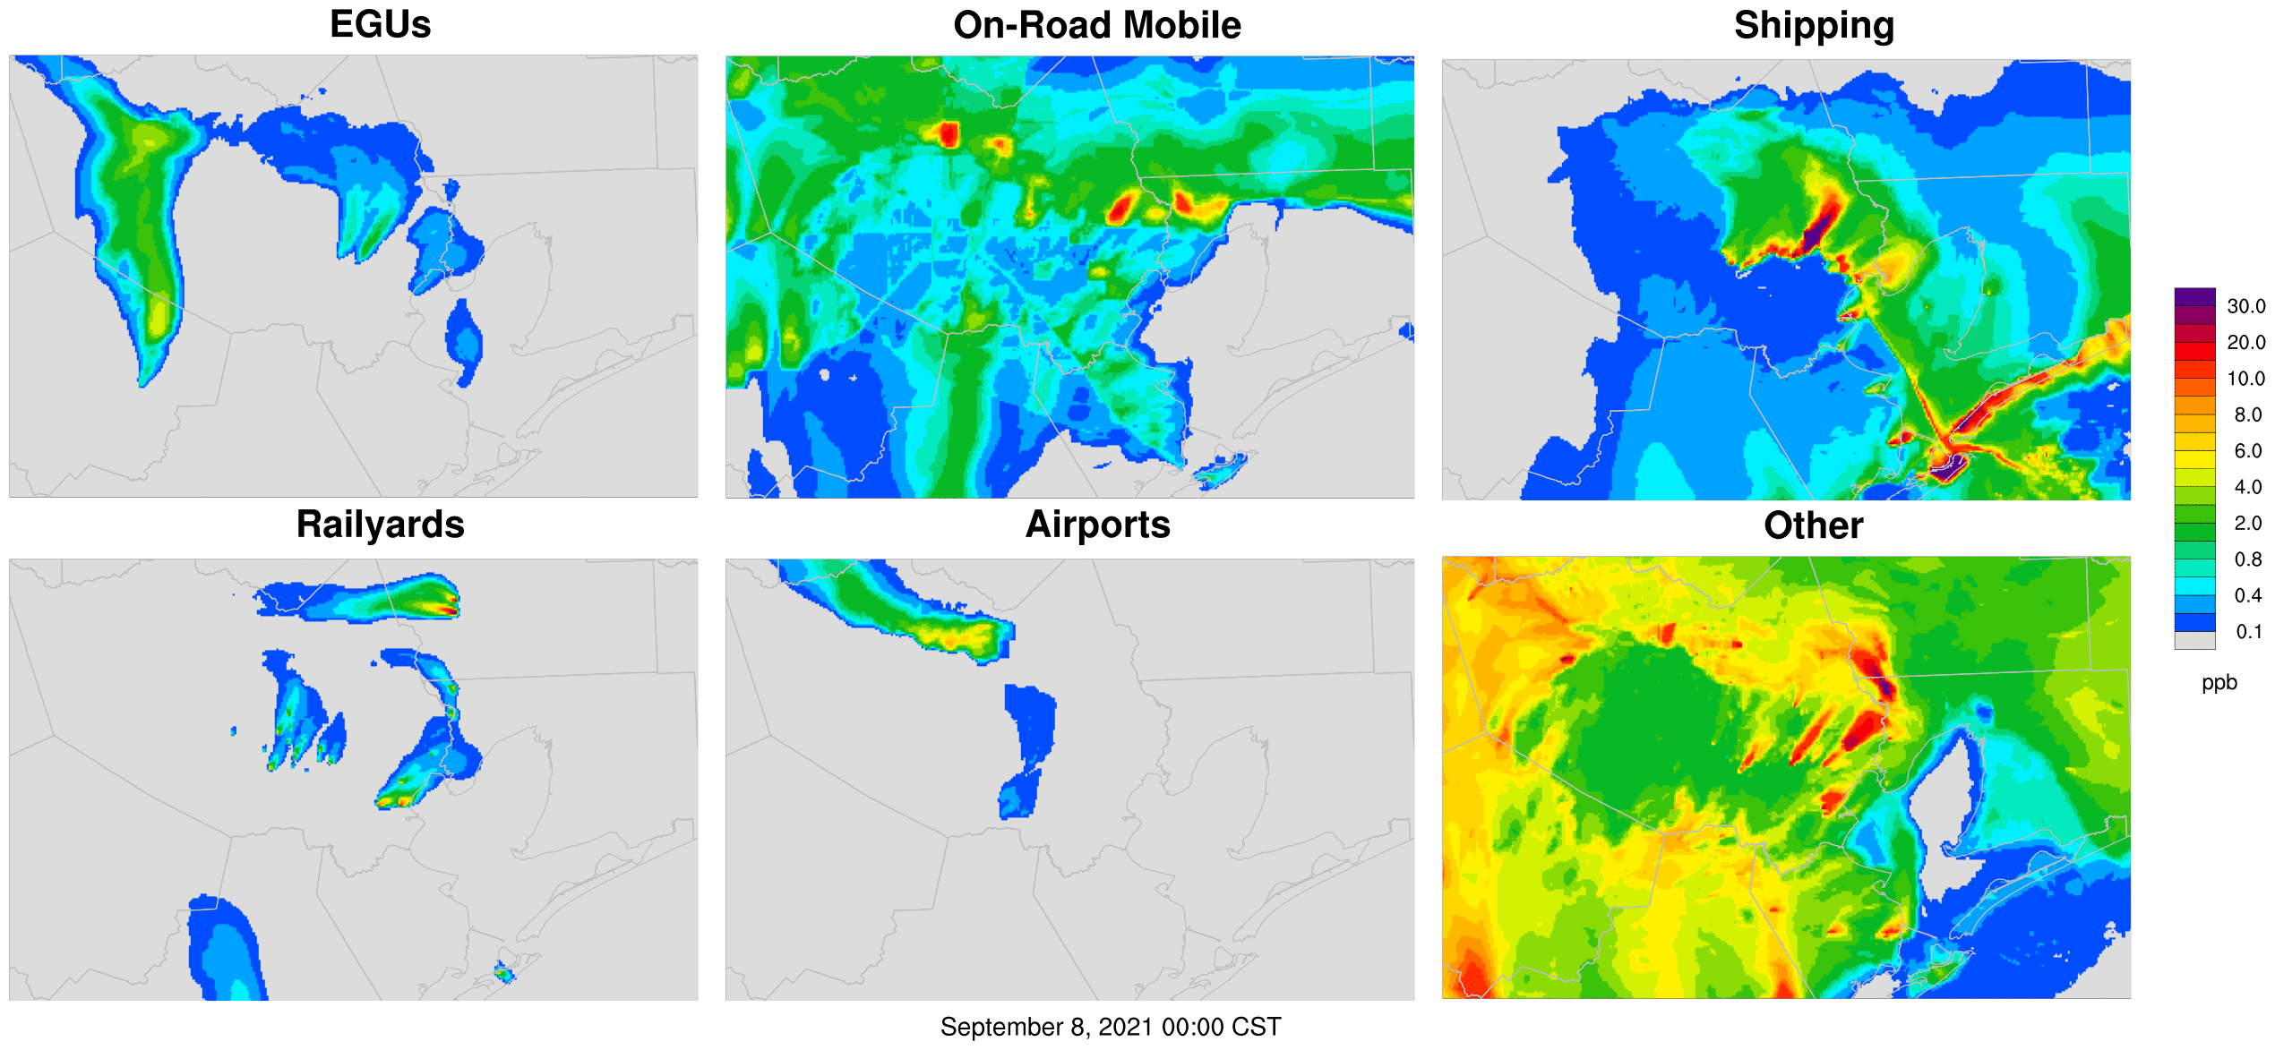
Motivation
10 flight days
1 flight day
The high spatial resolution (250 x 560 m²) of Geostationary Coastal and air pollution events Airborne Simulator (GCAS) provides a unique ability to understand NO₂ sources
Goal: To better understand the sector-specific NO_{X} emissions in Houston during TRACER-AQ September 2021 field campaign using a combination of:
Aircraft observations (GCAS at ~8.5 km)
Satellite data (TROPOMI at ~800 km)
Ground measurements
Hi-res CAMx with source apportionment
Goldberg et al., 2024
CAMx 444 m Hourly Tagged Surface Layer NO₂ Contributions: Sep 8, 2021

Slide 3
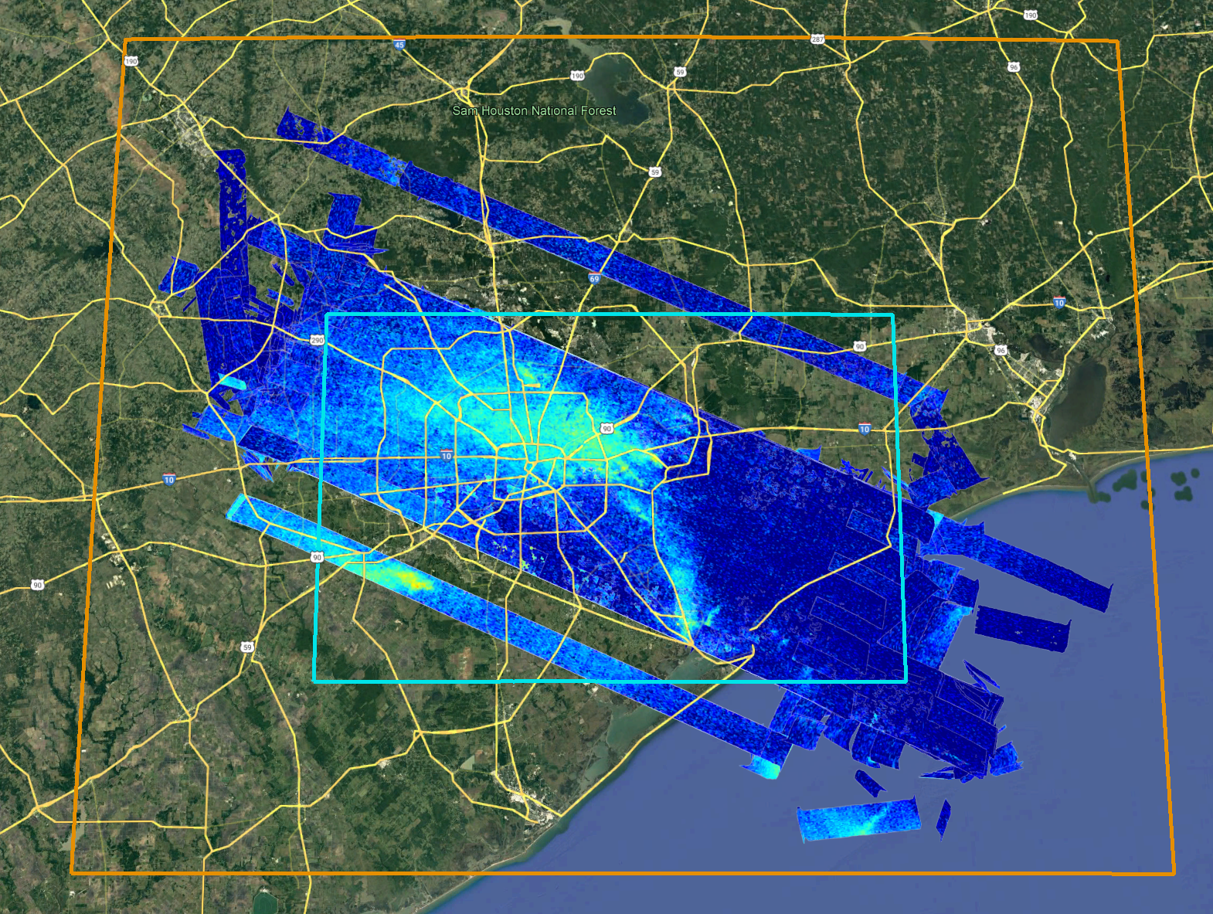
2021 TRACER-AQ WRF and CAMx Model Configuration
Use TCEQ 36/12/4 km 2019 SIP emissions as starting point
Updates to TCEQ SIP modeling
  WRF
    New 36/12/4/1.333/0.444 km simulation
    Physics options similar to TCEQ SIP modeling
    15-minute output frequency
  CAMx
    Initial 36/12/4 km simulation based on TCEQ platform
    Extracted boundary conditions from CAMx 4 km domain
    1.333/0.444 km domains over Houston to match resolution/extent of GCAS measurements
  Emissions
    Updated EGU emissions to use 2021 hourly CEMS data for top NOx emitters
    444 m resolution on-road and shipping emissions
    Natural emissions driven by new WRF simulation
    Re-processed 4 km emissions for other sectors to new grids
444 m
1.333 km

Slide 4
CAMx NO₂ Tagging Strategy and EGU NOx Emissions
Number | Tagged Emissions Sector
1-9 | EGUs
10 | On-road mobile
11 | Railyards
12 | Shipping
13 | KHOU airport
14 | KIAH airport
15 | Other
Station | NOx (tons/day)
W A Parish | 19.0
Cedar Bayou | 2.4
Pasadena Power Plant | 1.2
Texas City Cogeneration | 1.2
Odyssey Energy Altura Cogen, LLC | 1.0
Deer Park Energy Center | 0.9
South Houston Green Power Site | 0.9
Air Liquide Bayport Complex | 0.8
Channelview Cogeneration Facility | 0.8
EGUs with CEM data provide method evaluation
Tag line sources (on-road mobile and shipping) and airports because GCAS resolved them
Other sources likely confounded, and number of tags limited by computational constraints
Notes:
RGN is NO2 + NO3 radical and N2O5. During day, RGN essentially all NO2.

Slide 5
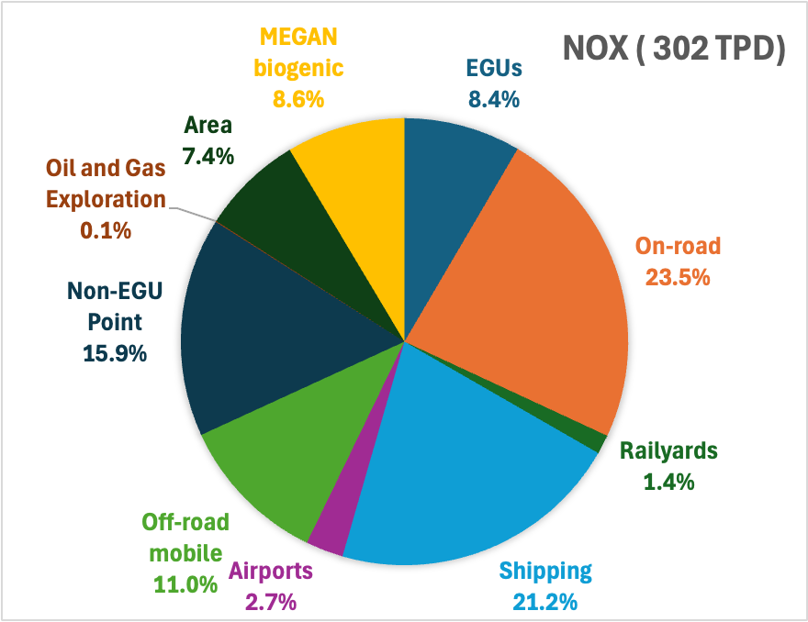
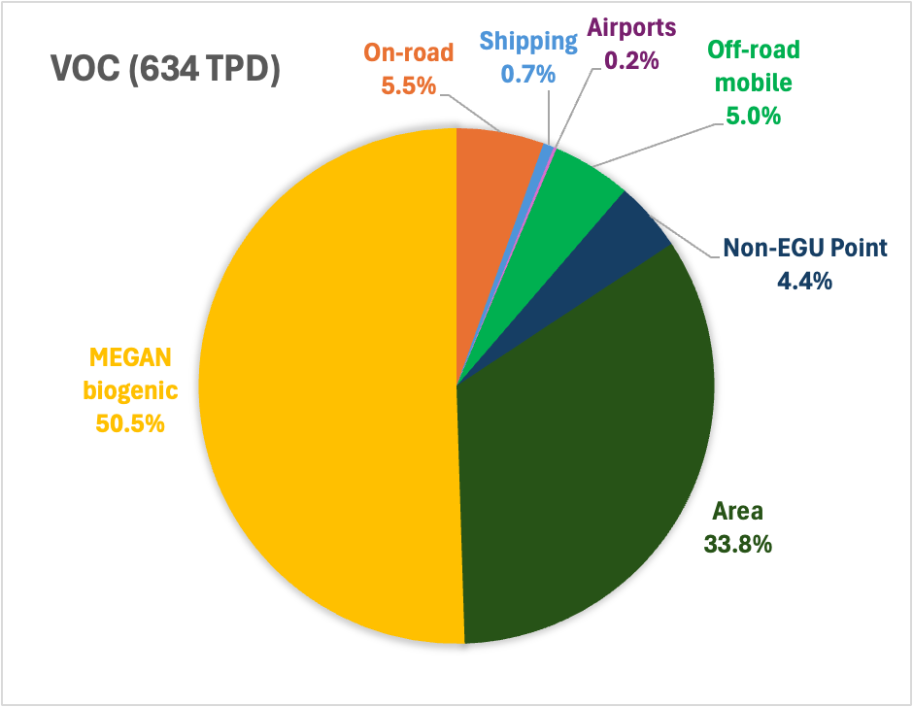
NOx and VOC Emissions Summary – 444 m Domain
Goldberg et al., 2024

Slide 6
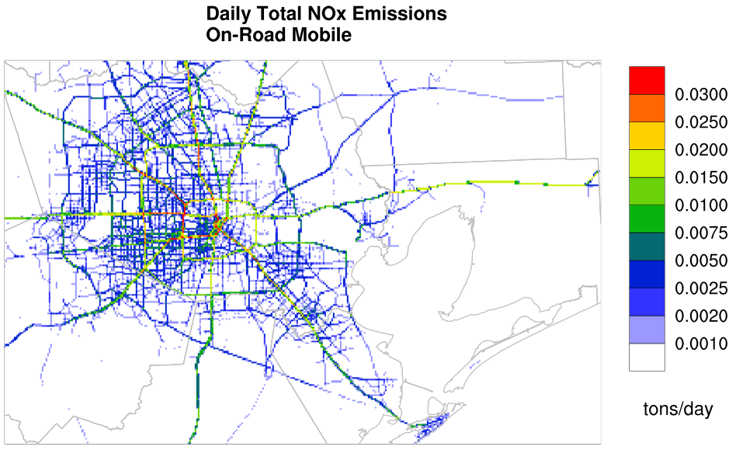
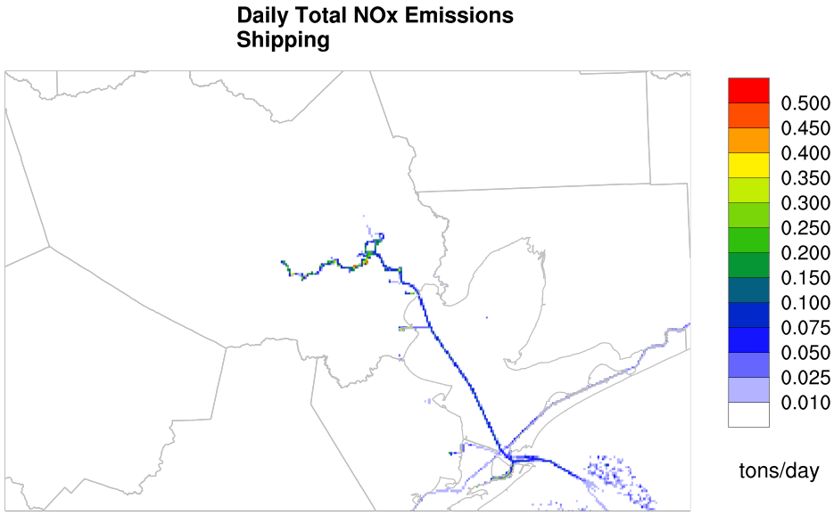
444 m On-Road Mobile and Shipping NOx Emissions
Goldberg et al., 2024
Uses 2019 TCEQ on-road mobile link-based emissions
Re-process links at 444 m resolution
Uses MARINE Emissions Resolver (MARINER) v2
Vessel ID, location, operation: Automatic Identification System (AIS) data for 2021
Vessel characteristics: Information Handling Services (IHS) database

Slide 7
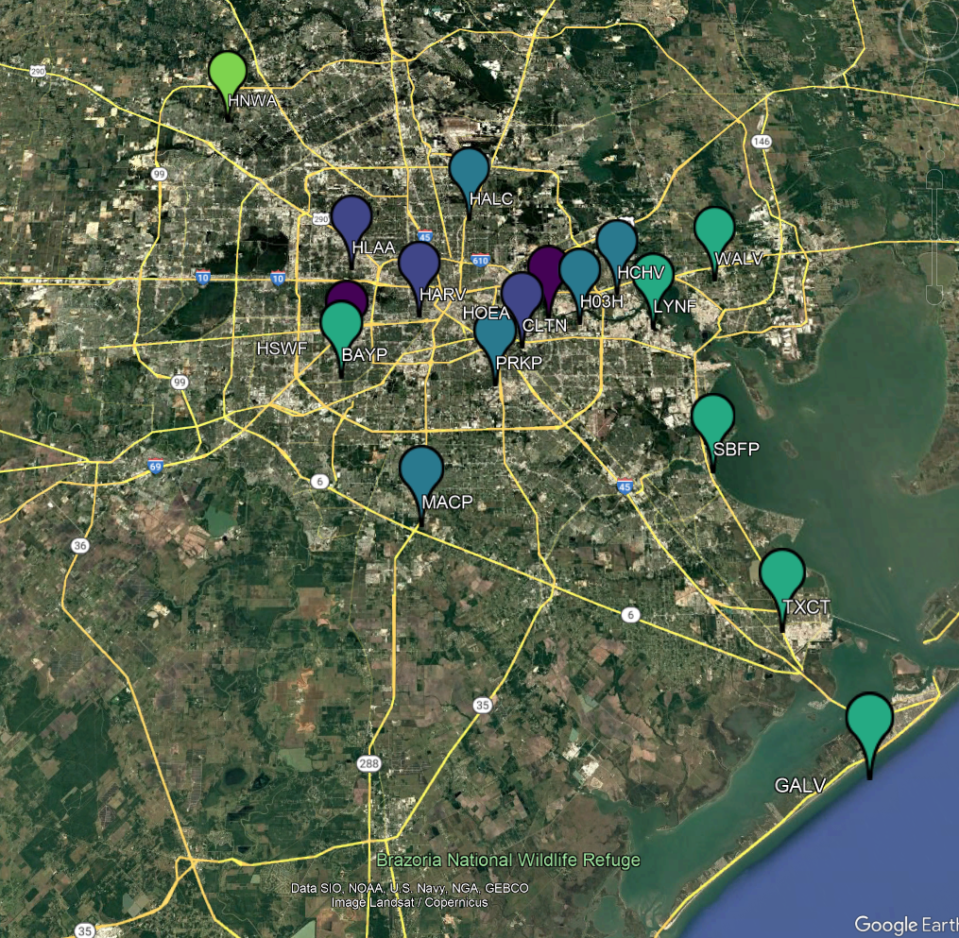

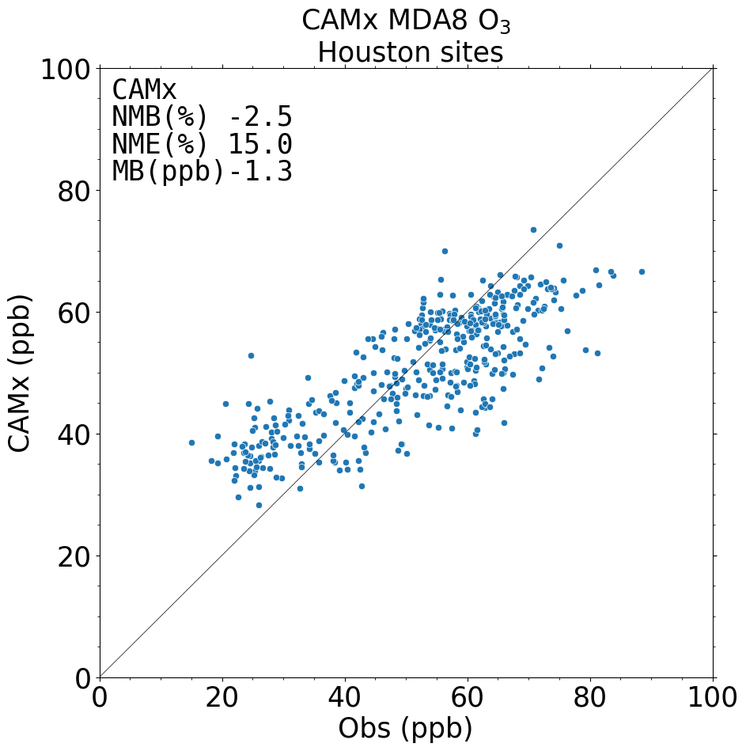
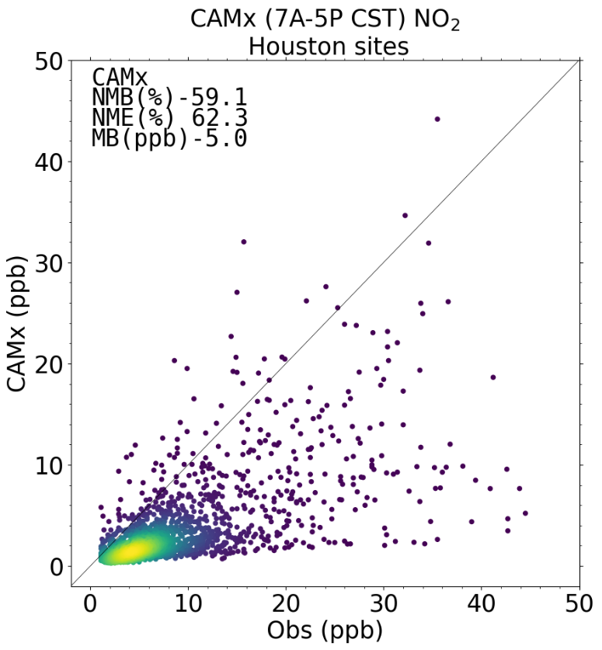
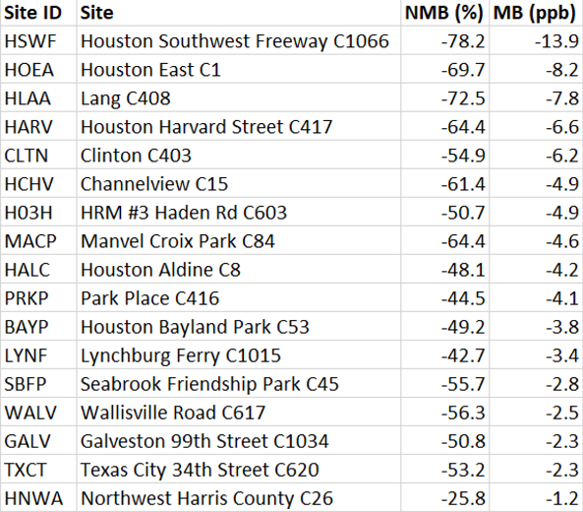
CAMx Ozone and NO₂ Model Performance at TCEQ Monitors
Overall excellent MDA8 ozone performance
  NMB (± 5%) and NME (< 15%) very close to goal benchmark*
Overall low NO₂ bias, largest at higher observed NO₂ concentrations
Smallest NO₂ bias at locations away from large emission sources
Largest biases w/in Houston core near large emission sources
  Houston SW Freeway CAMS ~50 m from roadway
  444 m resolution not sufficient to resolve near-roadway NO₂ here
NO₂ Mean Bias
*Emery et al., 2017

Slide 8
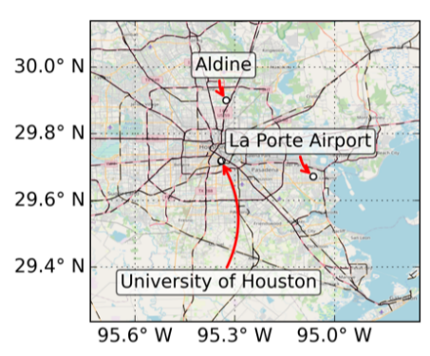
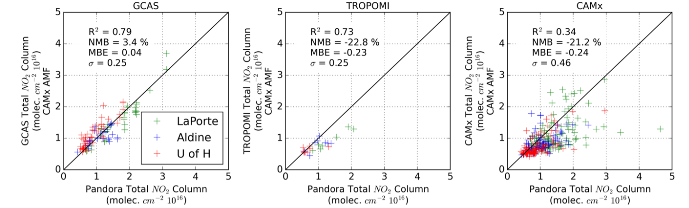
GCAS/TROPOMI/CAMx Comparison to Pandora
Pandora sites
Data from all possible GCAS overpasses within 15 min of Pandora observation
All daytime hours of each GCAS flight day
Nawaz et al., 2024
Notes:
3 Pandora sites located in Houston urban core (polluted). No Pandora “background” obs, so less certainty about comparison to GCAS outside of urban Houston.

Slide 9
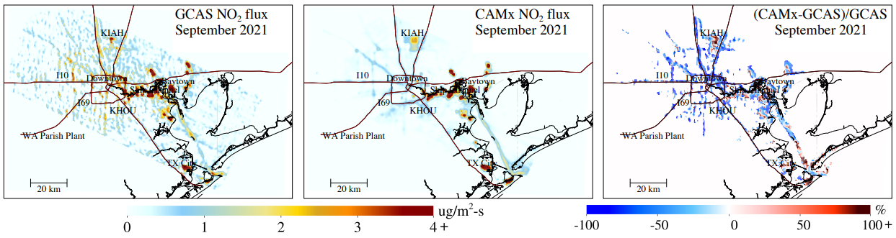
Using Flux Divergence Method to Compare CAMx with GCAS
Goldberg et al., 2024
First time flux divergence (FD) method applied to high resolution aircraft measurements
FD highlights road network, shipping lanes and point sources
CAMx NO₂ fluxes lower than GCAS for highways
Better agreement for shipping lanes, CAMx higher in outer Galveston Bay
Notes:
FD can identify point sources in TROPOMI NO2 retrievals better than VCDs. Typically need long temporal averages for TROPOMI. Higher spatial resolution of GCAS allows much shorter sampling period.
FD sampled over 27 scenes spanning 10 days. Better results when oversampled to 444 m CAMx domain grid cells.
Used NO2/NOx ratio = 0.76
Noise reduced when using CAMx AMFs and WRF meteorology.

Slide 10
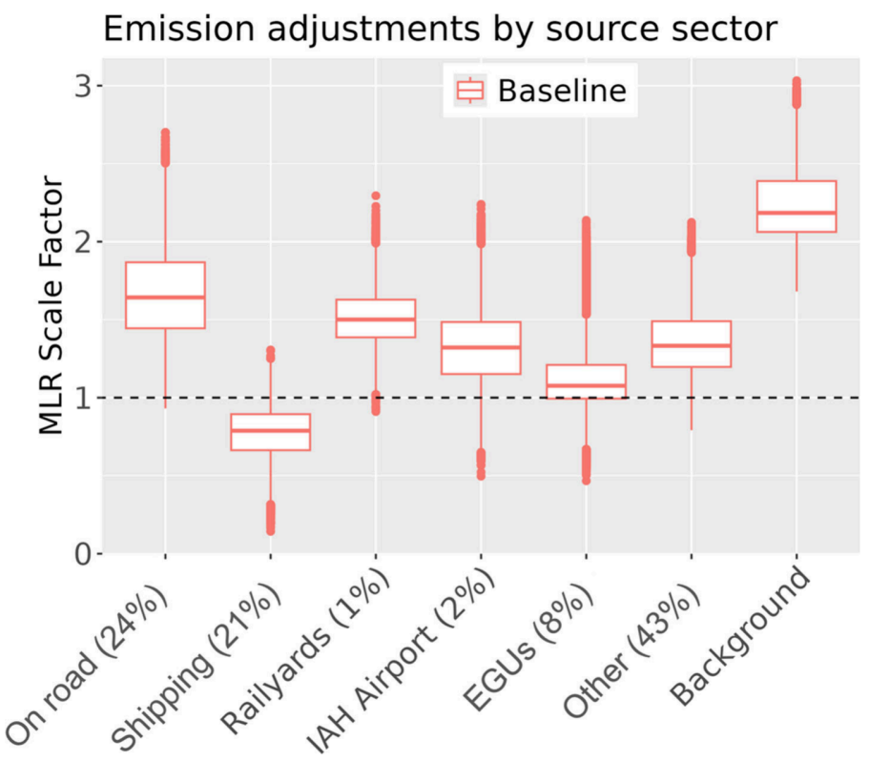
Using MLR to Estimate Sector-Specific Adjustments
Figure showing scale factor needed for CAMx tagged NO₂ in order to replicate GCAS NO₂
Powerful statistical methods like MLR applied to GCAS/CAMx NO₂ columns can identify and prioritize areas of EI improvement
CAMx background too low
New CAMx simulation scales emissions to MLR median scale factor
  On-road mobile (1.68x)
  Shipping emissions (0.77x)
On-road mobile NO₂ too low in CAMx
Shipping NO₂ too high in CAMx
% of NOx EI in 444 m domain
Goldberg et al., 2024
Notes:
MLR used to find optimal combination of sector-specific CAMx NO2 VCDs to match GCAS NO2 VCDs.
MLR assumes emission adjustments are time-invariant.
Model suffers when sources too close together. Some EGUs and Other, e.g.

Slide 11
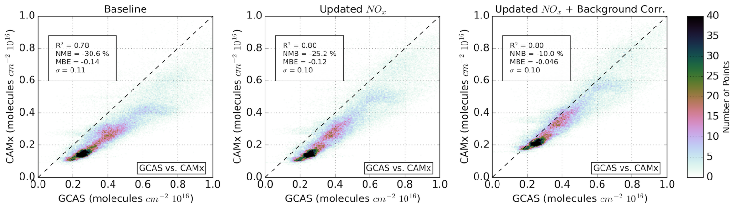
Comparison of CAMx NO₂ Columns against GCAS
Goldberg et al., 2024
Original CAMx simulation
New CAMx simulation with adjusted on-road mobile and shipping emissions
New CAMx simulation with adjusted on-road mobile and shipping emissions and increased NO₂ background concentrations

Slide 12
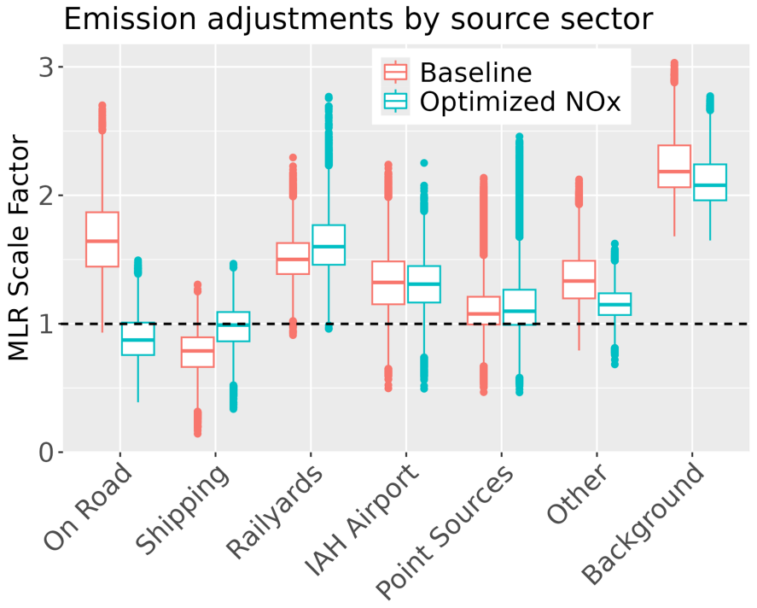
Source-Sector Adjustment for both CAMx Simulations
Figure showing scale factor needed for CAMx tagged NO₂ to replicate GCAS NO₂
Substantial improvements (closer to 1) for both on-road and shipping
On-road may have been over-corrected
MLR may work better for shipping due to spatial isolation from other NOx emission sectors
Other categories mostly steady, departures partially reflect inability to spatially isolate sectors from each other (e.g. Other)
Goldberg et al., 2024

Slide 13
Current Work/Next Steps
NASA ACMAP study ongoing; Chicago and NYC in addition to Houston
2024-2025 AQRP TEMPO NO₂ project investigating whether TEMPO can constrain NOx EI as well as GCAS
  Using CAMx NO₂ tagging by source sector for Aug-Sep 2023 period focused on Texas urban/rural regions
    TEMPO/CAMx NO₂ column comparisons (D. Goldberg; GWU)
    Apply FD and MLR to TEMPO (B. de Foy; SLU)
  TEMPO drawbacks/benefits
    Lower resolution (2.0 x 4.5 km²) compared to GCAS (250 x 560 m²)
    Hourly data (daylight hours) over more days than GCAS
    Sub-hourly data over Texas available for some September 2023 days
Contact:
Jeremiah Johnson JJohnson@ramboll.com

Slide 14
References
Goldberg, D.L., de Foy, B., Nawaz, M. O., Johnson, J., Yarwood, G., and Judd, L., 2024. Quantifying NOx Emission Sources in Houston, Texas Using Remote Sensing Aircraft Measurements and Source Apportionment Regression Models. https://pubs.acs.org/doi/10.1021/acsestair.4c00097
Nawaz, M. O., Johnson, J., Yarwood, G., de Foy, B., Judd, L. M., and Goldberg, D. L.: An intercomparison of satellite, airborne, and ground-level observations with WRF-CAMx simulations of NO₂ columns over Houston, TX during the September 2021 TRACER-AQ campaign, Atmospheric Chemistry and Physics, 24(11), pp.6719-6741. https://doi.org/10.5194/acp-24-6719-2024

