Slide 1
Can Electric Vehicles Adoption address
Environmental Inequalities in Georgia ?
Xin He¹, Yakun Zhou¹, T. Nash Skipper ¹, Zongrun Li ¹, Ziqi Gao ¹,
Armistead G. Russell¹, Jennifer Kaiser ^{1,2} *
¹ School of Civil and Environmental Engineering
² School of Earth and Atmospheric Sciences
Notes:
I am from GT
I AM A graduate student in XX
My topic is..

Slide 2

Background
  Internal combustion engine vehicle (ICEV):
  Primary source of traffic-related pollutants (PM_{2.5}, NO₂)
  EVs promise benefits on air quality, human health, and economics
  3. EVs adoption has adverse effects:
  EV charging:
  redistributes air pollution from urban roadways to power plant.
  Extra Battery usage:
  brake & tire wear and fugitive dust
  NO_{x} Scavenging: (NO + O₃ → NO₂ + O₂)
  O₃ increase despite less NO_{x} emissions from cars
  2. EVs adoption is rising:
  The U.S.:
  55% increase in EV sales in 2022
  Biden administration:
  50% of new vehicle sales to be EVs
  Georgia:
  77% increase in EV registrations
Notes:
internal combustion engine vehicle (ICEV) emissions, are a primary source of Traffic-related pollutants
In contrast, electric vehicles (EVs) XXX
The adoption of electric vehicles (EVs) is rising.
The U.S., saw a 55% increase in EV sales in 2022
the Biden administration aims for xxx
In the meantime, Georgia achieving XXX
However, electric vehicles (EVs) HAS adverse effects
Firstly, due to EV charging, it redistributes xxx
Secondly, extra battery usage, increased OTHER emission, such XX
Thirdly, DUE TO xxx, xxx

Slide 3
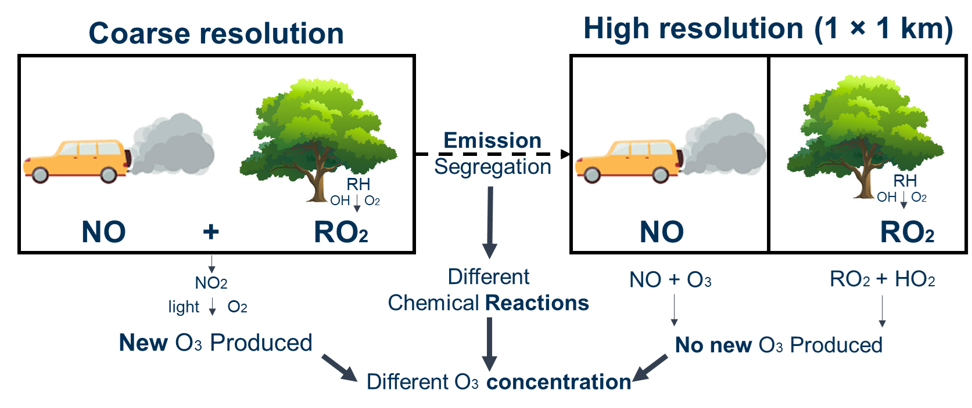
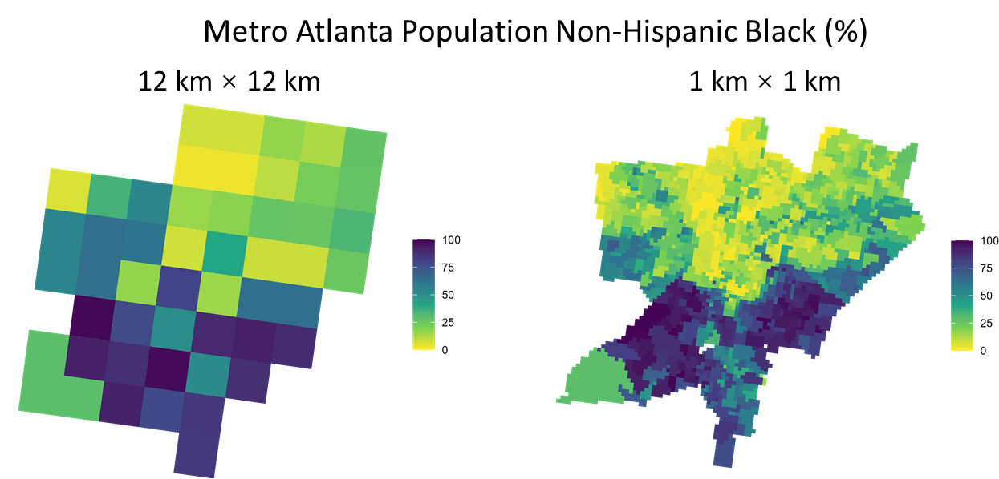
Why use high-resolution (1 km) air quality models?
Chemical Perspective
2. Environmental justice analysis
➔ Segregate emission into different cells
➔ Different chemical reactions happening
➔ Influence modeled pollution concentration
➔ Investigate neighborhood-level inequities
➔ Previous study: 4 / 12 km over Georgia
➔ Ours: first time conducting 1km
Notes:
The highlight of our research is XX
Using XXX means

Slide 4
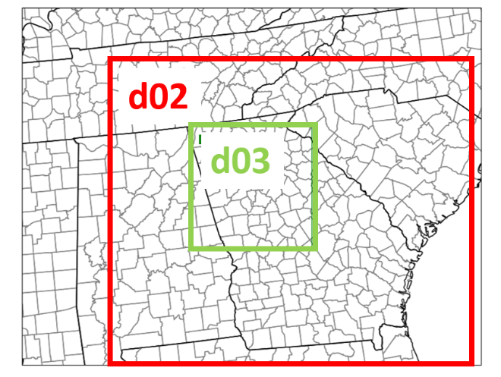
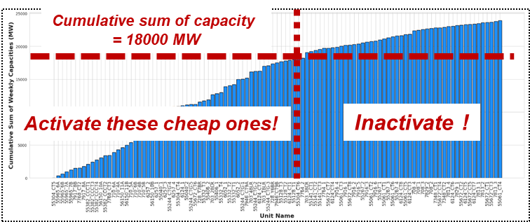

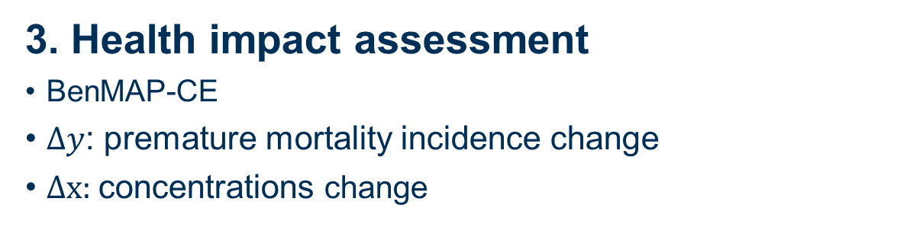
Method
1. high resolution air quality model (1 km) :
CMAQ v5.4
1 km grid source emissions (Ma & Tong, 2022):
Neighborhood Emission Mapping Operation (NEMO) emission dataset
month of July, 2017
2. Electricity dispatch model
Hypothesis: Replace 30% existing ICEV with EVs
Simple Dispatch Model (Deetjen & Azevedo, 2019):
allocate electricity demands from extra EV charging
to specific fleet of power plant units in GA
3. Health impact assessment
BenMAP-CE
$Δy$: premature mortality incidence change
$Δx:$concentrations change
$$Δy=(1−e^{−β×Δx})×y_{0}×Pop$$
Notes:
where $Δy$ is the change in the incidence of premature mortality;
$β$ is the concentration–response coefficient reflecting the relationship between the air pollutant concentration and associated health outcome;
$Δx$is the simulated change in the hourly mean air pollutant concentrations between the base and EV scenarios;
$y_{0}$is the baseline mortality rates; and $Pop$stands for the population within each census tract.

Slide 5
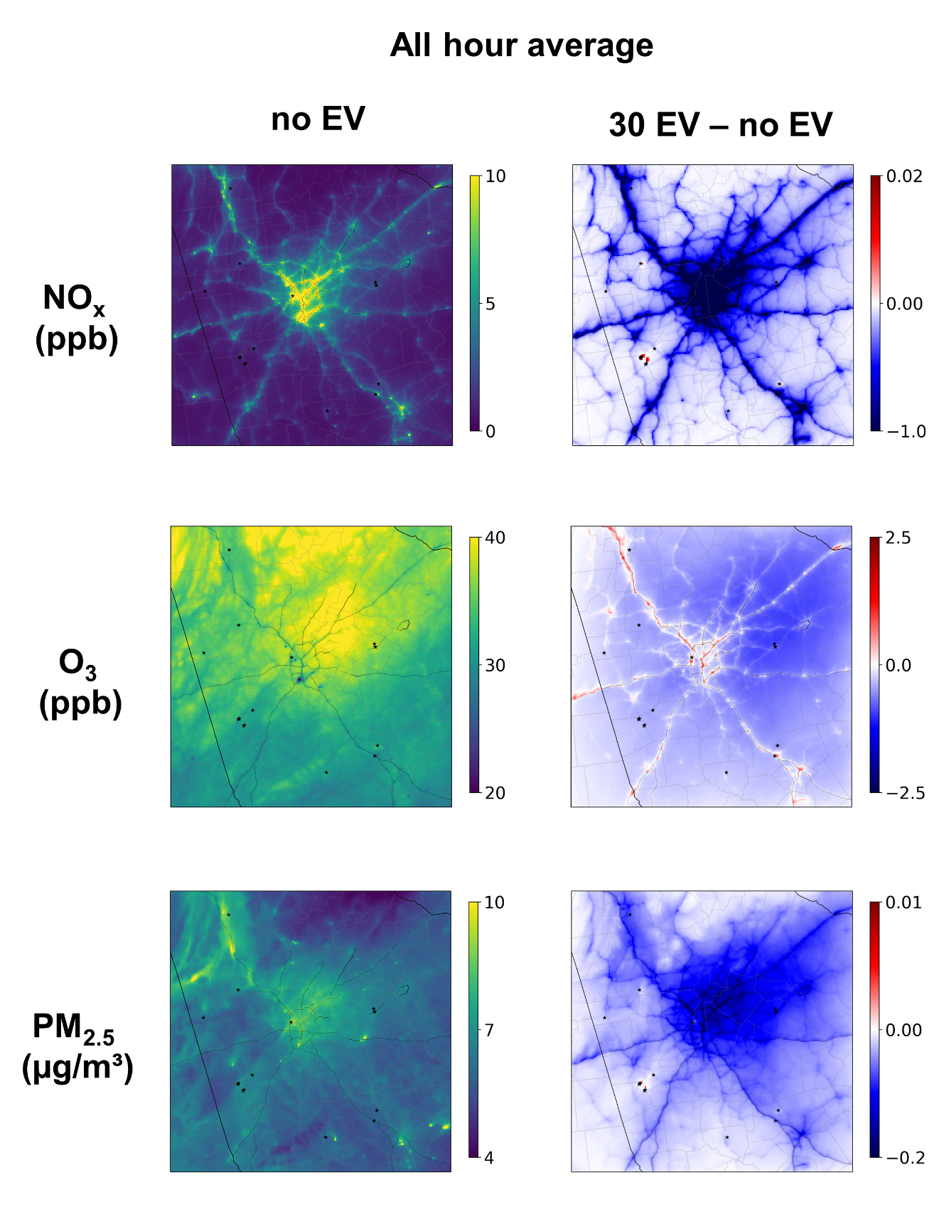
Result 1: Air quality change from 30% EV Adoption
Domain-wide average NO_{x} decreases by 0.25 ppb
Decreases along roads,
but localized increases near certain power plants (black points)
O₃ concentrations decrease by 0.40 ppb on average
Localized increases near major roads
due to reduced NO_{x} scavenging (NO + O₃ → NO₂ + O₂)
PM_{2.5} concentrations decrease by 0.06 µg/m³ on average
Decreases but more spread out due to SOA formation downwind
Localized increases near power plants
due to elevated EGU emissions
Notes:
In the NO EV (1 km) scenario, NO_{x} concentrations are highest along major roads, with a domain-wide average of 1.7 ppb. O₃ concentrations are higher in the northern part of the domain, averaging 34.26 ppb, while PM_{2.5} levels are high near roads and point sources, averaging 6.22 µg/m³. Following a 30% EV adoption, the domain-wide average NO_{x} concentration decreases by 0.25 ppb, particularly along roads, though localized increases (red) are observed around certain power plants (plotted as black points). O₃ concentrations show a domain-wide average decrease of 0.40 ppb, with localized increases near major roads due to reduced NO_{x} emissions and subsequent less NO_{x} scavenging to consume O₃ (NO + O₃ → NO₂ + O₂). PM_{2.5} concentrations decrease by 0.06 µg/m³ on average, with decreases along roads (but more spread-out than NO_{x} due to SOA formation downwind of emission source) and localized increases near power plants due to elevated EGU emissions.

Slide 6
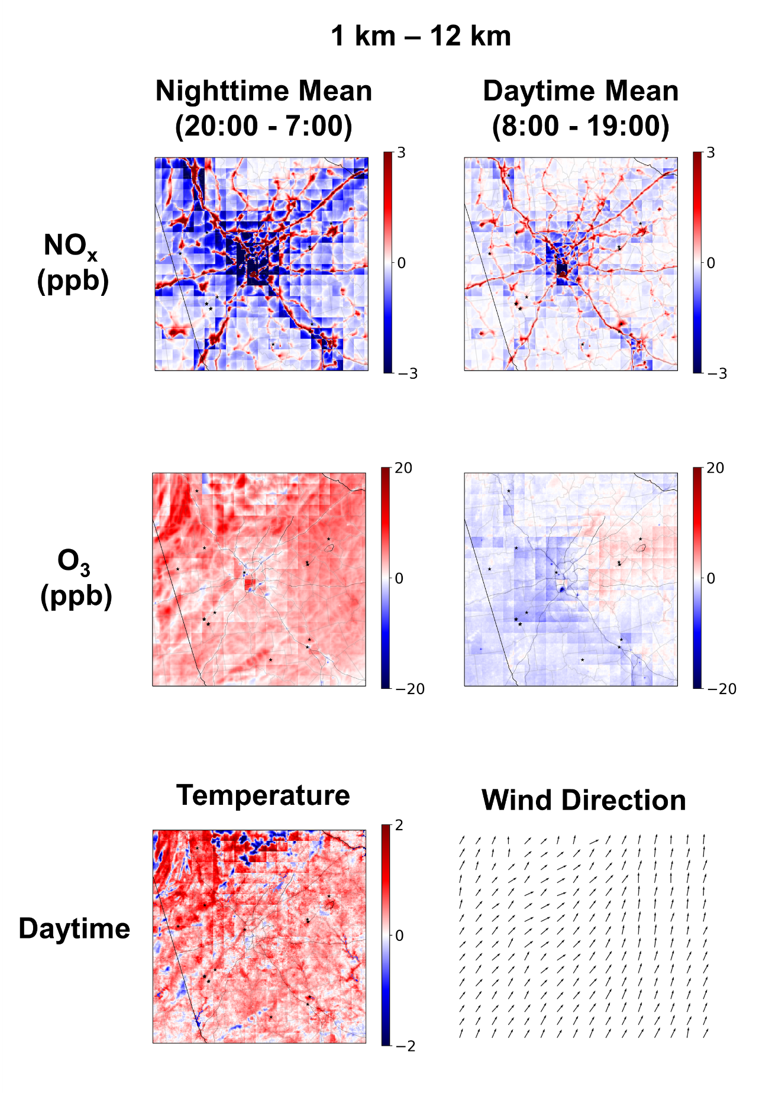
Result 2: Resolution Impact on Air quality
In our domain:
Nighttime: NO_{x} is high → NO_{x} scavenging reduces O₃ .
  O₃ increase as NO_{x} decrease.
Daytime: NO_{x} is low → VOC-saturated,
  O₃ increase as NO_{x} increase.
Nighttime:
O₃ concentrations higher in 1 km resolution across the domain
NO_{x} more blue (lower) near roads at 1 km resolution.
  At 1 km, emissions are concentrated on roads.
  At 12 km, emissions are dispersed (concentrations diluted).
  Non-road areas at 12 km show higher NO_{x} concentrations.
Daytime:
Lower O₃ in the west, higher O₃ in the east
Temperature higher at 1 km indicates higher reaction rates.
Wind direction (west to east)
  transports concentrated NO_{x} eastward.
  higher O₃ formation in the east and lower in the west at 1 km.
Notes:
For our domain
However…
As for the daytime, chemical reactions come into play

Slide 7
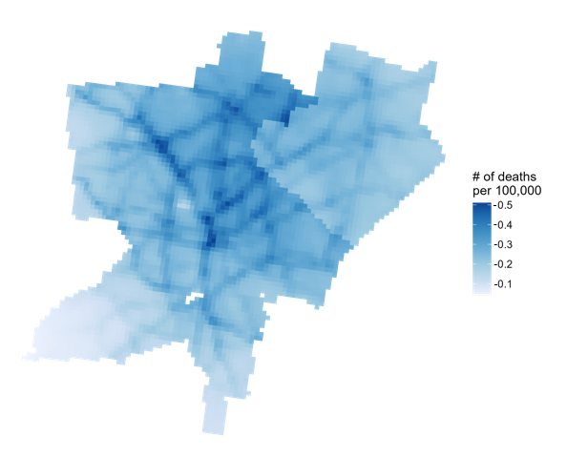
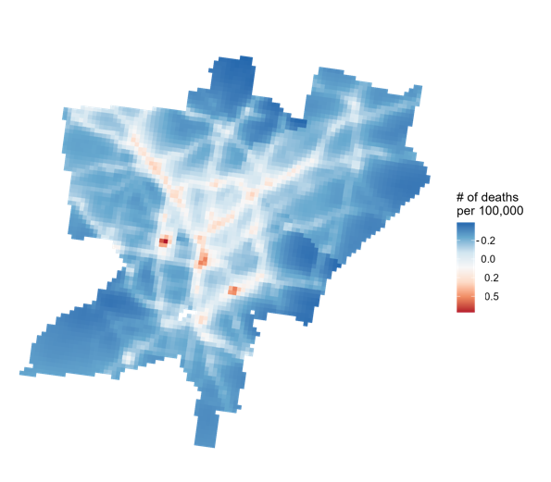
Result 2: Resolution Impact on Health Impact Assessment
(a) PM_{2.5}
(b) O₃
Changes in Premature Mortality Rate (per 100,000, annual average) in Metro Atlanta at 1 km Resolution
Coarse Resolution (12 km) vs Fine Resolution (1 km)
PM_{2.5} exposure is underestimated by 40-43% across different racial groups using coarse resolution
∵ coarse resolution is not able to capture extreme values as good as fine resolution one
Notes:
With a high resolution model, we are able to CAPTURE the reversed health impact from onroad O3 concentration increase
Also,

Slide 8
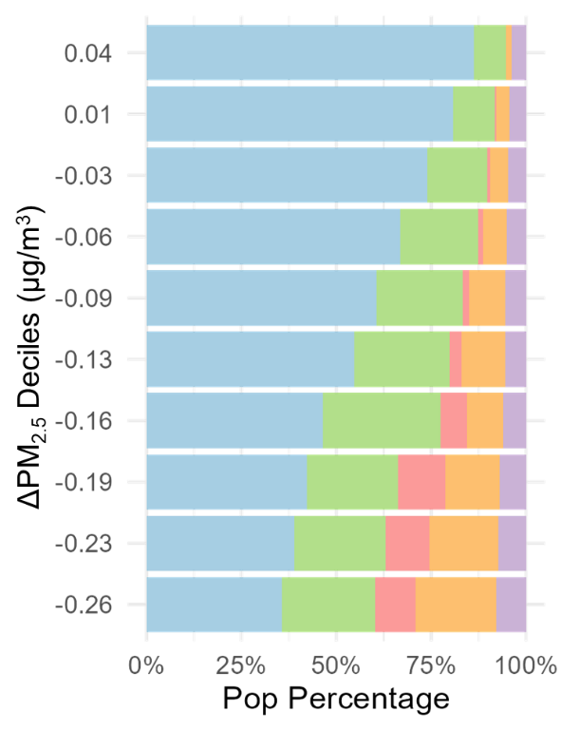
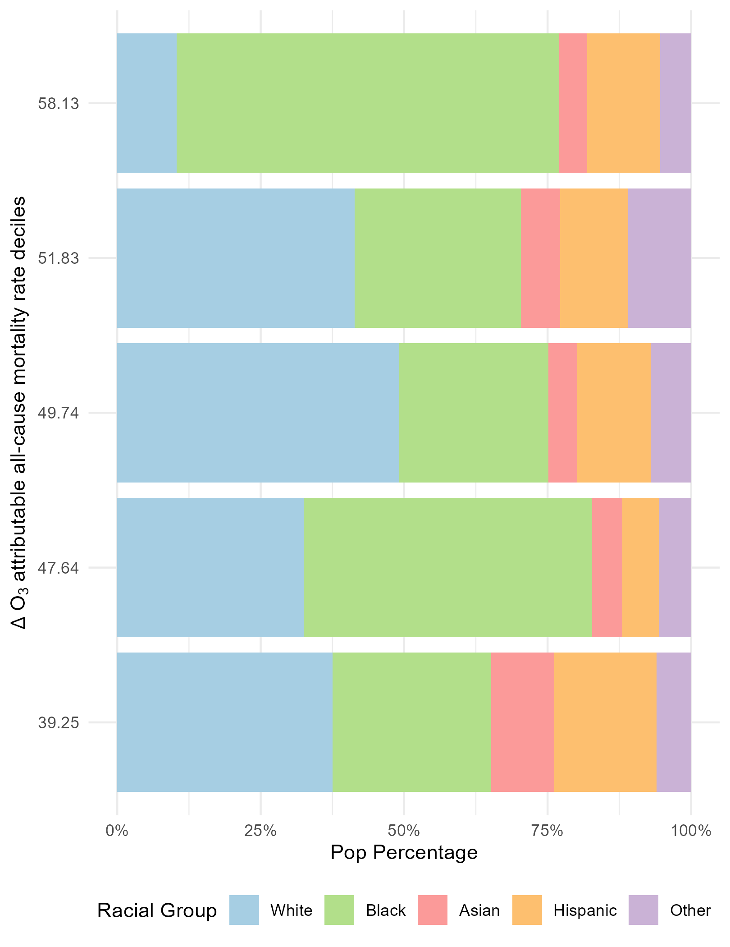
Result 3: Environmental Injustice
Environmental Injustice exists in Base case (no EV) PM_{2.5} Exposure :
Population Avg: 6.51 μg/m³
Higher for: People of Color (6.70), Black (7.16), Asian (6.81), Hispanic (6.81)
Lower for: White (6.38)
Environmental Injustice reduced with EV adoption
The bars represent decile groups of PM_{2.5} change
Largest PM_{2.5} Reductions (Bottom bar):
Occur in areas with relatively high minority populations:
Black: 27% , Asian: 9%, Hispanic or Latino: 12%
Smallest PM_{2.5} Reductions (Top bar):
Seen in areas where non-Hispanic White populations predominate:
White: 79%
Minority populations, previously exposed to higher pollution levels, see greater reductions compared to predominantly White areas
Notes:
We discuss this EJ problem
What this means is that…

Slide 9
Conclusion
Emission redistribution between different resolutions impact the O₃ concentration modeling via different chemical reaction rate.
EV adoption in Georgia can improve air quality overall, even though localized increases in pollution still occur near power plants or main roads.
EV adoption in Georgia can reduce environmental injustice: Minority communities, historically exposed to higher pollution levels, see the largest reductions in PM_{2.5} levels.

Slide 10
Reference
Ma, S., & Tong, D. Q. (2022). Neighborhood Emission Mapping Operation (NEMO): A 1-km anthropogenic emission dataset in the United States. Scientific Data, 9(1), 680.
Deetjen, T. A., & Azevedo, I. L. (2019). Reduced-order dispatch model for simulating marginal emissions factors for the United States power sector. Environmental science & technology
U.S. Environmental Protection Agency. (2021). Estimating PM2.5- and Ozone-Attributable Health Benefits.

Slide 11
SI

Slide 12
SI

Slide 13
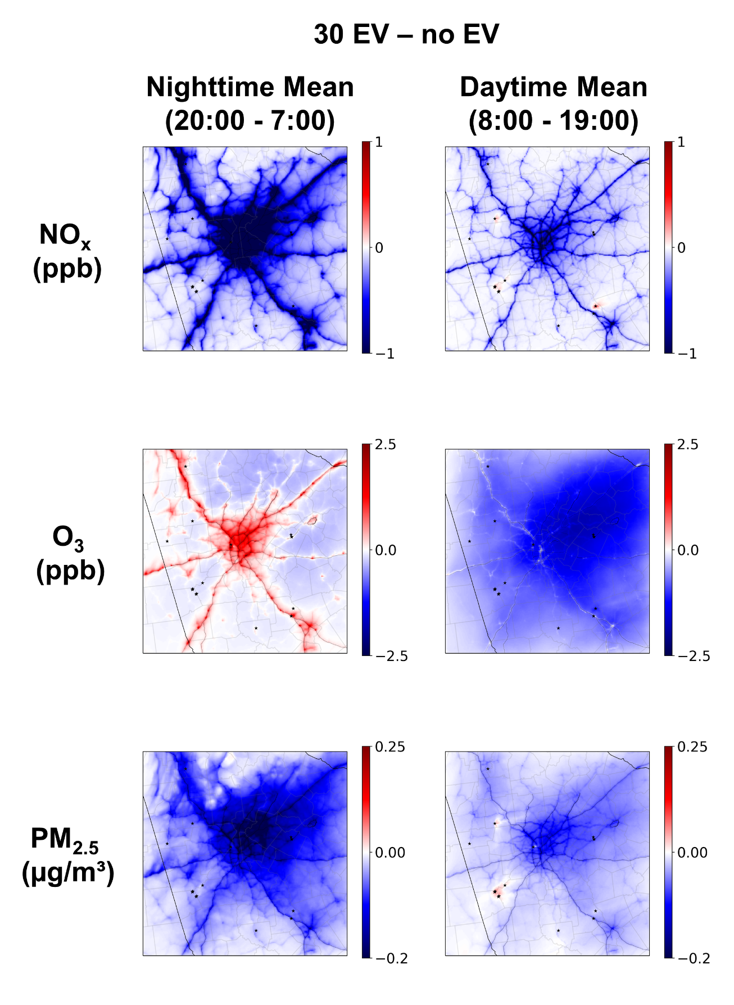
SI

