Slide 1
GPU Implementation of a Gas-Phase Chemistry Solver in the CMAQ Chemical Transport Model
Duncan Quevedo
23rd Annual CMAS Conference
October 21st, 2024
Chapel Hill, NC
Notes:
Good afternoon everyone, today I will be presenting my existing and proposed research as part of my qualifying exam.

Slide 2



Acknowledgements
UC Berkeley
Professor Cesunica Ivey
The AQMEL group
UC Riverside
Professor Bryan Wong
Dr. José Rodríguez Borbón
Dr. Khanh Do, Northeastern University
George Delic, HiPERiSM Consulting
Berkeley Research Computing Savio HPC cluster
The National Science Foundation Computational Data Science and Engineering Program
(CBET 2053560)

Slide 3
Introduction

Slide 4
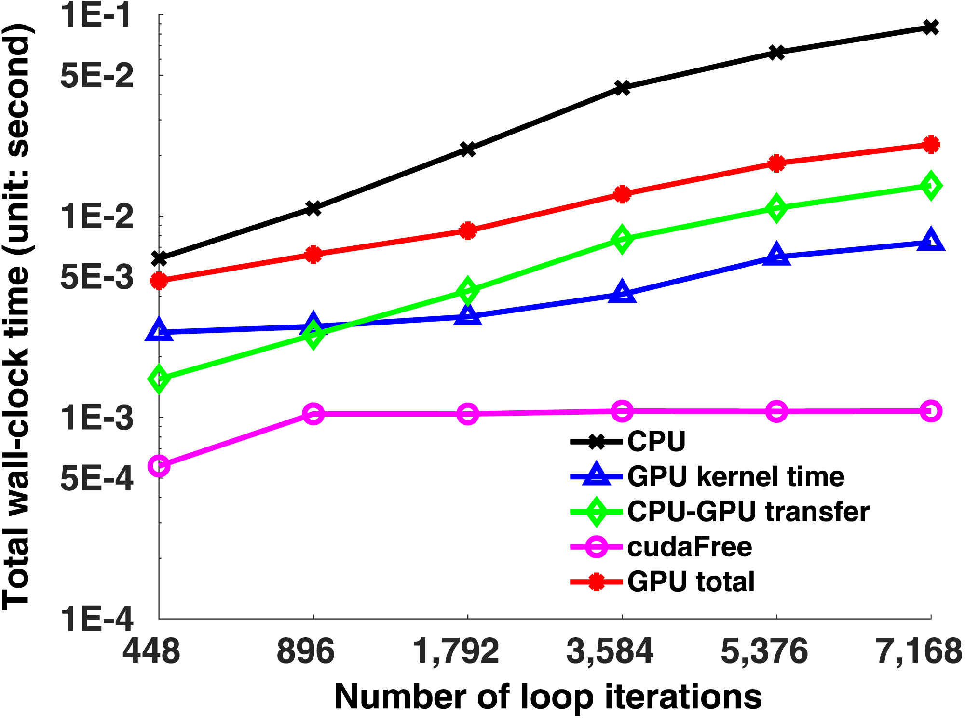
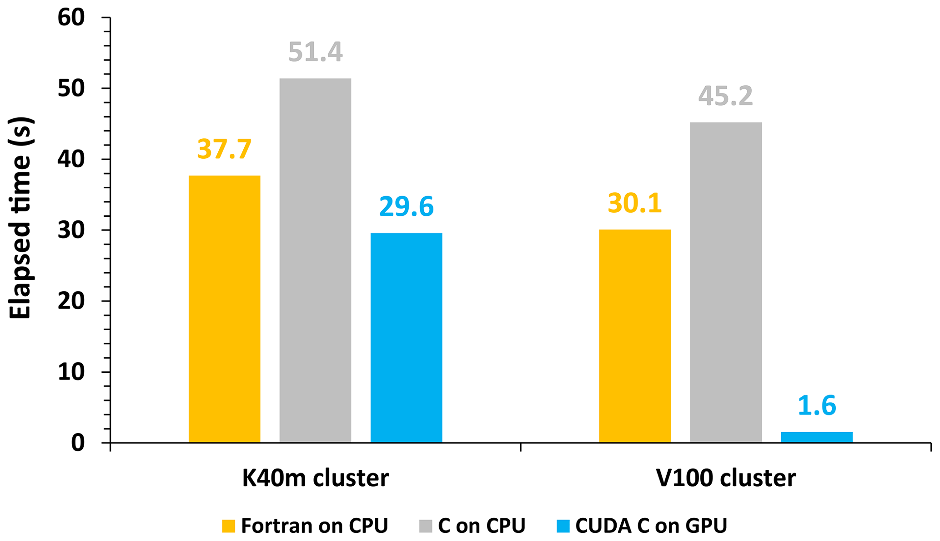
Graphics processing units accelerate simulations
MPI count | Walltime
24 processes | 2294 s (CPU) 918 s (GPU)
20 processes | 814 s (CPU) 437 s (GPU)
Alvanos & Christoudias. GMD (2017).
Cao et al. GMD (2023).
Horizontal advection in CAMx accelerates up to 28.25× using PPM on GPUs.
Sun et al. JAMES (2018).
Total walltime for EMAC accelerates up to 2.50× with gas-phase chemistry using ROS3 on GPUs.
Gas-phase chemistry in CAM4-Chem accelerates up to 3.82× using ROS2 on GPUs.
Cao et al. GMD (2023).
Sun et al. JAMES (2018).
Alvanos & Christoudias. GMD (2017).

Slide 5
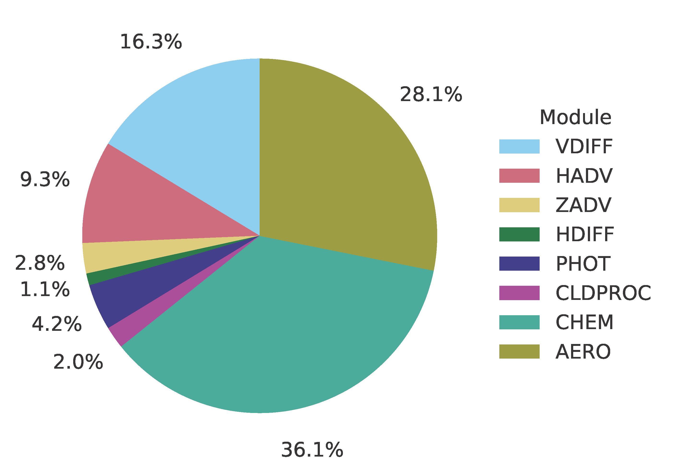
Gas-phase chemistry is a major computational burden for CMAQ
CMAQ simulates various science processes ranging from transport to chemistry.
Some processes are more difficult to simulate than others.
Gas-phase chemistry is represented as a large system of stiff nonlinear ODEs.
Module timing burdens per time step for an 8-core simulation using the ROS3 solver and CB6R5 chemical mechanism with aero7 SOA treatment and standard cloud chemistry for the CMAQ 2018 12NE3 benchmark scenario.

Slide 6
Can we accelerate gas-phase chemistry in CMAQ using GPU hardware?
We accelerate CMAQ’s gas-phase chemistry module, CHEM, by migrating the Fortran source code to CUDA Fortran.
We migrate the Rosenbrock-3 solver, ROS3, because it is mechanism agnostic and faster than SMVGEAR.
We test our accelerated implementation of CMAQv5.4, CMAQ-CUDA, using the 2018 12NE3 2-day benchmark scenario.
Module timing burdens per time step for an 8-core simulation using the ROS3 solver and CB6R5 chemical mechanism with aero7 SOA treatment and standard cloud chemistry for the CMAQ 2018 12NE3 benchmark scenario.

Slide 7
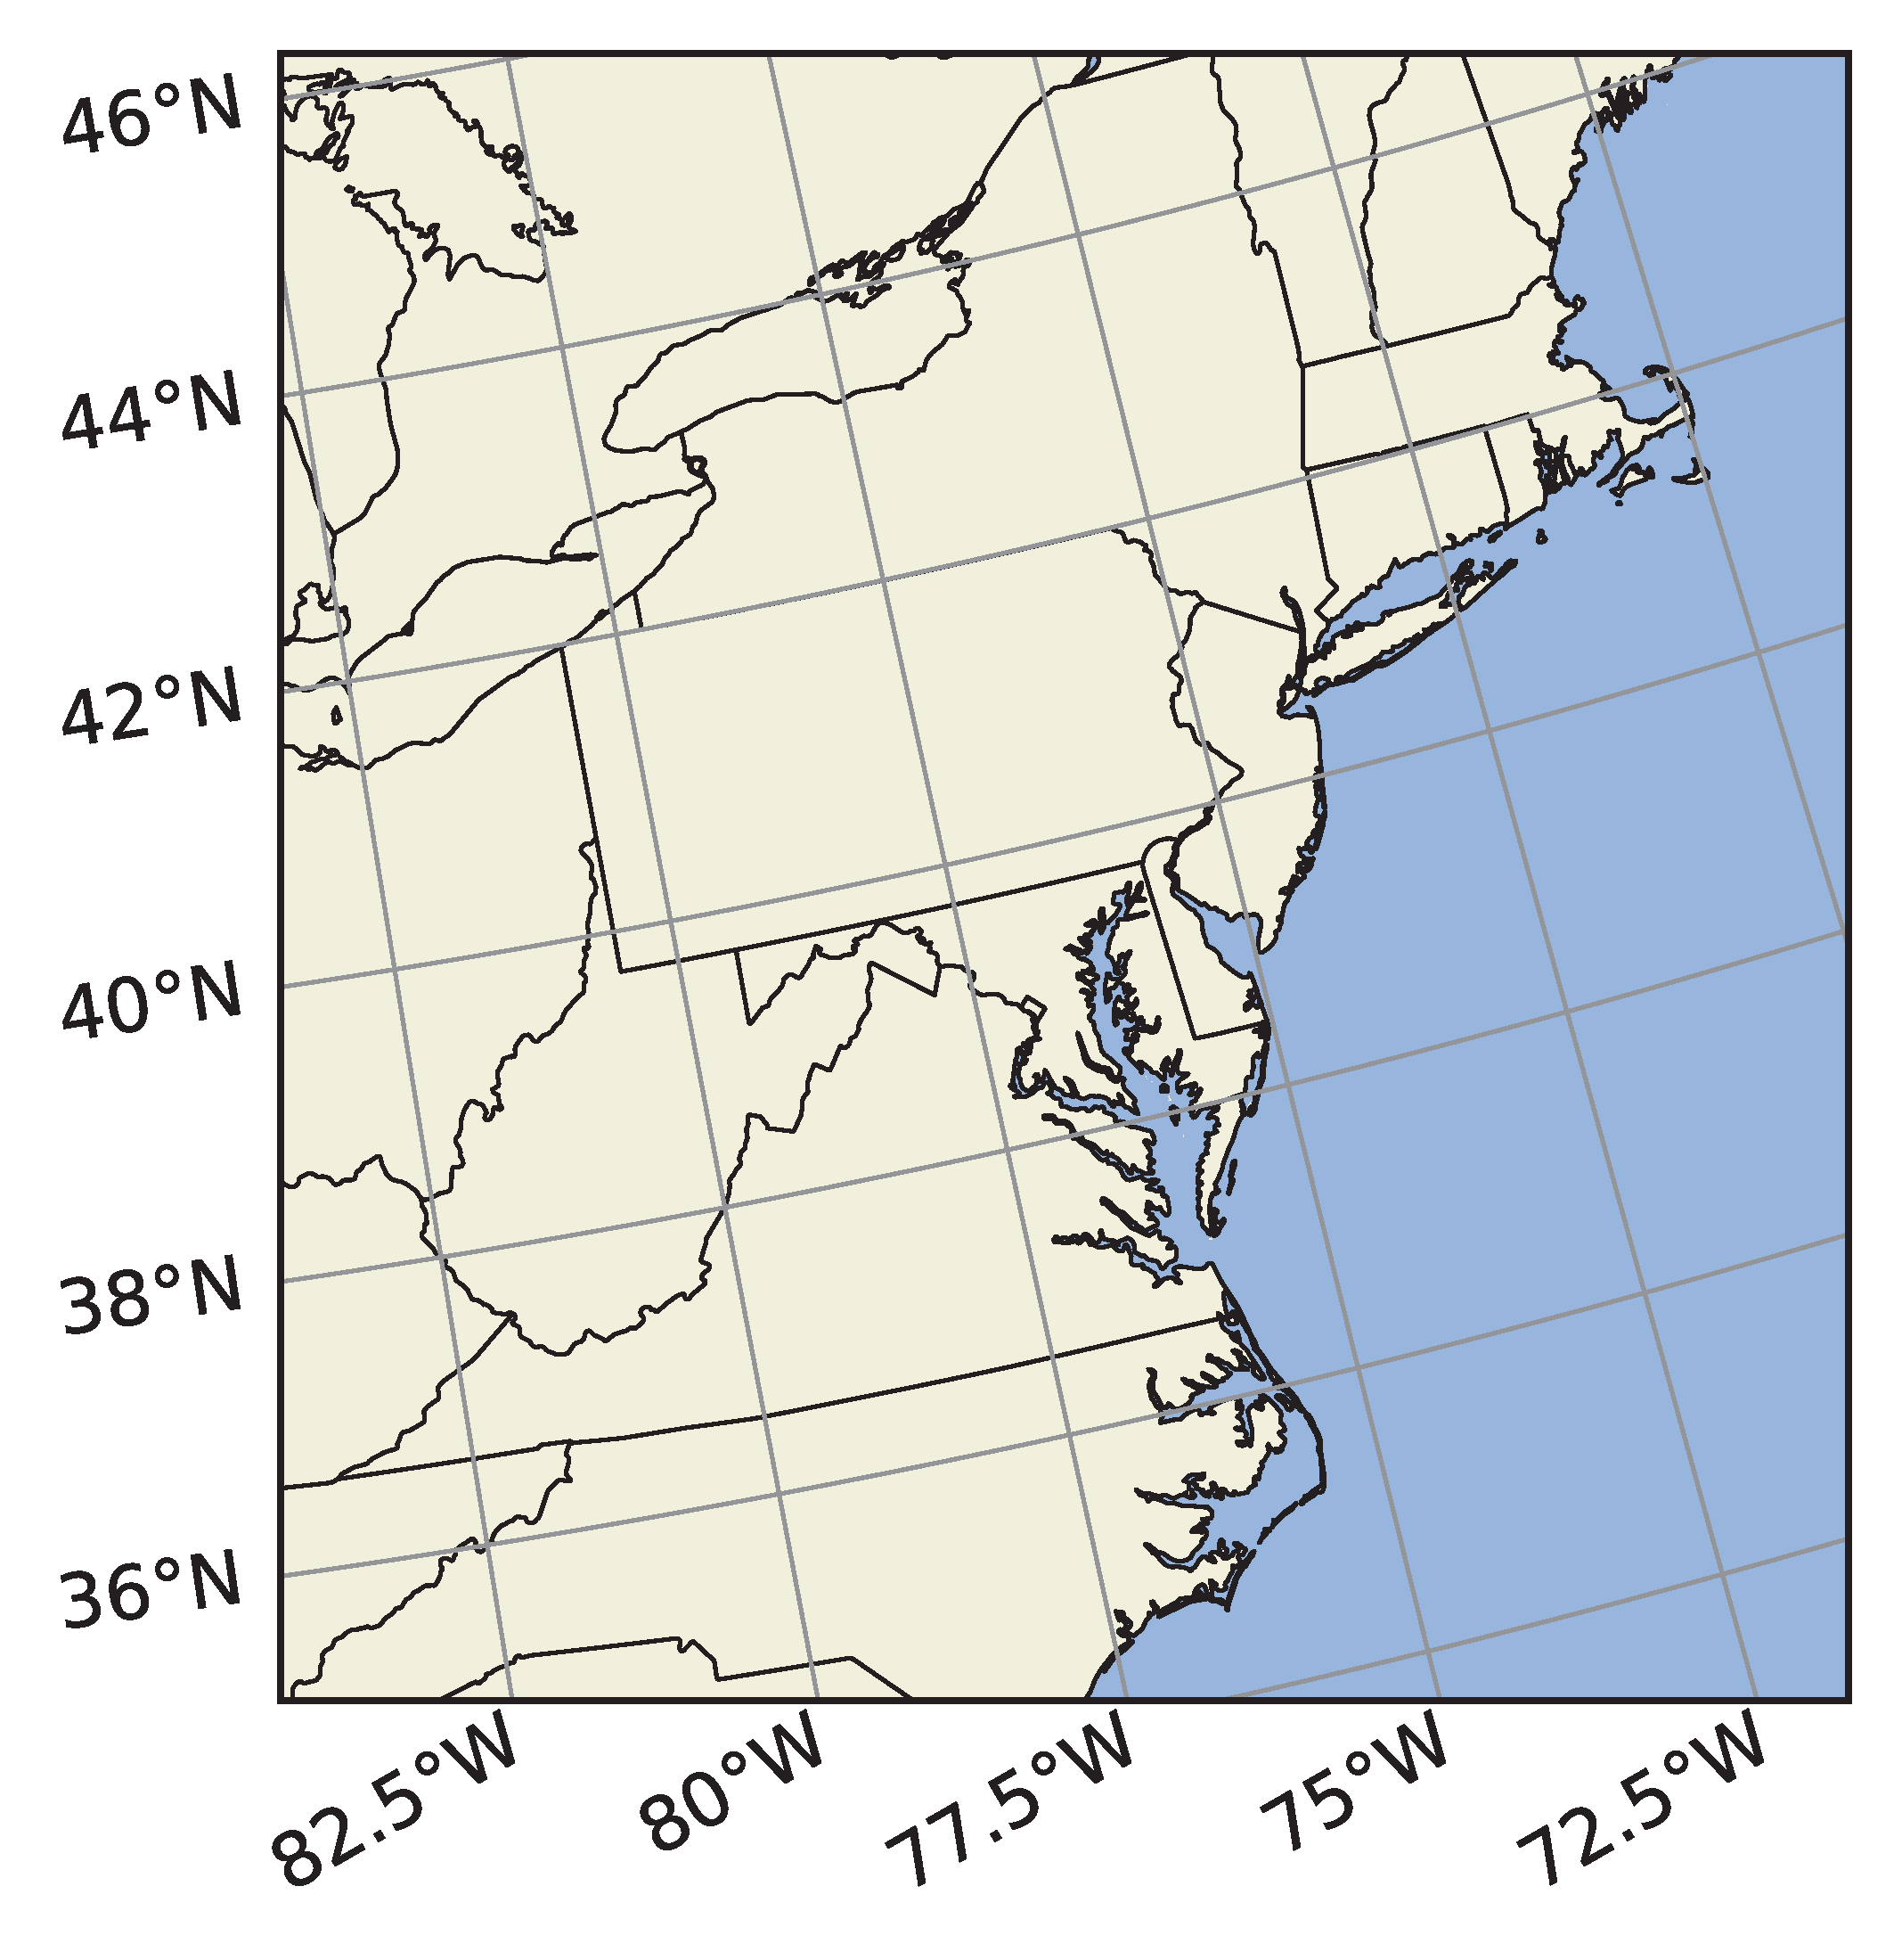
CMAQ-CUDA is evaluated with the 2018 12NE3 benchmark scenario
Northeast US domain: Tennessee to Maine
12 km horizontal resolution
100 columns × 105 rows × 35 layers
Simulation period: July 1st & 2nd, 2018
Emissions | Offline Meteorology | Science Options
2018 EQUATES (2017 NEI base) CB6R5 speciation Online lightning NO using NLDN Online BEIS biogenics with BELD5 land use | WRF 4.3.3 2011 NLCD40 land use KF1 sub-grid convection with NLDN assimilation MCIPv5.4 post-processing | Ocean chemistry WRF PX LSM Bi-directional NH₃ flux Surface HONO interaction Aerosol sedimentation

Slide 8
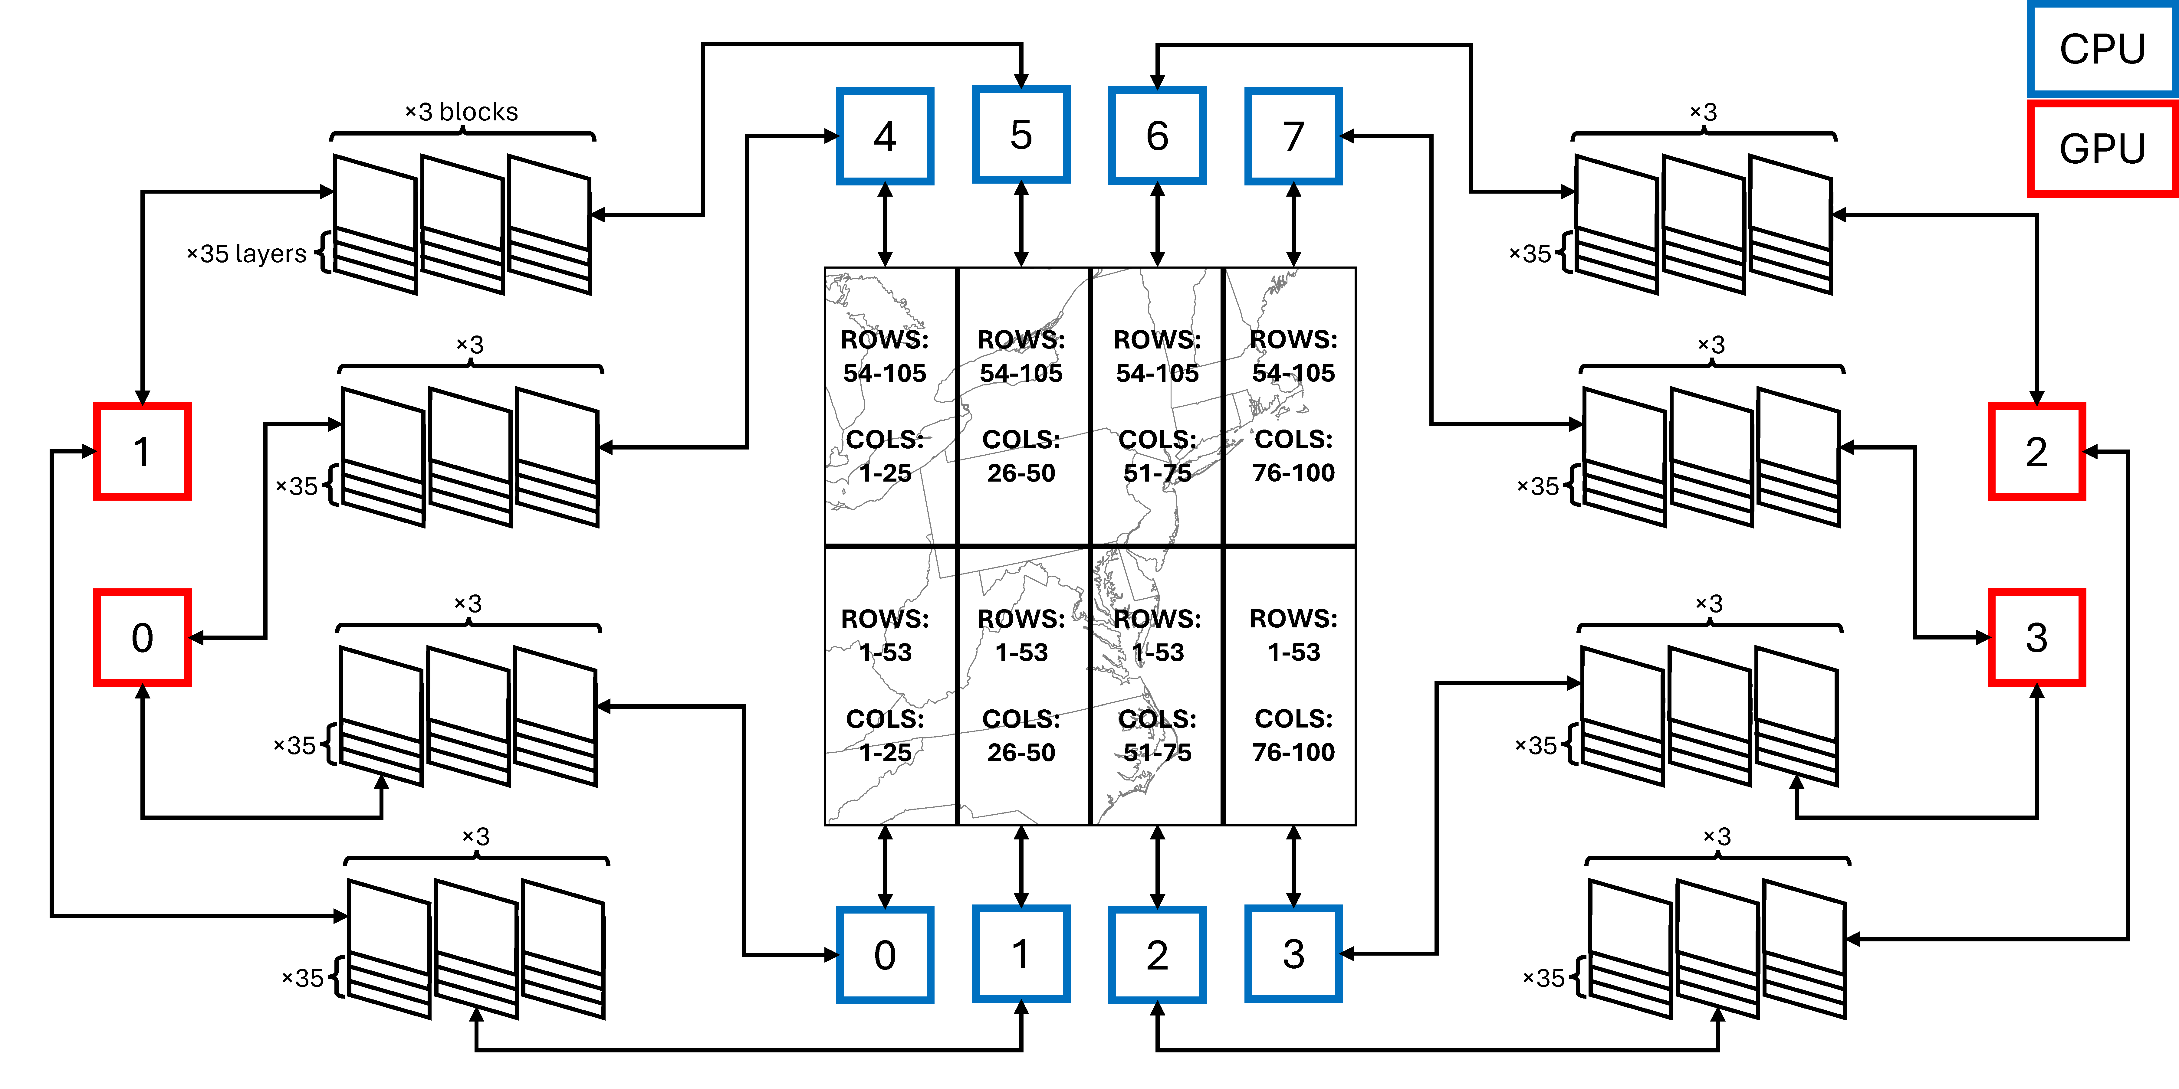
CMAQ-CUDA simulations use 8 MPI processes and 4 graphics cards
Intel Xeon Skylake 6130 (2.1 GHz) ×8
NVIDIA RTX 2080 Ti ×4

Slide 9
The CMAQ ROS3 implementation is modular
RBDRIVER
Collect output and loop through blocks
RBSOLVE
Solve linear system
RBDECOMP
Compute LU decomposition
RBSOLVER
Compute intermediate steps and iterate to convergence
RBFEVAL
Compute time derivative
RBJACOB
Compute Jacobian

Slide 10
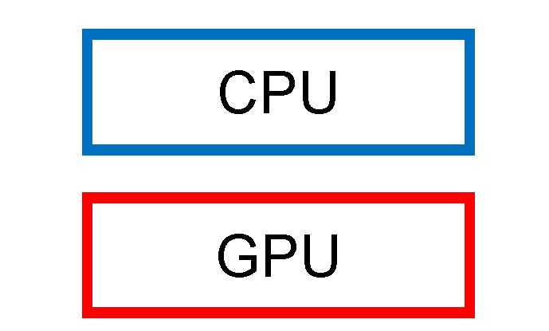
CMAQ-CUDA is a heterogeneous implementation of ROS3
RBDRIVER
Collect output and loop through blocks
RBSOLVE
Solve linear system
RBDECOMP
Compute LU decomposition
RBSOLVER
Compute intermediate steps and iterate to convergence
RBFEVAL
Compute time derivative
RBJACOB
Compute Jacobian
We migrate CMAQ’s ROS3 solver to CUDA Fortran GPU code

Slide 11
Timing

Slide 12
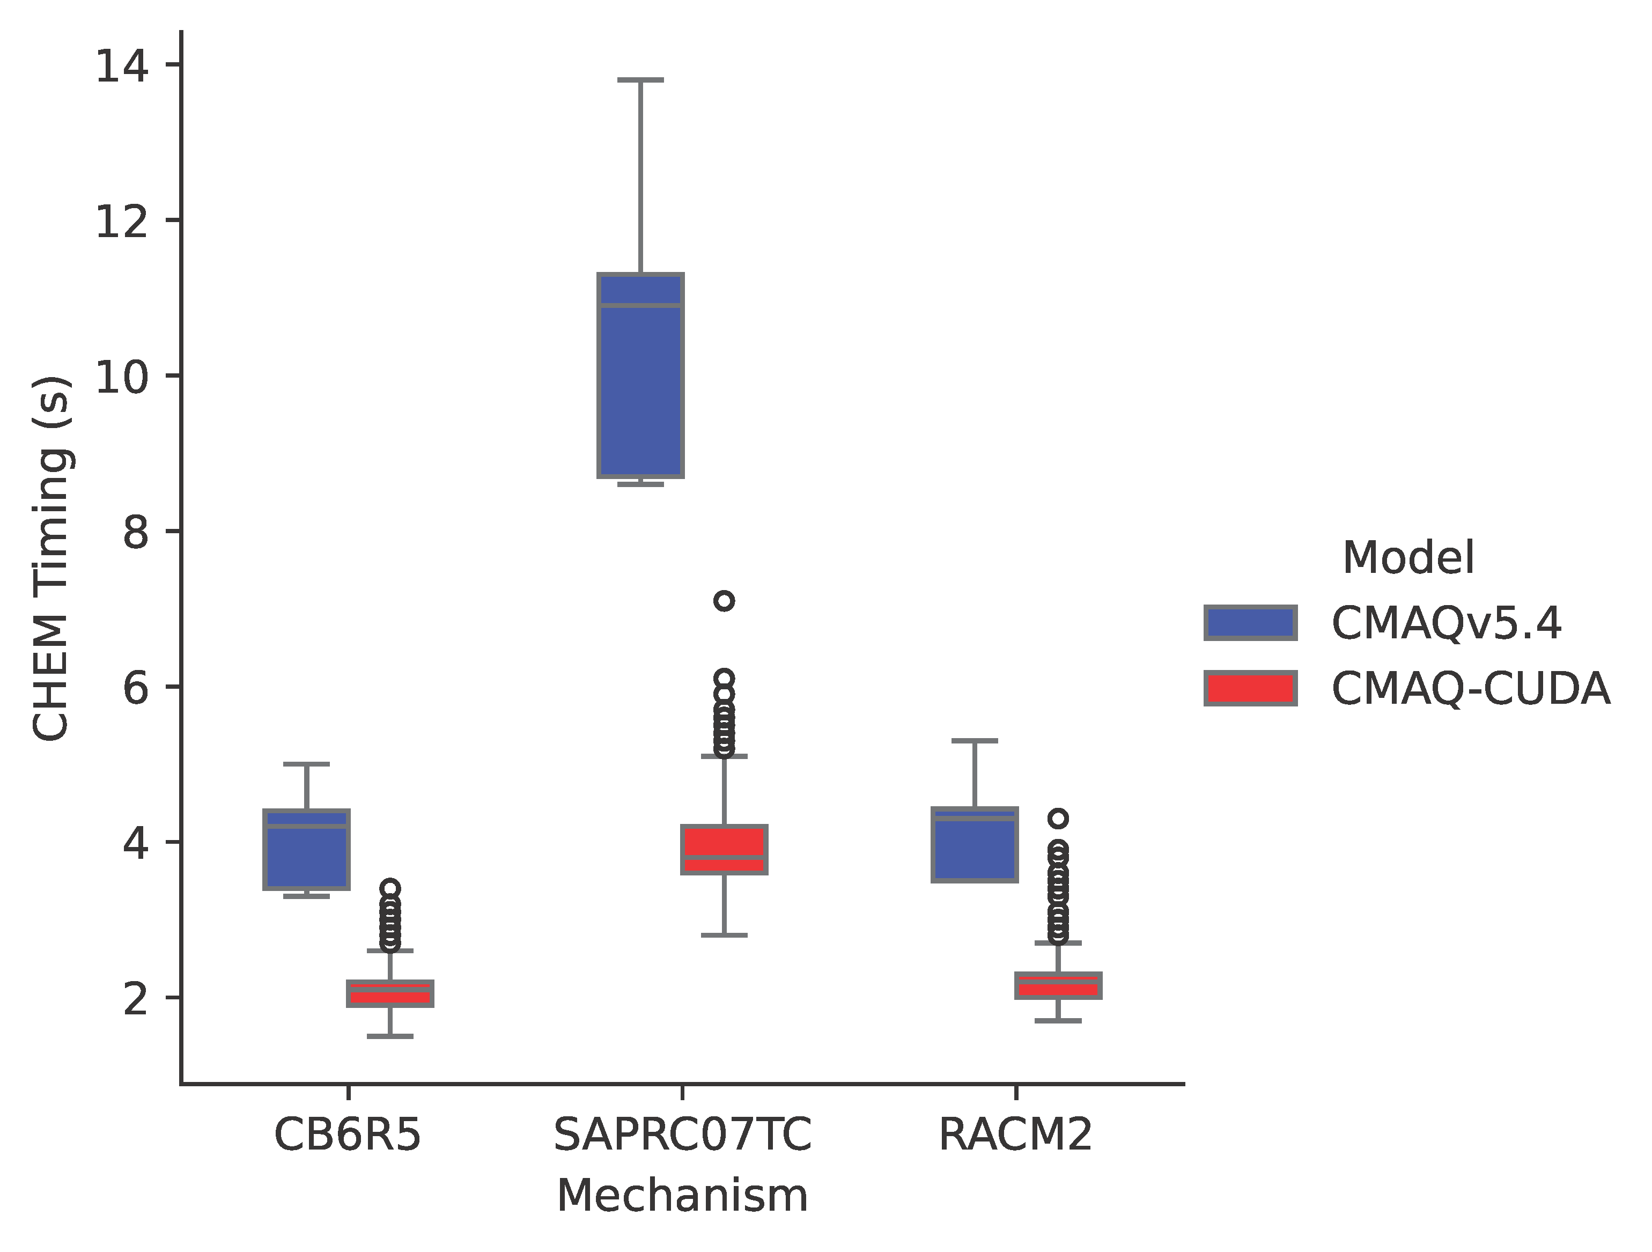
CMAQ-CUDA accelerates gas-phase chemistry in CMAQv5.4
CMAQ-CUDA significantly reduces execution time per synchronization time step.
Acceleration is greatest for the most complex mechanism.
CB6R5 (349 reactions): ~2× speedup.
RACM2 (411 reactions): ~2× speedup.
SAPRC07TC (752 reactions): ~3× speedup.
CHEM module timing per synchronization time step for CMAQv5.4 and CMAQ-CUDA across three mechanisms using 8 MPI processes and 4 NVIDIA RTX 2080 Ti graphics cards for the 2-day 2018 12NE3 benchmark scenario.
Quevedo et al. ACS ES&T Air (in review).

Slide 13
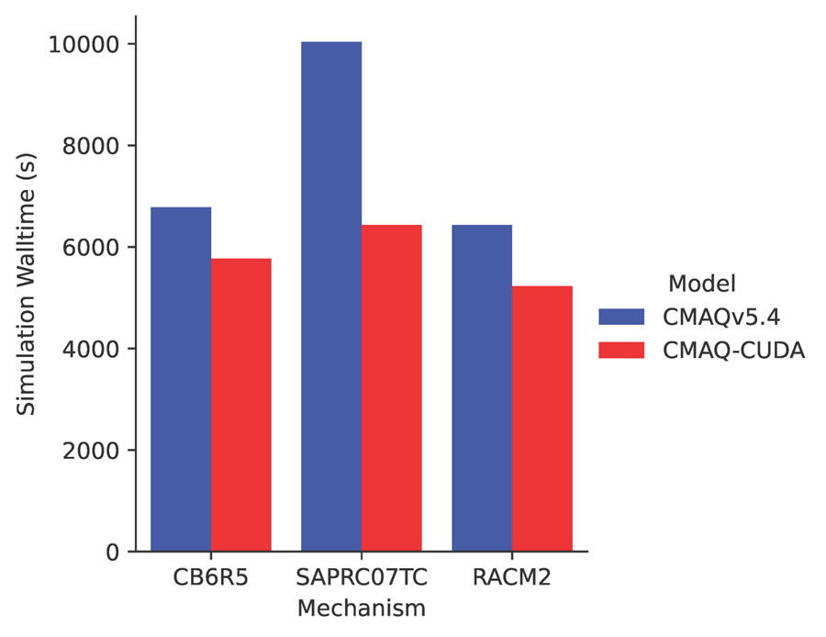
CMAQ-CUDA accelerates gas-phase chemistry in CMAQv5.4
Despite only accelerating one module, CMAQ-CUDA appreciably reduces total simulation time.
Acceleration is greatest for the most complex mechanism.
CB6R5 (349 reactions): ~1.2× speedup.
RACM2 (411 reactions): ~1.2× speedup.
SAPRC07TC (752 reactions): ~1.6× speedup.
CMAQ-CUDA scales well with mechanism complexity.
Total simulation timing for CMAQv5.4 and CMAQ-CUDA across three mechanisms using 8 MPI processes and 4 NVIDIA RTX 2080 Ti graphics cards for the 2-day 2018 12NE3 benchmark scenario.
Quevedo et al. ACS ES&T Air (in review).

Slide 14
Error Analysis

Slide 15
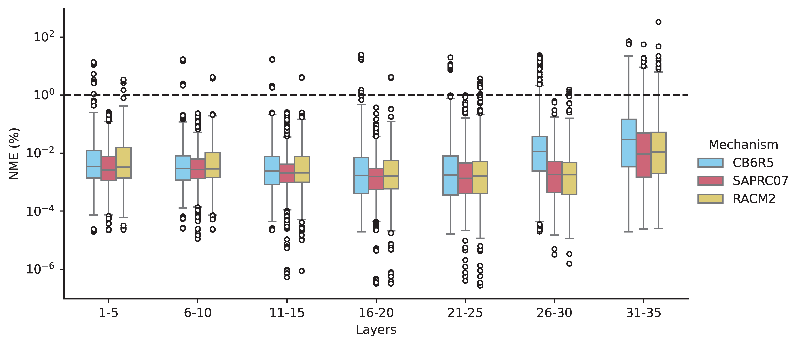
CMAQ-CUDA agrees best with CMAQv5.4 in lower vertical layers
1% threshold
NME between CMAQ-CUDA and CMAQv5.4 taken with respect to space and time and binned by vertical layer in the 2-day 2018 12NE3 benchmark scenario. Distributions are over mechanism species.
Quevedo et al. ACS ES&T Air (in review).

Slide 16
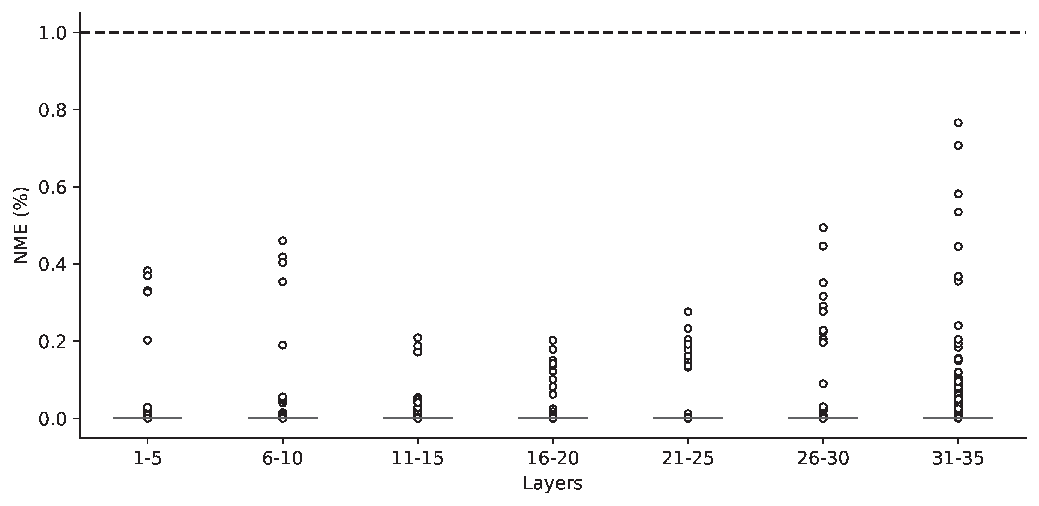
Isolating CHEM improves CMAQ-CUDA and CMAQv5.4 agreement
1% threshold
NME between CMAQ-CUDA and CMAQv5.4 taken with respect to space and time and binned by vertical layer in the 2-day 2018 12NE3 benchmark scenario. CHEM is the only active science process and CB6R5 with aero7 SOA treatment and standard cloud chemistry is the chosen mechanism. Distributions are over mechanism species.
Quevedo et al. ACS ES&T Air (in review).

Slide 17
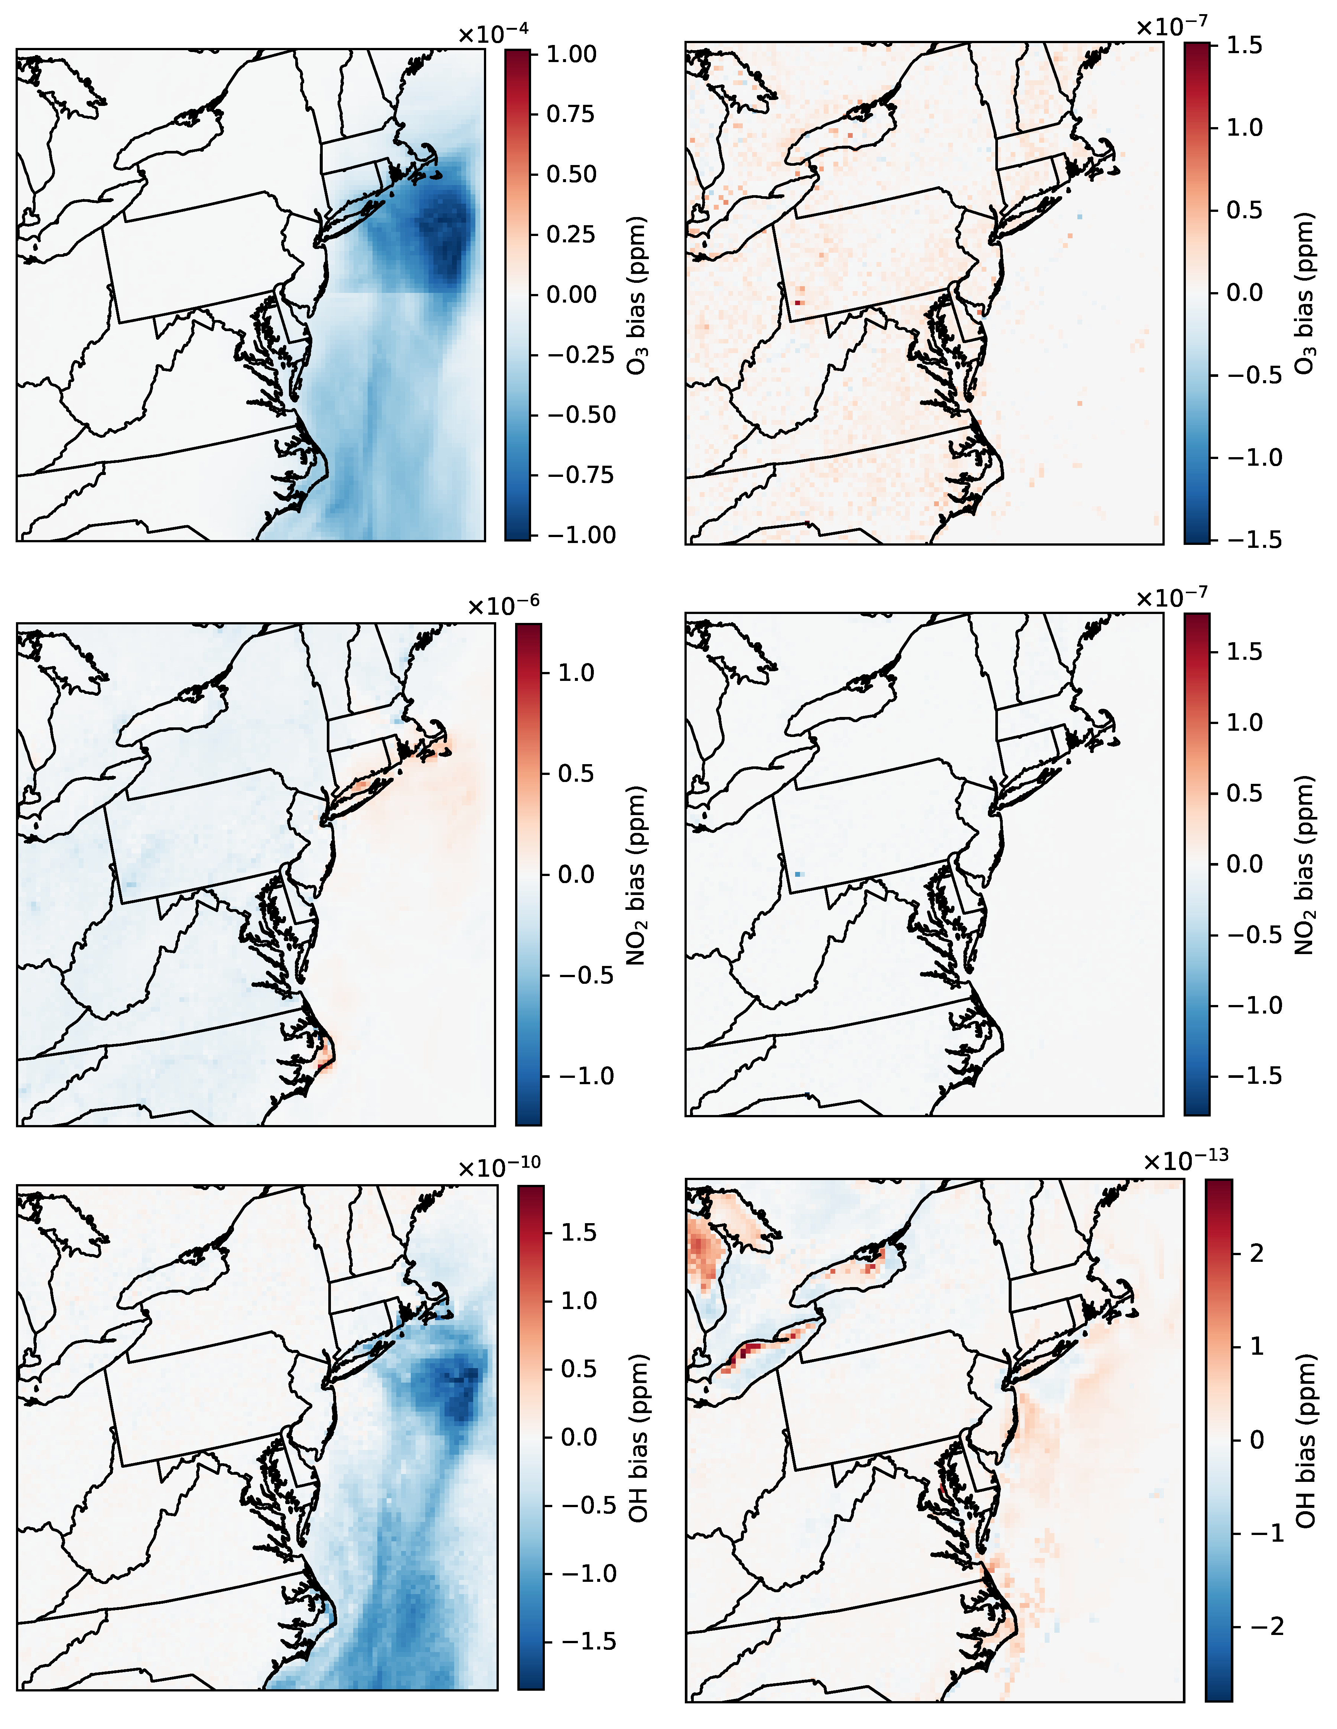
Spatial patterns in NME arise outside of CHEM
O₃
OH
NME in time for the full simulation (left column) and CHEM-only simulation (right column) for CB6R5 with aero7 SOA treatment and standard cloud chemistry.
NO₂
Quevedo et al. ACS ES&T Air (in review).

Slide 18
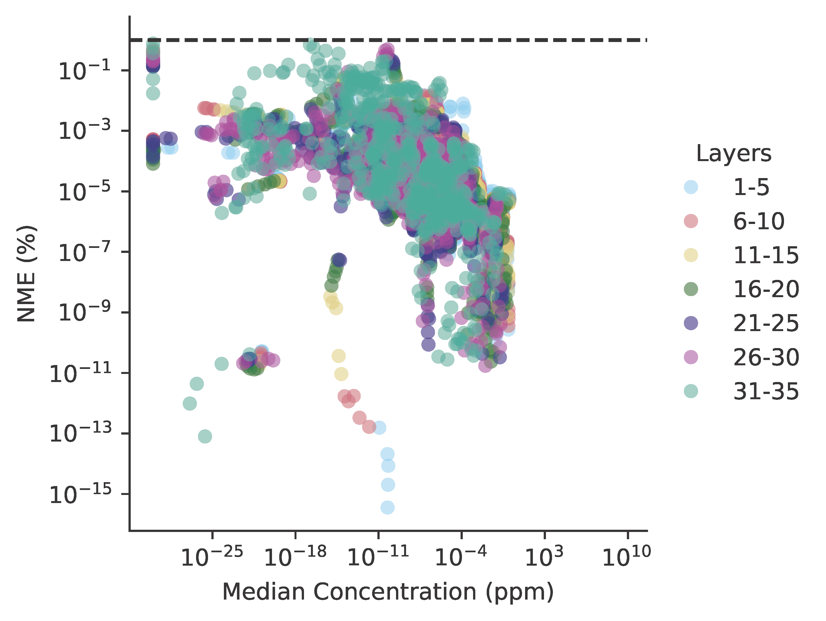
Disagreement is greater for species with small concentrations
Species occurring in smaller concentrations tend to exhibit larger NME.
Small differences are proportionally large for trace species and likely arise from architectural differences in roundoff error.
Hypothesis: small differences are magnified by other science process modules.
1% threshold
NME in space and time against median concentration across all vertical layers in the CHEM-only simulation for CB6R5 with aero7 SOA treatment and standard cloud chemistry.
Quevedo et al. ACS ES&T Air (in review).

Slide 19
Conclusions

Slide 20
Conclusions and moving forward
Conclusions
CMAQ-CUDA significantly accelerates CHEM
CHEM acceleration appreciably reduces total simulation walltimes
Agreement with unaccelerated CMAQ is good but degrades with other modules active
Future research directions
Accelerate other modules
Re-implement DDM, IRR
CHEM module timing per synchronization time step for CMAQv5.4 and CMAQ-CUDA across three mechanisms using 8 MPI processes and 4 NVIDIA RTX 2080 Ti graphics cards for the 2-day 2018 12NE3 benchmark scenario.
Quevedo et al. ACS ES&T Air (in review).

Slide 21

Conclusions and moving forward
Conclusions
CMAQ-CUDA significantly accelerates CHEM
CHEM acceleration appreciably reduces total simulation walltimes
Agreement with unaccelerated CMAQ is good but degrades with other modules active
Future research directions
Accelerate other modules
Re-implement DDM, IRR
Total simulation timing for CMAQv5.4 and CMAQ-CUDA across three mechanisms using 8 MPI processes and 4 NVIDIA RTX 2080 Ti graphics cards for the 2-day 2018 12NE3 benchmark scenario.
Quevedo et al. ACS ES&T Air (in review).

Slide 22
Conclusions and moving forward
Conclusions
CMAQ-CUDA significantly accelerates CHEM
CHEM acceleration appreciably reduces total simulation walltimes
Agreement with unaccelerated CMAQ is good but degrades with other modules active
Future research directions
Accelerate other modules
Re-implement DDM, IRR
NME in time for the full simulation (left column) and CHEM-only simulation (right column) for CB6R5 with aero7 SOA treatment and standard cloud chemistry.
Quevedo et al. ACS ES&T Air (in review).

Slide 23
Conclusions and moving forward
Conclusions
CMAQ-CUDA significantly accelerates CHEM
CHEM acceleration appreciably reduces total simulation walltimes
Agreement with unaccelerated CMAQ is good but degrades with other modules active
Future research directions
Accelerate other modules
Re-implement DDM, IRR
Module timing burdens per time step for an 8-core simulation using the ROS3 solver and CB6R5 chemical mechanism with aero7 SOA treatment and standard cloud chemistry for the CMAQ 2018 12NE3 benchmark scenario.
Quevedo et al. ACS ES&T Air (in review).

