Slide 1
Image-Based Wildfire Detection for Emission Control and Air Quality Improvement
Taylor J. Brown
tbrown145@broncos.uncfsu.edu
Matthew Wilkerson
mwilkerson1@broncos.uncfsu.edu
Sambit Bhattacharya
sbhattac@uncfsu.edu
^{Intelligent Systems Laboratory}
Notes:
Good morning, everyone. My name is Matthew Wilkerson, and I am honored to present our research on optimizing fire detection in edge devices through integrating early exits in compact models. This work was a collaborative effort between Fayetteville State University and the Jet Propulsion Laboratory at the California Institute of Technology.

Slide 2
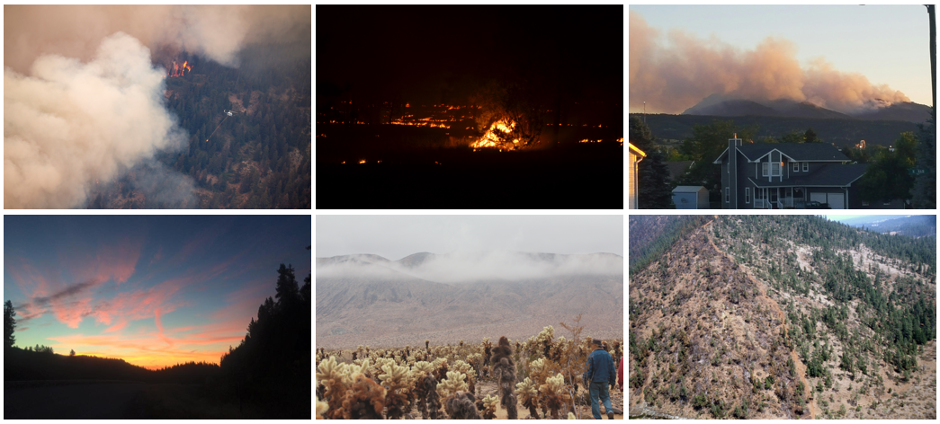






Real-time wildfire detection is essential for rapid response and mitigation
Estimated annual economic burden in the United States is $394 billion¹
4.2 million acres have burned in the US in 2024 alone²
Fire
Satellites
Drones
Fire Detection
No Fire
Surveillance
Committee, United States Joint Economic. “Climate-Exacerbated Wildfires Cost the U.S. between $394 to $893 Billion Each Year in Economic Costs and Damages.” United States Joint Economic Committee, 16 Oct. 2023.
“National Fire News.” National Fire News | National Interagency Fire Center, 18 July 2024
1
Notes:
Wildfires are a significant threat to ecological and economic stability.
Real-time detection is crucial for rapid response and mitigation. Traditionally, satellites, drones, and surveillance cameras have been used for fire detection, but these methods often face limitations in scope and delay in alert times.
To address these challenges, we utilized a wildfire dataset for research, which comprises of 2,700 RGB images classified into ‘Fire’ and ‘No Fire’ categories. The images were sourced from diverse environments with varying topographies, forest compositions, and densities. The dataset also includes different fire sizes, shapes, colors, intensities, and smoke patterns, ensuring a comprehensive representation of fire scenarios. The diversity makes the dataset robust and generalizable for training our models.
JPL fire alarm digital twin (software simulation for air quality) – Collaborating with JPL for the sensor data and prediction data

Slide 3
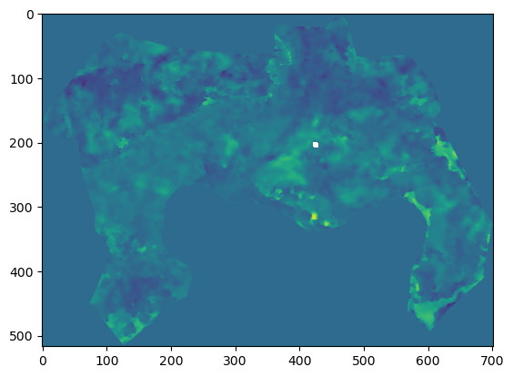
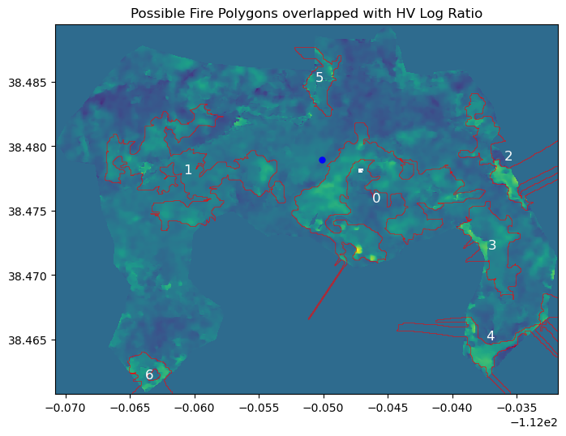

UAVSAR Wildfire Perimeter Mapping
https://nisar.jpl.nasa.gov/mission/get-to-know-sar/overview/

Slide 4
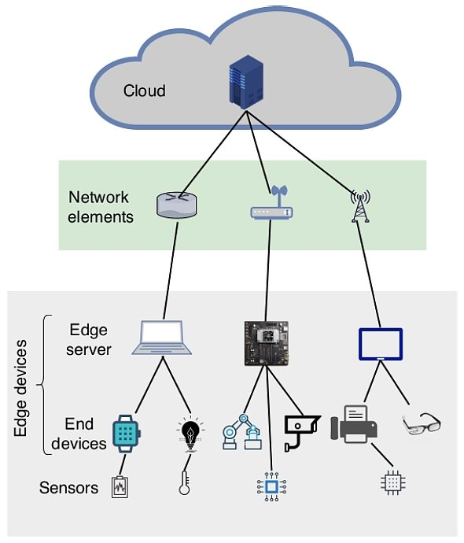
Why AI at the Edge is Important
Real-Time Responsiveness
Privacy Compliance & Data Protection
Cost Efficiency
Resource Optimization
Continuous Functionality
Triage Relevant Information
Notes:
Real-Time Responsiveness
Computations closer to the source
Reduces latency by processing data locally
Provides real_time decision making at the source
Privacy Compliance and Protection
Keeps data locally
Organization Control over data
Allows Steadfast security
Cost Efficiency
By processing data locally we can minimize the bandwidth requirements that larger networks have.
Resource Optimization
Local computations minimize the transfer of data to large data centers by only transferring what is relevant at the time of processing.
This ensures minimal loss of resources during the computational process.
Continuous Functionality
Performs independently
Allows for Uninterrupted services
Triage Relevant Information - On next slide

Slide 5

Triage Relevant Information
All Data
Relevant Data
Notes:
Triage Relevant Information
AI at edge brings high-performance computing decision-making at the edge
Relevant Information sent to back end server for further analysis.

Slide 6
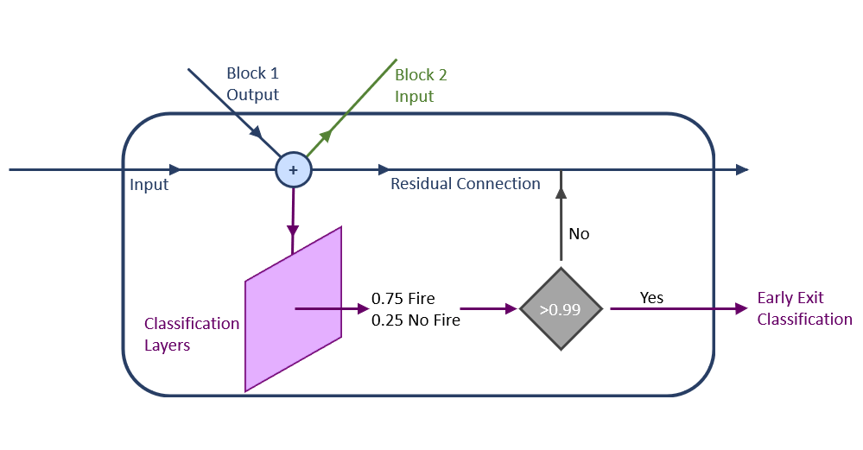
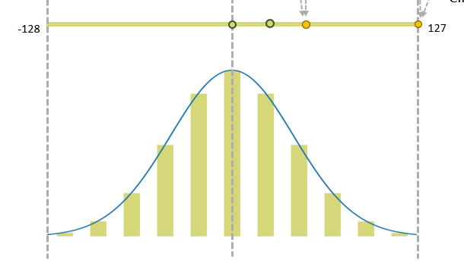
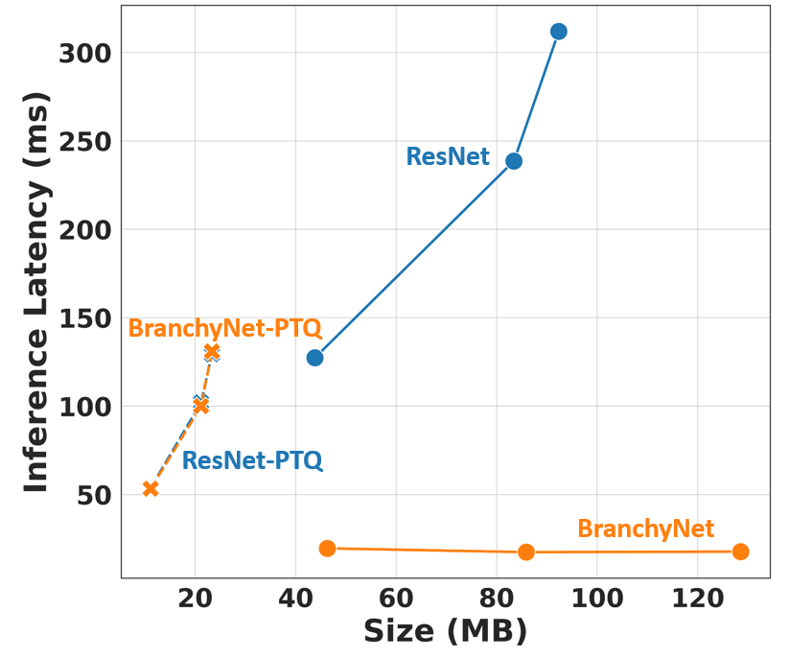
This study optimizes model architectures for real-time wildfire detection on edge devices
Dynamic Model Architecture
Model Compression
Balancing Metrics for Edge Computing
2
Notes:
Our study focused focuses on optimizing model architectures for real-time wildfire detection on edge devices. By leveraging dynamic model architectures and model compression techniques, we aim to balance the trade-offs between computational efficiency and detection accuracy.

Slide 7
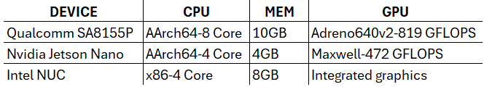
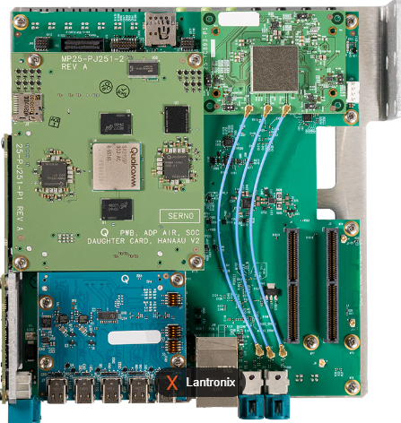
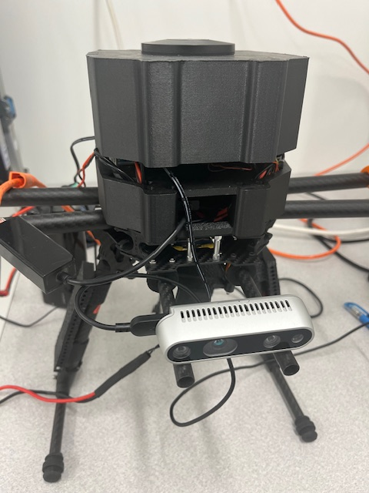
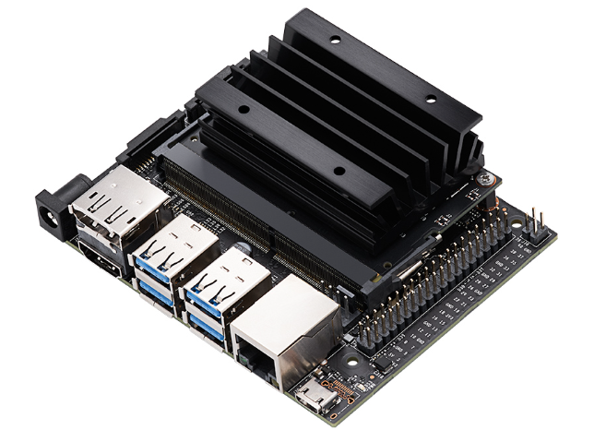
Edge Devices Tested
3
Notes:
We tested our models on various edge devices, including an Intel NUC affixed to a drone, a Nvidia Jetson Nano affixed to a Turtlebot, and a Qualcomm Snapdragon automotive development board. Each of these devices presents unique challenges and opportunities for implementing our optimized fire detection models. For example, the Intel NUC has a low-end CPU is not capable of GPU-accelerated tensor operations, whereas the Snapdragon has a GPU and neural processing unit with a Neural Processing Software Development Kit.

Slide 8
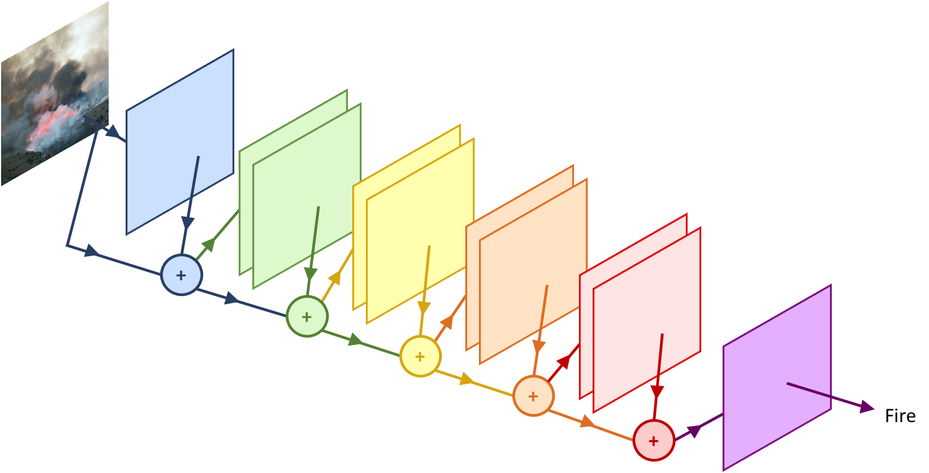
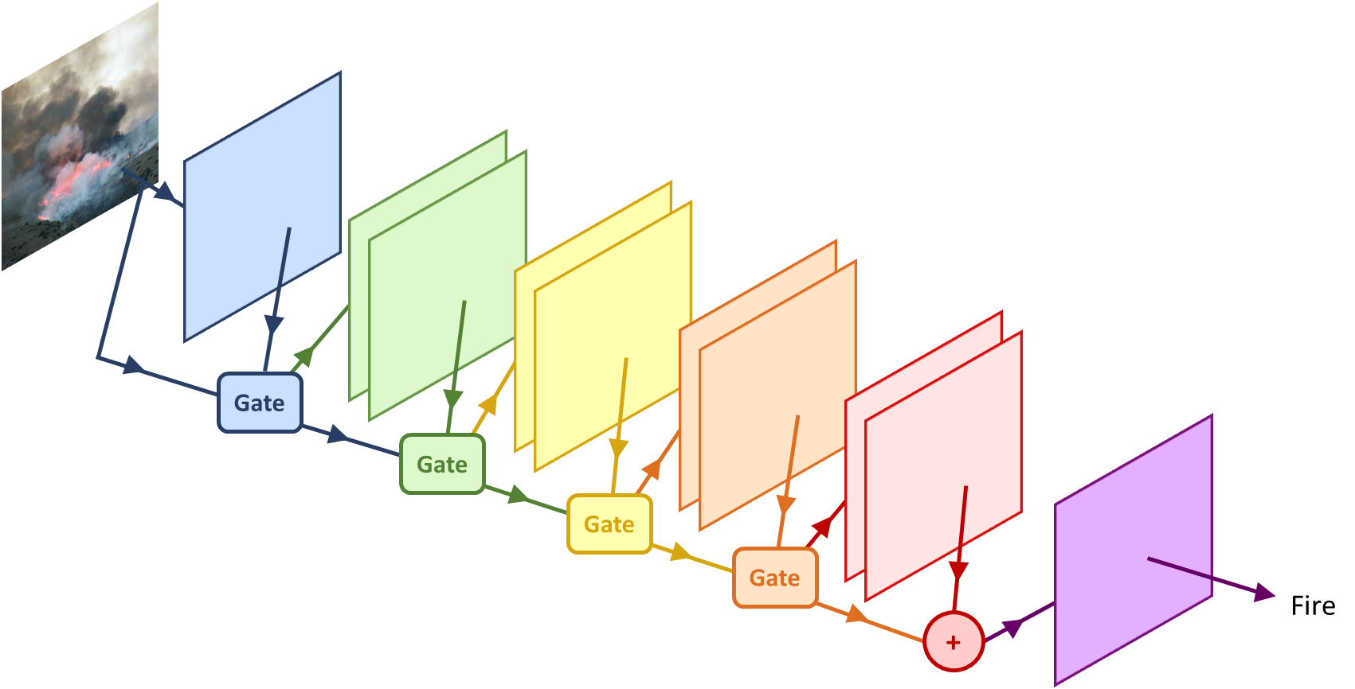
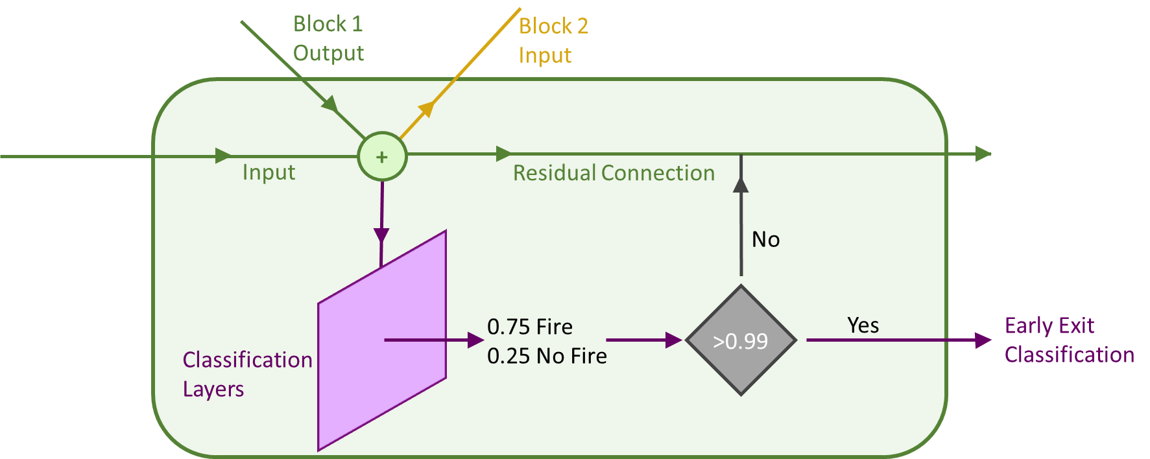
Early-exits adapt static model architectures to classify "easy" images earlier
Initial Layers
Dynamic ResNet Architecture
ResNet Architecture
Convolutional Blocks
Input Image
Classification Layers
Residual Connections
Exit Gates
Output
4
Notes:
ResNet, or Residual Network, is known for its residual connections, which help mitigate the vanishing gradient problem in deep networks. These connections allow the gradient to flow directly through the network, making training more efficient and improving performance.
We leveraged these residual connections to introduce exit gates at various stages in the network. This adaptation allows the model to perform early exits, classifying ‘easy’ images at shallower layers before processing through the entire network. This technique, implemented using the BranchyNet framework, significantly reduces computational load and inference time.
The model starts with an input image, which passes through the initial layers. As it moves through each block, the residual connections add the output of the previous block to the input of the next block. Here, we’ve introduced a gate that evaluates the classification confidence. If the model predicts with high confidence – greater than 0.99 – it takes an early exit, outputting the classification result. If the confidence is below the threshold, the image continues through the deeper layers for further processing. This gated approach allows the network to efficiently classify simpler images early, reducing overall computational load and improving inference speed on edge devices.

Slide 9
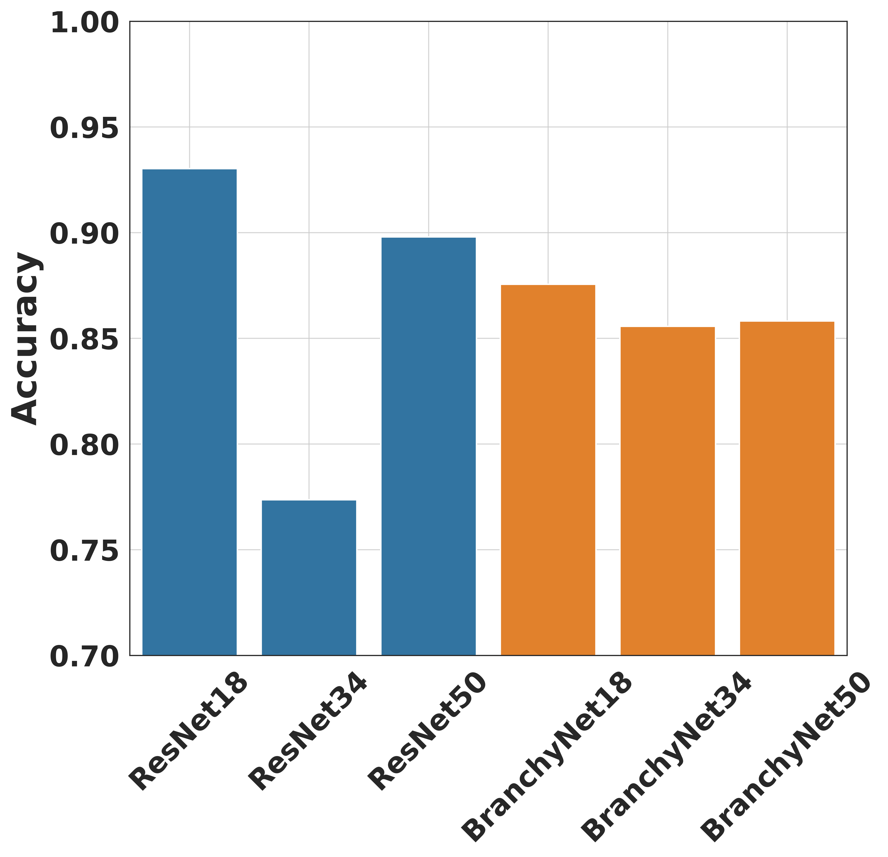
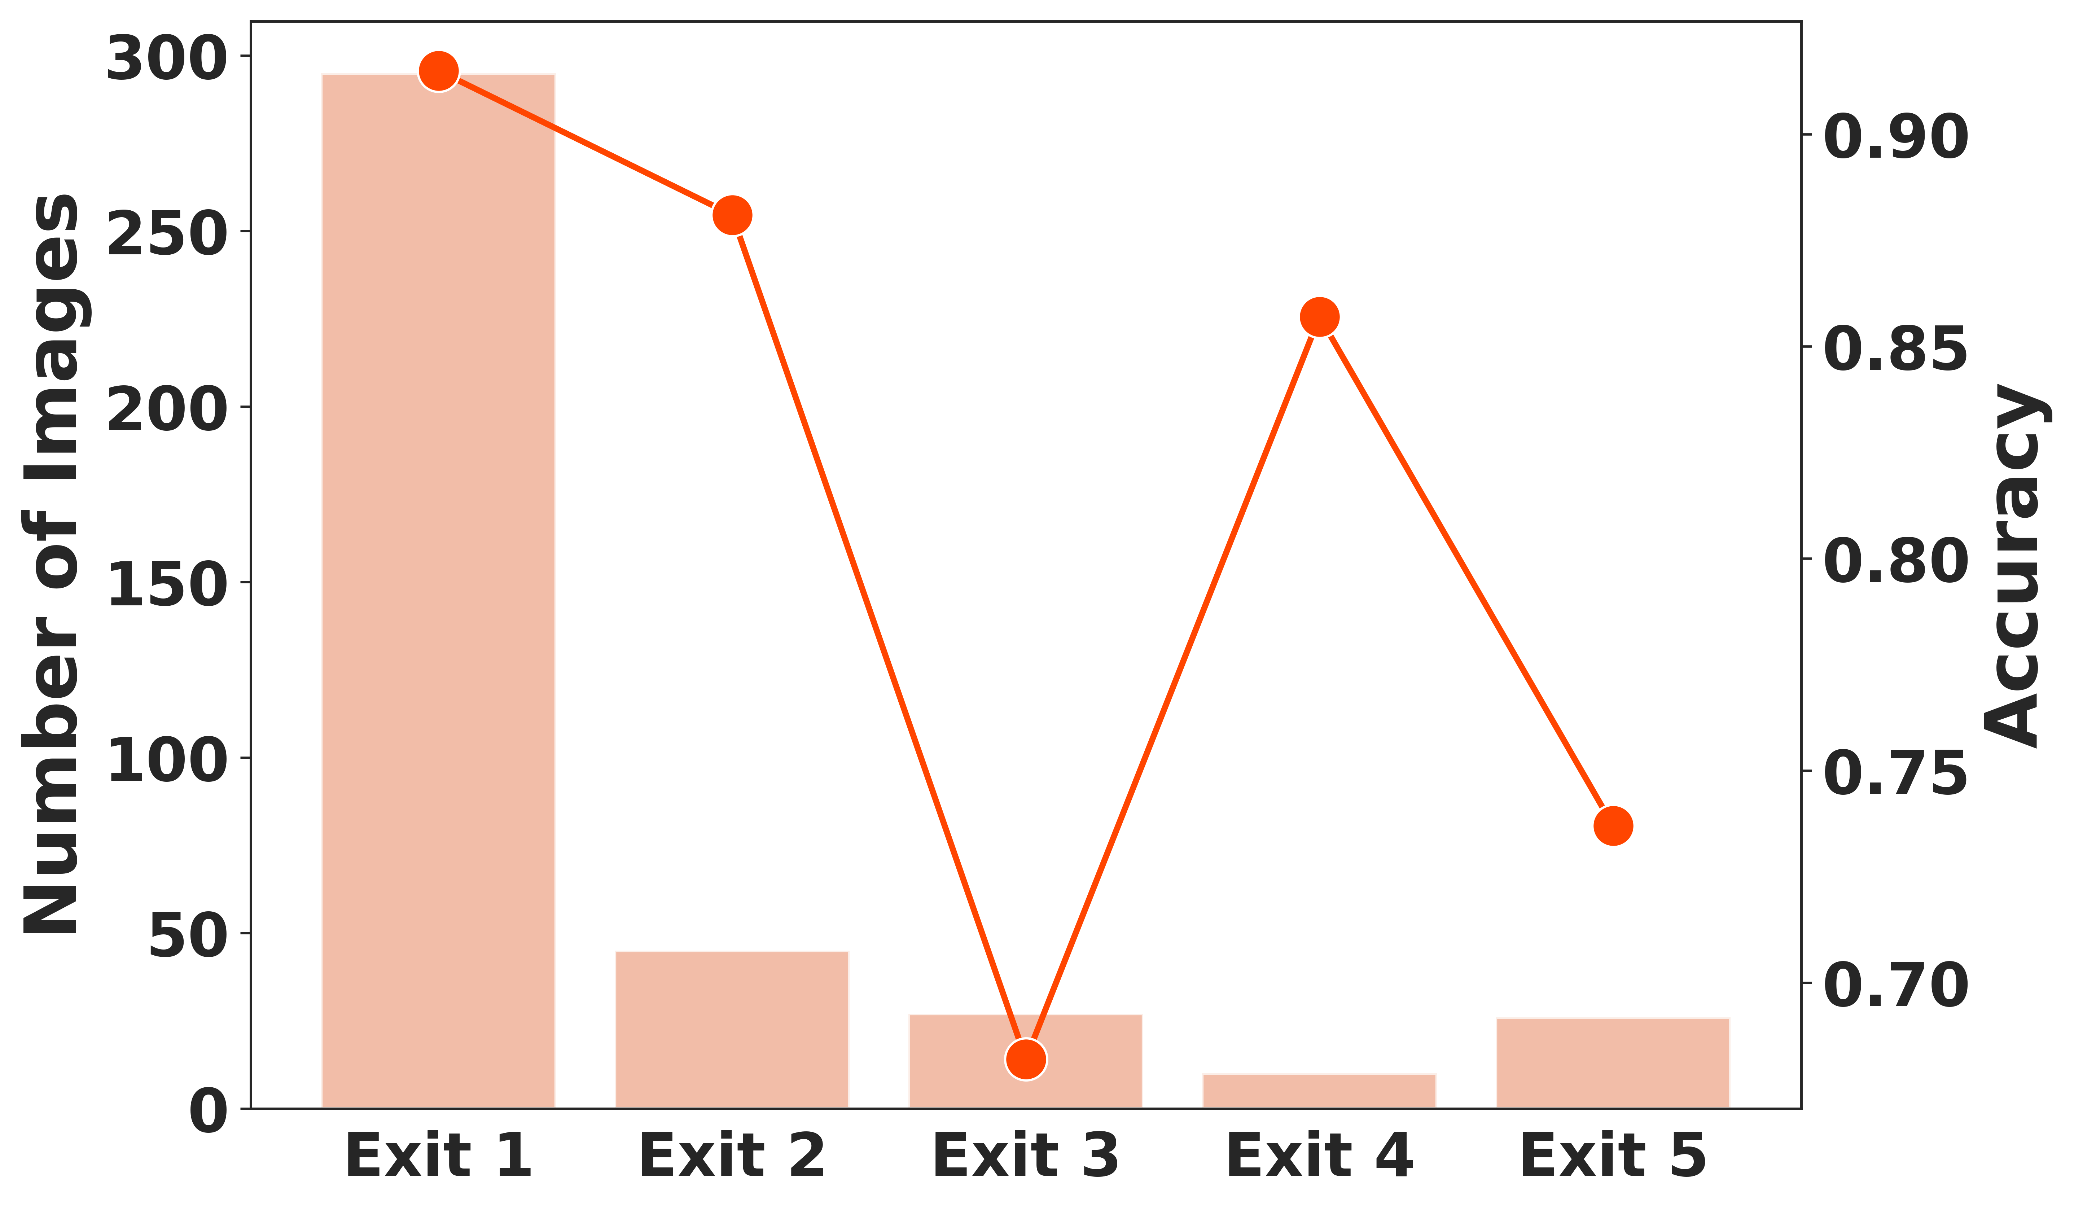
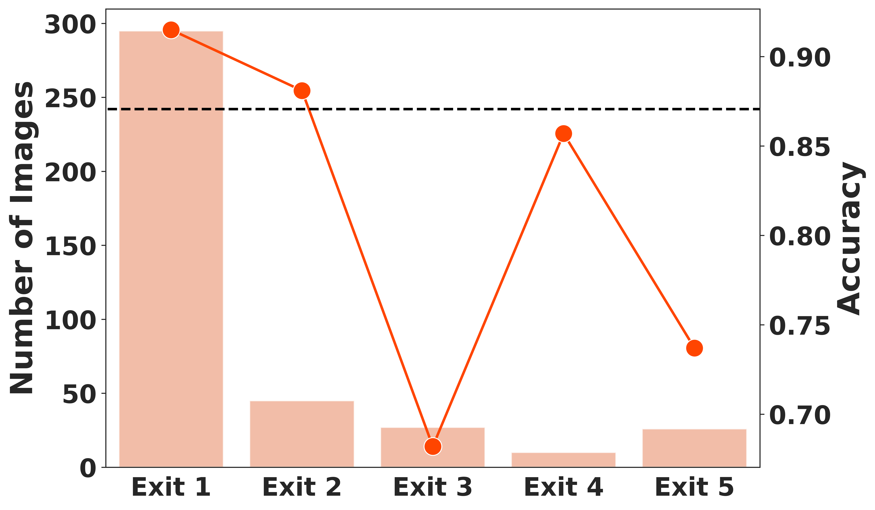
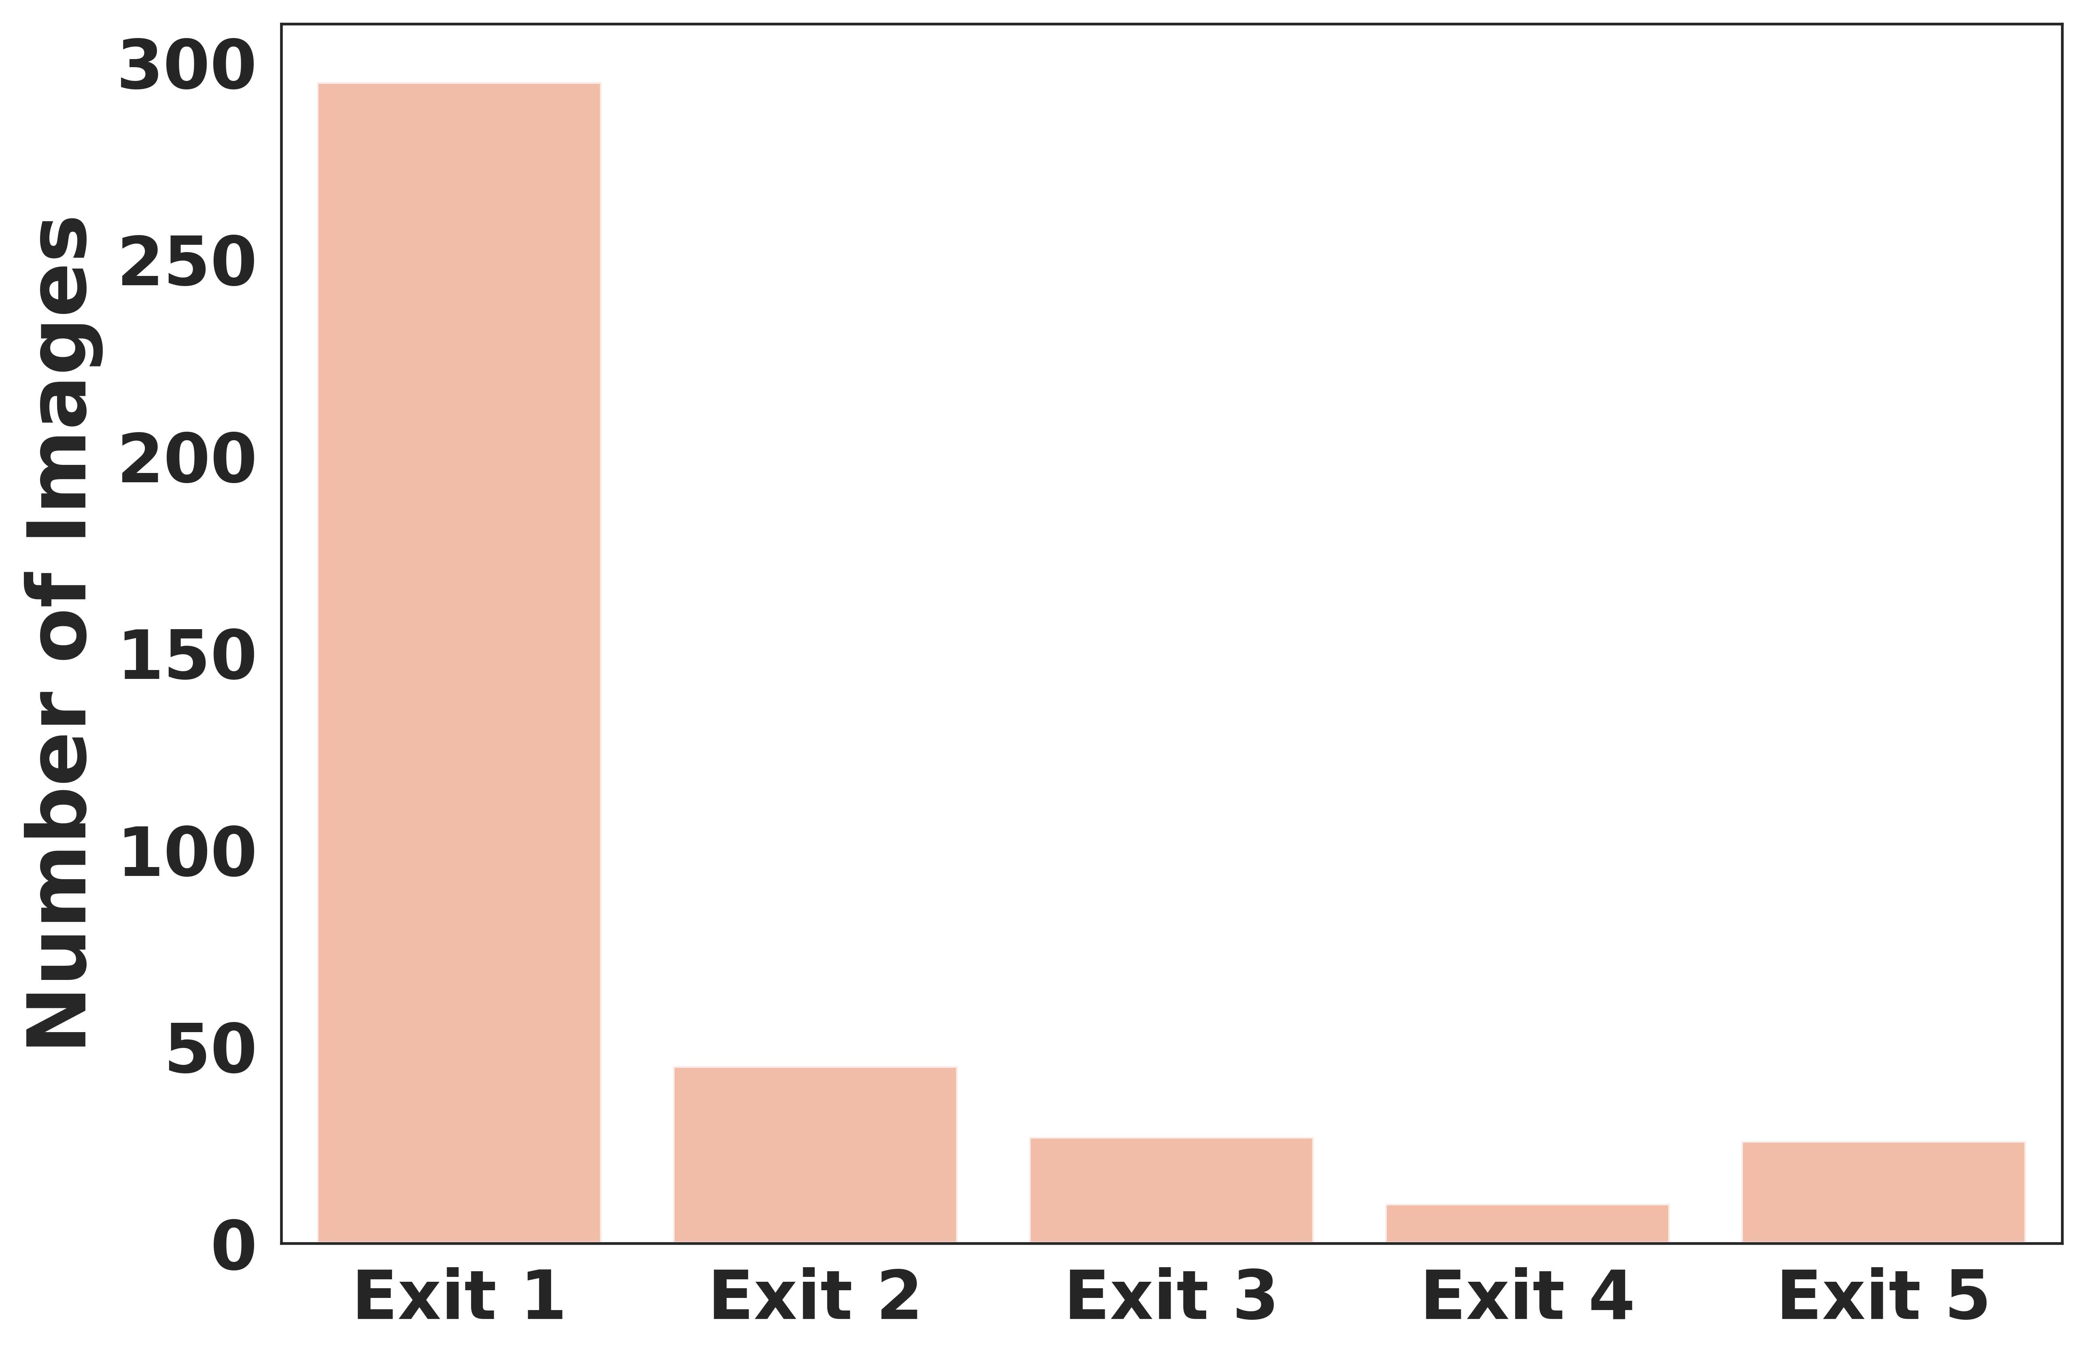
Dynamic architectures produce a comparable performance with fewer computations
Small Models are better learners
Overall Accuracy
5
Notes:
Our findings indicate that small models, such as those with ResNet-18 backbone, can achieve high accuracy while maintaining efficiency. These models consistently outperformed larger architectures in our tests, demonstrating that smaller models can be better learners for fire detection.
In this chart, we see the number of images that exited early at each of the exit gates in the BranchyNet-18 model. The majority of images were classified at the first exit, significantly reducing the need for deeper processing.
Here, we compare the accuracy for images that exited at each gate with the overall accuracy. You will notice, however, that some exit gates, particularly the third and fifth exits, have much lower accuracy compared to the first exit. This discrepancy arises because the early exits are designed to handle 'easy' images—those that can be confidently classified without extensive processing. The first exit captures the bulk of these easy images, leading to high accuracy. As the images that progress to later exits tend to be more challenging, the accuracy at these gates can drop. However, this does not significantly affect the overall model performance since only a small proportion of images reach these deeper exits.

Slide 10
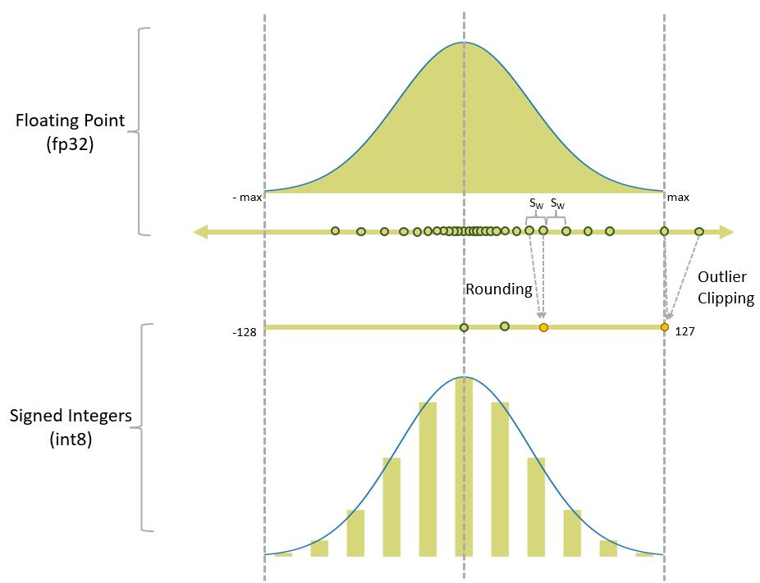
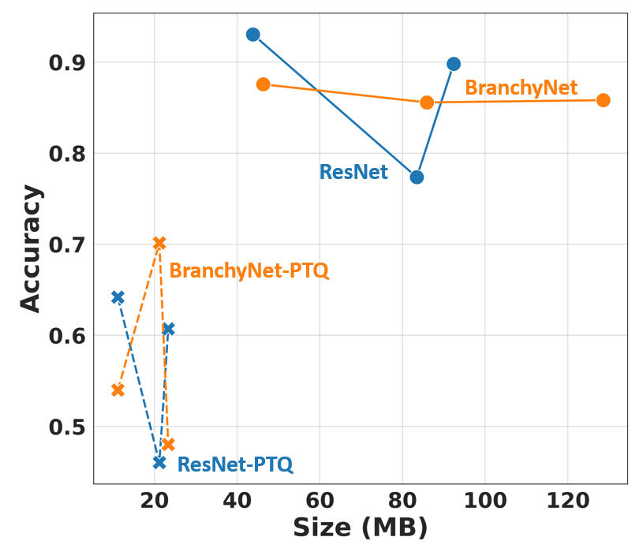
Quantization reduces resource storage requirements
During training weights and biases are fp32
Average decrease in model size is 76%
Post-training, the weights and biases are statically converted to int8
6
Notes:
To further enhance resource efficiency, we applied post-training quantization. Post-training quantization is a technique where the weights and biases of a trained model, which are originally in 32-bit floating-point (fp32) format, are converted to 8-bit integer (int8) format. This conversion significantly reduces the model size and computational requirements without requiring retraining of the model. As illustrated, during training, the weights and biases are in fp32 format, and post-training, they are statically converted to int8 using a scale factor, reducing resource storage requirements.
Next, let’s look at the impact of quantization on model size of both non-quantized and post-training quantized models. The average decrease in model size is 76%, as indicated. However, this reduction in size does come with a trade-off in accuracy. For example, the models experience a noticeable drop in accuracy after quantization. Despite the performance degradation, quantized models still offer a viable solution for deployment on resource-constrained edge devices due to their significantly reduced size.
Real-time wildfire detection requires maximizing accuracy while minimizing storage and inference speed. This chart emphasizes the necessity to balance storage and inference speed with accuracy. BranchyNet models, especially those with PTQ, manage to strike this balance effectively, maintaining a commendable level of accuracy with reduced storage requirements.

Slide 11
Real-time wildfire detection requires maximizing accuracy and reducing storage and inference speed
Inferencing on an Intel NUC
7
Notes:
When deploying on an Intel NUC, we observe that non-quantized BranchyNet models demonstrate significantly lower inference latency compared to both ResNet models and the BranchyNet-PTQ models. This is crucial for real-time applications, as it ensures faster detection and response times. The reason for the higher latency in BranchyNet-PTQ models compared to their non-quantized counterparts is likely due to the reduced precision in quantized weights. This reduction in precision can lower the confidence levels at early exit points, resulting in fewer early exits and more computations through deeper layers.
Post-training quantization is an effective technique to reduce model size and resource requirements, albeit with some loss in accuracy. However, dynamic models like BranchyNet can maintain a good balance between accuracy, storage, and inference speed, making them suitable for deployment in real-time wildfire detection systems.

Slide 12
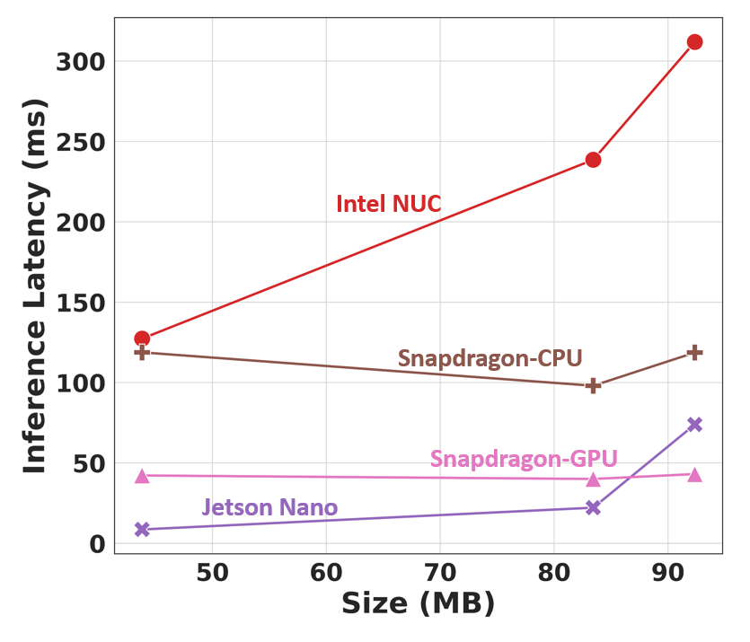
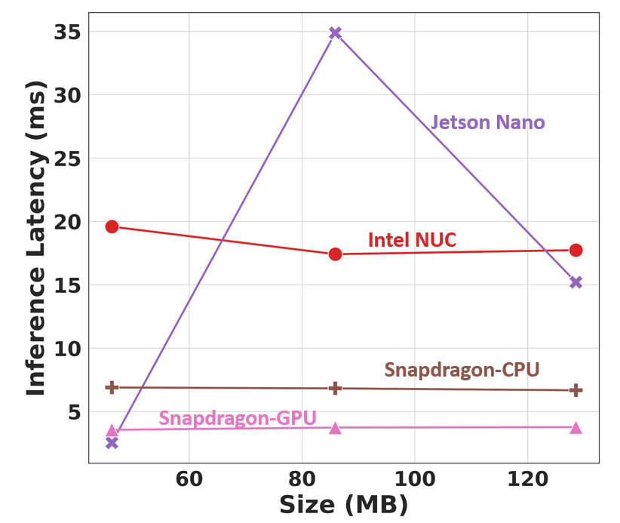
Early-exits reduce inference latency on edge devices
ResNet Models
BranchyNet Models
8
Notes:
On the left, we see the inference latency for ResNet models on various edge devices, including Intel NUC, Snapdragon (CPU and GPU), and Jetson Nano. The Intel NUC shows the highest latency, especially for larger models, reaching up to 300 milliseconds. The Snapdragon GPU and Jetson Nano exhibit the lower latencies, making them potential options for real-time applications.
On the right, we observe the inference latency for BranchyNet models. BranchyNet models demonstrate significantly lower latency compared to their ResNet counterparts. For instance, the latency on the Intel NUC remains consistent and low, around 15 milliseconds, regardless of model size. The Snapdragon GPU and Jetson Nano again shows excellent performance, with minimal latency.
This comparison highlights that early-exit architectures like BranchyNet can significantly enhance inference speed on edge devices. This is crucial for real-time applications, ensuring faster detection and response times. By leveraging early exits, BranchyNet models maintain high performance and efficiency, making them ideal for real-time wildfire detection on edge devices

Slide 13
In summary, small dynamic architectures balance performance and resources for real-time wildfire detection
Small dynamic models
(BranchyNet-18)
Improve inference speed on edge with comparable accuracy
FUTURE: Quantized-Aware Training, Earth Observations, and Segmentation Tasks
9
Notes:
In summary, our research demonstrates that small dynamic architectures, such as BranchyNet, can effectively balance performance and resource constraints for real-time wildfire detection.
Model Efficiency: Small models, particularly those with a ResNet-18 backbone, achieved high accuracy while maintaining computational efficiency. These models outperformed larger architectures, demonstrating that smaller models can be better learners for fire detection.
Early Exits: By leveraging early exits, BranchyNet models significantly reduce computational load and inference time. Early exits allow the model to classify 'easy' images at shallower layers, conserving resources and improving speed.
Quantization: Post-training quantization further reduces model size by converting weights from 32-bit floating-point to 8-bit integer format. Although this reduces accuracy slightly, the trade-off is worthwhile for deploying models on resource-constrained edge devices. However, non-quantized early exit models performed best.
Inference Latency: When tested on various edge devices, BranchyNet models consistently showed lower inference latency compared to ResNet models. This is crucial for real-time applications, ensuring faster detection and response times.
Overall, the implementation of early exits and model quantization significantly enhances the efficiency and feasibility of deploying these models on edge devices. Our findings validate the approach of using dynamic models like BranchyNet for accurate and efficient wildfire detection.
Looking ahead, our future research aims to implement quantization-aware training to mitigate the loss in accuracy observed with post-training quantization. This approach will allow us to maintain high model performance while still benefiting from reduced resource requirements. Additionally, we plan to apply these techniques to segmentation tasks, further expanding the applicability of our methods to various real-time edge applications.
By adopting these advanced techniques, we can develop robust fire detection systems that operate efficiently on edge devices, providing timely and reliable information crucial for rapid wildfire response and mitigation.

Slide 14
Acknowledgement
The research and its results outlined in this presentation is based upon work supported by NASA under award Nos. 80NSSC21M0312 and 80NSSC23M0054.
Questions?
Notes:
This research was supported by NASA under award Nos. 80NSSC21M0312 and 80NSSC23M0054. I would like to acknowledge my co-authors and collaborators from Fayetteville State University and the Jet Propulsion Laboratory.
Grace Vincent, the primary author, is a Ph.D. candidate at North Carolina State University, Nathan Couch is a graduate student at the University of Central Florida, and Laura DeSantis recently graduated in May.
Zaki Hasnain and Michel Ingham are our collaborators from JPL, and Sambit Bhattacharya is the PI.
Thank you for your attention. I am now happy to take any questions you may have.

