Slide 1

Addressing PM_{2.5} Exposure Disparities:
High-Resolution Modeling and
Health Assessment for Environmental Justice Across the Contiguous U.S. (CONUS)
Kai Fan, Zhen Qu
23rd annual CMAS Conference
October 22, 2024
Notes:
More self introduction

Slide 2
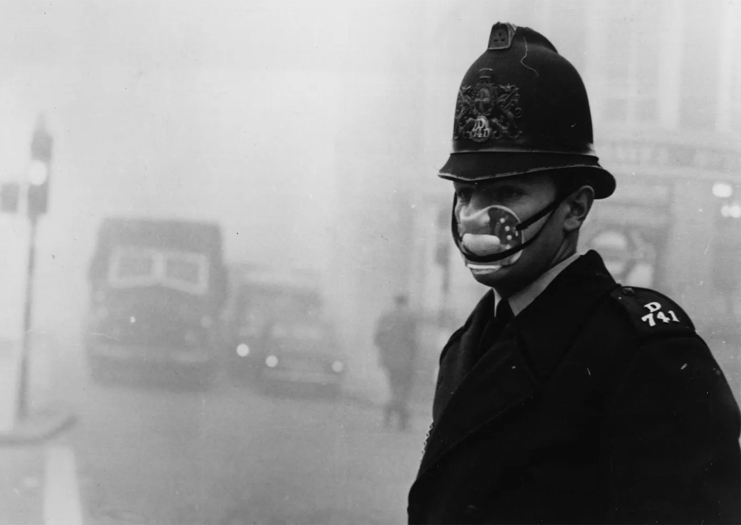
Great Smog of London
Dec. 5 – Dec. 9, 1952
4000+ Deaths
Motivation
With the rapid development of the economy and industry, PM_{2.5} has been significantly impacting human health, especially after industrial revolution
Based on data in 2015, ambient PM_{2.5} was the fifth-ranking mortality risk factor (Cohen et al., 2017)
(https://www.britannica.com/event/Great-Smog-of-London)
Notes:
Pm2.5 are particles that are 2.5 μm or less in diameter

Slide 3
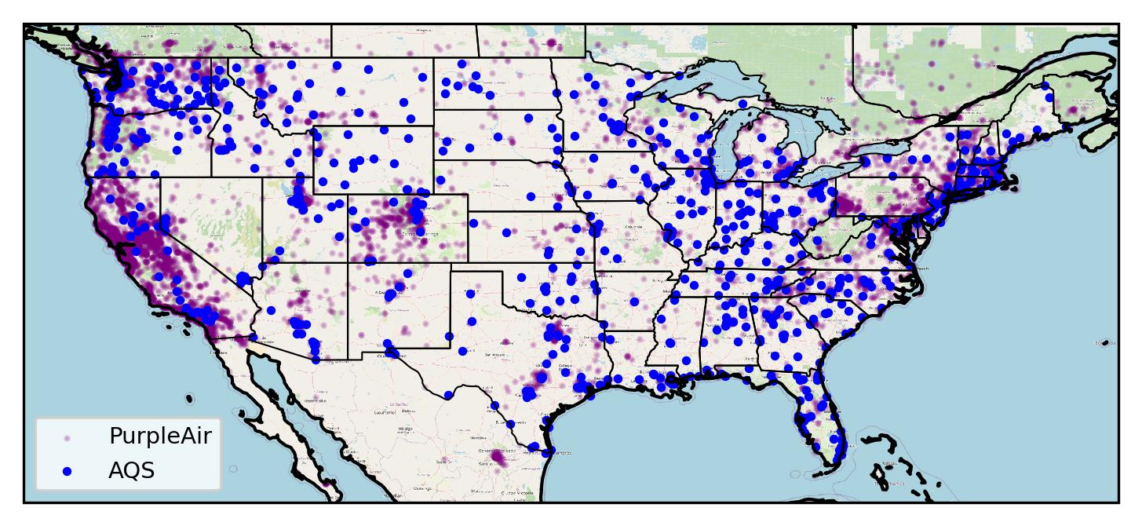
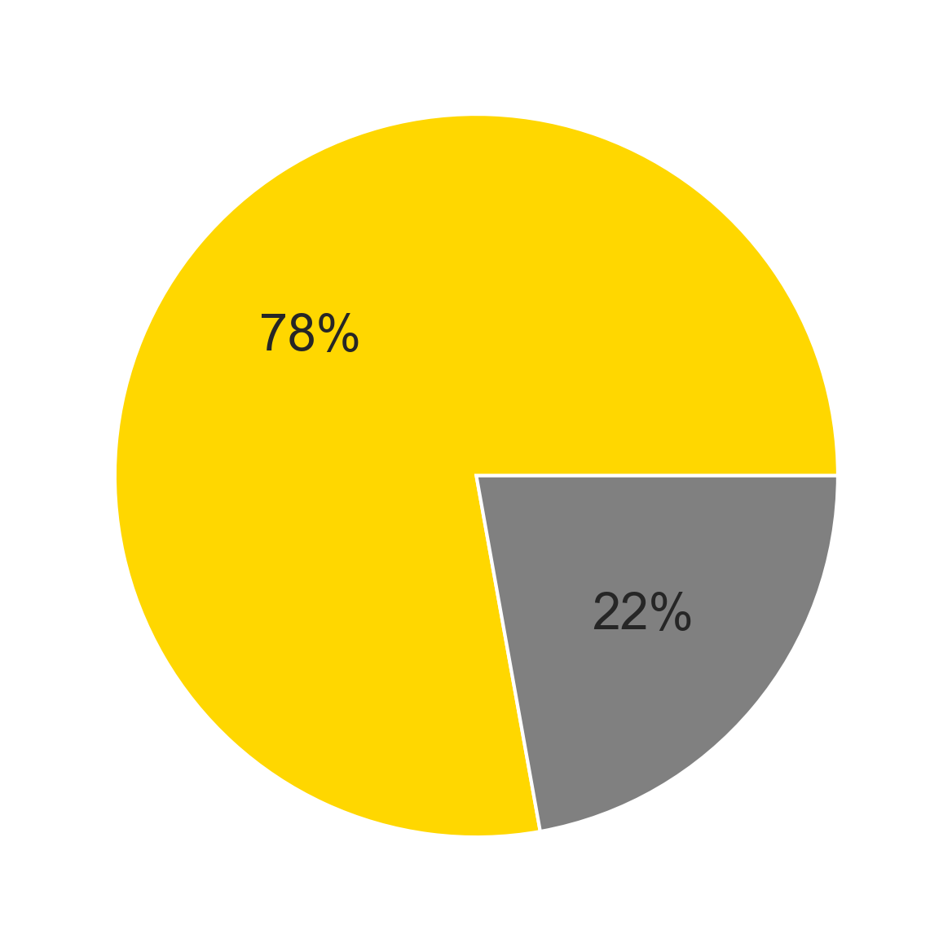
Motivation
PM_{2.5} measurement sites over CONUS
Predominantly White Census Tract
The U.S EPA Air Quality System (AQS) has been monitoring air quality since 1970s. Until 2023, there has been 1000+ sites measuring PM_{2.5}
PurpleAir, a low-cost sensor system, serves as an important supplement for PM_{2.5} monitoring. There has been 16000+ sensors until 2023.
Notes:
AQS sites at 22% counties
Only 21% PurpleAir sensors are in disadvantaged communities (including low income, low employment status, low housing cost, and high pollution exposure)
Climate and Economic Justice Screening Tool (CEJST) defines census tracts as disadvantaged communities based on a combination of variables including low income, low employment status, low housing cost, and high pollution exposure.
Air pollution significantly impacts human health, but air quality monitoring is predominantly focused in high-income, predominantly white areas. This disparity leaves disadvantaged communities unaware of their exposure levels and associated health risks, we want to improve air quality modeling to address this issue.
Add map of residence of different groups

Slide 4
Air quality modeling
Chemical transport model (CTM)
  Pros
    Based on physical chemical mechanisms
  Cons
    Large input data
    Heavy computational burden
    Uncertainty
Machine learning model
  Pros
    Efficiency
    Adaptability
  Cons
    Usually use CTM model output for training
Develop a machine learning model without relying on CTM simulations to predict high-resolution PM_{2.5}
Notes:
Highlight the “not relying on ctm”

Slide 5
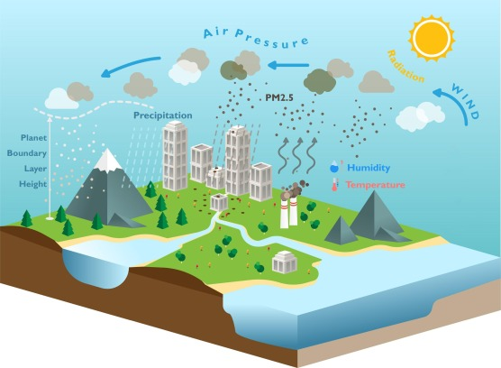

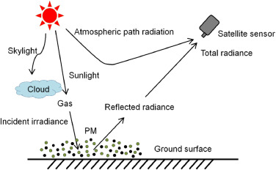
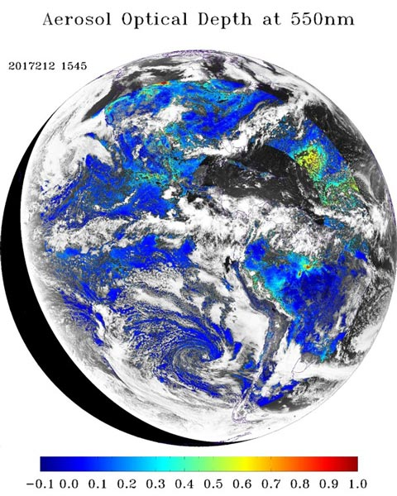
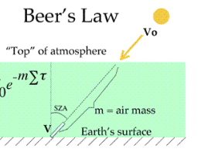
What are the factors that are associated with PM_{2.5}?
Meteorology
Land use
(Chen et al., 2020)
Aerosol optical depth (AOD)
Extinction of light passing through atmosphere
(Zhang et al., 2021)
goes-r.gov
Notes:
Cloud snow/ice

Slide 6
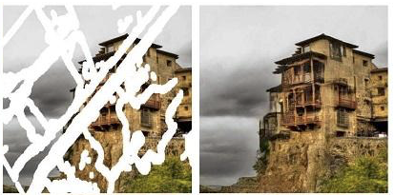
Modeling framework
AOD from
MERRA-2 reanalysis
1. AOD gap-filling
Training
U-Net architecture
using partial convolutions
Liu, et al., 2018.
AOD from
GOES-R
Prediction
2. PM_{2.5} prediction
Gap-filled AOD
ERA5 Meteorology
Features
Random Forest
Geographical data
Population data
Training
PM_{2.5} observations
Target
Prediction
3. Health assessment
PM_{2.5} over CONUS
Premature deaths
Population

Slide 7
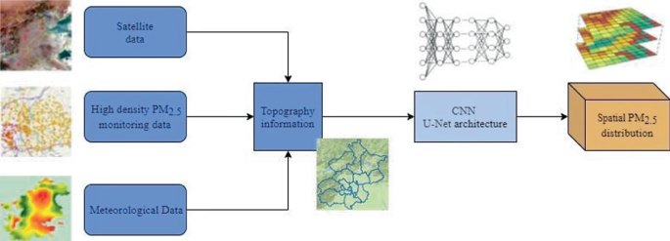
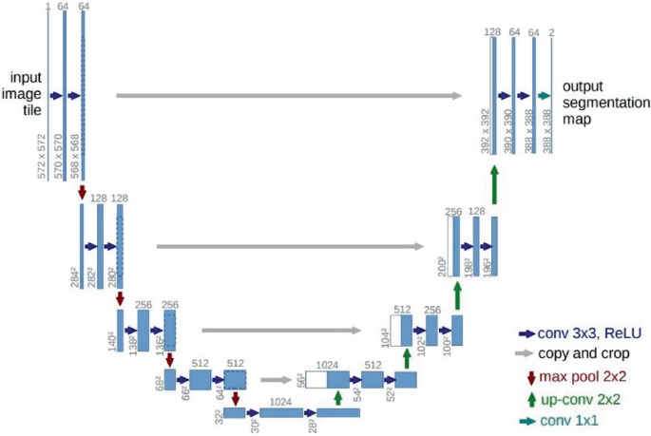
Ordinary U-Net Architecture
AOD Gap-filling
AOD from
2023 MERRA-2 reanalysis
Format the data into multiple 36 * 500 * 800 patch
For daytime
Randomly mask 50% data
For nighttime
Mask 100% data
(Wang et al., 2021)
Training
X, Y, MASK, VALMASK
U-Net architecture
using partial convolutions
AOD from
GOES-R
Prediction
Gap-filled AOD
This U-Net-like model vs ordinary U-Net
Better for irregular holes in image inpainting
More efficient
Smooth boarder

Slide 8
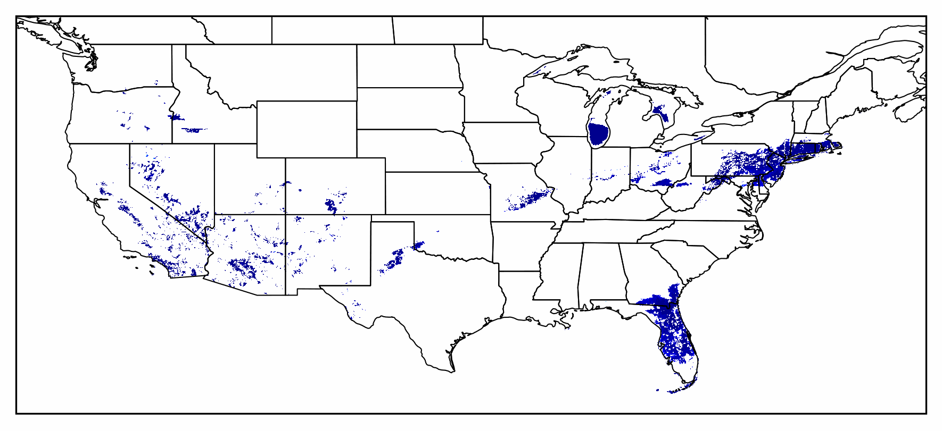
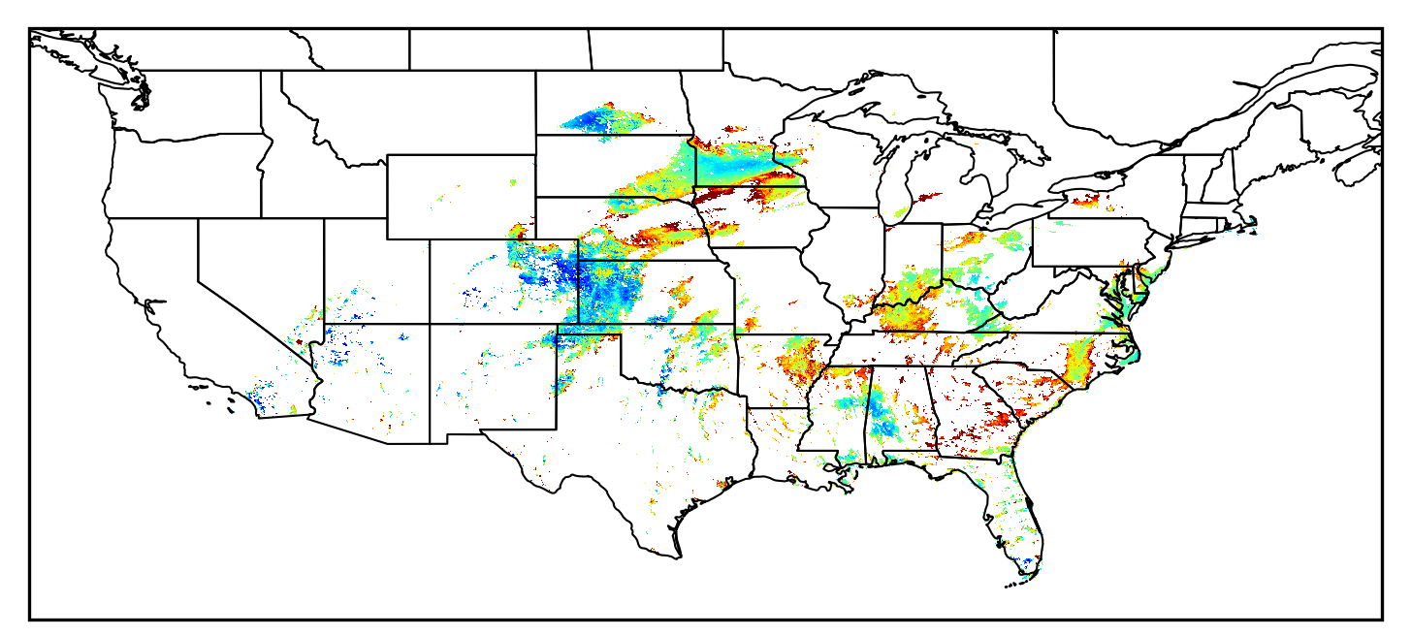
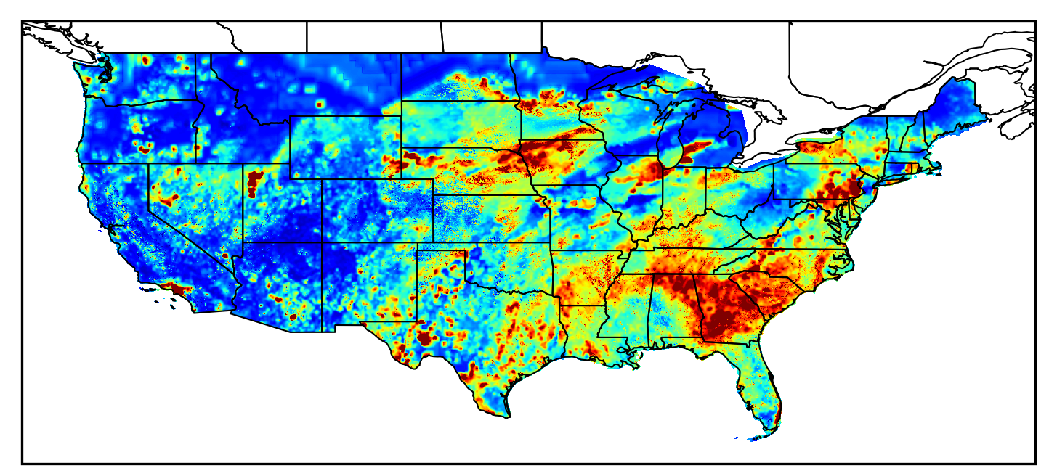
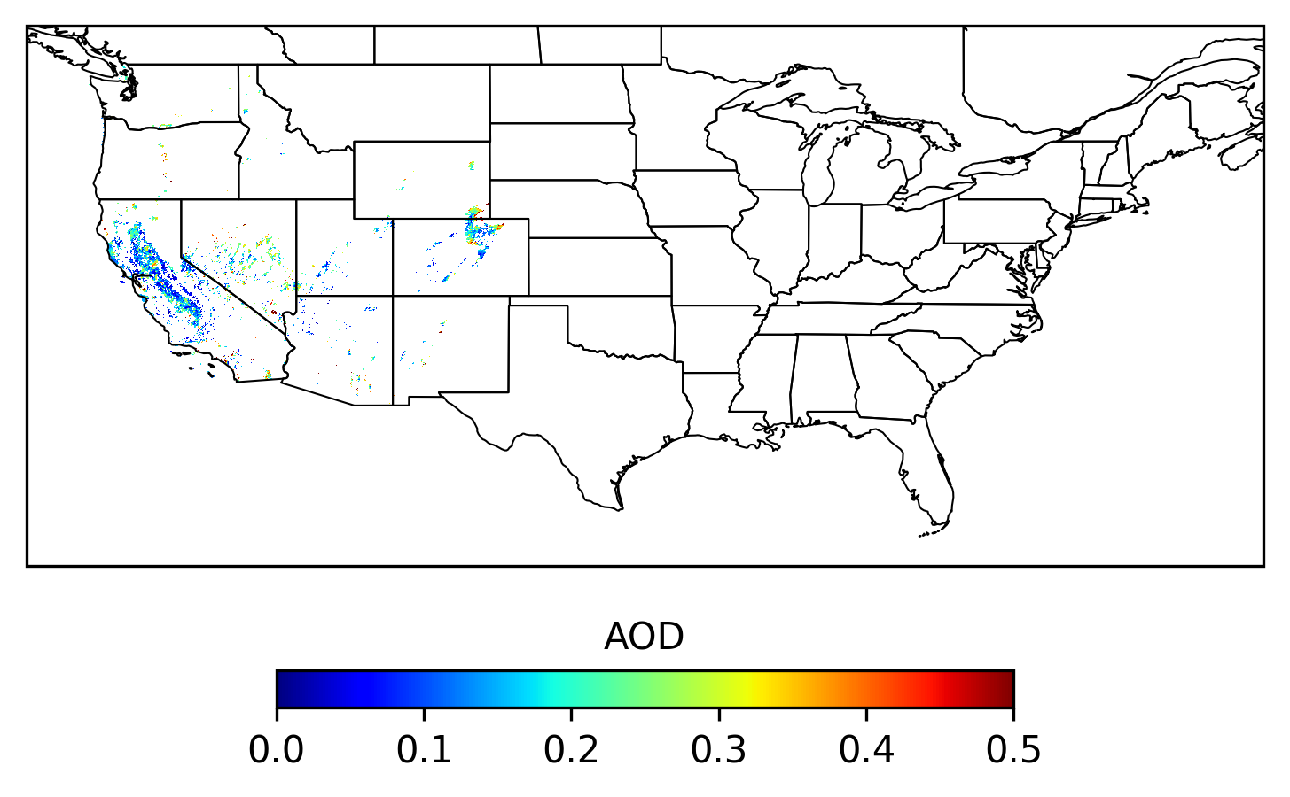
AOD Gap-filling
An example of AOD gap-filling
2019-09-10 19UTC (15EST)
GOES-East
GOES-West
The gap-filling process may require up to 10 iterations, but it only takes a few minutes to complete.

Slide 9
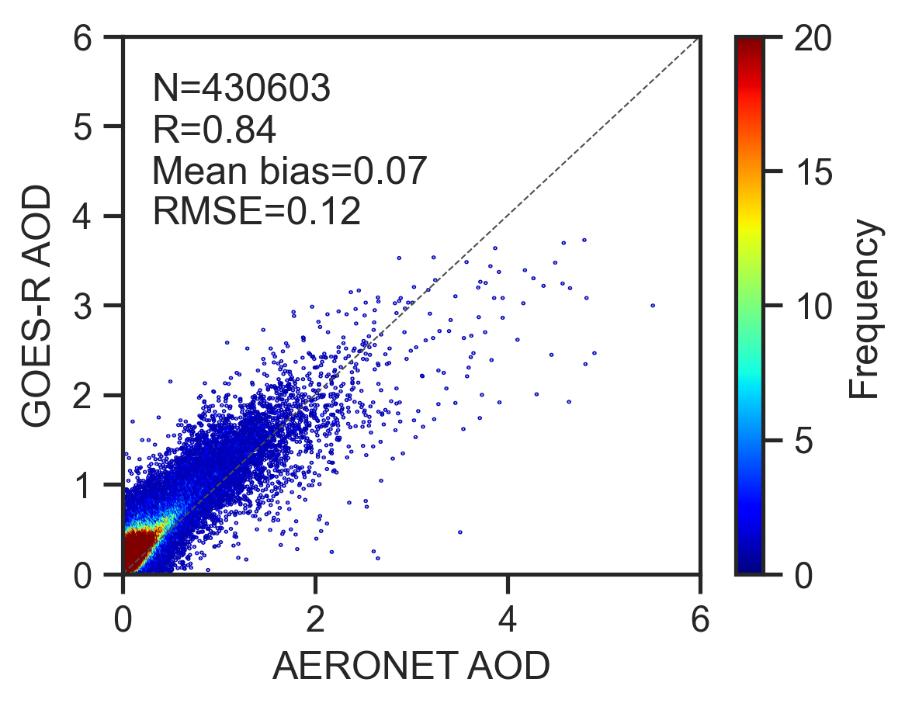
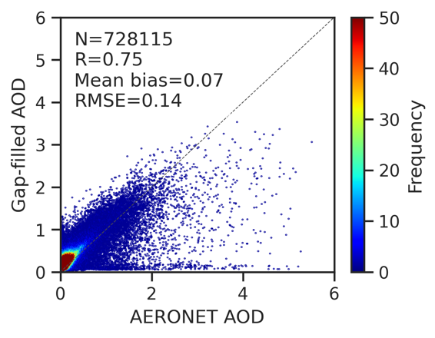
AOD Gap-filling
Evaluation of gap-filled AOD against ground-based measurements from AERONET network During 2019 – 2023
Before Gap-fill
After Gap-fill
Although the correlation coefficient (R) decreased by ~0.1 after gap-filling, the model retains the mean bias and RMSE

Slide 10
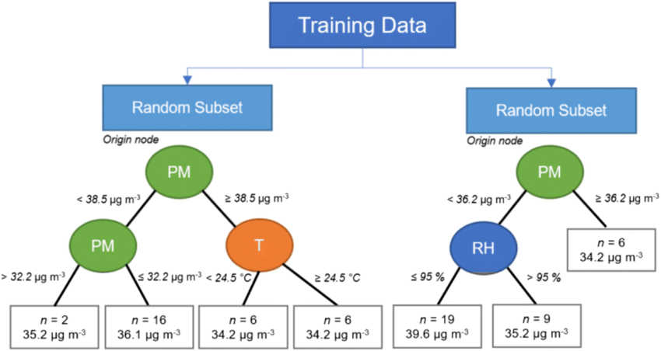
PM_{2.5} prediction
Surface T, U-wind, V-wind, PBL, Solar radiation
Gap-filled AOD
GPU-based
Random Forest
ERA5 Meteorology
Prediction
Features
Land cover, terrain height
Geographical data
PM_{2.5} over CONUS
Population data
Training
AQS, PurpleAir
PM_{2.5} observations
Target
Example of Random Forest
(Caquilpan et al., 2019)
Notes:
Compared to CPU-based Random Forest, GPU-based Random Forest could accelerate the model training up to 45x

Slide 11
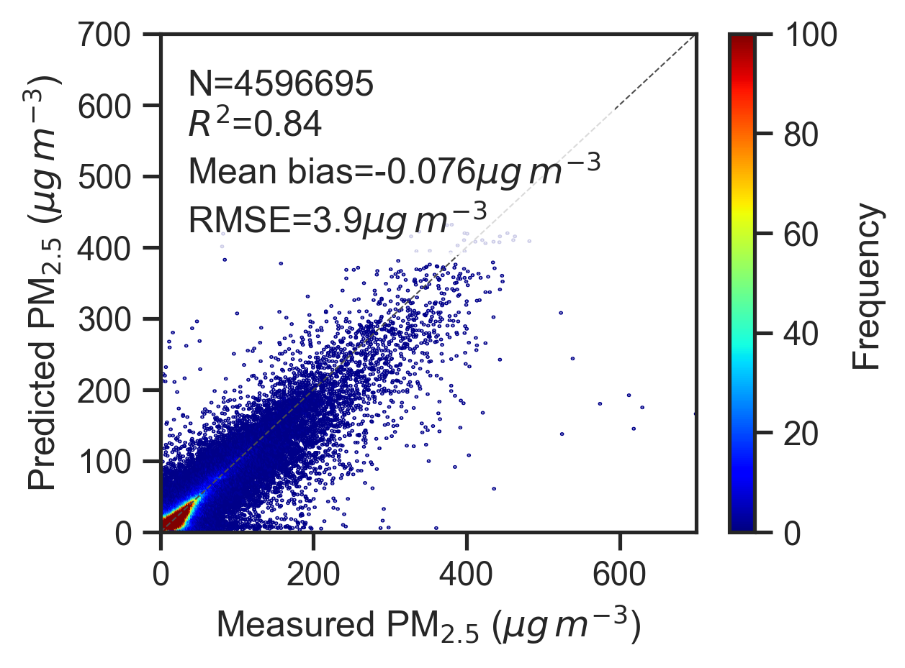
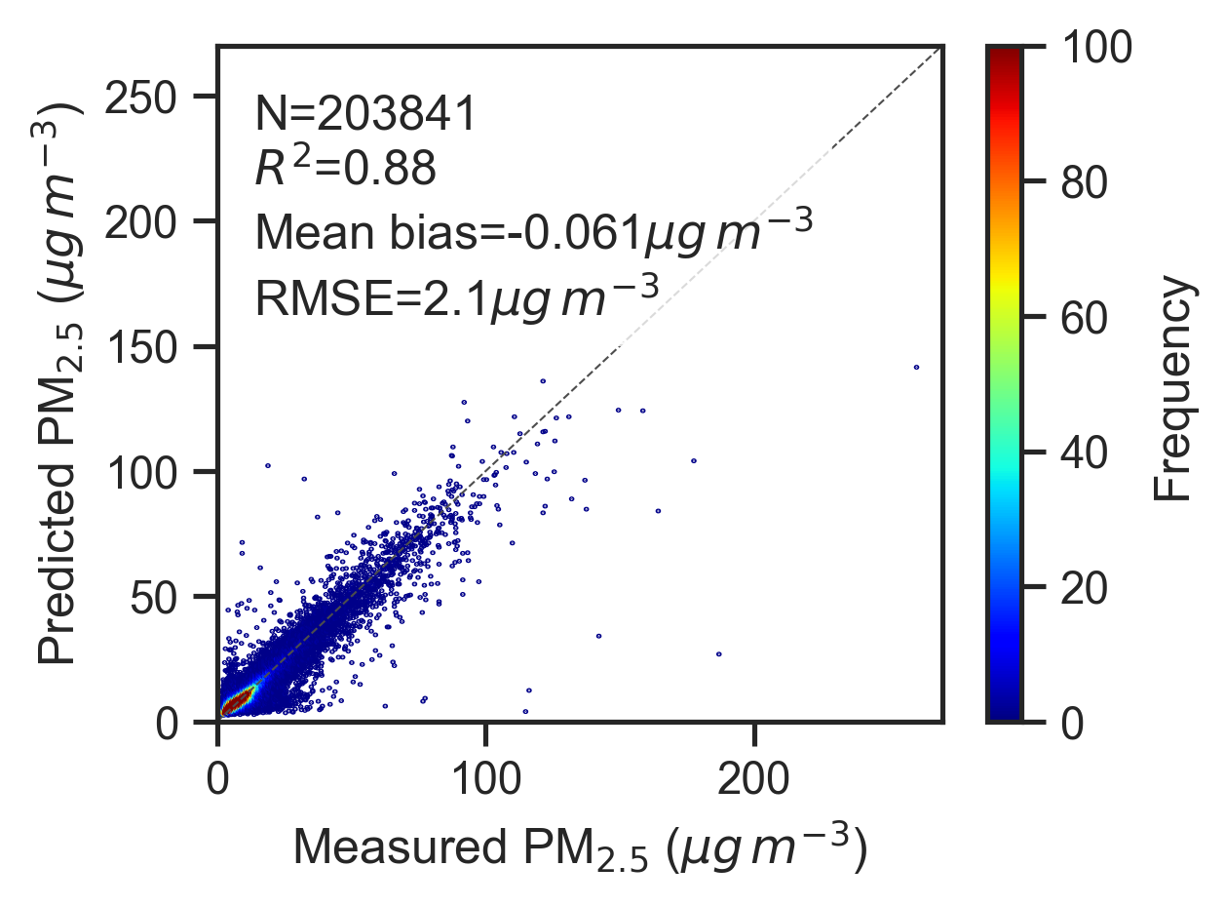
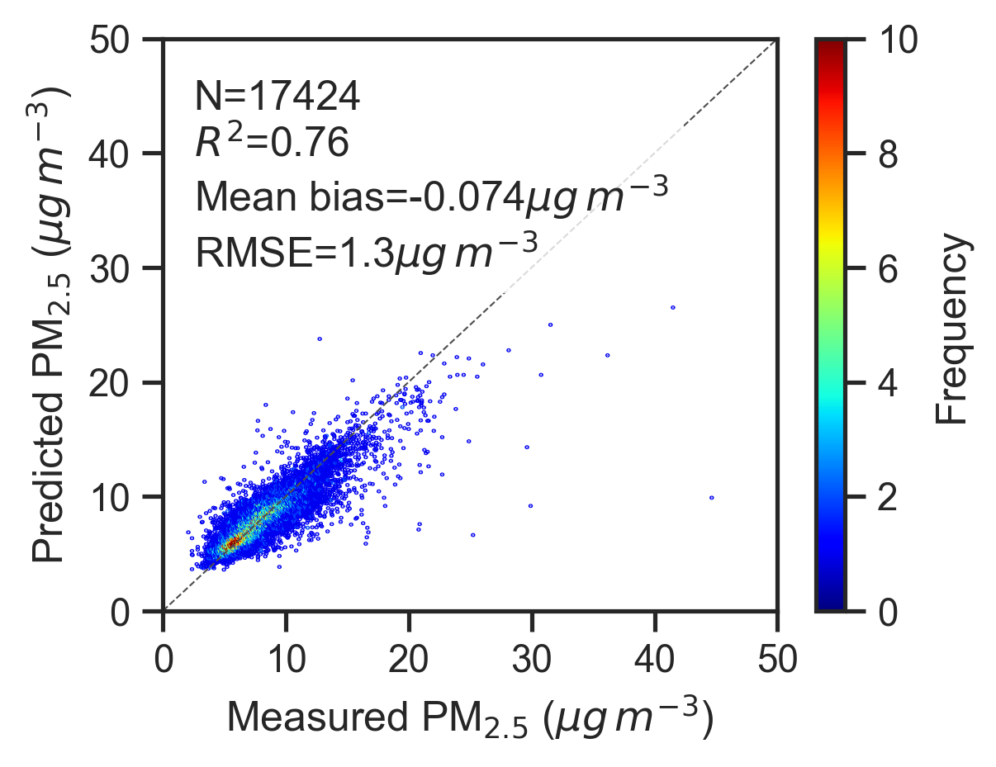
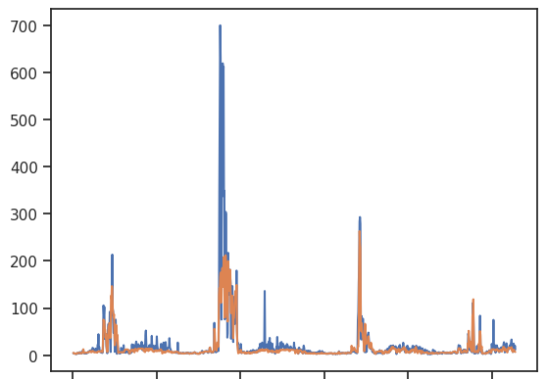
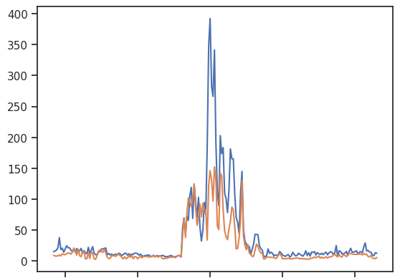
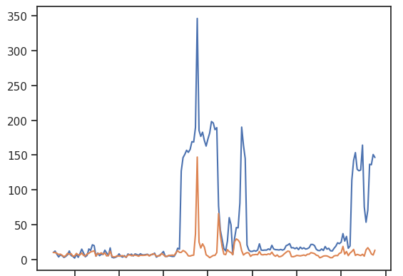
PM_{2.5} prediction
Spatial-based cross-validation
Daily
Monthly
Annual
Compared to AQS / PurpleAir measurements, this ML model provides accurate PM_{2.5} in daily, monthly and annual scale (R² > 0.7, mean bias ~-0.07 μg/m³, RMSE < 4 μg/m³)
PM_{2.5} concentration (μg/m³)
Observation
ML prediction

Slide 12
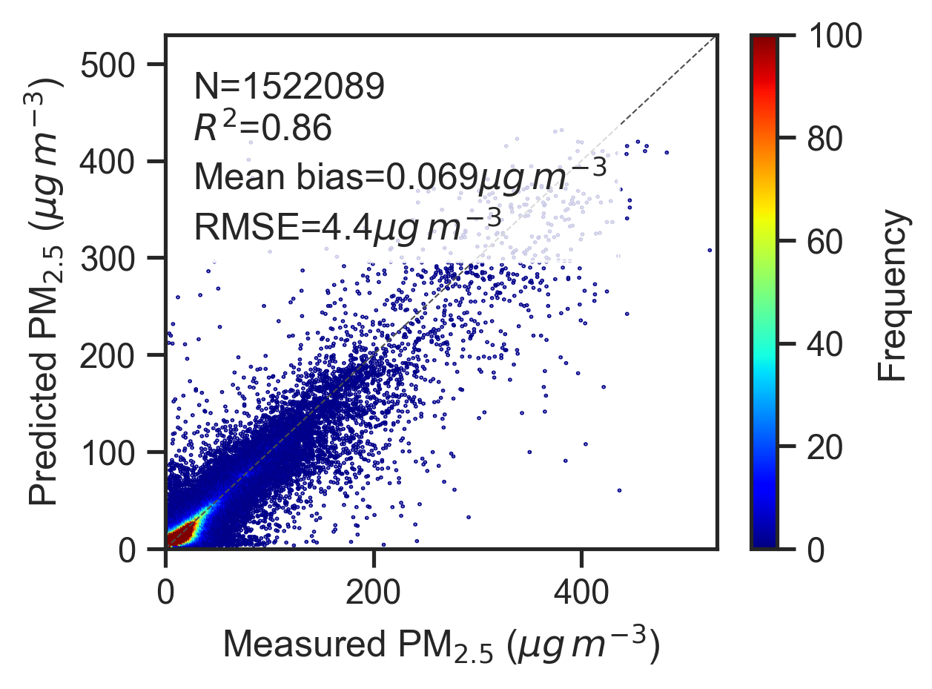
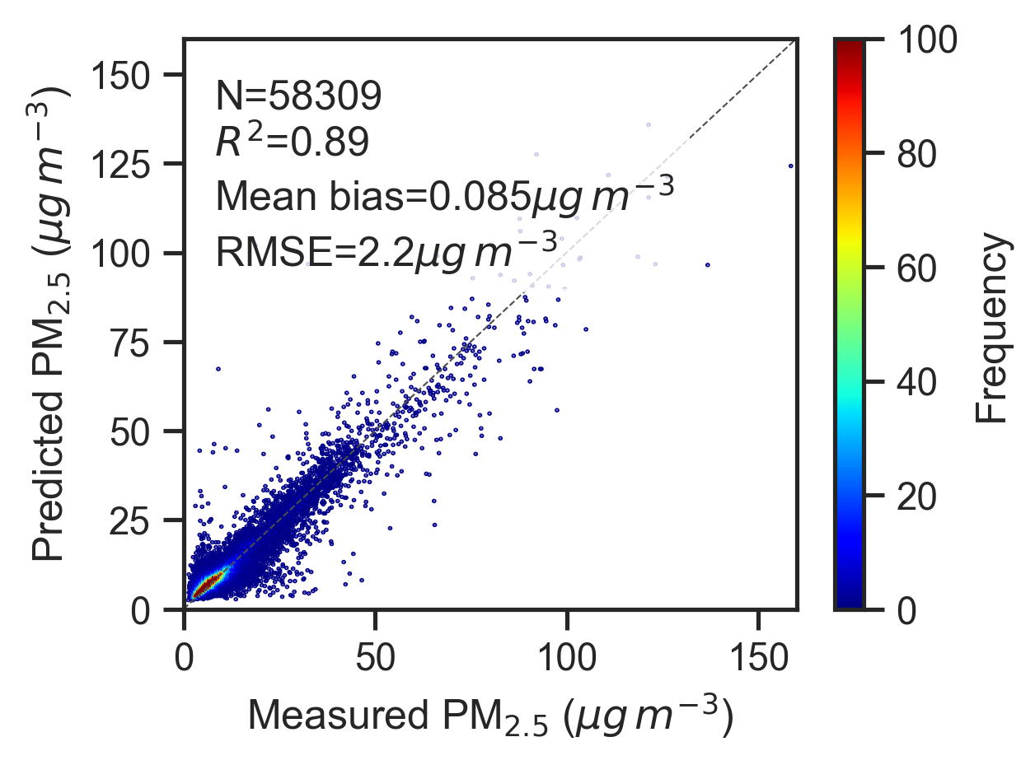
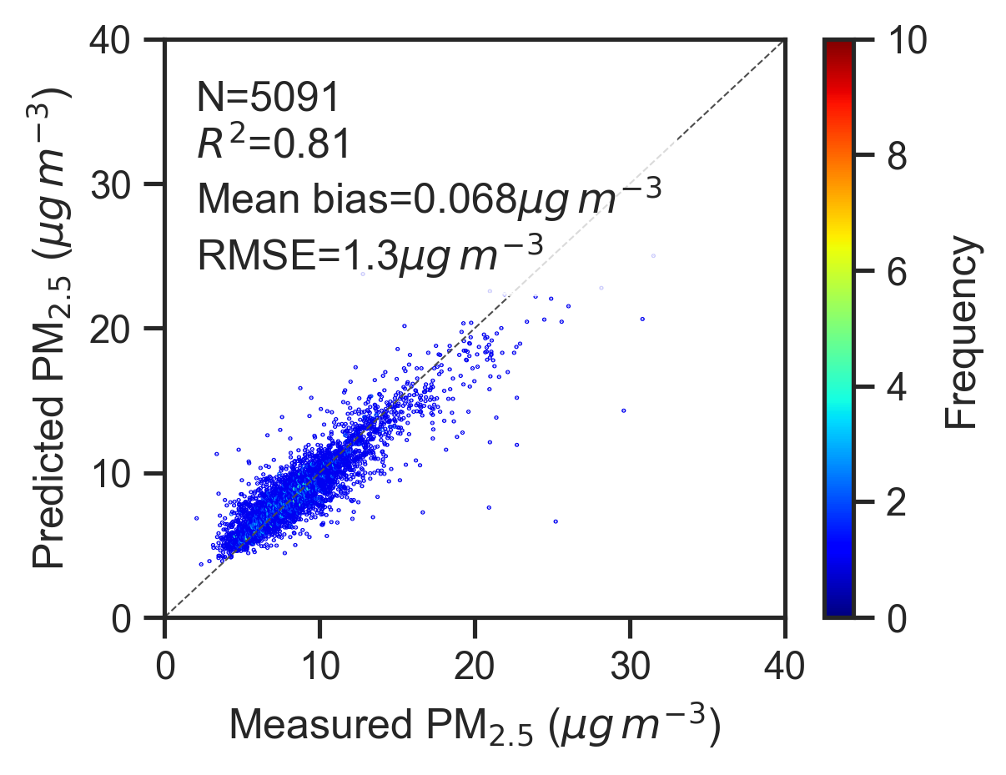
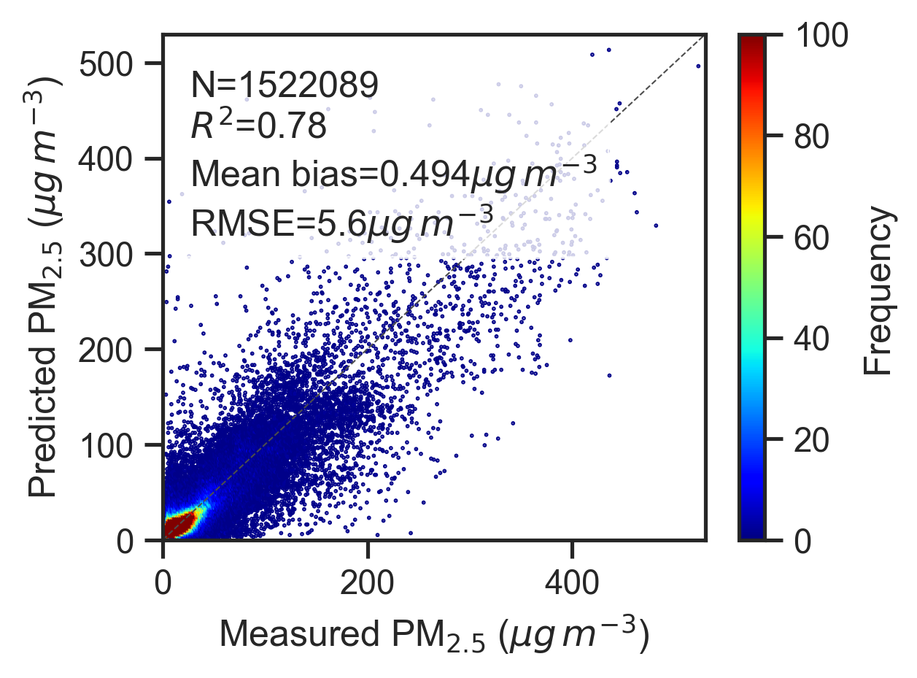
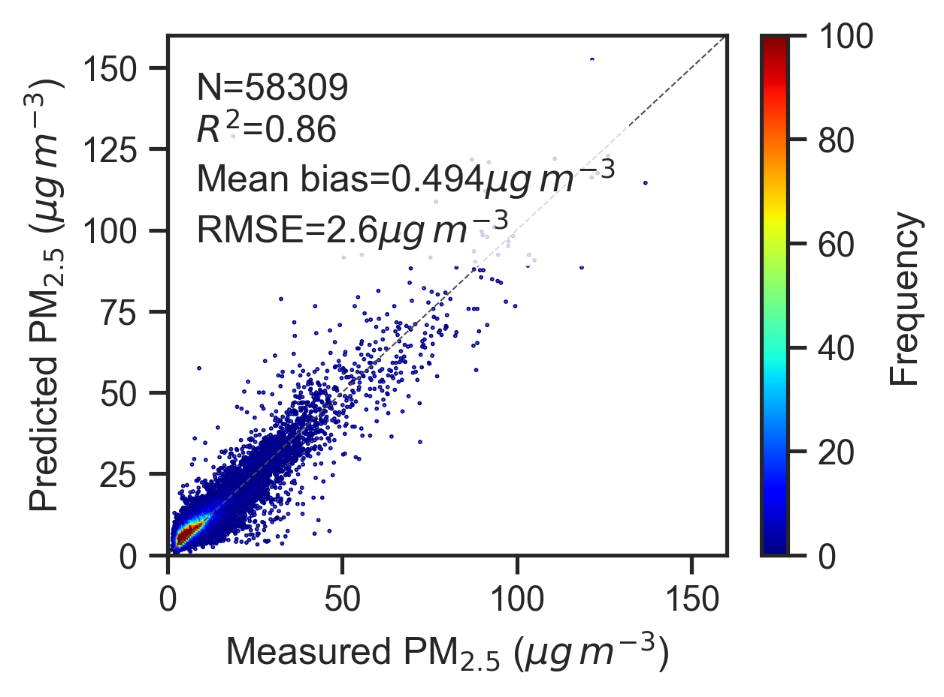

PM_{2.5} prediction
Spatial-based cross-validation
Daily
Monthly
Annual
PM_{2.5} predictions using spatiotemporally weighted deep forest (SWDF, Wei et al., 2023).
Our model outperforms the SWDF deep learning model with higher R² and lower bias and error

Slide 13
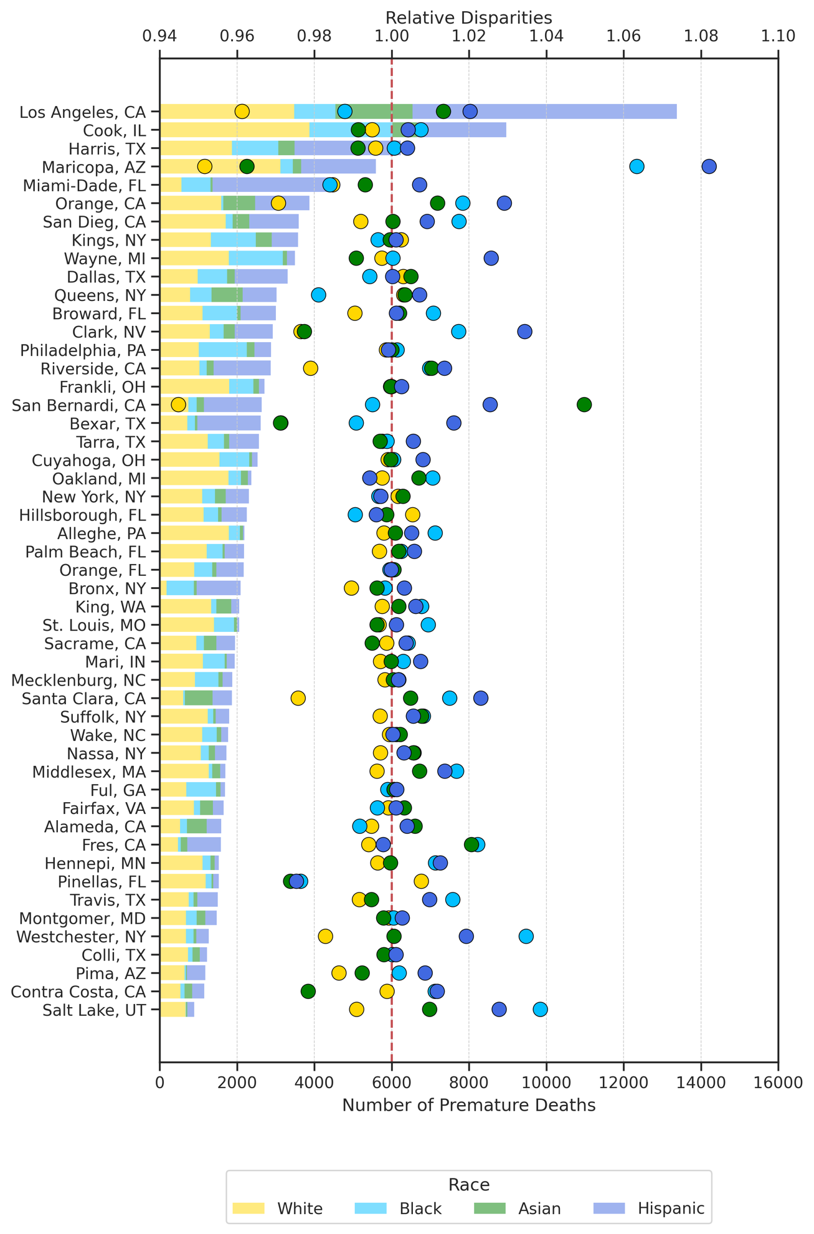
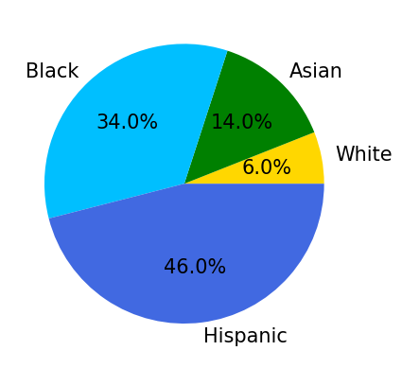

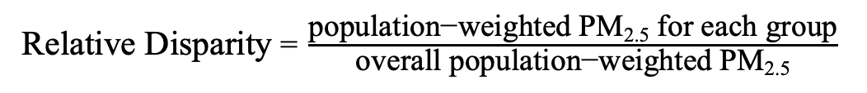
Relative Disparities
Health assessment of 50 most populous counties in the CONUS
1
2
3
4
5
6
7
8
9
10
11
12
13
14
15
# of Premature Death = $P × {BR}_{O}×AF(z)$
P Population
BR_{O} Baseline mortality rate
AF(z) Attribution fraction of a pollutant exposure z
Relative Disparity = $\frac{\text{population}\text{−}\text{weighted} \text{PM}\text{2.5} \text{for} \text{each} \text{group}}{\text{overall} \text{population}\text{−}\text{weighted} \text{PM}\text{2.5}}$
……
35
36
37
38
39
40
41
42
43
44
45
46
47
48
49
50
Distribution of Highest Relative Disparity by Group Across 50 Counties
At only 3 out of 50 counties, the relative disparity of NH-White population is higher than other groups
# of Premature Deaths

Slide 14
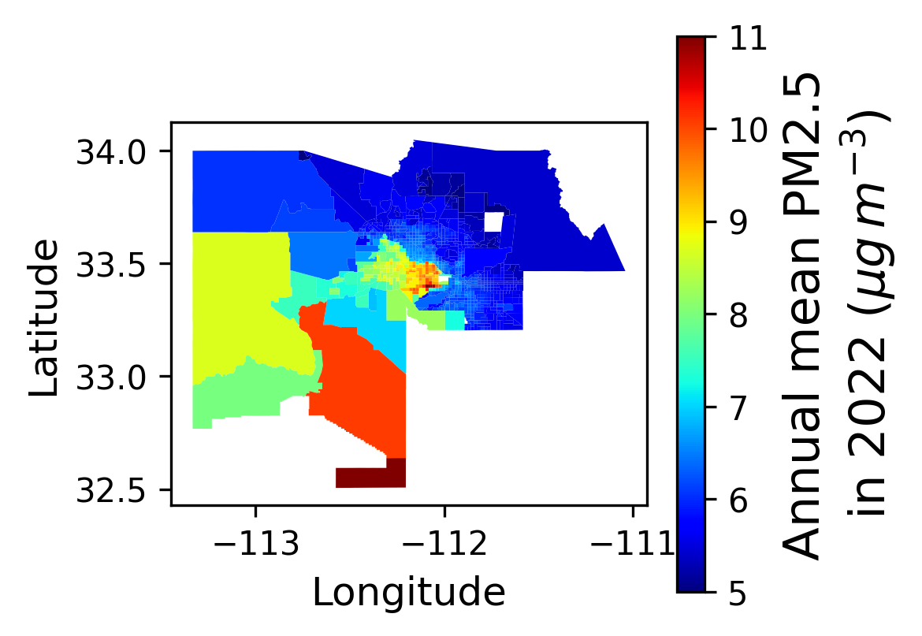
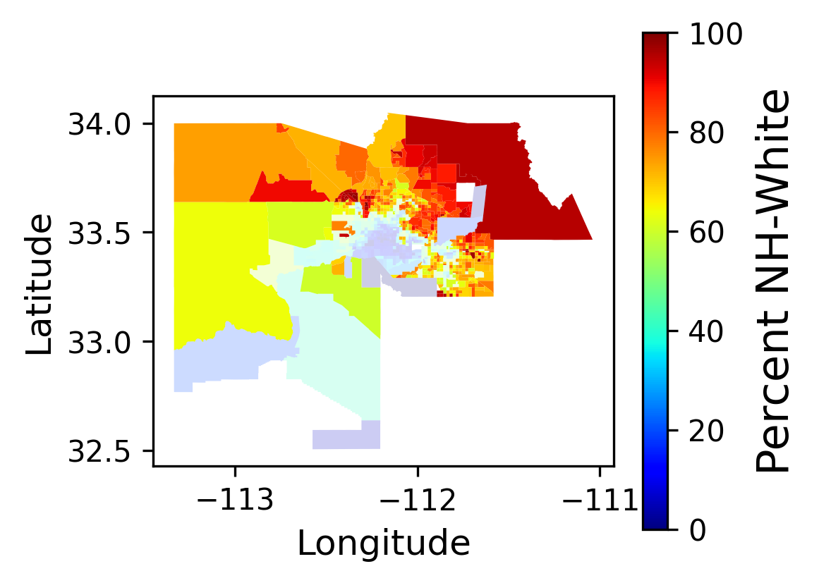
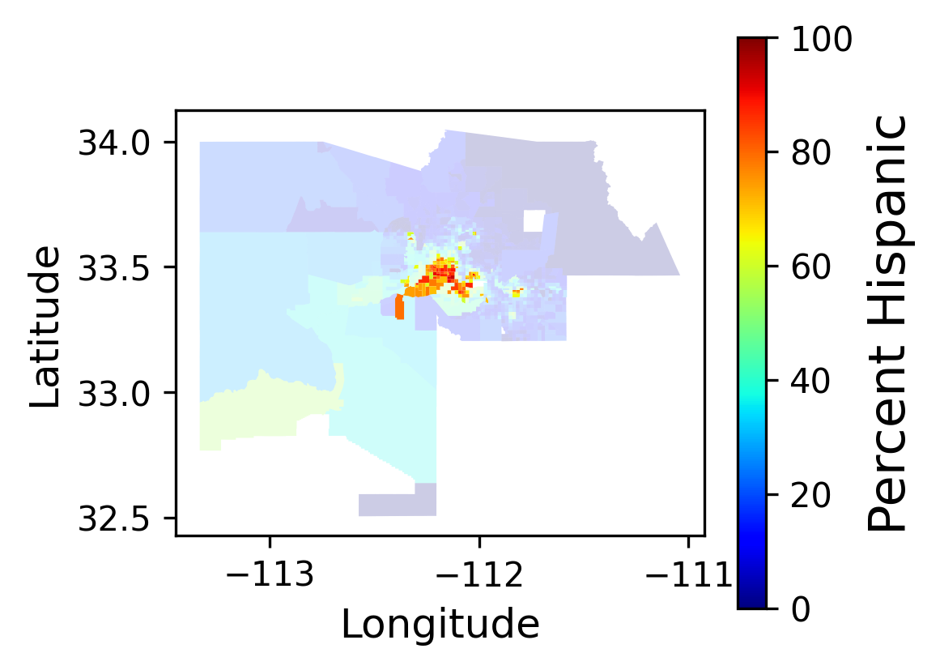
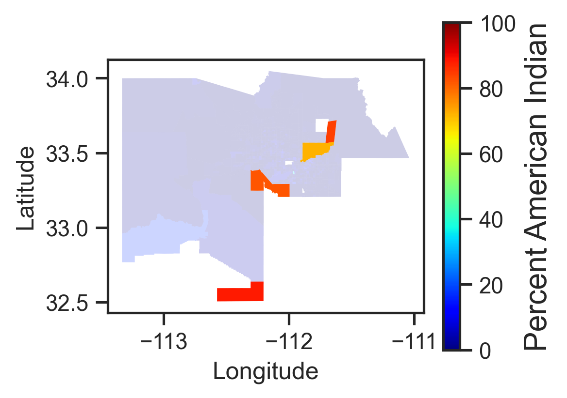
Health assessment of Maricopa County, AZ
The largest difference of relative disparities between NH-White and Hispanic population occurred in 2022
Census-tract-level
Annual mean PM_{2.5} in 2022
Percentage of NH-White
in total population
Percentage of Hispanic
in total population
Percentage of American Indian
in total population
PM_{2.5} levels in downtown Phoenix are higher compared to surrounding areas, where the Hispanic population is the predominant group.
In contrast, PM_{2.5} levels are significantly lower in northern Maricopa County, where the NH-White population predominantly resides.
American Indian are exposed to high PM_{2.5} level in the southern county.

Slide 15
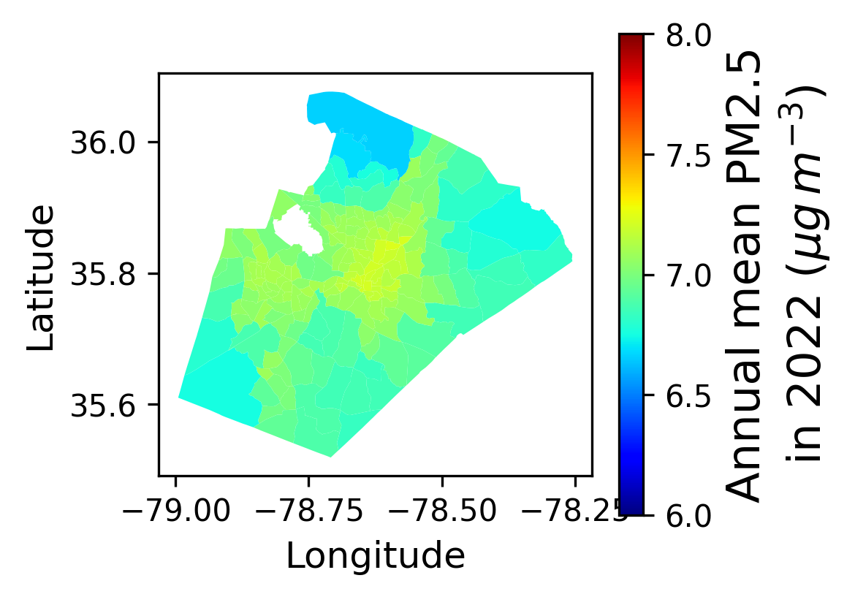
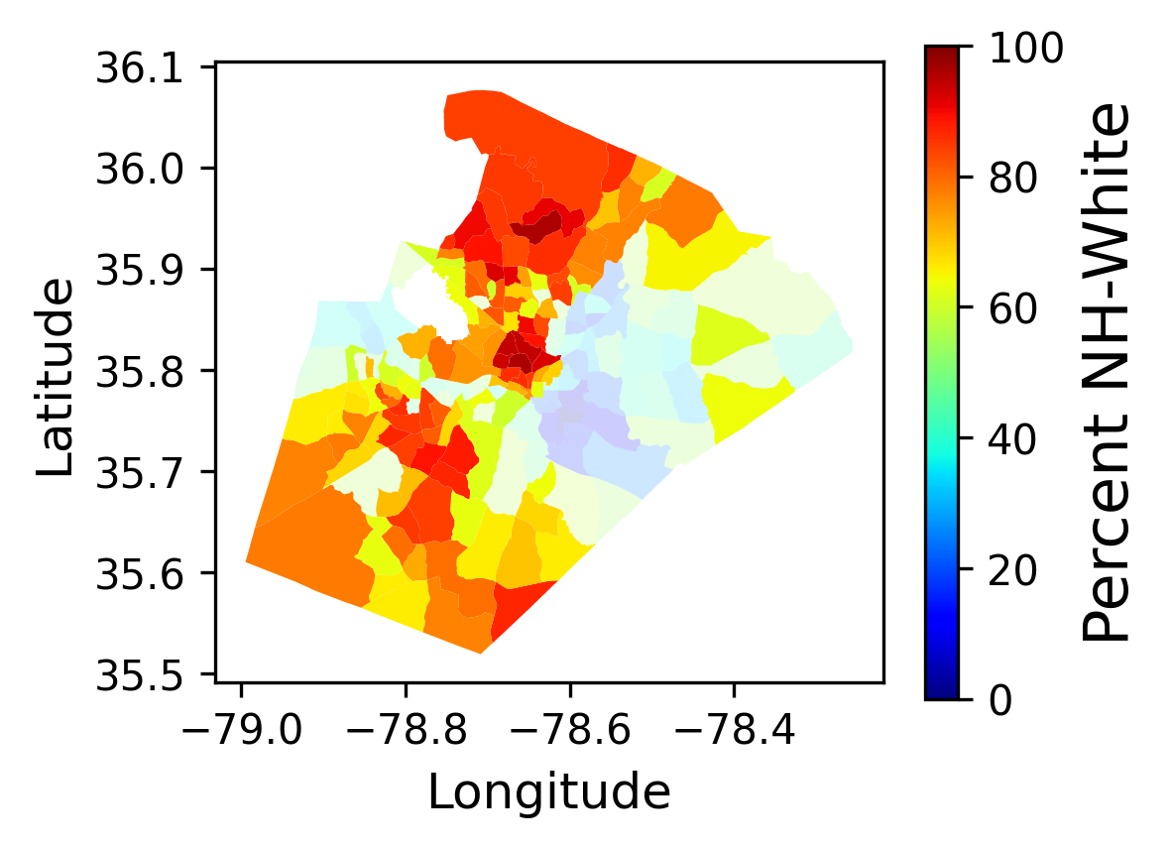
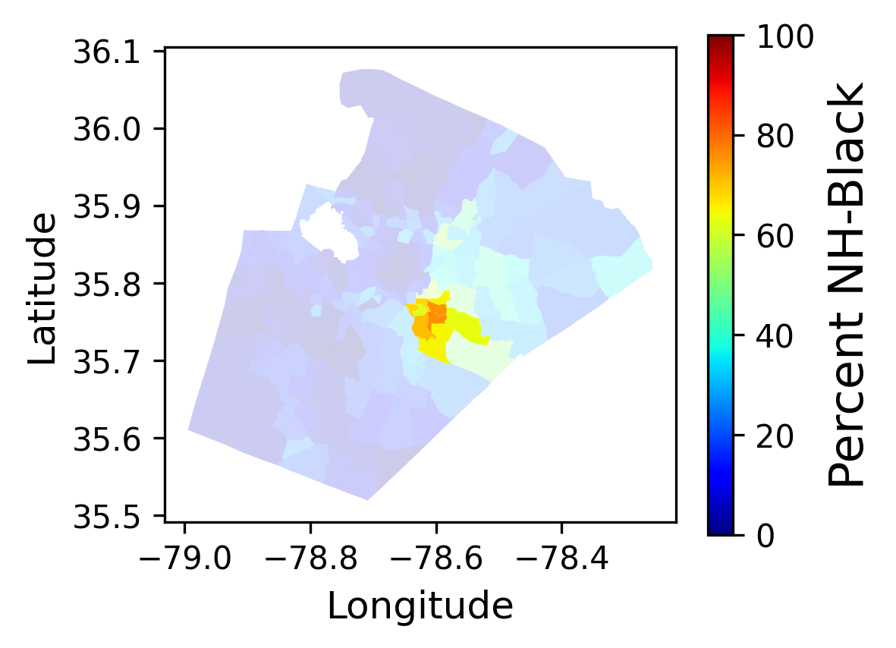
Health assessment of Wake County, NC
Wake County, the most populous county in North Carolina, is one of the counties with the smallest disparities in relative PM_{2.5} exposure across racial groups
Census-tract-level
Annual mean PM_{2.5} in 2022
Percentage of NH-White
in total population
Percentage of NH-Black
in total population
Similar to Maricopa, AZ, more people of color live in downtown Raleigh, while NH-White residents primarily live in the northern and southeastern parts of Wake County
due to relatively low and consistent PM_{2.5} levels (6.6–7.2 μg/m³) across the county, the difference in relative disparity between NH-White and NH-Black residents is minimal, at just 0.0018.
Notes:
Now where we live

Slide 16
Summary
We developed a hybrid machine learning framework to predict PM_{2.5} across CONUS using gap-filled AOD measurements, meteorological reanalysis data, and other publicly accessible predictors. Our model achieved an R² of 0.76 when compared to annual averaged PM_{2.5} ground observations.
The model is computationally efficient, does not depend on CTM outputs, and avoids the associated CTM uncertainties.
We assessed PM_{2.5} exposure from 2019 to 2023 in the 50 most populous U.S. counties. Non-Hispanic (NH) Black and Hispanic populations face higher PM_{2.5} exposure than NH White populations, with relative disparities exceeding the average in 33 and 43 counties, respectively.
Maricopa County has the largest relative disparity between NH White and Hispanic populations due to higher PM_{2.5} levels in downtown Phoenix, where many Hispanic residents live. In contrast, Wake County, NC, demonstrates more balanced PM_{2.5} exposure across racial groups, with lower PM_{2.5} levels.

Slide 17
Thanks
Any questions?

