Slide 1
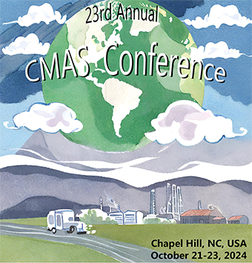


Influence of Chemical Mechanism on Carbonyl and Ozone Formation During Winter
Loknath Dhar*
Department of Chemistry and Biochemistry, Utah State University, Logan, UT, USA
a02391298@usu.edu
Seth Lyman
Director and Research Professor at Utah State University's Bingham Research Center and Department of Chemistry and Biochemistry, UT, USA

Slide 2
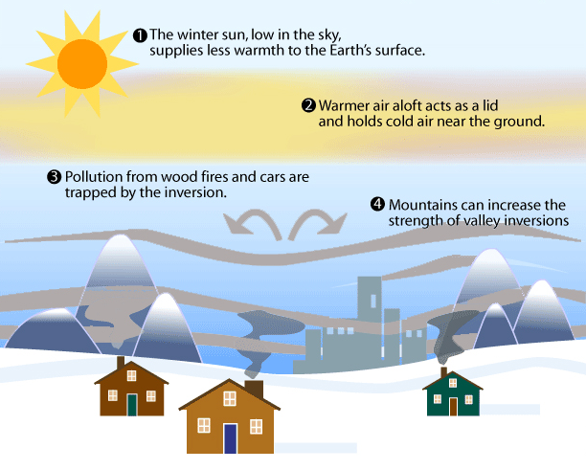
Background
Winter ozone refers to the generation of ozone (O₃) through photochemical reactions of pollutants in the troposphere during the winter months.
Elevated concentration of ozone during winter months become a concern in the places like Uinta Basin, Utah.
Requirements of formation:
Thermal inversions.
Snow cover.
Precursor emissions.
Impacts:
Health issues.
Environmental impacts.
Changing Climates.
Fig: Inversion during winter months.
Lyman, S., & Tran, T., 2015. Inversion structure and winter ozone distribution in the Uintah Basin. Atmos. Environ., 123, 156-165.
Mansfield, M. L., & Hall, C. F., 2013. Statistical analysis of winter ozone events. Air Qual. Atmos. Health, 6, 687-699.
H. Wylie, Feb 16, 2022, Winter Air Quality, Last Viewed: Oct 18th, 2024, (https://airquality.climate.ncsu.edu/2022/02/16/winter-air-quality/)
2

Slide 3
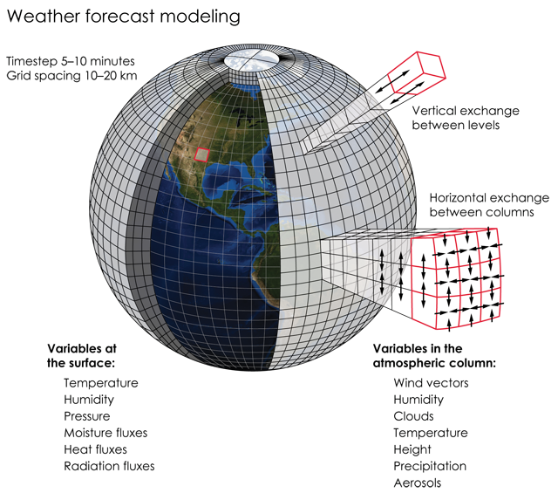
Background
Three-dimensional (3D) photochemical models are struggling to accurately simulate winter ozone events particularly in complex terrains like the Uinta Basin. Key challenges in simulating winter ozone events are as follows:
Meteorological Modeling Issues:
  Inversion Layers.
  Temperature Biases.
  Surface Characteristics.
Chemical Mechanisms & Emissions:
  Inadequate Emission Inventories.
  Chemical Mechanisms.
Fig: Overview of 3D model.
1. Cumulative Summary of Research Relating to Uinta Basin Air Quality (2024), Utah State University, Bingham Research Center. Last Viewed: Oct 18th, 2024
(https://www.usu.edu/binghamresearch/cumulative-research-summary)
2. Last Viewed: May 1, 2023, (https://wxguys.ssec.wisc.edu/wp-content/uploads/2019/03/WeatherModel.png.
3

Slide 4
Background
Insights about Chemical Mechanisms:
The CB6 mechanism performed well for simulating summertime ozone and other pollutants.
However, CAMx with CB6 predicted winter ozone levels 1-3 ppb lower than CB05.
Both CB6 and RACM2 struggled to accurately simulate high wintertime ozone levels in the Uinta Basin, UT.
The SAPRC07 mechanism has been adapted for lower temperatures.
4
1. Cumulative Summary of Research Relating to Uinta Basin Air Quality (2024), Utah State University, Bingham Research Center. Last Viewed: Oct 18th, 2024
(https://www.usu.edu/binghamresearch/cumulative-research-summary)

Slide 5
Objective
Investigate the contribution of different volatile organic compounds to winter ozone formation.
Compare the output of different chemical mechanisms in simulating ozone events.
5

Slide 6
Method
Simulation Period: From February 24-27, 2019.
Model: FOAM (0-D Atmospheric Modeling) box model.
Meteorological Data: Average Hourly meteorological data for the 4-day period.
Chemical Mechanism: A subset of the Master Chemical Mechanism version 3.3.1 (MCMv331), with 3423 species and 10309 reactions, was used as the base mechanism.
Comparison: MCMv331 was compared with lumped mechanisms like RACM2, SAPRC07, and CB6.
1. Saunders, S.M., et al., 2003. Development of the Master Chemical Mechanism v3. Atmos. Chem. Phys., 3, 161−180.
2. Zaveri, R. A., et al., (1999). A new lumped structure photochemical mechanism for large-scale applications. J. Geophys. Res.: Atmospheres, 104(D23), 30387-30415.
6

Slide 7
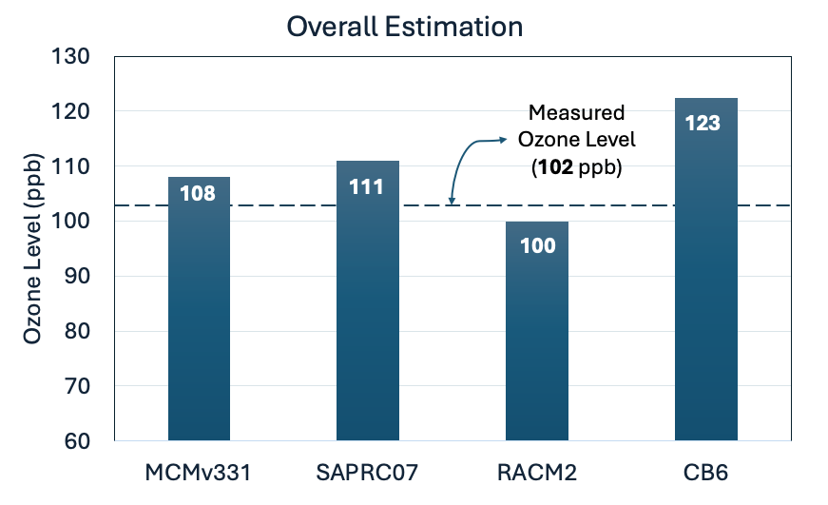
Comparative Analysis of Ozone Production Using Different Chemical Mechanisms.
The measured ozone level was 102 ppb. RACM2 came closest, predicting 100 ppb. MCMv3.3.1 and SAPRC07 gave similar estimates between 108 and 111 ppb, slightly overestimating the measured value. CB6 significantly overestimated, predicting 123 ppb.
7
Fig: Maximum ozone production at day 4th of the simulation period.

Slide 8
Contribution of Carbonyl Compounds to Ozone Production
Baseline Simulation: The F0AM Box model was run initially without any modifications to establish baseline winter ozone production.
Testing Carbonyl Compounds: Mixing ratios of individual carbonyl compounds were set to zero to evaluate their influence on ozone.
Comparison of Scenarios: Ozone production rate was compared between the baseline and modified scenarios on the 4th simulation day.
Quantifying Contributions: The change in ozone levels helped quantify the individual impact of each carbonyl compound on winter ozone production.
8

Slide 9
Contribution of Carbonyl Compounds to Ozone Production
Formaldehyde was found to be the most important carbonyl for ozone production, followed by acetaldehyde in the MCMv331, RACM2, and SAPRC07 mechanisms. Only the CB6 mechanism showed ketones as the main carbonyl contributor to ozone formation. In MCMv331 and SAPRC07, Benzaldehyde had a negative impact on ozone production.
Mostly Carbon Ketone Bond.
9
Fig: Impact of Different Carbonyl Compounds on Ozone Production.

Slide 10
Sensitivity of Primary Emitted Organics to Carbonyls.
Baseline Carbonyls: The model was first run without modifications to establish the baseline.
Average Concentration: The average concentration of carbonyls were determined between 1-5 pm (ppb).
Variation of Organics: The initial mixing ratios of alkanes, alkenes, alkynes, alcohols, and aromatics were varied by increasing them by 50%.
Impact on Carbonyls: The percent changes in average concentration of carbonyl’s were observed after modification to quantify the impact of each organic group on carbonyl compounds.
10

Slide 11
Sensitivity of Primary Emitted Organics to Formaldehyde.
MCMv331, SAPRC07, and RACM2 showed similar chemistry for formaldehyde formation. CB6 showed negative contribution from alkanes.
Fig: Percent Changes in Average Formaldehyde Concentration from 1 - 5 PM.
11

Slide 12
Sensitivity of Primary Emitted Organics to Acetaldehyde.
Alkanes showed the highest sensitivity in the percent change of acetaldehyde's mixing ratio.
Fig: Percent Changes in Average Acetaldehyde Concentration from 1 - 5 PM.
12

Slide 13
Sensitivity of Primary Emitted Organics to Ozone
Baseline Ozone: The model was first run without modifications to establish the baseline ozone production rate.
Ozone Production Rate: The average ozone production rate was measured between 9am – 4pm (ppb/hr).
Variation of Organics: The initial mixing ratios of alkanes, alkenes, alkynes, alcohols, and aromatics were varied by increasing and decreasing them by 50%.
Impact on Ozone: The changes in ozone production rates were observed to quantify the impact of each organic group on winter ozone production.
13

Slide 14
Sensitivity of Primary Emitted Organics to Ozone
Change in Ozone Production Rate (ppb/hr)
MCMv331 and SAPRC07: Alkanes were the main contributors, with aromatics as the second. RACM2: Alkanes and aromatics contributed almost equally. CB6: Alkanes were the main contributor, followed by alkenes and alkynes.
14

Slide 15
Conclusion
RACM2 with F0AM Box model predicted ozone level closest to measured value.
Formaldehyde was found to be the most important carbonyl for ozone production, followed by acetaldehyde.
Alkanes were the primary contributors of ozone production along with aromatics as the second according to MCMv331 and SAPRC07.
15

Slide 16
Future Work
Comparing the outputs of MCMv331, SAPRC07, RACM2, and CB6 with CMAQ to observe the differences in how organics impact carbonyls and ultimately ozone levels.
16

Slide 17
Thank You...

Slide 18
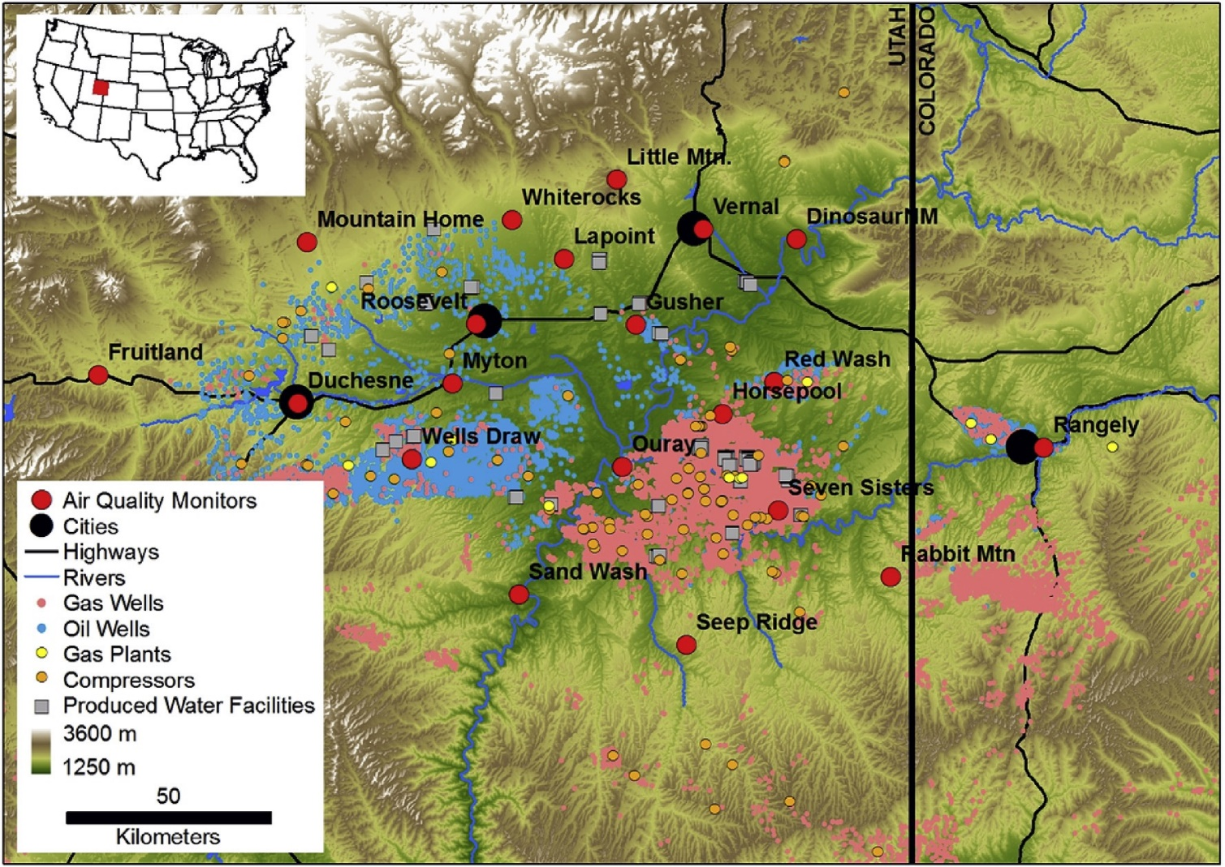
Emission Sites in Uinta Basin
Fig. 1: Map of ozone measurement sites and oil and gas facilities around the Uintah Basin, Utah, U.S.A. during winter 2012–13.
S. Lyman, T. Tran, 2015, Atmospheric Environment 123, 156-165
18

Slide 19
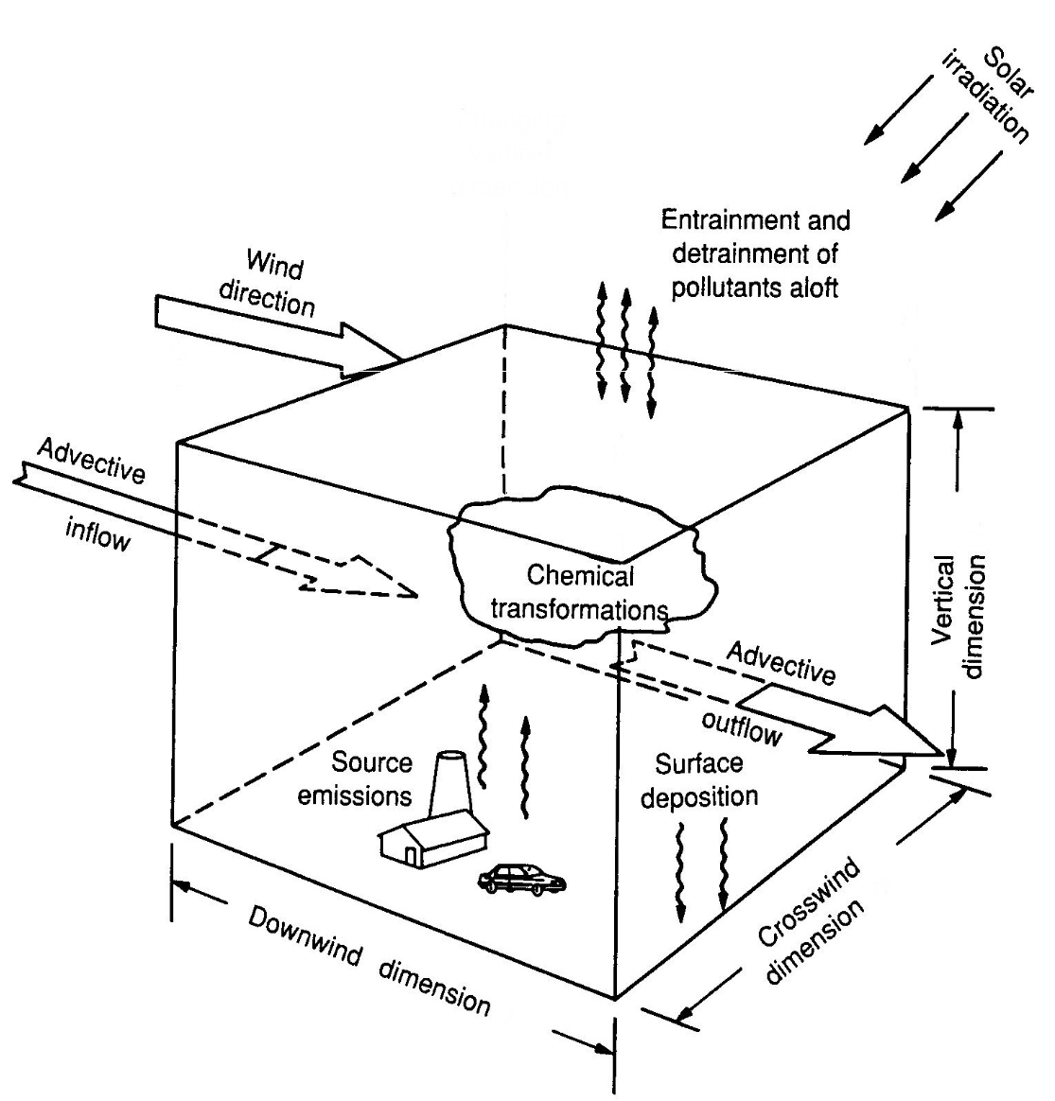
F0AM Box Model
Simplicity and Efficiency: Focuses on a single atmospheric box to reduce complexity while capturing essential chemical processes.
Controlled Meteorological Conditions: Simplifies comparison of outputs and performances of various chemical mechanisms.
Scenario Testing: Allows adjustment of input parameters like precursor emission rates to study atmospheric chemistry impacts.
Validation and Calibration: Enables validation against observed data to improve the accuracy of chemical mechanisms.
Box (0-D) Model
19
1. Wolfe, G.M., et al., 2016. The Framework for 0-D Atmospheric Modeling (F0AM) v3.1. Geosci. Model Dev., 9(9), 3309-3319.

Slide 20
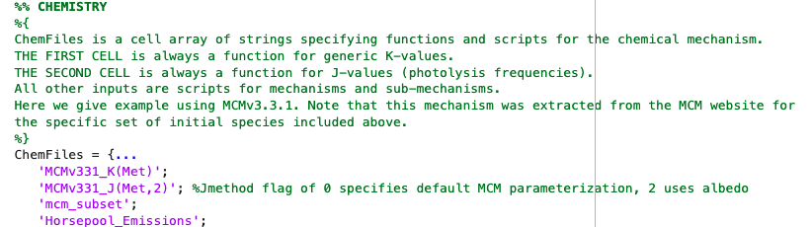
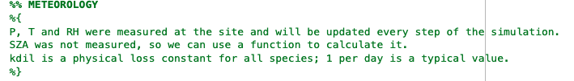
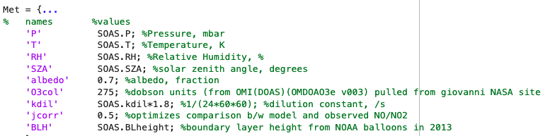
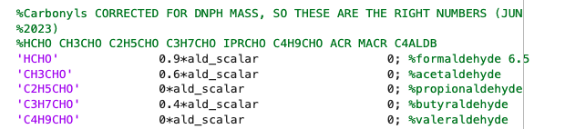
FOAM BOX Model
Box (0-D) Model
20

Slide 21
Findings
Source of Carbonyls:
Emission factors were zero or nearly zero after optimization, which indicates carbonyl compounds were mostly secondary pollutants, created in the atmosphere from photochemistry.
Carbonyl Species | Initial Conc. (ppb) | Emission Factor | Max Conc. (ppb) at day four.
Formaldehyde | 0.9 | 0.000 | 1.356
Acetaldehyde | 0.6 | 0.000 | 2.228
Propionaldehyde | 0.0 | 0.000 | 0.548
Butyraldehyde | 0.4 | 0.210 | 0.521
Valeraldehyde | 0.0 | 0.000 | 0.004
Acrolein | 0.4 | 0.167 | 0.555
Methacrolein | 0.2 | 0.236 | 0.351
Crotonaldehyde | 0.0 | 0.000 | 0.000
Benzaldehyde | 1.6 | 0.139 | 1.832
Acetone | 0.7 | 0.000 | 4.649
Methyl ethyl ketone | 0.2 | 0.000 | 1.556
Cyclohexanone | 0.0 | 0.000 | 0.293
21

Slide 22
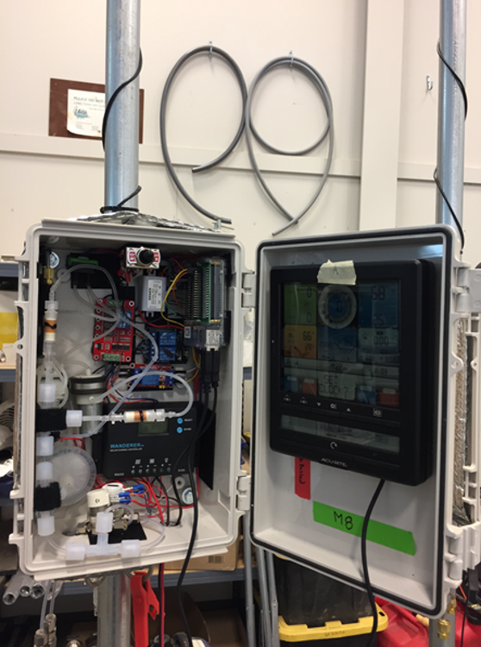
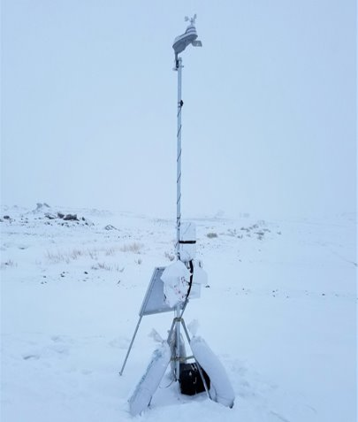
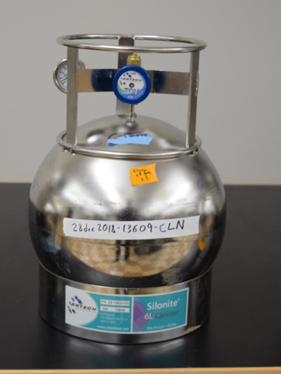
DNPH cartridge collecting carbonyls.
Sample Collection Method:
Collection of silonite-coated canister samples for C2-C10 hydrocarbons and light alcohols.
Collection of DNPH cartridges for carbonyls.
Samples were analyzed to identify 73 separate organic compounds.
Air samples collected over 6hr periods in the day or night.
Stations are equipped with standard meteorological instrumentation.
Each station is controlled by a Rasbery Pi with software.
Met station
Control Box
Rasbery Pi
Solar panel
Ambient Air Canisters
Battery box
22

Slide 23
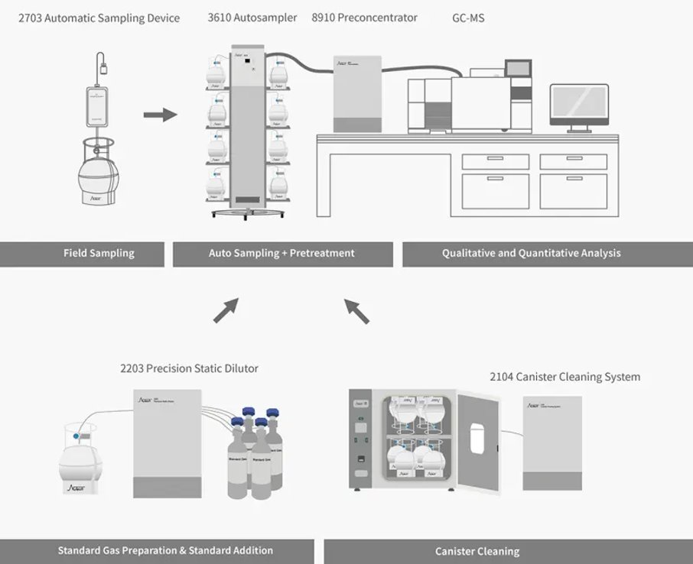
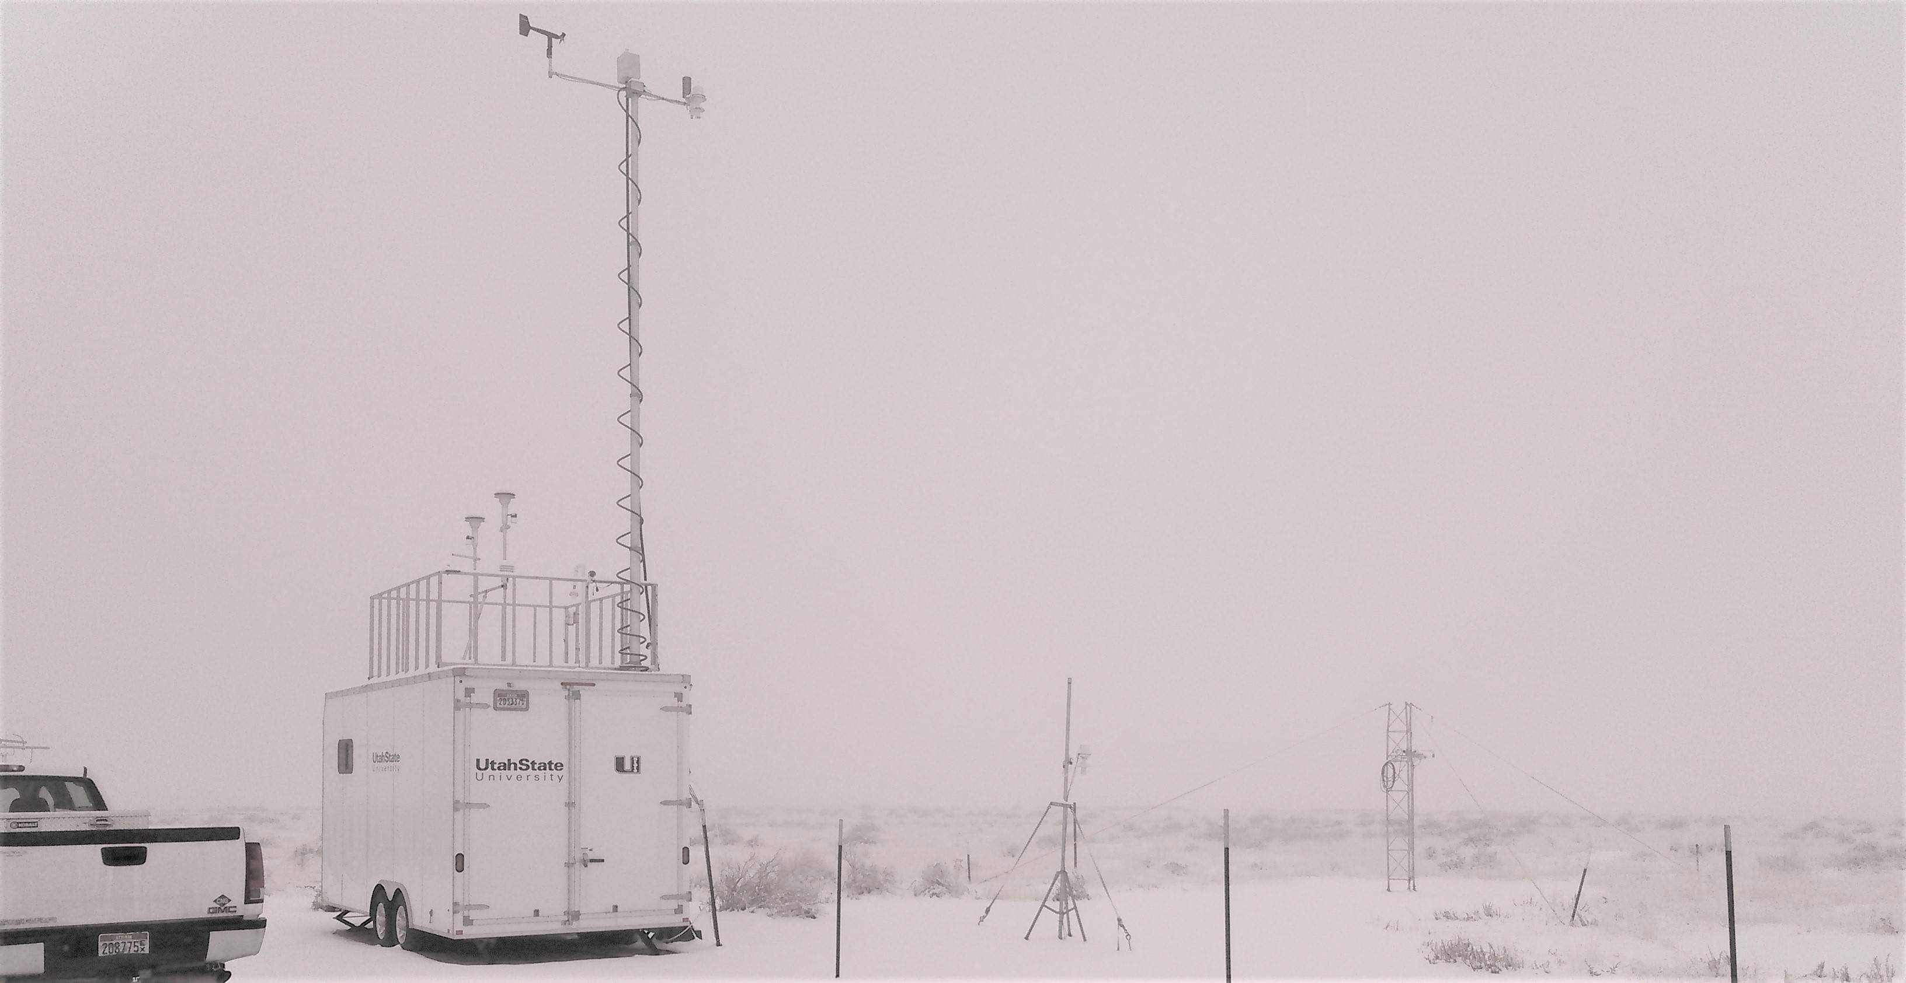
Sample Analysis
Whole-air canisters analyzed for C2-C10 hydrocarbons and light alcohols by GC-FID/GC-MS.
DNPH cartridges analyzed for carbonyls by HPLC-UV detection.
Horsepool site in winter
23

Slide 24
Boundary-layer height, which showed a growth in mixing height from 5–25 m during the night to 130– 160 m between 12:00 and 16:00 local time.
F0AM: Framework for 0-D Atmospheric Modeling.
MCMv331: Master Chemical Mechanism V.3.3.1.
RACM2: Regional atmospheric chemistry mechanism V.2.
SAPRC07: Statewide Air Pollution Research Center chemical mechanism V.07.
CB6: Carbon Bond V.6.

