Slide 1
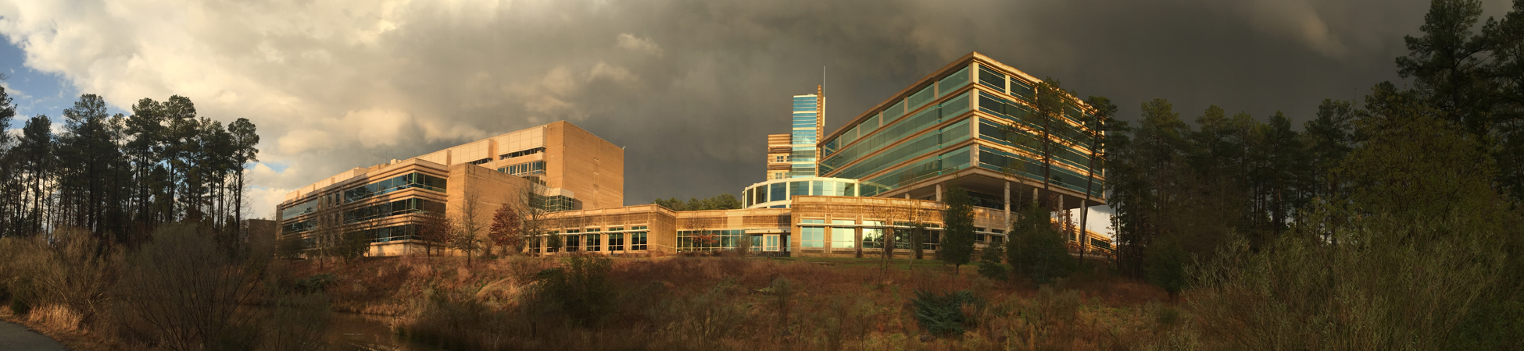
The views expressed in this presentation are those of the authors
and do not necessarily reflect the views or policies of the U.S. EPA.
Development of Year 2022 Emissions for the 2022v1 Emissions Modeling Platform
Karl Seltzer,¹ Zac Adelman,² Michael Aldridge,¹ Christine Allen,³ James Beidler,¹ Andrew Bollman,⁴ Art Diem,¹ Yijia Dietrich,¹ Lindsay Dayton,¹ Alison Eyth,¹ Caroline Farkas,¹ Janice Godfrey,¹ Mark Janssen,² Byeong Kim,⁵ Tom Moore,⁶ Rhonda Payne,⁷ Matt Roark,³ Sarah Roberts,¹ Tom Richardson,⁸ Kevin Talgo,³ Mary Uhl,⁷ Jeff Vukovich¹
¹US EPA, ²LADCO, ³GDIT, ⁴NC DEQ, ⁵GA DNR, ⁶Denver/NFR RAQC, ⁷WESTAR, ⁸OK DEQ
United States Environmental Protection Agency
Office of Air and Radiation
October 23, 2024
Presentation to: CMAS Conference

Slide 2
The 2022 Emissions Modeling Platform
  Platform based on the year 2022 with analytic years of 2026, 2032, and 2038.
  Developed in collaboration with states / MJOs to help them meet their Clean Air Act requirements:
    Used by states to develop ozone NAAQS SIPs (2026, 2032)
    Likely modeling to support PM NAAQS implementation (2032)
    Support for studies that need a year later than 2032 (2038)
  EPA will use the platform to support various needs (e.g., PM designations, AirToxScreen).
  Why 2022?
    Concern about the 2020 NEI being non-representative due to COVID impacts.
    The 2023 NEI will not be ready until 2026 (does not meet timing for upcoming modeling needs).
    Summer of 2022 had more ozone-conducive meteorology across the US and fewer acres burned from wildfires, compared to 2020 and 2021.

Slide 3
Collaborative Structure
  Collaborative Co-leads:
    Zac Adelman (LADCO), Mary Uhl (WESTAR), and Alison Eyth (EPA OAQPS)
  Communication support:
    Tom Richardson (OK DEQ), Tom Moore (Denver/NFR RAQC), Rhonda Payne (WESTAR)
  Coordination Committee:
    28 members from MJOs, state agencies, and US EPA staff from OAQPS, OTAQ, and OAP.
    Monthly calls and deliver quarterly outreach webinars.
  Workgroups:
    Existing: National O&G Emissions Committee, Electric Generating Unit workgroup, MJO MOVES workgroup, MARAMA Commercial Marine Vessel workgroup, Residential Wood Heating Task Force.
    Created 2022-specific workgroups for fires, emissions projections, and auxiliary modeling files.

Slide 4
2022v1 Development Timeline
Initiate workgroups
Q4 2023
Q3 2024
Q3 2023
Q1 2024
April 2024
Q4 2024
Kickoff project
Review 2020 NEI data
Review submitted
data
Finalize base year emissions and prepare for AQ modeling
Begin air quality modeling of 2022 base year
Develop year 2022
base year emissions
30-day SLT review of
base year emissions
Q2 2024
Finalize and release
analytic year inventories
SLTs submit point source emissions and activity data
Meteorological modeling
Develop boundary conditions
Complete draft
analytic year inventories
Draft technical support documentation
Perform AQM sensitivity runs
October 2024
30-day SLT review of 2022v1 analytic year inventories
  We’re here
  Note: There will be two versions of the 2022 EMP → 2022v1 and 2022v2.

Slide 5
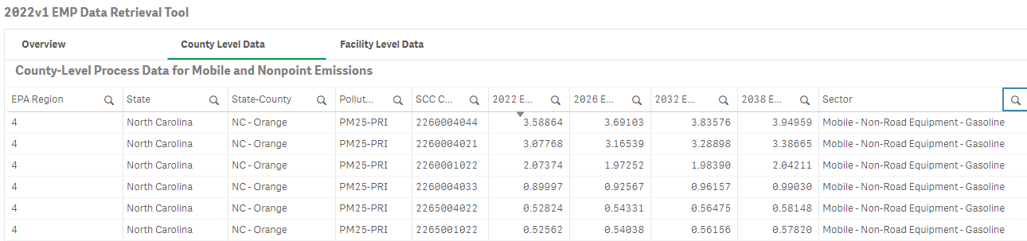
Accessing the Data
  2022v1 EMP Data Retrieval Tool
    All data are available at the County-/SCC-level in the “County Level Data” tab.
    All point data are available at the facility-level in the “Facility Data” tab.
  Base Year
  Analytic Years

Slide 6
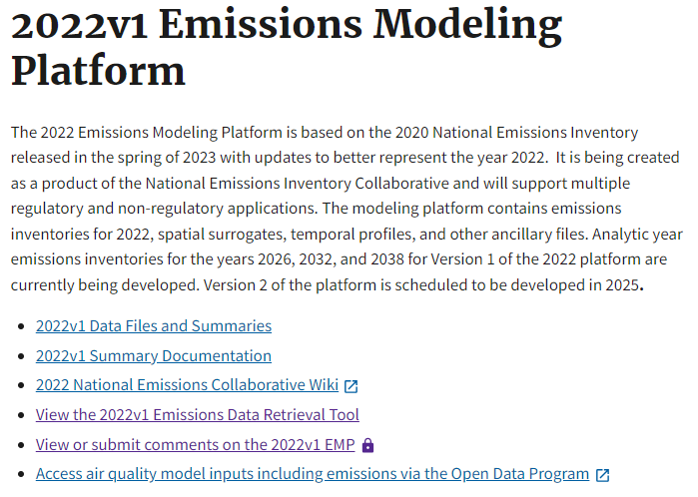
Accessing the Data
  EPA’s 2022v1 Emissions Modeling Platform website (click on “2022v1 Data Files and Summaries”).

Slide 7
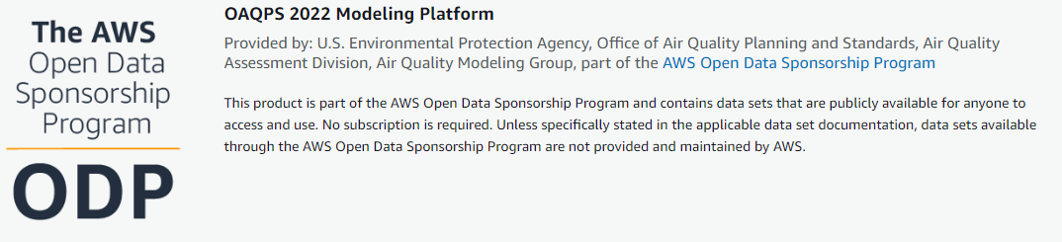

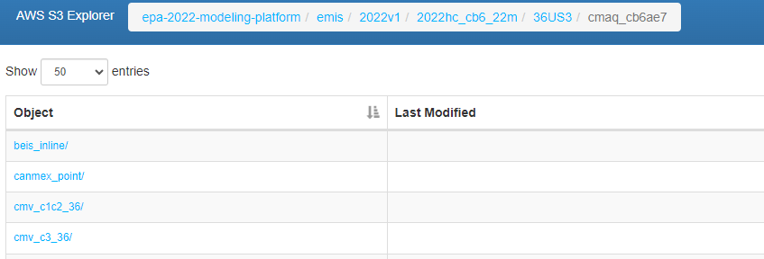
Accessing the Data
  Scroll down, click here
  Amazon Web Services; can be downloaded or used in cloud computing (click on “Browse Bucket”).

Slide 8
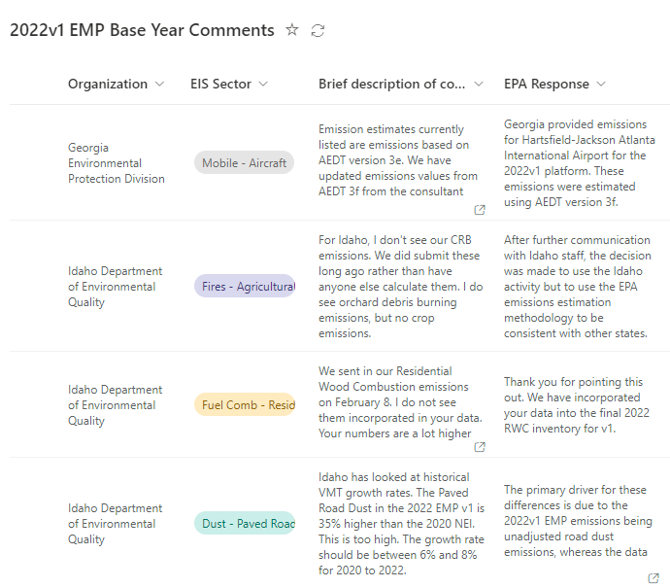
Base Year Data Review
  The Data Retrieval Tool enables the complete inventory to be easily filtered and downloaded.
  Stakeholders could then submit comments using a SharePoint form.
    Enabled a transparent review process, saved time, and helped EPA quickly triage comments.
    127 comments from 29 different organizations were submitted.
    Responses to individual comments were provided.
  Workgroup to review ancillary data:
    Comments provided to update speciation profiles, spatial surrogates, and temporal profiles.

Slide 9
Overview of Base Year Development
  Point sources:
    2022-specific and developed based on S/L/T-submitted and EPA data.
  Mobile sources:
    2022-specific for onroad, nonroad, commercial marine vessels, airports, and locomotives.
    23 S/L agencies provided Vehicle Miles Traveled (VMT) data for onroad mobile sources.
  Fires:
    2022-specific for wild and prescribed fires.
    29 S/L/T agencies provided fire activity data; Coordinated with EPA/ORD to develop grassland fire, agricultural fire and pile burn emissions.
  Nonpoint sectors:
    2022-specific for oil and gas emissions and livestock emissions; 2021-specific for solvents.
    Otherwise, 2022 nonpoint emissions are based on 2020 NEI emissions with projections.

Slide 10
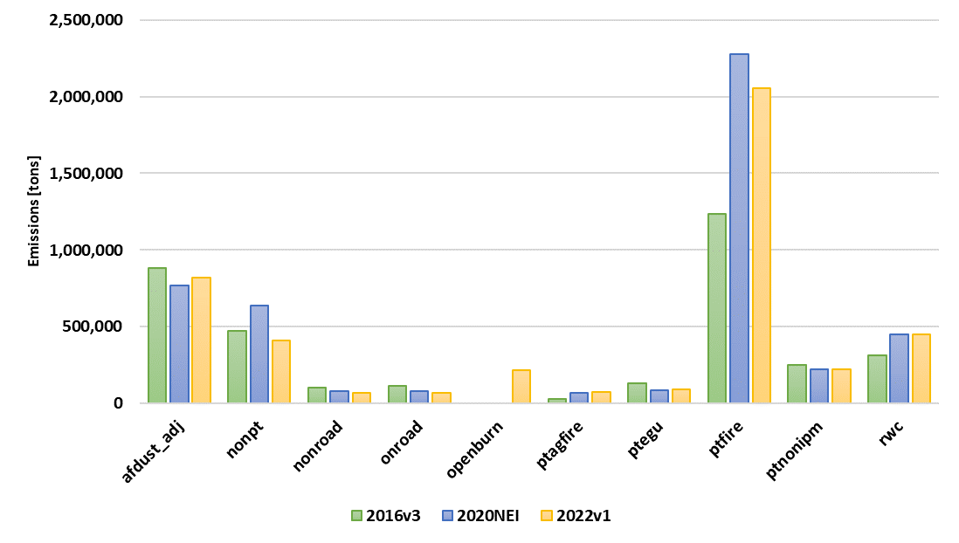
Emissions – PM_{2.5}
2016v3 | 2020 NEI EMP | 2022v1
3,614,644 | 4,727,536 | 4,329,687
  Ptfire (wild + Rx)
    2020 was a high activity year.
    2022 includes significant EF updates.
  RWC
    Notable changes in 2020 NEI; mainly related to wood consumption; see TSD.
  Openburn
    New emissions sector for 2022v1; previously in nonpt.

Slide 11
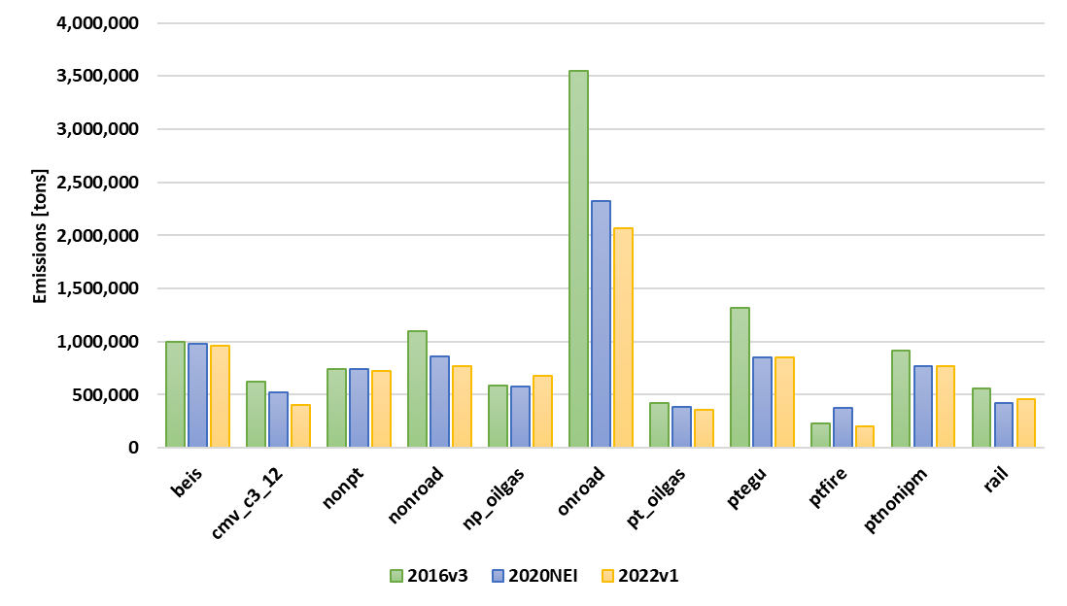
Emissions – NO_{x}
2016v3 | 2020 NEI EMP | 2022v1
11,420,192 | 9,104,891 | 8,608,798
  Onroad
    Decreases due to fleet turnover.
  All others
    Generally steady decreases (e.g., ptnonipm) or consistent (e.g., biogenics).
Notes:
MOVES3 was used for 2016v3 and 2020 NEI. MOVES4 was used for 2022v1.

Slide 12
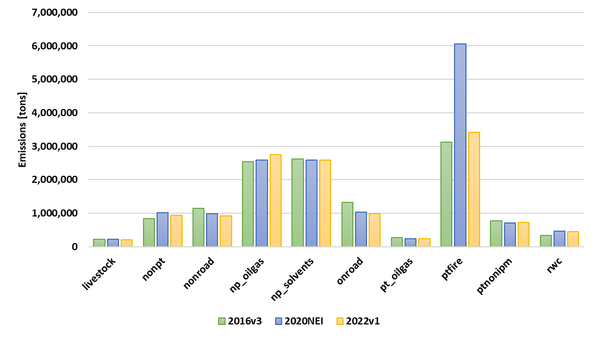
Emissions – VOC
2016v3 | 2020 NEI EMP | 2022v1
13,338,810 | 16,107,975 | 13,485,024
31,014,251 | 28,254,267 | 30,694,065
  Minus biogenics
  Biogenics
  Ptfire
    2020 was a high activity year.
  Onroad
    Again, decreases due to fleet turnover.
  All others
    Generally consistent (e.g., np_solvents).
Notes:
MOVES3 was used for 2016v3 and 2020 NEI. MOVES4 was used for 2022v1.

Slide 13
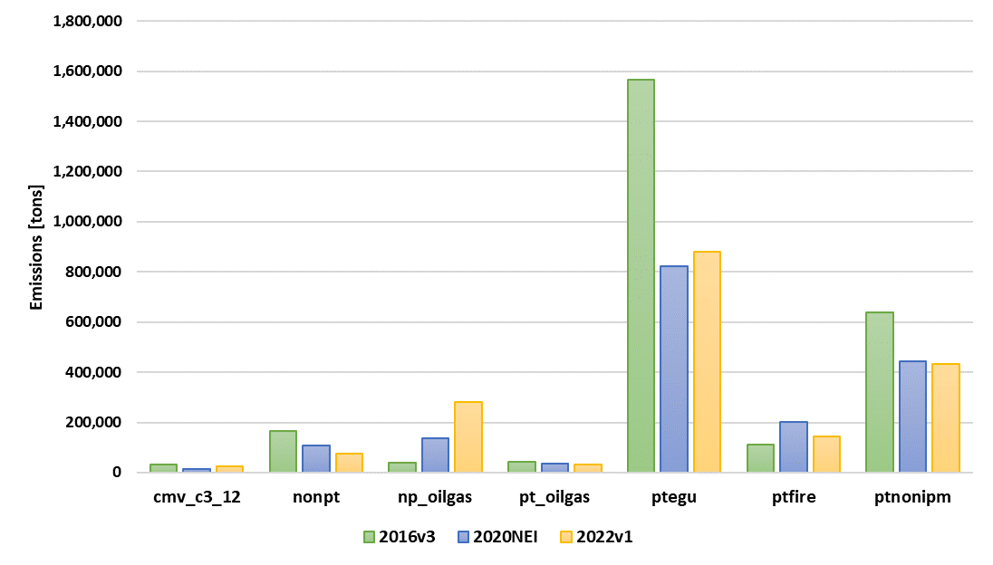
Emissions – SO₂
2016v3 | 2020 NEI EMP | 2022v1
2,836,802 | 1,828,935 | 1,917,941
  Ptegu
    Several large plant closures; several substantial decreases → controls.
  Np_oilgas
    Steady increases, mainly from tanks, completions, and fugitives. Mostly in the Permian Basin.

Slide 14
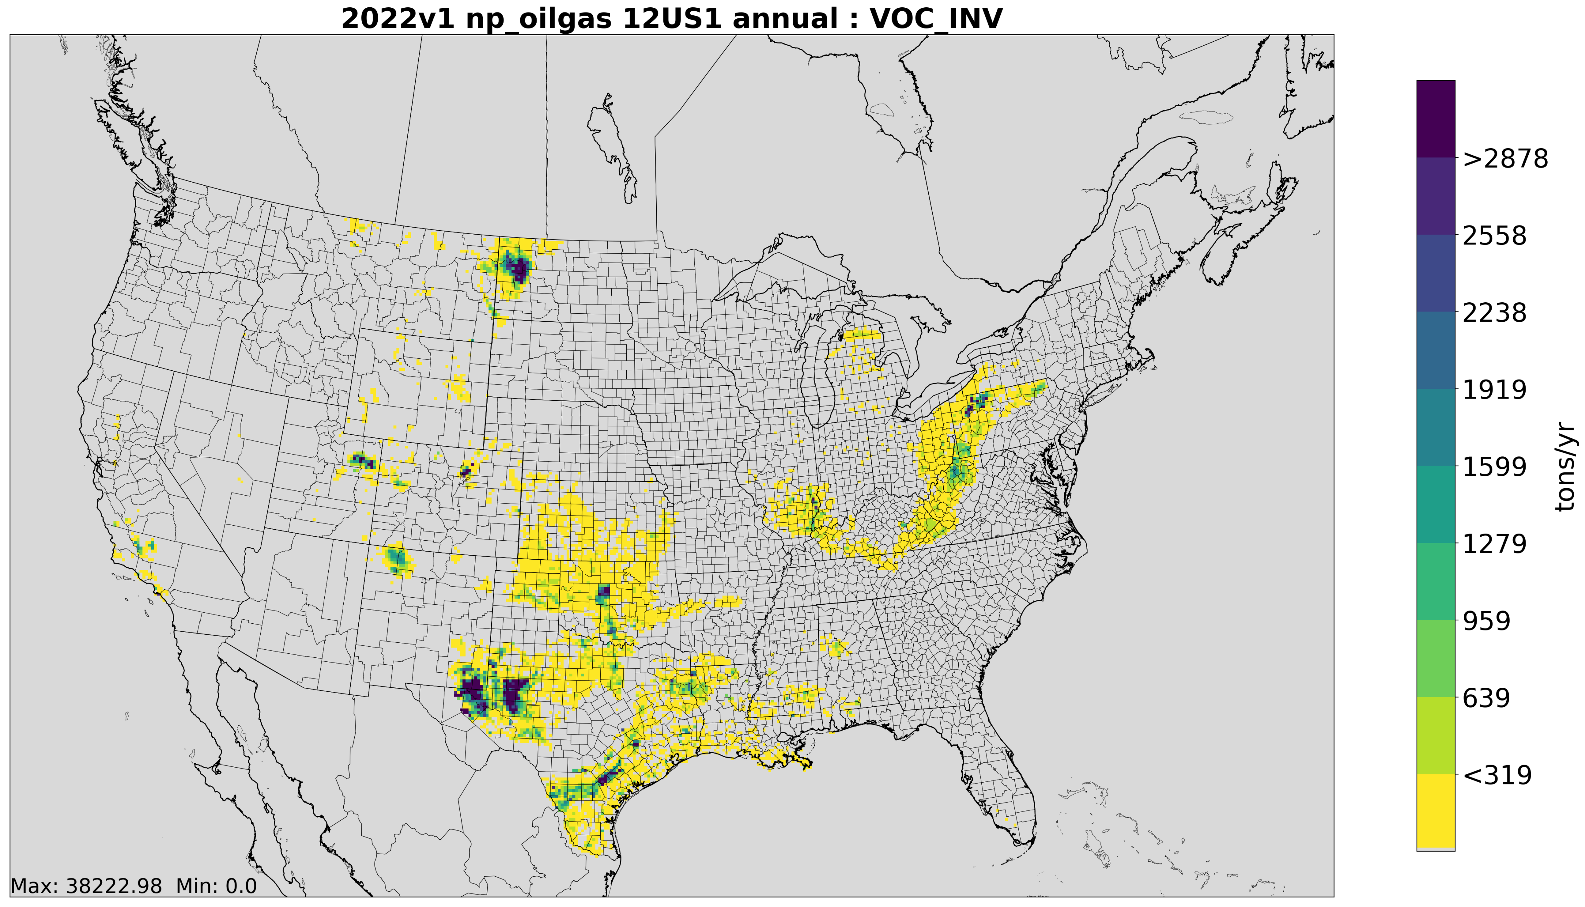
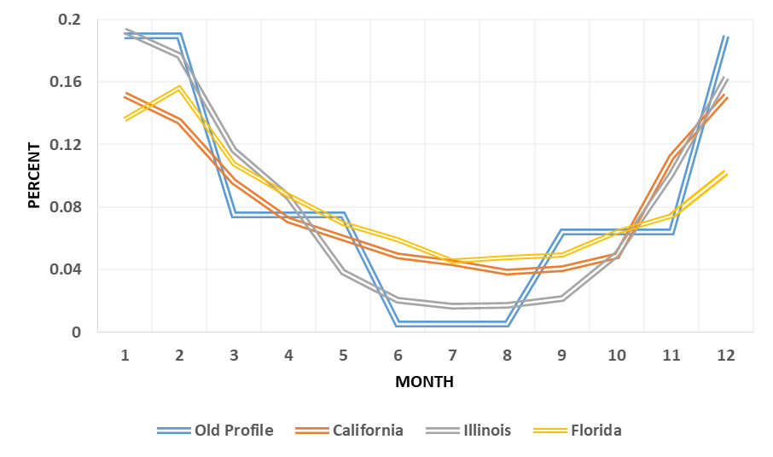
Ancillary Emissions Data
  Residential Natural Gas Monthly Profile
  Emissions are distributed in gridded and temporal space for each SCC, and relevant pollutants are speciated (e.g., VOCs to individual components).

Slide 15
Conclusions
A collaborative process was used to develop emissions for the year 2022.
  State and local agencies contributed data for the platform – especially onroad and fire activity data.
  A review of the 2022 was conducted with good participation from state and local agencies.
The 2022 emissions are now available to the community, including inputs to SMOKE and outputs from SMOKE in CMAQ format.
  2022v1 EMP Website; 2022v1 Data Retrieval Tool; CMAQ model-ready files on AWS.
Emissions for analytic years of 2026, 2032, and 2038 are currently being reviewed; will be finalized by end of calendar year.

Slide 16
Contact:
seltzer.karl@epa.gov

