Slide 1



A comparison of CAMx ozone source apportionment modeling results using emissions from two Electricity Generating Unit projection models and their impacts on upwind state contributions to downwind monitors
Jeongran Yun¹, Winston Hao¹, Yuhong (Ruby) Tian¹, Eric Zalewsky¹, Jin-Sheng Lin², Doris McLeod², Susan McCusker³, and Kevin Civerolo¹
¹ New York State Department of Environmental Conservation
² Virginia Department of Environmental Quality
³ Mid Atlantic Regional Air Management Association
23rd Annual CMAS Conference, Chapel Hill, NC
October 21-23, 2024

Slide 2
Objectives
EPA performed CAMx ozone source apportionment modeling to determine upwind contributions from each state to projected ozone design values at downwind monitor sites for the Good Neighbor Plan to address attainment of the 2015 ozone NAAQS.
For Electricity Generating Unit (EGU) point sources, EPA uses emissions projected from the IPM model, while member states of the Ozone Transport Commission use emissions projected from the ERTAC model.
We replaced the IPM-based point sources with ERTAC-based ones in the EPA's 2016/2026 V3 source apportionment modeling platform.
1. Discuss spatial differences when comparing emissions and CAMx modeling results using the two EGU models:
1) Integrated Planning Model (IPM)
2) Eastern Regional Technical Advisory Committee (ERTAC) model
2. Discuss the impacts of using ERTAC-based emissions in place of IPM-based emissions on upwind contributions to O₃ at downwind monitors.

Slide 3
State-level source apportionment modeling using CAMx
Ozone source apportionment modeling using the CAMx (v7.10) Anthropogenic Precursor Culpability Analysis (APCA) technique
12US2 domain, May to Sep
Tagged emissions files (mrgpt)
Meteorology
Boundary conditions
Using EPA’s 2016/2026 V3 (gf) source apportionment modeling platform
1: EPA/IPM EGU and nonEGU (EPA’s)
2: ERTAC EGU and ERTAC nonEGU (replaced)
The k-cell variable point source override approach for the region index

Slide 4
56 contribution categories (tags)
48 states and the District of Columbia
anthropogenic emissions
Biogenics
domain-wide
Initial and boundary conditions
Tribes
point source emissions from all of the tribal lands
Canada and Mexico
anthropogenic emissions from sources combined within the 12km modeling domain
Fires
wild and prescribed fires domain-wide
Offshore
emissions from offshore marine vessels and drilling platforms
Lightning NOx
49

Slide 5
Spatial Differences
Discuss the spatial differences attributed to the two EGU models.
1) NOx emissions
2) Maximum Daily Average 8-hr (MDA8) O₃
3) Contributions to O₃
4) Projected Future Design Values (DVF)

Slide 6
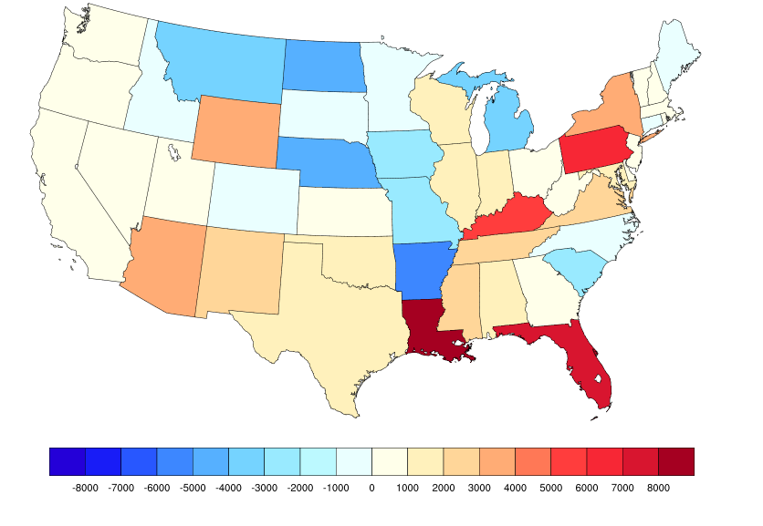
Differences in 2026 projected EGU + nonEGU point sources NOx Emissions (ERTAC – IPM)
May to Sep total in tons
Numbers were extracted from SMOKE netcdf files: (ptertac + ptnonertac) – (ptegu + ptnonipm)

Slide 7
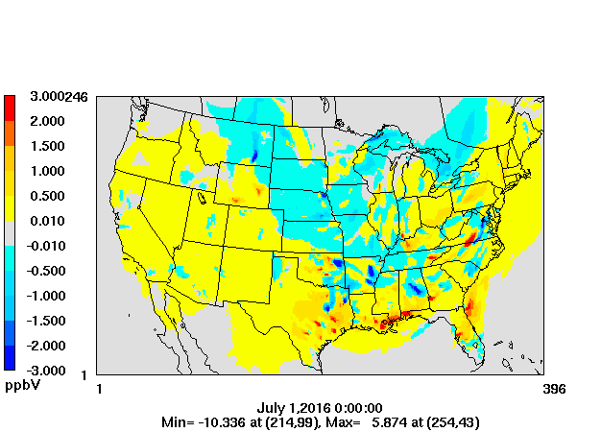
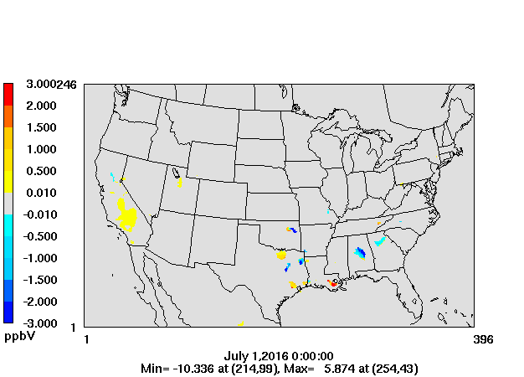
Differences in 2026 modeled MDA8 O₃ in July (ERTAC - IPM)
All data
>= 60 ppb threshold (IPM)

Slide 8
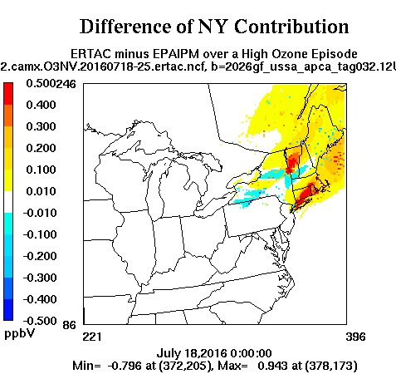
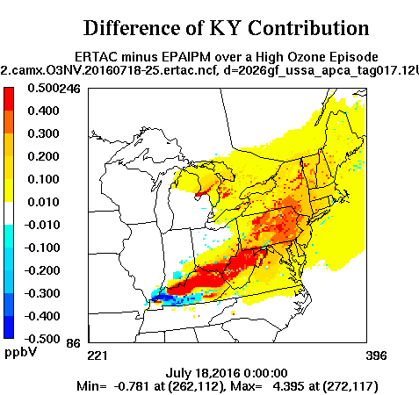
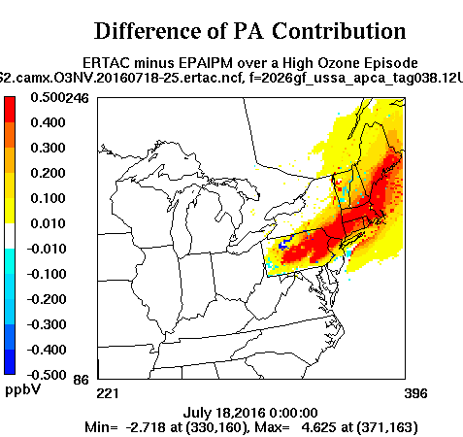
Differences in contributions in 2026
ERTAC – IPM from July 18-25
Differences in NY contribution
Differences in KY contribution
Differences in PA contribution

Slide 9
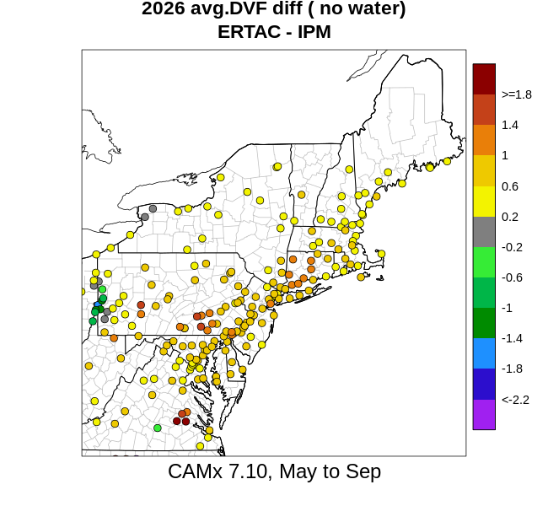
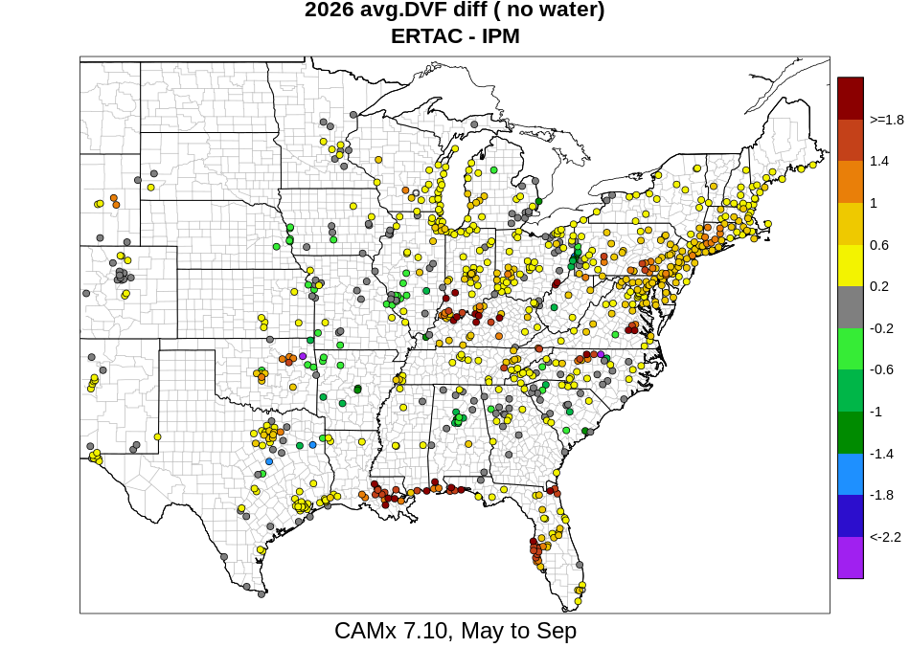
Differences in 2026 projected O₃ design values (DVF) (ERTAC – IPM)

Slide 10
Impacts on Contributions to O₃
Discuss the impacts of using ERTAC-based emissions in place of IPM-based emissions on upwind contributions by states to O₃ at downwind monitors.
1) Upwind/downwind linkages
2) Average contribution metric calculation (for contribution to O3 DVF)

Slide 11
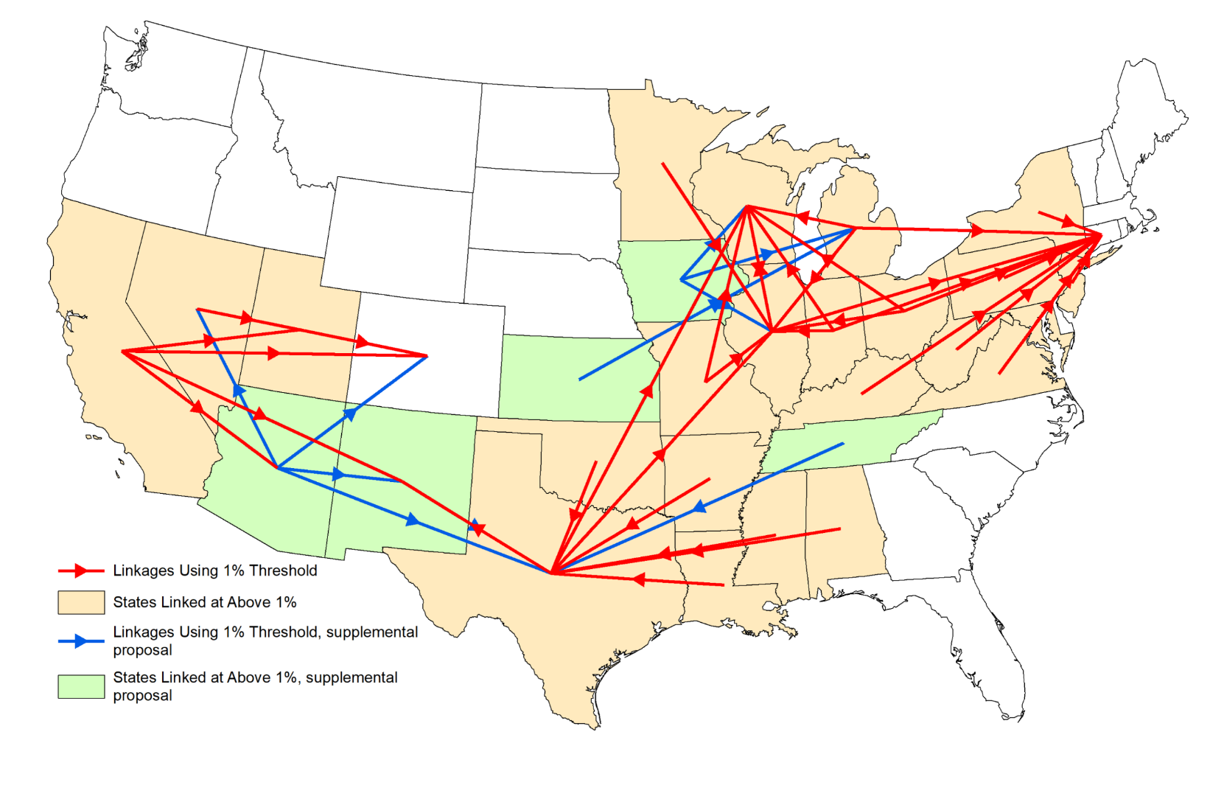
Interstate Pollution Linkages Under the Good Neighbor Plan and the Proposed Supplemental Rulemaking
Source: https://www.epa.gov/Cross-State-Air-Pollution/good-neighbor-plan-2015-ozone-naaqs

Slide 12
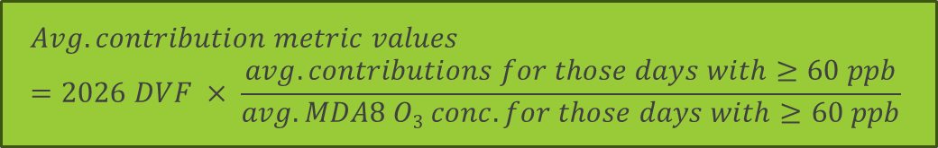
Average contribution metric calculation by each tag for each downwind monitoring site
Sort top 10 2026 modeled MDA8 O₃ days for the two platforms: IPM and ERTAC
Count no. of days with MDA8 O₃ >= 60 ppb
No further calculation
< 5 days
>= 5 days
$$Avg. contribution metric values =2026 DVF × \frac{avg. contributions for those days with≥60 ppb}{avg. MDA8 O3 conc. for those days with≥60 ppb}$$

Slide 13
Upwind contributions by states to O₃ DVF at downwind monitors in 2026
Case 1 (Holtsville, NY)
Same top 10 MDA8 O₃ days for ERTAC and IPM platforms
Case 2 (Queens College, NY)
Diff. top 10 MDA8 O₃ days for ERTAC and IPM platforms
2. Linkages are determined using their own top 10 MDA8 O₃ days. (different met. conditions)
1. Linkages are determined using the same dates selected based on the IPM platform. (using the same met. conditions)
1. Linkages are determined using the same dates (the same met. conditions)

Slide 14
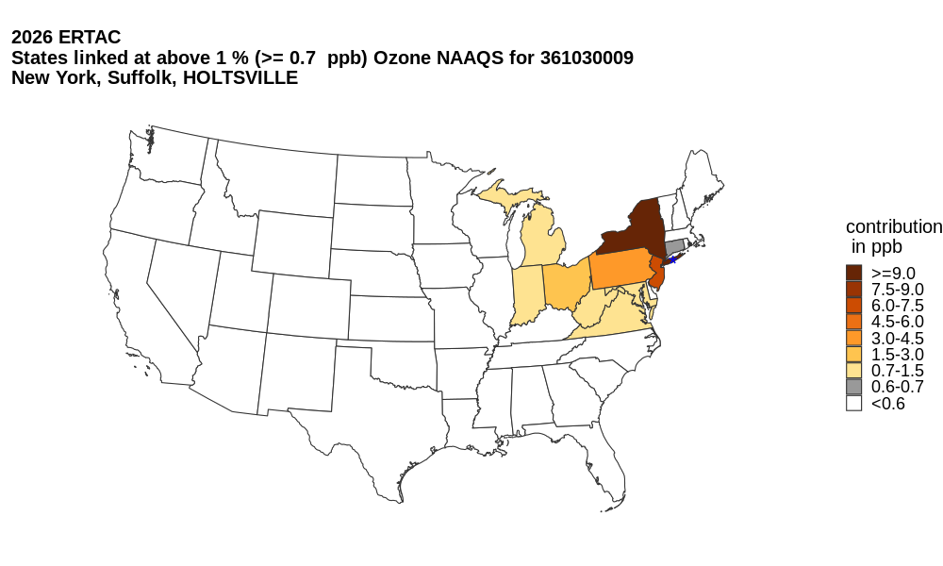
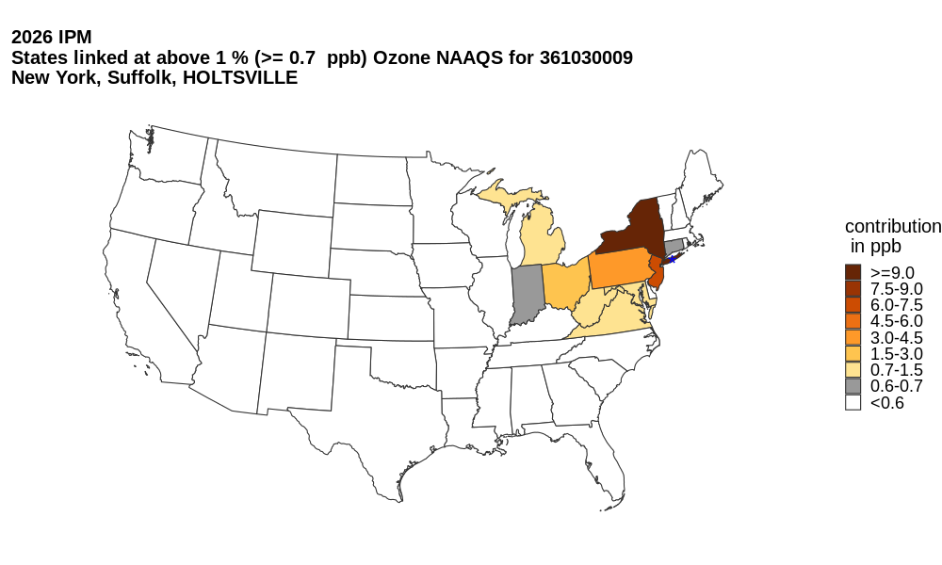
Case 1 (Holtsville, NY)
Upwind/downwind linkages (>=0.7 ppb) for Holtsville, NY in 2026 (the same top 10 MDA8 O₃ days)
The same meteorological conditions
Holtsville
Holtsville
Case 1: The top 10 MDA8 O₃ days for ERTAC and IPM platforms are the same.

Slide 15
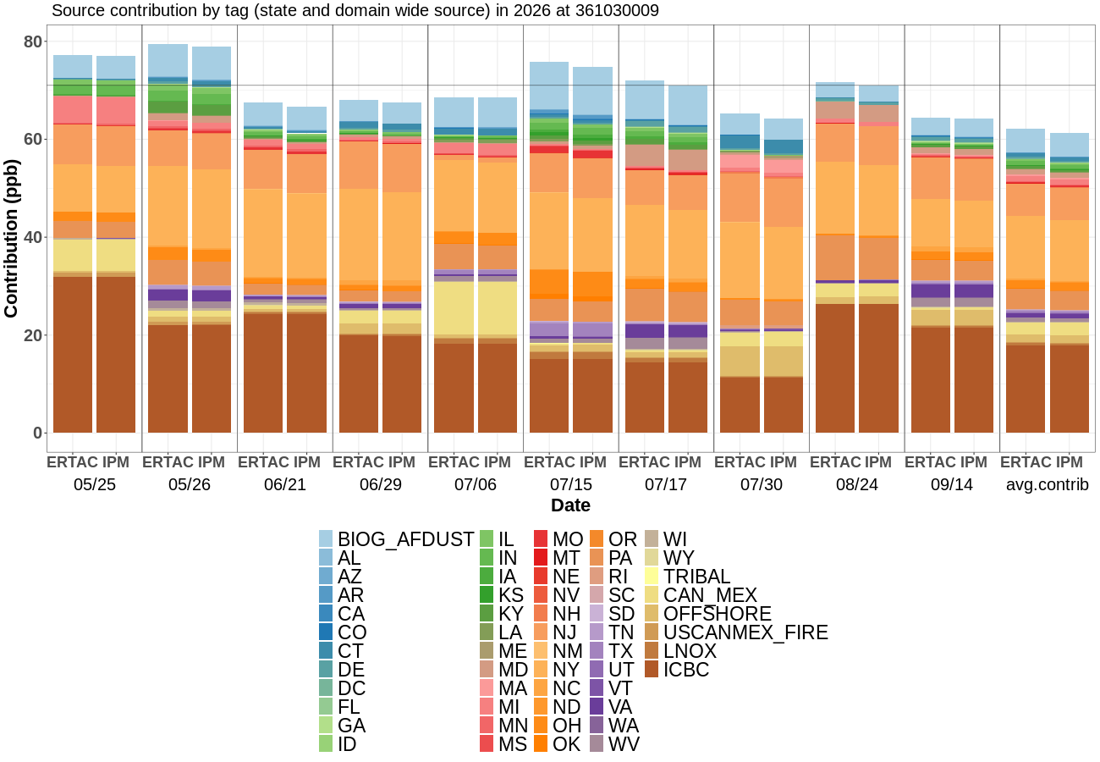
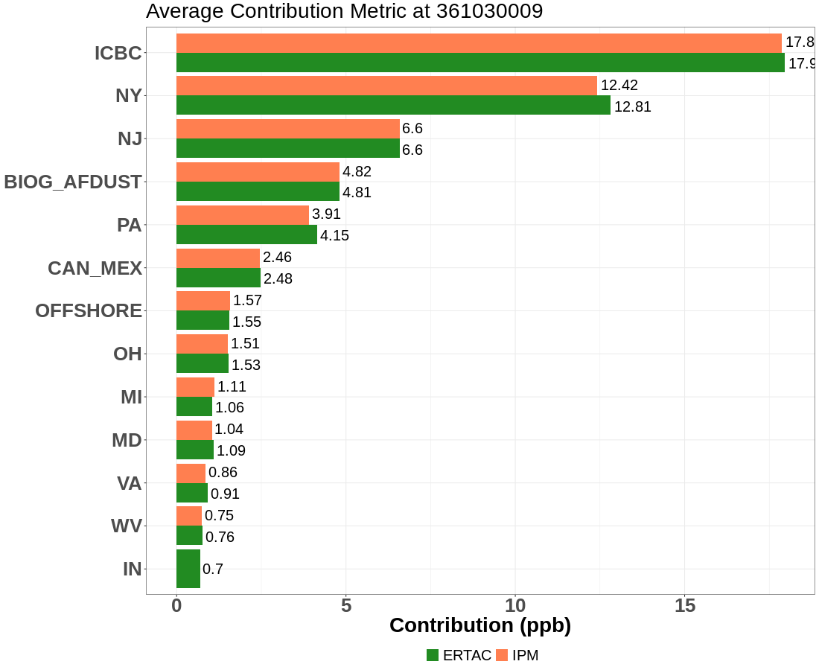
Case 1 (Holtsville, NY)
Source contribution by tag and average contribution metric at Holtsville, NY in 2026 (the same top 10 MDA8 O₃ days)
Average contribution metric
Average contribution metric
Case 1: The top 10 MDA8 O₃ days for ERTAC and IPM platforms are the same.

Slide 16
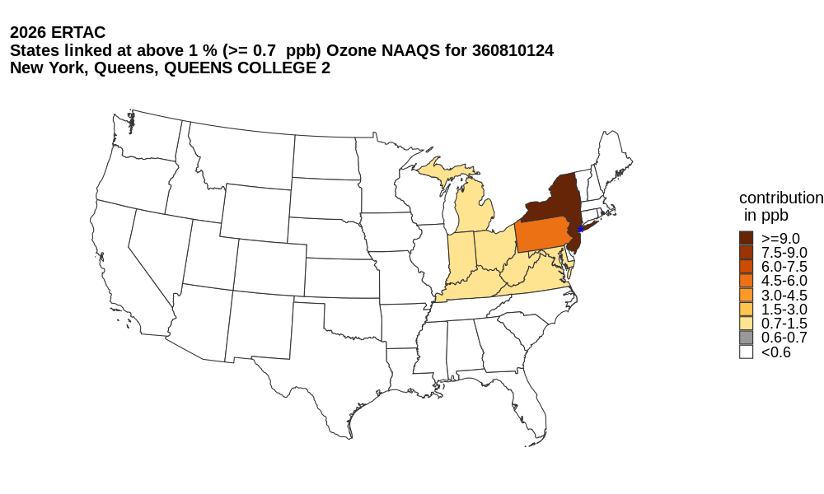
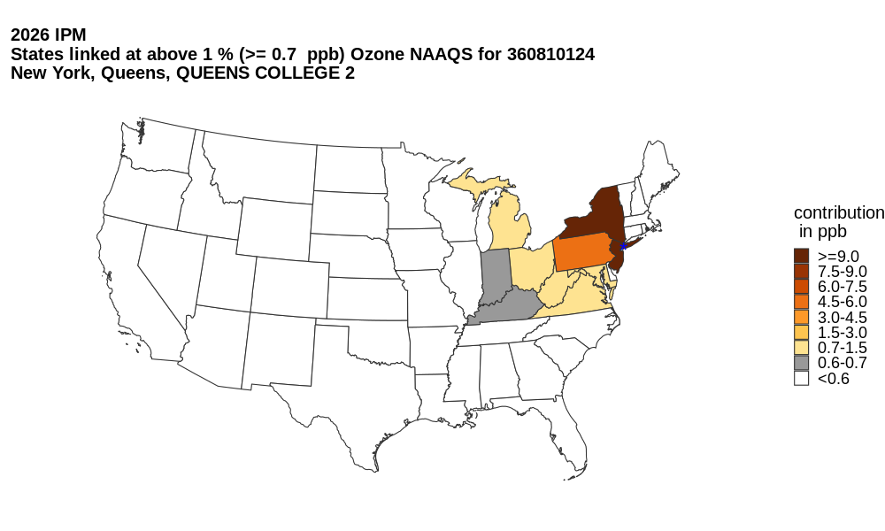
Case 2 (Queens College, NY)
Upwind/downwind linkages (>=0.7 ppb) for Queens College, NY in 2026 (top 10 MDA8 O₃ days based on the IPM)
The same meteorological conditions
Queens College
Queens College
Case 2-1: The top 10 MDA8 O₃ days for ERTAC and IPM platforms are different.
Linkages for both IPM and ERTAC are determined using the same dates selected based on the IPM platform.
Linkages are different.

Slide 17
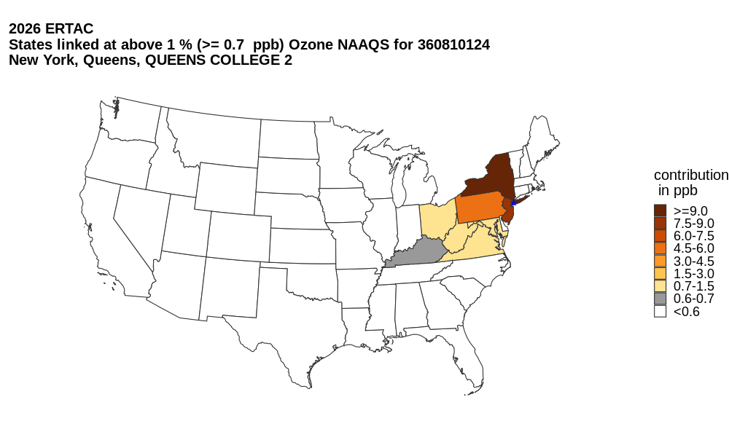
Case 2 (Queens College, NY)
Upwind/downwind linkages (>=0.7 ppb) for Queens College, NY in 2026 (different top 10 MDA8 O₃ days for each platform)
Different meteorological conditions
Queens College
Queens College
Case 2-2: The top 10 MDA8 O₃ days for ERTAC and IPM platforms are different.
Linkages for IPM and ERTAC are determined using their own top 10 MDA8 O₃ days.

Slide 18
Summary
We showed spatial differences between ERTAC and IPM projected emissions. ERTAC projections were higher for some areas while IPM projections were higher for others.
In the Northeast, ERTAC projections were more conservative, resulting in higher MDA8 O₃ predictions, and thus higher O₃ DVFs than IPM projections.
Using ERTAC or IPM platforms could result in different upwind/downwind linkages at a monitoring site.
The selection of dates affected upwind/downwind linkages at a monitoring site, partially due to different meteorological conditions.
Upwind/downwind linkages could be different in the 2022 modeling platform.
Disclaimer: The views expressed here do not necessarily reflect the views or opinions of the NYSDEC, VADEQ, and MARAMA.

Slide 19
Thank you!
Questions?
Jeongran Yun
[pronounced chung-nan]
jeongran.yun@dec.ny.gov
New York State Department of Environmental Conservation

