Slide 1
Air Toxics Exposure Disparities in Disadvantaged Communities
Xue Meng Chen, Shuming Du, Abdullah Mahmud, Yiting Li, Yunle Chen, Pingkuan Di, and Jeremy Avise
Notes:
Thanks for the introduction. Thank you all for sticking after lunch, I really appreciate it. List are the names of the contributors of this work. This presentation was supposed to be given by Sue, unfortunately, she could not be here today. So, I am just filling in for her. In the next fifteen minutes or so, I will be talking about exposure to air toxics disparities in disadvantage communities in California based on the 2017 California Air Toxic Assessment (CATA) study.

Slide 2
California Air Toxics Assessment (CATA)
  Assess exposure and health impact of major air toxics in California
  Iterative modeling and analysis to track risk reduction trends over time statewide: 2012, 2017, now 2021, and future years
  Bridges the scale between National (NATA) and Regional (such as MATES) efforts
  Support CARB’s Air Toxics Program, AB617, EJ programs and many others
    Identification of disproportionally impacted communities
    Assist in development of effective emission reduction measures to reduce exposure/risk (e.g., CERP)
    Estimate regional and statewide baseline cumulative risk over time
  Support other agencies, CalEnviroScreen, complement existing monitoring network, especially for EJ communities
Notes:
CATA is an ongoing study…

Slide 3
CATA Emissions Inventory
Emission Sources (~60 sectors!):
On-road Mobile (road-following lines)
Trucks, passenger cars, HD vs. LD.
Off-Road Mobile (lines or 1km x 1km grids)
Seaports: OGV (transit, maneuver, at-berth etc.), CHE (port, rail), CHC (fishing, ferries, etc.)
Locomotives (linehaul, switch yards, others)
Airports
TRUs
Area Sources (1km x 1km grids)
Agricultural activities
Construction
Agr and Rx burning, wildfires, charbroil, etc.
Consumer products, biogenic, etc.
Mexico sources
Stationary Sources (point)
Refineries, power generation plants, cements, chemical processing plants.
Diesel particulate matter (DPM)
Chromium VI, Lead, Arsenic, Cadmium, Nickel.
Heavy metals
VOCs
Benzene, 1,3-Butadiene, Formaldehyde, Acetaldehyde, Acrolein, Perchloroethylene, p-Dichlorobenzene, etc.
Notes:
This slide shows the list of major air toxic species that we have considered in the CATA study. Diesel PM, heavy metals and VOCs.
Modeling emission sectors separately for DPM and metals so that we can quantify their relative contributions in different regions.

Slide 4
Flowchart of the CATA Process
CARB Emissions Inventory
Air Quality Models
Ambient concentrations of air toxics
Health risk characterization
Meteorological Data
CALPUFF: DPM & heavy metals
CMAQ: VOCs
Population data &
OEHHA risk assessment guidelines
Notes:
This slide shows the modeling approach of the CATA.
We use CALPUFF for DPM and heavy metals and CMAQ for VOCs. We will have the second part of the modeling study right after the next presentation.

Slide 5
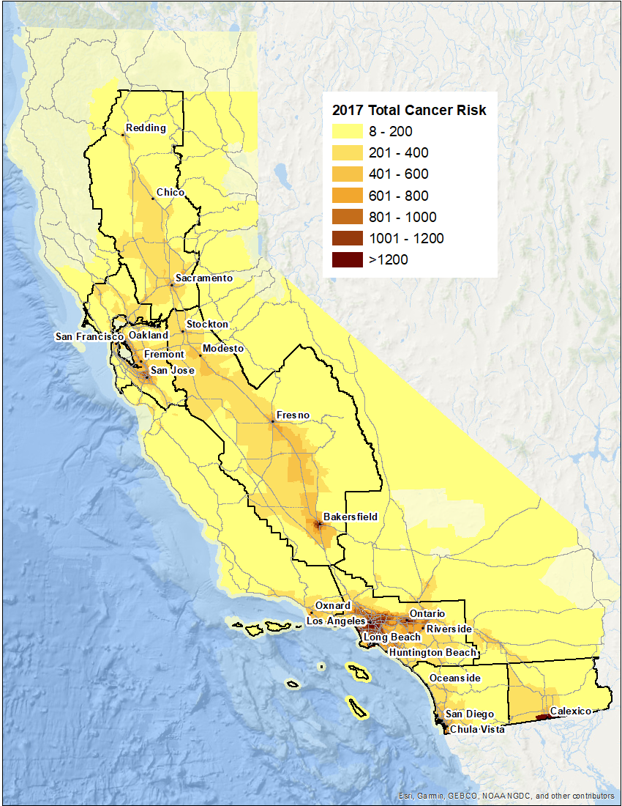
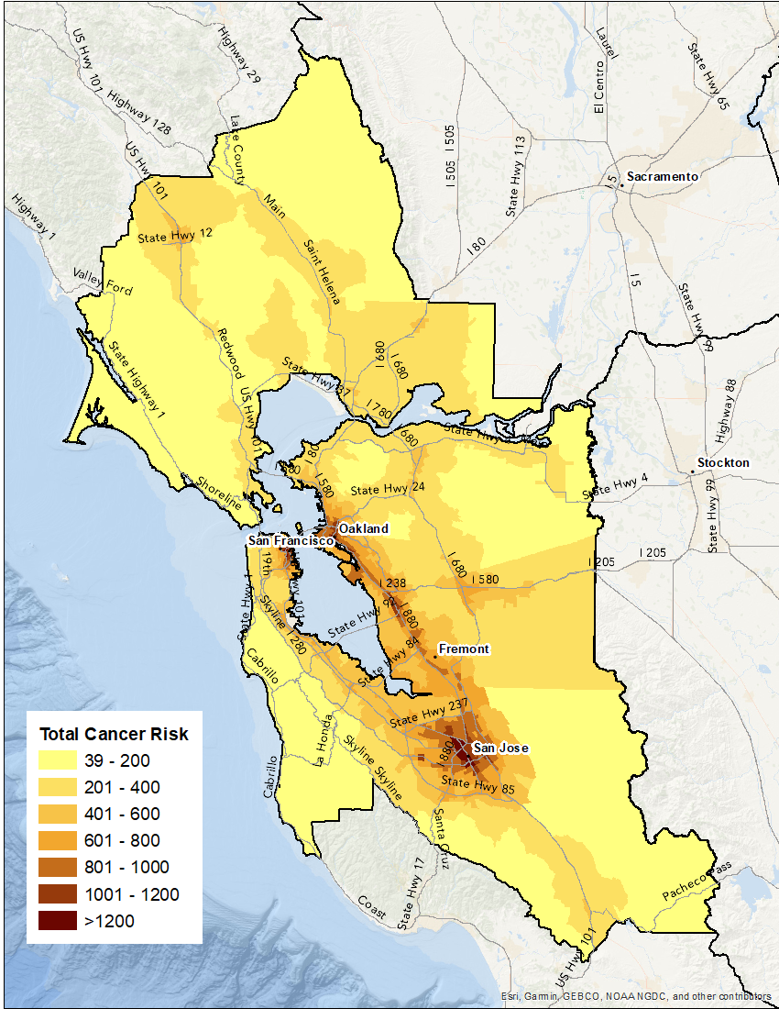
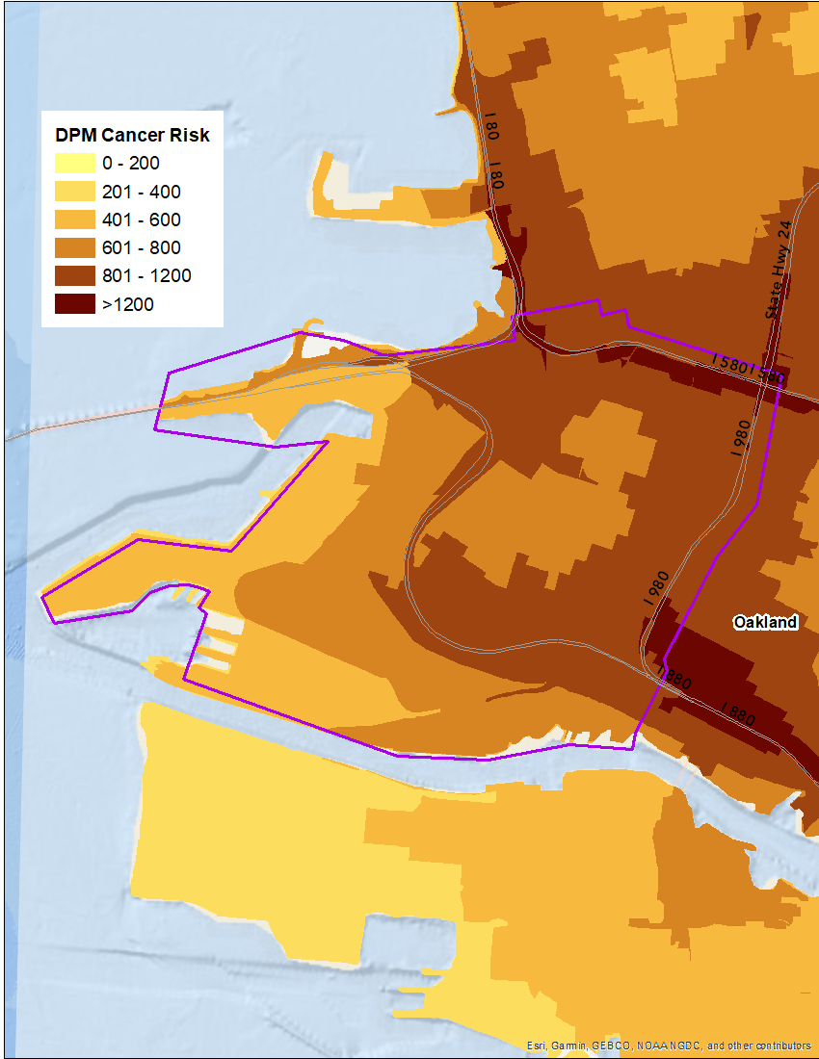
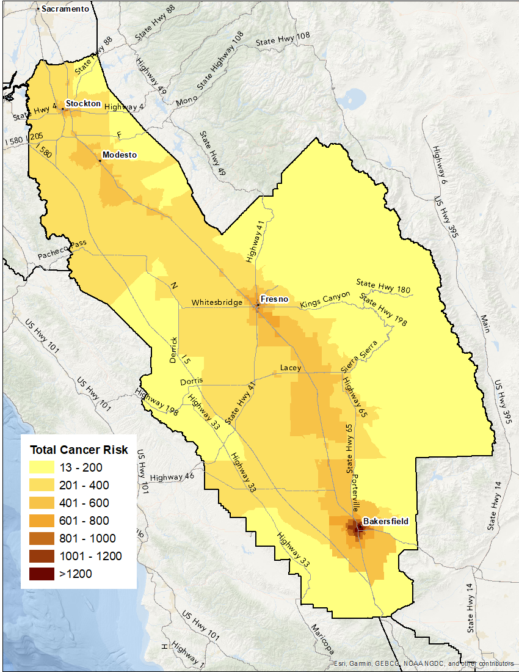
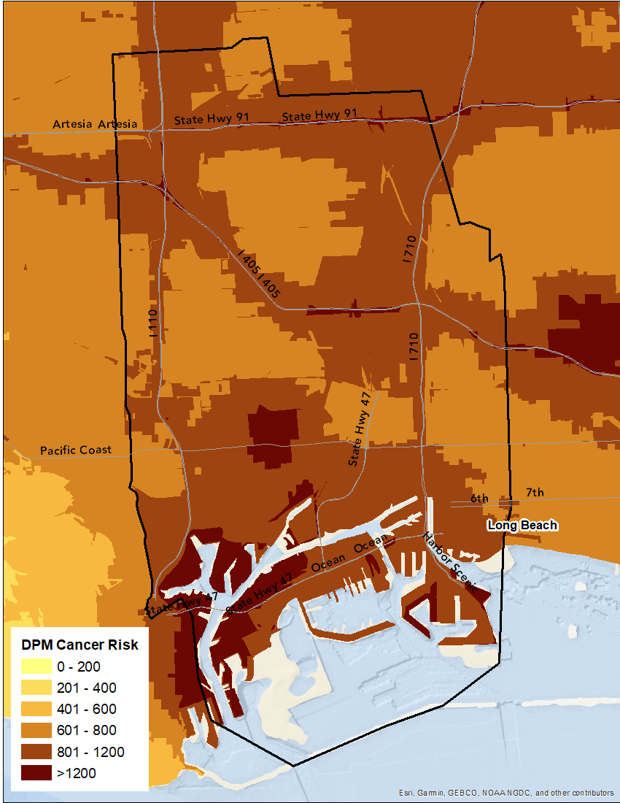
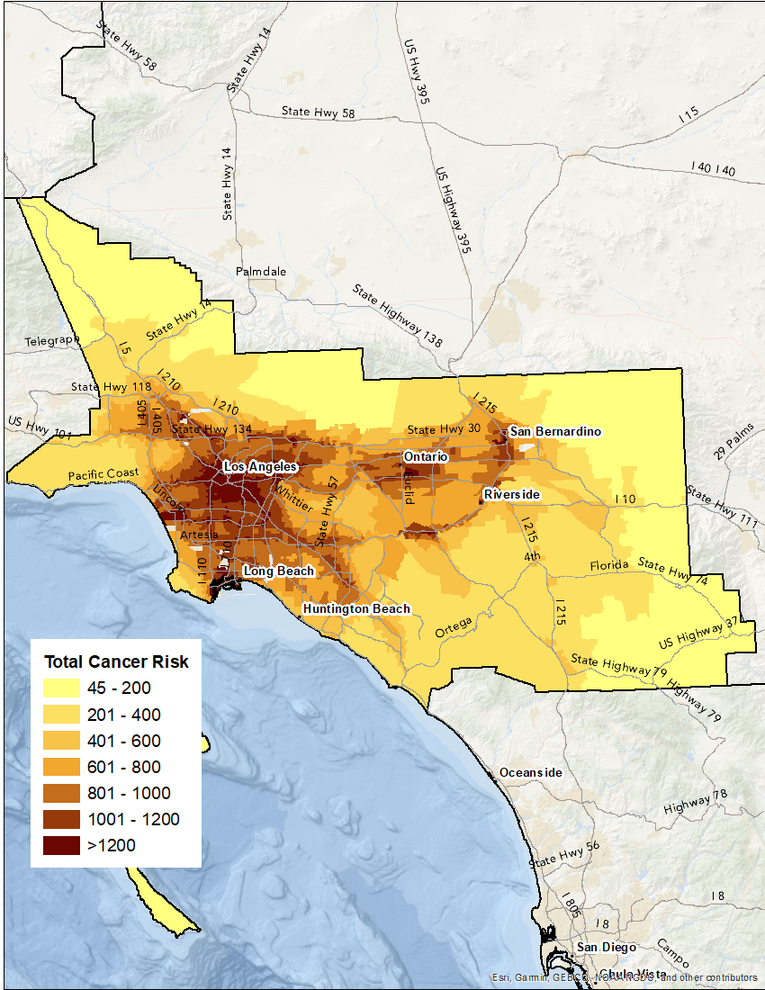
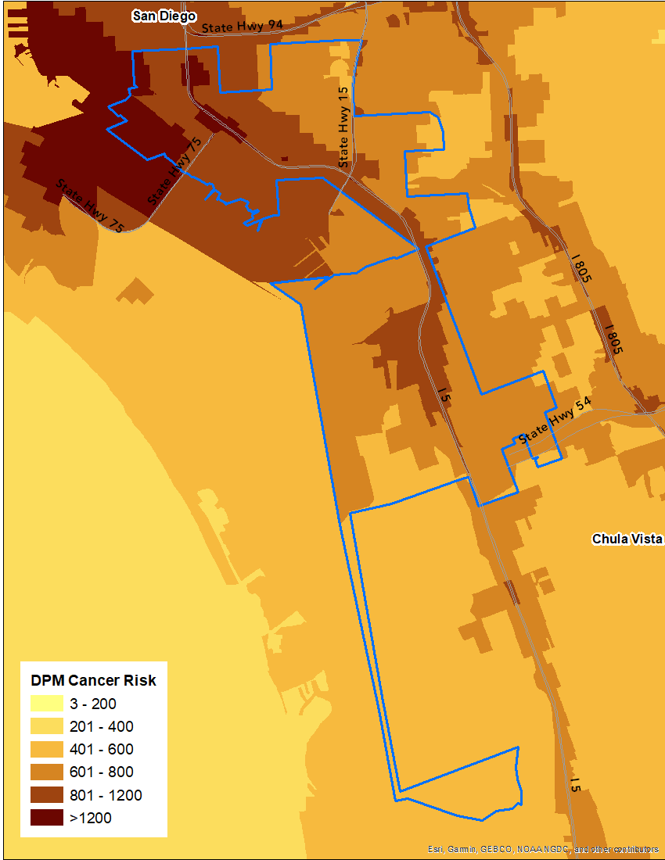
Modeling Results at Different Scales
Statewide
Air basins
Communities
S.F. Bay Area
W. Oakland
Wilmington Long Beach-Carson
SJV
South Coast
Portside
Notes:
The CATA assessment can be used at the statewide level to provide an overview of air toxics impact across California, changes in the health impact between years related to regulations of specific emission sectors. It can also provide useful qualitative information at the community level, for example to support the development of CERPs under AB617.

Slide 6
Geographical Disparities
AB617 & DACs under SB535
Notes:
We have looked at disparities in disadvantaged communities identified under AB617 which is the community air protection law, and under SB535 which allows California’s Office of the Environmental Health Hazard Assessment (OEHHA) to identify disadvantaged communities using the pollution and socioeconomic scores.

Slide 7
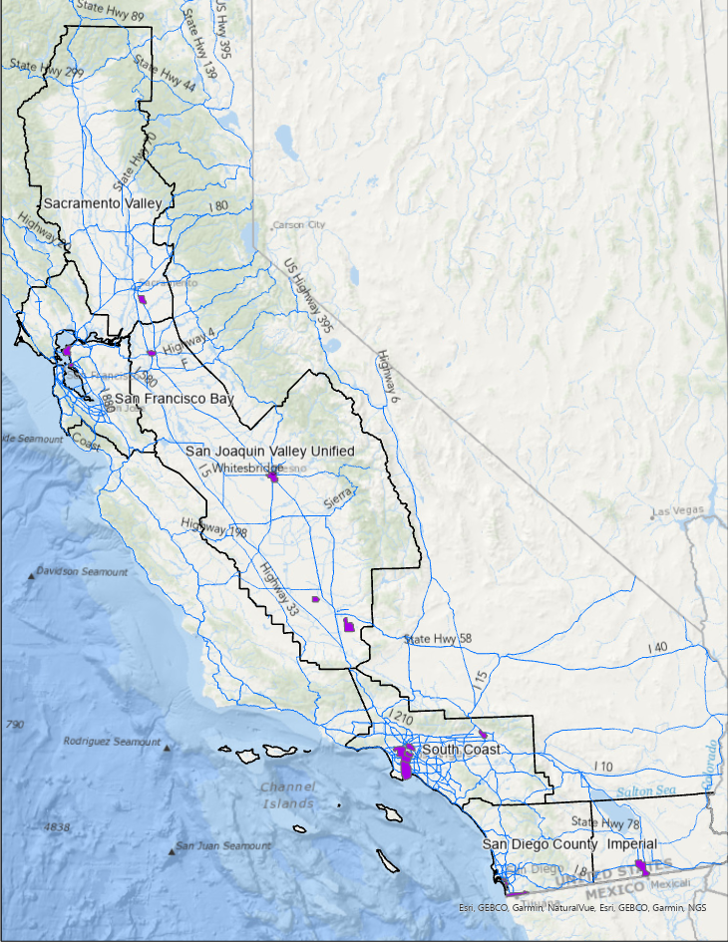
AB617 Communities (DACs)
Sacramento Valley
1. South Sacramento Florin
San Francisco Bay Area:
Richmond, North Richmond, San Pablo
West Oakland
South Coast:
Wilmington, West Long Beach, Carson
Southeast L.A.
East L.A., Boyle Heights, West Commerce
South LA
San Bernardino, Muscoy
San Joaquin Valley:
Shafter
South Central Fresno
Stockton
Arvin/Lamont
San Diego
International Border Community
Portside Environmental Justice Communities
IMP: Calexico, El Centro, Heber
Notes:
There are about 15 communities that have been identified under AB617 at the time we carried out the CATA study.

Slide 8
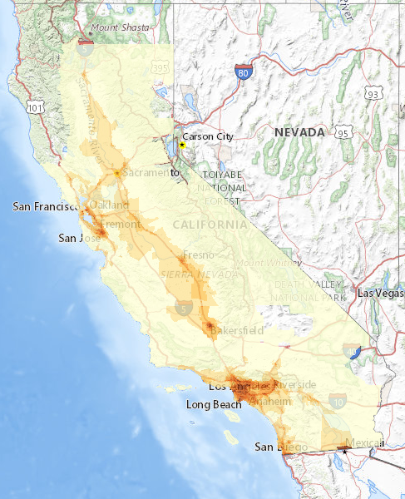
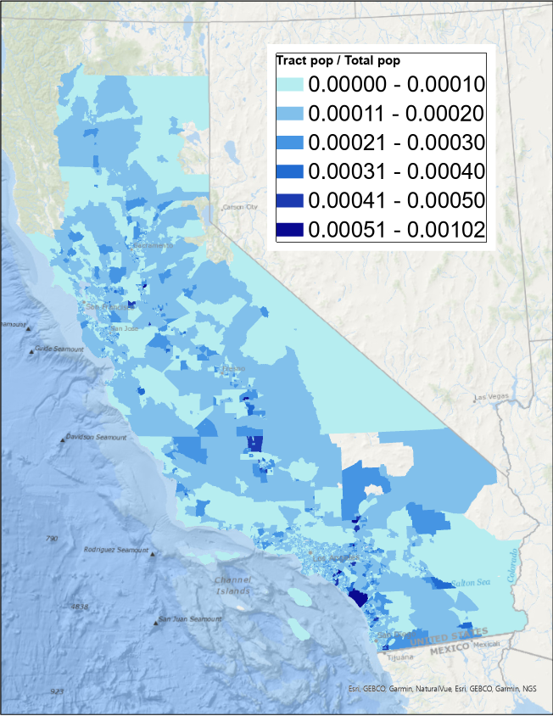
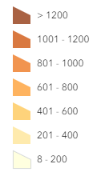

Population-weighted Risk Averages (PWR)
A single value that represents risks in a region, allows us to quantify comparisons and trends:
PWR $=\frac{\sum_{n=1}^{\# tract}{\left({pop}_{n}∗{risk}_{n}\right)}}{\sum_{n=1}^{\# tracts}{{pop}_{n}}}$
n denotes each census tract,
pop is each tract’s population,
risk is that tract’s PWR (from census block-level risks).
Census tract cancer risks
Normalized tract population
Statewide PWR, an average that weighs toward population.
summed
e.g.,
x
Notes:
Typically, we calculate inhalation cancer risk at each receptor or grid cell, but in order to create a single risk value, we use the population weighted risk for certain area of interest.

Slide 9
Total Cancer Risks for 2017 in AB617 Communities Compared to Statewide
SAV
SFB
SFB
SJV
SJV
SJV
SJV
SC
SC
SC
SC
SC
SD
SD
IMP
South <- North
Statewide
Statewide change (-38%)
Notes:
Chart on the left: most communities are burdened with higher cancer risks from air toxics than the statewide average. Communities in Southern CA tend to have higher cancer risks. (Abdullah-other factors such as income and other pollutants are also considered when selecting the communities…)
Chart on the right: Communities in Southern CA also saw smaller risk reductions.
Two potential reasons: large cross-border transport in Imperial and SD, and source apportionment: on-road sources were more dominant in the northern communities, whereas southern communities were more impacted by sources under less stringent, e.g., ports and locomotives

Slide 10
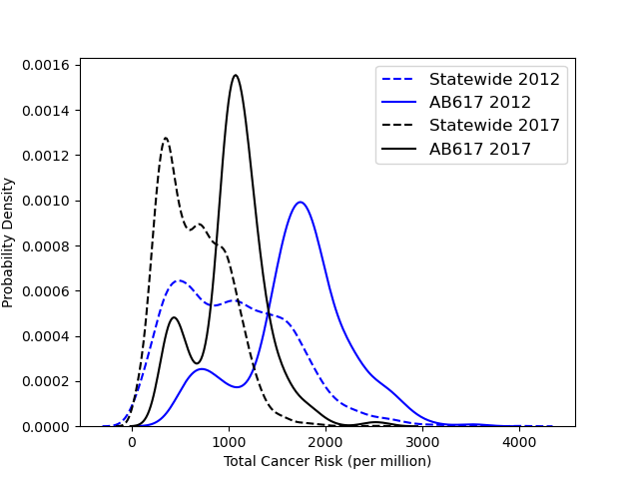
Probability Density of Total Cancer Risks in Census Tracts
Additionally:
More “concentrated” risk values in AB-617 DACs.
Small peak in low risks in the communities, may be emission sector-related.
Higher risks in AB617 DACs.
Clear decreases in risks.
Notes:
For both years, AB617 communities still face higher risks than their statewide counterparts. Even though there was a clear risk reduction from 2012 to 2017 in all regions, it did not eliminate disparity in AB617 communities.
Abdullah-small picks (low risk) indicate impacts from sector specific emissions

Slide 11
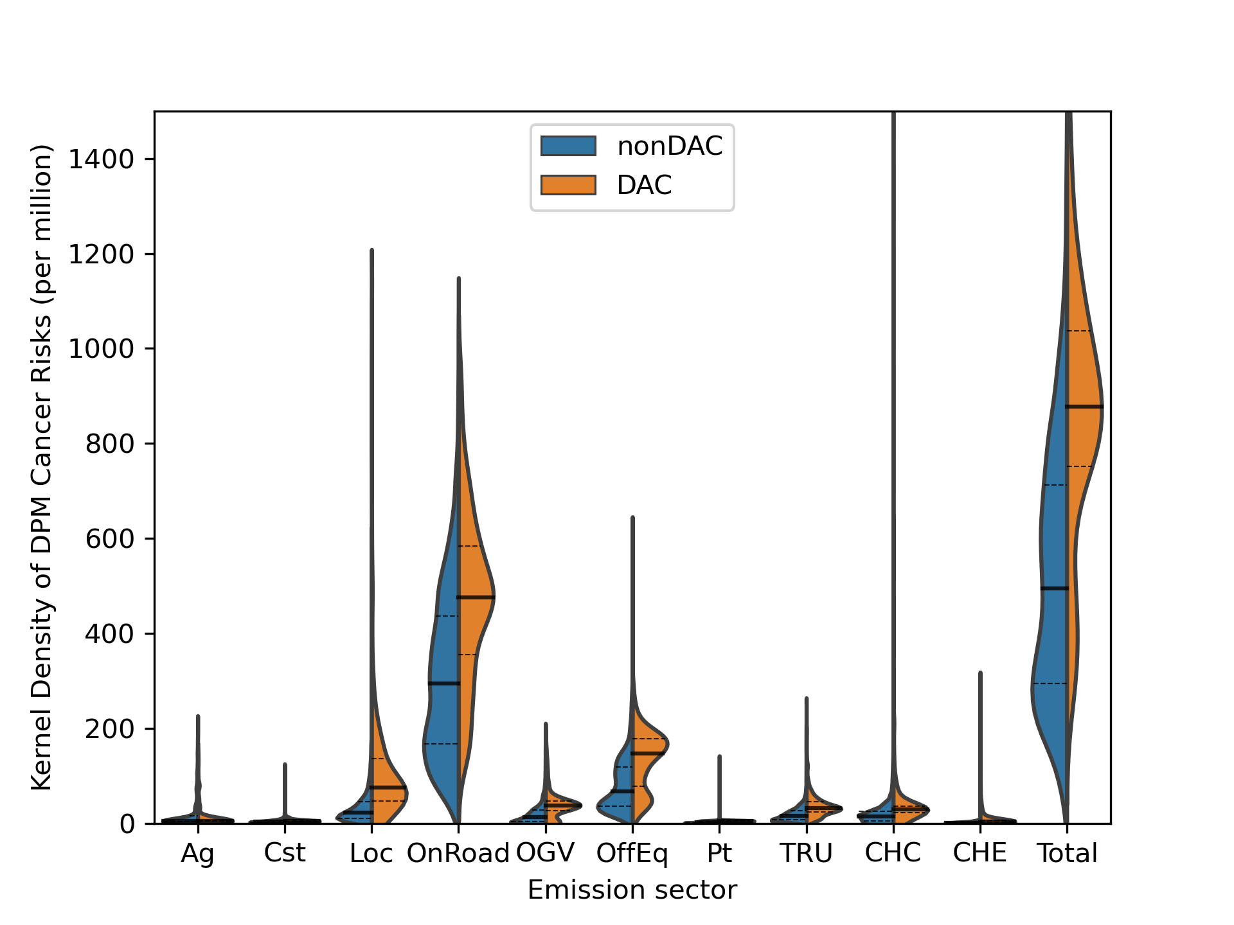
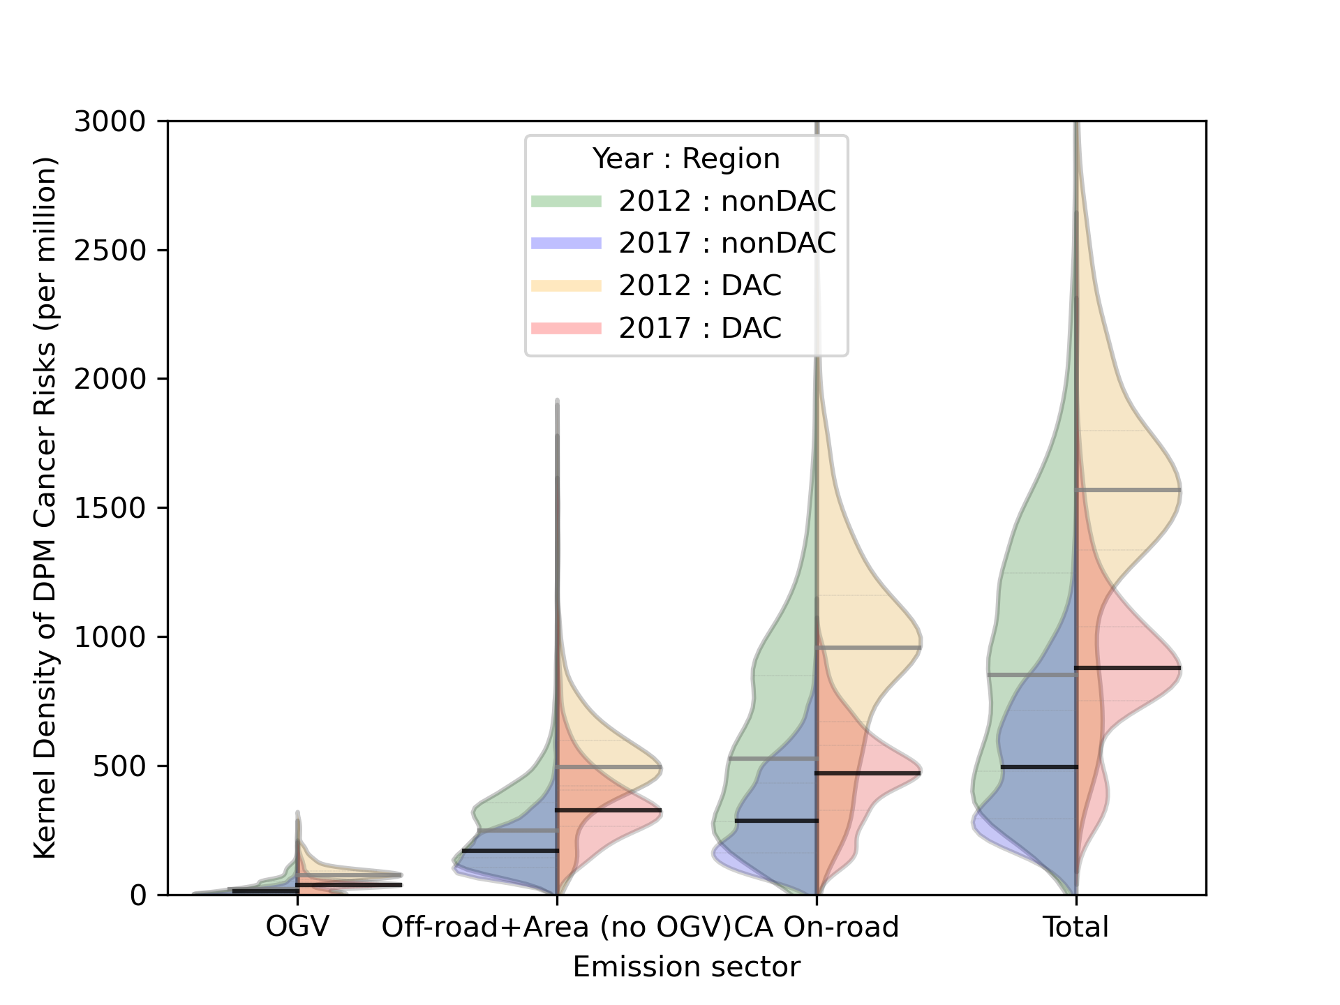
DPM Disparity in AB617 Communities by Sector
2017 Emission Sectors
2012 vs. 2017
-42%, -43%
-48%, -51%
-31%, -26%
Change in PWR:
-42%, -45%
Dominant sectors are similar for AB617 and non-AB617 population.
Clear disparity in exposure to on-road mobile and off-road sources (e.g., CHC, locomotives, TRU, off-road equipment).
Clear reductions from 2012 to 2017, larger from on-road.
On-road and OGV-related disparity between DAC and non-DAC decreased.
Notes:
Note that for certain sectors, e.g. locomotive and commercial harbor craft (CHC), the range of cancer risks is very large (generally low risks, but also small amount of very high risk tracts): certain densely-population tracts happened to be very close to some of those sources (localized impact).

Slide 12
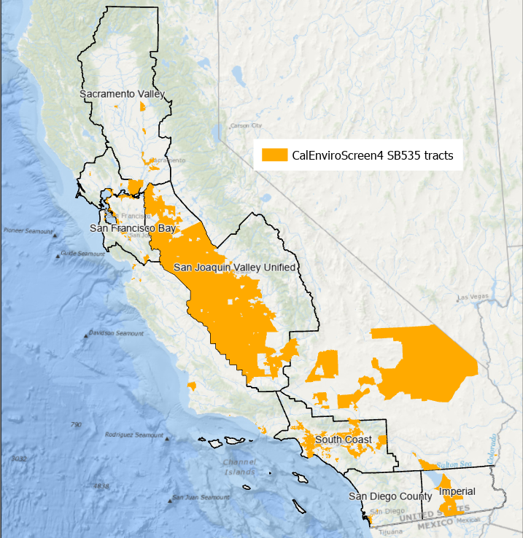
SB535 Disadvantaged Communities (DACs)
Final designation of DACs by CalEPA in May 2022 considered.
Tracts selected based on CalEnviroScreen 3.0 and 4.0 scores, which combine pollution and population characteristics.
Notes:
Ranked at the 75th percentile the DACs are selected..based on tracts, separated into air basin for analysis, spatial distributions are not uniform across air basins.

Slide 13
Total Cancer Risks for 2017 and 2012-2017 change
SB535 DACs vs. Basin-wide
Air basin average
Statewide change (-38%)
Notes:
DACs in all air basins had higher risks than the air basin averages, and saw risk reductions larger than average, i.e., a decrease in disparity, except SD and Imperial that are impacted by transported emissions from Mexico.

Slide 14
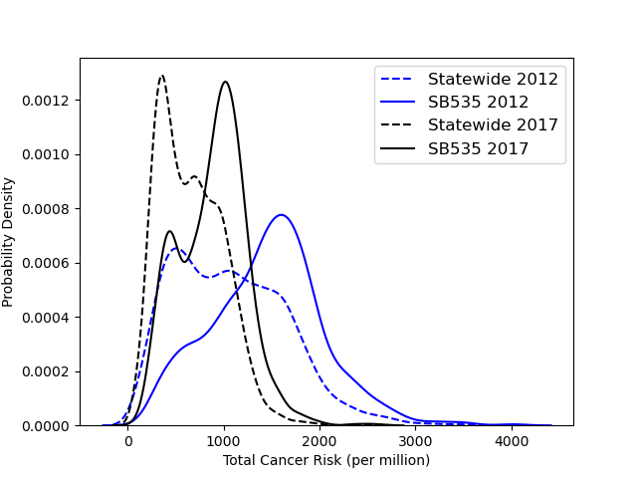
Total Cancer Risk for 2012 and 2017,
SB535 vs. Statewide
Notes:
Similar patterns as AB617 communities.

Slide 15
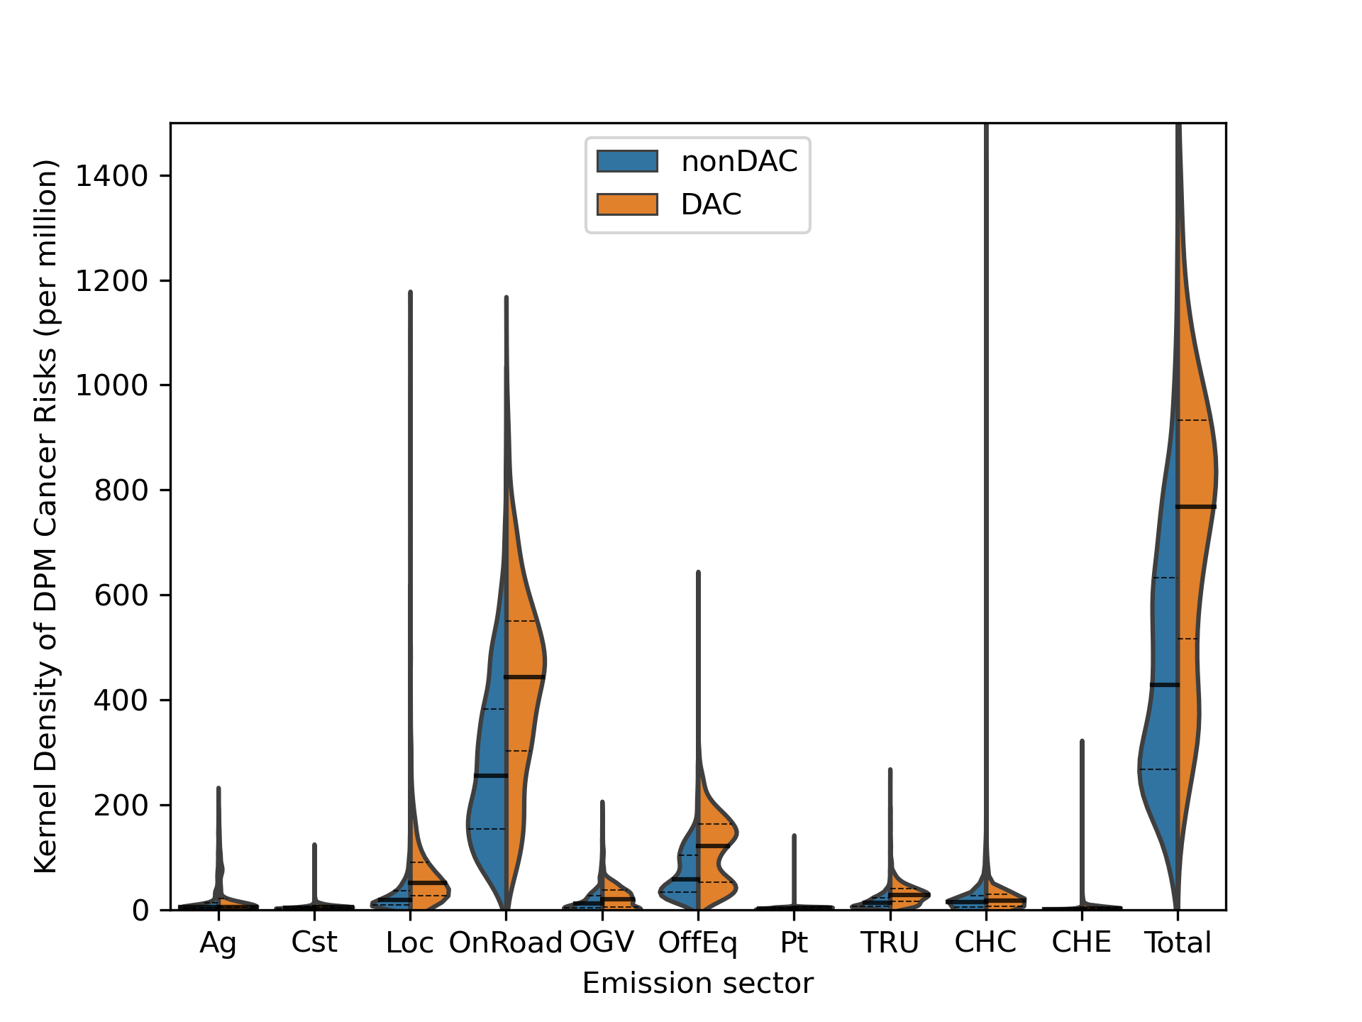
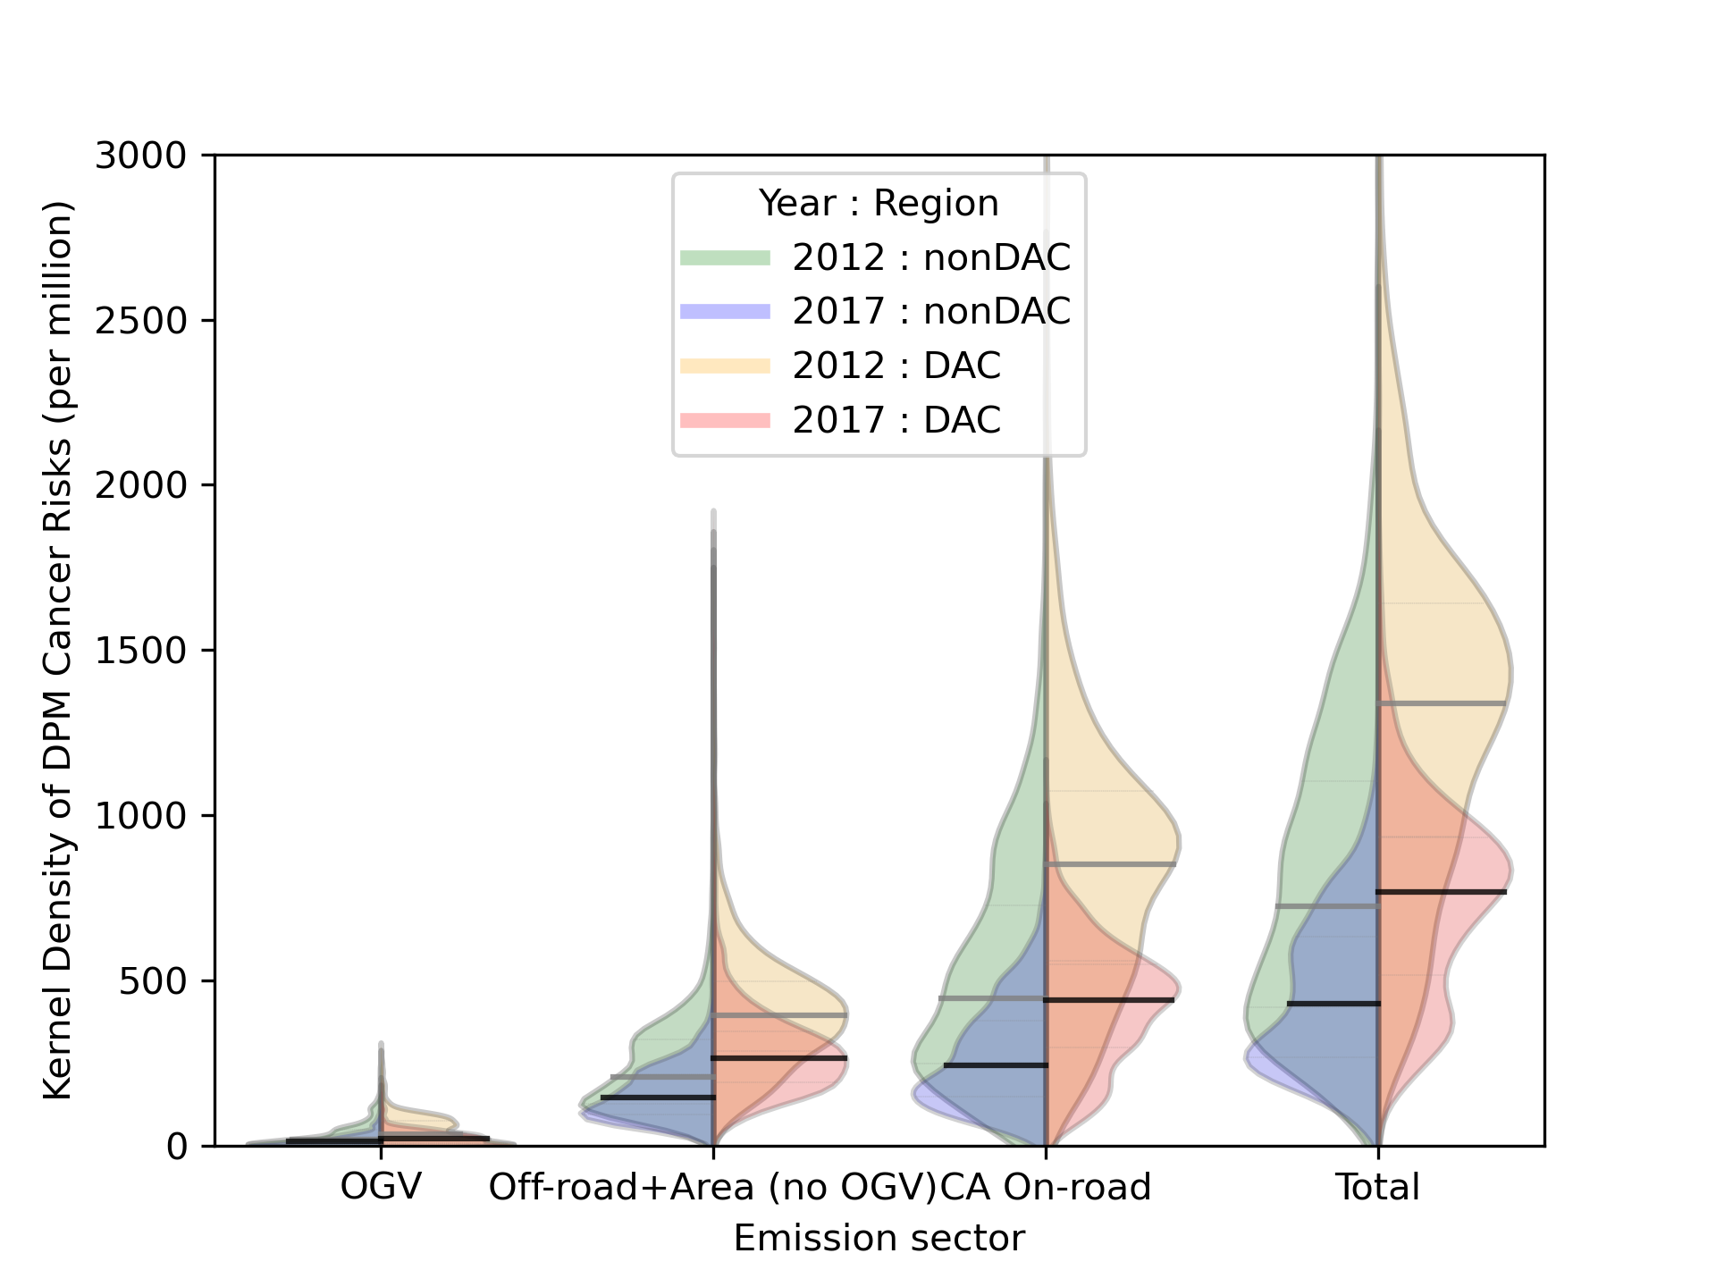
DPM Geographical Disparity in SB535 DACs by Sector
2017 Emission Sectors
2012 vs. 2017
Change in PWR:
-42%, -44%
-47%, -51%
-31%, -29%
-42%, -44%
Overall geographical disparity decreased for SB535 DACs, similar to AB617.
Smoother features than AB617 communities: larger sample size, and less local impacts (tracts more spread out).

Slide 16
Key Takeaways
  Geographical disparity was assessed between disadvantaged communities (DACs) and non-DACs under AB617 and SB535. CATA showed reductions in total cancer risks across all air basins and disadvantaged communities statewide, driven by DPM.
  In both 2012 and 2017, disparity is still present: DACs still bear a disproportionate cancer risk burden from air toxics.
  Communities in southern California had higher risks and lower reduction rates from 2012 to 2017. Potential reasons: cross-border transport, sources under less stringent regulations in southern California, e.g., ports and locomotives.
  The on-road and OGV sectors decreased disparity between DAC and non-DAC communities.

