Slide 1

Next generation atmospheric chemistry modeling with the Multiscale Infrastructure for Chemistry and Aerosols (MUSICA)
Gabriele Pfister
Mary Barth, Louisa Emmons, Matthew Dawson, Rajesh Kumar, Bill Skamarock
& many other MUSICA members
Atmospheric Chemistry Observations and Modeling (ACOM) Laboratory
NSF National Center for Atmospheric Research (NCAR)

Slide 2
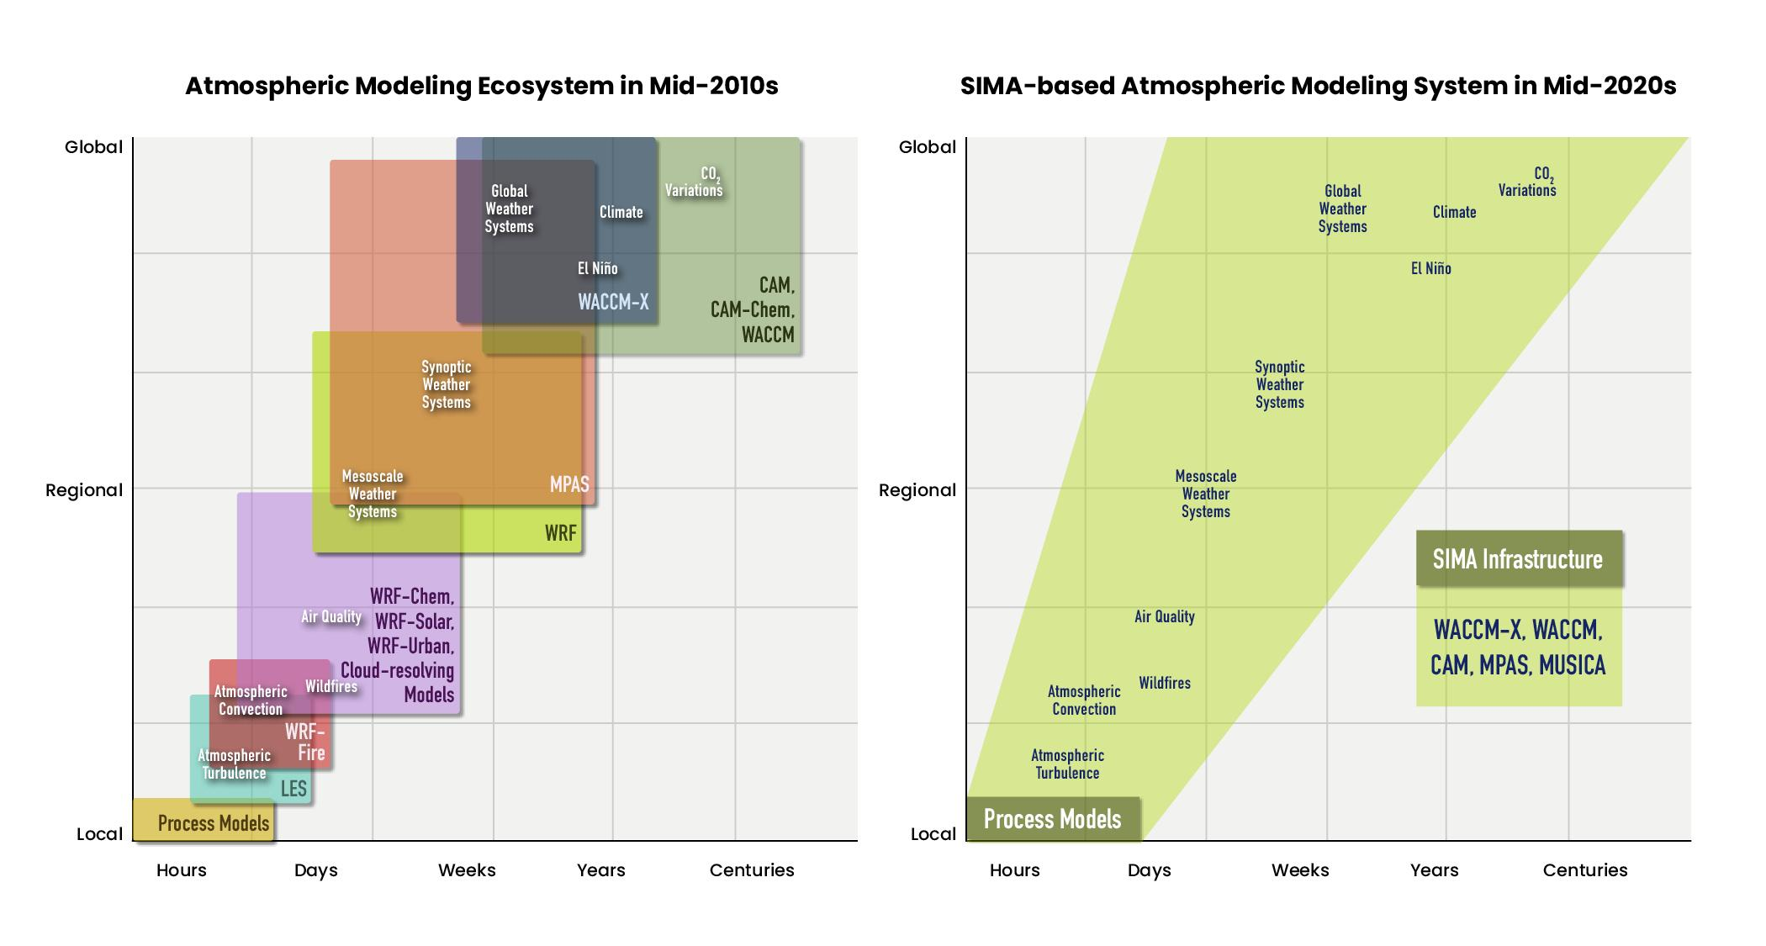
Motivation
Current
Different models for applications
at different scales
Current chemical transport models inadequately account for the two-way coupling of atmospheric chemistry with other Earth system components over the range of urban/local to regional to global scales and from the surface up to the top of the atmosphere.

Slide 3
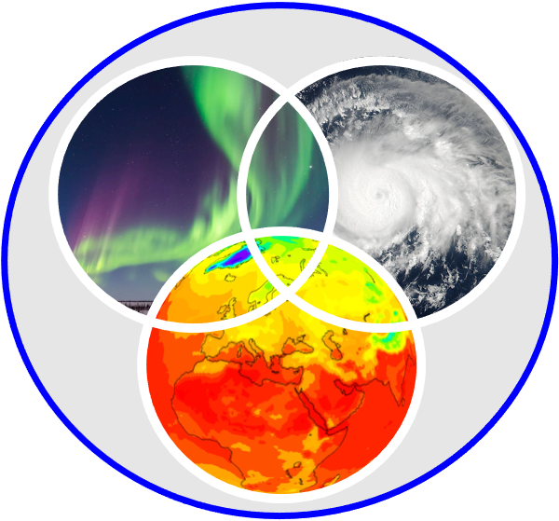
Unification of the NCAR Atmospheric Modeling System
Current
Different models for applications
at different scales
Future
Chemistry and aerosols simulated at
different scales in a coherent fashion
Global
Regional
Local
Hours Days Weeks Years Centuries
Hours Days Weeks Years Centuries

Slide 4
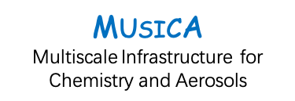
MUSICA: MUlti-Scale Infrastructure for Chemistry & Aerosols
A new model-independent infrastructure,
which will enable chemistry and aerosols
to be simulated at different resolutions in
a coherent fashion
Will facilitate use of a variety of chemistry schemes, physics parameterizations and atmospheric models
Coupled to other earth system component
models (land, ocean, sea ice, etc.)
Whole atmosphere framework: troposphere to thermosphere
Future
Chemistry and aerosols simulated at
different scales in a coherent fashion
Hours Days Weeks Years Centuries

Slide 5
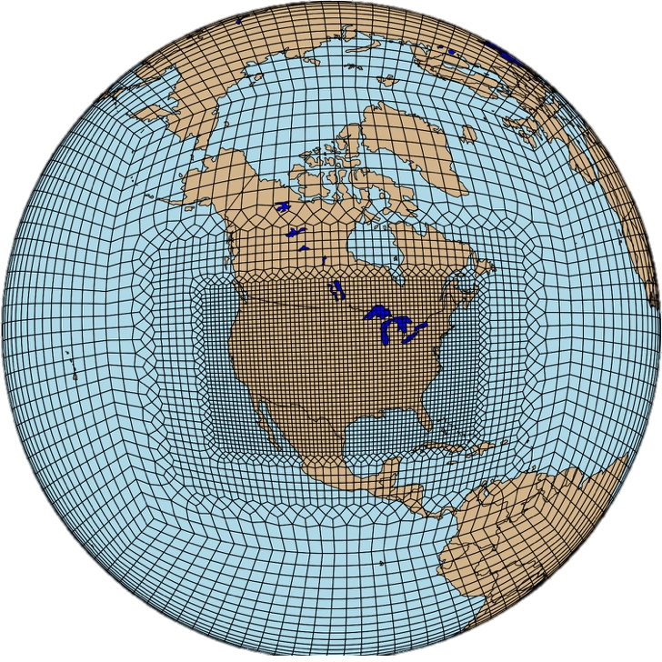
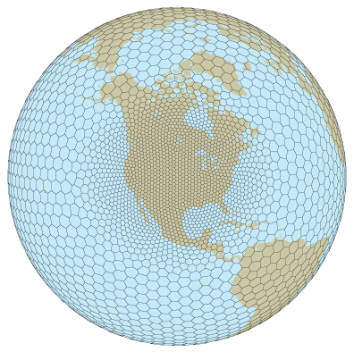
MUSICA Versions 0 and 1
MUSICAv0
MUSICAv1
CESM/CAM
CESM/CAM
Hydrostatic Spectral Element DyCore
Non-Hydrostatic MPAS DyCore
First realizations of MUSICA are a configuration of the
Community Atmosphere Model (CAM) within the Community Earth System Model (CESM)
Notes:
Still within the traditional software framework

Slide 6
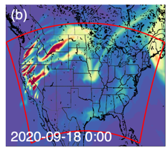
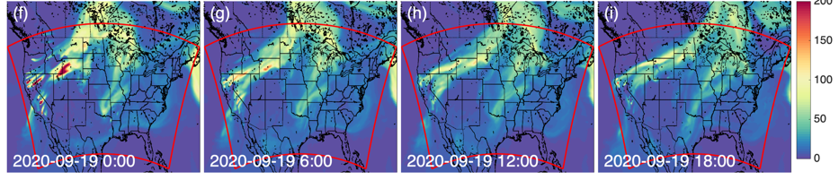
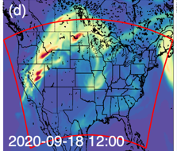
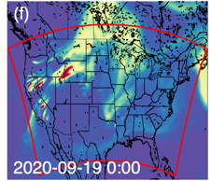
Benefits of MUSICA over limited-area models
No inconsistencies due to the use of lateral boundary conditions
Resolves influence of stratospheric ozone on troposphere
Ability to couple to all earth system components (land, ocean, ice)
CO (ppb)
Fire plumes simulated in MUSICAv0 get transported outside of, and back into, the WRF-Chem domain
Wenfu Tang et al., JGR, 2023

Slide 7
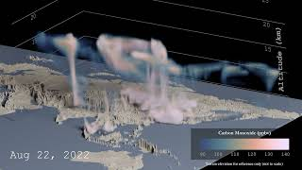
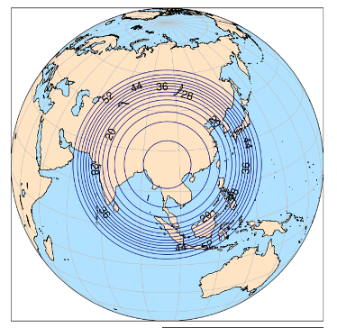
Simulating local to global connections with MUSICAv1
The 2022 ACCLIP (Asian summer monsoon Chemical and Climate Impact Project)
sampled the chemical and aerosol composition of air masses lofted by the
Asian summer monsoon into the upper troposphere and lower stratosphere.
3 km
60 km
Regional refinement alters surface
air quality and enhances the
convective transport of pollutants
by the Asian monsoon into the UTLS with global implications.
Design by R. Smith, J. Zhang, S. Honomichl (ACOM), rendering by M. Rehme (CISL)

Slide 8
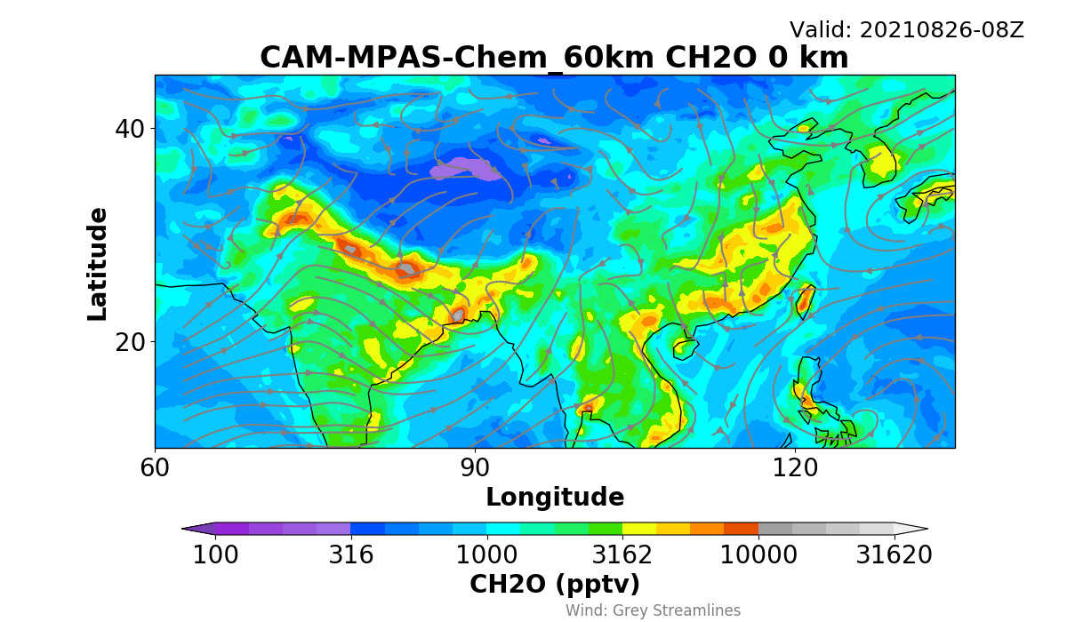
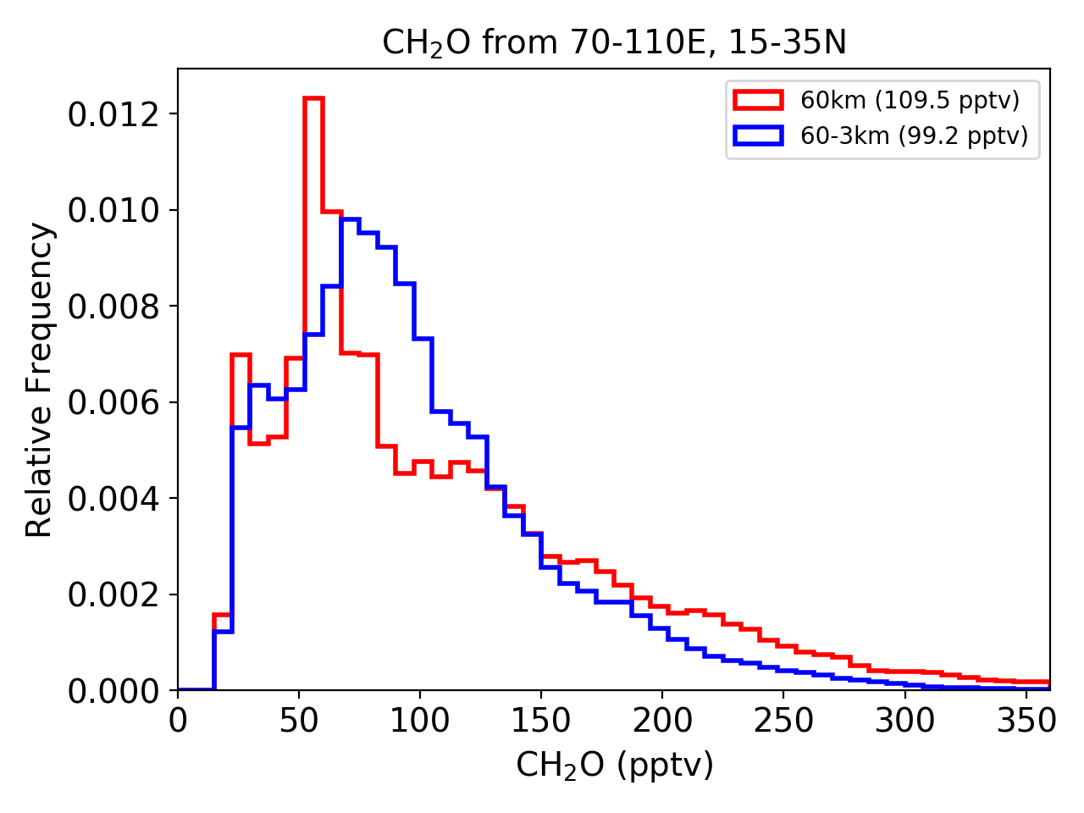

Simulating local to global connections with MUSICAv1
Regular 60km grid
Both convective transport and chemistry as well as scavenging by the convection are all playing a role in controlling the mixing ratios.
60km uniform grid
60-3km regionally refined grid
MUSICAv1 with 3km refinement
Formaldehyde @ Surface (pptv)
Formaldehyde @ 14km (pptv)

Slide 9
MUSICA Software Development Ecosystem
Industry-defined standards, modularity and efficiency
Truly model-independent components
Connected to other components through well defined & flexible interfaces
MUSICA Interface (Fortran)
MUSICA Interface (Python)
MUSICA Infrastructure
MUSICA Library (C)
MICM = Model Independent Chemistry Module
MICM (C++)
TUV-x (C++)
Aerosols (C++)
Current Development
Future Development
Proposed Development
Arrows show what each element is dependent upon

Slide 10
Software Development Ecosystem
Can be connected to any atmosphere model
NOAA
CAT-Chem (UFS)
CAM = NCAR Community Atmosphere Model
CAM-SIMA
MPAS-A
CCPP = Common Community
Physics Package
CCPP MUSICA Wrapper
MUSICA Interface (Fortran)
MUSICA Interface (Python)
MUSICA Infrastructure
MUSICA Library (C)
Interface
NCAR Atmosphere Model
MICM = Model Independent Chemistry Module
MICM (C++)
Other Atmosphere Model
TUV-x (C++)
Aerosols (C++)
Current Development
Future Development
Proposed Development
Arrows show what each element is dependent upon

Slide 11
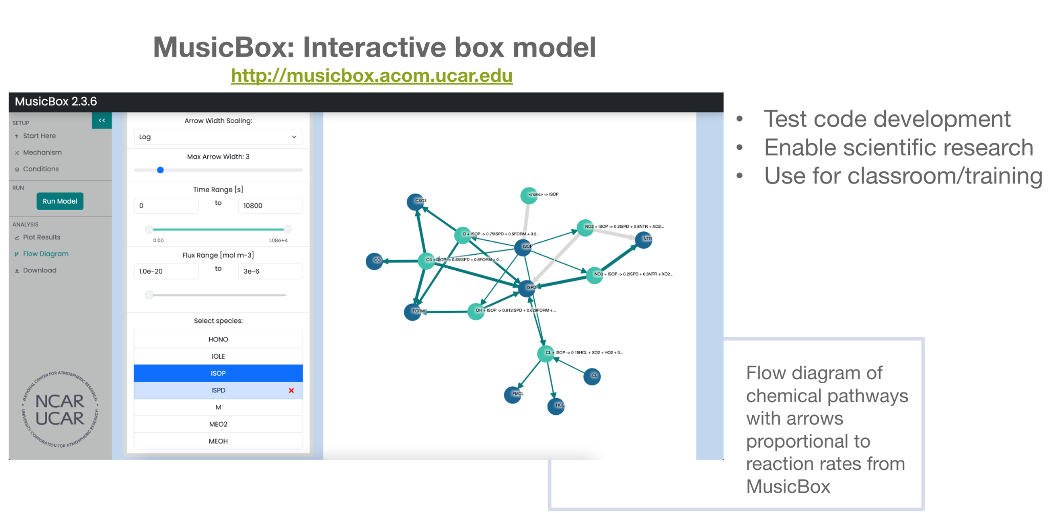
Software Development Ecosystem
Can be connected to any atmosphere model
NOAA
CAT-Chem (UFS)
CAM = NCAR Community Atmosphere Model
CAM-SIMA
MPAS-A
… or box model
CCPP = Common Community
Physics Package
CCPP MUSICA Wrapper
MUSICA Interface (Fortran)
MUSICA Interface (Python)
MusicBox
MUSICA Infrastructure
MUSICA Library (C)
Interface
NCAR Atmosphere Model
MICM = Model Independent Chemistry Module
MICM (C++)
Other Atmosphere Model
TUV-x (C++)
Aerosols (C++)
Current Development
Future Development
Proposed Development
Arrows show what each element is dependent upon

Slide 12
Software Development Ecosystem
Can be connected to any atmosphere model
NOAA
CAT-Chem (UFS)
CAM = NCAR Community Atmosphere Model
CAM-SIMA
MPAS-A
… or box model
CCPP = Common Community
Physics Package
CCPP MUSICA Wrapper
MUSICA Interface (Fortran)
MUSICA Interface (Python)
MusicBox
MUSICA Infrastructure
MUSICA Library (C)
Interface
NCAR Atmosphere Model
MICM = Model Independent Chemistry Module
MICM (C++)
Other Atmosphere Model
TUV-x (C++)
Aerosols (C++)
Current Development
Future Development
Proposed Development
Arrows show what each element is dependent upon

Slide 13
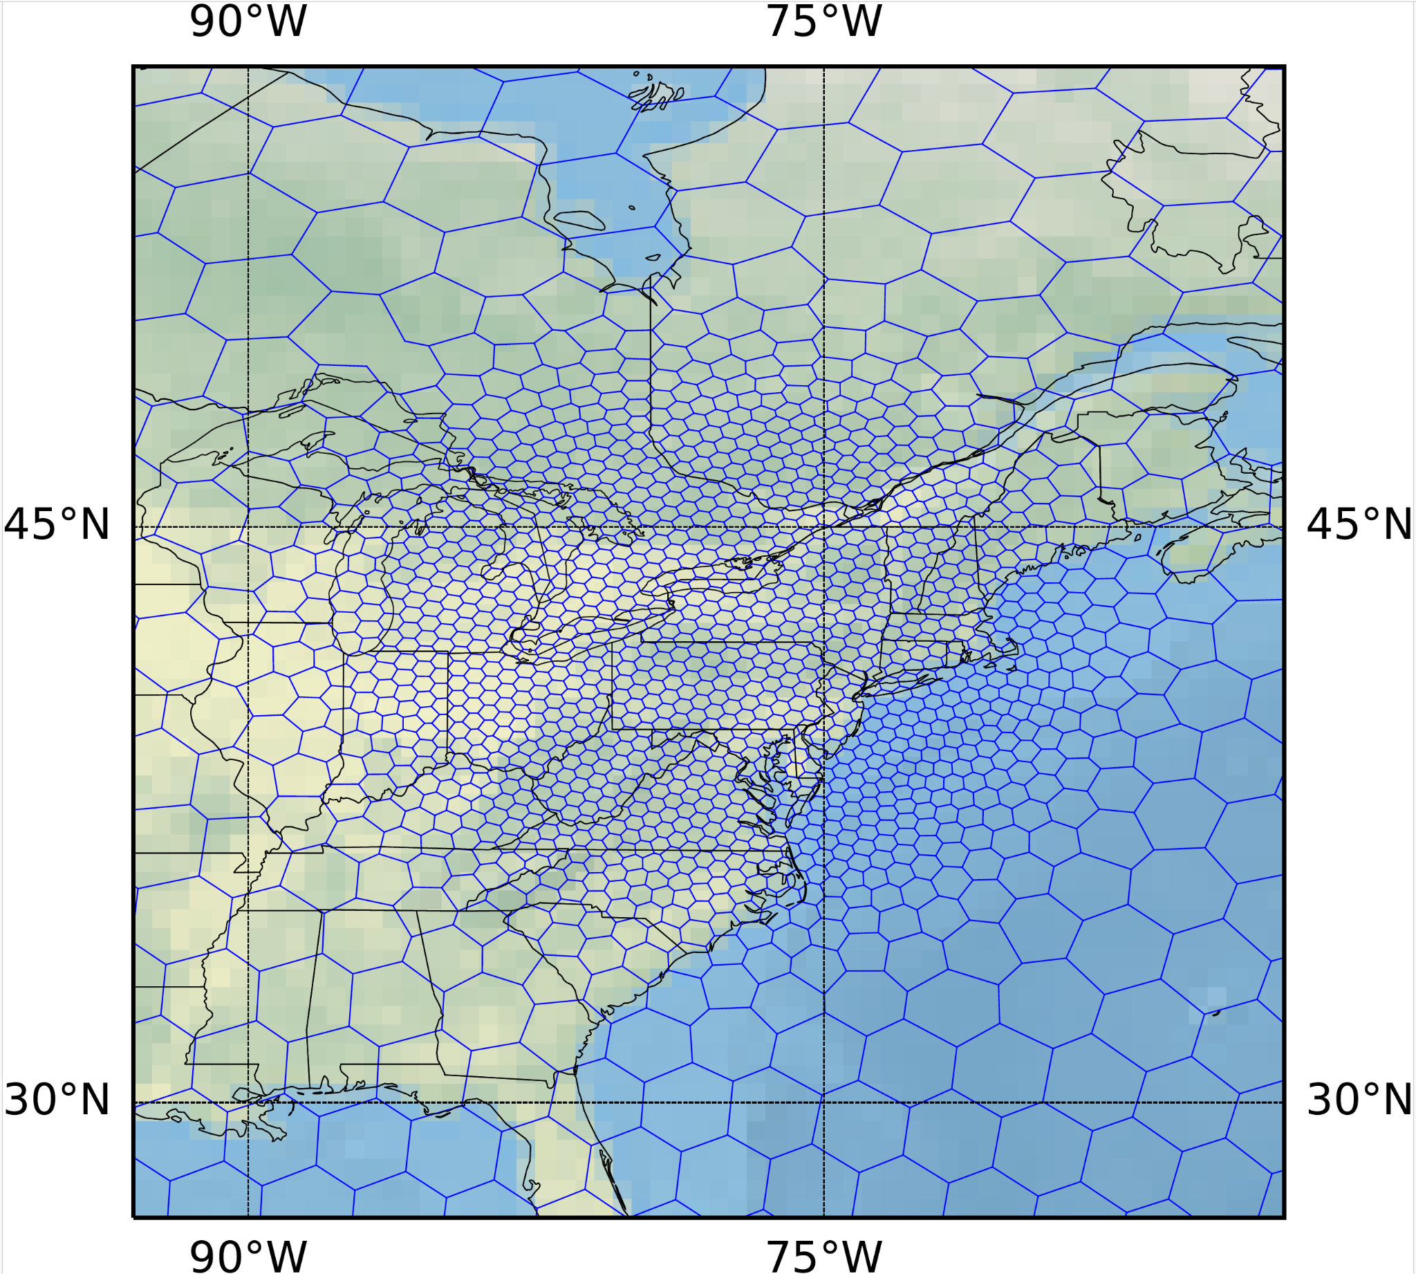
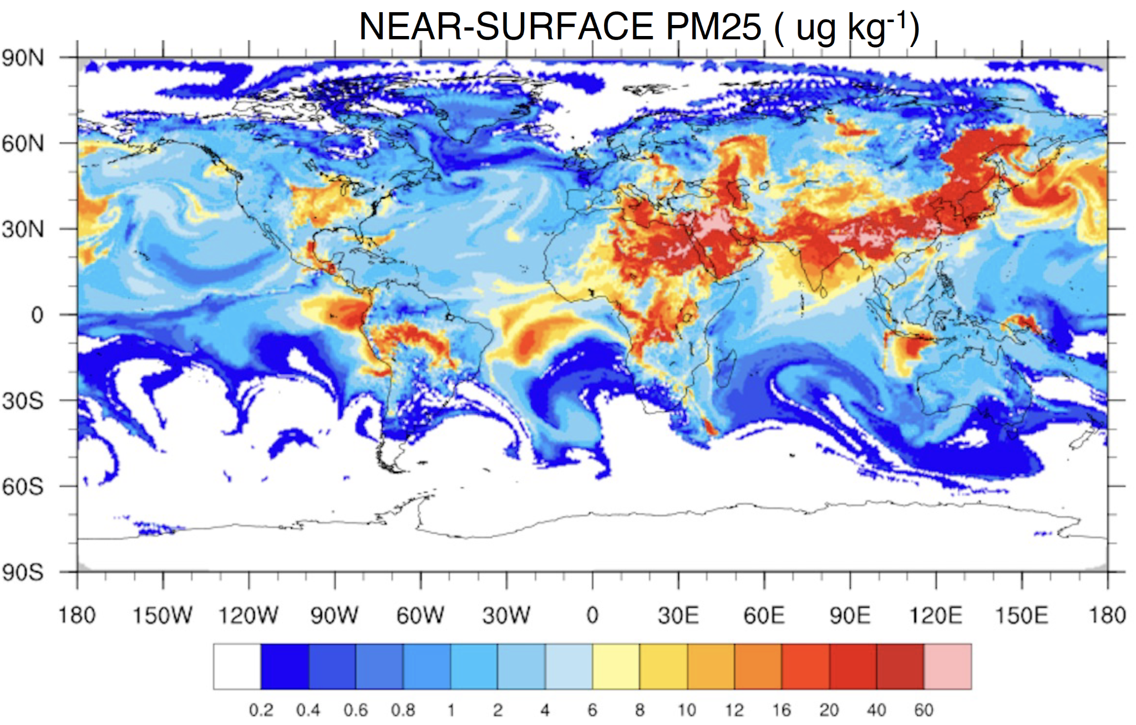
MUSICA Library in MPAS-A
MPAS-A = Model for Prediction
Across Scales - Atmosphere Model
WRF is still supported but being transitioned to MPAS-A
WRF-Chem is no longer developed and support is limited
Need for MPAS-A with Chemistry
Initial and current step:
Currently adding GOCART-2G bulk aerosol scheme and a
tracer option to MPAS-A (pilot version)
  With MPAS-A-JEDI can extend the analysis variables to aerosol species
  Working on adding a fire plumerise calculation
    Planning stage:
    Add full gas-phase chemistry to MPAS-A through MUSICA Library
    Collaborations with NOAA, EPA and university partners are being
    developed to further advance MPAS-A-Chem
    Resources for this development work is very limited currently
    No timeline yet of when MPAS-A-Chem code releases will begin

Slide 14
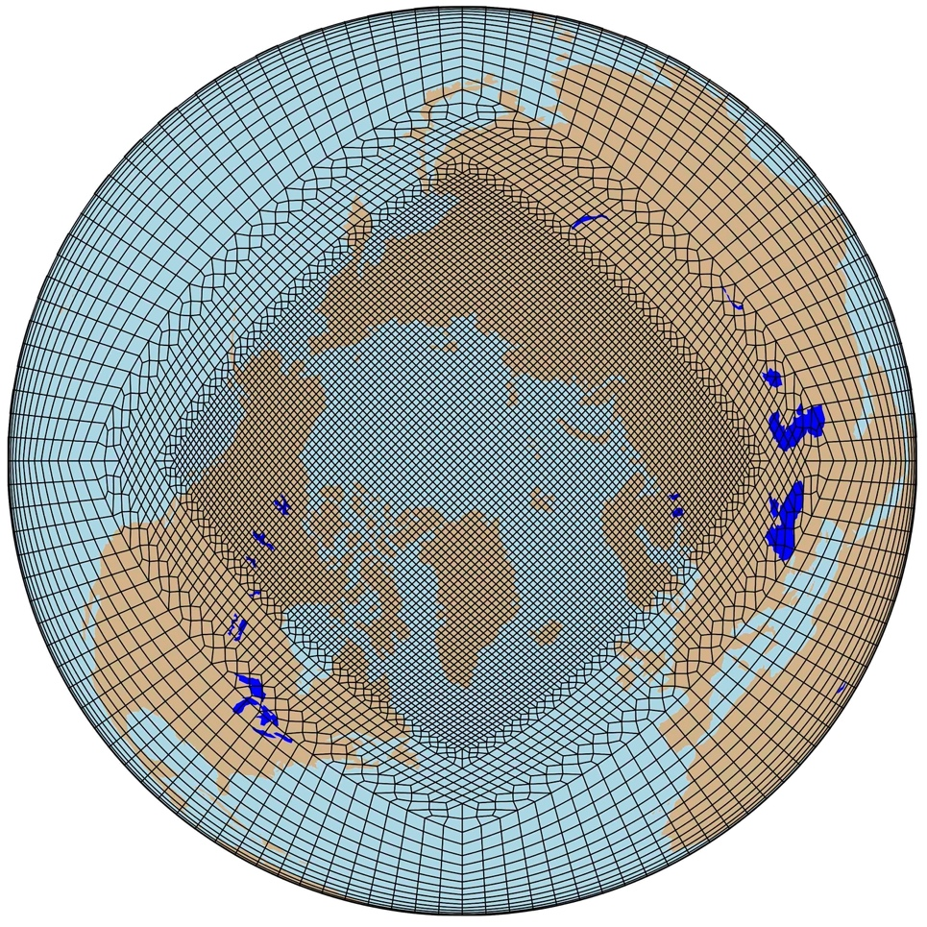
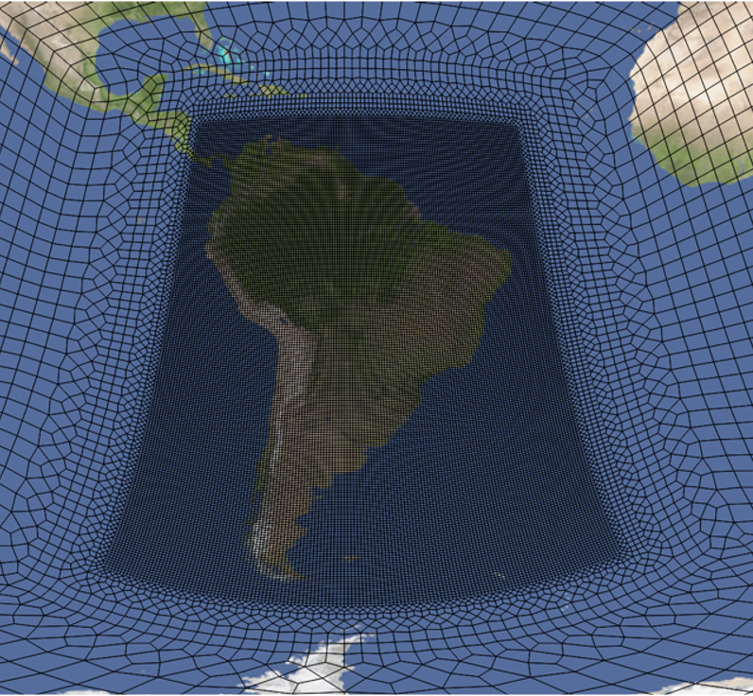
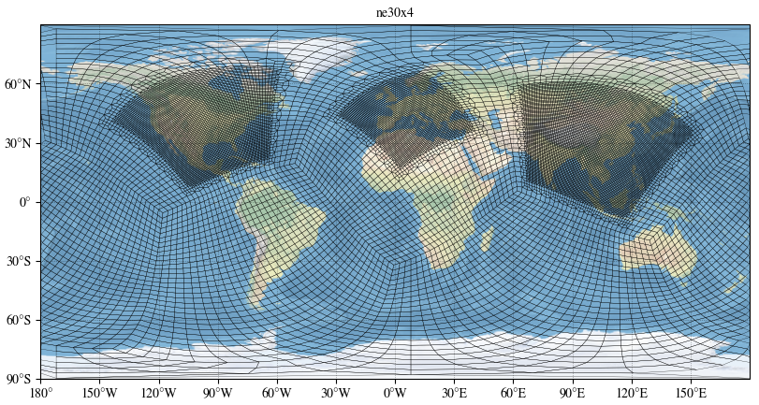
Take-away message
MUSICA
To be developed collaboratively with university and government researchers
To become the next-generation community infrastructure for atmospheric chemistry & aerosol research
To contribute to both advancing the science and to providing relevant and actionable information for the development of mitigation policies or warning systems
Currently being implemented in MusicBox and CESM;
in planning stage: UFS and MPAS-A
Community Involvement
Use released model configurations
Use existing output
Contribute to development
MUSICA website

Slide 15
EXTRAS

Slide 16
Software Development Ecosystem
Opportunity to bring in partner models and modules
NOAA
CAT-Chem
CAM-SIMA
MPAS-A
GEOS-Chem
CCPP MUSICA Wrapper
MUSICA Interface (Fortran)
MUSICA Interface (Python)
MusicBox
HEMCO
HEMCO = Harmonized Emissions Component
MUSICA Infrastructure
MUSICA Library (C)
Interface
NCAR Atmosphere Model
MICM = Model Independent Chemistry Module
MICM (C++)
ISORROPIA
Partner Atmosphere Model
TUV-x (C++)
Partner Chemistry Modules
Aerosols (C++)
Cloud-J
Current Development
Future Development
Proposed Development
Arrows show what each element is dependent upon
Notes:
And finally there is also the opportunity to bring in partner models, either directly into the MUSICA Library. While strictly speaking outside of MUSICA but still connected is also the link to GEOS-Chem and HEMCO through SIMA-CAM.
As part of inclusion of GEOS-Chem in MUSICA, several components are being connected as modules:
HEMCO emissions tool
ISORROPIA gas-aerosol exchange module
CLOUD-J photolysis calculations

Slide 17

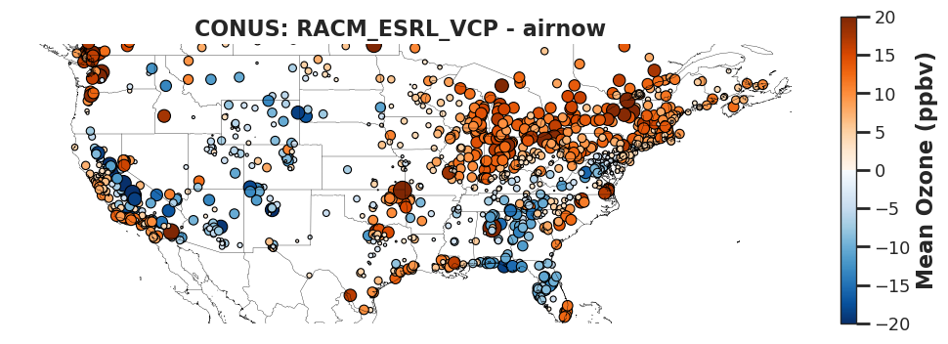
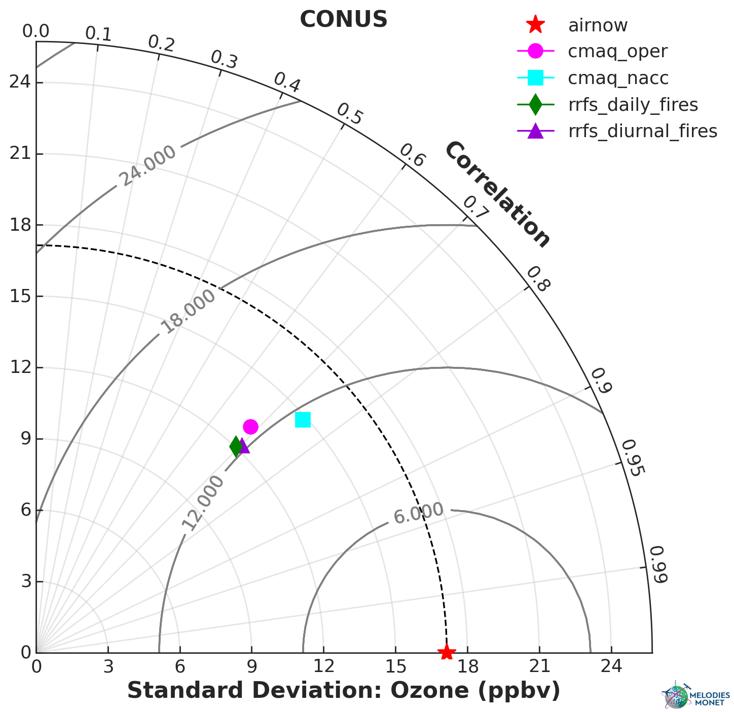
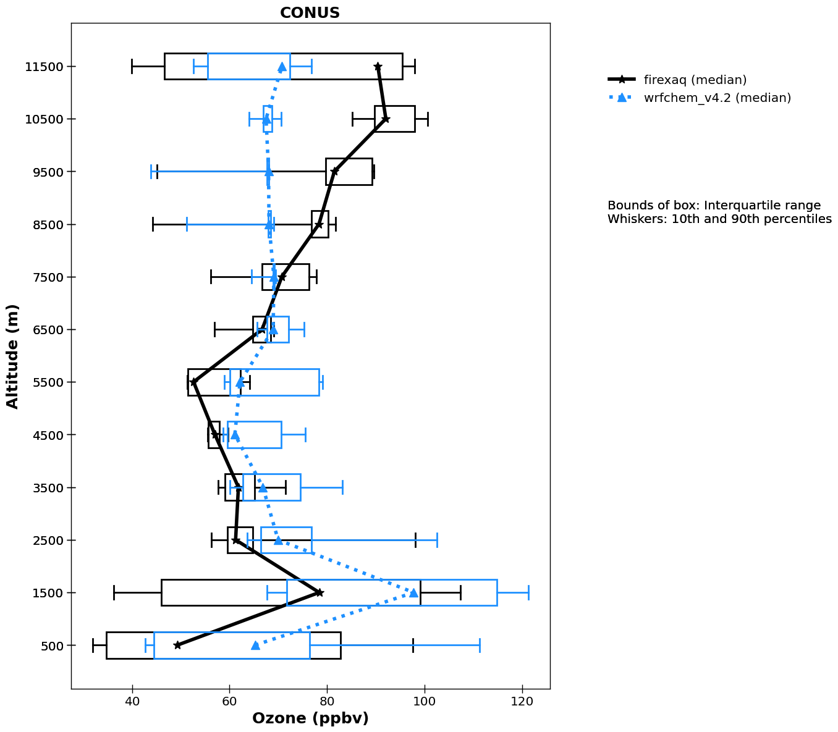
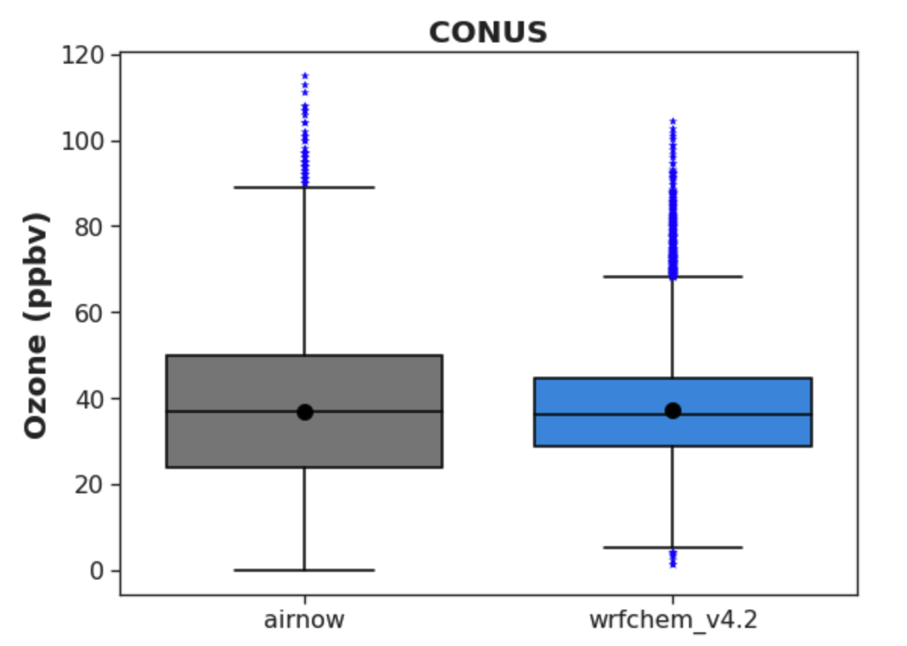
Model Evaluation made easy
A modular python-based framework to compare model results and observations of atmospheric chemistry from various platforms
A collaboration between NSF NCAR and NOAA
YAML configuration file
Read model
Read obs
WRF-Chem
WRF-CMAQ
CAMx
MERRA-2
CAM-Chem
RAQMS
UFS-AQM
Surface Data
Aircraft Data
Satellite Data
Match model to obs
Plots, statistics,
data output
Source code publicly available: https://github.com/NOAA-CSL/MELODIES-MONET
Notes:
And one last effort as part of MUSICA I want to mention is MELODIES MONET which is …
MELODIES MONET works for a variety of models, so is also a great tool to compare different models to each other.
mention TEMPO evaluation possible now

