Slide 1
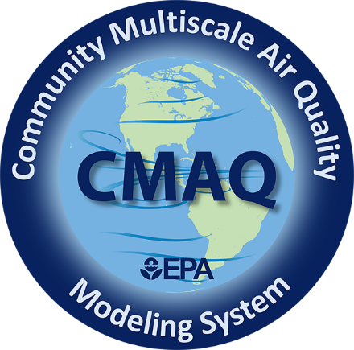
Connecting Disparate Scales in Air Pollution Modeling:
Perspectives from Development and Applications of the CMAQ Modeling System
Rohit Mathur & The CMAQ Team
Center for Environmental Measurement and Modeling
Disclaimer:
The views expressed in this presentation are those of the authors and do not necessarily reflect the views or policies of the U.S. EPA.
US EPA Office of Research and Development
Center for Environmental Measurement and Modeling
23rd Annual CMAS Conference
October 21-23, 2024
Notes:
Focus on scales of several km and up

Slide 2
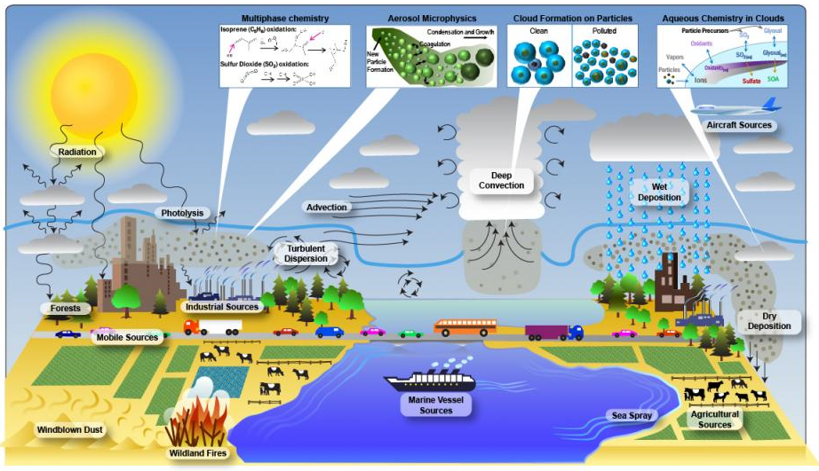
Background
Atmospheric processes are inherently complex in that they occur over disparate space and time scales
The complexity of physical and chemical atmospheric processes, combined with the enormity of the atmosphere, make results obtained from laboratory and field experiments difficult to interpret without a clear conceptual model of the workings of the atmosphere, e.g.:
  Extrapolation of results to other geographic areas
  Assessing atmospheric chemical state in response to emission perturbations
Managing air quality requires an evolving understanding of complex interactions between physical, dynamical, and chemical processes over varying space and time scales
Notes:
Aerosol and cloud microphysics involve particle and droplet size in the um range; intercontinental transports spans 10s of thousands of km
Tail pipe emissions evolve chemically within a few meters of their release while international shipping span the vast oceanic regions across the globe
Chemical reactions involve reaction rates that span several orders of magnitude amongst species whose lifetimes span seconds to several days

Slide 3
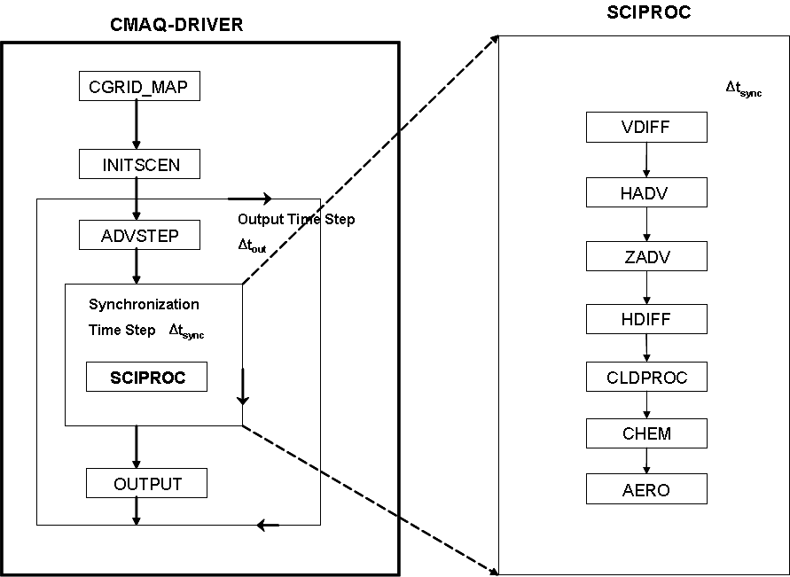
Model Formulation and Solution Methods
Convey the varying process space & time-scales
Generalized Coordinate Formulation
Solution Method: Fractional Steps
horizontal
advection
vertical advection
horizontal
diffusion
vertical diffusion
chemistry
emissions
clouds
aerosols
where,
encapsulates coordinate transformation from physical to computational space
Notes:
Longer term simulations over larger domains reduce the impact of initialization and LBC specification and increase the emphasis on representing the source-snik balance across scales are intended in the formulation of the governing equations.
The fractional step method also implicitly conveys that for an accurate and stable numerical solution, processes with the largest characteristic time scale (i.e., slowest evolving process) be solved first

Slide 4



Process Time-scales: Example
Approximate time-scale for air masses
to traverse US East-West
Approximate Time-scales for Vertical Mixing
$${∆t}_{adv}=\frac{∆x}{u}$$
Mixing time-scale,
$$∆t≅ \frac{{\left(∆z\right)}^{2}}{K_{z}}$$
$\frac{∂c}{∂t}= \frac{∂}{∂x}(uc)$ or
Tropopause
(~10-15km)
PBL ventilation with
mid-troposphere
~ month
Daytime PBL (~1-3 km)
~ week
< day
Surface
Air masses in the free-troposphere can laterally traverse the continental U.S. in ~week
Atmospheric “turn-over” from vertical mixing over the region could occur at comparable time-scales
Atmospheric space and time scales are linked
  Longer regional scale simulations will be impacted by influences from outside
Δx_{US East-West} ~ 4500km

Slide 5
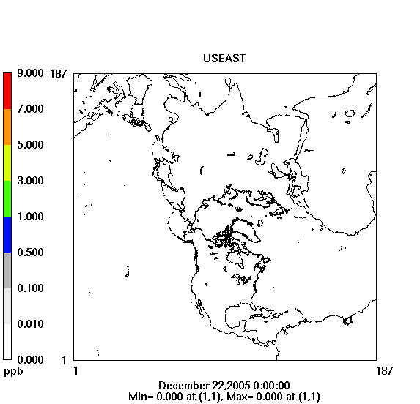
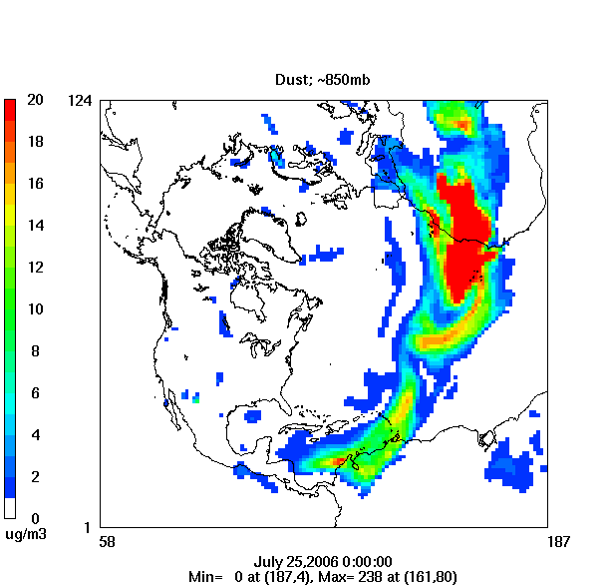
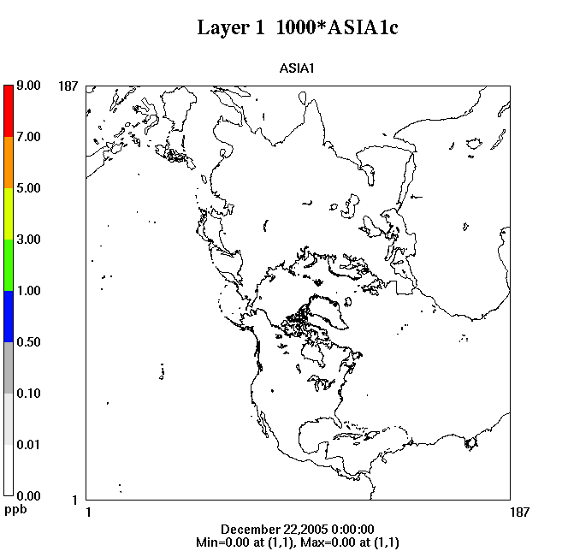
Multiscale Modeling Need
Air pollution has no boundaries
CMAQ Simulation of
Trans-Atlantic Transport of Saharan Dust
Pollutants near the Earth’s surface can be lofted to higher altitudes where strong winds can efficiently transport then from one continent to another
Examining U.S. air quality in context of the changing global atmosphere
Notes:
Air pollution has no boundaries. Both tracer transport tests and actual simulations of Saharan dust transport illustrate that emissions from one continent can be convectively lofted to the FT where efficient winds can transport them inert-continentally in 5-10 days.
Infact as illustrated in the tracers examples continental outflow can also be subject to recirculation which then modulate the perceived “background” to that region itself. Nonlinear chemical evolution of chemically active trace species in these air masses necessitate the consideration of chemical reactions that influence not only near-source features but also evolution of the emitted species as well as longer lived reservoir species that can undergo multi-day transport and chemical evolution.

Slide 6
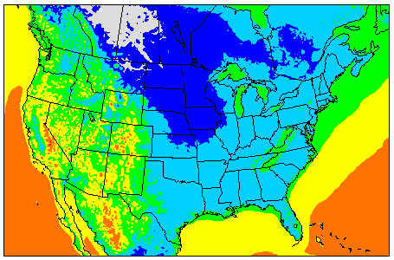
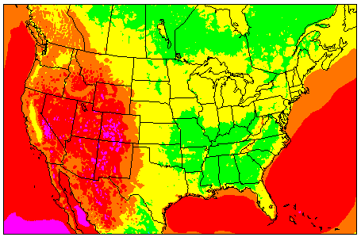
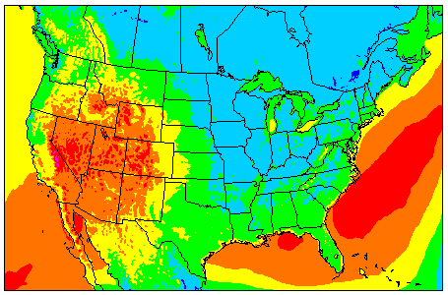
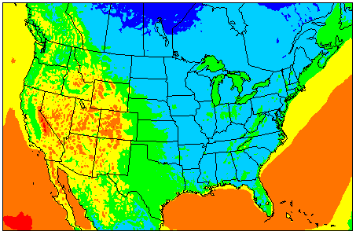

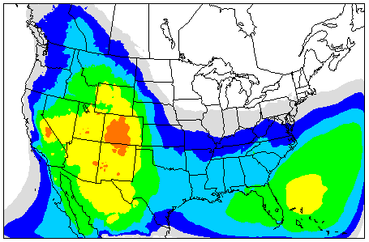
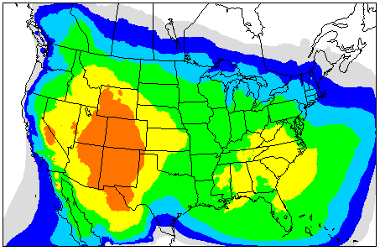
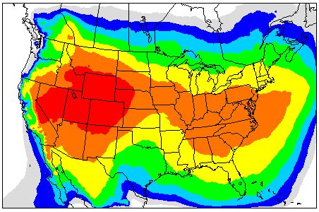
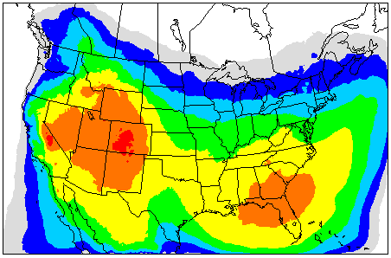
A Regional Model’s View of “Background” Pollution:
Spatial & Seasonal Variability
Diagnostic tracers
BL: Surface – 750 hPa; FT: 750-250 hPa; ST: 250-50 hPa
“background” concentration = originating from outside the model domain
Winter
Spring
Summer
Fall
Surface-level Model “Background” Normalized Concentrations
Fractional Free Tropospheric Contribution
Spatial & seasonal variability in “background” values, with higher values in warm seasons (spring & summer)
More than half of the surface/boundary layer background is dictated by long-range transport occurring above the nominal daytime boundary layer

Slide 7
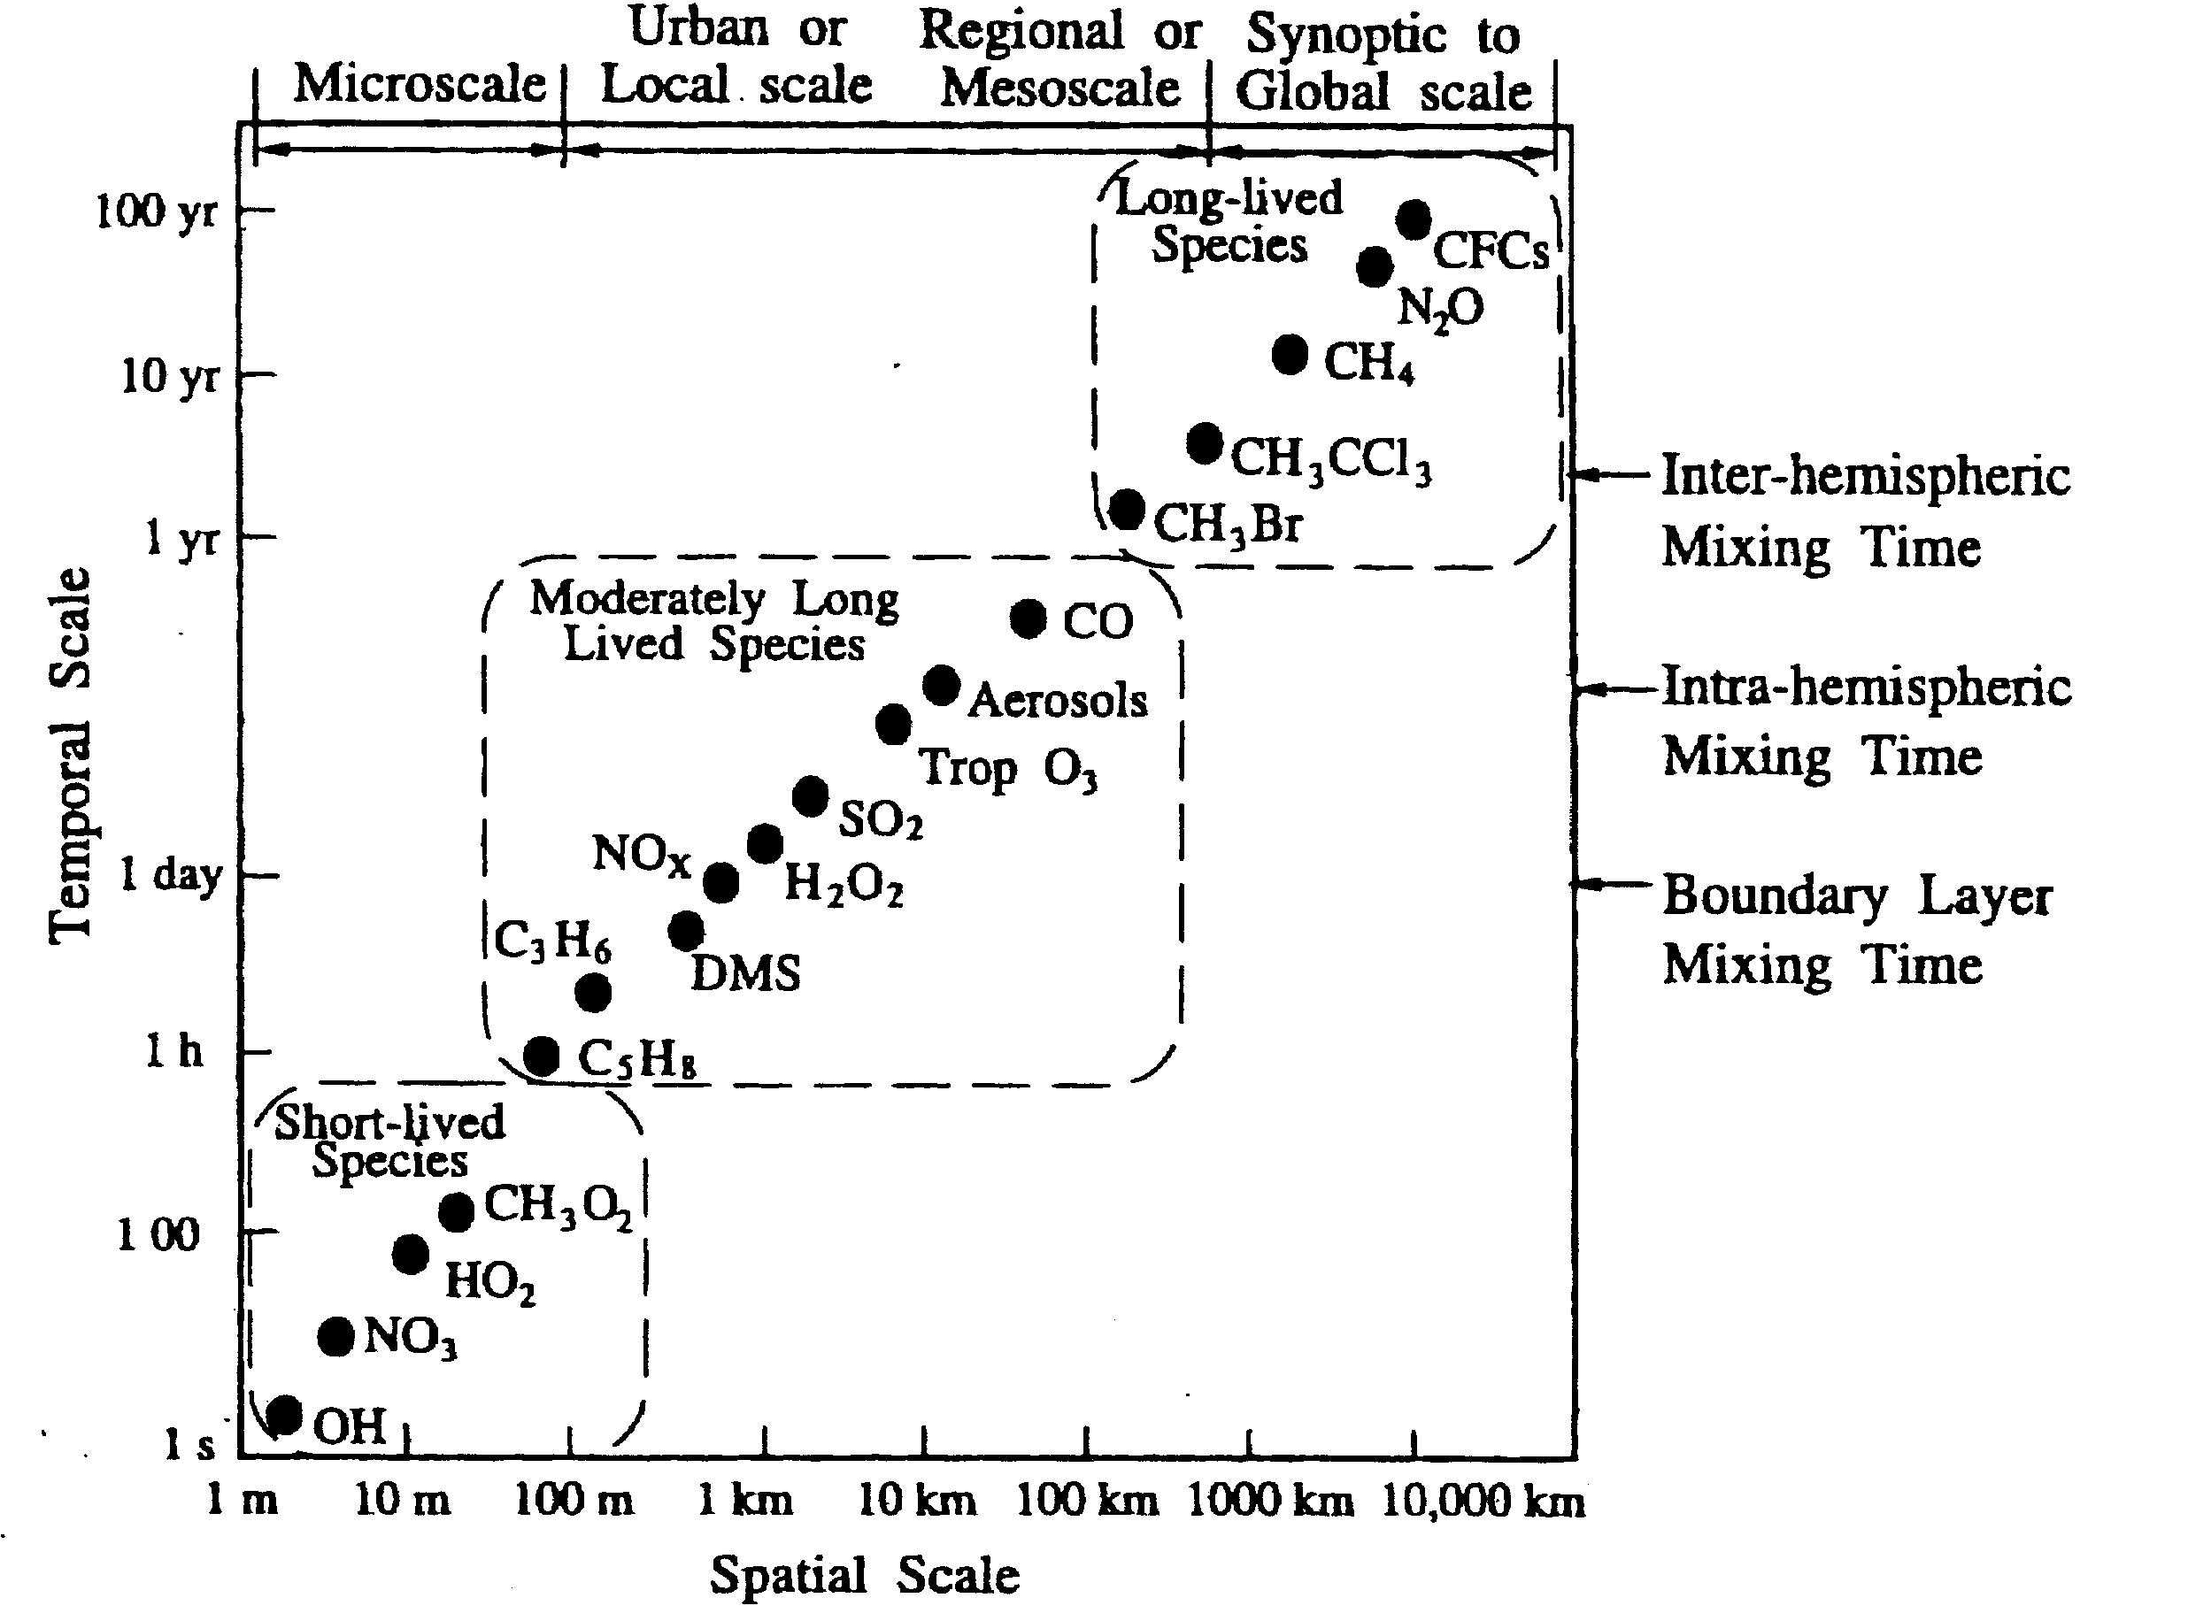
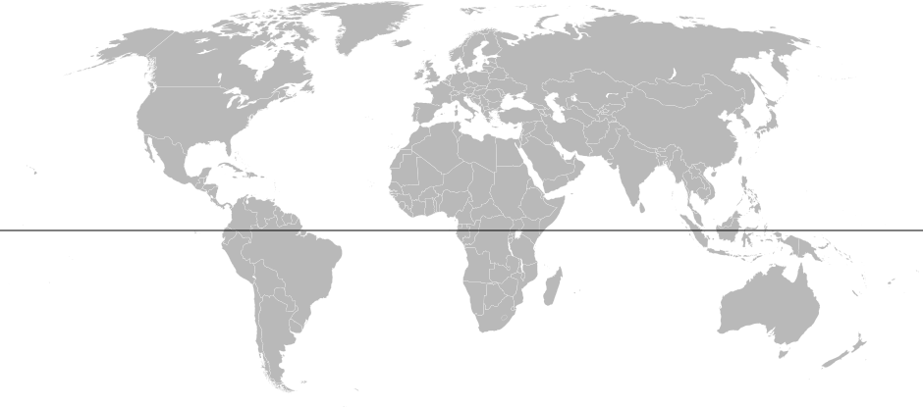
Air Pollution Space and Time Scales are Linked
Air pollution transport pathways
Midlatitude-
Arctic Exchange
(1-4 weeks)
days
Cross-Atlantic
(days-weeks)
Midlatitude-
Tropics Exchange
(1-2 months)
Cross-Pacific
(days-weeks)
Inter-hemispheric exchange (~ 1year)
Seinfeld and Pandis
Most air pollution issues arise from interactions between chemical species that exhibit characteristic space and time scales that span several orders of magnitude
Atmospheric chemistry-transport models need to represent the interactions between various physical, chemical and dynamical processes over spatial scales ranging from a few to thousands of kilometers laterally, from the surface to the upper troposphere vertically, and on temporal scales ranging from a few seconds to annual cycles.

Slide 8
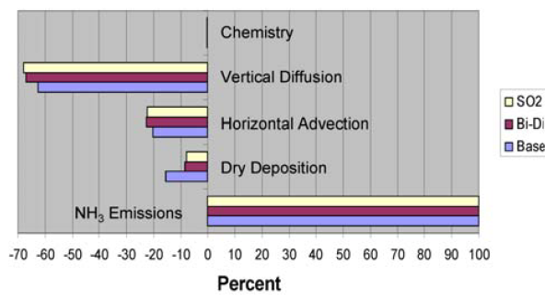
Multiscale Process Interactions Example
Fate of NH₃ Emissions: sensitivity to dry deposition
NH₃ Range of influence
Distance within which 50% of emission deposit
Regional Fate of NH₃ emissions
NH_{x} budget for surface layer: Sampson County cell
Fate of NH_{x} at surface dominated by turbulent mixing that transports majority of surface NH₃ emissions up and away
Local dry deposition flux 8-15% of emissions
NH₃ transport distance depends on the magnitude of the wet+dry deposition flux
Range of influence of a single cell’s emissions is sensitive to uncertainty in NH₃ dry deposition
At regionally representative distances (~500km), wet and dry deposition differences offset each other
For all dry deposition cases, ~25% of the regional emissions are transported out
Process interactions influence inferences across scales
Dennis et al. (2010); doi: 10.5094/APR.2010.027

Slide 9
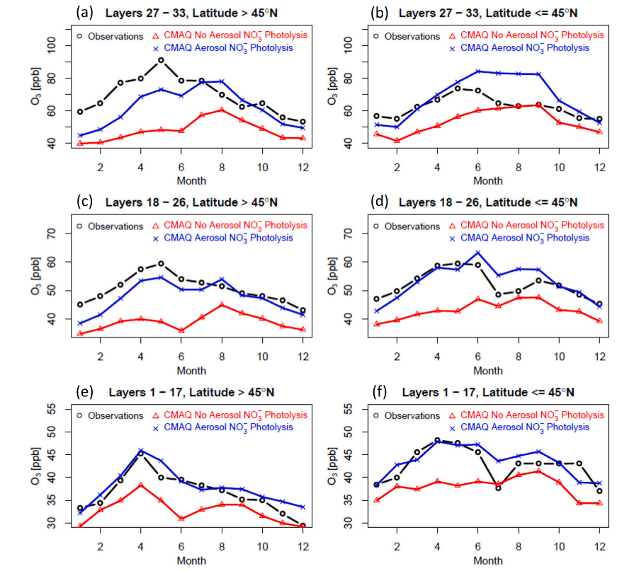
Multiscale Process Interactions Example
Impacts of NO_{x} recycling on O₃ production across scales
Experimental and observational studies suggest that nitrate photolysis in aerosol particles is accelerated by many orders of magnitude relative to bulk solution reaction, but factors and mechanisms affecting pNO₃⁻ photolysis remain controversial
pNO₃⁻ → 0.33NO₂ + 0.67 HONO J_{pNO3} = EF x J_{HNO3} EF = 100([SSA]/([SSA]+[pNO3])
NO_{x} sequestered in reservoir organic nitrates and pNO₃ can get transported away from regions of origin
The rate of recycling of this NO_{x} influences O₃ production and distributions through the mid-troposphere and across hemispheric scales
Declining global SO₂ emissions and consequently pSO₄ levels lead to increased pNO₃ tropospheric burden and increasing relevance of the pNO₃ pathway in modulating large-scale tropospheric O₃ (e.g., Shah et al., GRL, 2024)
► NO_{x} recycling from pNO₃⁻ photolysis is influential in modulating large-scale O₃ distributions
See G. Sarwar’s talk at 1:40pm
Courtesy: Golam Sarwar; https://doi.org/10.1016/j.scitotenv.2024.170406

Slide 10
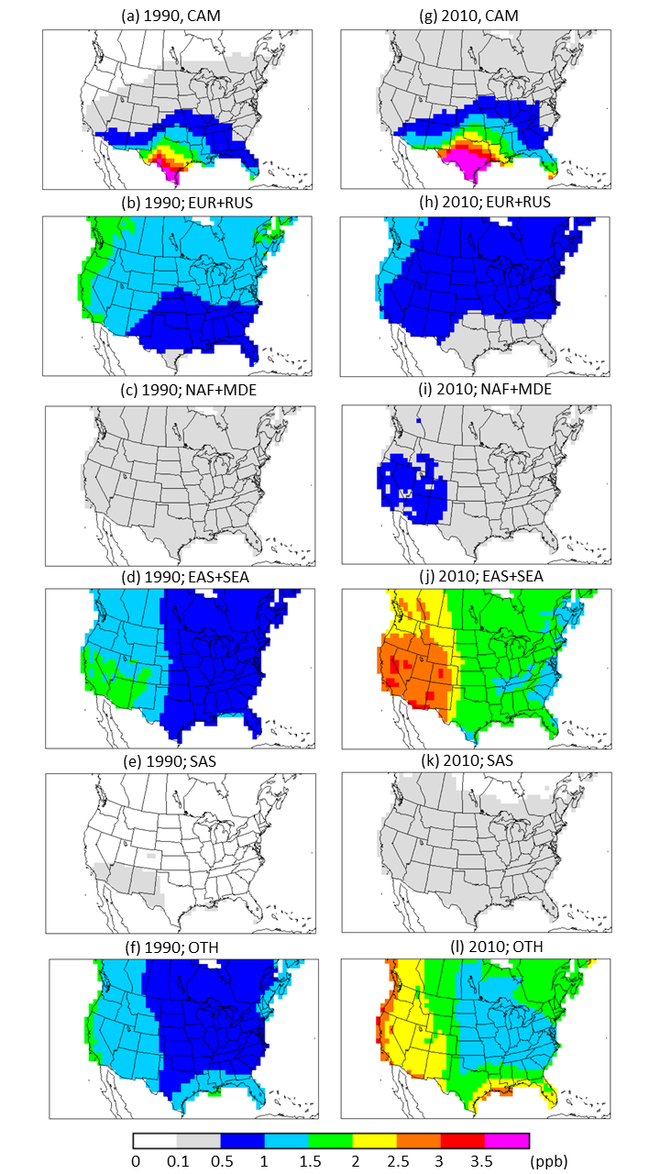
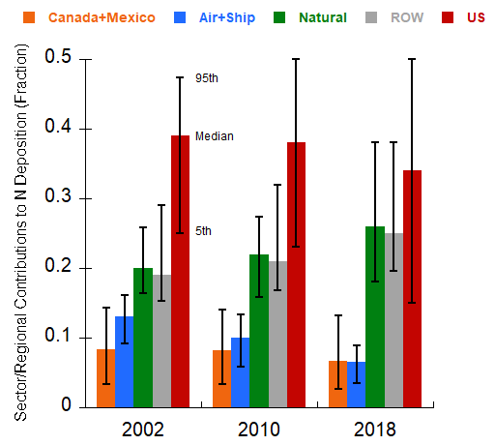
Do Process & Scale Interactions Change Over Time?
Long-range transport change Impacts
Contributions to LRT O₃
Source Region/Sector Contributions to U.S. N-Deposition
Central America
Europe+Russia
N. Africa
+
Middle East
East Asia
+
SE Asia
South Asia
Increasing prominence of contributions from other world regions and natural sources to U.S. air quality & nitrogen deposition, as domestic emission controls reduce local source contributions
Are process interactions across multiple scales also changing due to changes in dynamical (climate) and chemical (emission) state of the atmosphere?
Oceans
(International Shipping)

Slide 11
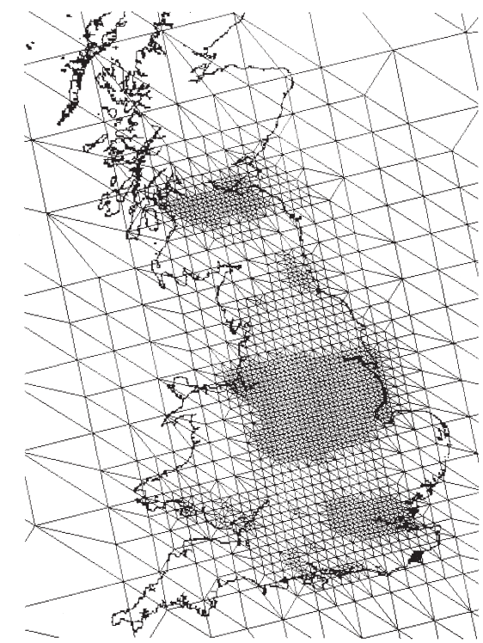
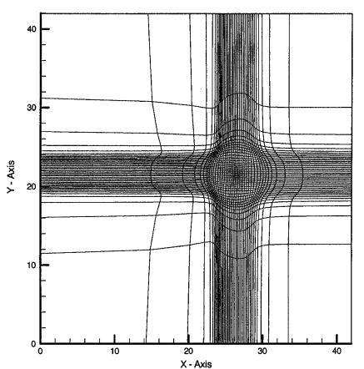
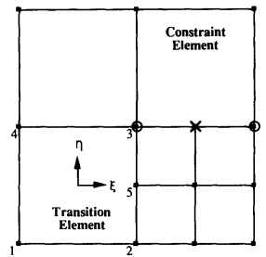
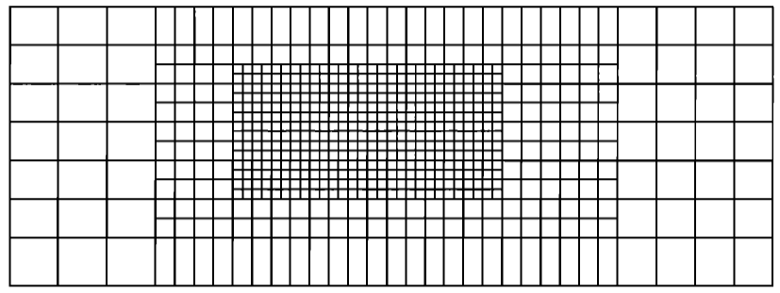
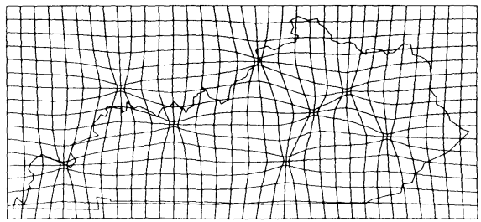
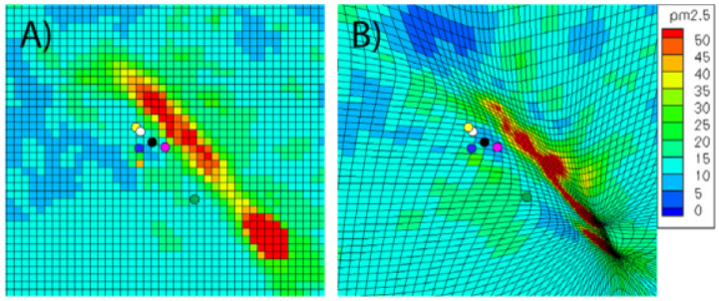
Multiscale Methods
Representing Interactive Scales through Mesh Refinement
Air pollution modeling over UK
Puff transport and chemistry
Idealized cases; Application to southern California
Odman et al. (1991); Kumar et al. (1993)
Idealized cases; Downwind evolution from source clusters
Tomlin et al. (2000)
Srivastava et al. (2000)
Plume transport & chemistry
Mathur et al. (1991)
Provides finer resolution where needed
In all cases, mesh refinement was found to yield a more accurate representation of near-source gradients and downwind transport
Garcia-Menendez et al. (2010)
Notes:
Mesh refinement is a common approach used in many fields involving fluid flow to represent interactions across scales. Over the past 3 decades many attempts have been made to apply similar approaches to air pollution transport and chemistry problems. A hinderance for their operational use has likely been the lack of comparable systems for atmospheric dynamics - Until recently, operational meteorological models employing similar approaches were not available.

Slide 12
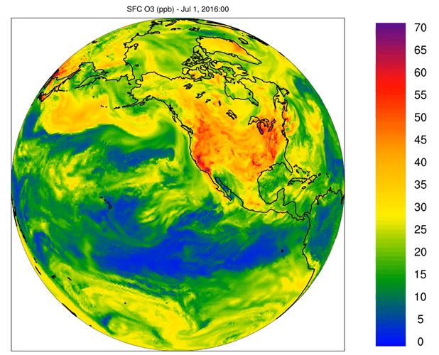
Consistent Representation of Air Pollution Process-Interactions Across Scales
Structured mesh refinement
Linking CMAQ with the Model for Prediction Across Scales (MPAS)
Seamless mesh refinement to local scales
  Finer resolution in regions of interest
  Coarser resolution across rest of the world to capture
  interactions with large-scale processes
Long-range O₃ Transport
Pleim et al., EM, 2019; Wong et al., GMD, 2024
Courtesy: Jeff Willison

Slide 13
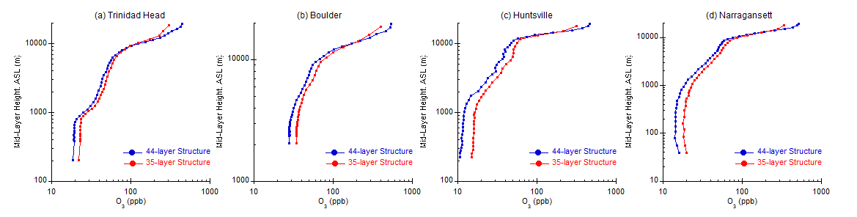
Vertical Resolution is (also) Important
Impact of layer configuration on simulated monthly-mean O₃ vertical profiles; zero-out of U.S. emissions
Finer resolution above the boundary layer is needed to represent
  Long-range transport (LRT) in the free troposphere
  Stratospheric Tropospheric exchange (STE) processes
  Influences from cloud mixing both at the sub-grid- and resolved scale
Coarser vertical resolution likely overestimates the downward transport of both LRT and STE effects
Mathur et al. (2017)

Slide 14
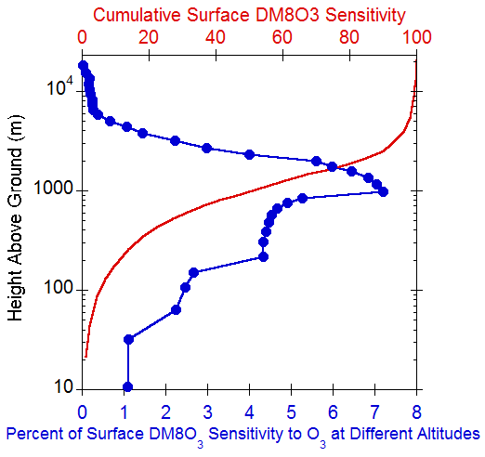
Are Surface Network Observations Sufficient for Evaluating Multiscale Modeling?
Need for Multiscale Observations
Spatial correlation in nocturnal O₃
CMAQ derived e-folding distance
CMA-adjoint Sensitivities
DM8O₃ to O₃ at different altitudes
Largest sensitivity of surface DM8O₃ is to O₃ aloft
~80% of the DM8O₃ sensitivity could be captured by improved characterization of O₃ distributions between 200-1200m
Air pollution in the residual layer provide direct information on pollution imported to a location
10m AGL
400-500m AGL
e-folding distances increase with altitude
>200km in the nocturnal residual layer
Sparser density of measurements needed to characterize spatial variability
Mathur et al. (2018)
Notes:
Correlation between synoptic component at a grid point with that at each other grid point
Examine relationship between this correlation and distance between the points (generally an exponential decline)
E-folding distance ~ distance at which correlation at a location with remote locations drops below 0.37

Slide 15
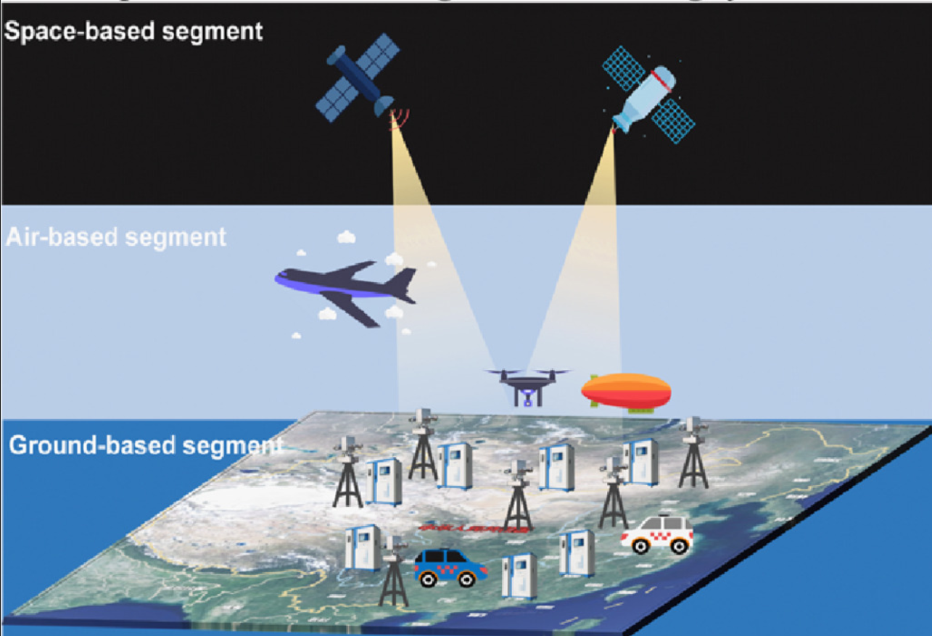
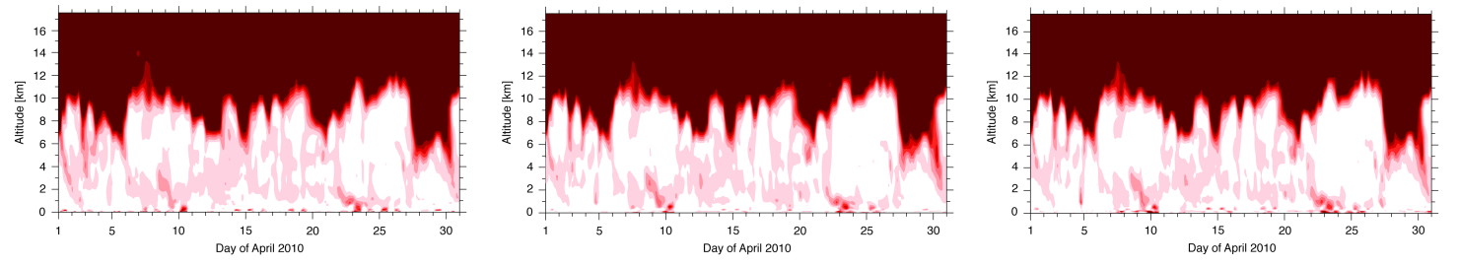
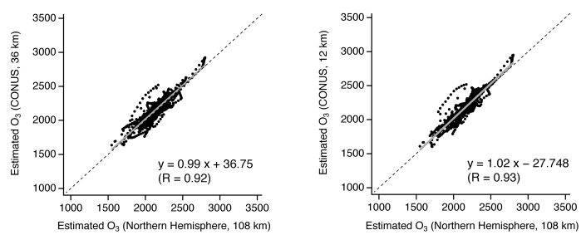
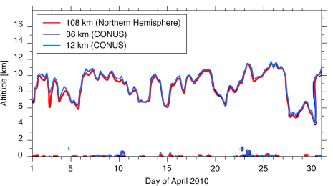
Multiscale “Data Assimilation”
Data assimilation allows information from (discrete) asynoptic observations to be propagated to a common synoptic time through the use of a detailed model
Challenge
Opportunity
Modeled PV at Trinidad Head Derived from WRF with Data Assimilation
Δx = 108km
Δx = 36km
Δx = 12km
Zhou et al., JES (2023)
Modeled 2PVU Altitude
Tropopause Height
Estimated “Stratospheric O₃” at Model Top
Emerging ground- (sensors) and space-based (e.g. TEMPO) observations provide unprecedented opportunities to improve air pollution fields through “assimilation” with models
While data assimilation can strongly enable the incorporation of observed/re-analysis information, it can also “squelch” possible gains from resolution and/or process improvements if scales are not considered adequately
Incorporation of “scale representativeness” of assimilated information may enable more optimal use of observations in evolution of multi-scale models
Itahashi et al., ACP (2020)
Notes:
Assimilation, whether dynamic or post-process intrinsically attempts to “merge” information across scales
Amount of information and data will continue to increase. How do we combine models and observations to preserve the “multiscale” process signatures?

Slide 16
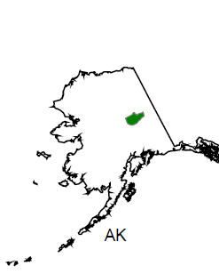
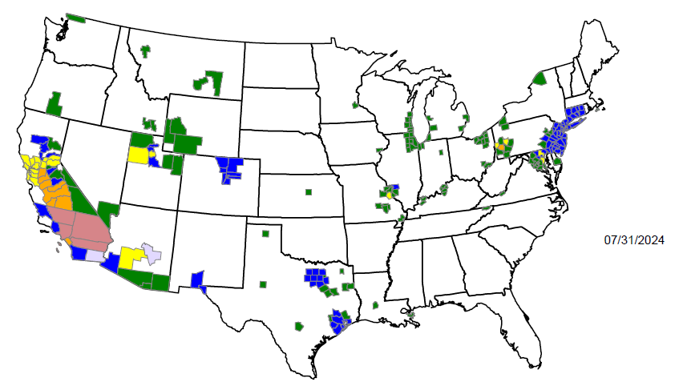
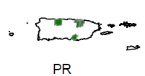
Closure
Non-attainment in many regions presents unique multi-scale process modeling challenges due to a combination of
emission sources, meteorological conditions, geographical features and/or non-controllable sources
Residential combustion
Complex terrain/
elevation
Space and time scales are correlated, and both must be considered in multi-scale air quality modeling
Land-water
interface
Stratospheric O₃
Oil & gas
emissions
Observational information that also reflect these multiple scales are needed to better evaluate and constrain models
Stable air mass/
cold pools
Inter-continental
transport
Metro-agro complexes
Highly reactive
VOC emissions
Since the atmosphere across the globe is connected, air pollution issues have and will continue to require consideration of processes that occur across multiple scales
It is likely that process interactions across multiple scales are also changing with time in response to changing emissions and climate globally
Non-attainment areas map from: https://www3.epa.gov/airquality/greenbook/mapnpoll.html
Notes:
The continued need for multiscale modeling is illustrated in context of existing AQ management challenges – current non-attainment regions across the U.S.

Slide 17
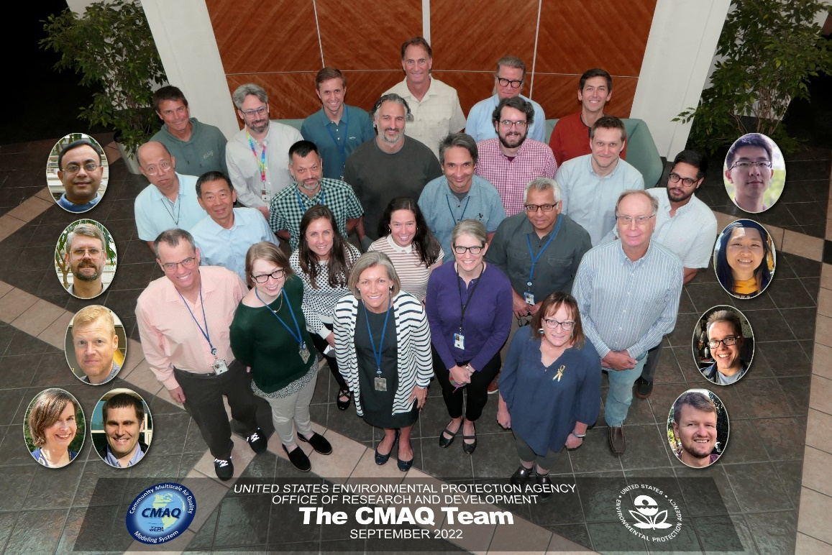
Acknowledgements
The CMAQ Team
Wyat Appel
Jesse Bash
James Beidler
Russ Bullock
Emma D’Ambro
Kathleen Fahey
Sara Farrell
Kristen Foley
Robert Gilliam
Jerry Herwehe
Christian Hogrefe
Bill Hutzell
Daiwen Kang
Megan Mallard
Benjamin Murphy
Sergey Napelenok
Chris Nolte
Robert Pinder
Jon Pleim
George Pouliot
Havala Pye
Golam Sarwar
Fahim Sidi
Nash Skipper
Tanya Spero
Alan Vette
Jeff Willison
David Wong
Kirk Baker
Jon Brunton

