Slide 1

Unflattening the Trend
Challenges and Opportunities in Regulatory and SIP Modeling for Continuing to Improve Air Quality in the U.S.
Zac Adelman
LADCO Executive Director
23rd Annual CMAS Conference
October 21-23, 2024

Slide 2
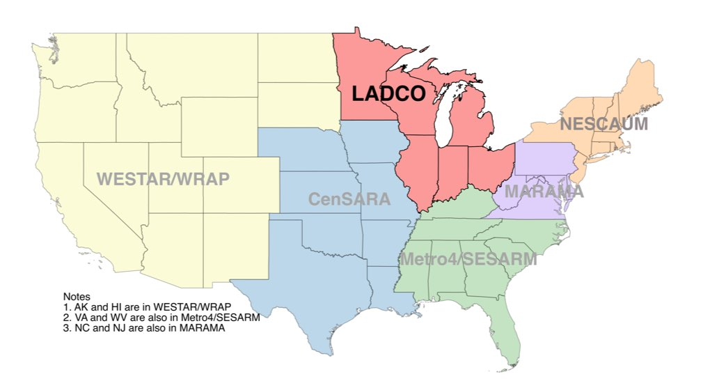
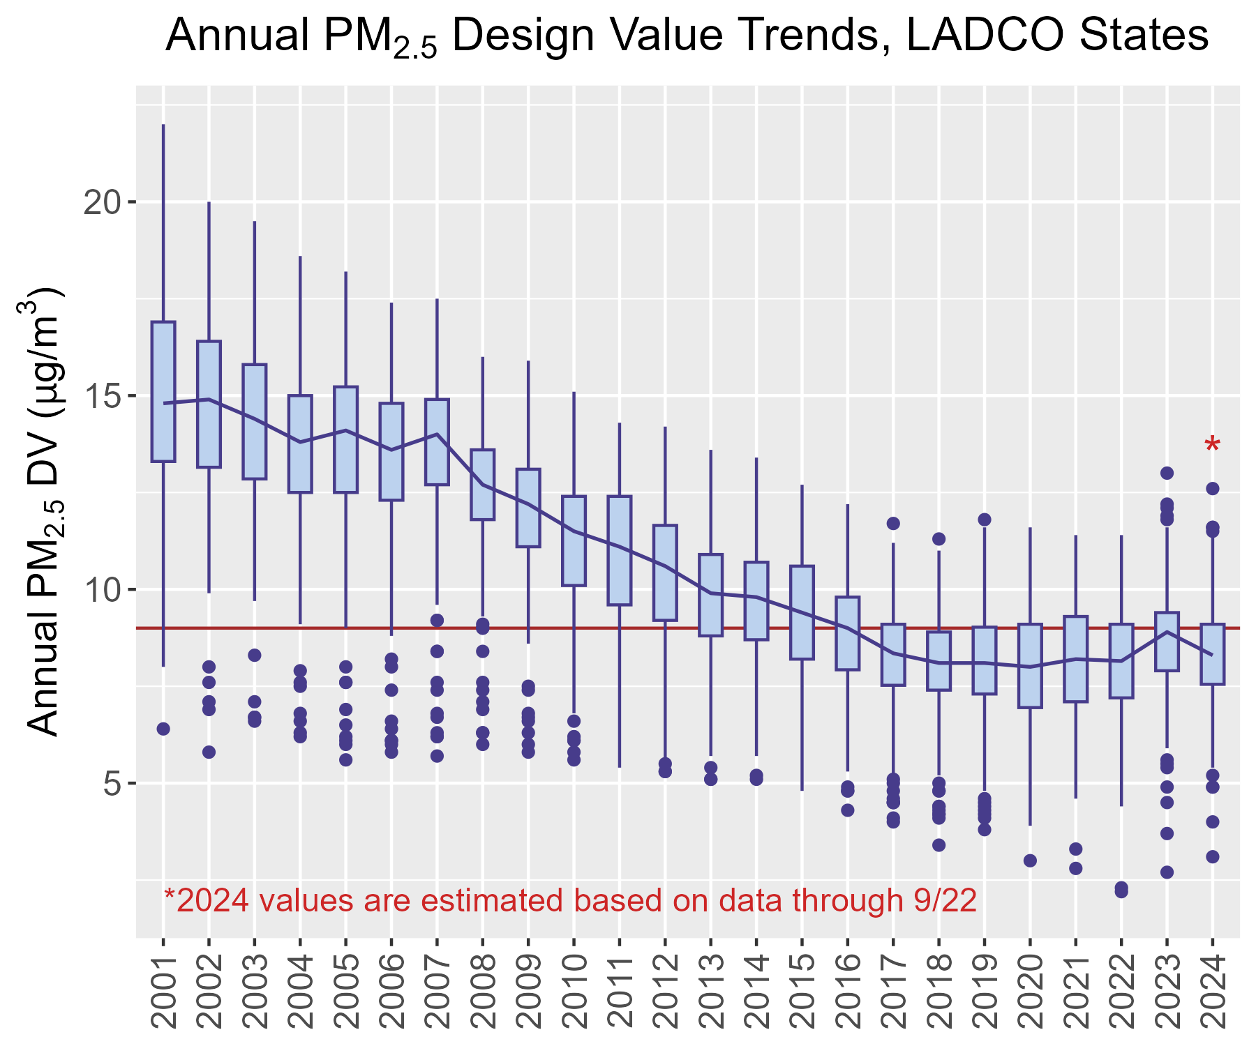
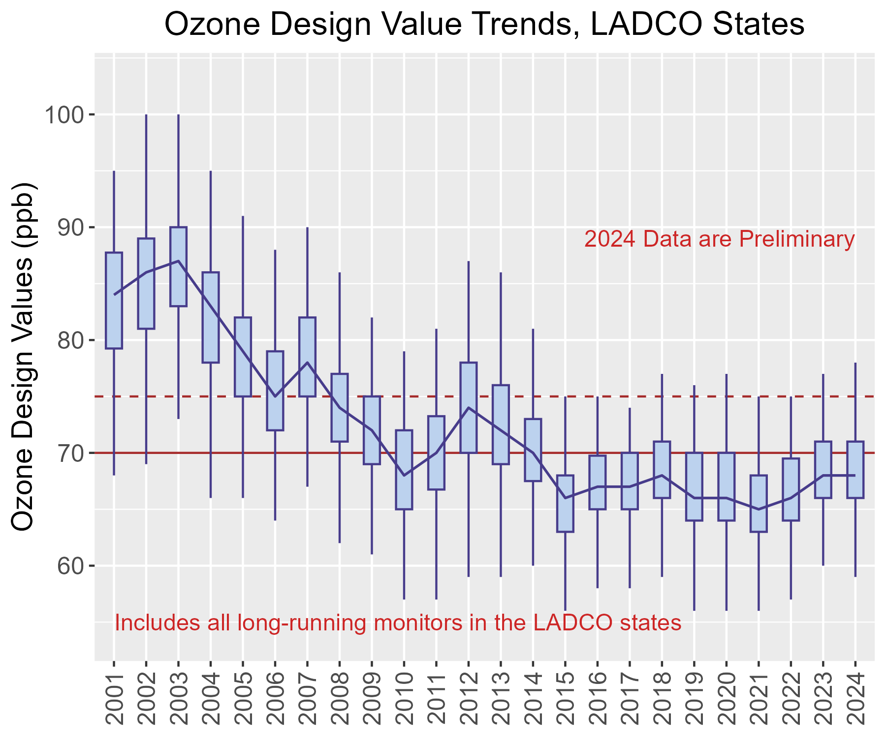
Concentrations of PM_{2.5} and Ozone in the LADCO region have been “flat” over the past 8-10 years
PM2.5
O3

Slide 3
U.S. Air Pollution Attainment and Planning Milestones in 2025
Ozone NAAQS attainment demonstrations
PM2.5 NAAQS area designations
Inflation Reduction Act Grants
New national emissions modeling platform
Modeling software improvements
Opportunities to make this happen

Slide 4
U.S. Air Pollution Attainment and Planning Milestones in 2025
Ozone NAAQS attainment demonstrations
PM2.5 NAAQS area designations
Inflation Reduction Act Grants
New national emissions modeling platform
Modeling software improvements
Opportunities to make this happen

Slide 5
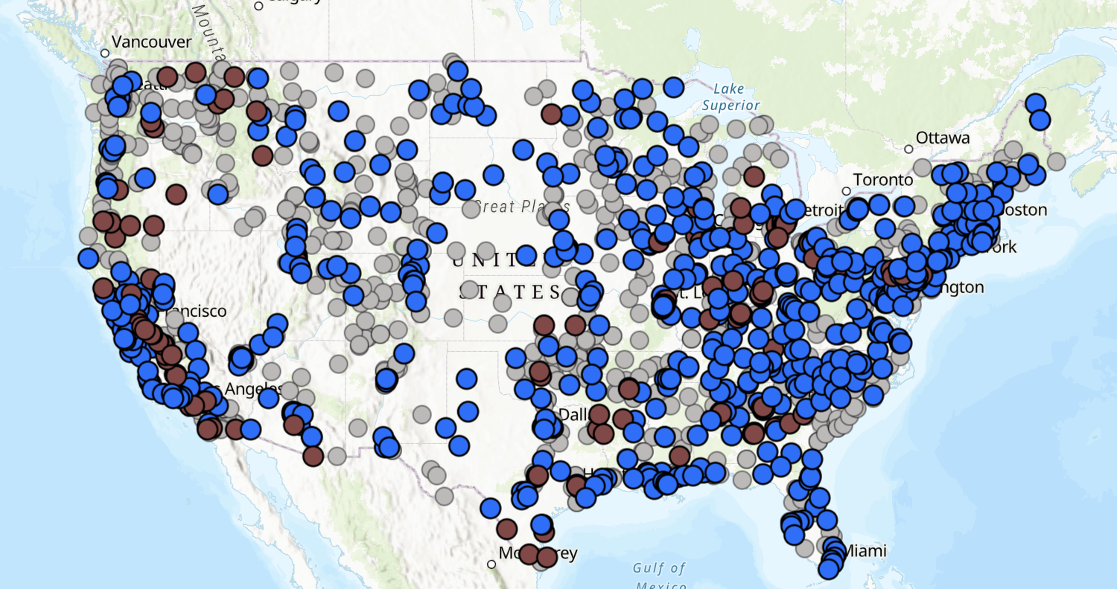
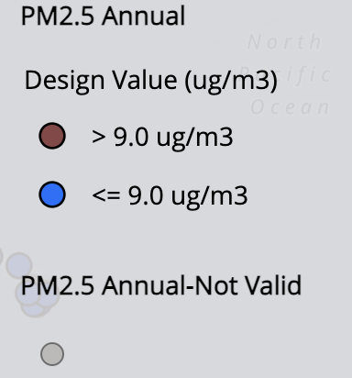
Current Challenges: Two Examples
(1) PM_{2.5} precursor significance
Which of the gas-phase precursors to PM_{2.5} are impactful in a nonattainment area?
Planning Implications: emissions control programs, stationary source permitting
Photochemical modeling may be used to show that any of NOx, SO₂, NH₃, or VOC emissions can be excluded from PM_{2.5} NAAQS requirements
Different approaches are needed for attainment planning and air permitting
Significance threshold?: 0.13 ug/m3

Slide 6
Current Challenges: Two Examples
(2) Emissions reduction programs
Air quality and climate planning in the U.S. are currently not well integrated
NAAQS planning needs better connection to co-benefits from climate programs
Climate Pollution Reduction Grants
Unprecedented action to stimulate modernization in buildings, transportation, industry, and agriculture
Air quality planners need to be at the table with tools to inform CPRG project design on co-benefits and NAAQS attainment
Climate | Air Quality
National/state | County
2-5 decades | 2-5 years
Voluntary | Enforceable
Emerging policies | Established statutes

Slide 7
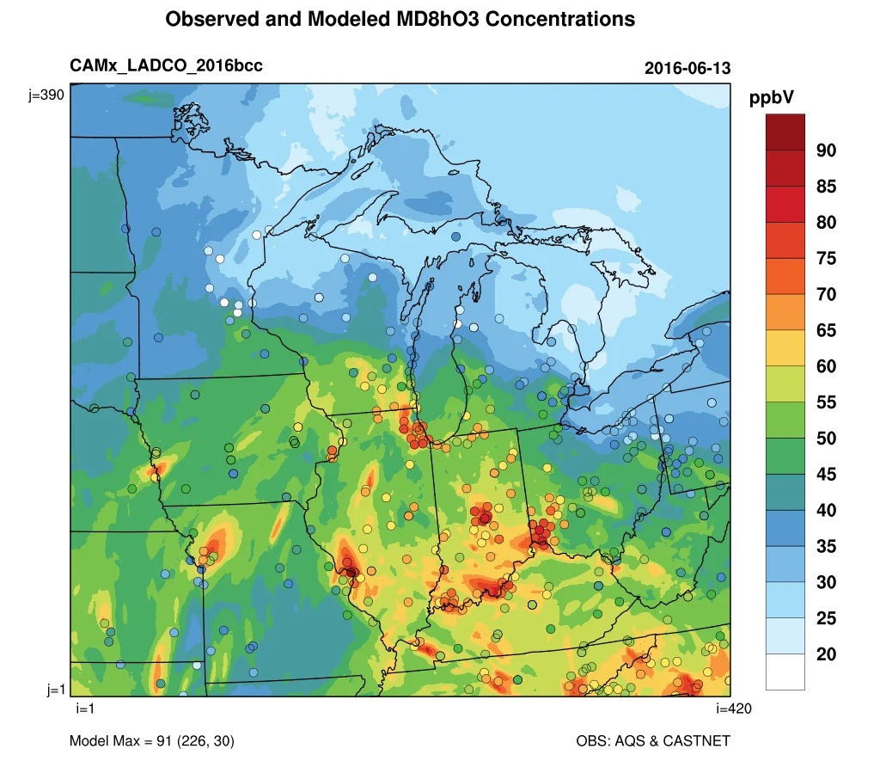
Decision Support
Photochemical models are excellent air pollution research platforms…
…as decision support platforms they have practical limitations
  Very difficult and resource-intensive to stand up, run, and interpret
  As the modeling tools and data are becoming more complex state/local air agency resources are not increasing
Attainment testing and scenario modeling are two distinct applications
  Recent modeling platforms have not afforded time for emissions reduction scenario modeling

Slide 8
Focus on Planning Needs
Enable a process that leads with planning constraints
  Start with identifying what policies can be implemented given the resources, timing, and jurisdiction
Meta-analysis tools
  Assimilate the massive body of research on air pollution
  Train on state of the science models and data
  Optimization problem: what is the most effective way to get this solution given these constraints
Goal
Research Solutions
Policy Assessment
Action
Goal
Policy Assessment
Research Solutions
Action

Slide 9
Air Quality Planning Paradigm
Strategy
Observations
Emissions
Control Options
Endpoint Optimization
Understand the chemistry regime in the area (i.e., which pollutants are impactful to attainment)
Annual inventories that are constrained by observations and include CAPs, HAPs, and GHGs
Control strategy tool to optimize on different endpoints: control cost, GHG reductions, CAP reductions…
Shorten the scenario modeling lifecycle from months to days

Slide 10

43rd Annual CMAS Conference (+ 20 years)
Machine learning models trained on observations and multi-media deterministic models
Cloud-based modeling-as-a-service
Rapid emissions scenario building to evaluate co-benefits for air pollution, climate, health, and equity
Meta analysis tools for supporting state/local policy development

