Slide 1
Estimating Air Quality Exposure in 1940 and 2010 For Future Application to Health Analyses
Xiaorong Shan
Advisor: Lucas Henneman
23rd CMAS Conference
October 22 2024

Slide 2

Three broad processes dictate air pollution exposure
H₂O₂
Emissions processes
Physical atmospheric processes
Chemical atmospheric processes
Ozone (O₃)
OH:
Daytime
O₃
SO₂
H₂SO₄
O₂
hv
Particulates (PM_{2.5})
Nighttime:
O₃, H₂O
NO
NO₂
NaCl
HNO₃
NaNO₃
WIND
OH:
Daytime
NH₃
RO₂ /HO₂
RO/OH
NH₄NO₃
SO_{x}
NO_{x}
OC
PM
NO_{x}
CO
VOCs
NO_{x}
EC
PM
VOCs
Deposition
2
Henneman CEIE 649

Slide 3
Motivation: estimate and evaluate source-specific exposure in 1940
Why source-specific?
Air pollution from different sources may pose varying risks to health.
Why 1940?
Early-life air pollution exposure may increase the risk of cognitive decline and neurodegenerative diseases in late life.
Notes:
Exposure assessment
Approach: Quantify population exposure to specific air pollution sources in the U.S. in 1940 using available data and methods that appropriately account for emissions processes, physical processes, and chemical processes
Evaluation: Apply comparable exposure estimates in a period with extensive observations (2010)

Slide 4
Research plan designed
Emissions
Exposure
Evaluation
  Lack of accurate records in 1940
  Reduce complexity models
  2010 standard monitor measurement
Notes:
I think it’s important to address that:
1) We want exposure estimates (including source-specific exposure)
2) There are times and places when it is difficult to estimate exposure (e.g., before air pollution observations throughout the US)
3) We need new ways to model exposure from these sources and evaluate the models

Slide 5
Air pollution sources considered
Pollution source | Major Health-Related pollutants | % Total Emissions in 1940
Power Plants | SO₂, NOx, PM and CO | 60% of SO₂ emissions
Automobiles | NOx, CO and PM_{2.5} | 40% of NOx emissions
Wells of Oil & Gas | Methane, VOCs, NOx, PM_{2.5} | 15% of total PM_{2.5} emissions
Residential & Commercial Coal Combustion | SO₂, CO₂, PM_{2.5}, CO | 25% of total PM_{2.5} emissions
National Air Pollutant Emission Estimates, 1940-1990 (US EPA)
Notes:
Larger text
I don't think the Impact column is necessary, since each of these has many impacts
What if instead of Impacts you report the fraction of total 1940 emissions from each source in the US, per CMIP6? So, power plants were probably something like 60% of SO2 emissions; automobiles contributed something like XX% of NOx, etc.
Austin: for this research I am going to present the power plants, but the at the end I am going to show the exposure maps for different sources

Slide 6
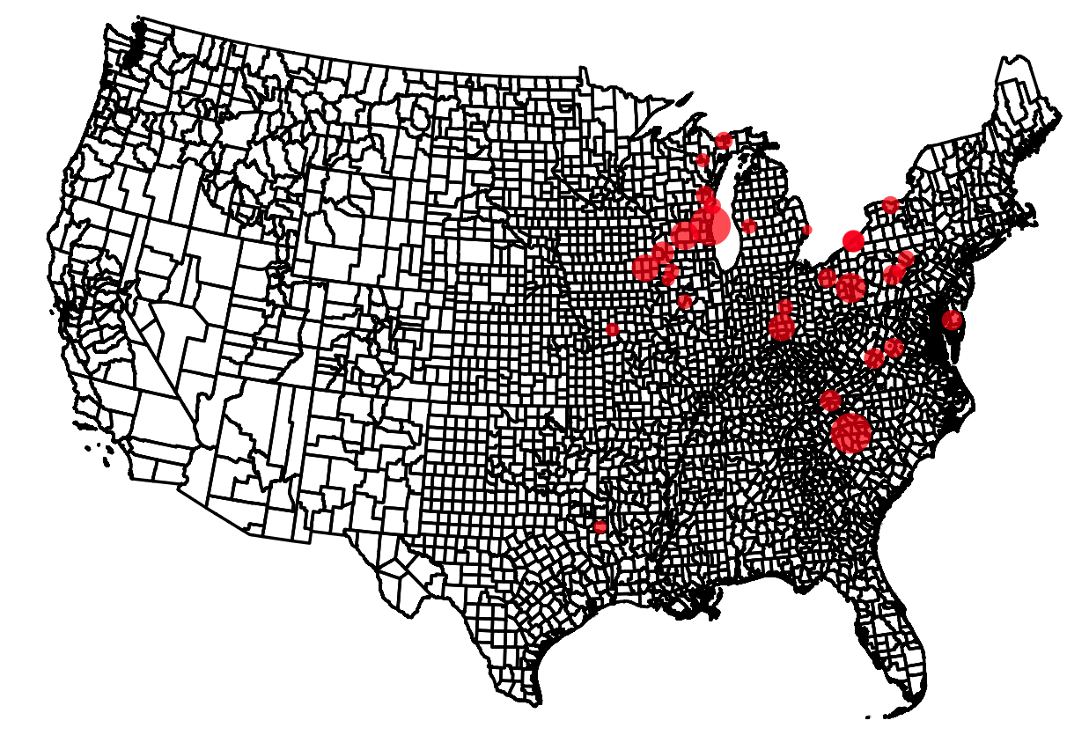
Fossil fuel power plants were a major air pollution sources in 1940
233 fossil fuel power plants were in operation in 1940 (EIA)
48 burned coal, 129 burned petroleum, and 56 burned natural gas
Contributed to 60% of SO₂, 30% of NOx, 20% of PM, and 10% of CO emissions
No regulations in 1940 required emissions controls
EIA (Energy Information Administration)
Notes:
Be clear for automobiles or vehicles
Make this 1940-centric. Some suggestions:
Title: Fossil fuel power plants were major air pollution sources in 1940
XX power plants were in operation in 1940 (EIA)
Of these, YY burned coal and ZZ burned natural gas
No regulations in 1940 required emissions controls
60% electricity?

Slide 7
1940 power plant-level emissions factors derived using data in 2010
E₁₉₄₀ = A₁₉₄₀ x EF₂₀₁₀ x (1-ER₁₉₄₀/100)
EPA eGRID
Power plant emissions in 2010
Emission factors (EF₂₀₁₀)
ER₁₉₄₀ = 0
EIA
Power plant facility info in 1940
Power plant emissions in 1940
A₁₉₄₀
EPA eGRID (Environmental Protection Agency Emissions & Generation Resource Integrated Database)
EIA (Energy Information Administration)
Notes:
Recommend larger text
Recommend building this slide piece by piece—then whole flow chart is overwhelming
LH: Note somehow that today's data is reliable because it is measured at each stack and reported to EPA

Slide 8


Physical atmospheric processes: two approaches
Inverse Distance Weighted (IDW)
HYSPLIT Average Dispersion (HyADS)
Unitless exposure
Physical unit [ug/m³]
Assumption: equal dispersion of pollutant in all directions
${exposure}_{i, j}^{IDW}$ = ${emissions}_{j}{ ∗distance}_{i, j}^{−1}$
Benefit: Simple and easy to apply
Drawback: dispersion does not reflect real-world conditions, especially in varying terrains
Assumption: dispersion governed by atmospheric conditions and terrain influences
${exposure}_{i, j}^{HyADS}$ = ${emissions}_{j}{ ∗ parcels}_{i,j}$
Benefit: accounting of atmospheric dispersion
Drawback: meteorological data represents 1940 climatic conditions
Henneman et al. 2019 (Atmospheric Environment)
Notes:
Recommend larger text
Recommend building this slide piece by piece—then whole flow chart is overwhelming
LH:
Recommend a slide introducing the 2 exposure methods to approximate the physical transport process (I added this above):
IDW assumes equivalent transport in all directions, and is often applied to assess point-source exposure
Trajectory models use wind fields to track pollution transport, but reanalysis wind fields available in 1940 are only representative
So, we apply both and compare

Slide 9
Chemical Processes
From emissions parameterizations, we do know which chemicals are emitted
But applying a Chemical Transport Model like CMAQ would require lots of computation, and we don't have the observations to compare it against
We use statistical parameterizations for HyADS derived from Henneman et al. 2019 (Atmospheric Environment)
Notes:
Power plants can highlight the project
Similar distribution exposure HyADS & IDW

Slide 10
HyADS model setup for 1950
Account for 1951 to 1960 meteorology data (10 years)
Incorporate 1940 power plant estimations as input
Divide the entire U.S. mainland into different grid cells
Run the model to simulate dispersion and count air parcels in each grid cell to determine exposure
Notes:
You might need an additional slide that describes your hyads approach - it's very cool that you ran the model accounting for 10 years' worth of meteorology since 1940 is just an estimate. Make sure that comes through!

Slide 11
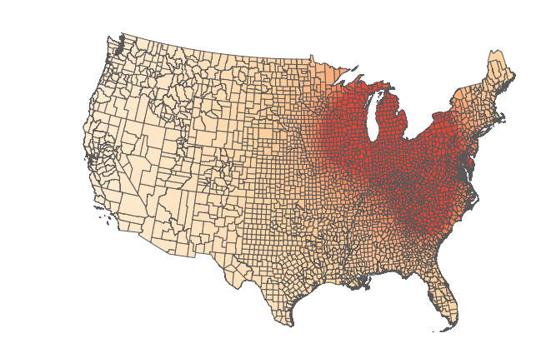
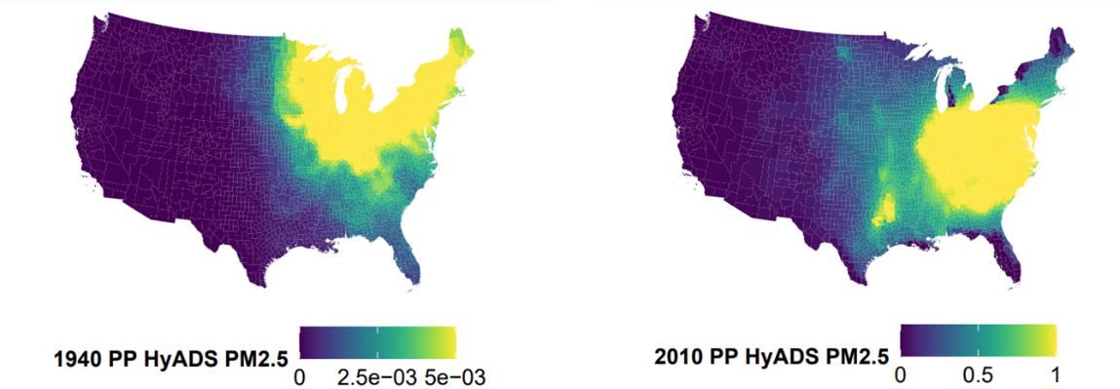
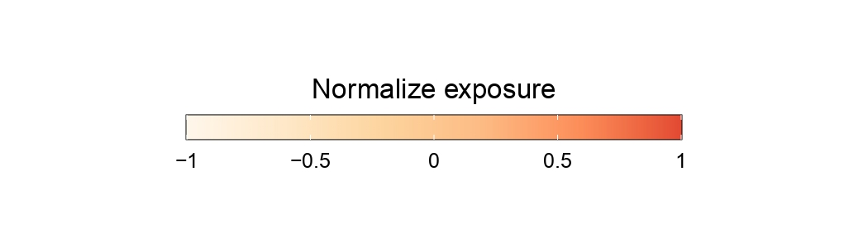
1940 power plant (PP) IDW and HyADS exposure comparison
90% of SO₂ exposure originates from coal power plants
Coal is the dominant source of exposure relative to the other fuels
Power plant SO₂ exposure is concentrated in the Midwest and Southeast regions
1940 PP HyADS [ug/m³]
1940 PP IDW [unitless]
Notes:
Power plants can highlight the project
Similar distribution exposure HyADS & IDW
LH:
There are definite differences between HyADS & IDW - you can see much more "real"-looking dispersion patterns from HyADS

Slide 12
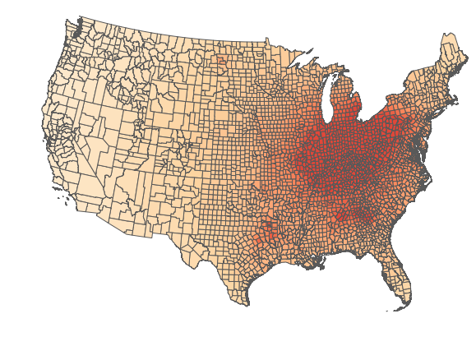
1940 and 2010 power plant IDW exposure comparison
Normalize separately
Concentration magnitude:
  1940: 0.087 to 3.07, median 0.33
  2010: 1.88 to 17.88, median 7.25
Compared to 1940, 2010 shows higher exposure in the South than in the Midwest
1940 PP IDW coal
2010 PP IDW coal
Notes:
Differences between maps
Having the location of the facility
Difference in magnitude: emissions source or the amount of emissions
Movitation: exposure, what driven the change of exposure in space and magnitude
Another slide for hydas 1940 & 2010

Slide 13
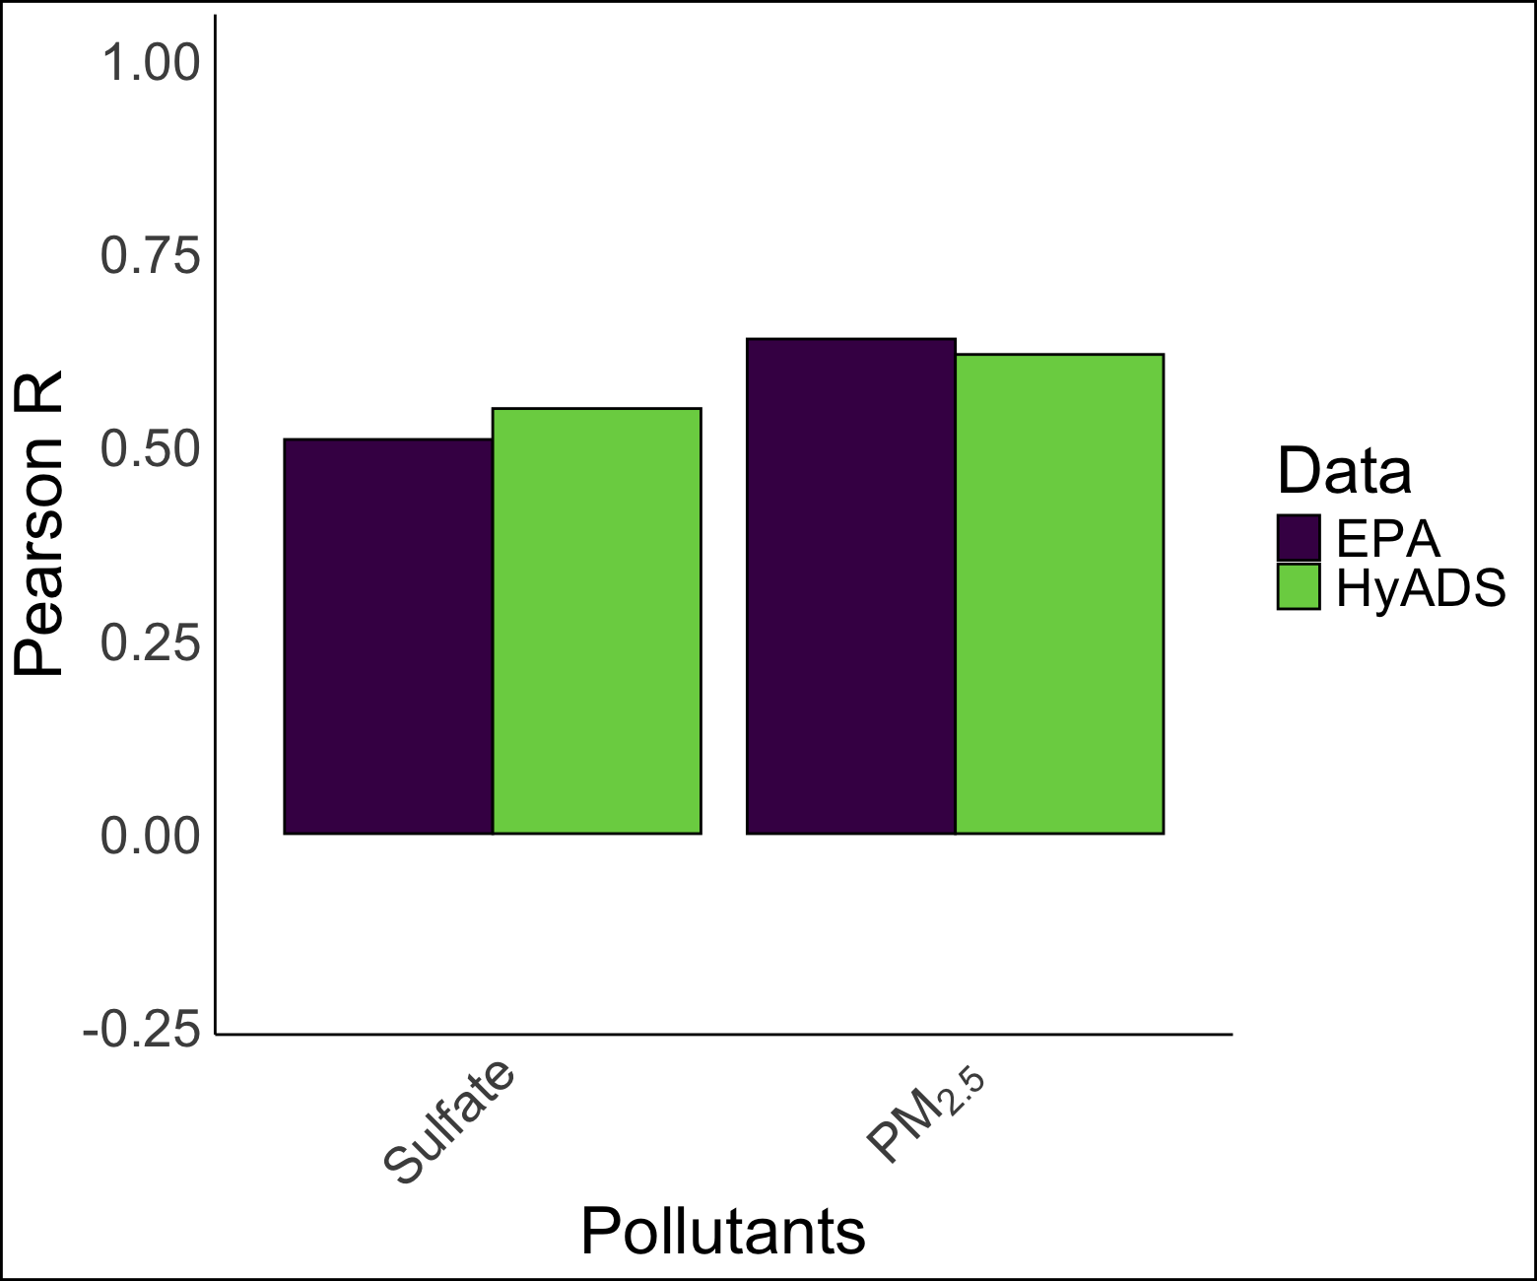
Power plant IDW exposure evaluation with EPA monitor measurement in 2010
328 EPA monitors in total, different number of monitors for pollutant types
County-level exposure V.S. stationary measurement may cause different results
Notes:
If possible, compare both hyads & idw by their performance with monitors
What about sulfate? That would be the most importtant one. Actually, you could safely present just sulfate and total PM2.5
First of all, we found a supervising negative R result for NOx, the county level exposure v.s. stationary measurement may cause different results. Pink is anything less than 0, blue is 0-0.5, and green is higher than 0.5
Do hyads and more than just correlation legend (IDW & HyADS)
Lucas sciences paper

Slide 14
Limitation and future research
Lack of observations available in 1940 and of source-specific pollutants
  Motivate the use of reduced complexity approaches
  Make only indirect evaluation possible
Future work
  Assess the influence of environmental exposures on cognitive decline by linking the exposures with health data
  Explore the exposure to specific pollutants from power plants
  Identify the driving factors of legislation and economics that influenced exposure changes
Notes:
LH:
Not interested in CO2 exposure, since it doesn't have health effects
Lack of observations available in 1940 and of source-specific pollutants:
Motivate the use of reduced complexity approaches
make only indirect evaluation possible
Future work
Assess the influence of environmental exposures on cognitive decline by linking the exposures with health data
Explore the exposure to specific pollutants from power plants
Identify the driving factors of legislation and economics that influenced exposure changes

Slide 15
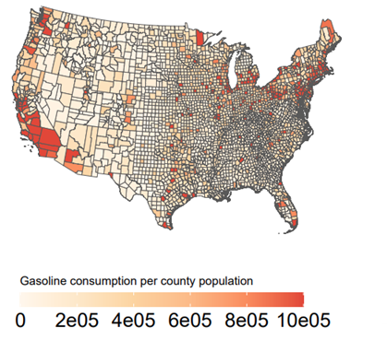
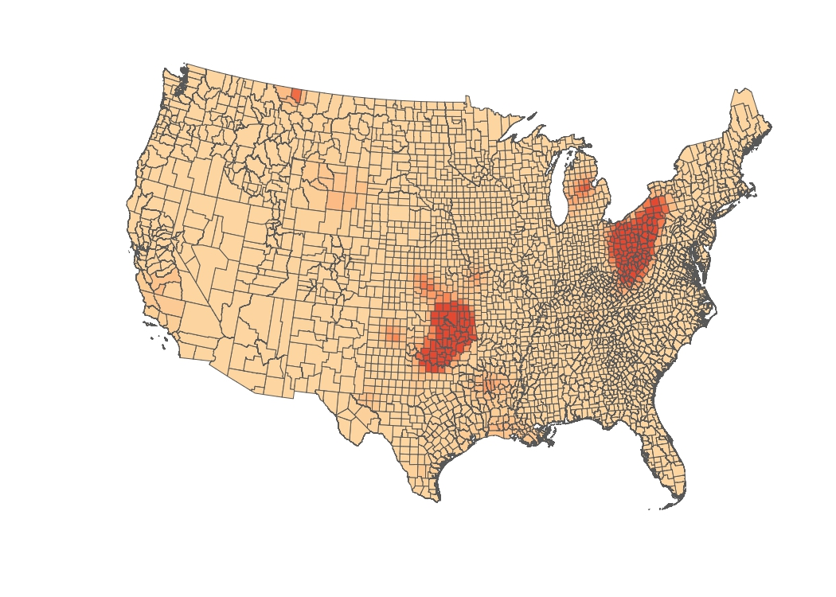
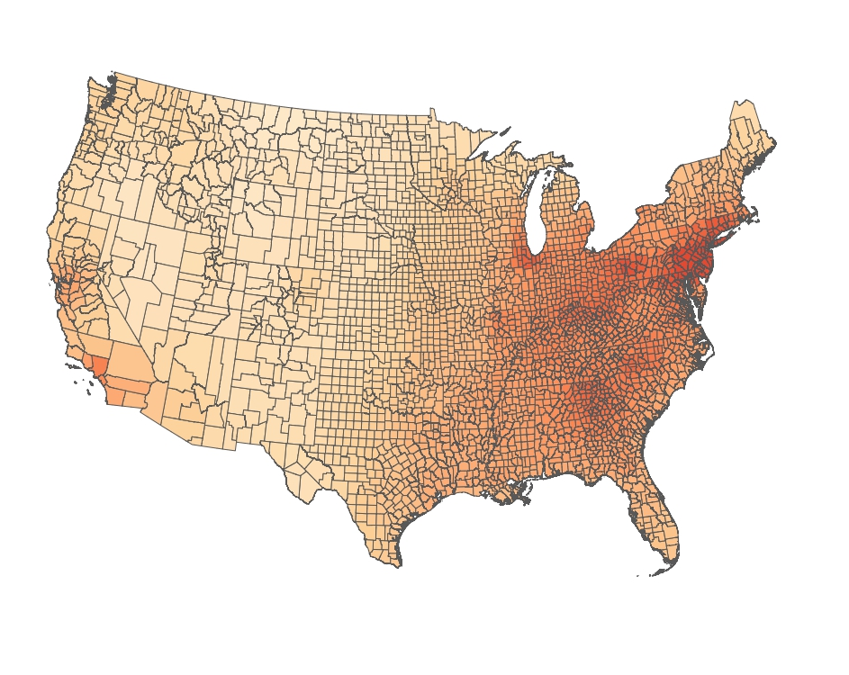
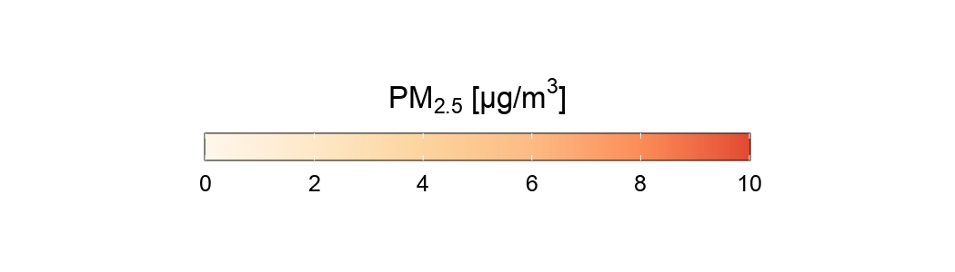
Other sources’ exposure in 1940
1940 Automobile
1940 Well IDW
1940 Total PM_{2.5}
Notes:
Make slide for other sources, no necessary go into details, show the major points of each source
LH – recommend showing one map per source (1940 exposure). It is better to show less information and explain it well
It would be helpful if you can come up with a consistent format between this slide and the information in slide 5
Austin:

Slide 16
Acknowledgment
This project was supported by funding from the National Institute of Health (NIH) grant number R01AG074359.

Slide 17
Thank you
Questions?
xshan2@gmu.edu

