Slide 1

Timely Updates of Anthropogenic Emissions with Satellite and Ground Observations: Comparing of multiple rapid emission refresh methods
Siqi Ma¹, Daniel Tong^{1,2}, Fei Liu^{3,4}, Jia Xing⁵, Bok H. Baek², Chi-tsan Wang², Yunyao Li⁶
¹ Department of Atmospheric, Oceanic and Earth Sciences, George Mason University, Fairfax, VA 22030, USA
²Center for Spatial Information Science and Systems, George Mason University, Fairfax, VA 22030, USA
³Goddard Earth Sciences Technology and Research (GESTAR) II, Morgan State University, Baltimore, MD 21251, USA
⁴NASA Goddard Space Flight Center, Greenbelt, MD 20771, USA
⁵Department of Civil and Environmental Engineering, University of Tennessee, Knoxville, TN 37996, USA
⁶Department of Earth and Environmental Sciences University of Texas at Arlington, Arlington, TX 76019, USA

Slide 2
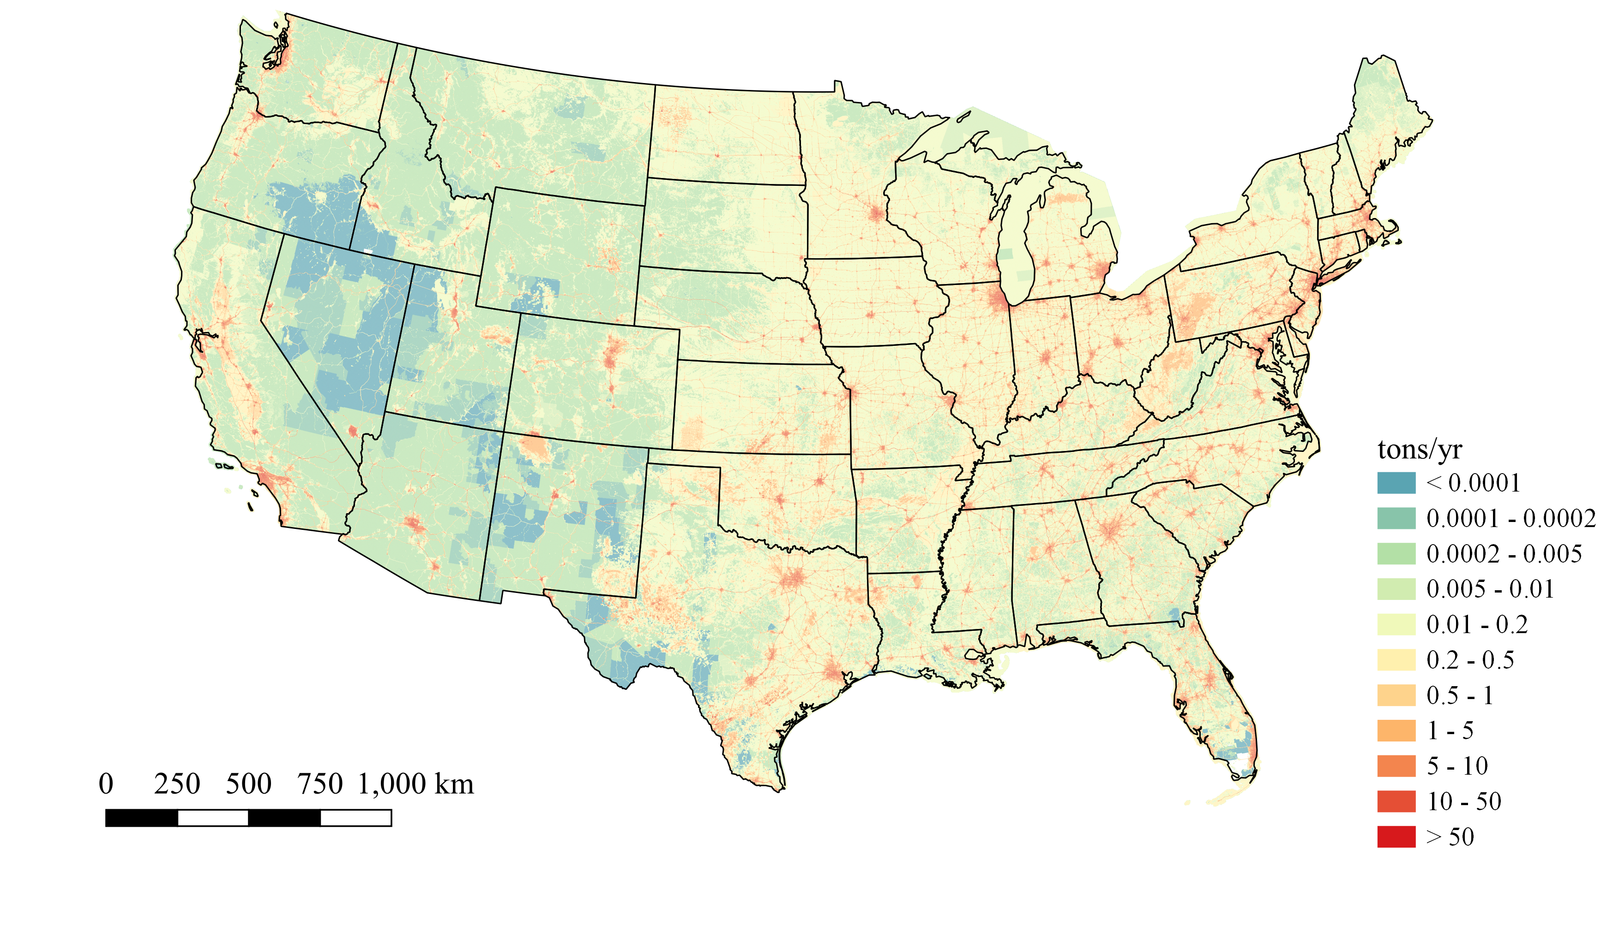
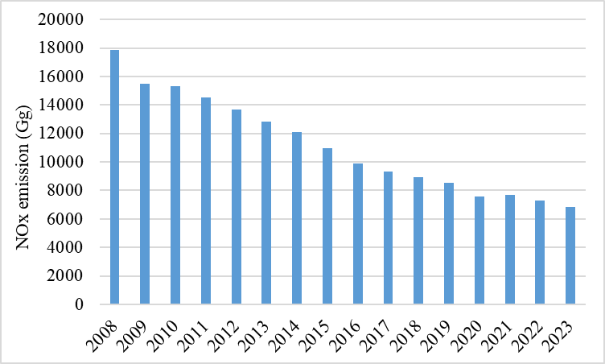
Background
Emissions of air pollutants are the main driver of many Earth system processes, such as air pollution and climate change.
Creating emission inventories typically lags by 3 years which may not reflect the current emission status.
Updating emissions to the specific forecast year using observations is an effective way to reduce the uncertainties of outdated emission inventories.
NO_{x}
NEI | Release Date
2008v2 | Feb 2012
2011v1 | Jun 2014
2014v1 | Sep 2016
2017v1 | Sep 2019
2020 | Mar 2023
2023 | Mar 2026
Objectives:
1) Updating anthropogenic emissions with multiple rapid emission refresh methods;
2) Assessing the effectiveness of each method.

Slide 3
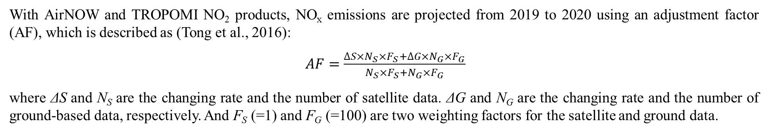
Method
NOx emissions refresh:
With AirNOW and TROPOMI NO₂ products, NO_{x} emissions are projected from 2019 to 2020 using an adjustment factor (AF), which is described as (Tong et al., 2016):
$AF=\frac{∆S×N_{S}×F_{S}+∆G×N_{G}×F_{G}}{N_{S}×F_{S}+N_{G}×F_{G}}$
where ΔS and N_{S} are the changing rate and the number of satellite data. ΔG and N_{G} are the changing rate and the number of ground-based data, respectively. And F_{S} (=1) and F_{G} (=100) are two weighting factors for the satellite and ground data.
Model configuration:
Model Setup:
Model: WRFv4.0 for meteorological simulations
CMAQv5.3.2 for air quality simulations
Date: July, 2020
Domain: Contiguous United States (CONUS) 12 km
Meteorological: ECMWF ERA5, 0.25° × 0.25°, 4/day
Initial Conditions: CMAQ profile IC
Boundary Conditions: GEOS-Chem monthly data
Six Scenarios:
Control: Using base year emission (NEI2019 platform)
N2020: Using current year emission (NEI2020) released by EPA
ADJ: state-level AF based on AirNOW and TROPOMI.
Budget-Aware (BA): state-level AF with specific city AF masked by surface emission contribution (>90%) from process analysis. Each city mask has a maximum of 150×150 km²
SatNOx: state-level AF with city-level AF based on TROPOMI estimated NOx emission (Liu et al., 2024).
VAE: state/city-level AF based on machine learning (Variational AutoEncorder, VAE) emissions (Xing, et al., 2022).

Slide 4
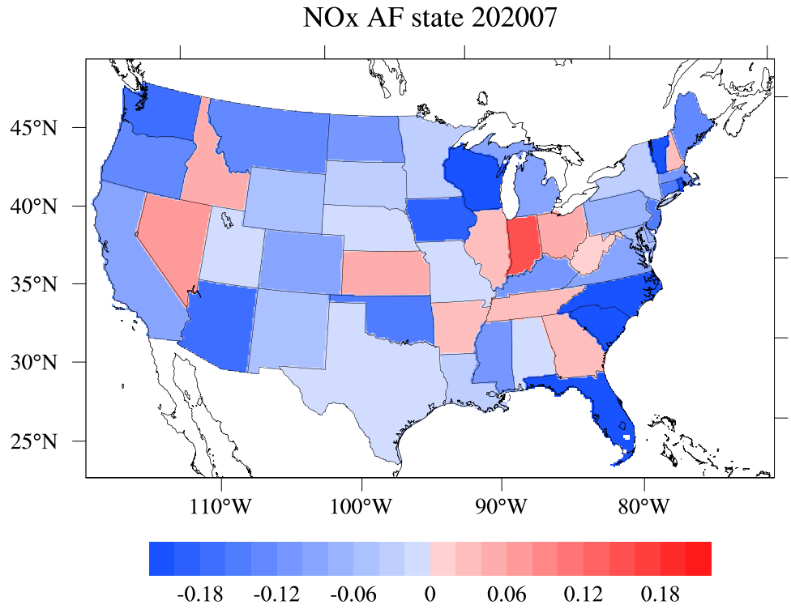
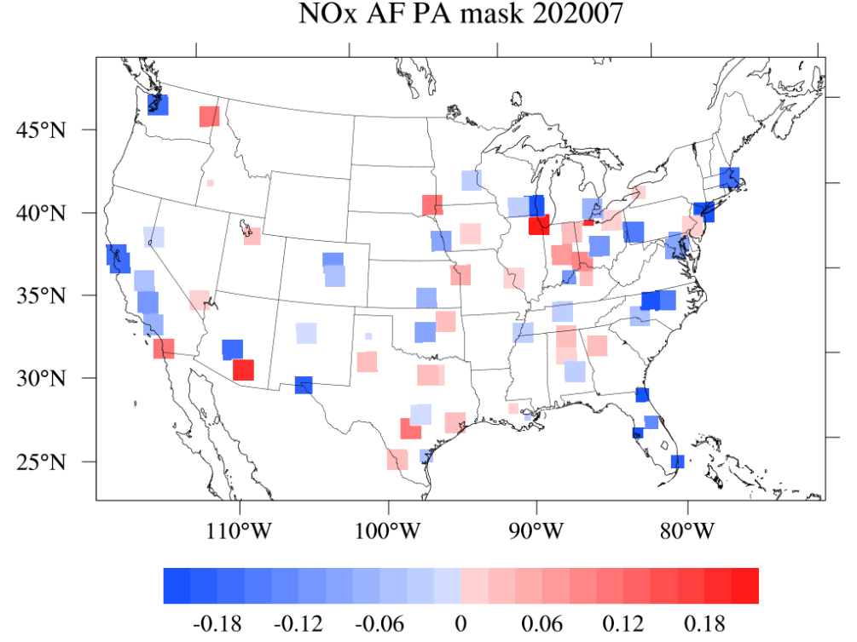
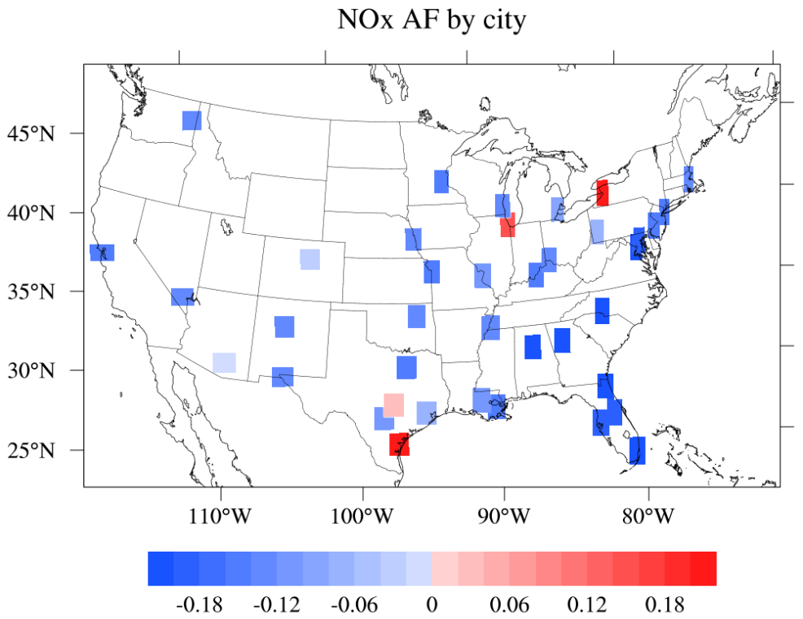
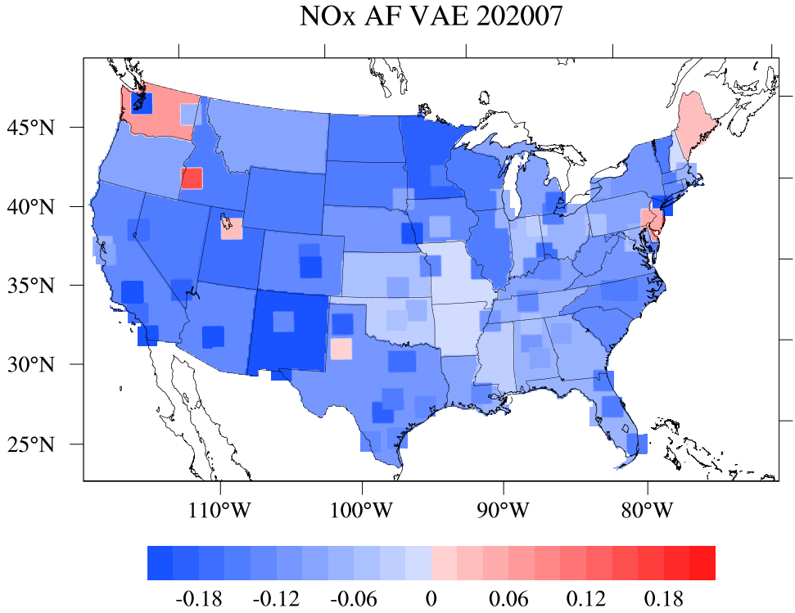
State- and City-level Adjustment Factors
States in the west present a medium decline, while eastern states see significant reductions.
States in the central US present smaller decreases/increases.
AFs in cities and states may show opposite trends.
ADJ NO_{x} AF state
BA NO_{x} AF urban mask
SatNOx NO_{x} AF city
VAE NO_{x} AF state & city

Slide 5
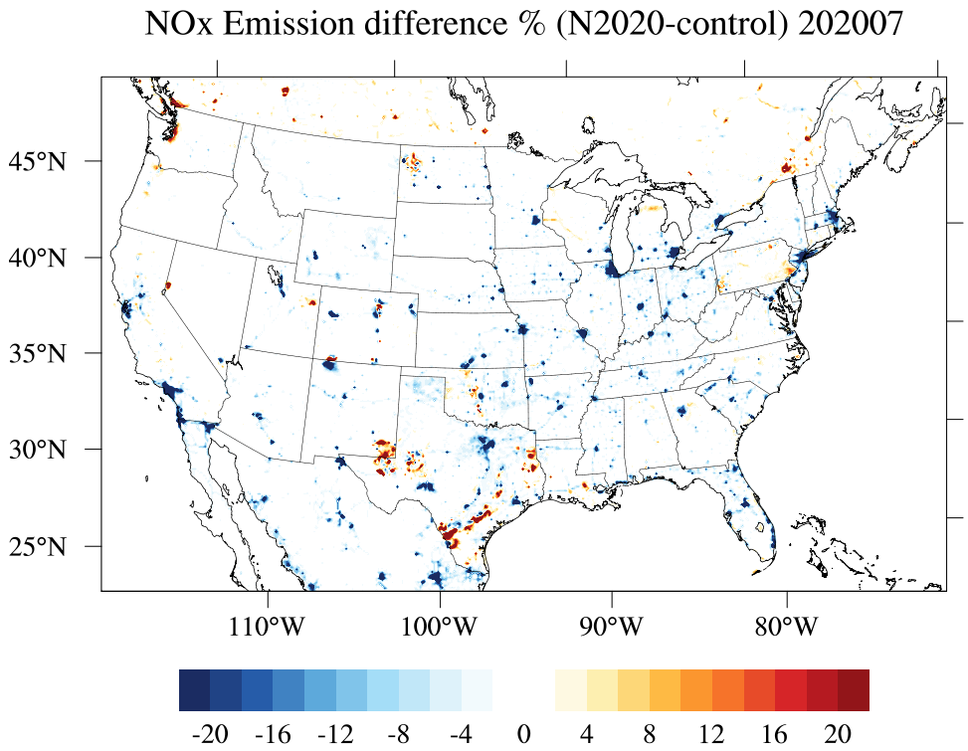
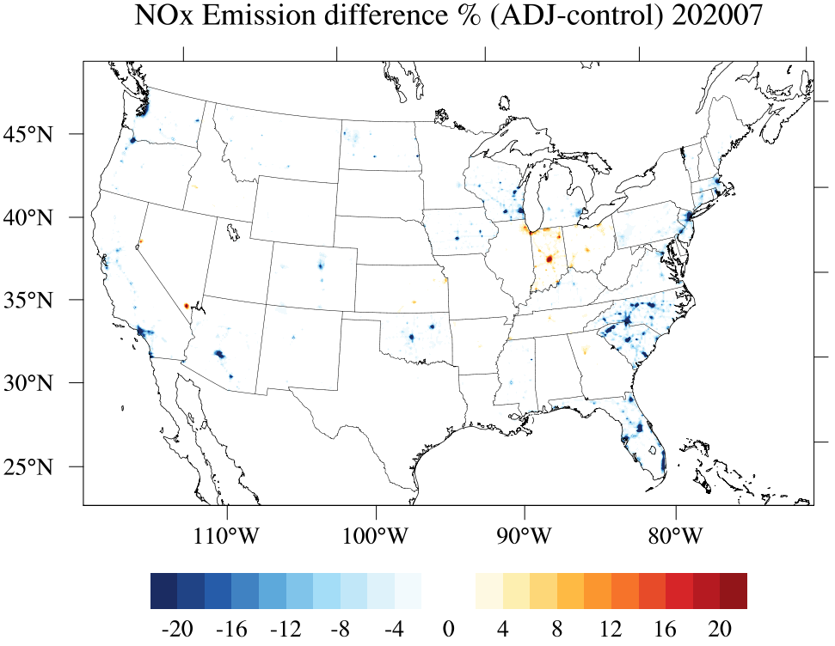
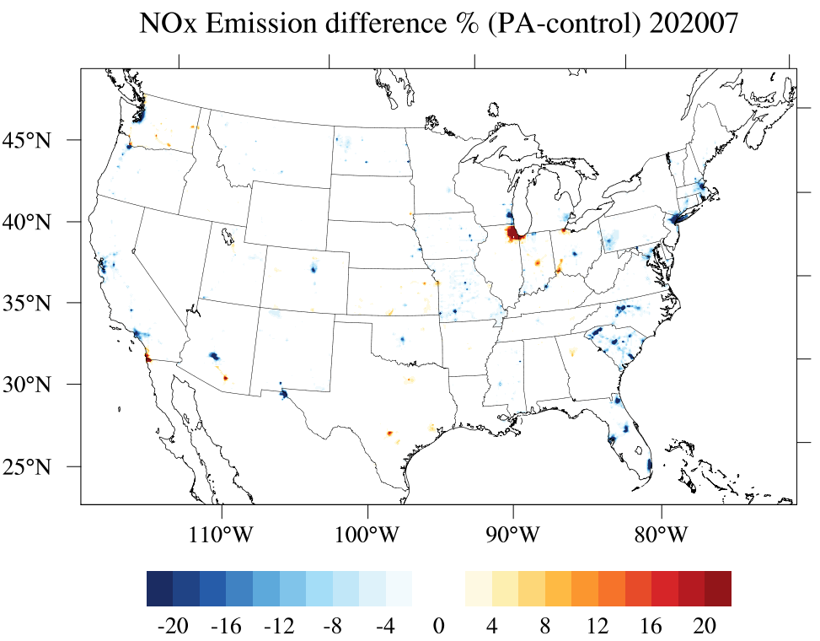
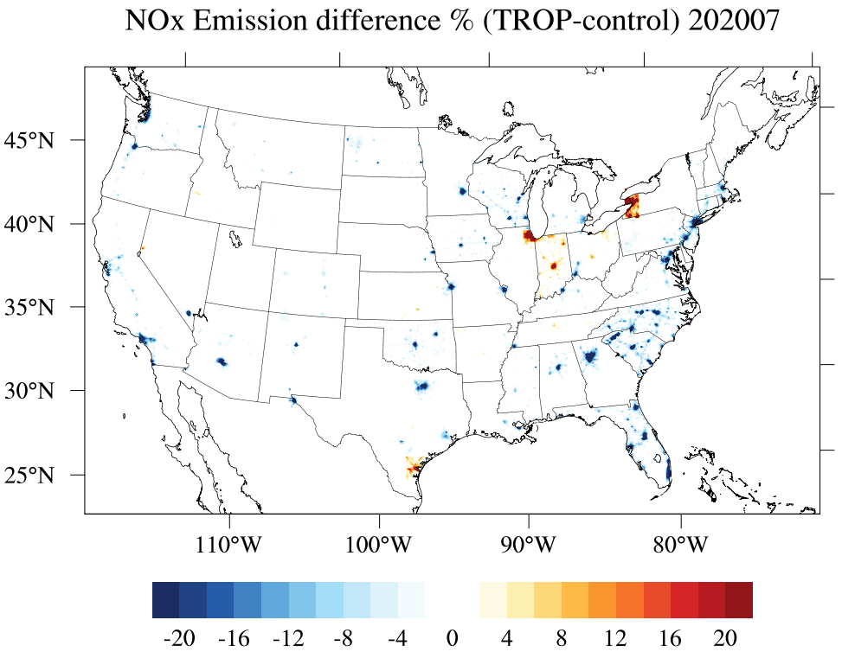
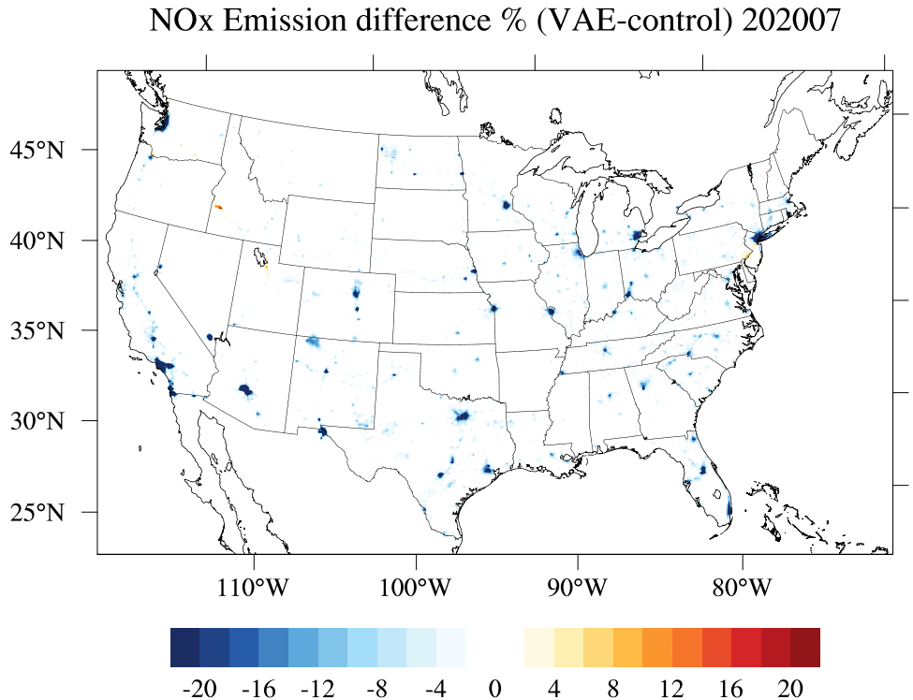
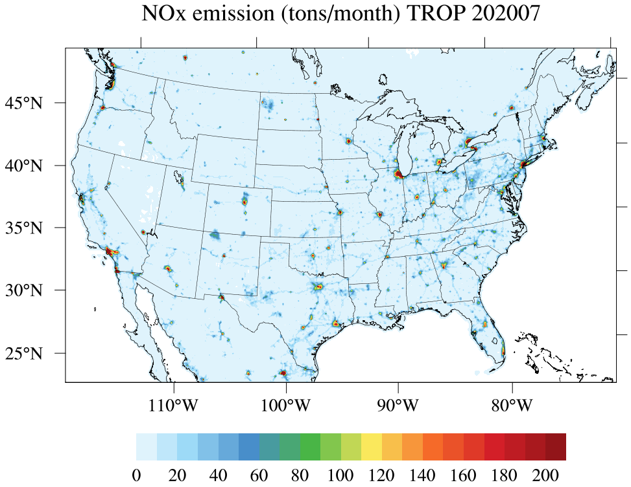
Anthropogenic NOx Emissions in July 2020
NO_{x} differences % (N2020-control)
NO_{x} differences % (ADJ-control)
NO_{x} differences % (BA-control)
383 Gg
416 Gg
425 Gg
NO_{x} differences % (SatNOx-control)
NO_{x} differences % (VAE-control)
NO_{x} monthly emission (control)
411 Gg
396 Gg
445 Gg
Emissions from NEI2020 in parts of TX/NM have increased.
ADJ/BA/SatNOx present less NOx change in the central US.
VAE yields the closest emission to NEI2020 over CONUS
tons/month
Changes compared to NEI2019
N2020 | ADJ | BA | SatNOx | VAE
-13.7% | -6.9% | -5.7% | -7.1% | -10.4%

Slide 6
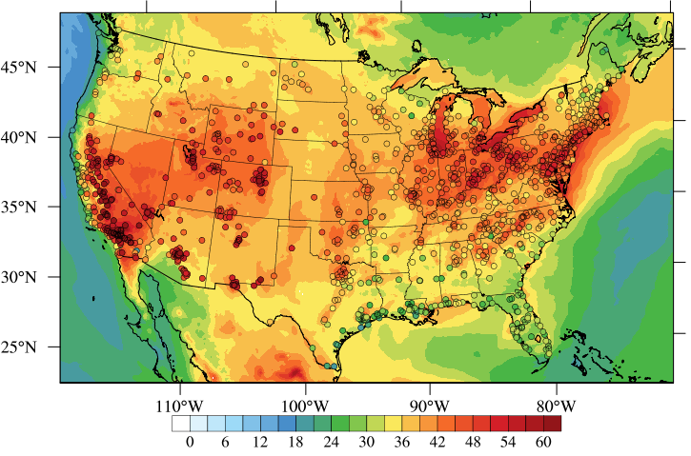
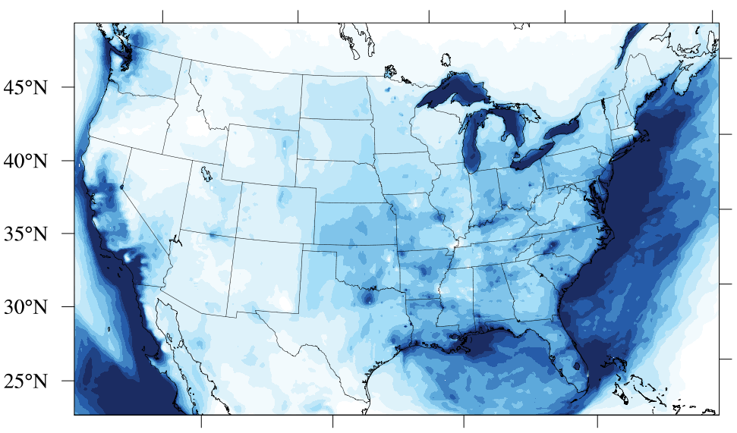
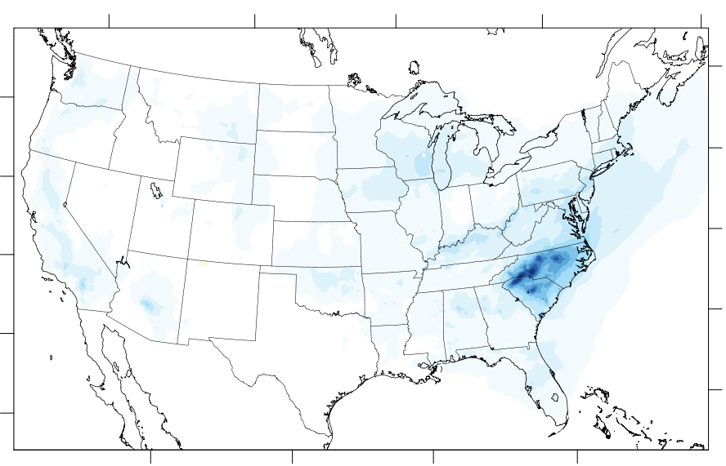
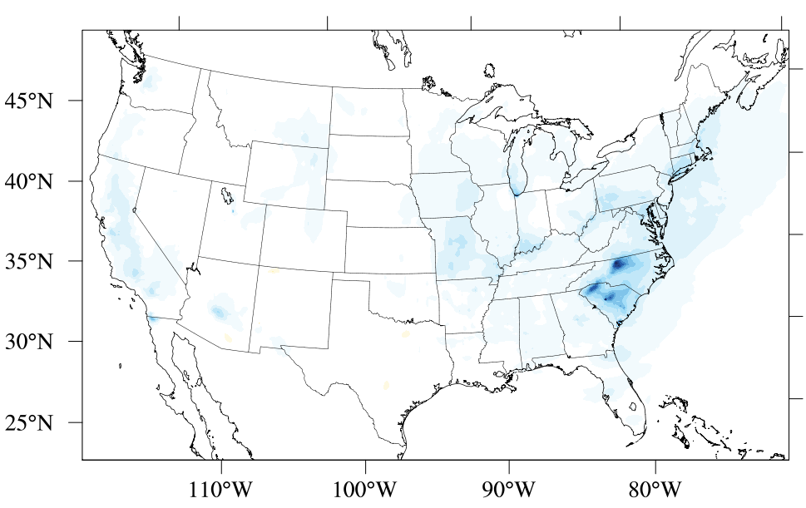
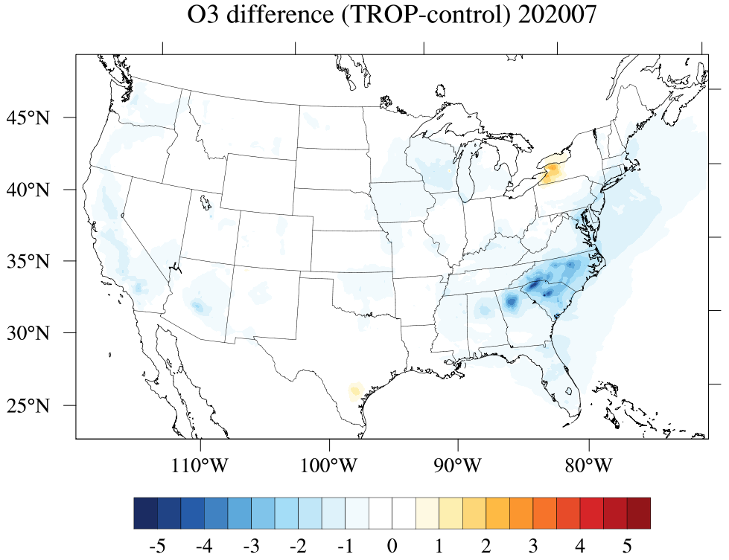
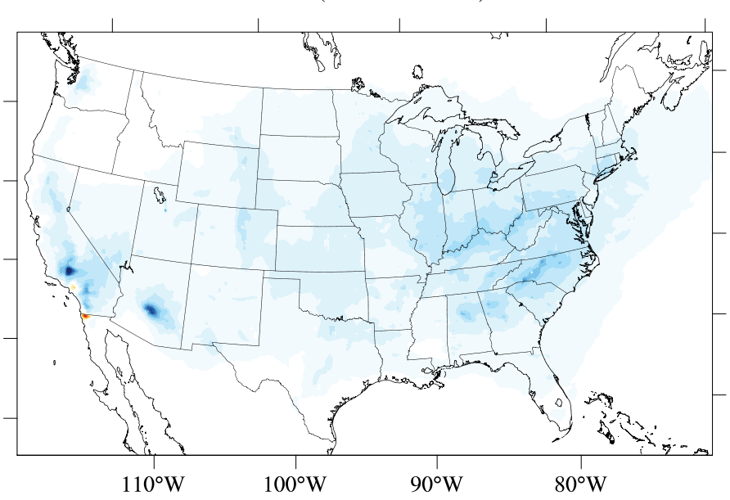
Effects of Emission Refresh on Ozone Prediction
O₃ (control) 202007
N2020 shows the most decrease.
ADJ/BA/SatNOx: large O₃ decrease in NC/SC; VAE: AZ/CA
O₃ is generally underpredicted in the western US.
O₃ differences (N2020-control)
O₃ differences (ADJ-control)
O₃ differences (BA-control)
O₃ differences (SatNOx-control)
O₃ differences (VAE-control)

Slide 7
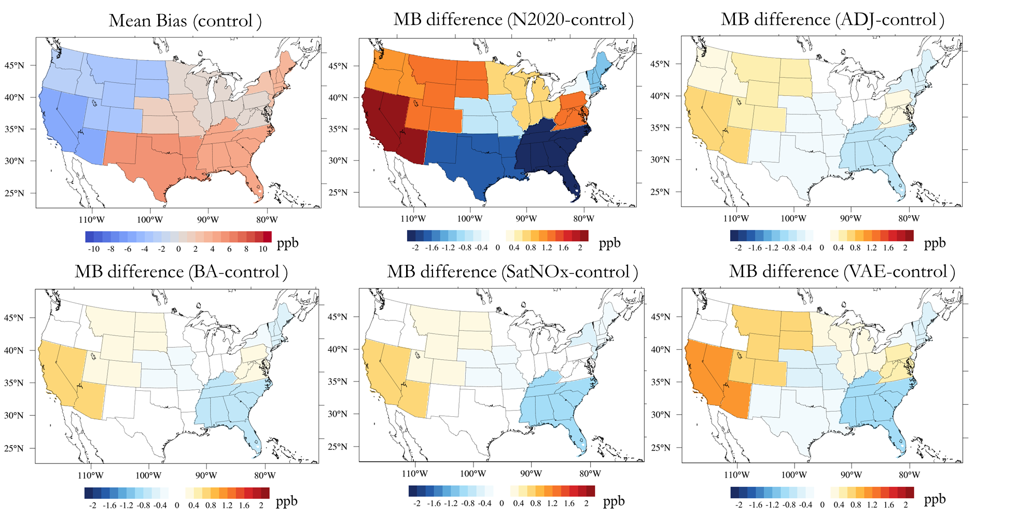
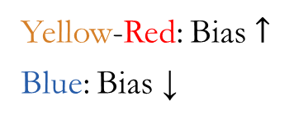
Do They Improve the Ozone Prediction?
Yellow-Red: Bias $↑$
Blue: Bias ↓
East: overestimation; West: underestimation.
Emission update improves ozone prediction in the eastern US.
Mean Bias reduction in CONUS: 2% (VAE) – 13% (SatNOx)

Slide 8
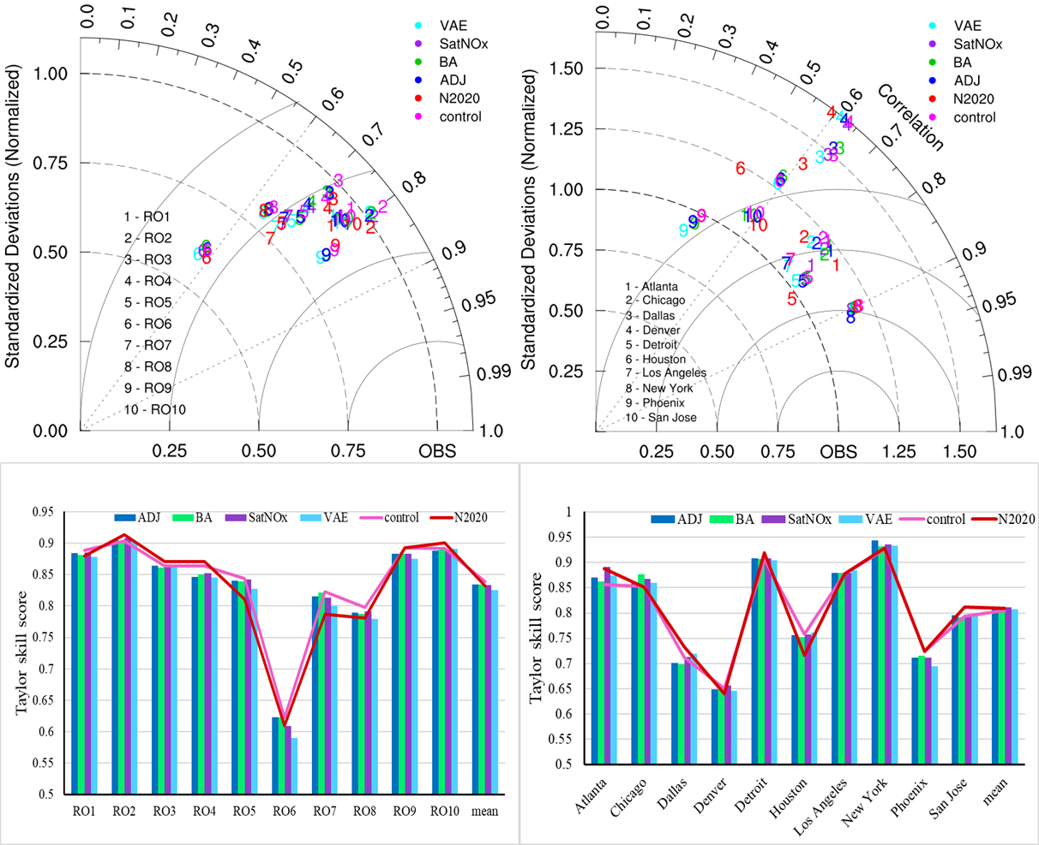
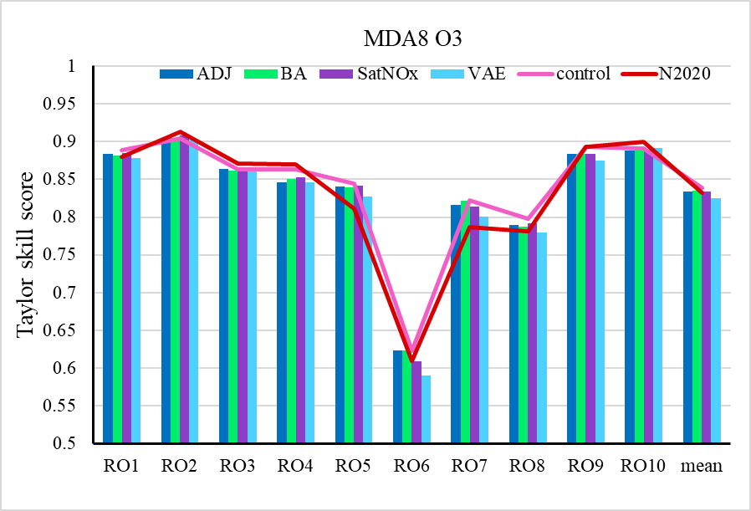
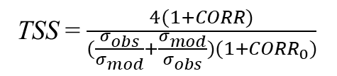
Taylor Diagrams and Skill Scores
EPA Regional Offices
Cities
TSS = $\frac{4(1+CORR)}{(\frac{σ_{obs}}{σ_{mod}}+\frac{σ_{mod}}{σ_{obs}})(1+{CORR}_{0})}$
Regional scale:
Smaller deviations, moderate correlations.
Northern east/west > Southeast/Southwest > Central US > South
SatNOx outperforms in 6 out of 10 regions; BA shows the highest mean TSS.
City scale:
Bigger variabilities than the regional scale
East/Central > South/Southwest
VAE scores highest in 4 cities while SatNOx has the best overall performance.

Slide 9
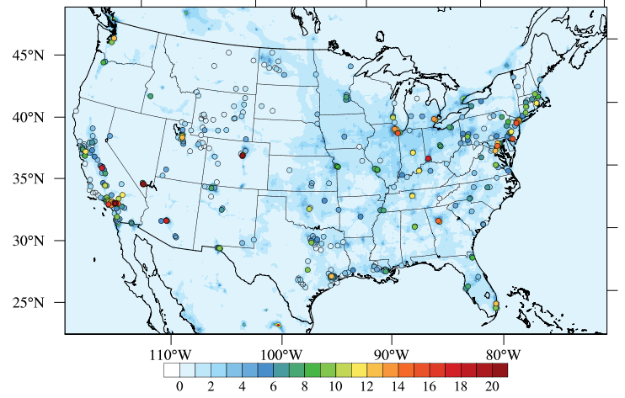
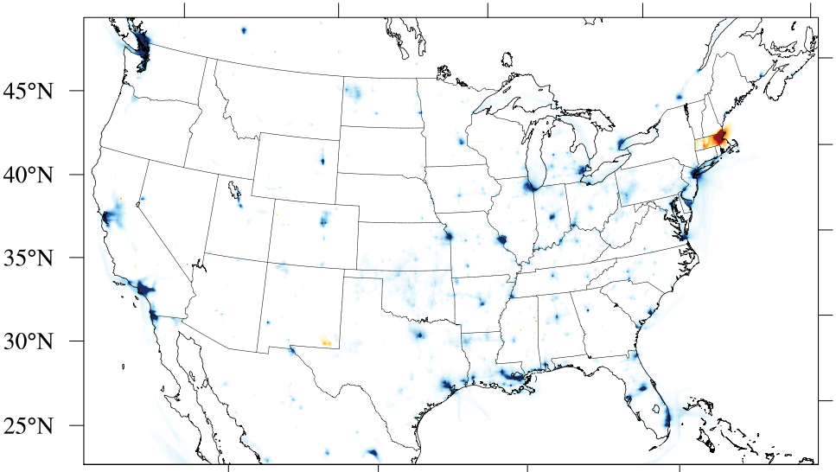
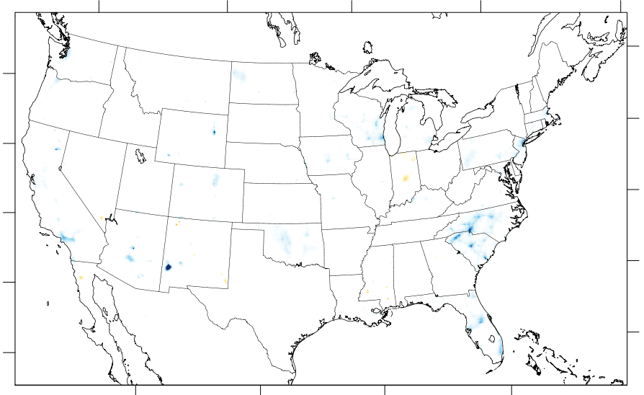
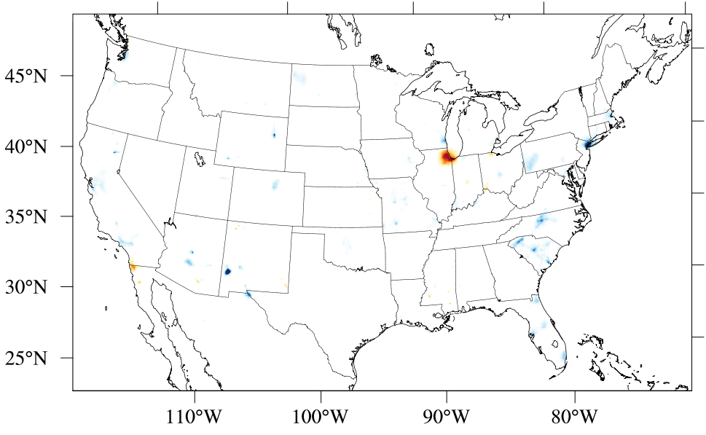

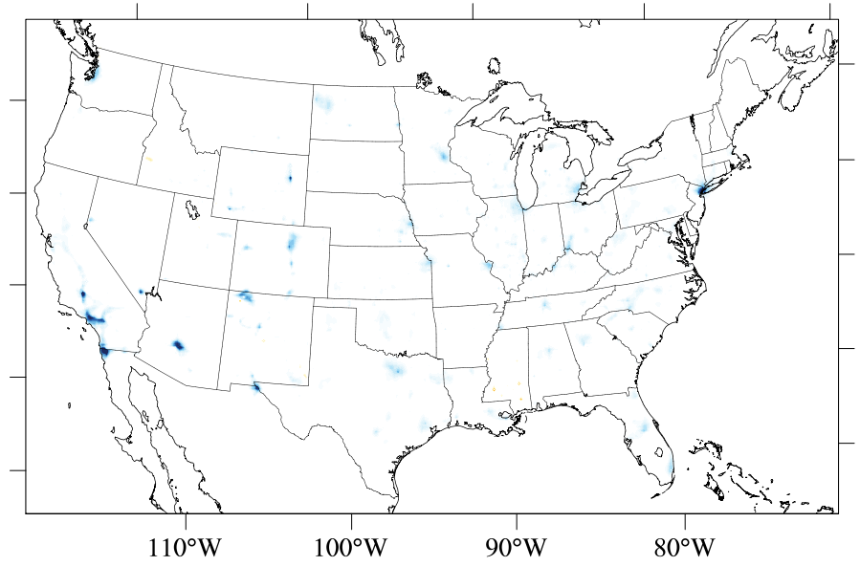
Effects of Emission Refresh on NO₂ Prediction
High differences in cities.
Increased NO₂ appears in some cities (i.e. Chicago, IL; Buffalo, NY).
Urban NO₂ is usually underestimated, MB increase: 1% (VAE) – 10% (SatNOx).
NO₂ (control) 202007
NO₂ differences (N2020-control)
NO₂ differences (ADJ-control)
NO₂ differences (BA-control)
NO₂ differences (SatNOx-control)
NO₂ differences (VAE-control)

Slide 10
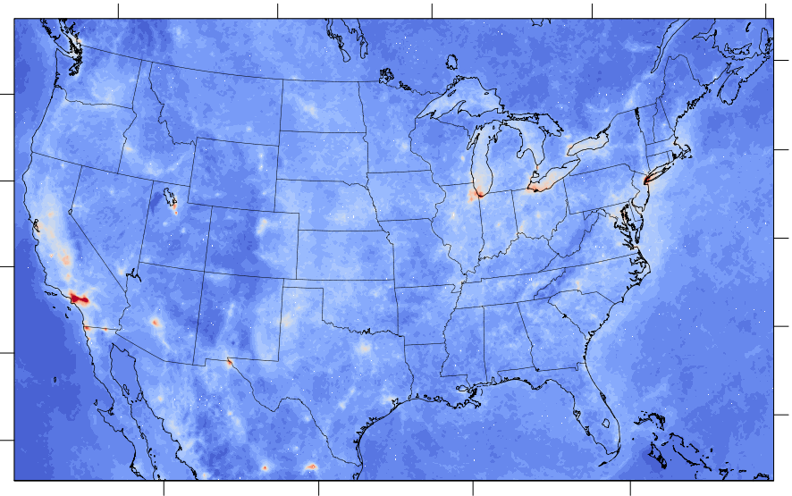
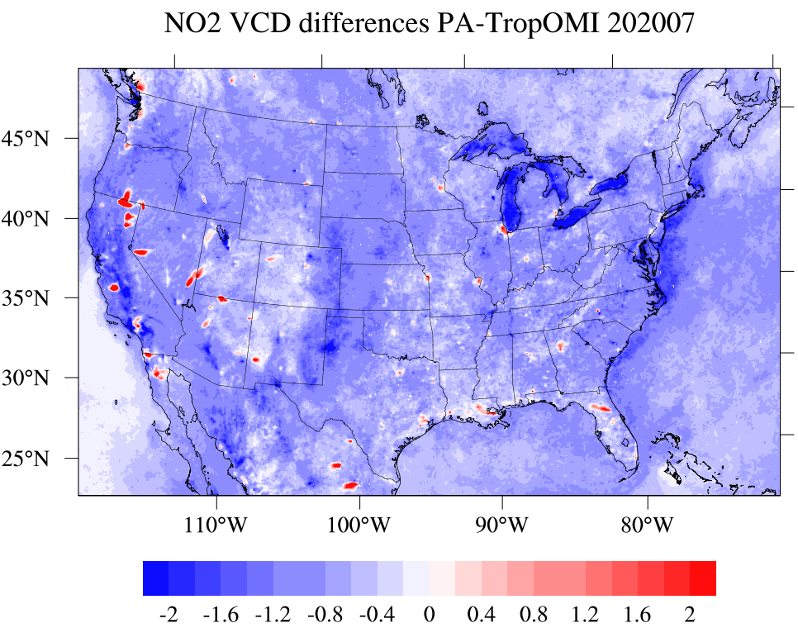
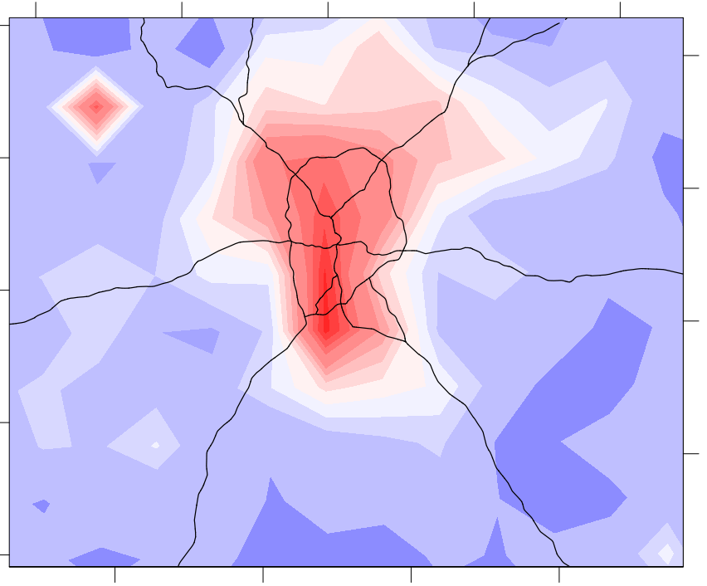
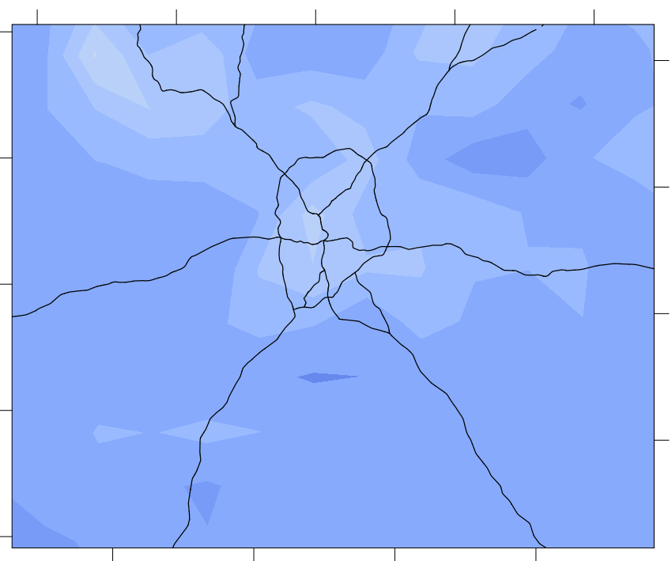
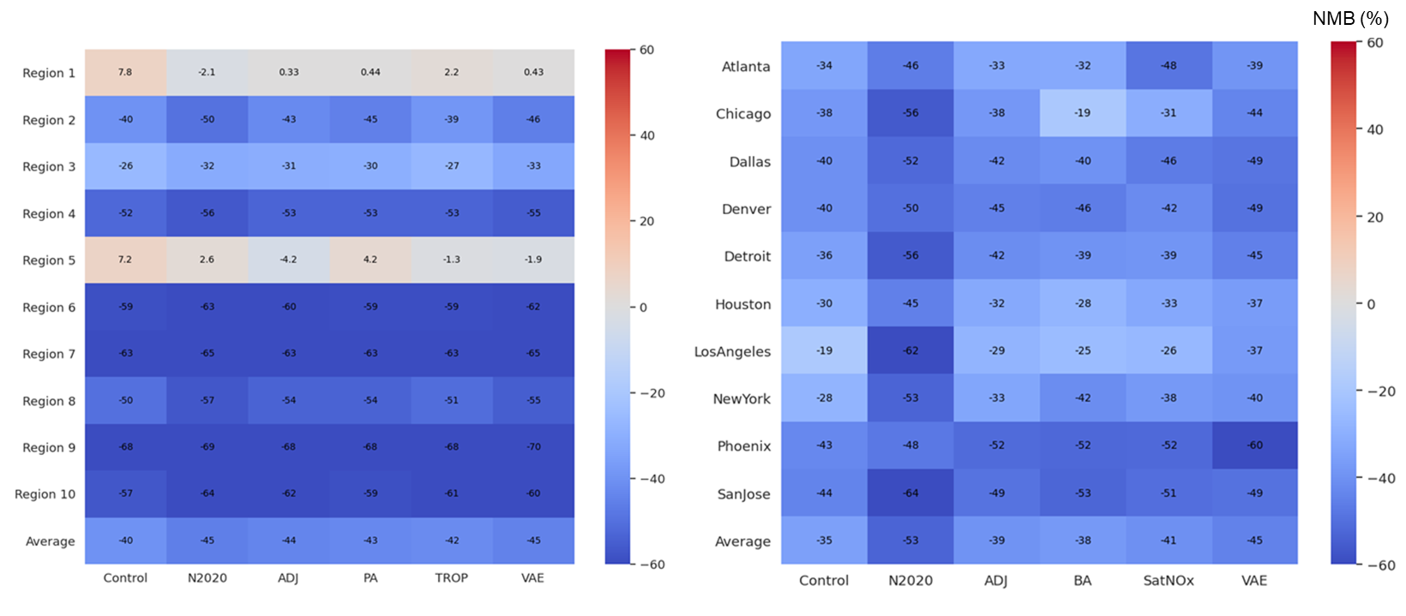
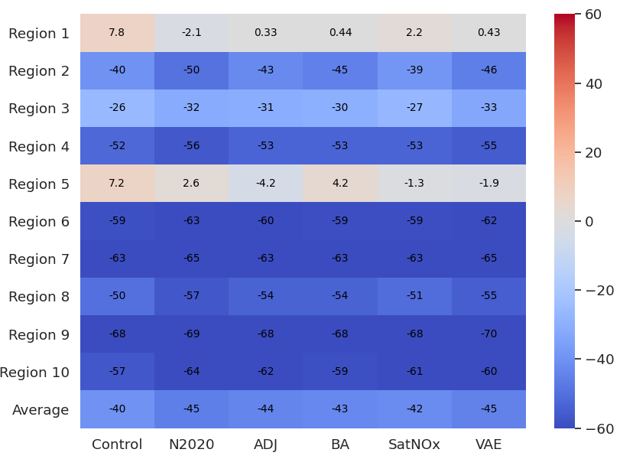
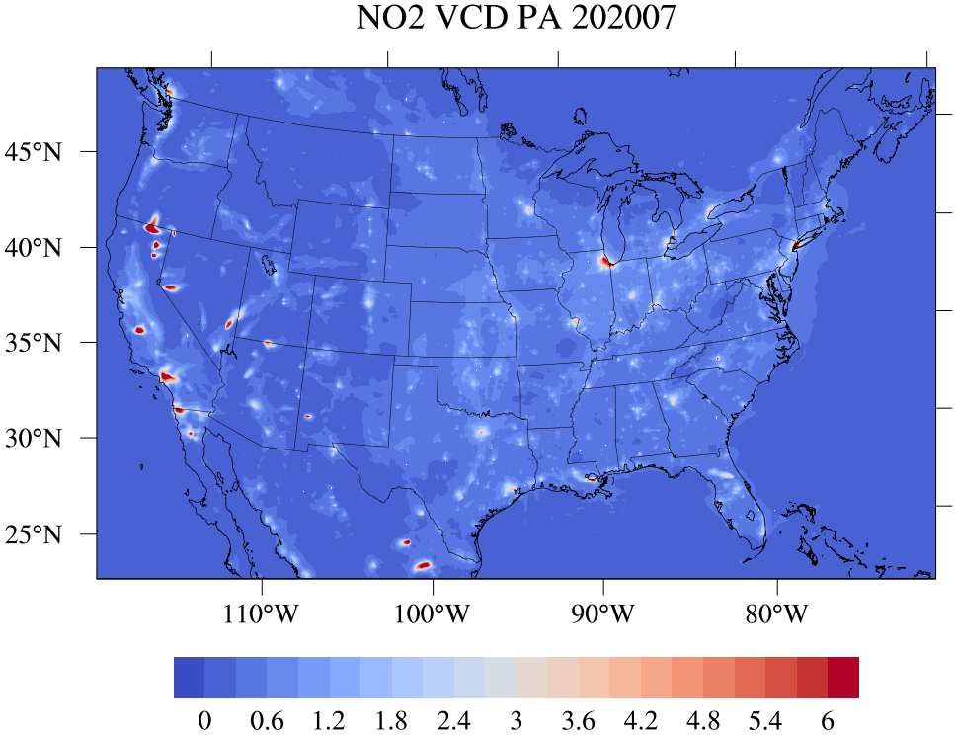
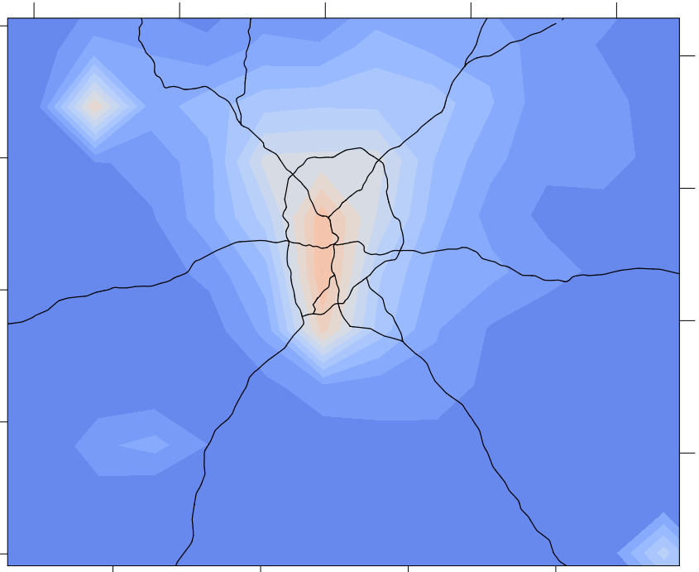
NO₂ Vertical Column Density
CONUS
Atlanta
EPA Regional Offices
Cities (50 km²)
TROPOMI
Difference
Difference
TROPOMI
Simulations can reproduce the high VCDs in cities and facilities.
Biased-high in downtowns, VCD rapidly declines from urban to rural areas.
CMAQ-BA
CMAQ-BA
Control run performs the best due to high NO_{x} emissions.
NMBs in cities are smaller than in EPA regions, except N2020.
Regional scale: SatNOx
City scale: Budget-Aware (BA)
10¹⁵ molecules cm⁻²
10¹⁵ molecules cm⁻²

Slide 11
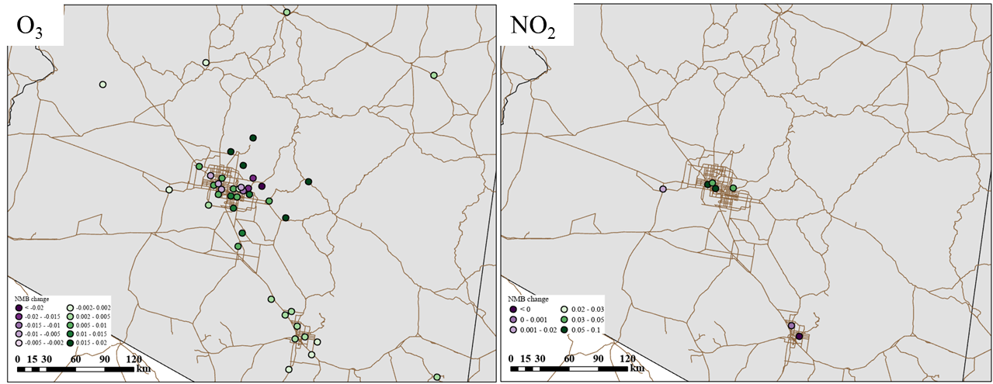
Combine with other adjustment methods
The decreasing of NO_{x} emission amplifies the model underprediction in the western US. A forward modeling method using NO₂ VCD is applied for emission adjustment in Phoenix:
NMB of O₃ presents a reduction of 11% (-7% → -6%),
and NO₂ NMB reduces with a percentage of 15% (-25% → -21%).
NMB change
Positive: NMB decrease; Negative: NMB increase

Slide 12
Conclusions
The updated emissions effectively reflect the NOx decrease trend in 2019–2020. VAE shows the nearest emission change (-10.4%) compared to NEI2020 (-13.7%).
The refresh methods reduce mean biases of modeled ozone by 2%–13% compared to the outdated emission inventory.
The Budget-Aware method outperforms at the regional scale and SatNOx performs better at the city scale.

