Slide 1
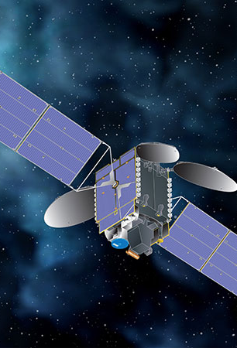
Improved Day-to-Day Variations of US NO_{x} emissions Inferred from TEMPO NO₂ Retrievals
Nana Wu, Zhen Qu*, Amir Ghajari
North Carolina State University
nwu3@ncsu.edu
CMAS 2024, 10/23/2024
Notes:
Hello everyone, I am Nana from NCSU. I am working with Professor Qu and I acknowledge her and Amir's contributions to this work.
Today I’m gonna present the improved day-to-day variations of US NOx emissions inferred from TEMPO NO2 retrievals.

Slide 2
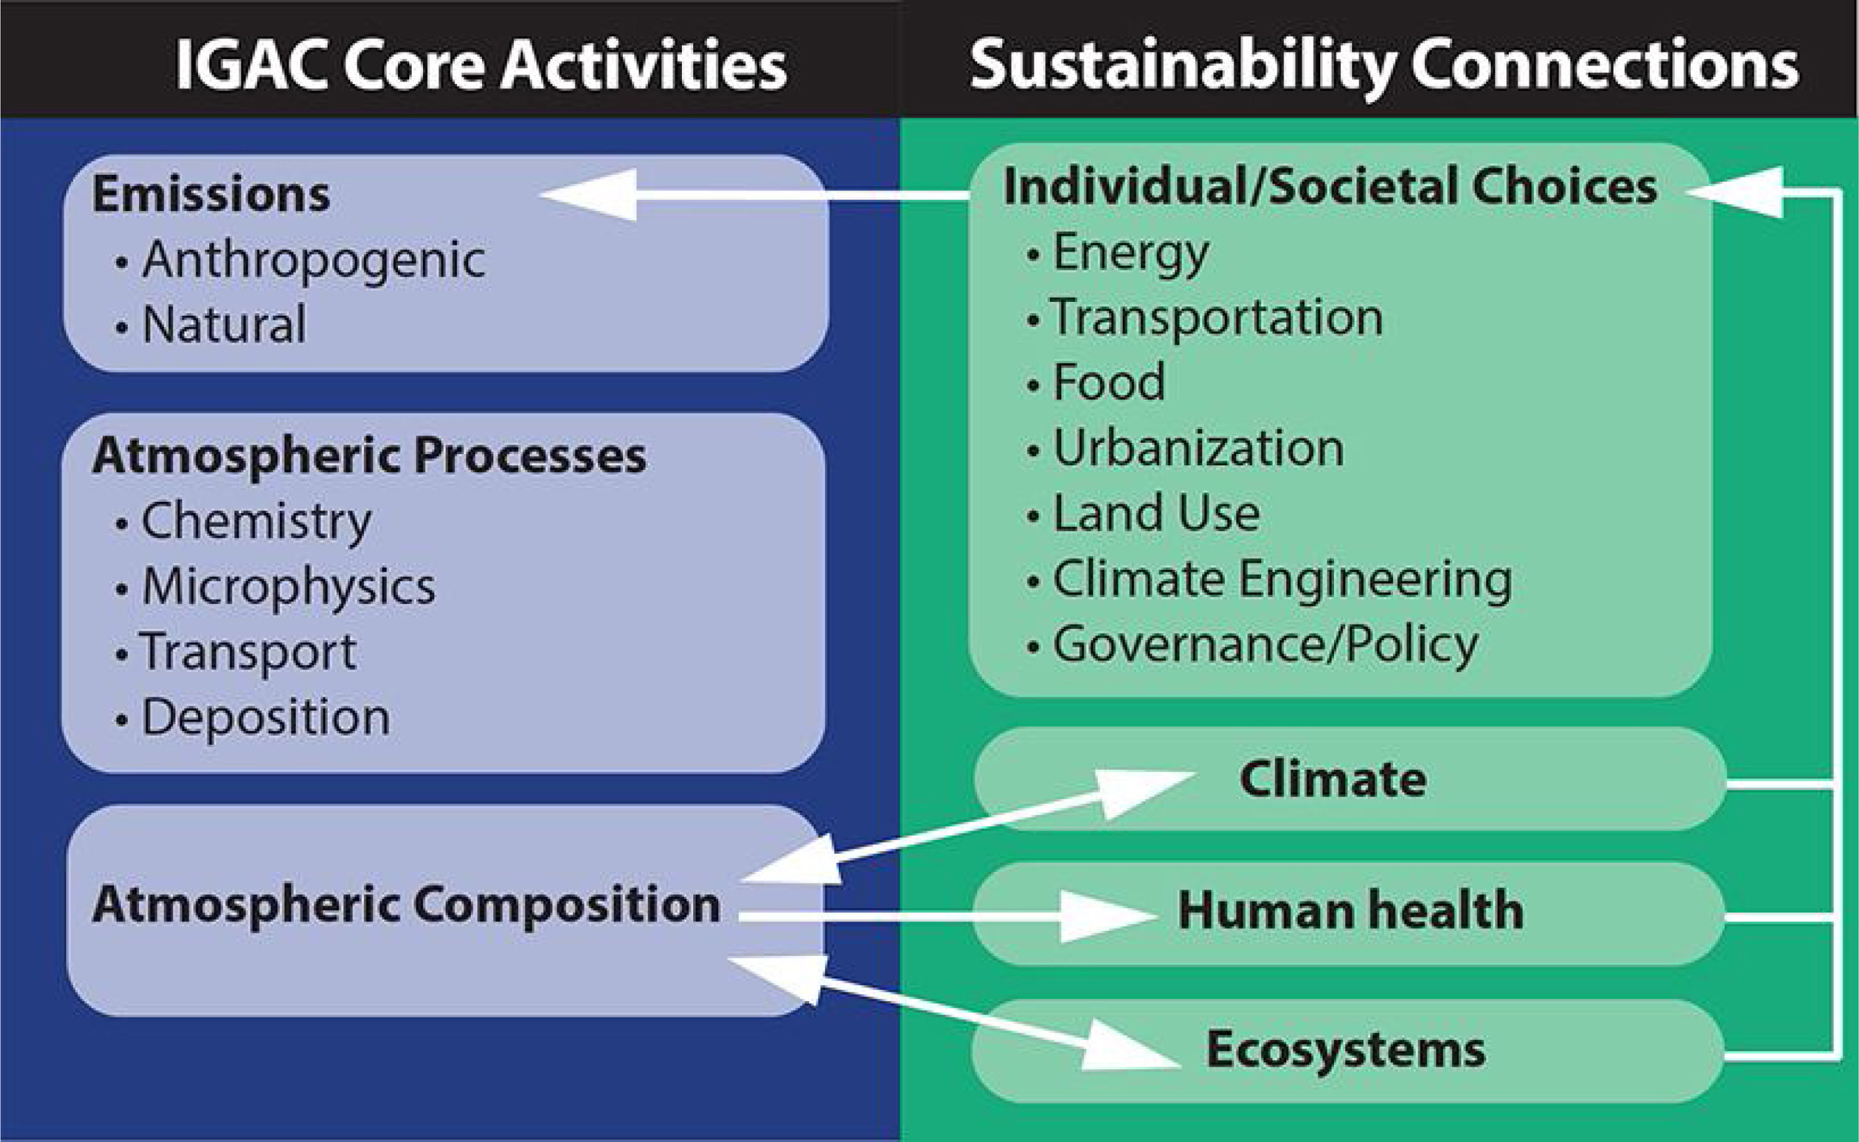
Accurate Emission Estimates are Essential for Atmospheric Research and Policy
（Melamed et al., Anthropocene, 2015)
[C. K. Gately et al., JGR, 2017]
Notes:
This is a relationship diagram from IGAC projects.
Air pollutants emitted from both anthro and natural sources undergo various atmospheric processes, and lead to changes in atmospheric composition.
These changes can significantly affect climate, human health, and ecosystems, and ultimately influence individual and societal decisions.
Therefore, accurate emission estimates are fundamental for atmospheric research and effective policymaking.

Slide 3
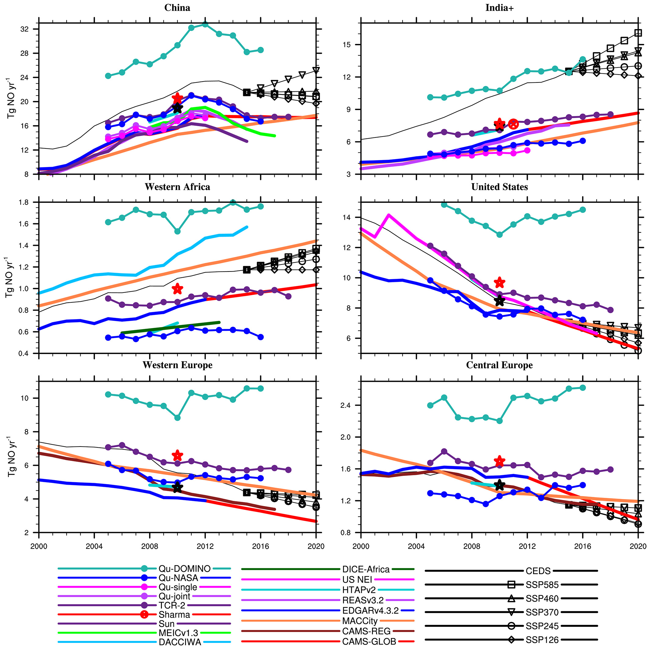
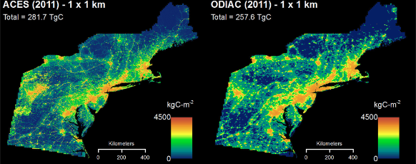
Uncertainties in Emission Estimates from Bottom-Up Methods
The general equation for emissions estimation: E = A x EF x (1-ER/100)
Emission Magnitudes
Spatial Distributions
（Elguindi et al., Earth’s Future, 2020)
（Gately et al., JGR Atmospheres, 2017)
[C. K. Gately et al., JGR, 2017]
Notes:
Bottom-up methods based on detailed activity rates and emission factors are commonly used to estimate emissions, but they come with a lot of uncertainties.
For example, when looking at NOx emission trends in the past twenty years, different research groups often report very different numbers.
For the spatial distributions, the use of spatial proxies like population cannot always reproduce the spatial mapping as accurately as point-source-based emissions, especially at fine spatial resolutions.

Slide 4
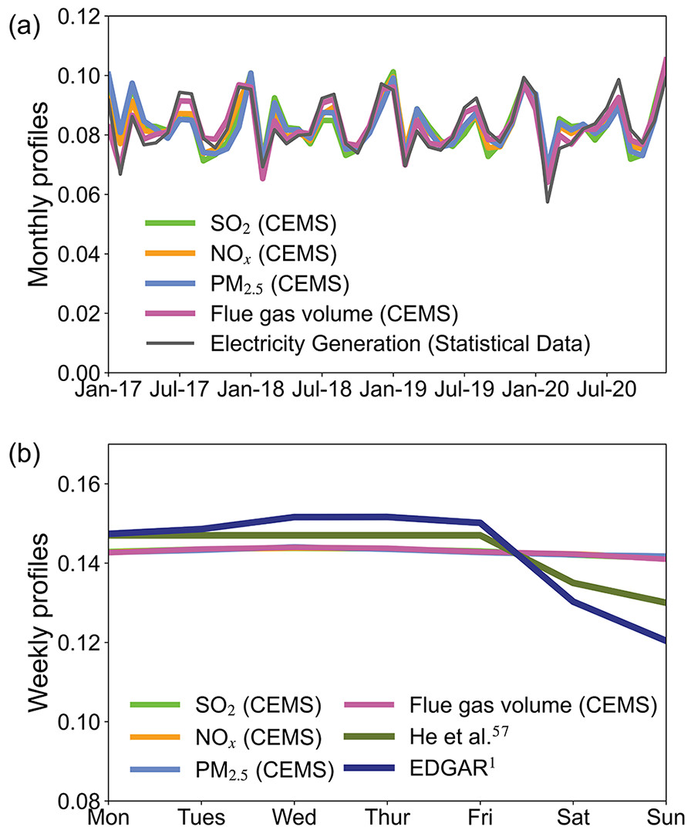
Uncertainties in Emission Estimates from Bottom-Up Methods
Daily Variations
The temporal allocation step in SMOKE allocates annual total emissions to hourly emissions using month-of-year, day-of-week, and diurnal profiles. This process relies on temporal variations in activity rates (e.g., fuel use, production rate, and traffic counts) and other surrogates.
The commonly used temporal profiles are reliable at monthly scales.
The day-of-week profiles might not fully capture the daily variations in emissions.
(Wu et al., Environmental ACS AU, 2022)
[C. K. Gately et al., JGR, 2017]
Notes:
The temporal allocation of emissions from yearly to hourly in SMOKE uses month-of-year, day-of-week, and diurnal profiles.
Due to the lack of widely emission measurements, these profiles rely on temporal variations in activity rates like fuel use, production rate, and traffic counts
This is an example for the power sector. The commonly used temporal profiles are reliable at monthly scales.
The day-of-week profiles might not fully capture the daily variations in emissions.

Slide 5
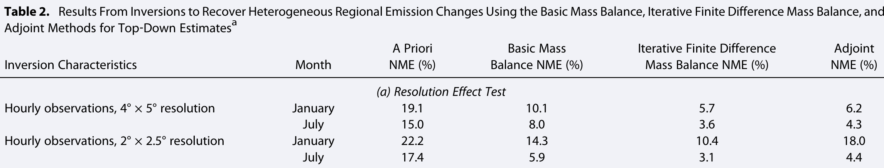
Top-Down Constraints on bottom-up emissions
(Cooper et al., JGR atmospheres, 2017)
The iterative finite difference mass balance method provides good accuracy at monthly scales.
An evaluation of mass balance methodologies is needed to identify their relative abilities to recover emission sources at finer temporal scales (e.g., daily).
[C. K. Gately et al., JGR, 2017]
Notes:
Top-down methods based on satellite data are effective to constrain bottom-up emissions.
And mass balance is a computationally effective inverse modeling method compared to adjoint-based 4d-var methods
Previous studies have validated its good accuracy at monthly scales
But more efforts need to be done to its ability to recover emission sources at finer temporal scales

Slide 6
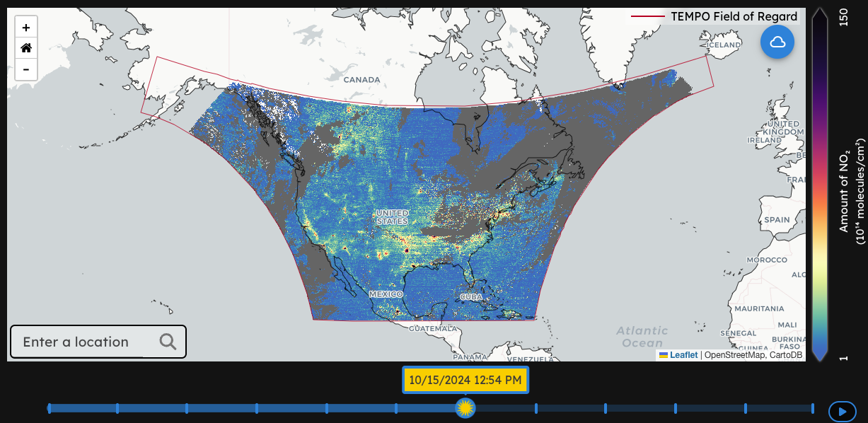
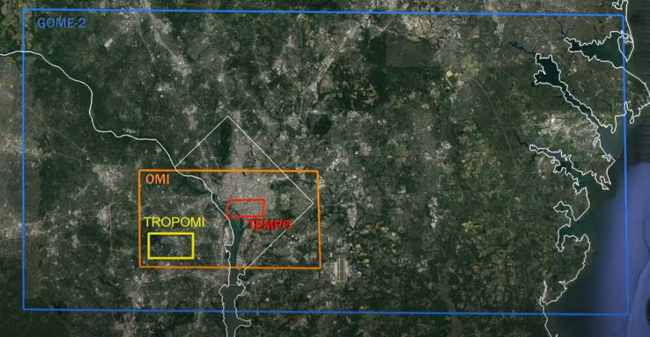
TEMPO provides high spatial-temporal NO₂ observations from space
TEMPO (Tropospheric Emissions: Monitoring of Pollution)
Data from 2023-08 onward was publicly released in 2024-05
Geostationary orbit allows TEMPO to continuously scan North America
  Hourly daytime air pollution measurements over North America
  2 $×$ 4.75 km² at center of field of regard
TEMPO offers the capability to enhance our understanding of the temporal and spatial variations in NO_{x} emissions from space!
Source: https://tempo.si.edu/
[C. K. Gately et al., JGR, 2017]
Notes:
Last year, the TEMPO hitched a ride on a commercial satellite and started to release data for August 2023 onward.
It’s in a Geostationary orbit which means TEMPO continuously scan North America and we can get high temporal resolution and spatial resolution data. And this is different from a lot of previous or current instruments that are in low earth orbits.
It’s making the first hourly daytime air pollution measurements of trace gases over North America. This is a figure of NO2 column at one hour for a few days ago.
At the center of field of regard results in a spatial resolution on ground about two by four point seven five square kilometers, which is higher than the GOME2, OMI and TROPOMI.
And this new data offers the capability to enhance our understanding of the temporal and spatial variations in NO_{x} emissions from space.

Slide 7
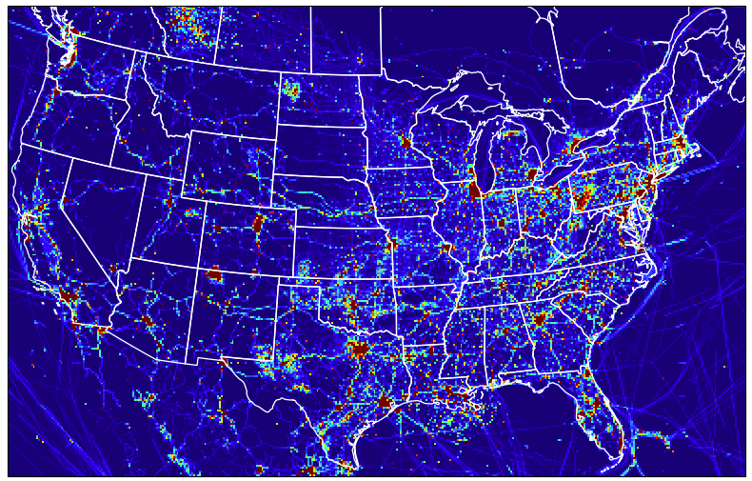
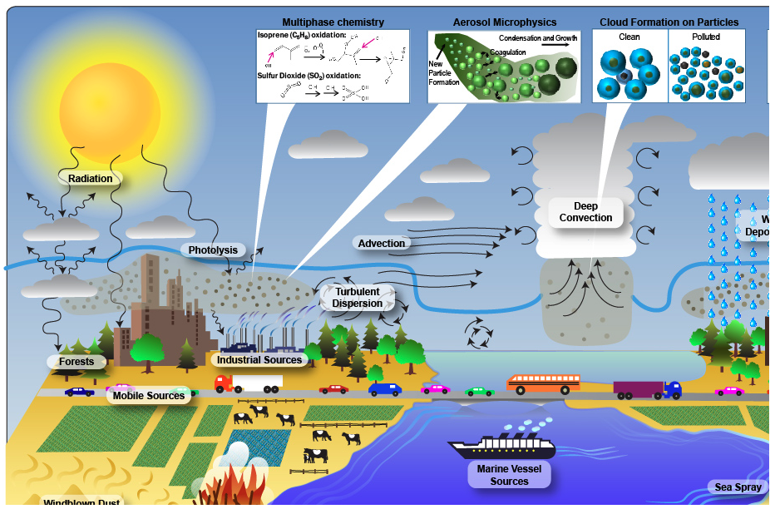
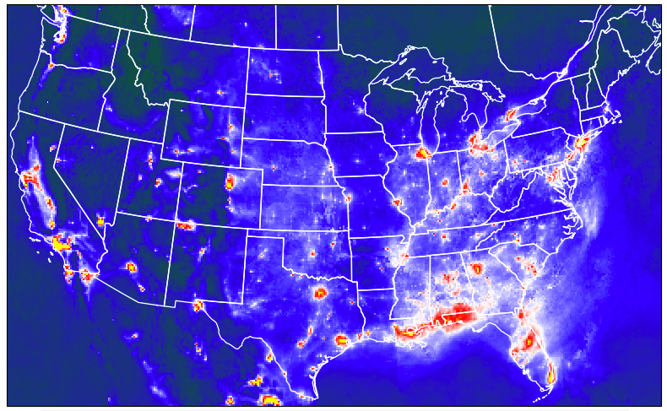
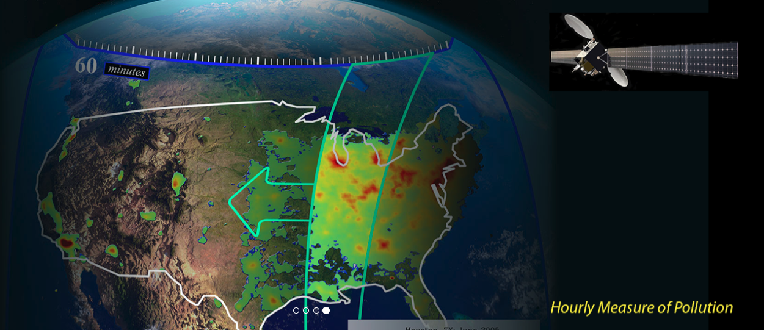
Objective
Evaluate the mass balance-based inverse modeling method at daily scales via a pseudo-observation experiment.
Improve day-to-day NO_{x} emissions from bottom-up methods by integrating TEMPO data, mass balance methods, and Chemical Transport Models.
bottom-up estimates (prior)
WRF-CMAQ model
Simulated NO₂
Observed NO₂
https://tempo.si.edu/
Correct bottom-up estimates (posterior)
Notes:
Building on the motivations we discussed earlier, our goals are to evaluate the mass balance-based inverse modeling method at a daily scale using a pseudo-observation experiment. We also aim to enhance bottom-up NOx emissions estimates by using TEMPO data, mass balance methods, and WRF-CMAQ.
The basic principle of the methods involves comparing the CMAQ-simulated NO2 with the NO2 observed by TEMPO to correct prior estimates and obtain more accurate posterior estimates.

Slide 8
Methodological Frameworks
True NO_{x} emissions
(EQUATES)
NO₂
Pseudo-observations
Evaluate the Inverse Modeling Systems
WRF-CMAQ model
Posterior NO_{x} emissions
Finite Difference Mass Balance
Prior NO_{x} emissions
(EQUATES with assumed uniform day-to-day variations)
Simulated NO₂ columns
Scattering weight from satellite
TEMPO NO₂ columns
Prior NO_{x} emissions
(EQUATES)
Applied to improving daily NO_{x} emissions
WRF-CMAQ model
Posterior NO_{x} emissions
Finite Difference Mass Balance
Simulated NO₂ columns
Scattering weight from satellite
Notes:
First, we need to evaluate our inverse modeling systems using a pseudo-observation experiment. Since we don’t have a true emission value, we’ll create a scenario.
We use the EQUATES NOx emissions as our reference value.
We input this data into WRF-CMAQ and incorporate scattering weight to get NO2 columns. These columns will serve as our synthetic pseudo-observations which is the benchmark.
Next, we’ll give the EQUATES data a hypothetical uniform day-to-day variations so that it can serve as prior emissions. We input this into CMAQ to get the simulated NO2. And compared with the pseudo-obs using a mass balance method to get the posterior NOx emissions.
After this, we will apply it to improving daily NOx emissions. in this case, the prior emissions will be EQUATES. Instead of using pseudo-observations, we'll use real satellite observations from TEMPO for the constraints.

Slide 9
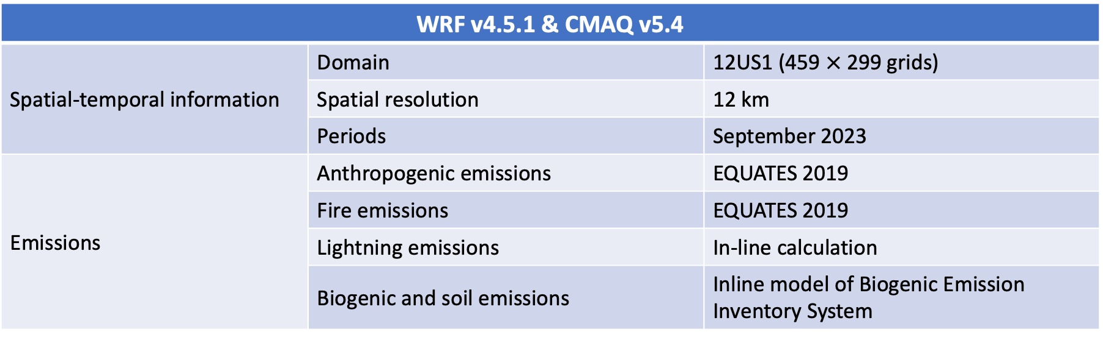
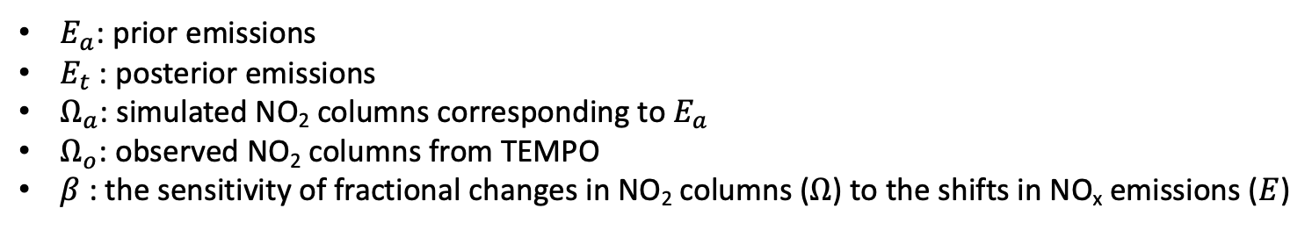
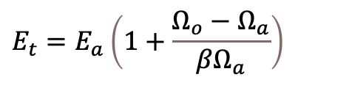
Model Setups
WRF v4.5.1 & CMAQ v5.4
Spatial-temporal information | Domain | 12US1 (459 $×$299 grids)
 | Spatial resolution | 12 km
 | Periods | September 2023
Emissions | Anthropogenic emissions | EQUATES 2019
 | Fire emissions | EQUATES 2019
 | Lightning emissions | In-line calculation
 | Biogenic and soil emissions | Inline model of Biogenic Emission Inventory System
Inverse modeling methods: Finite Difference Mass Balance (FDMB)
$E_{a}$: prior emissions
$E_{t}$: posterior emissions
$Ω_{a}$: simulated NO₂ columns corresponding to $E_{a}$
$Ω_{o}$: observed NO₂ columns from TEMPO
$β$ : the sensitivity of fractional changes in NO₂ columns ($Ω$) to the shifts in NO_{x} emissions ($E$)
$$E_{t}=E_{a}\left(1+\frac{Ω_{o}−Ω_{a}}{βΩ_{a}}\right)$$
Notes:
We use WRF-CMAQ to perform simulation for contiguous US at a resolution of 12 km for September 2023. And before this, we use half a month as the spin-up periods. For emissions data, anthropogenic and fire emissions are sourced from EQUATES 2019, while lightning and biogenic emissions come from inline calculations.
For the inverse modeling techniques, we employ the finite difference mass balance method, which takes into account how changes in NO2 columns are sensitive to shifts in NOx emissions. This approach helps reduce errors from nonlinear NOx-OH chemistry compared to basic mass balance methods

Slide 10
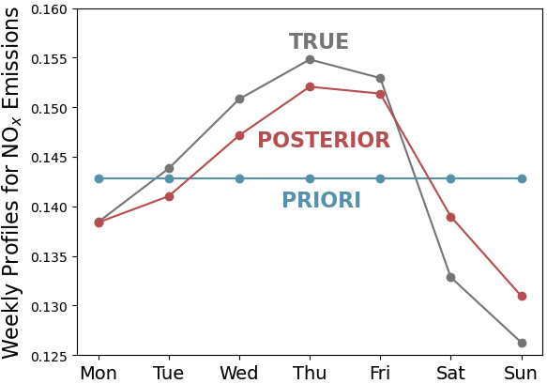
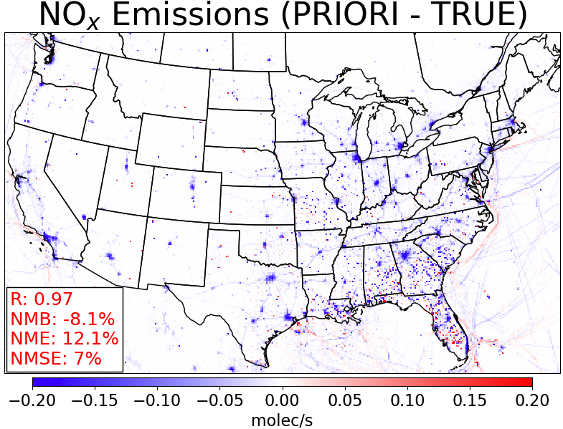
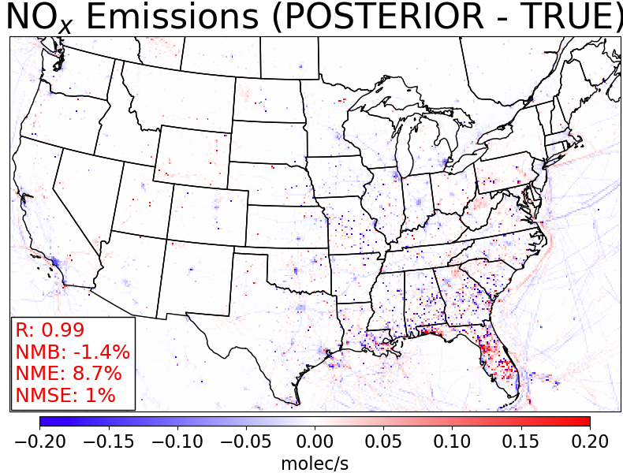
FDMB Methods Have the Potential to Recover Day-to-Day NO_{x} Emissions
moles/s
moles/s
The day-to-day variations shifted from being uniform to more closely reflecting the "TRUE" emissions.
Compared to the "TRUE" emissions, the NMB, NME, and NMSE of the prior emissions improved, decreasing from -8.1%, 12.1%, and 7% to -1.4%, 8.7%, and 1% for the posterior emissions.
Notes:
Let’s take a look at the results from our inverse modeling evaluation. In the figure on the left, we can see the daily variation profiles for three types of emissions: prior, posterior, and true emissions. For prior emissions, we assume that daily emissions are constant. However, the red and gray lines show that our inverse modeling makes the posterior emissions closely match the true emissions.
The spatial maps illustrate the differences between prior and posterior emissions compared to the true emissions. We also have some statistical variables, and the results indicate that the NMB, NME, and NMSE values are smaller for the posterior emissions, which means they are more accurate.

Slide 11
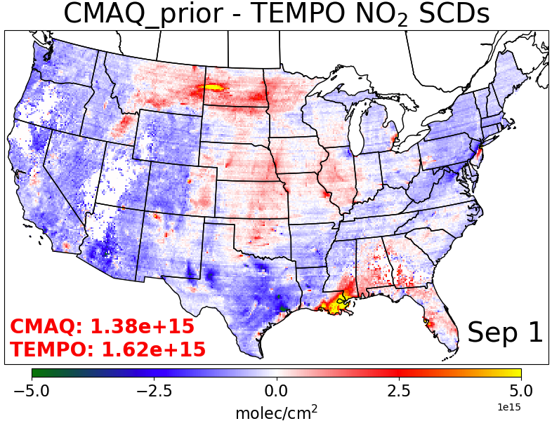
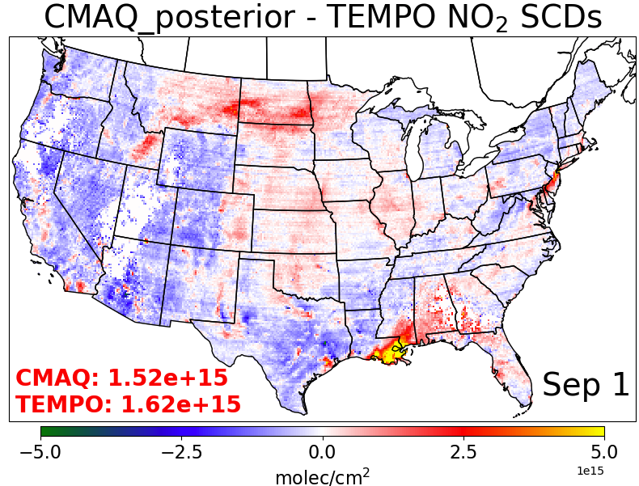
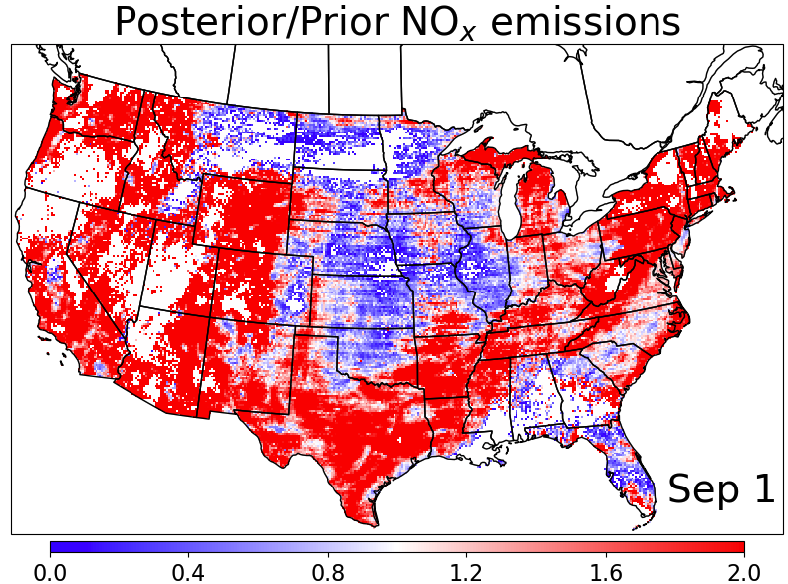
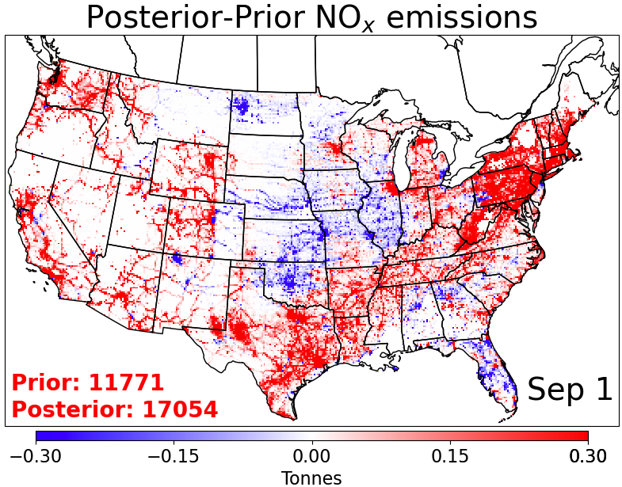
Spatial Maps of NO_{x} Emission Inversion Results for September 1st
The total prior NO_{x} emissions across the CONUS on September 1st from EQUATES data are 11,771 Tonnes.
TEMPO-constrained posterior NO_{x} emissions by FDMB methods are 17,054 Tonnes.
Notes:
This is the spatial maps for Sep 1st
The two figures on the top present the different between simulated and observed NO2 columns, one for the prior case and another for the posterior case. We can see the posterior case are closer to the TEMPO observations.
The two figures on the bottom are for the comparison of NOx emissions. The prior EQUATES emissions generally overestimate emissions in the central and north-central regions, while underestimating emissions in other areas.
One possible reason is that there are obvious wildfire on the northwest and northeast of us on that day, since we’re using the wildfire emissions from 2019, which will lead the underestimation of CMAQ modeling.

Slide 12
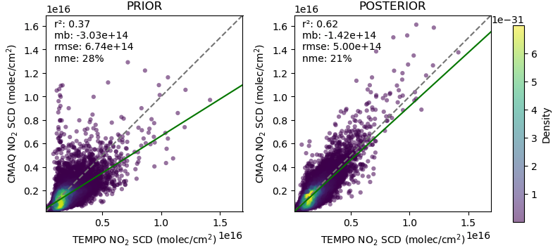
Spatial evaluation of the improved CMAQ performance for Sep 1st
Notes:
This scatter plot further supports the improved CMAQ performance based on posterior emissions compared to prior emissions.
We compare the grid level simulated slant column with the TEMPO, and we can see this through statistical parameters like R2, MB, RMSE, and NME.

Slide 13
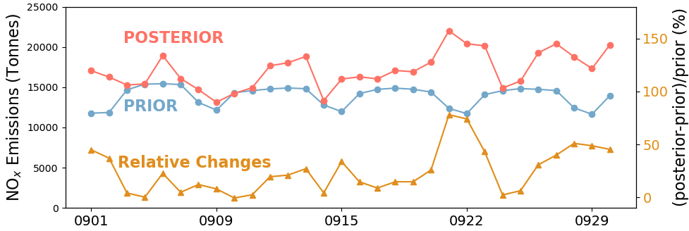
Day-to-Day Variations of Prior and Posterior NO_{x} Emissions
When comparing posterior and prior estimates, the relative changes in daily NO_{x} emissions across the CONUS in September range from -1% to 78%, with an average monthly change of 24%.
Notes:
This is a daily scale comparison between prior nox emissions and posterior nox emissions.
For the day-to-day prior emissions, they rely on temporal profiles and present a regular pattern of higher values during the weekdays and lower values on the weekends.
But the posterior emissions, the regular pattern is broken. We highlight a typical example, there are high values on weekends. One possible reason is that the average wildfire emissions over the last three days are three times those on the first day.
From the relative changes in daily NOx emissions across the CONUS range from negative 1% to 78%, and on monthly average, it shows an increase of 24%.

Slide 14
Summary
FDMB methods have the potential to recover day-to-day emissions.
The simulated NO₂ SCD with posterior NO_{x} emissions aligns more closely with TEMPO observations compared to the prior NO_{x} emissions.
Day-to-day emission variations based on temporal proxies may not always reflect real fluctuations, which can be improved via top-down emission inverse modeling.

Slide 15
Next Steps
The fire emissions from EQUATES 2019 were used for the 2023 simulation, but they should be updated to reflect the actual large fire emissions from 2023.
We will conduct iterative FDMB to reduce the smearing effects from transport of NO₂ and nonlinear chemistry.
We will constrain the daily co-emitted CO₂ emissions using NO_{x} emissions and CO₂/NO_{x} ratio.

Slide 16
THANKS
Any Questions?
Notes:
That’s all. Thank you for your attention and I’d be happy to take any questions.

