Slide 1
TREND+PROJ21
Towards better granularity, production speed and quality control of Canadian inventories.
Laurent Bruneau-Cossette, David Niemi, Mourad Sassi,
Maxim Bulat
REQA Section
Canadian Meteorological Center (Dorval, QC)

Slide 2
REQA
French acronym for “Air Quality Policy Response Section”
Part of CMC Operations
Vocation : produce AQ reanalysis and AQ impact analysis of regulatory scenarios
Task: yearly province totals → AQM-ready inventories
  Prerequisite of other REQA products
  Pollutant Inventories Reporting Division : Past totals
    Originates TREND
  Analysis and Modelling Division : Future totals
    Originates PROJ

Slide 3
REQA Inventories: TREND and PROJ
Example : TREND+PROJ19
End of
Emission Year
Next cycle,
Scenario work
2019
2020
2021
2022
2023
June NPRI
Report Deadline
Dec/Jan
TREND+PROJ19
2000-2019-2050
Feb 15
APEI
(past totals)
1990-2019
Sept
Preliminary NPRI
Data used in APEI
Dec/Jan
E3MC output
(future totals)
2019-2050

Slide 4

TREND+PROJ19
Previous inventory version
Sound methodology,
implementation issues
  MS Access
  Part manual, part automatic
  Some QC “after the fact”:
  lots of back-and-forth
Timing : ~ 9 months for TREND,
~ 3 months for PROJ
Little time for improvement
Need for improved efficiency
TREND
UPGRADE
TREND
UPGRADE
IMPROVING TREND
TREND
UPGRADE
TREND
UPGRADE

Slide 5

TREND+PROJ21: implementation goals
Translation of MS Access queries
into Postgres
Semi-automation of manual processes
  Objective: automate 95% of process
Make QC a baked-in, blocking process
Produce comparable results
Hexxus
Productivity
Time

Slide 6
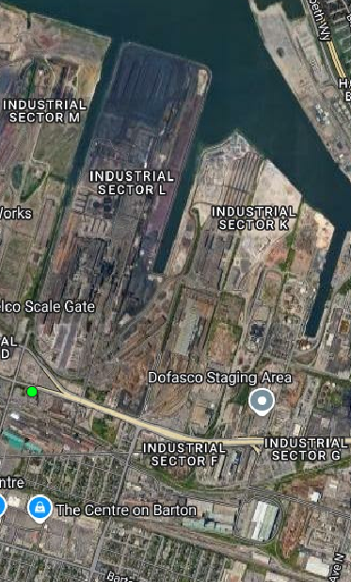
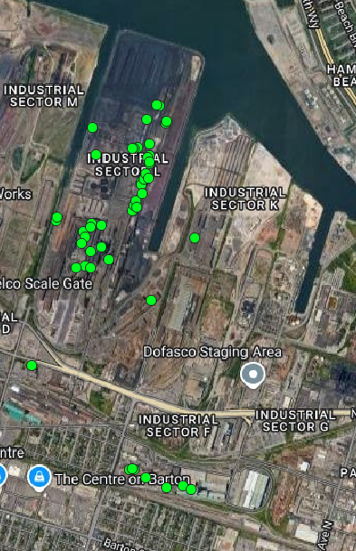
TREND+PROJ21 improvements
Point Source sector
  Reviewed stack proportions
  Reviewed VOC speciation
  Explicit stack location
  Explicit non-stack emissions (e.g. spills, fugitive)
Marine Transportation sector: MEIT as reference
  Refined ship type and process granularity
  Yearly → Monthly
TREND19
TREND21
Arcelor-Mittal Dofasco, Hamilton (ON), NPRI ID 3713

Slide 7
TREND+PROJ21 Processing times
Start of process: Feb 2024
  TREND21: years 2000-2021
  completed May 2024 (4 mo)
  PROJ21:
    USA proj years matching : 2026, 2028, 2030, 2032, 2036,
    Additional 5-year leaps : 2025, 2035, 2040, 2045, 2050
    Completed early August (2 mo)
End of process: Sep 2024 (1 month of testing + revisions)

Slide 8
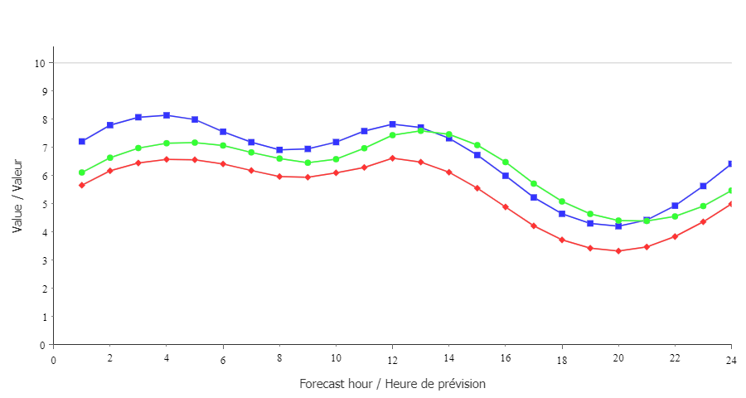
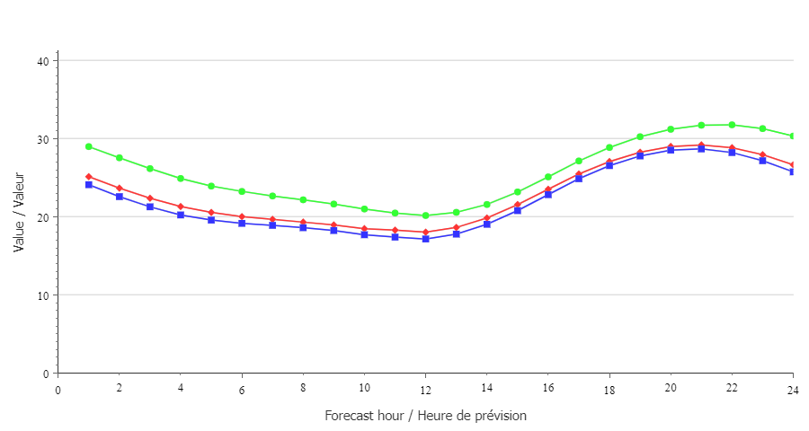
TREND21 vs TREND19
Yearly average for hourly NO₂ over Canada
Yearly average for hourly O₃ over Canada
TREND19
TREND21
Observation
TREND19
TREND21
Observation
More than meets the eye
  Results vary vs month and region
What happened to NO_{x}?

Slide 9
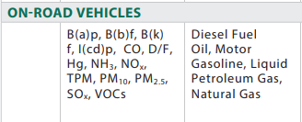
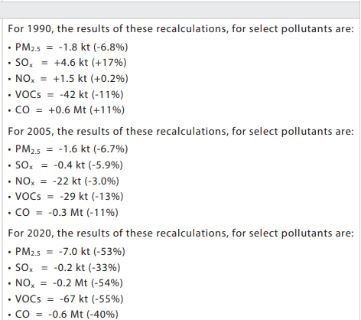
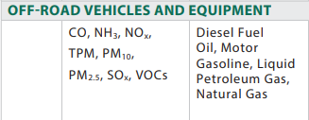
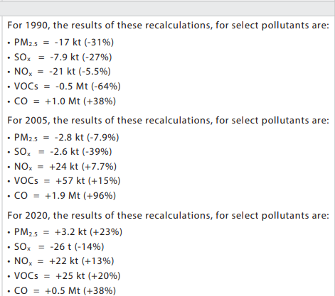
The TREND21 NO_{x} situation
TREND derives its data from APEI
APEI2023 recalculation, Table A3-4 (abridged) :
Removes ~180 000 tonnes NO_{x} in 2019 (-10%)
TREND19, TREND21 originate from resp. APEI2021, 2023
  No other significant method changes in between
Source : APEI2023 report (https://publications.gc.ca/collections/collection_2023/eccc/En81-30-2021-eng.pdf)

Slide 10
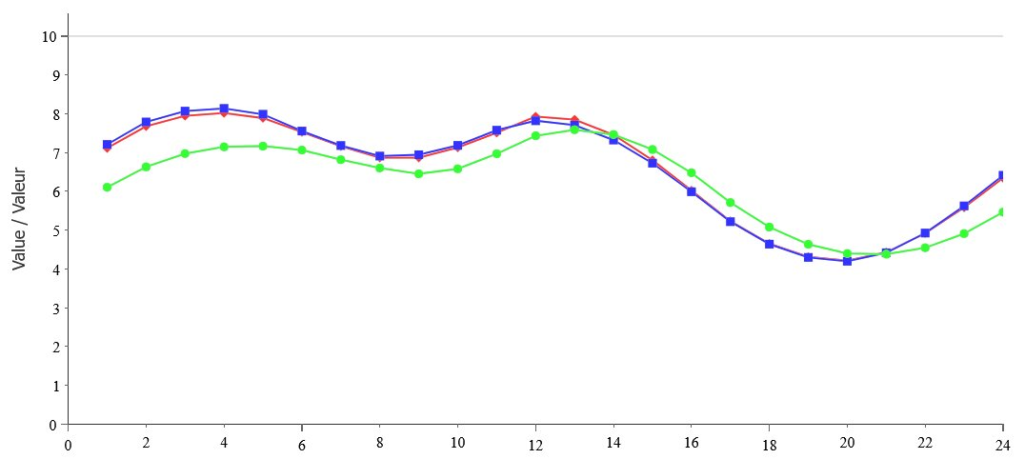
The TREND21 NO_{x} situation
What if we used On/Offroad from TREND20?
  For On- and Offroad: TREND19 = TREND20 (±1%)
Almost identical statistics : comparable emissions
Yearly average for hourly NO₂ over Canada
TREND19
TREND20+21 Hybrid
Observation

Slide 11
Is trend21 an improvement?
Implementation goals (mostly) reached
  Could use more automation
Production goals reached
  Results are comparable*
Faster processing vs TREND19
  7 months down from 12: more time for improvement
* APEI2023 recalculation: caution is advised
  To be addressed in a future TREND

Slide 12
Future Opportunities
Further automation (where possible)
Continued collaboration with PIRD and AMD
Improved search for outliers
  Unexpected increases/decreases in emissions

Slide 13
Future Opportunities
Improve Aviation:
  Monthly to Hourly : better representation of airplane movement
  3D surrogates
Improve Onroad:
  Use SMOKE-MOVES
Improve Marine:
  Area Monthly to Point Hourly
Improve Rail (tentative):
  Traffic flow analysis using camera data
Improve Point:
  Monthly to Daily : facility shutdowns
  Use new NPRI Fuel data : fuel-based speciation

Slide 14
Future Challenges
Keep it tidy
  Data Lake, not Data Swamp
Keep it growing
  Dataset detail vs Confidentiality issues
  Increase diversity/granularity of scenario works
Keep it secure
  Carefully manage reading privileges
  Provide appropriate training to ensure proper usage

Slide 15
Acknowledgements
REQA colleagues
  David Niemi, Mourad Sassi, Maxim Bulat
Pollutant and Inventories Reporting Division
  APEI and other ancillary data
Analysis and Modeling Division
  Custom E3MC model outputs and policy scenarios

Slide 16
Supplementary material

Slide 17

The Hexxus Project
Postgres + PostGIS database
TREND inventory
inspection workspace
Became an AQM-related data hoard
  TREND emissions
  GEM-MACH grid shapefiles
  Facility locations
  Surrogates (and more)
Used to improve QC of TREND19 data
Ideal candidate to host next TREND
MEIT
TREND data
Every shapefile
APEI
GE_DAT
Custom SRIDs
NPRI
EPA datasets
Like a dragon:
the bigger the hoard,
the more powerful it gets.

Slide 18
TREND+PROJ21 improvements
Batch output
  Parallel processing of all emission years
Improved validation utilities
  Comprehensive tracking of FF10 to SMOKE to GEM-MACH-ready emissions
Improved troubleshooting abilities
  Using GIS capabilities to pinpoint issues

Slide 19
TREND+PROJ19: example issues solved
Errors in stack emission distribution
  Stack proportions unexpectedly collapsed to 1/N_{stacks} beyond 2016
    NPRI database changes and issue with stack identifiers
  Fixed in TREND+PROJ20/21
Errors in facility speciation
  Unexpectedly high PAH emissions from some facilities vs NPRI reports
    NPRI ID 3824 and 31053 :
      ~ 7 tonnes of Pyrene and others in TREND19 2019
      Errors in TREND19 2019 speciation
  Issue not possible in TREND+PROJ20/21

Slide 20
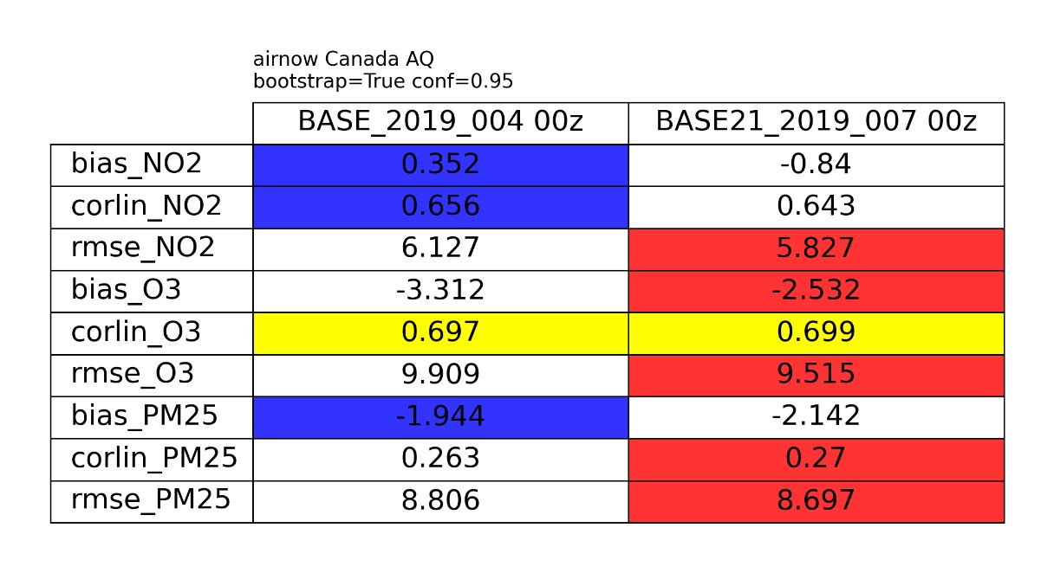
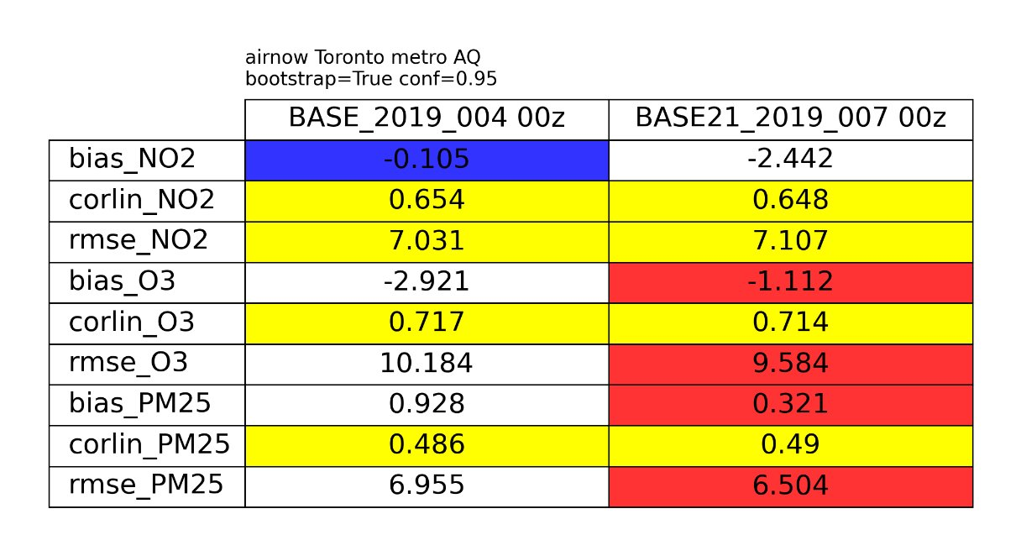
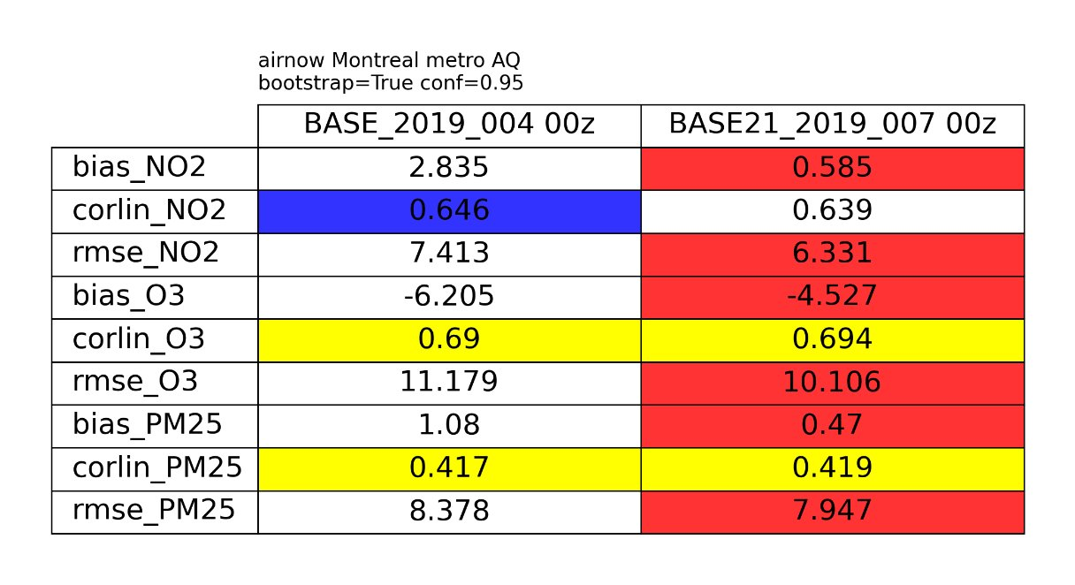
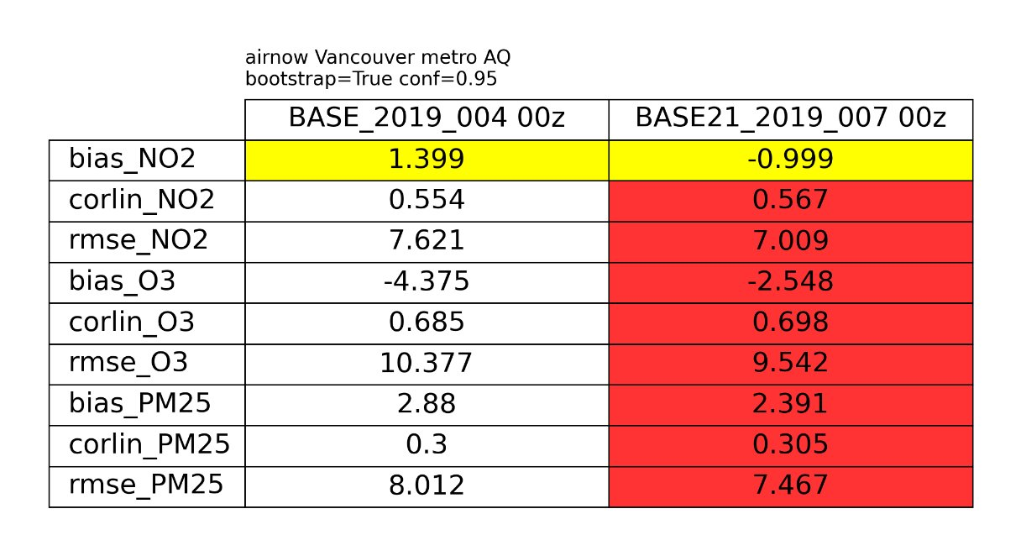
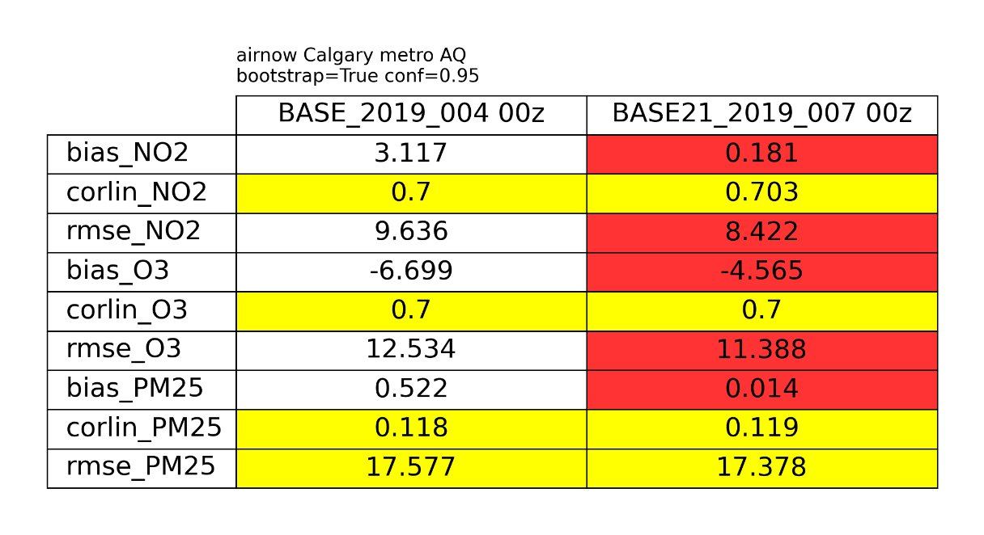
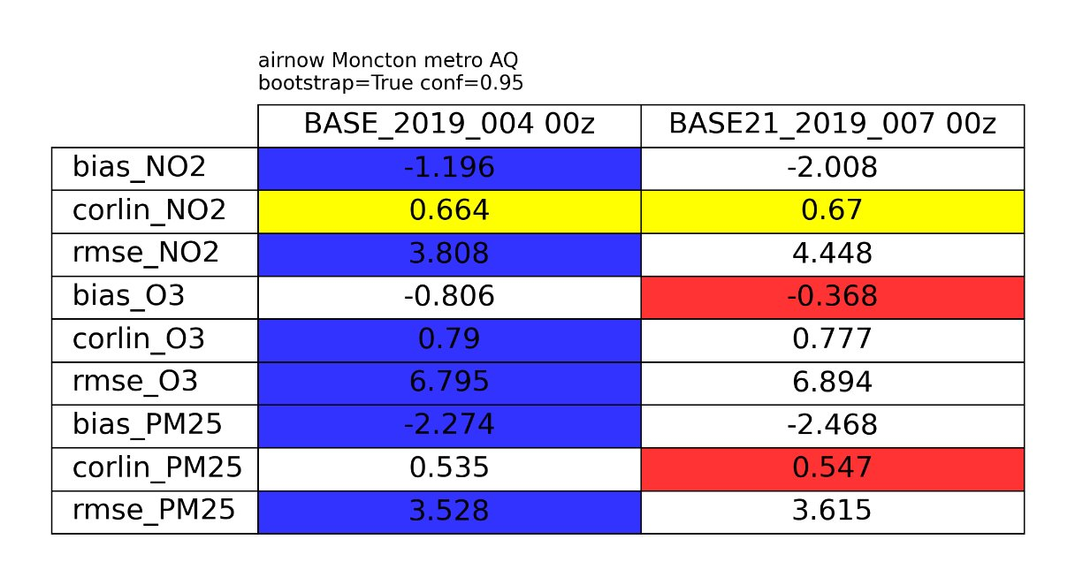
TREND21 vs TREND19
More than meets the eye
  See Junhua’s 8:50 AM presentation for more details

Slide 21
TREND21 vs TREND19
Region​ |  | AB​ |  | BC​ |  | MB​ |  | NB​ |  | NL​ |  | NT​
Polluant​ | Statistic​ | base_2019_004​ | base21_2019_007​ | base_2019_004​ | base21_2019_007​ | base_2019_004​ | base21_2019_007​ | base_2019_004​ | base21_2019_007​ | base_2019_004​ | base21_2019_007​ | base_2019_004​ | base21_2019_007​
NO2​ | mbias​ | 0.91​ | 0.32​ | -0.33​ | -1.97​ | 2.72​ | 1.37​ | 0.25​ | -0.84​ | -0.65​ | -0.76​ | -0.10​ | 0.22​
 | corr​ | 0.67​ | 0.66​ | 0.59​ | 0.59​ | 0.46​ | 0.42​ | 0.30​ | 0.30​ | 0.37​ | 0.38​ | 0.37​ | 0.36​
 | rmse​ | 7.13​ | 6.73​ | 6.24​ | 6.17​ | 6.19​ | 5.31​ | 4.90​ | 4.08​ | 3.11​ | 3.09​ | 3.66​ | 3.87​
O3​ | mbias​ | -5.55​ | -5.04​ | -3.06​ | -1.77​ | 2.13​ | 3.07​ | -2.30​ | -1.59​ | 1.12​ | 1.15​ | -0.88​ | -1.09​
 | corr​ | 0.69​ | 0.69​ | 0.67​ | 0.67​ | 0.56​ | 0.53​ | 0.71​ | 0.73​ | 0.68​ | 0.68​ | 0.59​ | 0.59​
 | rmse​ | 11.33​ | 10.99​ | 10.28​ | 9.83​ | 10.36​ | 10.79​ | 8.34​ | 7.79​ | 7.70​ | 7.72​ | 7.88​ | 7.92​
PM2.5​ | mbias​ | -2.17​ | -2.58​ | -1.88​ | -1.88​ | -1.62​ | -1.63​ | -3.19​ | -3.34​ | -3.14​ | -3.07​ | -4.63​ | -4.55​
 | corr​ | 0.14​ | 0.15​ | 0.21​ | 0.24​ | 0.13​ | 0.13​ | 0.38​ | 0.38​ | 0.17​ | 0.18​ | 0.08​ | 0.07​
 | rmse​ | 14.50​ | 14.37​ | 7.74​ | 7.62​ | 8.83​ | 8.84​ | 5.23​ | 5.28​ | 5.29​ | 5.24​ | 8.99​ | 8.95​
Region​ |  | NS​ |  | ON​ |  | PEI​ |  | QC​ |  | SK​ |  | YT​
Polluant​ | Statistic​ | base_2019_004​ | base21_2019_007​ | base_2019_004​ | base21_2019_007​ | base_2019_004​ | base21_2019_007​ | base_2019_004​ | base21_2019_007​ | base_2019_004​ | base21_2019_007​ | base_2019_004​ | base21_2019_007​
NO2​ | mbias​ | -0.45​ | -0.29​ | -0.44​ | -1.88​ | -0.23​ | -0.50​ | 2.78​ | 0.44​ | -0.18​ | -1.97​ | -2.32​ | -2.43​
 | corr​ | 0.35​ | 0.29​ | 0.68​ | 0.67​ | 0.56​ | 0.56​ | 0.65​ | 0.66​ | 0.61​ | 0.60​ | 0.60​ | 0.59​
 | rmse​ | 3.66​ | 4.40​ | 5.61​ | 5.64​ | 1.80​ | 1.90​ | 7.11​ | 5.82​ | 5.93​ | 5.71​ | 6.56​ | 6.62​
O3​ | mbias​ | -1.74​ | -2.01​ | -2.82​ | -1.86​ | 0.65​ | 0.70​ | -4.56​ | -3.65​ | -4.78​ | -3.60​ | -9.27​ | -9.19​
 | corr​ | 0.74​ | 0.73​ | 0.72​ | 0.71​ | 0.75​ | 0.74​ | 0.71​ | 0.72​ | 0.67​ | 0.67​ | 0.78​ | 0.78​
 | rmse​ | 7.03​ | 7.26​ | 9.40​ | 9.06​ | 6.48​ | 6.55​ | 9.64​ | 8.92​ | 9.90​ | 9.23​ | 12.34​ | 12.28​
PM2.5​ | mbias​ | -3.83​ | -3.88​ | -0.75​ | -1.08​ | -4.15​ | -4.13​ | -1.54​ | -1.79​ | -3.68​ | -3.72​ | -5.91​ | -5.88​
 | corr​ | 0.34​ | 0.34​ | 0.49​ | 0.50​ | 0.28​ | 0.28​ | 0.42​ | 0.42​ | 0.33​ | 0.33​ | 0.28​ | 0.28​
 | rmse​ | 4.92​ | 4.95​ | 6.09​ | 5.91​ | 6.70​ | 6.69​ | 7.04​ | 6.91​ | 6.26​ | 6.29​ | 11.02​ | 11.00​

Slide 22
The TREND21 NO_{x} situation
APEI2023 recalculations :
  Updated Onroad and Offroad vehicle populations
  Updated Onroad model
  Updated Onroad and Offroad fuel use
  Updated Onroad kilometer accumulation rates
Source : APEI2023 report (https://publications.gc.ca/collections/collection_2023/eccc/En81-30-2021-eng.pdf)

Slide 23
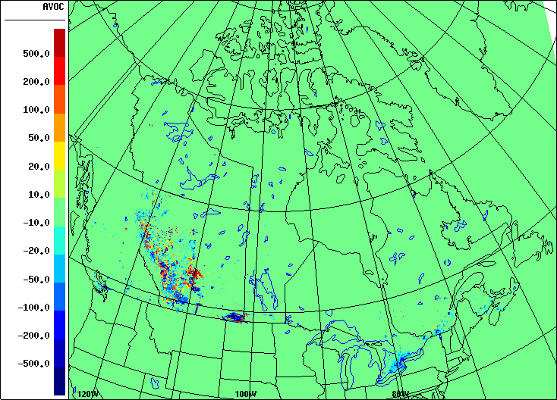
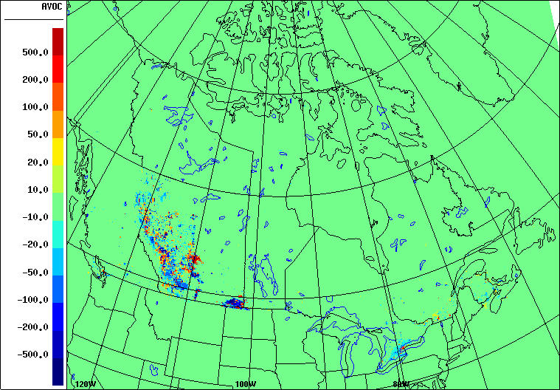
Comparison : emission year 2019 VOC
TREND21 – TREND19
(TREND20+21 hybrid) – TREND19
Quantities in tonnes/year

Slide 24
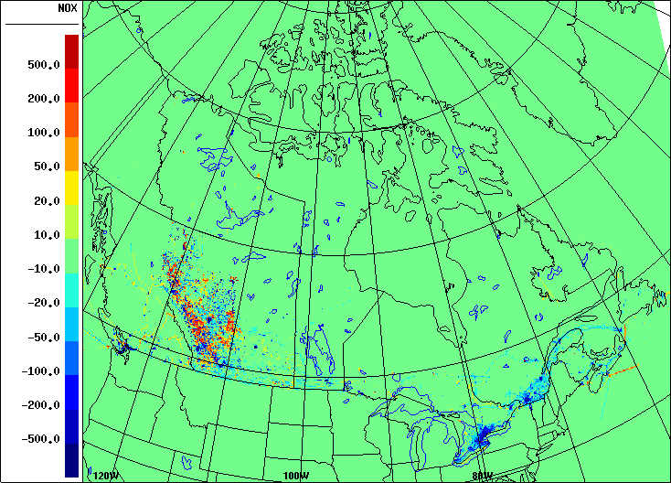
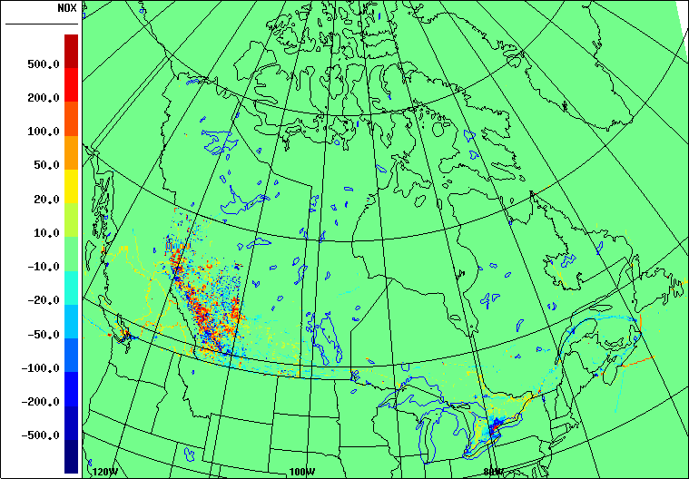
Comparison : emission year 2019 NOX
TREND21 – TREND19
(TREND20+21 hybrid) – TREND19
Quantities in tonnes/year

Slide 25
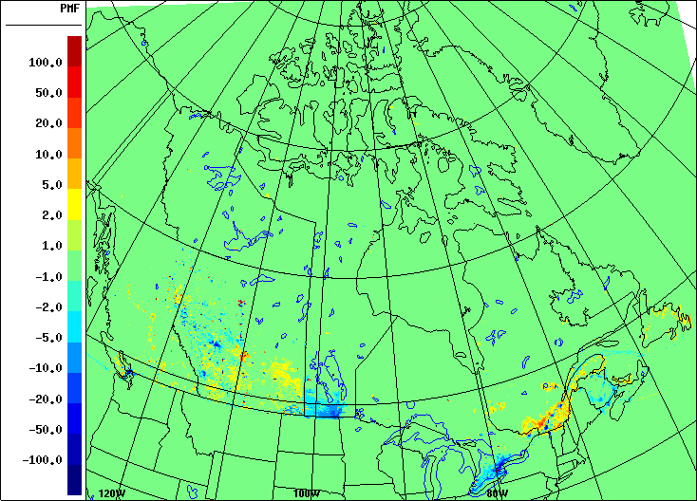
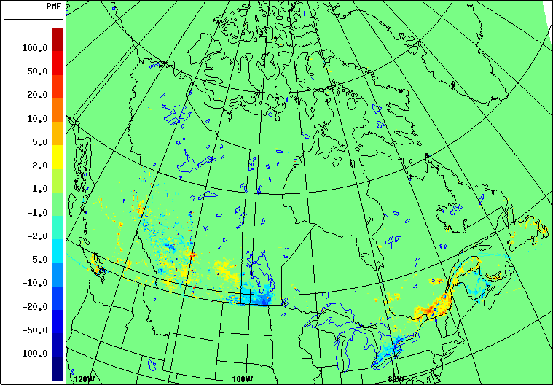
Comparison : emission year 2019 PM2.5
TREND21 – TREND19
(TREND20+21 hybrid) – TREND19
Quantities in tonnes/year

Slide 26
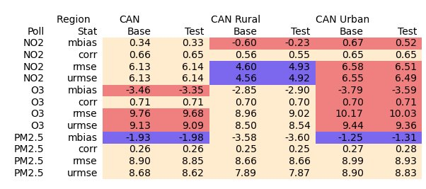
The TREND21 NO_{x} situation
What if we used On/Offroad from TREND20?
  On and Offroad: TREND19 = TREND20 (±1%)
  No method change in TREND21 for those sectors
Almost identical statistics : comparable emissions
Yearly average for hourly NO₂ over Canada
Base
Test
Observation
Base : BASE_2019_004 Test : BASE21_2019_008

Slide 27
Abstract
The TREND and PROJ inventories are AQM-ready inventories of respectively past and future Canadian pollutant emissions. They are created and used by REQA for regulatory work and provided to various domestic and foreign governments and regulatory agencies, as well as researchers and industry consultants. Recently, the work of updating, automating, and porting the existing methodology into a PostgreSQL + PostGIS database was undertaken. The resulting inventory, TREND+PROJ21, was produced in half the time and yields comparable results to TREND+PROJ19, with some additional improvements.

