Slide 1

Air Quality Model Reduction Using Scientific Machine Learning
Christopher Tessum
University Of Illinois Urbana-Champaign
10/23/2024
background: Petros Vrellis (2012) Interactive Starry Night

Slide 2
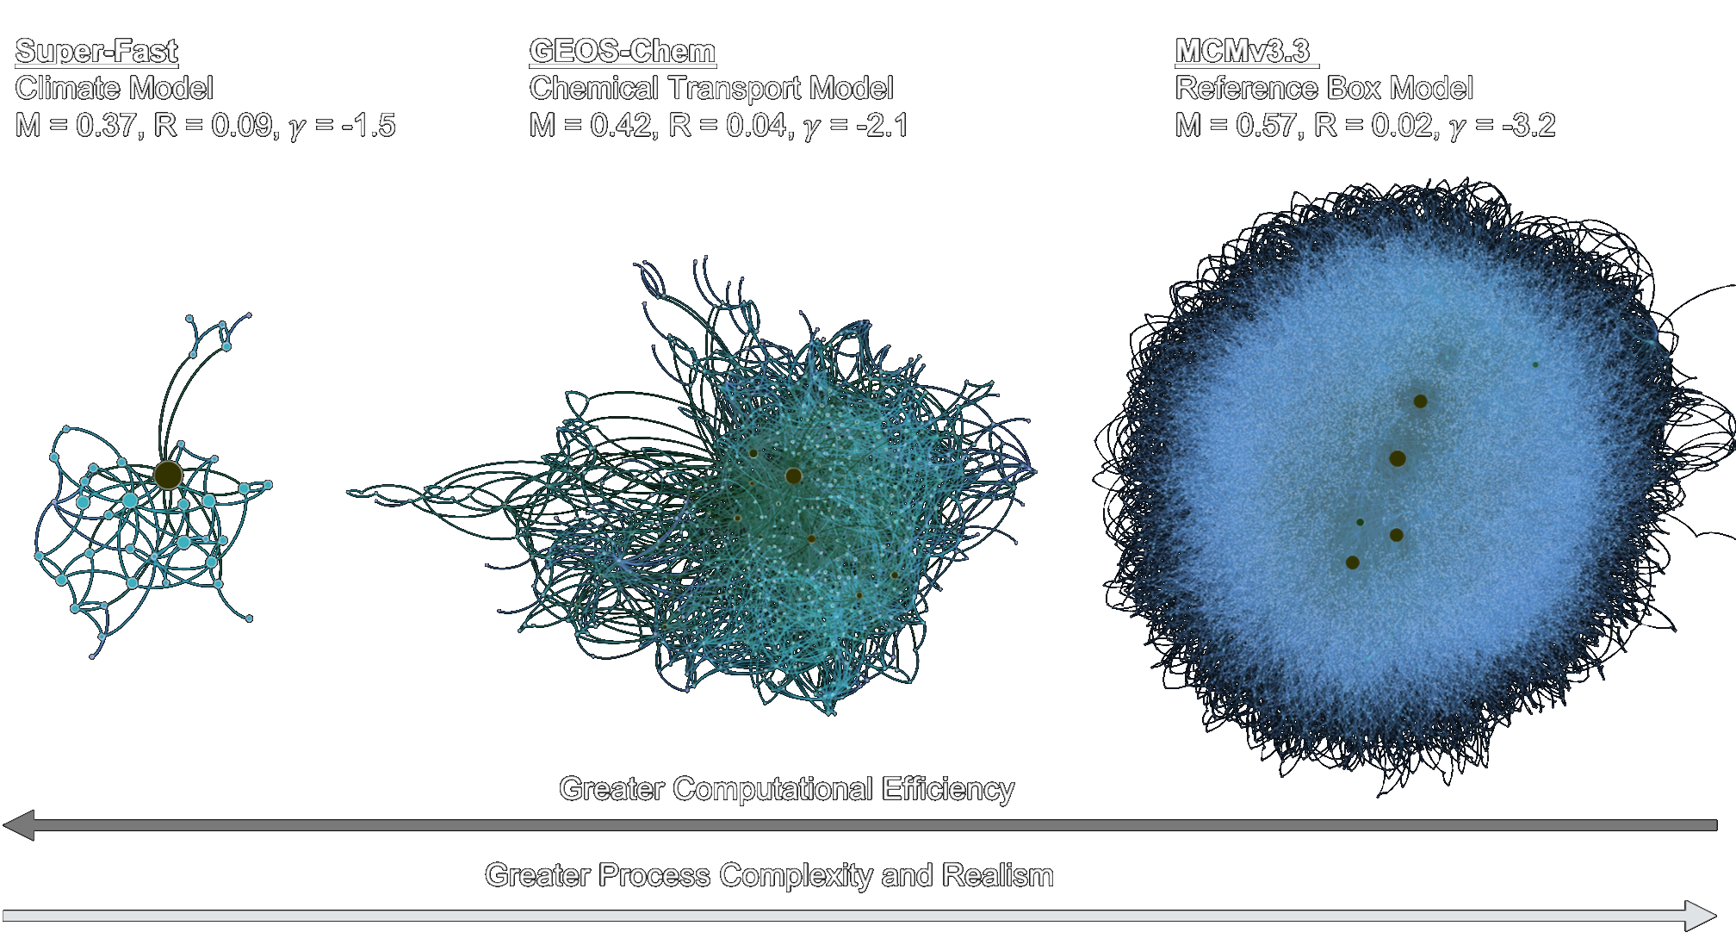
Air quality Models Use Reduced-Order Chemical Mechanisms
Silva, S. J., Burrows, S. M., Evans, M. J., & Halappanavar, M. (2021). GRL, 48(1)

Slide 3

What if we could do this model reduction automatically?

Slide 4
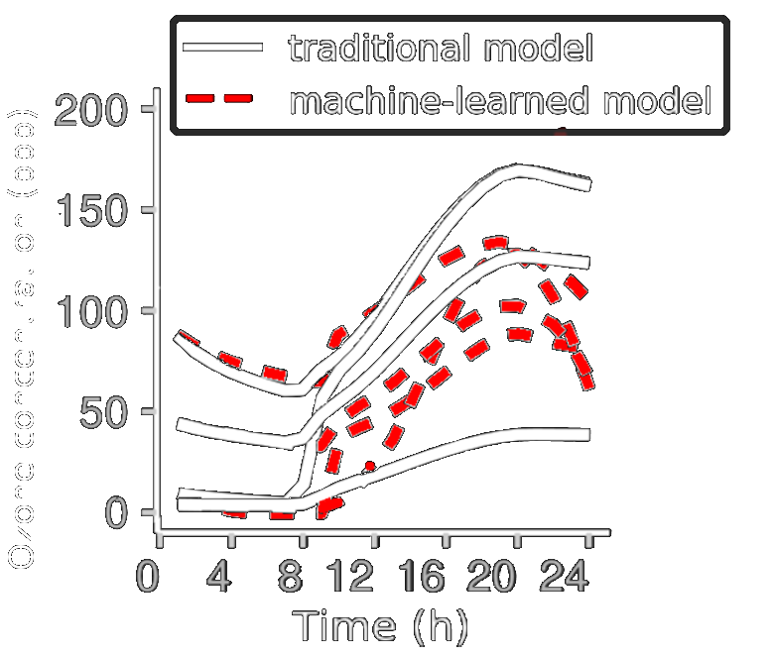
With a Neural Network?
Kelp, M., C.W. Tessum, and J.D. Marshall. (2018) https://arxiv.org/abs/1808.03874.

Slide 5

How to Handle Numerical Instability?
Too big to fail?
(e.g. Transformers)
Imperfect but interpretable?
(Scientific Machine Learning)

Slide 6


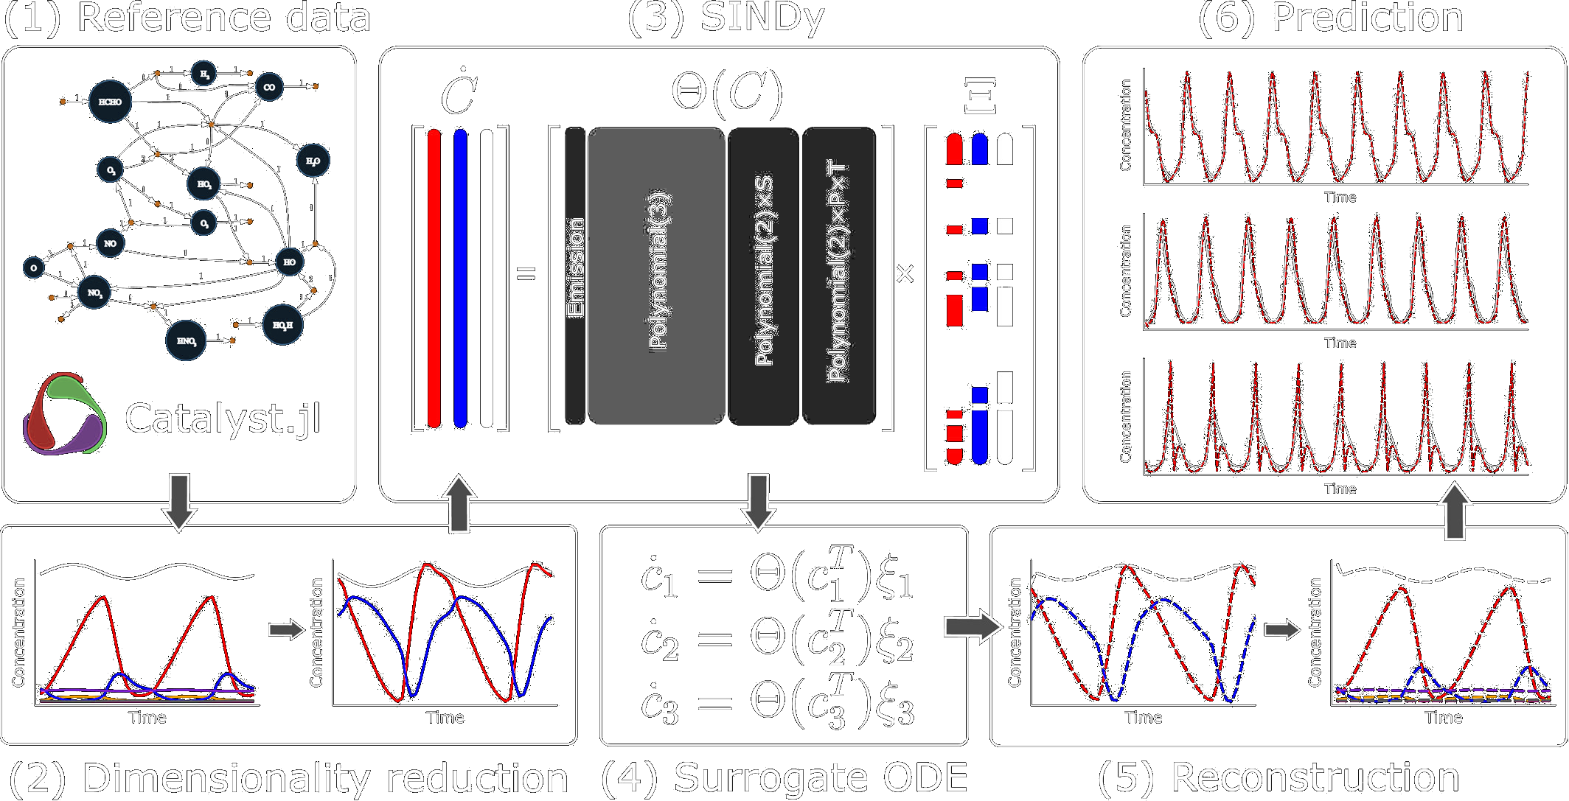

Sparse Identification of Nonlinear Dynamics (SINdy)
Yang, X. et al., 2024

Slide 7
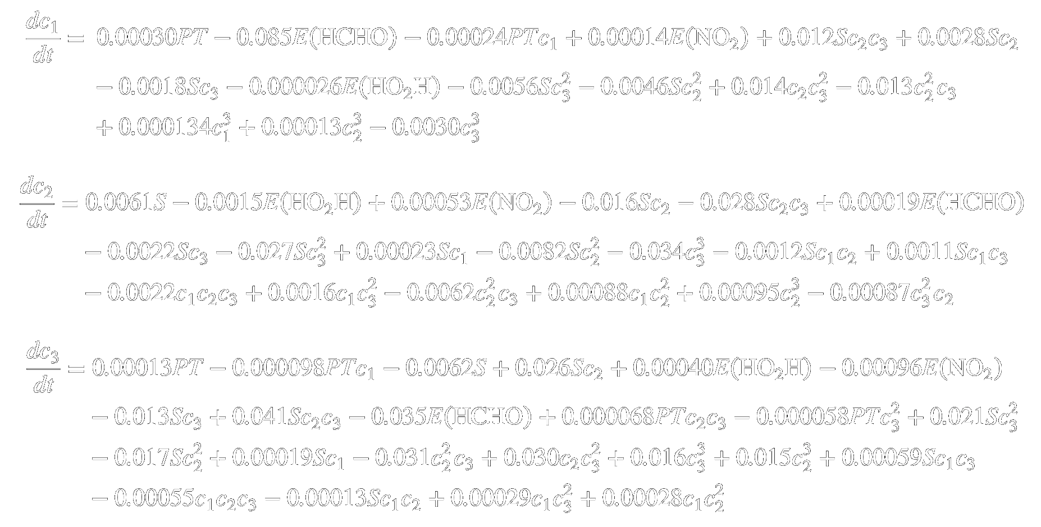
Discovered Equations
Yang, X. et al., 2024

Slide 8
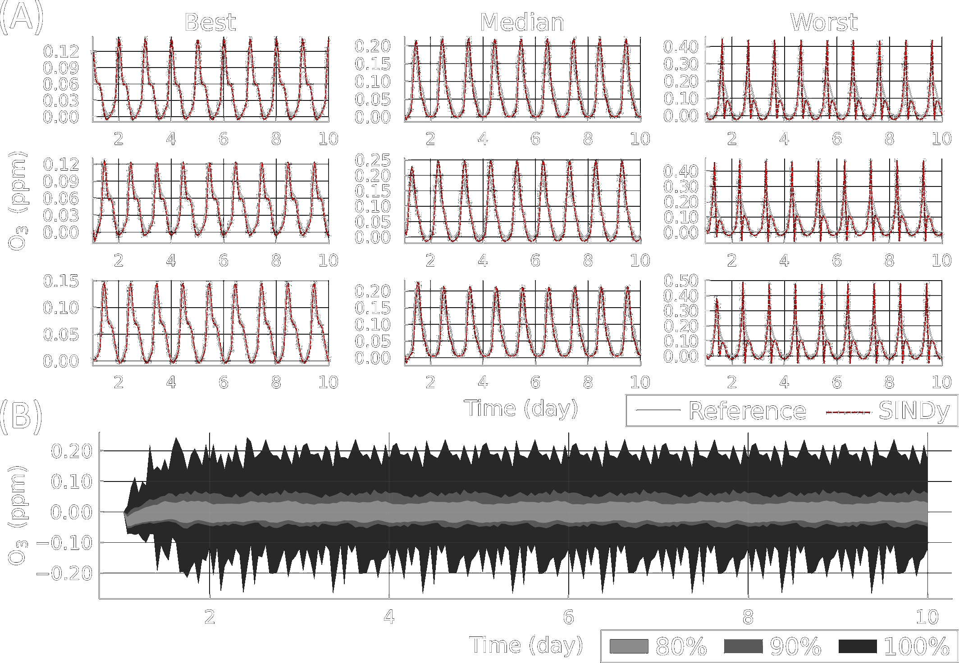
Model Performance
Yang, X. et al., 2024
(~10× Speedup)

Slide 9

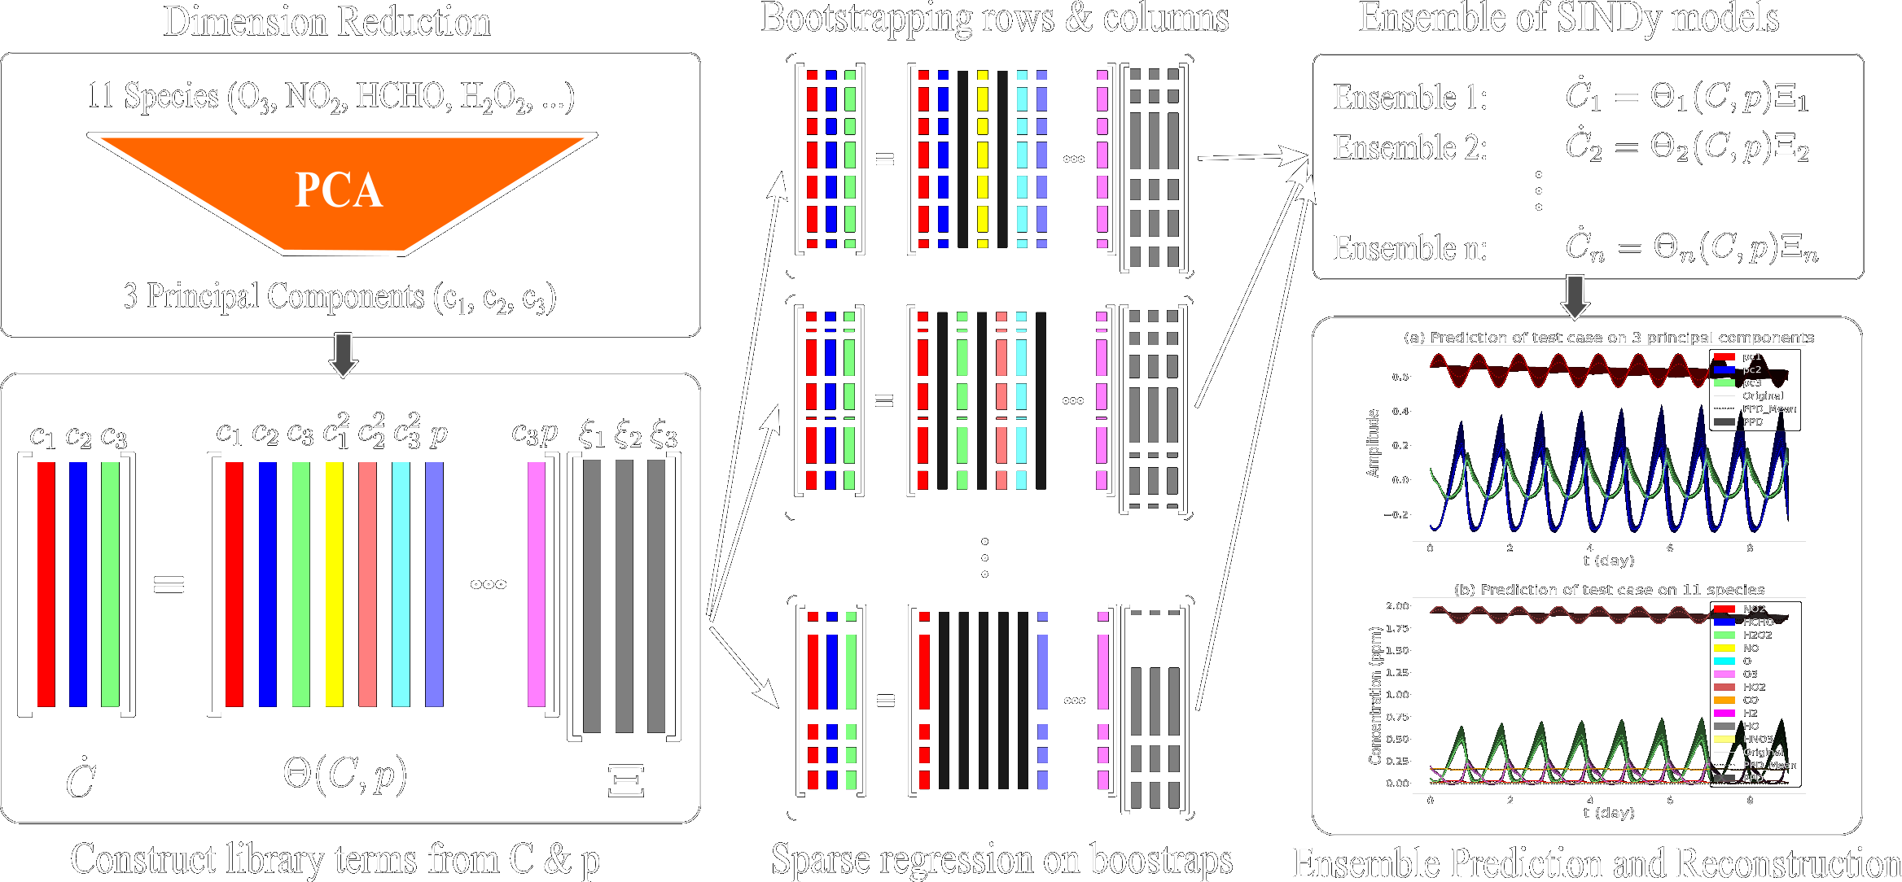
Uncertainty Quantification: E-SINDy
Guo
et al., 2024

Slide 10
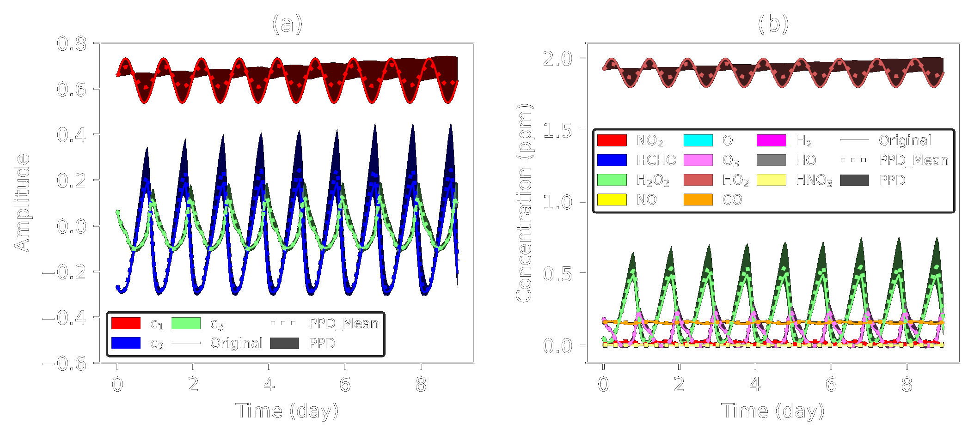
E-SINDy
Guo
et al., 2024

Slide 11
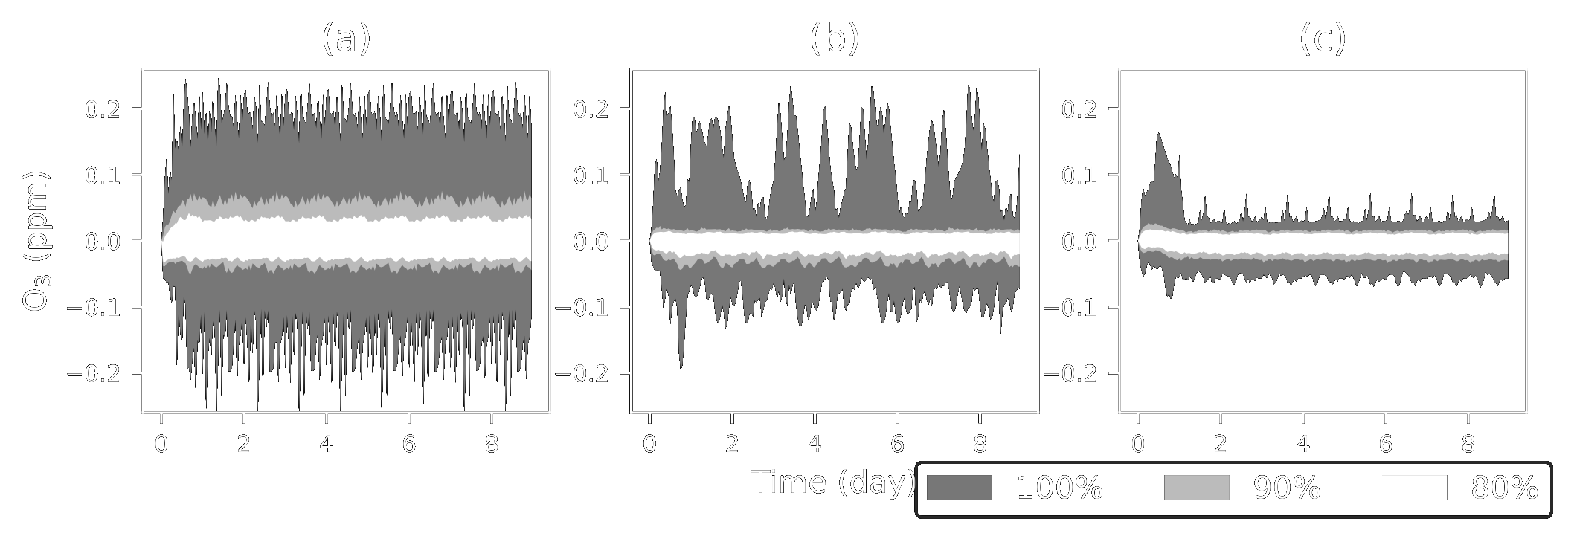
E-SINDy
Guo
et al., 2024
SINDy
E-SINDy: Best
E-SINDy: All

Slide 12


Problem with SINDy

Slide 13
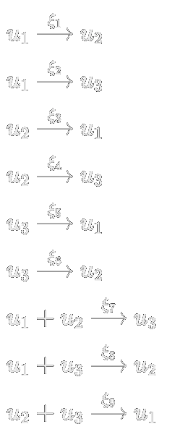
Solution: Sparse Identification of Mass-Action Dynamics (SIMADY)

Slide 14
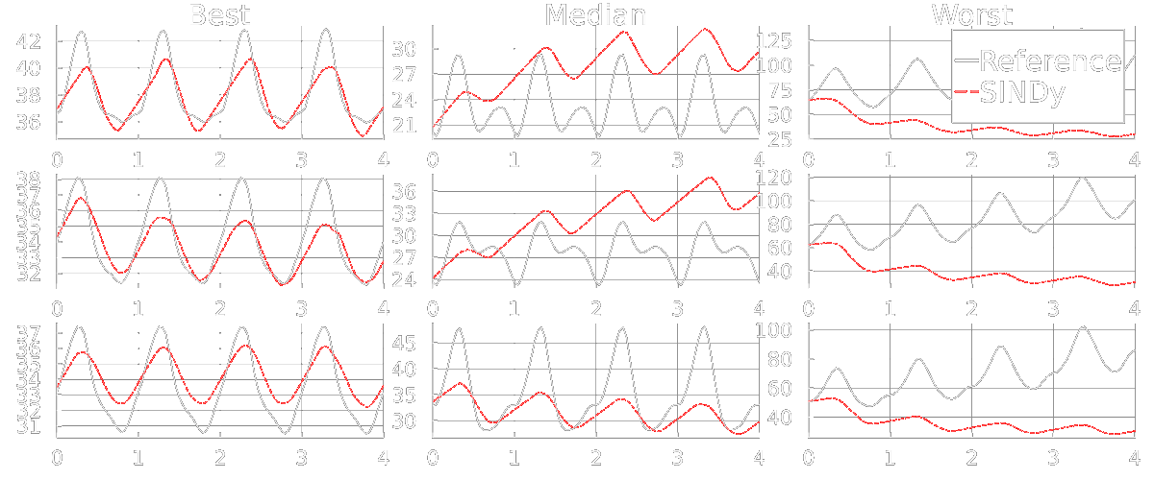
MCM-SIMADY: 10 Species (150,000 × speedup)

Slide 15

GEOS-Chem SIMADY (10 species): 7.2 × Speedup

Slide 16
Conclusions
Scientific machine learning (e.g. SINDy) can create data-driven models that are human-interpretable
SINDy becomes numerically unstable with >5 state variables
This can be fixed by requiring the SINDy model to take a certain form, for example a chemical reaction system in the case of atmospheric chemistry. The resulting models fail gracefully when they fail.

Slide 17


