Slide 1
On the development of an Energy-based Lightning NOx Model by Synergizing Satellite and Ground-based Lightning Datasets for Air Quality Modeling
Daiwen Kang, Yuling Wu, Arastoo Pour-Biazar, Rohit Mathur, David Wong, and Wyat Appel
23rd Annual CMAS Conference, October 21-23, 2024 | Chapel Hill, NC
Session: Emissions Inventories, Models, and Processes
Office of Research and Development
Center for Environmental Measurement & Modeling

Slide 2
OUTLINE
Lightning observations and datasets
Exploratory analysis of the lightning datasets from the World Lightning Location Network (WWLLN) versus that from Geostationary Lightning Mapper (GLM):
  The detection of lightning activity: flashes/strokes
  The energy property from both the WWLLN and the GLM lightning datasets
The lightning NOx emissions: flash/stroke-based, energy-based, and individual dataset versus the combined datasets

Slide 3
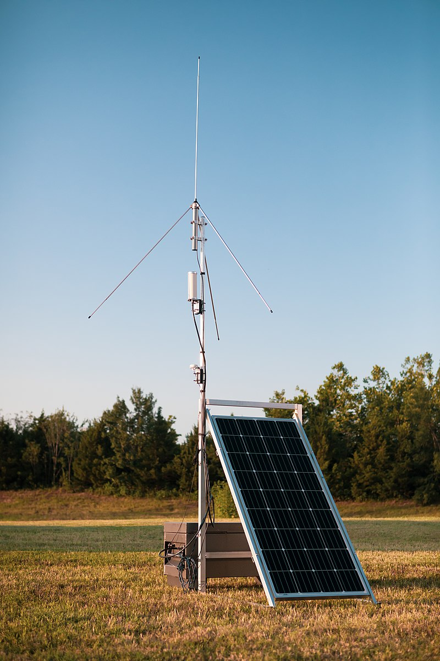
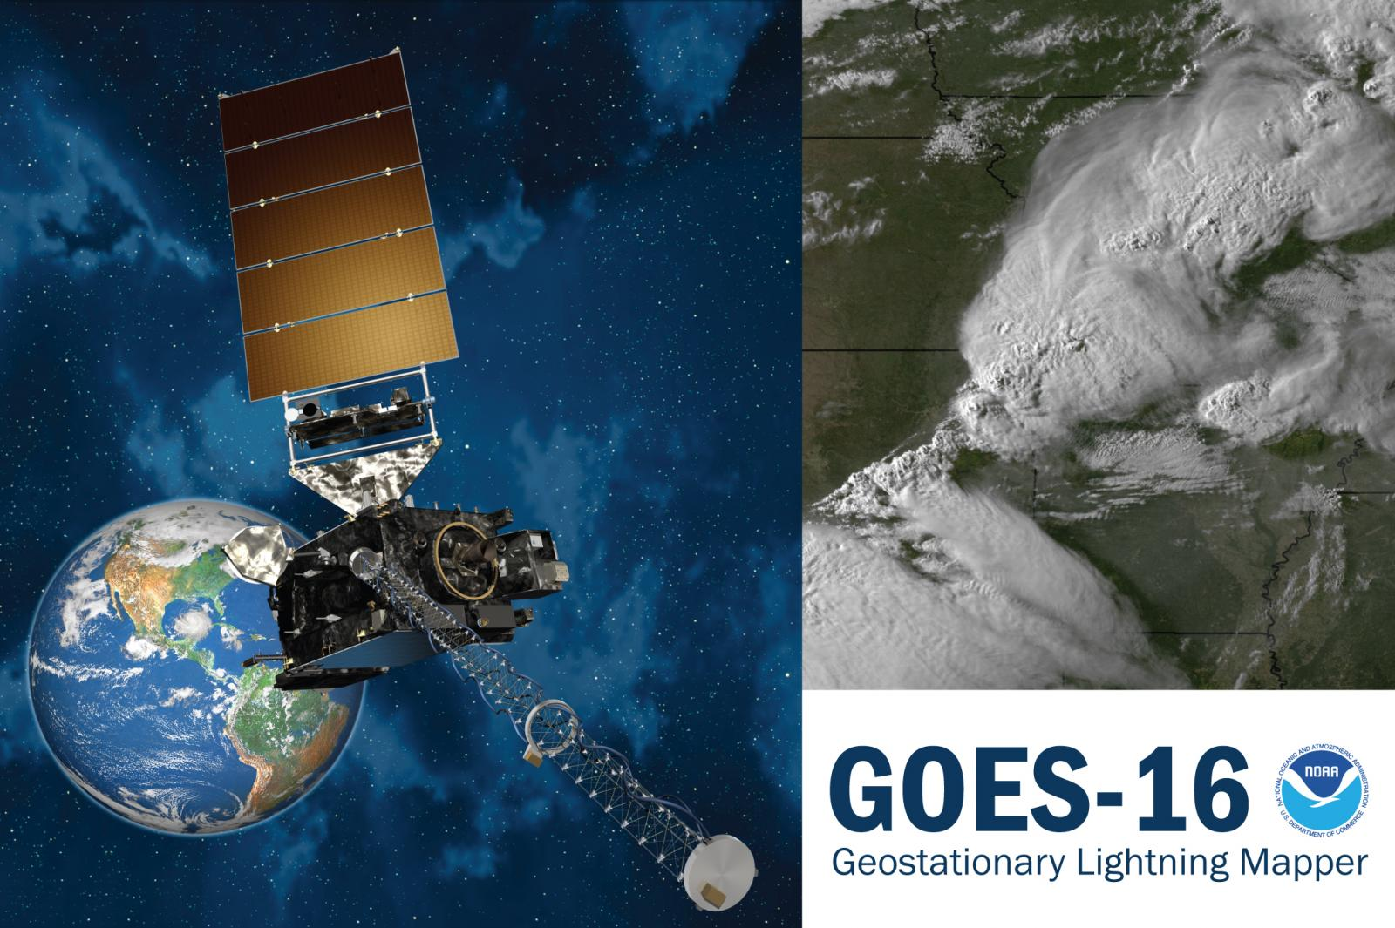
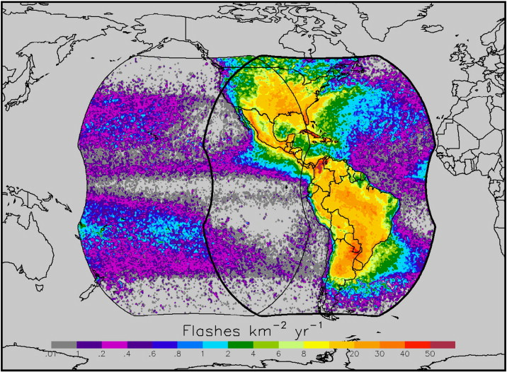
Lightning Detection Networks: WWLLN vs GLM
  WWLLN
  Ground-based global lightning detection network, WWLLN, has ~70 sensors globally
  Very Low Frequency (VLF, 3-30kHz) radio wave detection
  Detection Efficiency: 60-80% for Cloud to Ground strokes (CGs, > 40 kAmp), 10-11% for all strokes
  Location Accuracy: 4-5 km
GLM
Staring CCD* imager (1372x1300 pixels)
Coverage up to 52 deg latitude
70-90% flash detection day and night (better during night)
Single band 777.4 nm, 2-ms frame rate
GOES-R constellation comprises: GOES-16 (EAST, 75.2 W) and GOES-17 (=>GOES-18 since January 2023, WEST, 137.2 W)
*CCD, charge-coupled device, is a light-sensitive integrated circuit that captures images by converting photons to electrons.

Slide 4
Understanding Lightning Flashes/Strokes and Lightning Energy
Flashes/Strokes: Both WWLLN and GLM detects total lightning (no distinguish among lightning types), but WWLLN detects strokes only, GLM incrementally defines events, groups, and flashes. The classification of a flash over space and duration are all different across different networks:
GLM flash: group duration within 330 ms and spatial distance within 16.5 km (Mach, 2020)
NLDN (National Lightning Detection Network) flash: CG/IC strokes/pulses within 500 ms and 10/20 km. The maximum duration and spatial extent of an NLDN-CG flash extends to 1s and 10 km (Murphy et al., 2021)
ENTLN Earth Networks Total Lightning Network flashes: 0.7 s duration and 10 km (Marchand et al., 2019)
LIS (Lightning Imaging Sensor) flashes: 330 ms and 5.5 km (Mach et al., 2007)
Energy:
WWLLN stroke energy, RMS (Root Mean Square) energy (in Joules, J), is measured from 1.3-ms waveform sampling between 7 and 18 kHz.
GLM flash energy is the optical energy detected at the sensor aperture in femtojoule (fJ, 1fJ=10⁻¹⁵ J) at narrow 1-nm band centered on the 777.4-nm wavelength.
WWLLN energy and GLM energy represent separately a small fraction of the total lightning energy, but both reflect certain aspect of the same lightning power.

Slide 5
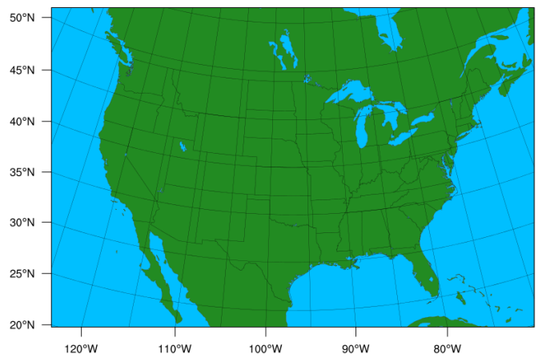
Aggregation of Datasets and Analysis Regions
Both WWLLN stroke/energy and GLM flash/energy from 2020-2023 are gridded onto 12x12 km grid cells with hourly time steps based on the 12US1 contiguous United States (CONUS) domain
The following terms are also used:
Domain: the entire 12US1 domain (459x299 grid cells)
Land: the grid cells over land within the domain
Ocean: all the grid cells within the domain over the ocean

Slide 6
How the Energy Aspect Correlates between the Two Datasets (2020-2023)
The direct (event by event) correlation between GLM and WWLLN is poor, but relationship between aggregated data (daily total over regions) is strong
To remove the ambiguity associated with energy property from the datasets, normalized (respective to maximum values) quantity is used
Similar but varying relationships are observed with the sub-regional data. The datasets over land have relatively better correlation coefficient than those over the ocean

Slide 7
Spectrum of Lightning Energy Distribution
Normalized WWLLN Energy (unitless)
2020
2021
Quantile-Quantile (QQ) plots could shed light on the spectrum of energy distribution of the two data sources.
At lower energy levels over the domain and Land, GLM tends to show higher relative values than WWLLN
Over the ocean, the data points shift towards WWLLN
2022
2023
Normalized GLM Energy (unitless)

Slide 8
Temporal and Spatial Detection of GLM Flashes vs WWLLN Strokes
MonthlyInst: The average (2020-2023) monthly instances (occurrence of detected lightning from a dataset at gridcell-hour: yes or no)
Occurrence Percent (%): the percentage of instances from either GLM, WWLLN, or both (GLMaWWLLN) to the total instances
The occurrence percent of GLM is greater than WWLLN during warm months (May-Sep) over the domain

Slide 9
Temporal and Spatial Detection of GLM Flashes vs WWLLN Strokes
Comparison of the lightning instances over land grid cells with those over ocean grid cells reveals:
  The occurrence percent of GLM is generally greater over land than WWLLN
  The occurrence percent of WWLLN is mostly greater than GLM over ocean grid cells
  The occurrence percent of both GLM and WWLLN (overlap) is ~40-50%

Slide 10
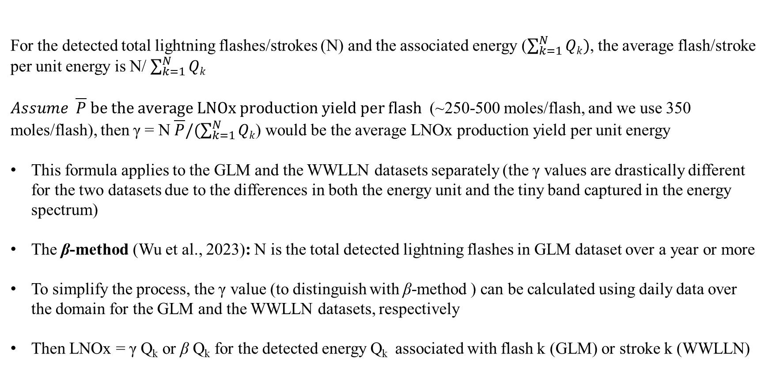
Converting LNOx Emissions from Flash-based into Energy-based
For the detected total lightning flashes/strokes (N) and the associated energy ($\sum_{k=1}^{N}{Qk})$, the average flash/stroke per unit energy is N/ $\sum_{k=1}^{N}{Qk}$
$Assume \overline{P} be the average LNOx production yield per flash$ (~250-500 moles/flash, and we use 350 moles/flash), then γ = N $\overline{P}/(\sum_{k=1}^{N}{Qk}$) would be the average LNOx production yield per unit energy
This formula applies to the GLM and the WWLLN datasets separately (the γ values are drastically different for the two datasets due to the differences in both the energy unit and the tiny band captured in the energy spectrum)
The β-method (Wu et al., 2023): N is the total detected lightning flashes in GLM dataset over a year or more
To simplify the process, the γ value (to distinguish with β-method ) can be calculated using daily data over the domain for the GLM and the WWLLN datasets, respectively
Then LNOx = γ Q_{k} or β Q_{k} for the detected energy Q_{k} associated with flash k (GLM) or stroke k (WWLLN)

Slide 11
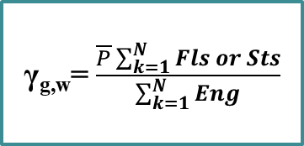
Flowchart for LNOx Production by Synergizing the Two Datasets in CMAQ
GLM Fls/Eng
WWLLN Sts/Eng
γ_{g,w}= $\frac{\overline{P}\sum_{k=1}^{N}{Fls or Sts}}{\sum_{k=1}^{N}{Eng}}$
LNOx (G,W) = γ_{g,w}*Eng (G, W)
Other options for WWLLN, such as the IC/CG ratio (z ratio), land/ocean monthly adjustment factor (based on climatological NLDN/WWLLN ratios, WWLLNs, Kang et al., 2023)
Max(LNOx(G), LNOx(W))
IS LTG present?
Yes
Force trigger; Use MU layer
Add up to 1 g/kg vapor to force deep cloud
No
NoSuppress
ShallOnly
Let KF run as normal
Only allow shallow Cu
Continue to next grid point

Slide 12
Cases to Produce LNOx Emissions
Case name | Description
GLMb | Based on the bulk β value for multiple years (350 moles/flash), β = 1.10e⁻²²
GLMe | Based on daily γ (G) value
GLMf | Use GLM flashes
WLNse | Use WWLLNs energy (apply adjustment factors, climatological NLDN/WWLLN)
WLNsf | Use WWLLNs strokes
GWe | Max (GLM γ method, WWLLN γ method), the original WWLLN energy
GWf | Max (GLM flashes, WWLLN strokes)
GWse | Max (GLM γ method, WWLLNs γ method)
GWsf | Max (GLM flash, WWLLNs stroke)
GWseU | Union of GLM γ method and WWLLNs γ method
WLNsz | WWLLNs with Ocean and ICCG adjustment (current default)
GWsz | Max (GLM γ method, WWLLN γ method with ICCG z ratio)
GWsez | Max (GLM γ method, WWLLNs γ method with ICCG z ratio)

Slide 13
Annual Total LNOx Emissions
Domain total emissions among the cases are the proof of correct treatment from flash/stroke-based to energy-based model: GLMe and GLMf, WLNse and WLNsf are the same.
Small difference between GLMb (β method, 3-years’ data) and GLMe (γ method, daily data)
Reference
(current in CMAQ)
GLM Only
WWLLN Only

Slide 14
Annual Total LNOx Emissions
Reference
(current in CMAQ)
Separating grid cells over land from those over ocean helps understand how the various LNOx production cases behave, respectively
Due to similar but slightly higher detection rate from WWLLN than GLM over ocean grid cells, the difference is minimal between either (GLMe, WLNse) or the combined (GWse)
Reference
(current in CMAQ)

Slide 15
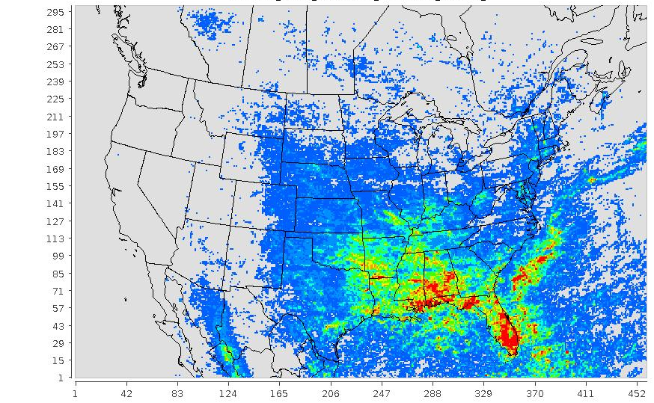
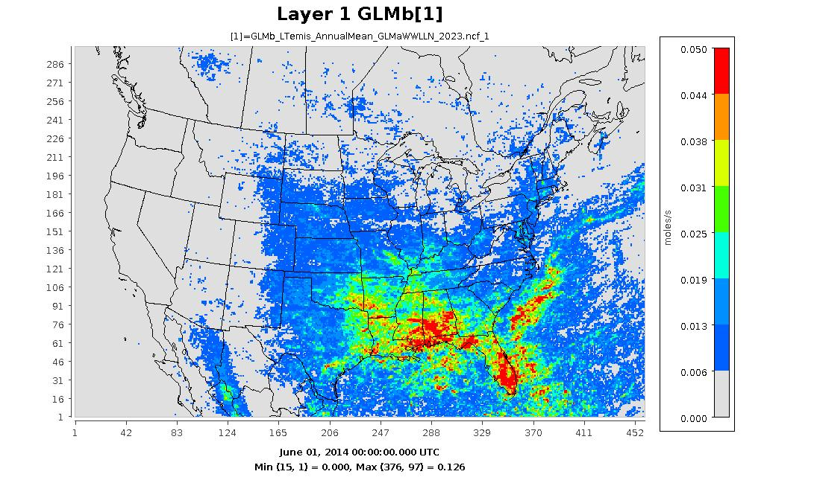
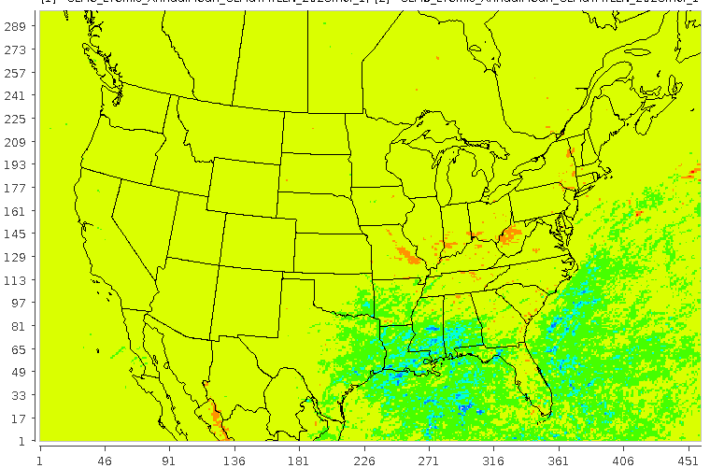
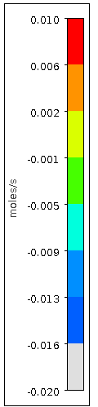
Spatial Distributions of Annual LNOx Emissions: GLMb vs GLMe
GLMe
GLMe: LNOx is produced using the GLM energy with γ method (daily data)
GLMb: LNOx is produced using the GLM energy with β method (3-year’s data)
GLMe - GLMb
GLMb

Slide 16
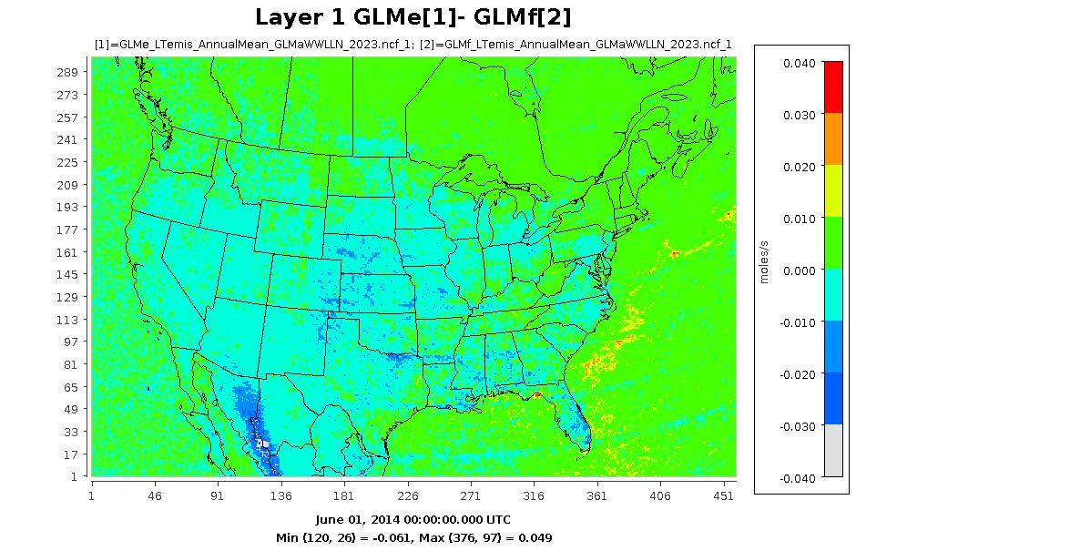
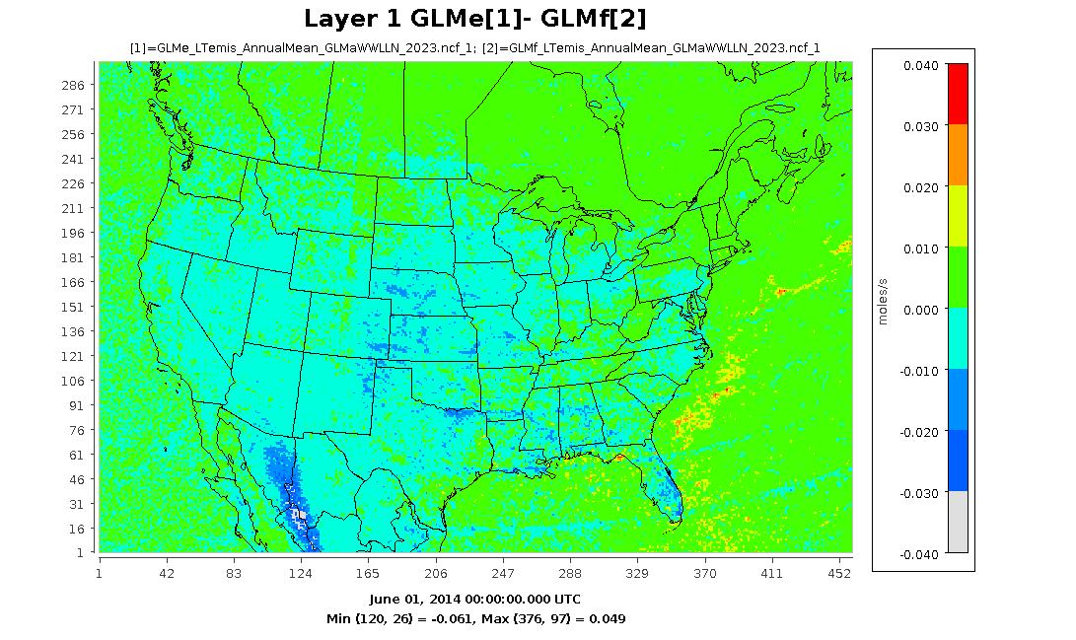
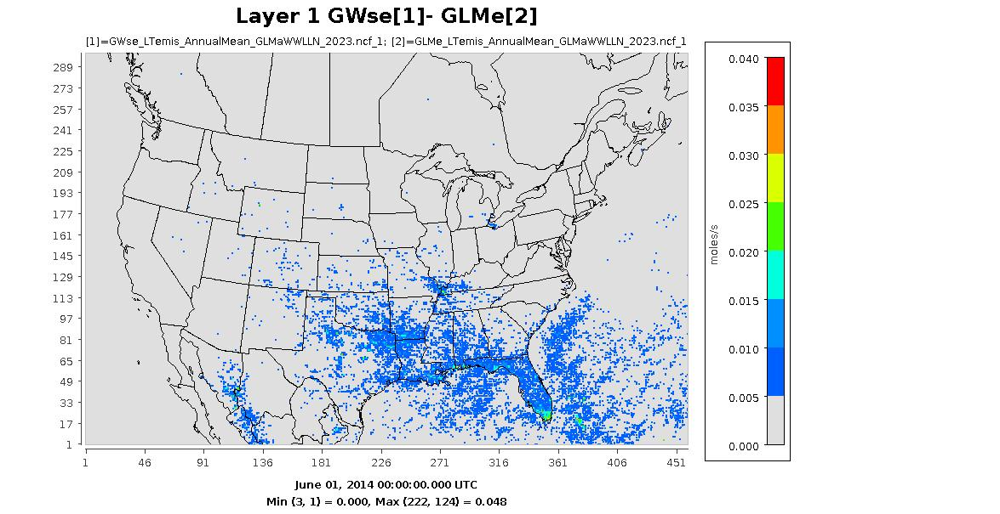
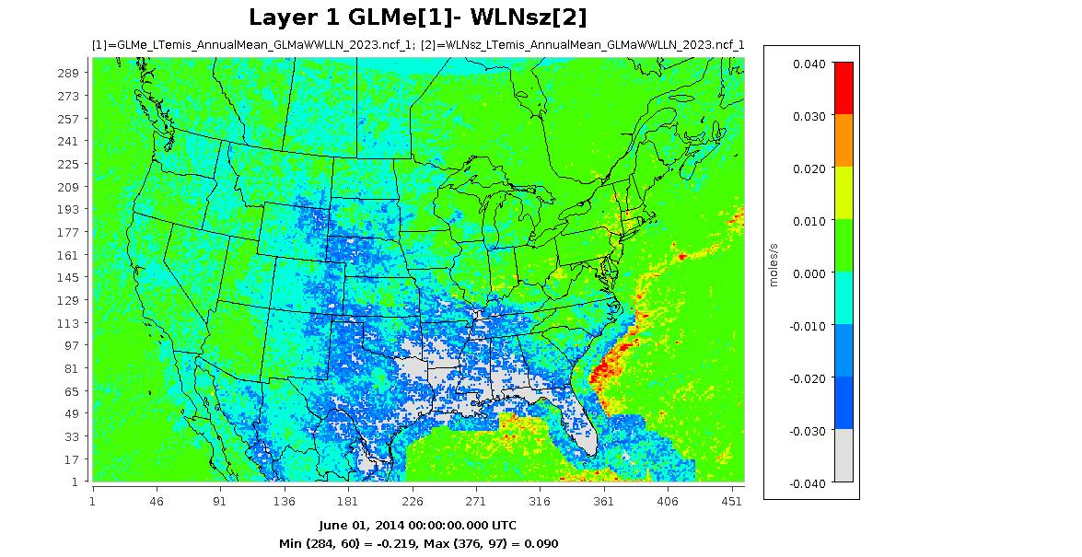
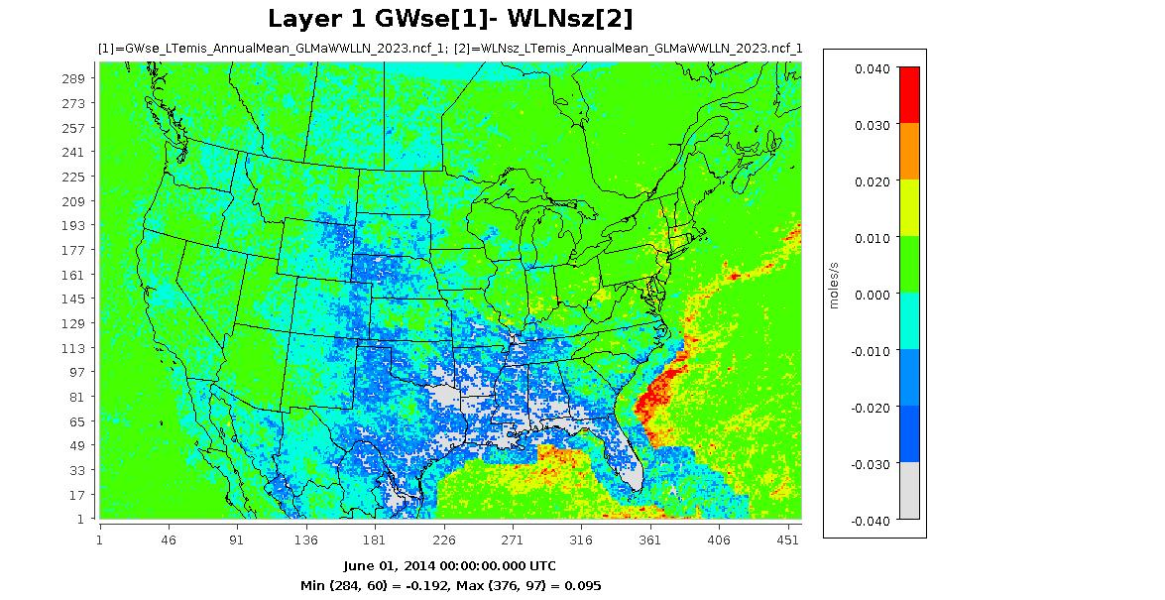
Spatial Differences of LNOx Emissions between Selected Cases
GLMe: LNOx is produced using the GLM energy with γ method (daily data)
GLMf: LNOx is produced using the GLM flashes (350 moles/flash)
GWse: LNOx is produced using synergized GLM and WWLLN energy (maximum of the two) with γ method (daily data)
WLNsz: default CMAQ LNOx production using WWLLNs strokes (350 moles/stroke) with IC/CG adjustment
GLMe - GLMf
GWse - GLMe
GLMe - WLNsz
GWse - WLNsz

Slide 17
Summary
Both aloft (satellite) and ground-based lightning detection techniques have its pros and cons, but the aggregated properties detected by either technique over time and space show strong correlations
The energy-based lightning NOx model could provide a more realistic lightning NOx emissions in time and space
By synergizing the GLM and WWLLN datasets which complementing each other in detection efficiency of different lightning types over time and space, a more accurate estimate of lightning NOx emissions could be made
The different options will be tested and evaluated with CMAQ simulations, and one or more options will become available in the upcoming CMAQv6.0 release

Slide 18
Disclaimer
References
  Mach et al.: Performance assessment of the optical transient detector and lightning imaging sensor, J. Geophys. Res., 112, D09210, doi:10.1029/2006JD007787, 2007.
  Marchand et al.: Geostationary lightning mapper and Earth networks lightning detection over the contiguous United States and dependence on ﬂash characteristics. Journal of Geophysical Research: Atmospheres, 124, 11,552-11,567.https://doi.org/10.1029/2019JD031039, 2019.
  Mach: Geostationary Lightning Mapper clustering algorithm stability. Journal of Geophysical Research: Atmospheres, 125,e2019JD031900. https://doi.org/10.1029/2019JD031900, 2020.
  Murphy et al.: Recent history of upgrades to the U.S. national lightning detection network. J. Atmos. Ocean. Tech., 38, 531-585, https://doi.org/10.1175/JTECH-D-19-0215.1, 2021.
  Kang et al.: Assessing the Impact of Lightning NOx Emissions in CMAQ Using Lightning Flash Data from WWLLN over the Contiguous United States. Atmosphere 13, 1248, https://doi.org/10.3390/atmos13081248, 2022.
  Wu et al.: LNOx Emission Model for Air Quality and Climate Studies Using Satellite Lightning Mapper Observations. J. Geo. Res. Atmosphere, 128, e2022JD037406, https://doi.org/10.1029/2022JD037406, 2023.
  Cheng et al.: Utility of Geostationary Lightning Mapper-derived lightning NO emission estimates in air quality modeling studies, Atmos. Chem. Phys., 24, 41–63, https://doi.org/10.5194/acp-24-41-2024, 2024.
The views expressed in this presentation are those of the authors and do not necessarily reflect the views or policies of the U.S. EPA

