Slide 1

Whole Home Electrification Impacts on O₃ and PM_{2.5} in Northeast US – Sensitivity Tests Using EPA 2016 V3 Emission Platform
Yuhong (Ruby) Tian¹, Winston Hao¹, Eric Zalewsky¹, Jeongran Yun¹, Alexandra Karambelas², and Kevin Civerolo¹
¹Division of Air Resources, New York State Department of Environmental Conservation, Albany, NY
²Northeast States for Coordinated Air Use Management, Boston, MA
CMAS Conference 2024
Oct. 21-23, 2024
Chapel Hill, NC, USA

Slide 2
Introduction
Parts of the Ozone Transport Region (OTR) continue to experience persistently high ozone levels affecting tens of millions of people.
According to EPA’s National Emissions Inventory (NEI), onsite fuel combustion in residential buildings was responsible for 10% of total NOx emissions in the OTR states in 2020. Residential building-related NOx emissions in OTR states is the fourth largest contributor after on-road vehicles, nonroad equipment and machines, and industrial processes¹.
Whole-home electrification (WHE) assumes conversion of space and water heaters, clothes dryers, air conditioners, stoves, and ovens from fossil fuels or electric resistance to heat pumps and electric cooking appliances¹.
¹NESCAUM and OTC: Residential Building Electrification in the Northeast and Mid-Atlantic: Criteria Pollutant and Greenhouse Gas Reduction Potential

Slide 3
Methods
Emission Modifications
Model Simulations

Slide 4
Residential Fuel Combustion (RESFC) SCC’s
Whole-Home Electrification - Methods
Following NESCAUM study using NREL ResStock tool but using EPA 2026 projected emissions
Zero out listed SCCs from nonpt sector over OTR
SCC Code | Category | Type | Fuel Type
2104004000 | Stationary Source Fuel Combustion | All Combustor Types | Distillate Oil
2104006000 | Stationary Source Fuel Combustion | All Combustor Types | Natural Gas
2104007000 | Stationary Source Fuel Combustion | All Combustor Types | Liquified Petroleum Gas (LPG)
2104011000 | Stationary Source Fuel Combustion | All Heater Types | Kerosene
Courtesy to: NESCAUM and OTC: Residential Building Electrification in the Northeast and Mid-Atlantic: Criteria Pollutant and Greenhouse Gas Reduction Potential.

Slide 5
EGU Adjustment Factors – Electricity Demand Adjustment
Adjusted electricity demand was applied per state and based on current fuel mix.
Adjusted electricity demand was split between heating season and cooling season with water heating spread evenly throughout the year.
Adjustment factors were applied to all model species in the Electric Generating Unit (EGU) SMOKE inline output files.
Adjustment Factors to Baseline EGU Emissions
 | CT, ME, MA, NH, RI, VT | NY | PA, NJ, DC, DE, MD | VA
Summer | 0.96 | 0.94 | 0.92 | 0.90
Winter | 1.56 | 1.51 | 1.18 | 0.87

Slide 6
CMAQ v5.3.3 Runs with 3 Emissions Scenarios
Emissions Scenarios:
BASE: 2026gf emissions (from EPA 2016V3 Platform) with ERTAC (Eastern Regional Technical Advisory Committee) EGU emissions
RESFC: nonpt emissions reductions only (removed emissions from residential fuel combustion)
RESFC+EGU: nonpt emissions reduction plus EGU adjustments
Simulation Periods:
Winter months: January (shown) and February
Summer months: June and July (shown)

Slide 7
Results
Emission Modifications

Slide 8
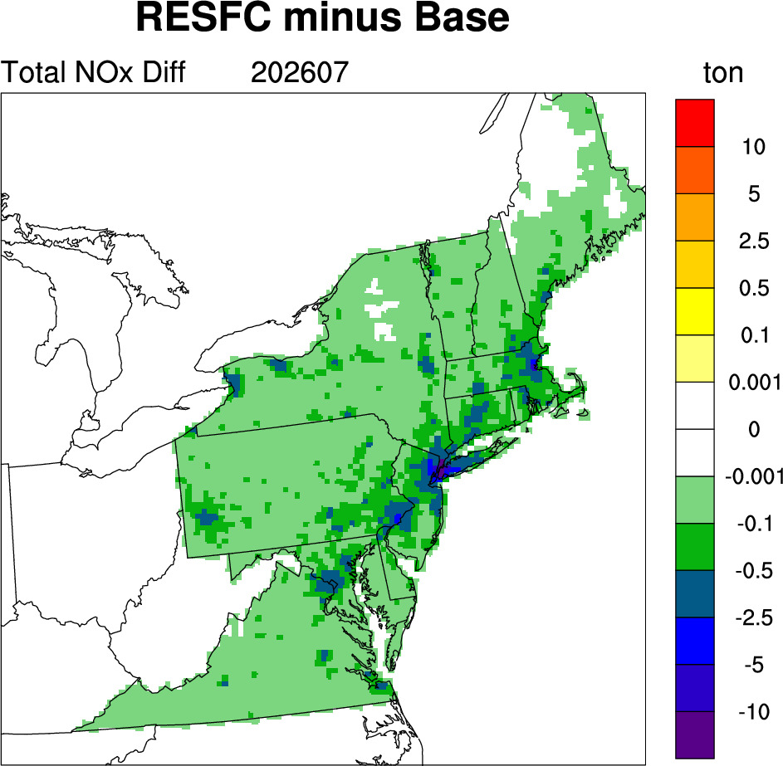
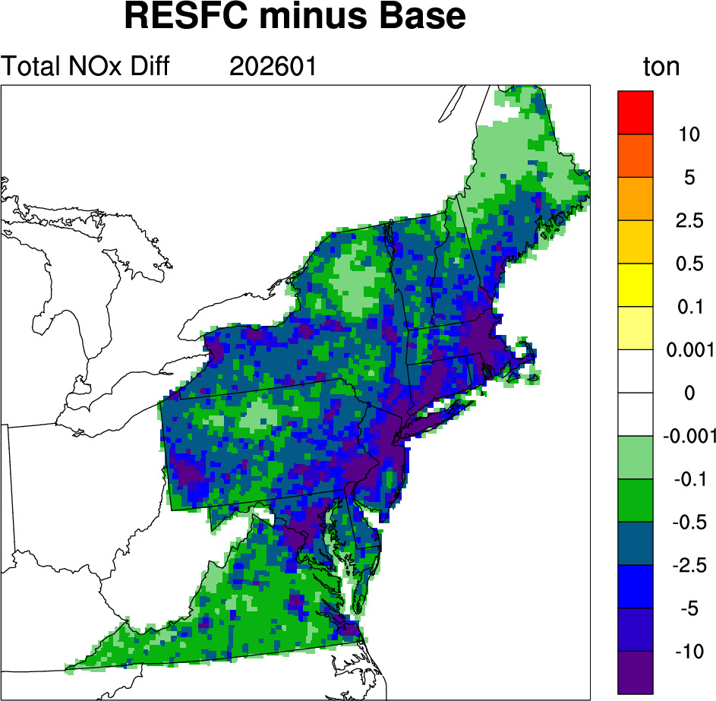
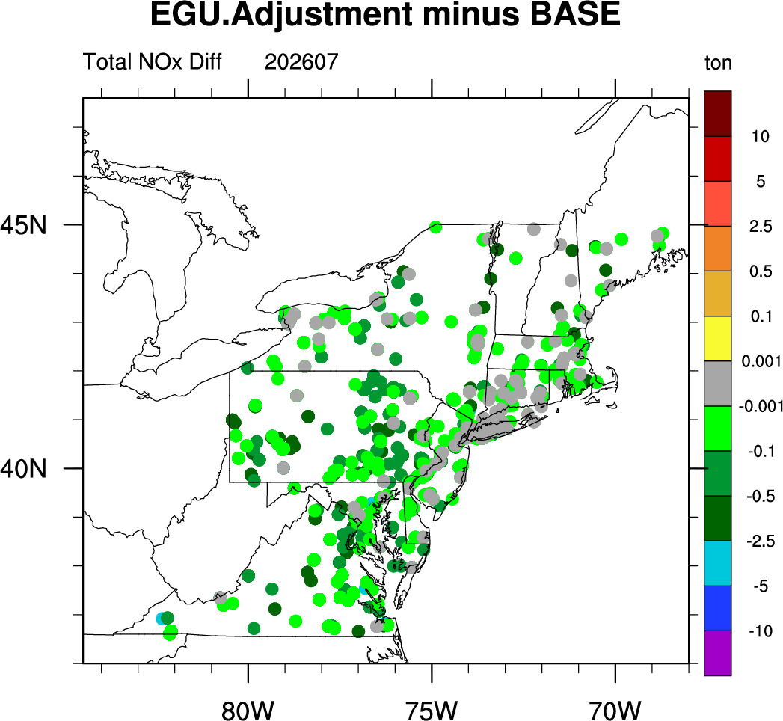
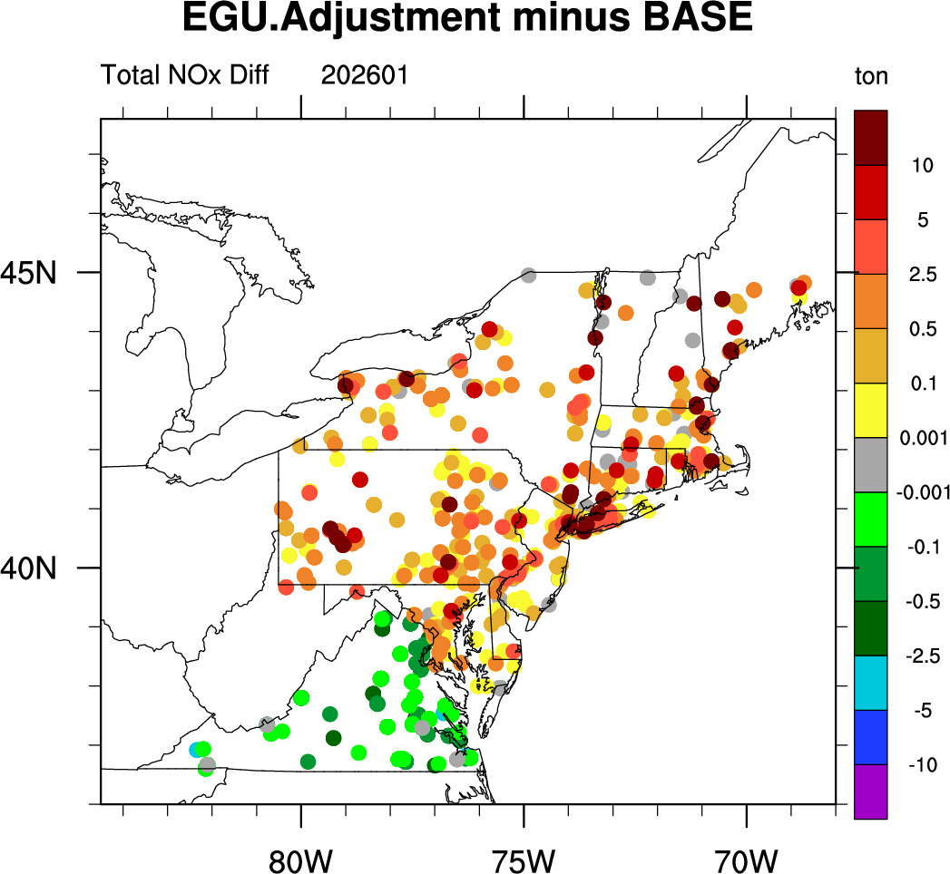
Monthly Differences in Total NOx Emissions
July
January

Slide 9
Summary of Emission Changes
Total emission changes by month (unit: tons)
 | NOx |  | VOC_INV |  | PM_{2.5}
 | Jan. | Jul. | Jan. | Jul. | Jan. | Jul.
RESFC minus BASE | -18084 | -517 | -904 | -25 | -897 | -28
EGU minus BASE | +1615 | -699 | +153 | -82 | +216 | -129
RESFC+EGU minus BASE | -16469 | -1216 | -651 | -107 | -681 | -157
Ratio of total emission changes to the total anthropogenic emission by month (%)
 | NOx |  | VOC_INV |  | PM_{2.5}
 | Jan. | Jul. | Jan. | Jul. | Jan. | Jul.
RESFC+EGU minus BASE | -20.4% | -1.8% | -0.6% | -0.1% | -2.3% | -0.5%

Slide 10
Results
Preliminary Modeling Analysis
Summer: Monthly Difference of Daily Maximum 8HR Average Ozone (MDA8 O₃)
Winter: Monthly Difference of Daily Mean PM_{2.5}
RESFC minus BASE
RESFC+EGU minus BASE

Slide 11
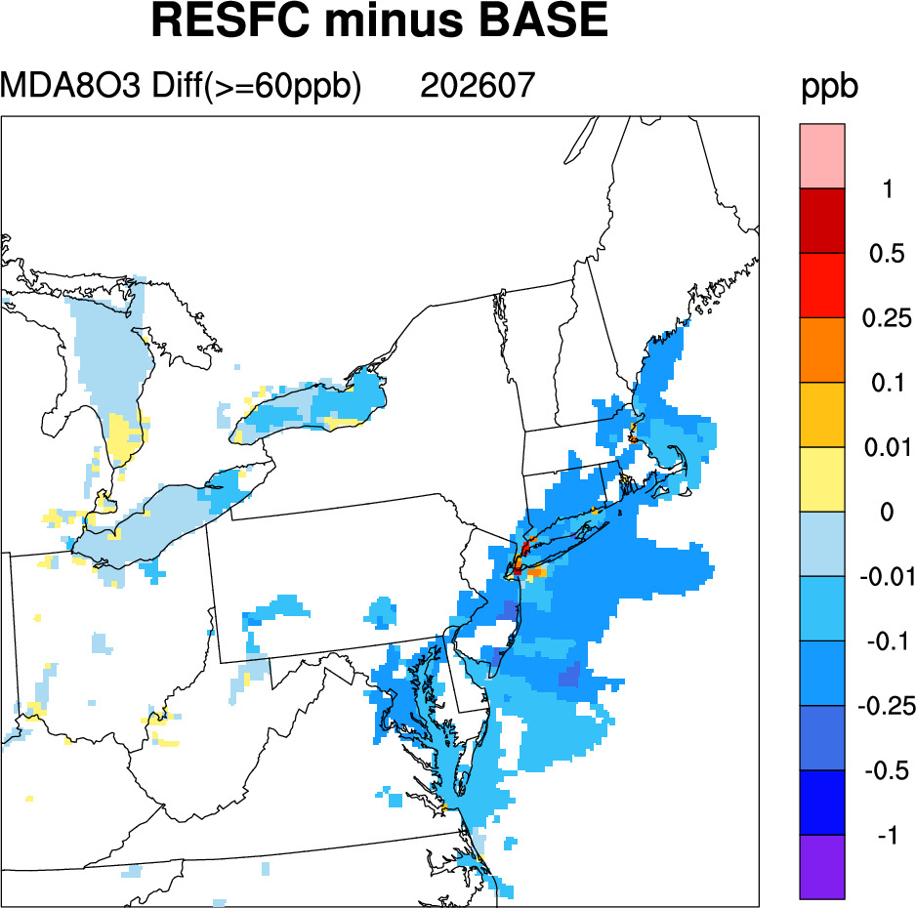
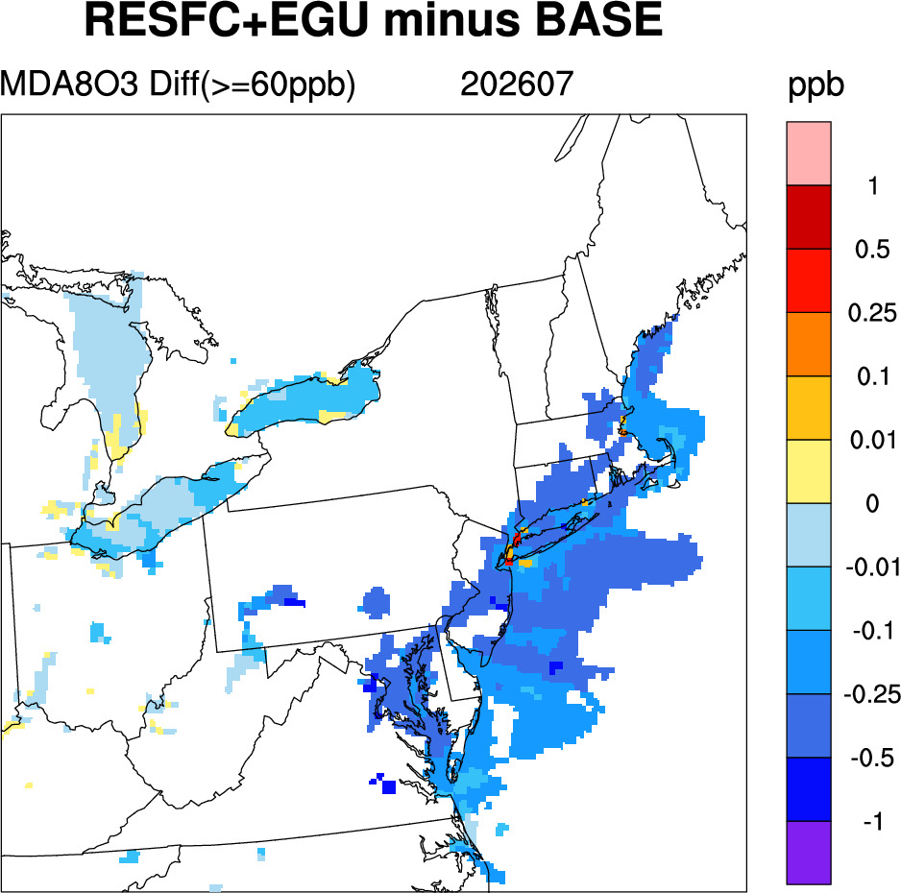
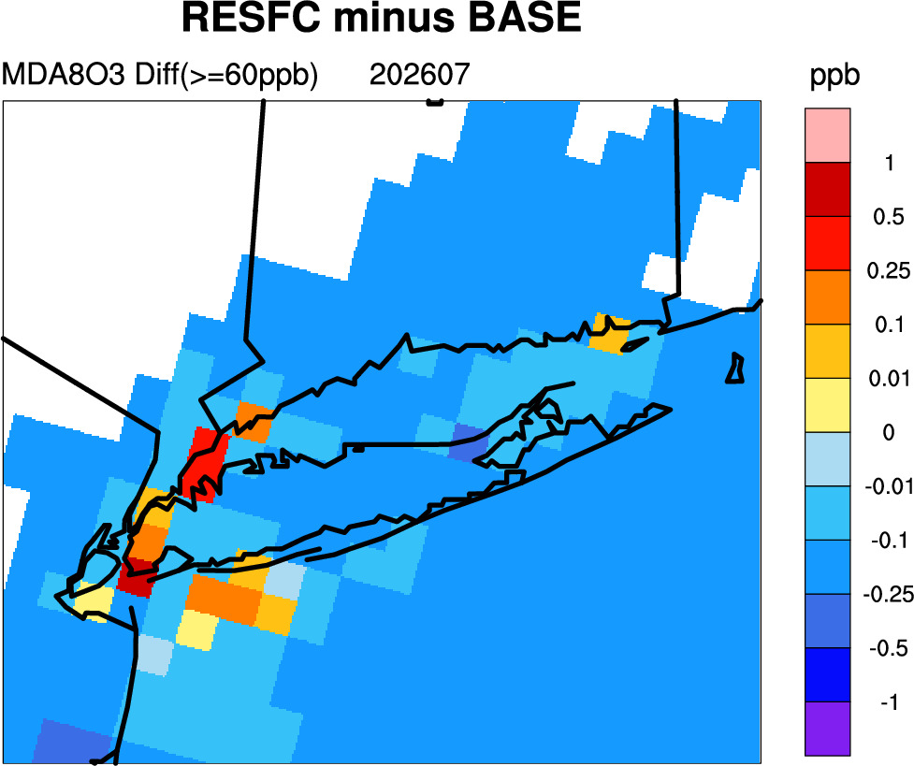
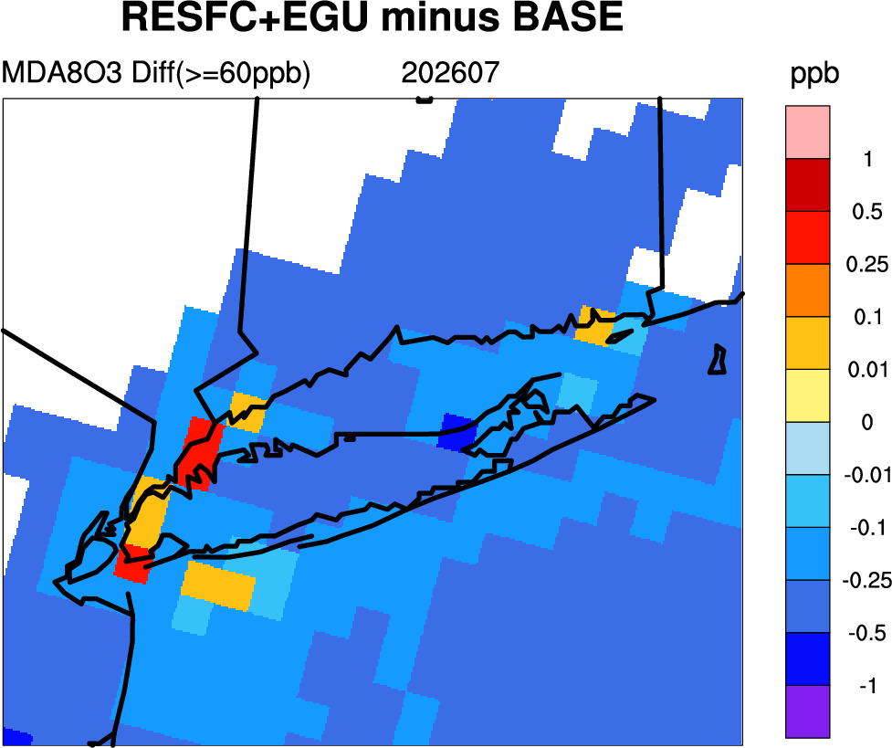
Summer MDA8 O₃ Changes
Impacts on elevated summertime ozone were generally small, with localized increases in NYC due to less NOx titration.
Including the adjusted electricity caused additional decreases in regions of elevated ozone.
Base model MDA8 O₃ ≥ 60ppb as threshold (i.e., high O₃ days)

Slide 12
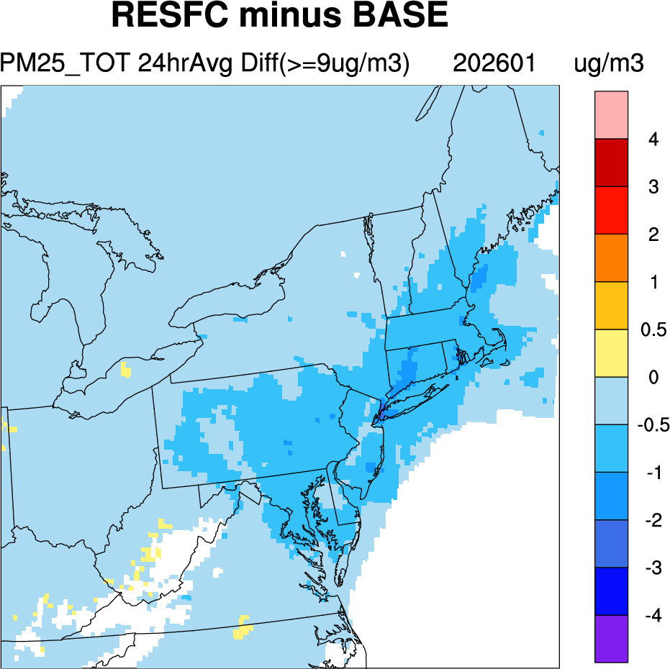
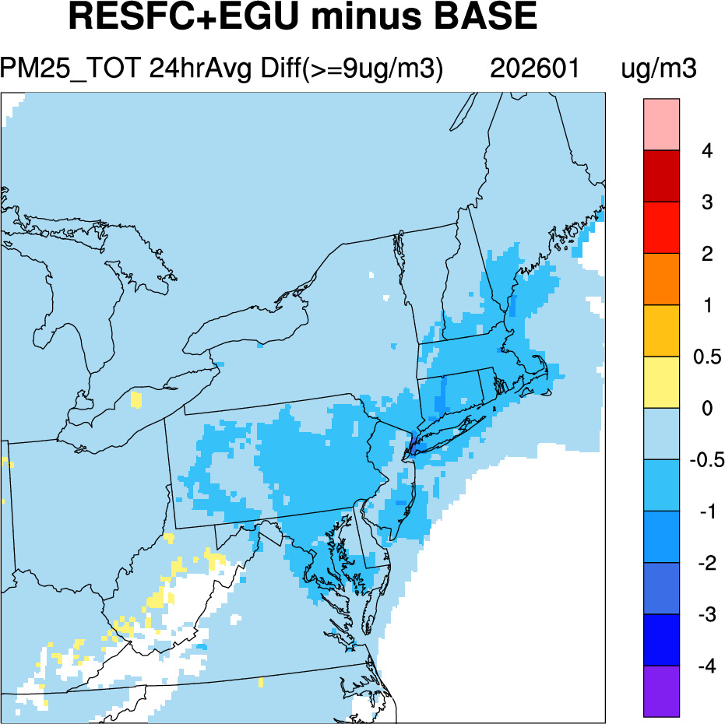
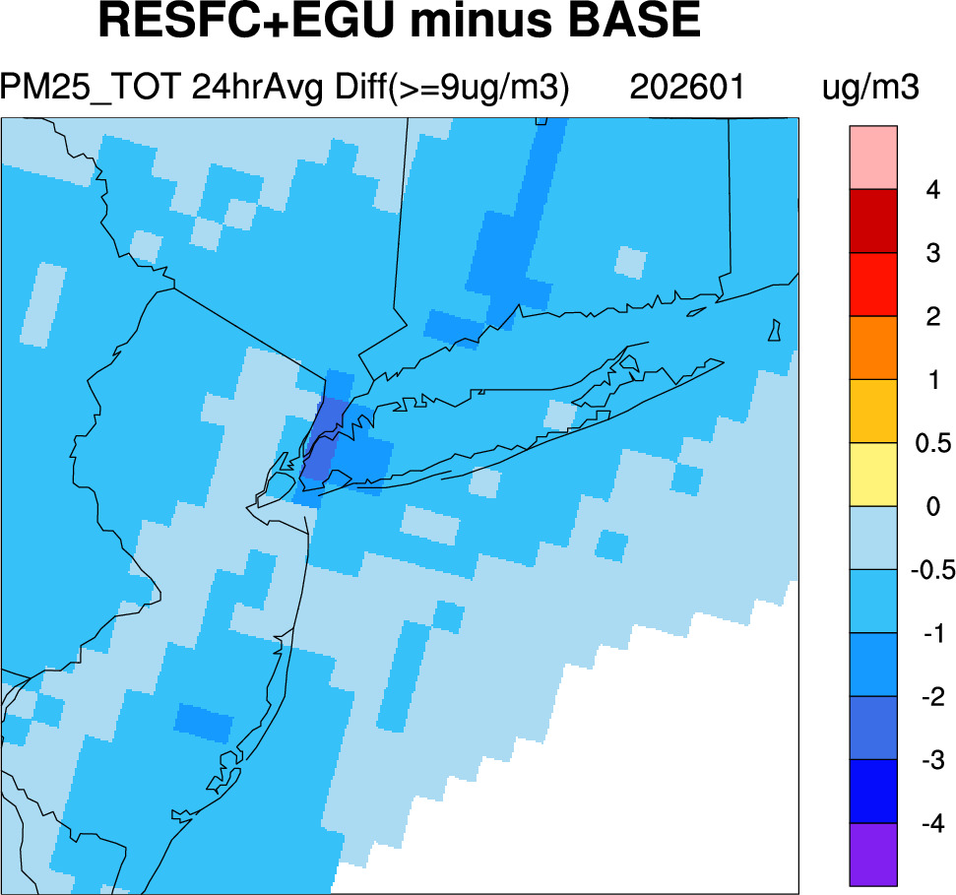
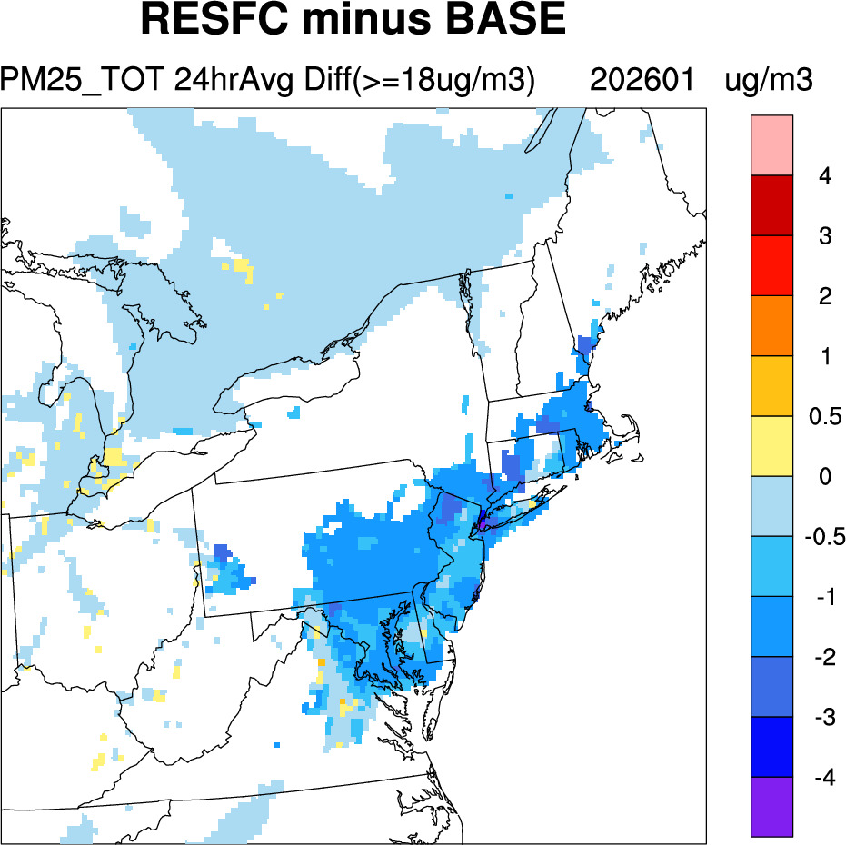
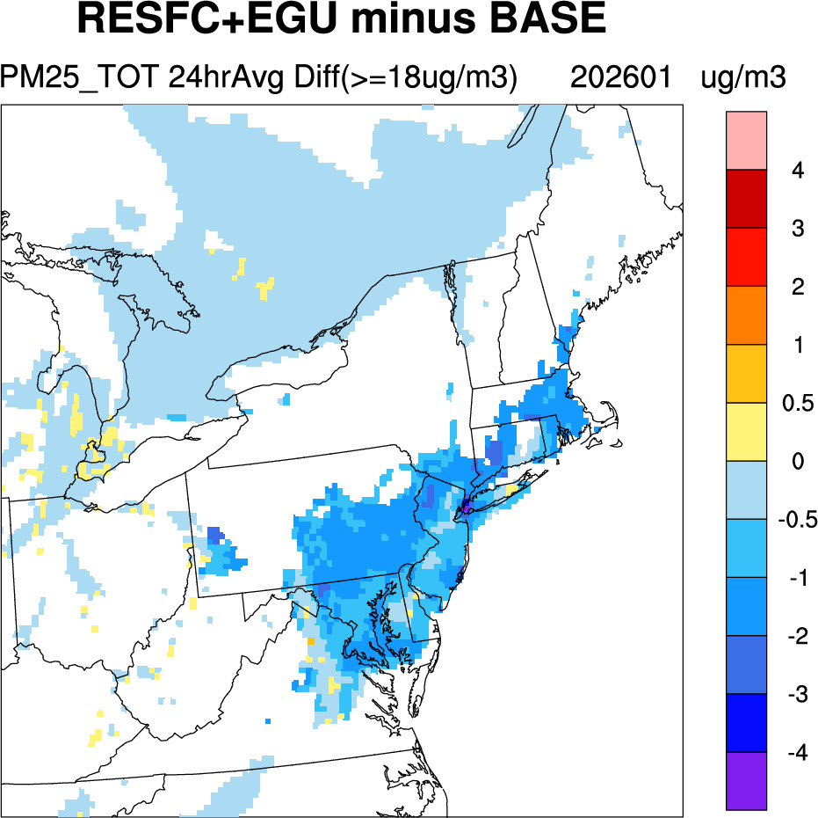
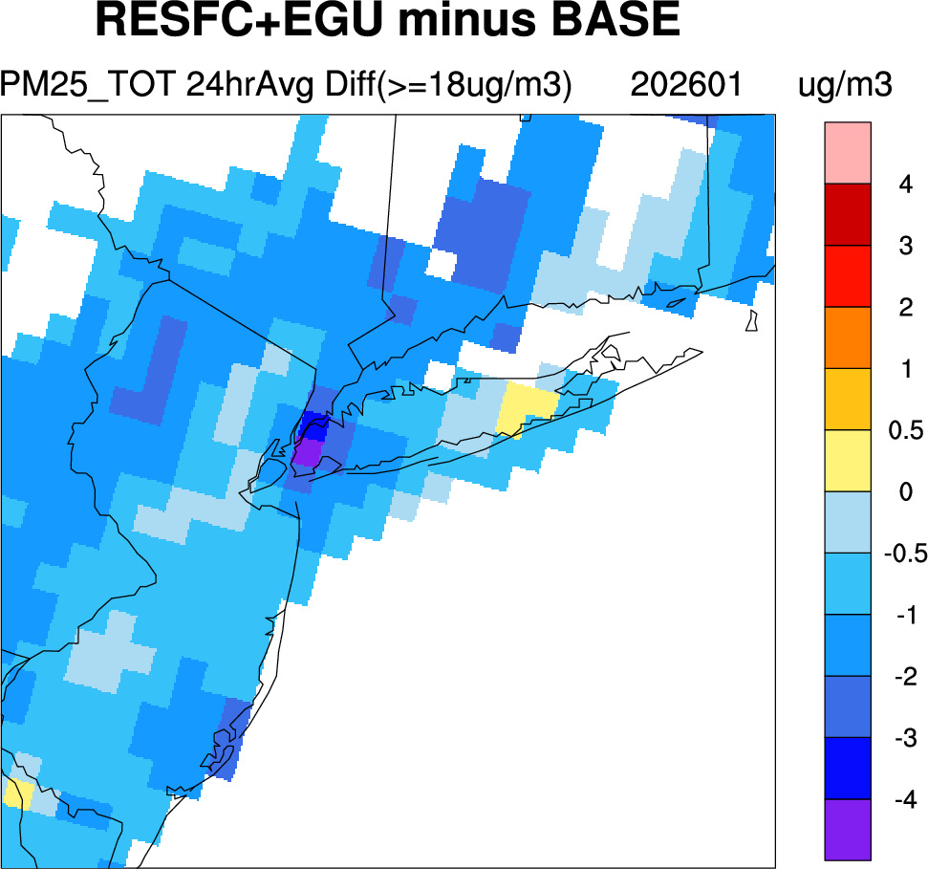
Winter PM_{2.5} Changes
Base model PM_{2.5} ≥ 9µg/m³ as threshold
On high PM_{2.5} days, decreases were larger
PM_{2.5} decreased by as much as 0.5-1 µg/m³ regionally; >4 µg/m³ in NYC
Base model PM_{2.5} ≥ 18µg/m³ as threshold (i.e., high PM_{2.5} days)

Slide 13
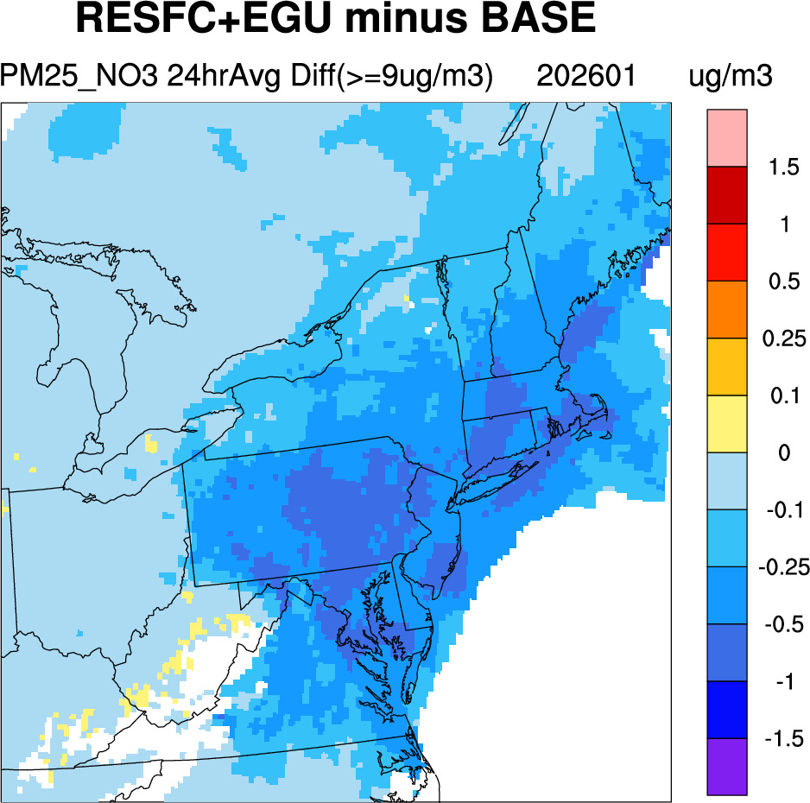
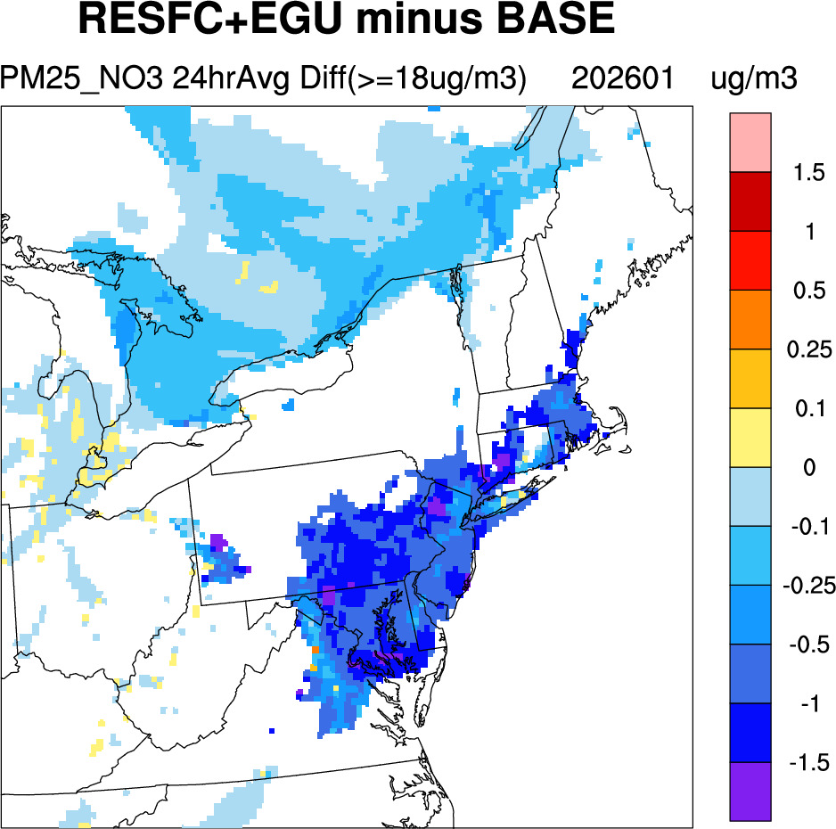
Winter NO₃ Changes
Much of the decrease in PM_{2.5} was attributed to nitrate decreases
Nitrate decreased by up to 1.5 µg/m³ on high PM_{2.5} days
Base model PM_{2.5} ≥ 9µg/m³ as threshold
Base model PM_{2.5} ≥ 18µg/m³ as threshold (i.e., high PM_{2.5} days)
PM_{2.5} = SO₄ + SOIL + OC + NO₃ + NH₄ + EC + UNSPEC1 + NA + CL

Slide 14
Conclusions
Whole-Home Electrification
Impacts on elevated summertime ozone were generally minor.
Impacts on PM_{2.5} were larger during the winter months.
PM_{2.5} decreased by as much as 0.5-1 µg/m³ regionally; >4 µg/m³ in NYC during high PM_{2.5} days.
Nitrate (NO₃) was the top contributor to PM_{2.5} decreases.
Disclaimer: The views expressed here do not necessarily reflect the views or opinions of the NYSDEC and NESCAUM.

Slide 15
Thank you very much!
Questions?
Ruby.Tian@dec.ny.gov
New York State Department of Environmental Conservation

Slide 16
Extra Slides

Slide 17
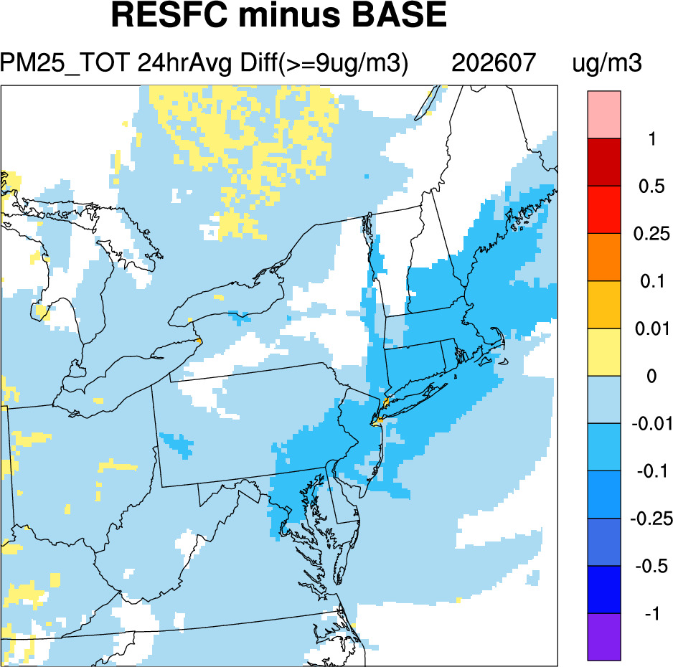
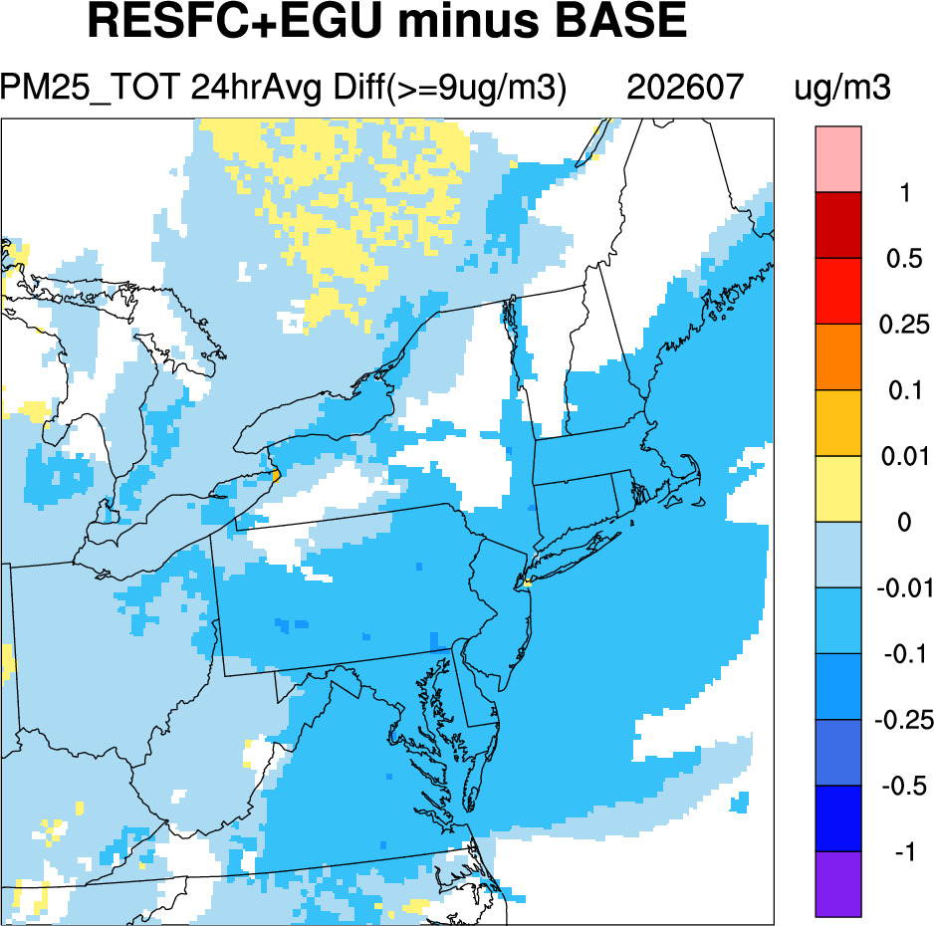
Summer PM_{2.5}
(Base model PM_{2.5} >= 9µg/m³ as threshold)

Slide 18
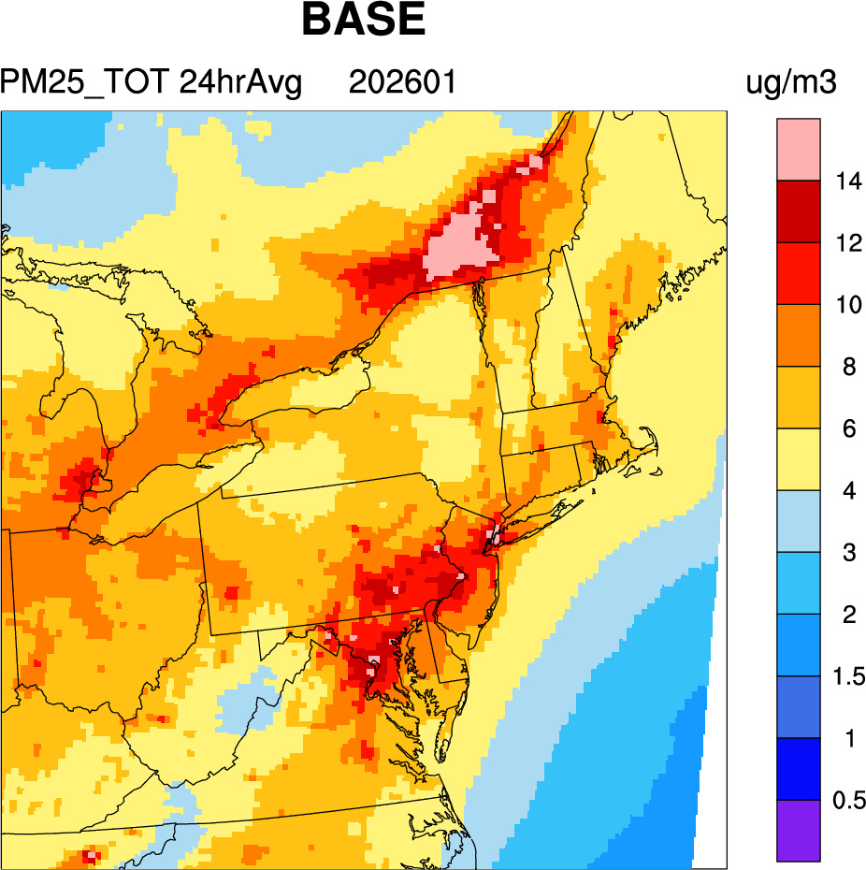
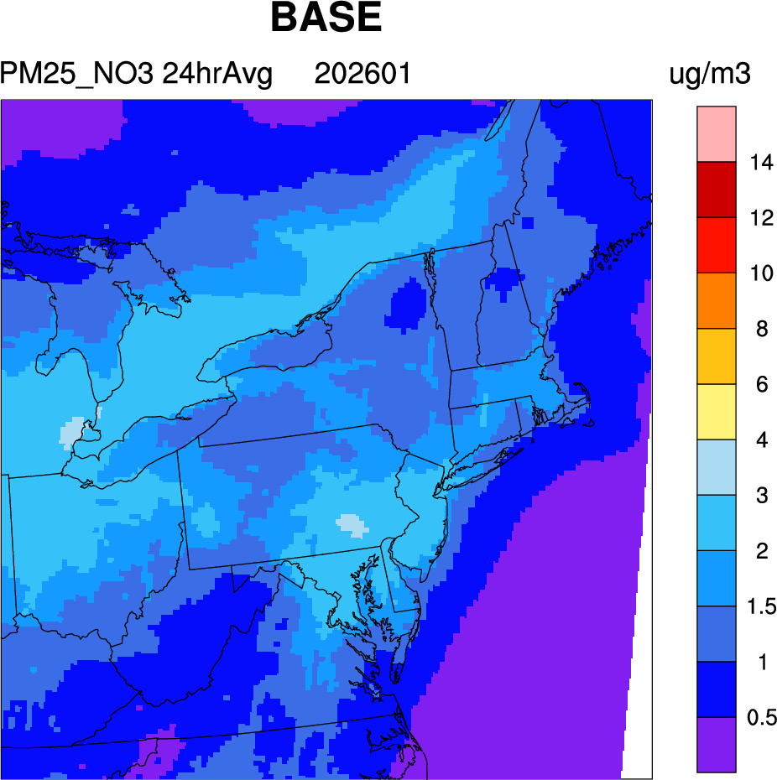
BASE Winter PM_{2.5}
(No threshold)

Slide 19
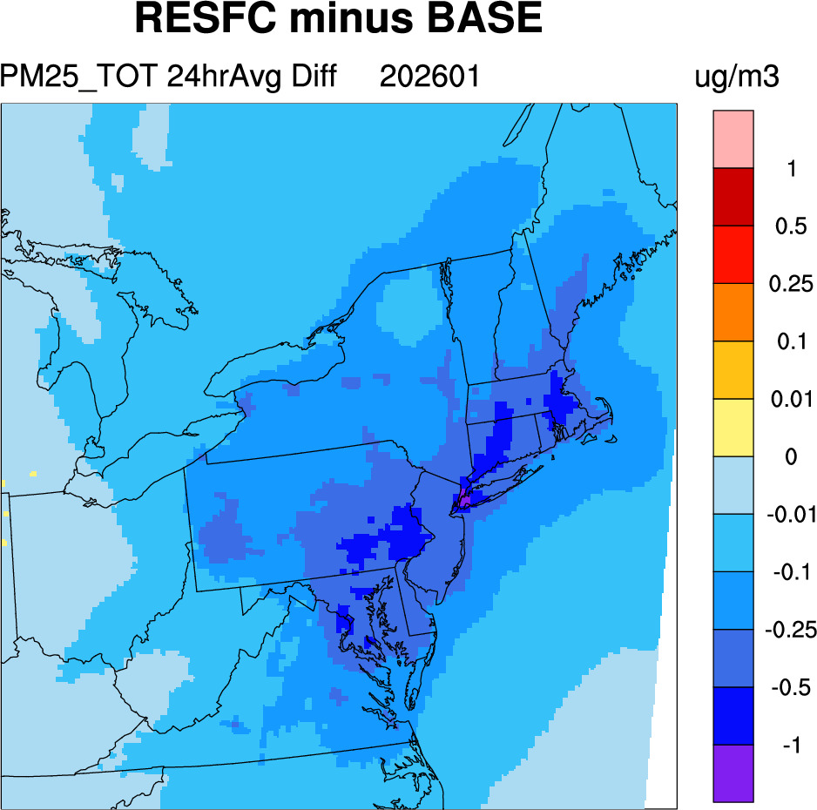
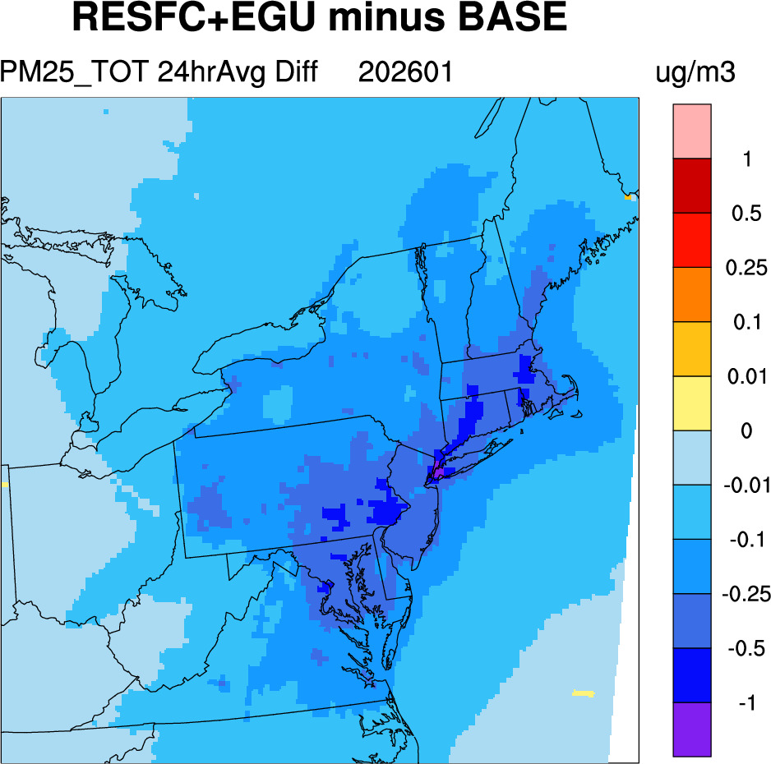
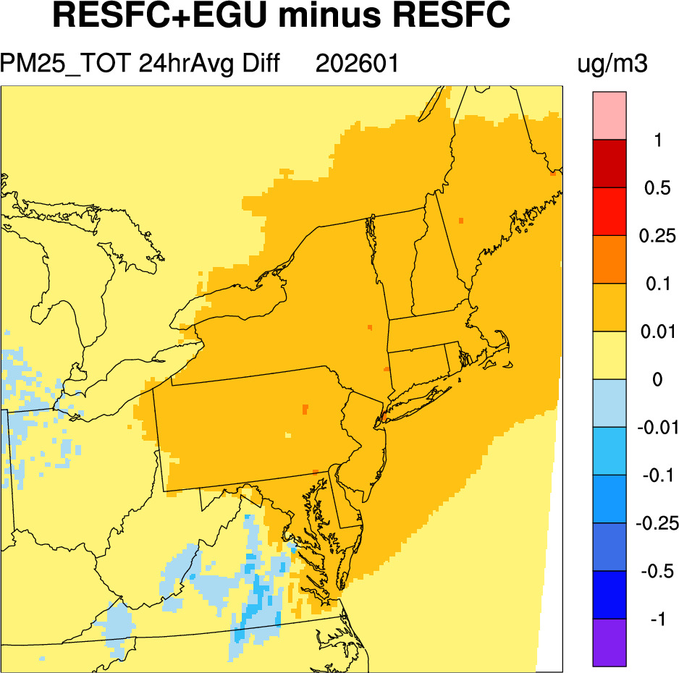
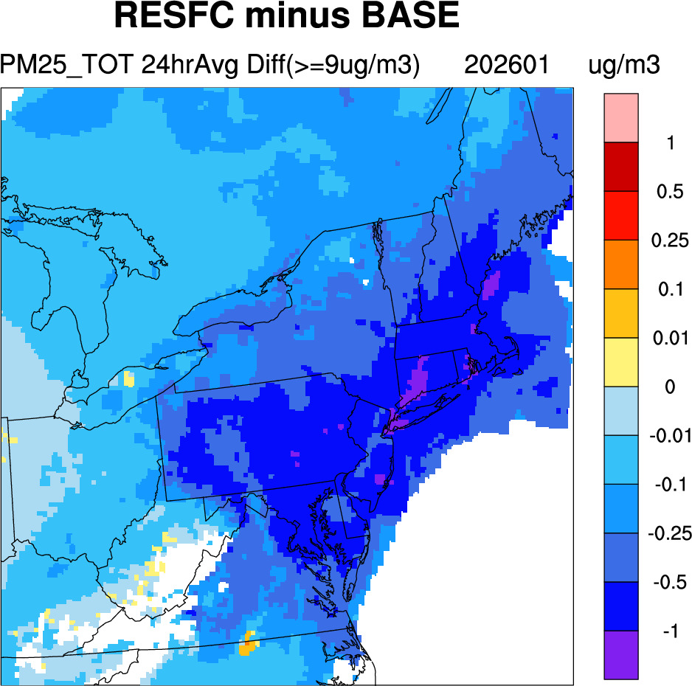
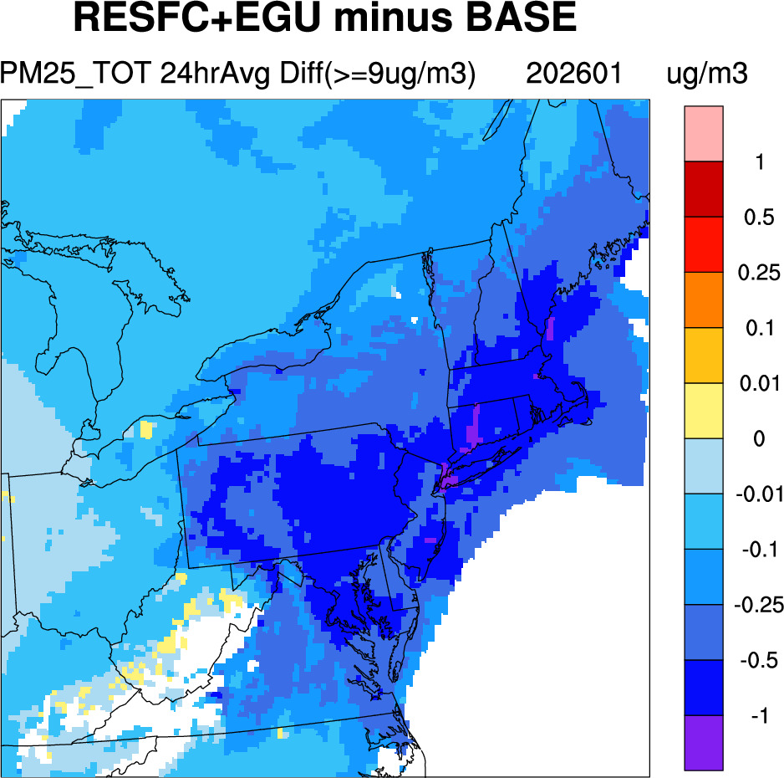
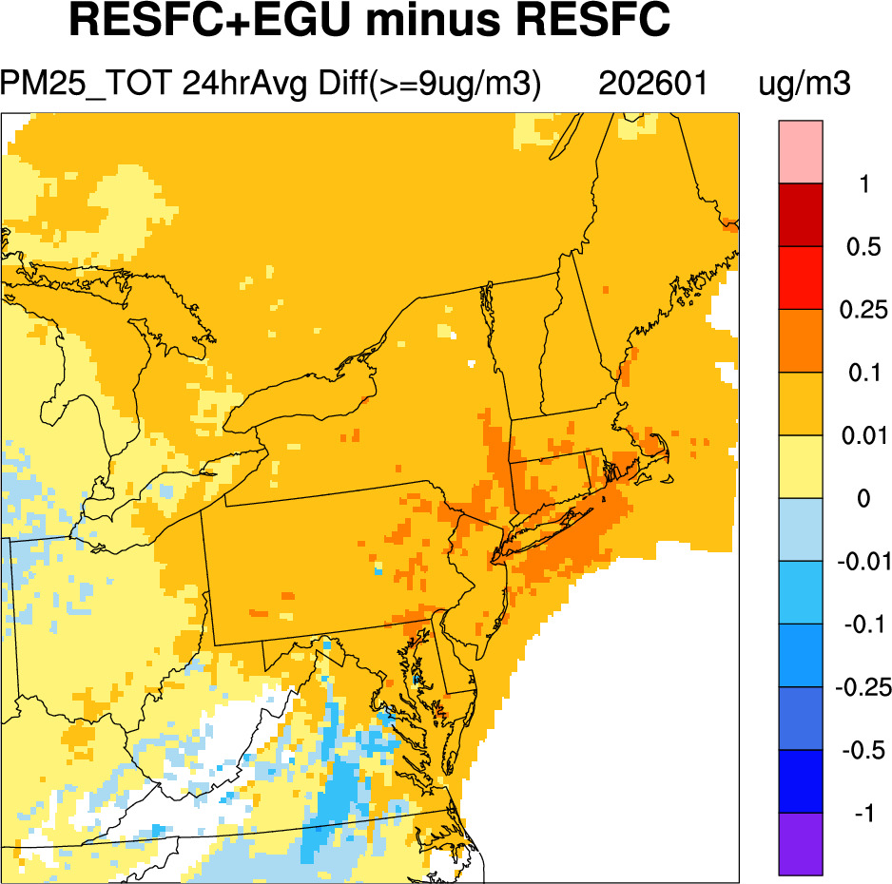
Winter PM_{2.5}
All modeled data are used, no threshold
Base model _{PM2.5} >= 9µg/m³ as threshold

Slide 20
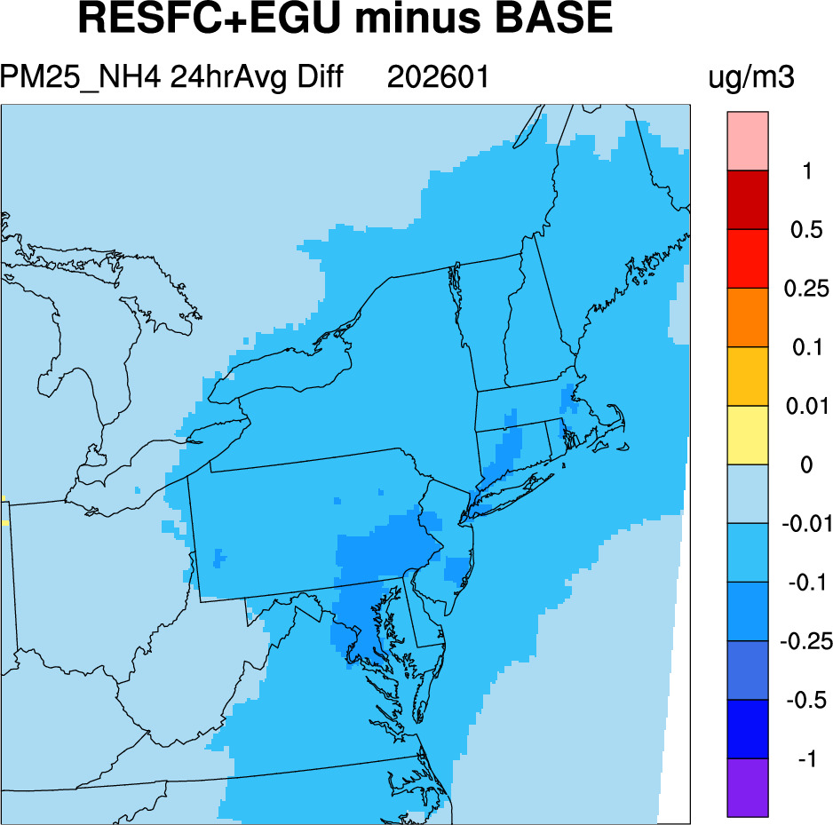
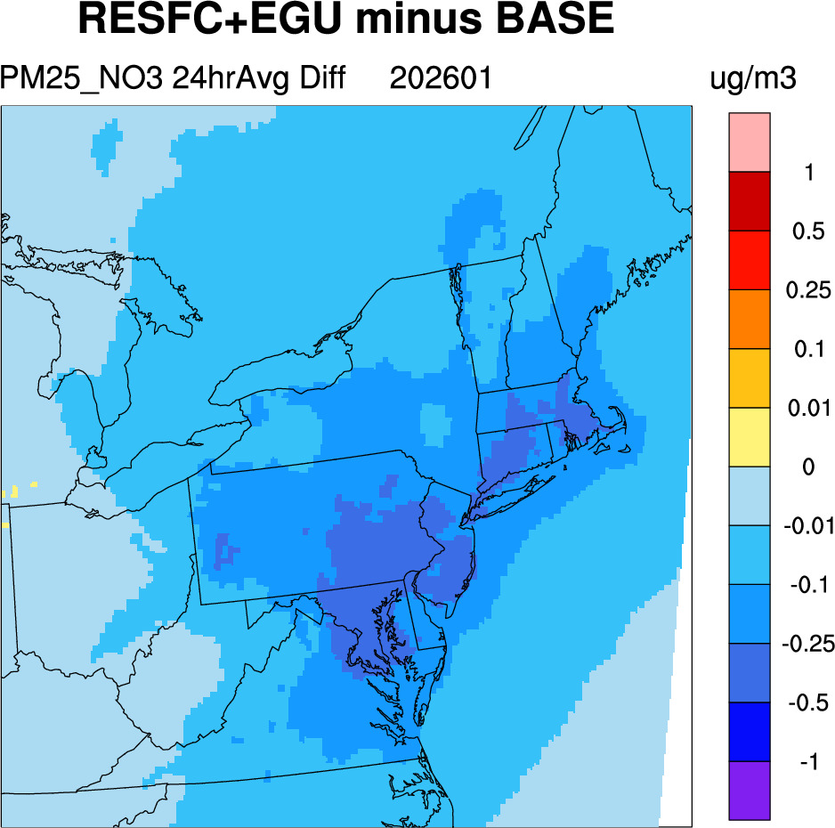
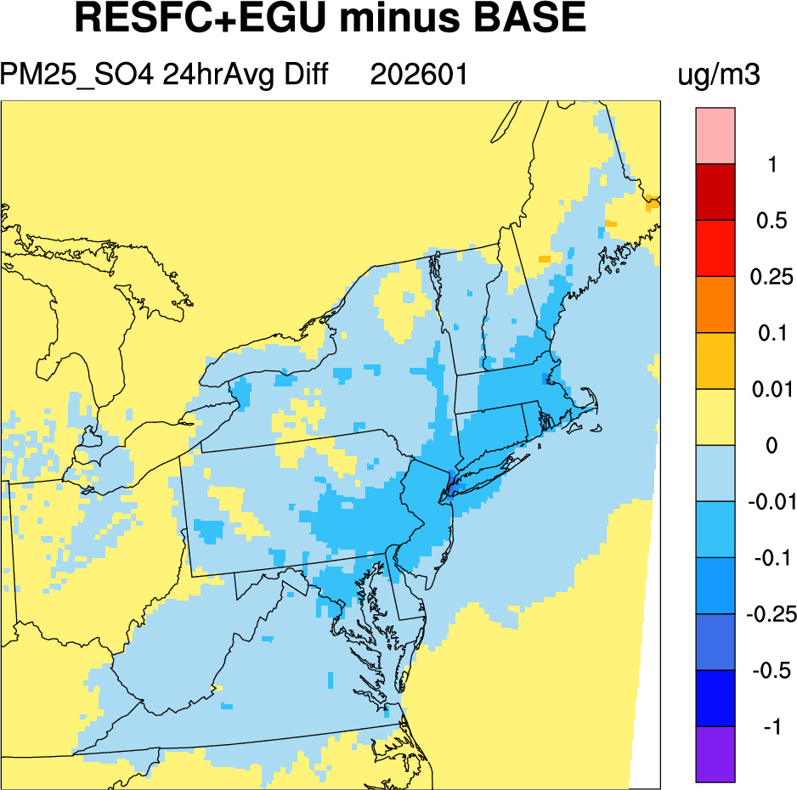
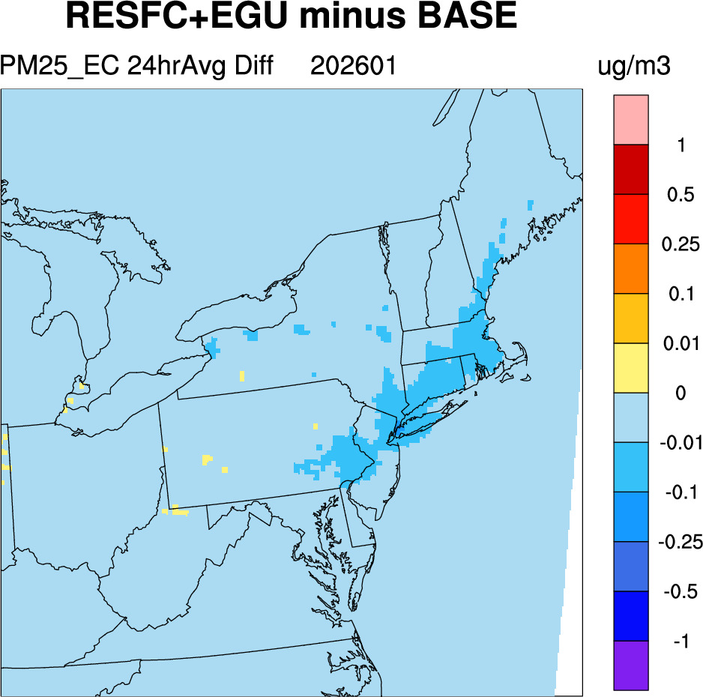
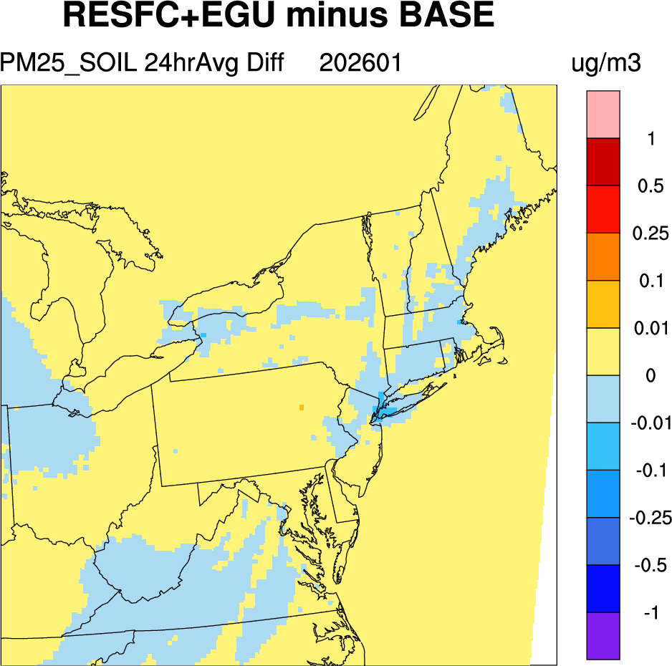
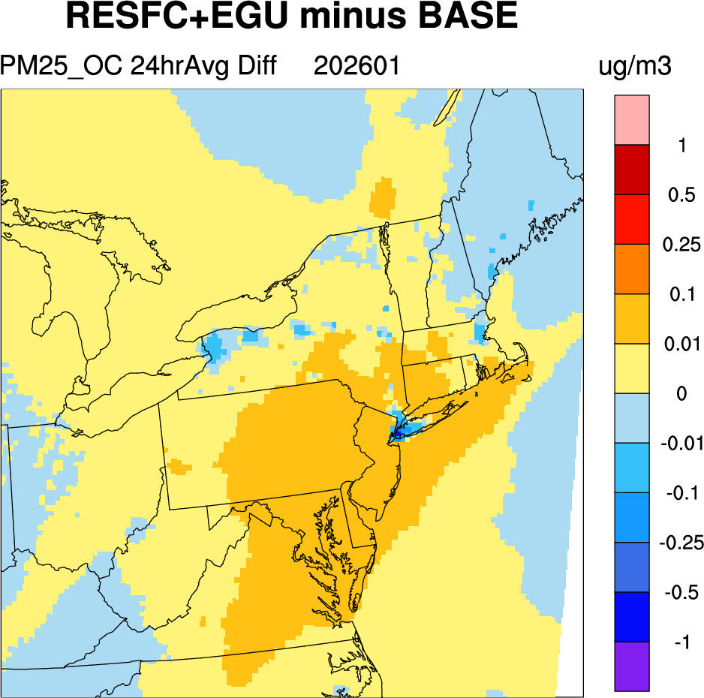
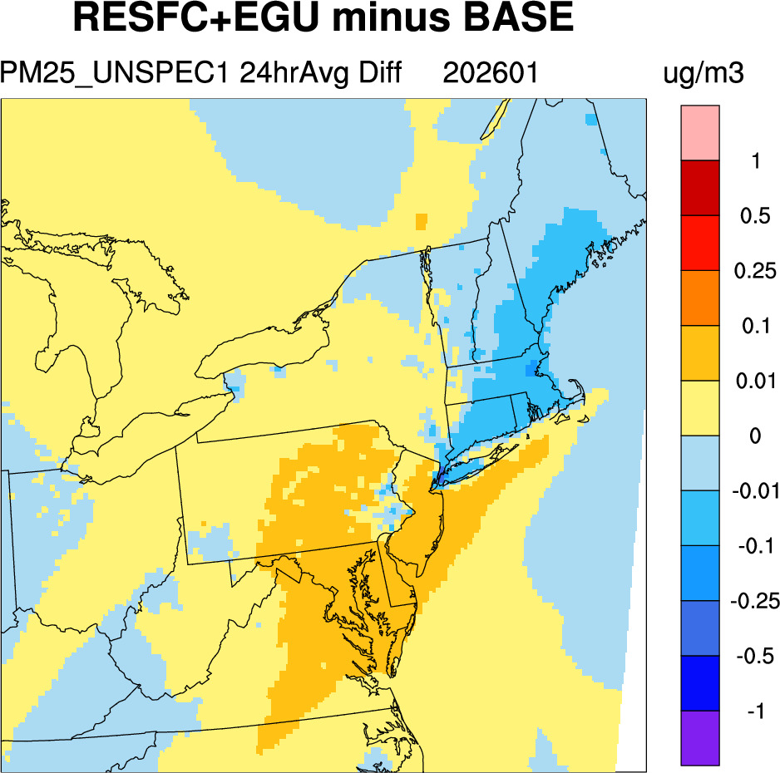
Winter PM_{2.5}: Individual Components
(No threshold)

Slide 21
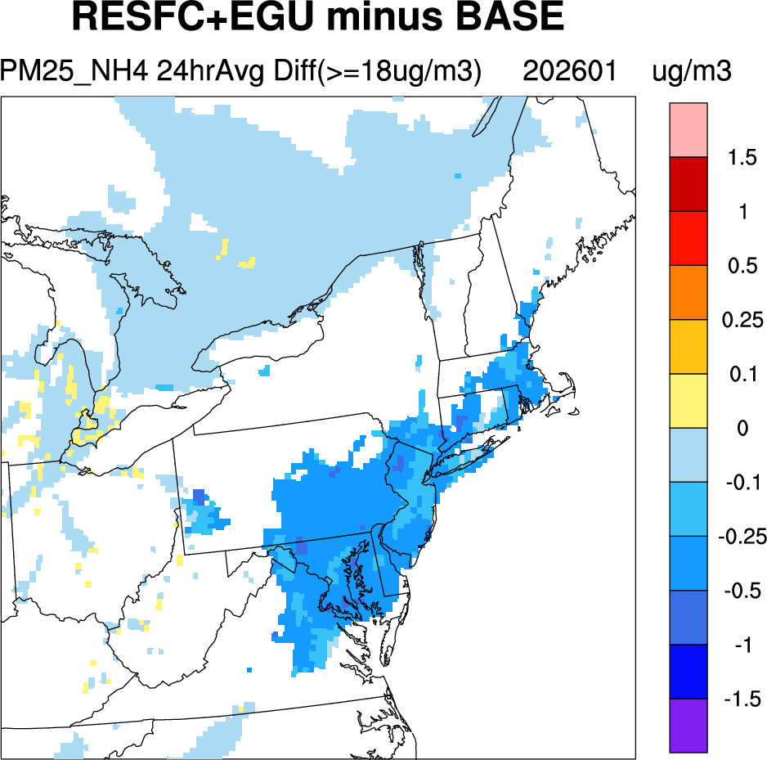
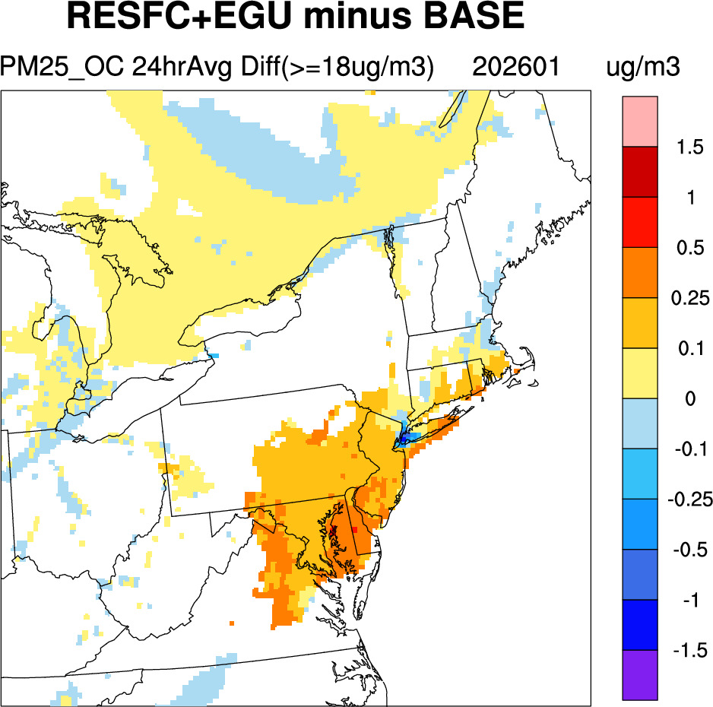
Winter PM_{2.5}: Individual Components
Base model PM_{2.5} >= 18µg/m³ as threshold

