Slide 1

Recent Gaseous and Particulate Emission Trends in Northeast Asia Using Top-Down Emission Adjustment Method with Surface Observations
CMAS Conference 2024
October 23, 2024
Seongeun Jeong, Eunhye kim, Yoon-Hee Kang, Soontae Kim
Ajou University, South Korea

Slide 2
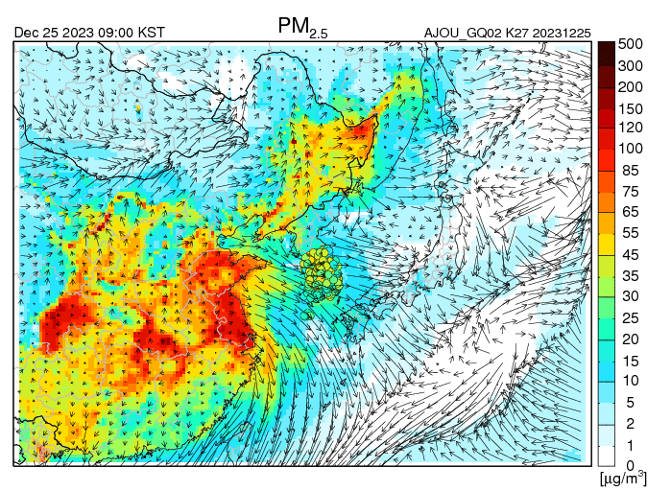
Motivation: Air Quality Overview in Northeast Asia
--- South Korea annual average air quality standards : 15 μg/m³
--- WHO annual average air quality guidelines : 5 μg/m³
In Northeast Asia, air quality has long been recognized as poor, leading to ongoing studies focused on improvement.
Understanding the source-receptor relationship between upwind and downwind regions is crucial because northwesterly winds are predominant in winter.

Slide 3


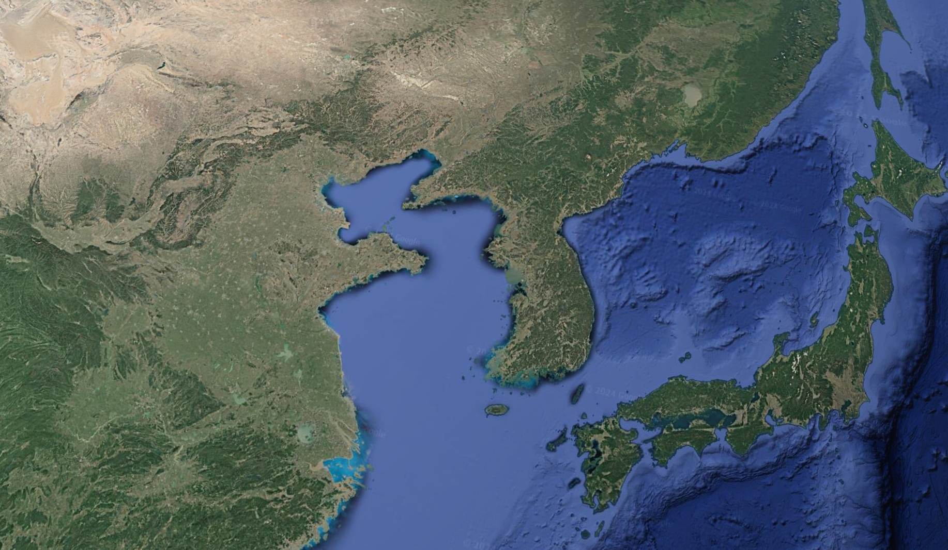



Motivation: International Projects Focused on Upwind-Downwind Relationship
https://espo.nasa.gov/asia-aq/category/Mission/ASIA-AQ
https://www.sijaq.org/
2016
Beijing
2024
Many international projects have been carried out to enhance understanding of upwind and downwind impacts.

Slide 4
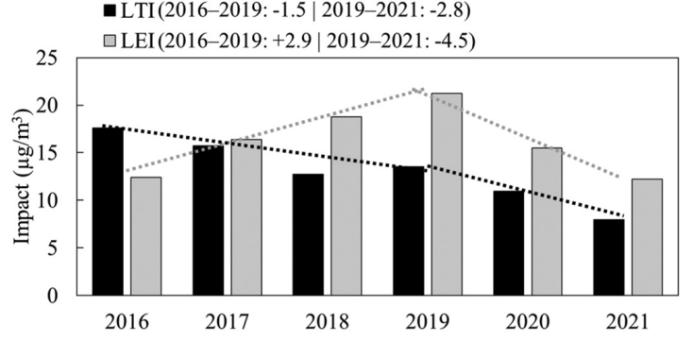
Motivation: Determining Factors of PM_{2.5} Levels in South Korea
< South Korea>
PM_{2.5} Concentrations in South Korea.
Domestic
Foreign + Domestic
Foreign
PM_{2.5}
PM_{2.5} concentrations in South Korea are significantly influenced by both foreign and domestic emissions (left figure).
Ensuring simulation accuracy from the upwind region is crucial.

Slide 5
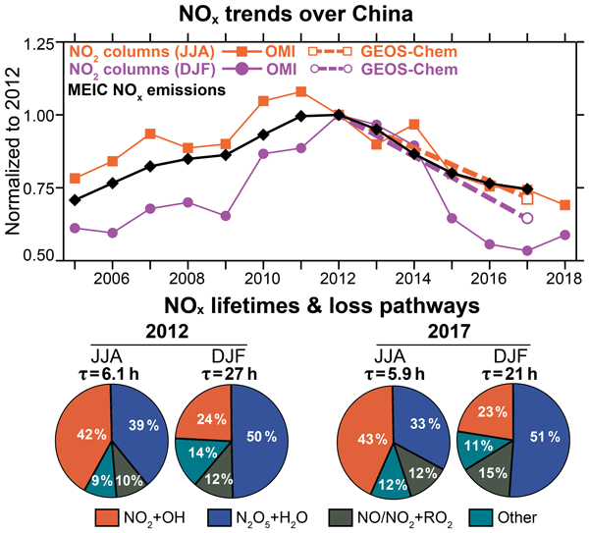
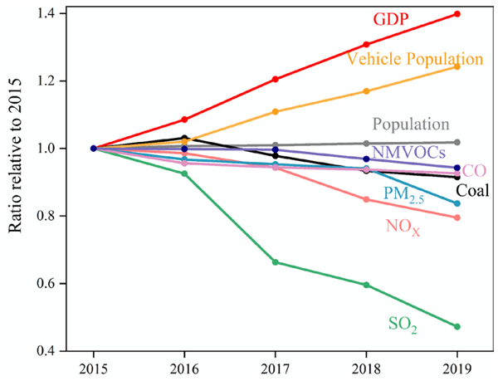
Motivation: Air Quality Overview in Northeast Asia
Gu et al., (2023)
Beijing
Rapid changes in emissions
Shah et al., (2020)
Previous studies reported that rapid changes in emissions in China have led to improvements in air pollution concentrations.
Capturing these changes in China, as the upwind source for South Korea, is crucial for accurately forecasting or estimating health impacts in South Korea

Slide 6
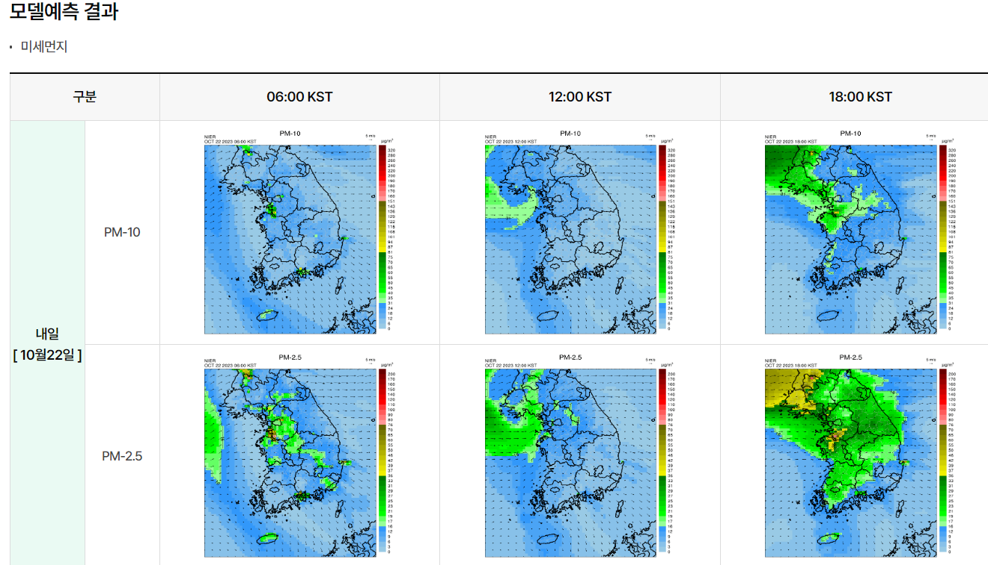
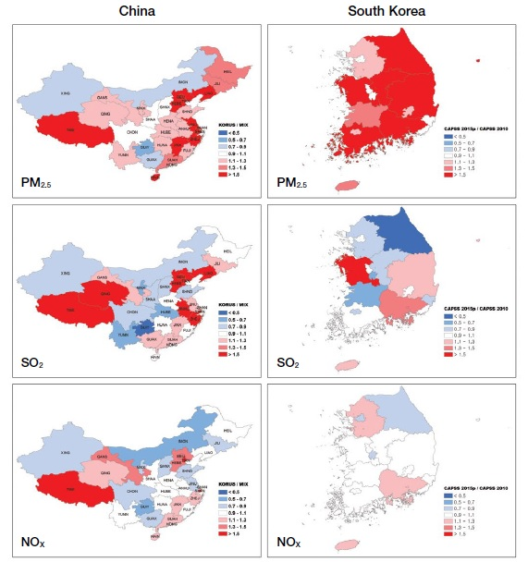


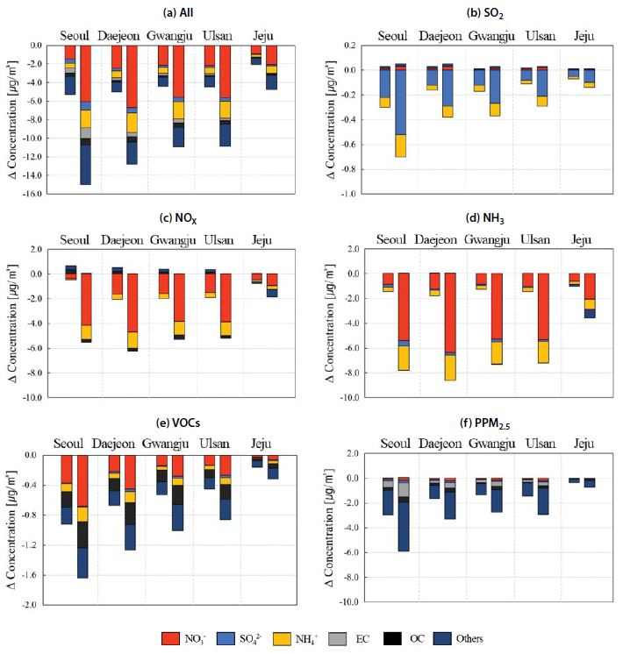
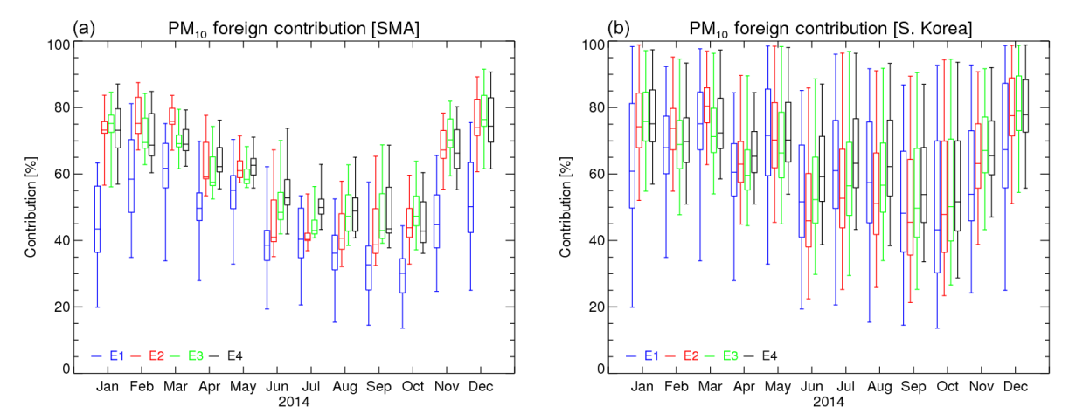
Characteristics of Bottom-Up Inventories
Forecasting
Policy effects
Choi et al. (2018)
Bottom-up
Emission Inventory
The available emission inventory (EI) in South Korea is based on data from the year 2021.
Differences in Air Pollution Forecast Concentrations
and Domestic and Foreign contributions
Kang et al. (2022)

Slide 7
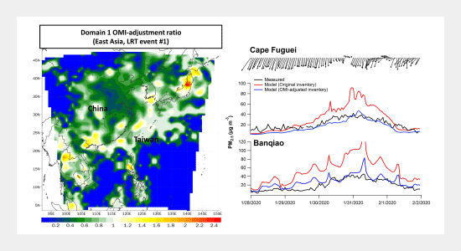
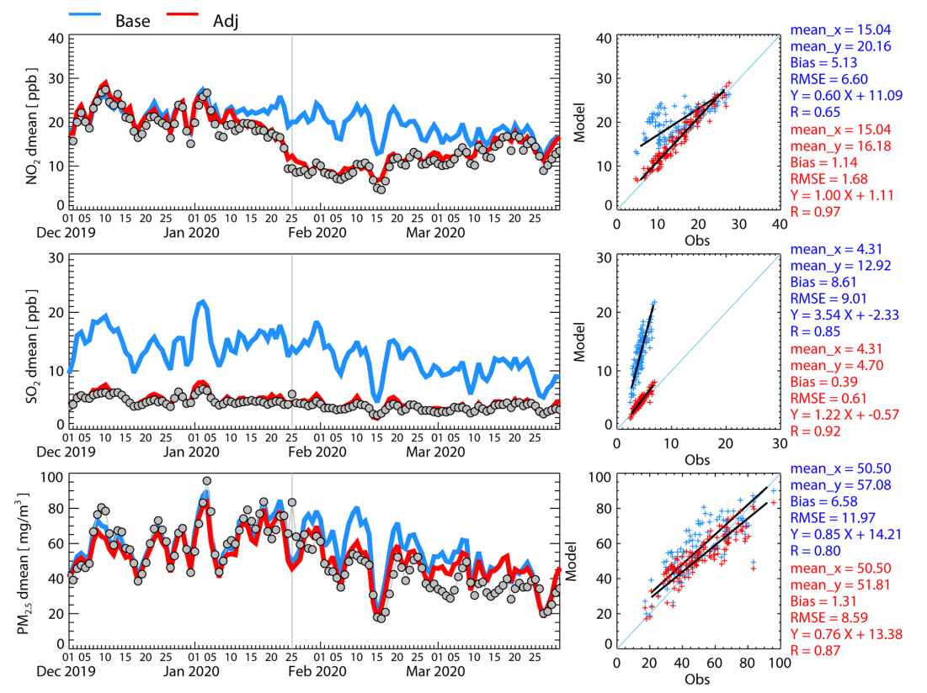
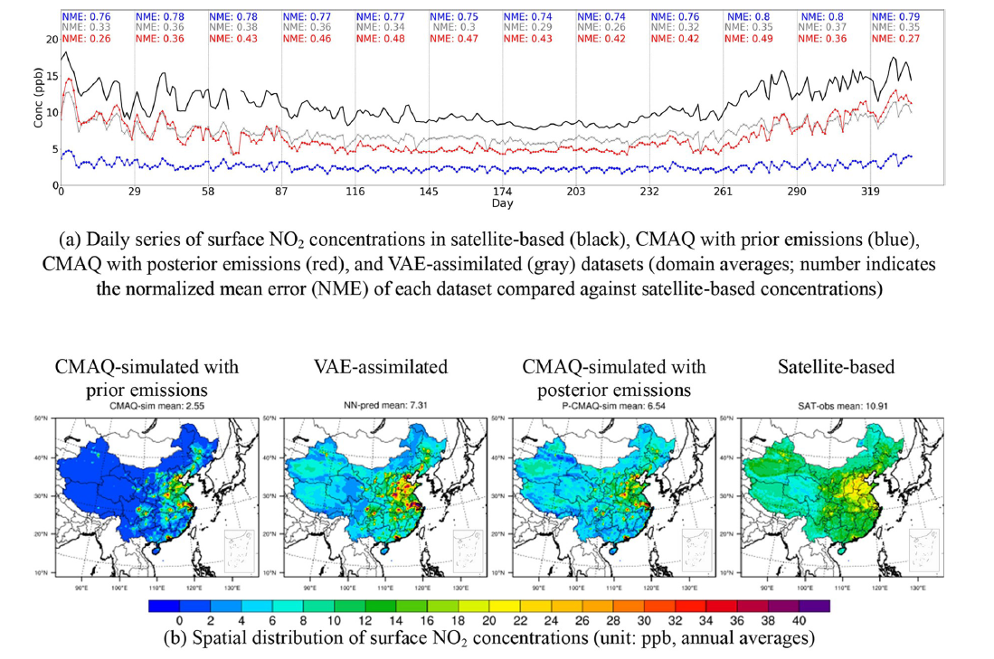
The Need for Top-Down Emission Approaches
Various previous studies have proposed methods for adjusting emissions
using satellite observations and ground-based measurement data.
satellite observations
ground observations
Huang et al. (2021)
BASE
Kim et al. (2021)
ADJ
Xing et al. (2022)

Slide 8
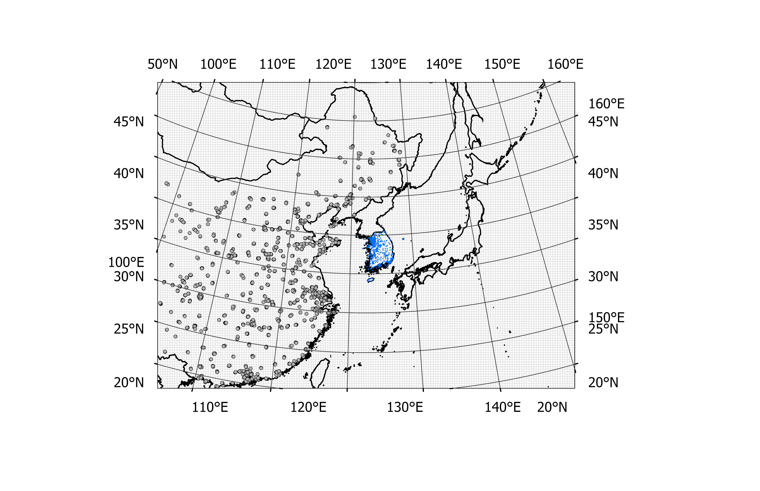
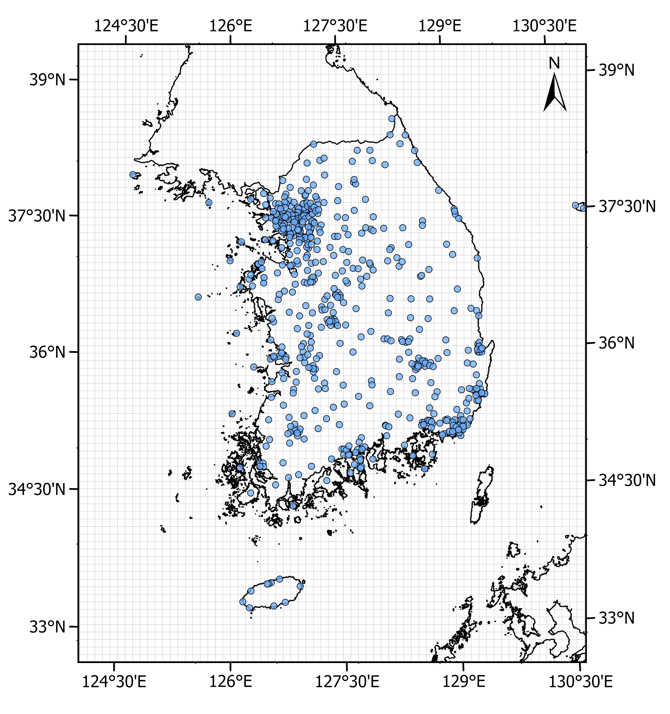
Objective: Adjusting Gaseous and Particulate Matter Emissions
The current methods for adjusting particulate matter emissions, which can affect PM_{2.5} and PM₁₀ concentrations, are limited.
(Kang et al., 2024; Kim et al., Under review)
Ground Observation sites
Abundant ground observations
China's rapidly changing emissions are regarded as a moving target
Adjusting gaseous and particulate matter emissions based on ground observation data

Slide 9

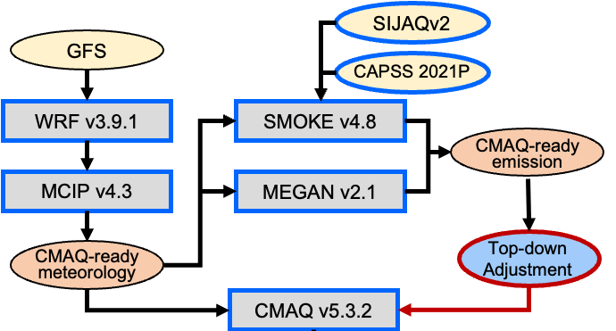
Methods: Modeling System and Domain
Modeling System
Modeling Domain
FNL
For the anthropogenic emissions inventory, we used SIJAQ version 2 for the upwind and CAPSS 2021 for the downwind, with 2021 as the base year for both.
We applied a 27-km horizontal grid resolution for the upwind region and a 9-km resolution for the downwind region

Slide 10
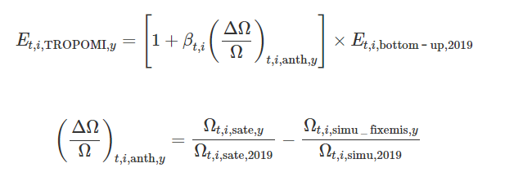










Methods: Adjusting Emissions Approach
Li et al. (2022)
1st Emission Adjustment
$${E_{adj}^{1st}}_{s,t}={E_{priori}}_{s,t}× [1+{\left(C_{obs}−C_{priori}\right)}_{s,t}/S_{s,t}]$$
$$S_{s,t}=\frac{ΔC_{s,t}}{Δε_{s,t}}=\frac{{C_{sens}}_{t,i}−{C_{base}}_{t,,i} }{{E_{sens}}_{t,i} /{E_{base}}_{t,i}}$$
$$s=areas level$$
$$t=specific times$$
$${C_{obs}}_{t.i}$$
$${C_{adj}^{1st} }_{t.i}$$
2nd Emission Adjustment: for remaining discrepancies
${C_{adj}^{1st} }_{t.i}−$ ${C_{base}}_{t,i}$
$${E_{adj}^{2nd}}_{s,t}={E_{adj}^{1st}}_{s,t}×[1+\left({C_{obs}}_{s,t}−{C_{adj}^{1st}}_{s,t}\right)/S_{s,t}^{2nd}]$$
$$S_{s,t}^{2nd}=\frac{ΔC_{s,t}}{Δε_{s,t}}= \frac{{C_{base}}_{s,t}−{C_{sens}}_{s,t}}{{{(E}_{base}}_{s,t}−{E_{sens}}_{s,t})/{E_{adj}^{1st}}_{s,t}}×(\frac{{C_{obs}}_{s,t}−{C_{base}}_{s,t}}{{C_{obs}}_{s,t}−{C_{adj}^{1st} }_{s,t}})$$
$${C_{obs}}_{t.i}−{C_{base}}_{t,i}$$
$${C_{base}}_{t,i}$$
$${E_{adj}^{2nd}}_{s,t}$$
10
$${E_{adj}^{1st}}_{s,t}$$

Slide 11
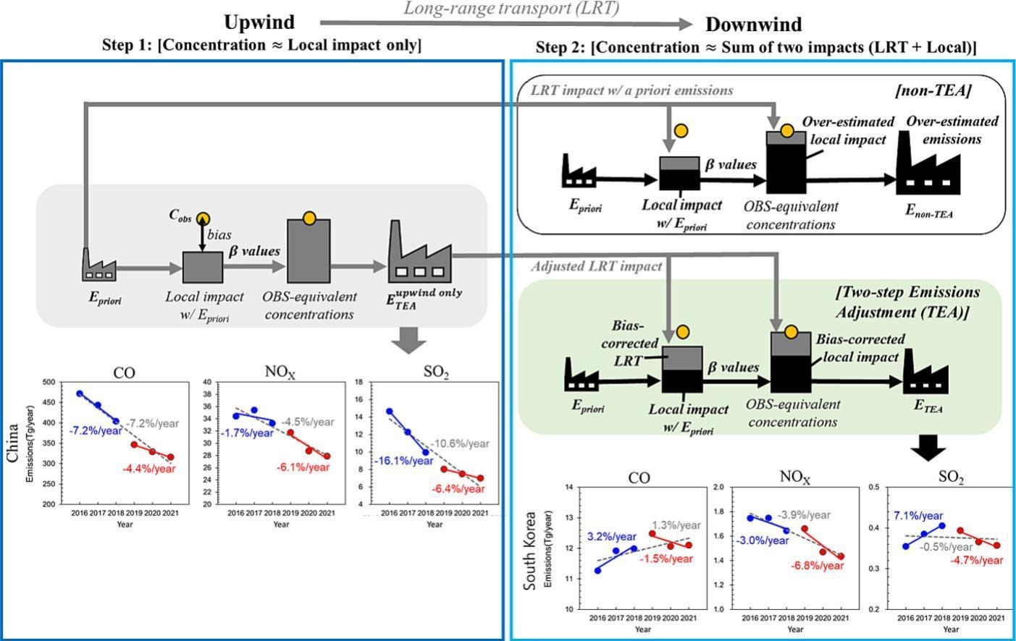
Methods: Sequential Adjustments of Upwind and Downwind Emissions
Overview
BASE
(simulated using Emission Inventory)
Kim et al. (2024)
Adjust emissions based on
ground observations
Upwind (China)
Downwind (South Korea)
TEA method
After adjusting upwind emissions based on ground observation concentrations, downwind emissions are subsequently corrected.
ADJ
(simulated using Adjusted Emissions)

Slide 12
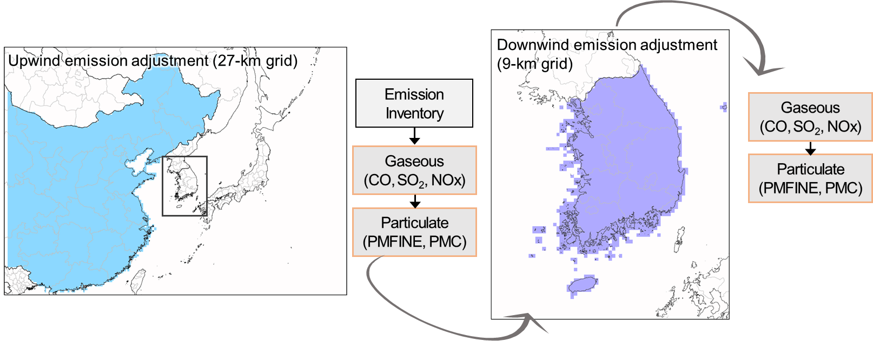
Methods: Adjusted Emission Pollutants
Pollutants
Emission type | Emissions | Concentrations
Gaseous | CO | CO
 | SO₂ | SO₂, Sulfate
 | NO, NO₂ | NO, NO₂, Nitrate
Primary aerosol | Primary PM_{2.5} | Primary PM_{2.5}
 | PMC | PM₁₀
Given that gaseous concentrations affect the secondary formation of particulate matter, we corrected particulate emissions sequentially after adjusting gaseous emissions.

Slide 13
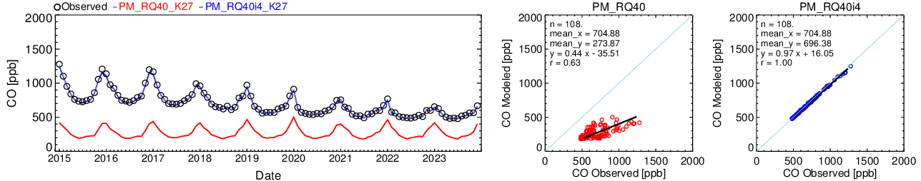
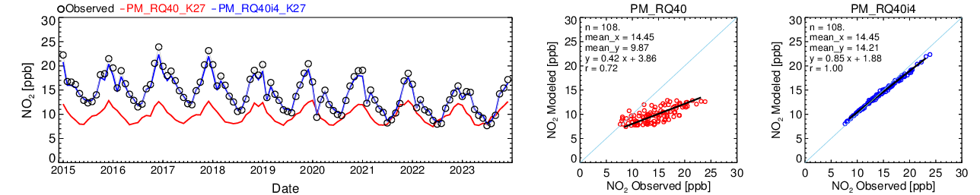
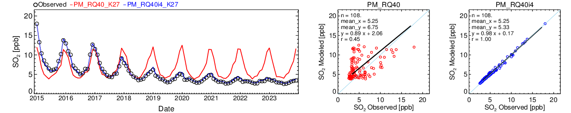
Results: Emission Adjustment Results in China from 2015 to 2023
Upwind (China)
― EI-based ― Adjusted_Up
EI-based
Adjusted_Up
MB: -431.0 ppb
MB: -8.5 ppb
After the adjustment,
the correlation coefficient and mean bias (MB) improved.
― EI-based ― Adjusted_Up
EI-based
Adjusted_Up
MB: -4.6 ppb
MB: -0.2 ppb
― EI-based ― Adjusted_Up
EI-based
Adjusted_Up
MB: 1.5 ppb
MB: 0.1 ppb
Notes:
그 결과 배출량은 이런식으로 산정이 되었고 농도는 이렇게 되었다.

Slide 14
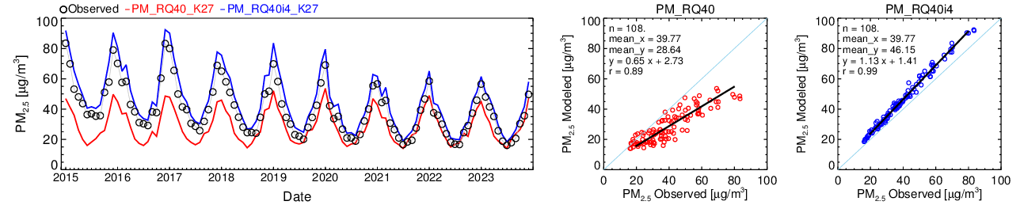
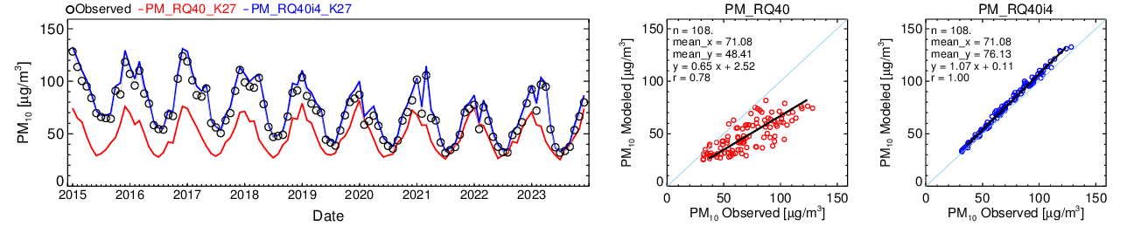
Results: Emission Adjustment Results in China from 2015 to 2023
Upwind (China)
Over-estimate
― EI-based ― Adjusted_Up
EI-based
Adjusted_Up
Random error ▼
Systematic error O
MB: 6.4 ㎍/㎥
MB: -11.1 ㎍/㎥
― EI-based ― Adjusted_Up
EI-based
Adjusted_Up
MB: 5.1 ㎍/㎥
MB: -22.7 ㎍/㎥
This method only considered each area's emission impacts on its own concentrations, so it did not account for inter-provincial interactions
Notes:
Although the emission adjustments were applied twice consecutively, which accounted for some transport, the interactions between regions were not fully considered

Slide 15
Results: Emission Adjustment Results in China from 2015 to 2023
Upwind (China)
Over-estimate
― EI-based ― Adjusted_Up
EI-based
Adjusted_Up
Random error ▼
Systematic error O
MB: 6.4 ㎍/㎥
MB: -11.1 ㎍/㎥
― EI-based ― Adjusted_Up
EI-based
Adjusted_Up
MB: 5.1 ㎍/㎥
MB: -22.7 ㎍/㎥
This method only considered each area's emission impacts on its own concentrations, so it did not account for inter-provincial interactions
Notes:
Although the emission adjustments were applied twice consecutively, which accounted for some transport, the interactions between regions were not fully considered

Slide 16
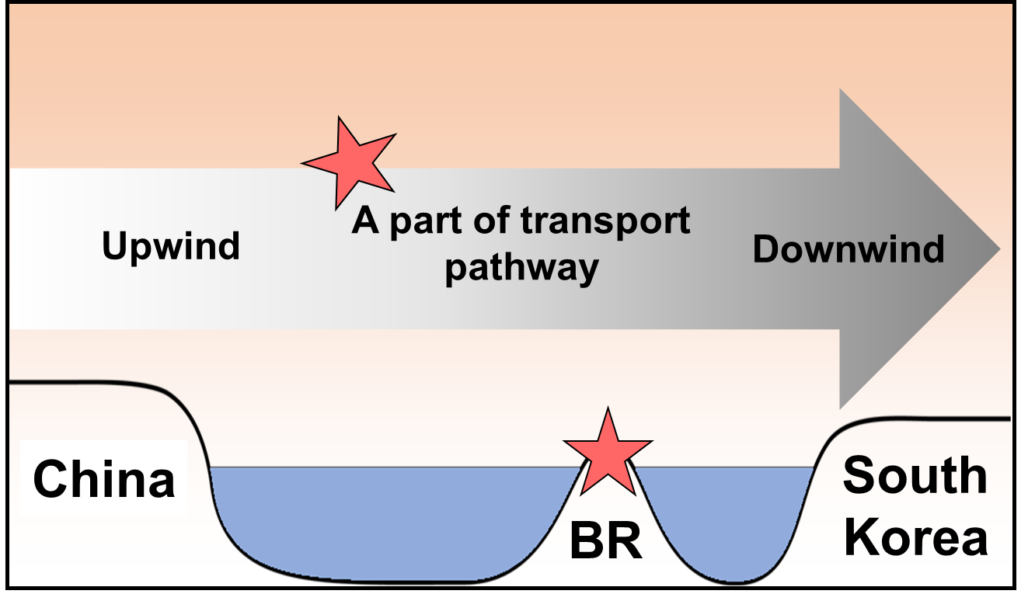
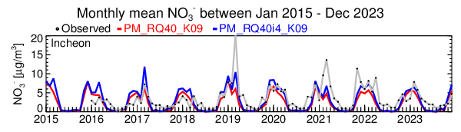
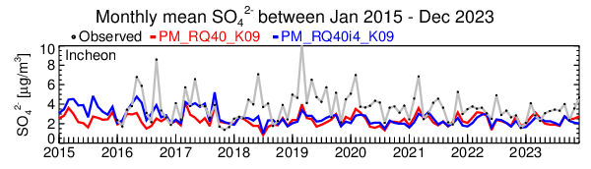
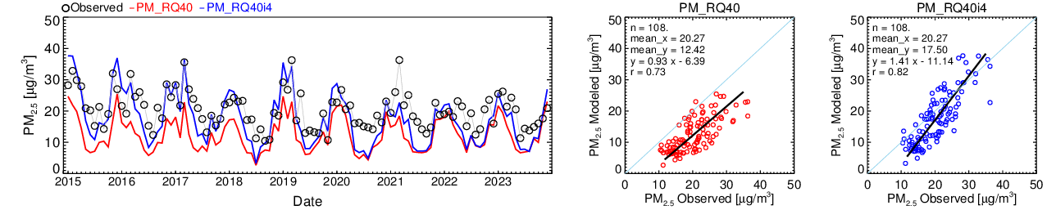
Results: Emission Adjustment Results in BR from 2015 to 2023
Nitrate
― EI-based ― Adjusted_Up
Sulfate
― EI-based ― Adjusted_Up
― EI-based ― Adjusted_Up
EI-based
Adjusted_Up
Notes:
그 결과 배출량은 이런식으로 산정이 되었고 농도는 이렇게 되었다.

Slide 17
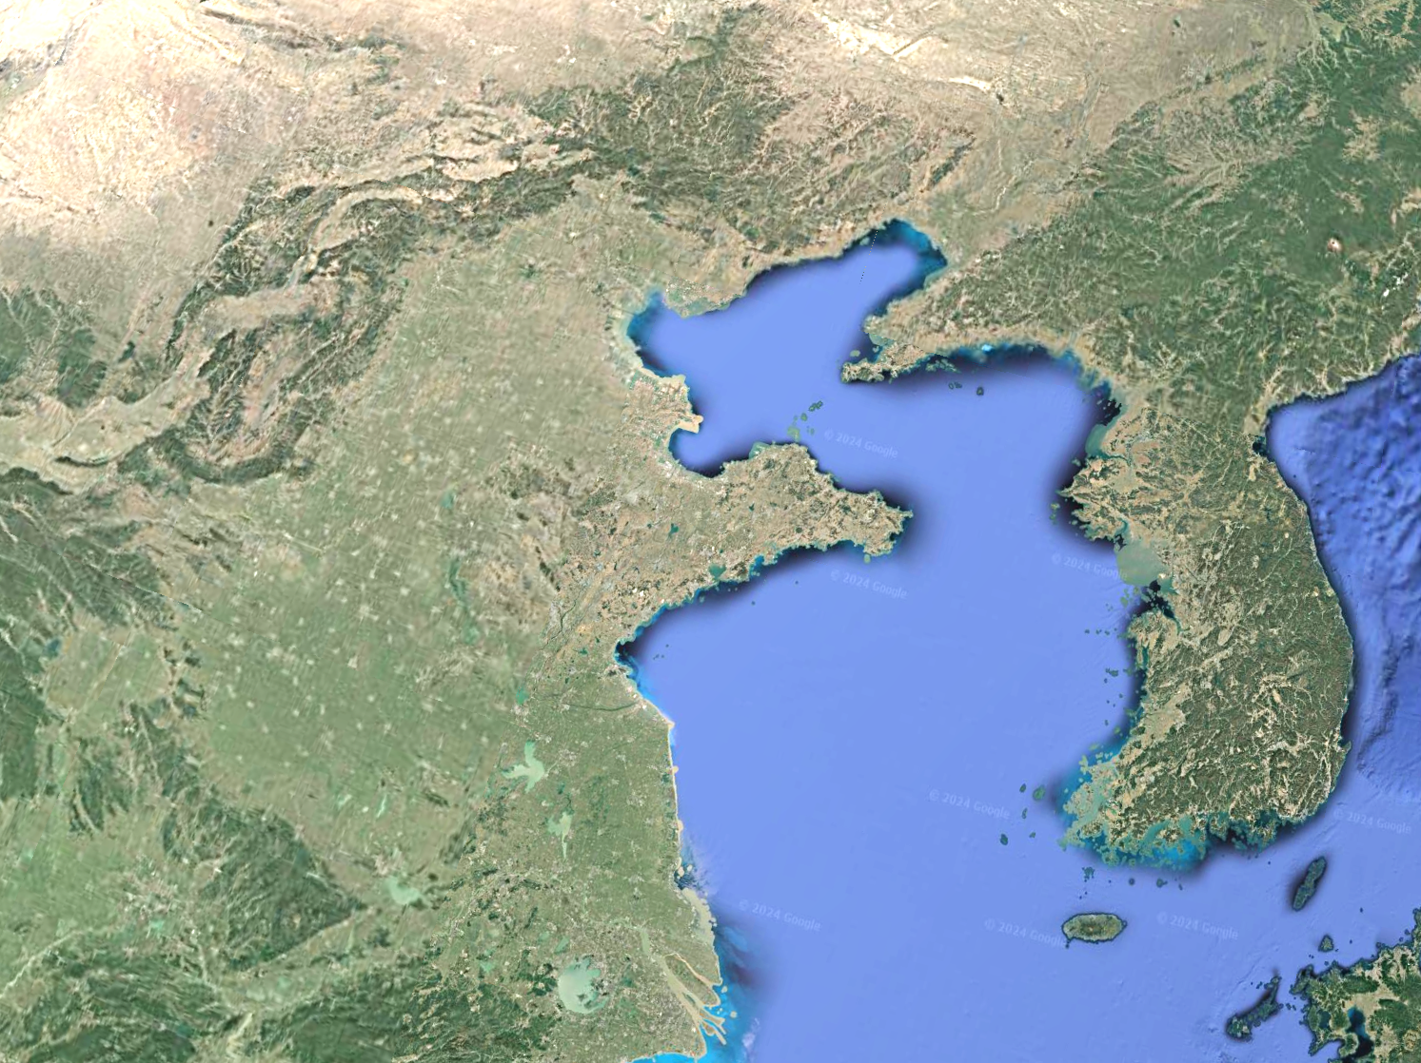
Results: Emission Adjustment Results in BR from 2015 to 2023
Nitrate
― EI-based ― Adjusted_Up
Sulfate
― EI-based ― Adjusted_Up
― EI-based ― Adjusted_Up
EI-based
Adjusted_Up
Notes:
그 결과 배출량은 이런식으로 산정이 되었고 농도는 이렇게 되었다.

Slide 18
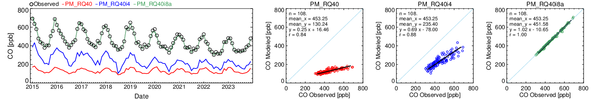
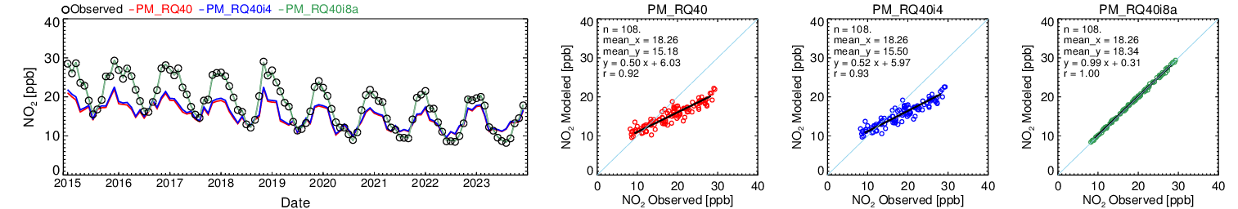
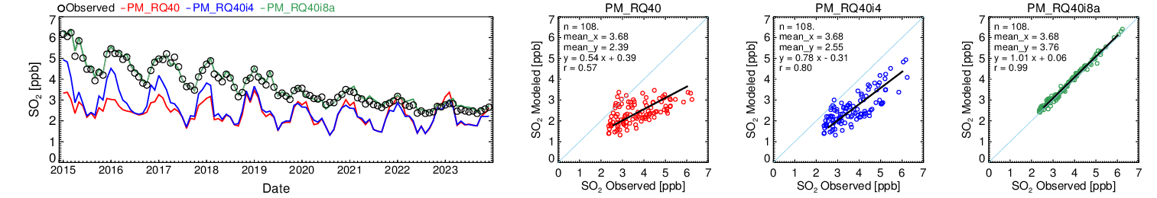
Results: Emission Adjustment Results in South Korea from 2015 to 2023
Downwind (South Korea)
― EI-based ― Adjusted_Up ― Adjusted_Down
EI-based
Adjusted_Up
Adjusted_Down
After the adjustment,
the correlation coefficient and mean bias (MB) improved.
― EI-based ― Adjusted_Up ― Adjusted_Down
EI-based
Adjusted_Up
Adjusted_Down
― EI-based ― Adjusted_Up ― Adjusted_Down
EI-based
Adjusted_Up
Adjusted_Down
Notes:
그 결과 배출량은 이런식으로 산정이 되었고 농도는 이렇게 되었다.

Slide 19
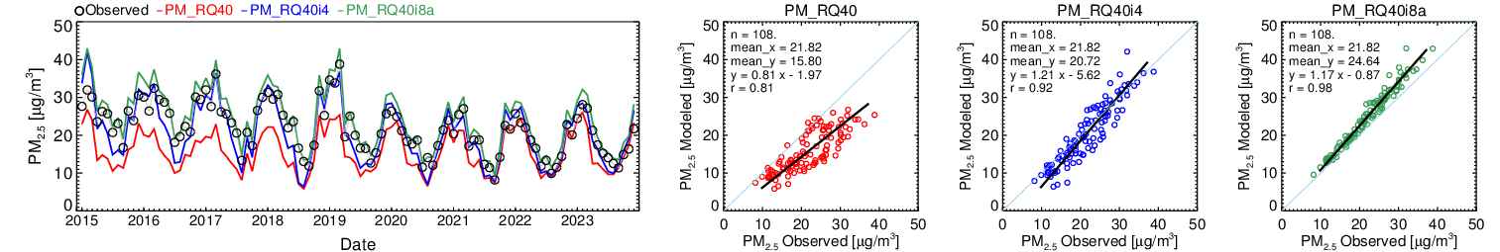
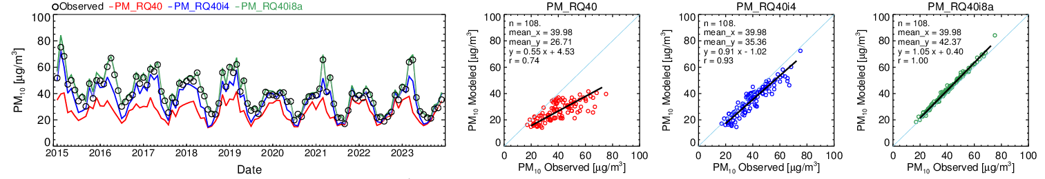
Results: Emission Adjustment Results in South Korea from 2015 to 2023
Downwind (South Korea)
Random error ▼
Systematic error O
Over-estimate
― EI-based ― Adjusted_Up ― Adjusted_Down
EI-based
Adjusted_Up
Adjusted_Down
― EI-based ― Adjusted_Up ― Adjusted_Down
EI-based
Adjusted_Up
Adjusted_Down
MB: 5.1 ㎍/㎥
MB: -11.1 ㎍/㎥
Notes:
그 결과 배출량은 이런식으로 산정이 되었고 농도는 이렇게 되었다.

Slide 20
Results: Emission Adjustment Results in South Korea from 2015 to 2023
Downwind (South Korea)
Random error ▼
Systematic error O
Over-estimate
― EI-based ― Adjusted_Up ― Adjusted_Down
EI-based
Adjusted_Up
Adjusted_Down
― EI-based ― Adjusted_Up ― Adjusted_Down
EI-based
Adjusted_Up
Adjusted_Down
MB: 5.1 ㎍/㎥
MB: -11.1 ㎍/㎥
Notes:
그 결과 배출량은 이런식으로 산정이 되었고 농도는 이렇게 되었다.

Slide 21
Results: Comparison of Emission Changes Between Bottom-Up and Top-Down Approaches
Notes:
그 결과 배출량은 이런식으로 산정이 되었고 농도는 이렇게 되었다.

Slide 22
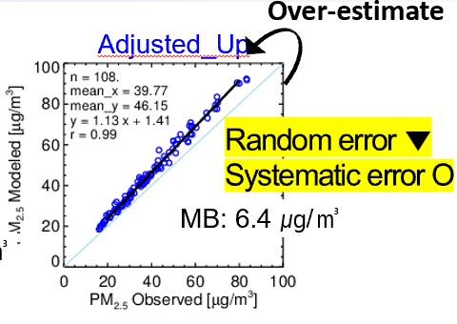
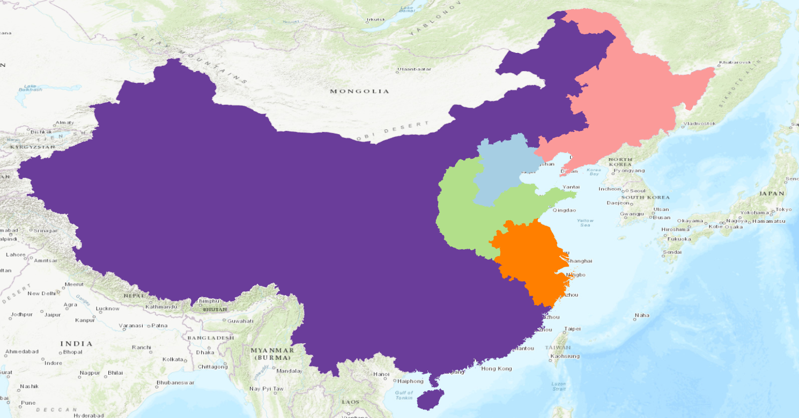
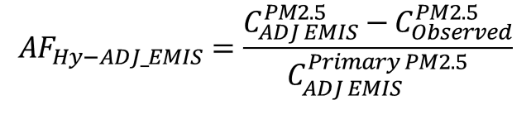

Methods: Correction of Systematic Bias
Additional
Re-adjust primary PM_{2.5} emissions for each of the five regions in China to reduce the overestimation of PM_{2.5}.
The ratio of observed to simulated PM_{2.5} concentrations was applied to primary PM_{2.5} emissions, followed by re-simulation.
NEC
BTH
COT
NRB
BTH
$$E_{Hy ADJ} =E_{ADJ EMIS}^{Primary PM2.5}×[ \left(1−AF_{Hy ADJ}\right)]$$
$$AF_{Hy−ADJ_EMIS}=\frac{C_{ADJ EMIS}^{PM2.5}−C_{Observed}^{PM2.5}}{C_{ADJ EMIS}^{Primary PM2.5}}$$
Additional simulation
$$C_{Hy−ADJ EMIS}=f(E_{Hy ADJ}, MET)$$
Notes:
5개 지역으로 나누어 Systematic 한 바이어스를 다ㅣㅅ 배출량에 곱해서 재산정해싿.

Slide 23
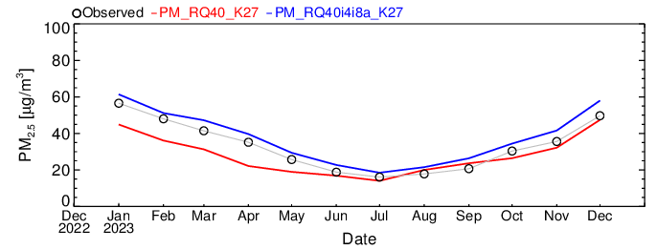
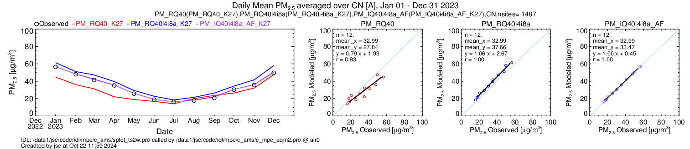
Comparison of Observed and Simulated PM_{2.5} Concentrations in China for 2023
Upwind (China)
― EI-based ― Adjusted_Up
EI-based
Adjusted_Up
Over-estimate
MB: -5.2 ㎍/㎥
MB: 4.7 ㎍/㎥
Notes:
그 결과 배출량은 이런식으로 산정이 되었고 농도는 이렇게 되었다.

Slide 24
Comparison of Observed and Simulated PM_{2.5} Concentrations in China for 2023
Upwind (China)
― EI-based ― Adjusted_Up ― Adjusted_Up2
The overestimation of PM_{2.5} has been reduced
EI-based
Adjusted_Up
Adjusted_Up2
Over-estimate
MB: -5.2 ㎍/㎥
MB: 4.7 ㎍/㎥
MB: 0.5 ㎍/㎥
Notes:
그 결과 배출량은 이런식으로 산정이 되었고 농도는 이렇게 되었다.

Slide 25
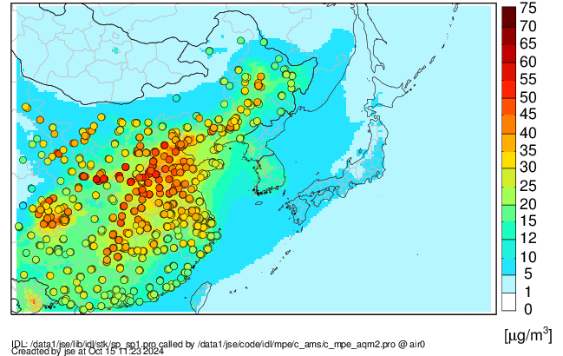
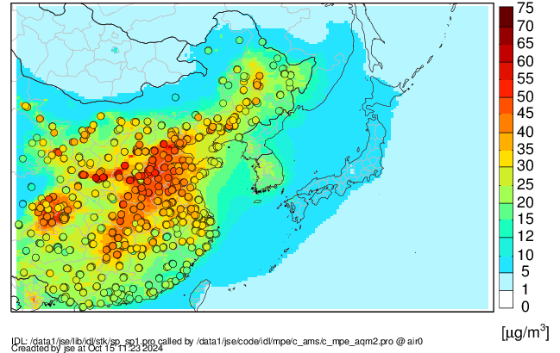
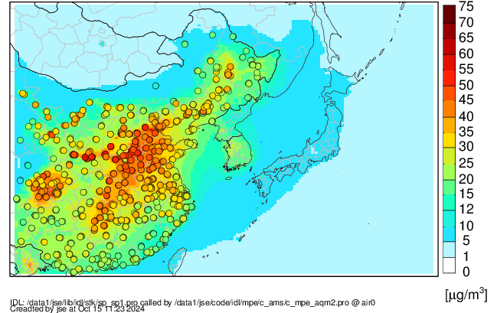
Comparison of Observed and Simulated PM_{2.5} Concentrations in China for 2023
Upwind (China)
EI-based
Adjusted_Up
Adjusted_Up2
Under-estimations
Over-estimations
The simulated PM2.5 concentrations using adjusted emissions were more similar to observed values in high PM2.5 regions compared to the EI-based approach.
The spatial distribution in the simulation, referred to as Adjusted_Up2, was more consistent with the observations

Slide 26
Conclusions
We developed emission adjustment methods based on ground observations in both upwind and downwind areas of Northeast Asia.
After adjusting the emissions, the simulated gaseous and particulate matter concentrations more closely matched the observations.
However, the simulated PM_{2.5} concentrations were initially overestimated compared to the observed values.
Next Steps
While the current focus has been on aligning PM_{2.5} mass concentrations using primary PM_{2.5} emissions, the next step is to apply an approach aimed at adjusting the PM_{2.5} component concentrations.

