Slide 1
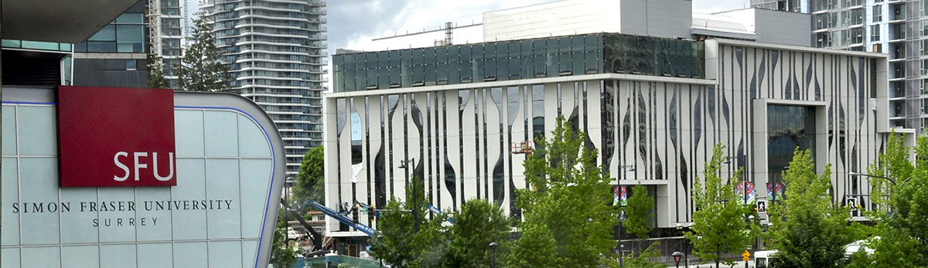
Using Machine Learning to Enhance on-road Fleet Composition input for Mobile Source Emissions Inventory
Maha Shehadeh¹, Vahid Hosseini ²
¹ PhD Student
² Associate Professor
School of Sustainable Energy Engineering, Simon Fraser University,
Vancouver, BC, Canada
CMAS Conference 2024
October 21-23
UNC Friday Center, Chapel Hill, NC, USA

Slide 2

Outlines
Project overview
Introduction
Motivation
Base case description
Research Methodology
Results and Future Work

Slide 3
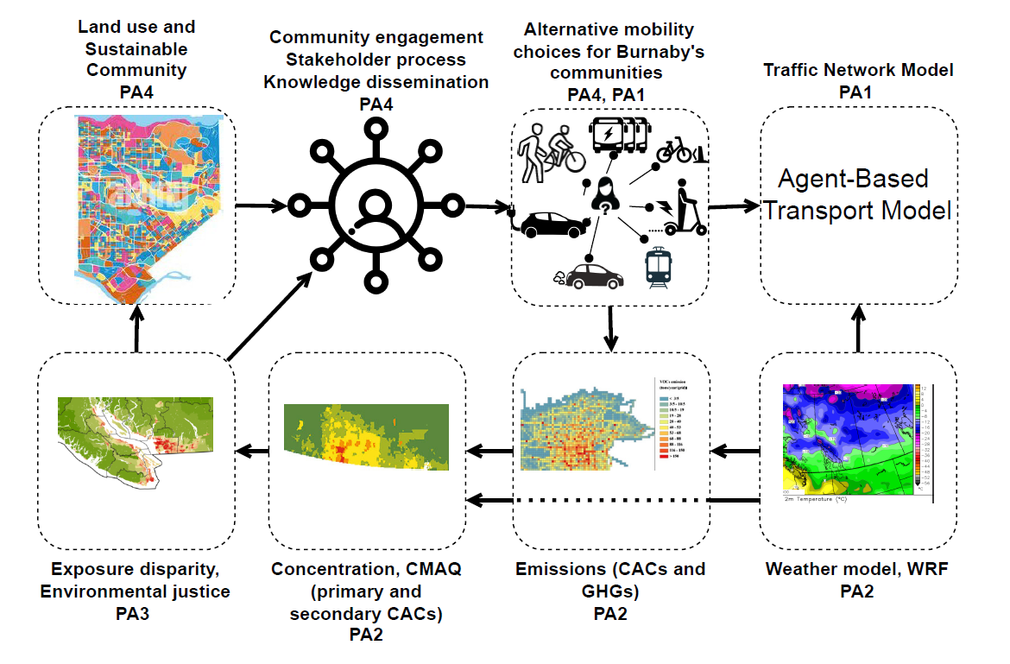




The overarching Project
Community-centred Alternative Urban Transportation Decarbonization Pathways
Looking at paths that are geared towards reducing VmT
Environmental justice and equity is a key element
Funded by the Natural Sciences and Engineering Research Council of Canada (NSERC)
~$1 m, 4 years , 2023-2027

Slide 4
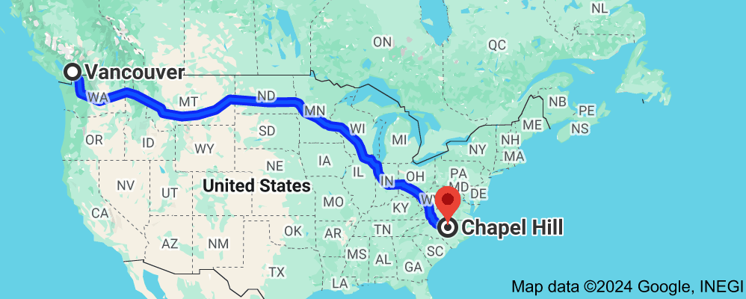
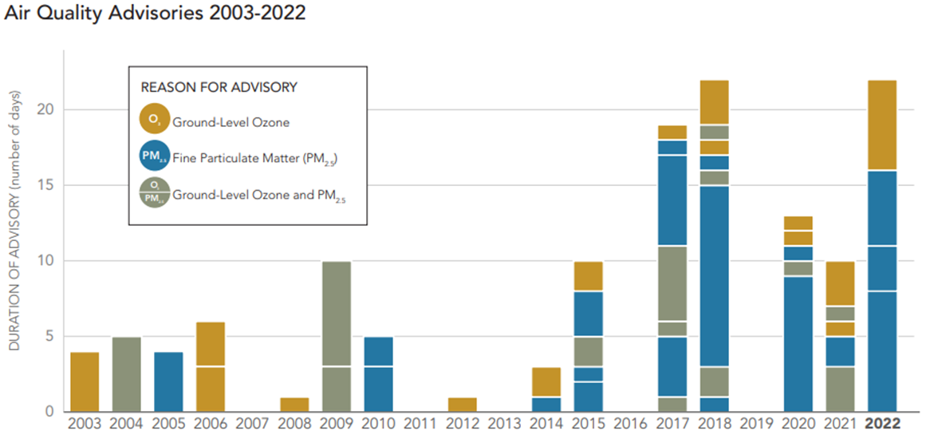
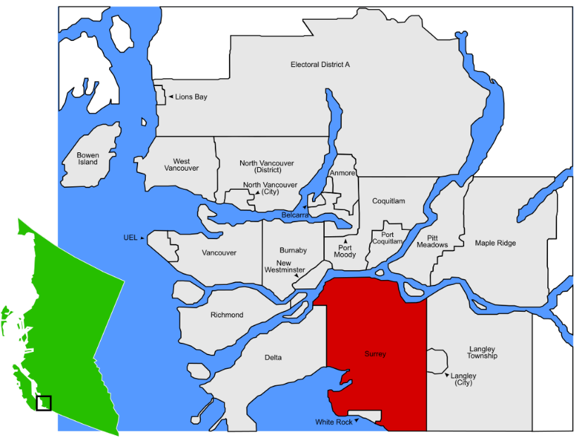
Study Area – City of Surrey
City of Surrey is the largest by land area and 2nd most populated in Metro Vancouver.
Metro Vancouver issues multiple AQ advisories each year. (Annual AQ report 2022)
Heavy-duty vehicles (HDVs) disproportionately contribute to the creation of air pollutants

Slide 5
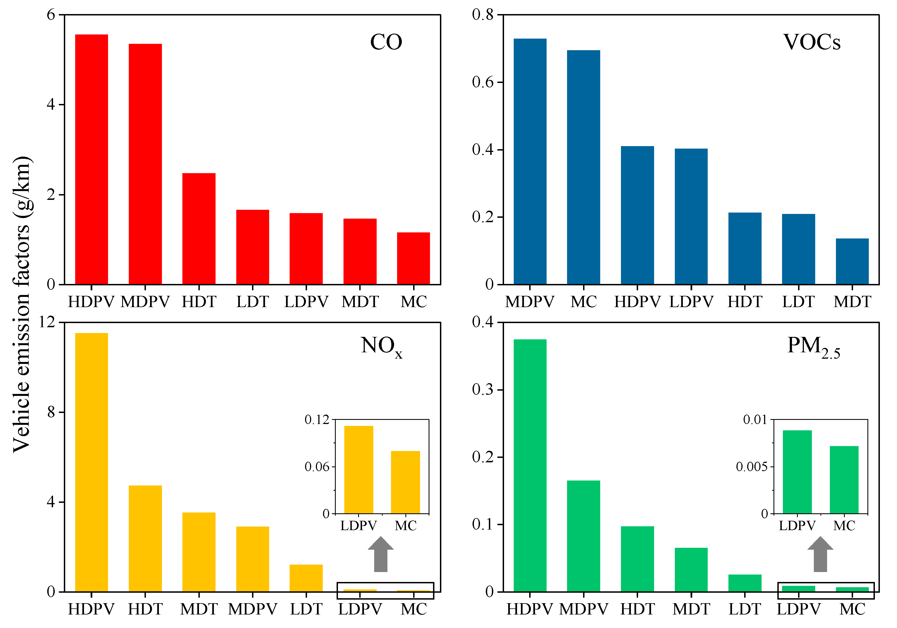
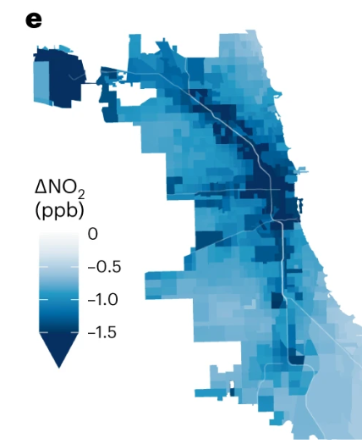
Motivation and Objectives
Impacts of Increased Heavy-Duty Vehicles (HDVs)
Higher Emissions:
  Streets with a higher concentration of HDVs are associated with elevated NOx and PM emissions, contributing to air pollution and adverse health effects in surrounding communities.**
MDA8O₃:
  Reducing NOx emissions, areas that were previously producing more ozone due to NOx could see a reduction in ozone formation through NOx-driven reactions.*
Inequitable Exposure:
  Vulnerable populations living near high-density HDV routes face greater exposure to traffic-related air pollution (TRAP), leading to health disparities.*
Emission factors of different vehicle types in Changzhou Guo et al 2022 **
NO2 attributable mortality rate changes(Chicago II) ,Equity Implications of eHDV adoption Camilleri et al. 2023 *
*Camilleri, S.F., Montgomery, A., Visa, M.A. et al. Air quality, health and equity implications of electrifying heavy-duty vehicles. Nat Sustain 6, 1643–1653 (2023). https://doi.org/10.1038/s41893-023-01219-0
** Guo, M.; Ning, M.; Sun, S.; Xu, C.; Zhang, G.; Zhang, L.; Zhang, R.; Zheng, J.; Chen, C.; Jia, Z.; et al. Estimation and Analysis of Air Pollutant Emissions from On-Road Vehicles in Changzhou, China. Atmosphere 2024, 15, 192. https://doi.org/10.3390/atmos15020192

Slide 6
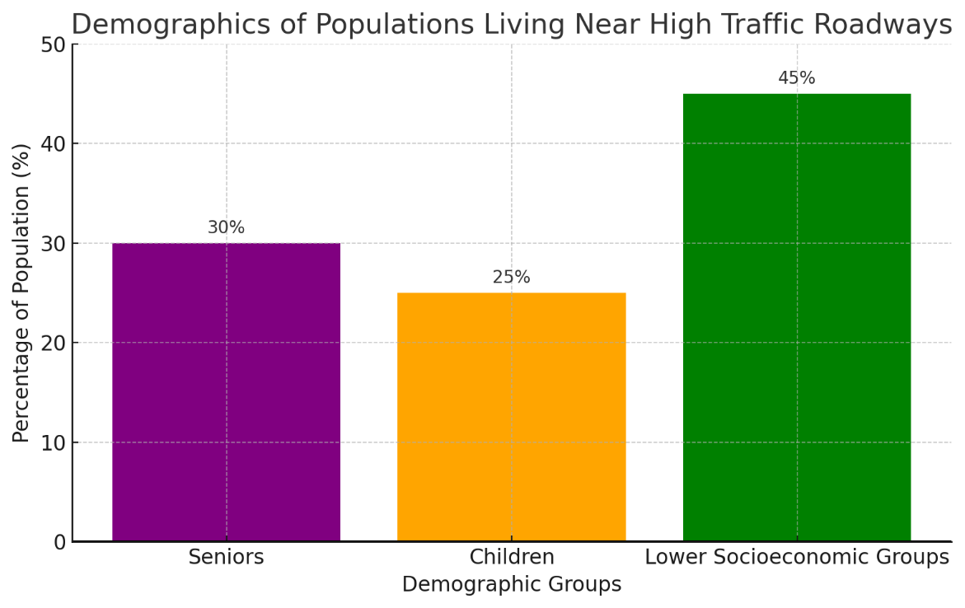
Motivation and Objectives
Fleet composition distribution is crucial for ensuring accurate data outputs and fostering social justice.
Key Health Impacts of TRAP, according to Health Canada* :
Premature Deaths:
  1,200 premature deaths annually
  210,000 asthma symptom days annually
  2.7 million acute respiratory symptom days annually
  Estimated cost of health impacts: $9.5 billion per year
Population Exposure:
40% of Canadians live within 250 metres of a high traffic roadway
  Includes highways, major roads, expressways, arterial roads
https://www.canada.ca/en/health-canada/services/air-quality/outdoor-pollution-health/traffic-related.html

Slide 7







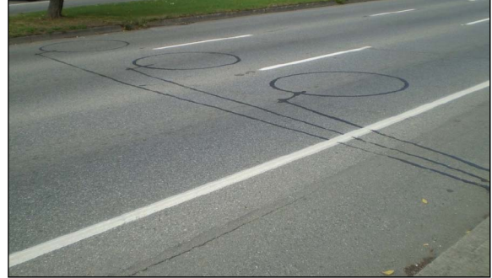
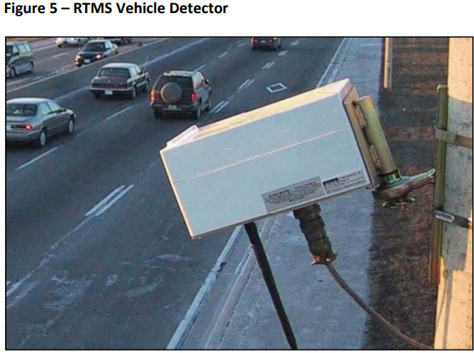
Research Questions
Primary Question
What is the impact of transportation decarbonization pathways on near-road air quality and environmental justice in communities?
Focus of This Work
How to use data to enhance the inhomogenity of the mobile source emission inventory?
Contribution
Develop a data collection methodology for fleet composition input data
TransLink
Metro Vancouver
BC Gov.Highway
Municipalities

Slide 8
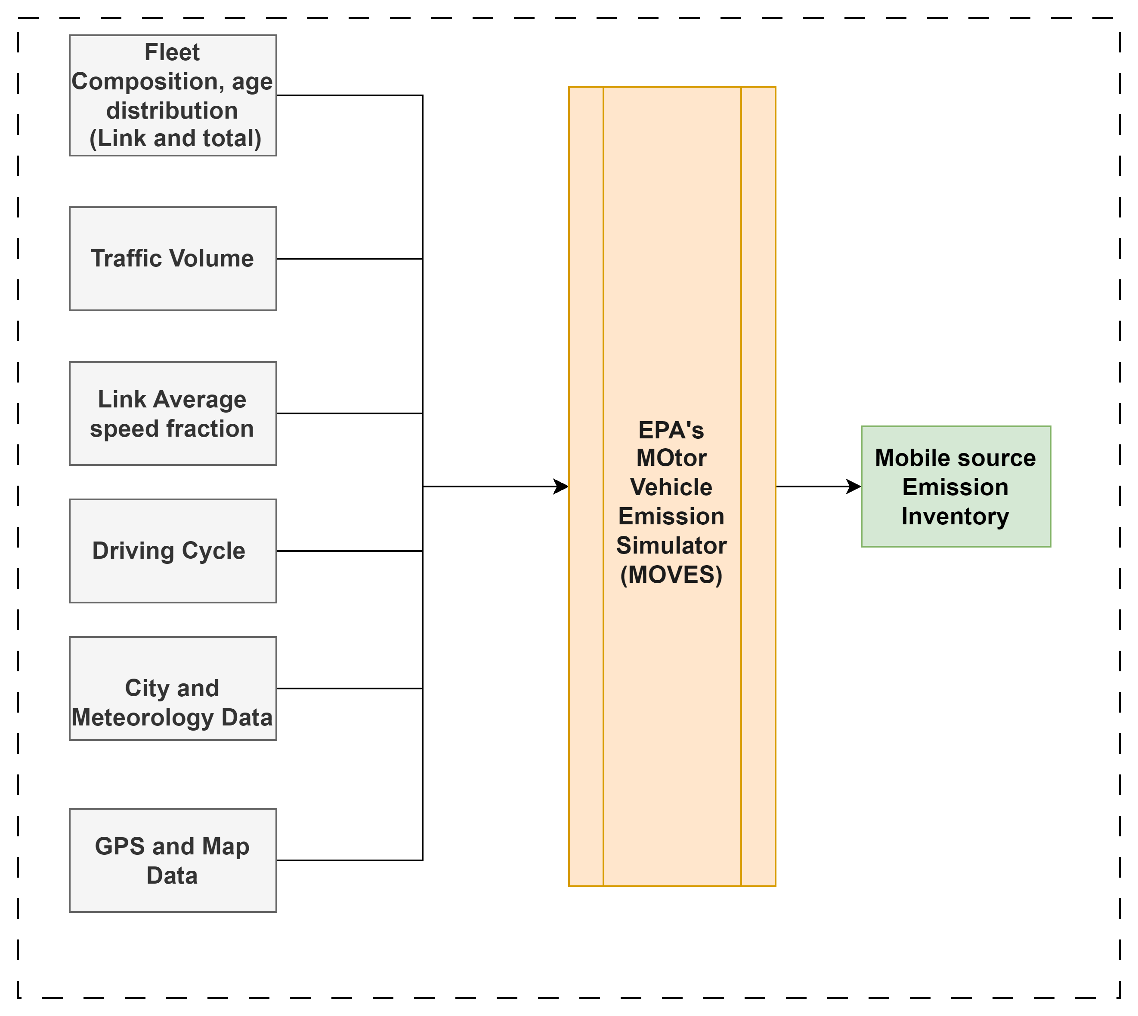

MOVES Configurations
Time Domain | 1 hour – SEPT 2024
Volume | AADT – 2461 links
Fuel | ICBC Insurance -Surrey
AGE | ICBC Insurance -Surrey
Speed | Posted Speed
Driving cycle | MOVES default
Process | Running Exhaust
Run | Project Scale
Notes:
Accurate input data is crucial for using the MOVES (Motor Vehicle Emission Simulator) model developed by the EPA to produce reliable emissions inventories for on-road vehicles. This is because MOVES uses these inputs to estimate emissions at various levels (national, county, and project) for criteria air pollutants, greenhouse gases, and air toxics. If the input data on vehicle types, usage patterns, fuels, and other factors are incorrect or incomplete, the resulting emissions inventory will not reflect actual on-road conditions, leading to potentially misguided policy decisions and ineffective emissions control strategies.

Slide 9
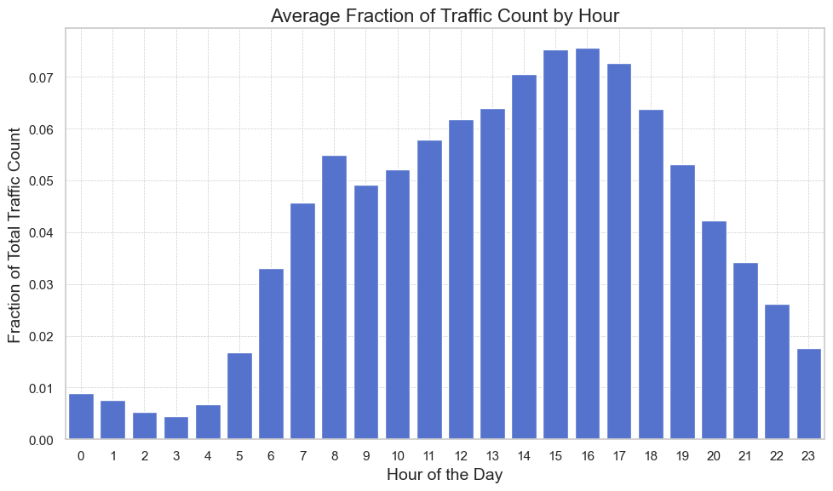
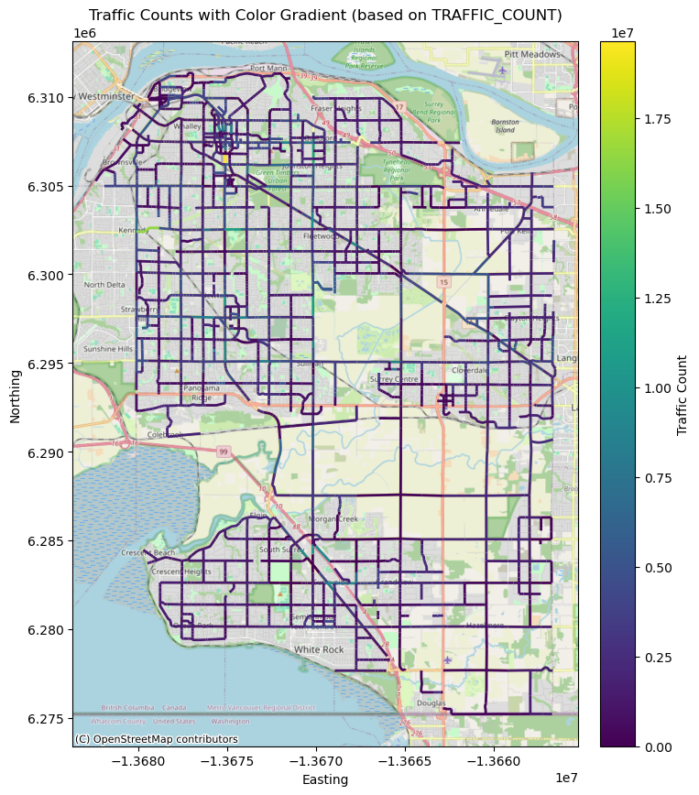
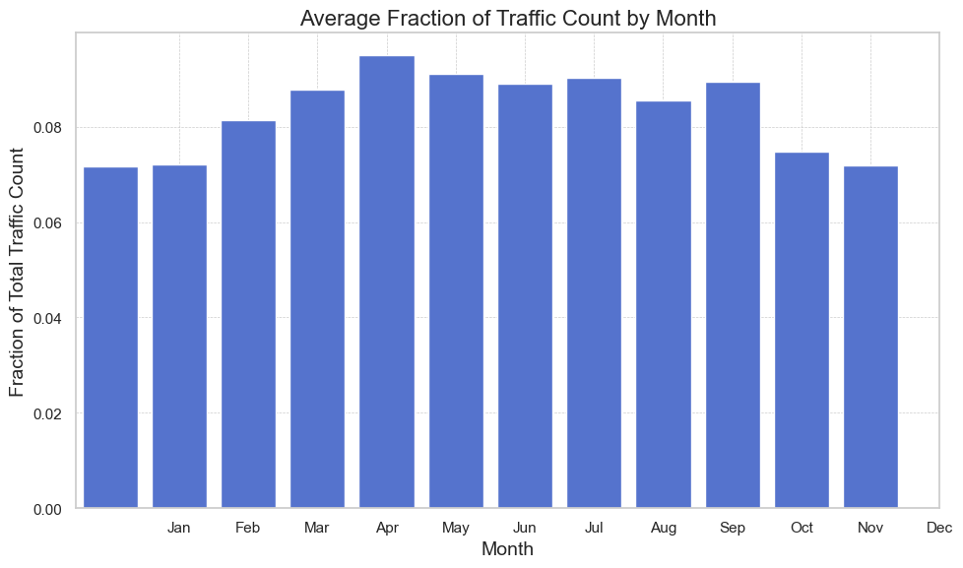
MOVES – AADT – Hourly and Monthly Profiles
Notes:
Accurate input data is crucial for using the MOVES (Motor Vehicle Emission Simulator) model developed by the EPA to produce reliable emissions inventories for on-road vehicles. This is because MOVES uses these inputs to estimate emissions at various levels (national, county, and project) for criteria air pollutants, greenhouse gases, and air toxics. If the input data on vehicle types, usage patterns, fuels, and other factors are incorrect or incomplete, the resulting emissions inventory will not reflect actual on-road conditions, leading to potentially misguided policy decisions and ineffective emissions control strategies.

Slide 10
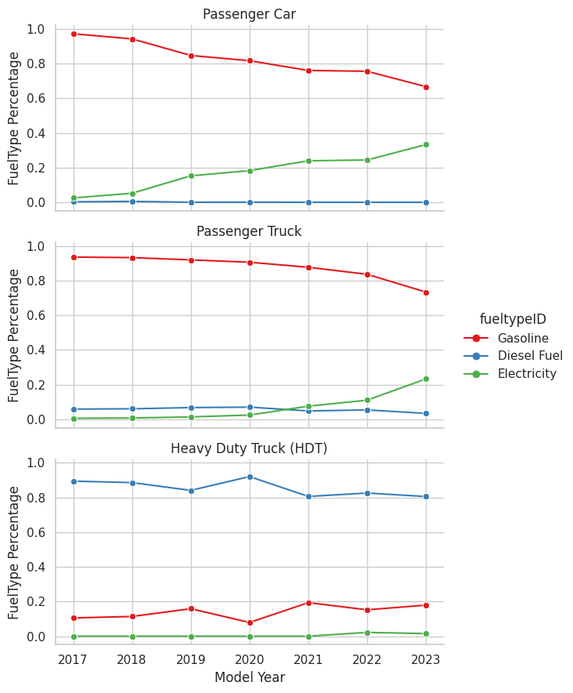
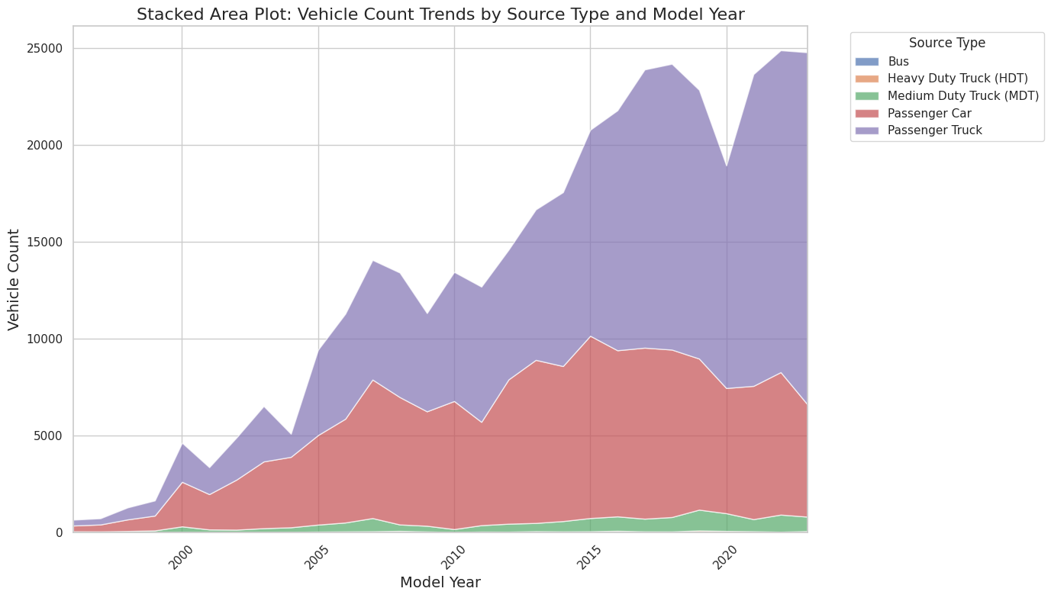
Existing Fleet -Insurance Data
Fuel Type
Source Type
Notes:
This stacked area plot shows the trends in vehicle counts for different source types (e.g., Passenger Car, Transit Bus, Heavy Duty Truck) over the years, from the earliest model years up to 2023. It provides a clear view of the fleet's composition changes and how each vehicle source type contributes over time.

Slide 11
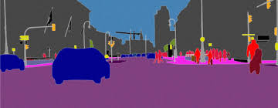
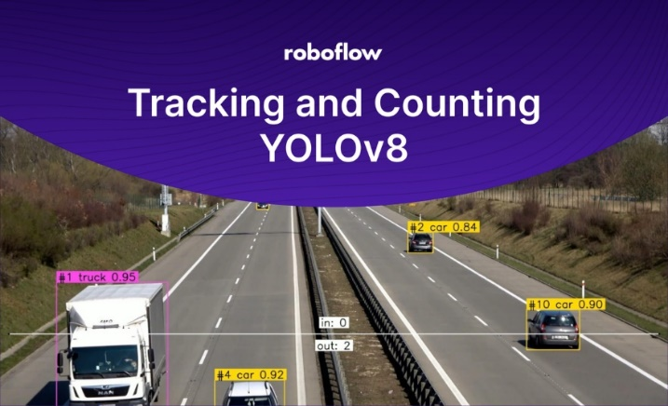
Computer Vision and Object Detection Models
How can we enhance fleet composition link-based input data?
Homogeneous Fleet Composition
insurance policies (ICBC)
SourceType Fraction
Computer Vision and Object Detection Models
Edit Fleet Comp. based on Street Cameras
“Track and Count Objects Using YOLOv8,” Roboflow Blog. Accessed: Oct. 04, 2024. [Online]. Available: https://blog.roboflow.com/yolov8-tracking-and-counting/
M. Cordts et al., “The Cityscapes Dataset for Semantic Urban Scene Understanding,” in 2016 IEEE Conference on Computer Vision and Pattern Recognition (CVPR), Las Vegas, NV, USA: IEEE, Jun. 2016, pp. 3213–3223. doi: 10.1109/CVPR.2016.350.
Notes:
There has been a rising interest in developing computer vision models for vehicle detection and classification. To
train such models, different datasets have been compiled and made available for public use, such as the COCO
(Lin, et al., 2014) and Cityscapes (Cordts, et al., 2019) datasets.

Slide 12
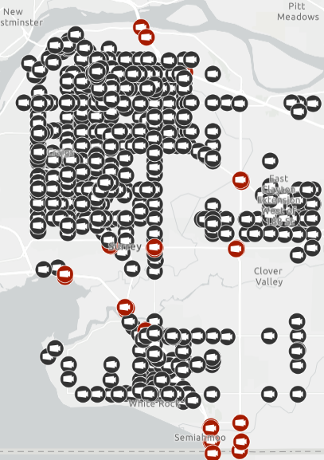

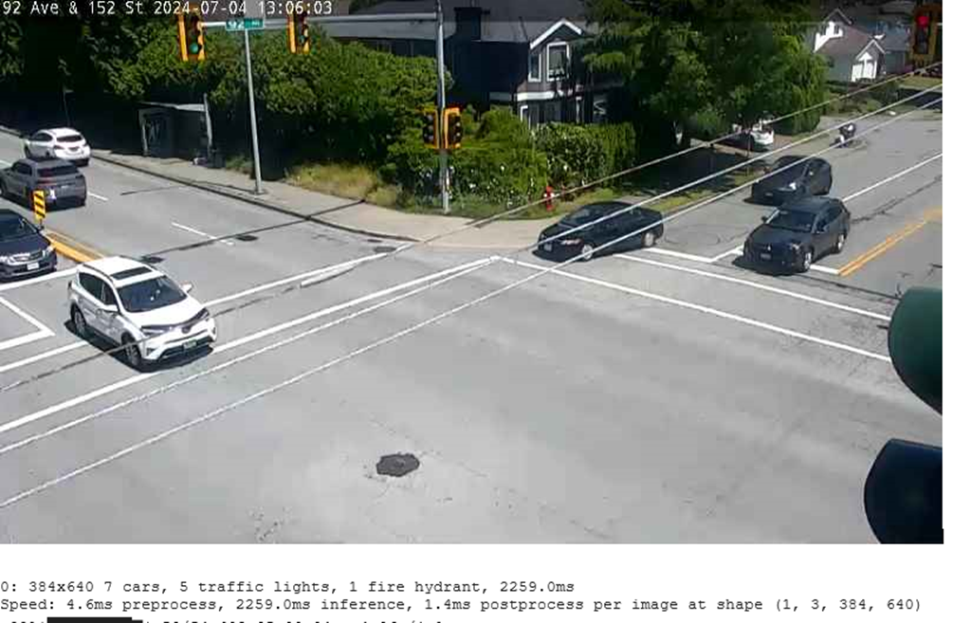
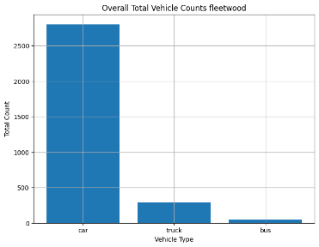
Methodology
Data Acquisition
Model Initialization
Data Aggregation and Analysis
Image Processing
Image URLs from traffic cameras located in the study area
The YOLOv8 model, pre-trained for object detection tasks, was utilized to identify and classify vehicles within the images
identify and count cars, buses and trucks
Generate hourly total vehicle counts and to visualize temporal trends in traffic patterns
Notes:
Methodology:
To enhance the accuracy of vehicle emissions inventories, we developed a system for monitoring and analyzing traffic data through machine learning and optical character recognition (OCR). The system leverages publicly available traffic camera images to estimate vehicle counts and extract relevant text data, which is crucial for understanding fleet composition in urban environments. The following steps outline the methodology implemented:

Slide 13
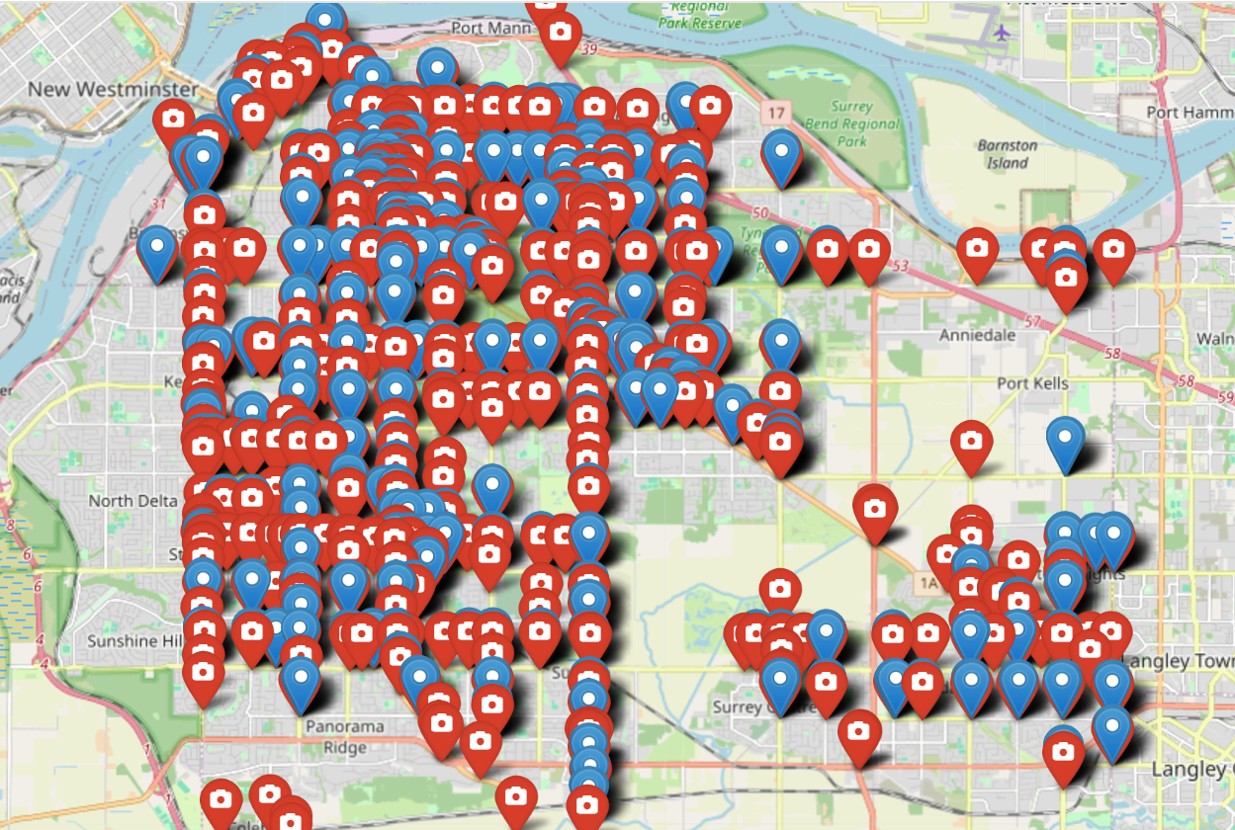
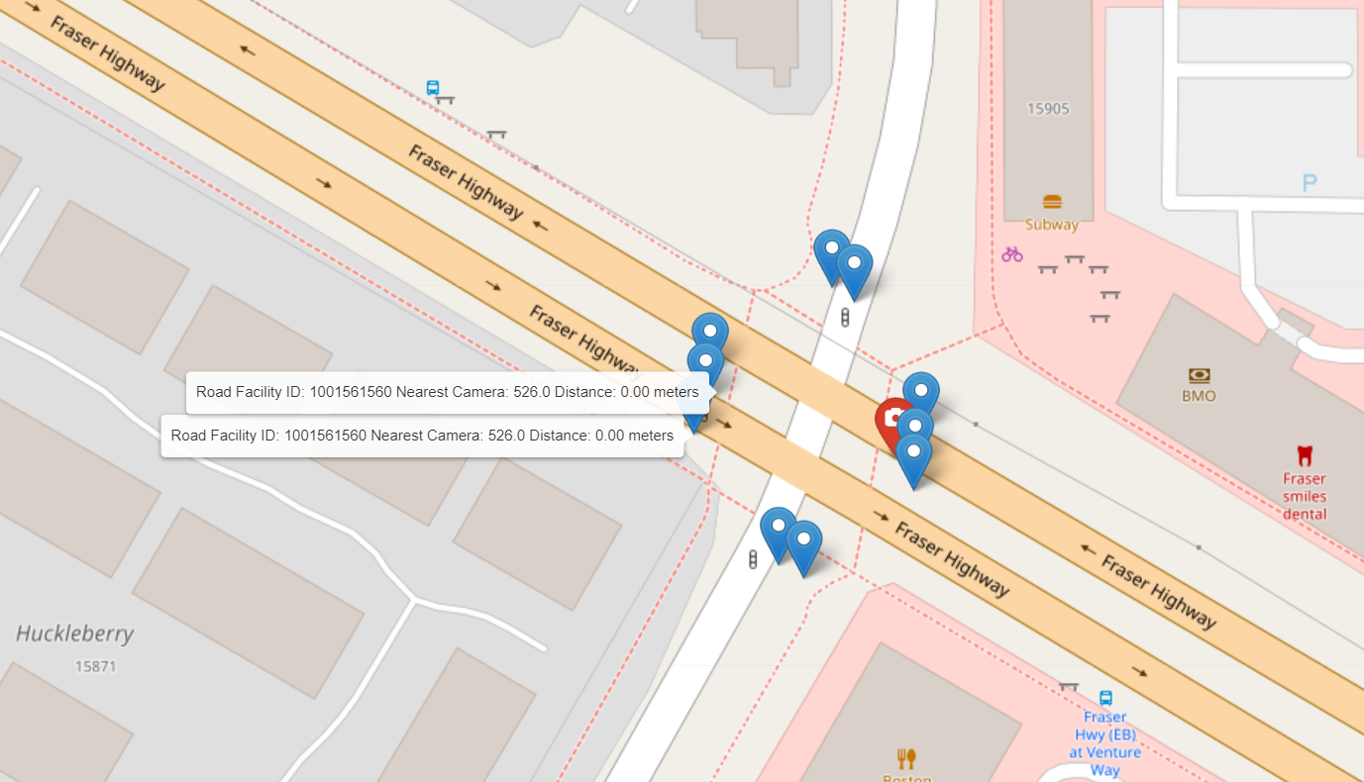
Find the closest camera for each road_facilityid
Calculate Nearest Cameras:
Use spatial operations to identify the nearest camera for each road segment.
Create a Visualization Map:
Use geopandas to visualize the camera locations and their associated road segments.
Color Code Associations:
Assign roads to cameras using the grid method then aggregate link-based emissions for each subdivision
Notes:
The code:
import geopandas as gpd
import pandas as pd
from scipy.spatial import cKDTree
from shapely.geometry import Point
import folium
# Step 1: Load the Data
cameras_df = pd.read_csv("cameras.csv") # Assuming cameras data in CSV
roads_gdf = gpd.read_file("roads.json") # Read road data from JSON
# Convert 'latitude' and 'longitude' columns to numeric values for camera data
cameras_df['longitude'] = pd.to_numeric(cameras_df['longitude'], errors='coerce')
cameras_df['latitude'] = pd.to_numeric(cameras_df['latitude'], errors='coerce')
# Drop rows with missing longitude or latitude values
cameras_df = cameras_df.dropna(subset=['longitude', 'latitude'])
# Step 2: Create Geometries for Cameras and Roads
cameras_gdf = gpd.GeoDataFrame(cameras_df, geometry=gpd.points_from_xy(cameras_df['longitude'], cameras_df['latitude']))
cameras_gdf = cameras_gdf.set_crs(epsg=4326) # Set CRS to WGS84
roads_gdf = roads_gdf.set_crs(epsg=4326) # Ensure CRS is consistent
# Step 3: Find the Nearest Camera for Each Road
# Create a cKDTree for camera points
camera_coords = cameras_gdf.geometry.apply(lambda geom: (geom.x, geom.y)).tolist()
camera_tree = cKDTree(camera_coords)
# Find the nearest camera for each road segment based on its centroid
roads_gdf['centroid'] = roads_gdf.centroid
road_coords = roads_gdf['centroid'].apply(lambda geom: (geom.x, geom.y)).tolist()
distances, camera_indices = camera_tree.query(road_coords, k=1) # k=1 means the closest point
# Get the nearest camera geometries and details
nearest_cameras = cameras_gdf.iloc[camera_indices].reset_index(drop=True)
roads_gdf['nearest_camera_id'] = nearest_cameras['camera_id']
roads_gdf['distance_to_camera'] = distances
# Step 4: Visualize Using Folium
# Initialize the folium map centered around the mean of road geometries
mean_coords = [roads_gdf['centroid'].y.mean(), roads_gdf['centroid'].x.mean()]
m = folium.Map(location=mean_coords, zoom_start=12)
# Add roads to the map
for _, road in roads_gdf.iterrows():
folium.GeoJson(
road['geometry'],
style_function=lambda feature: {'color': 'blue', 'weight': 2},
tooltip=f"Road Facility ID: {road['road_facilityid']}\nNearest Camera: {road['nearest_camera_id']}\nDistance: {road['distance_to_camera']:.2f} meters"
).add_to(m)
# Add cameras to the map with different colors
for _, camera in cameras_gdf.iterrows():
folium.Marker(
location=[camera.geometry.y, camera.geometry.x],
popup=f"Camera ID: {camera['camera_id']}",
icon=folium.Icon(color='red', icon='camera', prefix='fa')
).add_to(m)
# Save the map as an HTML file
m.save("cameras_roads_association_map.html")
--------------------------------------------------------------------------------
import pandas as pd
import geopandas as gpd
from shapely.geometry import Point
from scipy.spatial import cKDTree
# Step 1: Load GIS data
cameras_df = pd.read_csv("cameras.csv") # Use pandas to inspect the data first
roads_df = gpd.read_file("roads.json") # Read the JSON file for roads
# Check the column names
print("Columns in cameras_df:", cameras_df.columns)
# Step 2: Ensure latitude and longitude are numeric
# Convert columns to numeric, forcing errors to NaN
cameras_df['longitude'] = pd.to_numeric(cameras_df['longitude'], errors='coerce')
cameras_df['latitude'] = pd.to_numeric(cameras_df['latitude'], errors='coerce')
# Drop rows with NaN values in 'longitude' or 'latitude'
cameras_df = cameras_df.dropna(subset=['longitude', 'latitude'])
# Create geometries for cameras
cameras_df['geometry'] = gpd.points_from_xy(cameras_df['longitude'], cameras_df['latitude'])
cameras_gdf = gpd.GeoDataFrame(cameras_df, geometry='geometry')
# Ensure both GeoDataFrames have the same CRS
cameras_gdf = cameras_gdf.set_crs(epsg=4326)
roads_df = roads_df.set_crs(epsg=4326)
# Step 3: Associate cameras with the nearest road
def nearest_neighbor(gdf_a, gdf_b):
# Function to find the nearest geometry in gdf_b for each point in gdf_a
b_coords = gdf_b.geometry.apply(lambda geom: (geom.centroid.x, geom.centroid.y)).tolist()
a_coords = gdf_a.geometry.apply(lambda geom: (geom.x, geom.y)).tolist()
# KDTree for fast spatial lookup
btree = cKDTree(b_coords)
dist, idx = btree.query(a_coords, k=1)
# Return the associated road segment and distance
return gdf_b.iloc[idx].reset_index(drop=True), dist
# Find nearest roads for cameras
nearest_roads, distances = nearest_neighbor(cameras_gdf, roads_df)
# Step 4: Combine results
cameras_gdf['nearest_road'] = nearest_roads['ROAD_FACILITYID'] # Assuming roads have 'road_id'
cameras_gdf['distance_to_road'] = distances
# Step 5: Save the results
cameras_gdf.to_csv("camera_road_associations.csv", index=False)
# Print some results
print(cameras_gdf[['cameranumber', 'nearest_road', 'distance_to_road']].head())

Slide 14
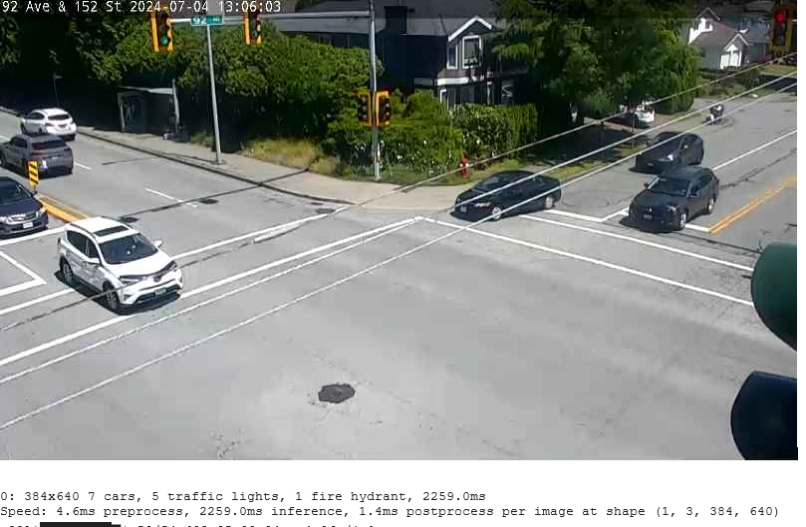
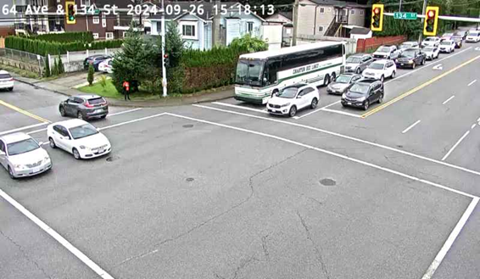
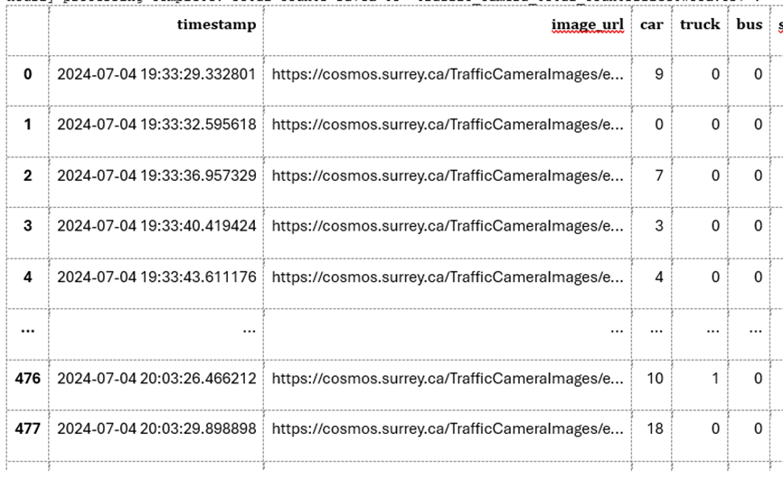
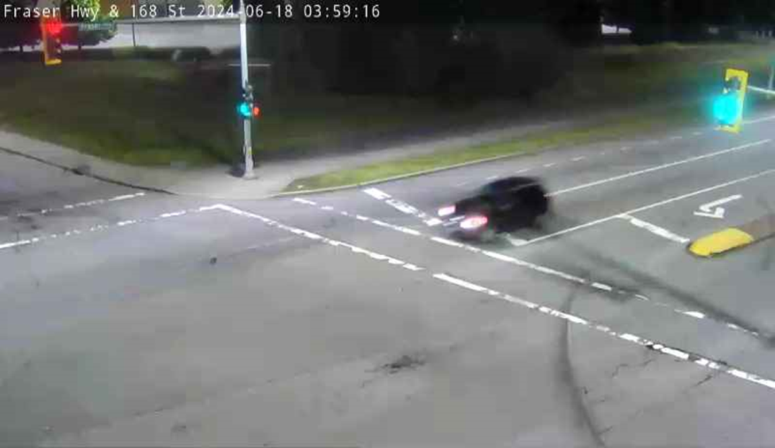
Sample output
*Bad weather /night lights may impact the quality
Notes:
Results from 1 link was first calculated then city wide link based project inventory MOVES run.
Results are then compared with CEEI Transportation Data using Sum of LE ( liter Equivalent ), sum of VKT and total energy.

Slide 15
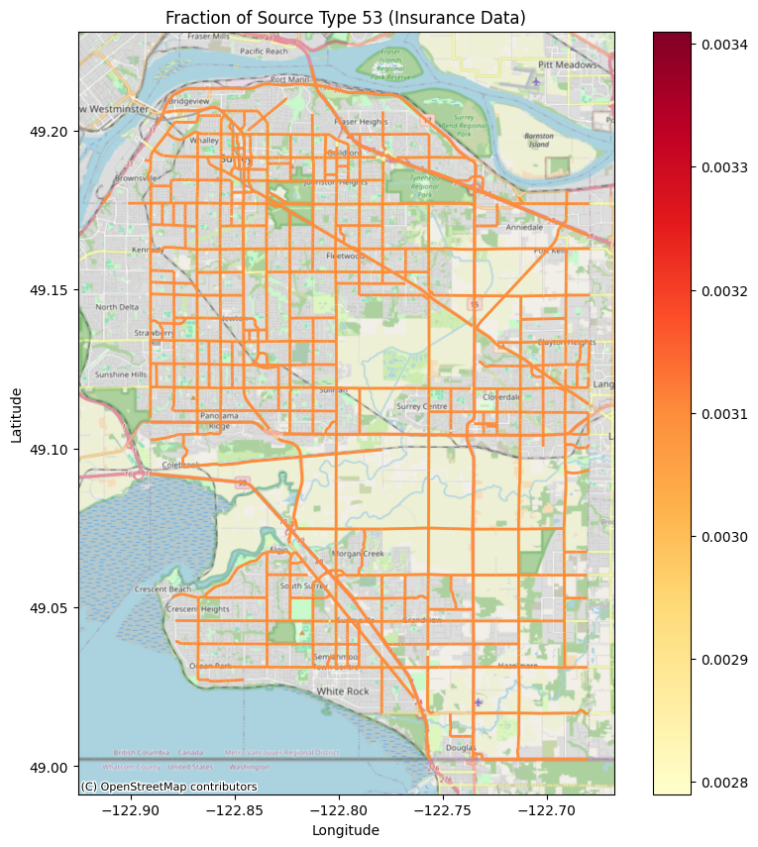
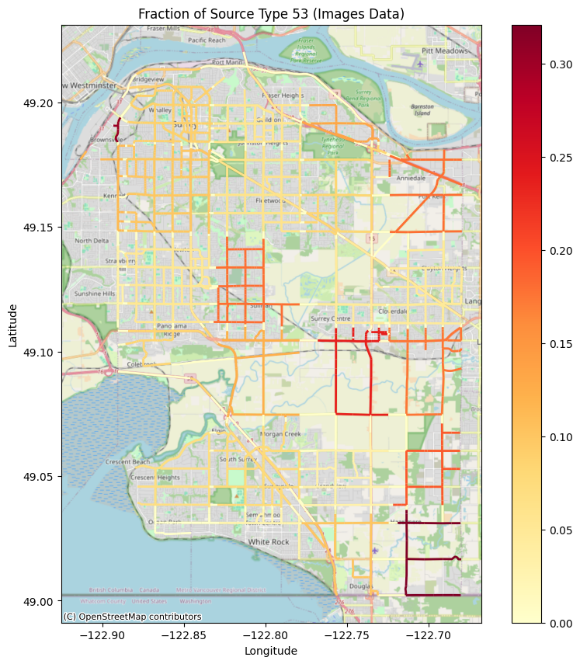
Comparison of fleet composition distribution
Insurance data
Camera data
Notes:
!pip install shapely
import geopandas as gpd
import pandas as pd
from shapely.geometry import Point, box, LineString
import matplotlib.pyplot as plt
import contextily as ctx
import numpy as np
from shapely import wkt # Import the wkt module from shapely
import pyproj
# Define the boundaries of Surrey, BC (approximate coordinates)
surrey_bounds = (-122.94, 49.0, -122.67, 49.22) # (min_long, min_lat, max_long, max_lat)
# Read the camera data with latitude and longitude
camera_df = pd.read_csv('camera.csv')
# Convert the camera data to a GeoDataFrame
geometry = [Point(xy) for xy in zip(camera_df['longitude'], camera_df['latitude'])]
camera_gdf = gpd.GeoDataFrame(camera_df, geometry=geometry, crs="EPSG:4326")
# Clip camera data to Surrey's boundaries
surrey_box = box(*surrey_bounds)
surrey_gdf = camera_gdf[camera_gdf.within(surrey_box)]
# Read the links data
links_df = pd.read_csv('links.csv')
# Convert WKT geometries to GeoDataFrame with the correct CRS
links_df['geometry'] = links_df['wkt_geom'].apply(wkt.loads)
links_gdf = gpd.GeoDataFrame(links_df, geometry='geometry', crs="EPSG:26910") # Assuming UTM Zone 10N
# Transform to EPSG:4326
links_gdf = links_gdf.to_crs("EPSG:4326")
# Clip links data to Surrey's boundaries
links_gdf = links_gdf[links_gdf.within(surrey_box)]
# Divide the area into 30 approximately equal grids
num_grids = 30
cols = int(np.sqrt(num_grids))
rows = int(np.ceil(num_grids / cols))
# Calculate grid sizes
lon_min, lat_min, lon_max, lat_max = surrey_bounds
lon_step = (lon_max - lon_min) / cols
lat_step = (lat_max - lat_min) / rows
# Create the grids and calculate grid centroids
grid_polygons = []
grid_centroids = []
grid_ids = []
grid_id = 1
for i in range(cols):
for j in range(rows):
min_lon = lon_min + i * lon_step
max_lon = lon_min + (i + 1) * lon_step
min_lat = lat_min + j * lat_step
max_lat = lat_min + (j + 1) * lat_step
grid_polygon = box(min_lon, min_lat, max_lon, max_lat)
grid_polygons.append(grid_polygon)
# Calculate centroid
centroid = grid_polygon.centroid
grid_centroids.append((centroid.x, centroid.y))
# Assign grid_id
grid_ids.append(grid_id)
grid_id += 1
# Create a GeoDataFrame for the grid
grid_gdf = gpd.GeoDataFrame({'grid_id': grid_ids, 'geometry': grid_polygons}, crs="EPSG:4326")
# Create a DataFrame for grid GIS info (grid_id, longitude, latitude)
grid_gis_info = pd.DataFrame({
'grid_id': grid_ids,
'longitude': [x for x, y in grid_centroids],
'latitude': [y for x, y in grid_centroids]
})
# Save the grid GIS info to a CSV file
grid_gis_info.to_csv('grid_gis_info.csv', index=False)
print("Saved grid GIS information to 'grid_gis_info.csv'.")
# Plot the grid and camera locations on the map
fig, ax = plt.subplots(1, 1, figsize=(12, 10))
grid_gdf.boundary.plot(ax=ax, color='blue', linestyle='--')
surrey_gdf.plot(ax=ax, color='red', markersize=10, label='Cameras')
# Check if links_gdf is empty before plotting
if not links_gdf.empty:
links_gdf.plot(ax=ax, color='green', linewidth=2, label='Links')
ctx.add_basemap(ax, crs="EPSG:4326", source=ctx.providers.OpenStreetMap.Mapnik)
plt.title("Surrey, BC Camera Locations and Grids")
plt.legend()
plt.show()
# Assign cameras to grids and save each grid's cameras to a separate file
for idx, grid in grid_gdf.iterrows():
# Find cameras within this grid
cameras_in_grid = surrey_gdf[surrey_gdf.within(grid.geometry)]
# Save to a new CSV file if there are cameras in this grid
if not cameras_in_grid.empty:
grid_filename = f'cameras_in_grid_{grid["grid_id"]}.csv'
cameras_in_grid.drop(columns='geometry').to_csv(grid_filename, index=False)
print(f"Saved {len(cameras_in_grid)} cameras to {grid_filename}")
# Find links within this grid
links_in_grid = links_gdf[links_gdf.within(grid.geometry)]
# Save to a new CSV file if there are links in this grid
if not links_in_grid.empty:
links_filename = f'links_in_grid_{grid["grid_id"]}.csv'
links_in_grid.drop(columns='geometry').to_csv(links_filename, index=False)
print(f"Saved {len(links_in_grid)} links to {links_filename}")

Slide 16
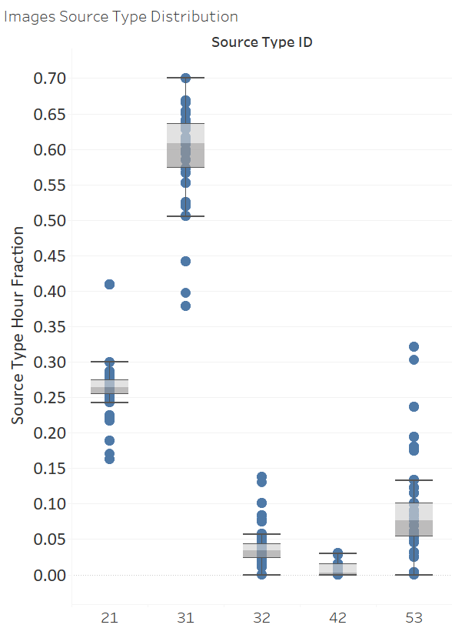
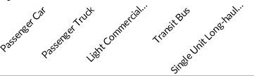
Vehicle Type Distribution

Slide 17
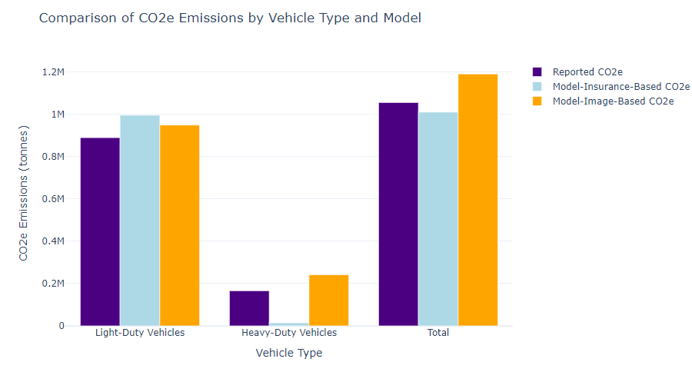
Model Validation: CO2e Reported Vs EI Model
2019 Reported
Reported CO2e data source: City of Surrey, https://climateactiontracker.surrey.ca/background/carbon-pollution-sources#q0
Notes:
Verification data , then Why does that matter?

Slide 18
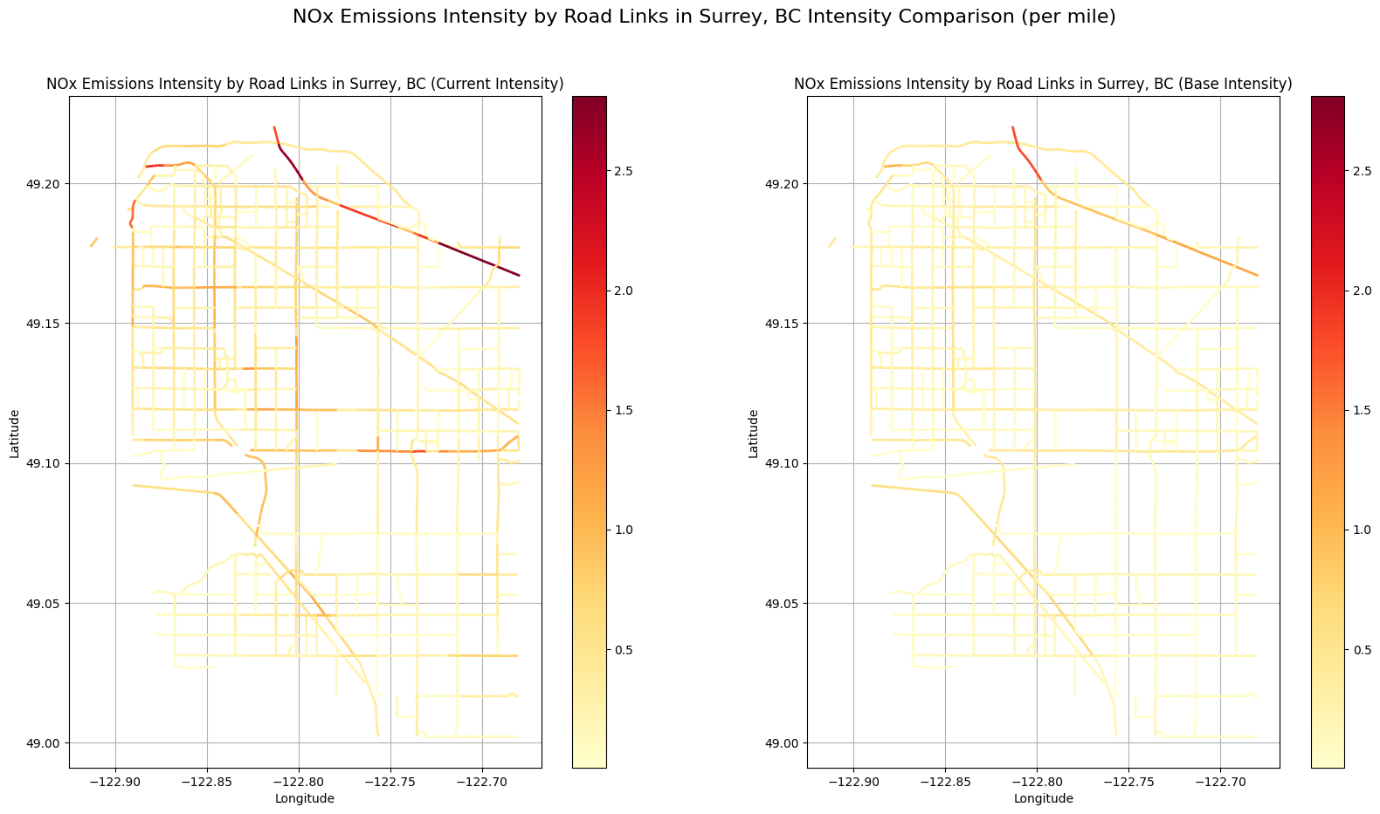
NOx link-based Emission Intensity- kg/mile
Image processing
Insurance data

Slide 19
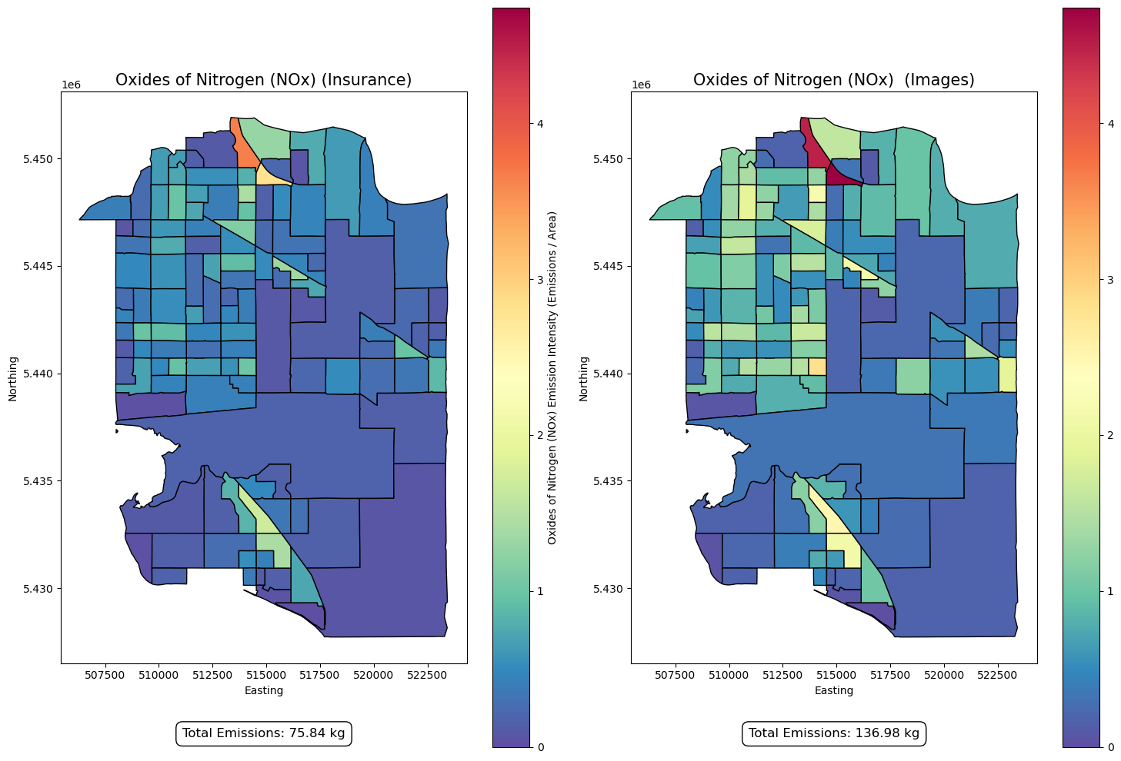
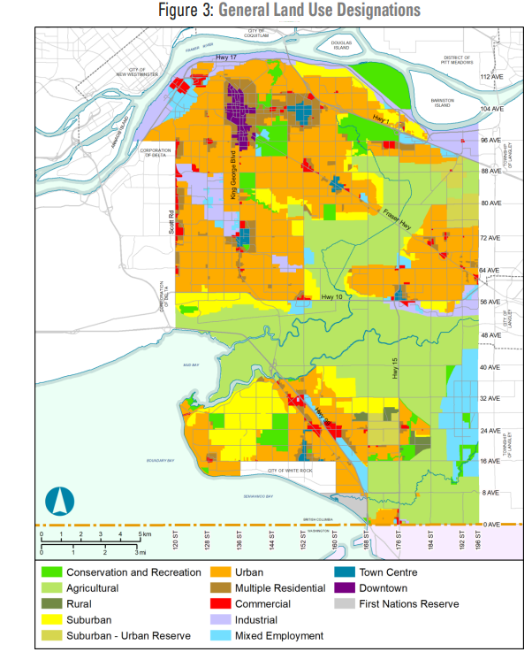
Spatial distribution of NOx - Census Subdivisions
One-hour run, running exhaust only
Surrey BC
https://www.surrey.ca//OCPLandUsesandDensities.pdf

Slide 20
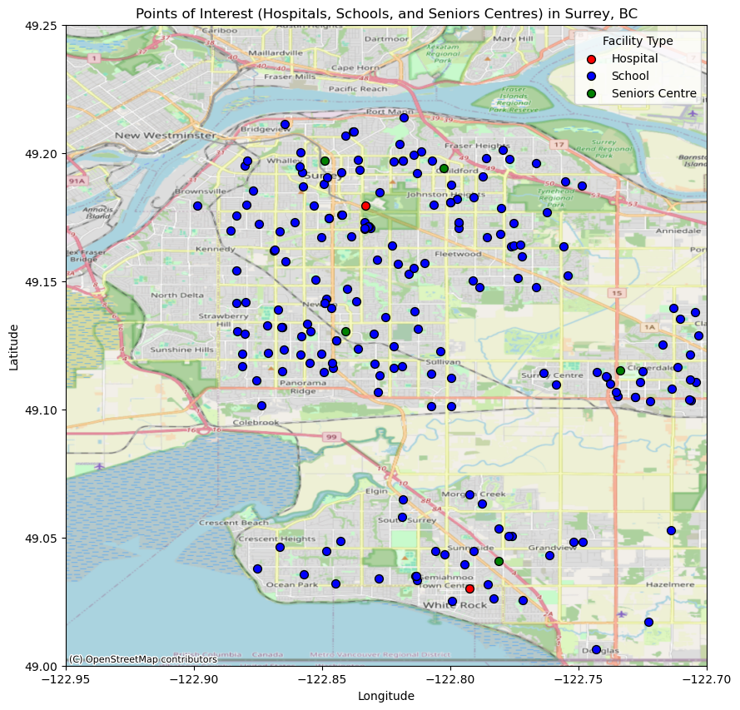
Spatial distribution NOx - POIs
One-hour run, running exhaust only
Surrey BC
https://www.sfu.ca/geog/geog452spring03/group1/surrey.jpg

Slide 21
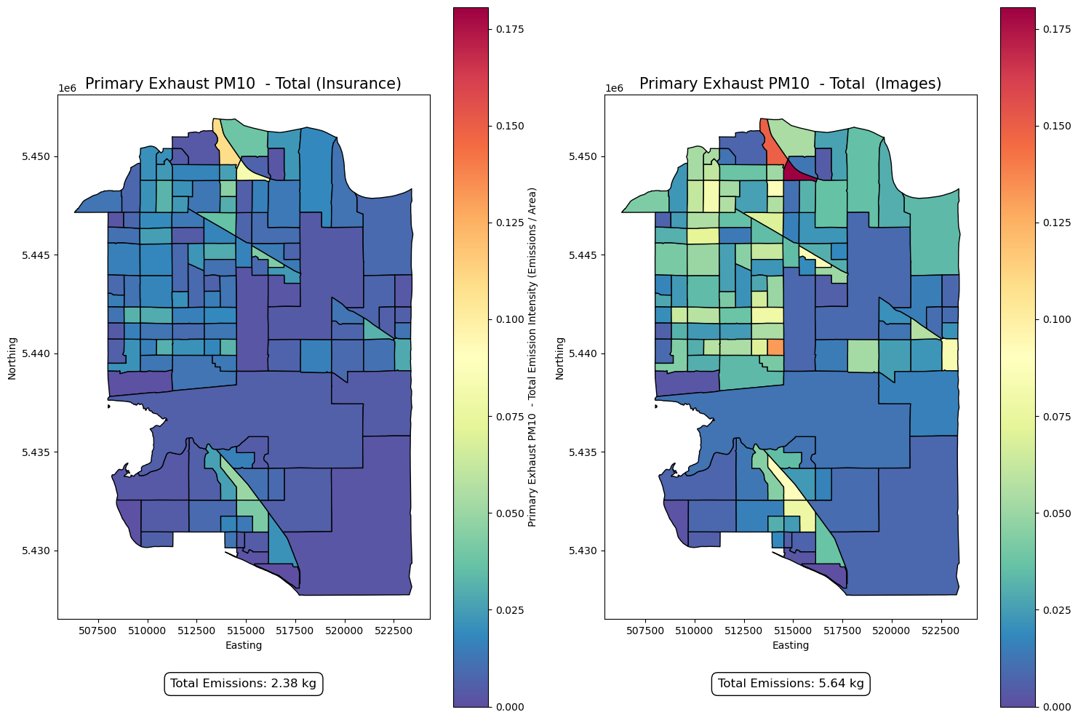
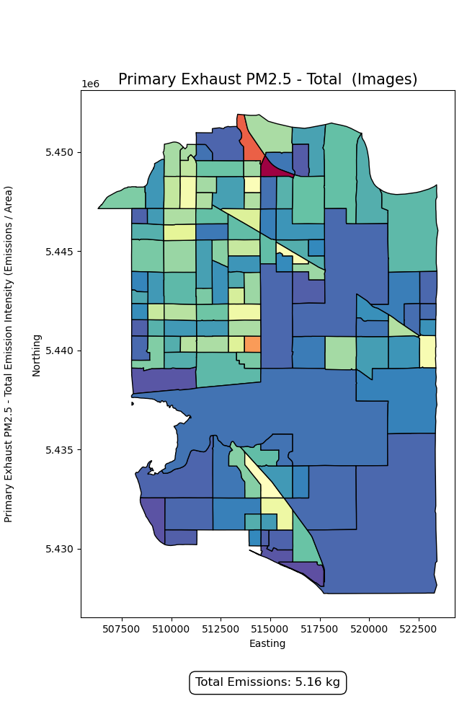
Spatial distribution PM10 and PM2.5
One-hour run, running exhaust only

Slide 22
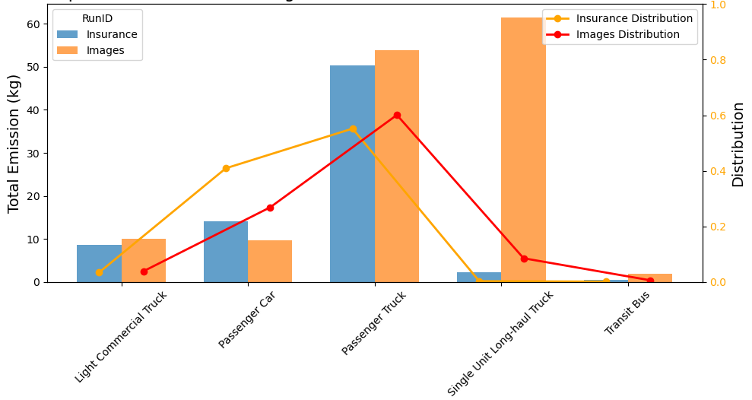
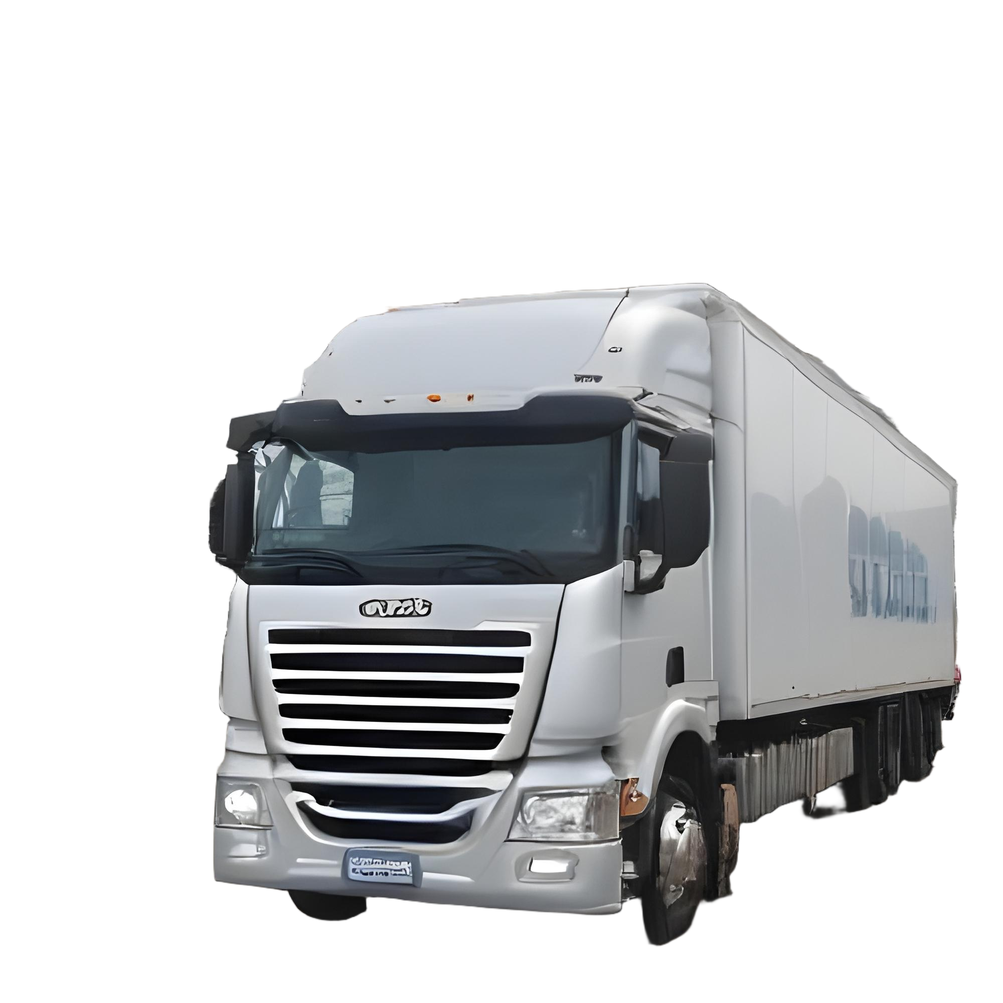
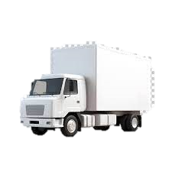
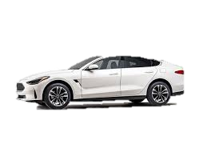
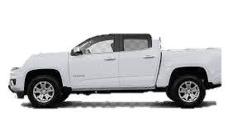
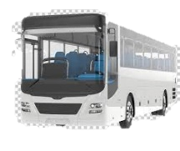
NOx distribution based on fleet

Slide 23
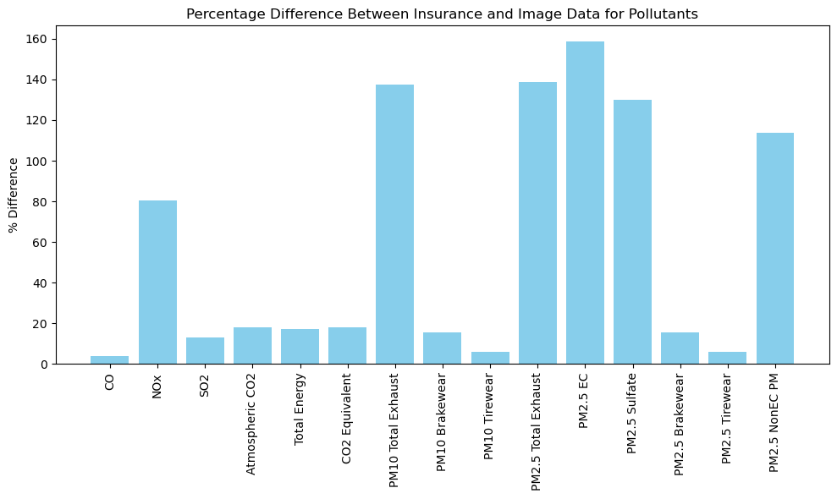
Emissions difference
Homogenous vs. non-homogenous fleet composition distribution
The most significant differences are observed for PM2.5 EC (158.52%), PM2.5 Total Exhaust (138.85%), and NOx (80.62%).
The change in total energy consumption (17.21%) and CO2 equivalent emissions (17.86%) is relatively small compared to the differences in pollutants.

Slide 24
Conclusions
Air quality is directly related to the proximity of emission sources. Different subdivisions in Surrey, Canada are impacted variably by on-road emissions and traffic-related air pollution (TRAP).
Homogeneous fleet distribution for link-based emissions inventory (EI) models is not sufficient to show HDV's impact on drive-through communities. In this study, EI based on non-homogenous image-recognition source type distributions were higher than those based on homogenous insurance data.
Insurance-based data tends to underestimate the contribution of HDVs, potentially overlooking their significant impact on near-road air quality.
The most significant differences are observed for PM2.5 Total Exhaust (138.85%), and NOx (80.62%).
The change in total energy consumption (17.21%) and CO2 equivalent emissions (17.86%) is relatively small compared to the dramatic differences in pollutants like NOx and particulate matter (PM10, PM2.5).

Slide 25

Future Work
We are implementing the fleet recognition toolbox for the pre-processing of MOVES hourly runs.
A MOVES interface is under development to capture this, as well as many other pre-processing needs (high emitters, impact of extreme cold): the Canadian Urban Transportation Emission Calculator (CUTEC), which will be released in 2024.
An agent-based traffic model is developed to be coupled with MOVES. A mobility survey was conducted to understand transportation mode distribution.
The emission model is coupled to CMAQ to gain insight on community-level pollutant.

Slide 26

Acknowledgments
Financial support of the Government of Canada (Natural Sciences and Engineering Research Council of Canada ), project ALLRP 577085-2022.
Research collaborators: Mahmudur Fatmi and Amanda Giang (UBC), Alison Shaw and Chris Buse (SFU)
Research team
Questions?
Maha Shehadeh: maha_shehadeh@sfu.ca
https://www.sfu.ca/see/research/sustainable-urban-transportation.html

