Slide 1

2024 PM NAAQS: Overview and Modeling Considerations
23rd Annual CMAS Conference
21-23 October 2024
Chapel Hill, NC USA
James T Kelly
US Environmental Protection Agency
Office of Air Quality Planning & Standards
Research Triangle Park, NC USA

Slide 2
Purpose
Provide an overview of the 2024 PM NAAQS decision and consider PM_{2.5} data and modeling to understand drivers of elevated PM_{2.5} concentrations and technical needs under the new standard
Outline
Overview of the PM NAAQS rule
Recent trends in PM_{2.5}
Regulatory Impact Analysis (RIA) model projections
Examples of projected exceedance areas
Future analytic directions

Slide 3
I. Overview of the PM NAAQS Rule

Slide 4
Main Elements of the PM NAAQS Final Decision
On Feb. 7, 2024, EPA strengthened the National Ambient Air Quality Standards for Particulate Matter (“PM NAAQS”) to protect millions of Americans from harmful and costly health impacts, such as heart attacks and premature death.
EPA strengthened the level of the primary (health-based) annual standard for fine particles (PM_{2.5}) to 9.0 micrograms per cubic meter (µg/m³) to reflect the latest available health science.
EPA did not change all other PM standards:
  The primary (health-based) and secondary (welfare-based) 24-hour PM_{2.5} standards stay at the level of 35 µg/m³
  The primary and secondary 24-hour PM₁₀ standards stay at level of 150 µg/m³
  The secondary annual PM_{2.5} standard stays at the level of 15.0 µg/m³
EPA also:
  Revised the Air Quality Index (AQI) to improve public communications about the risks from PM_{2.5} exposures
  Made changes to the monitoring network to enhance protection of air quality in communities overburdened by air pollution
Primary (Health-Based) PM_{2.5} Standard
NAAQS Decision | Annual (μg/m³) | 24-hr (μg/m³)
1997 | 15 | 65
2006 | 15* | 35
2012 | 12 | 35*
2020 | 12* | 35*
2024 | 9 | 35*
*Retained, without revision

Slide 5
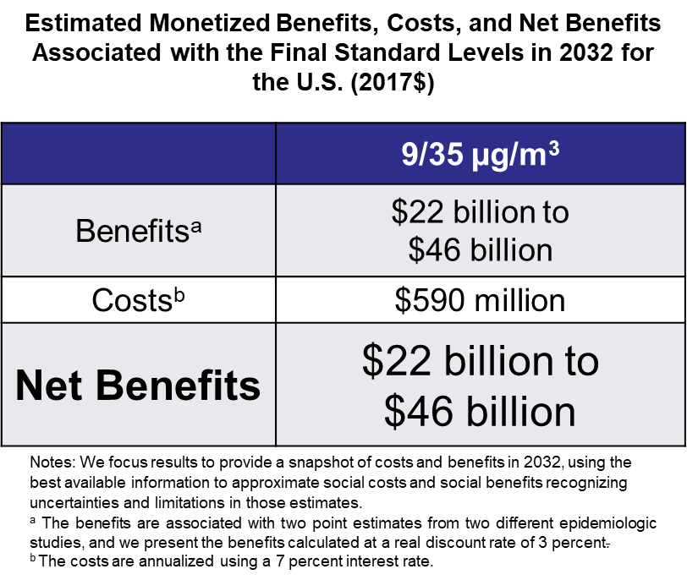
Public Health Benefits of Final PM NAAQS
Improve air quality and prevent thousands of premature deaths across the country
  Stronger standard will improve health for millions of people, including at-risk populations such as children, older adults, people with pre-existing respiratory and cardiovascular disease, communities of color and low-income communities.
Better protect overburdened communities
  EPA analyses show that in general more stringent fine particle standards are expected to reduce both exposure and mortality risk disparities for overburdened communities
https://www.epa.gov/system/files/documents/2024-02/naaqs_pm_reconsideration_ria_final.pdf

Slide 6
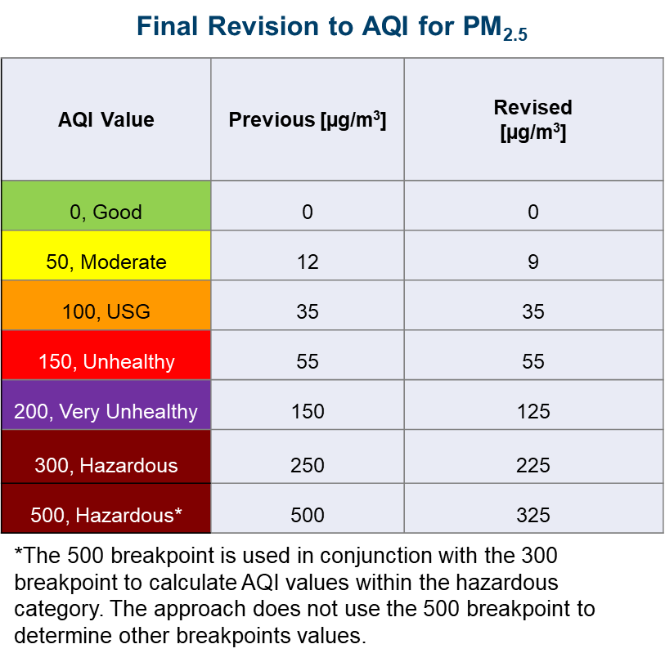
Revisions to the Air Quality Index (AQI) for PM_{2.5}
The AQI is EPA’s color-coded tool used by state and local governments to help inform the public about current and daily air quality and recommends steps that individuals can take to reduce their exposure to air pollution
The AQI converts PM_{2.5} concentrations to a number on a scale from 0 to 500
EPA is updating some of the breakpoints to reflect the change to the annual standard and the newest scientific information

Slide 7
Modification of PM_{2.5} Monitoring Network Design
To enhance air quality protection for communities subject to disproportionate air pollution risk, EPA has modified the PM_{2.5} monitoring network design criteria to include an Environmental Justice factor.
This factor will account for proximity of populations at increased risk of PM_{2.5}-related health effects to air pollution sources of concern.
Specifically, for areas with additional required State and Local Air Monitoring Stations, a monitoring station is to be sited in an at-risk community where there are anticipated effects from sources in the area (for example, a major port, rail yard, airport, or industrial area).
The network design change does not add a requirement for new monitors; rather, it utilizes existing sites and ensures at-risk communities are considered if sites need to move.

Slide 8
Implementation Timeline Annual PM_{2.5} NAAQS
Effective date of final revised NAAQS, May 6, 2024 – Revised standard applies with respect to pre-construction Prevention of Significant Deterioration permitting upon the effective date, May 6, 2024
Within 2 years after the promulgation, by February 7, 2026, of a revised NAAQS – Based on available information, including most recent monitoring data, EPA must "designate" areas as meeting (attainment) or not meeting (nonattainment) the revised NAAQS considering input from states and tribes.
  All PM_{2.5} nonattainment areas are initially classified as “Moderate.” (CAA §188)
Within 3 years after the promulgation, by February 7, 2027, of a revised NAAQS – All states and territories are required to submit SIP revisions to show they have the basic air quality management program components in place to implement the final NAAQS and address interstate transport (commonly referred to as “infrastructure SIPs”). (CAA §110)
Within 18 months after the effective date of nonattainment designation – SIPs for attaining the PM_{2.5} NAAQS are due, likely in Fall 2027. (CAA §189)
End of the 6th calendar year after the effective date of designations – “Moderate” area attainment date, likely in 2032. (CAA §188)

Slide 9
II. Recent Trends in PM_{2.5}

Slide 10
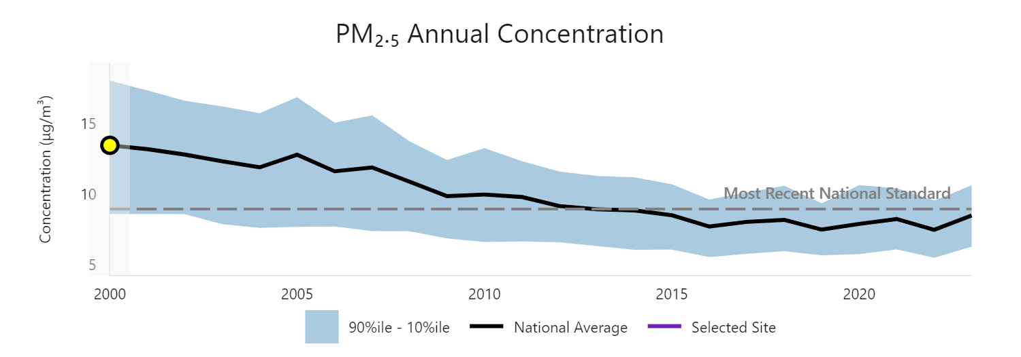
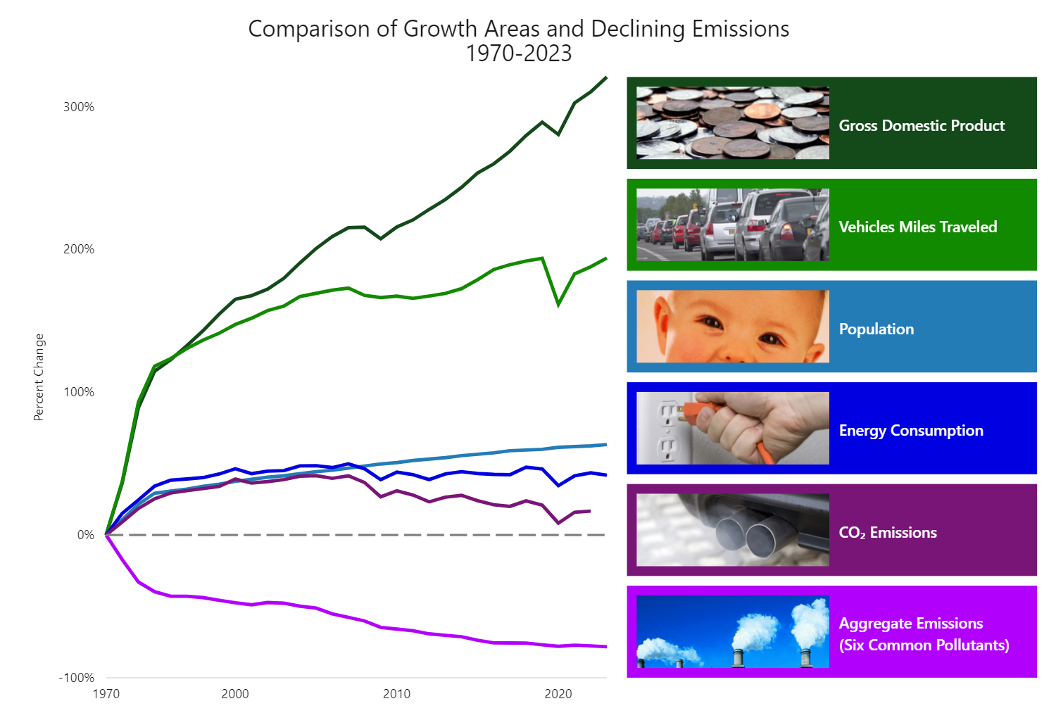
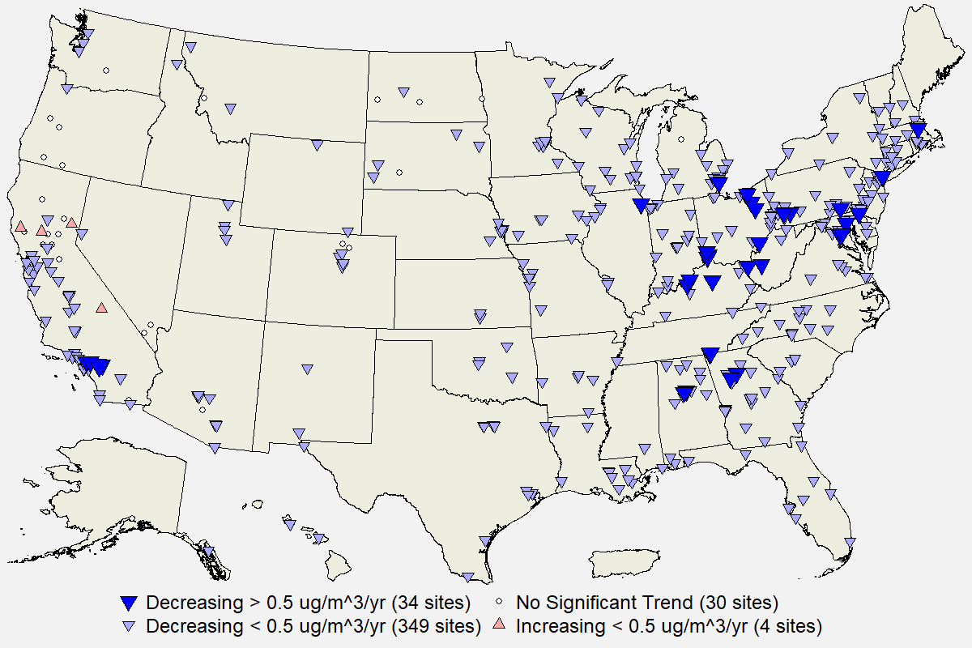
Decades of PM_{2.5} Improvement
2000 to 2022: 44% decrease in National Average
2000 to 2023: 37% decrease in National Average
321%
194%
Annual PM2.5 Trends, 2002-2023
63%
42%
17%
-78%
Emission reductions associated with federal programs have improved PM_{2.5} air quality in recent decades during a period of economic growth

Slide 11
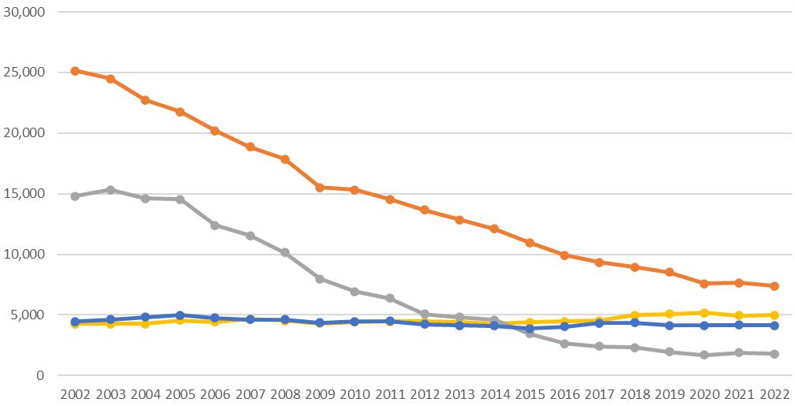
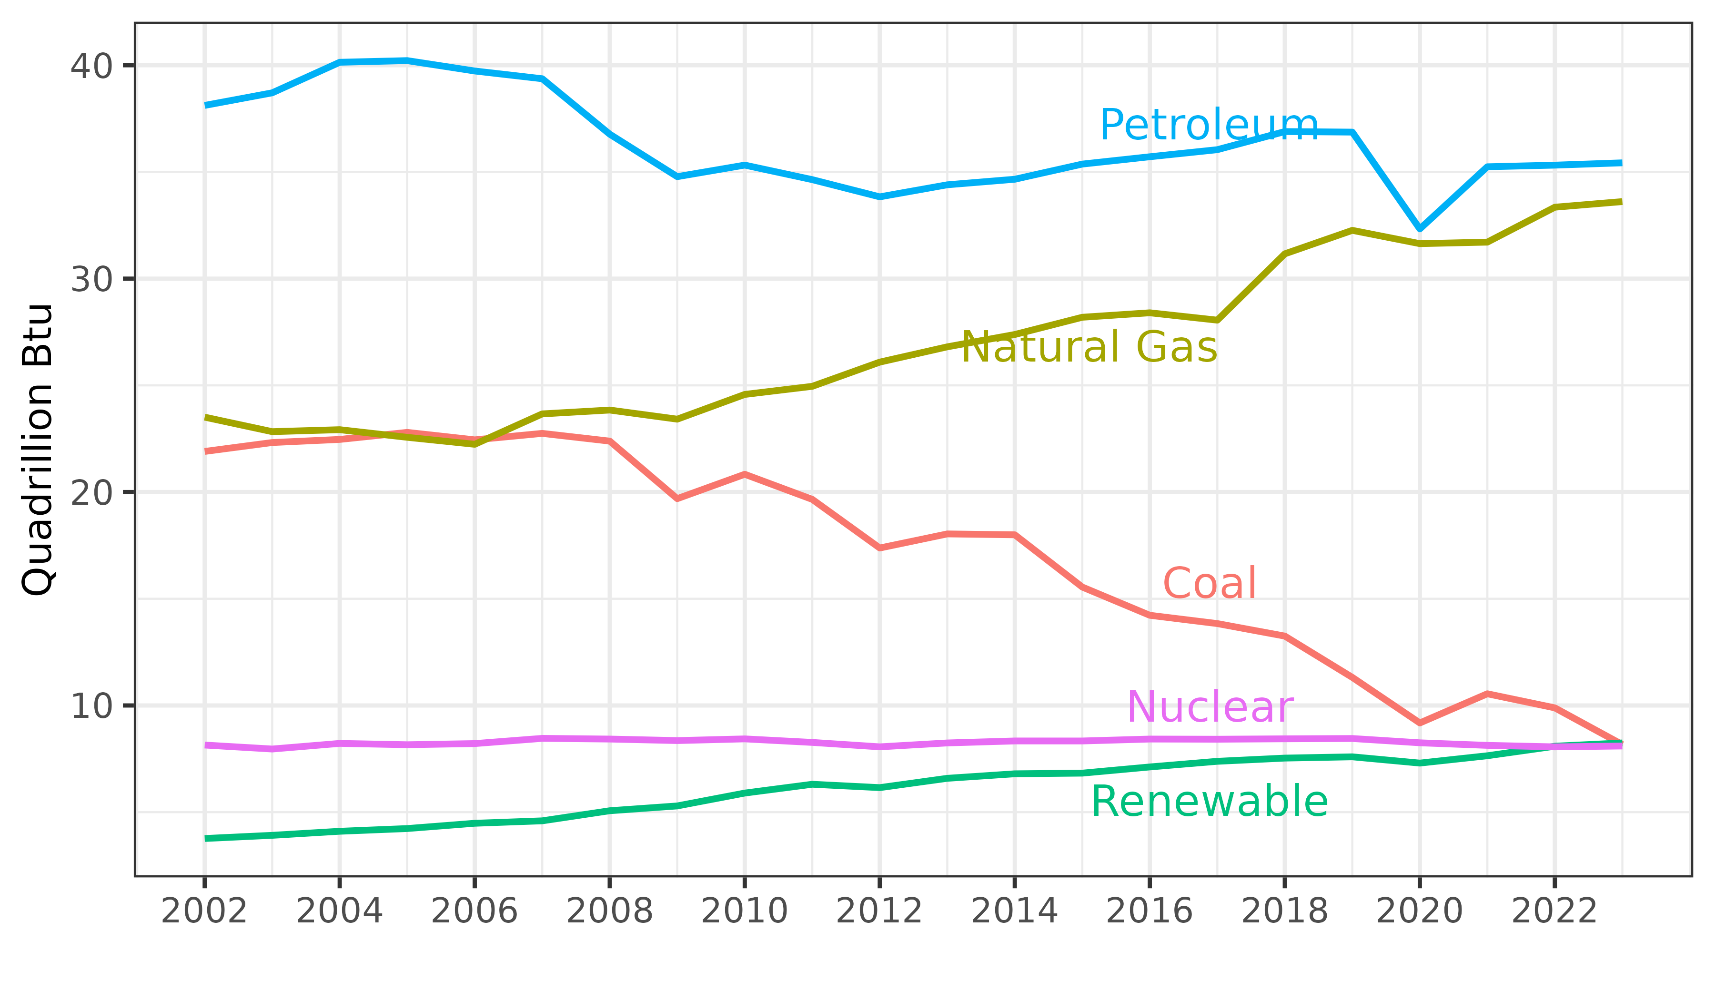
Trends in PM-Related Emissions
US Emissions (2002-2022)
Primary Energy Consumption (2002-2023)
NOx
Emissions (kton)
SO₂
PM_{2.5}
NH₃
2002
2022
Source: https://www.epa.gov/air-emissions-inventories/air-pollutant-emissions-trends-data
Data Source: Monthly Energy Review, July 2024
During 2002-2022, retrospective emissions show an 88% decrease in SO₂ (13M tons) and 71% decrease in NOx (17.8M tons) emissions
Emission reductions are consistent with energy source trends (e.g., coal and natural gas)
Previous model projections anticipated large SO₂ reductions, e.g.,
  MATS 2011 RIA projected 8.2M ton reduction in SO₂ from 2005 to 2017 base case
  CSPAR 2011 RIA projected 3.8M ton reduction in SO₂ for 2014 control case
Direct PM_{2.5} and NH₃ emissions have been relatively flat at the national level during this period

Slide 12
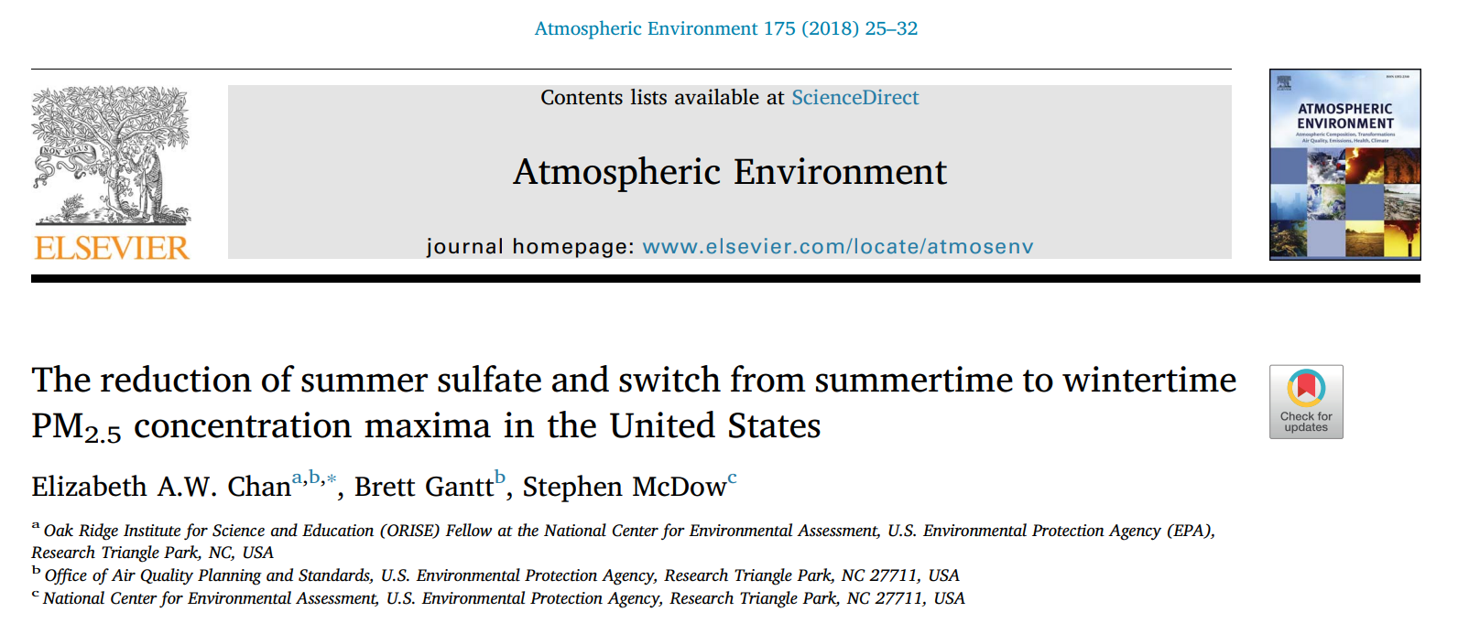
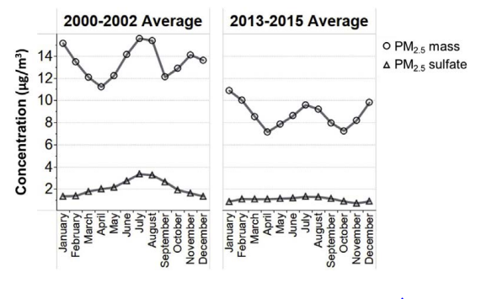
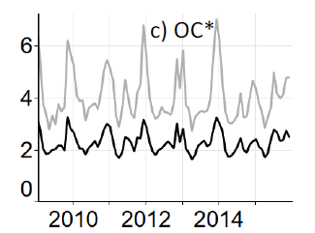

Changing Nature of PM Concentrations
The large SO₂ emission reductions in recent decades flattened the peak in summer sulfate concentrations by 2013-2015 (e.g., figure, red circles)
  SO₂ emissions have further decreased by 2.8M tons from 2014 to 2022
While sulfate concentrations have steadily decreased, organic carbon concentrations have been relatively flat (e.g., figure right)
Overall, the reductions in SO₂ and NOx emissions with relatively steady direct PM_{2.5} emissions have increased the importance of organic carbon and wintertime PM
Organic Carbon

Slide 13
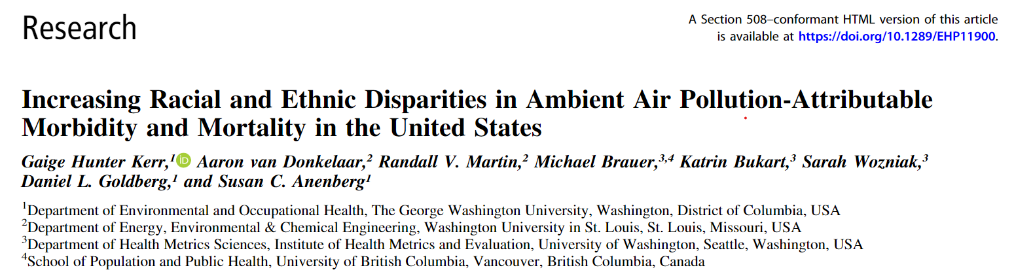
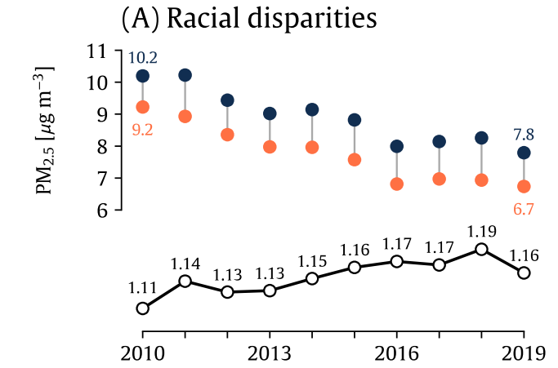
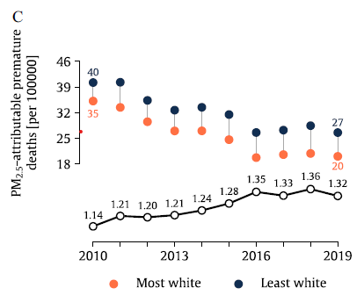
Trends in PM_{2.5} Exposure Disparities
The decreases in PM_{2.5} driven by regional precursor emission reductions have improved PM_{2.5} concentrations for exposed populations throughout the country
However, exposure disparities among racial-ethnic groups have persisted (or increased, by some metrics) as regional emission reductions have occurred
Addressing exposure disparities may require more targeted application of primary PM_{2.5} emission reductions to high-PM_{2.5} concentration areas
Kerr et al. (2024) EHP

Slide 14
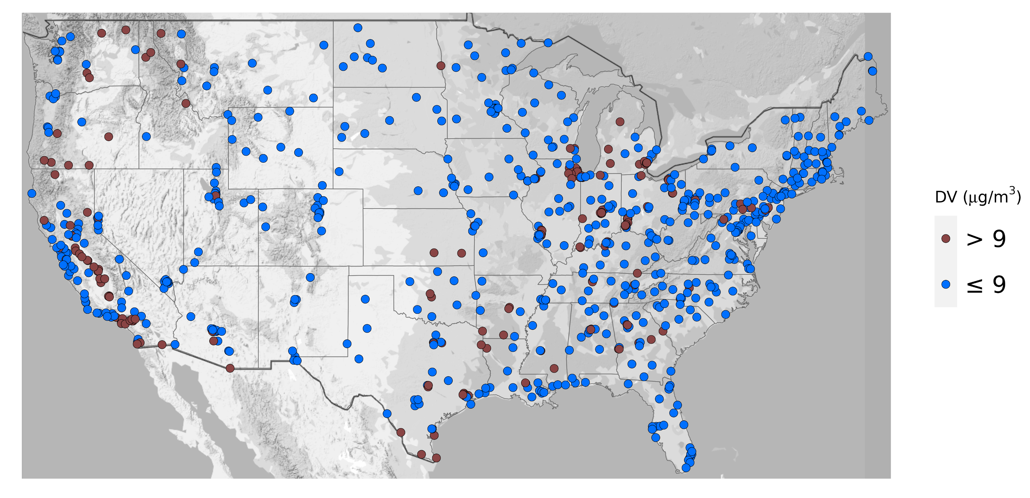
2023 Annual PM_{2.5} Design Values
The 2023 Annual PM_{2.5} design values (DVs) provide the most recent picture of measured values across the country
However, these data are currently influenced by events (e.g., wildfires) that may later be excluded from the DV calculation according to the Exceptional Events policy
The ambient DVs also do not reflect expected emission reduction from finalized rules that will improve PM_{2.5} prior to the attainment date
https://epa.maps.arcgis.com/apps/MapSeries/index.html?appid=bc6f3a961ea14013afb2e0d0e450b0d1

Slide 15
III. Regulatory Impact Analysis (RIA) Model Projections

Slide 16
Modeling PM_{2.5} for a Future Analytic Year
Understanding of the scope of PM_{2.5} attainment challenges under the 2024 NAAQS can be improved by examining the exceedances that remain after accounting for expected emission reductions from finalized rules
In the PM NAAQS RIA, national 12-km photochemical air quality modeling was performed with CMAQ for 2018 and 2032 to project 2032 DVs using 2016-2020 PM_{2.5} monitoring data
Finalized rules* reflected in the 2032 emissions case include:
  EGU: Inflation Reduction Act of 2022 (IRA) Tax Incentive Provisions; 2023 Final Good Neighbor Plan; 2021 Revised Cross-State Air Pollution Rule Update; 2016 Standards of Performance for Greenhouse Gas Emissions from New, Modified, and Reconstructed Stationary Sources; 2011 Mercury and Air Toxics Rule (MATS)
  Mobile: 2022 Control of Air Pollution from New Motor Vehicles: Heavy-Duty Engine and Vehicle Standards; 2021 Final Rule to Revise Existing National GHG Emissions Standards for Passenger Cars and Light Trucks Through Model Year 2026; 2020 Heavy-Duty Engine and Vehicle Standards SAFE Vehicles Final Rule for Model Years 2021-2026; 2016 GHG Emissions Standards and Fuel Efficiency Standards for Medium- and Heavy-Duty Engines and Vehicles, Phase 2; 2014 Tier 3 Motor Vehicle Emission and Fuel Standards
Change in U.S. Anthropogenic Emissions: 2018 to 2032
Pollutant | % Change | Absolute Change (million tons)
NOx | -41 | -3.6
SO₂ | -48 | -1.1
PM_{2.5} | -4 | -0.12
VOC | -7 | -0.9
NH₃ | +4 | +0.2
*Rules not finalized by March 2023 were not included (111/MATS/mobile)

Slide 17
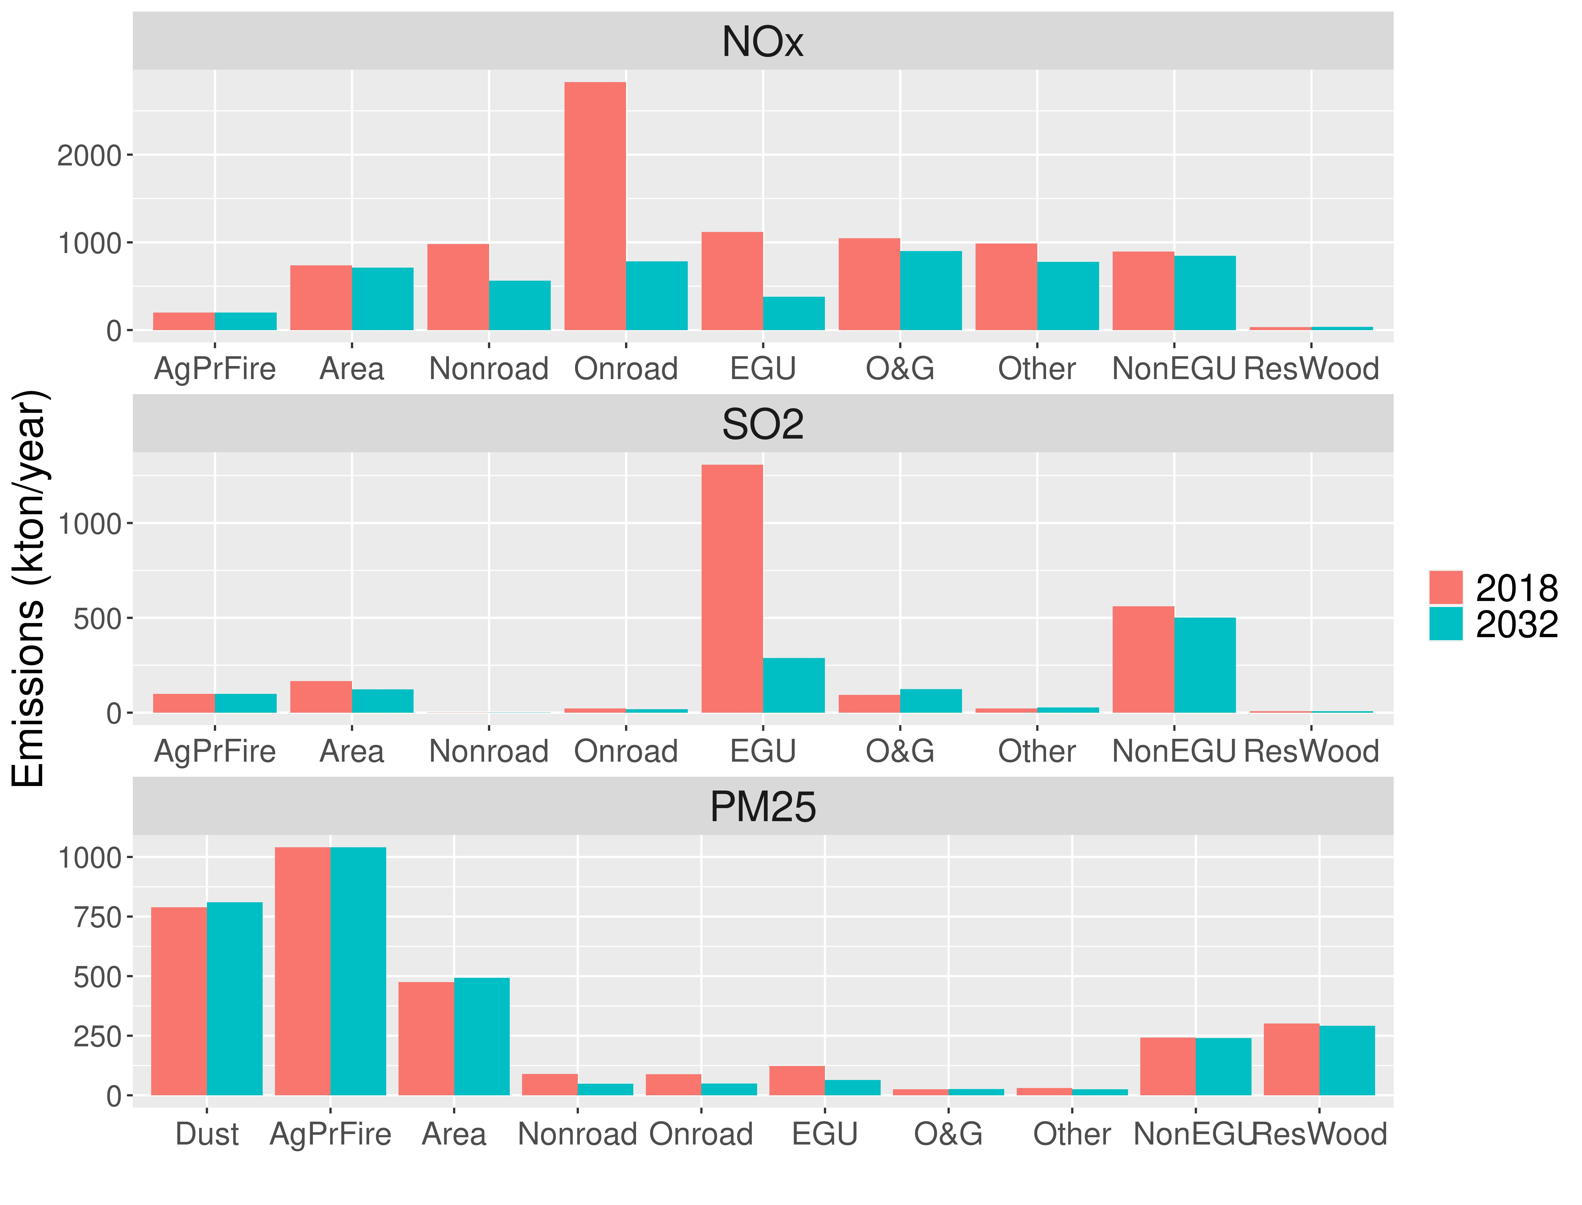
Projected 2032 Emissions Continue Recent Trends
The 2032 projections continue the trend of NOx/SO₂ emissions reductions with relatively flat PM_{2.5} emissions (see figures to right)
Large reductions in NOx projected between 2018 and 2032 for largest emission sectors (mobile and EGU)
SO₂ emissions projected to decrease from 1.3 million tons in 2018 to 295k tons in 2032 for the largest emission sector (EGU)
Relatively flat emissions for largest direct PM emission sectors (e.g., dust/area/residential wood combustion)

Slide 18
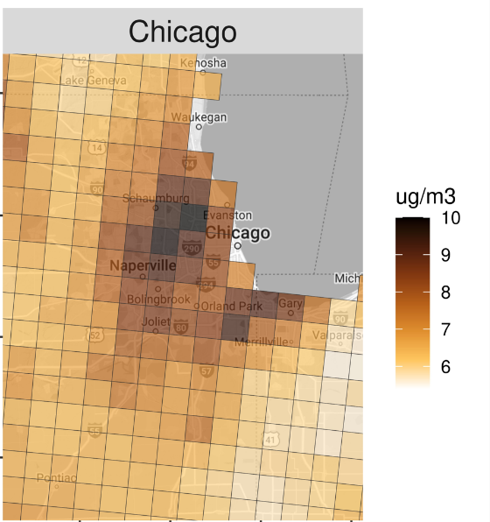
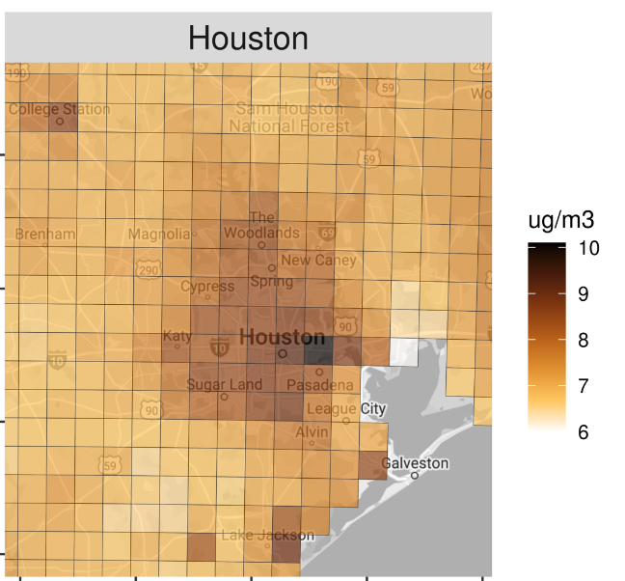
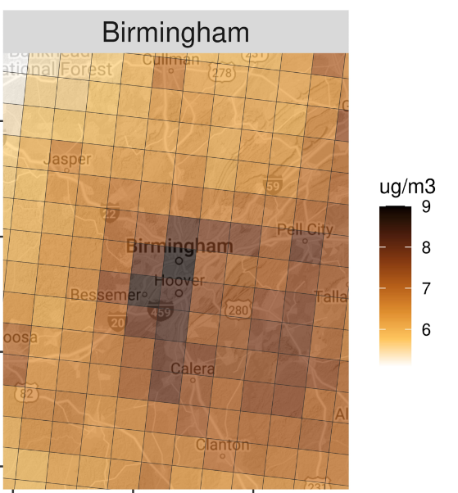
Urban Increment in 2032 PM_{2.5} Concentrations
Urban areas experience higher PM_{2.5} than the surrounding region due to the influence of PM_{2.5} sources associated with urban activity (e.g., home heating, commercial cooking) and reduced regional PM_{2.5} concentrations
Also, local sources (e.g., steel, petroleum, roads, airports) are sometimes in monitored urban areas
For rural areas (i.e., mountain valleys), local emissions from home heating sources are also the drivers of high PM_{2.5}
Therefore, emission reductions from primary PM_{2.5} sources in and near projected nonattainment areas would be most effective for meeting the 2024 NAAQS in combination with regional precursor reduction from existing rules

Slide 19
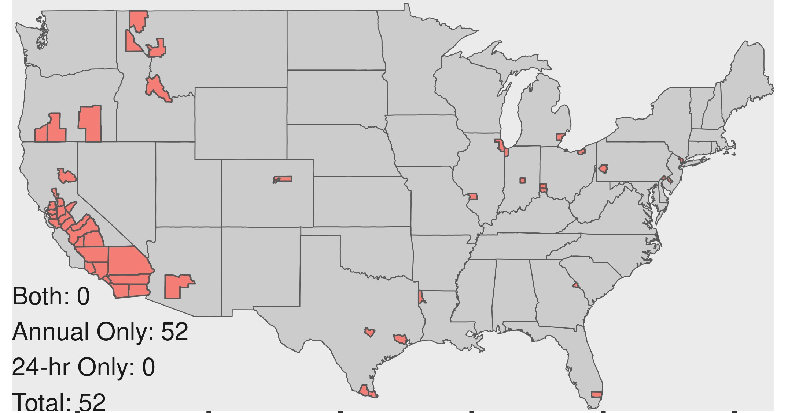
Projected Nonattainment for 2032 Analytic Year
Counties with monitors projected to exceed the annual standard in 2032 can be classified as follows:
Pacific NW and N. California: Exceedances are associated with woodsmoke emissions in small mountain valleys that experience wintertime temperature inversions as well as wildfire influence
Major CA Air Basins: Exceedances due to complex/long-standing local challenges in meeting PM_{2.5} NAAQS (e.g., SJV/SoCAB) as well as wildfires
US-Mexico Border: Counties are influenced by cross-border transport, dust, and local emissions
Eastern US: Exceedances are generally associated with the urban, near-road, and nearby source PM_{2.5} increment

Slide 20
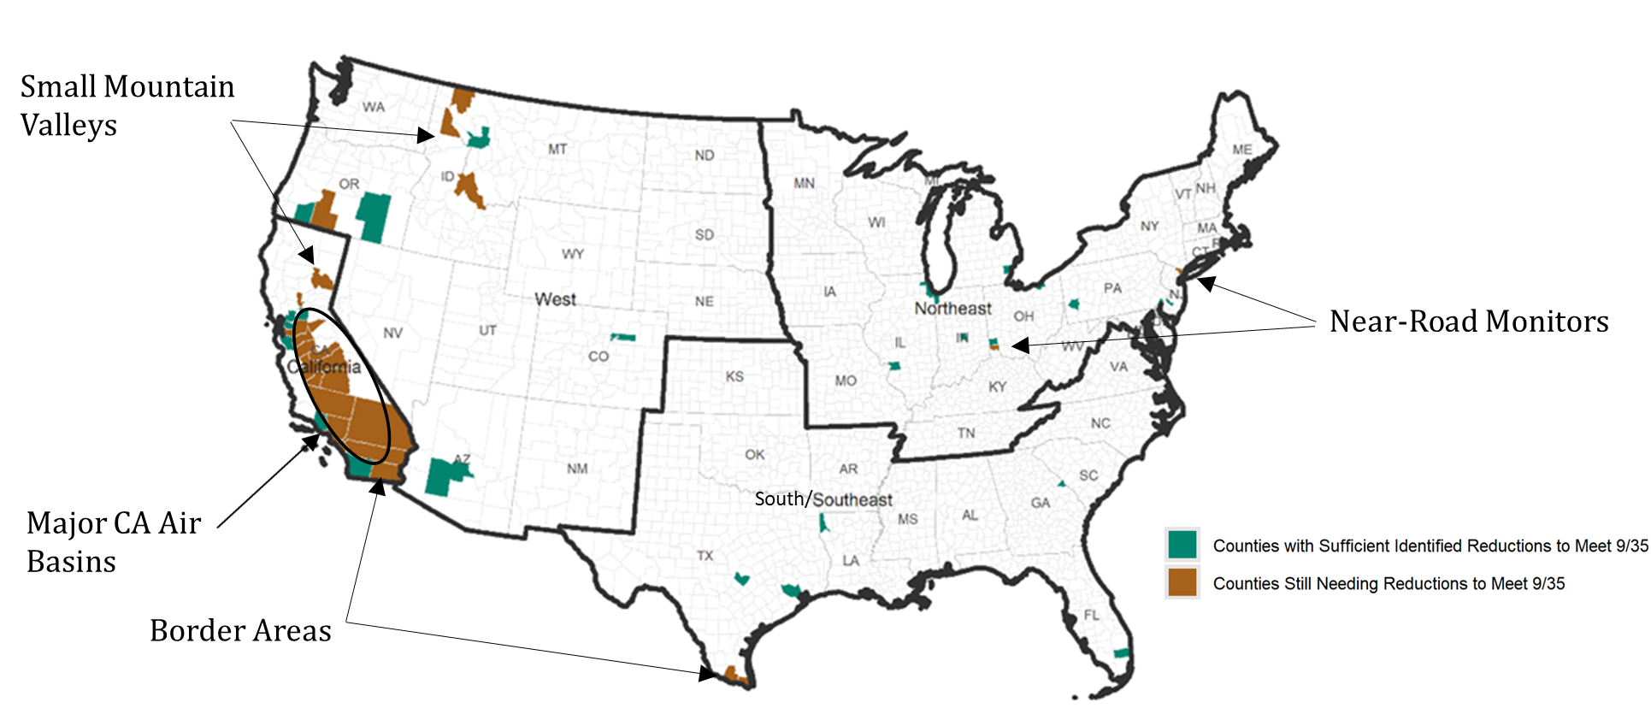
Some Areas Require Refined Local Information
The RIA identified several groups of areas have air quality characteristics that limit the ability to characterize how the standard would be met given highly local influences that require more specific information beyond what is available for a national analysis.

Slide 21
IV. Examples of Projected Exceedance Areas

Slide 22
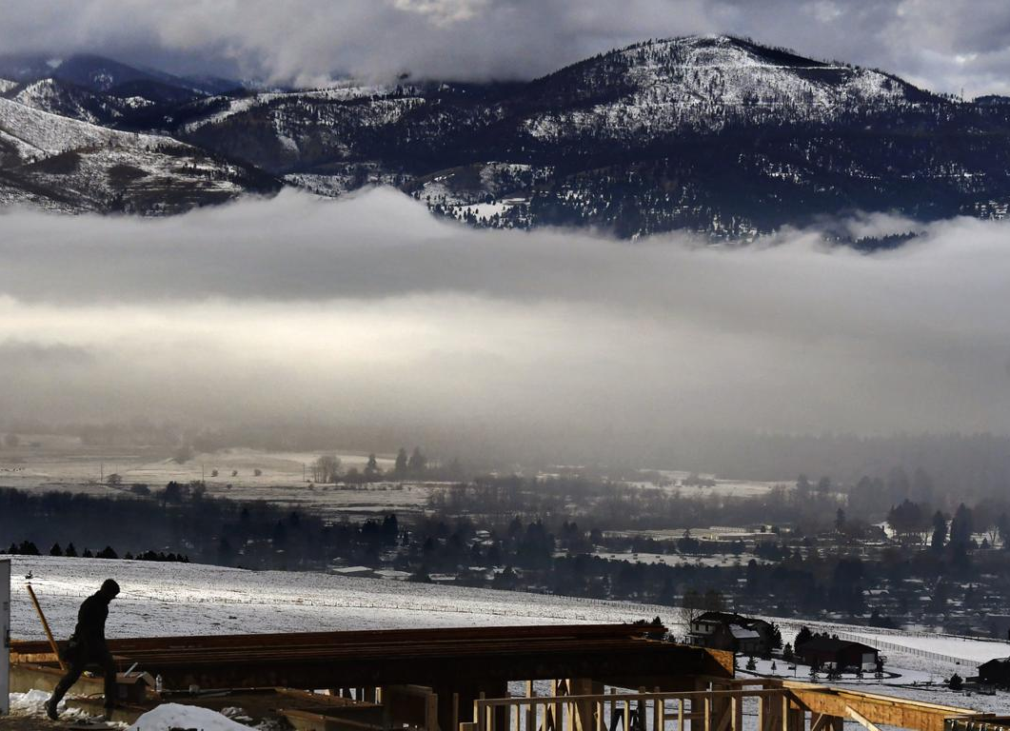
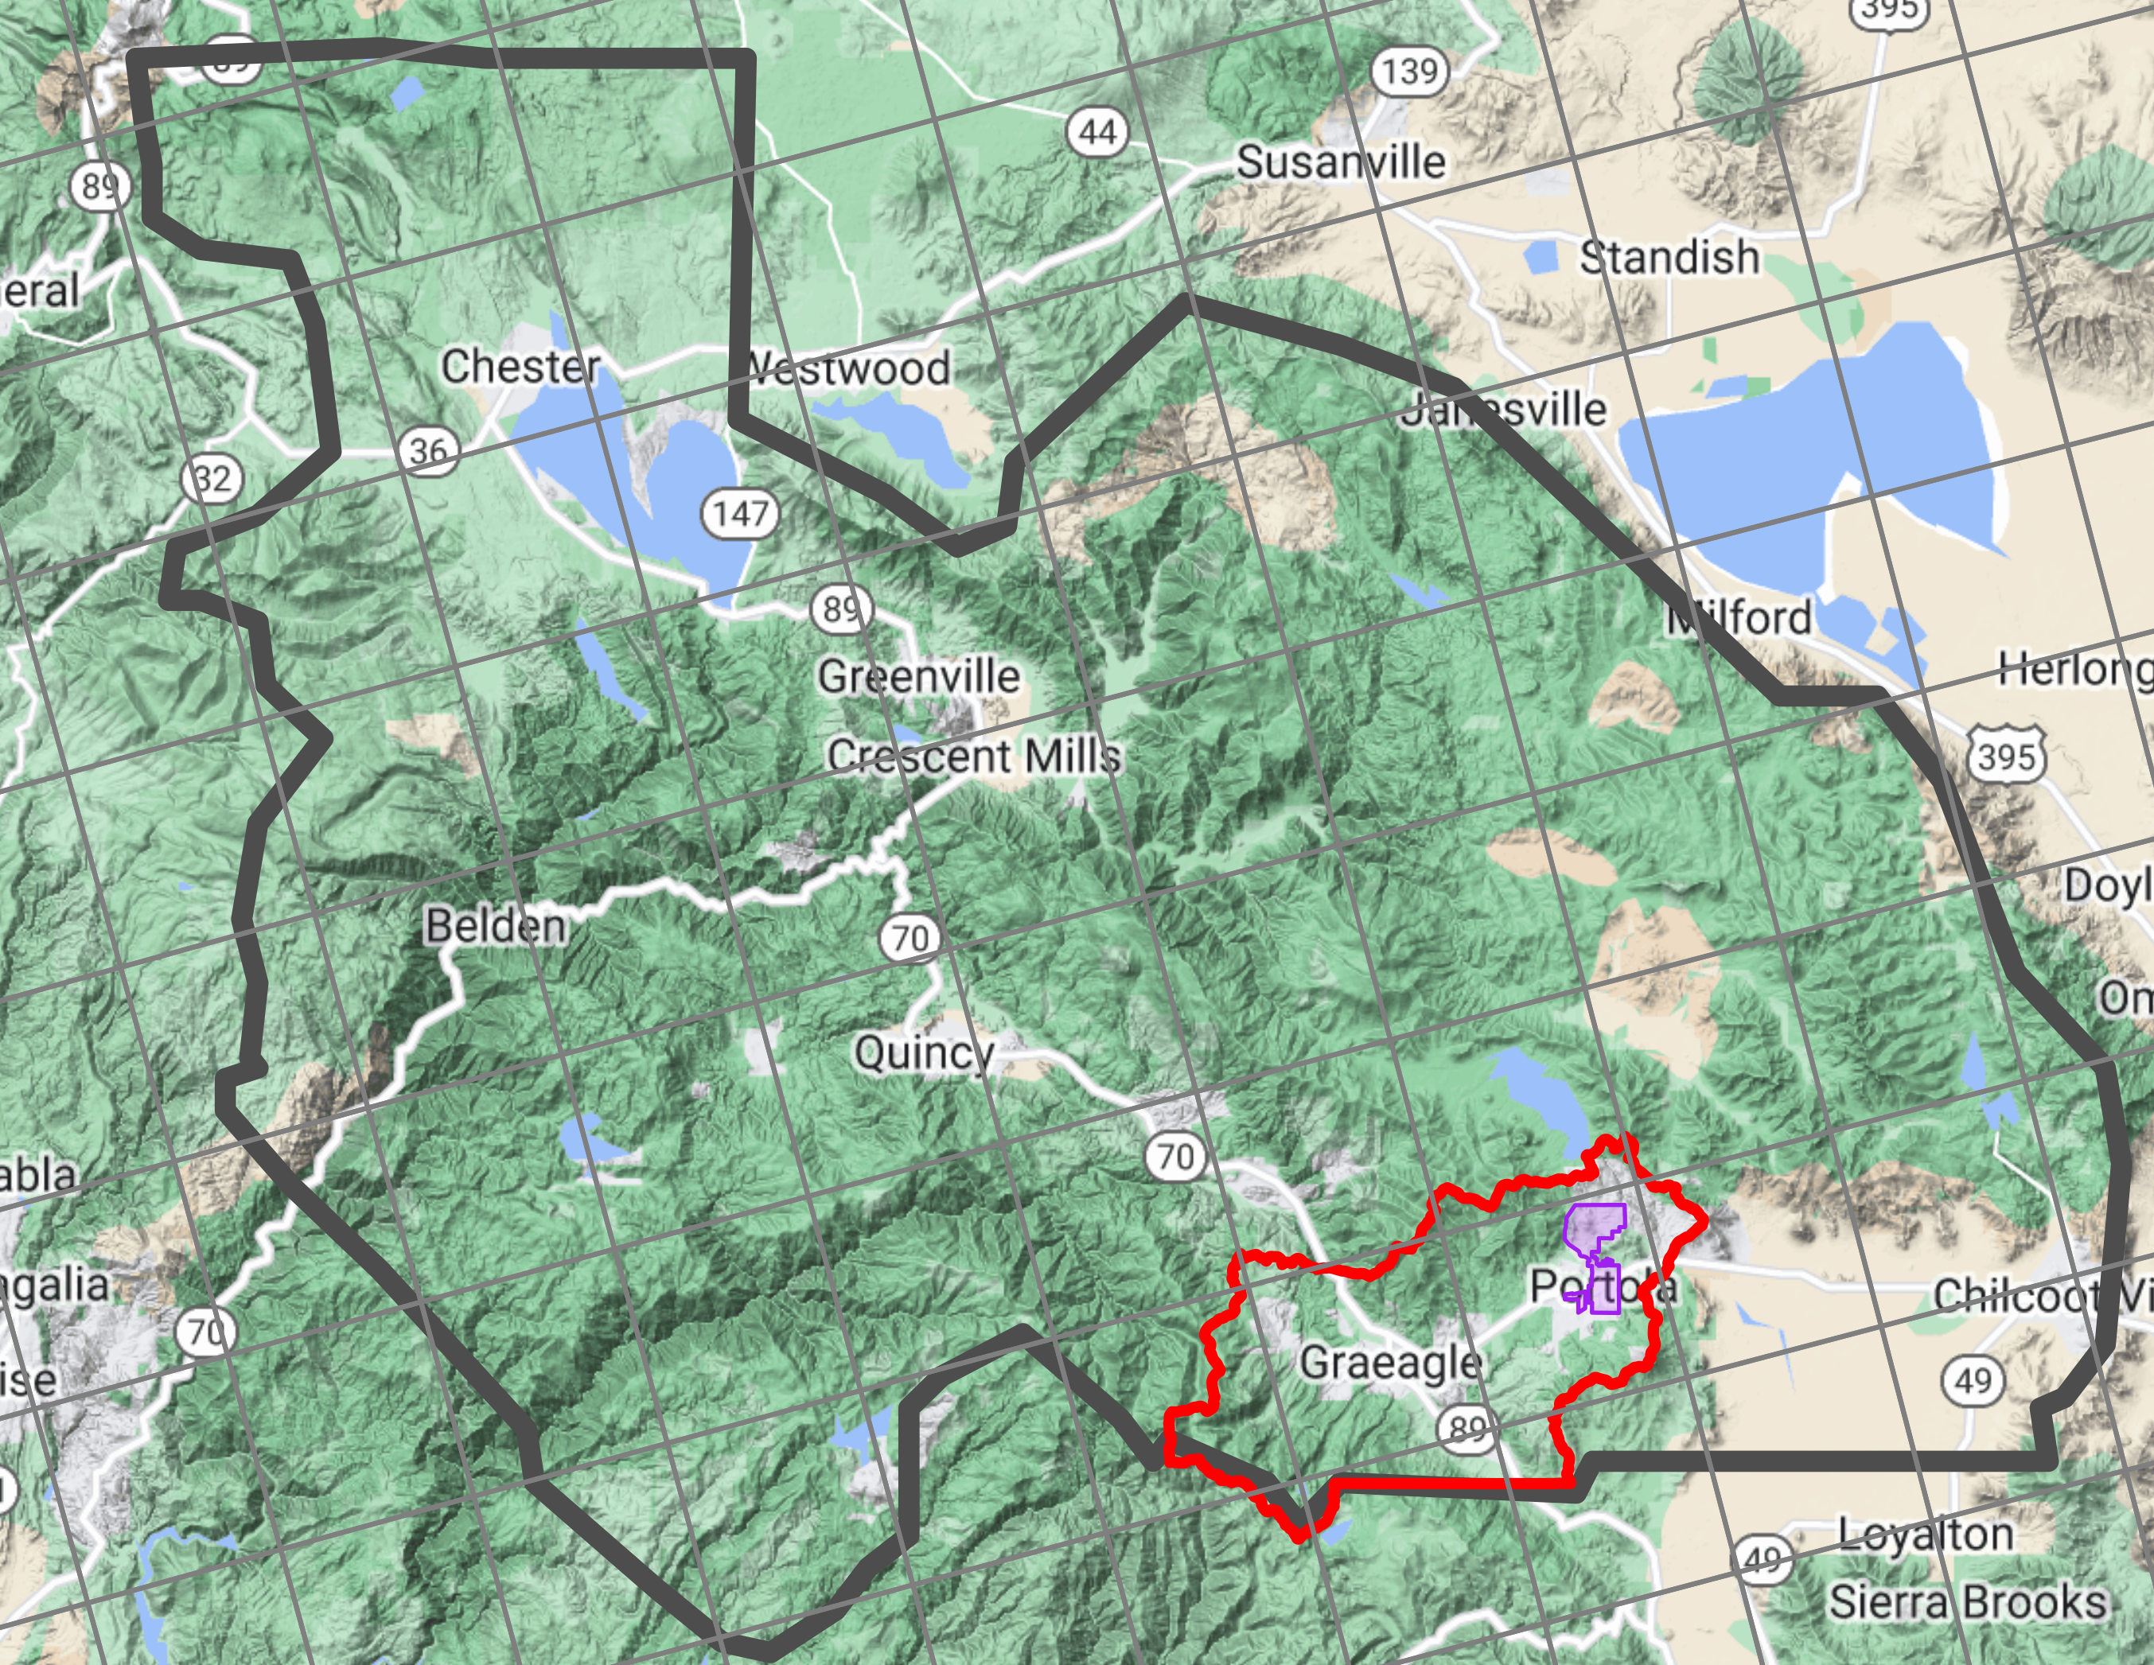
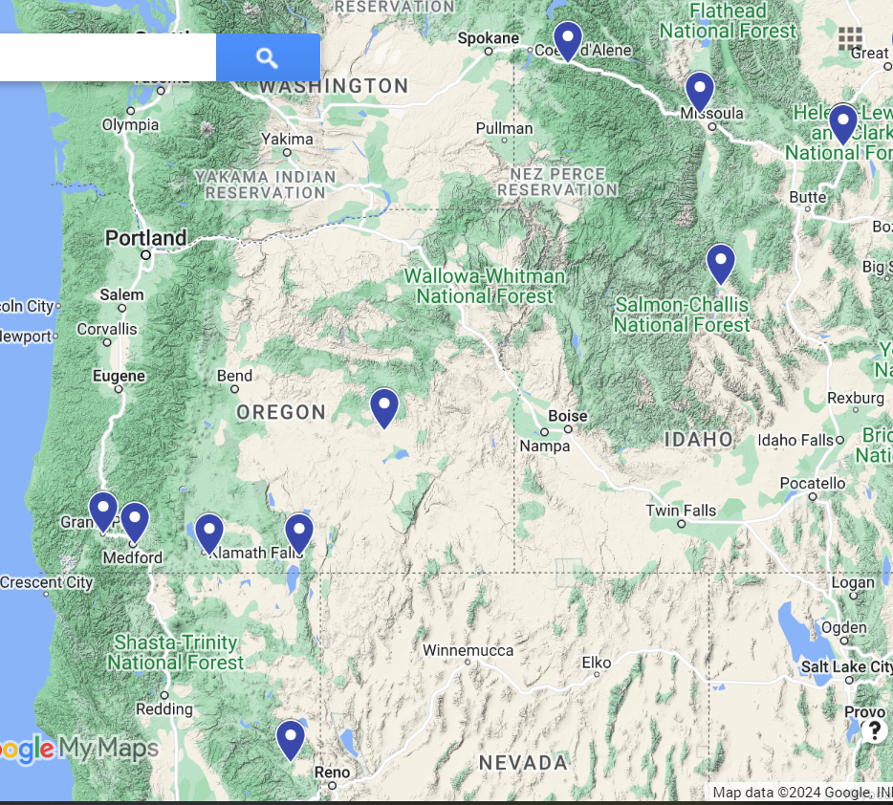
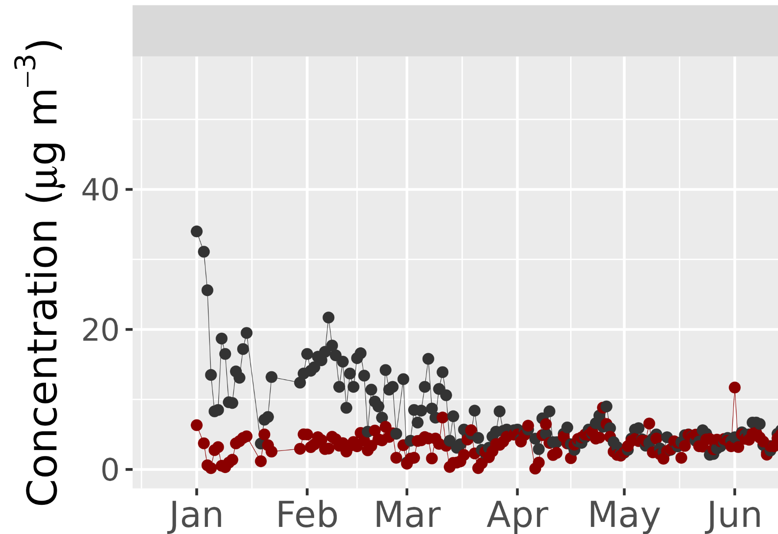

Small Woodsmoke-Influenced Valleys in West
Plumas Co.
Missoula, MT, 2018. Source: Missoulian
City of Portola
(Pop. 2,041)
Portola Nonattainment Area
Small mountain valleys in the west experience elevated PM_{2.5} in winter when temperature inversions trap woodsmoke emissions near the surface in the valley
SIPs use statistical rollback modeling with refined local inventories and data analysis for these areas because the strong influence of complex terrain and local emissions is not resolved by operational regional/national air quality modeling
Projections in these areas are also influenced by western wildfires in the 2016-2020 monitoring period
PM_{2.5}
Terrain, and therefore, meteorology not resolved by national model

Slide 23
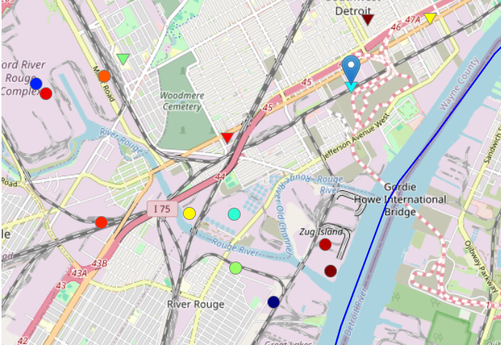
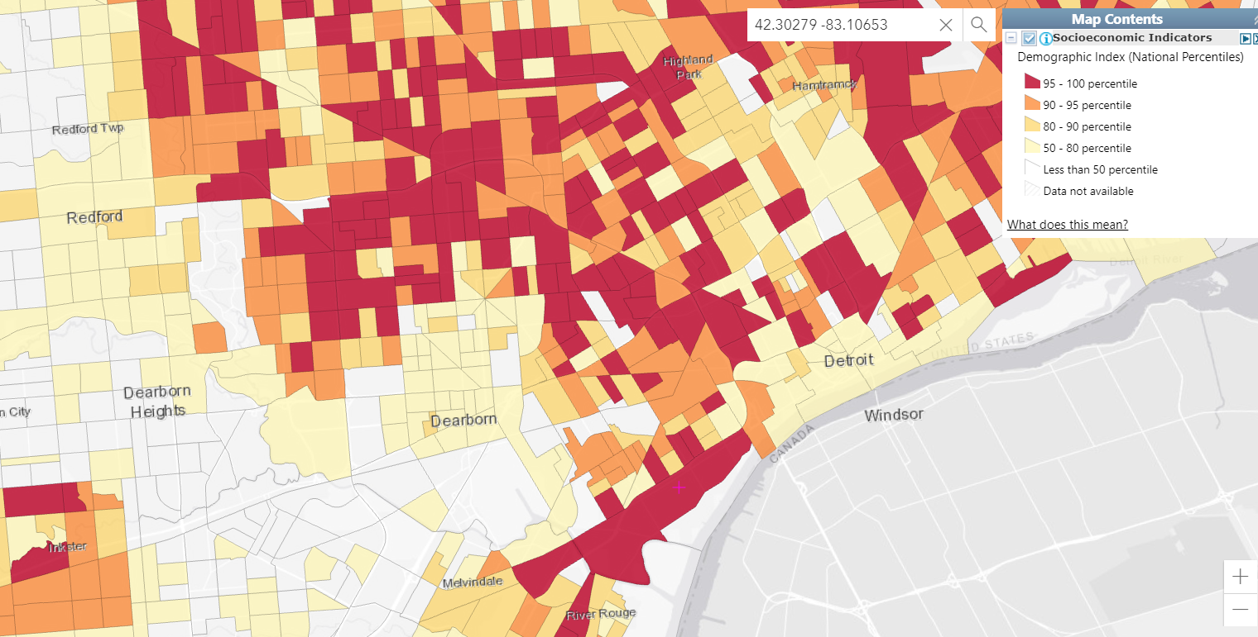
Urban Area with Nearby Sources: Detroit, MI
The Detroit site is near steel, coke, and petroleum facilities with direct PM_{2.5} emissions
Wesson et al. (2010) previously identified control of local direct PM sources as effective in Detroit
The high demographic index (low income + people of color) suggests that local controls would be benefit communities in the area
Detroit: PM_{2.5} Sources
Detroit: Demographic Index
Monitor 261630015
AK Steel Dearborn Works
EES Coke Battery LLC
Marathon Petroleum Company
Monitor 261630015
US Steel Great Lakes Works
https://ejscreen.epa.gov/mapper/

Slide 24
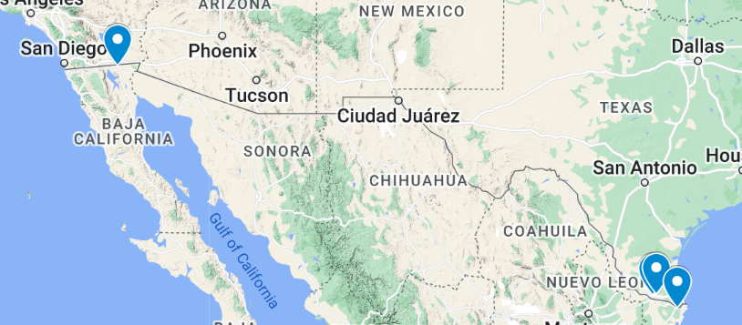
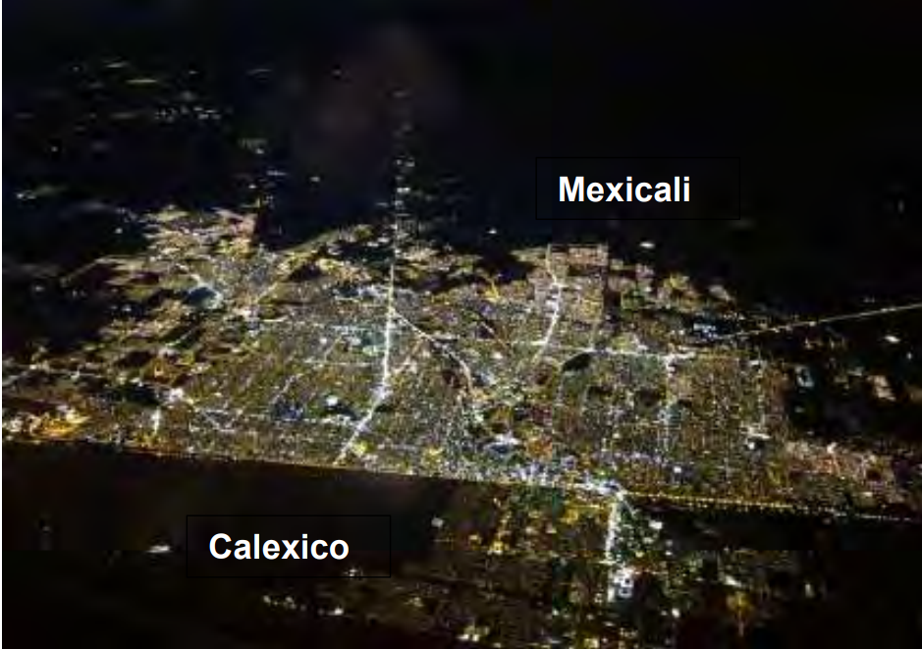
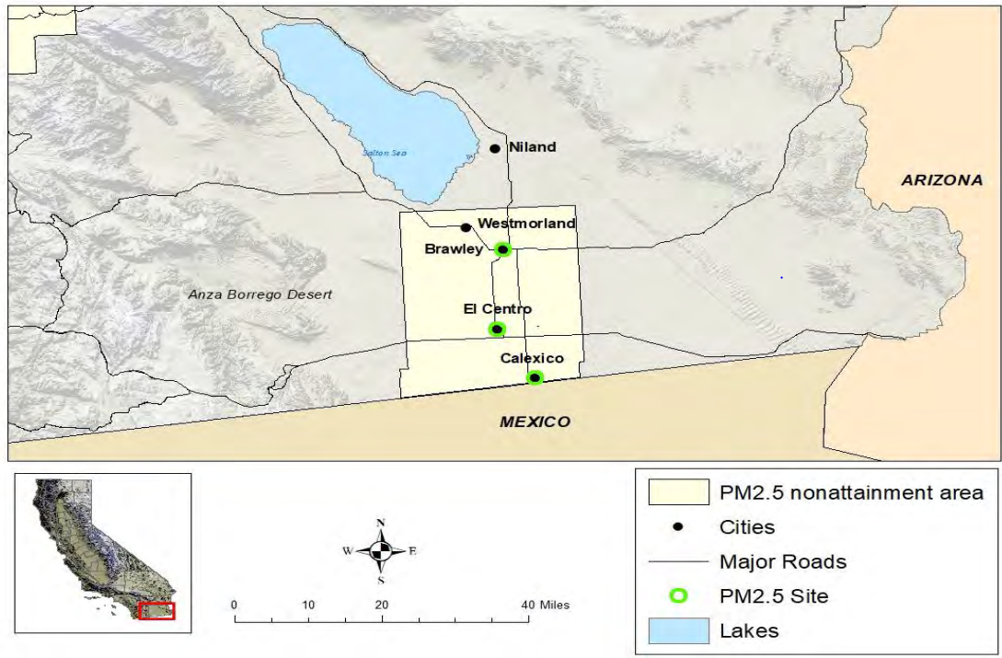
U.S.-Mexico Border Counties
Monitors in U.S. cities along the U.S.-Mexico border can routinely be influenced by local emissions from neighboring metropolitan areas in Mexico within the same airshed
Agricultural burning and wildfire in southwestern Mexico and Central America as well as episodic transport of Saharan dust may also influence border county PM_{2.5}
Fugitive dust sources are often the dominant contributor to emissions in U.S. border counties
Refined analyses of international transport are needed to assess the relevance of Section 179B of the CAA for meeting standards in several border counties
8.7 ug/m³
12.4 ug/m³

Slide 25
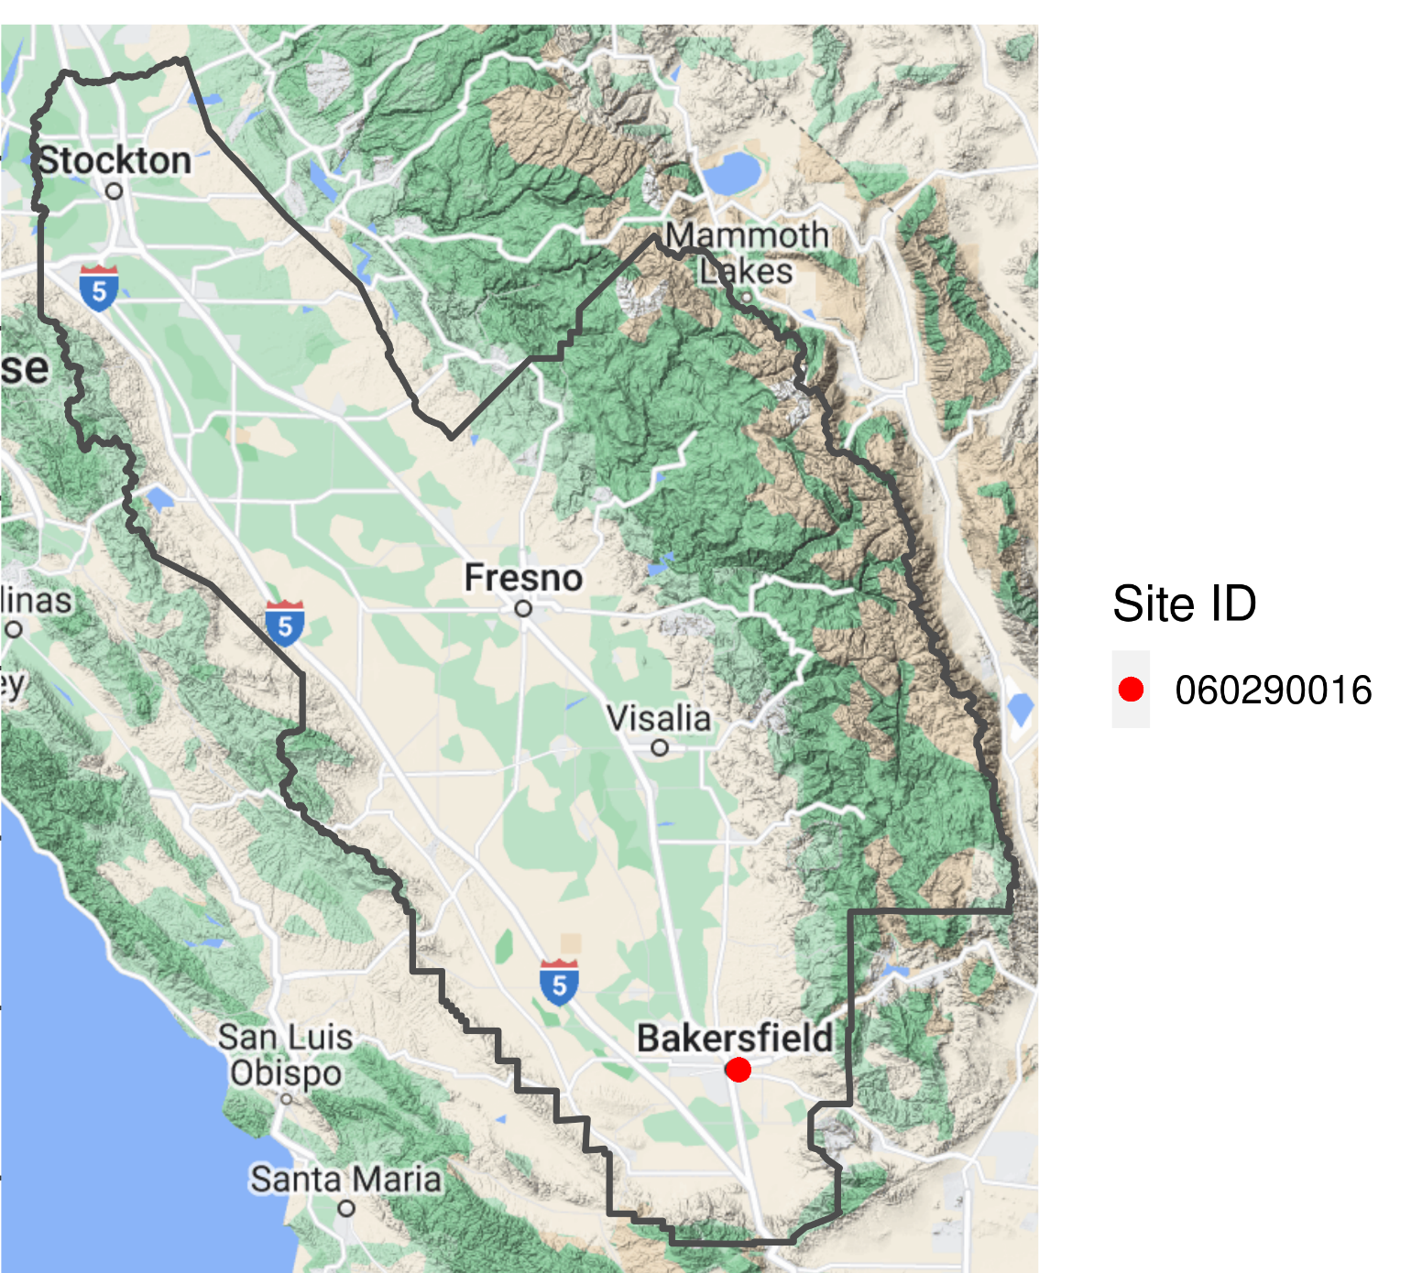
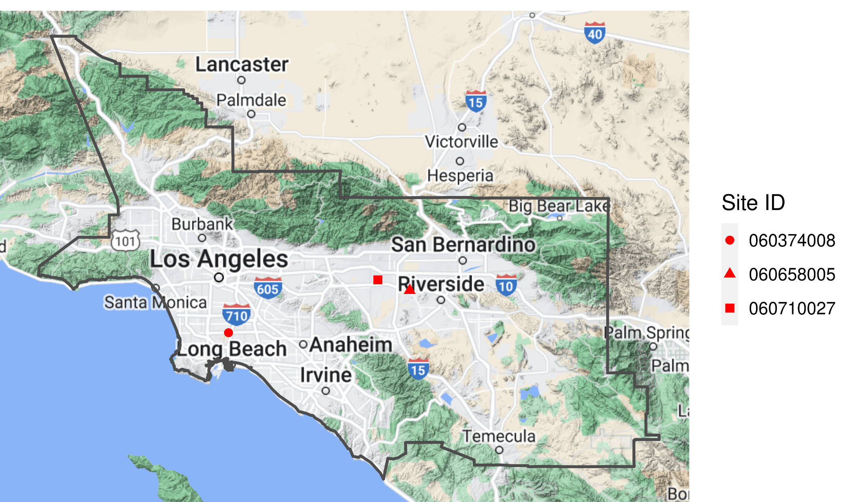
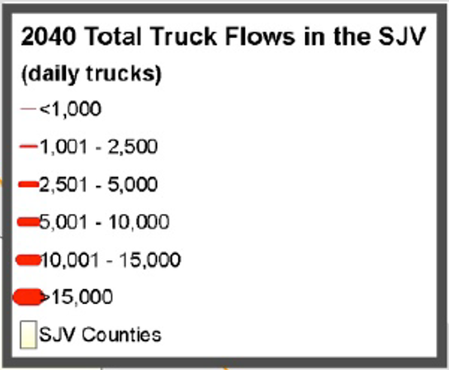
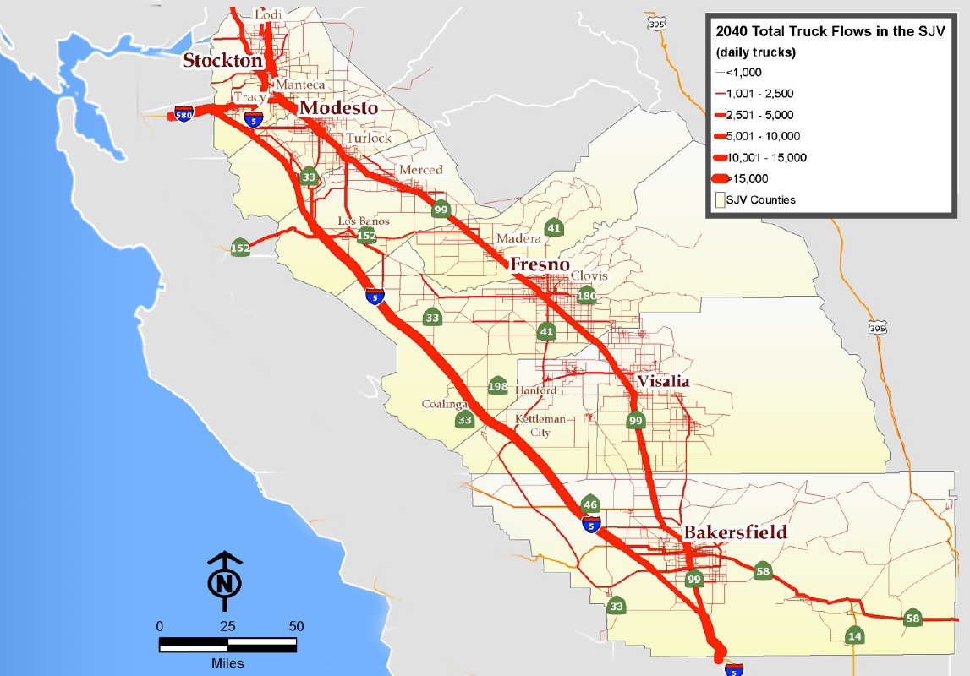
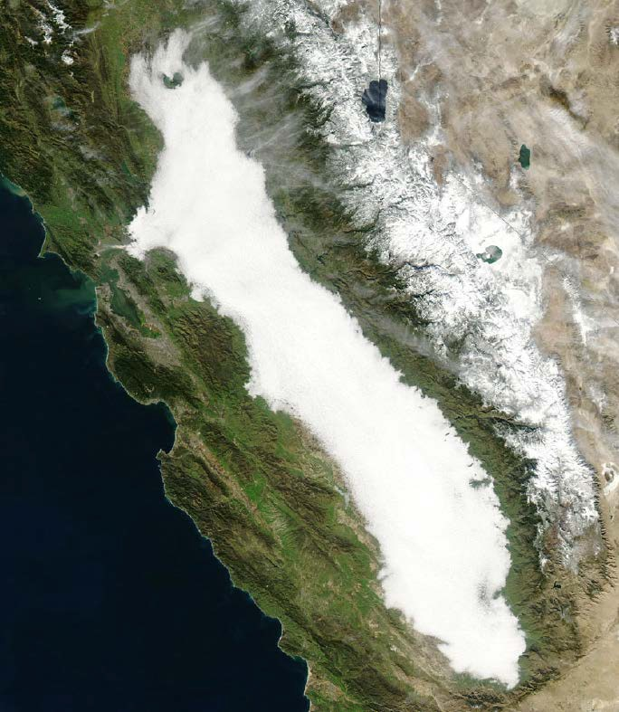
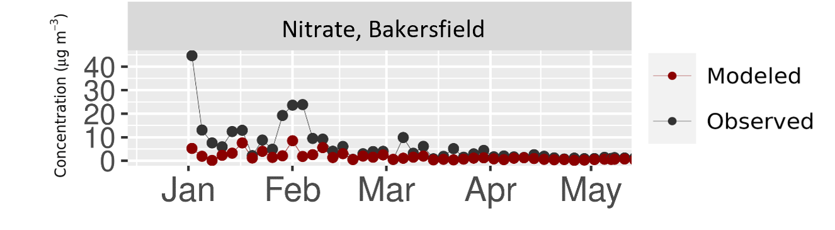
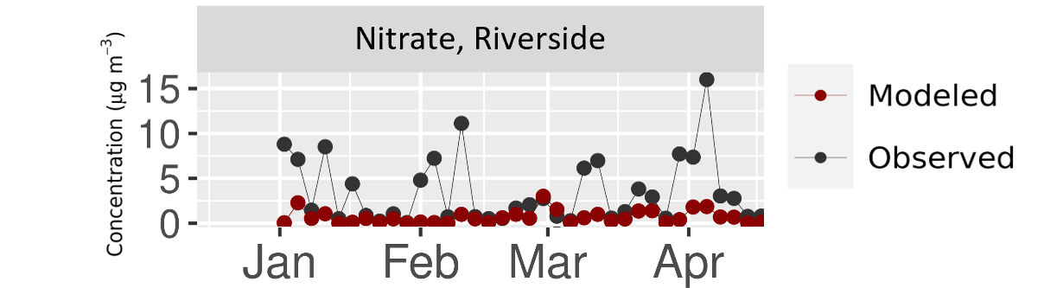
Major California Air Basins
San Joaquin Valley
South Coast Air Basin
Nitrate episodes in complex terrain not resolved by national models
PM_{2.5} in major California air basins is influenced by diverse emissions from urban centers, transport corridors, agriculture, and wildfire as well as meteorology affected by complex terrain and temperature inversions
Detailed local analyses are needed to address these areas due to the magnitude of the exceedances, the challenging terrain and meteorological conditions, and challenging emission sources (e.g., dust, residential wood combustion, near-road, cooking, agricultural, etc.), and wildfire influence

Slide 26

V. FUTURE DIRECTIONS
“Post-CAIR [Clean Air Interstate Rule] nonattainment forecasts for O₃ and the 2006 PM_{2.5} NAAQS suggest post-CAIR attainment strategies will need to focus on subregional and urban scale sources. A focus on urban sources of primary PM is also consistent with a robust strategy to reduce all of the major components of PM_{2.5}.”
John Bachmann, J. Air & Waste Manag. Assoc., 2007
John Bachmann (2007) Will the Circle Be Unbroken: A History of the U.S. National Ambient Air Quality Standards, Journal of the Air & Waste Management Association, 57:6, 652-697, DOI: 10.3155/1047-3289.57.6.652

Slide 27
Recent Analyses Suggest Future Directions
Areas where regional emission programs alone did not result in attainment of previous standards can require higher resolution modeling and more local data than default national/regional 12-km platforms, e.g.,
  California
    South Coast Air Basin: 4-km photochemical modeling combined with near-road AERMOD analysis
    San Joaquin Valley: 4-km photochemical modeling and consideration of intensive field study data
    Portola: statistical rollback of woodstove emissions
    Imperial: 4-km photochemical modeling with data analysis of emissions, met, and monitoring for 179B demo
  Pennsylvania
    Allegheny: nested 1.33-km photochemical modeling combined with AERMOD for local sources
  Utah
    Salt Lake: 1.33-km modeling for mountain valleys with model adjustments for local emissions/processes
  Alaska
    Fairbanks: 1.33-km photochemical modeling with chemistry, met, and emissions updates
  Assessments often include weight-of-evidence related to local issues, e.g., NH₃, chemistry, near-road
Notes:
Salt Lake: https://deq.utah.gov/air-quality/tsds-for-pm2-5-serious-sip-salt-lake
South Coast: https://www.aqmd.gov/home/air-quality/air-quality-management-plans/other-state-implementation-plan-(sip)-revisions/2012-annual-pm2-5-plan
SJV: https://ww2.valleyair.org/rules-and-planning/air-quality-plans/particulate-matter-plans/plan-for-the-2012-pm25-standard/
https://ww2.arb.ca.gov/resources/documents/2024-san-joaquin-valley-pm2-5-plan
Portola: Northern Sierra Air Quality Management District (2017) Portola Fine Particulate Matter (PM2.5) Attainment Plan. January
Imperial: IMPERIAL COUNTY 2018 ANNUAL PARTICULATE MATTER LESS THAN 2.5 MICRONS IN DIAMETER STATE IMPLEMENTATION PLAN
California Air Resources Board. January 5, 2018. Clean Air Act Section 179B Technical Demonstration Imperial County PM2.5 Nonattainment Area
Allegheny: Allegheny County Health Department Air Quality Program. Revision to the Allegheny County Portion of the Pennsylvania State Implementation Plan. Attainment Demonstration for the Allegheny County, PA PM2.5 Nonattainment Area, 2012 NAAQS. September 12, 2019
https://www.awma.org/emjune17

Slide 28
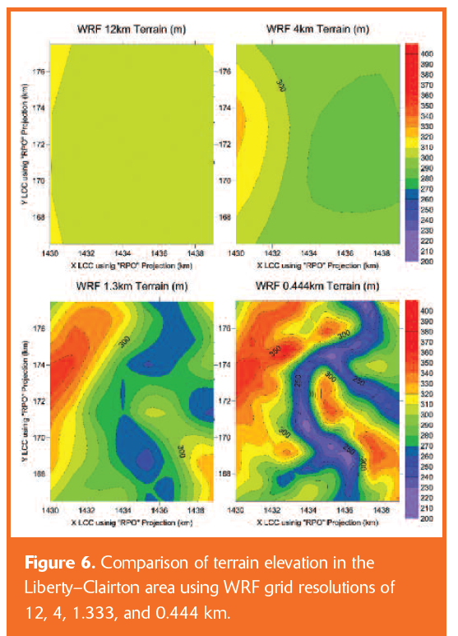
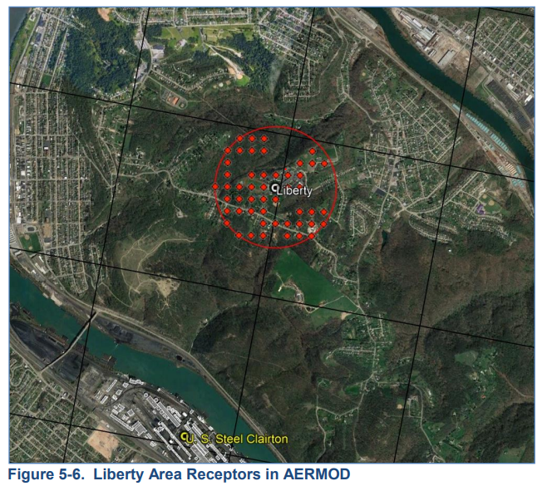
Near-Source Monitor in River Valley Terrain: Allegheny, PA
(A)
WRF 12km Terrain (m)
WRF 4km Terrain (m)
Liberty
WRF 1.3km Terrain (m)
WRF 0.444km Terrain (m)
US Steel Clairton
Fig. Liberty monitor with 1.3-km CAMx grid and 20-m AERMOD receptors
PM_{2.5} at the Liberty monitor in Allegheny is highly influenced by nearby facilities and meteorology associated with the river valley
Fine-scale terrain features not fully resolved at 1.3-km resolution (Fig. A) influence the US Steel facility impacts at the Liberty monitor
The PA SIP applies AERMOD combined with 1.3-km CAMx modeling
Brashers et al. (2017) EM https://www.awma.org/emjune17

Slide 29
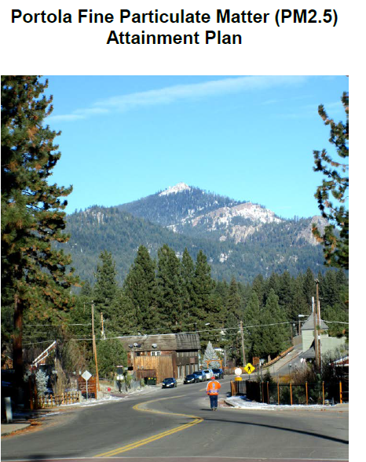
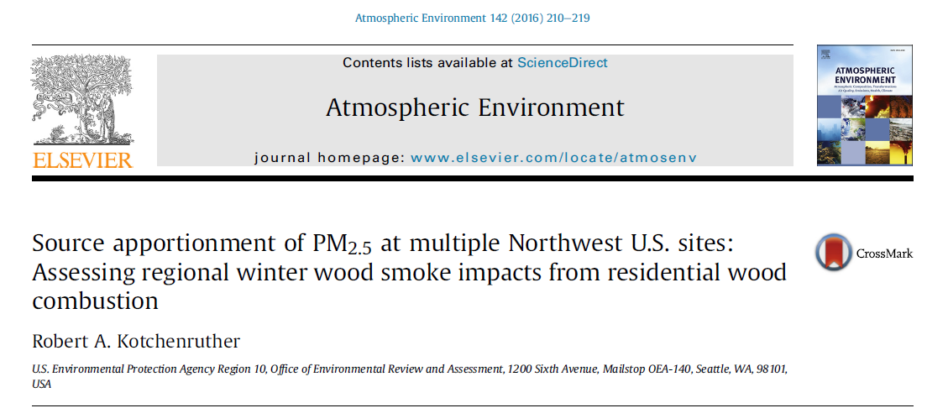
Statistical Rollback Approach for Woodsmoke Valley
Statistical rollback relates the wood-smoke contribution at the exceeding monitor to the local wood combustion emission totals to estimate the needed tons of emission reductions
The method uses statistical source apportionment (e.g., Positive Matrix Factorization) and assumes a linear relationship between emissions and measured concentrations
Reliable information on emissions from the local area is a key input to the method

Slide 30
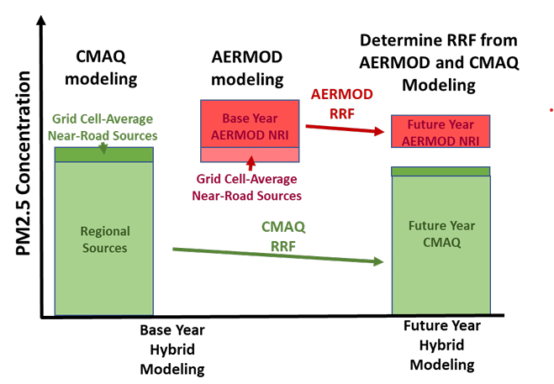
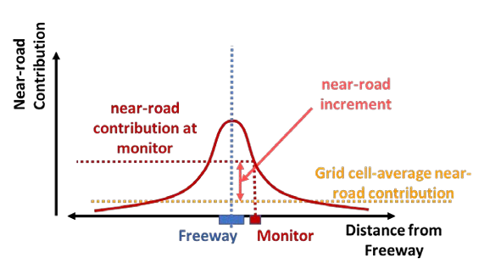
Near-Road Sites
Near-road sites are not always the highest design value sites in a CBSA, and most near-road sites were projected to meet the NAAQS in the RIA modeling
However, certain near-road sites are the highest DV sites in the area and do exceed standards
  E.g., Ontario-California in South Coast
Hybrid modeling approaches that use AERMOD for the near-road increment and CMAQ for regional sources are being implemented (e.g., SCAQMD, right)
Understanding the near-road PM_{2.5} increment is important to inform and evaluate these approaches
https://www.aqmd.gov/home/air-quality/air-quality-management-plans/other-state-implementation-plan-(sip)-revisions/2012-annual-pm2-5-plan

Slide 31
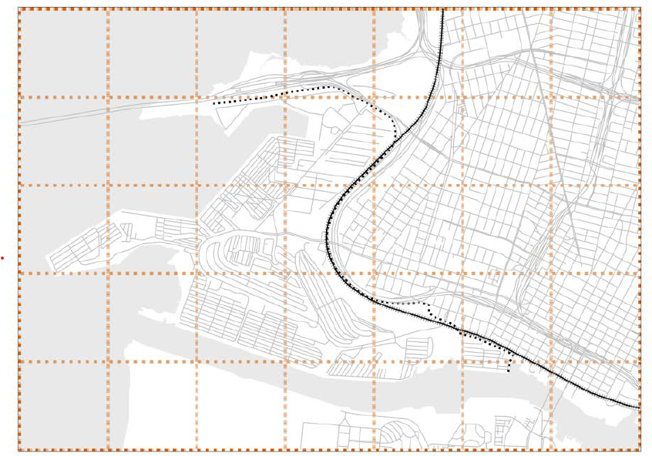
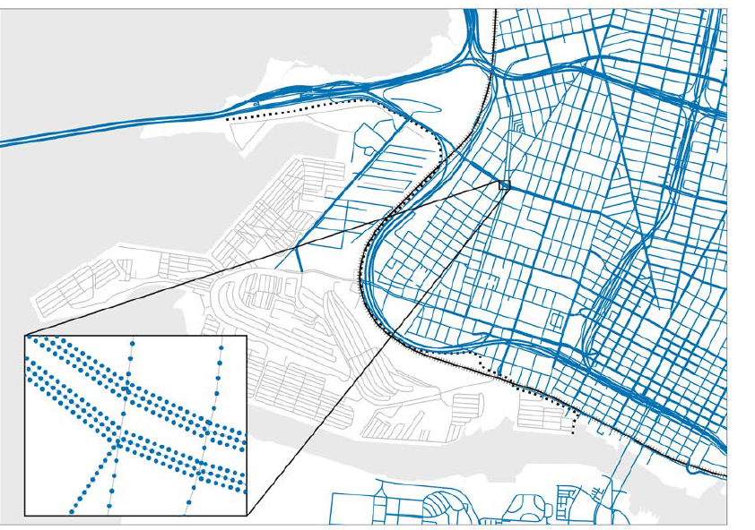
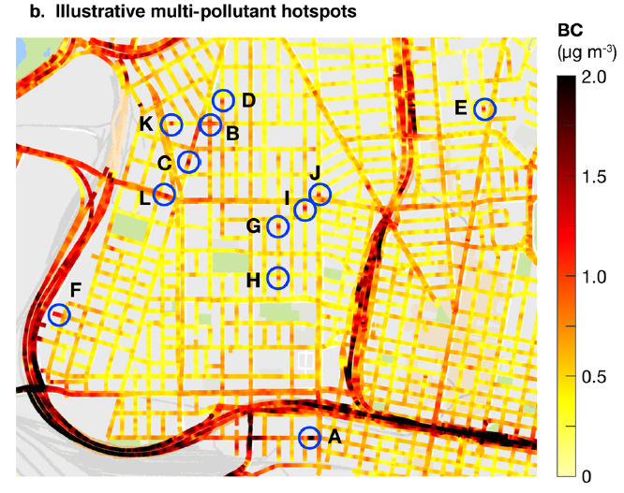
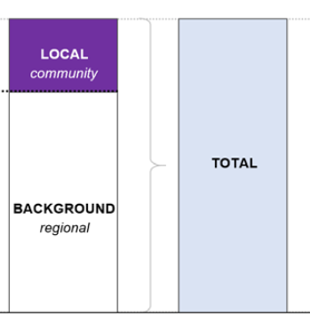
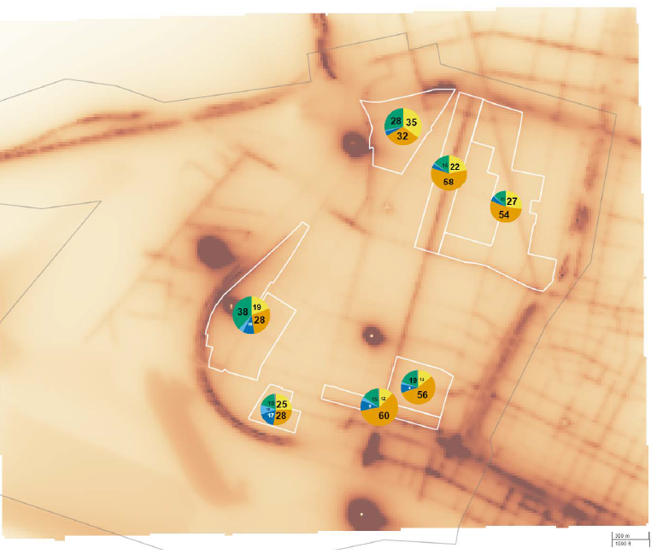
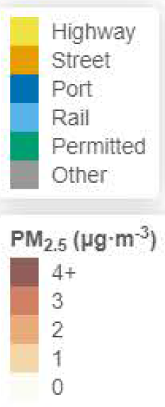
West Oakland
1-km CMAQ Grid
AERMOD Sources
Mobile Monitoring
Hybrid
AERMOD PM Modeling
Apte et al. (2017) ES&T
AERMOD
Mobile monitoring has observed elevated carbonaceous PM near local sources including a major truck route, vehicle repair facilities, and industrial sites with associated truck traffic
The West Oakland Community Action Plan was developed to protect and improve community health by reducing disparities in exposure to local air pollution
The uses detailed PM_{2.5} characterization based 1-km CMAQ modeling and local AERMOD dispersion modeling
1-km CMAQ
The West Oakland Community Action Plan -- Volume 2: Appendices, October 2019, BAAQMD and W. Oakland Environmental Indicators Project

Slide 32
Observational Constraints for High-Resolution Modeling
Modeling tools can be inexact and uncertain in capturing specific local conditions at specific monitors
Complementary observation-driven data analysis can inform air pollution conceptual models and supplemental weight-of-evidence analyses
Examples include
  Sensor data analysis
  Mobile monitoring in urban areas
  Intensive field measurement and analysis studies
  Model-monitor fusion
  Historical trends and responses to prior emission controls

Slide 33
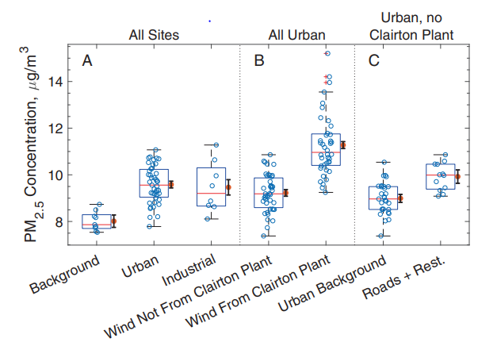
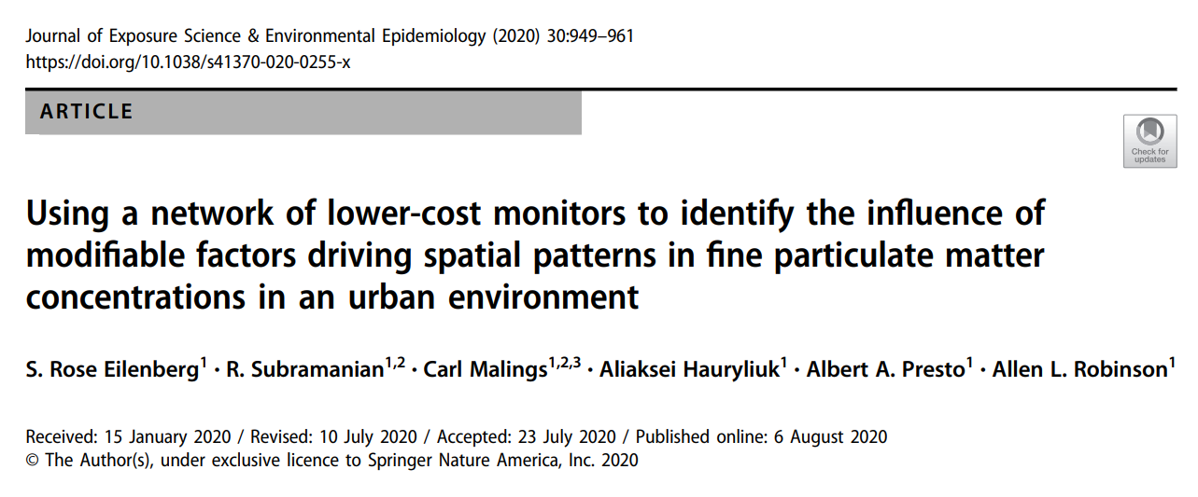
Calibrated Sensor Network PM_{2.5} Increment Analysis
https://www.nature.com/articles/s41370-020-0255-x
Well-calibrated networks of lower-cost sensors can provide insights on modifiable factors driving urban PM_{2.5} spatial patterns and contribute to supplemental weight-of-evidence that supports modeling estimates

Slide 34








Field Campaign Data
Intensive field campaigns collect data using comprehensive suite of measurements to understand specific pollution problems
Scientific analysis can improve understanding of the drivers of complex air quality problems to inform local solutions
Can help to corroborate modeling analyses as well as provide data for model evaluation
e.g., CalNex-2010, DISCOVER-AQ, SOAS-SENEX, ALPACA, LADCO Winter Nitrate Study
Source: NASA
Source: Miller et al. (2015)
Notes:
https://pubs.acs.org/doi/full/10.1021/acs.est.6b06603
https://pubs.acs.org/doi/10.1021/acs.est.2c05376
https://www.pnas.org/doi/full/10.1073/pnas.1803295115
Miller, D. J., et al. (2015), Ammonia and methane dairy emission plumes in the San Joaquin Valley of California from individual feed-lot to regional scales, JGR, 120, 9718–9738

Slide 35

Closing Remarks
Large emission reductions from regional SO₂ and NOx programs have led to improvements in PM_{2.5} concentrations (especially summer sulfate) throughout the US in recent decades
National rules are expected to continue the trend of regional SO₂ and NOx reductions
The PM_{2.5} attainment challenges under the 2024 NAAQS will likely be strongly influenced by relatively local sources and processes
High-resolution analyses in recent SIPs and emerging observational information from next-gen platforms suggest a path forward
Location-specific strategies have also been identified as an effective method to address racial-ethnic exposure disparities
https://www.pnas.org/doi/full/10.1073/pnas.2205548119

