Slide 1
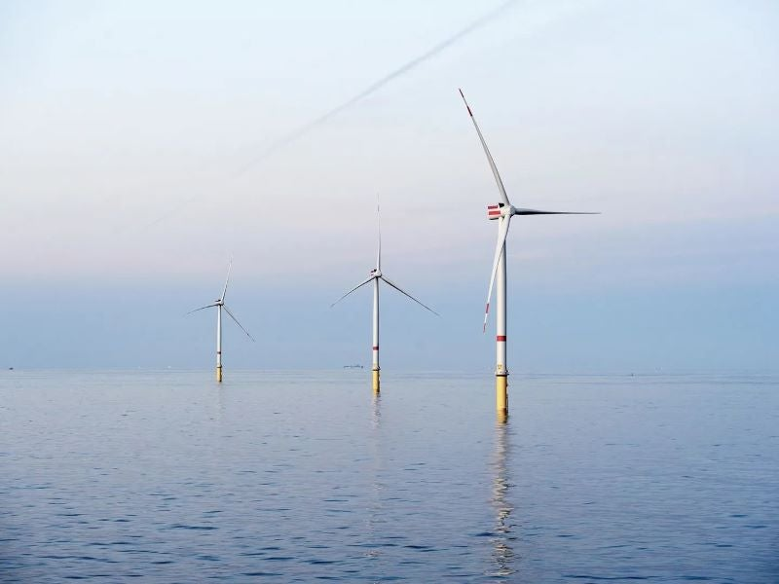
Modeled Air Quality Impacts of Wind Energy Projects Off the Northern Atlantic U.S. Coast
October 2024
…and onshore EGU impacts
Kirk Baker; Colby Tucker, Kevin Talgo, Nancy Hwang, James Beidler, Lara Reynolds, Tyler Fox
Neha Sareen, Brian Marmo, Jay McAlpine, Sarah Carroll, Tim Leon-Guerrero
Disclaimer: The views expressed in this presentation are those of the authors and do not necessarily reflect the views or policies of the U.S. EPA.
Notes:
I want to begin by expressing my gratitude to everyone that has provided support for this project. In particular I appreciate the continued information exchange with the EPA Regional contacts that work on offshore wind energy permits.

Slide 2
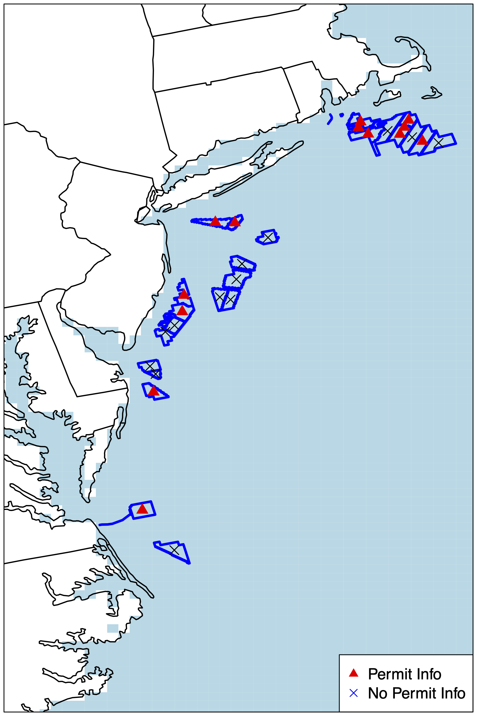
Project Scope
This presentation is intended to provide a preliminary assessment of annual average PM2.5 and seasonal average MDA8 (maximum daily 8-hr average) O3 impacts related to the construction and operation of wind energy projects off the U.S. Atlantic coast
Also intended to make preliminary assessment of PM2.5 and O3 impacts related to the change in emissions from onshore EGUs resulting from increased offshore electrical generation
Assessment is focused on the subset of projects that have emissions and generation information as of Summer 2024
Looking for feedback from those more familiar with different aspects of the project to inform the next phase of work

Slide 3
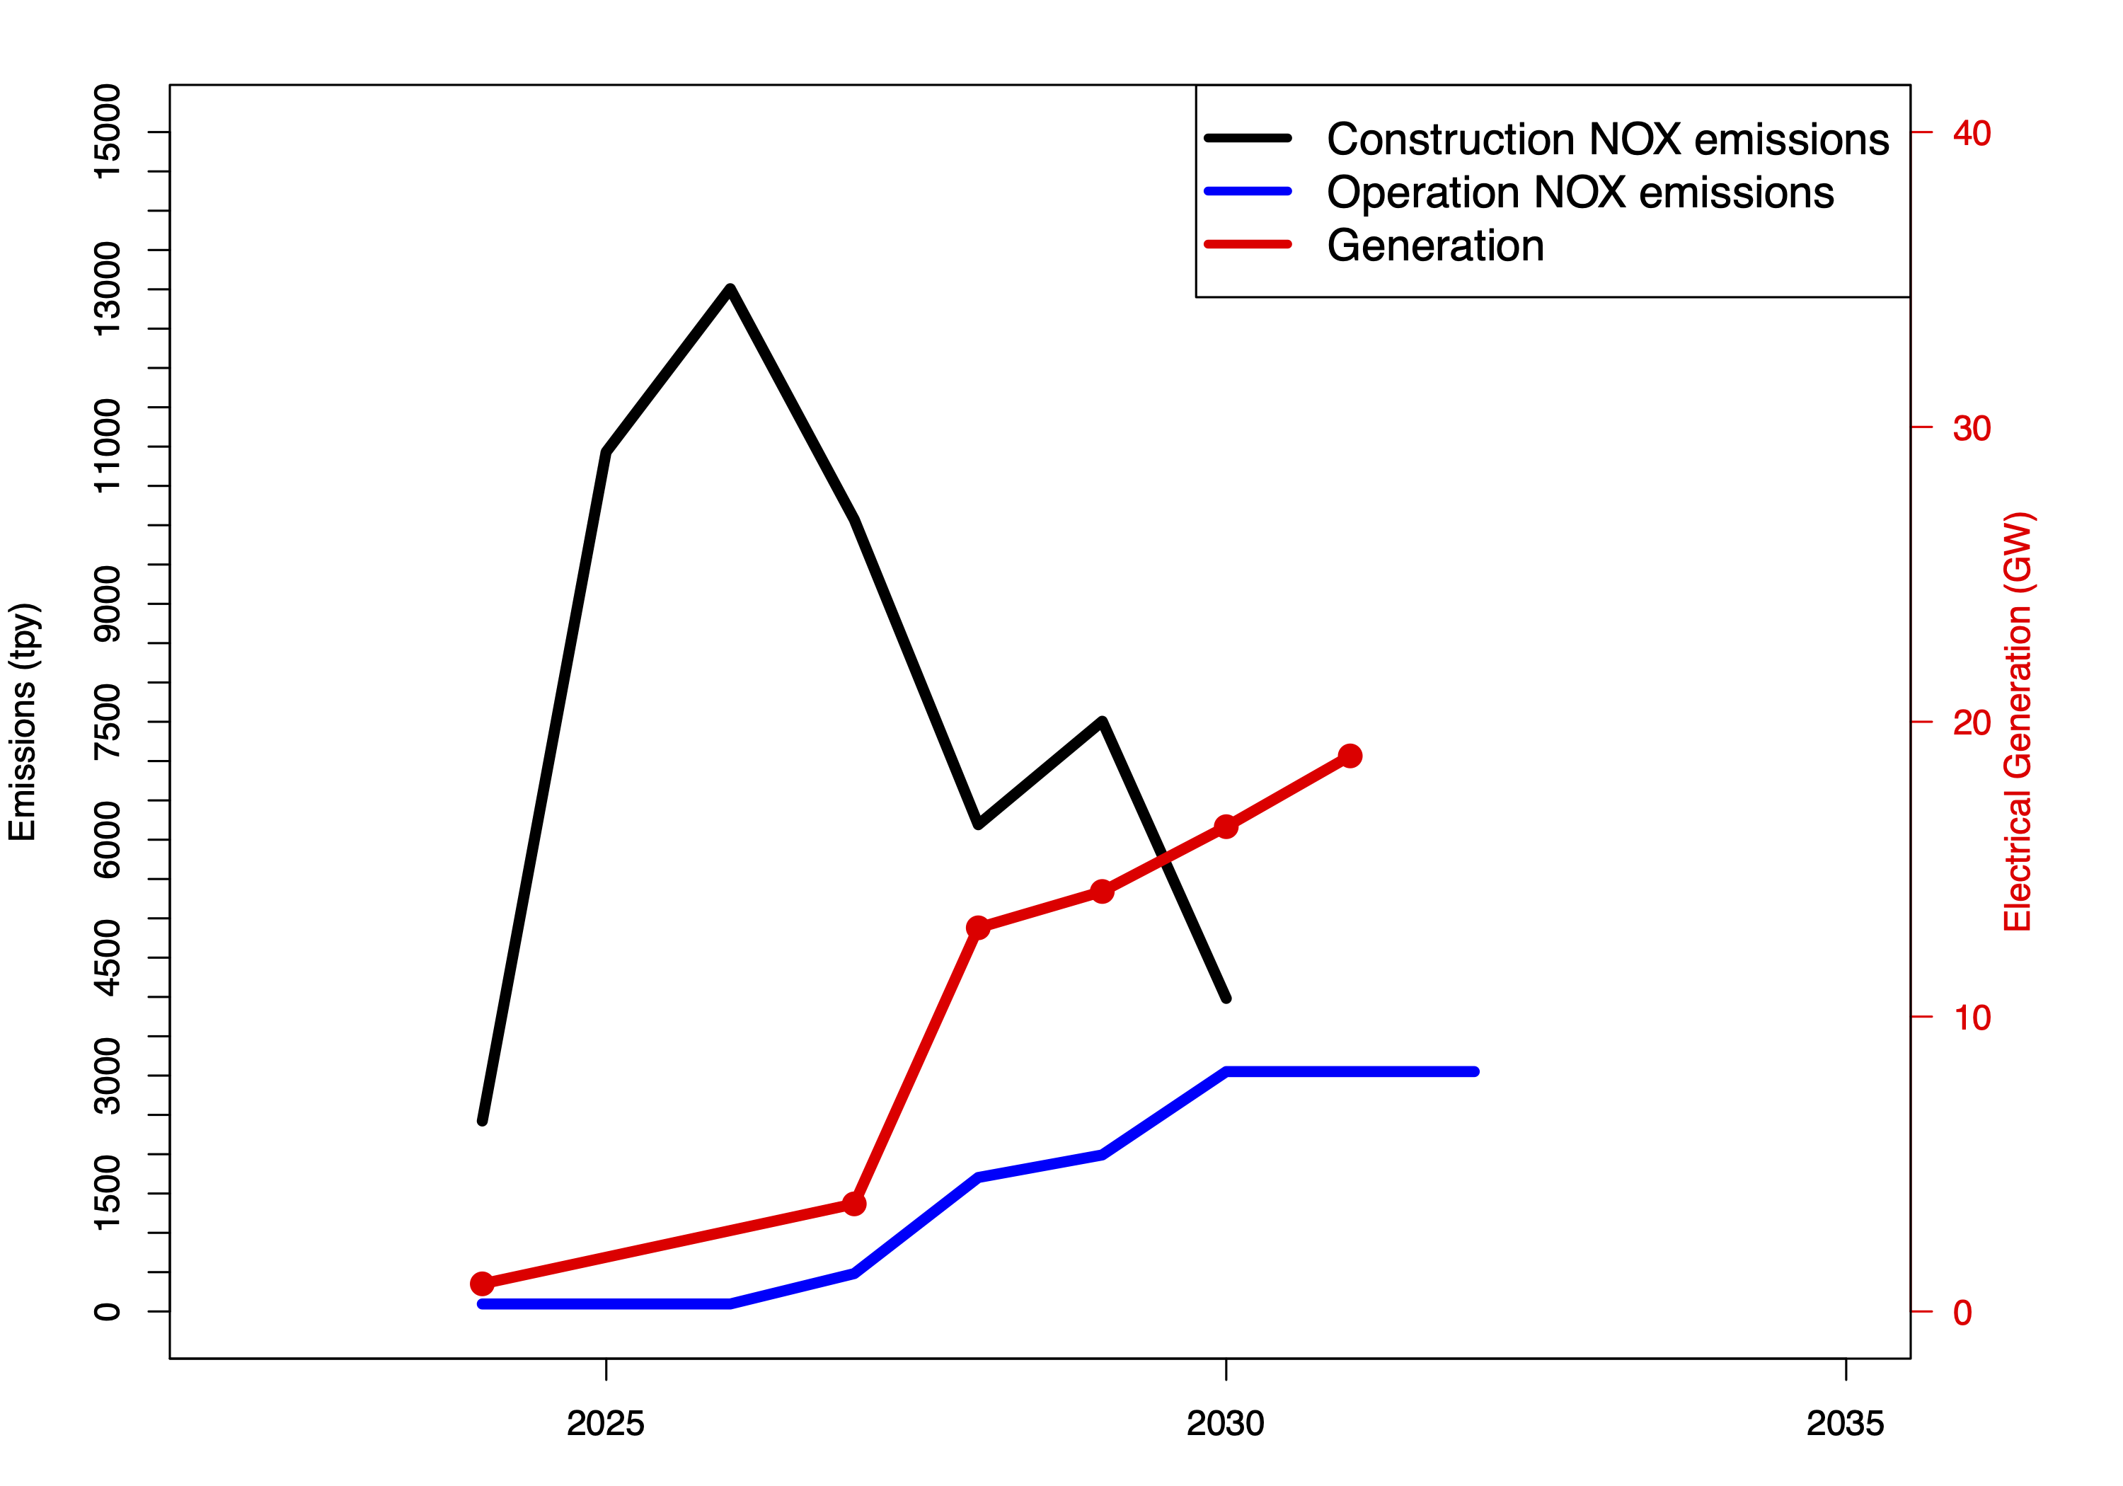
Offshore Wind Project Emissions
Emissions related to the operation of commercial marine vessels (CMV); large ships (Class 3) for construction and small ships (Class 1 and 2) for operation/maintenance
  Operation/maintenance phase emissions include occasional repairs and construction projects
  Construction phase emissions much higher than operation/maintenance phase
  In this modeling assessment construction emissions given CMV Class 3 stack characteristics and operation/maintenance phase emissions given CMV Class 1/2 stack characteristics
Emissions based on information provided on permits (Do not have information for all leased areas!)
  Permit emission rates are potential to emit so most likely somewhat conservatively high
  Emissions dominated by NOX with moderate amounts of primary PM2.5; not much VOC, SO2, or NH3

Slide 4
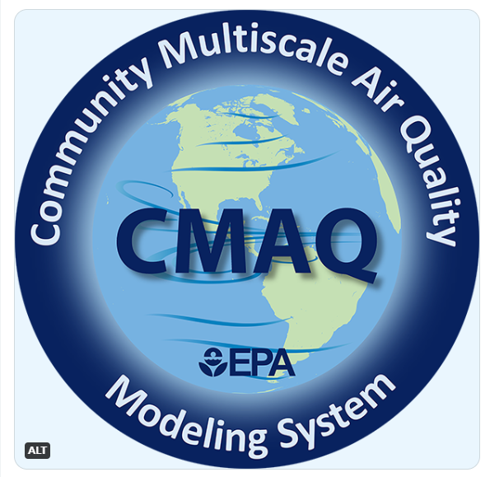
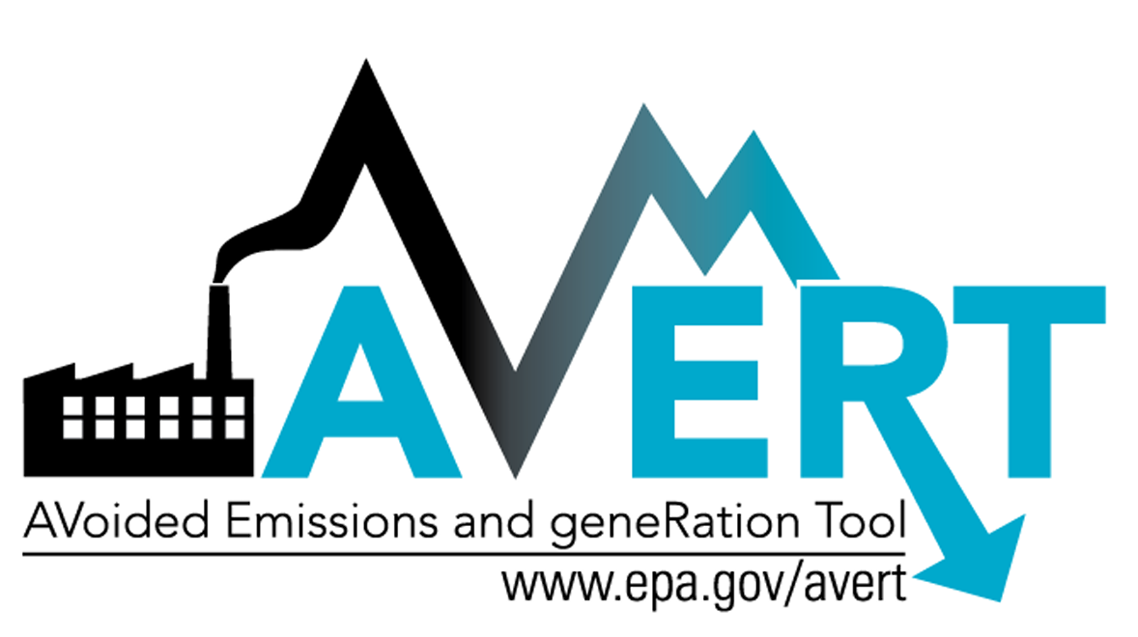
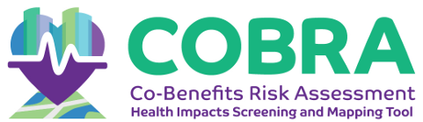
Model Simulations
CMAQ v5.4 (epa.gov/cmaq) annual 12 km CONUS simulations using 2016 meteorology; all future year anthropogenic sector emissions projected from 2016
  2026 scenario to characterize offshore wind project construction and operation phase emissions expected in 2026
  2055 scenario to characterize offshore wind project operation phase emissions from all projects
  Run #2 with onshore EGU emissions changes
Reduced complexity model Pattern Constructed Air Pollution Surfaces (PCAPS v1.1); embedded in COBRA (epa.gov/cobra)
  Separate year specific estimates of wind project operation phase, wind project construction phase, and EGUs for 2024 to 2032
  EGU emissions based on 2021 CEM/NEI emissions

Slide 5
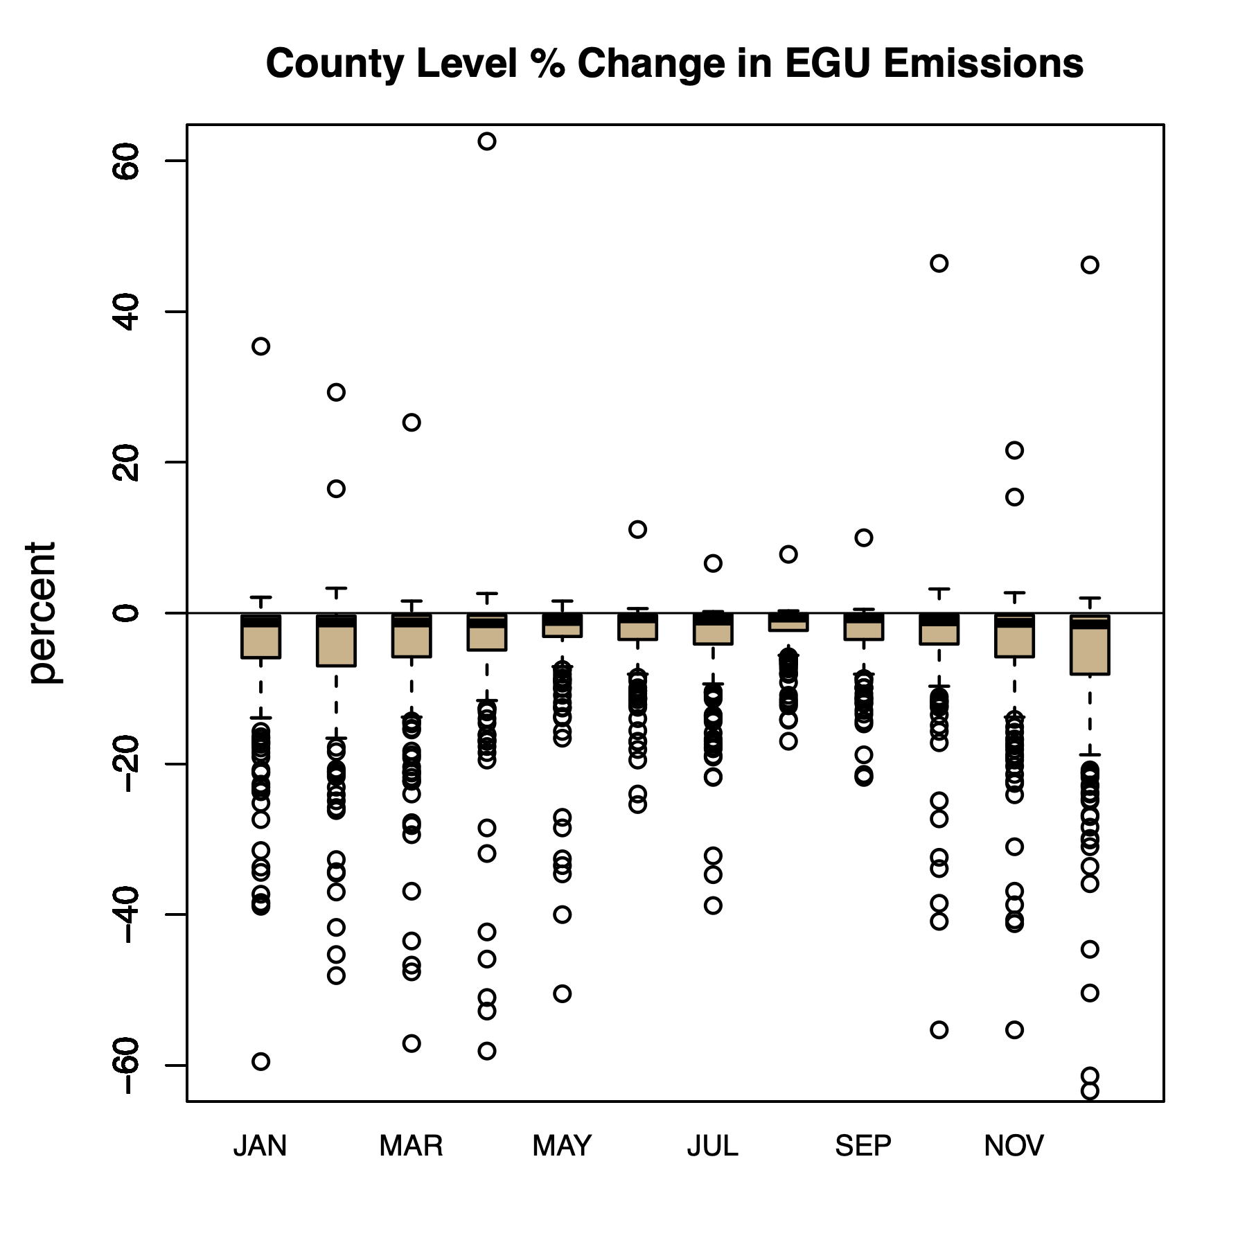
Onshore EGU Emissions
Increased offshore energy capacity should result in changes to onshore EGU emissions
Applied EPA’s Avoided Emissions and generation Tool (AVERT) version 4.3 to estimate changes in onshore EGU emissions related to increased offshore energy generation (epa.gov/avert)
  AVERT monthly percent change by precursor and county were applied to CMAQ EGU input files
Predicted reduction in EGU emissions tended to be highest in the colder months (shown at right)

Slide 6
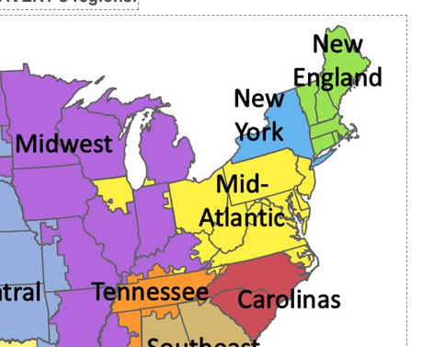
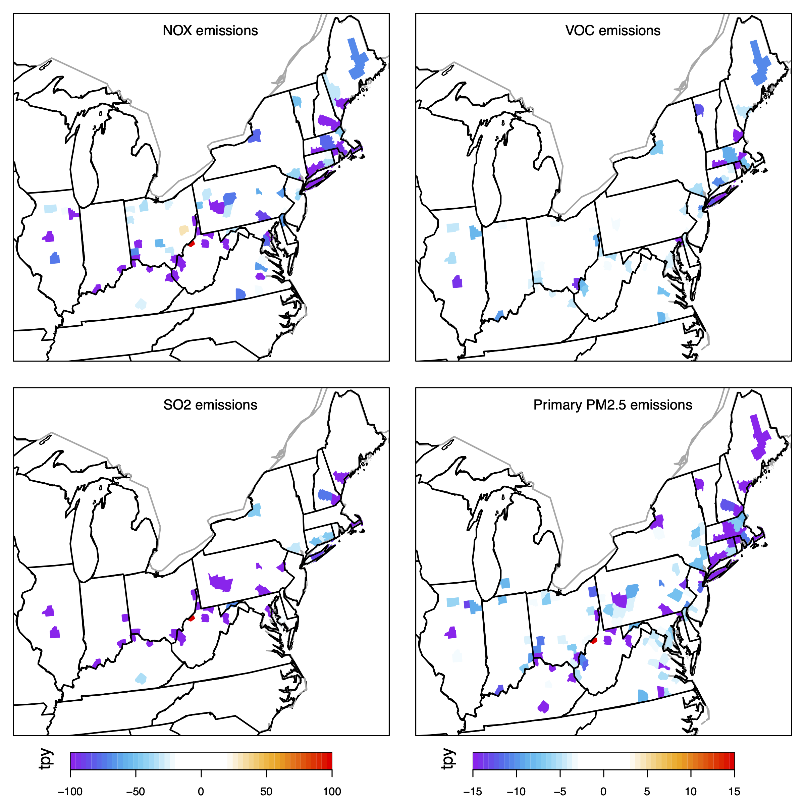
Offshore generation capacity estimates mapped by AVERT to onshore interconnects
Simple assumptions about relationship between offshore generation and onshore grid interconnects
County total change in emissions

Slide 7
Results

Slide 8
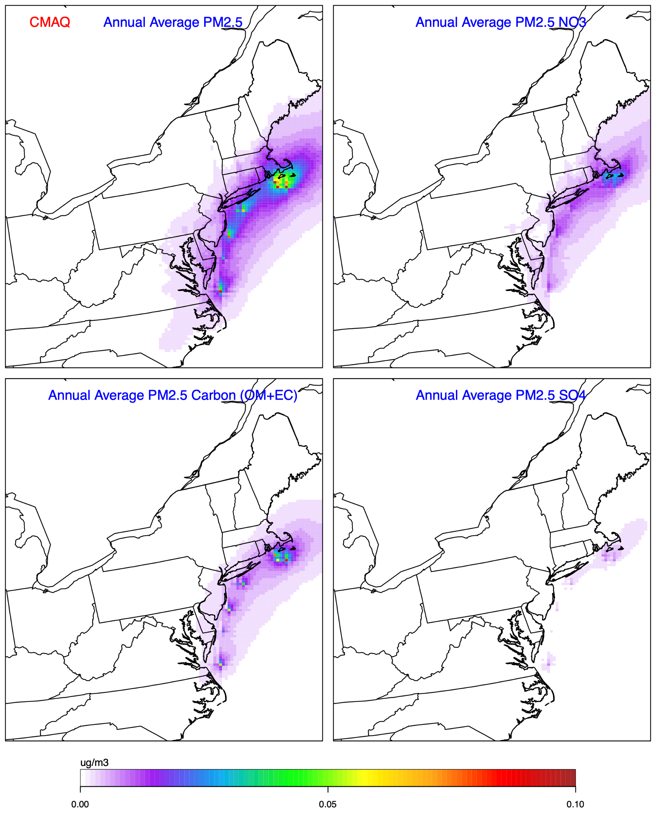
CMAQ predicted annual average PM2.5
CMAQ predicted impacts on annual average PM2.5 (top left) and major chemical components for 2026 scenario
  PM2.5 nitrate ion (top right)
  PM2.5 carbon (bottom left)
  PM2.5 sulfate ion (bottom right)
Most PM2.5 impacts related to primary PM2.5 and secondarily formed nitrate

Slide 9
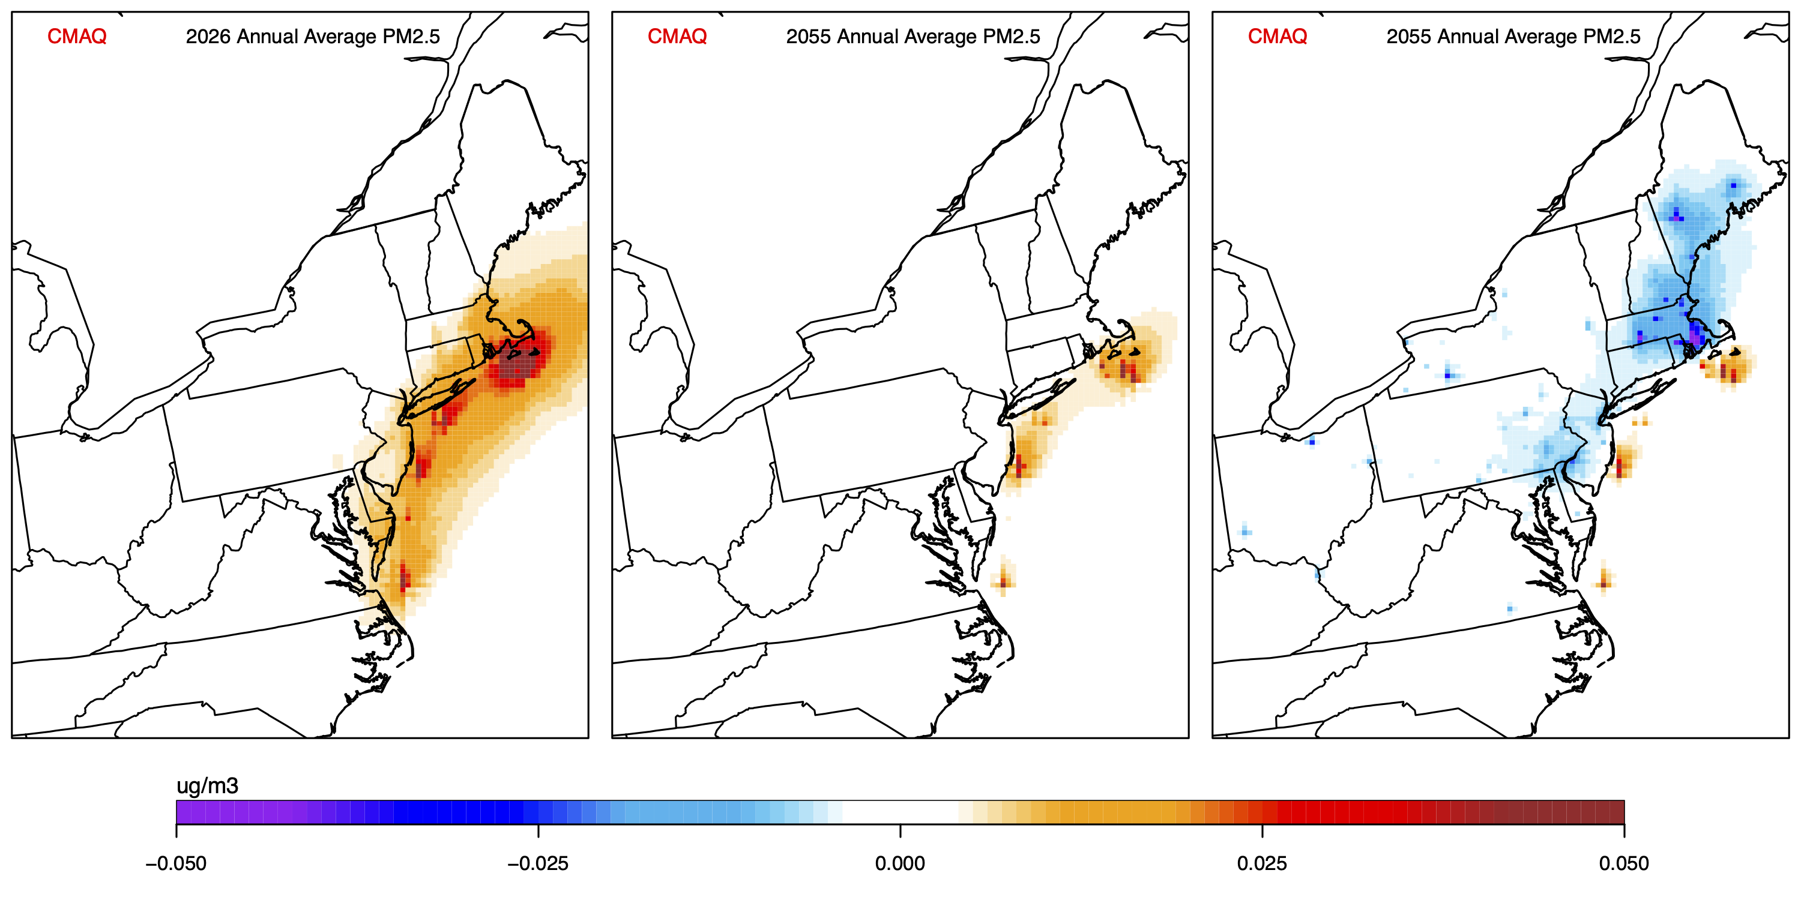
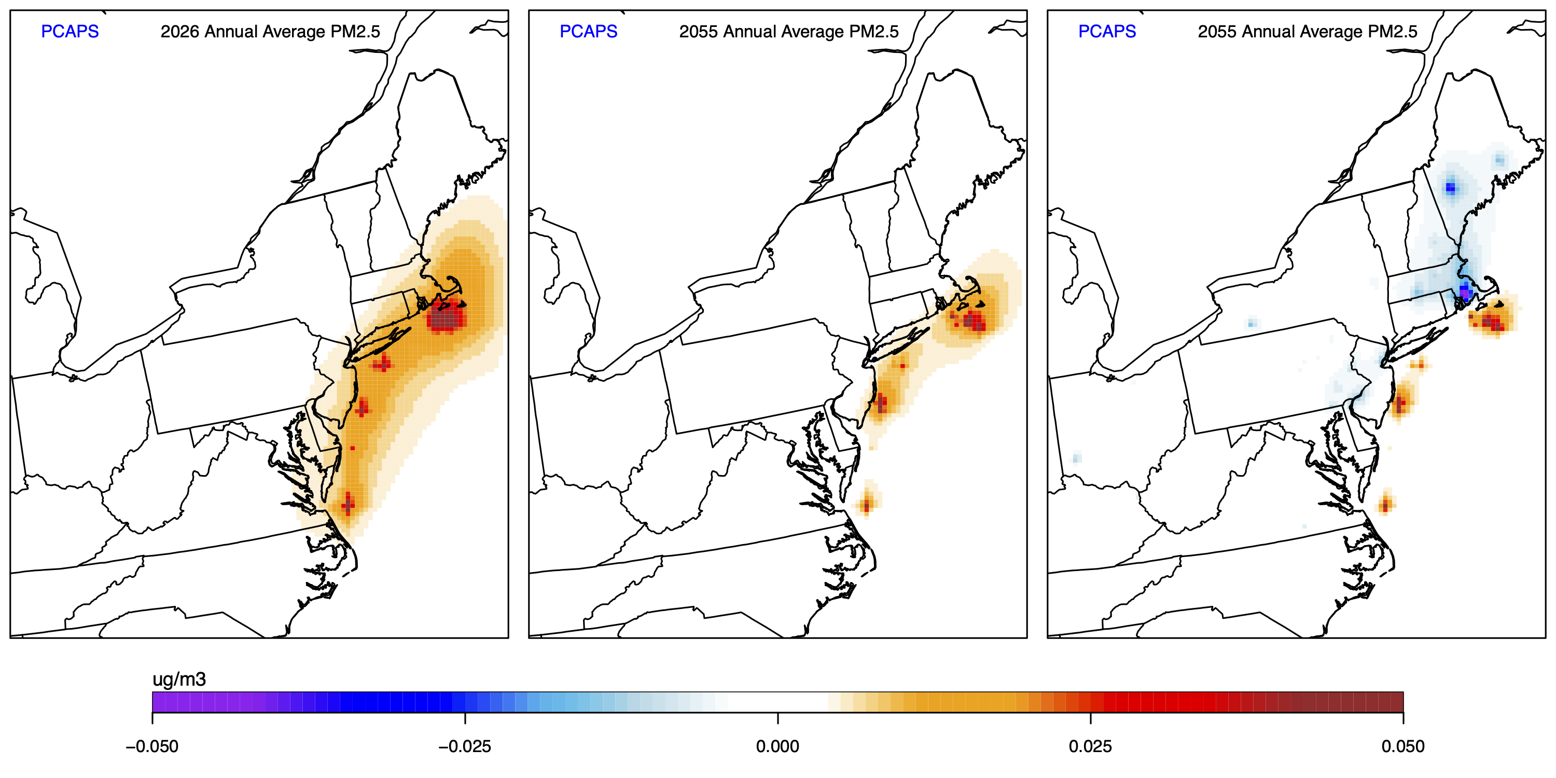
2026 wind project operation & construction
2055 wind project operation phase
2055 wind project operation phase + change in onshore EGUs
CMAQ
CMAQ predicted annual average PM2.5
PCAPS reduced complexity tool predicted annual average PM2.5
PCAPS

Slide 10
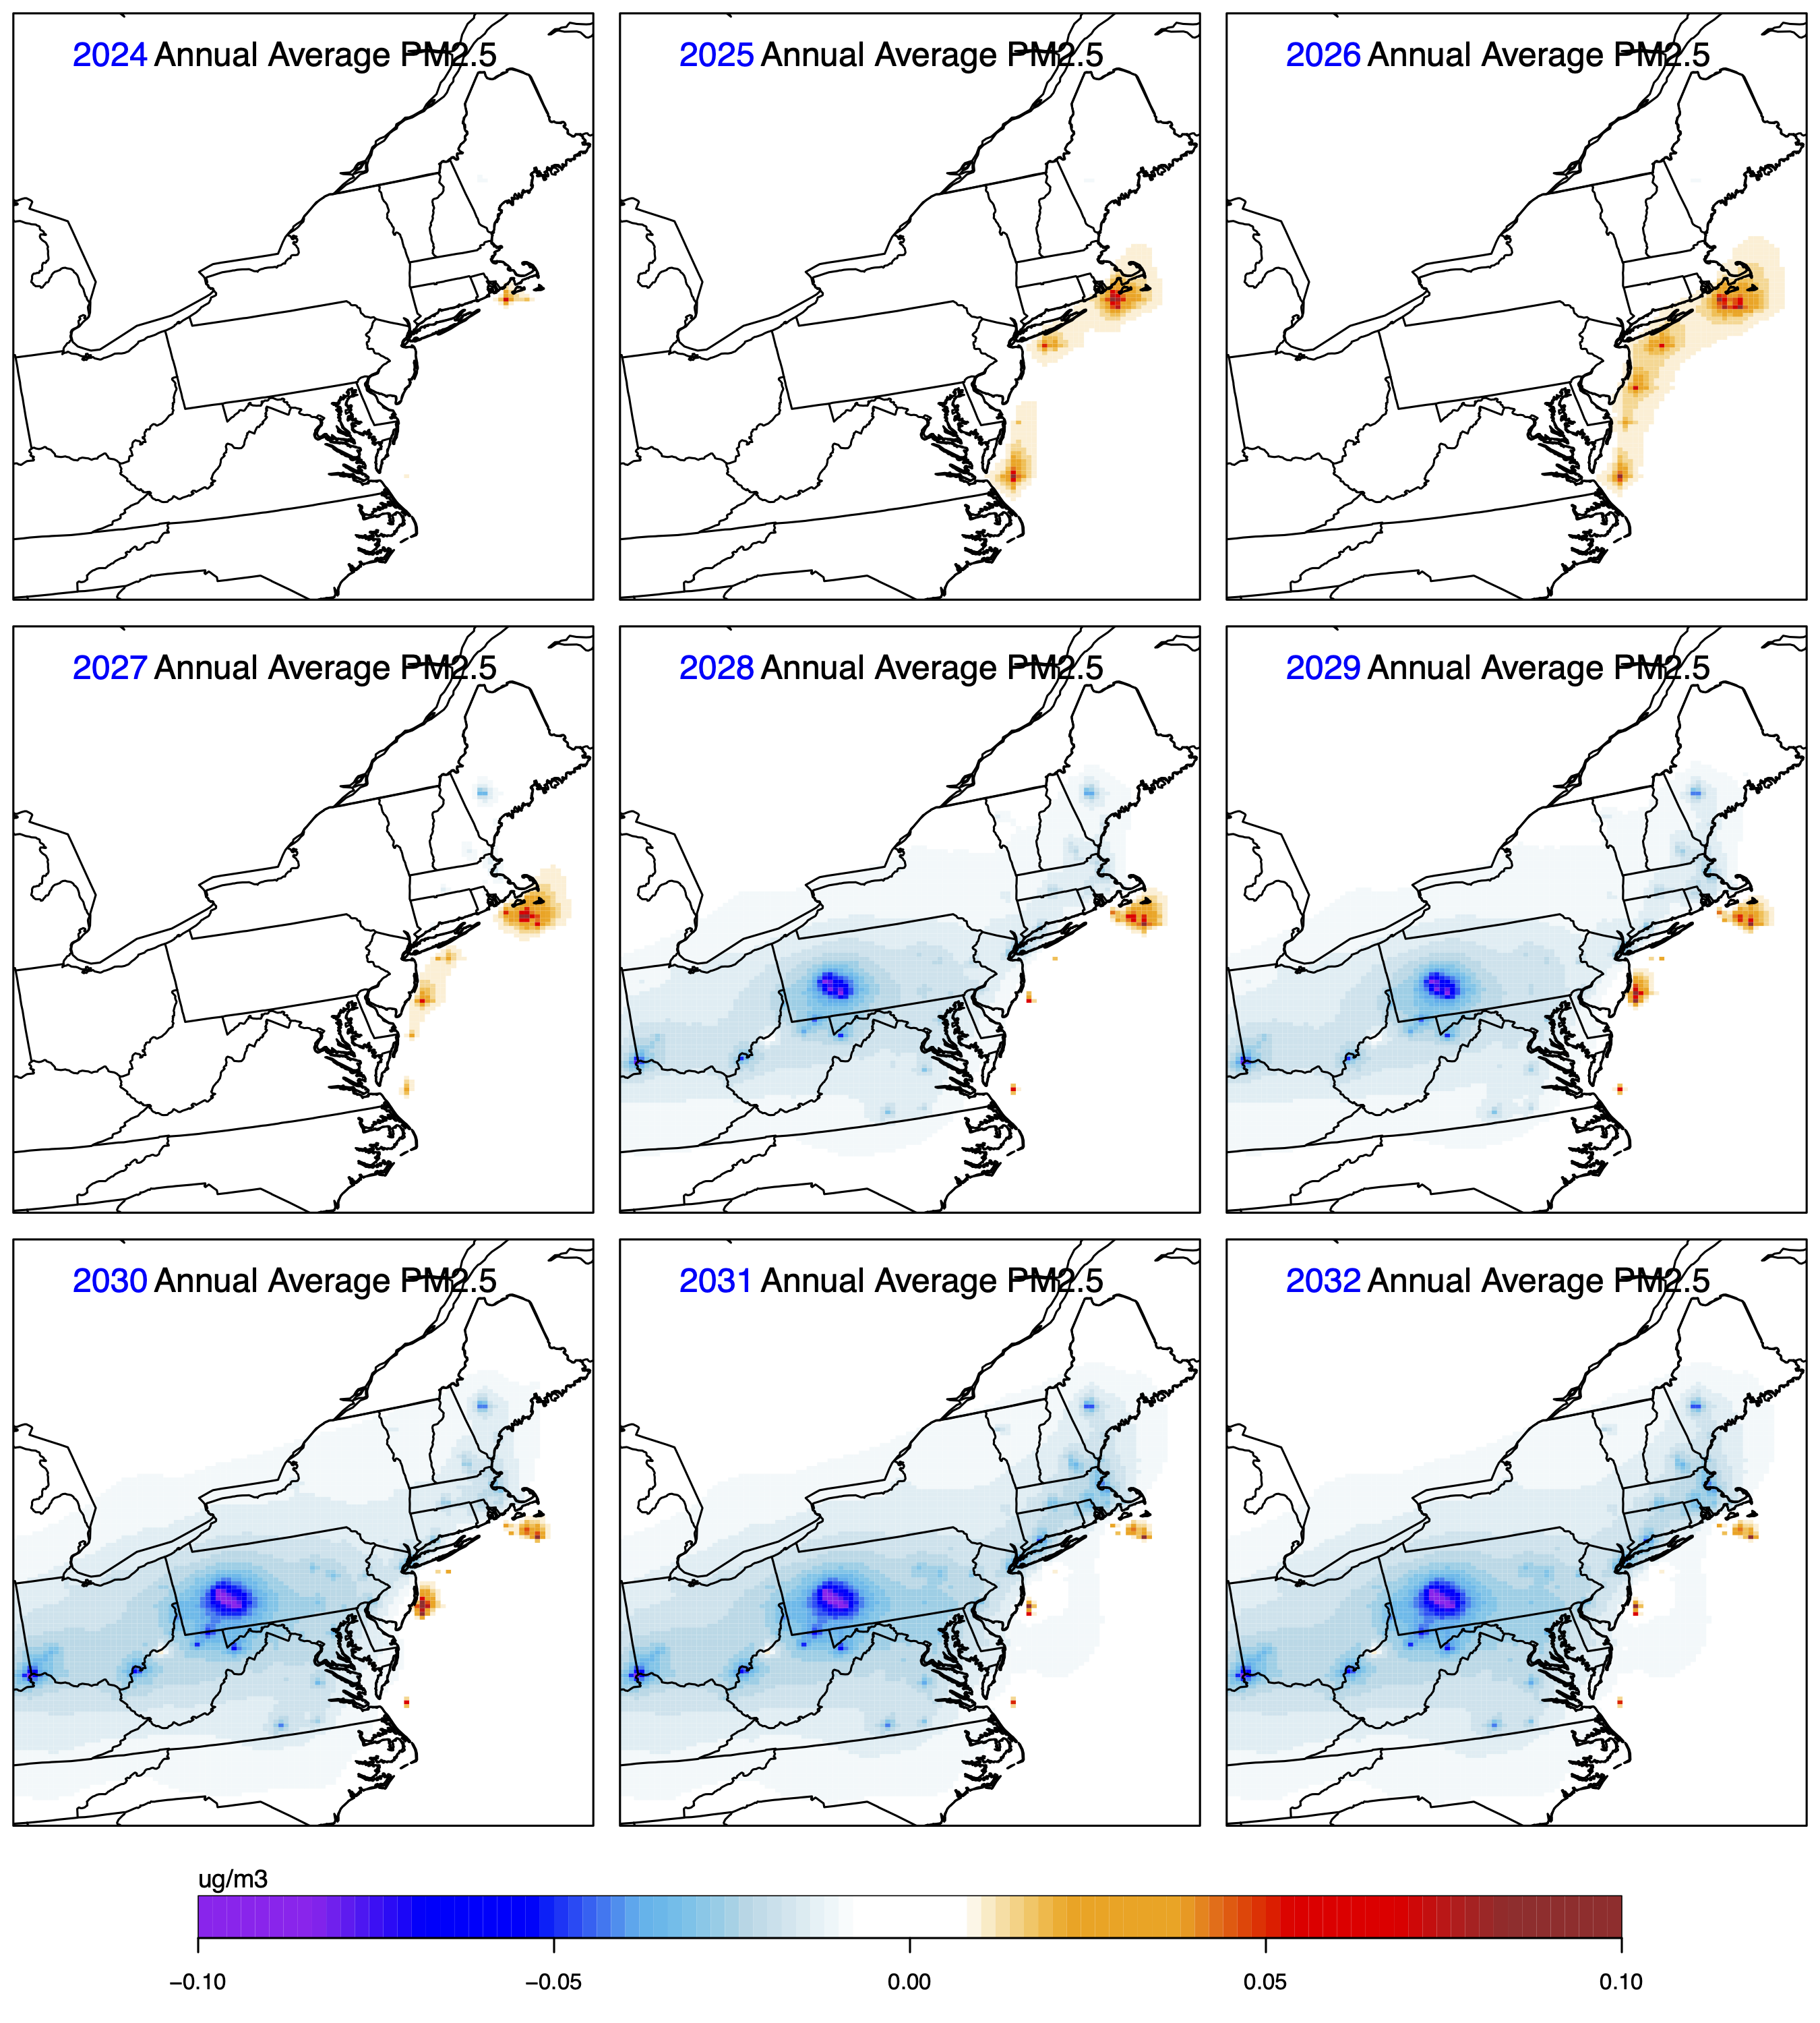
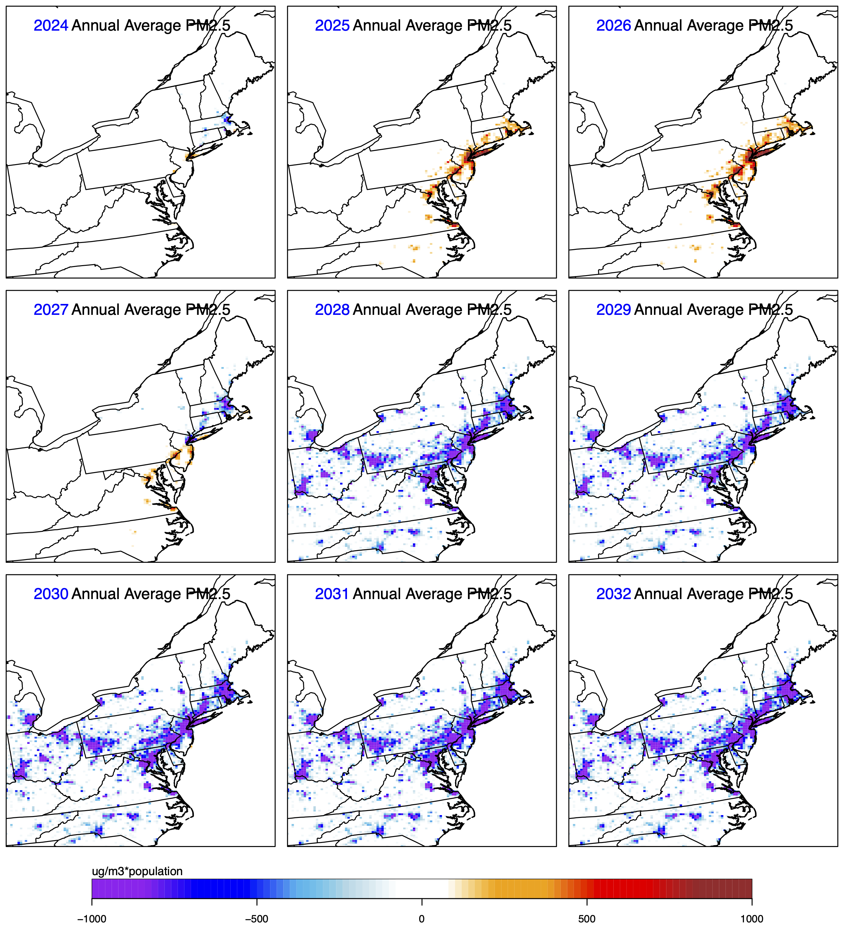
PCAPS predicted 2024 to 2032 annual average PM2.5 concentrations
PCAPS predicted 2024 to 2032 annual average population influenced PM2.5 concentrations

Slide 11
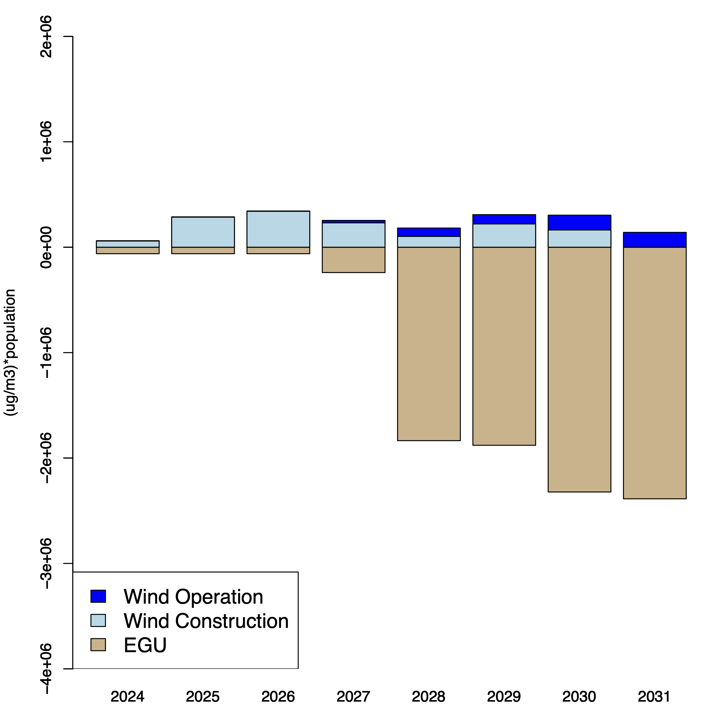
Population Exposure: PM2.5
Total (over all grid cells) population influenced annual PM2.5 concentrations predicted by PCAPS for 2024 to 2031
  Contribution to wind project operation/maintenance, wind project construction, and onshore EGU emissions shown (left)
  Negative values reflect decrease in population weighted exposure
Impacts related to onshore EGU reductions outpace offshore wind project increases as more wind projects begin providing energy

Slide 12
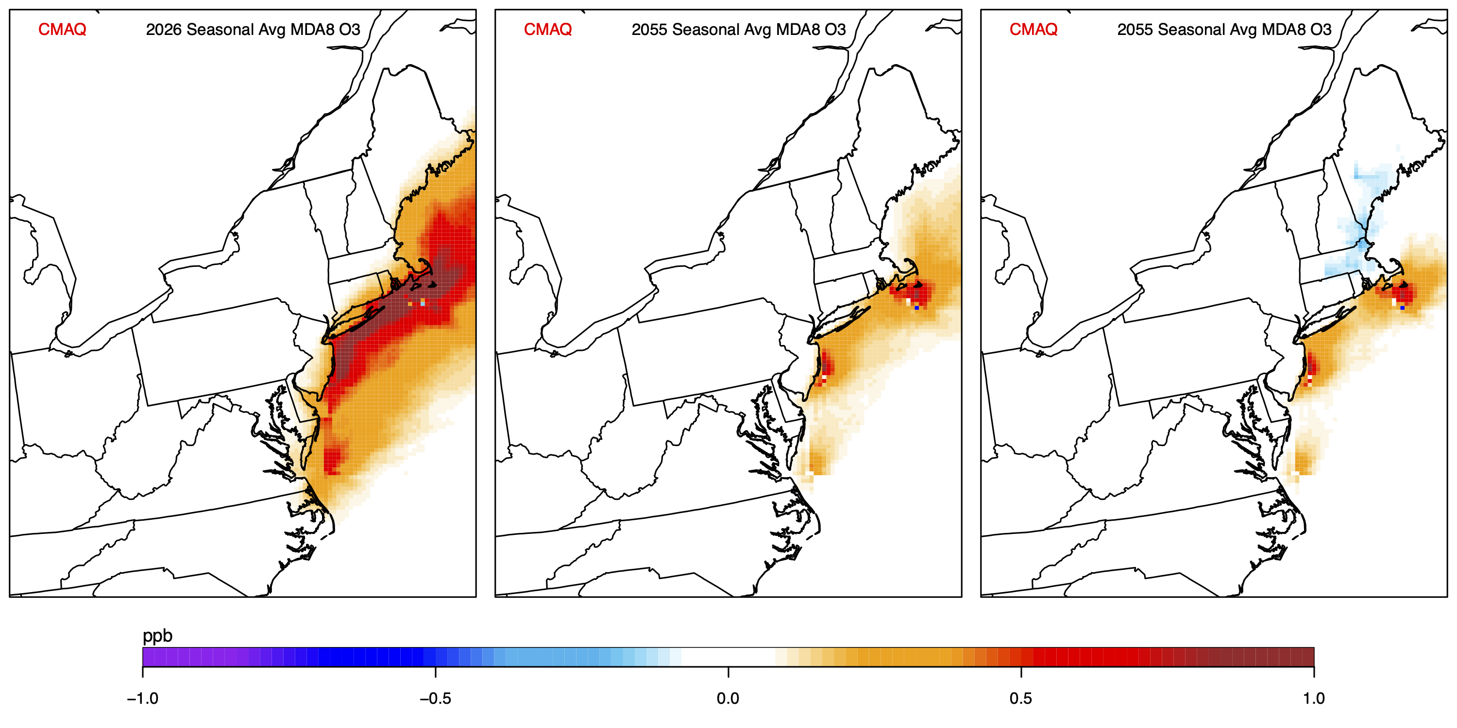
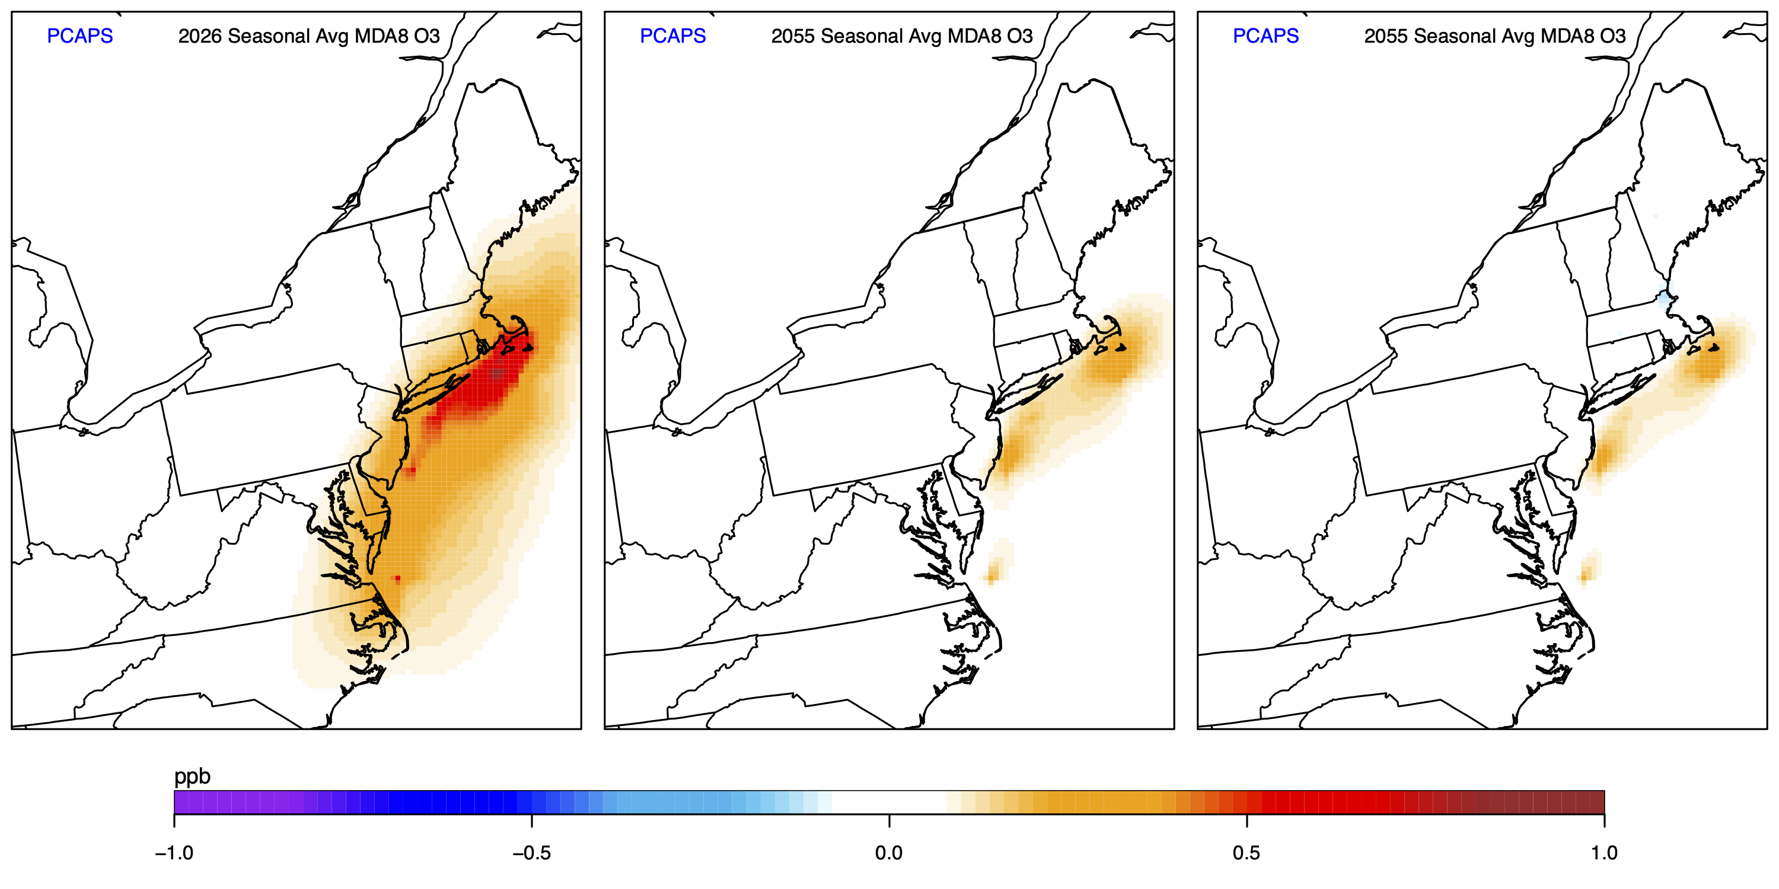
2026 wind project operation & construction
2055 wind project operation phase
2055 wind project operation phase + change in onshore EGUs
CMAQ
CMAQ predicted seasonal average MDA8 O3
PCAPS reduced complexity tool predicted seasonal average MDA8 O3
PCAPS

Slide 13
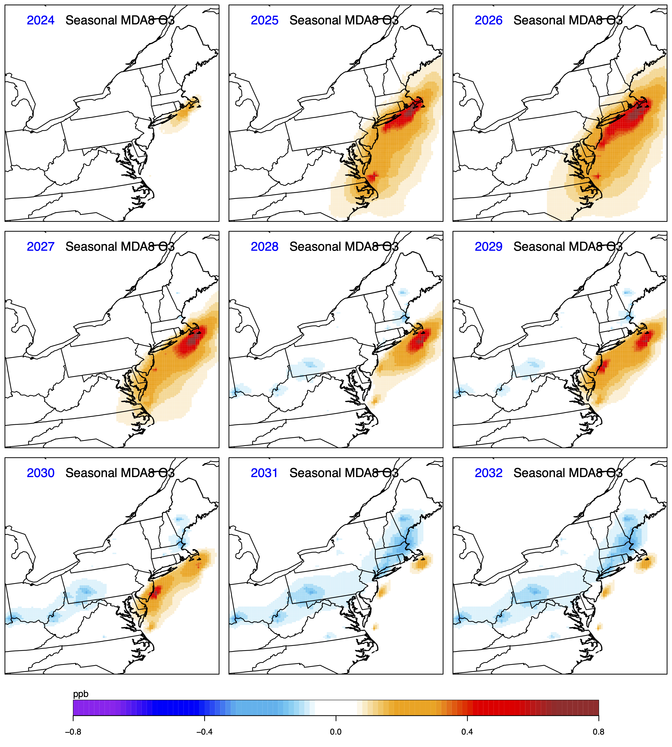
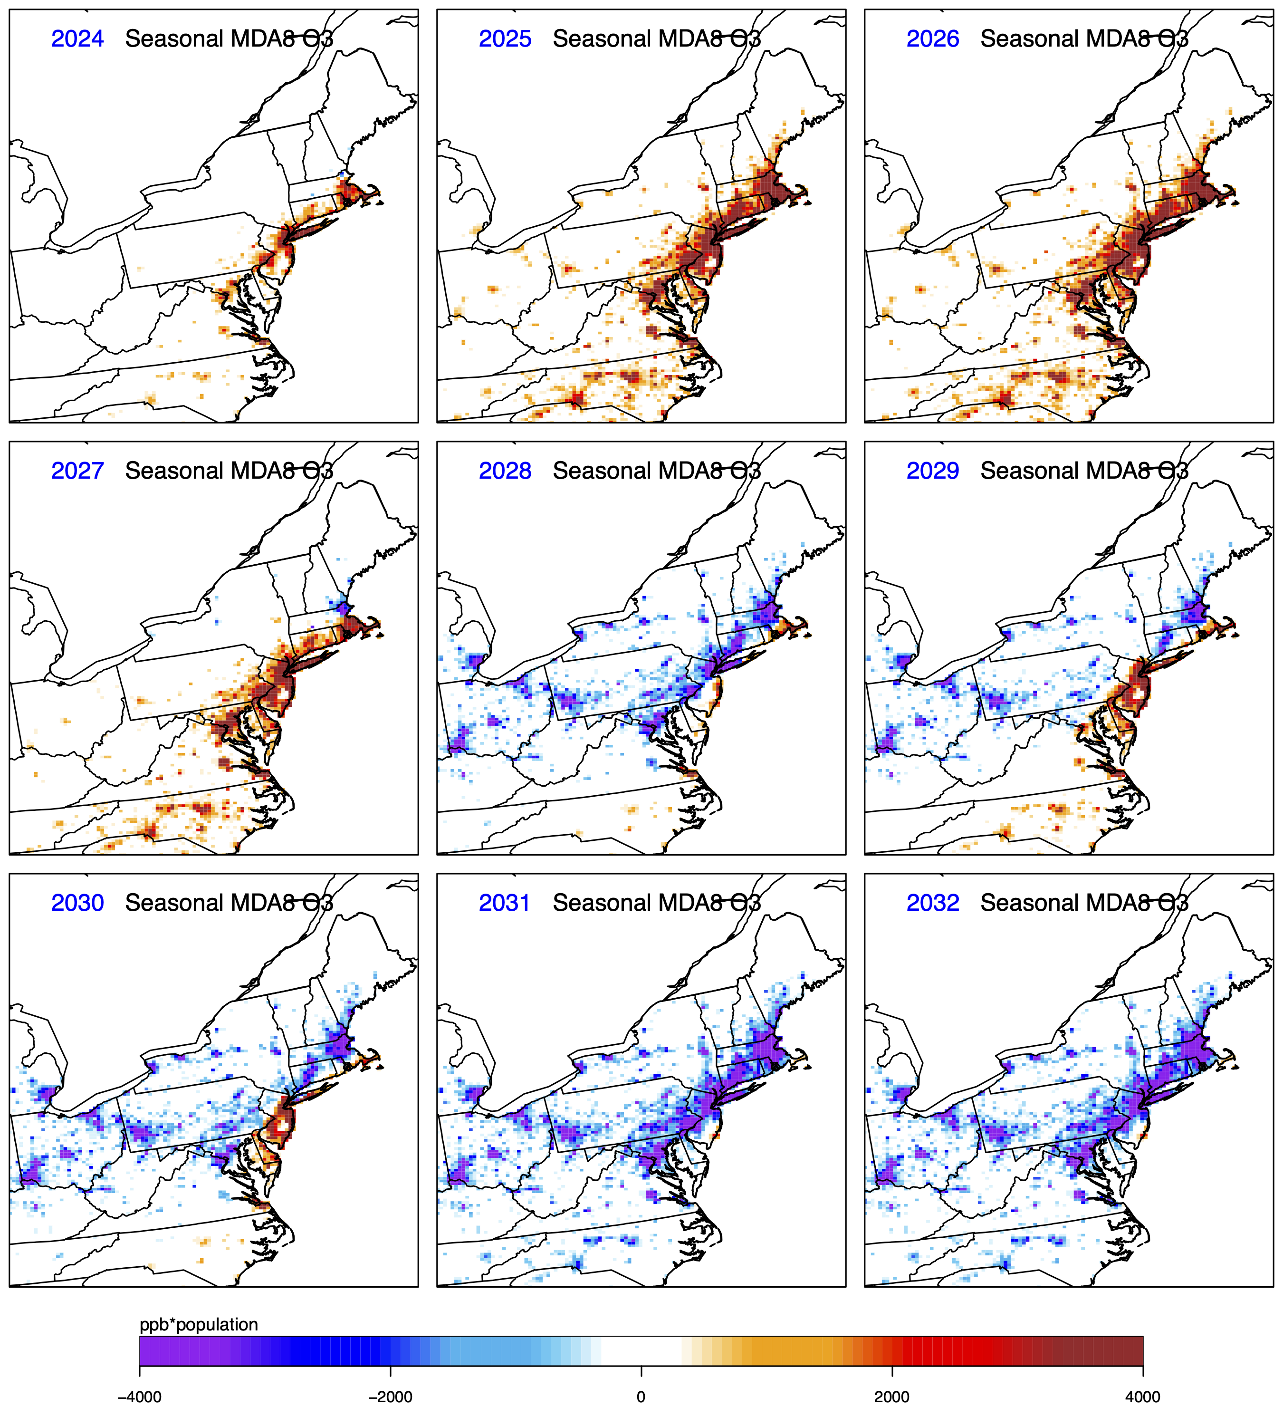
PCAPS predicted 2024 to 2032 seasonal average MDA8 O3
PCAPS predicted 2024 to 2032 seasonal average population influenced MDA8 O3

Slide 14
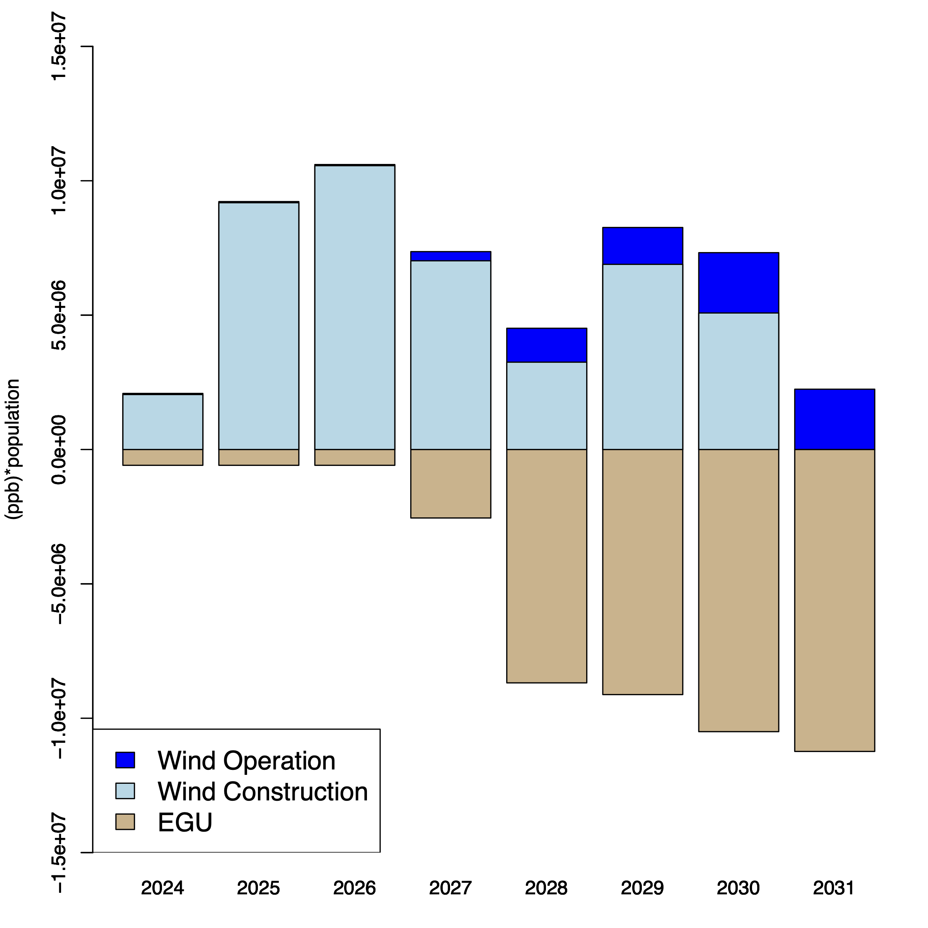
Population Exposure: MDA8 O3
Total (over all grid cells) population influenced MDA8 O3 predicted by PCAPS for 2024 to 2031
  Contribution to wind project operations, wind project construction, and onshore EGU emissions shown (left)
  Negative values reflect a decrease in population weighted exposure
Onshore EGU decreases important but less impactful for O3 than PM2.5 because emission reductions largest in the colder months based on AVERT
Onshore EGU emissions decreases outweigh impacts from offshore wind project operation/maintenance emissions

Slide 15
Next Steps
Continue to update and improve offshore wind project emissions and energy capacity information
Quantify scenario specific health impacts related to PM2.5 and O3 exposure using BenMAP
Corroborate AVERT predicted changes in onshore EGUs due to increased offshore energy capacity with other emissions models
Additional model evaluation for the offshore environment using special field study measurements

Slide 16
Thank You

Slide 17
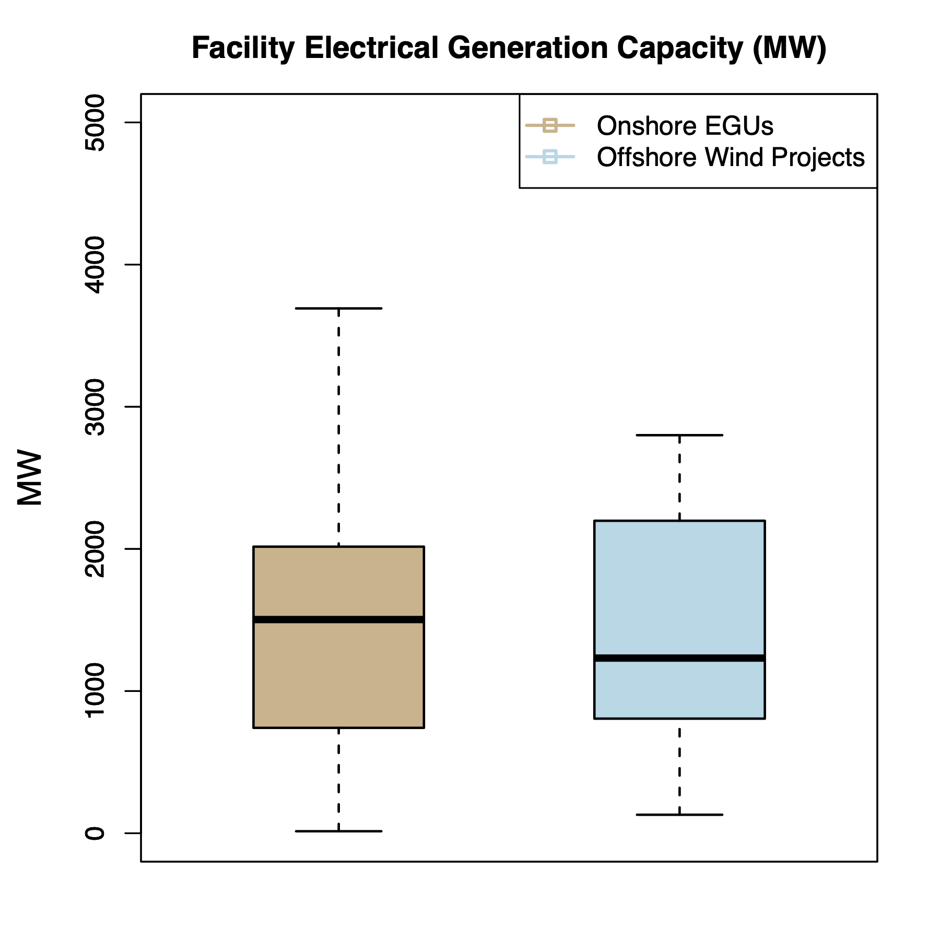
Electrical Generation Comparison
How does the electrical generation capacity of offshore wind energy projects compare to onshore facilities?
Distribution of energy capacity for EGUs (facilities with NOX emissions > 100 tpy in conterminous U.S.) compared against planned energy capacity for offshore wind projects shown at left

