Slide 1
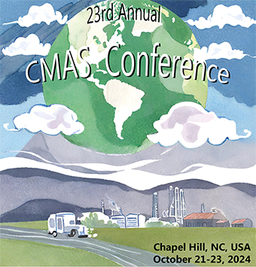
State of the
Center for Community Modeling and Analyses System (CMAS)
> 2 Decades of Serving the Community
Sarav Arunachalam
Director, CMAS Center

Slide 2
The CMAS Center at UNC https://www.cmascenter.org/
Established in 2001, the U.S. EPA’s CMAS Center has been hosted at UNC since 2003, which works with the agency to lead the international, open-source, community-based air quality modeling and analysis software used to develop policies and analyze air quality impacts
Objectives
  Serve as bridge between segments of the AQ modeling community
  Foster growth of developer and user communities
  Serve as hub for modeling education and training
Functions
  Model Research and Development
  User Support
  Applications and Training
  Outreach

Slide 3
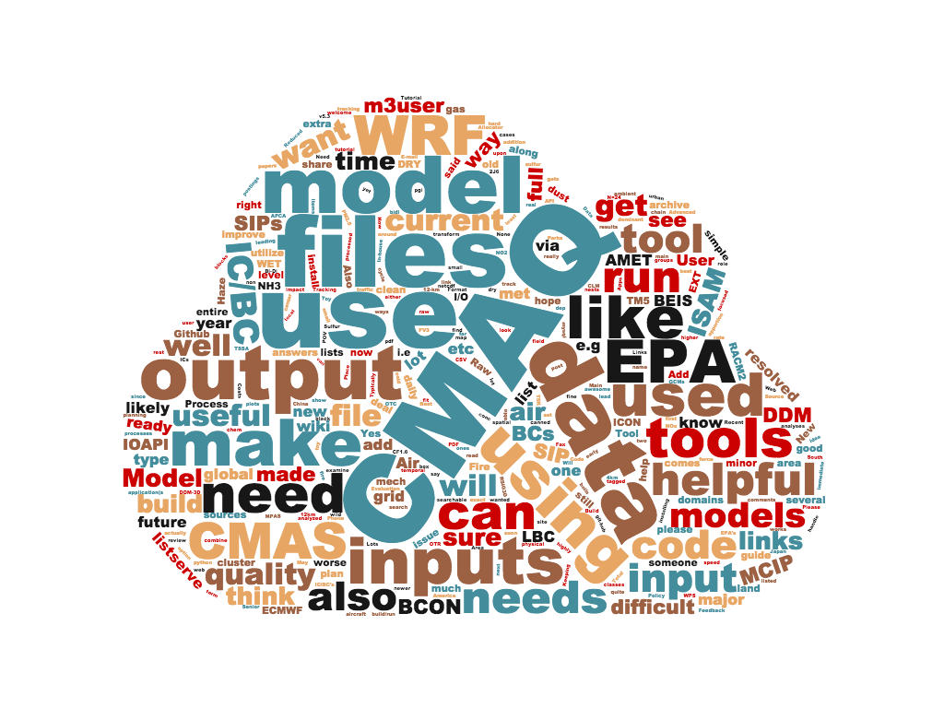
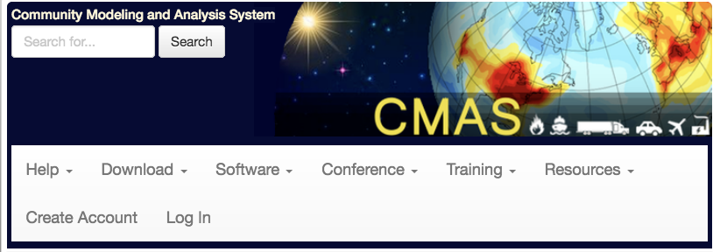
Tool Suite @ CMAS Center
23rd year of operation, serving > 10,000 users globally
See https://www.cmascenter.org
to download these tools

Slide 4
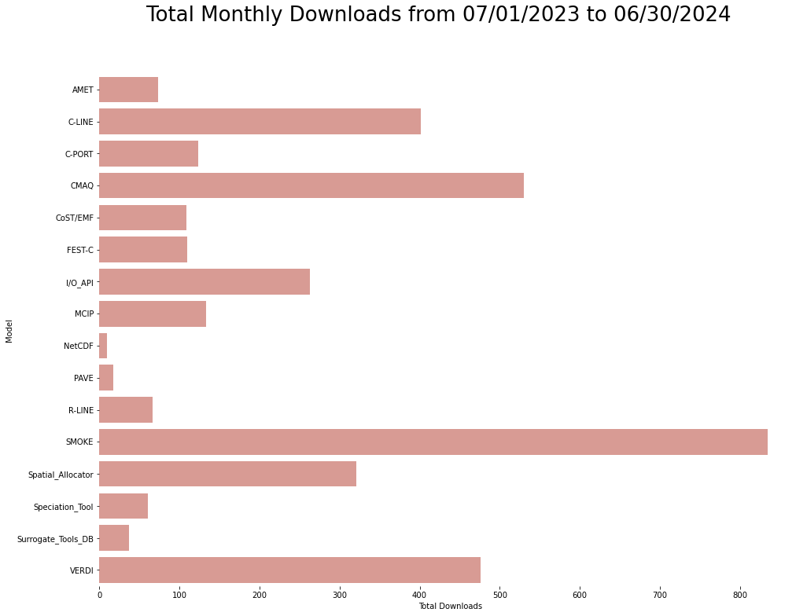
Model Downloads
USER SUPPORT
Model Releases during 2023 – 2024
CMAQ v5.5
SMOKE v5.1
VERDI 2.1.5

Slide 5
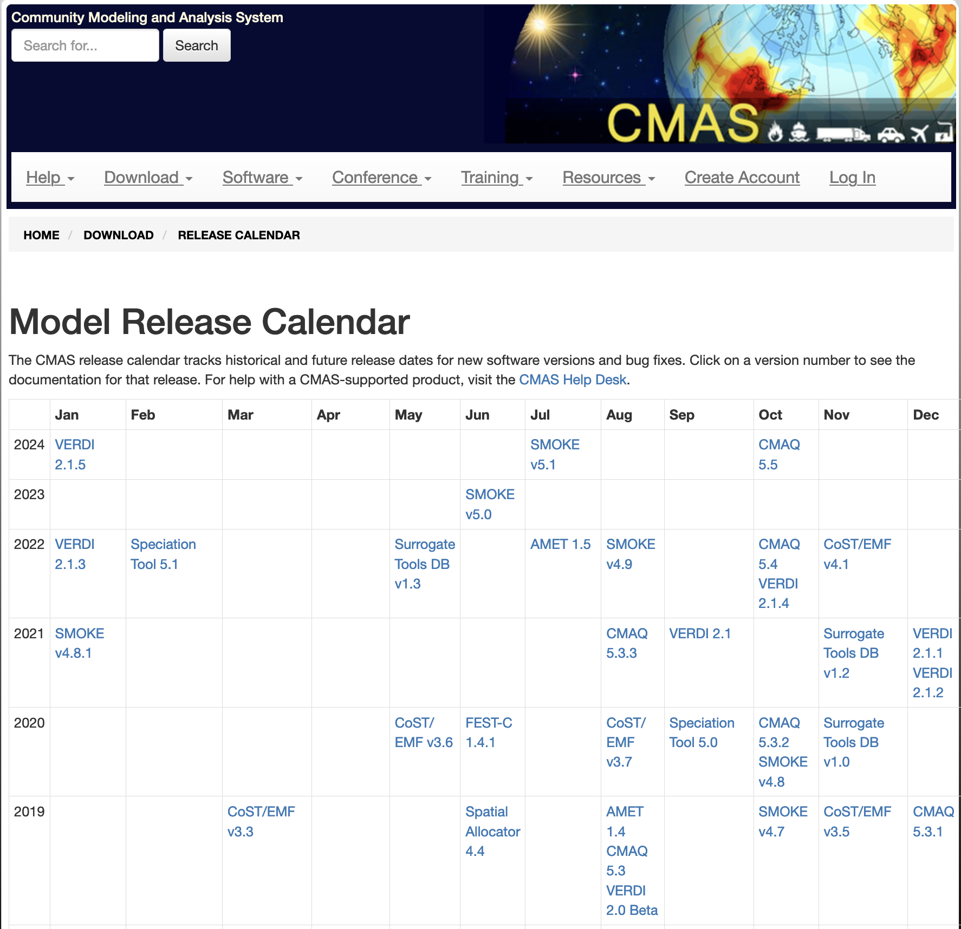
Software Release Calendar
USER SUPPORT

Slide 6




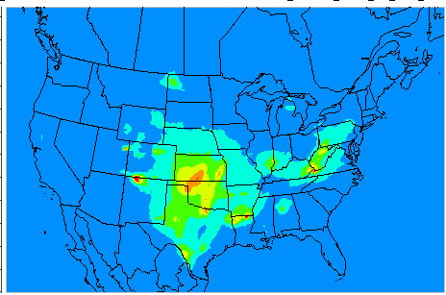

CMAS Data Warehouse
USER SUPPORT
Emissions (NEI)
Reporting
Met (WRF/MCIP)
AQ (CMAQ)
Modeling
Data Warehouse on Google Drive & AWS
Observations
Visualization
~160 TB and Growing
Cloud computing using AWS and Microsoft Azure

Slide 7
CMAS Data Warehouse
- both for and from the community
USER SUPPORT
Current datasets available for CMAS community
  CMAQ on AWS Open Data Program
    See registry at: https://registry.opendata.aws/cmas-data-warehouse/
    Metadata available at: https://dataverse.unc.edu/dataverse/cmascenter
    All data on AWS S3 bucket
  Multiple years of data available
    EQUATES* EPA’s Air QUAlity TimE Series project data from 2002 – 2019
    CMAQ Release Benchmark data
    MPAS-CMAQ Input data
    CMAQ 2016v3, 2018, 2019, 2020 modeling platforms
    SMOKE 2016 modeling platform and test case
    CMAQ WWLLN data for 12US1 from 2016 – 2022
  Egress fees not charged to host or to the end-user
Interactive Forms interface to share datasets from researchers to others
*Foley et al, Data In Brief, 2023

Slide 8
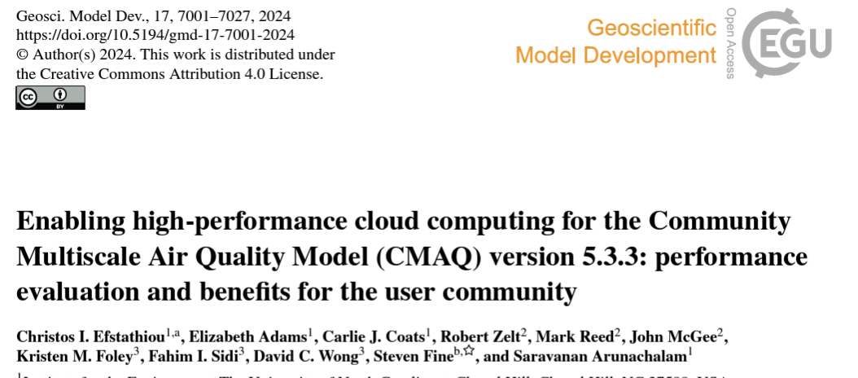
CMAQ on the Cloud
USER SUPPORT
Significant progress in running CMAQ v5.4 on Cloud
  Extensive testing on AWS and Azure
  Using both native builds and containers
  Single node vs. Multiple nodes (ParallelCluster and CycleCloud)
Two detailed tutorials
  Best practices for running CMAQ on a Cloud (AWS and Azure)
  Access datasets from AWS S3 bucket while on compute nodes
  Includes postprocessing capabilities on the cloud

Slide 9
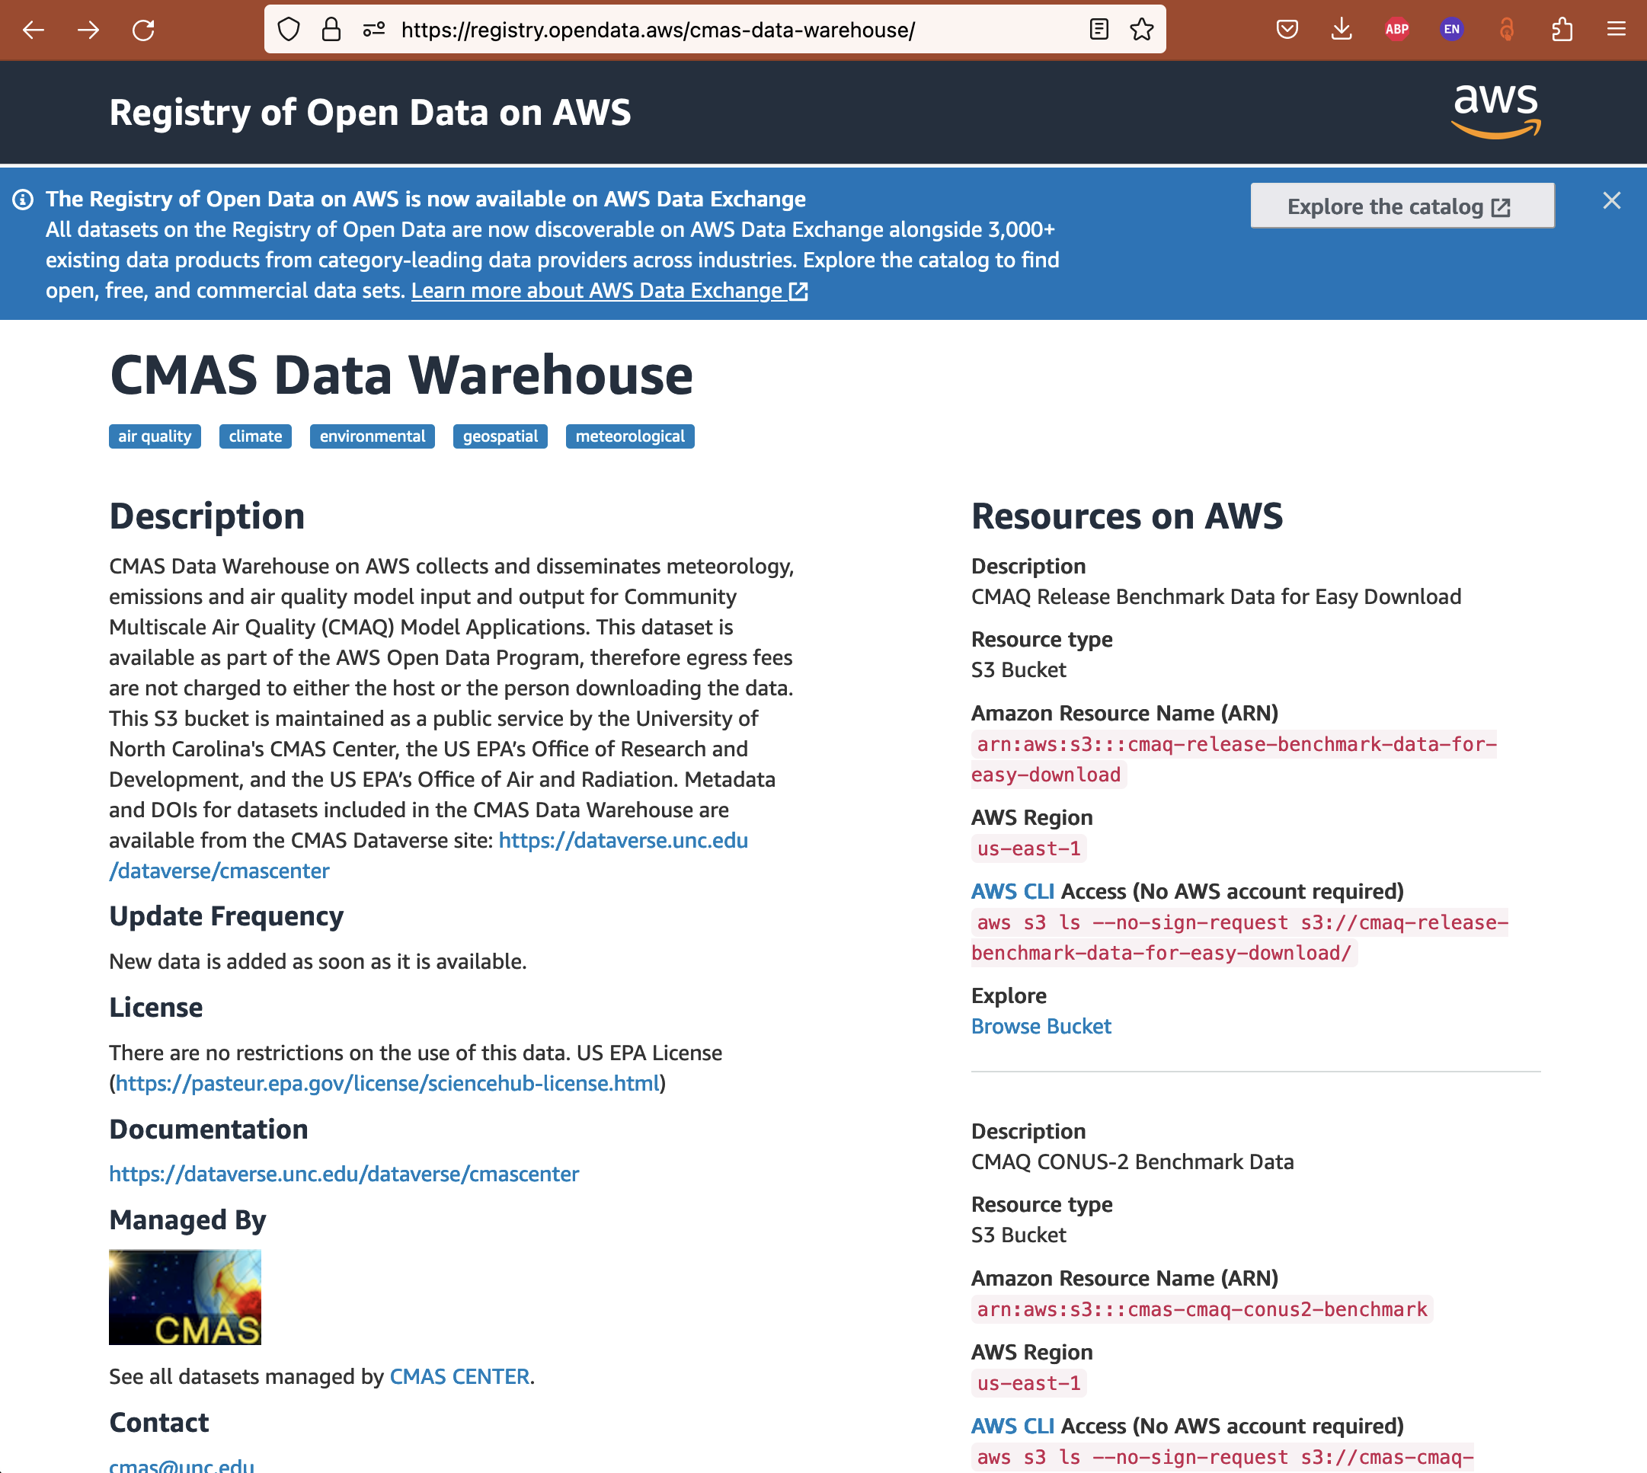
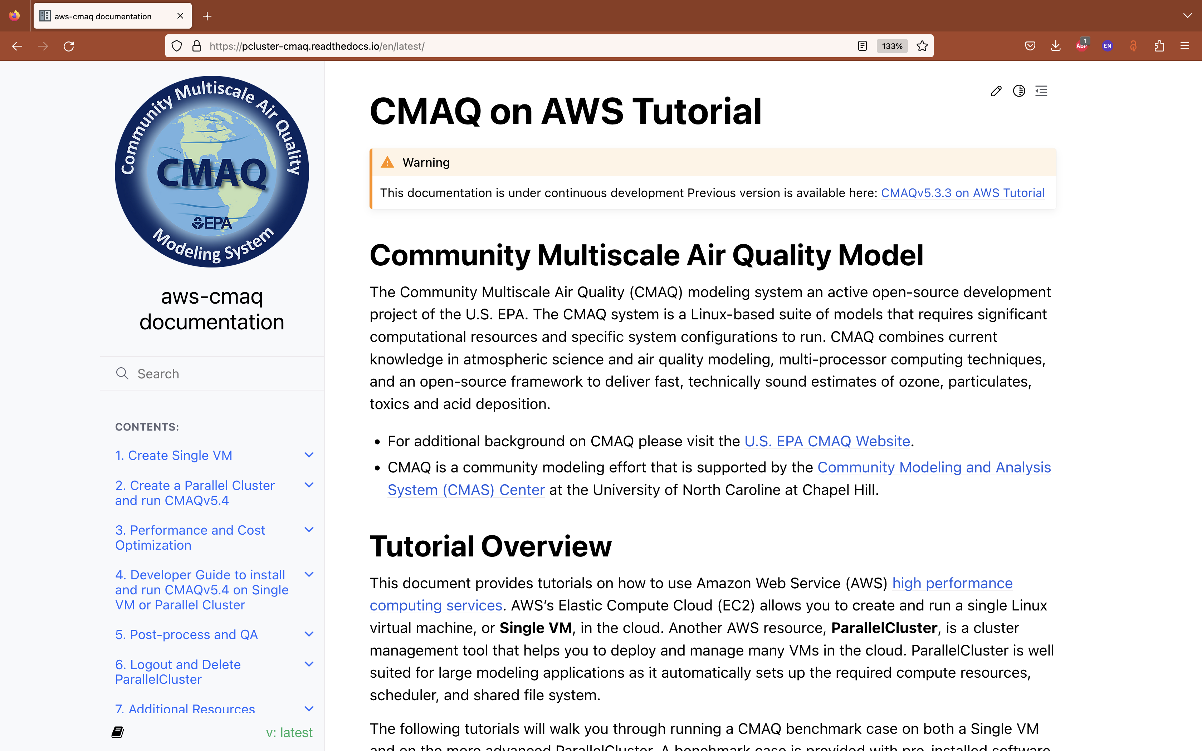
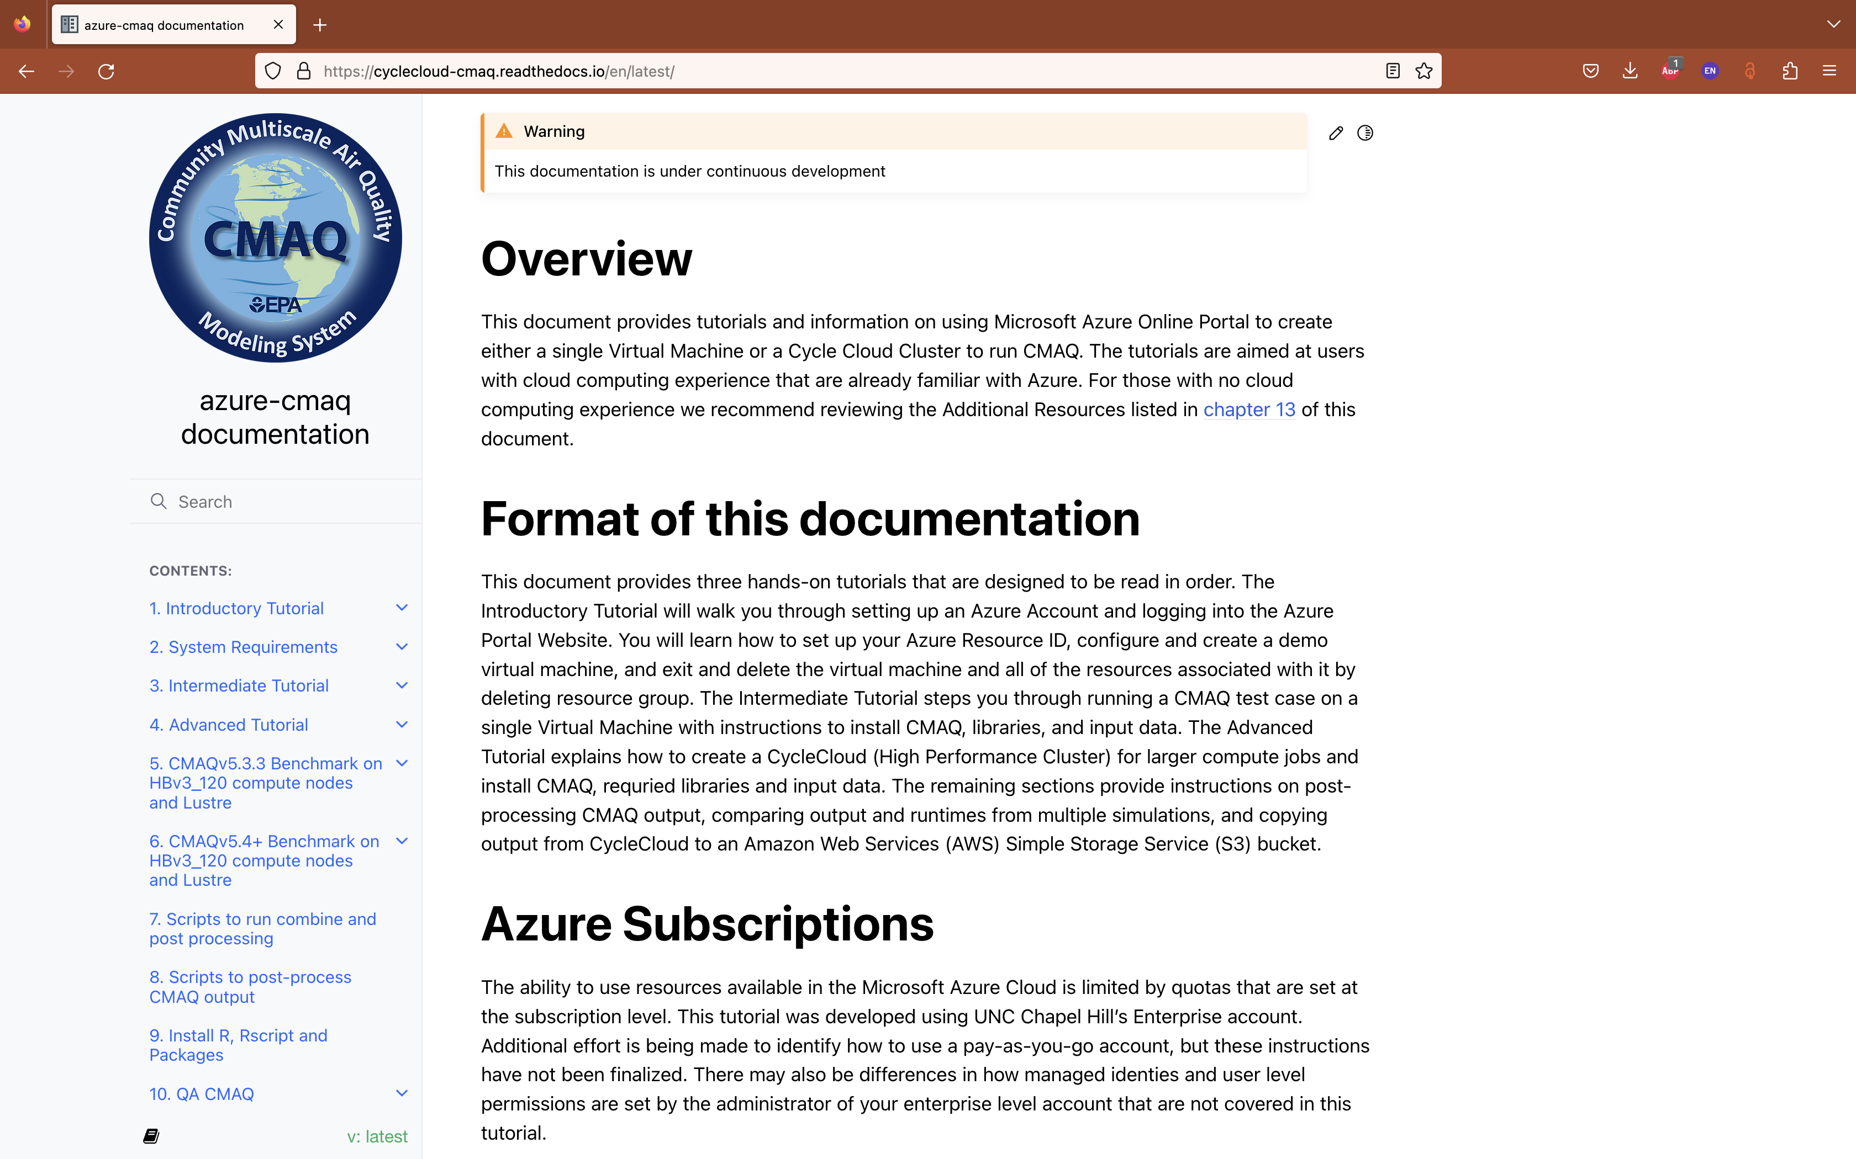

Slide 10

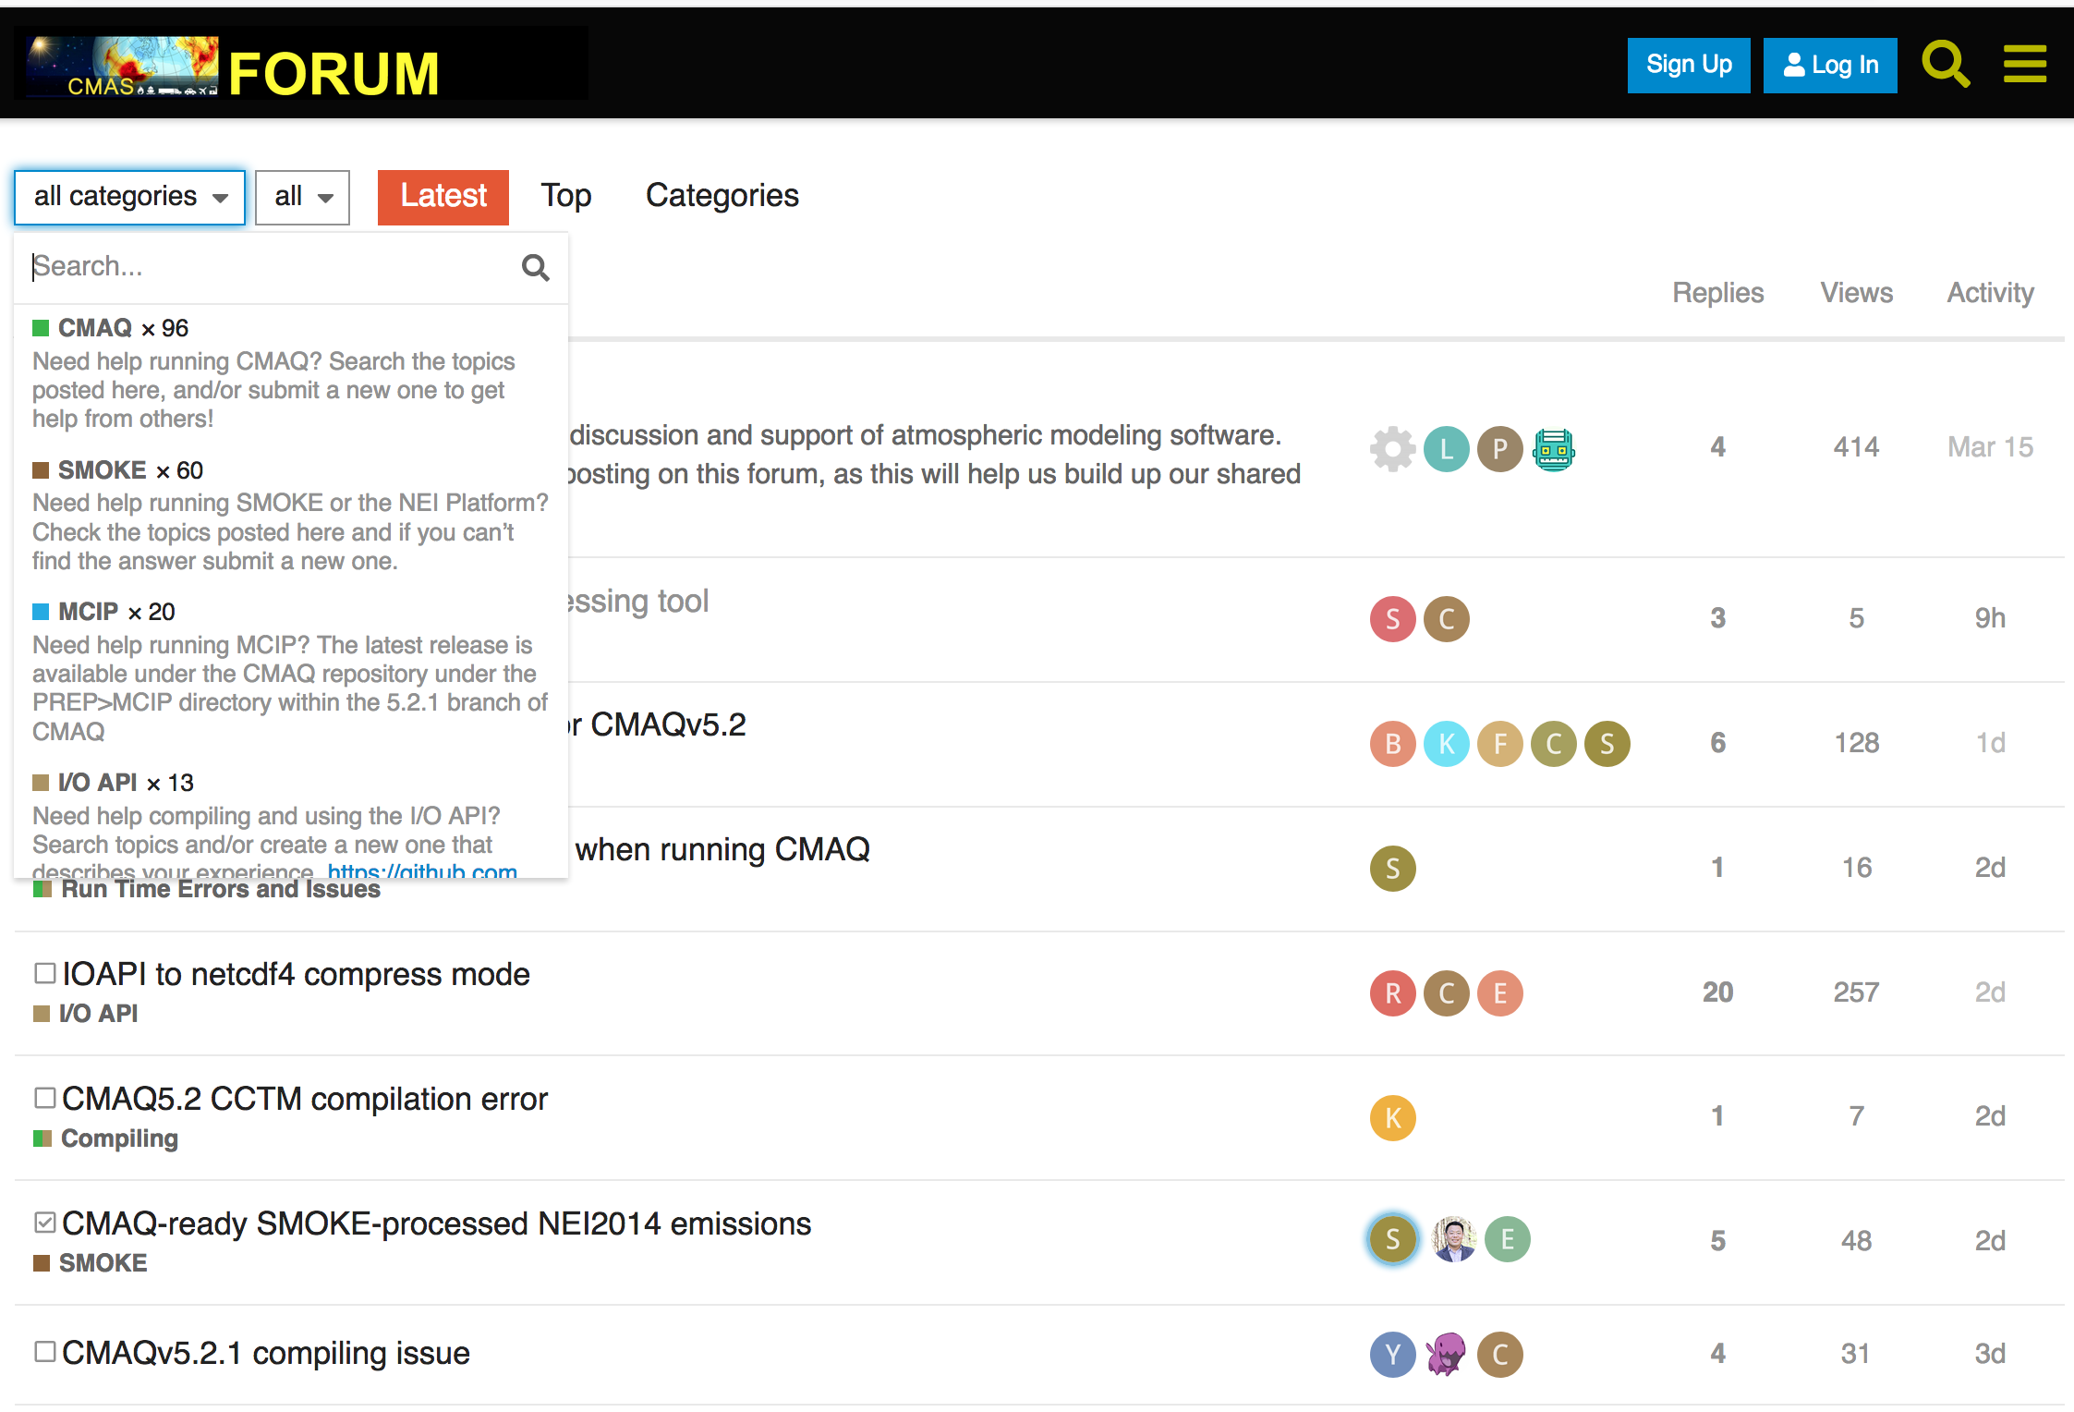
CMAS Discourse Forum http://forum.cmascenter.org
USER SUPPORT
About ~50 queries from user community each month on various CMAS products

Slide 11
Training – both Onsite and Offsite
APPLICATIONS AND TRAINING
Transitioned completely to online training
  Lecture and Hands-on components using AWS EC2 instances
  Twice a year, Spring and Fall 2024*
Conducted international training sessions
  Brazil, Bulgaria, Canada, China, Colombia, Greece, Hong Kong, India, Japan, Mexico, S. Korea
Special trainings
  Python for Air Quality Research and Applications
  Model Interpretive Analyses
* SMOKE Training October 15 – 18, 2024
CMAQ Training October 29 – Nov 1, 2024

Slide 12
Collaboration and Information Sharing
OUTREACH
CMAS Conferences
  Annually at Chapel Hill, NC during October
  Asia
    CMAS – Asia Pacific Conference (Saitama, Japan in July 2023)
    CMAS – Asia Pacific Conference (Seoul. S. Korea in Summer 2025)*
  South America
    5th CMAS South America Conference (São Paulo in June 2024)
  Africa in 2026?
Webinars
  Webinar series on special topics or new releases
CMAS Visiting Scientist Program
  Brazil, China, Hong Kong, Korea, Portugal
Special Issues with Peer-reviewed Journal Articles
  Atmos. Environ., (2004), J. Applied Meteorol. (2005),
  Environ. Fluid Mech. (2007), J. Air and Waste Mgmt. Assoc. (2020)
* Stay tuned for detailed announcements

Slide 13
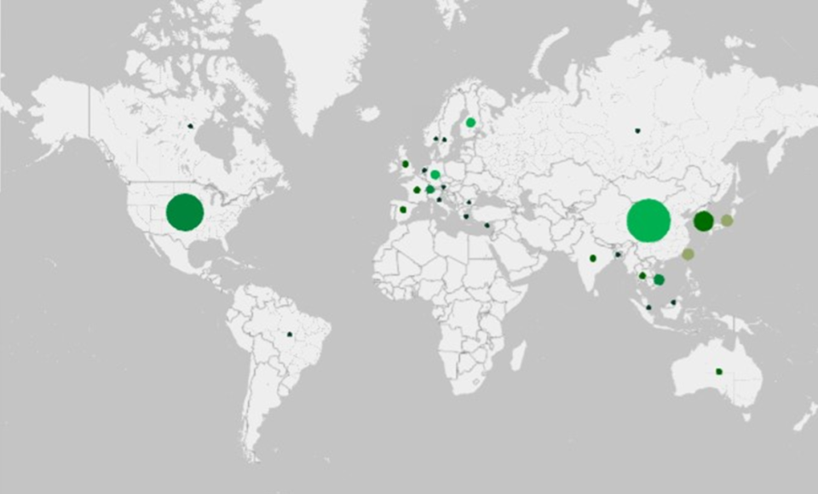
CMAQ Publications by Co-authors for Y2023
170 papers published
Data from Web of Science
Source: U.S. EPA

Slide 14
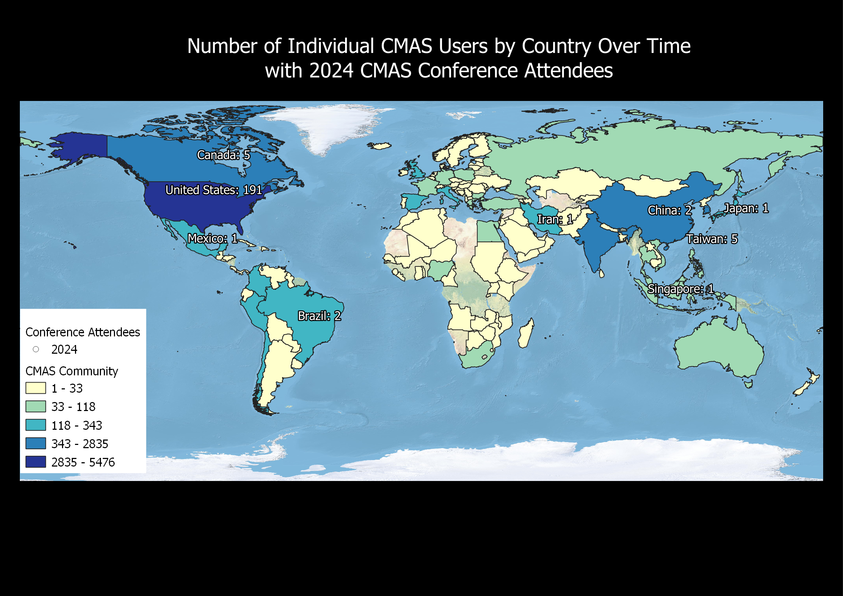
CMAS Global Footprint
OUTREACH and USER SUPPORT

Slide 15
CMAS Center Team @ UNC
Director and Outreach
  Sarav Arunachalam
Research and Applications
  Sarav Arunachalam, Liz Adams
Training and Conference
  Liz Adams, Manish Soni, Catherine Seppanen, Huy Tran
  Brian Naess, Sedona Ryan
User Support and Documentation
  Liz Adams, Huy Tran, Catherine Seppanen, Carlie Coats
Communications and Events
  Brian Naess, Sedona Ryan, Emily Williams
Technical Editing
  Sedona Ryan

Slide 16
Acknowledgements
CMAS Community
U.S. EPA
Kristen Foley, U.S. EPA ORD
  CMAS Center Program Officer
Hanna Poster session Co-chairs
  Yang Zhang and Taciana Albuquerque
Conference Team
  Sedona Ryan, Brian Naess, UNC-IE
  Sessions Chairs from the CMAS Community, and
  UNC Student Volunteers

Slide 17


