Slide 1
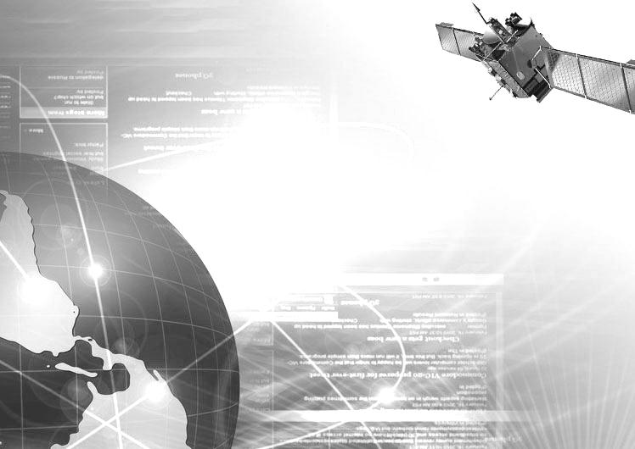

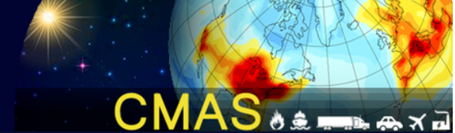

The Role of Physical Models in the Epic Advancement of Machine Learning
Siwei Li*, Jia Xing, Joshua S. Fu, Ge Song, Yu Ding
* Wuhan University, Hubei, 430000, China
siwei.li@whu.edu.cn
Notes:
Good morning every one, I am really appreciate for the meeting organizer let me give the presentation online when I couldn’t make it off line due the VISA issue. I will share some works about using physical models in remote sensing using machining learning techniques.

Slide 2
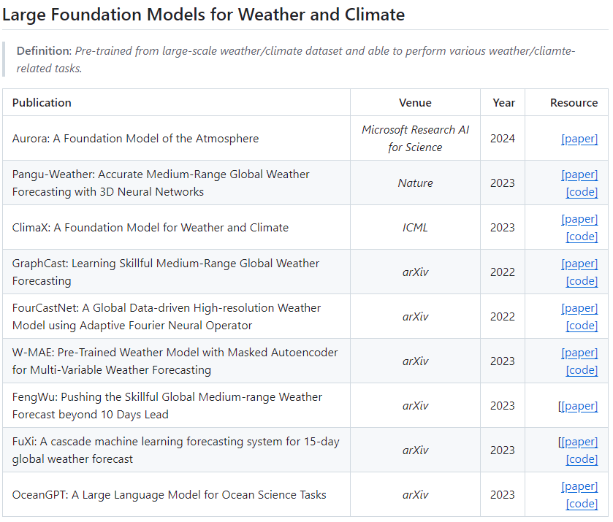
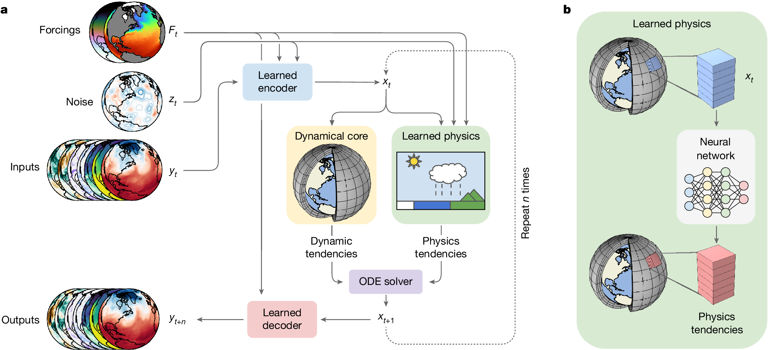
Background
Question: Will AI replace physical models?
AI has proven to be highly beneficial for atmospheric sciences!
Google’s new weather prediction system combines AI with traditional physics (Nature, 2024)
https://github.com/shengchaochen82/Awesome-Foundation-Models-for-Weather-and-Climate?tab=readme-ov-file
Notes:
AI发展的很快，很多公司都发展了AI大模型，结果相比于传统的数值模型会好很多，效率也高很多？那么AI是否会彻底代表数值模型呢？基于我们过去很多用AI做科研的经历来看，AI有很多局限性，在目前来看不能彻底代替数值模型。目前大部分大模型的training数据都用到了数值模型集合观测产生的数据。Data fusion， data assimilation的数据也好，都是模型+观测的结果。包括最近google的这个文章，也是利用了数值模型的结果帮助AI做training。本质是人脑 VS AI
AI is developed very fast in recent years. In the atmospheric Sciences area, AI also has proven to be highly beneficial. There are many AI models developed for weather forecasting, air pollution and performs well, sometimes even better than numerical models. The advantage of the AI model is easy to use and can get the results promptly after training. But will AI replace physical models? My answer is no, at least in a period of time, maybe before we retired.

Slide 3

Outline
Why physical model is important for machine-learning?
1
Training Data provided by physical model
2
Evaluation testbed based on physical model
Notes:
我们分享两个我们的工作，结合AI个数值模型的优点对大气环境要素进行反演。观测数据非常少
Even machine-learning is changing our life, Physical models is important for machine-learning. Based on our works, at least from two aspects.
Machine-learning rely on a lot of data, physical model could provide training data for machine-learning when observation data is not enough.
Second, physical model could provide a testbed for machine-learning method.

Slide 4
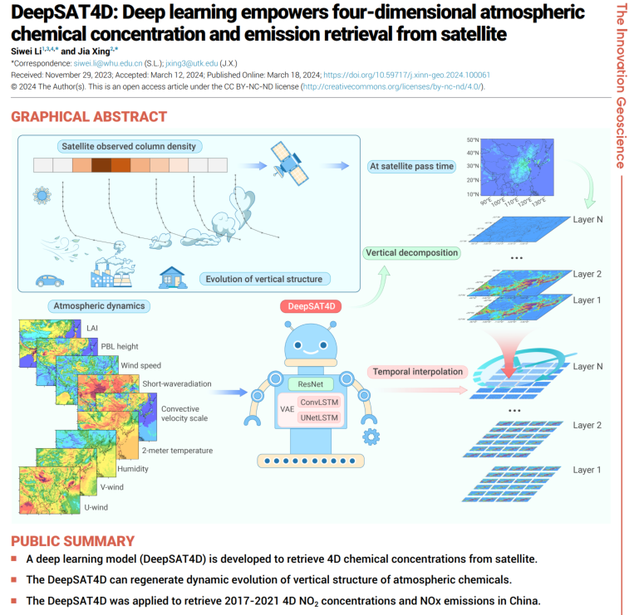
Topic 1: Data-driven AI need the data from physical model
Satellite remote sensing has been used a lot in the atmospheric sciences and AI simplified the retrieval to some extent
Objective:
Can we expand single-hour total column satellite measurement into four-dimensional scale information?
Hypothesis:
The natural linkage between the column measurement, meteorology conditions, emissions and 4D concentrations
Challenge:
No observation data for the AI to learn
Li and Xing, The Innovation Geoscience, 2024
Notes:
卫星做反演是现在的趋势。但卫星数据有限，我们想要的永远比卫星直接观测的多，那我们如何利用有限的卫星观测尽量准确的反演更多的信息。我们针对这个问题，做了一个工作，结合了观测和数值模型以及AI技术，利用卫星观测的柱浓度以及气象（wrf reanalysis data（NOAA的数据））参数反演四维时空的污染物（NO2）。
整个模型是三个模块的叠加，第一个resnet(因为考虑到周边的空间信息，CNN based的模型适用于利用周边网格的信息。没有时间信息，所以用这个模型。)， 第二个模块是convolution LSTM（因为要考虑到时间信息）， 第三个模块是VAE（unet+LSTM），用来反演排放的后向模型。用观测反演排放，同时得到更准备廓线信息。
Satellite remote sensing has been used

Slide 5
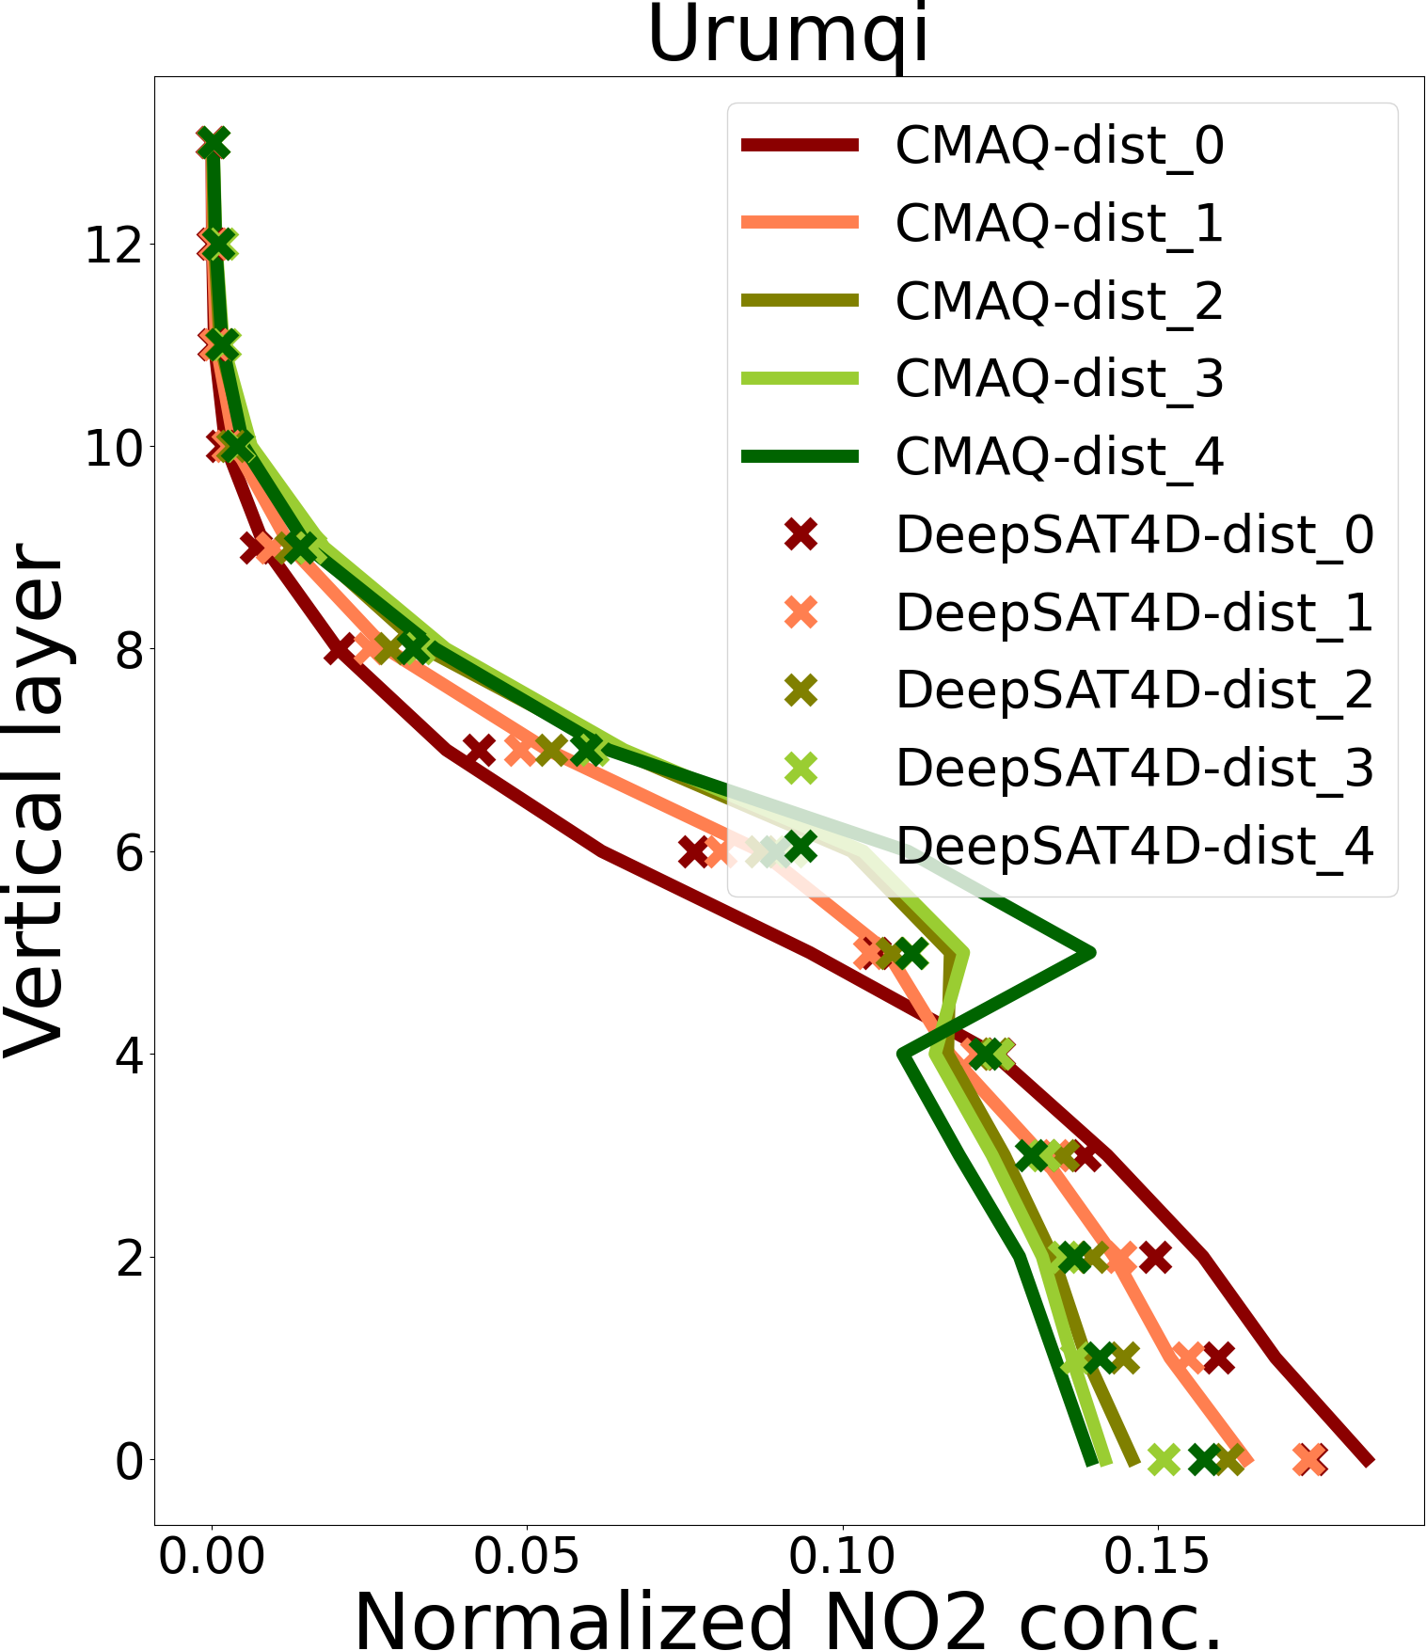
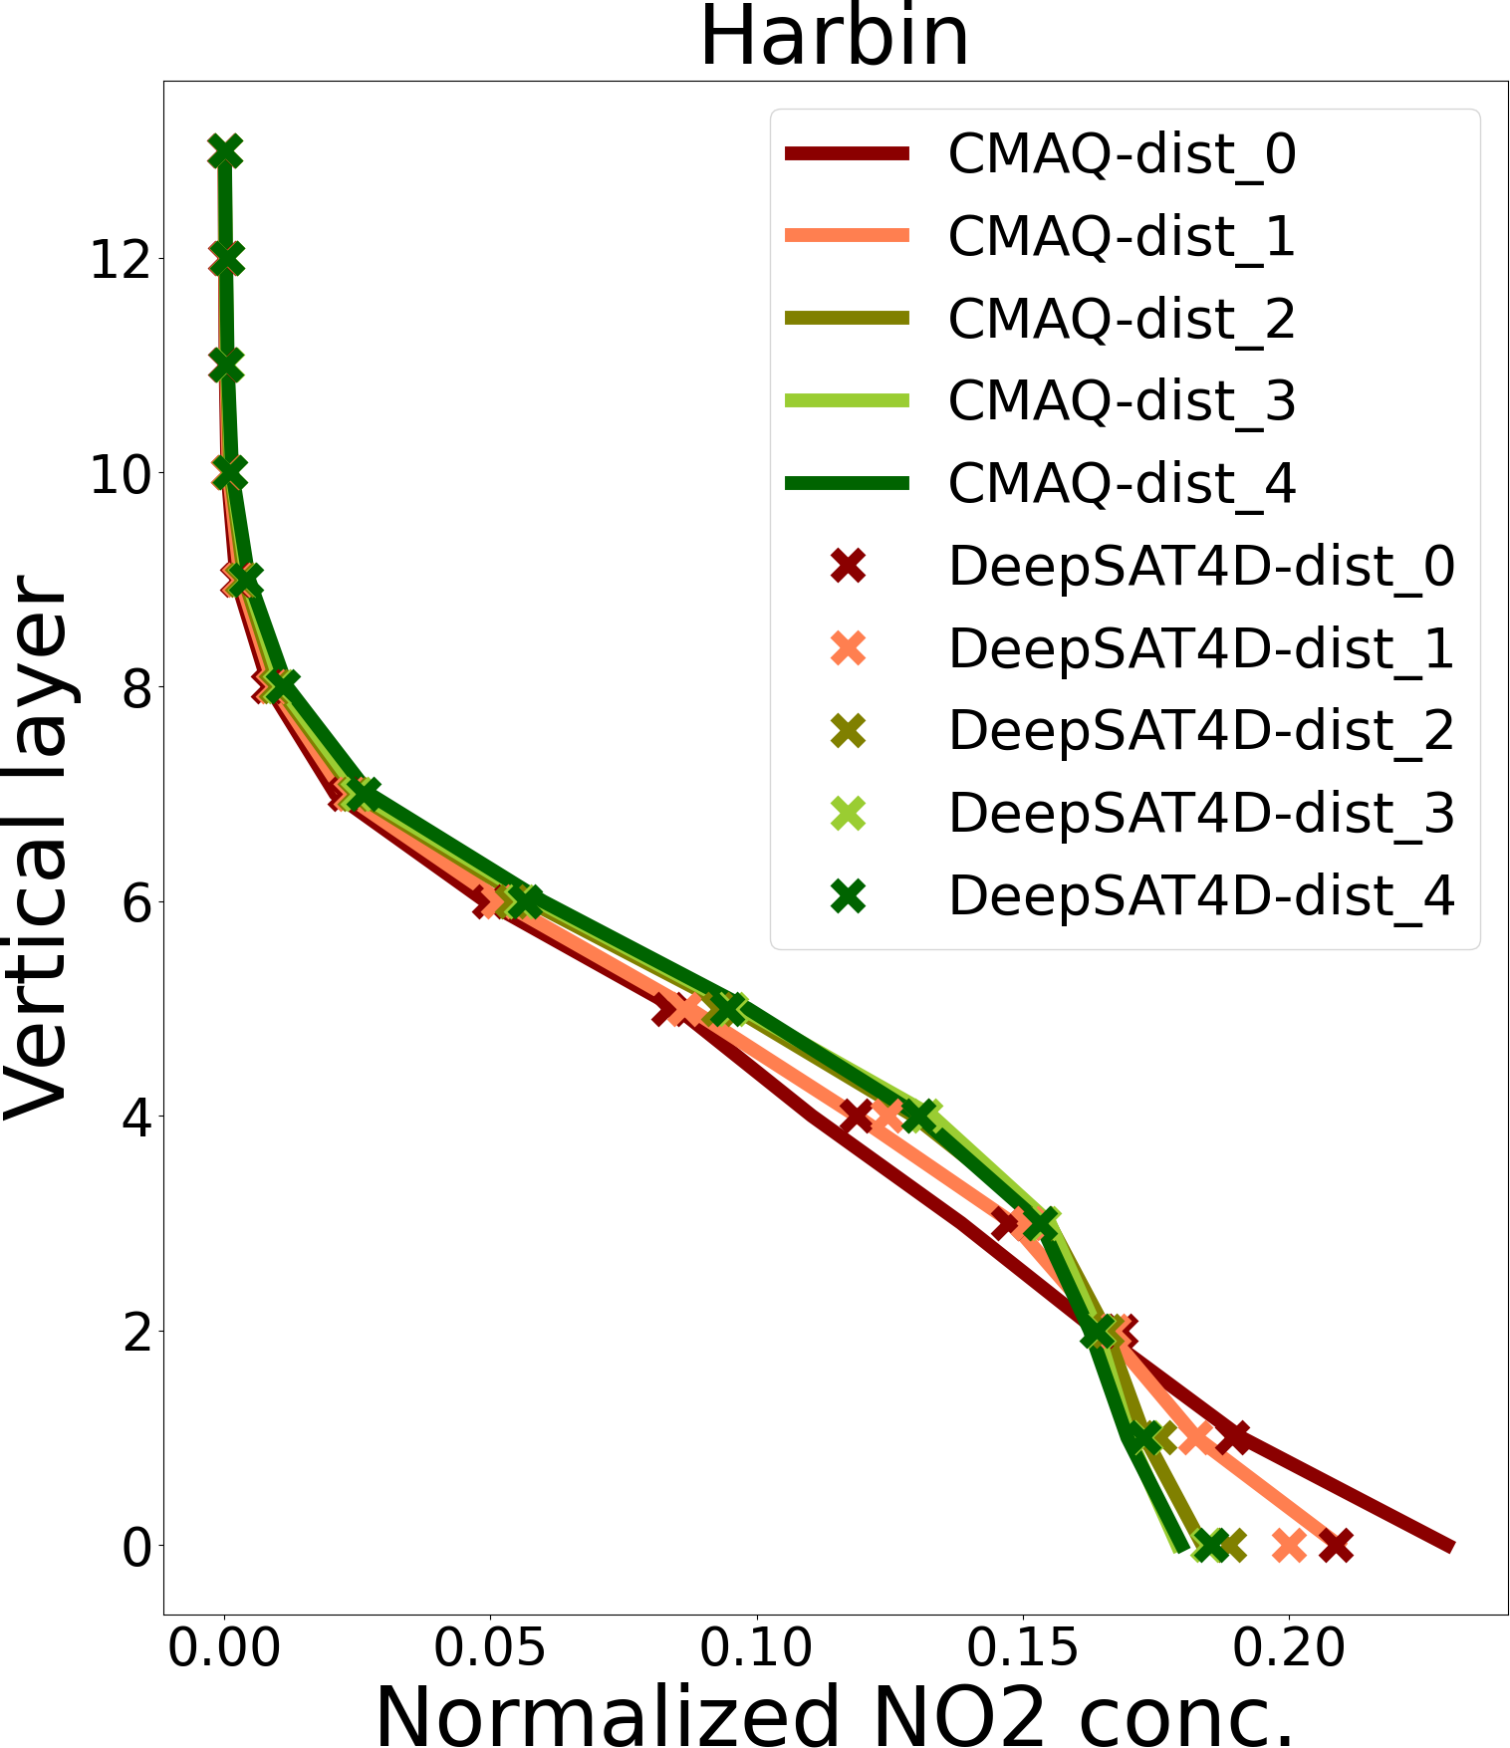
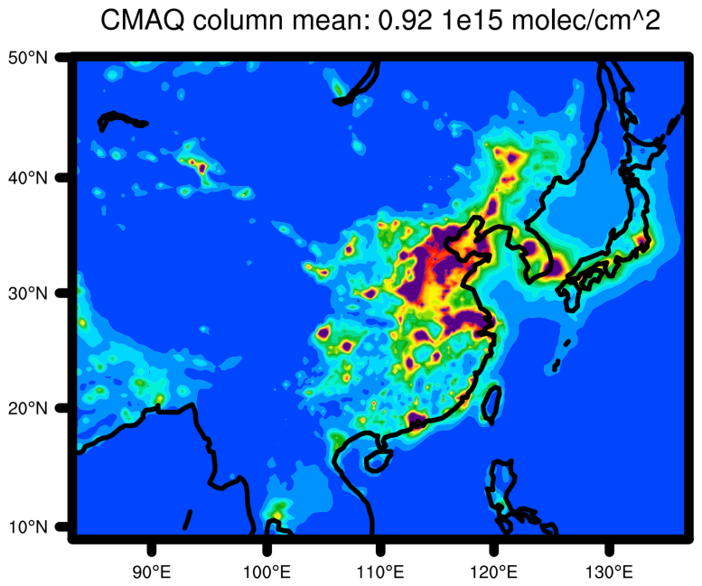


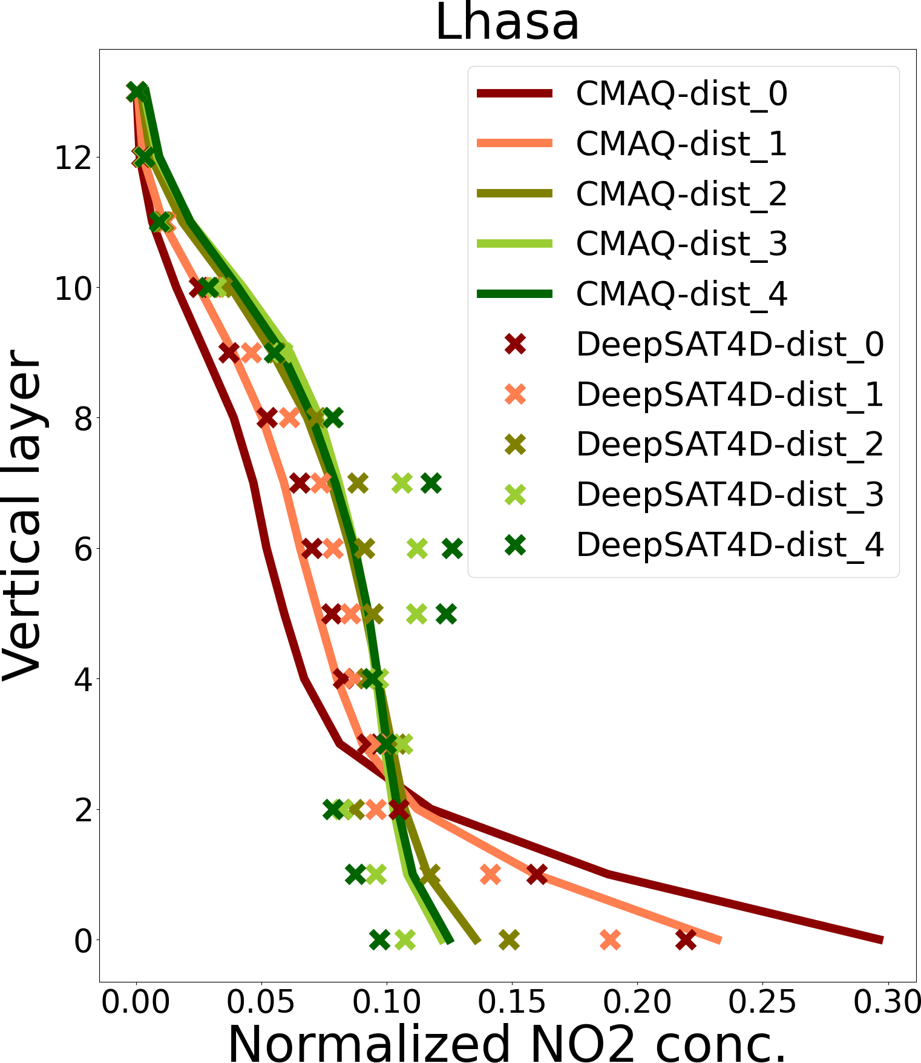
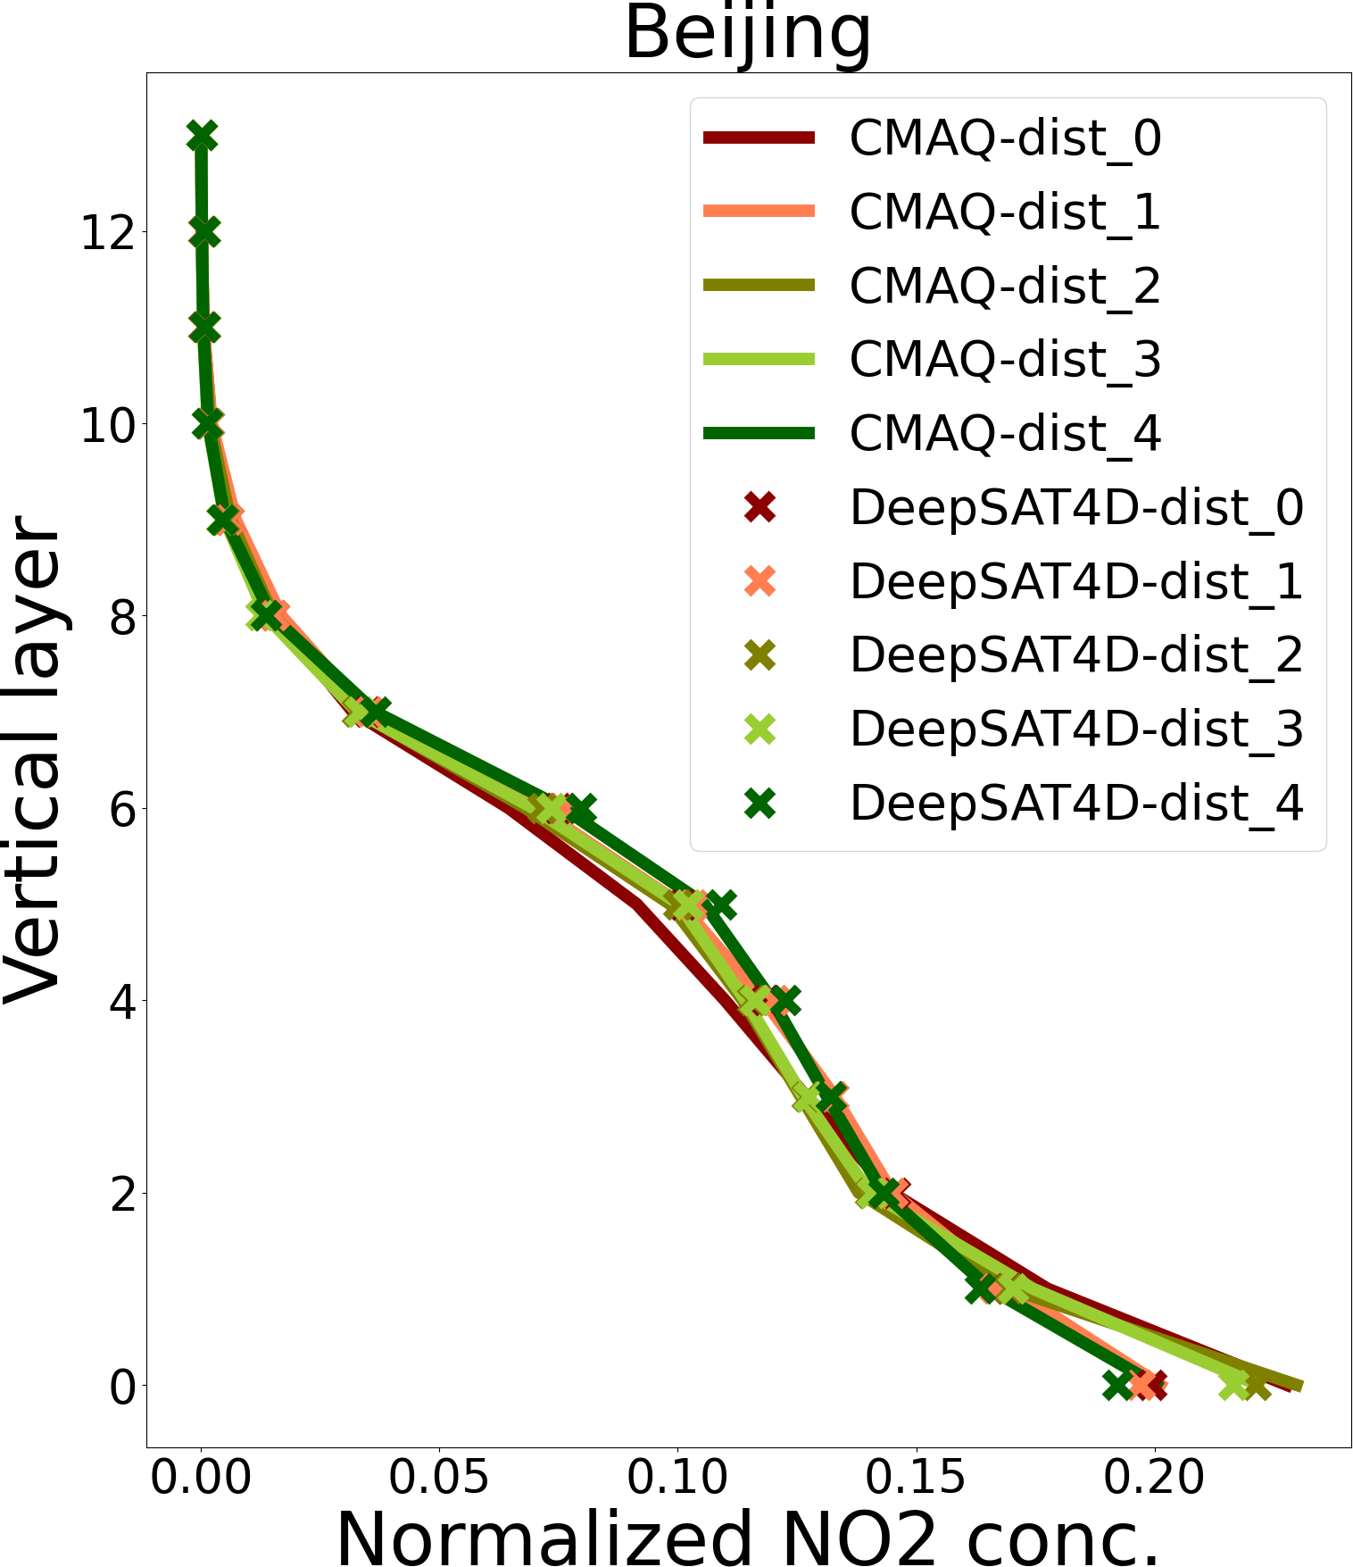

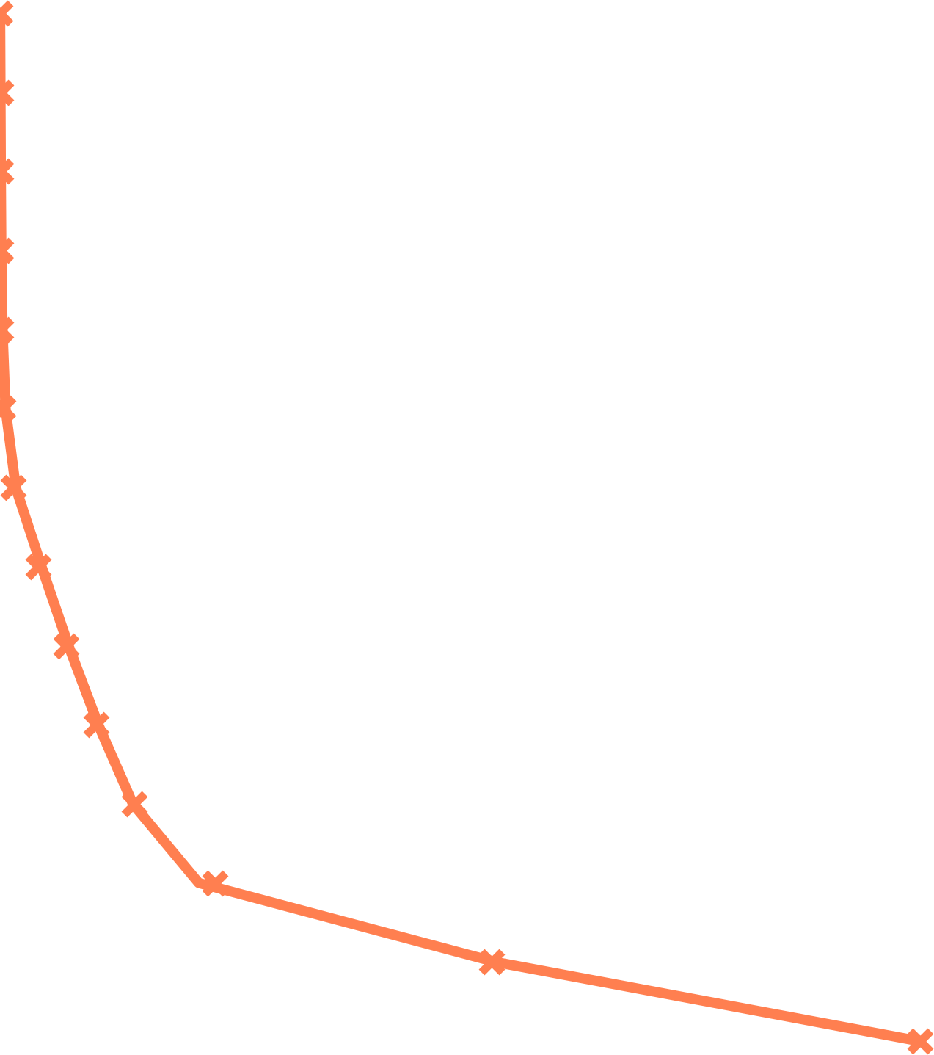
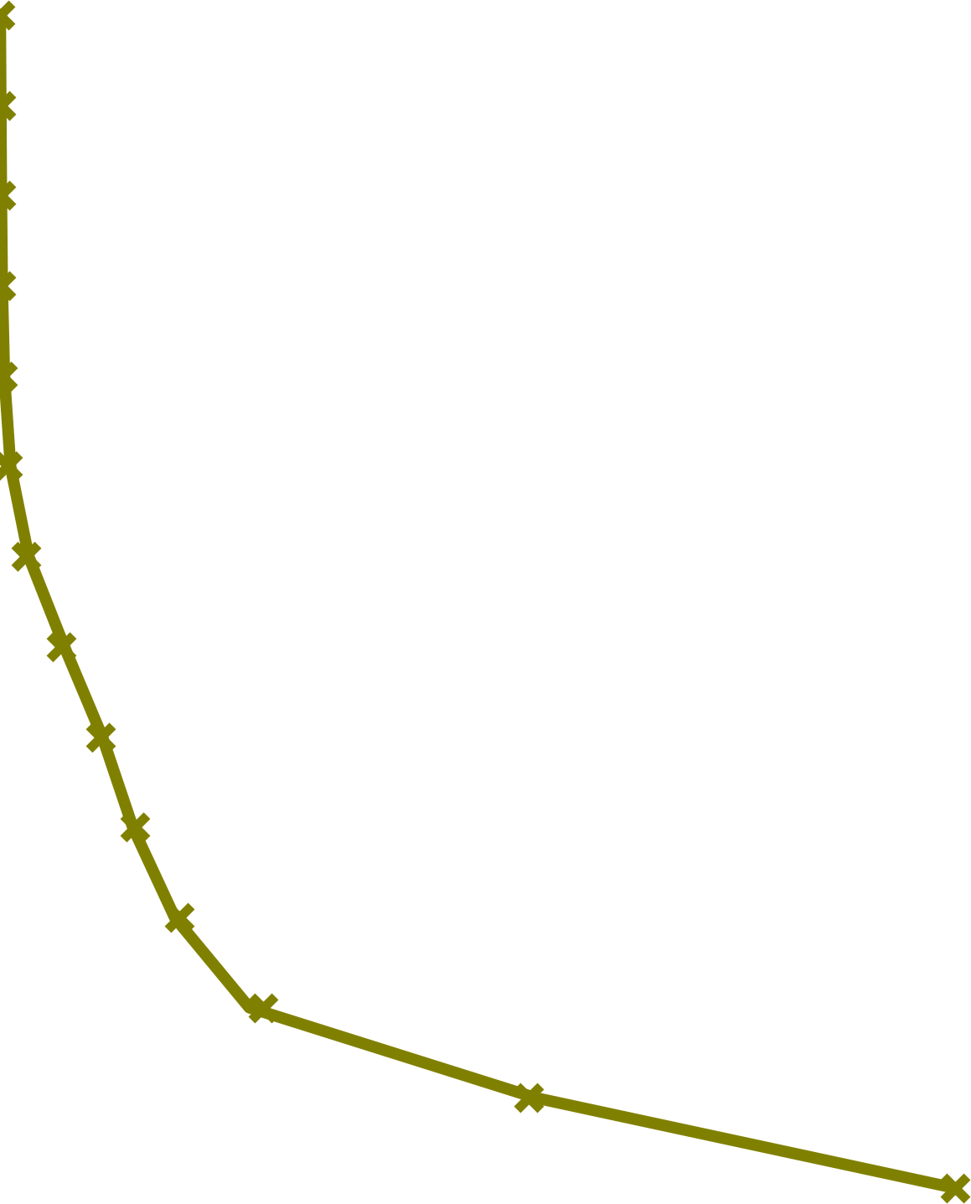
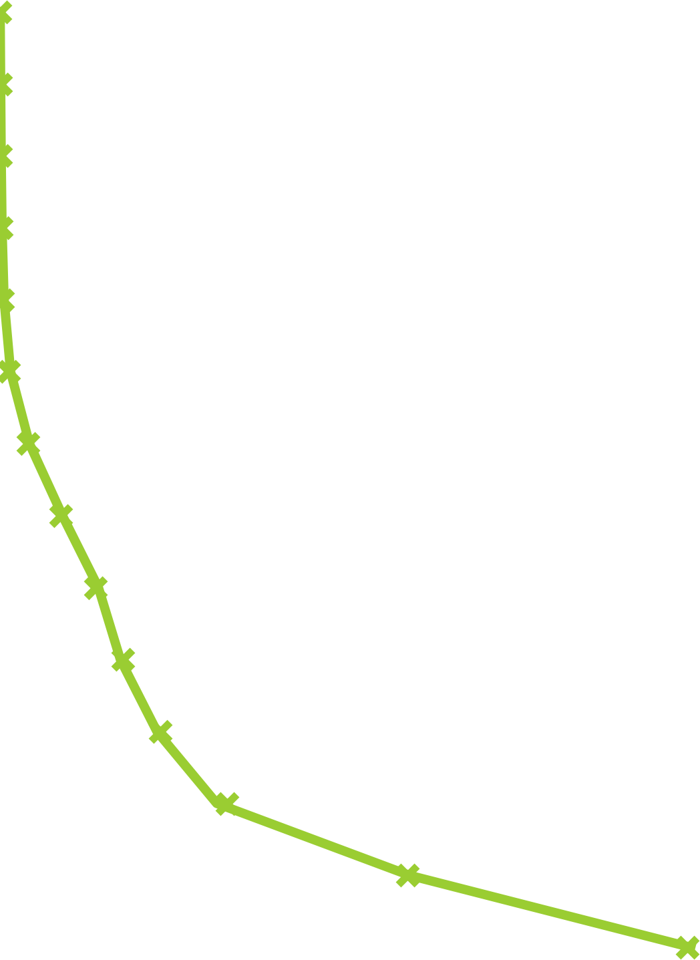
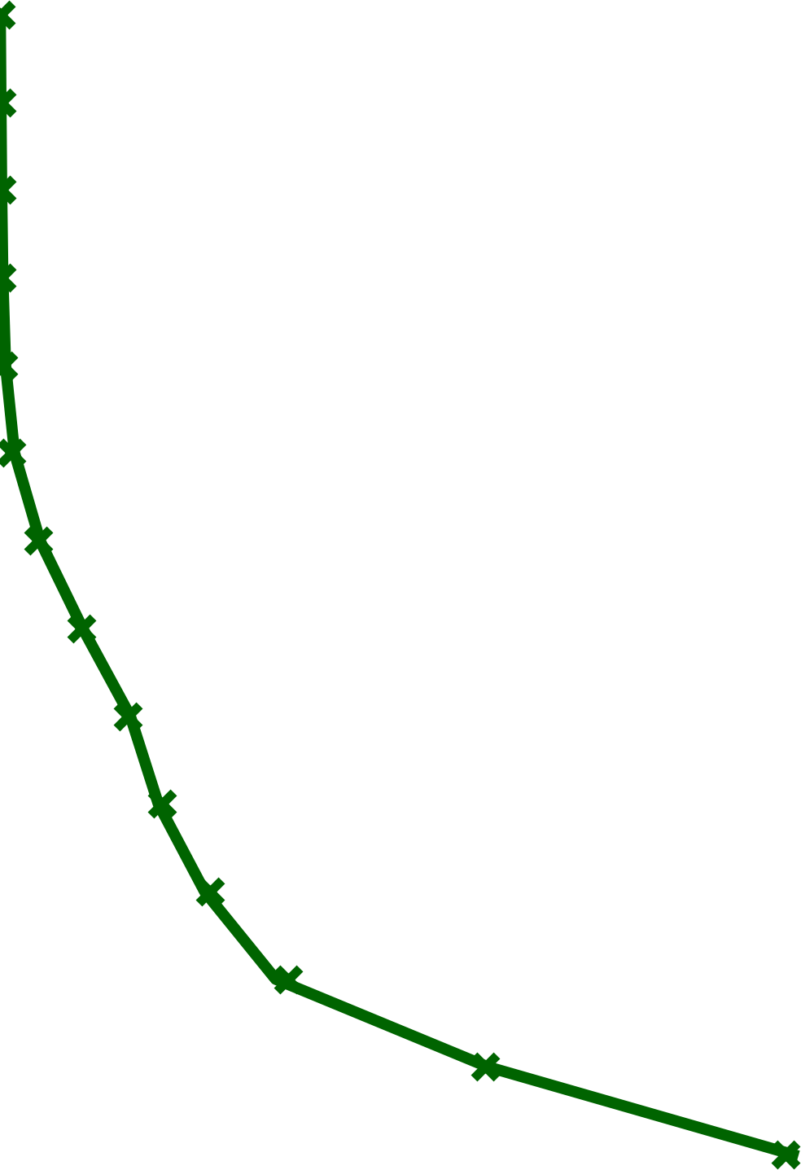
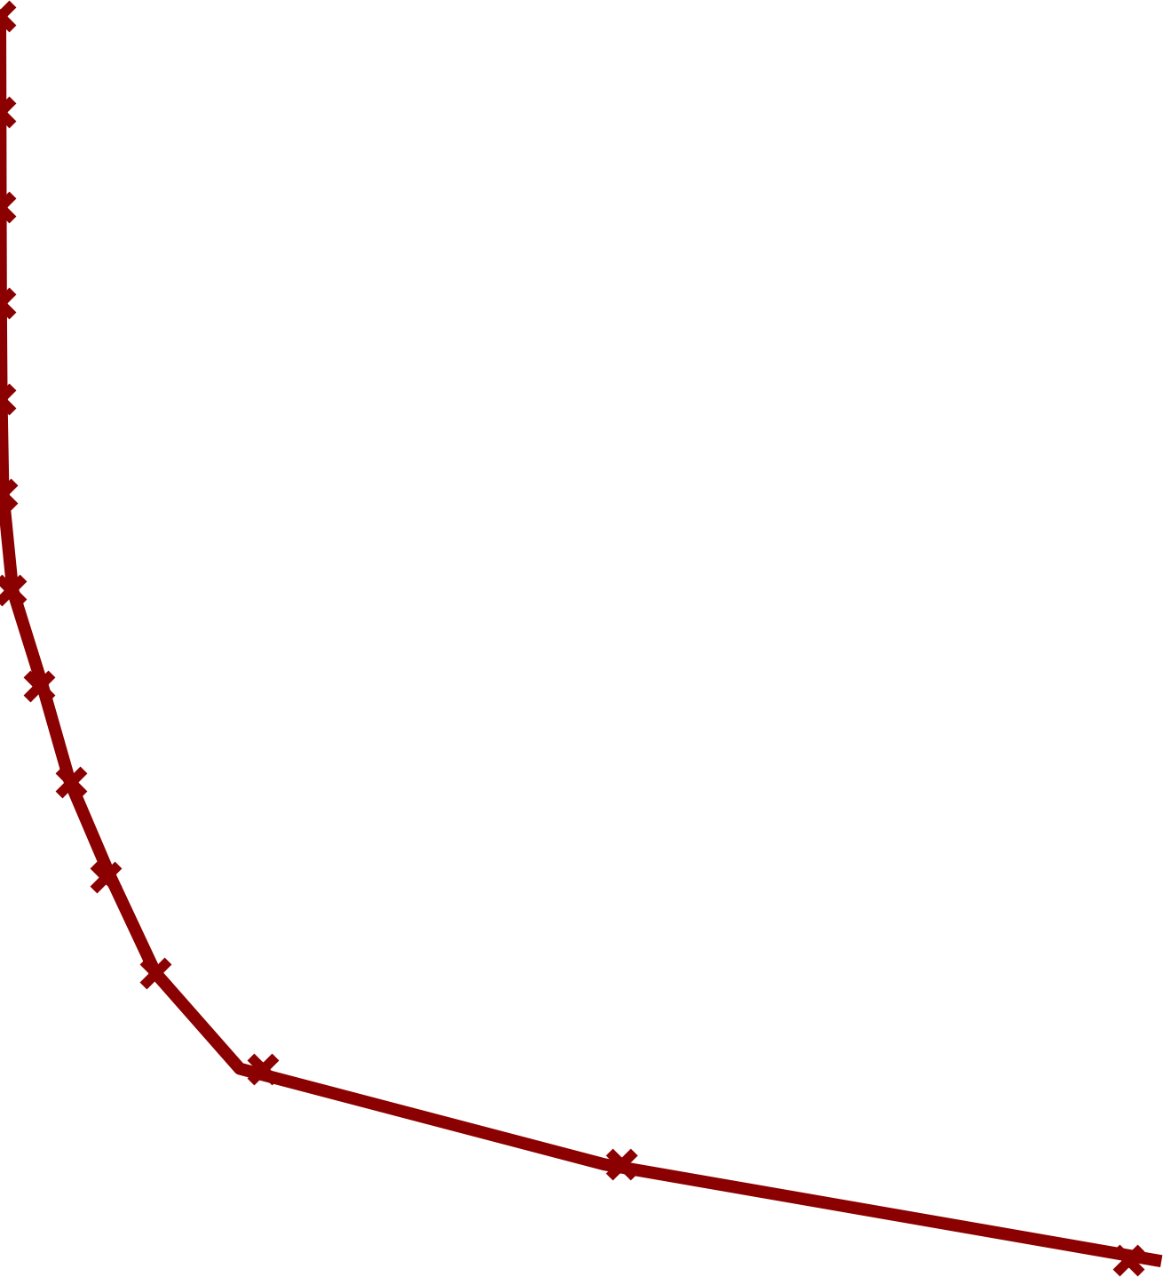
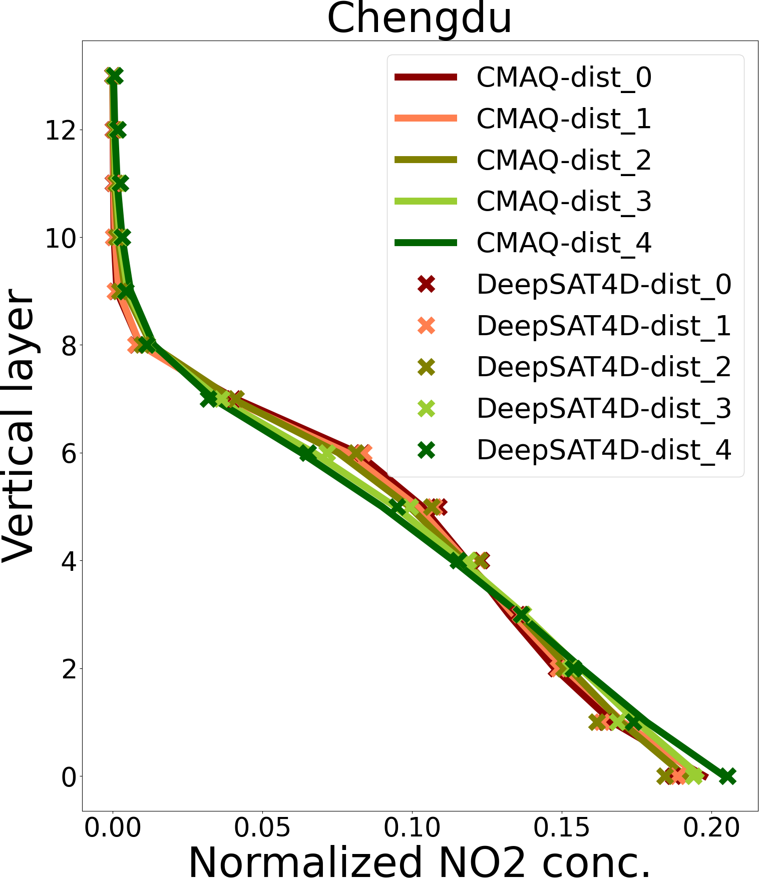
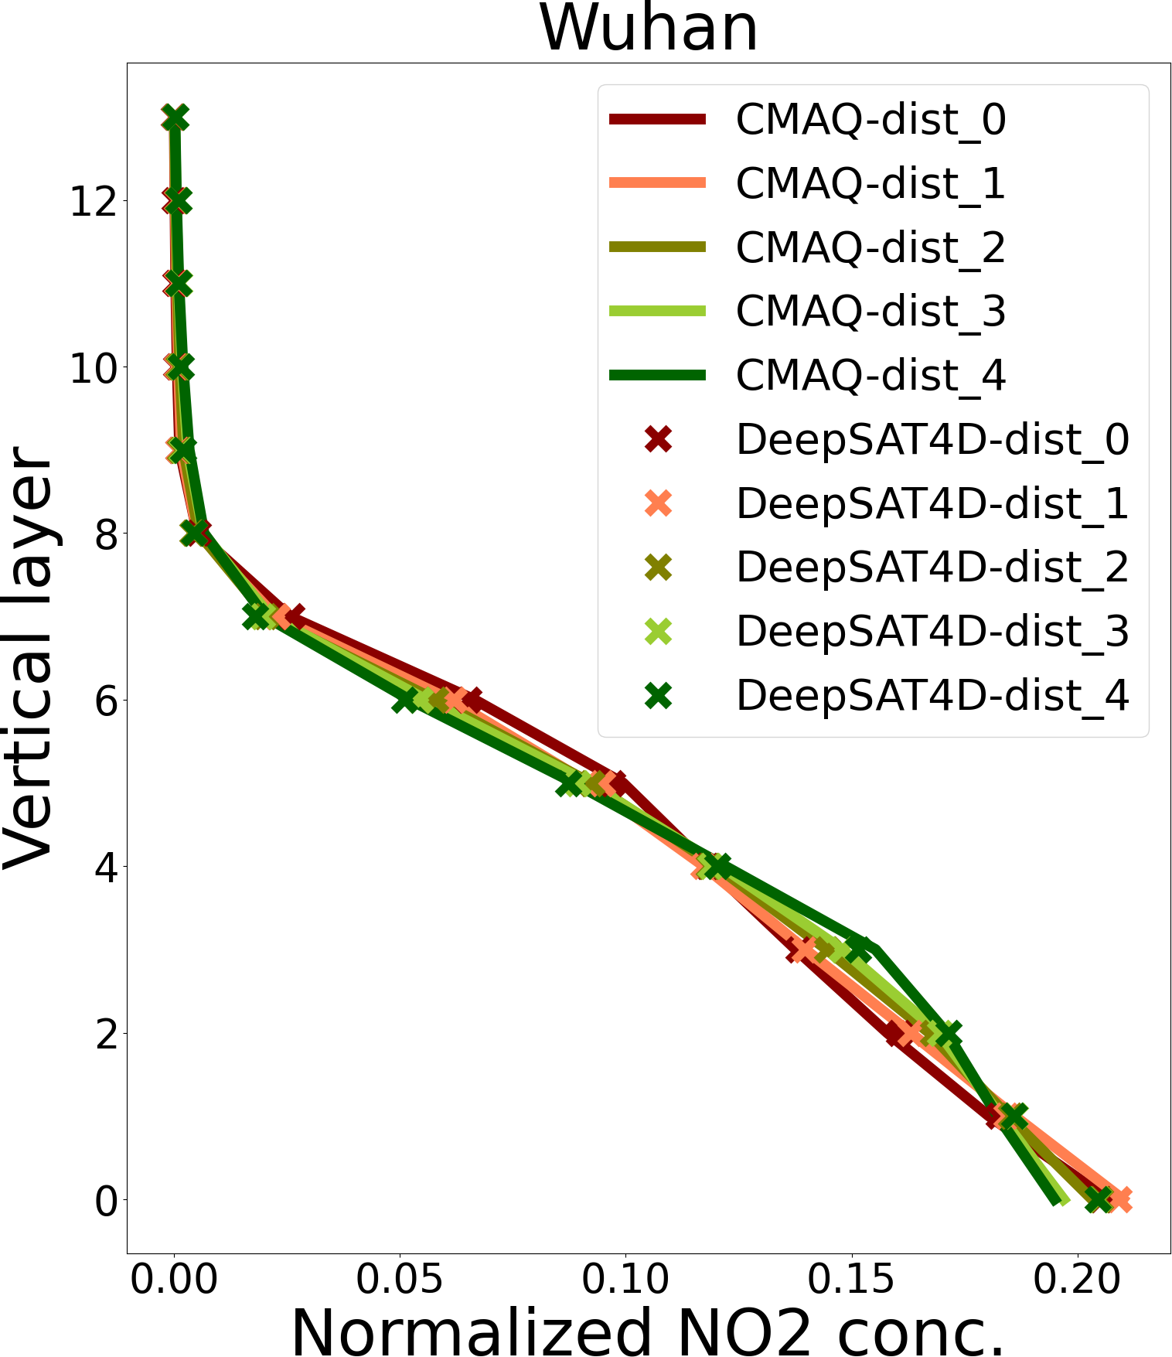
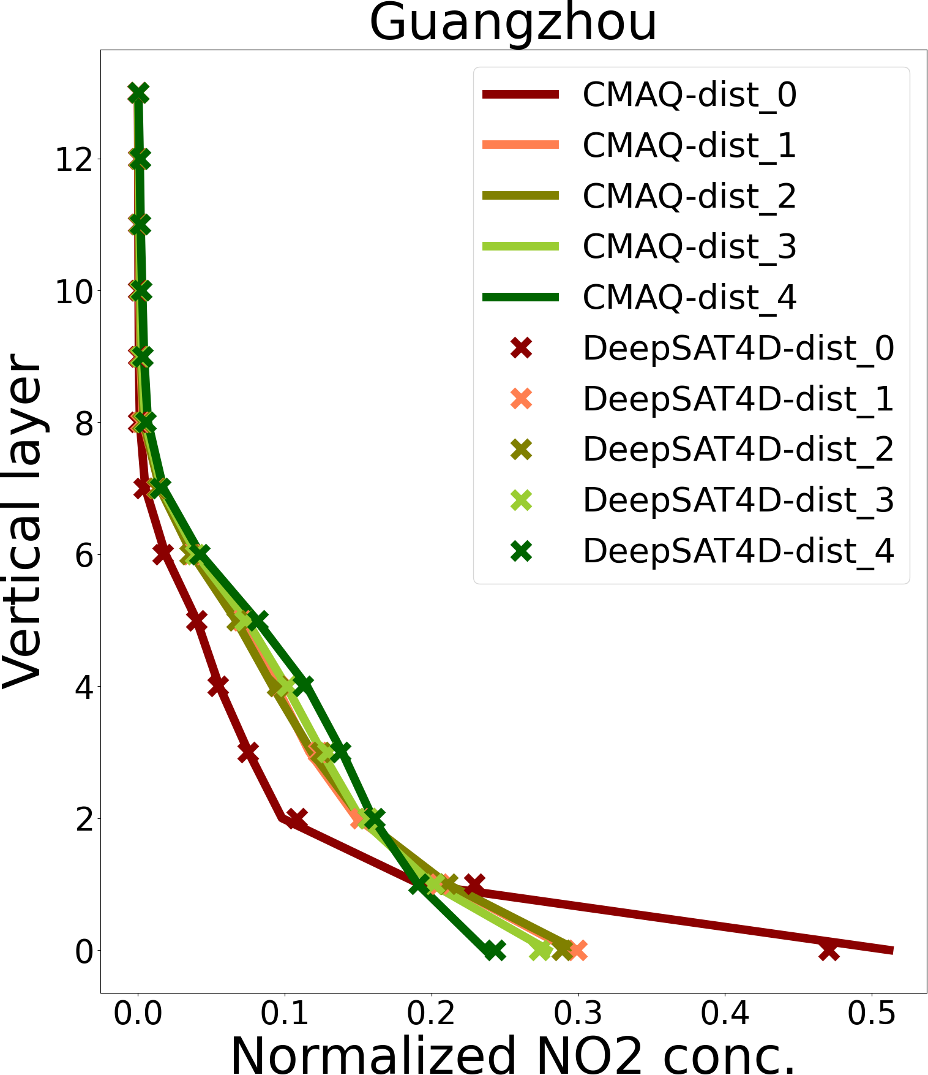
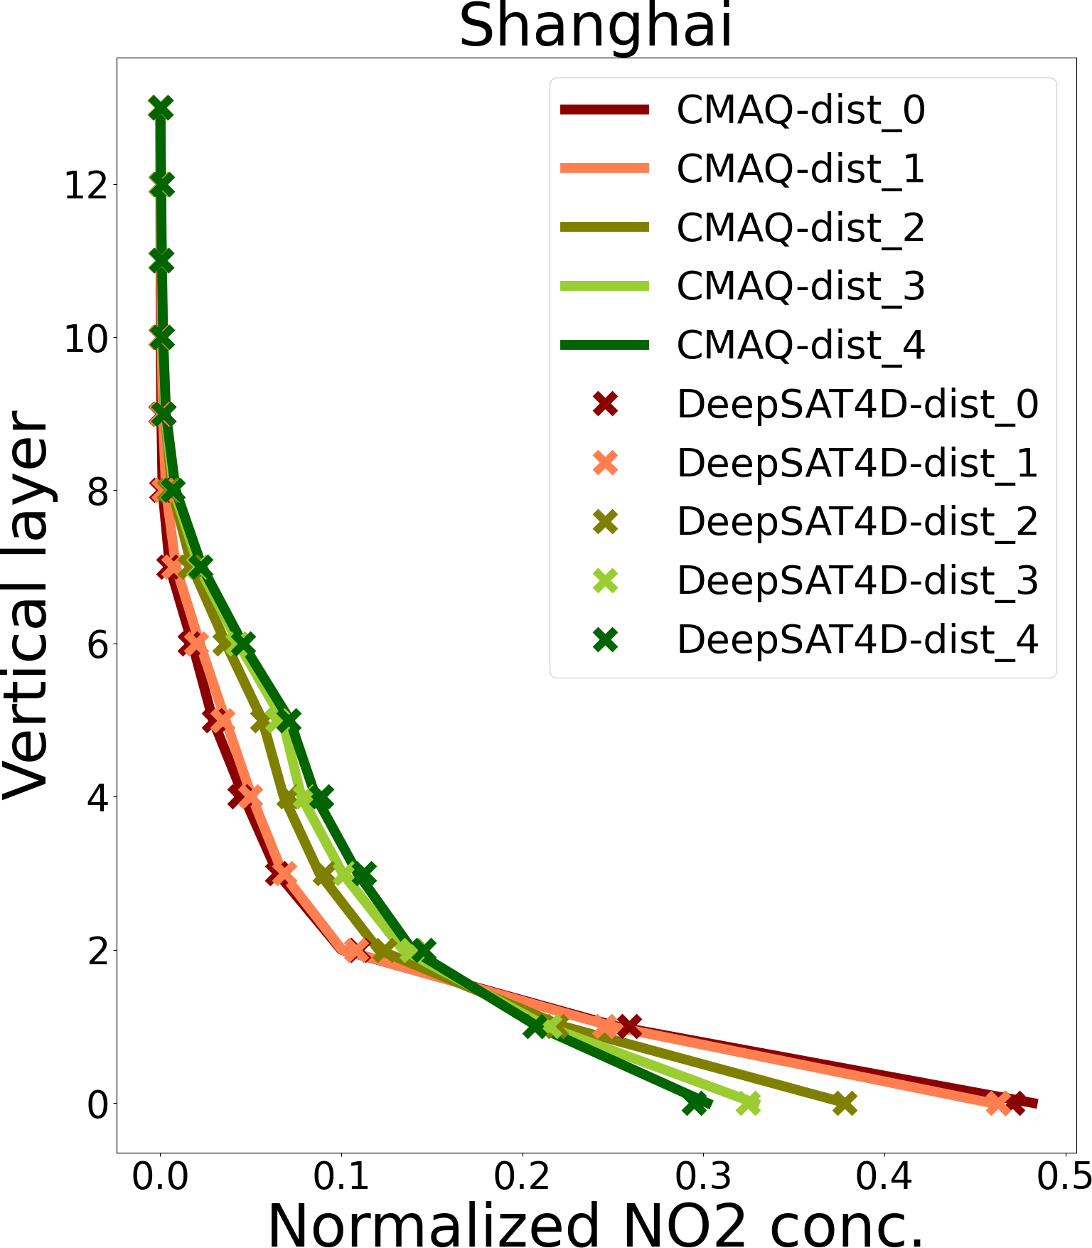



Topic 1: Data-driven AI need the data from physical model
(1) Evolution of vertical profile
——driven by the plume arise from emission source and up aloft direct to the downwind area
NO2 vertical profile from urban (red) to rural (green)
Satellite observed column density
Evolution of vertical structure
AI model (DeepSAT4D) well captured the variation
Notes:
One of the key points is how to well present the evolution of vertical profile. We know it is driven by the plume arise from emission source and up aloft direct to the downwind area.
在污染源附近，污染物浓度集中在近地表，profile就是下面高，上面低。但随着扩散，污染物慢慢升高，上面的浓度增加，近地面浓度下降。Urben和rural不同。卫星虽然看到的是柱浓度，但一定程度上能看到源头在哪。高值通常是近地面多的，低值区的廓线又不一样。但实际上的情况是很复杂的，任意一点周边的气象条件和柱浓度共同影响该点的廓线情况。这个关系反算起来很复杂，所以我们通过AI来学习，简化这个反演过程，简单的建立复杂的关系。
我们用数值模型模拟了NO2的垂直廓线从城市到郊区。Cross是deep sate4d的模拟。和数值模型吻合的非常的好。同时，模型和我们的假设吻合的很好。周边我们做的是平均。

Slide 6
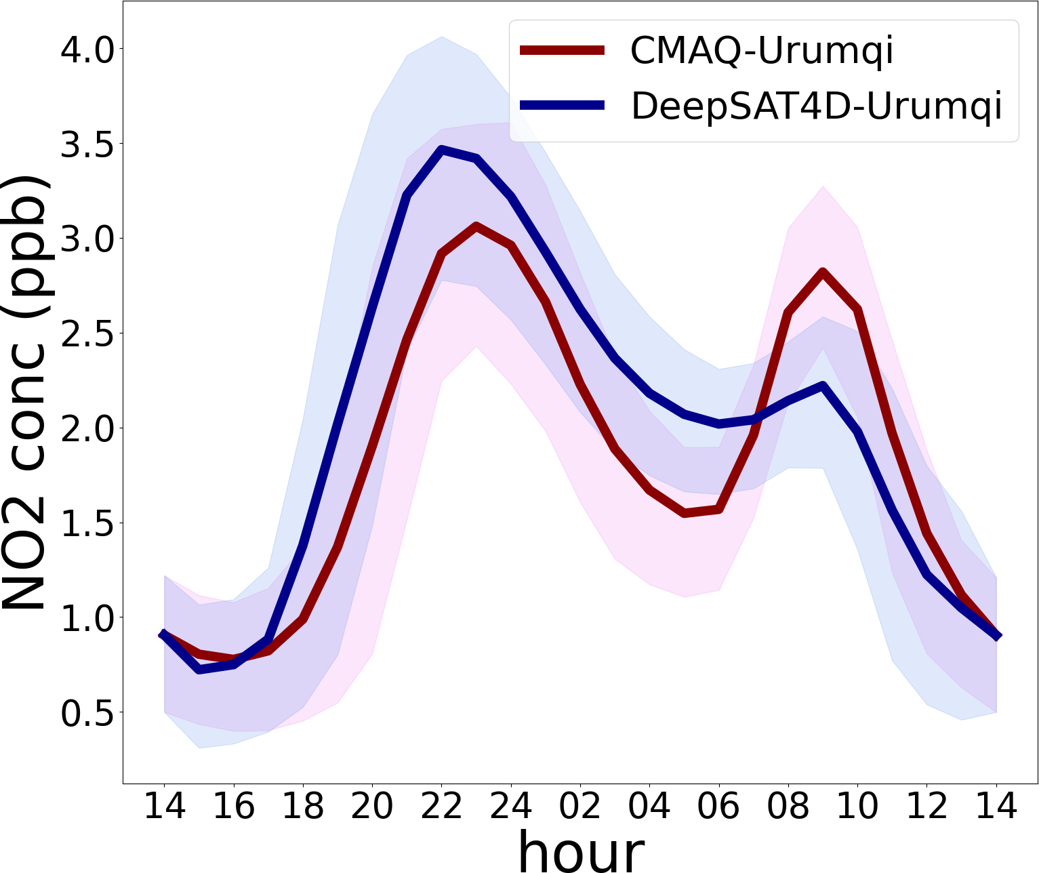
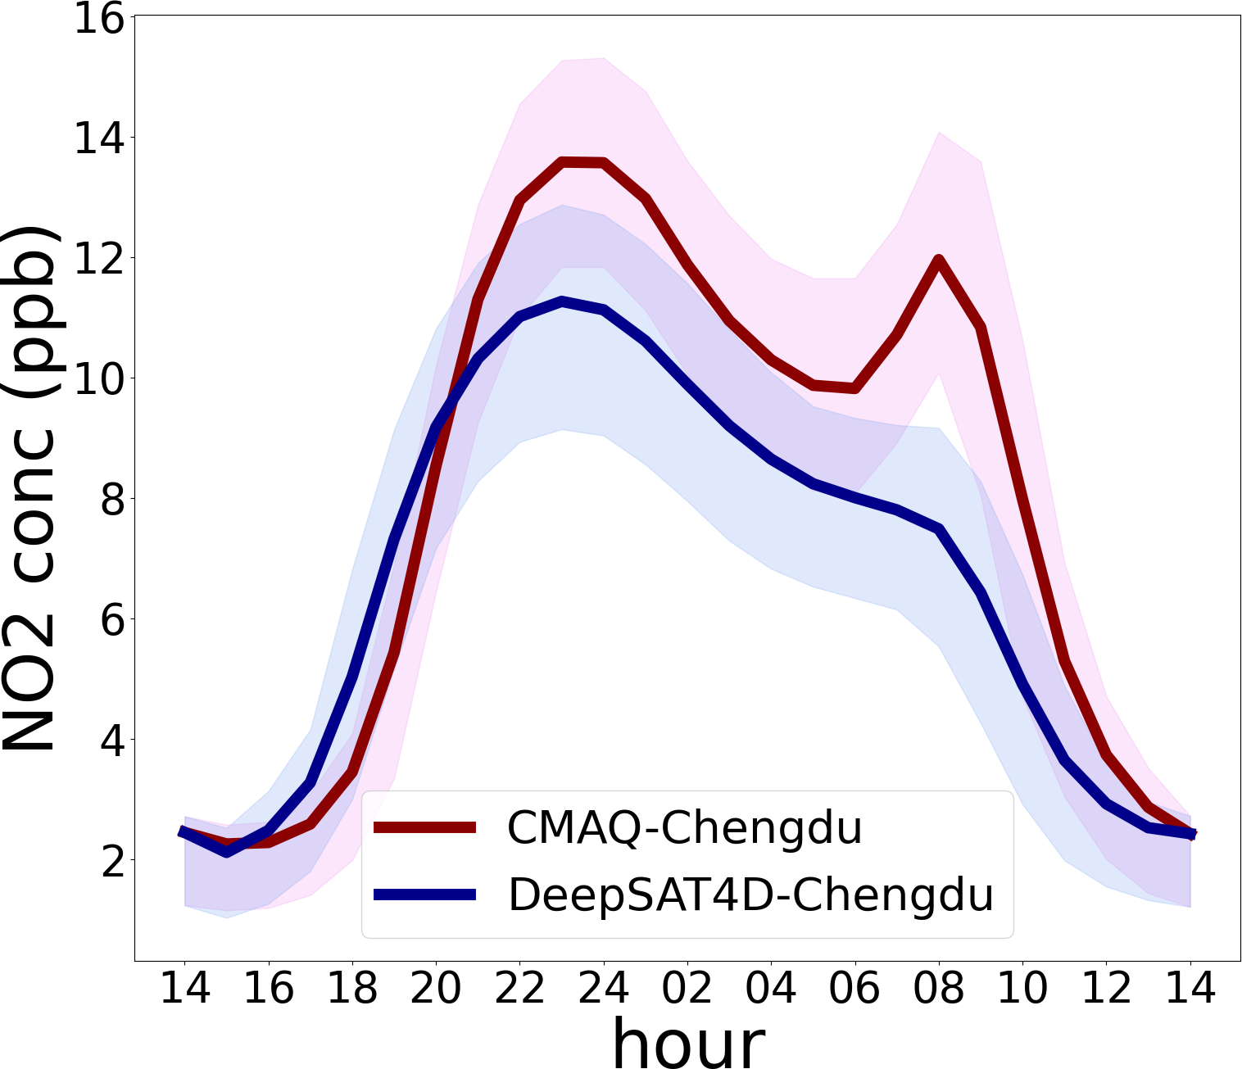
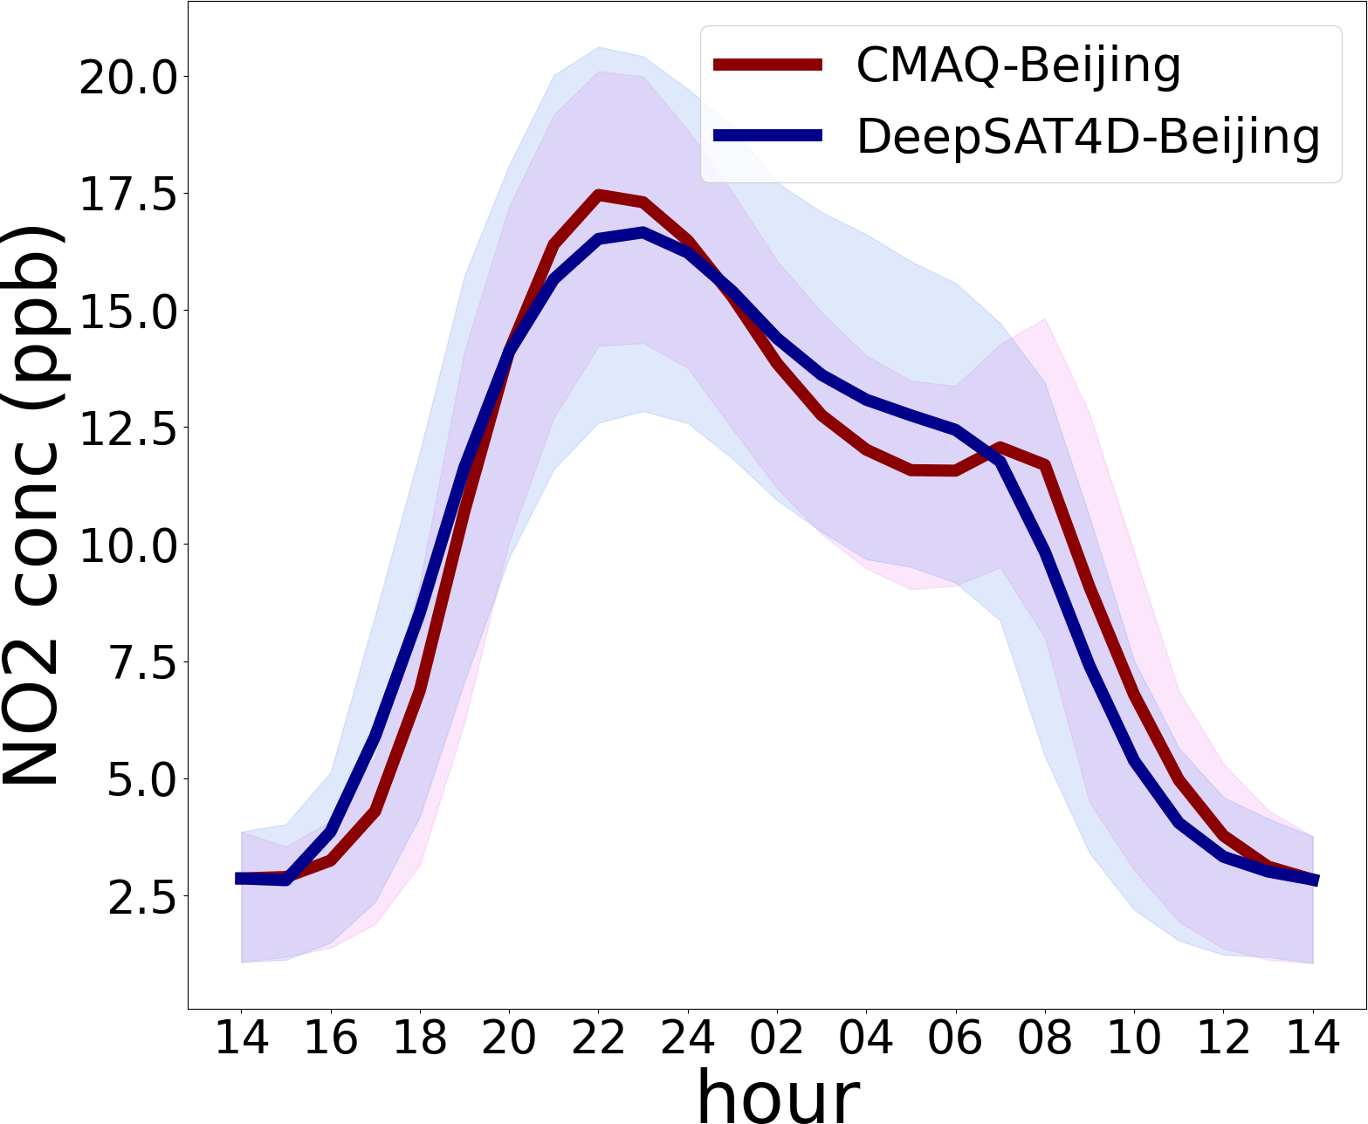
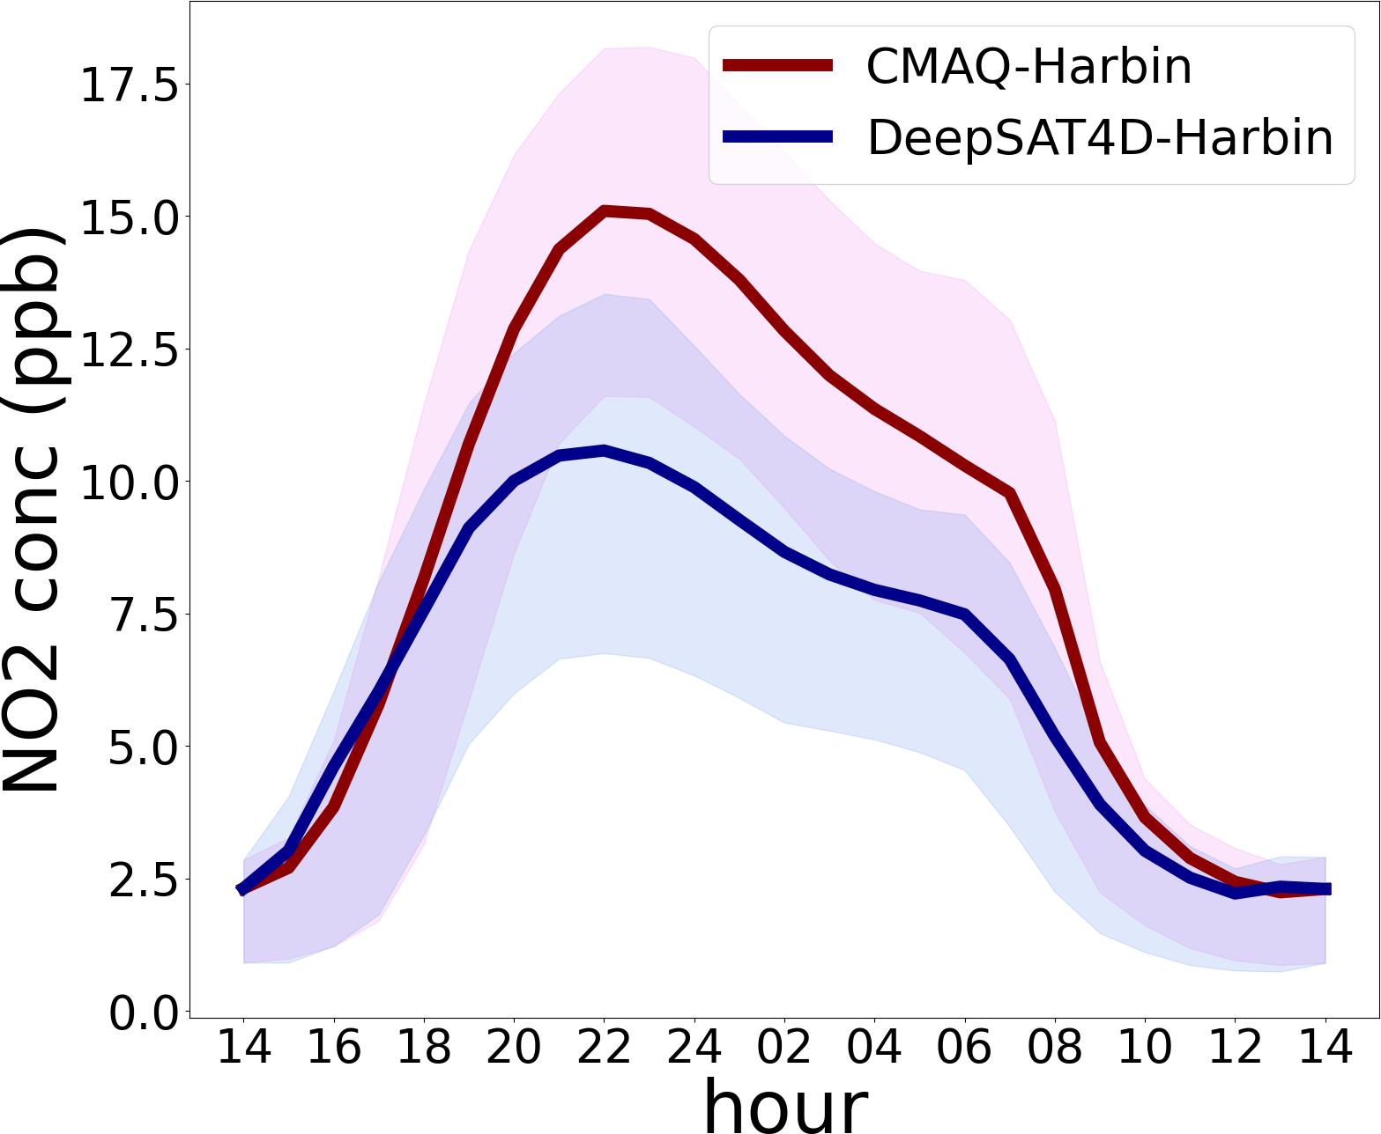
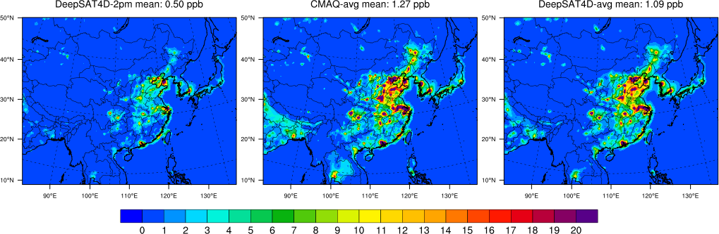
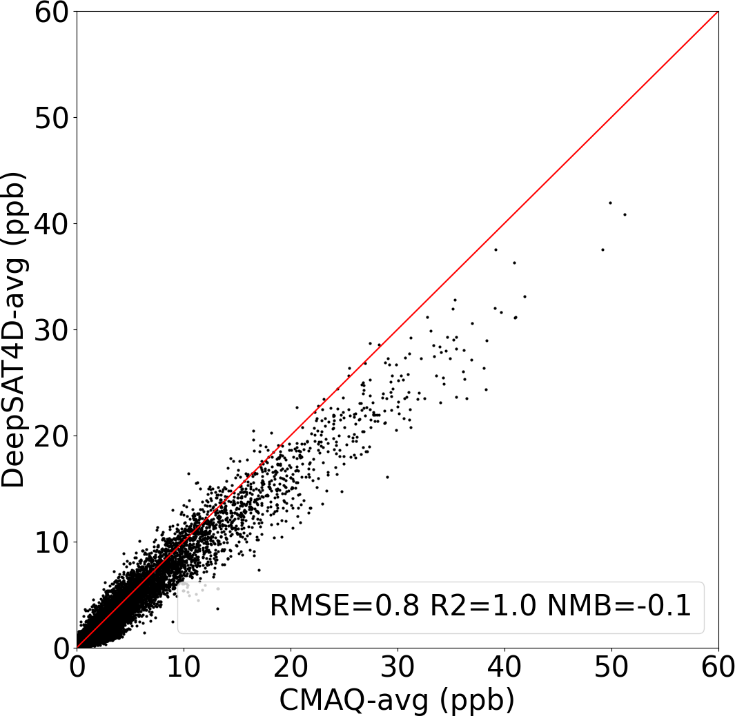
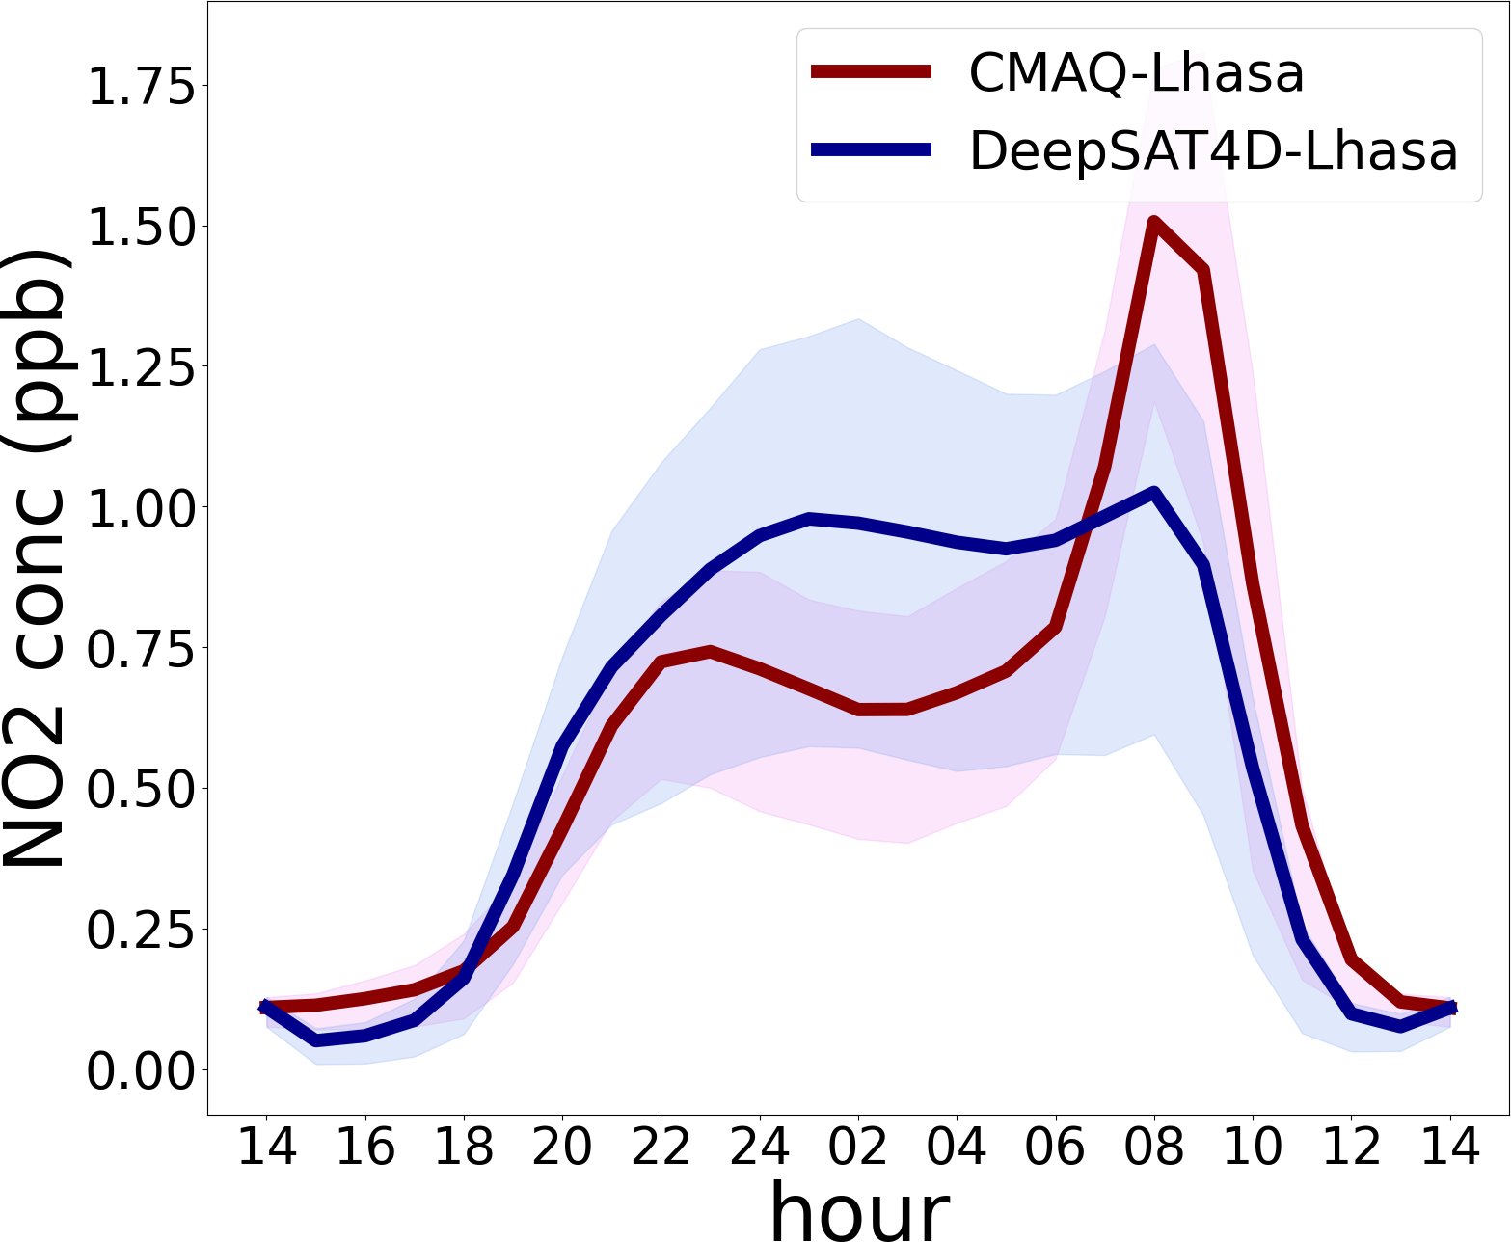
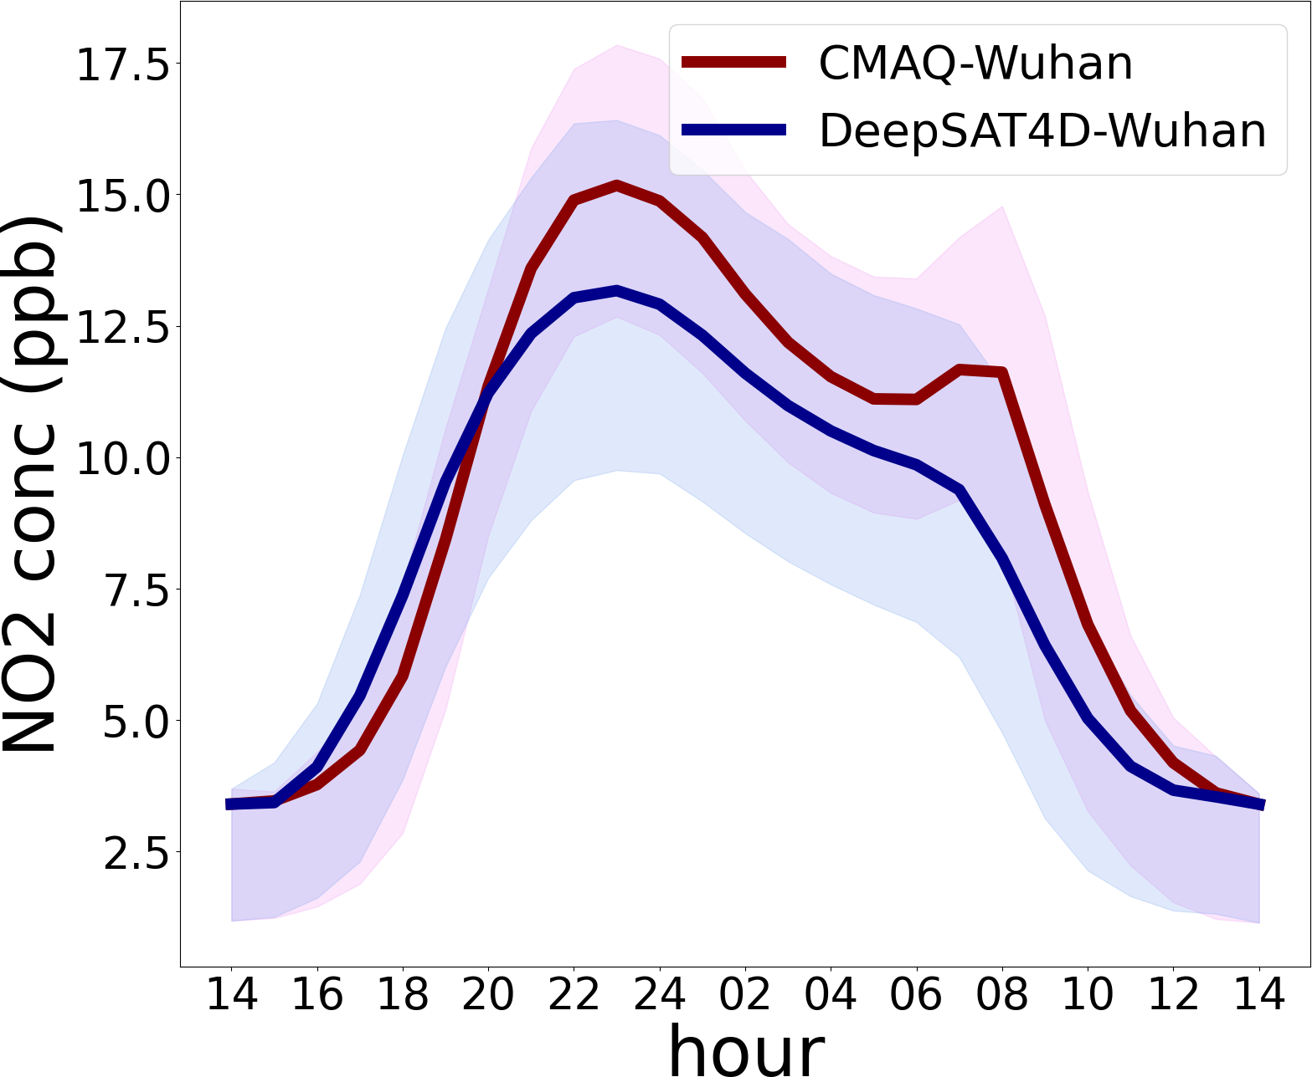
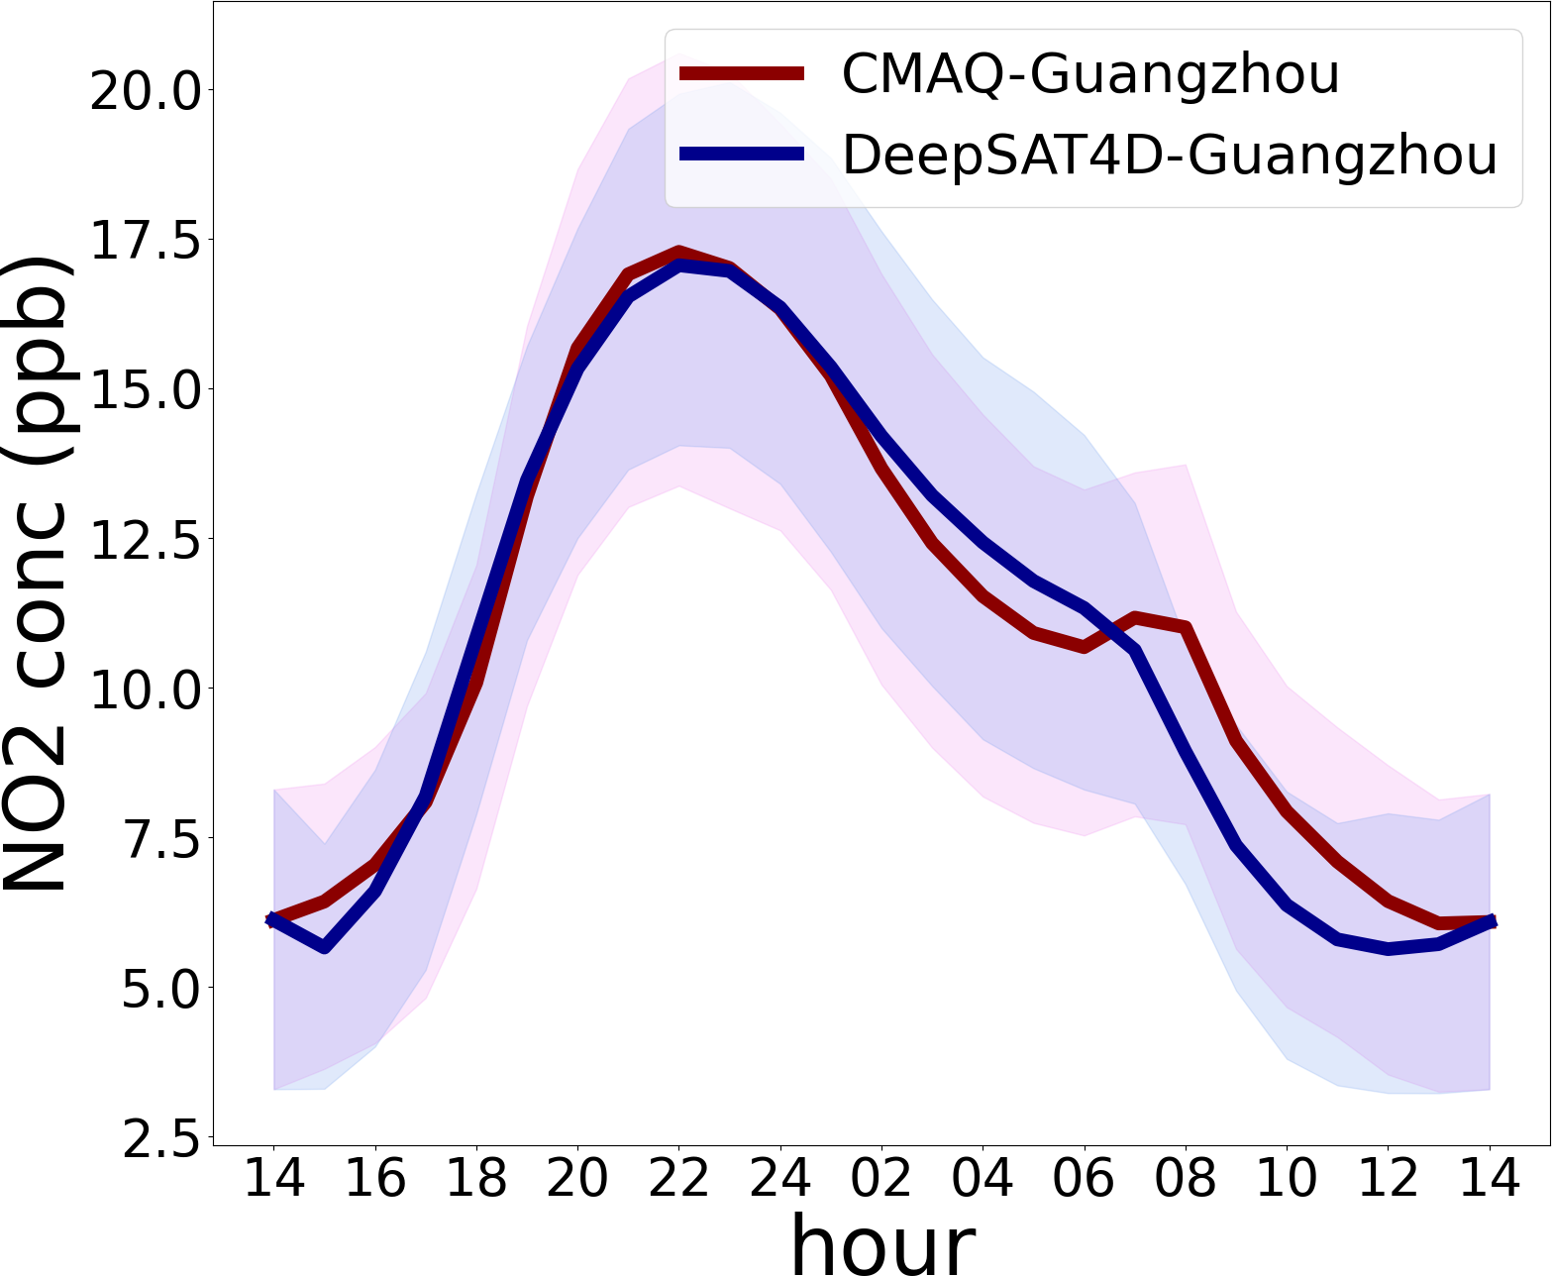
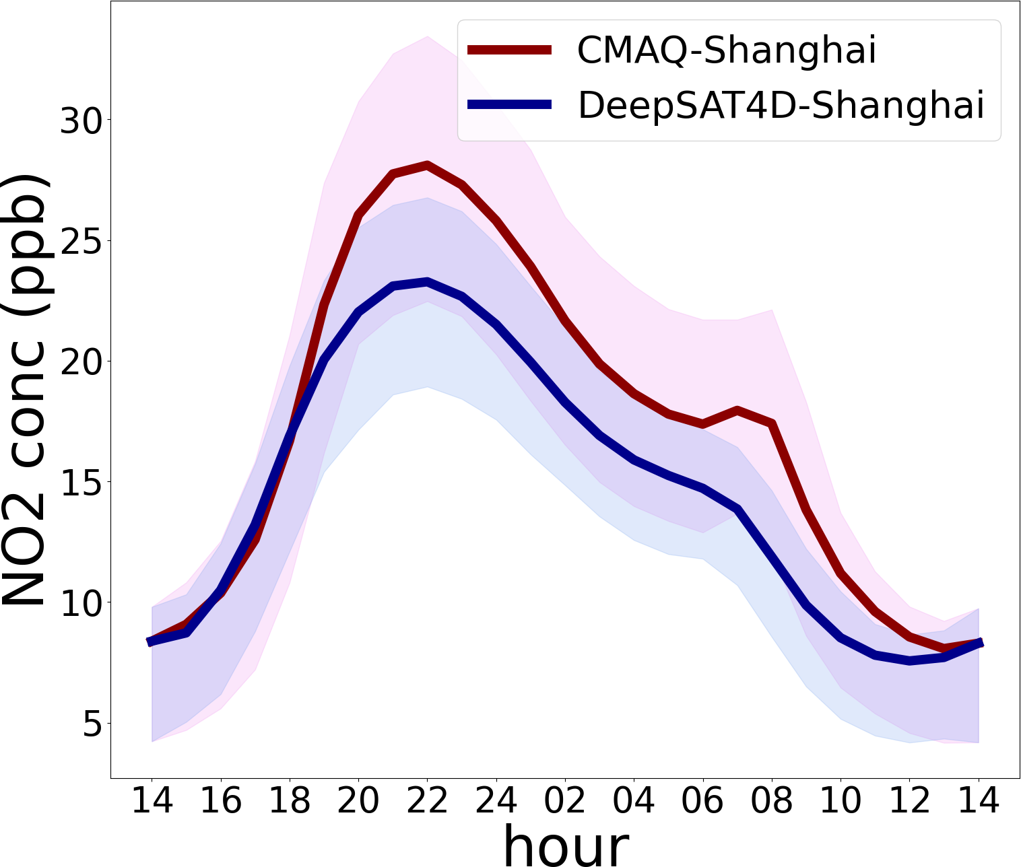
Topic 1: Data-driven AI need the data from physical model
(2) Evolution of diurnal pattern
——driven by the emission and met-condition
interpolation from two 2pm to 23 hours in between
hourly concentration
AI model (DeepSAT4D) well captured the variation
hourly meteorological variable + daily emission
Notes:
The other key point is evolution of diurnal pattern. Since most satellites only observe one place on the specific time per day, so knowledge of diurnal pattern is important to derive the 24hours continuous concentration. 同时对日均值的反演也很重要。This pattern is driven by both the emission and meteorology conditions. 所以我们模型中的第二个模块con lstm解决了这个问题，实现了构建两个反向的lstm，保证误差最小化，前向后向，从第一个时刻向前预测，第二个时刻向后预测。最后取weighting的average。这样可以通过用前后两个观测时间点，把中间的23个小时的浓度变化捕捉出来。
我们用到了emission，但这个数值模型的emission只是一个先验的信息，我们整个反演过程会有卫星观测的浓度来修正了emission。

Slide 7
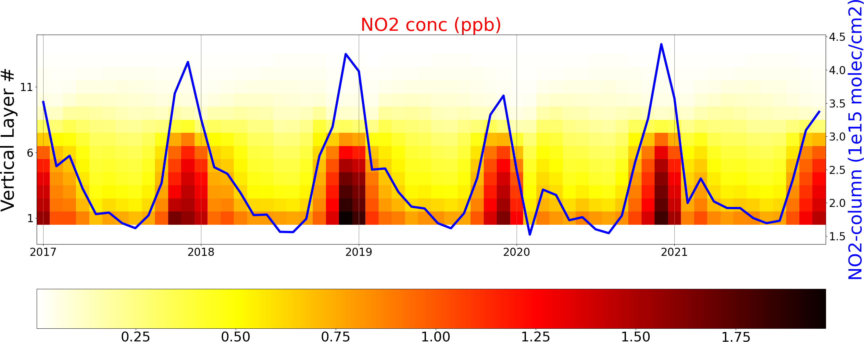
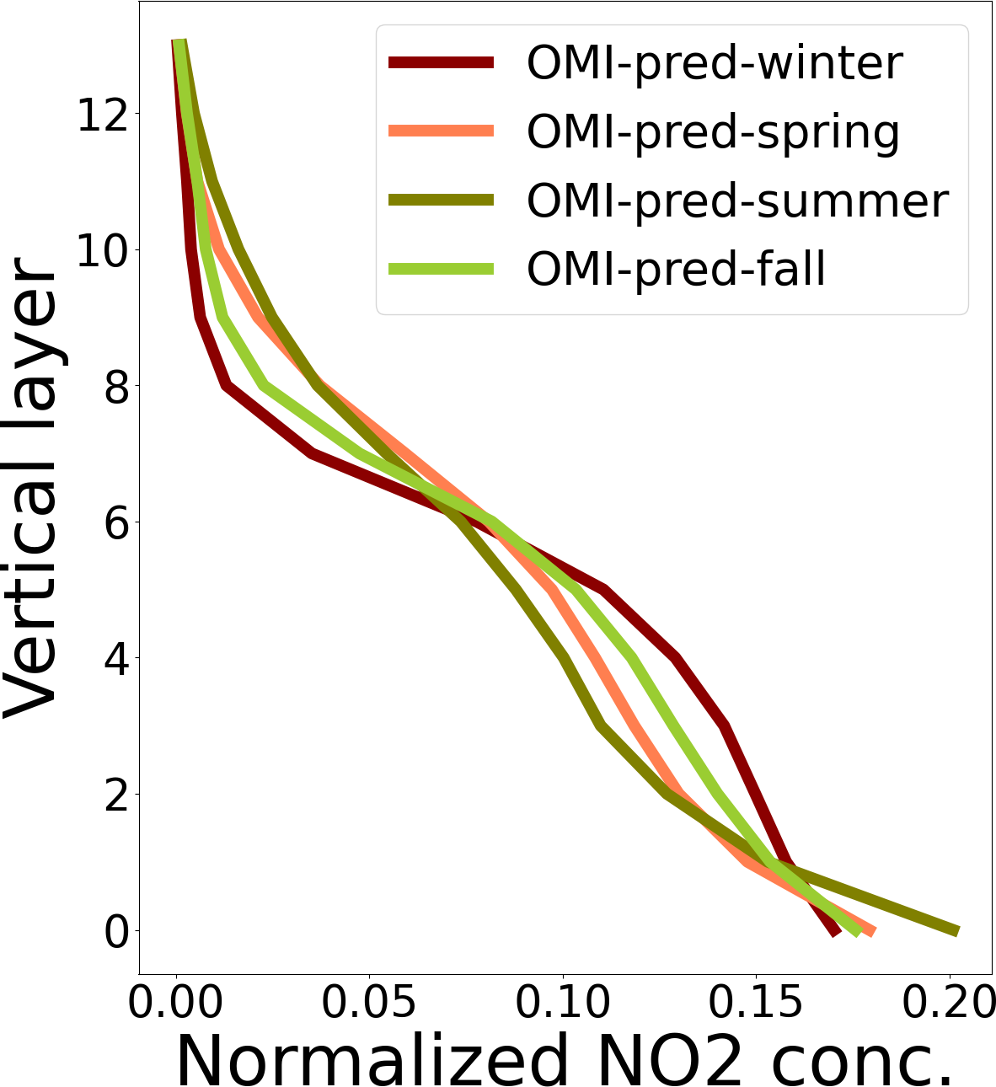
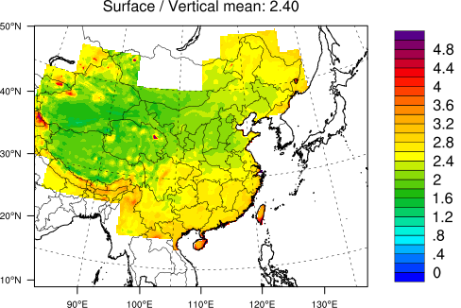
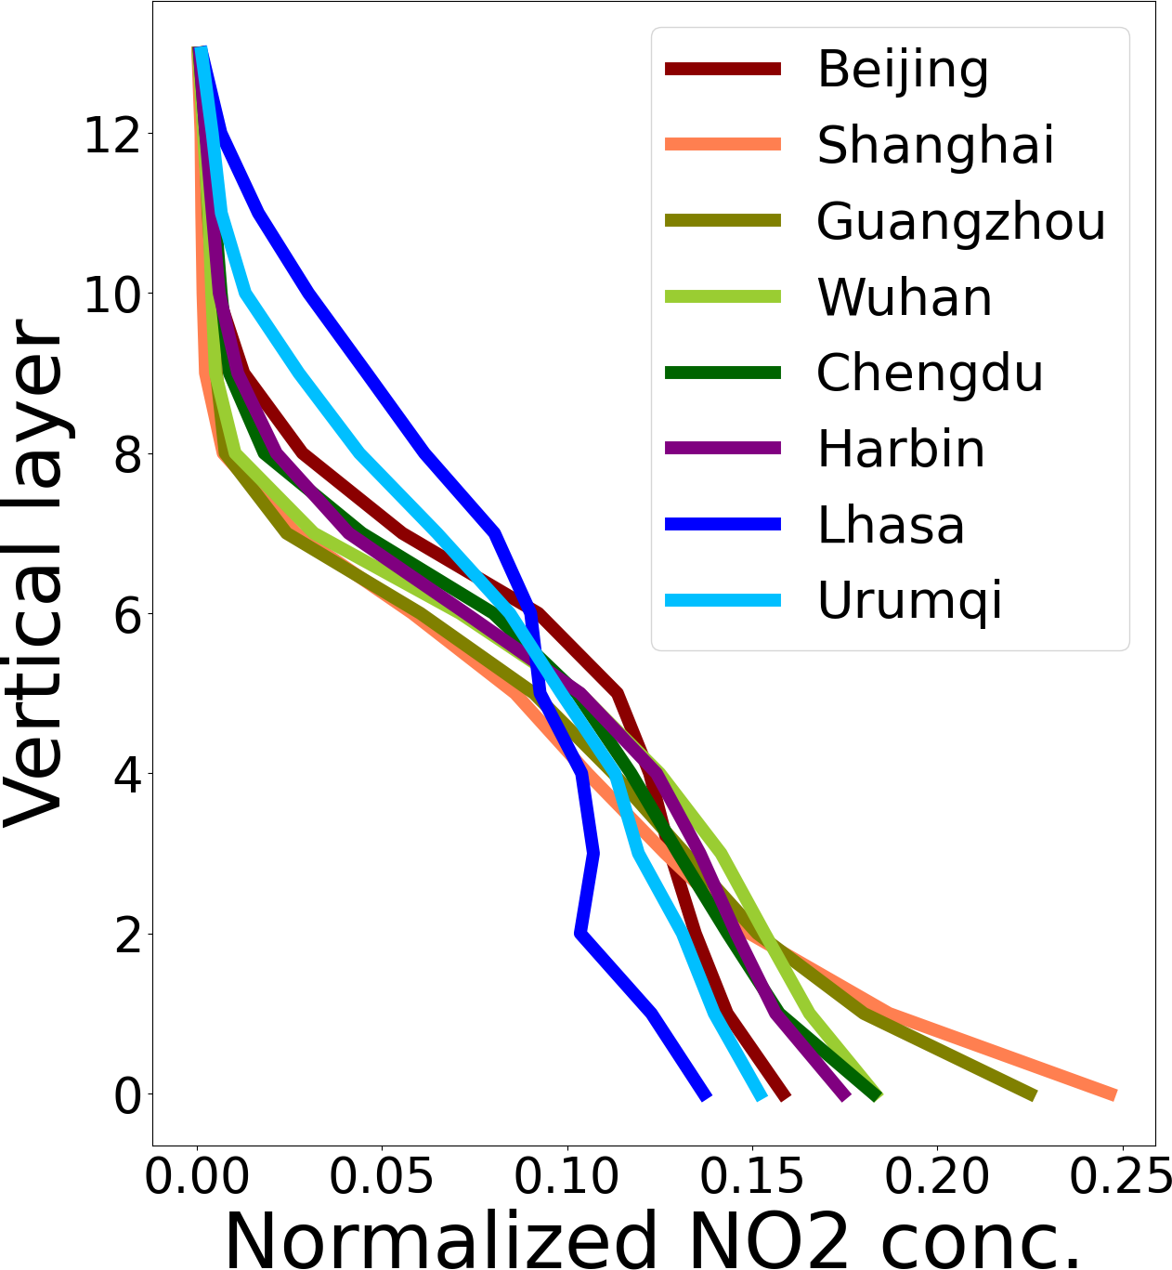
Topic 1: Data-driven AI need the data from physical model
(3) Apply the OMI measurement for AI trained with simulation data of physical model
retrieved 4D NO₂ concentration
difference among season
stronger vertical gradient in summer
difference among cities
less polluted -> more polluted
Notes:
我们的deep能很好的capture这个关系，所以我们利用真是OMI的观测数据来应用看结果如何。整个中国2017到2021这5年的平均NO2廓线的月平均的情况。蓝线是卫星的column观测。我们分解到了每一层。
不同季节不同，冬天的近地表的廓线梯度低，夏天梯度大。不同的城市来看。不同城市的廓线也不同，上海和广州梯度都大。

Slide 8
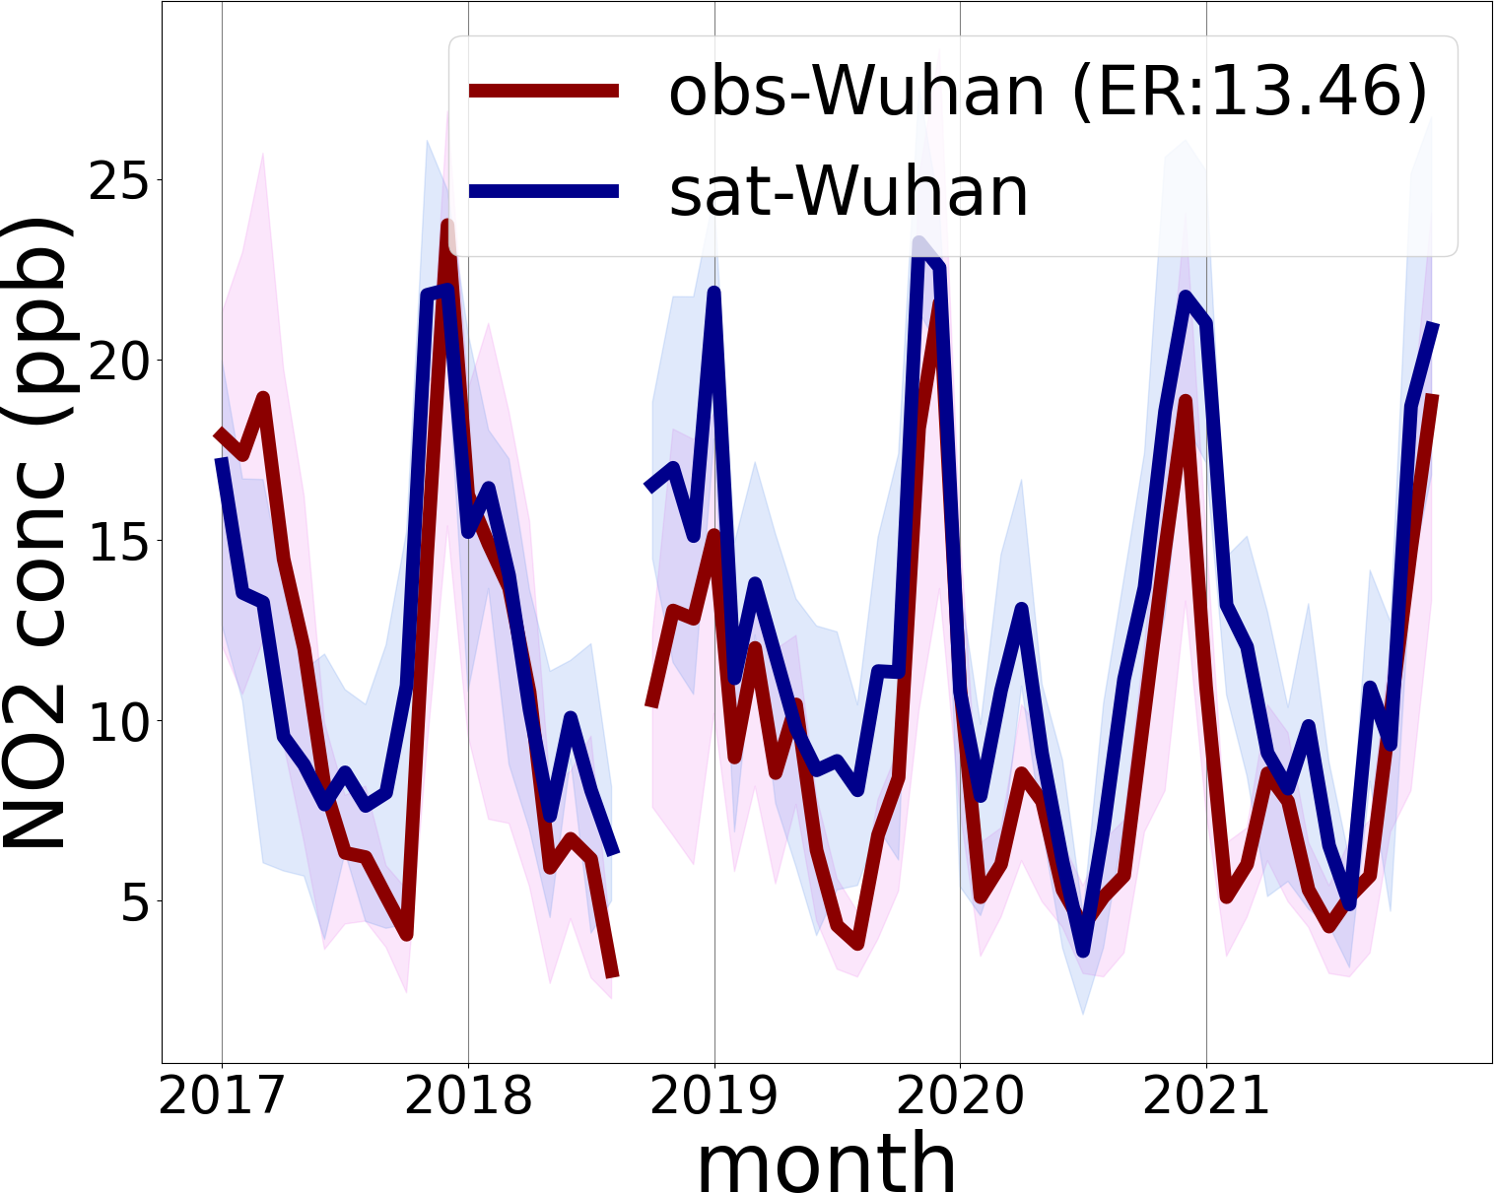
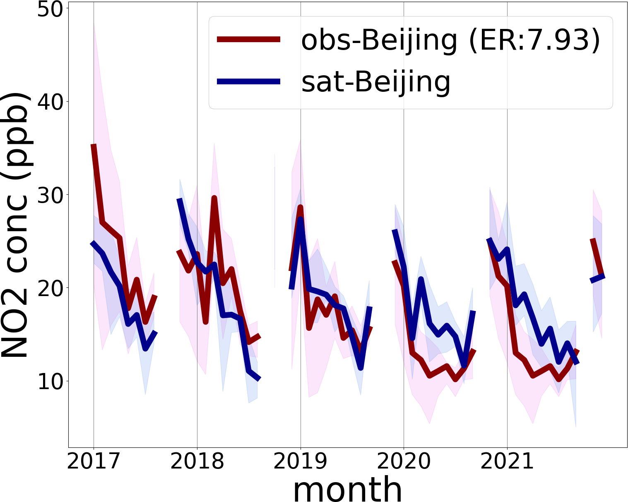
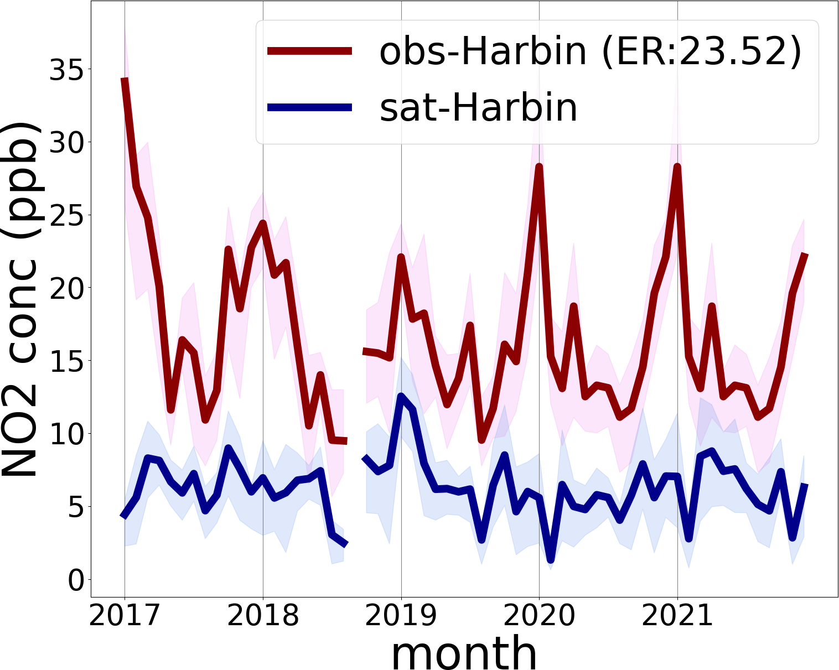
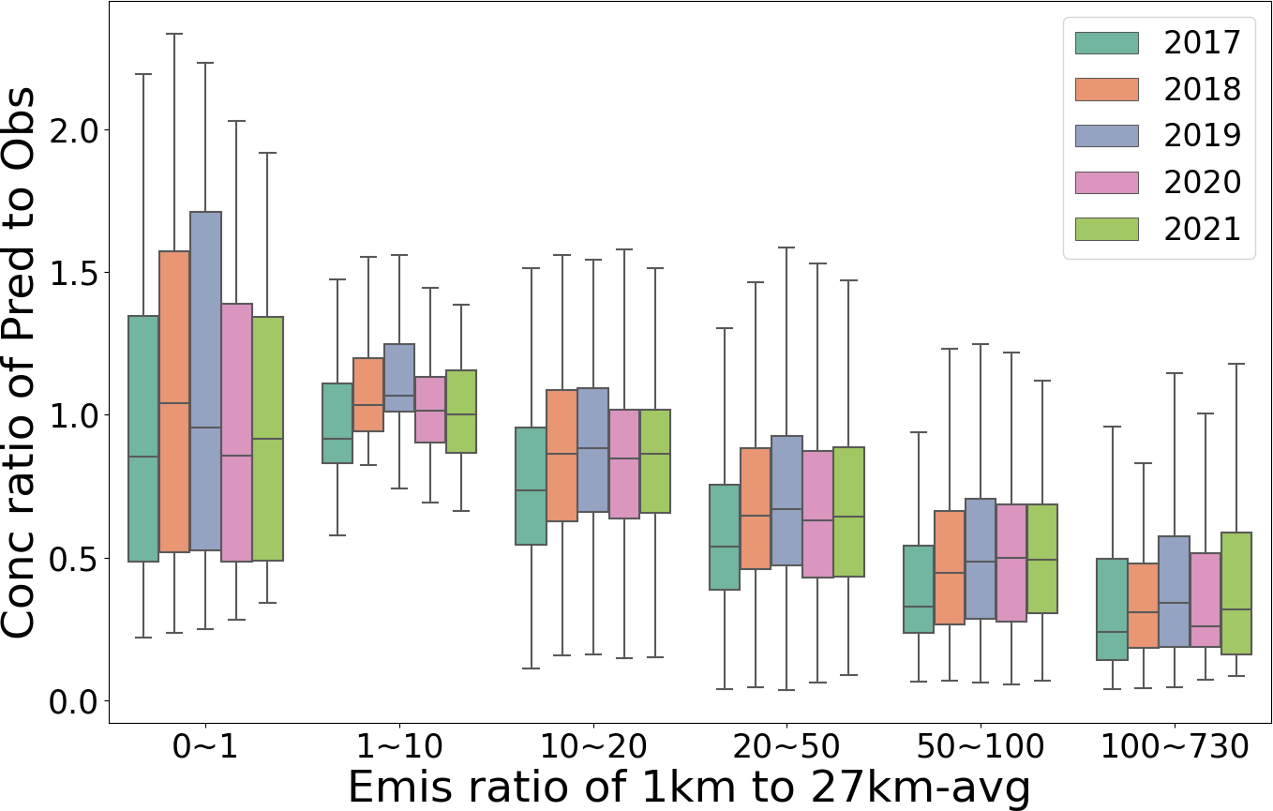
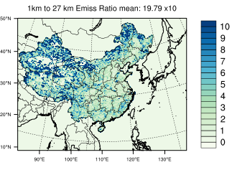
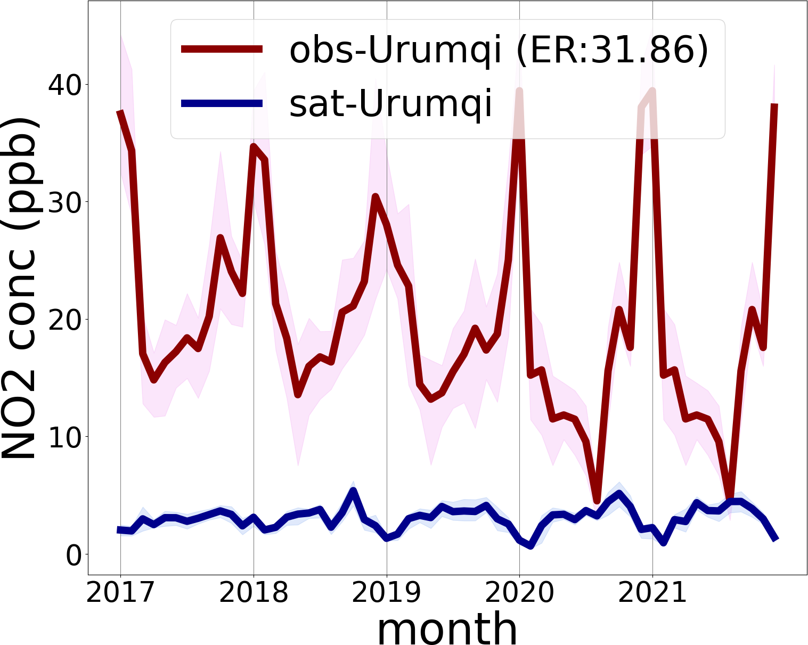
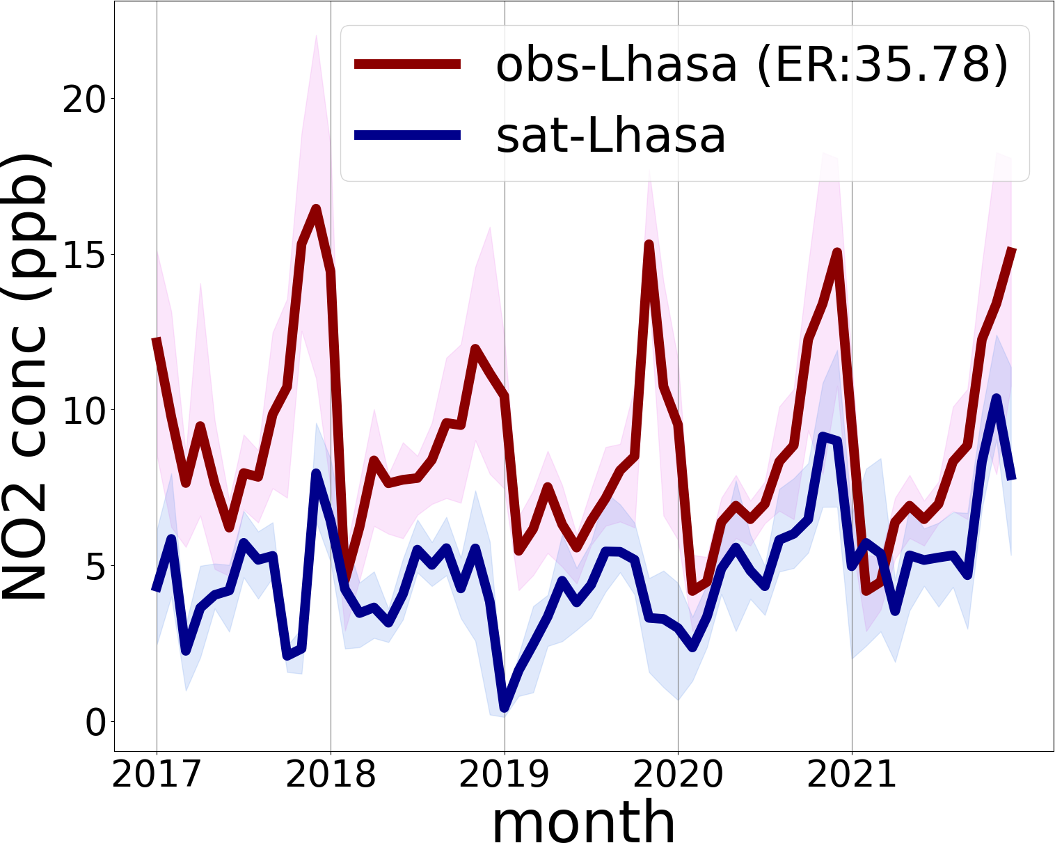
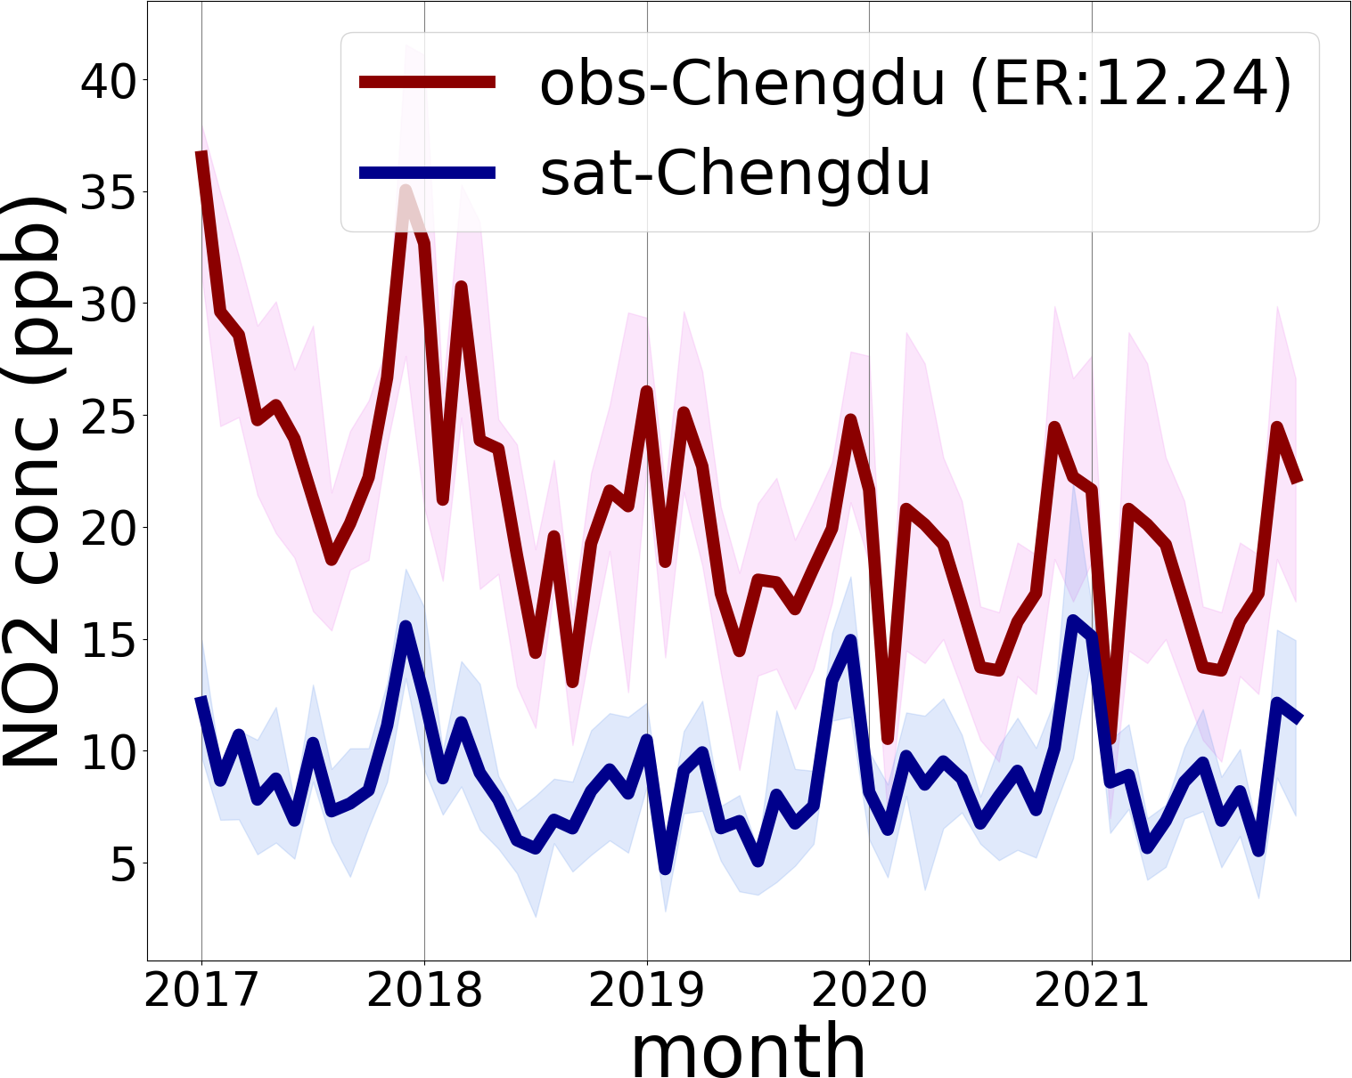
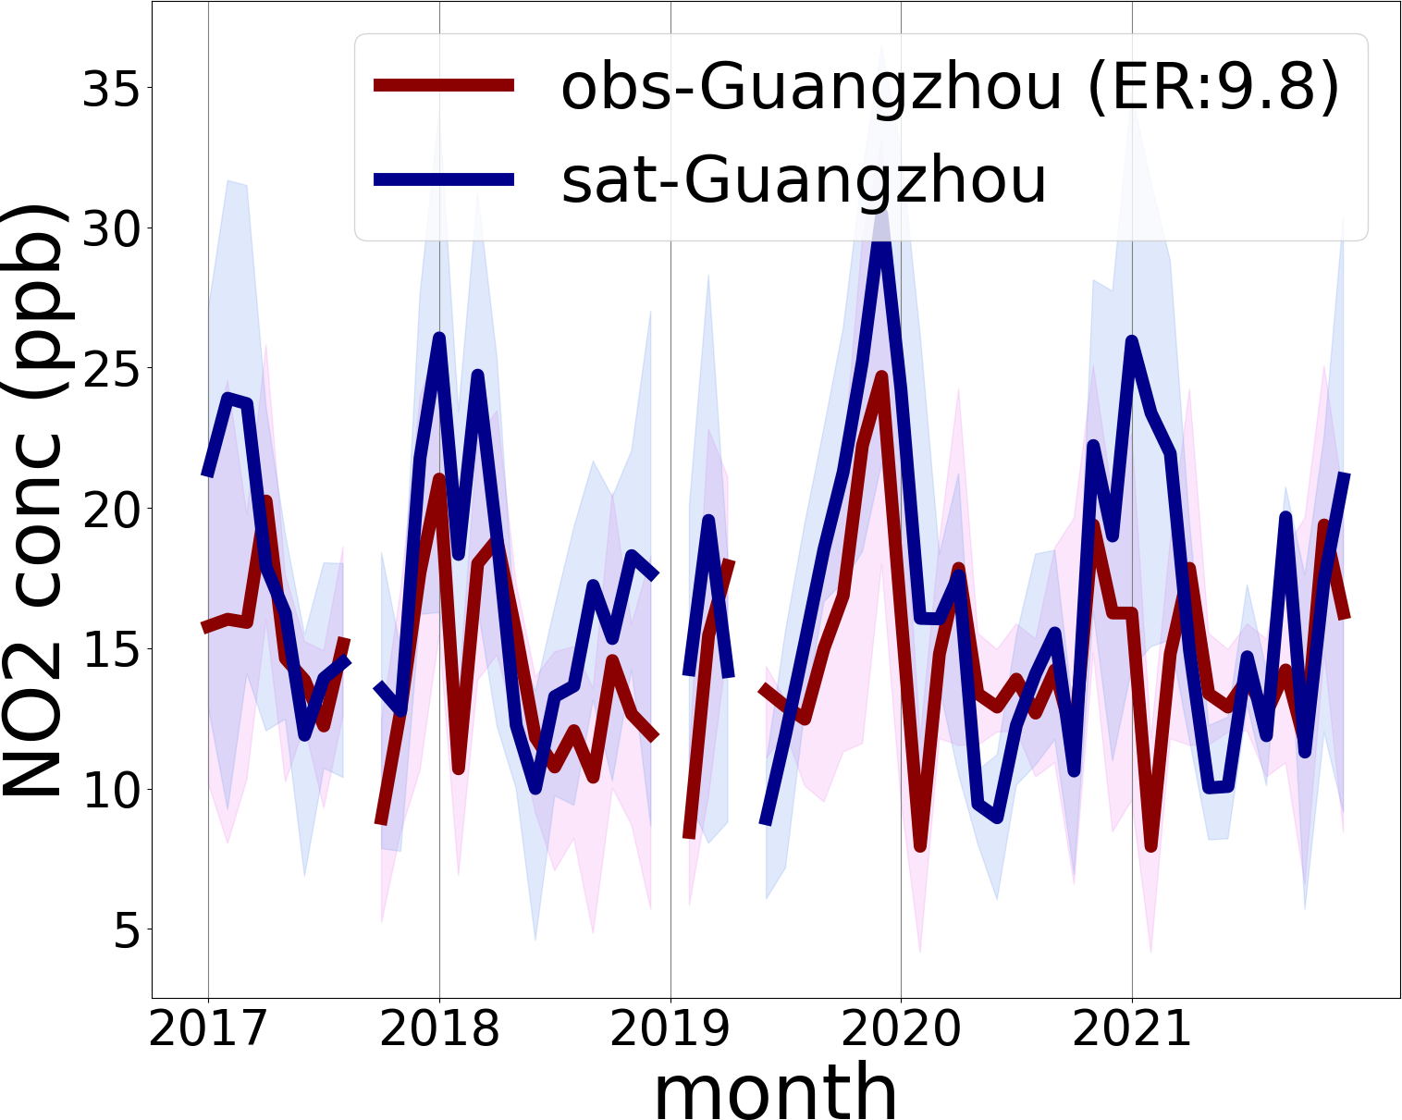
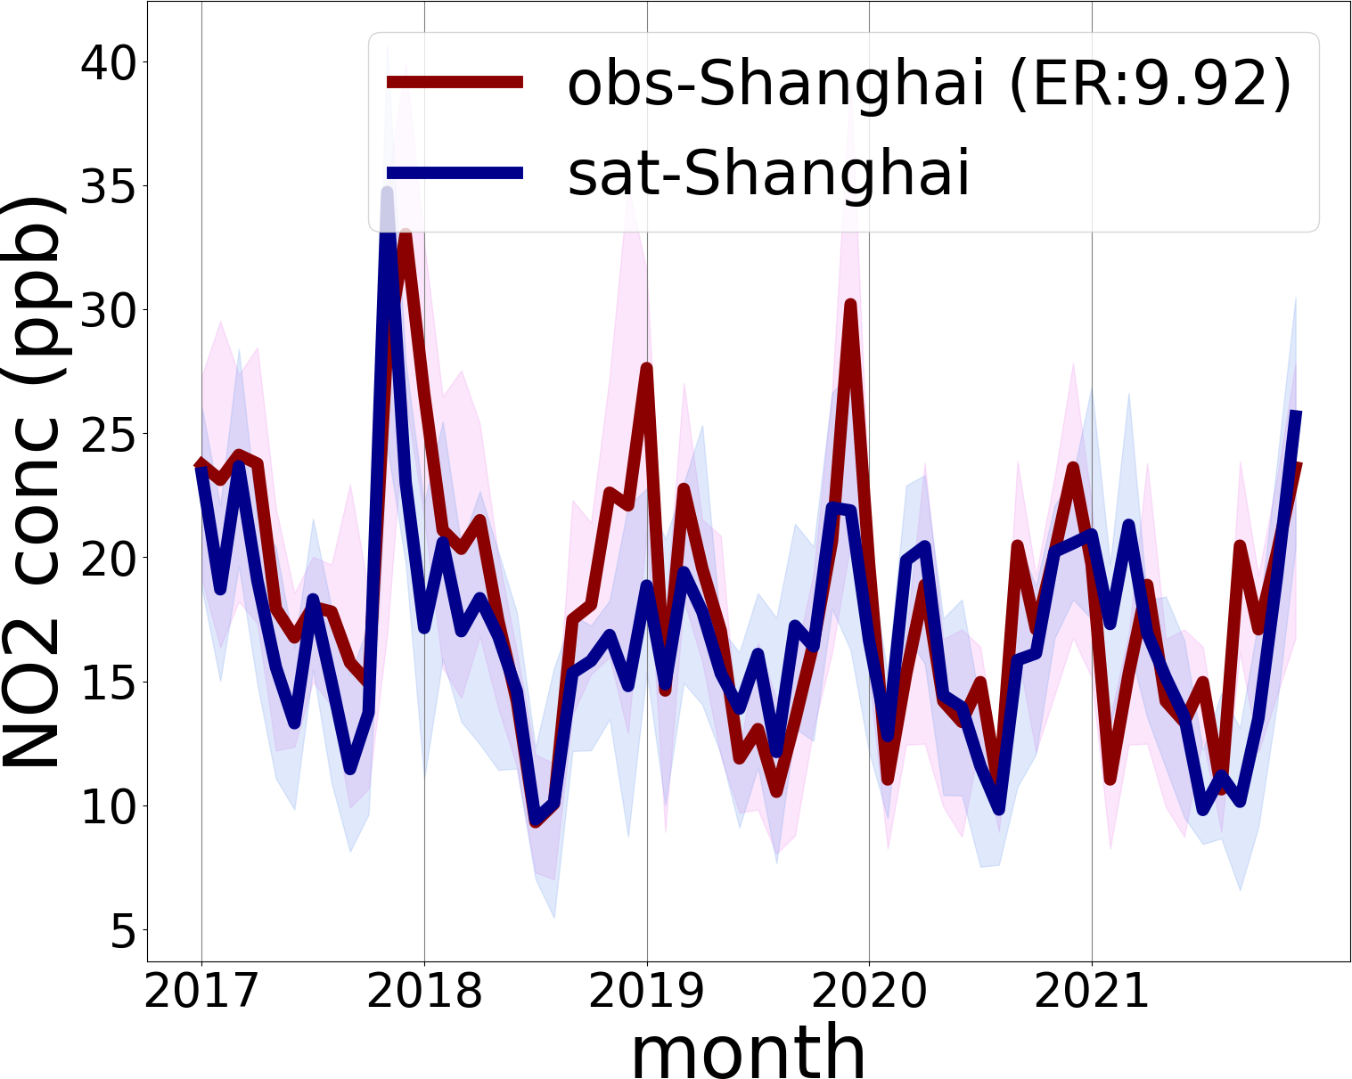
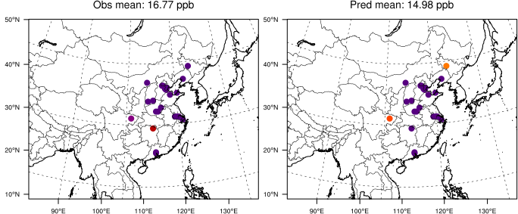
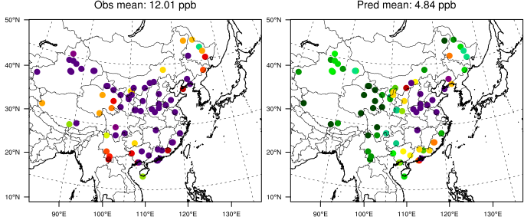
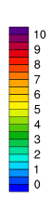
Topic 1: Data-driven AI need the data from physical model
(4) Comparison with ground-measurement
1km-to-27 km Emission Ratio (ER) is the ratio of the maximum emissions within 729 1-by-1 km grid cells within one 27-by-27 km grid cell to the average emissions
no emission
Mid-ER (1-10)
Large-ER (>50)
good agreement in low ER, but worse in high ER
Notes:
为了验证我们反演的结果，我们把我们的方法反演出来的近地表浓度与地表观测的近地表浓度进行了对比。我们这个比较与普通的卫星学习地表观测进而反演地表浓度的工作有本质的不同。我们的方法没有用到地表浓度的观测数据。因此我们得到的地表浓度与地表观测是完全独立的反演，不受地表浓度的影响，是真实的反演结果。大部分城市的结果都非常的好，但在乌鲁木齐和拉萨反演的结果并不好。我们认为这是尺度的原因引起的不同。我们反演的是27km的浓度，而在乌鲁木齐和拉萨比较清洁，而NO2观测站点是城市高值区，因此无法代表27km区域的值。因此我们定义了一个ER值来判断网格的代表性。网格代表性越好（越均匀），我们预测结果越好，网格代表性越差（越不均匀），我们和观测的结果差别也越大

Slide 9
Outline
Why physical model is important for machine-learning?
1
Training Data provided by physical model
2
Evaluation testbed based on physical model

Slide 10
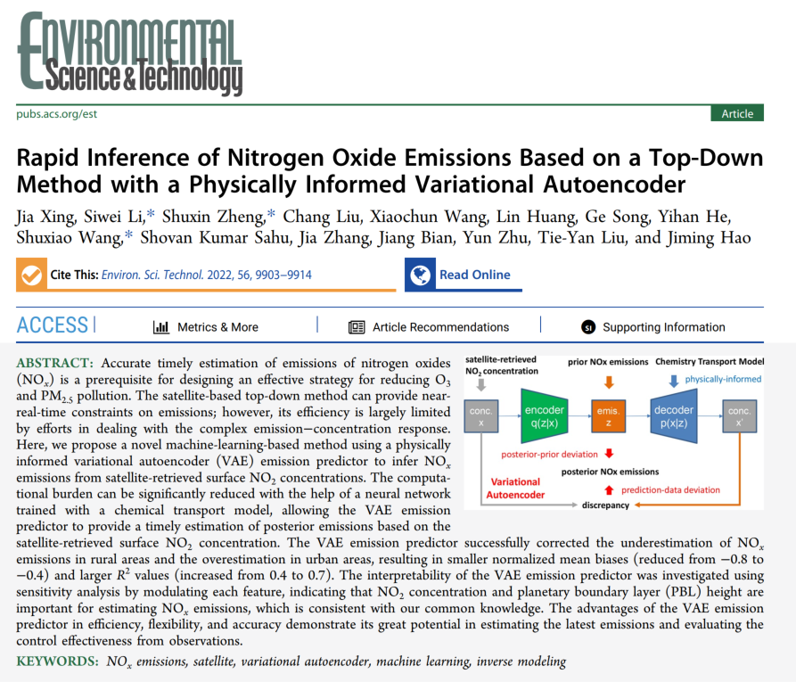
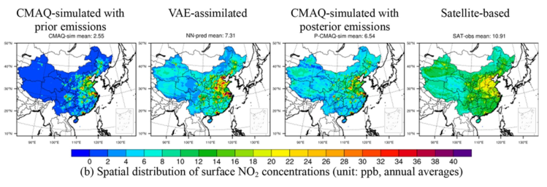
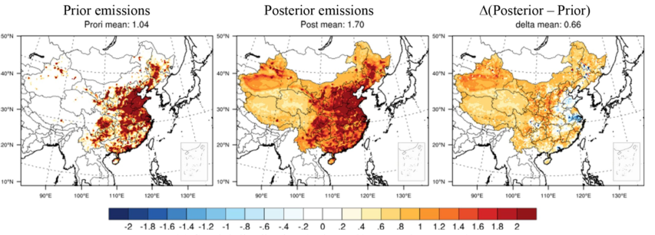
Topic 2: Evaluate and optimize AI with physical model testbed
It All Began with One Paper...
very high satellite-retrieved NO2 concentration than CMAQ
is that really true?
large increase of NOx emissions
2022
updated emissions are suspicious high in the west
Notes:
首先讲现在很多AI用地表数据来学习卫星，但其实其中一个很大的问题就是地表站点和卫星的观测不是scale，而且由于地表分布的问题，郊区站点少，所以会有sample imbalance。
我们当时做了一个工作，基于卫星和深度学习去反演排放。因为模型中误差的一个很大的来源是排放不准确，相对于模型本身机理来说。所以模型模拟的污染物会与观测有较大的差异。因此，我们就想用是观测来对排放进行校正，得到更准确的排放信息。
但在这个工作中，由于地表观测的局限性，我们使用了卫星数据学习地表浓度去作为模型的输入文件。从我们的结果发现，基于卫星数据反演的浓度和cmaq的浓度在郊区差别很大。我们当时认为可能是一些天然源例如闪电造成的。因此我们在这些区域反算除了较高的排放。但是这是真实的情况吗？由于缺乏实际的观测，我们无法给出确切的答案。

Slide 11

Topic 2: Evaluate and optimize AI with physical model testbed
Typical machine learning method
$$Conc=ML (features)$$
ground measurement
(label)
satellite
meteorological factors
geographic variables
during training
optimized parameters
during prediction
all grid cells across the space
(output)
The method is not right if the label has very different distribution as the predicted grid cells!!!
during validation
a small set from “label”
Notes:
后来我们在没有观测验证的情况下，从理论和机器学习方法上重新审视了这个问题。我们用的training数据是有限的地表数据，validation的数据是其中摘选的一部分，还是受限于地表数据。如果地表数据的分布存在imbalance，那么训练出来的模型会学习到这些imbalance的特征，而无法准确的表征实际的多样性的情况。
还有一个scale的问题。

Slide 12
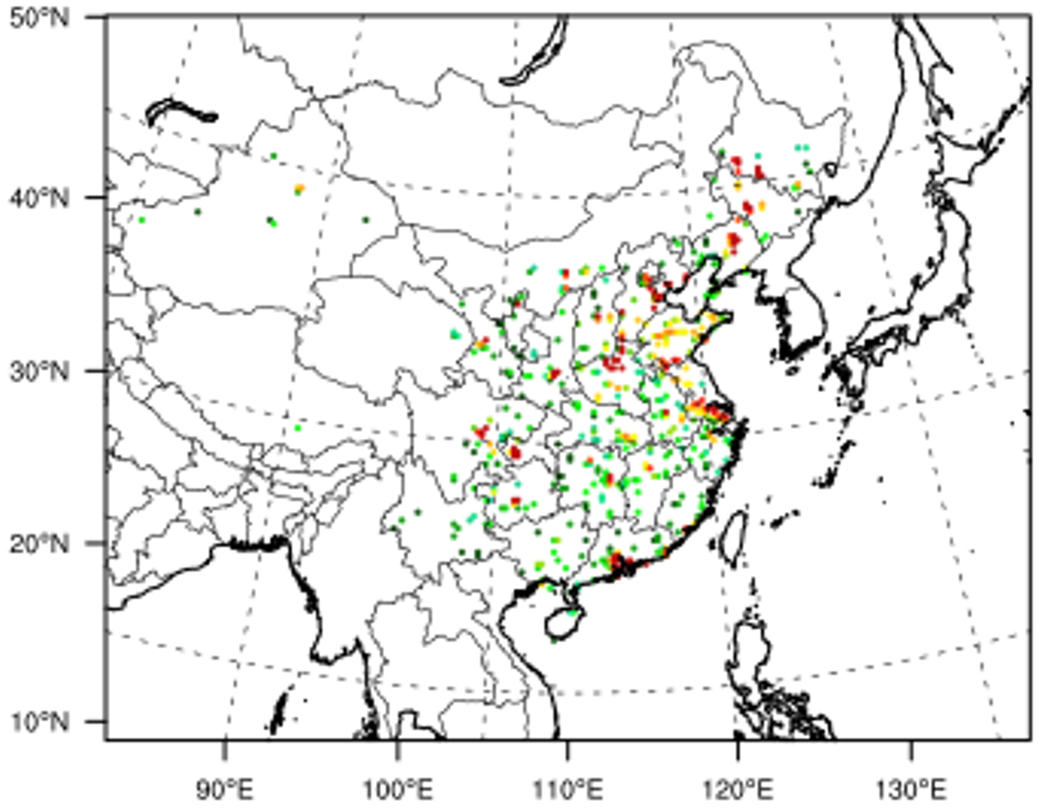


Topic 2: Evaluate and optimize AI with physical model testbed
Sample imbalance problem in data fusion
Key point: ground measurement is mostly located at urban; but the prediction is dominated by rural areas in the west (no data available for validation)
~500 ground-based monitor sites
label is much higher
larger % conc is near ground in label
Purpose: to protect human health so all in high polluted area
ground = % * satellite (total column)
lead overestimation in the rural
Notes:
所以我们就做了第二个工作来分析sample imbalance的问题，基于cmaq模型的分析，通过对观测站点所在网格特征和其它拟预测网格特征的对比分析发现，有观测站点的区域的污染物的垂直结构与其它网格的垂直结构有很大的不同。观测站点的地方，大部分污染物更靠近地面。所以如果用站点来训练，对没有站点的地方容易高估。

Slide 13


Topic 2: Evaluate and optimize AI with physical model testbed
How to validate the data fused concentration?
Initiate the testbed using chemical transport model (CTM)
conduct CTM simulations
select grids matching the monitors
reproduce the entire space
marked
interpolate
validate
Objective
physical model like CTM can provide the ”ground-truth” for the area outsides the monitor points thus can be used as a testbed to evaluate the performance for the interpolation method with various of machine-learning models
Notes:
为了进一步去验证我们的想法，imbalance带来的问题，我们就用模拟数据建立了一套testbed去仿真传统ml的方法对空间反演的performance。

Slide 14




Topic 2: Evaluate and optimize AI with physical model testbed
Considerable Sample-Imbalance-induced Biases
Ground-truth on ground monitors
Prediction on ground monitors
Ground truth
Prediction from RF
training set
test set
overestimation in downwind/rural area
Notes:
这张ppt展示真实的结果，没有想象中的乐观，特别是西部郊区。但我们在传统有站点的地方验证，performance是非常好的。但在没有站点的地方，效果比较差。有系统性的差别。我们做了一个分析，去看performance随着距离观测站点的远近的关系。我们发现距离观测站点越远，overestimation的现象越显著。散点图只是表现在站点网格的performance

Slide 15

















Topic 2: Evaluate and optimize AI with physical model testbed
Using Testbed to improve the model to mitigate the error
“ground truth”
mimic the observation as “label”
prediction
validate
select
train
simulate with CMAQ
match grids to monitors
reproduce the entire space
additional training samples
feature and model structure
optimize
AOD
NO2 column
neighborhood
New method
t-1
LAI
t
PBL height
Wind speed
Short-wave radiation
t+1
Precipitation
Cloud cover
convective velocity scale
2-meter temperature
V-wind
humidity
U-wind
application with real measurement
satellite products
suggested additional sites
uncertainties in prediction
ground observations
Notes:
我们想用模型去改进sample imbalance的问题。我们模型去模拟我们加了一些观测站点后，如何能更好的改进对污染物的反演。
第二行，我们尝试增加观测站点，改进AI反演模型的结构得到新的结果。

Slide 16



Topic 2: Evaluate and optimize AI with physical model testbed
Reduce the sample-imbalance induced error in exposure estimation
New method mitigates PM_{2.5} overestimation and corresponding exposure in the downwind area
Notes:
基于新方法和卫星观测得到的新结果。老方法高估了pm，新方法缓解了这个问题。

Slide 17

Topic 2: Evaluate and optimize AI with physical model testbed

Slide 18
Summary and Future Plan
Physical model is important to help us to understand the mechanism and guides AI model
Observation data especially high resolution satellite data are important for both physical model and AI model
Combining observations, physical model and AI model could be important for prediction

Slide 19


Thank you for your attention!
siwei.li@whu.edu.cn

