Slide 1
Proposed Updates to Canadian Air-Quality Deterministic Prediction System
Verica Savic-Jovcic, Craig Stroud, Junhua Zhang, Qiong Zheng, Elisa Boutzis, Jack Chen
Air Quality Research Division, Environment and Climate Change Canada,
4905 Dufferin Street, Toronto, ON, M3H5T4, Canada
verica.savic-jovcic@ec.gc.ca
Sylvain Ménard, Dragana Kornic
National Predictions Development Division, Environment and Climate Change Canada,
2121 route Transcanadienne, Dorval, QC, H9P 1J3, Canada
22nd CMAS, Oct. 16th-18th, 2023, Chapel Hill, NC

Slide 2
outline
Overview of current Canadian Air-Quality Prediction System
Summary of the Proposed Updates to the System
Review of Updates to the Canadian Anthropogenic Emissions
New Residential Wood Combustion Surrogates
Concluding remarks

Slide 3
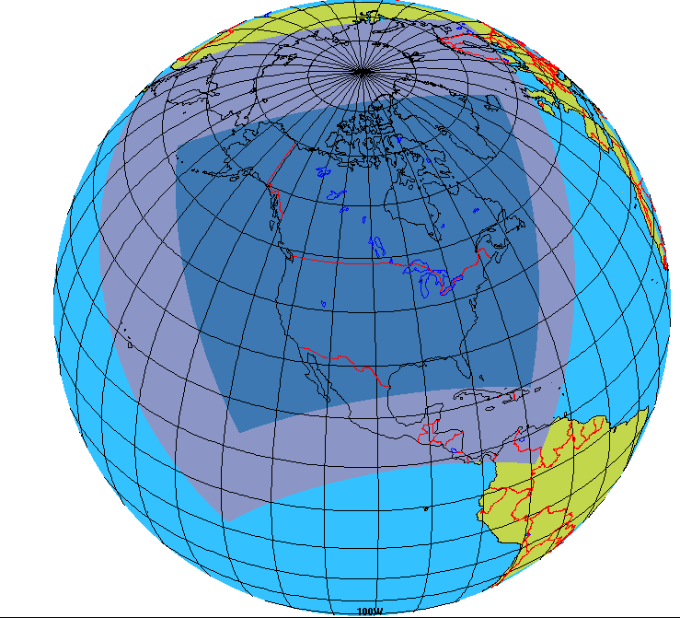
Overview of Canadian Air-Quality Deterministic Prediction system
RAQDPS and RAQDPS-FW | Regional Air-Quality Deterministic Prediction System and FireWork
Grid Configuration | Limited Area Model (LAM) over North America on Rotated Latitude-Longitude Grid with: 10 km horizontal resolution and 84 Vertical Hybrid Levels up to 0.1 hPa (~60 km)
Runs per Day | 72-hour forecasts twice a day (00 and 12 UTC)
Model Output | NO₂, Ozone and PM_{2.5} reported to public and for the AQHI Forecast Program Additionally, Meteorological & Chemistry Variables available for Evaluation and Further Research
On-line Chemistry Processes | ADOM-II Gas-Phase Chemistry (42 species, 114 reactions) 2-bin Version of Canadian Aerosol Module (CAM) with Particle Speciation to 9 Chemical Components (SO4, NO3, NH4, EC, pOC, sOC, crustal material, sea salt and particle-bound water) which are Assumed to be Internally Mixed for Aerosol Dynamics Aqueous-Phase chemistry (25 species, 25 reactions) HETerogeneous Vectorized (HETV) Algorithm for Inorganic Heterogeneous Chemistry Instantaneous secondary organic Aerosol Yield (IAY) Scheme for Secondary Organic Aerosol Formation Dry Deposition Mechanisms for Gas and for Aerosol Wet Deposition (In-Cloud and Below-Cloud scavenging) Meteorological Modulation of Emissions
Emissions | Canadian, U.S. and Mexican Anthropogenic Emissions BEIS 3.0.9-ECCC Biogenic Emissions (BELD3) Canadian Forest Fire Emission Prediction System (CFFEPS) v4.1 for Wildfire Emissions (FireWork only)
Lateral Boundary Conditions | Meteorological are from the operational Regional Deterministic Prediction System (RDPS) Chemical are from the seasonal averages of MOZART output
RAQDPS/FireWork Grid

Slide 4
Proposed System Updates
Merge of the Twin Systems | New System to run with Wildfire Emissions and estimate fire plumes based on the ratio of the PM specie concentrations as evident in the fire emissions (BC/POA ~ 0.10-0.17 and (BC+POA)/CM ~ 5-15)
Chemistry Model | Vehicle Induced Turbulence (VIT, Makar et al, 2021) Below-Cloud Scavenging (Ghahreman et al, 2023 and Wang et al, 2014) ADOM-II Gas Phase Mechanism updated to KPP version
Chemistry Inputs | Canadian Anthropogenic Emissions (Inventory and Surrogates) Biogenic Emissions Rates to BEIS 3.7 using BELD 4 Database MODIS-based Monthly LAI (Zhang, J. et al., 2020) Monthly Climatology for Gas Species Lateral Boundary Conditions (CESM2.2:CAM-chem as Boundary Conditions)
Meteorological Inputs | Lateral Boundary Conditions to be from the Global Deterministic Prediction System

Slide 5
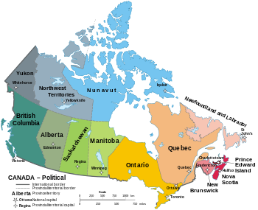
Emissions INVENTORY Updates
Country | Availability | Current | Updated
Canada | By province or territory | 2020 projected emissions based on 2015 emissions released in 2017 national Air Pollutant Emission Inventory (APEI) | 2023 projected emissions based on 2019 emissions released in 2021 national Air Pollutant Emission Inventory (APEI)
U.S.A. and Mexico | By county | 2023 projected emissions from EPA 2016 v1 Emissions Modeling Platform
Provinces and territories of Canada - Wikipedia

Slide 6
Emissions Surrogates Updates (Zheng et al., 2023)
Spatial Surrogates Play an Important Role in Processing of Canadian Area Emissions
Based on 2012 Natural Resources Canada survey for “Residential Fuelwood Combustion in Canada” and other created 3 equipment-specific surrogates for Residential Wood Combustion:
Fireplace,
Stove and
Furnace
Based on Microsoft Canadian Building Footprints Dataset, OpenStreetMap land-use data, Google Maps and other, updated surrogates for sources related to Restaurants, Hardware and Paint Stores, Dry Cleaners, Gas Stations, Foundries, Domestic Landfills, Grain Elevators, Ready Mix Concrete Suppliers, and Golf Course Fields
Based on 2015 agriculture fertilizer NH3 annual emissions inventory (on the level of Soil Landscape of Canada (SLC) polygons) and 2015 Annual Crop Inventory (30 m resolution) created surrogates for sources related to Off-road Agriculture Vehicle Usage and Pesticide Application

Slide 7
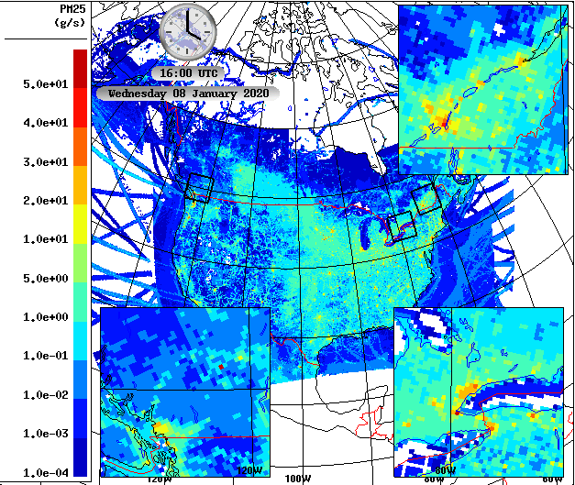
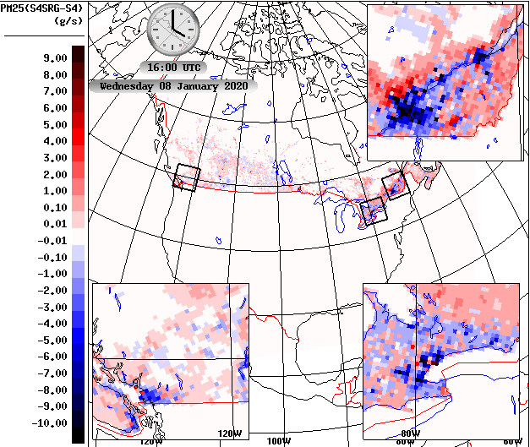
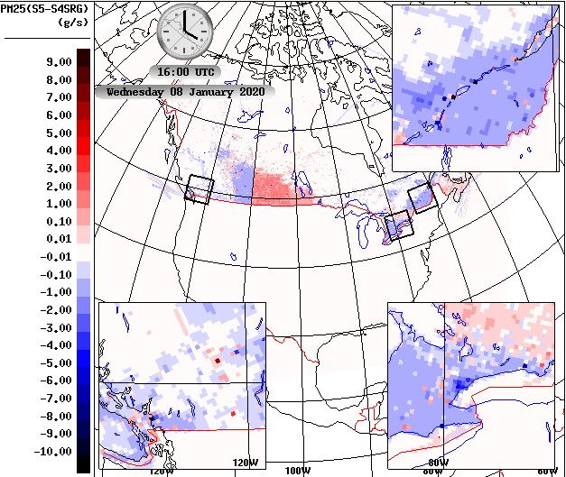
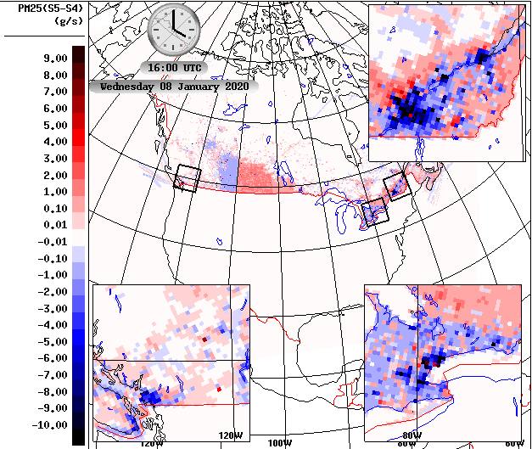
Emissions Updates to winter PM2.5
Jan PM2.5 Emissions at 16Z
Surrogate Updates
Inventory Update
Total Emissions Updates
New surrogates allocate a large amount of PM2.5 emissions, particularly PM2.5 emissions from residential wood combustion, from cities to rural areas, which significantly improves positive PM2.5 bias for large cities.
Update in inventory varies by province: Decrease for BC, AB, ON, and QC, and increase for SK and MB.

Slide 8
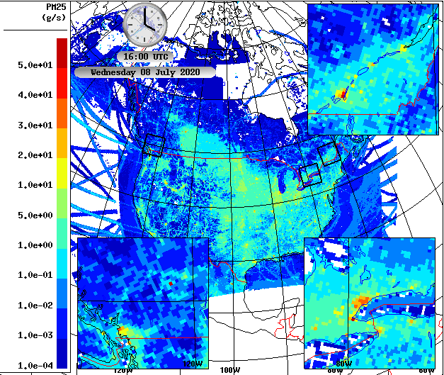
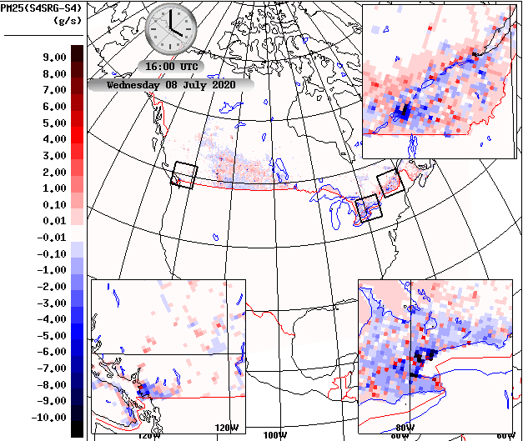
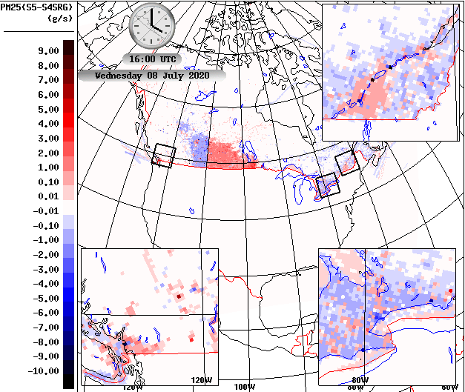
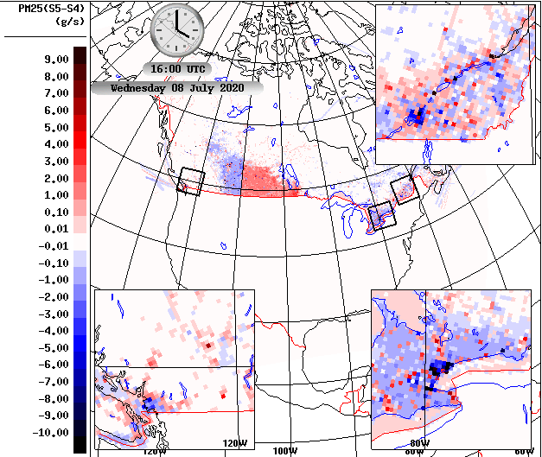
Emissions Updates to summer PM2.5
July PM2.5 Emissions at 16Z
Surrogate Updates
Inventory Update
Total Emissions Updates
New surrogates allocate summertime PM2.5 emissions also from cities to rural areas, but not as much as wintertime.
Update in inventory varies by province: Decrease for BC, AB, ON, and QC, and increase for SK and MB.

Slide 9
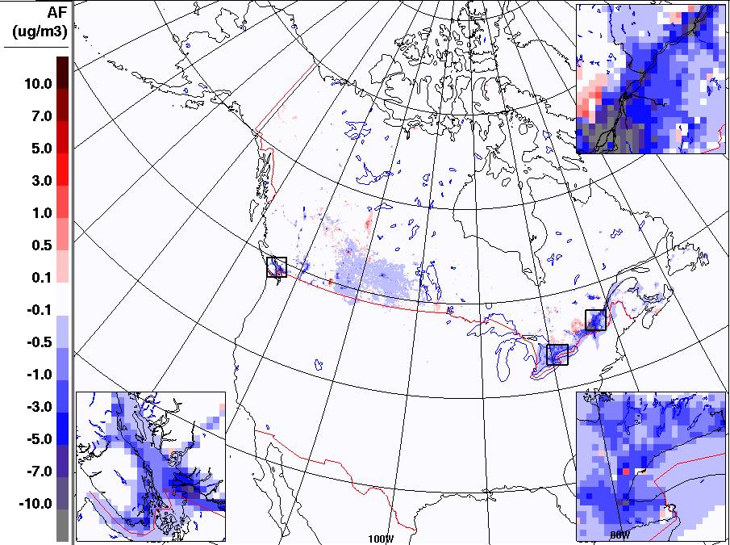
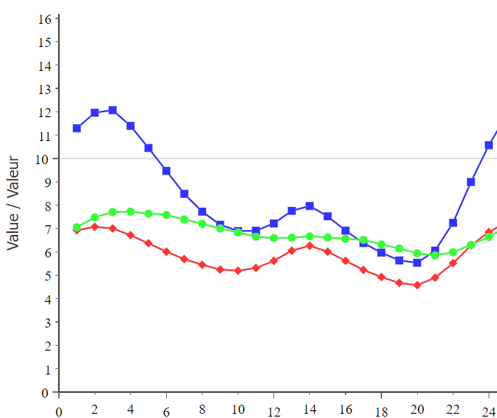
Impact of Emissions Update on wintertime PM2.5 Concentration
Decreases largest over cities
Increase in some of rural areas
Impact larger at night helping to flatten the diurnal profile
Boxes show absolute change in the hourly bias and how that change relates to the observed daily mean
Canada-Wide PM2.5
-1.6 (-27%)
-3.1 (-41%)
-0.007 (0%)
-0.019 (0%)
Forecast hour / Heure de prévision

Slide 10
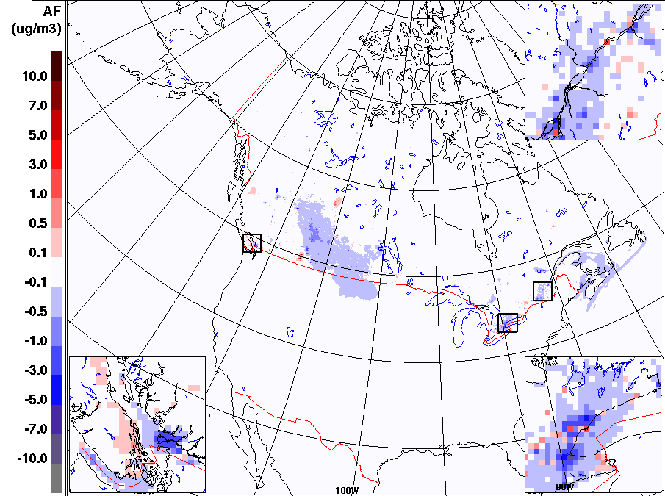
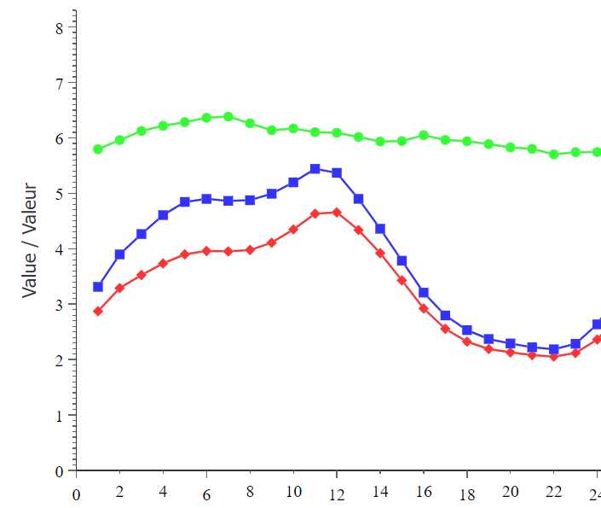
Impact of Emissions Update on summertime PM2.5 Concentration
Decreases over Prairies and over Canadian cities
Small increases over Oil Sands and parts of BC
Less pronounced improvements in the diurnal cycle
Boxes show absolute change in the hourly bias and how that change relates to the observed daily mean
Canada-Wide PM2.5
-0.25 (-5%)
-0.41 (-12%)
-0.006 (0%)
-0.025 (0%)
Forecast hour / Heure de prévision

Slide 11
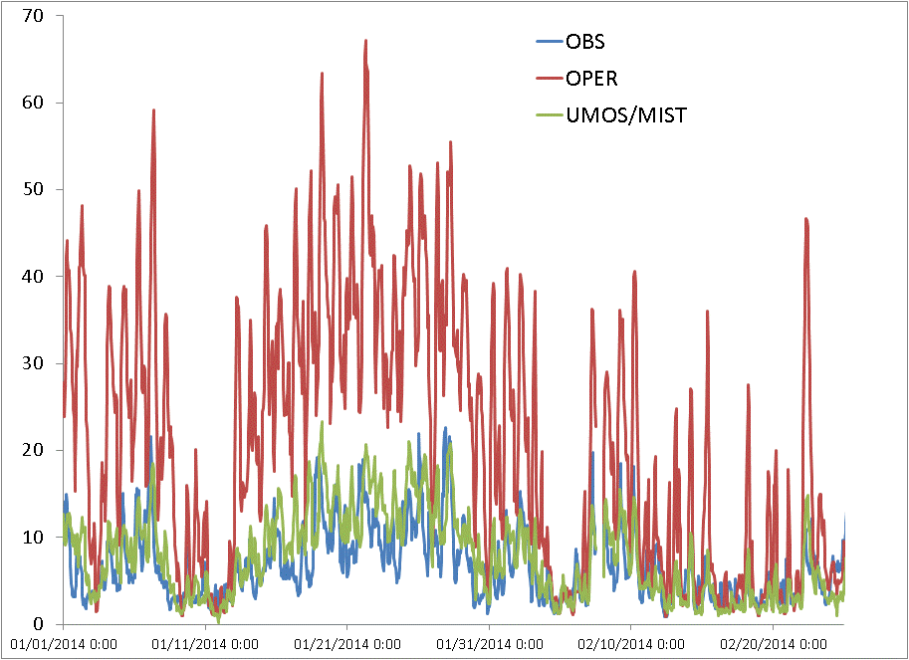
Residential Wood Combustion (RWC)
RWC is a very important source of PM_{2.5} emissions in Canada; Nationally, it accounts for 37% of 2021 non-dust PM_{2.5} emissions
RAQDPS overpredictions of wintertime PM_{2.5} concentrations for some cities (e.g., Moran et al. 2015) are largely caused by RWC emissions being over-allocated to urban areas
A decade-old problem despite several attempts to improve the spatial surrogates for RWC emissions (e.g., Zheng et al., 2015; Samaali et al., 2018)
Vancouver PM_{2.5} Concentrations (ug m⁻³), Jan-Feb 2014: Observed, Forecast, and Adjusted (UMOS-AQ/MIST)

Slide 12
3 new spatial surrogates for RWC
Considerations when creating new RWC surrogates:
Survey on Residential Fuelwood Burning Activities in Canada
Household Climate Zone defined by Heating Degree Days
Household proximity to the forest
Building type of the urban household

Slide 13
survey on residential fuelwood burning activities in Canada: Overview
RWC spatial surrogate is based on three surveys of Canadian residential fuelwood burning activities at provincial level from1997, 2006, and 2012
Last survey provided many useful pieces of information, such as:
Classification of households based on the type of fuelwood-burning equipment (fireplace, stove, and furnace)
Specific descriptions of rural and urban wood-burning activities in terms of:
Number of Canadian households burning fuelwood and the quantity of fuelwood burned in the households
Quantities of wood burned in each of the various types of wood-burning equipment in the communities within each province
Differences in wood burning behavior between rural and urban households

Slide 14
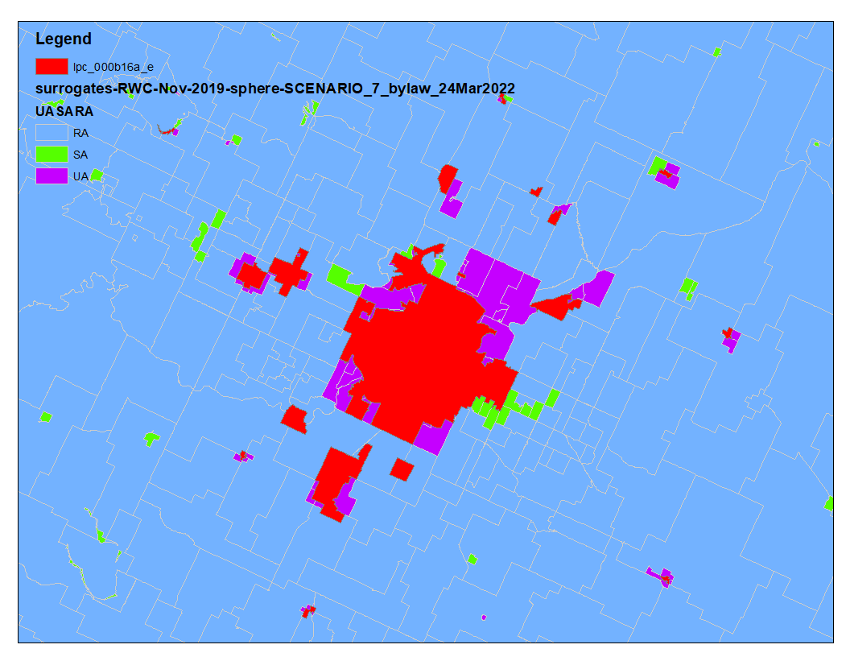
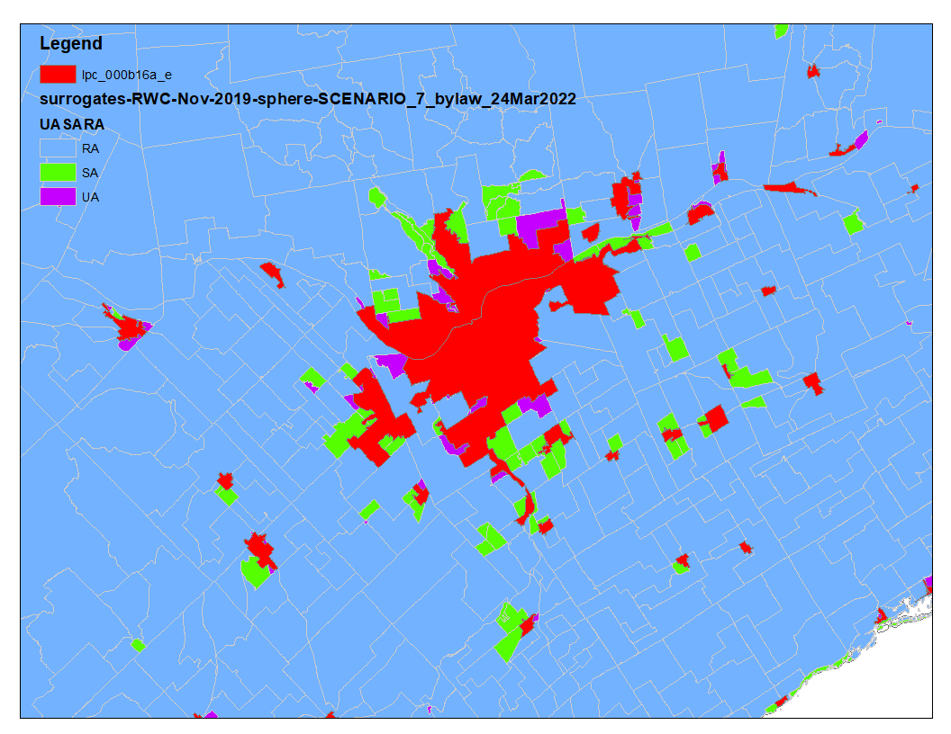
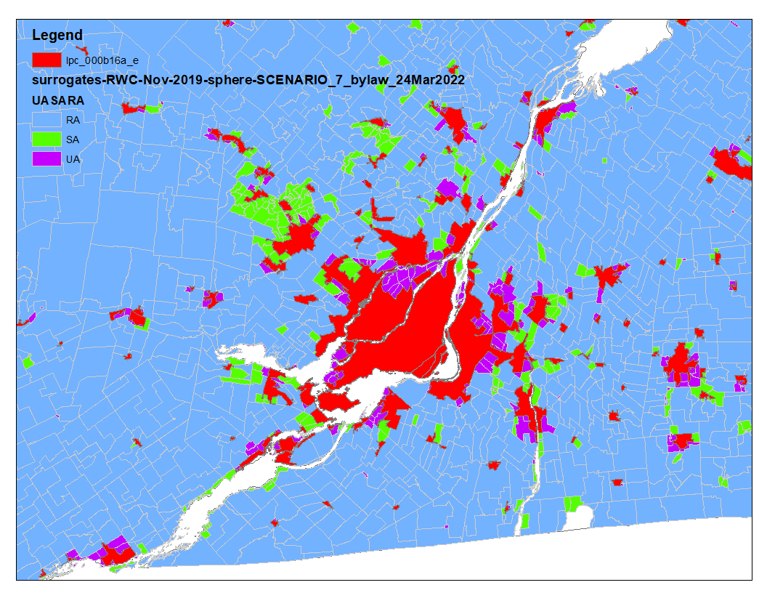
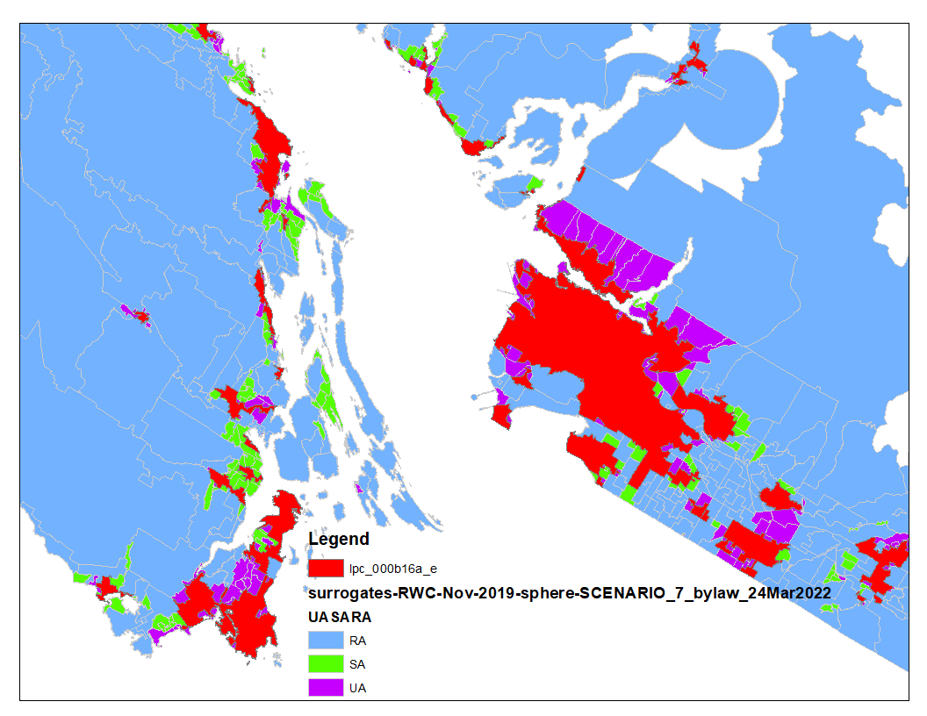
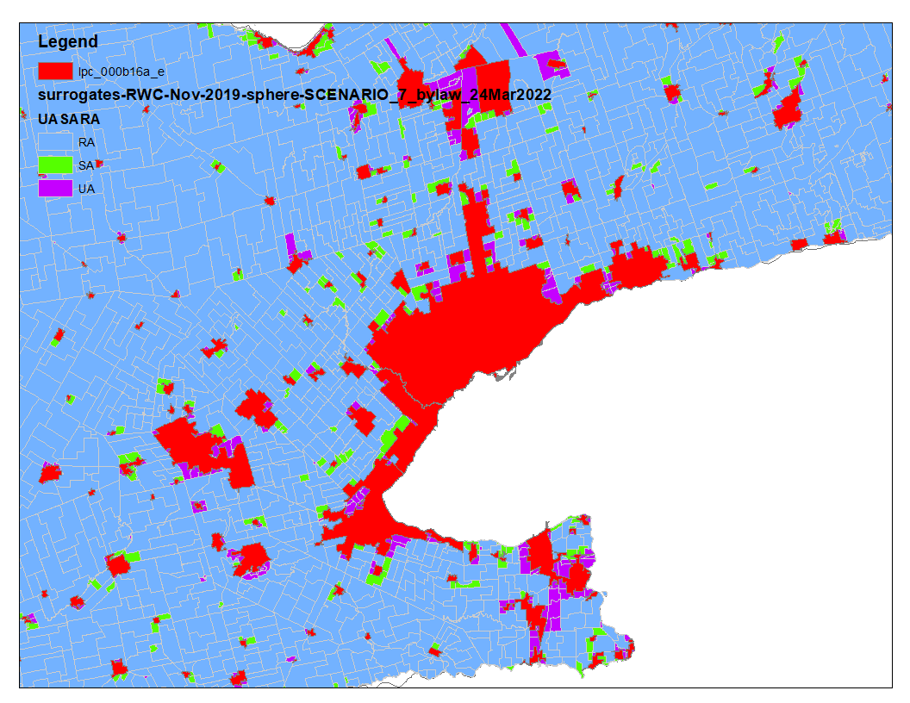
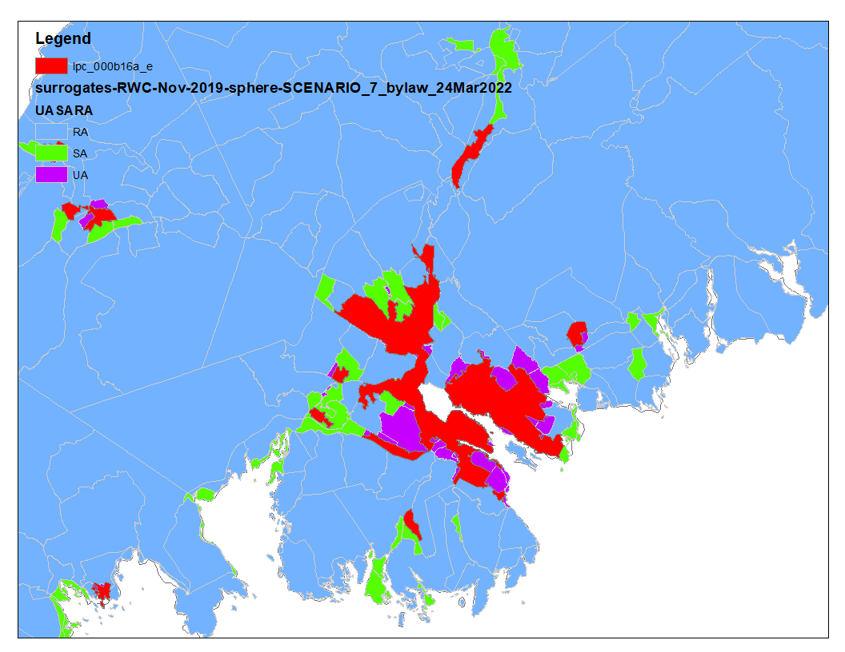
Construction of RWC spatial surrogates Determination of Urban, Suburban, and Rural Areas (1)
Urban, suburban, and rural areas around a few main cities in Canada
Red
Urban area within POPCTR
Purple
Urban area outside POPCTR
Green
Suburban area outside POPCTR
Blue
Rural area
Dissemination Area (DA) is the smallest standard geographic area for which all census data are disseminated, targeted from 400 to 700 persons (can be much higher or lower for some Das)

Slide 15
Construction of RWC spatial surrogates Determination of Urban, Suburban, and Rural Areas (2)
Urban, suburban, and rural areas are defined by household density within the census Dissemination Areas (DAs) and Population Centres (POPCTRs)
A DA is the smallest standard geographic area for which all census data are disseminated, targeted from 400 to 700 persons (can be much higher or lower for some DAs)
A POPCTR has a population of at least 1,000 and a population density of 400 persons or more per square kilometre, DAs within a POPCTR considered as urban area
DAs outside the POPCTRs are grouped into three areas:
Urban areas: house densities above 150 house/km²
Suburban areas: house densities between 30 and 150 house/km², treated as 50% urban and 50% rural
Rural areas: house densities below 30 house/km²

Slide 16
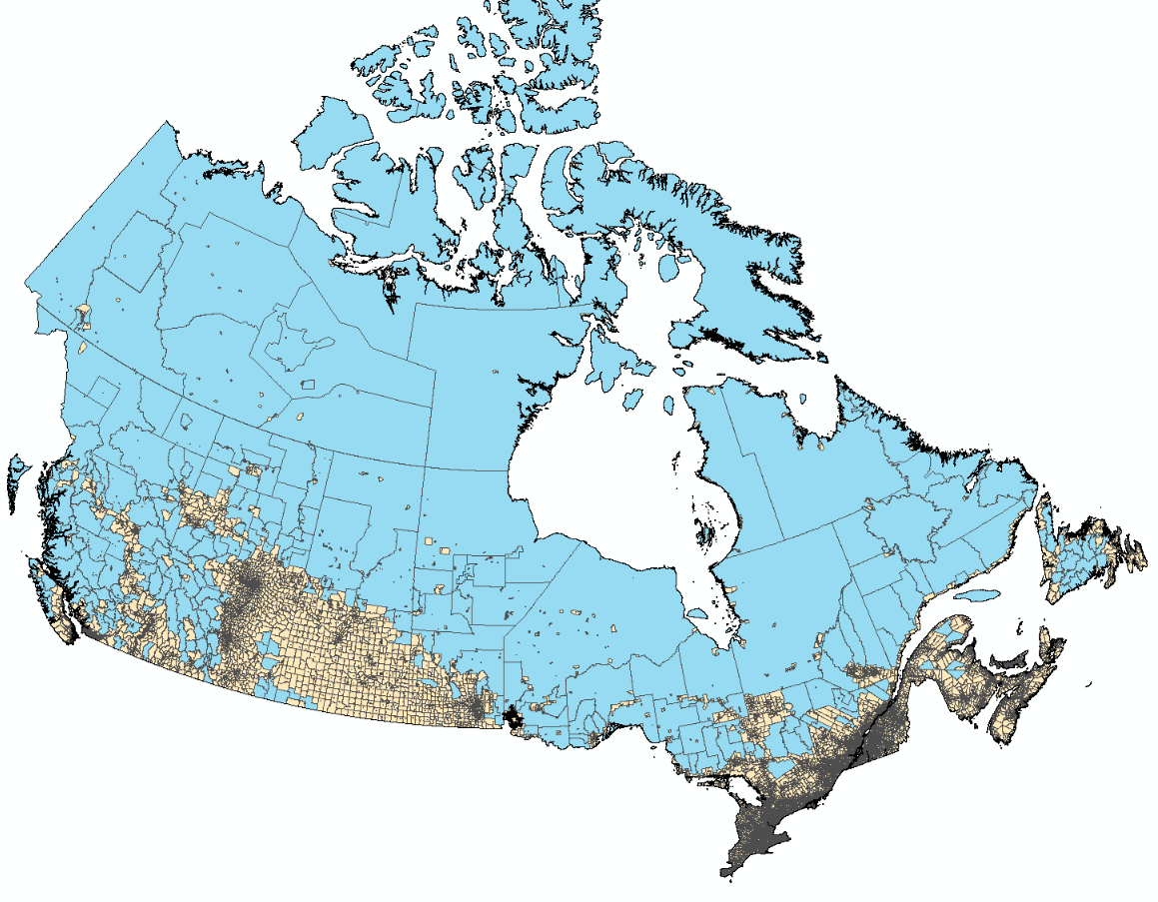
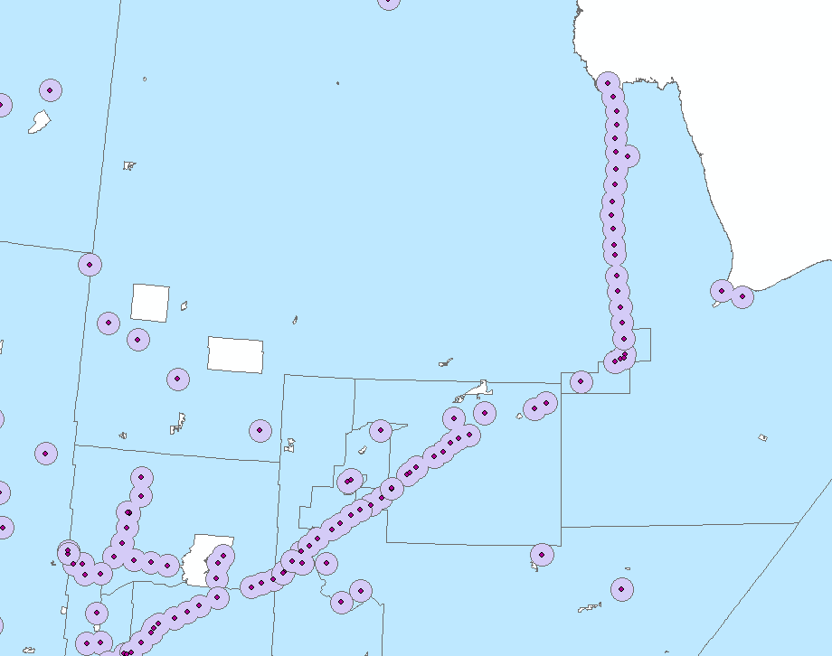
Construction of RWC spatial surrogates Consideration for Rural Communities in the Remote Areas
DAs are small in populated areas, but very large in the remote areas with isolated small local communities
For large remote DAs, RWC emissions were allocated to the villages/hamlets with a 10km buffer

Slide 17
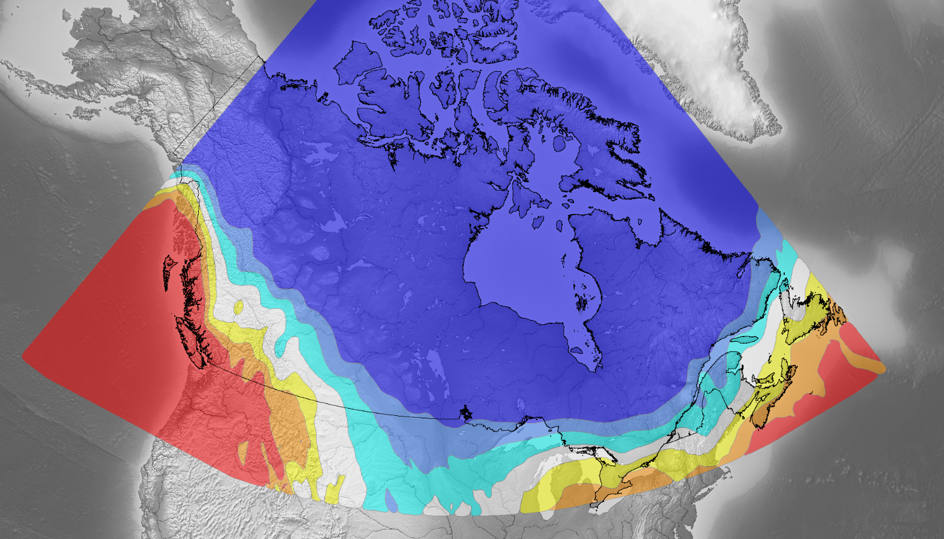
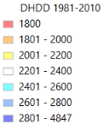
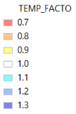
Construction of RWC spatial surrogates Consideration of Climate Zone Based on Heating Degree Day
Heating Degree Day (HDD) is a measurement designed to quantify the demand for energy needed to heat a building: number of degrees that a day's average temperature is below 65º Fahrenheit (18º Celsius)
Temperature-dependent factors (TF) applied based on average of annual sum of Daily Heating Degree Days (DHDD) over 1981-2010 for 7 climate zones
Zone 1:
if DHDD ≤ 1800 then TF = 0.7 or -30%
Zone 2:
if 1800 < DHDD ≤ 2000 then TF = 0.8 or -20%
Zone 3:
if 2000 < DHDD ≤ 2200 then TF = 0.9 or -10%
Zone 4:
if 2200 < DHDD ≤ 2400 then TF = 1 or 0%
Zone 5:
if 2400 < DHDD ≤ 2600 then TF = 1.1 or +10%
Zone 6:
if 2600 < DHDD ≤ 2800 then TF = 1.2 or +20%
Zone 7:
if 2800 < DHDD ≤ 4850 then TF = 1.3 or +30%
+30%
-30%
-20%
No
change
+20%
-10%
+10%

Slide 18
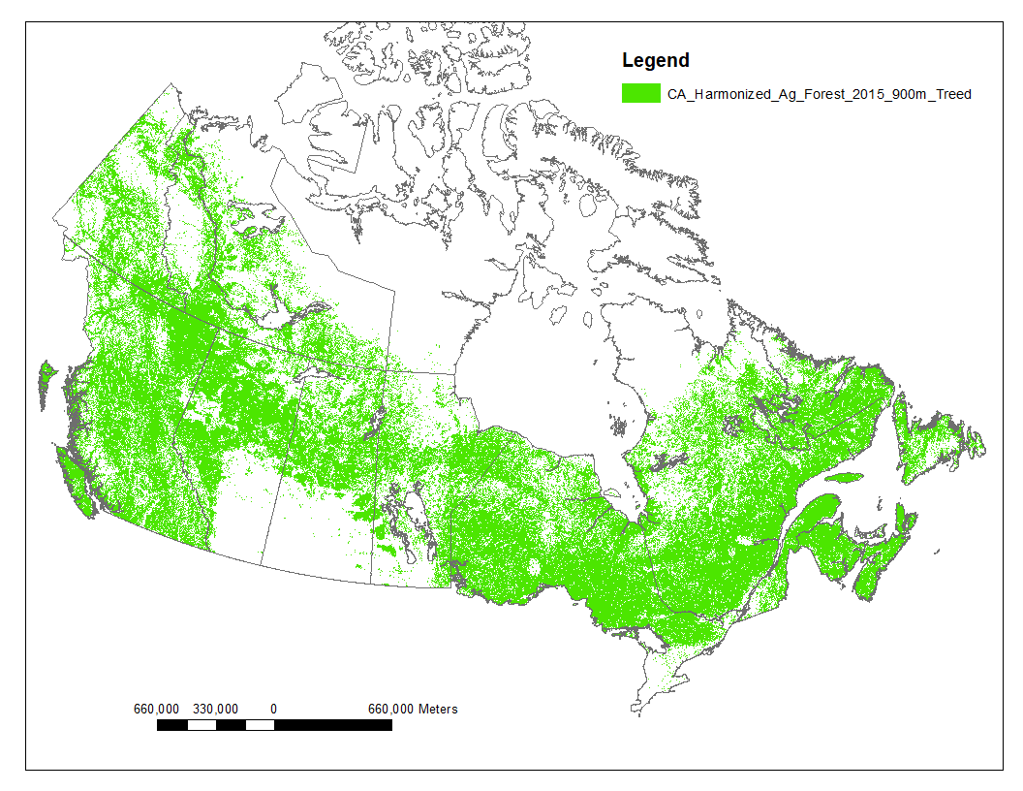
Construction of RWC spatial surrogates Readiness for Accessing Fuelwoods
Households located within or close to forests are more likely to burn wood than households located in prairie or cleared (agricultural) locations (e.g. southwestern Ontario)
A forest map is applied with an assumption that households close to the forests are 4 times more likely to burn fuelwoods than other households

Slide 19
Construction of RWC spatial surrogates Other Considerations and Final Formula
Wood burning is unlikely to occur in high-density, multi-storey, multiple-unit buildings. For DAs with dwelling density larger than 3000 dwelling/km², assumed zero RWC emissions. Only single, semi, and row houses are accounted
Single and semi houses are much more likely to use wood for space heating than the row houses which don’t have space for storing the wood.
RWC Weight = (single dwelling + semi + row/4) * forest_factor * house density cap factor * DHDD FACTOR * rural_urban_ratio

Slide 20
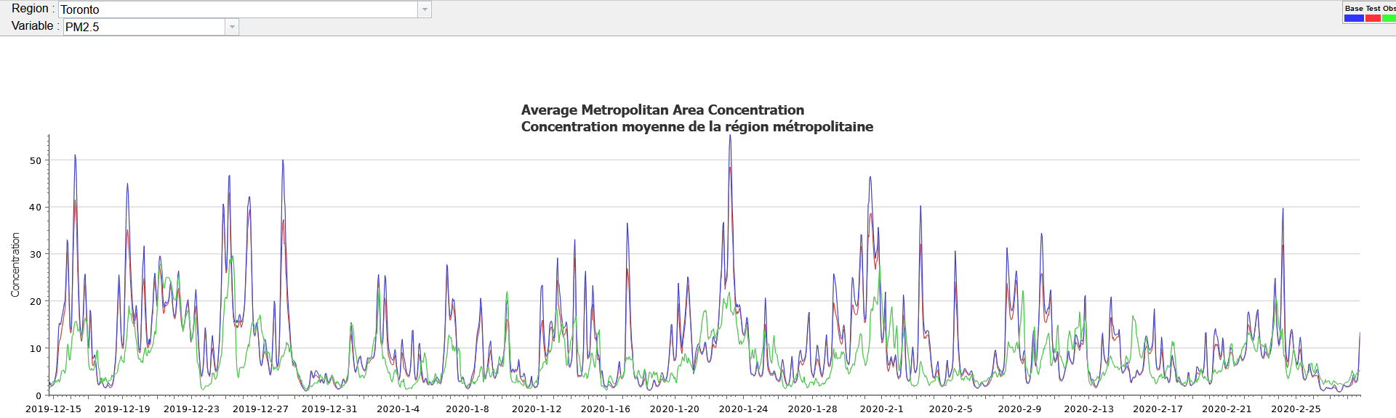
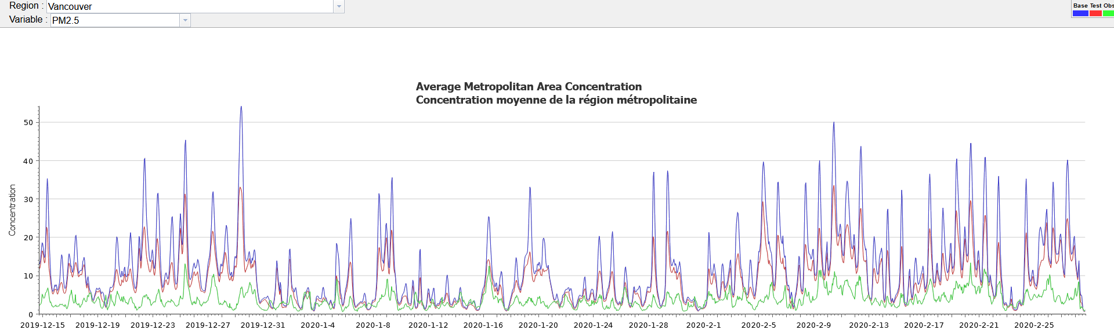
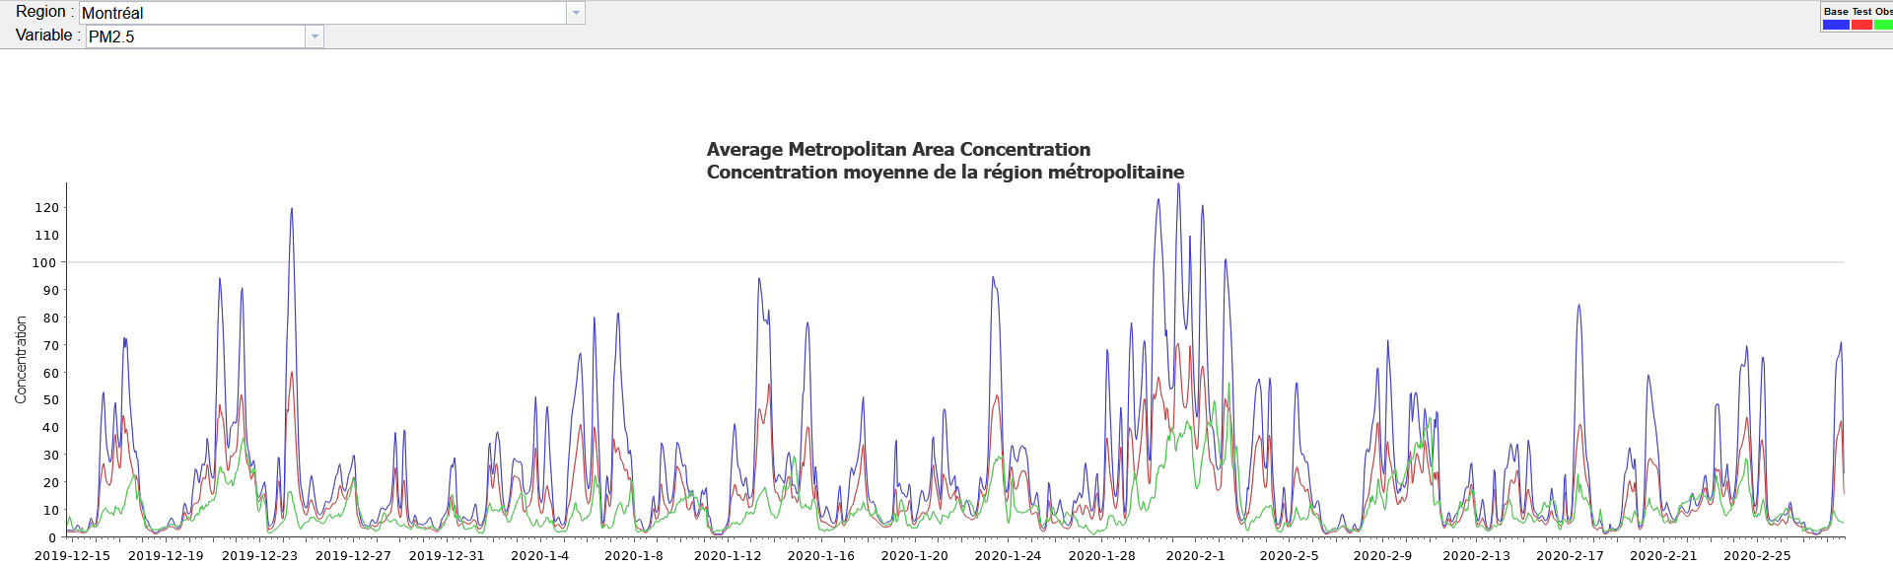
Impacts of the new surrogates on Pm_{2.5} concentration prediction for large cities
Montreal
Green: Obs
Blue: Base
Red: Test
Vancouver
Green: Obs
Blue: Base
Red: Test
Toronto
Green: Obs
Blue: Base
Red: Test

Slide 21
summary
This presentation is a report on the latest progress in improving Canadian Regional Air-Quality Deterministic Prediction System (RAQDPS)
Updates to the Canadian anthropogenic emissions are discussed
Details of the Residential Wood Combustion surrogates are presented
New RWC surrogates significantly improve model prediction of PM2.5 concentration for most of the large Canadian cities
Overprediction of PM2.5 concentration is still seen for some cities; PM2.5 emissions from other sources need to be investigated and/or the factors used for constructing the RWC surrogates need to be further adjusted

Slide 22
Thank You for Your Attention!

Slide 23
References
Gong, S., 2003, A parameterization of sea-salt aerosol source function for sub- and super-micron particles. Global Biogeochemical Cycles, 17(4), https://doi.org/10.1029/2003GB002079
Ghahreman, R. et al., 2023, Modeling below-cloud scavenging of size resolved particles in GEM-MACHv3.1, under review for journal Geoscientific Model Development, https://doi.org/10.5194/gmd-2023-86
Makar, P. A. et al.,2021. Vehicle-induced turbulence and atmospheric pollution, Atmos. Chem. Phys., 21, 12291-12416, https://doi.org/10.5194/acp-21-12291-2021
Moran, M.D., et al., 2015. Contribution of improved spatial allocation of emissions to reducing urban overpredictions of NO2 and PM2.5 concentrations. 14th CMAS Conference, 5-7 Oct., Chapel Hill, North Carolina. [see https://www.cmascenter.org/conference/2015/slides/0930_michael_moran_spatial_concentrations.pptx]
Samaali, M., et al., 2018. Updating spatial surrogates for the Canadian Regional Air Quality Deterministic Prediction System. Poster, 9th International Workshop on Air Quality Forecasting Research, Nov. 7-9, Boulder, Colorado [see https://esrl.noaa.gov/csd/events/iwaqfr/2018/presentations/posters/45_Samaali.pdf].
Wang, X. et al., 2014. Development of a new semi-empirical parameterization for below-cloud scavenging of size-resolved aerosol particles by both rain and snow, Geosci. Model Dev., 7, 799–819,, https://doi.org/10.5194/gmd-7-799-2014
Zhang, J. et al., 2023. A Survey-based Major Update to Spatial Surrogates for Processing Canadian Residential Wood Combustion Emissions. 2023 International Emissions Inventory Conference, 26-29 Sep., Seattle WA.
Zhang, J. et al., 2020. Examination of MODIS Leaf Area Index (LAI) Product for Air Quality Modelling. 19th CMAS Conference, 26-30 Oct., Virtual, https://www.cmascenter.org/conference/2020/slides/ZhangJ_MODIS_LAI_CMAS_2020.pdf
Zheng, Q., et al., 2015. Development of some improved Canadian spatial surrogates. Poster, 21st International Emissions Inventory Conference, 13-17 April, San Diego. [see https://www.epa.gov/sites/default/files/2015-09/documents/qzheng.pdf]
Zheng, Q., et al., 2023. Recent improvements of Canadian Spatial Surrogates for Air Quality Modelling. Poster, 2023 International Emissions Inventory Conference, 26-29 September, Seattle

