Slide 1
CMAQ Modeling, Data and Analysis on the Cloud
Elizabeth Adams¹, Christos Efstathiou^{1†}, Carlie Coats¹, Robert Zelt²,
Mark Reed², John McGee², Saravanan Arunachalam¹
¹Institute for the Environment, The University of North Carolina at Chapel Hill, NC, USA
†Currently with Physicians, Scientist, and Engineers for Healthy Energy, Oakland, CA, USA
² Research Computing, Information Technology Services, The University of North Carolina at Chapel Hill, NC, USA
CMAS Conference 2023
Notes:
I’d like to thank all of my colleagues who helped collaborate on this project and are listed here. This work was funded by the EPA with the goal of enabling the CMAS Community to run CMAQ workloads on the cloud.

Slide 2
Why the Cloud is ideal for running CMAQ!
Train new users
Software and input data are pre-installed.
EC2 instances are provisioned within five minutes.
Avoid wait times in queue encountered on shared system.
Avoid costly computer purchases.
Learn how to use performance metrics to improve hardware and software.
Run CMAQ and do analysis/visualization on the cloud.
Right size compute resource utilization/spending
Based on domain size/resolution, required time to solution and budget.
Use preconfigured CMAQ software (in the form of a snapshot specific to the Operating system and VMs or EC2 instance of different sizes in the same family
One thread per core: HPC EC2 instances have multi-threading disabled by default. This is recommended for high performance computing (HPC) workloads.
CMAQ Benchmark | Grid Domain | EC2 (cores) | OnDemand Cost/core/hr
12US1 cb6r5 | (459x299x35) | 3 x hpc7g.16xlarge (64) | $1.68
Notes:
Obtained a 4.29 x speed up when going from 16 cores on c6a.8xlarge to 96 cores on c6a.48xlarge, if scaling was linear it would be a 6x speedup. Ability to speed up is constrained by the domain size (larger, high resolution domain provides more work per core).
Pricing spot/on-demaind c6a.2xlarge (.2879/.306), c6a.8xlarge (1.0008/1.224), c6a.48xlarge (5.5809/7.344)

Slide 3
Why the Cloud is ideal for running CMAQ! (continued)
“Accelerate time to results for compute-heavy workloads” *
Autoscaling capability of ParallelCluster or CycleCloud (add VMs to run on more cores)
Expand the extent of domains and use higher resolution with access to more compute cores, or add more cores to get faster completion time.
Quickly obtain resources for even the most demanding simulations, such as two-way coupled WRF-CMAQ, CMAQ-ISAM, CMAQ-DDM3D.
Benchmark CMAQ on different processor types (Intel, AMD, ARM), Operating Systems, and Compilers (Intel, GCC), and MPI implementations (OpenMPI, Intel MPI)
Quickly install and build libraries and CMAQ using csh scripts in the developer guide.
Modify run scripts to match the cores available.
Newer AWS EC2 instances and Azure Virtual Machines are faster, less costly, and more energy efficient.
Expandability of low-cost data storage
Facilitates sharing data on S3 Storage Buckets.
Members of the CMAS Community are encouraged to contribute and use publicly available data via the CMAS Data Warehouse on AWS.
Notes:
quote from AWS video Deep dive on Amazon FSx for Lustre
https://www.youtube.com/watch?v=m8_wy1xkwA8

Slide 4
CMAQ Data Warehouse on AWS
CMAS Data Warehouse on AWS collects and disseminates meteorology, emissions, and air quality model input and output for Community Multiscale Air Quality (CMAQ) Model Applications.
https://registry.opendata.aws/cmas-data-warehouse/
This repository is available as part of the AWS Open Data Program, therefore egress fees are not charged to either the host or the person downloading the data.
These public S3 buckets are hosted by the CMAS Center on behalf of the U.S. EPA’s Office of Research and Development, and the U.S. EPA’s Office of Air and Radiation.
Metadata for the datasets in the CMAS Data Warehouse are available from the CMAS Dataverse site: https://dataverse.unc.edu/dataverse/cmascenter

Slide 5
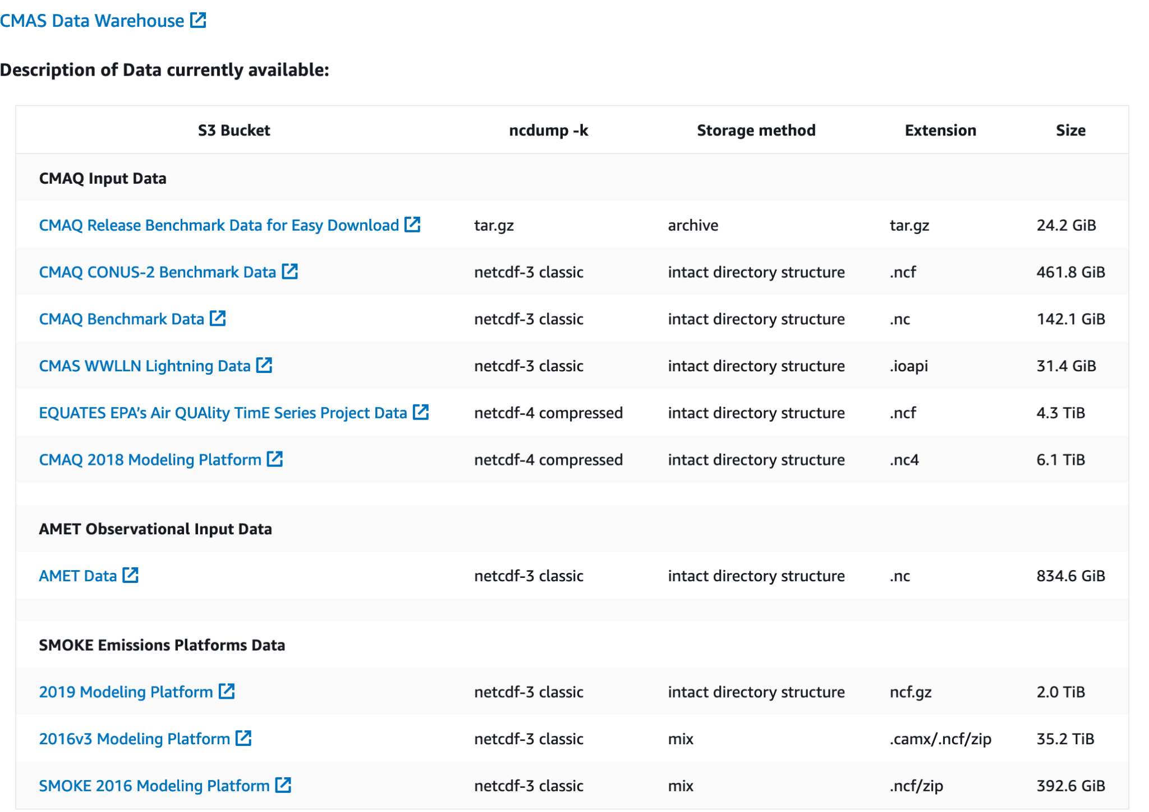
Current data available on AWS Open Data Program

Slide 6
CMAQ on the Cloud
Current Status of Online tutorials:
CMAQ on AWS Tutorial
CMAQv5.4+ using cb6r5_ae7_aq mechanism
Contains Parallel Cluster YAML Configuration files and snapshots for
hpc6a (AMD EPYC) for Ubuntu OS
hpc7g (Graviton 3E) for Ubuntu OS
CMAQ on Azure Tutorial
CMAQv5.4+ using cb6r5_ae7_aq mechanism
Cycle Cloud for HBv3_120 (AMD EPYC)
Unable to run HBv4_120 (need to update Azure HPC Image and retry)
CMAQ on AWS HPC Workshop (based on tutorial)
Create ParallelCluster and run CMAQ using hpc7g on Alinux2
https://catalog.workshops.aws/cmaq-tutorial/en-US

Slide 7
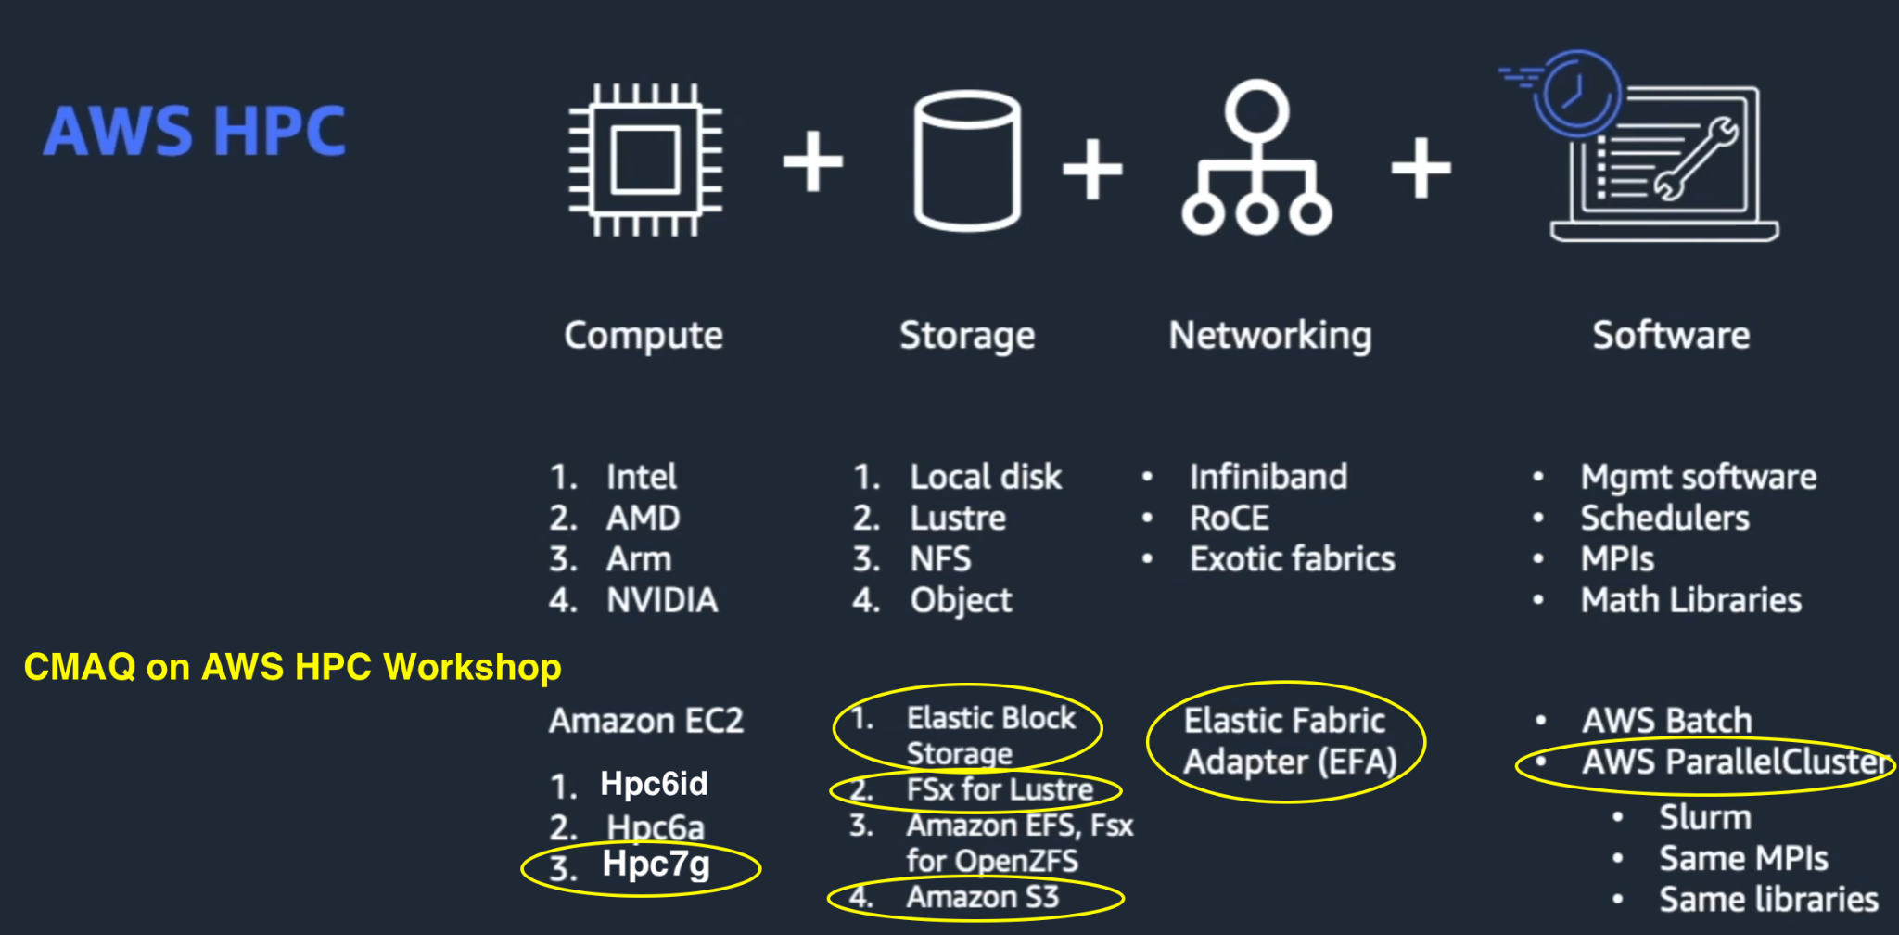
AWS HPC Resources
AWS Elastic Compute Cloud (EC2) Instance Types are comprised of varying combinations of CPU, memory, storage, and networking capacity. Note: 3 instance types are optimized for HPC workloads.
AWS HPC Tech Short Videos
https://youtu.be/i2T7Hi2Yjoc?feature=shared
https://www.youtube.com/watch?v=KHx22oJSNso
* Image from above video, but was annotated to highlight resources used in webinar in yellow.

Slide 8
AWS EC2 Instance Type
Hpc7g.16xlarge (64 cpu) - AMD Graviton 3E processors (limited regions)
CPU option: hyperthreading disabled
On-demand pricing
https://aws.amazon.com/ec2/instance-types/hpc7g/
This instance type was chosen as it offers significant cost savings, fast performance, and high energy efficiency.
“Hpc7g instances are powered by AWS Graviton 3E processors and provide up to 35% higher vector instruction performance, uses AWS Nitro System to provide 200 Gbps network bandwidth for low-latency internode communication for tightly coupled workloads that require highly parallelized, clustered compute resources.”

Slide 9
Storage Used
Elastic Block Storage (EBS)
Configure to use maximum Input/Output Operations per Second (IOPS) and throughput. EBS allows users to provision performance independent of storage capacity.
High performance, low-latency disk.
Lustre/FSx (used on ParallelCluster)
Process massive datasets at up to hundreds of gigabytes per second of throughput, millions of IOPS, and sub-millisecond latencies.
Capable of lazy loading data (loading data when it is first used) from S3 bucket.
Simple Storage Service (S3) (used on ParallelCluster)
Archive data at the lowest cost
Run cloud-native applications by lazy loading from the s3 bucket to /fsx
Network Options used
Elastic Fabric Adapter enabled
Placement group enabled
50 Gbps for network bandwidth
High throughput, low-latency network
Notes:
https://docs.aws.amazon.com/fsx/latest/LustreGuide/performance.html
https://docs.aws.amazon.com/AWSEC2/latest/UserGuide/ebs-volume-types.html
https://docs.aws.amazon.com/AWSEC2/latest/UserGuide/provisioned-iops.html#io2-block-express
Placement groups ensure that you have high throughput between ec2 instances.
https://aws.amazon.com/blogs/hpc/in-the-search-for-performance-theres-more-than-one-way-to-build-a-network/

Slide 10
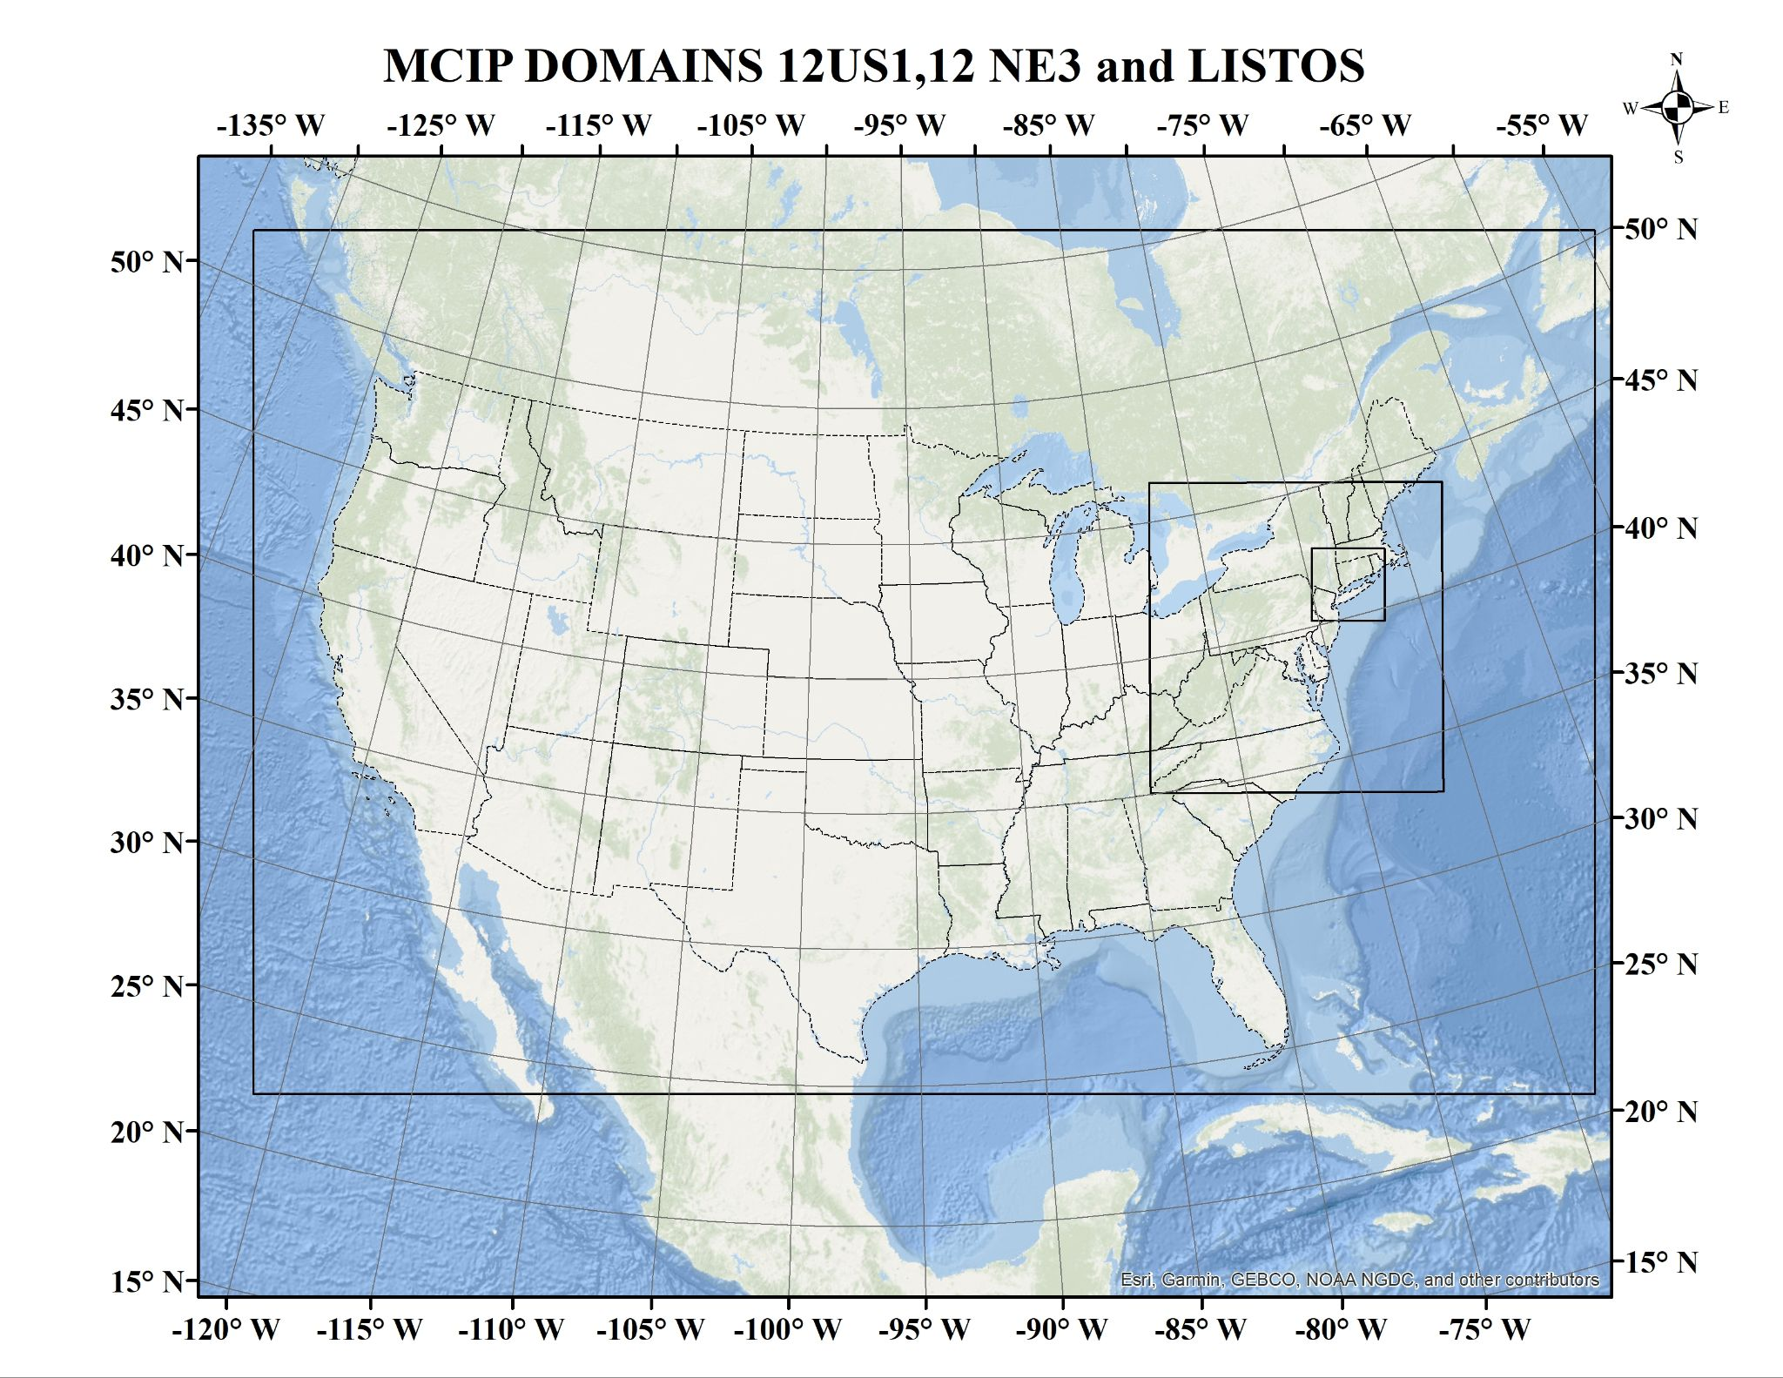
CMAQ Benchmark Case
CMAQv5.4 (cb6r5_ae7_aq)
1-day 12x12 km 12US1 (459x299x35), 85 GB
compressed netCDF4 converted to classic netCDF3 to avoid memory leak issue

Slide 11
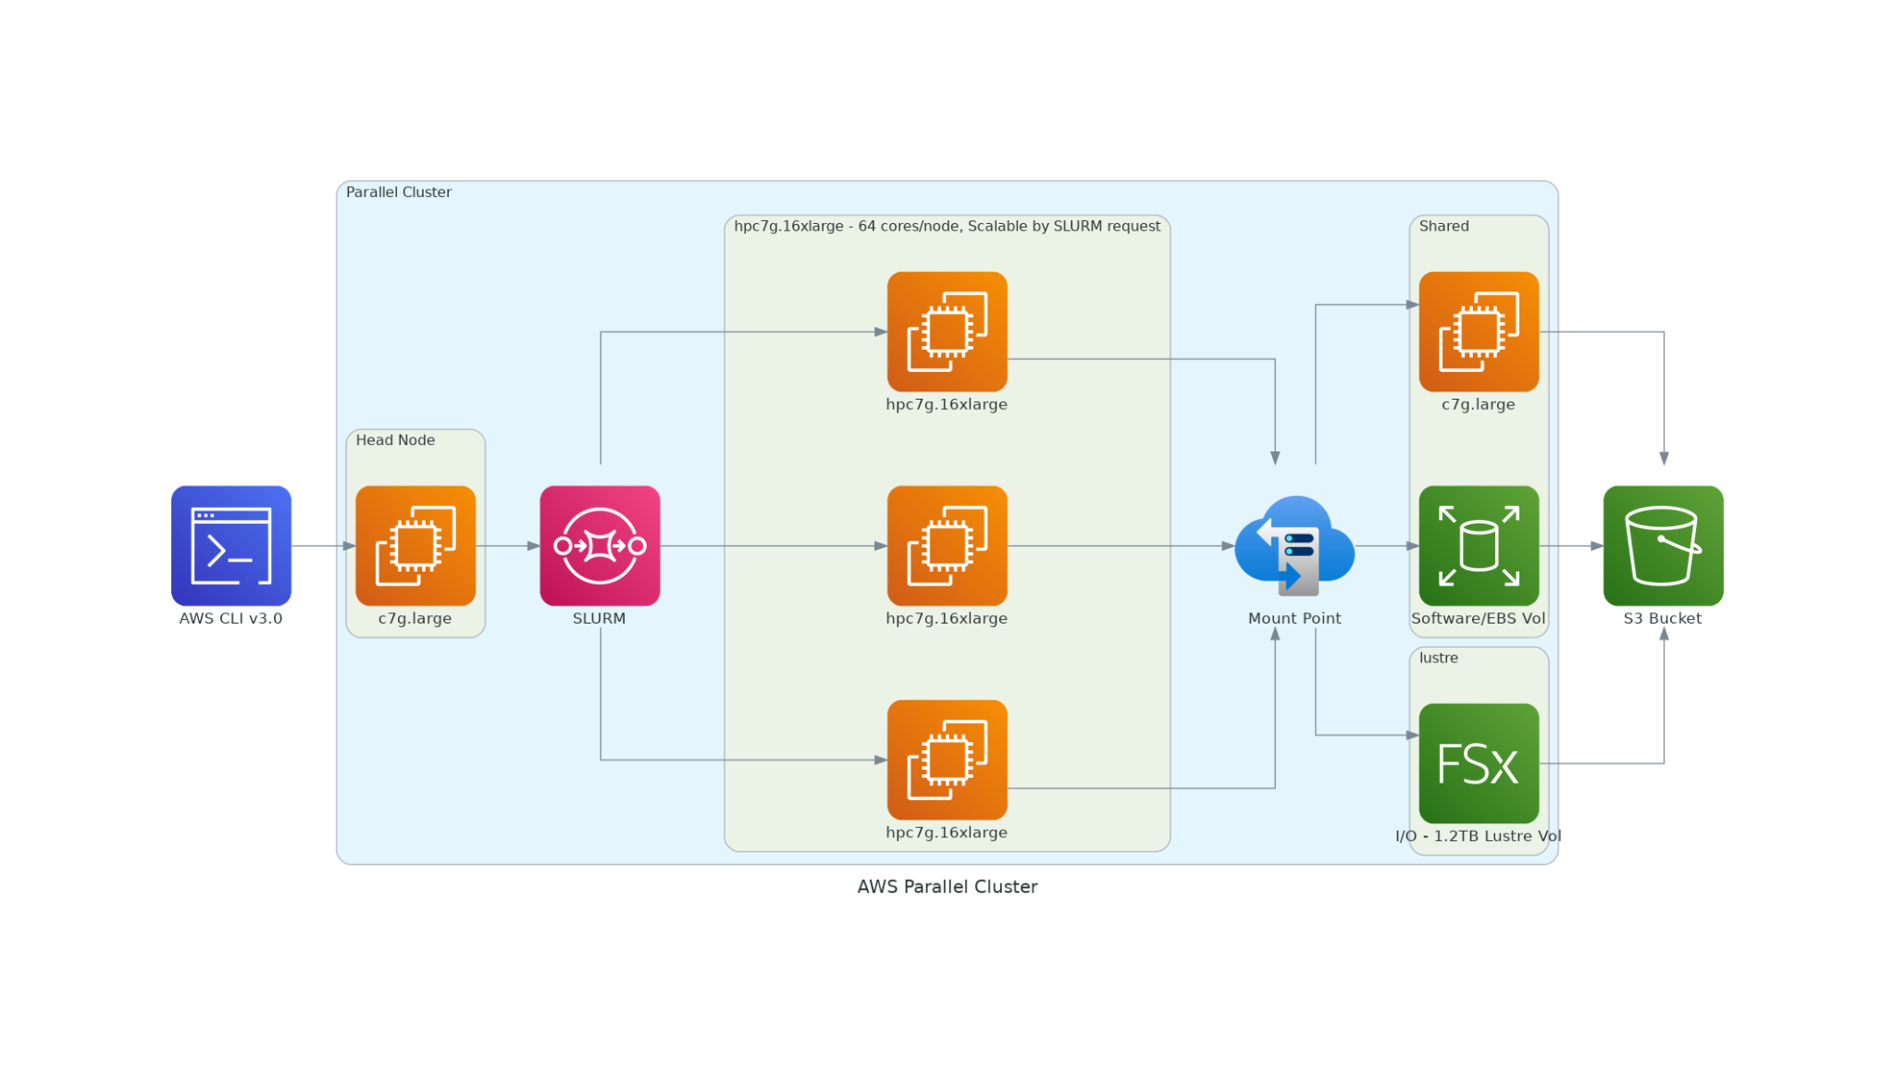
AWS HPC ParallelCluster Diagram

Slide 12
HPC Autoscaling
SLURM auto-scaling on AWS ParallelCluster and Azure CycleCloud
submit multiple CMAQ runs (e.g. base and zero-out) submitting jobs to the queue.
submit CMAQ run for any number of cores (add additional VMs)
Required number of compute nodes are provisioned and ready to start the job within a few minutes. Compute nodes only incur costs when running.
If the cluster remains idle for more than a preset time, the cluster will automatically shut down the compute nodes after job completion.
The head node remains running and available to start jobs when the user uses sbatch to submit to the Slurm queue. The Lustre file system (/fsx) accumulates charges as long as the head node is up. To reduce costs, terminate the cluster after the workload is complete. (cost is $384 if you leave it on for a month)

Slide 13
Analysis and Visualization
Alinux2 snapshot for workshop contains
Jupyter Notebook script to plot CMAQ output as well as difference and percent difference daily average values.
Scripts to plot output using Visualization Environment for Rich Data Interpretation (VERDI)
(will add these scripts to the ParallelCluster and Cycle Cloud tutorials)

Slide 14
CMAQv5.4 on AWS: The Big Picture
Summary:
CMAQv5.4 workloads scale on AWS High Performance Computers (HPC). AWS enables sharing of software (public snapshots and AMIs) and Data (public S3 Buckets) to allow groups to quickly start 12US1 annual workloads from pre-installed, pre-set HPC configurations.
Single Virtual Machine (VM)
2-day CMAQv5.4 12US1 Domain on 96 cores completes in 2 hours for $13 using c6a.48xlarge.
note, hpc7g.16xlarge does not have enough memory to run 12US1 domain.
Parallel Cluster (many VMs)
2-day CMAQv5.4 12US1 Domain on 192 cores (2 nodes) completes in 1 hour for $16 using c6a.48xlarge (96 cores/node).
2-day CMAQv5.4 12US1 Domain on 192 cores (3 nodes) completes in 1 hour for $4.9 using hpc7g.16xlarge (64 cores/node)
Extrapolated cost for Annual run on Parallel Cluster
hpc6a.48xlarge using 1 node: $969 with 14 days to complete
hpc6a.48xlarge using 2 node: $1149 with 8.3 days to complete
hpc7g.16xlarge using 2 nodes: $780 with 9.6 days to complete
hpc7g.16xlarge using 3 nodes: $898 with 7.4 days to complete

Slide 15
Cloud Computing Resources
Join our Cloud Computing Workgroup:
https://github.com/CMASCenter/modeling-in-the-cloud/wiki/Modeling-in-the-Cloud-Workgroup-Charter
Answer our poll to help us understand your needs:
https://forms.gle/gbWqHWAeNoFUeYuK6
Please try the CMAQ on AWS and Azure tutorials!
https://pcluster-cmaq.readthedocs.io/en/latest/index.html#
https://cyclecloud-cmaq.readthedocs.io/en/latest/index.html
Please try the CMAQ on AWS Workshop!
https://catalog.workshops.aws/cmaq-tutorial/en-US
Need help? Create new issue on the CMAS Center Forum.
https://forum.cmascenter.org/c/cloud-computing/95

Slide 16
Additional CMAS Cloud Computing Resources
Webinar Recording of CMAQ on AWS Cloud
https://www.youtube.com/watch?v=mAeV1KvGwxA
Zoom Help Sessions - Provided the first Friday of each month from 2pm-3pm ET, hosted by Liz Adams of the CMAS Center
Every month on the first Friday until December 1, 2023. 2pm - 3pm EST
November 3, 2023 02:00 PM
December 1, 2023 02:00 PM
Register here:
Notes:
https://www.pcluster.cloud/

Slide 17
Acknowledgments
The U.S. EPA, through its Office of Research and Development, partially funded and collaborated in the research described here under Contract EP-W-16-014 to the Institute for the Environment at the University of North Carolina at Chapel Hill.
We thank the following AWS team for their help with running and optimizing in their systems and for the AWS Open Data Warehouse:
Timothy Brown
Tommy Johnston
Chris Stoner
We thank the following staff at the EPA for several inspiring and helpful discussions and contributions to this work:
Fahim Sidi
Kristen Foley
Chris Misenis
Ed Anderson
Tom Pierce - retired
We thank the leaders of the Modeling in the Cloud Computing Workgroup:
Zac Adelman (LADCO)
Steve Fine (EPA) - retired
Fahim Sidi (EPA)
We thank the members of the UNC Institute of the Environment for their contributions:
Manish Soni for creating the domain plots showing the extent of the CMAQv5.4 Benchmark cases using ArcGIS, testing and helping with CMAQ on AWS Workshop
Erin Valentine for help with Workshop and Training.

Slide 19
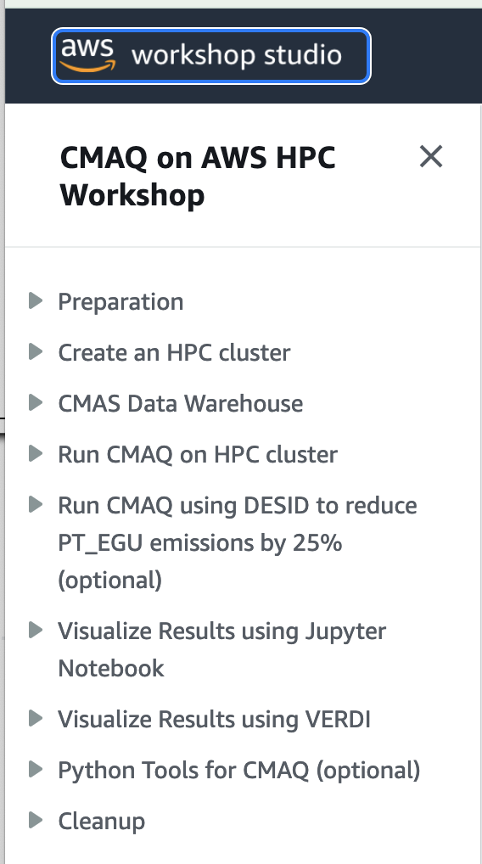
Workshop Objectives
Work independently, but help each other. Liz Adams (CMAS), Manish Soni (CMAS) and Tim Brown (AWS) will be available to help and demonstrate the material.
Create a ParallelCluster using a cluster management file to do high performance computing (HPC) on the cloud
Provide guidance for configuration settings in yaml file.
Review CMAS Data Warehouse on AWS
Run CMAQ on ParallelCluster for
1 day for 12US1 domain for base case
1 day for DESID (25% emission reduction of Point Source EGU Emissions in NY) case
Visualize output using Jupyter Notebook and VERDI
https://catalog.us-east-1.prod.workshops.aws/workshops/8ce2b56a-5cbf-465d-8a65-96b006d71127/en-US
Notes:
The webinar will introduce and demonstrate a method to run CMAQ on AWS HPC systems. Pre-requisite: https://aws.amazon.com/getting-started/launch-a-virtual-machine-B-0/

