Slide 1

ANALYSIS OF GLOBAL ENVIRONMENTAL HEALTH Inequality using the adjoint of hemispheric cmaq
Yasar Burak Oztaner, ANAS ALHUSBAN, Shunliu Zhao, Amir Hakami* (Carleton University)
Barron Henderson, Rohit Mathur (US EPA)
Disclaimer: The views expressed in this presentation are those of the authors and do not necessarily reflect the views or policies of the U.S. Environmental Protection Agency.
OCTOBER 17TH, 2023

Slide 2
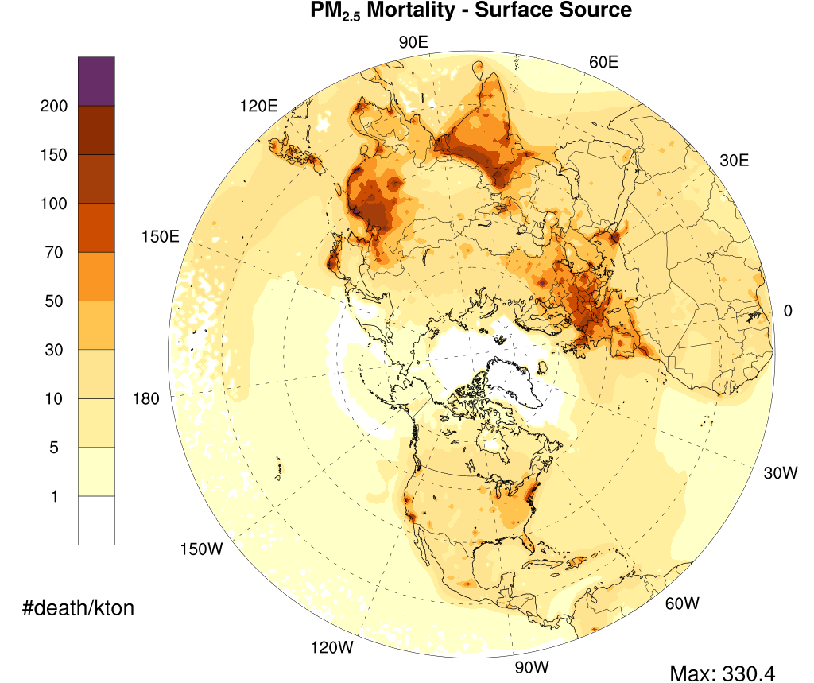
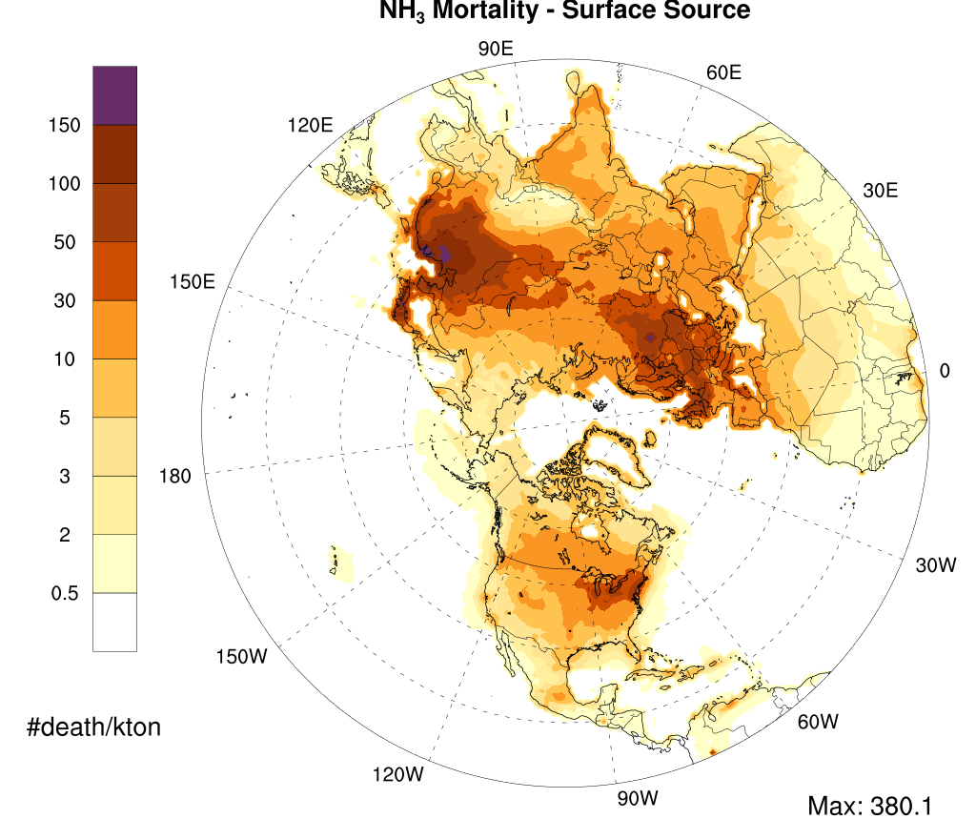
INTRODUCTION
Use adjoint of Hemispheric CMAQ (H-CMAQ) to examine national-level inequalities in exposure to to PM2.5 in the Northern Hemisphere.
  Complements health impact analysis (presented last year at CMAS)

Slide 3
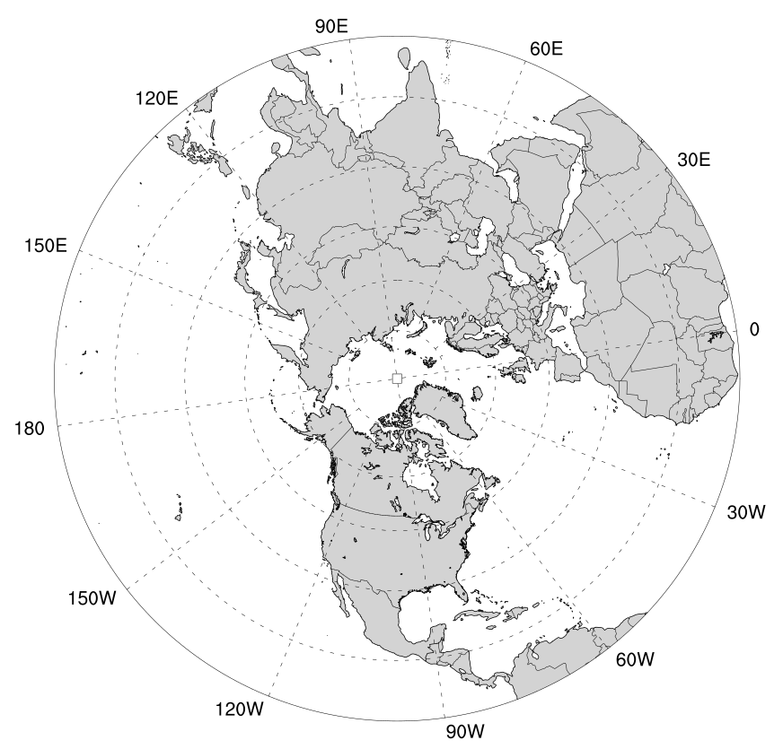
Methodology
 | Northern Hemisphere | USA
Study Period | 2016 (Full Year) (2 weeks of backward spin-up period)
Meteorology | GFS initialization / WRF v3.8.1
Emissions | The 2016 Hemispheric Emission modelling platform (US EPA, 2019)
Spatial Resolution | 108km - Polar Stereographic Projection (187 x 187)
CTM | CMAQ v5.0 and its ADJOINT (revised NTR chemistry as in Mathur et al, 2017)
Objective function (Inequality index) | Concentration Index

Slide 4
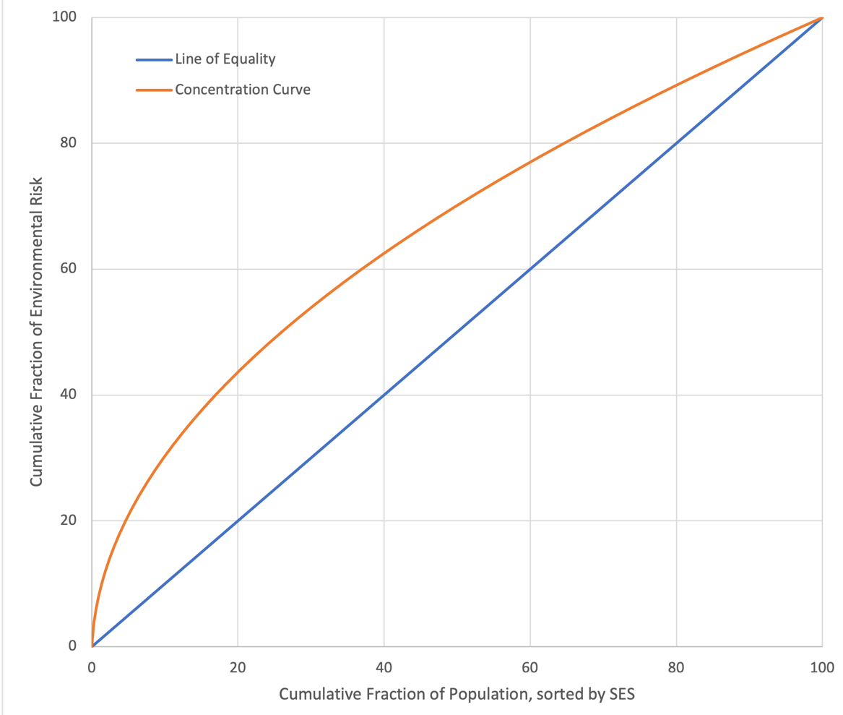
Concentration index and Lorenz curve
Modified Lorenz curve, a visual illustration of environmental inequality, represents a cumulative fraction of health impact due to exposure to PM_{2.5} concentration (y-axis) against a cumulative fraction of the population based on the socio-economic status (SES) groups (x-axis) starting from the lowest income group.
The 45º line (or 1:1 line) illustrates the line of equality.
The Concentration Index is an indicator of inequality, defined as equivalent to double the area between the concentration curve and the line of equality.
Notes:
We CI a

Slide 5
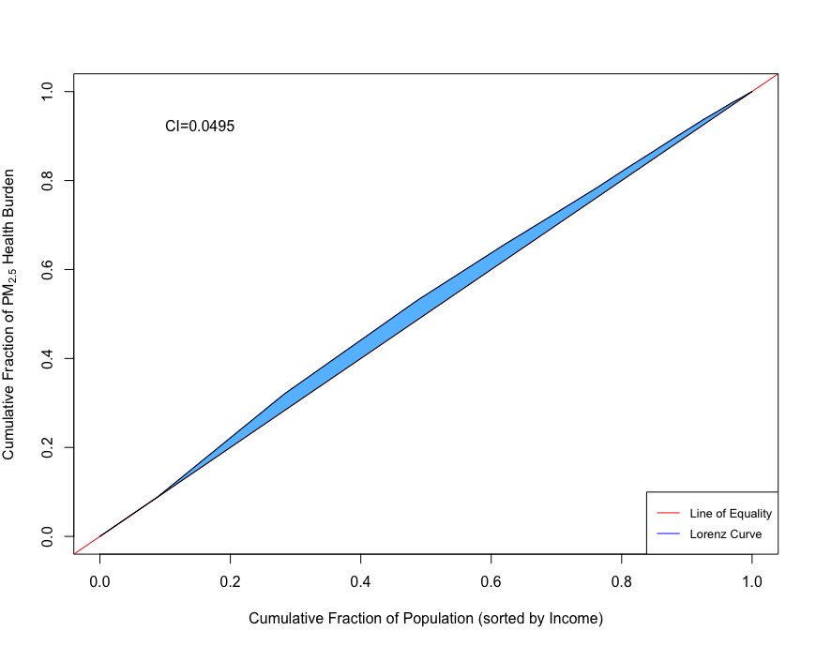
Concentration INDEX (CI) as the Adjoint Objective Function
An adjoint application requires definition of an objective (or cost) function:
The Concentration Index (Wagstaff, et al., 1989) is used here as the quantitative measure of exposure inequality.
Concentration Index are indicators of inequality, defined as the equivalent to double the area between the Lorenz curve and the line of equality.
Population health risk of exposure to ambient PM_{2.5} concentrations at the hemispheric scale is evaluated using the Global Exposure Mortality Model (GEMM, Burnett et al., 2018).
Notes:
CI value is comparable but larger at the international level

Slide 6
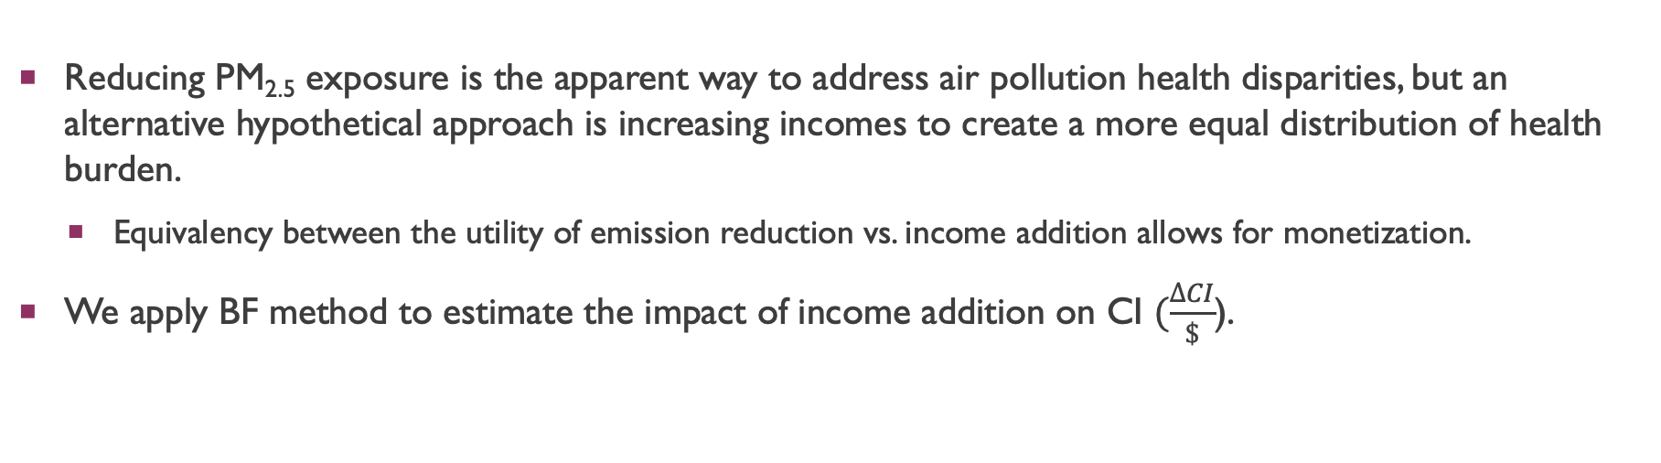
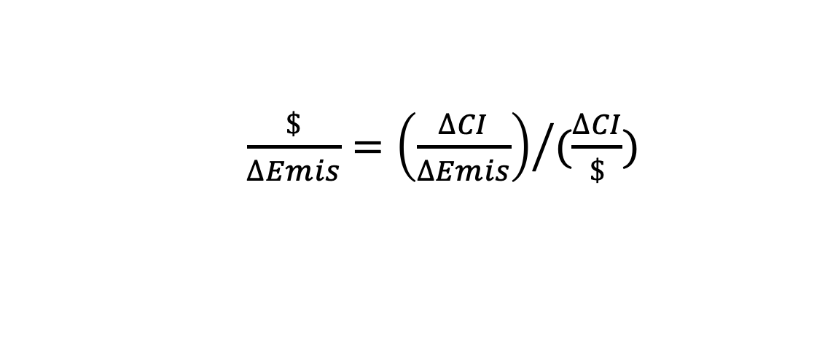
MONETIZATION of HEALTH INEQUALITY
  $\frac{\$}{∆Emis}={\left(\frac{∆CI}{∆Emis}\right)}/{(\frac{∆CI}{\$})}$
Minimum amount of additional income required to produce the same impact as the CI sensitivities of an emission reduction of one ton.
Concentration Index Sensitivities
Reducing PM_{2.5} exposure is the apparent way to address air pollution health disparities, but an alternative hypothetical approach is increasing incomes to create a more equal distribution of health burden.
  Equivalency between the utility of emission reduction vs. income addition allows for monetization.
We apply BF method to estimate the impact of income addition on CI $(\frac{∆CI}{\$}$).
Notes:
To monetize the benefits/disbenefits of emissions reductions (as dollar per change in ton of emissions) we have two terms the first one come

Slide 7
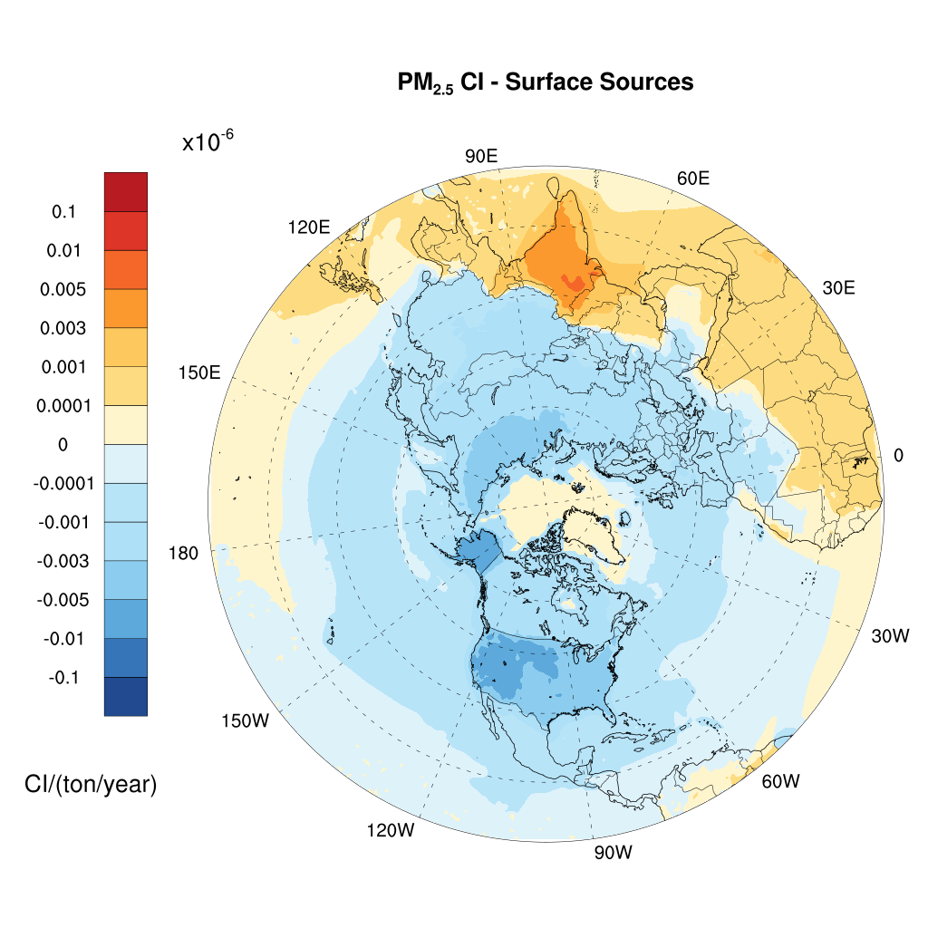
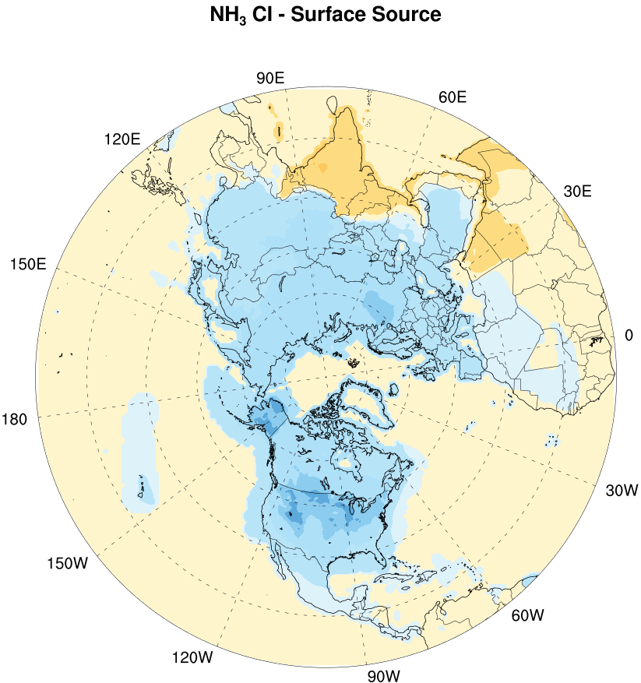
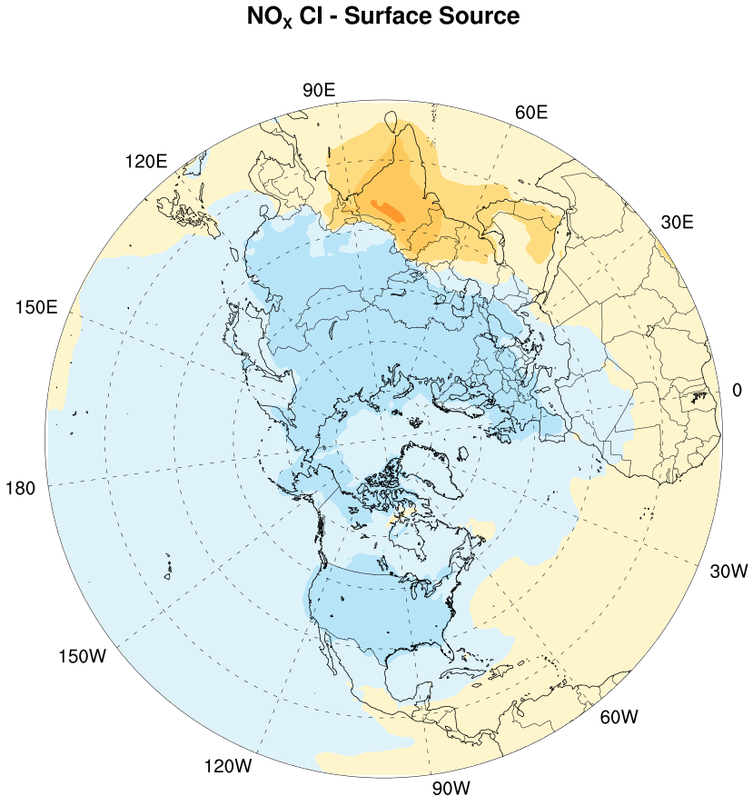
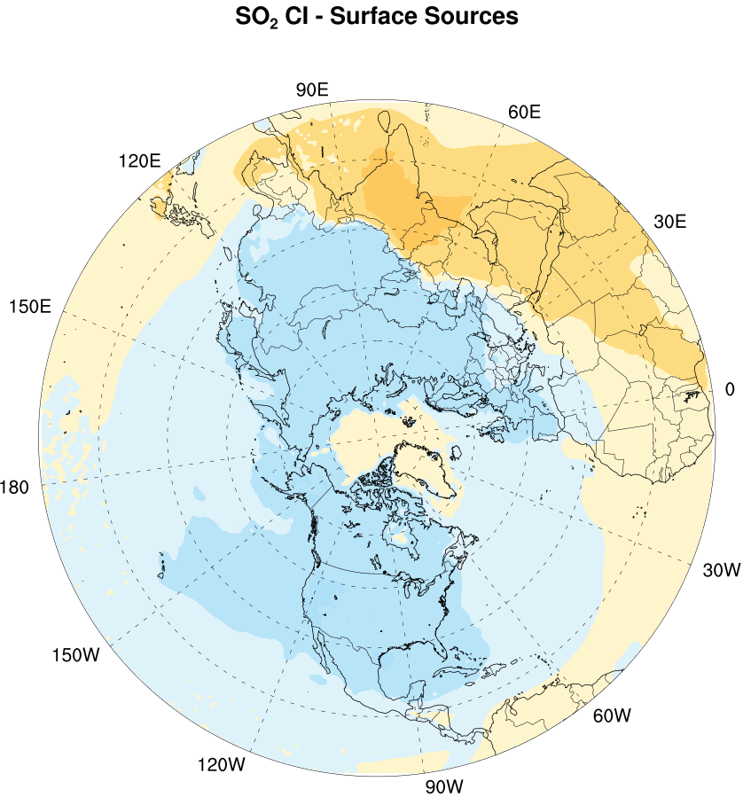
RESULTS:
CI SENSITIVITIES –
[Surface sources]
PM_{2.5} CI Surface Sensitivities
NH₃ CI Surface Sensitivities
NO_{X} CI Surface Sensitivities
SO₂ CI Surface Sensitivities
Notes:
The change in CI on the hemi scale due to 1 ton reduction at that location

Slide 8
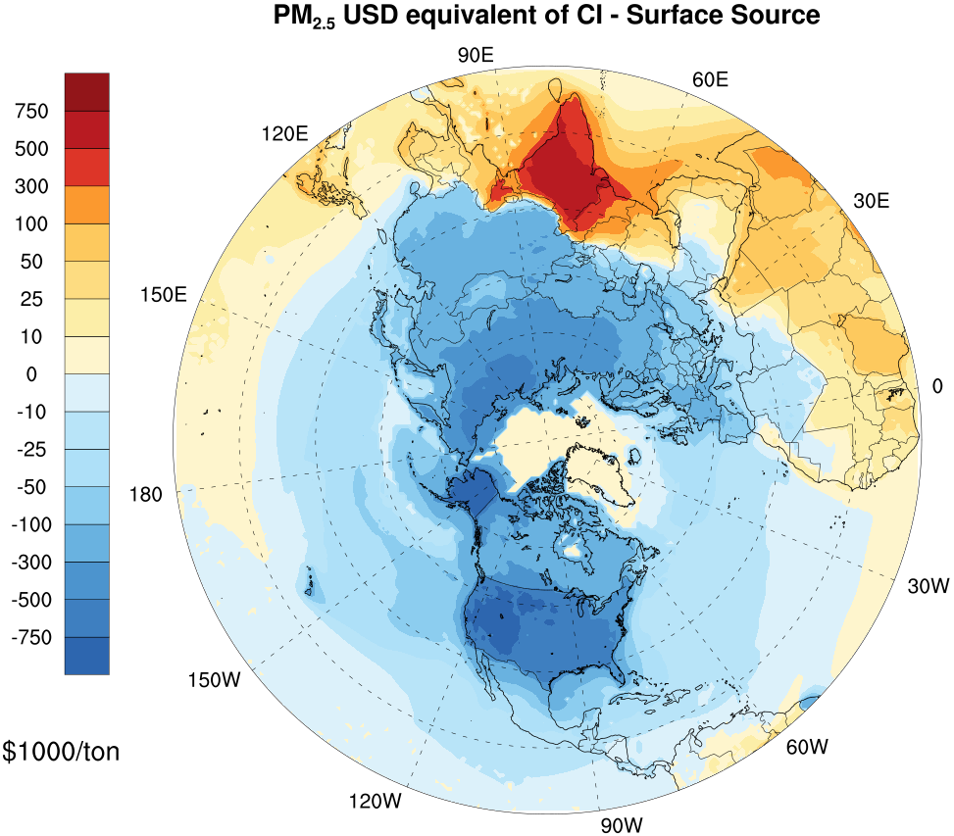
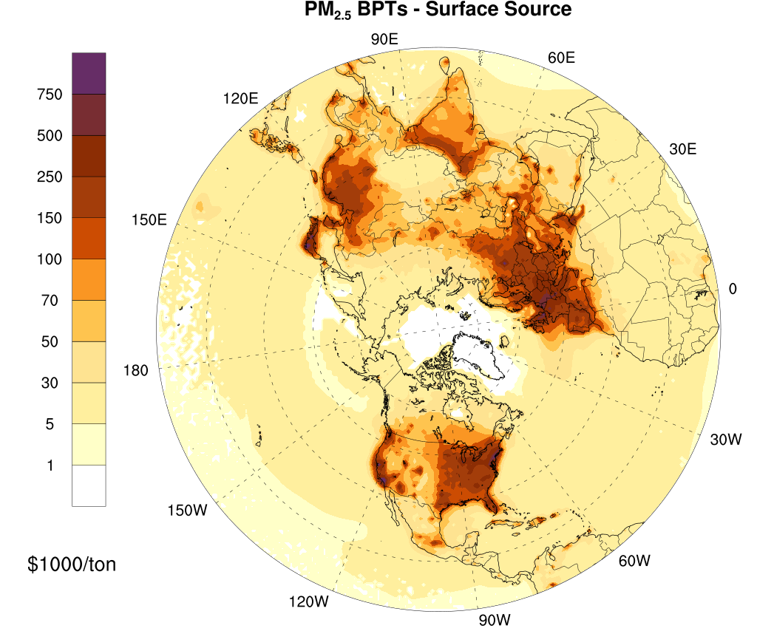
RESULTS
MONETIZED CI SENSITIVITIES and BPTs
Primary PM_{2.5} [Surface sources]
Notes:
Primary PM_{2.5} emissions carry the largest impact in India, with a monetary value above $1M/ton in many densely populated areas of India
Inorganic precursors are showing larger negative disparity in air pollution health burden across the northern hemisphere.
However, that does not mean that reducing emissions over high-income countries have negative benefits in air pollution. These results suggest that as a secondary policy endpoint, health inequality should provide benefits in those low income countries beyond the health benefits.

Slide 9
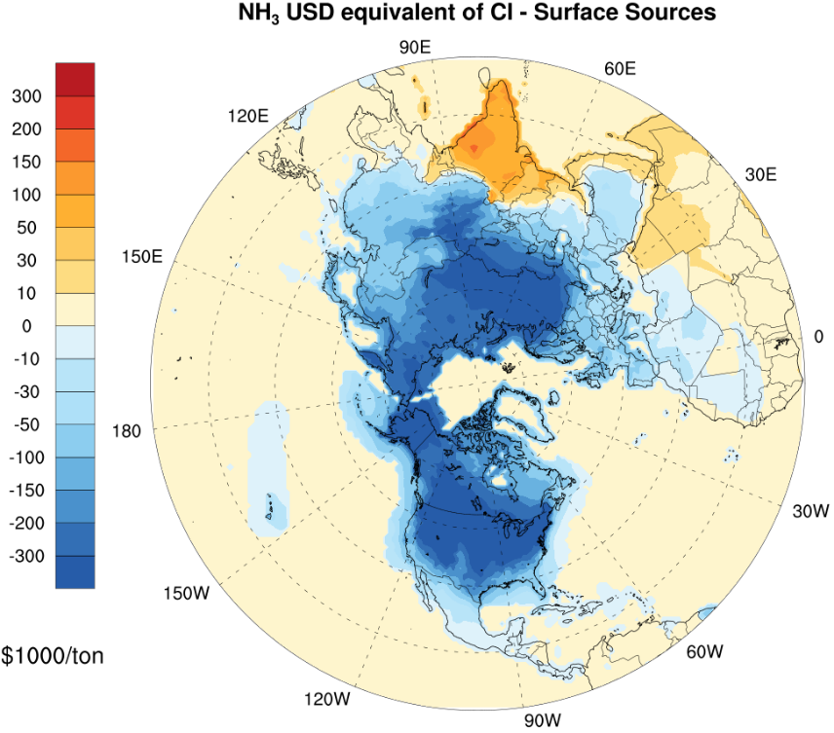
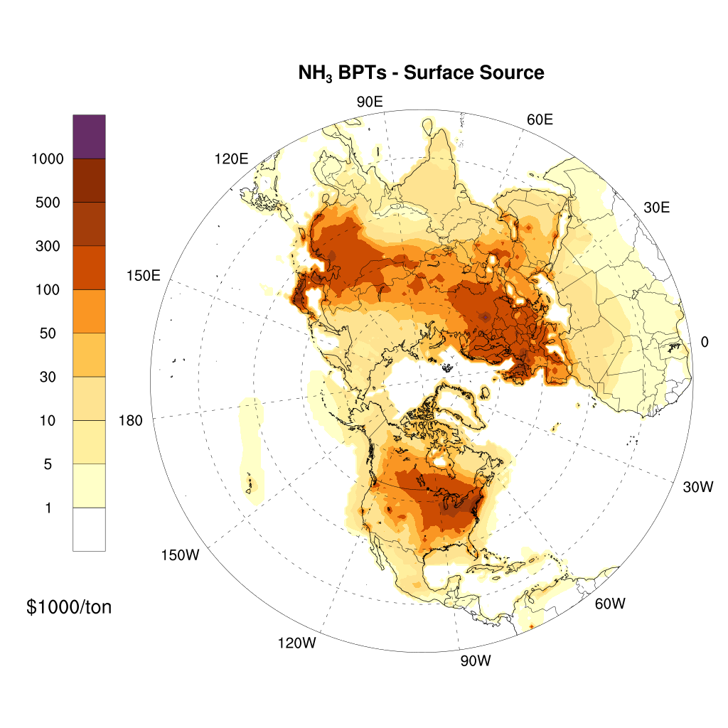
RESULTS
MONETIZED CI SENSITIVITIES and BPTs
NH₃ [Surface sources]

Slide 10
SCENARIO Analysis
We designed three hypothetical emission reduction scenarios for primary PM_{2.5} and inorganic precursor emissions.
Overall 10% domain-wide reductions in emissions. Starting with the most effective grid cells (ranking the most sensitive locations in BPTs and/or monetized CI sensitivities), we decrease up to 30% of the emissions in each grid cell until the overall 10% emission reduction target is reached.
  Scenario 1: Prioritize Health Benefits
  Scenario 2: Prioritize Equality Benefits
  Scenario 3: Combined Impact

Slide 11
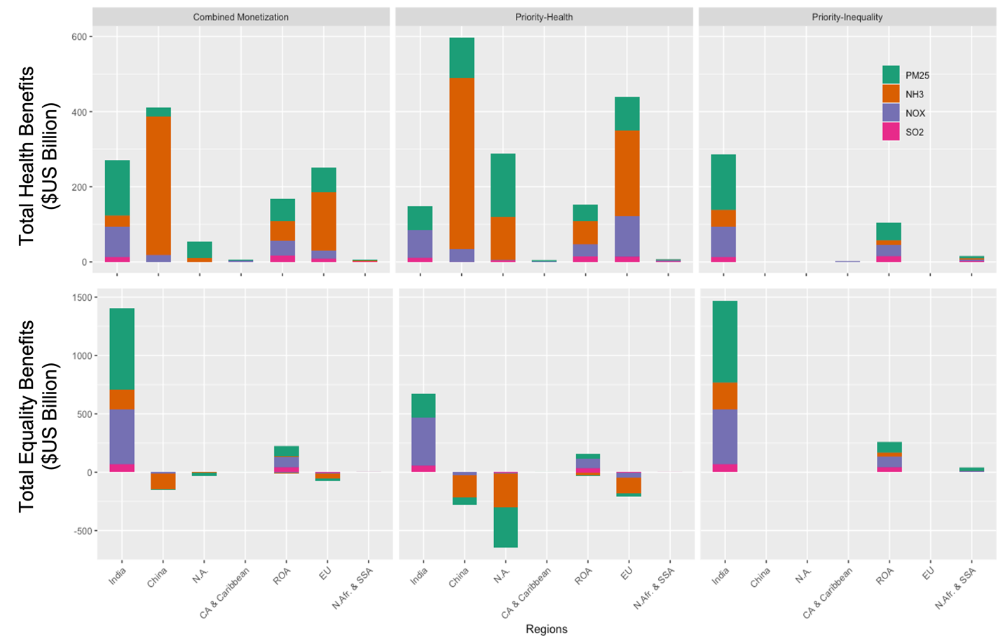
REGIONAL TOTAL BURDEN for PRIOTIZING scenarios
Combined Monetization
Prioritize Health Benefits
Prioritize Equality Benefits
India
China
N.A.
ROA
EU
India
China
N.A.
ROA
EU
India
China
N.A.
ROA
EU
C.A. & Caribbean
N.Afr. & SSA
C.A. & Caribbean
N.Afr. & SSA
C.A. & Caribbean
N.Afr. & SSA

Slide 12
Primary PM_{2.5} emissions changes in prioritizing scenarios

Slide 13
TOTAL BURDEN for Scenarios
 |  | Flat Reduction | Prioritize Health | Prioritize Equality | Combined Monetization
Total Health Benefits ($ Billion) | PM_{2.5} | 245 (10%) | 492 (20%) | 204 (8.3%) | 328 (13.4%)
 | NO_{X} | 111 (10%) | 265 (23.9%) | 119 (10.8%) | 172 (15.5%)
 | SO₂ | 23 (10%) | 47 (19.9%) | 29 (12.6%) | 42 (18%)
 | NH₃ | 347 (10%) | 892 (25.8%) | 62 (1.8%) | 645 (18.6%)
Total Equality Benefits ($ Billion) | PM_{2.5} | 18 (0.26%) | -214 (-3.1%) | 837 (12.1%) | 772 (11.1%)
 | NO_{X} | 134 (1.9%) | 425 (6.2%) | 580 (8.4%) | 545 (7.9%)
 | SO₂ | 14 (0.2%) | 73 (1.1%) | 112 (1.6%) | 105 (1.5%)
 | NH₃ | -195 (-2.8%) | -642 (-9.3%) | 269 (3.9%) | -21 (-0.3%)
 | Total | 697 | 1338 | 2212 | 2588
The percentages in the paratheses represent the change in total health and equality benefits due to 10 % change in total emissions.
Notes:
Adjoint location specific bpts help in maximizing health/inequality benefits
Negatives increase in disparity and positives decrease in disparity

Slide 14
CONCLUSION
The results show India as the country where emissions reduction are most beneficial from inequality standpoint due to PM_{2.5} exposure.
The monetized magnitude of national inequalities is comparable to hemispheric BPT estimates.
The scenario analysis indicates that targeted policies yield higher overall benefit than indiscriminate reduction in emissions.
Policies that target both health and inequality yield largest benefits.
Equality benefits could be taken into consideration in policy implementations, as a secondary policy endpoint.
NB: This study examines international health inequality and does not consider subnational and urban level inequalities within each country.

Slide 15
THANK YOU
REFEFERNCES:
  Global Burden of Disease Collaborative Network. Global Burden of Disease Study 2019 (GBD 2022) Reference Life Table. Seattle, United States: Institute for Health Metrics and Evaluation (IHME), 2022.
  Burnett et al (2018). Global Estimates of Mortality Associated with Long Term Exposure to Outdoor Fine Particulate Matter, PNAS, Vol. 115, no. 38, pp.9592-9597.
  Mathur, R., Xing, J., Sarwar, G., Hogrefe, C., Pleim, J., Pouliot, G et. al. (2017). Extending the Comunity Multiscale Air Quality (CMAQ) modeling system to hemispheric scales: overview of process considerations and initial applications. Atmospheric Chemistry and Physics, 17, 12449-12474.
  Institute for Health Metrics and Evaluation (IHME) (2015). GBD Tool. Seattle, WA: IHME, University of Washington, 2015. Available from http://ghdx.healthdata.org/gbd-results-tool. (Accessed July 2, 2021)
  US EPA. (2019). Technical Support Document (TSD) of preparation of Emissions Inventories for the Version 7.1 2016 Hemispheric Emissions Modeling Platform.
  Wagstaff, A., van Doorslaer, E., & Paci, P. (1989). Equality in the finance and delivery of health care: some tentative cross-country comparisons. Oxford review of economic policy, 5(1), 89-112.
  World Inequality DataBase (WID) https://wid.world (Accessed May 2021)

Slide 16
Acknowledgements
Dr. Barron Henderson and Dr. Rohit Mathur (EPA) for their help in the study design, implementation, and the update to Hemispheric CMAQ adjoint.
Digital Research Alliance of Canada for computational resources.

Slide 17
EXTRA SLIDES
MONETIZED CI SENSITIVITIES AND BPTs (Primary PM_{2.5} and precursor PM_{2.5} emissions).
INPUT DATA SETS FOR ESTIMATING BPTs.
COMBINED BENEFITS FOR A TON REDUCTION.
EMISSIONS CHANGES IN PRIORITIZING SCENARIOS.

Slide 18

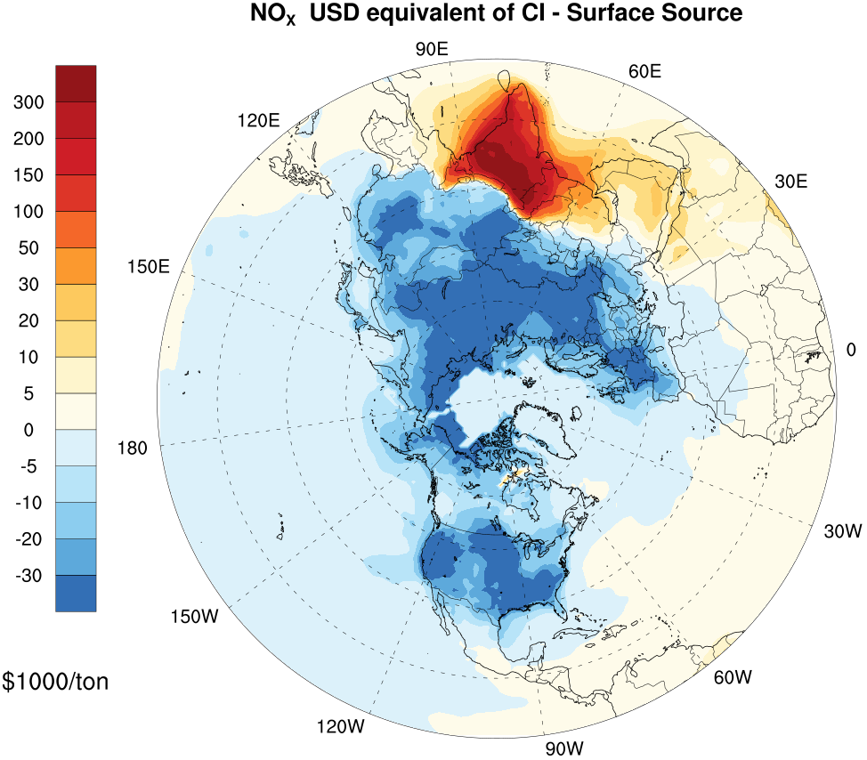
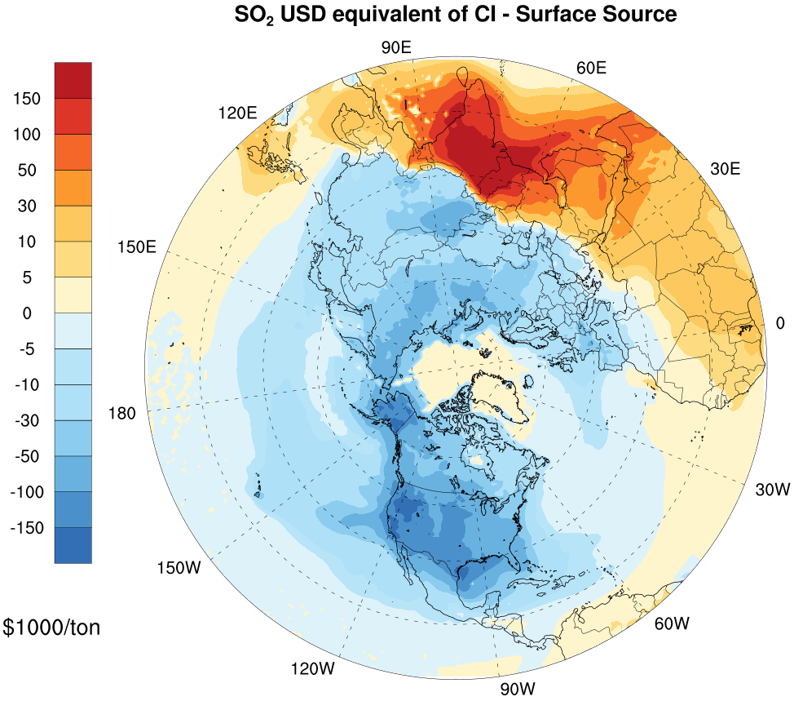
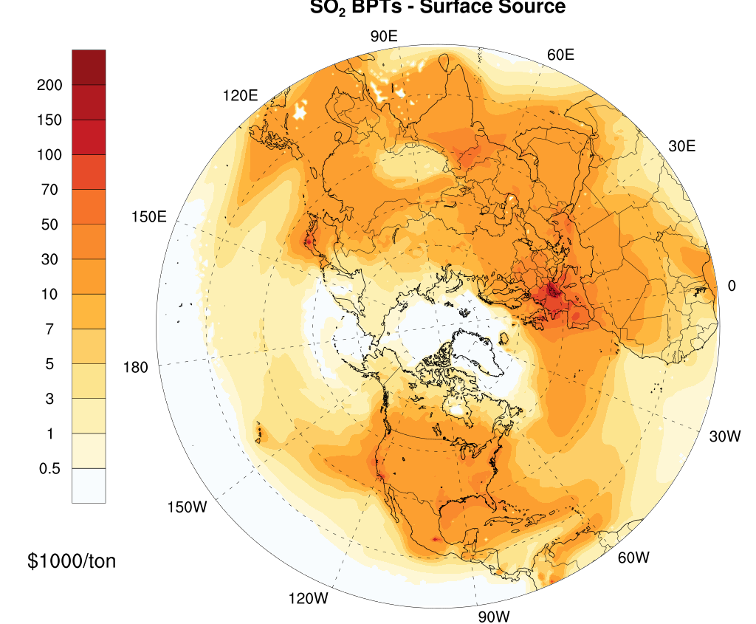
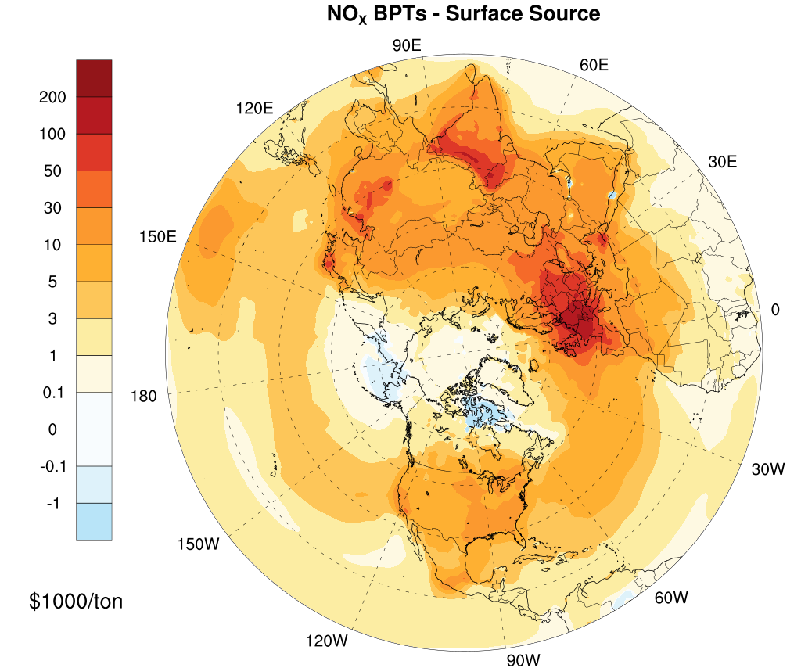
MONETIZED CI SENSITIVITIES and BPTs
Primary PM2.5 and Precursor PM2.5 Emissions
BPTs
Notes:
Primary PM_{2.5} emissions carry the largest impact in India, with a monetary value above $1M/ton in many densely populated areas of India
Inorganic precursors are showing larger negative disparity in air pollution health burden across the northern hemisphere.
However, that does not mean that reducing emissions over high-income countries have negative benefits in air pollution. These results suggest that as a secondary policy endpoint, health inequality should provide benefits in those low income countries beyond the health benefits.

Slide 19
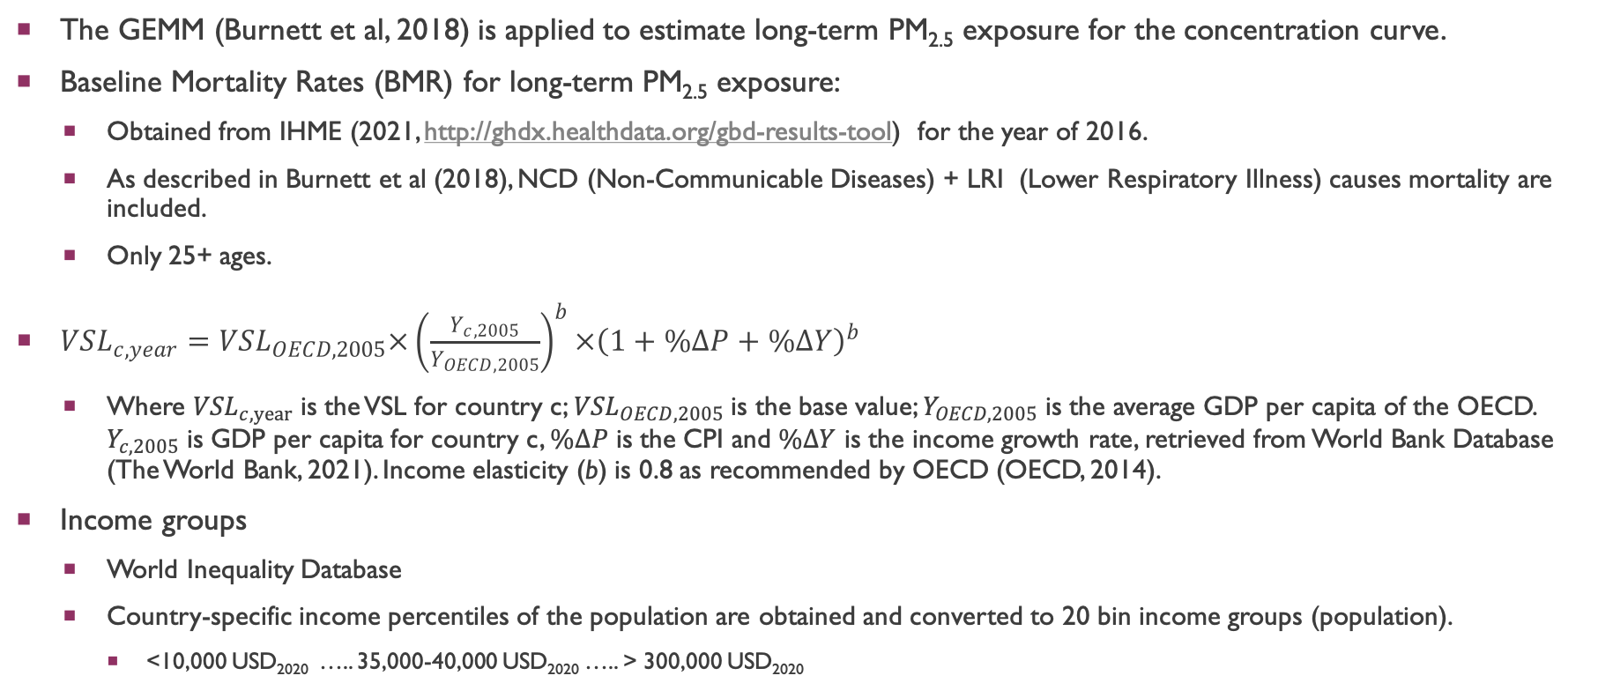
INPUT DATASET
The GEMM (Burnett et al, 2018) is applied to estimate long-term PM_{2.5} exposure for the concentration curve.
Baseline Mortality Rates (BMR) for long-term PM_{2.5} exposure:
  Obtained from IHME (2021, http://ghdx.healthdata.org/gbd-results-tool) for the year of 2016.
  As described in Burnett et al (2018), NCD (Non-Communicable Diseases) + LRI (Lower Respiratory Illness) causes mortality are included.
  Only 25+ ages.
${VSL}_{c,year}={VSL}_{OECD,2005}×{\left(\frac{Y_{c,2005}}{Y_{OECD,2005}}\right)}^{b}×{\left(1+\%∆P+\%∆Y\right)}^{b}$
  Where ${VSL}_{c,year}$ is the VSL for country c; ${VSL}_{OECD,2005}$ is the base value; $Y_{OECD,2005}$ is the average GDP per capita of the OECD. $Y_{c,2005}$ is GDP per capita for country c, $\%∆P$ is the CPI and $\%∆Y$ is the income growth rate, retrieved from World Bank Database (The World Bank, 2021). Income elasticity (b) is 0.8 as recommended by OECD (OECD, 2014).
Income groups
  World Inequality Database
  Country-specific income percentiles of the population are obtained and converted to 20 bin income groups (population).
    <10,000 USD₂₀₂₀ ….. 35,000-40,000 USD₂₀₂₀ ….. > 300,000 USD₂₀₂₀

Slide 20
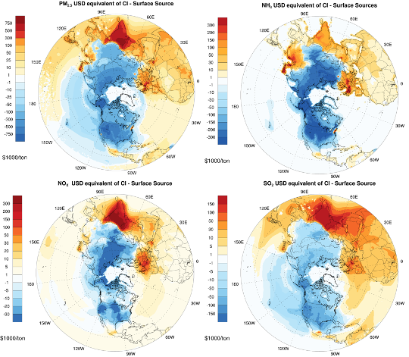
Combined benefits for a ton reduction in primary PM_{2.5} and PM_{2.5} precursor emissions.
Combined benefits are estimated by integrating the health and equality benefits.

Slide 21
NH₃ emissions changes in prioritizing scenarios

Slide 22
SO₂ emissions changes in prioritizing scenarios

Slide 23
NO_{X} emissions changes in prioritizing scenarios

Slide 24
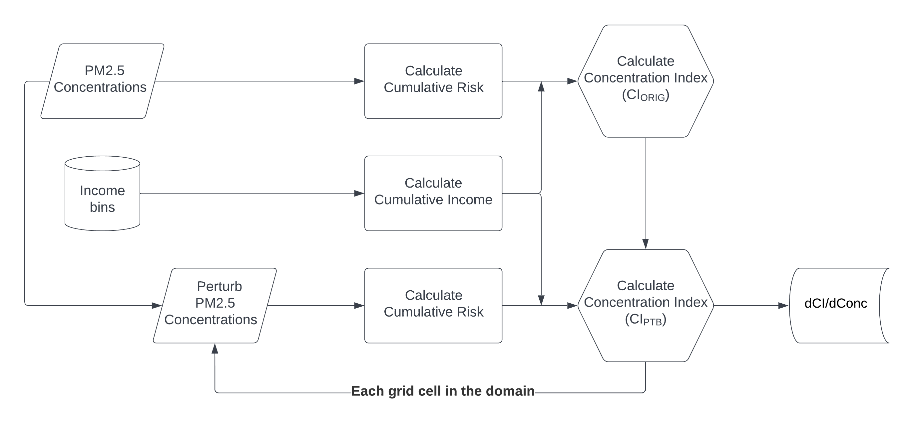

Adjoint Cost function (Cont.)
A Brute-Force approach is implemented to create adjoint forcing terms for health inequality.
Perturbing the average concentration in each grid cell in the modeling domain would result in a change in the Concentration Index which could be used as the objective function.
The PM_{2.5} Health burden is estimated using the GEMM (Burnett et al., 2018).
$$\frac{∆CI}{∆Conc}$$
  $\frac{∂J}{∂E}=\frac{∆CI}{∆Emis}=\frac{∆CI}{∆Conc}×\frac{∆Conc}{∆Emis}$ >>Concentration Index Sensitivities
The national-level average household income data is retrieved from World Inequality Database (WID.world, 2021) which provides percentiles for each country.
Notes:
A Brute-Force (BF) approach is implemented to create the adjoint forcing terms for health inequality. Firstly, we calculate the concentration index for PM_{2.5} health burden based on mortality using the national-level household income and gridded annual average PM_{2.5} concentrations. The area between the curve and the line of equality is estimated using trapezoidal rule. Later, we perturb the average PM_{2.5} concentrations in each grid cell in the modeling domain, resulting in a change in the CI at individual grid cells which can be used as the forcing term ($∂$CI/$∂$Conc).
. It should be noted that this approach only includes international level health inequality, rather than intra-national level inequalities.

