Slide 1
A new paradigm for PBL modeling in meteorological and air quality models
Kiran Alapaty¹ , Jesse Bash¹ , Rob Gilliam¹, Christian Hogrefe¹, Barron Henderson², Daiwen Kang¹, Bin Cheng³, Chris Nolte¹, Sarav Arunachalam³, and Alan Vette¹
¹Center for Environmental Measurement and Modeling, Office of Research and Development,
U.S. Environmental Protection Agency, RTP, NC
²Office of Air Quality Planning and Standards, U.S. Environmental Protection Agency, RTP, NC
³Institute for the Environment, The University of North Carolina at Chapel Hill, Chapel Hill, NC
October 16, 2023
Office of Research and Development
Center for Environmental Measurement and Modeling
Disclaimer: The views expressed in this presentation are those of the authors and do not necessarily reflect the views or policies of the U.S. EPA.
Notes:
I am a part-time researcher . Pretty much every coauthor has contributed to this work and without their valuable contributions, I could not have pulled this work to this shape. Thanks to all coauthors…

Slide 2
Background
Similarity functions are used in regional and global meteorological and air quality models to help represent surface and mixed layer processes in the PBL in a best possible way. For horizontal wind speed, for example:
$$U =\frac{u_{∗}}{k} \left[\ln\left(\frac{z−z_{d}}{z_{0}}\right)+ ψ_{m}\right]$$
However, different similarity functions used in models contribute to differences among different models (e.g., Liu et al. 2006; regional & global meteorological and air quality models, & earth system models)
For the past 50+ years, there is no viable alternative to unify MET and AQ models. One MUST use these similarity functions or models will fail.
Notes:
Point (1) When we look at the literature, we will find numerous different stability correction functions for similarity profiles across regional and global meteorological and air quality models as well as earth system models. This is one source of model-2-model outcome differences and this can be potentially avoided by NOT using similarity functions at all… For about half-a-century similarity functions are ruling these models. (2) turbulence strength is underrepresented in some of the formulations and thus there is a room for improvement; (3) our new 3D turbulence velocity scale provides an opportunity to avoid these issues and can be a source of community formulations representing turbulence effects in a best possible way in MET and AQ models.; (4) this new velocity scale was evaluated and validated using measured velocity variances and a dry dep box model and these results were documented in Alapaty et al. 2022 which showed that there is no need to use similarity functions in PBL modeling. But it was done using a single-point (box) model but not a 3D MET or AQ model.

Slide 3
To alleviate these issues, a 3-D velocity scale ($e_{∗}$ ) has been developed that does not depend on the usage of similarity functions
In Alapaty et al., 2022; Cheng et al., 2022, $e_{∗}$was estimated as:
2
Notes:
The new velocity scale (e*) is a function of friction velocity, convection velocity, and Obukhov length for convective conditions in PBL; and for stable conditions it is proportional to friction velocity and for neutral conditions as well along with mean wind speed. Thus, in that study we proved that aerodynamic resistance can be expressed without using similarity functions by using the e* and it becomes a seamless formulations for all models (box, 1D, 2D, and 3D MET and AQ models) since it does not depend on similarity functions.

Slide 4
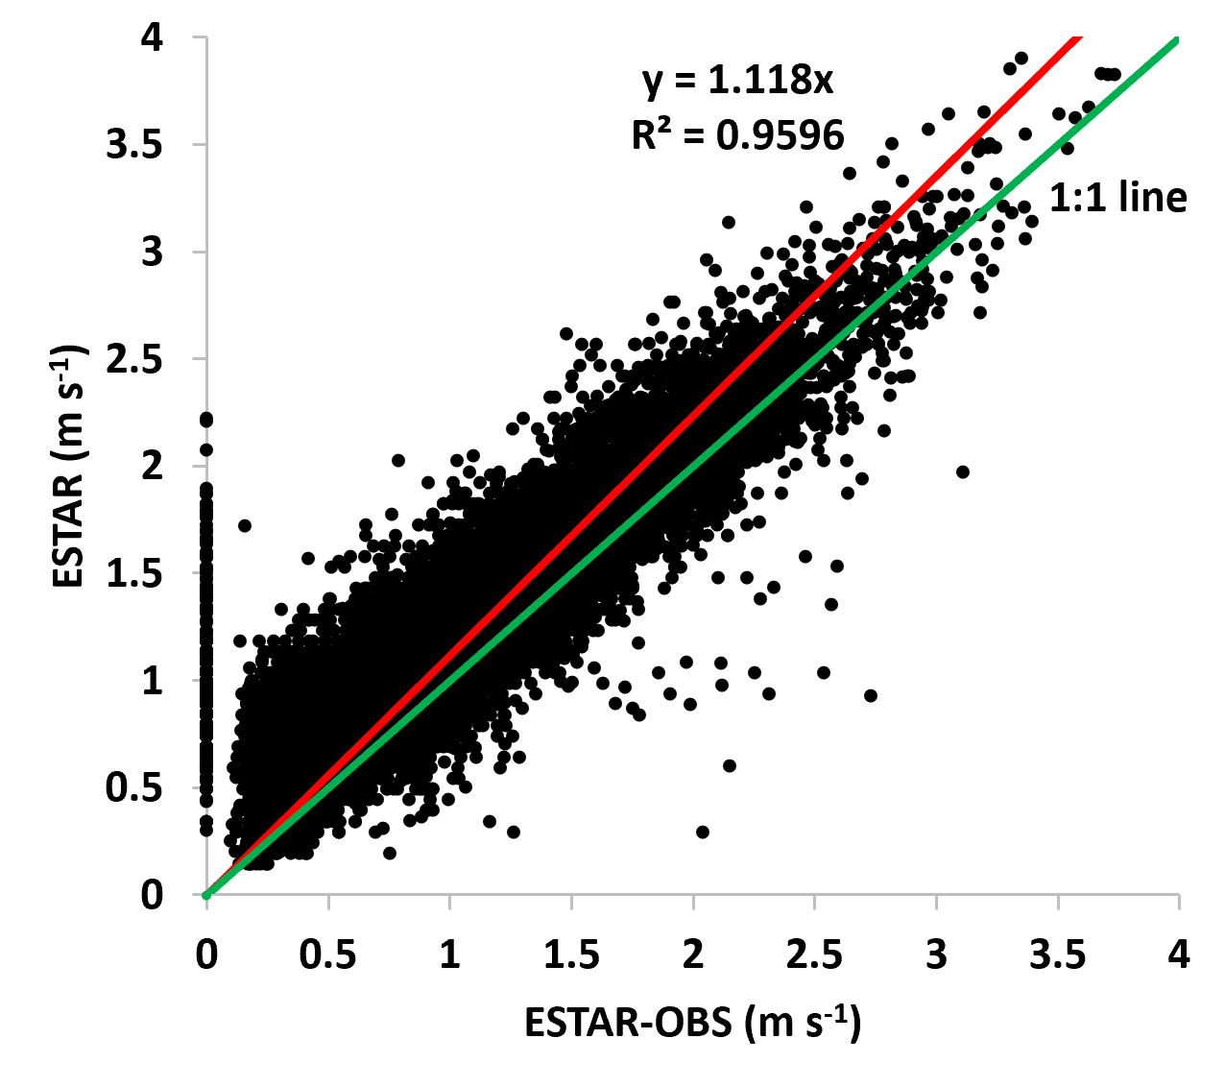
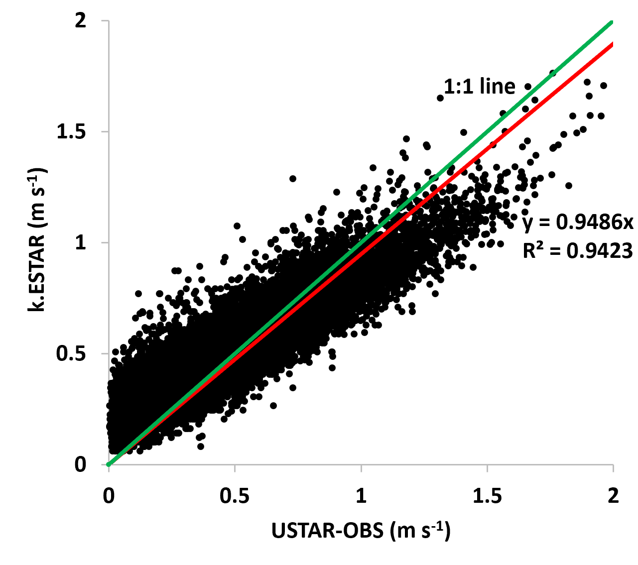
$u_{∗c}$ ≈ ${k e}_{∗}$
Validation of e* Estimation Using 3-D Sonic Anemometer Micrometeorological variance Data (1991-2000) at Harvard Forest site
Alapaty et al., 2022
Parameterized $e_{∗}$
Measured $e_{∗}$ ${ ( e}_{∗}obs$ )
Sonic anemometer measured friction velocity $u_{∗c}$ can be approximated as the product of $e_{∗}$ and k., von Karman constant
Notes:
To the best of our knowledge, no one has used measured velocity variances from the 3D sonic anemometer for turbulence modeling and thus we are the first ones to use such data that was collecting dust…. The sonic data are used to validate the parameterized e* and results are very apparent. Further we showed that the measured friction velocity can be replaced by the product of von Karman constant and parameterized e*. This is the key result that helped us to get rid of all similarity functions in pbl modeling.

Slide 5
How $e_{∗}$ dodges similarity functions in 3-D MET and AQ models?
$$Measurements and a box model was used$$
$$to validate the e_{∗} (the 3−D velocity scale)$$
New$surface layer modeling:$
Alapaty et al. (2022) showed and validated that the traditional surface windspeed equation:$U =\frac{u_{∗}}{k} \left[\ln\left(\frac{z−z_{d}}{z_{0}}\right)+ ψ_{m}\right]$
can be written as $U=e_{∗} ln\left[\frac{z−z_{d}}{z_{0}}\right]$ where no similarity function ($ψ_{m}$) is used.

Slide 6
How $e_{∗}$ dodges similarity functions in 3-D MET and AQ models…
ACM2
New$PBL modeling…$
$e_{∗ }$ACM2
$$f_{conv }= {\left(1+ \frac{k^{−2/3}}{0.1 a} \left[− {\frac{h}{L}}^{−1/3}\right]\right)}^{−1}$$
Convection fraction
$$f_{conv }= {\left(\frac{e_{∗}^{2} }{e_{∗}^{2} −3.8u_{∗}^{2}}\right)}^{−1}$$
$$\}$$
$$K_{m }=k\frac{u_{∗}}{φ_{m} (\frac{z_{s}}{L})}z_{f}{\left(1−\frac{z_{f}}{h}\right)}^{2}$$
$${K_{z }=K}_{m }{= K}_{h }= k^{2}e_{∗}z_{f}{\left(1−\frac{z_{f}}{h}\right)}^{2}$$
Coeff. Eddy Diffusivity
$$K_{h }=k\frac{u_{∗}}{φ_{h} (\frac{z_{s}}{L})}z_{f}{\left(1−\frac{z_{f}}{h}\right)}^{2}$$
No minimum Kz is used
$$M_{2u }=\frac{f_{conv} K_{h}(z_{1.5})}{{∆z}_{1.5}(h−z_{1.5})}$$
Vertical Mixing
$$M_{2u }=\left(\frac{k f_{conv} e_{∗}}{h}\right)$$
5
Notes:
Notice the new formulations based on e* are totally different than those used in the ACM2 and relatively simpler and avoid the usage of similarity functions . Also, only a single coeff of eddy diff is used instead of different Km, Kh, ( and Kq in some models).

Slide 7
In CMAQ: TV-STAGE Resistance Formulations
How $e_{∗}$ dodges similarity functions in 3-D MET and AQ models…
New aerodynamic resistance (R_{a}) for different stability regimes in PBL for 0-D, 1-D, 3-D MET and AQ models (seamless)
$$R_{a}= \frac{1}{k^{2}e_{∗}} ln\left[\frac{z}{z_{0}}\right]$$
Revised leaf boundary layer resistance (R_{blf}) & soil boundary layer resistance (R_{bsoil})
$$R_{blf}=\frac{v {(l_{leaf} {ke}_{∗}/(v {LAI}^{2}))}^{1/3}}{D{ke}_{∗}}$$
$$R_{bsoil}=\frac{\frac{v}{D} − log\left\{\frac{10 D}{k \exp\left(−LAI∗0.5\right) {ke}_{∗}}\right\}}{k \exp\left(−LAI∗0.5\right) {ke}_{∗}}$$
New in-canopy aerodynamic resistance (R_{inc})
$$R_{inc}= R_{a}\left(e^{0.5 LAI}−1\right)= \frac{U}{{k^{2}e}_{∗}^{2}} \left(e^{0.5 LAI}−1\right)$$
6

Slide 8
What we want to do . . . (objectives)
Using WRF model (MET model) and the CMAQ model (AQ model):
Is it possible to perform model simulations without using similarity functions in PBL formulations (and dry deposition)?
If so, then what is the performance of such models that do not use similarity functions?
How we want to do . . . (methodology)
Develop and test new surface layer formulations.
Develop and test new PBL formulations that use
the 3-D velocity scale in WRF and CMAQ
models instead of similarity functions.

Slide 9
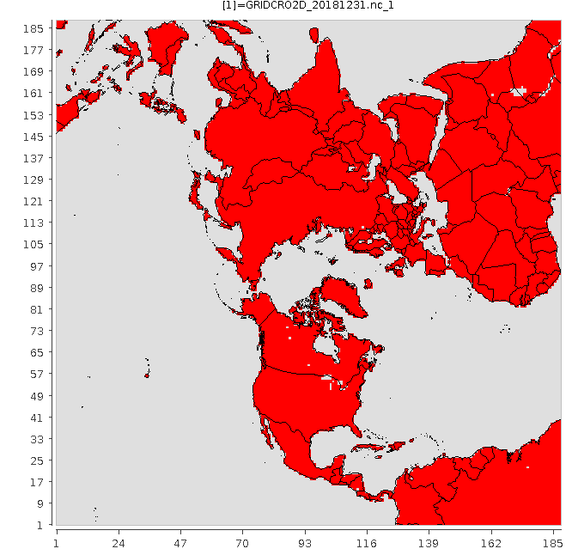
Models and Simulations
WRF model v4.3.3
CMAQ model v5.4
Modeling domain
Entire year 2018 (2 weeks spin up into 2017 December)
108 km grid, N. Hemisphere
Two simulations:
SPM (Similarity Profile Method)
TVM (Turbulence Velocity Method)
In the TVM, because it uses the 3-D turbulence velocity scale, there is no need to use similarity profiles in: surface layer, PBL, dry deposition schemes.
Notes:
Since this is a part-time unfunded research , we picked modeling cases from on-going projects. Now, it is an exciting time to find out whether we can really avoid the 50+ year old practice of using similarity functions!!!

Slide 10
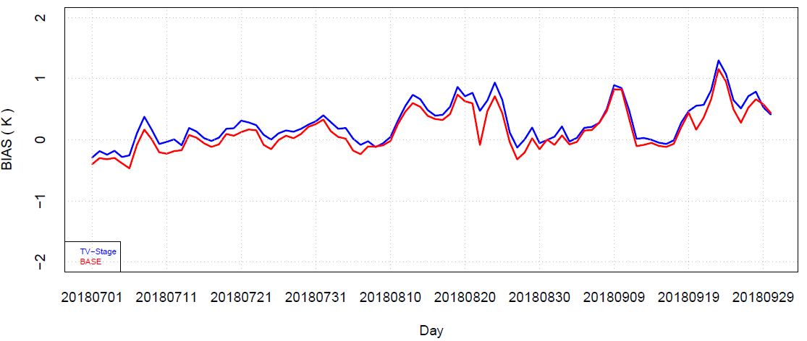
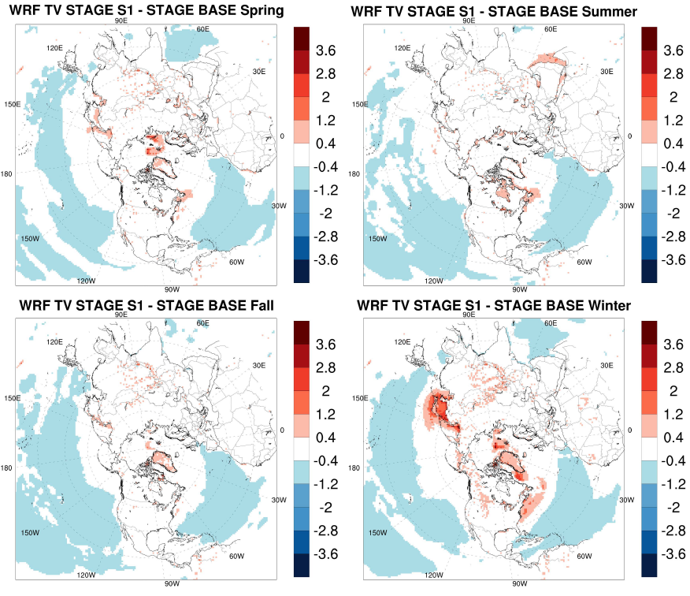
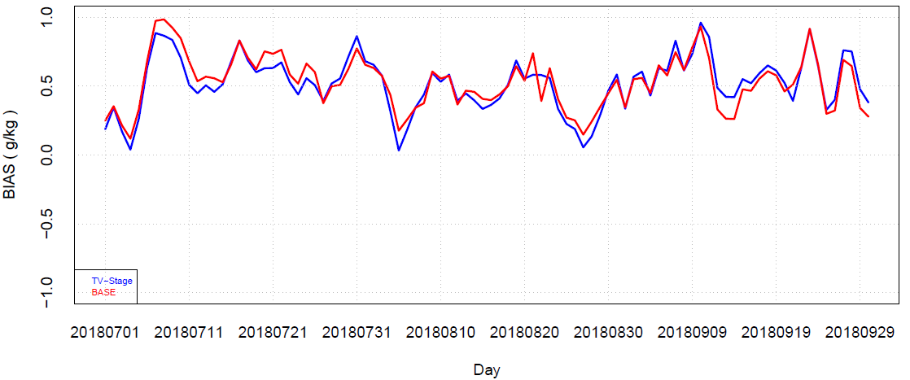
2018 WRF modeling results
2 m AGL seasonal air temperature differences (K)
SPM
TVM
2 m AGL daily air temperature bias (K) for JAS 2018
SPM
TVM
2 m AGL daily water vapor mixing ration bias (g/kg) for JAS 2018
Notes:
(Left panel) Time series statistical measures indicate that there is an insignificant warm bias with TVM for T2, and an insignificant reduction in Q2 bias when compared to SPM. Also, bias differences are well within accuracy of measurements. Insignificant warm bias in TVM time series plot on left side indicates that the Kz in TVM is always tiny bit higher than the Kh SPM. And also, there is no Km & Kh concept in TVM.
(right panel) In general, spatial difference results are very similar between the two simulations that use (TVM) and don’t use (SPM) similarity functions with minor heterogeneous differences. With seasons, there are small differences between simulations with exception to Winter over open waters and snow covered regions. For all seasons, oceans have relatively cooler air temperatures in TVM. Most likely, turbulence maybe stronger during stable conditions. Most likely, soil moisture nudging over land may be a key player for muted response while over water there is no surface nudging. Thus, differences over water are mostly related to differences in formulations in the SPM and TVM. Interesting to note that Kzmin is used in the SPM while no such thing was used in the TVM.

Slide 11
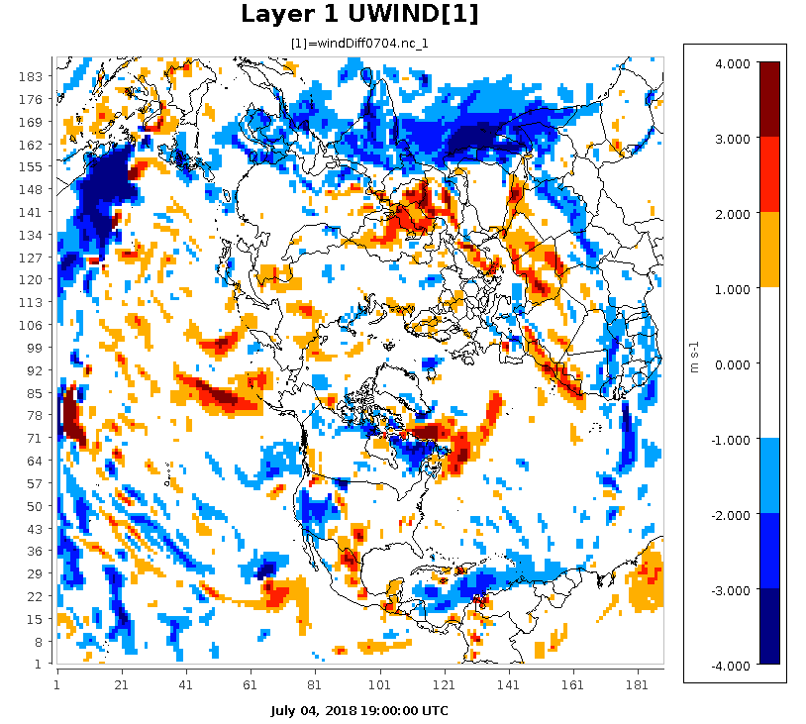
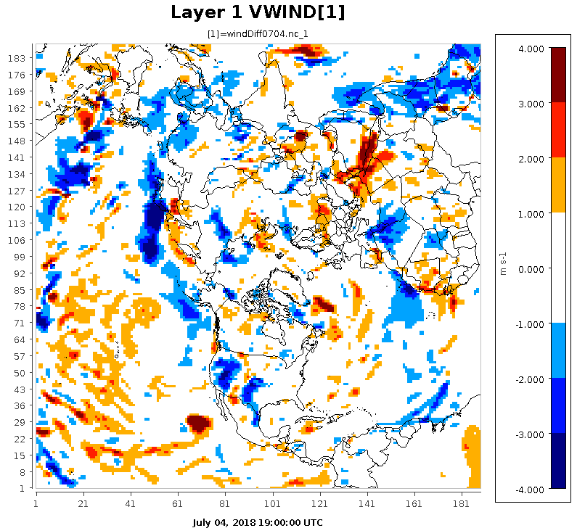
Layer 1 horizontal wind differences (m/s)
(TVM-SPM)
Zonal Wind differences
Meridional Wind differences
10
1900 UTC July 04, 2018
Notes:
There are no systematic patterns in the differences except that the u-wind differences are clearly present over the ITCZ regions because easterlies dominate in the tropics. In other areas, differences in clouds and radiation can contribute to differences in the surface winds. Also, note that momentum fields at the surface are not nudged and thus differences are directly due to formulation types used in SPM and TVM. Since TVM explicitly uses surface momentum and sensible heat fluxes, and since over the oceans sensible heat flux is weekly either +ve or –ve over oceans, momentum fields can be different between SPM and TVM. This result has direct bearing on the precipitation intensity, in particular over the ITCZ areas. Again, there is only one Kz in the TVM while Km is used in the SPM with a minimum Km value which could be another source for u-wind differences over the ITCZ

Slide 12
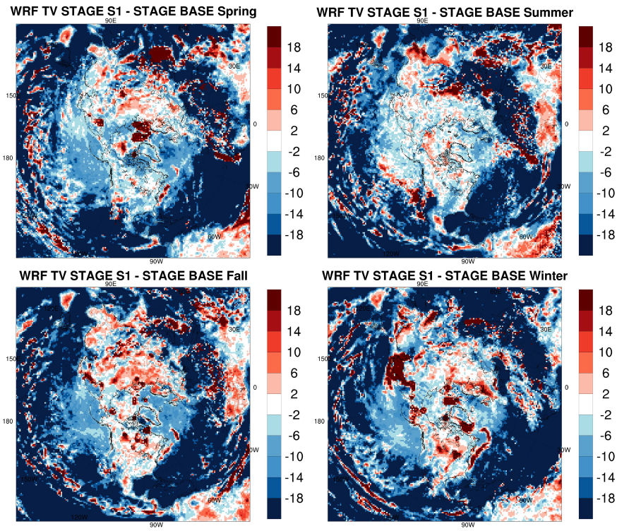
Normalized Total surface precipitation difference (%)
(TVM-SPM) for each season
$$\left(\left\{\frac{TVM−SPM}{SPM}\right\}∗100\right)$$
11
Notes:
Large reduction of total surface precip can be seen over the oceans and in particular tropical oceans where ITCZ is present. With the WRF configuration used, we know that it rains too much over the waters. We will acquire global precip data for further evaluation in our further analysis.

Slide 13
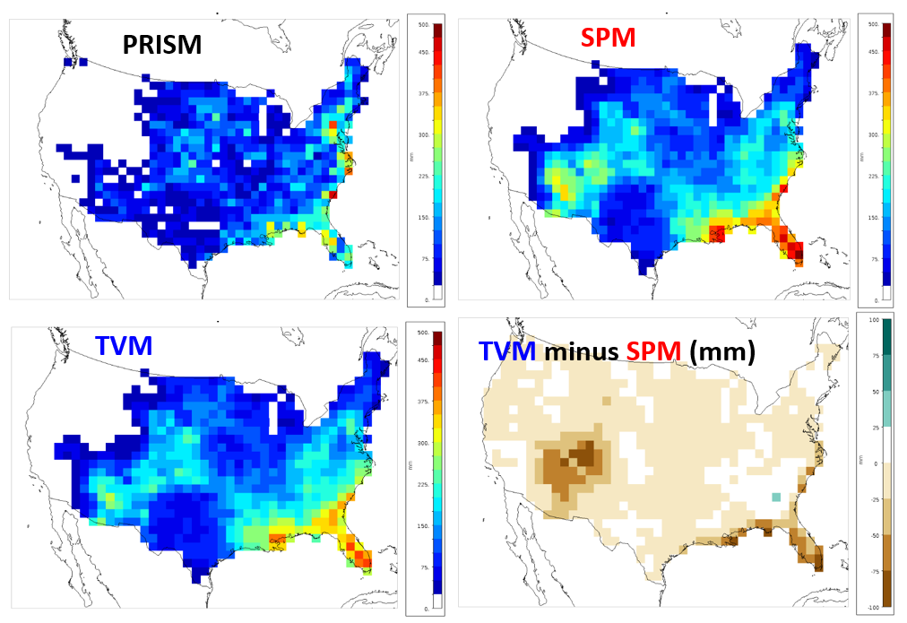
Total surface precipitation for USA for July 2018
12
Notes:
Top left panel is for the precip accumulated obtained from PRISM data and both simulations (SPM & TVM) overpredict surface precip when compared to PRISM data. Precip in TVM has reduced wet bias as compared to SPM. Right bottom panel also indicate that, in general precip wet bias is reduced in particular eastern coastal areas and southwestern regions. Definitely, TVM produced better precip estimates.

Slide 14
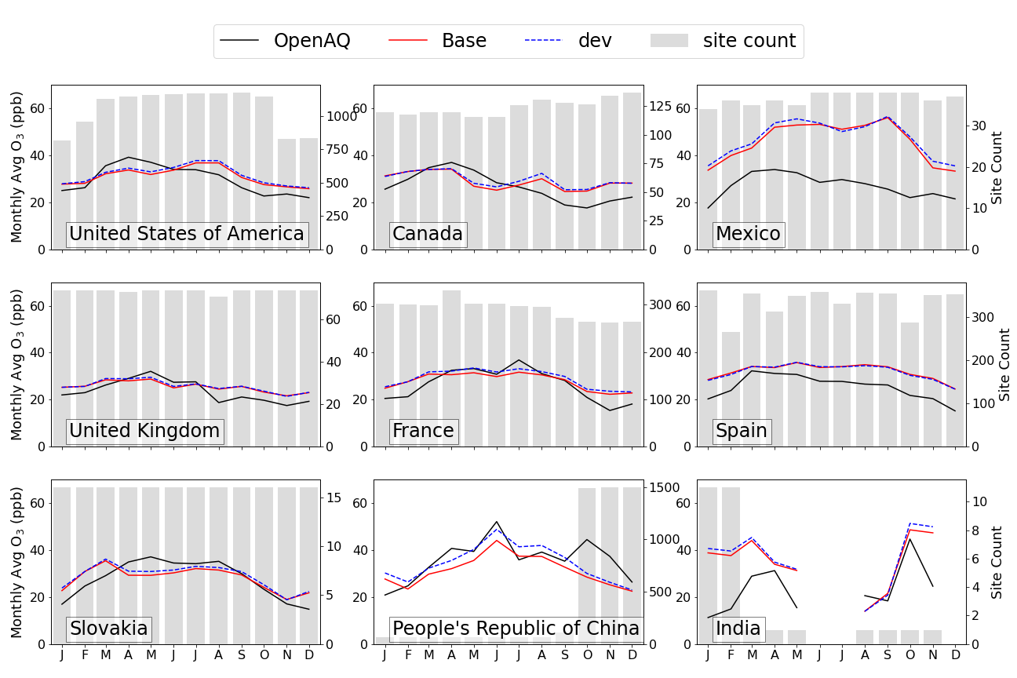
2018 CMAQ modeling results
SPM
TVM
Monthly Averaged surface ozone conc variation
13
Notes:
Seasonal variation of monthly averaged sfc ozone for different countries sow that at a gross level, both SPM and TVM produce very similar trends and magnitudes. This confirms that on average the TVM was able to successfully simulated sfc ozone. For some reason, we see that TVM to produce noticeable improvements for China unlike for other countries.

Slide 15
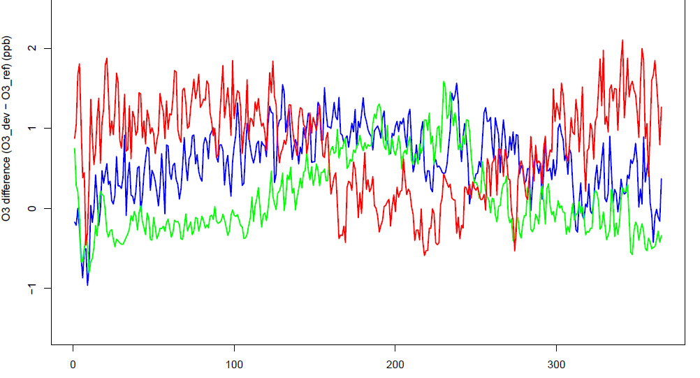
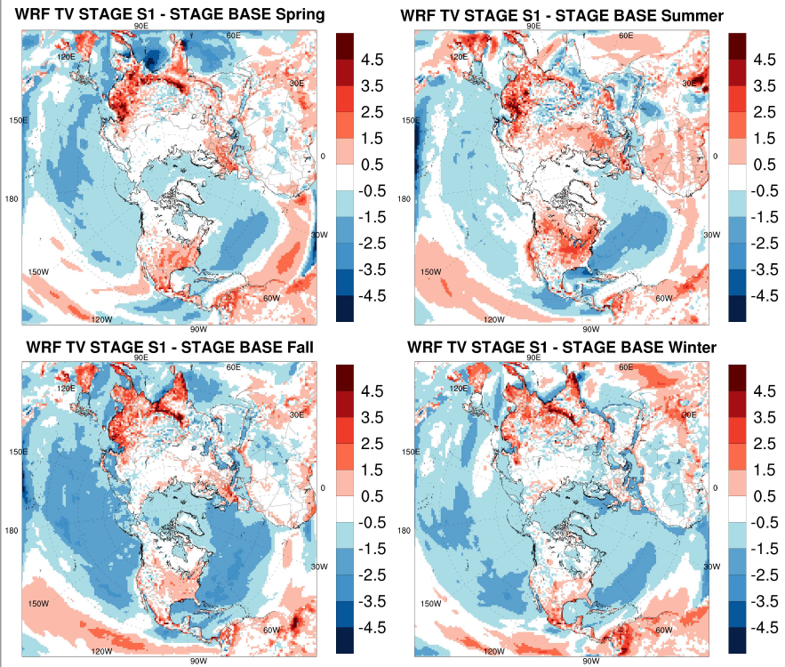
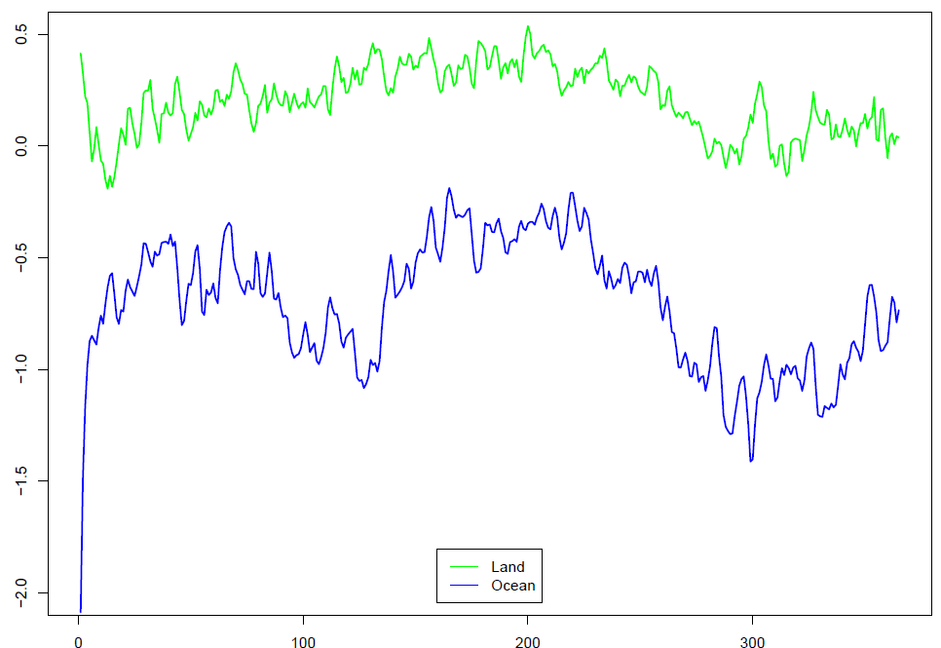
2018 CMAQ modeling results…
Surface ozone differences (ppb)
(TVM-SPM) for each season
Surface ozone differences (ppb) (TVM-SPM)
14
Notes:
Left top panel: One interesting feature is that modeled differences show dependence on latitude.
For tropical countries, (Mexico, India) modeled difference during winter/spring is highest and in summer difference goes to lowest and for Fall it goes to highest.
For midlatitude countries, (US, China) differences go up slowly before summer and slowly come down towards end of summer and go up little bit in winter
For high latitude country, (Canada) differences are just below zero line in from Jan and go up starting late spring to summer and fall down early Fall. The amplitude of difference is larger for Mexico. For MX and CA countries we found that the differences are large when sfc ozone concs are at lower levels and differences are small when sfc ozone concs are at high levels. Left bottom panel: most pronounced differences over ocean with a 130 day oscillations
Right Panel: on average TVM produces more surface ozone over many land areas during all seasons while over oceans differences are similar across seasons.
It seems that Bromide over the marine environment in TVM in general is higher than in SPM; some implications from halogen chemistry …

Slide 16
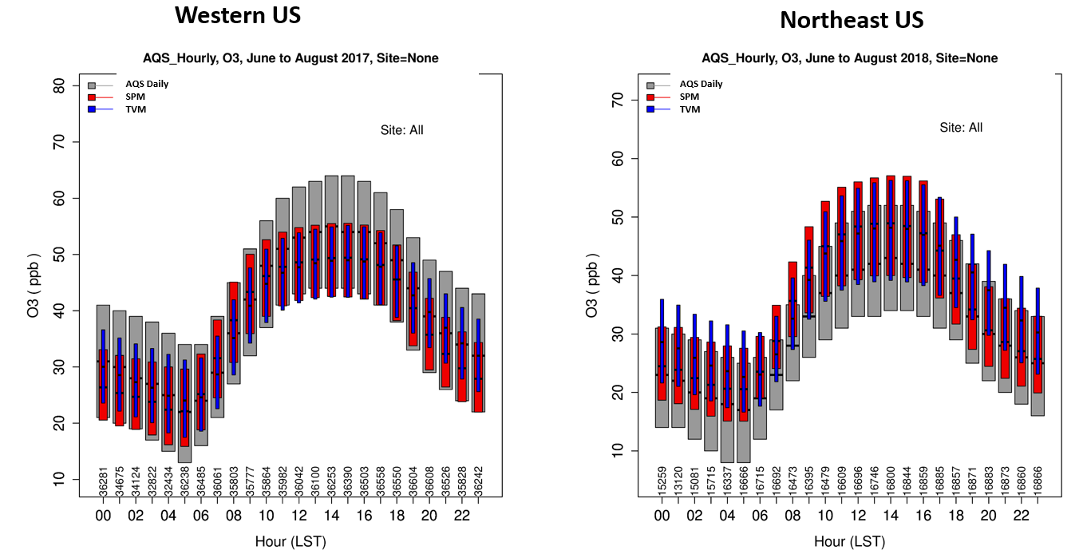
Diurnal variation of yearly averages for each hour
15
Notes:
Left panel: With SPM (red), average minimum values are well simulated while the TVM (blue) min and max averages are positioned halfway of the observed ranges. Both, underpredict max sfc ozone during daytime hours.
Right panel: for similar type of vegetation areas (NE US) both the SPM and TVM overpredict sfc ozone with TVM having insignificant reduction in bias during daytime conditions while during evening and night conditions (stable PBL) TVM has increased +ve bias. This indicates that , in TVM, nighttime/stable PBL processes may be little overactive but since ozone formation is complex, we need to look at precursors and other diagnostics to get insights.

Slide 17
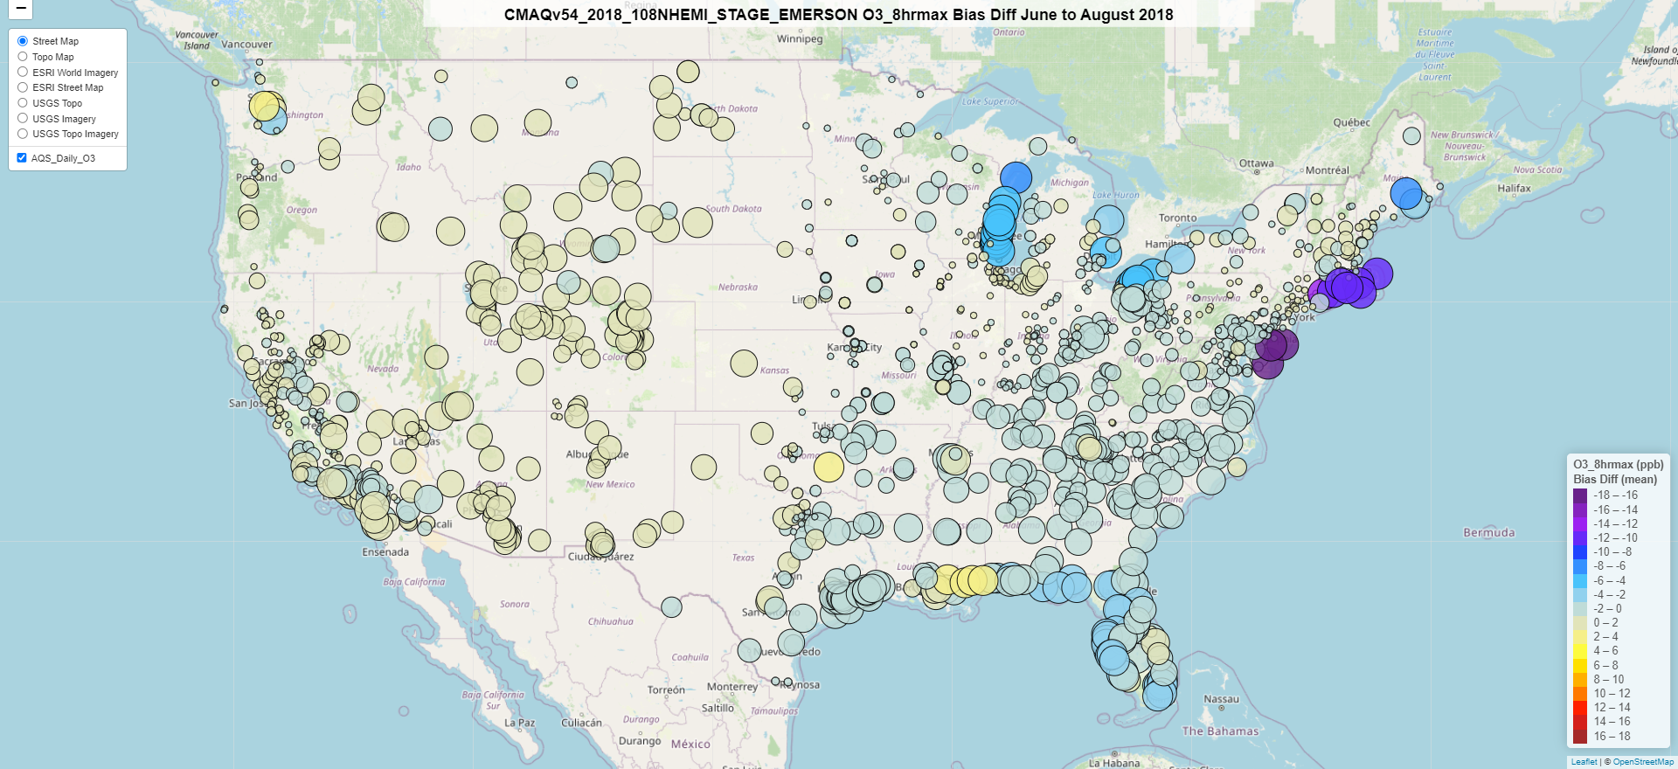
JJA bias differences (TVM bias minus SPM bias) for MDA8 Ozone
16
Notes:
Difference in absolute bias: warm colors = increase in bias, cool colors = decrease in bias; size of the circle = small circle of same color indicates lower bound value of the range and bigger circle of same color indicates upper bound value; of the range interestingly for the western US almost all of the sites TVM has insignificant increase in bias while for the eastern US bias differences, almost all sites show minor to moderate reductions in bias in TVM. Coastal and lake areas have large reductions in bias in TVM.
MDA8 definition: The daily maximum 8-hour concentration for a given calendar day is the highest of the 24 possible 8-hour average concentrations computed for that day. This process is repeated, yielding a daily maximum 8-hour average ozone concentration for each calendar day with ambient ozone monitoring data.

Slide 18
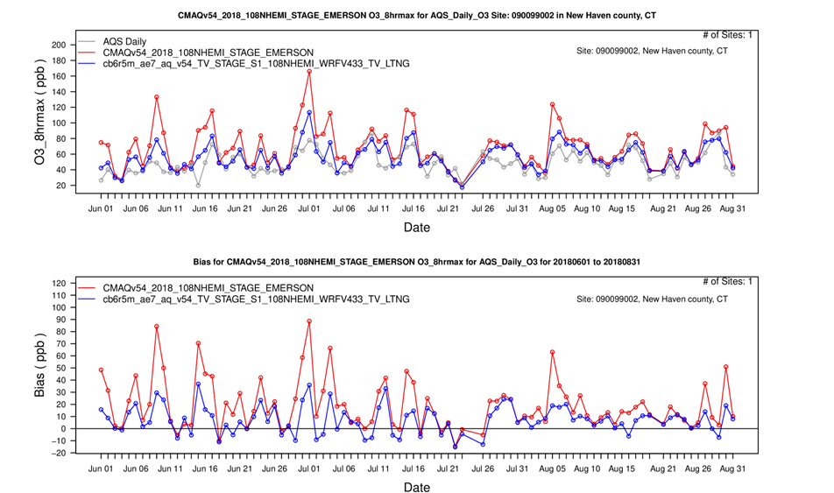
New Haven county, CT
AQS Daily
SPM
TVM
Western US
17
Notes:
Note that we are using 108 km grid spacing and thus comparing model estimations with measurements may not be best methodology for coastal areas since modeled landuse in WRF is water while it is land for the site of AQ measurements. However, to get some insights, we perform this analysis.
(top panel) Surface ozone measurements and corresponding modeled (SPM and TVM) temporal variation during JJA (summer). TVM performs significantly different up to mid-July and even after that TVM differs little when compared to SPM.
(bottom panel): differences (“bias”) are quite big and are clearly visible .
Again, a general note of caution against quantitatively comparing 108 km model results (from any configuration) against coastal monitors. The model (at least when using PX LSM in WRF) represents these grid cells as either being all water or all land. In this case, the model sees this grid cell as all water (with consequently much lower PBL) and yet is still being influenced by anthropogenic emissions occuring in that grid cell, so overpredictions are expected. Model modifications that increase over-water mixing or deposition will lessen the overprediction, but it’s still fundamentally a comparison between different phenomena in the model and observation data. The only way to have a meaningful comparison to such observation data is to dramatically increase model resolution to 4 km or maybe even 1 km

Slide 19
$$\left(\left\{\frac{SPM−TVM}{SPM}\right\}∗100\right)$$
New Haven county, CT
18
Notes:
(top panel): TVM predicts larger friction velocity than the SPM during the first 45 days as indicated by –ve values and maximum can be over 100% at times.
(bottom panel): Similarly, TVM predicts deeper boundary layers than the SPM and at times maximum can be over 100% deeper PBL in TVM.
Thus, significantly lower ozone in TVM is directly related to TVM formulations.
Thus, the big bias reduction in surface ozone in TVM is directly related to TVM formulations that tend to increase wind speeds and mixing over coastal grid cells. This increased mixing reduces ozone concentrations and yields closer agreement with observations at this monitor. It should be noted that while WRF PX LSM considers this grid cell as being covered by water when computing surface fluxes, the underlying fractional land use data indicates that more than 40% of the grid cell is over land and includes significant sources of anthropogenic and biogenic emissions. Therefore, this comparison is meant to illustrate how differences in mixing between SPM and TVM over coastal grid cells can affect ozone predictions, but much higher resolution modeling would be needed to have confidence in the model's characterization of the processes affecting ozone measured at this location.

Slide 20
SUMMARY
Preliminary results from WRF and CMAQ models’ coarse grid simulations indicate that:
For the first time in the history, both the WRF and CMAQ models didn’t use similarity functions and yet successfully produced TVM results comparable to that with SPM.
The new 3-D velocity scale seems to be functional in WRF and CMAQ models at hemispheric scales over different landuse and weather/climate regimes.
New PBL scaling (TVM) seems to produce better meteorology with a mix in ozone trends.
Next, we plan to introduce an advanced particle deposition science in the TVM (Cheng et al., 2022).
Finally, analysis of other chemical species and diagnostic evaluation will be performed.

Slide 21
Thank you for
watching and listening!
Questions/Comments?

Slide 22
Extra slides…
Notes:
Since this is a part-time unfunded research , we picked modeling cases from on-going projects and thus some disconnect between the MET case and AQM case study. If these things work well, then we can do rigorous & consistent tests. but for now, these are tailored for proof of concept to save resources and time expenditure. Now, it is an exciting time to find out whether we can really avoid the 50+ year old practice of using similarity functions!!!

Slide 23
Modeling configurations:
WRF model v4.3.3
CMAQ model v5.4
EPA standard retrospective model setup (KF and ACM2 with PX)
June 20 to August 1, 2018
FDDA and Soil moisture nudge
12 km grids CONUS
Two simulations:
(i) ACM2 and (ii) e* ACM2
CB6r5, AERO7, ACM2
Entire year 2018 (2 weeks spin up into 2017 December)
108 km grids hemispheric
EQUATES emissions
Two simulations:
(i) STAGE and (ii) TV-STAGE
Notes:
Since this is a part-time unfunded research , we picked modeling cases from on-going projects and thus some disconnect between the MET case and AQM case study. If these things work well, then we can do rigorous & consistent tests. but for now, these are tailored for proof of concept to save resources and time expenditure. Now, it is an exciting time to find out whether we can really avoid the 50+ year old practice of using similarity functions!!!

