Slide 1


Application of the hyperdual-step method in CMAQ for the assessment of aerosol formation from volatile chemical products
Jiachen (Ed) Liu, Shannon Capps
Drexel University
22nd CMAS Conference, Chapel Hill, NC

Slide 2
Motivation
Volatile chemical products (VCPs), such as personal care products and coatings, have become a major concern for human health due to direct VOC exposure and secondary organic aerosol (SOA) formation. (McDonald et al., 2018).
Pye et al. (2021a) found that VCPs contribute to one-half of emitted VOCs in 33 industrialized cities.
The focus on further reducing the PM_{2.5} concentrations in the U.S. requires a deeper understanding of VCP emissions and SOA contributions to PM_{2.5} (Qin et al., 2021).

Slide 3
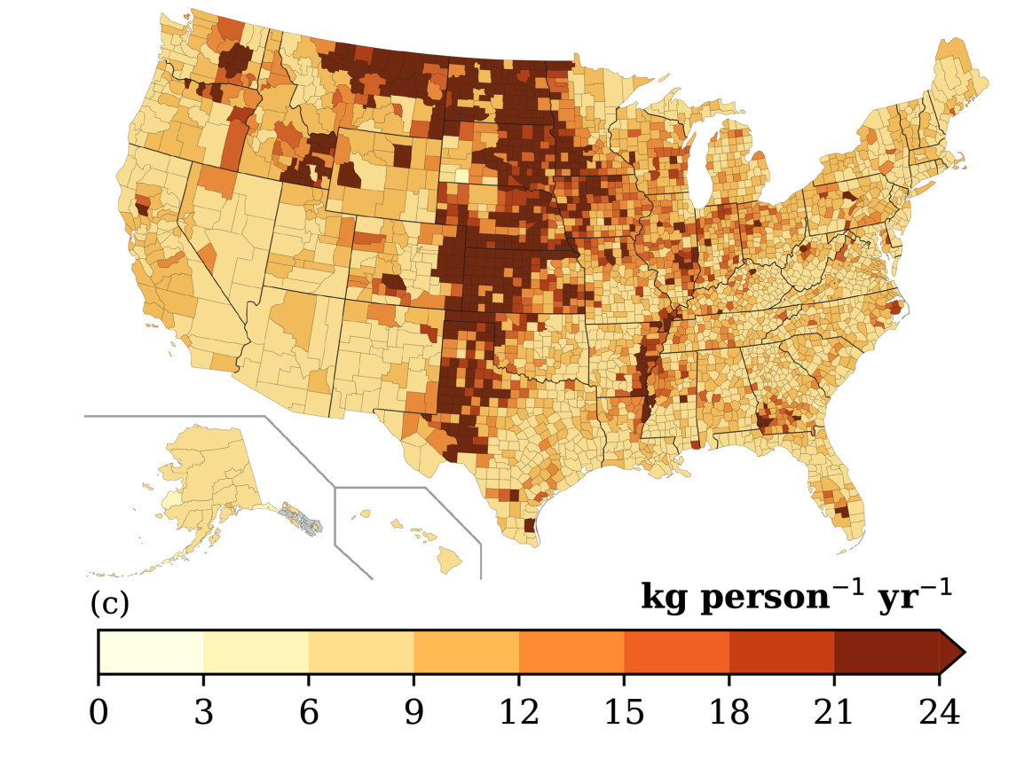
Estimated VCP emissions
Seltzer et al. (2021) developed a new framework, VCPy, to estimate the VCP emissions in CONUS.
The average per-capita emissions from VCPs are 9.5 kg per-person per-year.
VCPs are a dominant source of emissions of VOCs in certain locations.
The nationwide total is broadly consistent with the USEPA’s 2017 National Emission Inventory (NEI); however, county-level and categorical estimates can be different.
county-level per capita VCP emissions from Seltzer et al. (2021)

Slide 4
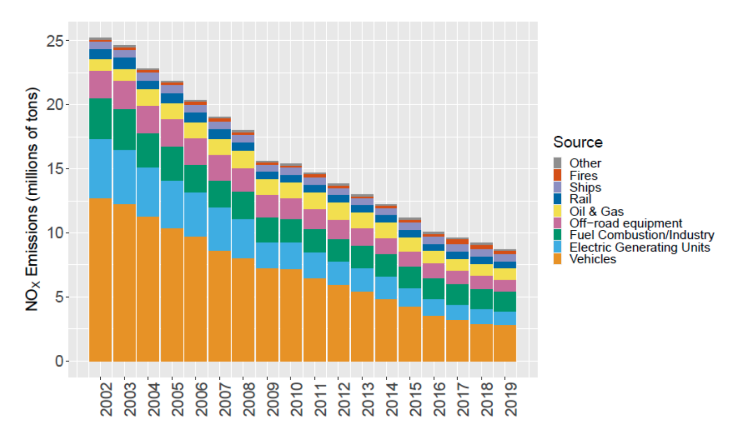
EQUATES modeling platform
EQUATES provides a unified set of modeled meteorology, emissions, air quality and pollutant deposition from year 2002 to 2019 (Foley et al., 2023).
The EQUATES emissions were developed using consistent input data and methods.
Importantly for this work, EQUATES includes VCP emissions following Seltzer et al. (2021).
annual NO_{x} emissions from 2002 to 2019 from Foley et al., 2023

Slide 5


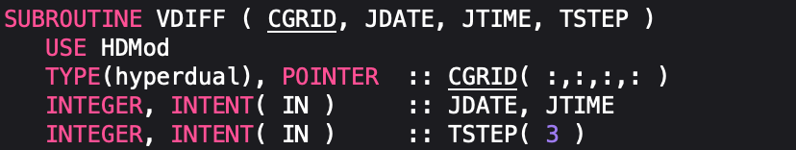
Sensitivity analysis with the
hyperdual-step method
Fike and Alonso (2011) developed the hyperdual-step method to compute first- and second-order derivatives.
The method is an operator-overloading approach similar to the finite-difference approach for computing sensitivities.
The computed sensitivities are numerically-exact, free from subtractive cancellation and truncation errors.
example of hyperdual CMAQ as described
in Liu et al., GMDD, 2023
Notes:
Point 2: instead of a real value perturbation, this perturbs the concentration in the hyperdual space.
Point 3: Due to some special mathematical properties,

Slide 6
Sensitivity analysis with CMAQ-hyd
CMAQ
CMAQ-hyd
emissions
concentrations
emissions
concentrations
Physicochemical Processes
Physicochemical Processes
VOCs
ANO3I
VOCs
ANO3I
NOx
ANO3J
NOx
ANO3J
VCPs
Atmospheric Transport
AAVB
VCPs
Atmospheric Transport
AAVB
NOx, ϵ₁
AAVB, ϵ₁
VCP, ϵ₂
ANO3J, ϵ₁
AAVB, ϵ₂
ANO3I, ϵ₁
ANO3J, ϵ₂
AAVB, ϵ₁₂
ANO3I, ϵ₂
ANO3J, ϵ₁₂
CMAQ-hyd v.5.3.2 has been modified to propagate sensitivities from emissions to concentrations through hyperdual numbers (Liu et al., GMDD, 2023).
ANO3I, ϵ₁₂
sensitivities
Notes:
A lot of stuff are not included for the better viewign

Slide 7
Modeling VCP contributions with CMAQ-hyd
EQUATES emissions
concentrations
point source emissions
CONC
sensitivities
non-VCP gridded emissions
CMAQ-hyd
PM_{2.5}, ϵ₁
AAVB, ϵ₁
PM_{2.5}, ϵ₂
ANO3J, ϵ₁
AAVB, ϵ₂
VCP, ϵ₁
PM_{2.5}, ϵ₁₂
ANO3I, ϵ₁
gridded VCP emissions
ANO3J, ϵ₂
AAVB, ϵ₁₂
VCP, ϵ₂
ANO3I, ϵ₂
ANO3J, ϵ₁₂
ANO3I, ϵ₁₂
The VCP emissions were separated from the merged gridded emissions using date-specific files.
Using CMAQ-hyd, the VCP emissions are perturbed in hyperdual space to obtain first- and second-order sensitivities of all modeled concentrations with respect to total VCP emissions.
Notes:
VCP emissions generated are premerged – need to be separated out from the gridded emission prior to being perturbed

Slide 8
Verifying VCP emissions separation
Total daily gridded CONUS monoterpene emissions in kilograms on Jan 2nd, 2019
VCP gridded emissions (np_solvents)
EQUATES gridded emissions
non-VCP gridded emissions
Notes:
Doesn’t include biogenic ones (calculated online), only from gridded emissions.

Slide 9
Proof-of-concept CMAQ-hyd configuration with VCP emissions
Model configuration
  7:00 PM EST on Jan. 1st , 2019 to 7:00 AM EST on Jan. 2nd, 2019
  Domain: 12US1 grid
  Chemical mechanism: cb6r3_ae7_aq
  Aerosol module: aero7
The concentrations of PM_{2.5} are nearly identical with the hyperdual implementation.
PM_{2.5}
Notes:
Introduce the model configuration.
Main content is the local time (12 hr) Jan 2^{nd, 2019}
Proof of concept model configuration
Chemical mechanism cb6r3_ae7_aq, aero7

Slide 10
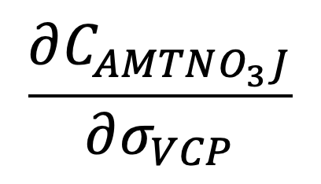
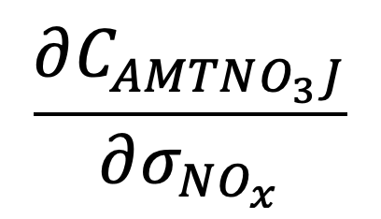
Probing aerosol contributions
of VCPs and NOx
The nighttime formation of accumulation-mode monoterpene nitrate aerosols (AMTNO3J) depends on both monoterpenes from VCP and NO_{x} emissions.
Notes:
These are the first-order sensitivities
These sensitivities are seminormalized, represents the amount of AMTNO3J
Large cities here

Slide 11
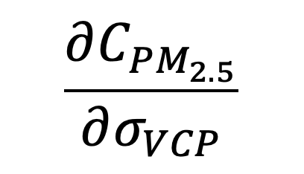
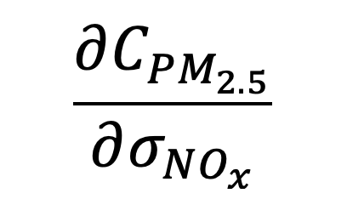
Probing aerosol contributions of VCPs and NOx
In parts of the central US, VCPs react with nitrate to form AMTNO3J, leading to less ammonium nitrate formation, which leads to a slightly negative sensitivity of PM_{2.5} concentration to VCP emissions.
Notes:
The ammonium ANH4J ANH4I have negative
More VCP -> More monoterpene -> more nitrate forming AMTNO3J -> Less nitrate available for ammonium -> Net negative effect in terms of dPM2.5 / dVCP
In parts of eastern US, there is enough nitrate available for both AMTNO3J and ammonium

Slide 12
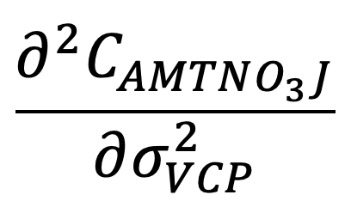
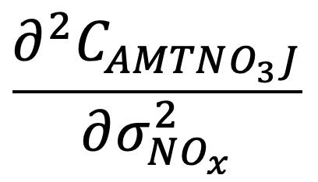
Probing the nonlinearity of aerosol contributions of VCPs and NOx
Notes:
AMTNO3 to VCP -> mostly linear, the second-order is small
AMTNO3 to NOx -> pretty unlinear, especially for southeastern US
Second-order sensitivities negative -> the relationship between numerator and denominator will be concaving down.

Slide 13
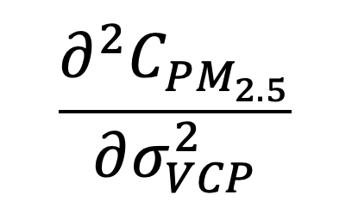
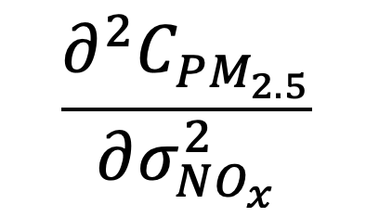
Probing the nonlinearity of aerosol contributions of VCPs and NOx

Slide 14
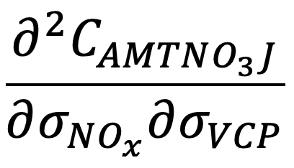
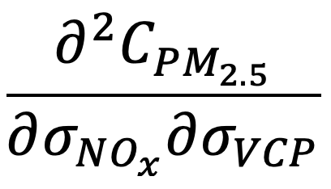
Probing the interdependence of
aerosol contributions of VCPs and NOx
Notes:
Synergistic effect
Negative: reducing Nox will lead to an increase in first-order sensitivity of AMTNO3 with respect to VCP
Positve: reducing NOx will lead to a decrease first-order sensitivity of PM2.5 with respect to VCP

Slide 15
Conclusions & Future Directions
We have developed an augmented version of CMAQ which can compute first- and second-order sensitivities to machine precision.
We plan to run monthly simulations across different seasons.
We also plan to evaluate the health-related impact of VCP emissions based on the calculated sensitivities.

Slide 16
Acknowledgements
Funding: NSF CAREER award (1944669) to Shannon Capps
High-performance computing: Cheyenne (doi:10.5065/D6RX99HX) and Derecho: HPE Cray EX System (https://doi.org/10.5065/qx9a-pg09) provided by NCAR's Computational and Information Systems Laboratory, sponsored by the National Science Foundation.
Emissions Data: Dr. Kristen Foley provided the requisite pre-merged files for the VCP emissions analysis for EQUATES.
Debugging: CMAS Forum

Slide 17
References
Foley, K. M., Pouliot, G. A., Eyth, A., Aldridge, M. F., Allen, C., Appel, K. W., Bash, J. O., Beardsley, M., Beidler, J., Choi, D., Farkas, C., Gilliam, R. C., Godfrey, J., Henderson, B. H., Hogrefe, C., Koplitz, S. N., Mason, R., Mathur, R., Misenis, C., Possiel, N., Pye, H. O. T., Reynolds, L., Roark, M., Roberts, S., Schwede, D. B., Seltzer, K. M., Sonntag, D., Talgo, K., Toro, C., Vukovich, J., Xing, J., and Adams, E. (2023). 2002-2017 Anthropogenic Emissions Data for Air Quality Modeling over the United States. Data in Brief. 109022.
Liu, J., Chen, E., and Capps, S. L.: The first application of a numerically-exact, higher-order sensitivity analysis approach for atmospheric modelling: implementation of the hyperdual-step method in the Community Multiscale Air Quality Model (CMAQ) version 5.3.2, Geosci. Model Dev. Discuss.[preprint], (2023).
Pye, H.O.T., Ward-Caviness, C.K., Murphy, B.N., Appel, K.W., Seltzer, K. M. Secondary organic aerosol association with cardiorespiratory disease mortality in the United States. Nat Commun 12, 7215 (2021).
Qin, M. et al. Criteria pollutant impacts of volatile chemical products informed by near-field modelling. Nat. Sustain. 4, 129–137 (2021).
Seltzer, K. M., Pennington, E., Rao, V., Murphy, B. N., Strum, M., Isaacs, K. K., and Pye, H. O. T. (2021) Reactive Organic Carbon Emissions from Volatile Chemical Products, Atmos. Chem. Phys., 21, 5079-5100.

Slide 18
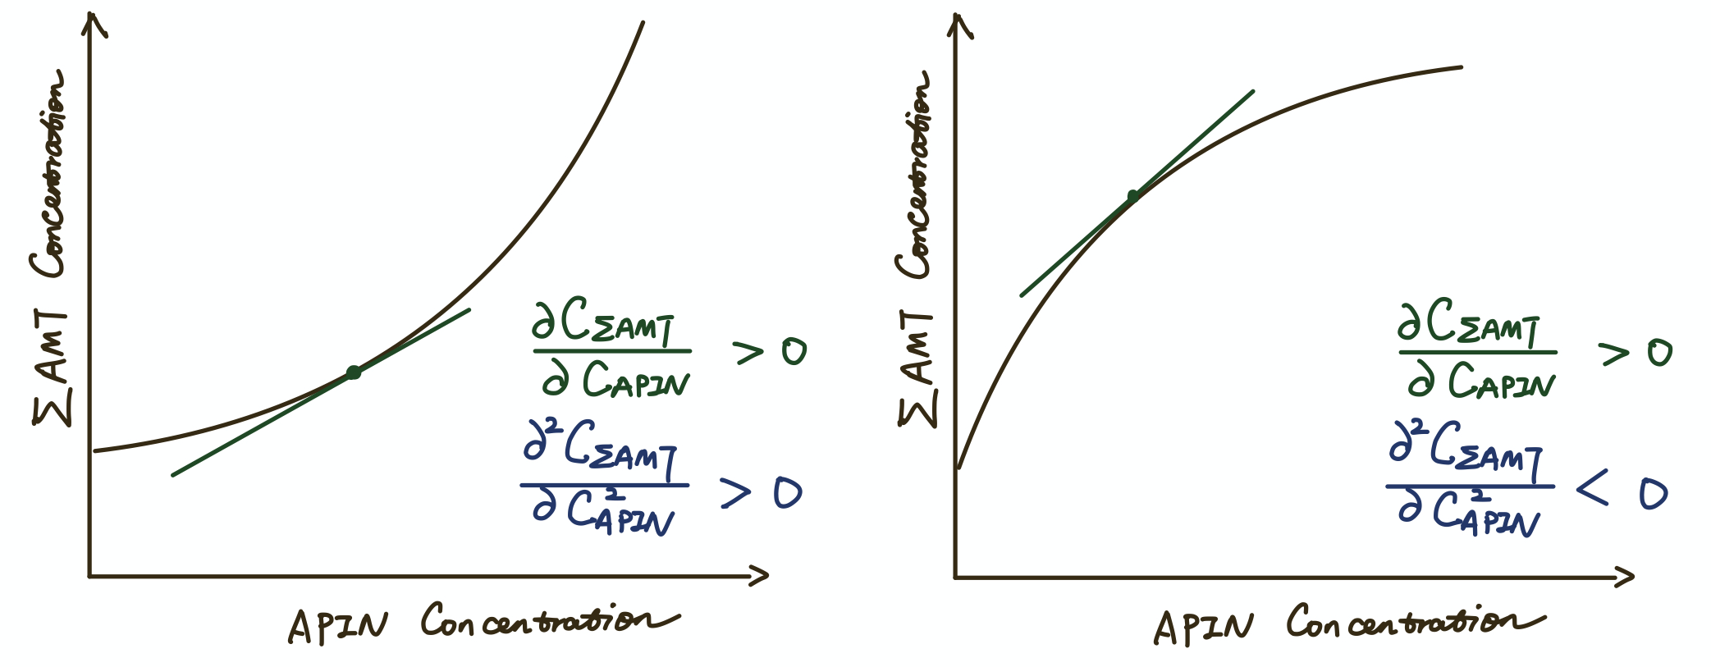
The Physical Meaning of Second-Order Derivatives
If we only consider the first-order sensitivity of a reduction of demominator:
Underestimate the effect
Overestimate the effect
Notes:
More columns are ignored for this figure
- The hybrid method in general agrees with the second-order calculations with e12
- There are definitely outliers in this case: can be attributed to subtractive cancellation or truncation errors
- abs() > 0.5
remove row col information herer
Add DDM slide on

Slide 19
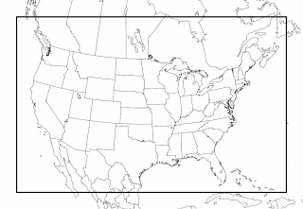
12US1 domain over CONUS: 299 rows x 459 columns x 35 layers

Slide 20


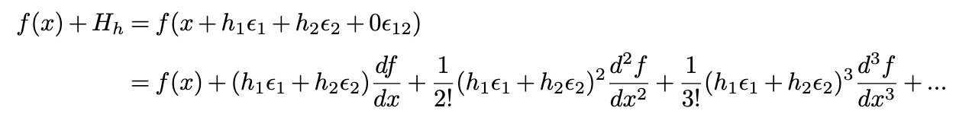
Hyperdual Numbers and the Hyperdual-Step Method
Let’s name the input variable as x₀ and the output variable as f(x₀)
Then, we perturb the input variable with a hyperdual number: H_{h}= h₁ε₁ + h₂ε₂
Expand the equation with Taylor Expansion
Fike & Alonso, 2011

Slide 21
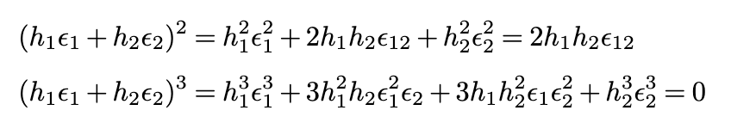

Hyperdual Numbers and the Hyperdual-Step Method
Fike & Alonso, 2011

Slide 22
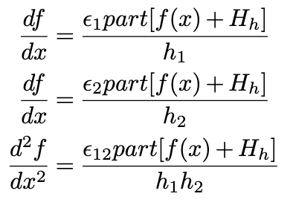
Hyperdual Numbers and the Hyperdual-Step Method
The first-order and second-order sensitivities are separated into different terms.
Both the first- and second-order sensitivities here are exact. All higher-order terms are 0 because of the definition of hyperdual numbers.
Fike & Alonso, 2011

