Slide 1
Evaluation of an Advanced Aerosol Dry Deposition Model
Bin Cheng¹, Kiran Alapaty², Qian Shu², and Saravanan Arunachalam¹
¹Institute for the Environment, The University of North Carolina at Chapel Hill, Chapel Hill, NC
²U.S. Environmental Protection Agency, Research Triangle Park, NC
Presented at
The 21st Annual CMAS Conference, Chapel Hill, NC
October 17-19, 2022
Disclaimer: The views expressed in this presentation are those of the authors and do not necessarily reflect the views or policies of the U.S. EPA.

Slide 2
Introduction
Aerosols (particles) have substantial influences on the air quality, radiative balance of the earth, climate, & ecosystem
More turbulent conditions may lead to higher particle deposition fluxes
Friction velocity (u*) parameter by itself is not adequate to represent strong turbulence effects
Improved estimation of aerosol dry deposition is much needed via efforts (e.g., development & refinement of formulations as well as making needed comprehensive long-term measurements) (Wu et al., 2018)
Particle dry deposition is controlled by various processes including Brownian diffusion, gravitational settling, interception, and impaction
Essential resistances included in a particle dry deposition model are aerodynamic resistance (R_{a}) and surface resistance (R_{b}), both strongly influenced by the strength of the atmospheric turbulence
Empirical formulations are used to enhance turbulence effects on particle deposition; rigorous evaluations are needed and there are opportunities for improving the representation of turbulence effects on particle deposition

Slide 3
Problem Statement & Objectives
Some issues…
Large uncertainties exist in the modeling of particle dry deposition
Turbulence is under-represented in some of the resistances’ formulations
None of the deposition schemes for particles utilize the three-dimensional (3-D) turbulence (i.e., variances of velocity fluctuations) to represent effects of turbulence on deposition
OBJECTIVES
Identify particle deposition formulations and related sub-formulations and improve turbulence representations
Evaluate the performance of these new formulations using available measurements and a single-point model

Slide 4
Introducing New Turbulence Parameters for Particle Deposition
Wesely et al. (1985) introduced a convection factor (W_{f}) to increase V_{d} via R_{b} term to match with measurements since u* alone can’t represent strong convection impacts on particle deposition as turbulence is underrepresented in R_{b}
Convection factor (W_{f}) was written as:
W_{f} was not validated by any measurements or intercompared with similar factor
We propose another factor, turbulence factor, T_{f} , based on a new turbulence velocity scale
Wesely et al. (1985) stated that convective motions in the PBL have nonlinear influence on particulate sulfate deposition velocity
There seems to be a physical connection between convective velocity in the PBL and the friction velocity in the surface layer influencing particle deposition velocity
Wesely et al. (1983) suggested that this connection might lead to rapid multidirectional flow around surface elements and thus a connection between buoyancy and horizontal flows.
They also stated that σ_{v} is more strongly correlated to enhanced particle deposition than σ_{u}
Accordingly, we gave more weight to the σ_{v} coefficient than σ_{u} coefficient in the development of a new turbulence factor
$$W_{f}=0.24\frac{w_{∗}^{2}}{u_{∗}^{2}}$$

Slide 5
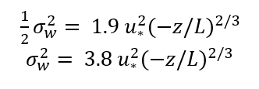
New Turbulence Parameters
(He and Alapaty, 2018)
$$T_{f}=\frac{σ_{v}^{2}+σ_{w}^{2}}{σ_{u}^{2}}$$
Then, Turbulence Factor
$T_{f}=\frac{σ_{v}^{2}+σ_{w}^{2}}{σ_{u}^{2}}= \frac{\left(5.32u_{∗}^{2}+0.44w_{∗}^{2}\right)+ \left(3.8u_{∗}^{2}{(−z/L)}^{2/3}\right)}{2.28u_{∗}^{2}}$ to replace W_{f}

Slide 6
Introducing Effective Sedimentation Velocity & Effective Stokes Number
$${ V}_{g} =\left(\frac{g{Cρ}_{p}d_{p}^{2}}{18 μ}\right)$$
Sedimentation velocity,
a.k.a. gravitational settling velocity,
terminal velocity, etc…
Downdraft of eddies will bring particles down faster, which is not modeled in the V_{g}
To include turbulence effects, we propose effective ${ V}_{g}$ as, ${ V}_{ge}$
$$\left.{ V}_{ge}=V_{g}{\left(1+ I\right.}_{t}\right)=\left(\frac{g{Cρ}_{p}d_{p}^{2}}{18 μ}\right) \left(1+ I_{t}\right)$$
Intensity of turbulence: $I_{t}= \frac{e_{∗}}{U}$
Stokes number is defined as ratio of particle response time scale & time scale of flow, thus, St number is good for neutral conditions
Smooth surfaces:$St =\frac{V_{g }u_{⋆}^{2}}{gν}$
Vegetated surfaces: $St=\frac{V_{g }u_{⋆}}{gA}$
We define effective St number that is good for all PBL conditions; by using $u_{⋆}$ = k $e_{⋆}$, Effective Stokes Number (St_{e}) is written as:
${St}_{e}=\frac{V_{ge }{k^{2}e}_{⋆}^{2}}{gν}= \frac{\left(1+I_{t}\right)V_{g}{{ k}^{2}e}_{⋆}^{2}}{gν}$ Smooth
${St}_{e}=\frac{V_{ge }ke_{⋆}}{gA}=\frac{{(1+I_{t})V}_{g }ke_{⋆}}{gA}$ Vegetated

Slide 7
The Z01 and New C01 Schemes
Zhang et al. 2001 scheme = Z01-B (CAMx)
Proposed New scheme = C01
$$R_{a}=\frac{1}{{ku}_{∗}}\left( ln\left[\frac{z_{r}}{z_{0}}\right]− Ψ_{H}\right)$$
$$R_{a}=\frac{1}{{e_{∗}k}^{2}}ln\left[\frac{z_{r}}{z_{0}}\right]$$
C01-E
$$R_{b}= \frac{1}{{ε_{0}ke}_{⋆}\left(E_{B}+E_{IMe}+E_{IN}\right)R_{1e}}$$
$$R_{b}= \frac{1}{ε_{0}u_{⋆}\left(E_{B}+E_{IM}+E_{IN}\right)R_{1}}$$
C01-ETF
$$R_{b}= \frac{1}{{\left(1+T_{f}\right)ke}_{⋆}\left(E_{B}+E_{IMe}+E_{IN}\right)R_{1e}}$$
$$R_{1}= e^{−\sqrt{S_{t}}}$$
$R_{1e}= e^{−\sqrt{S_{te}}}$
$$E_{B}= S_{c}^{−γ}$$
$$E_{B}= S_{c}^{−γ}$$
$$E_{IM}= {\left(\frac{S_{t}}{α+S_{t}}\right)}^{2}$$
$E_{IMe}= {\left(\frac{S_{te}}{α+S_{te}}\right)}^{2}$
$$E_{IN}= \frac{1}{2}{\left(\frac{d_{p}}{A}\right)}^{2}$$
$$E_{IN}= \frac{1}{2}{\left(\frac{d_{p}}{A}\right)}^{2}$$
$$V_{d}=V_{g}+\frac{1}{R_{a}+R_{b}}$$
$$V_{d}=V_{ge}+\frac{1}{R_{a}+R_{b}}$$

Slide 8
Single-Point Particle Dry Deposition Model
Numerical model used in this study is the same single-point model (DepoBoxToolv1.0) that was used by Shu et al. (2022) to test different particle dry deposition schemes for different land use
DepoBoxToolv1.0 was configured as an open-source Python tool, which can be easily modified to incorporate updates on the dry deposition schemes
Models.py: all the deposition schemes
functions.py: basic functions
eval_luc.py: land category definition and parameterization
The source code and required model inputs can be downloaded from the GitHub source (https://github.com/shumarkq/DepoboxTool/tree/master) & Zenodo open data repository (http://doi.org/10.5281/zenodo.4749636)

Slide 9
Measurements and Numerical Simulations
A field experiment at an alpine forest site in the foothills of Mt. Asama in central Japan was conducted on July 2-8, 2009 (5.5 days -132 data points)
PM_{2.5} sulfate fluxes were estimated as the product of four-hour averaged transfer velocity between two measurement heights (21 & 27 m) and conc. difference at these heights
Sulfate particle density was set as ρ = 1500 kg m⁻³, and the PSD was characterized by d_{pg} = 0.48 μm, and geometric standard deviation (𝜎_{g}) = 1.7
The PSD was assumed to be discrete size bins for 100 bins
Model simulations were performed for 132 hours (5.5 days)
Results are shown in chunks of four-hour intervals
(hourly values are also analyzed)

Slide 10
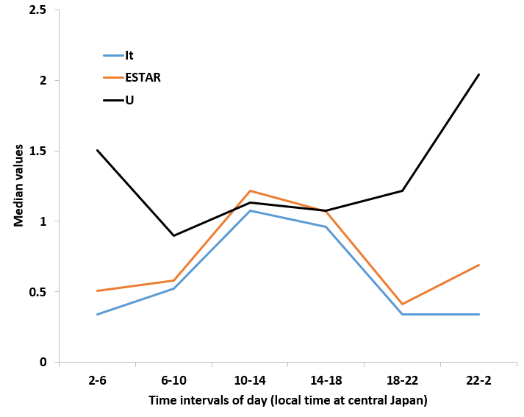
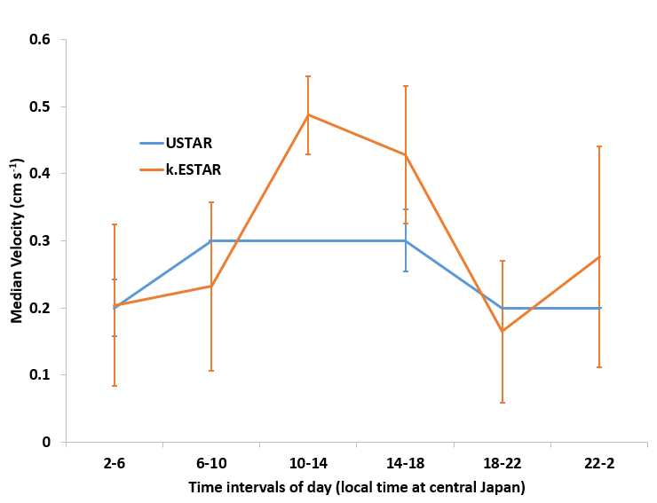
Results and Discussion 1 of 3
The $e_{∗}$includes the contribution by the surface sensible heat flux to the turbulence, showing a variability like heat flux during daytime
I_{t} varies from 0 to about 1, usage of I_{t} in equations for V_{g} & St not only introduce diurnal variability but also an increase in magnitudes of such estimations
The measured wind speeds (U) are higher during nighttime than during daytime reflecting trends in $e_{∗}$ during nighttime
$u_{∗}$ confined between 0.2 and 0.3, thus, the usage of $u_{∗}$ without a stability function underrepresents turbulence in formulations
The advantage of $e_{∗}$ is that it includes buoyancy and shear forces & thus responsible for large diurnal variation
Part-1 (Alapty) talk proved that the product of k & $e_{∗}$ can successfully replace $u_{∗}$ measured by 3-D sonic anemometer

Slide 11
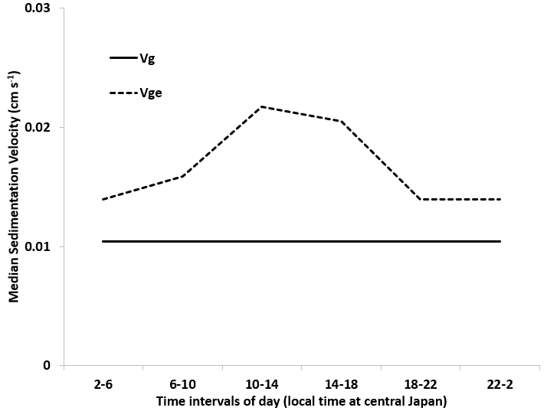
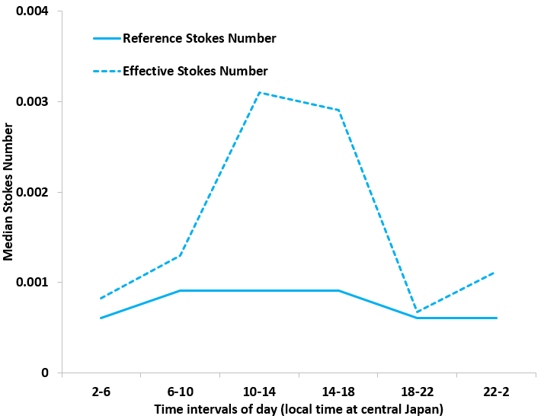
Results and Discussion 2 of 3
For the chosen particle diameter, sedimentation velocity is constant & is independent of time
With the usage of I_{t}, turbulence effects are reflected in the effective sedimentation velocity estimation, showing a diurnal variation
The maximum median V_{ge} is about 2 times of V_{g} & for all days of simulation V_{ge} has been always higher than V_{g} irrespective of PBL stability regimes
Variability for the St is solely dictated by the variation of $u_{∗},$other parameters are constant
The St_{e} estimation is controlled by both the V_{ge} and $e_{∗}$ & thus the net impact of these parameters has introduced increased diurnal variability accounting for diurnally varying turbulence
The St_{e} is always higher than St for all PBL conditions & since R_{b} estimation depends on the magnitude of Stokes number, its magnitude will also be affected

Slide 12
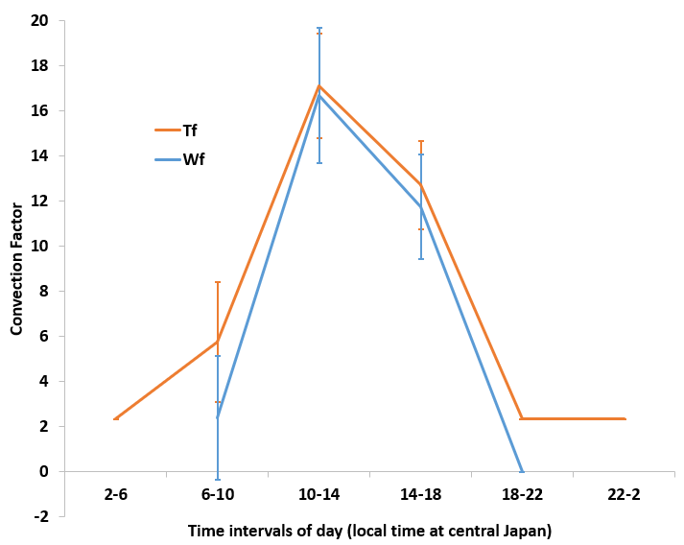
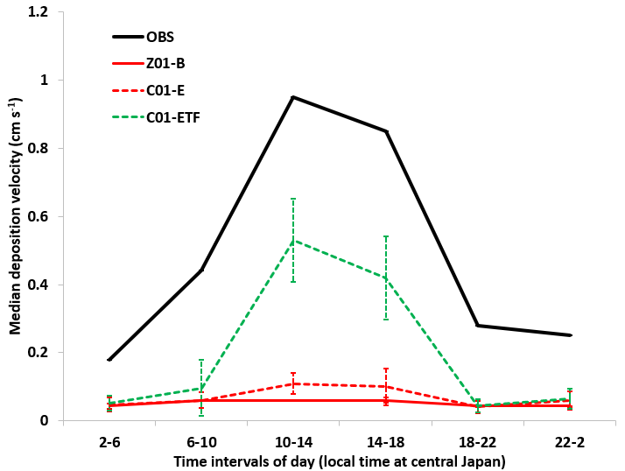
Results and Discussion 3 of 3
For nighttime (SBL), W_{f} is not applicable (set to zero) while T_{f} is non-zero by design, thus, during nighttime, R_{b} estimations using T_{f} will be lower as compared to using W_{f}
T_{f} is always higher than W_{f} and thus turbulence effects are stronger in formulations where T_{f} is used as compared to that with W_{f}
Median V_{d} for OBS ranges from about 0.2 to 1 cm s⁻¹ with maximum occurring at time interval 1000 to 1400 LT, & measured V_{d} values were significantly higher during daytime than nighttime due to convective conditions in PBL
All schemes underestimated V_{d} when compared to corresponding measured values, both Z01-B and C01-E didn’t capture strong diurnal variation found in measured V_{d} while C01-ETF predicted relatively stronger diurnal variation with higher deposition velocities during daytime

Slide 13
CMAQ Scheme
S21-B scheme (Pleim & Ran, 2011)
C21-ETF scheme (S & M)
$$R_{a}=0.95\frac{\ln\left(\frac{Z_{R}}{Z_{0}}\right)−Ψ_{H}}{ku_{⋆}}$$
$$R_{a}=0.95\frac{\ln\left(\frac{Z_{R}}{Z_{0}}\right)}{κ^{2}e_{⋆}}$$
$$R_{b}={\left[\left.\begin{aligned}\left(1+f_{veg}\left(max\left(LAI−1,0\right)\right)\right)∗ \\ \left(1+W_{f}\right)∙u_{⋆}\left(E_{B}+E_{IM}\right.\end{aligned}\right)\right]}^{−1}$$
$$R_{b}={\left[\left.\begin{aligned}\left(1+f_{veg}\left(max\left(LAI−1,0\right)\right)\right)∗ \\ \left(1+T_{f}\right)∙{ke}_{⋆}\left(E_{B}+E_{IMe}\right.\end{aligned}\right)\right]}^{−1}$$
$$T_{f}=\frac{σ_{v}^{2}+σ_{w}^{2}}{σ_{u}^{2}}=$$
$$\frac{\left(5.32u_{∗}^{2}+0.44w_{∗}^{2}\right)+ \left(3.8u_{∗}^{2}{(−z/L)}^{2/3}\right)}{2.28u_{∗}^{2}}$$
$W_{f}=$ $0.24\frac{w_{∗}^{2}}{u_{∗}^{2}}$
$$E_{IN}= 0$$
$$V_{d}=\frac{V_{g}}{1−e^{−\left(R_{a}{+R}_{b}\right)V_{g}}}$$
$$V_{d}=\frac{V_{ge}}{1−e^{−\left(R_{a}{+R}_{b}\right)V_{ge}}}$$

Slide 14
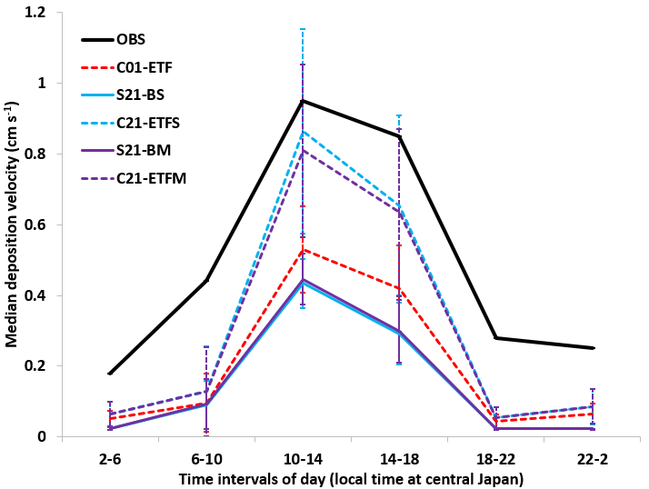
Simulation Results from S21 and C21 Formulations
The C21 scheme (i.e., C21-ETFS and C21-ETFM) performed better than all other 3 schemes (i.e., C01-ETF, S21-BS, and S21-BM)
The minor differences between simulated V_{d} for sectional and modal approaches of S21 and C21 schemes can be attributed to the type of representation of aerosol size distribution methodologies used
All schemes underestimated V_{d} during nighttime while C21 schemes performed marginally better than other schemes
Diurnal variation of median dry deposition velocity

Slide 15
Summary
Introduced three turbulence parameters:
(1) a new turbulence velocity scale in the place of friction velocity
(2) intensity of turbulence
(3) a new turbulence factor
Introduction of three turbulence parameters into the Zhang and CMAQ schemes significantly improved the model performance and predicted stronger diurnal variation of V_{d} though it is still underpredicted when compared to measured V_{d}
These three parameters either introduced or added more diurnal variability to processes and subprocesses during daytime due to the strong diurnal variability of these three turbulence parameters
Better quality and comprehensive meteorological and particle measurements are still needed in the future to further validate the fidelity of the new schemes used in this research

Slide 16
Selected References
1. Wu, Z., Schwede, D. B., Vet, R., Walker, J. T., Shaw, M., Staebler, R., and Zhang, L.: Evaluation and intercomparison of five North American dry deposition algorithms at a mixed forest site, Adv. Model Earth Syst., 10, 1571–1586, doi:10.1029/2017MS001231, 2018.
2. He, J. and Alapaty, K.: Precipitation partitioning in multiscale atmospheric simulations: impacts of stability restoration methods, J. Geophys. Res.: Atmos., 123, 185-10, doi.org/10.1029/2018JD028710, 2018.
3. Shu, Q., Murphy, B., Schwede, D., Henderson, B. H., Pye, H. O. T., Appel, K. W., Khan, T. R., & Perlinger, J. A. (2022), Improving the particle dry deposition scheme in the CMAQ photochemical modeling system. Atmospheric Environment. 289: 119343.
4. Wesely, M. L., Cook, D., & Hart, R. L. (1983). Fluxes of gases and particles above a deciduous forest in wintertime. Boundary-Layer Meteorology, 27(3), 237−255.
5. Wesely, M. L., Cook, D. R., & Hart, R. L. (1985), Measurements and parameterization of particulate sulfur dry deposition over grass. Journal of Geophysical Research: Atmospheres, 90(D1), 2131−2143.
Acknowledgments
This work has been benefitted by the reviews provided by: Drs. Christian Hogrefe, Zhiyong Wu, Ben Murphy, and Sergey Napelenok
Our sincere appreciation goes to AQMEII4 Dry Deposition modeling group for sharing data and general group discussions
Inspired by papers published by Drs. Jesse Bash, John Walker, Christian Hogrefe, Jon Pleim, Qian Shu, Rick Saylor (NOAA), and Donna Schwede and many other papers from the literature
Our sincere gratitude goes to Mr. John M. Southerland, Jr. for supporting this research

Slide 17
Thank you!
Any questions?

Slide 18
Equations used to represent several processes in each of the schemes

Slide 19
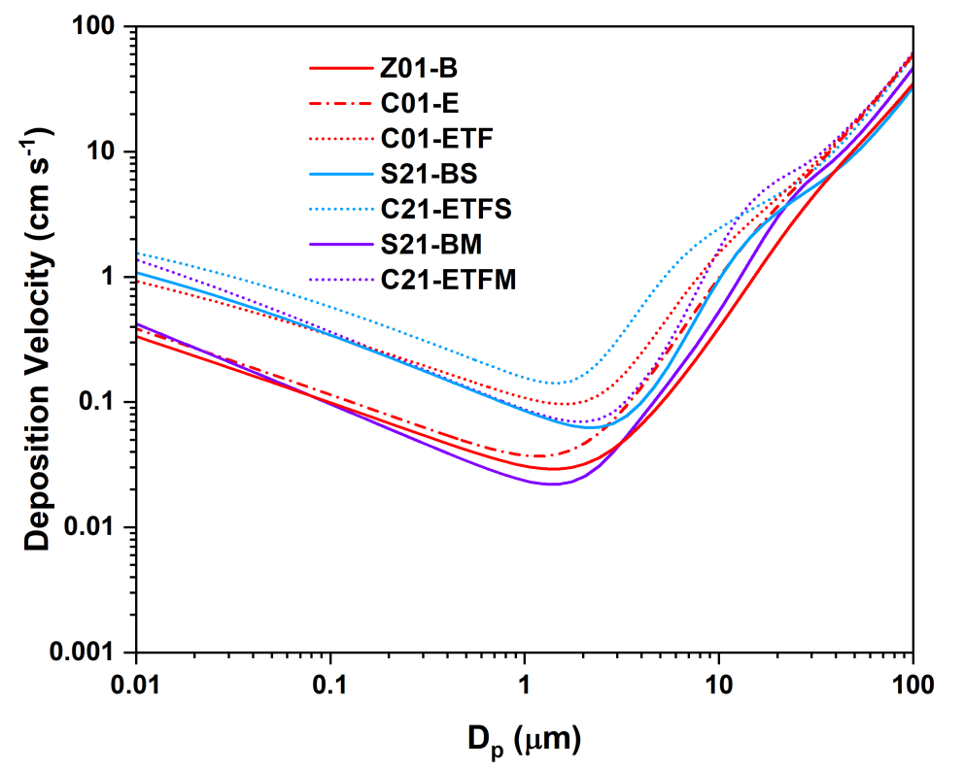
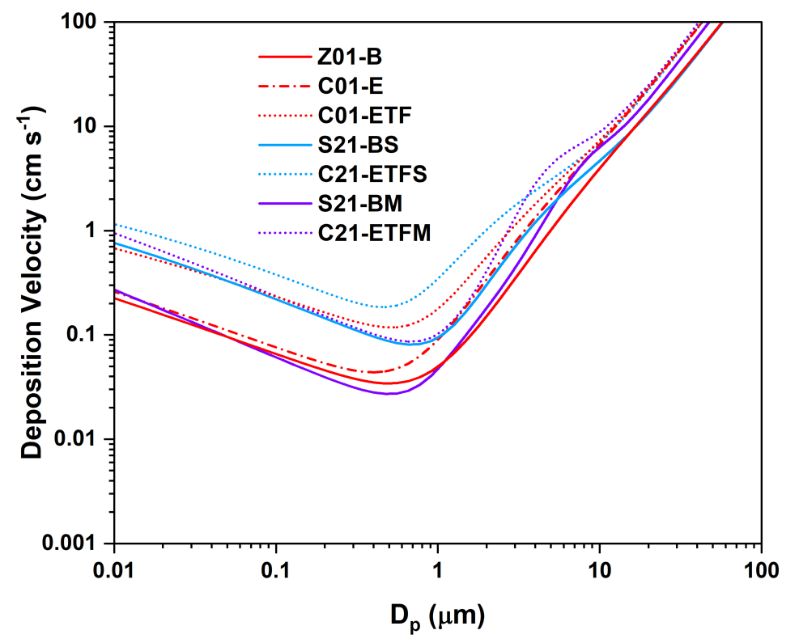
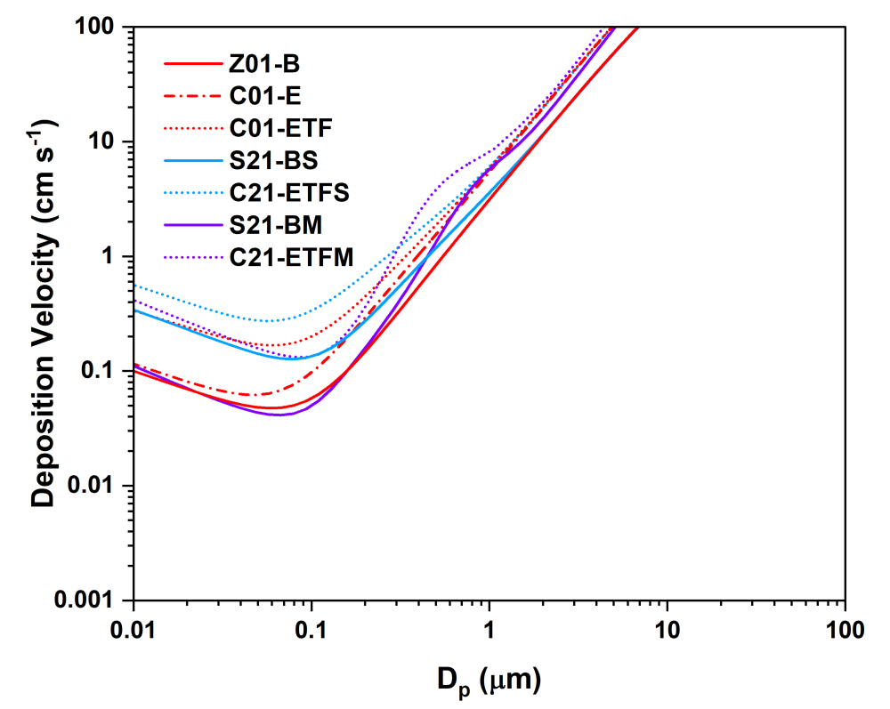
The comparison of simulated V_{d} across schemes is not σ-dependent because all schemes exhibit consistent patterns as σ changes
When sigma is increased from 1.01 to 2.5, the V_{d} trends for all schemes shift to the left, bringing the minimum V_{d} from 2 to 0.1 microns
$$σ= 1.01$$
$$σ= 1.7$$
$$σ= 2.5$$

Slide 20
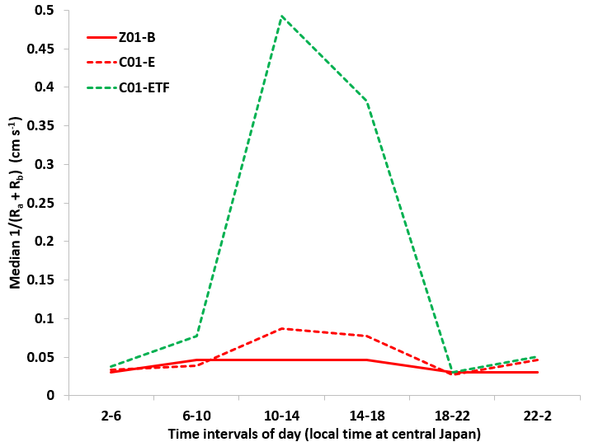
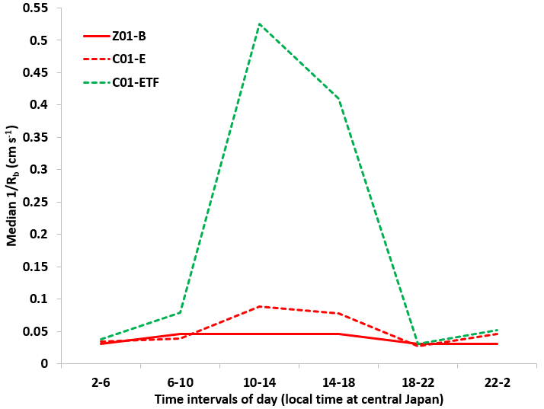
Results and Discussions
Introduction of T_{f} & $e_{∗}$ into the Z01 scheme has increased boundary layer conductance in C01-ETF and resulted in the better model performance of estimating V_{d}
R_{b} is the driving force for the V_{d}

Slide 21
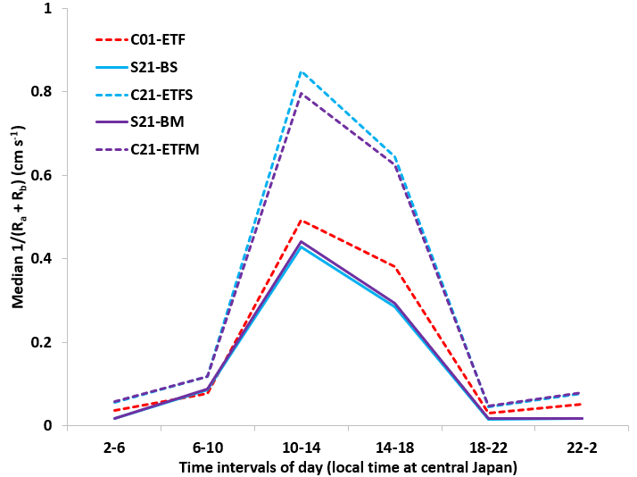
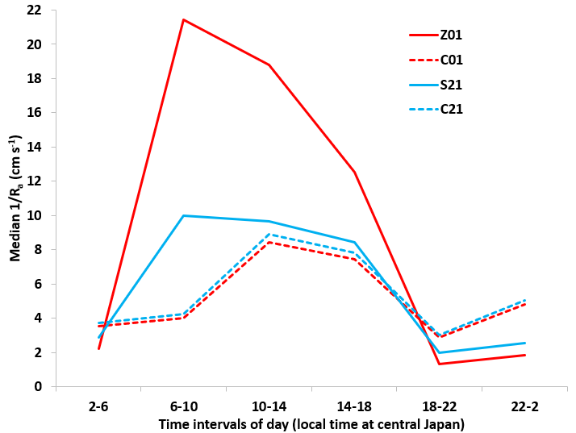
Simulation Results from S21 and C21 Formulations
Since contribution by V_{g} is smaller compared to other terms in V_{d} estimation, total conductance magnitude and its temporal variation is very similar to that in V_{d}
The median 1/R_{a} for Z01 scheme is higher than other schemes and this is because S21 used a different stability function – which is a source of differences and can be avoided by using our new R_{a} formulation, that is one of the objectives of the research

