Slide 1
Examining the Air Quality Co-benefits of Two Alternative Future Emission Scenarios Modeled in GCAM-USA version 5.4
U. Shankar¹, B. Murphy¹, M. Weber², Y. Ou², S. J. Smith², D. H. Loughlin¹, and C. G. Nolte¹
¹Office of Research and Development, U.S. Environmental Protection Agency, RTP, NC, USA
²Joint Global Change Research Institute, Pacific Northwest National Laboratory, College Park, MD, USA
21st Annual CMAS Conference
October 17-19, 2022
Chapel Hill NC
Office of Research and Development
Health and Environmental Effects Assessment Division
Notes:
I am presenting results from ongoing research on modeling the air quality impacts of future energy scenarios as the companion talk to the one that you just heard by Dr. Loughlin.. 0:19

Slide 2
Motivation
State and regional air quality (AQ) managers must demonstrate compliance with the NAAQS for O₃, PM, NO_{x}, etc., on an ongoing basis
Many states have adopted comprehensive greenhouse gas (GHG) mitigation targets to reduce the impacts of climate change
Options such as renewable electricity and energy efficiency are seen to offer co-benefits in reducing the emissions of air pollutants such as NO_{x} and SO_{x} co-emitted with GHGs
The Global Change Analysis Model (GCAM) can produce scenario-, state-, technology- and pollutant-specific air pollutant emission projections
Research objective:
Link GCAM to a comprehensive air quality model and quantify the co-benefits of GHG mitigation strategies to air quality.
Office of Research and Development
Health and Environmental Effects Assessment Division
Notes:
Slide 2: This work is motivated by the fact that air quality management demonstrating compliance with the NAAQS for criteria air pollutants, ozone, PM and NOx have found that adopting comprehensive greenhouse gas mitigation targets, such as renewable electricity and energy efficient buildings provide air quality co-benefits to meeting the NAAQS in conjunction with more standard air pollution control measures. The Global Change Analysis Model provides a means to this end. It is a technology-rich human-earth system model to simulate energy supply, demand and impacts in which technologies are allowed to compete for market share based on their relative prices, subject to additional modeled constraints. While GCAM is primarily used to examine scenarios for reducing emissions of CO₂ (and in later versions, CH₄ and N₂O), the model also produces scenario-, region-, technology- and pollutant-specific emissions of air pollutants co-emitted with GHGs. Our research objective then is to link the GCAM to a comprehensive air quality model, to quantify the air quality co-benefits of specific GHG reduction scenarios. In this application we run GCAM-USA described next. 1:20

Slide 3
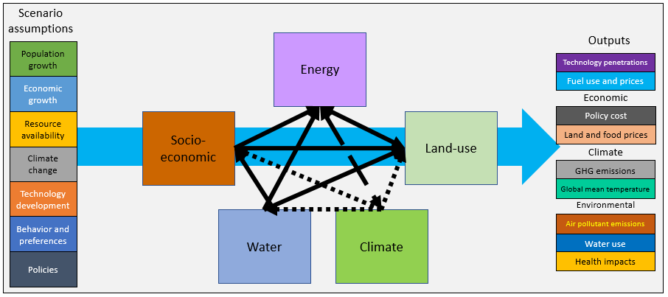
Estimating air quality impacts of future energy scenarios
GCAM-USA
Developer: PNNL
Availability: Open Source, free
Platforms: Windows, Mac, Linux
Run-time: 1-5 hours
Spatial coverage: global
Spatial resolution: 31 global
regions + 50 US states + DC
Temporal range: 2010 - 2100
Temporal resolution: 5-years
Emissions:
GHGs: CO₂, CH₄, N₂O
Air pollutants: NO_{x}, SO₂, VOC, PM, CO, NH₃
CMAQ
Air quality
assessment, decisions
Emissions
Concentrations
Challenge:
Translating GCAM-projected emissions into hourly CMAQ inputs
Office of Research and Development
Health and Environmental Effects Assessment Division
Notes:
In this work we have the main ingredients to meet out research objective, namely the energy system model and the air quality simulation model. The challenge is how best to translate the annual emissions of air pollutants from GCAM efficiently to the spatial and temporal scale needed for CMAQ simulations to examine hourly air pollutant concentrations and assess the impacts of the driving energy scenario. 0:33

Slide 4
Estimating air quality impacts of future energy scenarios
GCAM-USA
CMAQ
Air quality
assessment, decisions
Emissions
DESID
Concentrations
Approach:
Develop state-, sector- and pollutant-specific growth factors in GCAM
Use in CMAQ’s DESID module to estimate future emissions
Office of Research and Development
Health and Environmental Effects Assessment Division
Notes:
The recent development of the DESID module in CMAQ helps us meet this challenge. For each energy scenario in GCAM, we use GCAM output to develop state-, sector- and pollutant-specific growth factors of emissions and then use them to scale the emissions in CMAQ-DESID from a base year of 2015 to the respective 2050 scenario. So, what is DESID? 0:27

Slide 5
CMAQ DESID* Module
DESID: Detailed Emission Scaling, Isolation and Diagnostic module
Allows user to scale emissions from a baseline value in CMAQ by region, sector, and pollutant
Advantages
Avoids overhead in reprocessing sectoral emissions for each future scenario in SMOKE
A flexible and efficient way to analyze the potential impacts of longer-term energy production and consumption choices
* Murphy, B. et al., GMD, 2021
Office of Research and Development
Health and Environmental Effects Assessment Division
Notes:
The Detailed Emission Scaling, Isolation and Diagnostic module in CMAQ was developed by Murphy et al. and published in GMD last year. Its primary purpose is scaling emissions at the region, sector and pollutant level, without the overhead of processing emissions over the whole domain for multiple sectors to examine the impacts of a particular emissions change scenario. It is an efficient way to ingest the emissions projections into the future from a model like GCAM and analyze the air quality impacts. It allows sectors to be kept separate in the scaling, important for understanding the relative AQ impacts of various sectors. 0:45

Slide 6
Illustrative Application
Two energy scenarios were run in GCAM-USA v5.4
ref50: a reference case that reflects continuing current legislation through 2050
80x50: a mitigation scenario requiring an 80% reduction 2010-2050 in total CO₂ emissions
Emissions for the CMAQ 2015 base year (baseyr) are from EQUATES*
GCAM emissions were aggregated to the existing EQUATES categories
Most GCAM emission categories map directly to EQUATES emission sectors
Growth factors for oil and gas operations are national averages, applied to all states in an aggregated ‘oilgas’ sector
Include refinery and pipeline emissions
*EPA’s Air Quality Time Series Project, Foley et al., Presentation #2588, 20th Annual CMAS Conference. Also see https://www.epa.gov/cmaq/equates.
Office of Research and Development
Health and Environmental Effects Assessment Division
Notes:
In this initial application of this system, we are simulating two energy scenarios in GCAM, a reference scenario that continues current energy legislation to 2050, labeled ref50, and a mitigation policy that reduces CO₂ by a total of 80% by 2050 relative to the 2010 reference year, labeled 80x50. We use these to scale 2015 emissions developed for the EPA Air Quality Time Series project (Foley et al., 2022). Several GCAM sectors had to be aggregated to the existing sectors in EQUATES. Oil and gas scaling for conversion processes (gas-, coal- and biomass-to-liquid) uses USA-average scaling factors in every state due to large uncertainties in state-specific values. 0:58
ref50 scenario does not include explicit representation of air, climate and energy policies but DOES include (1) Regional Greenhouse Gas Initiative (RGGI); (2) Sec 177 ZEV targets; (3) LDV near-term GHG emission rule; (4) Tier 3 standards to reduce air pollution from on-road mobile sources; (5) Various NSPSs and (6) Production and Investment Tax Credits (PTC and ITC) for renewable energy production. This has the effect of respectively reducing the levelized cost of production per GJ ~ for wind ($4.81), geothermal ($8.71) and for biomass ($4.62) technologies, and a 12-30% credit for capital costs of a renewable energy project, modeled in GCAM v5.4 as a reduction in the fixed charge rate. Does NOT include IRA, state-level CO2 reduction targets or COVID-19 impacts on energy demands.

Slide 7
GCAM-to-CMAQ Sector Mapping
GCAM Source Sector |  | CMAQ Emissions Stream
Electricity generation from all non-biomass fuels |  | ptegu
Electricity generation from biomass Industrial energy use and feedstocks Cement, fertilizer, and H₂ production |  | ptnonipm
Unconventional oil production, oil refining, gas pipelines Gasification, coal-to-liquids, and biomass-to-liquids |  | oilgas
All commercial and residential sectors except residential wood heating Regional biomass production for bioenergy and biofuels |  | nonpt
Residential wood heating |  | rwc
Onroad heavy-duty freight vehicle |  | onroad_diesel
Onroad light-duty vehicles and buses |  | onroad_gas
Domestic and international aviation |  | airports
Nonroad passenger and freight rail transport |  | rail
Domestic shipping |  | pt_cmv_c1c2_12
International shipping |  | pt_cmv_c3_12
Office of Research and Development
Health and Environmental Effects Assessment Division
Notes:
Many GCAM source categories relevant for tracking energy flow are collapsed into single EQUATES emission streams. These mappings mostly follow what is recommended by OAQPS for mapping emissions into nonpt and ptnonipm source categories. Several GCAM industrial categories have been mapped to ptnonipm. All residential and commercial energy use except residential wood combustion are mapped to nonpt, as well as regional biomass production for biofuel and bioenergy feedstock. Also, many vehicle classes of light-duty vehicles tracked separately in GCAM are mapped to onroad_gas in EQUATES. In the EQUATES emissions inputs both this category and onroad_diesel are disaggregated between California and the rest of CONUS. 0:59

Slide 8
Methods: Bridging GCAM and CMAQ
An R script was developed to link GCAM v5.4 outputs to DESID
Calculates scale factors (SF)* for each 2050 scenario from GCAM emissions outputs
*SF = GCAM future-year (FY) emissions ÷ GCAM base-year (BY) emissions
Generates the CMAQ Emissions Control name list file (.nml) including these factors in emission scaling “rules” for each emissions stream, region and pollutant
DESID calculates CMAQ emissions for the future scenario:
CMAQ Emissions_{FY} = SF x CMAQ Emissions_{BY}
CMAQ emission surrogate species from R Script:
CO, NO_{X}, VOC, NH₃, SO₂, PM_{2.5} and PMC
VOC, PM_{2.5} emissions further speciated under chemical family names in the .nml file:
20 VOC species (for the cb6r3_ae7_aq mechanism in CMAQ)
18 primary PM_{2.5} components (consistent with default aerosol composition specified in the base year)
Office of Research and Development
Health and Environmental Effects Assessment Division
Notes:
We developed a bridge script in R to transform the GCAM output into scaling factors written to the emission control file read by the DESID module. The scaling factor is just the ratio of 2050 emissions to 2015, calculated for each pollutant and aggregate emission sector for each state and the District of Columbia. The chemical family definition in DESID is used to apply the scaling factor calculated from GCAM for VOC and PM2.5 to all their respective constituents. PMC isn’t output directly by GCAM but is derived as the difference of PM₁₀ and PM_{2.5} with a floor value of 0. Due to differences in methods of estimating BC, OC and PM_{2.5} emissions in GCAM, CMAQ inputs for elemental and organic carbon emissions use the same scaling as PM_{2.5} (using DESID’s chemical family name definitions). 1:07

Slide 9
CMAQ Emission Control Name List File Sample
EM_NML=
! Region | Stream Label |Emission | CMAQ- |Phase/|Scale |Basis |Op
! Label | |Surrogate| Species |Mode |Factor| |
'TN','pt_egu', 'NOX', 'NOX', 'GAS', 0.5356,'UNIT','m',
'TX','pt_egu', 'NOX', 'NOX', 'GAS', 0.7104,'UNIT','m',
'UT','pt_egu', 'NOX', 'NOX', 'GAS', 0.6831,'UNIT','m',
'VA','pt_egu', 'NOX', 'NOX', 'GAS', 0.193,'UNIT','m',
'VT','pt_egu', 'NOX', 'NOX', 'GAS', 1.495,'UNIT','m',
'WA','pt_egu', 'NOX', 'NOX', 'GAS', 0.436,'UNIT','m',
'WI','pt_egu', 'NOX', 'NOX', 'GAS', 0.5088,'UNIT','m',
'WV','pt_egu', 'NOX', 'NOX', 'GAS', 0.5041,'UNIT','m',
'WY','pt_egu', 'NOX', 'NOX', 'GAS', 0.6896,'UNIT','m',
Office of Research and Development
Health and Environmental Effects Assessment Division
Notes:
Groups of states can be specified under the region family name definition, and EVERYWHERE can be used for whole-domain application of a rule. ‘m’, ‘a’ and ‘o’ are, respectively, multiply, add and overwrite operations to be used with the specified scaling factor. ‘o’ is used in this study for domestic and international shipping, by first applying national-average scale factors everywhere to handle offshore sources, then overwriting in each state the state-specific ones for the onshore sources.

Slide 10
Methods: CMAQ v5.3.2 Simulations
All inputs (met, icbc, emissions and surface) except the Emiss_Ctrl files for the 2050 scenarios are from the EQUATES 2015_12US1 (CONUS 12-km resolution)
cb6r3_ae7_aq chemical mechanism
STAGE dry deposition scheme
Wildfire (WF) and Rx fire emissions, also Canadian and Mexican WFs are for 2015 (static)
Inline biogenic, sea spray, and lightning NO_{x}
NH₃ bi-directional flux model and MOSAIC (with land use-specific deposition velocities)
Fertilizer application emissions are from EPIC modeling of 2015 for all simulations
baseyr, ref50 and 80x50 annual simulations were performed
Results are presented for the period May-September for the sake of brevity
Office of Research and Development
Health and Environmental Effects Assessment Division
Notes:
All inputs to CMAQ are from 2015, except for the emissions control files for the two 2050 simulations. That is, we do not change the meteorology. All non-anthropogenic and non-US sector emissions are static. 0:45

Slide 11
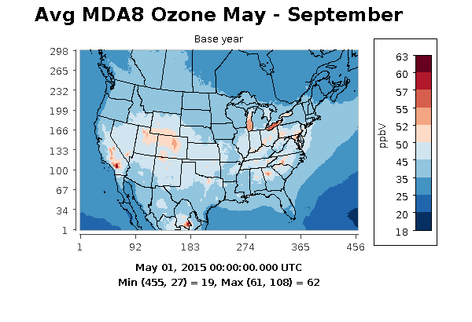
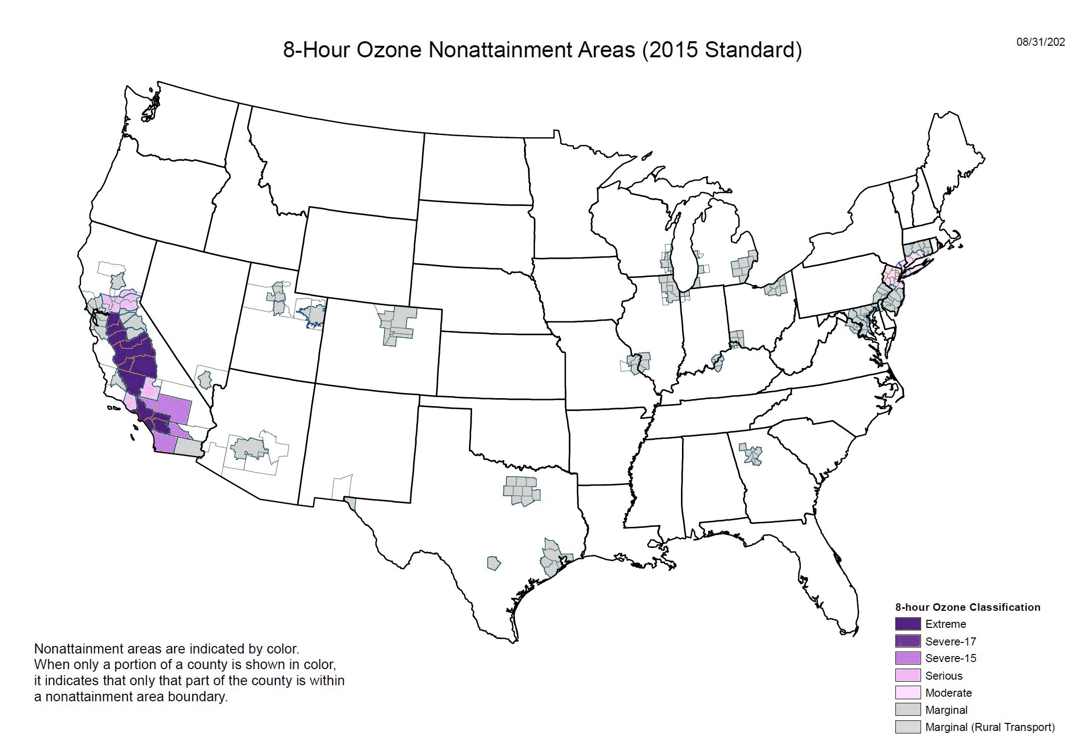
2015 CMAQ May-Sept Avg MDA8* and NAA Designations
Avg
MDA8
19 - 62
ppb
2015 MDA8 Standard = 70 ppbV
Map Source: EPA Green Book
*Maximum Daily 8-hr Average Ozone
Office of Research and Development
Health and Environmental Effects Assessment Division
Notes:
The map on the right shows the NAAs, and the one on the left the base year MDA8 values averaged over the warm months. It illustrates why the co-benefits of GHG mitigation might be useful to some airsheds. Many of the areas with NAA designations (right map) show up in warm colors in the base year CMAQ simulation (left map) as having some of the highest 5-mo avg MDA8. The highest value of 62 ppb is in Southern CA, which has an extreme NAA designation. As Dan said in the previous talk, some 100 million Americans live in these NAAs, some which show moderate to extreme exceedances despite dramatic controls in emissions of the standard air pollutants SOx and NOx.

Slide 12
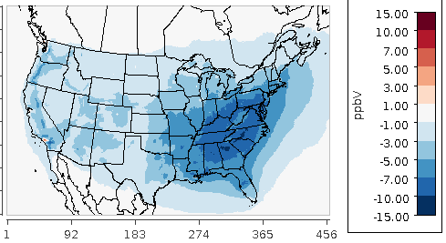
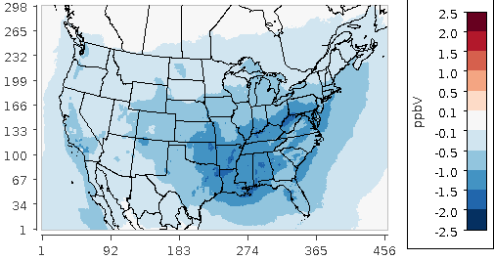
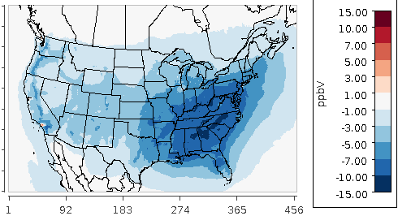
Base Year May-Sept Avg MDA8 and Differences in 2050
Avg
MDA8
19 - 62
ppb
ref50 – baseyr
min = -11.3 ppb
Max
Co-ben
-2.8 ppb
80x50 – baseyr
min = -13.4 ppb
Co-benefit (co-ben) is the concentration difference
80x50 – ref50
Office of Research and Development
Health and Environmental Effects Assessment Division
Notes:
The GCAM emissions had the effect of reducing MDA8 substantially in the ref50 case. The maximum co-benefit is in an area that is not designated NAA, as the deep decarbonization scenario is a total across all sectors, i.e., not targeted toward specific sectors or regions. However, the regions in the OH valley with marginal NAA designations do show MDA8 co-benefits, as do some of the areas of extreme nonattainment in California.

Slide 13
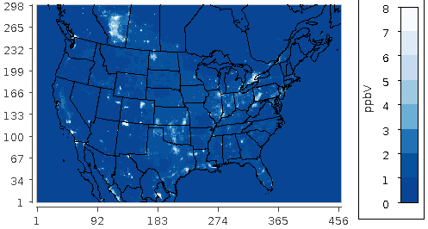
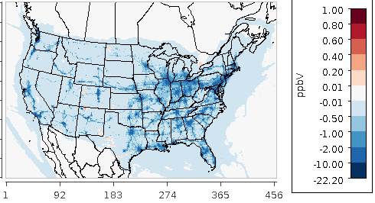
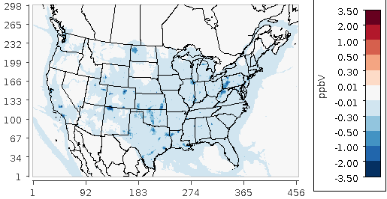
Base Year May-Sept Avg NO_{x} and Differences in 2050
Avg
NO_{x}
0 - 50
ppbV
ref50 – baseyr
min = -22.1 ppb
Max NO_{x}
Co-ben
-3.5 ppbV
80x50 – baseyr
min = -23.7 ppb
Office of Research and Development
Health and Environmental Effects Assessment Division
Notes:
The spatial patterns show that the onroad mobile sources and point sources are major contributors of NOx, and that there are no disbenefits for NOx. The greatest co-benefits are from sources in TX, ND, NM, and WV/PA. The deeper decarbonization reduces the small NOx increases in TX and the Four Corner states to 0 or negative relative to base year. The source of these positive values in the ref50 case is most likely sources in airports and non-egu point sources (buildings and industry), with smaller contributions from oil and gas sources in TX and ND. The max co-benefit occurs in northwest NM. The positive differences ref50-base year at this location turned negative in the 80x50 scenario, and thus this was the largest diff in 80x50 – ref50.

Slide 14
Total Sectoral NO_{x} and VOC Emissions (kT) in GCAM
Office of Research and Development
Health and Environmental Effects Assessment Division
Notes:
NOx is a major driver of ozone production and is emitted by several anthropogenic sectors targeted in the GCAM scenarios. GCAM uses a single aggregated oilgas sector while CMAQ disaggregates them into non-point and point oil and gas “streams” (sectors) via the stream family definitions in DESID. It drives much of the VOC emissions, which decline by about 20000 kT in the 2050 scenarios relative to 2015. Although most sector emissions of NOx are lower in both scenarios in 2050, ptnonipm NOx emissions grow slightly over time in the ref50 scenario, likely due to industrial growth but also grow in the oilgas sector due to increased conversion to liquid fuel. However, NOx concentrations are mostly reduced in both future scenarios over most of the domain, consistent with the overall emissions trends in the left-hand plot.1:20

Slide 15
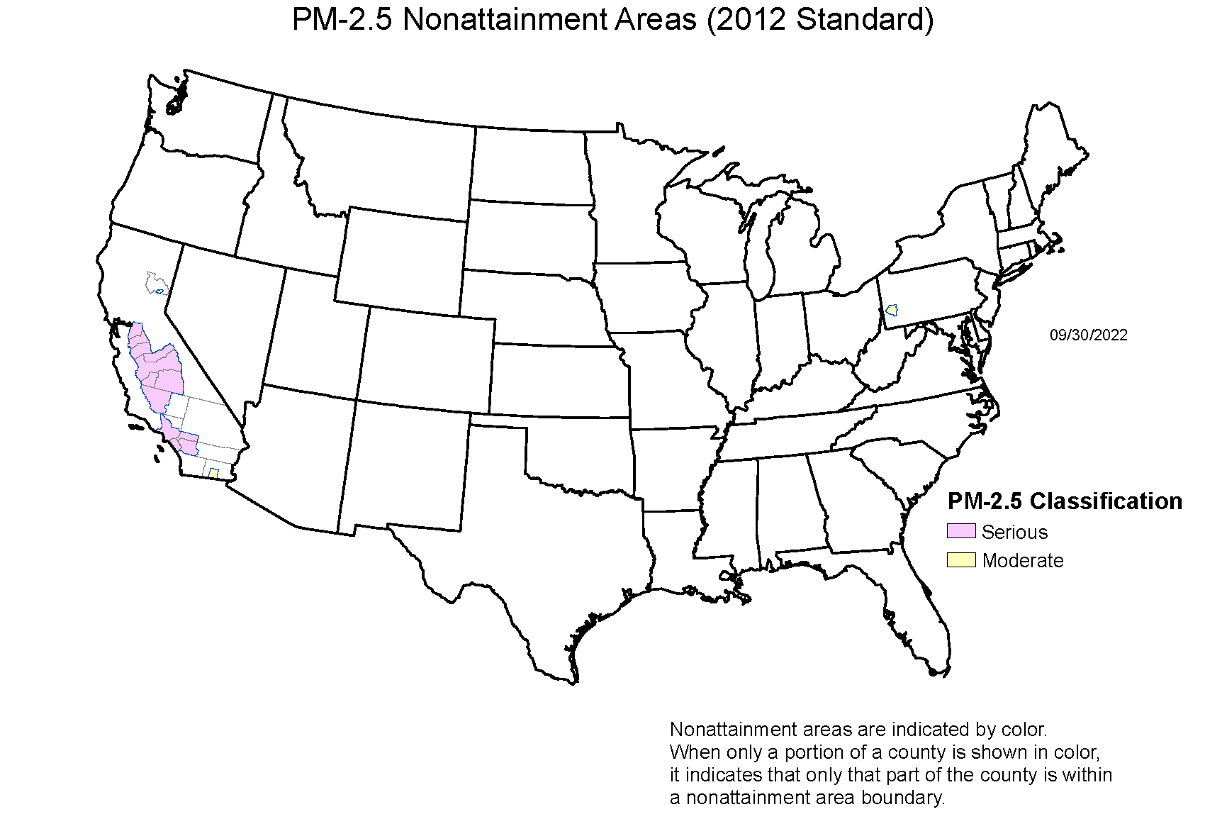
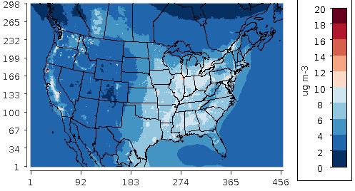
2015 CMAQ Annual Avg PM_{2.5} and NAA Designations
CMAQ 2015 Average PM_{2.5}: 1 – 80 μg/m³
2012 Annual Primary Standard‡ = 12 μg/m³
‡Annual average over three years
Map Source: EPA Green Book
Office of Research and Development
Health and Environmental Effects Assessment Division
Notes:
Very large max value for annual average is due to major wildfires in the west, shown in the high conc locations. Pattern of NAAs over CA resembles that for MDA8 ozone.

Slide 16
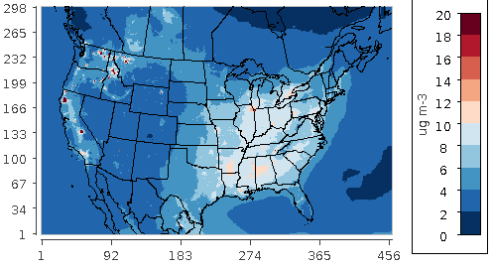
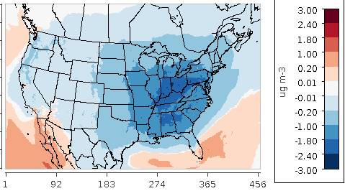
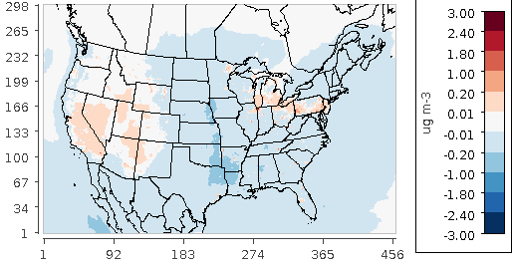
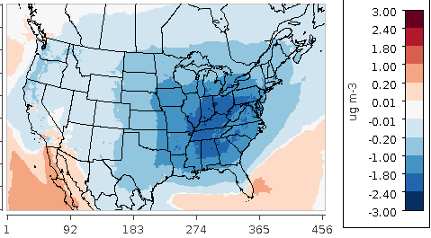
Base Year May-Sept Avg PM_{2.5} and Differences in 2050
Avg
PM_{2.5}
1 - 147
μg/m³
ref50 – baseyr
min -3.0 μg/m³
Max
Co-ben
-0.35
μg/m³
80x50 – baseyr
min -2.9 μg/m³
Office of Research and Development
Health and Environmental Effects Assessment Division
Notes:
The very high PM concentrations in the base year May – September are from wildfires that burned for several weeks beginning in the end of August in California, as well as others in WA, ID and MT. The GCAM emissions had the effect of already reducing PM2.5 substantially in the ref50 case, and the co-benefits are therefore not large. The spatial patterns of differences from base year are nearly identical in the two 2050 scenarios, and the co-benefits are commensurately small. The positive differences are mainly due to SO2 increases in 80x50 over the reference case due to increased coal use with carbon capture in the pt_egu sector in CA and increases in SO2 and PM2.5 due to fuel switching in a dozen states in the ptnonipm (industry) sector. It must be emphasized that this is a hypothetical scenario in demonstration of this projection method and should not be interpreted as a probable future.

Slide 17
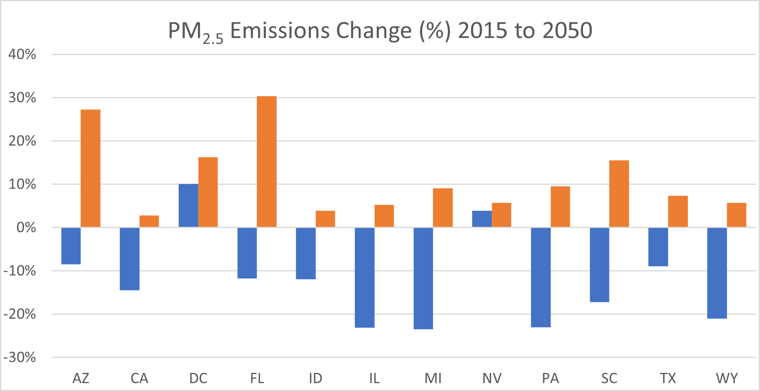
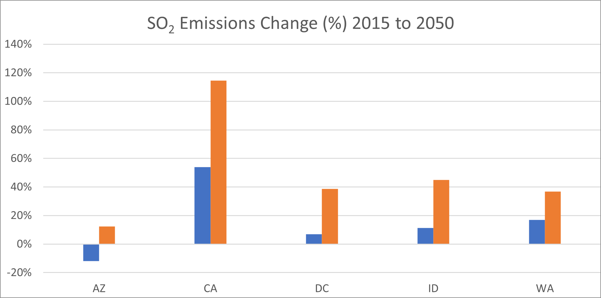
Where Do PM_{2.5} and SO₂ Emissions Increase in 2050 and…
Office of Research and Development
Health and Environmental Effects Assessment Division
Notes:
The PM concentration disbenefit is mainly due to SO2 and primary PM2.5 emissions increases in the ptnonipm and pt_egu sectors. Technology switching to carbon capture and storage available in 2050 increases fossil-fuel use in these sectors in a few hot spots in the states shown here with a positive percent change. However, the concentrations also include transport and atmospheric transformation as much as to emissions, so the hot spots do not always occur in the states where these sources show an increase, e.g., NJ at the PA border.

Slide 18
…In Which Sectors?
SO₂ Emissions (kT)
PM_{2.5} Emissions (kT)
Office of Research and Development
Health and Environmental Effects Assessment Division
Notes:
Much of the PM concentration difference is from SO2 and primary PM2.5 emissions increases in the ptnonipm sector. PM2.5 increases in the 80x50 scenario a total of ~200 kT compared to ref50 mostly from industry (180 kT ) and the power sector (27 kT). SO2 also increases in ptnonipm in the 80x50 scenario by 96 kT over the base year (additional 72 kT over ref50 in 2050). The ref50 scenario sees increases in all sectors (88 kT total) except the power sector, which declines by 85% (1200 kT).

Slide 19
Conclusions and Next Steps
For both ozone and PM_{2.5} this demonstration application shows that
the continuation of current policy on GHG mitigation significantly reduces O₃, PM_{2.5} and NO_{x} by 2050 relative to the base year domain-wide, but especially in the eastern US.
The 80x50 scenario results in additional co-benefits with a max value of 3 ppbV for MDA8 and 0.4 μg/m³ for PM_{2.5} averaged over May-September.
Many marginal-to-severe NAAs benefit from these CO₂ reductions.
ptnonipm emissions of PM_{2.5} and SO₂ increase in the 80x50 scenario relative to the base year and to ref50 due to an increase in fossil fuel use with CCS technology.
PM_{2.5} concentrations increase in a dozen states but exceed 1 μg/m³ only in isolated locations.
More realistic alternatives to this demonstration 80x50 scenario could include regional and state-level policy constraints targeting various sectors, e.g., a 100% shift to ZEVs in the HDV sector, adoption of a Renewable Portfolio Standard, increased energy efficiency in buildings.
Future work will examine the effect of
these more targeted CO₂ reductions in GCAM, particularly in the NAAs
better matching with DESID emission streams to capture some of the detail in the GCAM source categories
Office of Research and Development
Health and Environmental Effects Assessment Division
Notes:
We will next extend this work to do annual simulations. Not all pollutants appear to have a co-benefit from the 80% CO2 reduction strategy. Technology switching involving CCS could lead to greater use of fossil fuels in this scenario and increase emissions of SOx and PM2.5. We will investigate this issue further. We will also examine the AQ impacts of more targeted CO2 emission reduction scenarios, such as RPS and various levels of vehicle electrification in various onroad mobile sectors. 0:52

Slide 20
Acknowledgments
Dr. Kristen Brown (UT-San Antonio) for providing the template for the bridge R code
George Pouliot, Jesse Bash, Kristen Foley and Wyat Appel (EPA ORD) for clarification on various aspects of the CMAQ base year model simulation
Disclaimer: This presentation represents the views of the authors and does not necessarily represent the views or policies of the U.S. Environmental Protection Agency
Office of Research and Development
Health and Environmental Effects Assessment Division
Notes:
0:24

Slide 21
Additional Slides

Slide 22
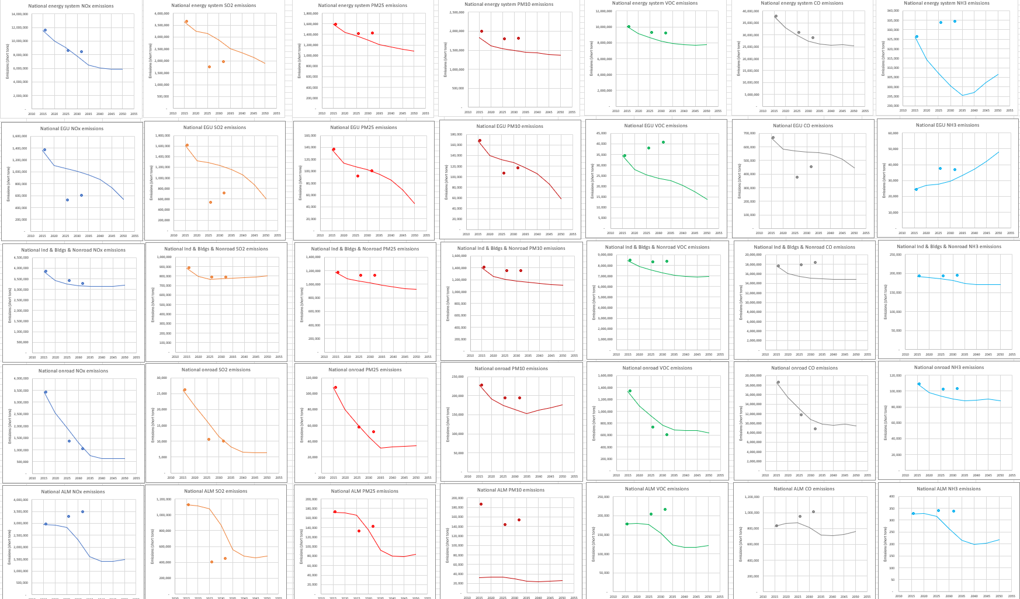
Updated DL Plots

Slide 23
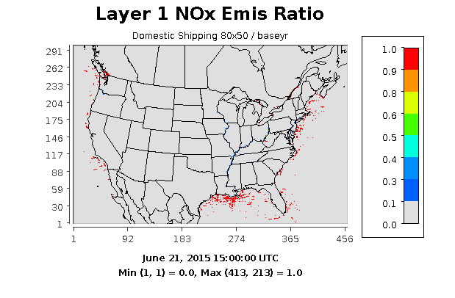
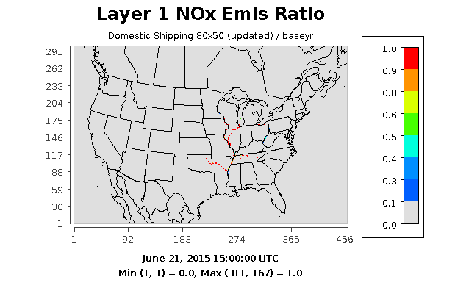
PT_CMV_C1C2 NO_{x} Ratios 80x50/baseyr
Original Scaling
Updated Scaling
Office of Research and Development
Health and Environmental Effects Assessment Division

Slide 24
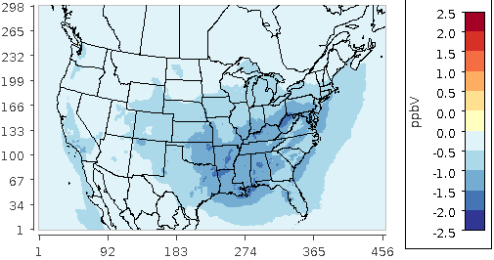
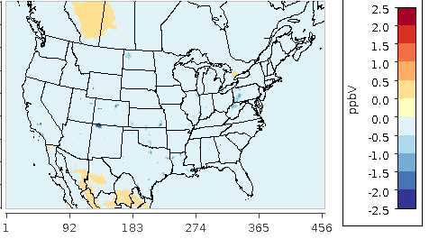
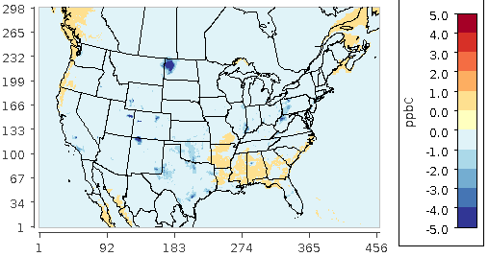
Avg O₃ and Precursor Co-Benefits May-September
MDA8 max:
-2.8 ppb
(-2.2 ppb in WV)
NO_{x} max:
-3.5 ppb
VOC max:
-18.6 ppb
Office of Research and Development
Health and Environmental Effects Assessment Division
Notes:
Corrections to DESID made little if any difference in the estimated benefits for MDA8 episode averages (policy – ref case). Maximum benefits in NOx and VOC are not collocated with those for MDA8.

Slide 25
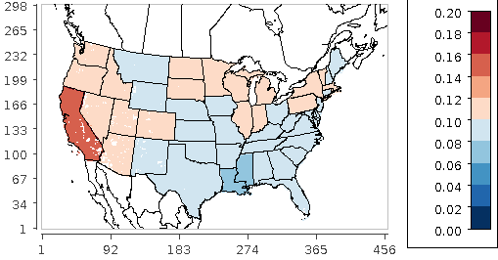
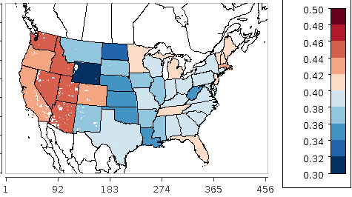
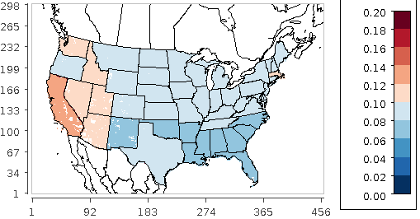
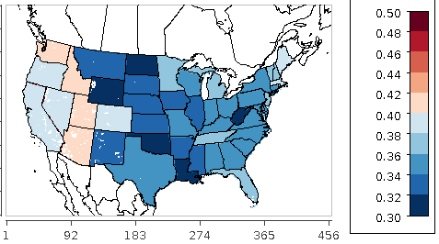
Avg Ratios NOx and VOC from Onroad Gas May-Sept
Avg
NOx
ref50 /
by
Avg
VOC
ref50 /
by
Avg
NOx
80x50 /
by
Avg
VOC
80x50 /
by
Office of Research and Development
Health and Environmental Effects Assessment Division
Notes:
Corrections to DESID made little if any difference in the estimated benefits for MDA8 episode averages (policy – ref case)

Slide 26
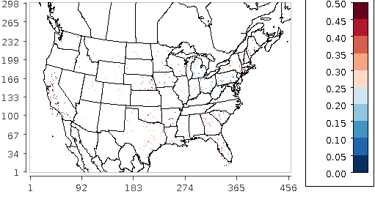
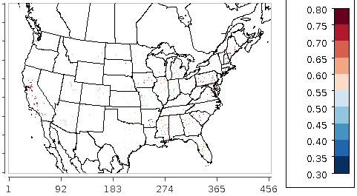
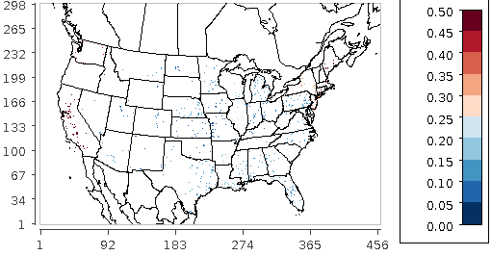
Avg Ratios NOx and VOC from PT_EGU May-Sept
Avg
NOx
ref50 /
by
Avg
VOC
ref50 /
by
Avg
NOx
80x50 /
by
Avg
VOC
80x50 /
by
Office of Research and Development
Health and Environmental Effects Assessment Division
Notes:
Corrections to DESID made little if any difference in the estimated benefits for MDA8 episode averages (policy – ref case)

Slide 27
Sector NO_{x} Emissions Reductions (kT): 80x50 – ref50
80x50 minus ref50 (%)
CMAQ (43-day)
GCAM
CMAQ
-73.7 | -72.7
-79.2 | -78.2
-49.5 | -49.5
-49.5 | -49.5
-60.8 | -61.6
-85.5 | -84.1
-48.1 | -43.9
-50.0 | -48.7
-88.2 | -66.7
-55.1 | -53.2
GCAM growth factors are state-level; unavailable for offshore pt_cmv_c1c2 sources.
Use of a national-average scaling factor for all offshore sources and state-level factors onshore in a 3-day test run cut the GCAM-CMAQ discrepancy in this sector by about a half.
A 6-week test for PT_EGU with DESID updates also showed a reduced discrepancy in that sector
Notes:
Emission differences in the table are negative numbers for all sectors (ref50 NO_{x} emissions in 2050 are greater than in the 80% CO₂ reduction scenario).

Slide 28
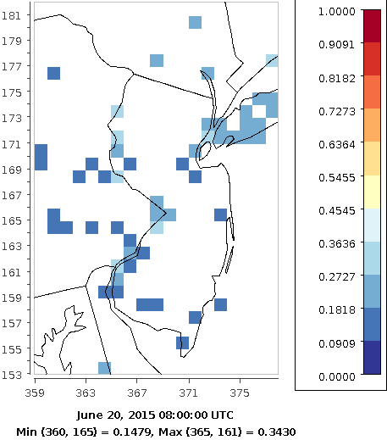
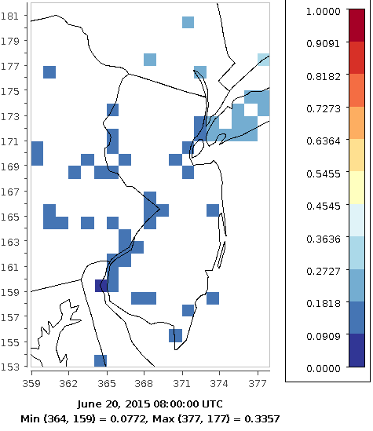
PT_EGU NOx Emission Ratios in the Northeast
80x50 Old DESID / baseyr
80x50 New DESID / baseyr
The DESID scaling algorithm was corrected and tested extensively
Border cells at 8 UTC show a reduction in the emissions with the new code, which is of the correct magnitude
The updates have been verified at multiple locations and times and found to perform correctly
Office of Research and Development
Health and Environmental Effects Assessment Division

Slide 29
Sector NO_{x} Emissions Reductions (kT): 80x50 – ref50
80x50 minus ref50 (%)
CMAQ (43-day)
GCAM
CMAQ
-73.7 | -72.7
-79.2 | -79.2
-49.5 | -49.5
-49.5 | -49.5
-60.8 | -62.3
-85.5 | -85.5
-48.1 | -48.0
-50.0 | -50.0
-88.2 | -64.5
-55.1 | -55.5
Results for all sectors have been updated with results from the 6-week simulations with DESID updates
GCAM-CMAQ discrepancy in domestic shipping (80x50-ref50) is reduced from 54% to 24%
Discrepancy is reduced from 16.2% to 5.5% in ref50/baseyr and from 24.0% to 7.8% in 80x50/baseyr
Investigated whether intra-annual variability in emissions could be a source of the remaining discrepancy

Slide 30
Corrected PT_CMV_C1C2 Seasonal Domain Sum NO_{x}
Season | Baseyr Emissions (kT) | %Δ from avg
winter | 30.0 | -15.6
spring | 37.0 | 3.8
summer | 39.6 | 11.1
autumn | 35.9 | 0.8
Average | 35.6
The inter-seasonal emissions variability is large enough to account for the GCAM vs. CMAQ discrepancy in this sector in 2050. Summertime emissions > 11% above average.
Office of Research and Development
Health and Environmental Effects Assessment Division
Notes:
These are comparing results for a full base year run among the seasons. The seasonal emissions totals also include a 41% reduction due to a correction in the conversion from mol/s to kT/h. However, this does not change the % difference from average and the conclusions regarding intra-seasonal variability still apply. Note that the 2050 simulations will carry the same seasonal swings because the scaling is applied uniformly in all seasons to the base year emissions.

Slide 31
Preliminary Findings
NO_{x} emissions for 2050 were lower in 80x50 than in ref50 (all sectors, both models)
NO_{x} and VOC emissions were greater in ref50 in 2050 than in 2015 for
ptnonipm in every state
ptegu in VT
rwc in CA, CO and the New England states
Differences between GCAM and CMAQ in the 80x50 – ref50 sector NO_{x} emissions were relatively small (up to 6% in ptegu) given differences in:
model formulations
base year emissions and the aggregation of their source categories
aggregation periods for the results (annual in GCAM vs. 43 days in CMAQ) and intra-annual variability in emissions
This lent support to the scaled emissions approach
Ozone air quality showed improvement over the base year
max decrease in average MDA8 of 18.4 ppb in 80x50 compared to 10.6 ppb in ref50
mostly over the eastern US, agrees well with spatial pattern of NO_{x} rather than VOC decreases
Office of Research and Development
Health and Environmental Effects Assessment Division
Notes:
To summarize, NOx emissions grow in ptnonipm in the ref50 scenario but both NOx and VOC emissions are much lower in every sector and state in the 80x50 scenario than in the ref50 scenario. The differences between GCAM and CMAQ are small in 2050 for these NOx emissions reductions. Given the different models, base year emissions and their aggregation, and the different summing period, this result is encouraging and lends support to the scaling approach. It shows a co-benefit for ozone in a simulation averaged MDA8 reduction of 18.4 ppb compared to a reference case average of 10.6 ppb. This modeling approach has not previously been used but efforts to link GCAM to WRF-Chem are ongoing at Northeastern University, led by Y. Zhang, and this same approach is underway at UT-San Antonio, led by co-author K. Brown. 0:56

Slide 32
Final Corrected CMAQ Domain Sum of NO_{x} – All Sectors
Stream | GCAM54 (kT) | CMAQcorr (kT) | CMAQ Aggrg (kT)
ptegu | 1393.7 | 1348.9
ptnonipm | 2333.4 | 864.7 | 1966.7 |  | if ptnonipm and nonroad are aggregated
nonroad_gas |  | 227.1 | 1101.9 |  | if nonroad gas and diesel are aggregated
nonroad_diesel |  | 874.9
oilgas | 375.4 | 998.4
nonpt | 100.9 | 665.2
rwc | 26.9 | 37.5
onroad_gas | 1185.9 | 1748.5
onroad_diesel | 2068.1 | 2155.9
rail | 649.3 | 546.3
airports | 563.8 | 112.8
pt_cmv_c1c2 | 848.4 | 210.8
pt_cmv_c3 | 1599.2 | 634.7
Post-processed CMAQ emissions previously used 30 g/mol and 46 g/mol respectively for NO and NO₂ molecular weights to convert NO_{x} emissions from mol/s to kTonne/hr. CMAQcorr applies a multiplier of 1.48 to make them consistent with NEI QA reports, which use only the NO₂ molecular weight in the conversion to mass units. CMAQ Aggrg shows the emissions totals when aggregated as noted.
Office of Research and Development
Health and Environmental Effects Assessment Division
Notes:
These are comparing results for a full base year run among the seasons. The seasonal emissions totals also include a 41% reduction due to a correction in the conversion from mol/s to kT/h. However, this does not change the % difference from average and the conclusions regarding intra-seasonal variability still apply. Note that the 2050 simulations will carry the same seasonal swings because the scaling is applied uniformly in all seasons to the base year emissions.

Slide 33
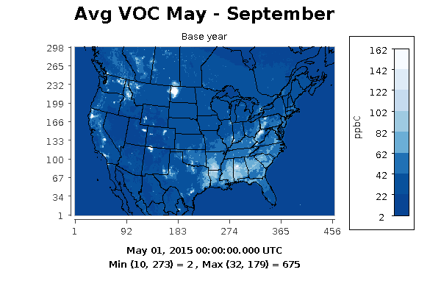
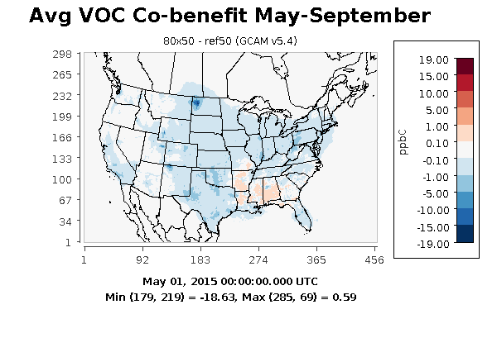
Avg Base Year NOx and VOC and Co-benefits May-Sept
Avg
VOC
2 - 675
ppbC
Avg
NOx
0 - 50
ppbV
Max VOC
decrease
-18.6 ppb
Max NOx
Co-ben
-3.5 ppbV
Office of Research and Development
Health and Environmental Effects Assessment Division
Notes:
The spatial patterns suggest that the greatest reductions in NOx and VOC are from the same sources in TX, ND, NM, and WV/PA, but the larger reductions in NOx compared to VOC also indicate that ozone formation in these areas may be NOx-limited.

Slide 34
Sector NO_{x} Emissions Reductions (kT): 80x50 – ref50
80x50 minus ref50 (%)
CMAQ (annual)
GCAM
CMAQ
-73.7 | -68.6
-79.2 | -78.2
-49.5 | -49.5
-49.5 | -49.5
-60.8 | -61.6
-85.5 | -84.1
-48.1 | -43.9
-50.0 | -48.7
-88.2 | -34.1
-55.1 | -53.2
Some discrepancies between CMAQ and GCAM in 2050 NOx emissions reduction (%) are expected due to the different aggregation periods for emissions in the models.
However, the pt_cmv_c1c2 (domestic shipping) discrepancy is much greater. ptegu and onroad_gas discrepancies are also larger than ideal given their bigger emissions fractions.
Notes:
Emission differences in the table are all negative numbers (ref50 NO_{x} emissions in 2050 are greater than in the 80% CO₂ reduction scenario).

Slide 35
GCAM-USA
Developer: PNNL
Availability: Open Source, free
Platforms: Windows, Mac, Linux
Run-time: 1-5 hours
Spatial coverage: global
Spatial resolution: 31 global
regions + 50 US states
Temporal range: 2010 - 2100
Temporal resolution: 5-years
Emissions:
GHGs: CO₂, CH₄, N₂O
Air pollutants: NO_{x}, SO₂, VOC, PM, CO, NH₃
GCAM 5.4 Documentation: https://jgcri.github.io/gcam-doc/
Office of Research and Development
Health and Environmental Effects Assessment Division
Notes:
GCAM is an open-source model developed by PNNL and version 5.4 documentation is available in the link at the bottom. It is a technology-rich model that simulates the co-evolution of the systems shown in the middle through time but is primarily energy-, land use- and water-focused. While it is often run to 2100 and beyond globally, here we run GCAM v5.2 for the US to 2050, which is more relevant for decarbonization goals and AQ planning. GCAM-USA models 31 global regions, 50 US states and the District of Columbia. In the CMAQ analyses we exclude AK and HI. GCAM evaluates the endpoints shown at the right for various scenario assumptions on the left on population and economic growth, resource availability, climate change, technology development, behavior and preferences, and policies either in place or emerging. It can be used to test the efficacy of existing mitigation policies or their combinations, and their cost-effectiveness. Relevant to this research, it evaluates the climate endpoints of global mean temperature and GHG emissions, and environmental endpoints of air pollutant emissions, water use, and health. Later versions of GCAM include controls on all GHGs listed here, this version only employs CO₂ mitigation strategies. Also, this presentation focuses on ozone impacts, and therefore on the precursor emissions, NO_{x} and VOC. 1:28

Slide 36
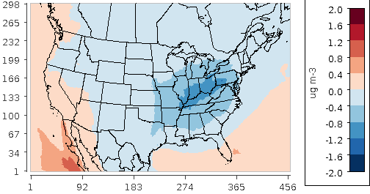
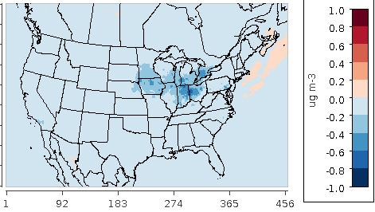
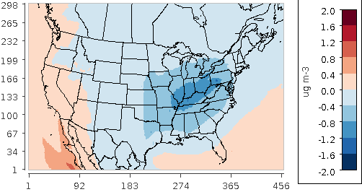
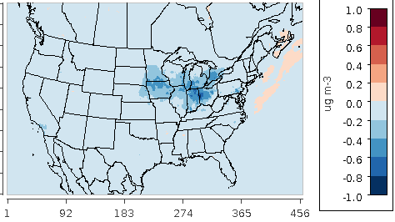
May-Sept Avg SO₄ and NO₃ Differences in 2050 from 2015
ref50-baseyr
min -1.4 μg/m³
ref50 – baseyr
min -0.9 μg/m³
80x50-baseyr
min -1.4 μg/m³
80x50 – baseyr
min -1.0 μg/m³
SO₄
NO₃
Office of Research and Development
Health and Environmental Effects Assessment Division
Notes:
The corrections to the GCAM emissions had the effect of reducing MDA8 substantially in the ref50 case, and the co-benefits are therefore not as large as were seen in the previous study using GCAM v5.2

Slide 37
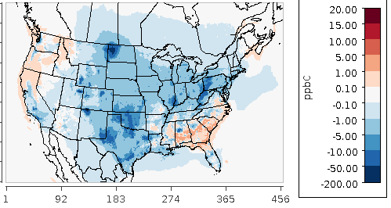
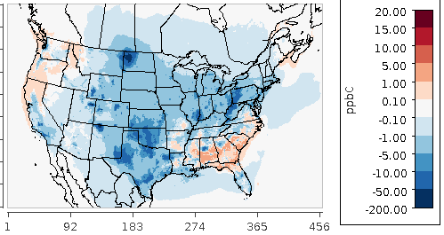
Avg Base Year VOC and Co-benefits May-Sept
Avg
VOC
2-675
ppbC
ref50 – baseyr
min = -187 ppb
Max VOC
Co-ben
-19 ppbC
80x50 – baseyr
min = -206 ppb
Office of Research and Development
Health and Environmental Effects Assessment Division
Notes:
The spatial patterns show that there are significant reductions over most of the domain, and the deeper decarbonization further reduces VOC in northwest ND, where the maximum co-benefit occurs. There are increases in VOC in the Southeast. As the state-level VOC emissions show no increases in any sectors these positive differences are attributable to secondary production, and we are investigating the responsible species. However, these future increases in VOC do not have an impact on MDA8, which suggests that ozone production is NOx-limited in these southeastern states.

Slide 38
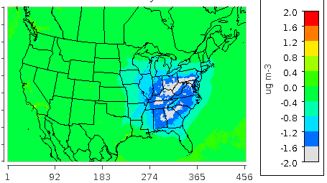
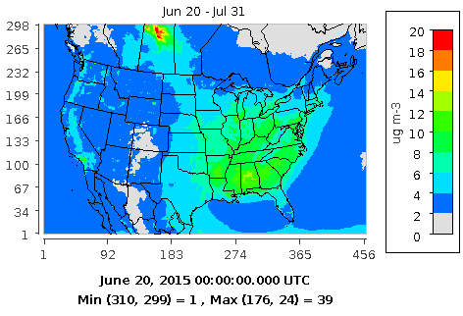
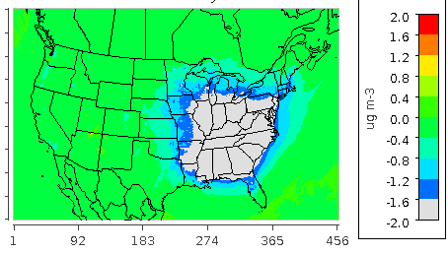
Average PM_{2.5} and Differences from Base Year
Average PM_{2.5}: baseyr
ref50 – baseyr min = -2.3 µg m⁻³
max = 1.8 µg m⁻³
80x50 – baseyr min = -12.2 µg m⁻³ max = 5.7 µg m⁻³
Although max average (positive) concentration differences from baseyr are much greater in the 80x50 scenario than in ref50, the average over the whole domain is a large AQ benefit, especially in the eastern US. Max differences are in border grid cells in UT/AZ, AZ/NM and OR/WA, and may change since the DESID updates.
Notes:
Can zoom to the locations referenced to see the impact of technology-switching on PM concentration diffs in the 80x50 case.

