Slide 1
Public health effects from the adoption of California’s Advanced Clean Cars II regulation in Oregon and Connecticut in 2040
By Jiaoyan (Joey) Huang, Eric Sussman, Jeff Houk, Shih-Ying Chang
Sonoma Technology, Petaluma, CA, USA
For 21st Annual CMAS Conference
October 17 - 19, 2022
STI-7615

Slide 2
Outline
California zero emission vehicle regulations
Advanced Clean Trucks and Fleets: STI and ICCT previous work
GHG phase 2
Advanced Clean Cars II
Motivations for this project
Methods
MOtor Vehicle Emission Simulator (MOVES)
CO-Benefits Risk Assessment (COBRA)
Results
Electric vehicle penetration
Emission reductions
Co-benefits
Conclusions
Notes:
Add GHG phase 2 ?

Slide 3
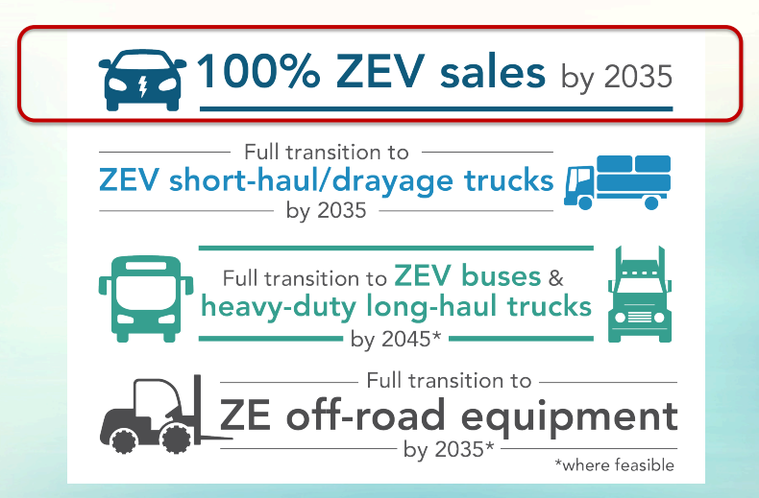
California Governor’s Executive Order N-79-20
Advanced Clean Cars (ACC)
Advanced Clean Fleets (ACF)
Advanced Clean Trucks (ACT)
Source: The Office of the California Governor

Slide 4
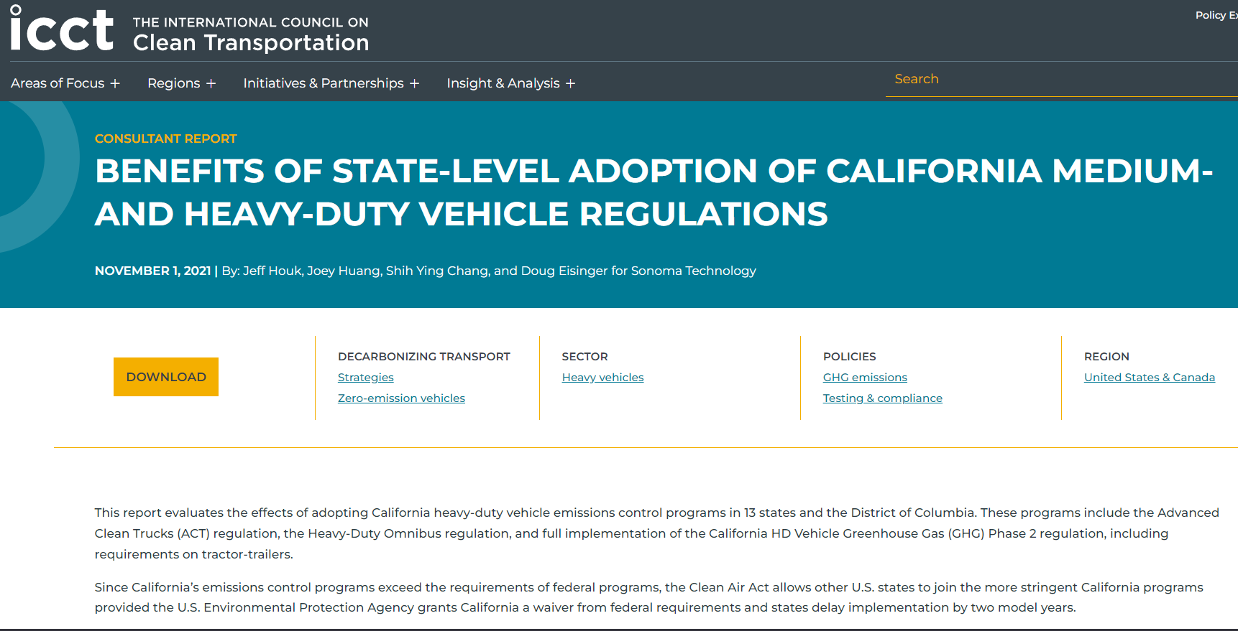
STI and ICCT’s Heavy-Duty Vehicle Analysis (ACT and Low-NO_{x} Omnibus adoption)
https://theicct.org/benefits-ca-multi-state-reg-data/
https://www.youtube.com/watch?v=Qmwm4-zdGfw&t=1s

Slide 5
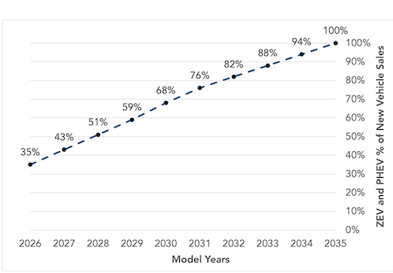
California Regulation – Advanced Clean Cars II (ACC II)
Zero emission vehicle (ZEVs) and Plug-in Electric Vehicles (PHEVs) will be 35% of light-duty vehicle (LDV) sales in 2026.
ZEVs and PHEVs will be 100% of LDV sales in 2035.
Low-emission Vehicle Regulations to include increasingly stringent standards for gasoline cars and heavier passenger trucks
ACC II ZEV and PHEV % of new sale in California

Slide 6
Motivation for this Project
Understand how California ACC II regulation impacts EV penetration and on-road emission reduction in OR and CT in 2030 and 2040
Investigate the health benefits from on-road emission reduction due to adoption of ACC II regulation in OR and CT

Slide 7
Methods – Scenarios and States
Scenarios | Description
BAU | Business as Usual
ACC II | ZEVs and PHEVs: 100% of light duty vehicles in 2035
 | Oregon | Connecticut
State total VMT | 3.68 x 10¹⁰ [Rank 29] | 2.97 x 10¹⁰ [Rank 34]
State total VPOP | 3.93 x 10⁶ | 3.04 x 10⁶
State LDV VMT | 3.10 x 10¹⁰ | 2.88 x 10¹⁰
State LDV VPOP | 3.33 x 10⁶ | 2.85 x 10⁶
Population | 4.24 x 10⁶ [Rank 27] | 3.61 x 10⁶ [Rank 29]
Population density | 44/mi² | 745/mi²

Slide 8
Methods – Modeling Workflow
MOVES
Post Process
Well-to-Wheel
COBRA
MOVES default data
CARB ACC II EV table
GREET emission factors by region
State renewable energy projections
County level emission changes
State data
Downwind state impacts
CARB ACC II emission reduction table
EQUATES 2017 data
Social cost (dollar)
MOVES 3.0.3
COBRA 4.1

Slide 9
Methods – MOVES3 Input Data
County-Level Run | EQUATES 2017 Representative Counties in Each State
MOVES3 Input | Oregon | Connecticut
VMT, VPOP | EQUATES 2017, grown to future years (2030 and 2040) using growth rates developed by OR | EQUATES 2017, grown to future years (2030 and 2040) using growth rates developed by CT
Fuel supply, fuel usage fractions, inspection/maintenance program parameters, VMT month, day, hour fractions | OR state data in 2020 | CT state data in 2020
Road type VMT distribution, vehicle age distribution | OR state data in 2020 | CT state data in 2020
Vehicle technology distribution, speed distribution | OR state data in 2020 | CT state data in 2020
Meteorology, retrofit program data | OR state data in 2020 | CT state data in 2020
LEV | EQUATES 2017 | EQUATES 2017
NLEV | - | EQUATES 2017

Slide 10
Results – EV penetration
ZEV fraction in light duty vehicle fleet is 40% higher than BAU scenario due to the ACC II.
Notes:
Should we only show 2030 and 2050 Tank to wheel

Slide 11
Results – NOx Emissions Reductions
NO_{x} Emissions Reductions (tons)
Year | Connecticut | Oregon
2020 | 0 | 0
2025 | 0 | 0
2030 | 56 | 237
2035 | 167 | 505
2040 | 523 | 835
Total | 2,619 | 6,341
NOx emission reduction is approximately 42% due to ACC II adoption in 2040
Larger reductions are seen in OR than in CT because of the EGU mix

Slide 12
Results – PM2.5 Emissions Reductions
PM_{2.5} Emissions Reductions (tons)
Year | Connecticut | Oregon
2020 | 0 | 0
2025 | 0 | 0
2030 | 2 | 3
2035 | 13 | 18
2040 | 40 | 52
Total | 187 | 242
PM_{2.5} emission reduction is 17% due to ACC II adoption in 2040

Slide 13
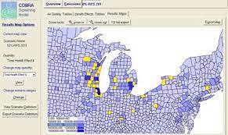
CO-Benefits Risk Assessment (COBRA) Screening Model
EPA screening model used to quantify how changes in air emissions from policy decisions affect human health
User inputs emissions estimates from various industries/sectors for a baseline scenario and a sensitivity case study for the following pollutants:
PM_{2.5}, NO_{x}, NH₃, SO₂, VOC, SOA
Model outputs the change in various air pollution related health incidence rates, as well as their associated economic costs
https://www.epa.gov/sites/default/files/2017-10/documents/cobra_training_eic_2017.pdf

Slide 14
Methods – COBRA Input Data
COBRA Input | Data | Scaling Factor (2040/2028)
Baseline Incidence File | Default | --
Modeled Year | 2028 | --
Population File | 2028 default data scaled to 2040 | U.S. Census projection data
Baseline Emission | 2028 default data with scaled electricity generation and highway vehicle emissions to 2040 levels | Electricity generation: Energy Information Administration (EIA) projection data Highway Vehicles: MOVES3 national scale default data
Sensitivity Emission File | 2028 default data with replacement electricity generation (from GREET) and highway vehicle (from MOVES3) emissions | --
Discount Rate | Both 3 and 7% | --

Slide 15
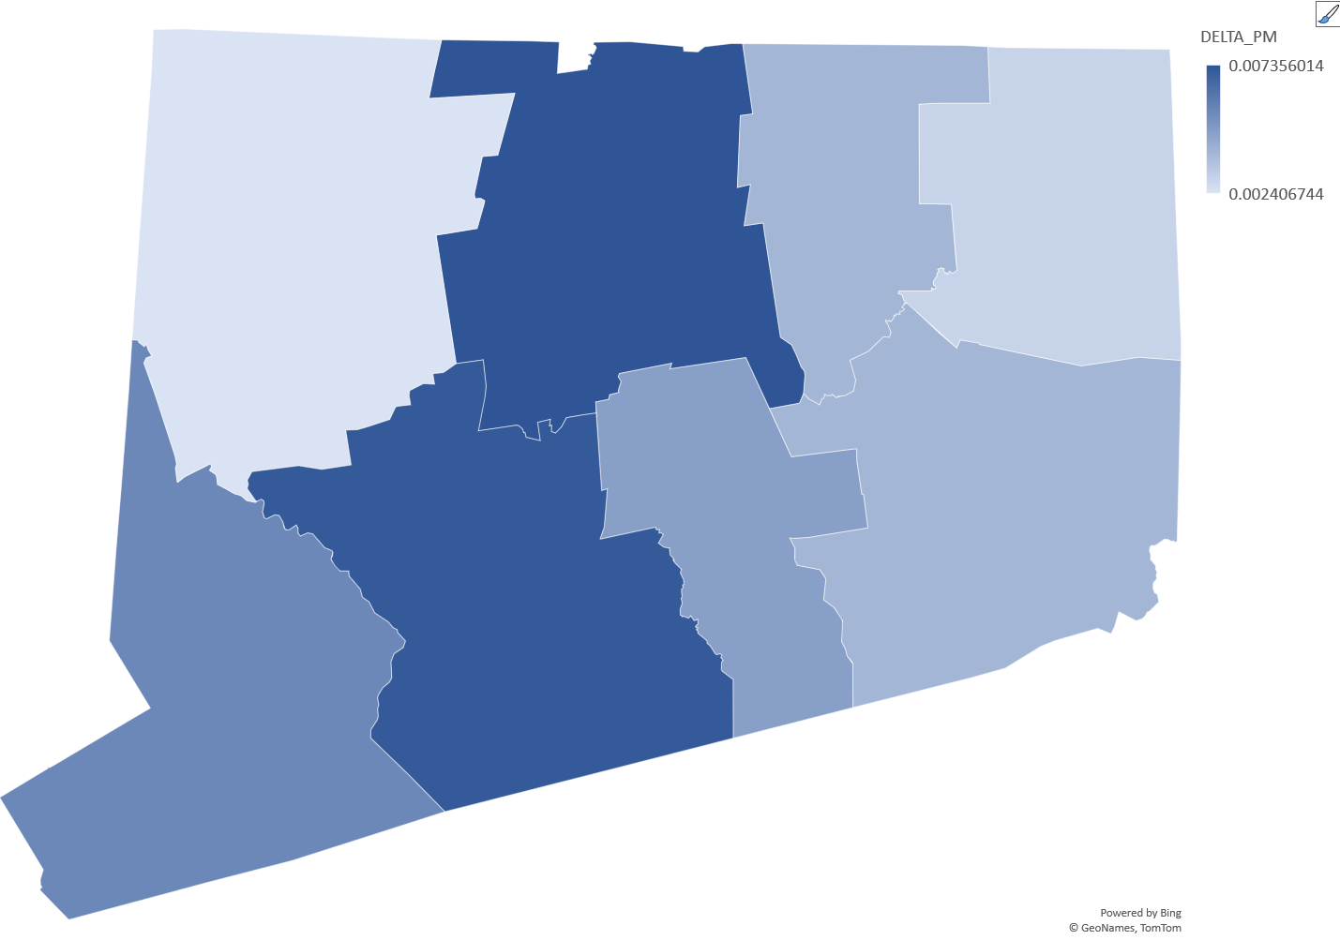
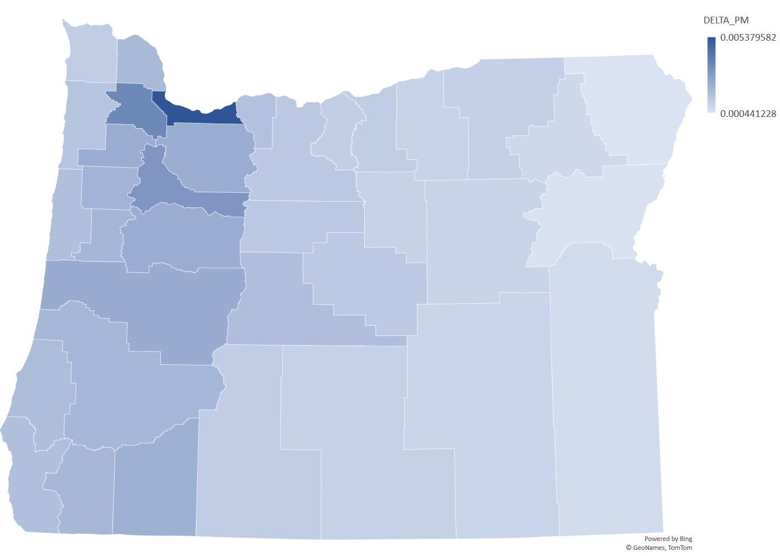
Results – COBRA, Modeled PM_{2.5} Concentration Decrease (µg/m3) from EV penetration from BAU in 2040
Connecticut
Oregon
Notes:
Only 7% interest shown
Dollars are 2017 dollars

Slide 16
Results – COBRA, Connecticut 2040
Annual COBRA-estimated economic values of CT adopting ACC II, in millions of US dollars
Analysis Year | In-State Benefit | Out-Of-State Benefit | In-State Burden | Out-Of-State Burden | Net Benefit
2040 | 15.58 | 10.01 | 0 | 0 | 25.60
Top five states that are most impacted by CT’s adoption of ACC II: New York, Massachusetts, Rhode Island, New Jersey, New Hampshire
Notes:
Only 7% interest shown
Dollars are 2017 dollars

Slide 17
Results – COBRA, Oregon 2040
Annual COBRA-estimated economic values of OR adopting ACC II, in millions of US dollars
Analysis Year | In-State Benefit | Out-Of-State Benefit | In-State Burden | Out-Of-State Burden | Net Benefit
2040 | 8.60 | 4.21 | 0 | 0 | 12.81
Top five states that are most impacted by OR’s adoption of ACC II: Washington, California, Idaho, Nevada, Montana

Slide 18
Conclusions
NO_{x} emission reduction (for RegClass 20, 30, 41) is approximately 42% and PM_{2.5} emission reduction (for RegClass 20, 30, 41) is 17% due to ACC II adoption in 2040
ZEV fraction in light duty vehicle fleet is slightly higher than 50% in 2040 which is 40% higher than BAU scenario.
Significant economic benefit for adopting ACC II for both the state (CT: $16M, OR: $9M) and their neighbors (CT: $10M, OR: $4M).

Slide 19
Joey Huang
Air Quality Scientist
jhuang@sonomatech.com
Eric Sussman Air Quality Engineer
esussman@sonomatech.com
Jeff Houk
Transportation / Air Quality Analyst and Emissions Modeler
jhouk@sonomatech.com
Shih-Ying Chang
Air Quality Scientist
cchang@sonomatech.com
SonomaTech.com 707-665-9900

Slide 20
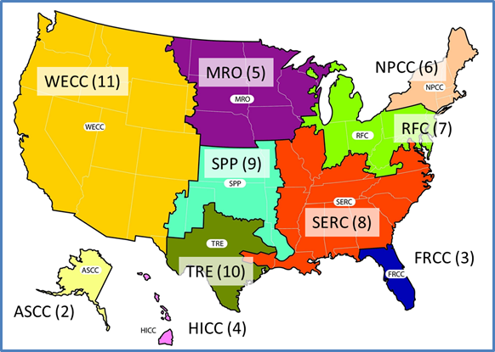
Methods –
 | NPCC Mix (CT, MA, ME, NY, RI, VT) | RFC Mix (DC, MD, NJ, PA) | SERC Mix (NC) | WECC Mix (CO, OR, WA)
NO_{x} | 19.370 | 45.157 | 50.017 | 39.549
PM_{2.5} | 2.180 | 5.985 | 5.147 | 3.988
CH₄ | 3.787 | 9.491 | 8.497 | 6.273
N₂O | 0.177 | 1.510 | 1.325 | 0.936
CO₂ | 51,233 | 106,161 | 94,078 | 68,252
These 2020 values used as a baseline for all calendar years, and state-provided grid renewable energy projections were used to adjust the rates for future years.

Slide 21
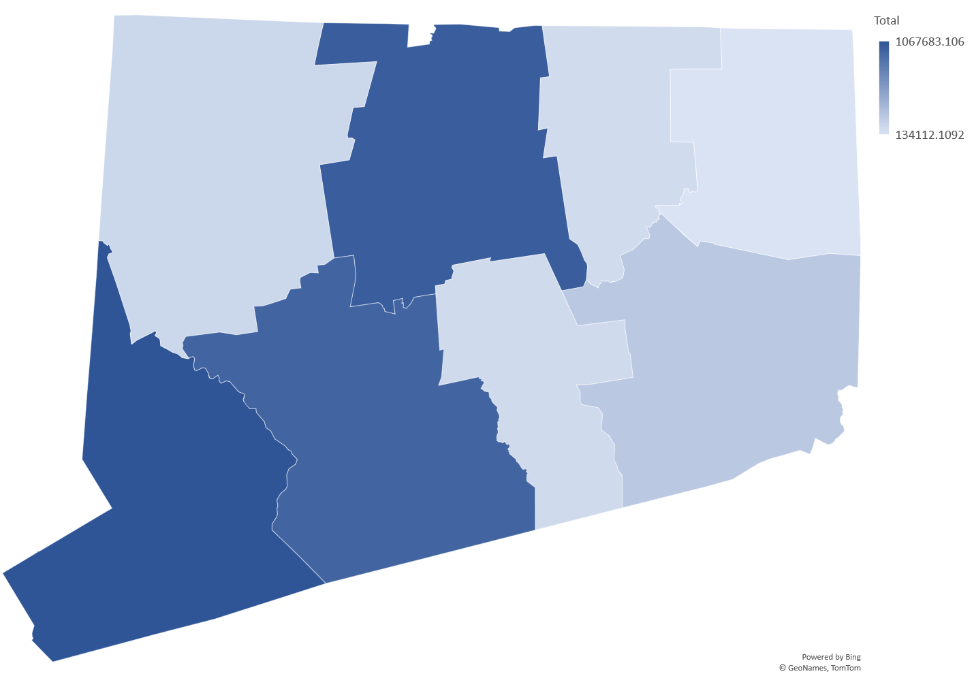
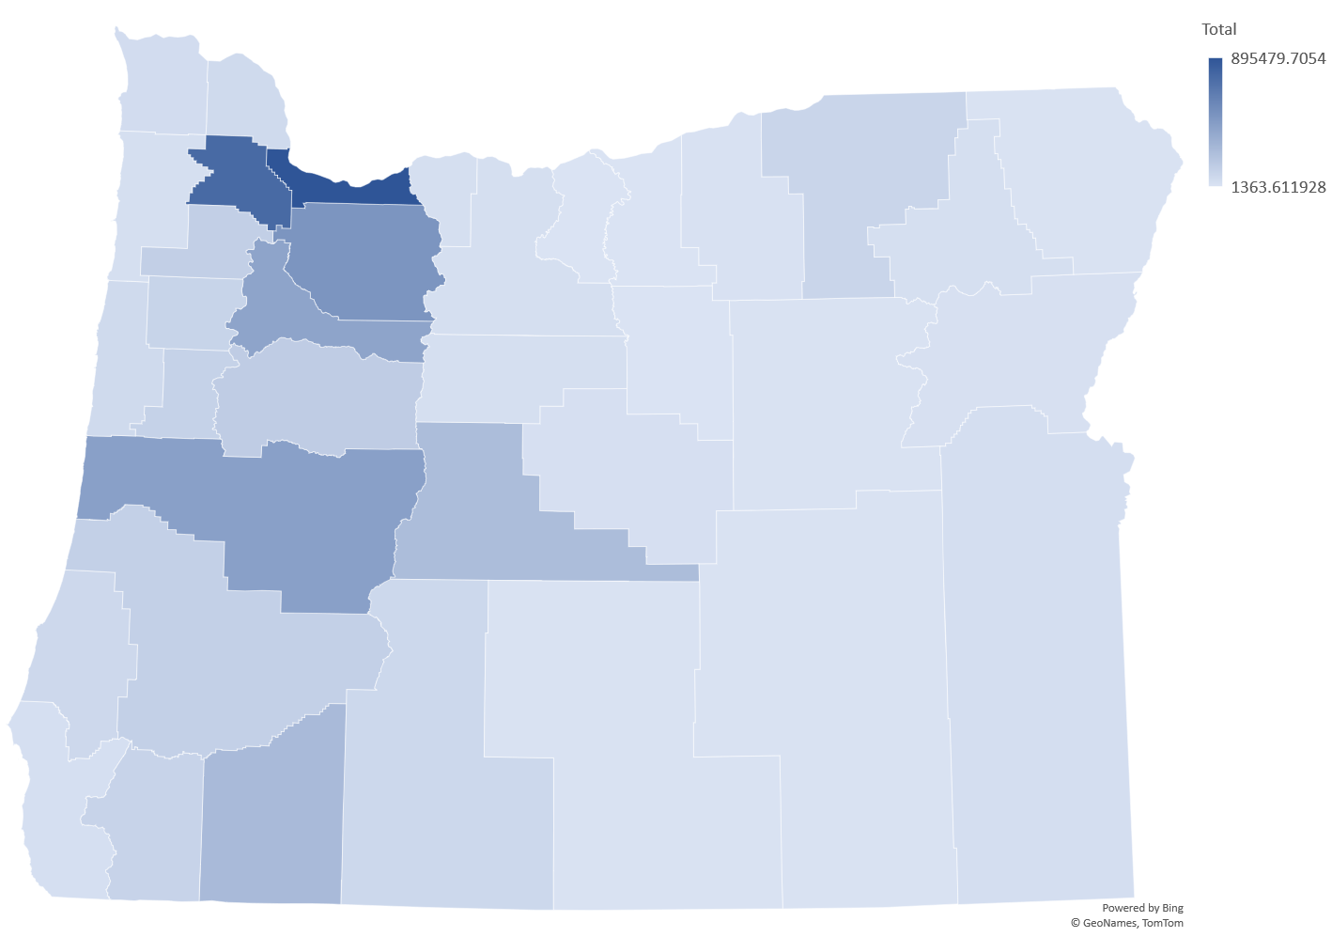
Results – COBRA, Population Map
Connecticut
Oregon
Notes:
Only 7% interest shown
Dollars are 2017 dollars

