Slide 1
Intensification of Extreme Precipitation in Eastern North Carolina Projected in Dynamically Downscaled CESM and CM3 Models Under Future Scenarios (2025-2100) Using WRF
A. M. Jalowska¹, J. H. Bowden ², T. L. Spero ¹
¹ Atmospheric Dynamics & Meteorology Branch | Atmospheric & Environmental Systems Modeling Division | Center for Environmental Measurement and Modeling | Office of Research and Development | U.S. EPA
² North Carolina State University
18th Annual CMAS Conference, Chapel Hill, NC
Oct 23, 2019 at 2:20 PM

Slide 2
Acknowledgments
The views expressed in this presentation are those of the authors and do not necessarily represent the views or policies of the U.S. Environmental Protection Agency.
The first author was supported in part by an appointment to the ORISE participant research program supported by an interagency agreement between EPA and DOE.
Authors would like to thank Brian Eder, Ana Torres-Vazquez (USEPA) & Geneva Gray, Barbara Doll and Daniel Line (NCSU).

Slide 3
Hurricane flooding in ENC Watersheds
PLUVIAL
(FLASH)
FLUVIAL
FLOODING
STORM SURGE
Preexisting conditions

Slide 4
Hurricane flooding in ENC Watersheds
PLUVIAL
(FLASH)
Raleigh, NC
Wilmington, NC
FLUVIAL
FLOODING
STORM SURGE
Preexisting conditions

Slide 5
Hurricane flooding in ENC Watersheds
Hurricane Floyd, September 16th 1999
Flooded street in Greene County. (Photo: Dave Saville, FEMA News).
https://www.ecu.edu/renci/StormsToLife/index.html

Slide 6
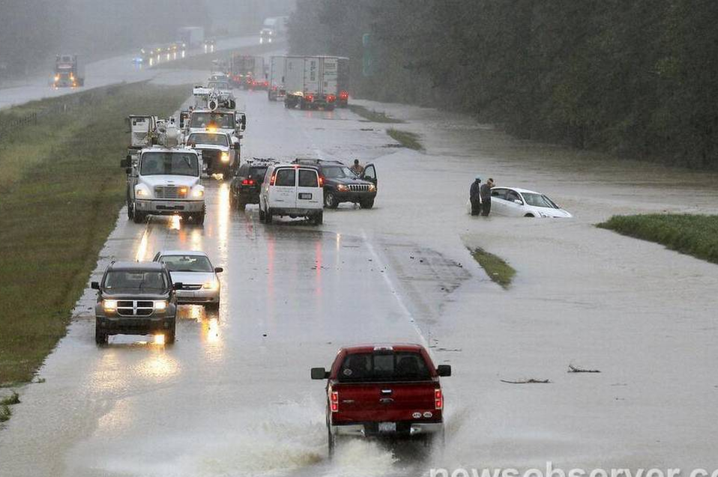
Hurricane flooding in ENC Watersheds
Hurricane Floyd, September 16th 1999
Hurricane Matthew October 8th 2016
Flooded street in Greene County. (Photo: Dave Saville, FEMA News).
https://www.ecu.edu/renci/StormsToLife/index.html
I-40 intersection with Highway 242 in Benson NC on Saturday, Oct. 8, 2016.
(Photo: Chris Seward )

Slide 7
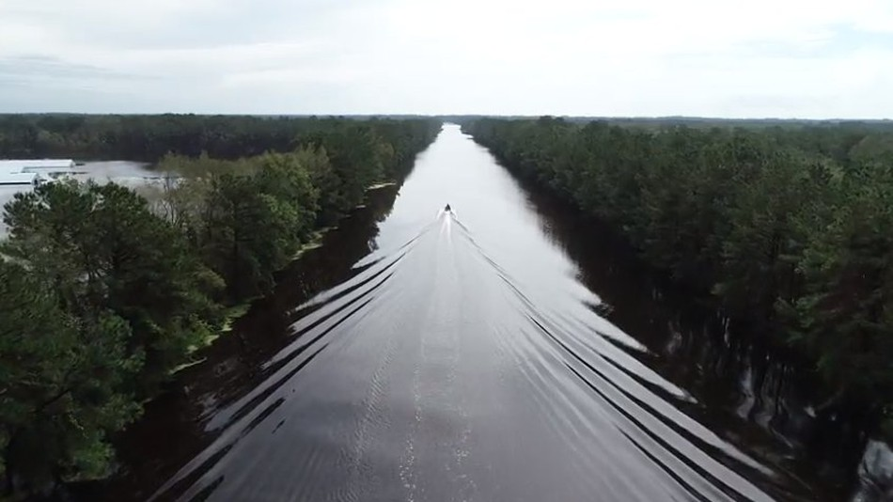
Hurricane flooding in ENC Watersheds
Hurricane Floyd, September 16th 1999
Hurricane Matthew October 8th 2016
Hurricane Florence, September 14th 2018
Flooded street in Greene County. (Photo: Dave Saville, FEMA News).
https://www.ecu.edu/renci/StormsToLife/index.html
I-40 intersection with Highway 242 in Benson NC on Saturday, Oct. 8, 2016.
(Photo: Chris Seward )
A North Carolina Highway Patrol drone captured this image of the I-40 (Pender County in Eastern North Carolina). Highway constructed in 1980’, probably using NOAA Atlas 1961.

Slide 8
Future Extreme Precipitation
A warming climate leads to fewer but more intense precipitation events.
Between 1895 and 2010, the extreme precipitation frequency index in the Southeast increased by 11% (Kunkel et al., 2013).
Recent climate research suggests that the magnitude of extreme precipitation in the U.S. will continue to increase throughout the twenty-first century.
What should we prepare for?
How to design infrastructure?
Adaptation and Resilience
for “2100” Hurricanes
Notes:
Extreme precipitation results in major floods and erosive runoff affecting human health, ecosystems, agriculture, infrastructures, and the economy.

Slide 9
What are IDF Curves ?
IDF curves for Wilmington, NC
IDF curves graphically represent the probability that an extreme event of particular INTENSITY at particular DURATION will occur.
At least 20-30 years of precipitation data.
Annual Maximum Series (AMS).
Fitting probability functions.
Calculating probability distributions.
Frequency
Intensity (mm/h)
Frequency
Hurricanes
Matthew
Duration (hours)
Florence
Notes:
Used in the design of urban storm-water systems, farm-terrace and drainage systems, highway and railway culverts, municipal storm-sewer systems, and other engineering works that must care for storm runoff.
EXPLAIN IDF CURVES WELL, EXPLAIN WILMINGTON, NC

Slide 10
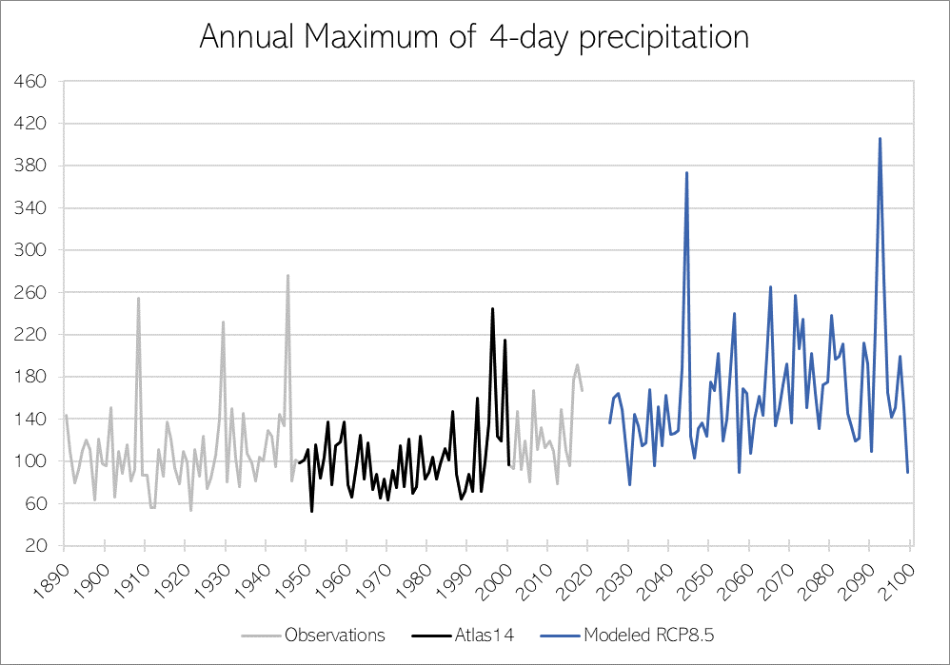
IDF curves and stationarity assumption
Major source of IDF curves in the US is Atlas 14 maintained by NOAA.
Probability distributions are calculated based on the assumption of the stationary nature of climate, however climate is changing.
Limitations imposed by data spatial and temporal availability.
Rainfall (mm)

Slide 11
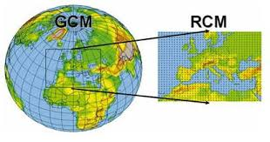
Modeled Data
Simulations from two Global Climate Models (GCMs):
CESM (The National Center for Atmospheric Research/Department of Energy (NCAR/DOE) Community Earth System Model, at grid spacing of ~1$°$.
CM3 (The Geophysical Fluid Dynamics Laboratory Coupled Model, at grid spacing of ~2.5$°$.
GCMs were dynamically downscaled to a 36-km grid over the CONUS using the Weather Research and Forecasting (WRF) .
Continuous hourly data for CONUS, for 76-year future period (2025-2100).
Downscaled projections inherited GCM biases (cold/dry biases).
Previous research showed that 36 km grid spacing is not sufficient to produce sub-daily IDF curves (Jalowska & Spero, in review).
Notes:
CONUS=contiguous U.S.

Slide 12
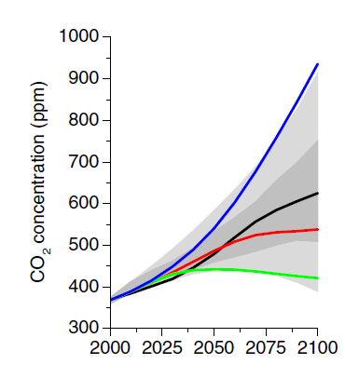
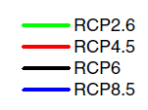
Representative Concentration Pathways
CESM RCP4.5
Moderate global emission reduction.
Assumes some mitigation strategies and technologies.
CO₂ concentration rising until 2040.
CO₂ concentration reaches 540 ppm by 2100.
CESM RCP8.5 & CM3 RCP8.5
- High GHG emission pathway scenario.
No global emissions reduction.
Reaching 940 ppm in 2100.
van Vuuren et al. (2011)
Notes:
2013= 400ppm
In 2019 maximum was 414.7ppm (3.5 higher than 2018)
At the current rate (2.2ppm/year) by 2040 we will have 459ppm
RCP2.6 The CO₂ concentration reaches 440 ppm by 2040 then slowly declines to 420 ppm by 2100
June 2018: 410.79 ppm
RCP4.5 650 ppm
RCP 8.5 1370 ppm

Slide 13
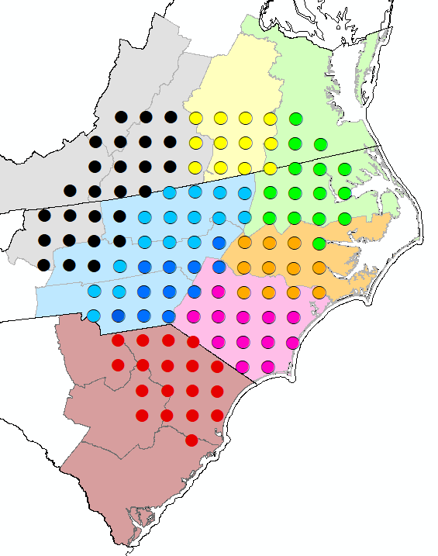
Methodology
Central Mountain
Northern Mountains
Southwestern Mountains
Western Piedmont
Eastern Piedmont
Tidewater
Northern Coastal Plain
Central Coastal Plain
Processed PRISM 4km gridded observational data for three hurricanes: Floyd 1999, Matthew 201l and Florence 2018.
Re-gridded (aggregated) the data to 36km WRF domain.
Subset for the ENC watersheds.
Regional Frequency Analysis (RFA) allows us to develop the IDF curves for the regions with the same probability distribution.
Defined 8 regions for RFA based on the US climate divisions: Mountains, Northern, Central and Southern Piedmont and 4 Coastal Plain regions, using each grid cell as a “station”.
Northern Piedmont
Central Piedmont
Southern Piedmont
Southern Coastal Plain
Central
North Central
Northeast
Southern
RFA regions
A
B
C
D
E
F
G
H
Notes:
PRISM=Parameter-elevation Regressions on Independent Slopes Model
Defined, RFA was based on 1000 simulations resulting in dissimilarity test D_{(i)} < |3|and heterogeneity test H_{(i)}< |2|.

Slide 14
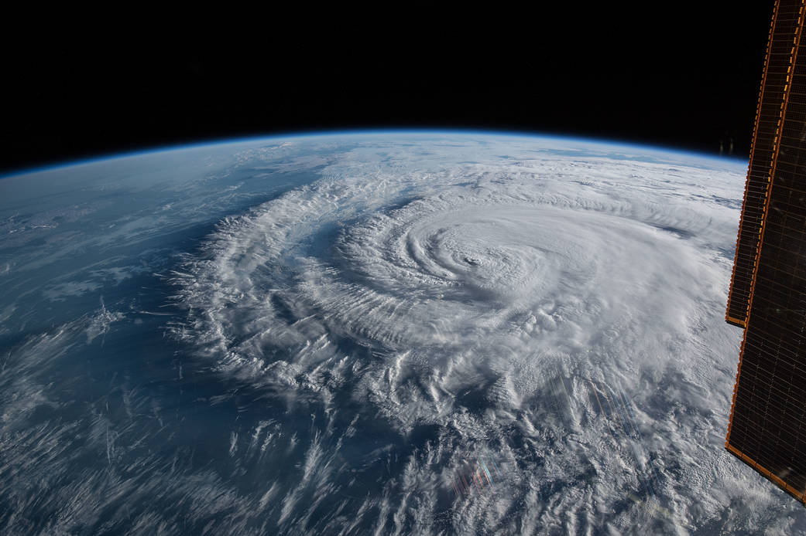
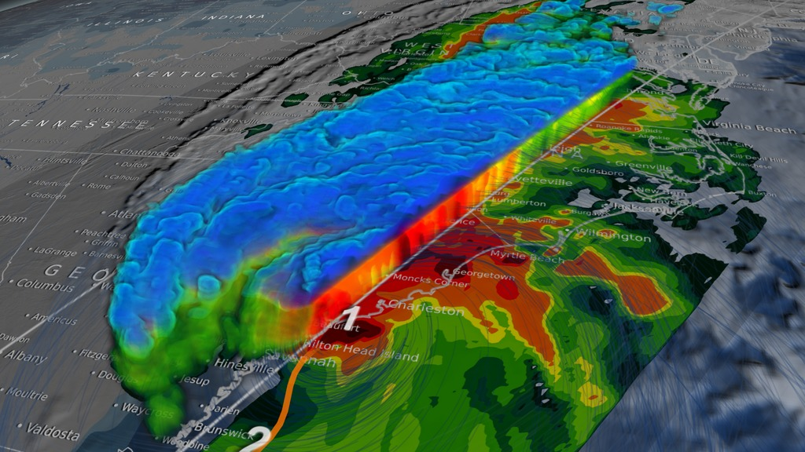
Methodology
Developed IDF using RFA for three realizations:
CESM 4.5
CESM 8.5
CM3 8.5
For two 30-year periods: 2025-2054 and 2070-2099.
Florence on Sept. 14, 2018 Photo credit: NASA
Calculated relative change in IDF curves between these two periods for two durations:
72-hour (Matthew)
96-hour (Floyd and Florence)
Applied developed ratios to rainfall amount and distribution of three hurricanes (a “design storm” approach).
3D model of Matthew over Carolinas. Photo credit: NASA
Notes:
Photo:
https://www.nasa.gov/image-feature/hurricane-florence-as-it-was-making-landfall-0

Slide 15
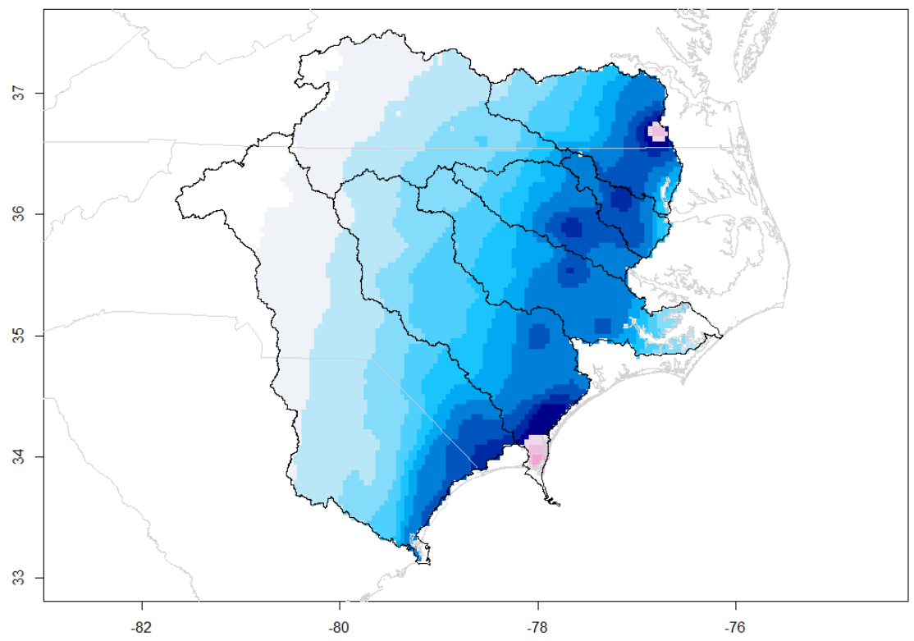
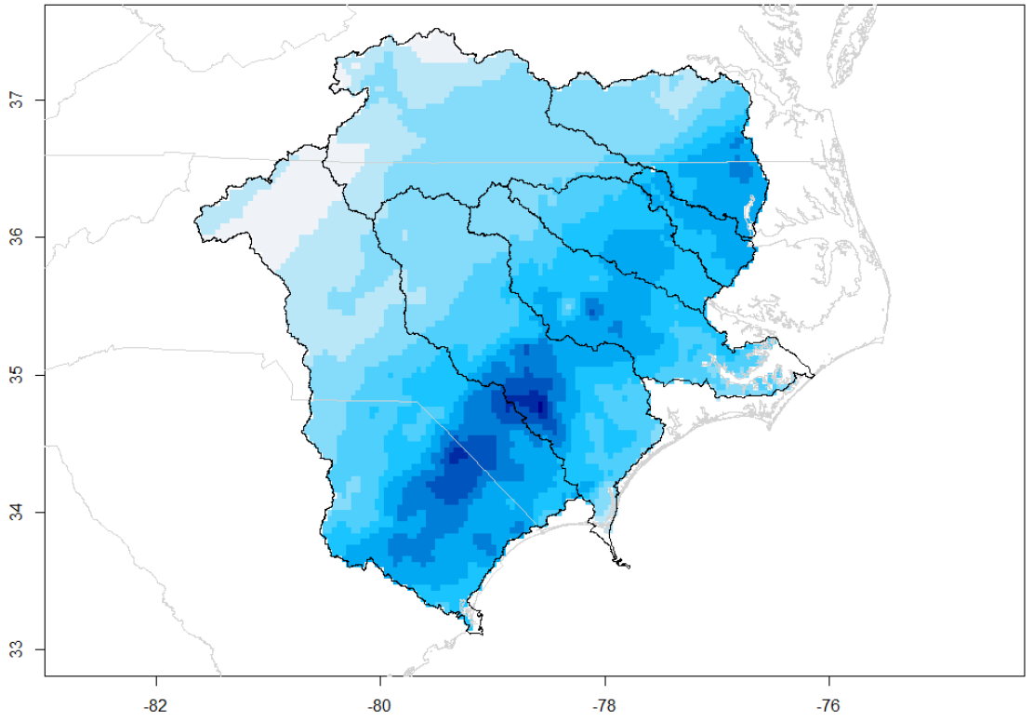
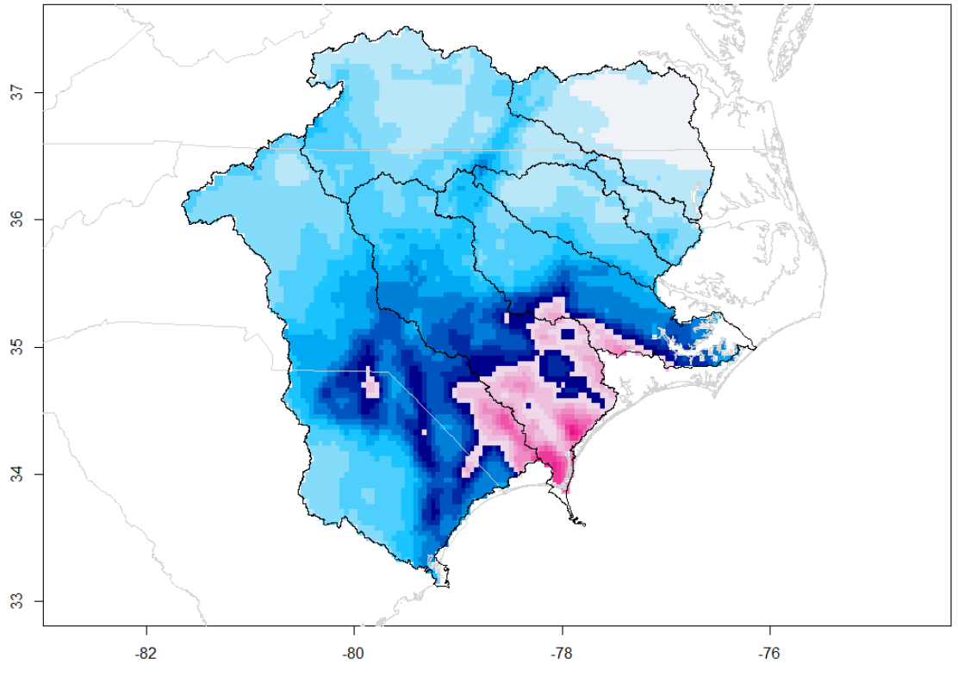
Observational data PRISM 4 km
Hurricane Floyd (1999) Total 96h rainfall
max = 611 mm
total = 22,842 tons of water
Hurricane Matthew (2016) Total 72h rainfall
max = 507 mm
total = 23,683 tons of water
Hurricane Florence (2018) Total 96h rainfall
max = 913 mm
total = 31,548 tons of water
Total rainfall (mm)
Start of the pink scale indicates the 1000-year rainfall or more (as of current NOAA Atlas 14)

Slide 16
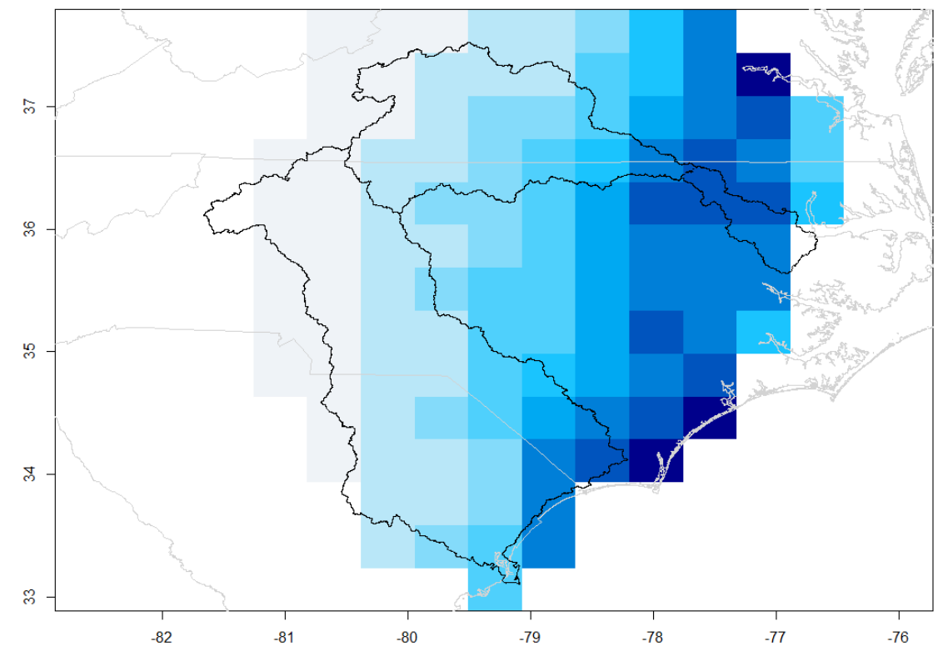
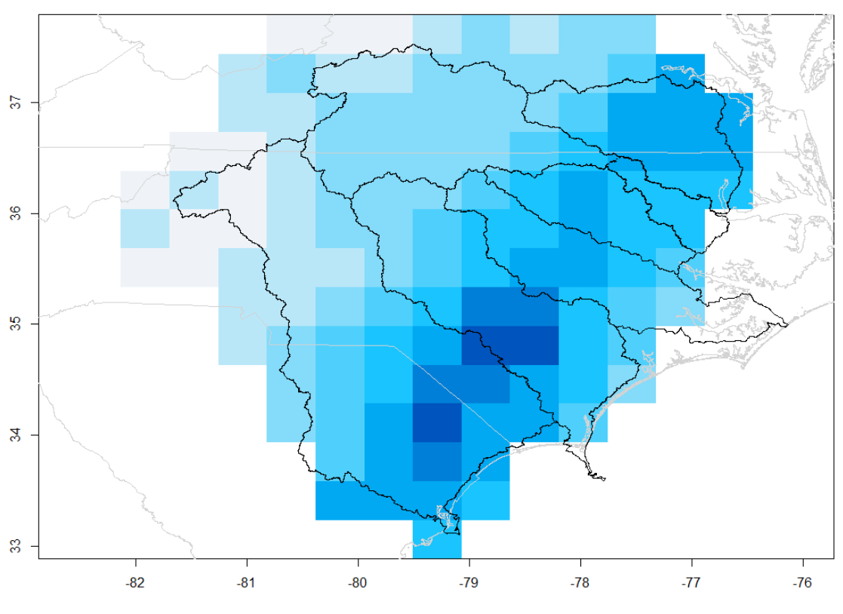
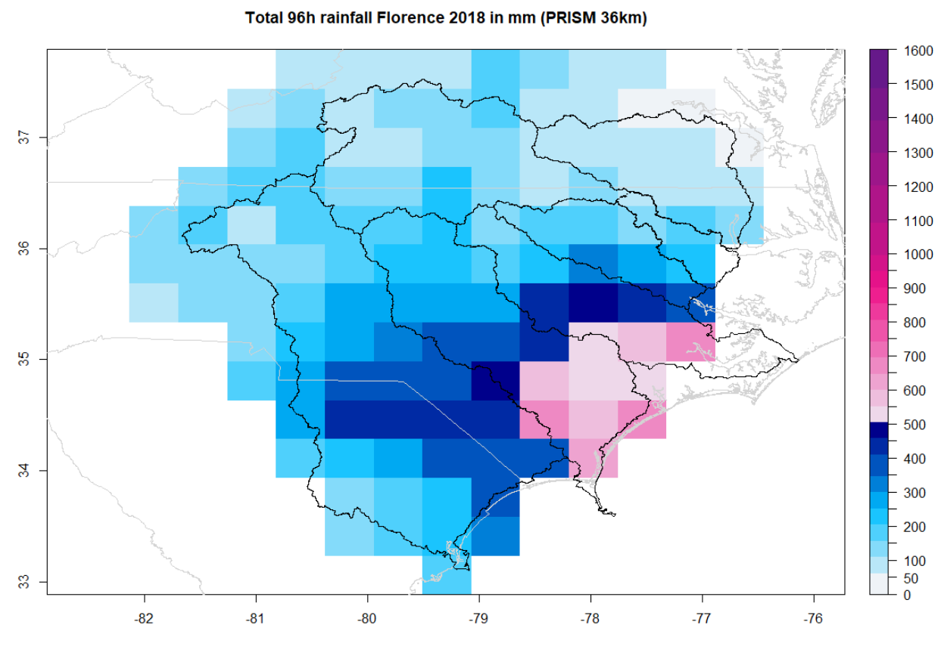
Observational data PRISM 36 km
Hurricane Floyd (1999) Total 96h rainfall
max = 499 mm
total = 21,921 tons of water
Hurricane Matthew (2016)
Total 72h rainfall
max = 375 mm
total = 22,426 tons of water
Hurricane Florence (2018)
Total 96h rainfall
max = 685 mm
total = 30,109 tons of water
Total rainfall (mm)
Re-gridding reduced total amount of rainfall by 5% and maximum rainfall by ~20%.

Slide 17
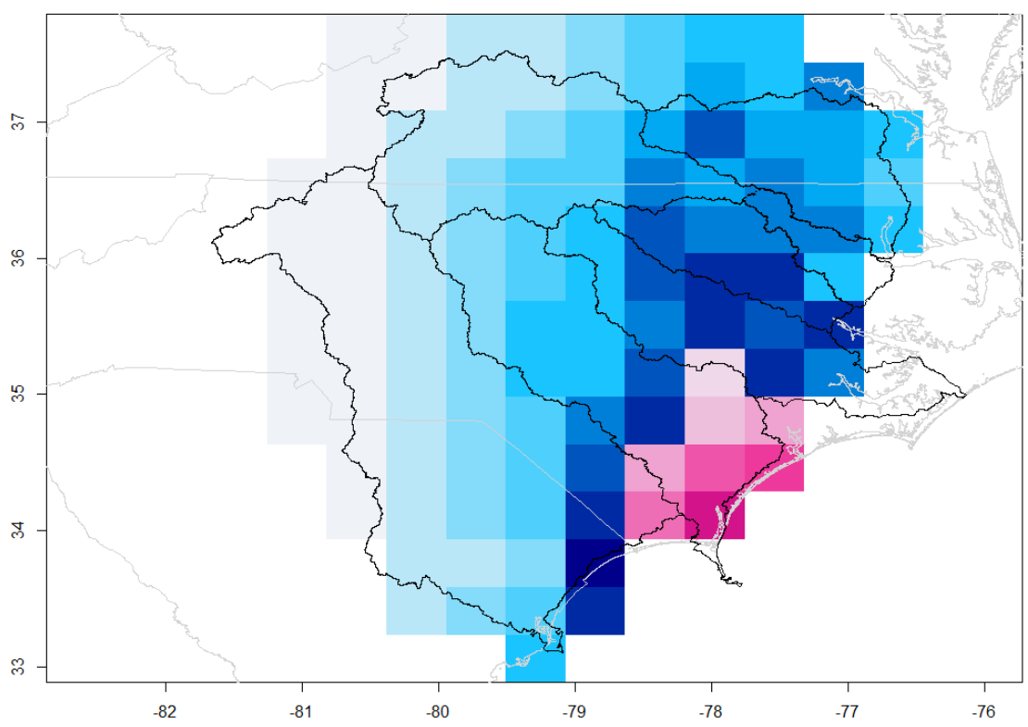
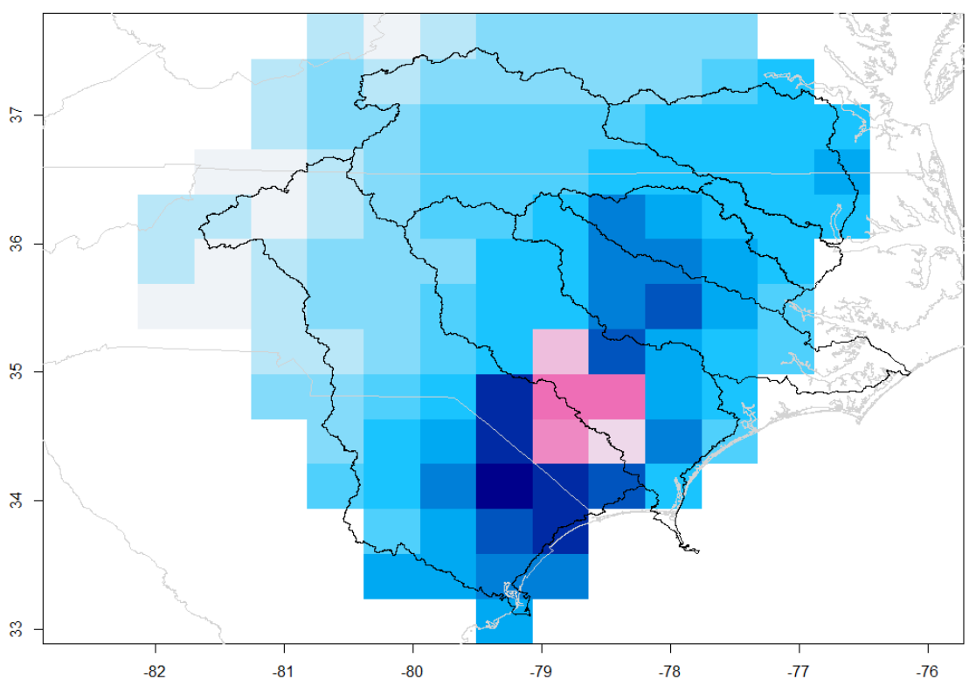
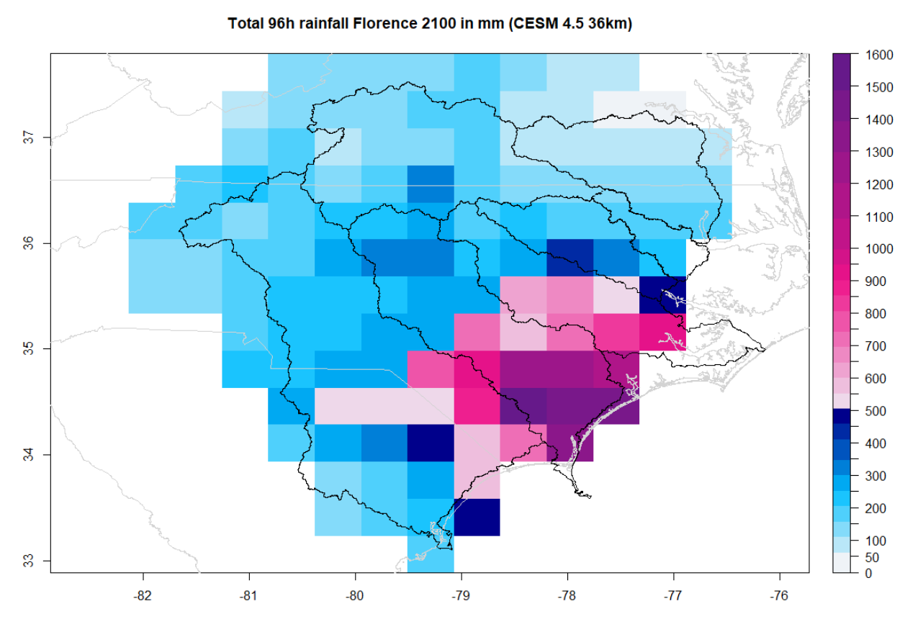
CESM RCP 4.5 36 km
Hurricane Floyd “2100”
Total 96h rainfall
max = 952 mm
total = 27,382 tons of water
Hurricane Matthew “2100”
Total 72h rainfall
max = 742 mm
total = 27,612 tons of water
Hurricane Florence “2100” Total 96h rainfall
max = 1564 mm
total = 42,425 tons of water
Total rainfall (mm)
The maximum rainfall increased by 46%-71%, total precipitation by 17%-34%.

Slide 18
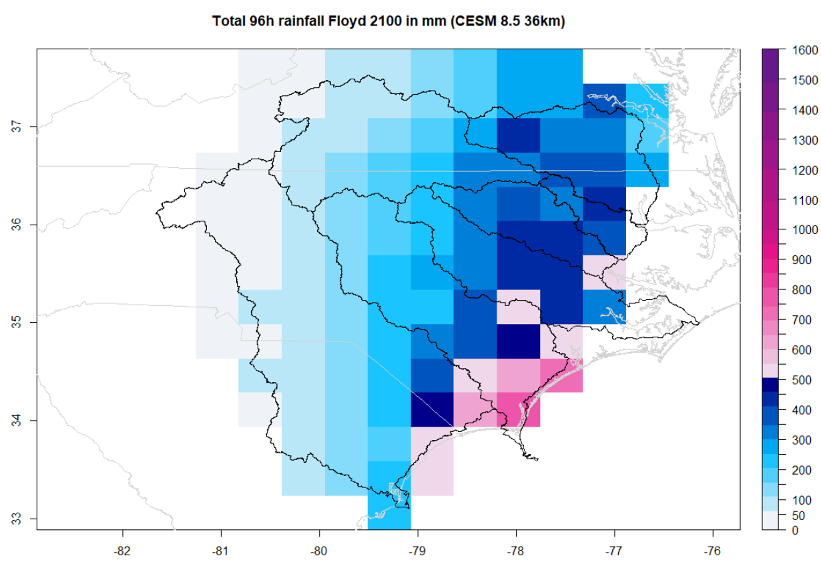
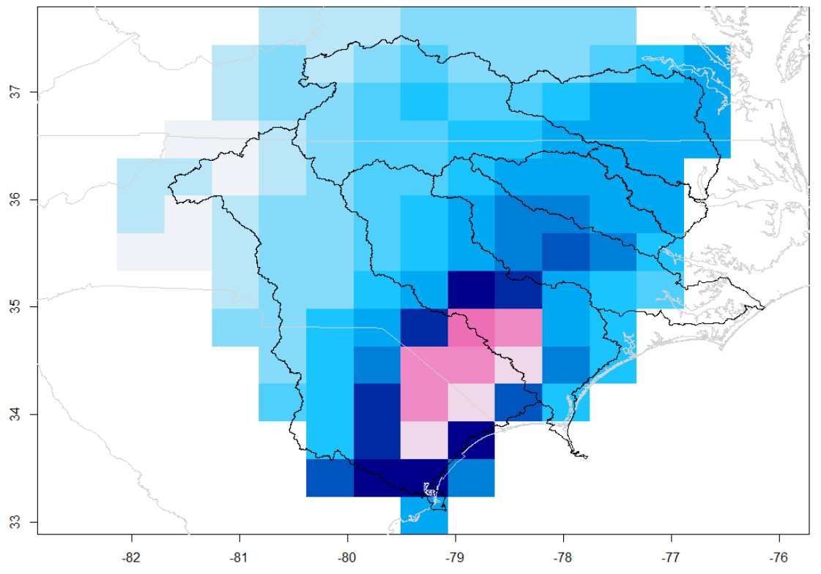
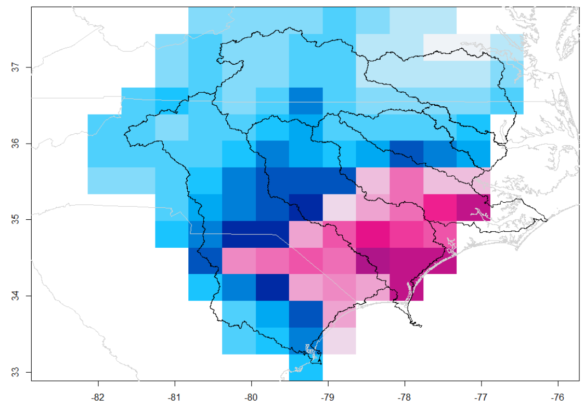
CESM RCP 8.5 36 km
Hurricane Floyd “2100”
Total 96h rainfall
max = 754 mm
total = 28,069 tons of water
Hurricane Matthew “2100”
Total 72h rainfall
max = 715 mm
total = 30,406 tons of water
Hurricane Florence “2100” Total 96h rainfall
max = 1163 mm
total = 42,292 tons of water
Total rainfall (mm)
The maximum rainfall increased by 23%-41%, total precipitation by 23%-34%.

Slide 19
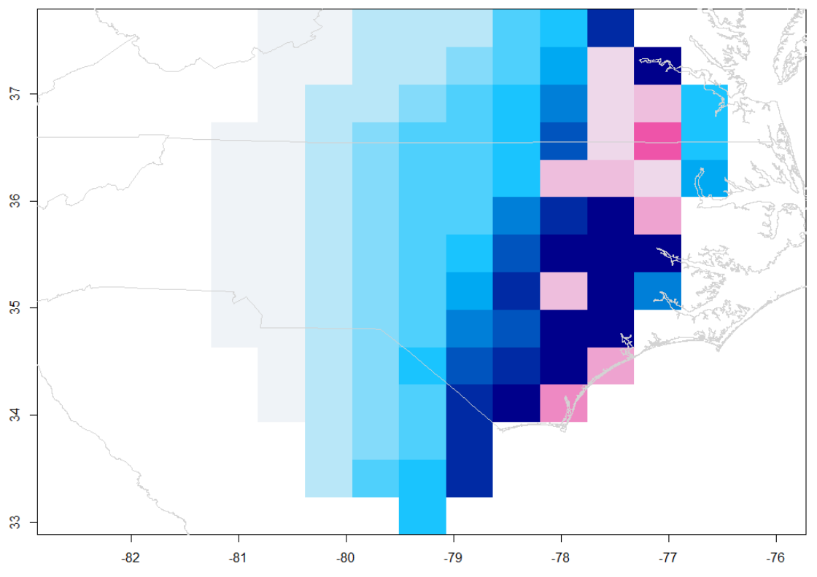
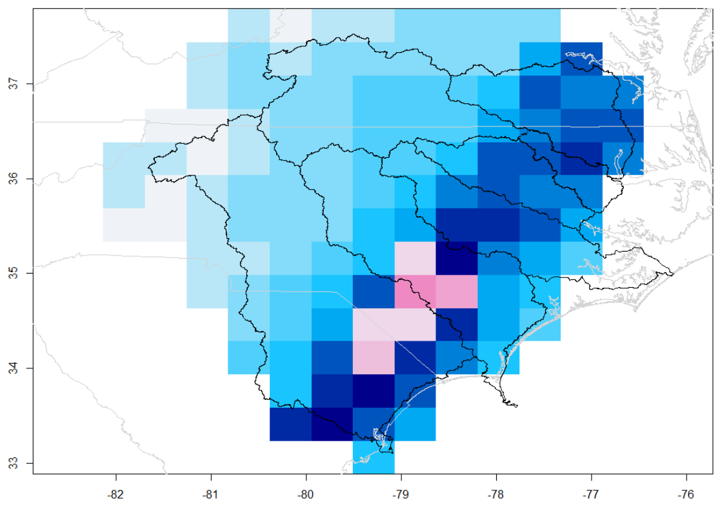
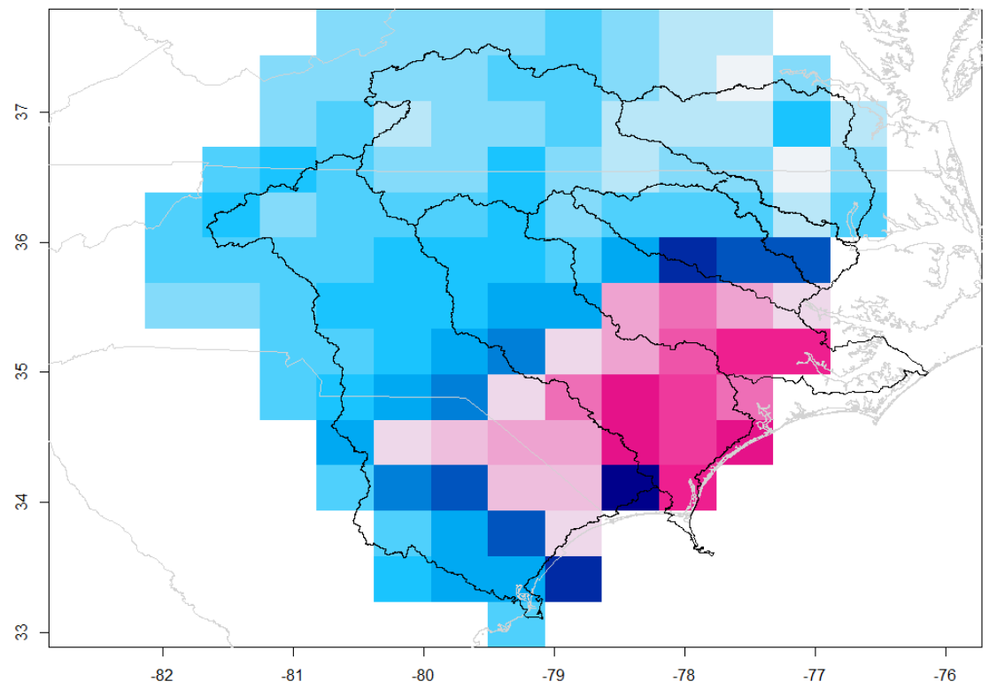
CM3 RCP 8.5 36 km
Hurricane Floyd “2100”
Total 96h rainfall
max = 793 mm
total = 29,293 tons of water
Hurricane Matthew “2100”
Total 72h rainfall
max = 666 mm
total = 30,063 tons of water
Hurricane Florence “2100” Total 96h rainfall
max = 944 mm
total = 38,527 tons of water
Total rainfall (mm)
The maximum rainfall increased up to 30%, total precipitation up to 28%.

Slide 20
Back to the Future …
FLORENCE, 2018
FLOYD “2100” CESM 4.5
FLOYD “2100” CESM 8.5

Slide 21
Back to the Future …
FLORENCE “2100” CESM 4.5
A simulated Florence “2100” (maximum rainfall = 1564 mm) also already happened!
Florence “2100” maximum corresponds to 2017 hurricane Harvey maximum rainfall of 1539 mm.

Slide 22
Conclusions
Our research suggests that in the future, ENC watersheds will experience:
A decrease in 2 to 10-year precipitation intensities.
An increase in 200-year and longer rainfall events.
A spatial “concentration” of storm precipitation.
CESM RCP 4.5 projected greatest change in long maximum rain events but smaller changes in total precipitation.
CESM RCP 8.5 projected greatest change in total precipitation per hurricane.
CM3 RCP 8.5 show most variability in future changes of extreme rainfall.
Notes:
North Carolina Sea-Level Rise Assessment Report March 2010
https://coast.noaa.gov/slr/#/layer/vul-soc/3/-8697884.147642963/4079244.2421634467/11/satellite/45/0.8/2050/interHigh/midAccretion

Slide 23
Thank you
Follow up questions:
jalowska.anna@epa.gov
@lacecoasts
CALL FOR PAPERS
7th Interagency Conference on Research in the Watersheds
ICRW7: Enhancing Landscapes for Sustainable Intensification and Watershed Resiliency
March 30 – April 2, 2020 in Tifton, Georgia
https://www.icrwatersheds.org/
Deadline: November 1, 2019

Slide 24
Modeling options
WRF Model Options
Shortwave Radiation | RRTMG
Longwave Radiation | RRTMG
Microphysics | WSM6
Convection | Kain-Fritsch with Radiative Feedbacks
PBL | WSU
Land-Surface Model | Noah
Nudging | Spectral Nudging toward GCM
 | NCAR/DOE CESM | GFDL CM3
GCM Resolution | 0.875 x 1.25 | 2 x 2.5
WRF Domain | 36-km only | 108-36-km, two-way
WRF Version | 3.4.1 + mods to K-F CuPa (Herwehe et al., JGR-A, 2014) | 3.6
Scenarios | RCP4.5 and RCP8.5 | RCP8.5
Radiative Forcing | Standard | Following the RCPs
Lake Temperatures | Imported from CLM (Spero et al., J. Climate, 2016) | Modeled with FLake (Mallard et al., JGR-A, 2014)
WRF Model Options
Shortwave Radiation | RRTMG
Longwave Radiation | RRTMG
Microphysics | WSM6
Convection | Kain-Fritsch with Radiative Feedbacks
PBL | WSU
Land-Surface Model | Noah
Nudging | Spectral Nudging toward GCM
WRF Model Options
Shortwave Radiation | RRTMG
Longwave Radiation | RRTMG
Microphysics | WSM6
Convection | Kain-Fritsch with Radiative Feedbacks
PBL | WSU
Land-Surface Model | Noah
Nudging | Spectral Nudging toward GCM
 | NCAR/DOE CESM | GFDL CM3
GCM Resolution | 0.875 x 1.25 | 2 x 2.5
WRF Domain | 36-km only | 108-36-km, two-way
WRF Version | 3.4.1 + mods to K-F CuPa (Herwehe et al., JGR-A, 2014) | 3.6
Scenarios | RCP4.5 and RCP8.5 | RCP8.5
Radiative Forcing | Standard | Following the RCPs
Lake Temperatures | Imported from CLM (Spero et al., J. Climate, 2016) | Modeled with FLake (Mallard et al., JGR-A, 2014)
 | NCAR/DOE CESM | GFDL CM3
GCM Resolution | 0.875 x 1.25 | 2 x 2.5
WRF Domain | 36-km only | 108-36-km, two-way
WRF Version | 3.4.1 + mods to K-F CuPa (Herwehe et al., JGR-A, 2014) | 3.6
Scenarios | RCP4.5 and RCP8.5 | RCP8.5
Radiative Forcing | Standard | Following the RCPs
Lake Temperatures | Imported from CLM (Spero et al., J. Climate, 2016) | Modeled with FLake (Mallard et al., JGR-A, 2014)
 | NCAR/DOE CESM | GFDL CM3
GCM Resolution | 0.875 x 1.25 | 2 x 2.5
WRF Domain | 36-km only | 108-36-km, two-way
WRF Version | 3.4.1 + mods to K-F CuPa (Herwehe et al., JGR-A, 2014) | 3.6
Scenarios | RCP4.5 and RCP8.5 | RCP8.5
Radiative Forcing | Standard | Following the RCPs
Lake Temperatures | Imported from CLM (Spero et al., J. Climate, 2016) | Modeled with FLake (Mallard et al., JGR-A, 2014)
 | NCAR/DOE CESM | GFDL CM3
GCM Resolution | 0.875 x 1.25 | 2 x 2.5
WRF Domain | 36-km only | 108-36-km, two-way
WRF Version | 3.4.1 + mods to K-F CuPa (Herwehe et al., JGR-A, 2014) | 3.6
Scenarios | RCP4.5 and RCP8.5 | RCP8.5
Radiative Forcing | Standard | Following the RCPs
Lake Temperatures | Imported from CLM (Spero et al., J. Climate, 2016) | Modeled with FLake (Mallard et al., JGR-A, 2014)
 | NCAR/DOE CESM | GFDL CM3
GCM Resolution | 0.875 x 1.25 | 2 x 2.5
WRF Domain | 36-km only | 108-36-km, two-way
WRF Version | 3.4.1 + mods to K-F CuPa (Herwehe et al., JGR-A, 2014) | 3.6
Scenarios | RCP4.5 and RCP8.5 | RCP8.5
Radiative Forcing | Standard | Following the RCPs
Lake Temperatures | Imported from CLM (Spero et al., J. Climate, 2016) | Modeled with FLake (Mallard et al., JGR-A, 2014)
 | NCAR/DOE CESM | GFDL CM3
GCM Resolution | 0.875 x 1.25 | 2 x 2.5
WRF Domain | 36-km only | 108-36-km, two-way
WRF Version | 3.4.1 + mods to K-F CuPa (Herwehe et al., JGR-A, 2014) | 3.6
Scenarios | RCP4.5 and RCP8.5 | RCP8.5
Radiative Forcing | Standard | Following the RCPs
Lake Temperatures | Imported from CLM (Spero et al., J. Climate, 2016) | Modeled with FLake (Mallard et al., JGR-A, 2014)
 | NCAR/DOE CESM | GFDL CM3
GCM Resolution | 0.875 x 1.25 | 2 x 2.5
WRF Domain | 36-km only | 108-36-km, two-way
WRF Version | 3.4.1 + mods to K-F CuPa (Herwehe et al., JGR-A, 2014) | 3.6
Scenarios | RCP4.5 and RCP8.5 | RCP8.5
Radiative Forcing | Standard | Following the RCPs
Lake Temperatures | Imported from CLM (Spero et al., J. Climate, 2016) | Modeled with FLake (Mallard et al., JGR-A, 2014)
 | NCAR/DOE CESM | GFDL CM3
GCM Resolution | 0.875 x 1.25 | 2 x 2.5
WRF Domain | 36-km only | 108-36-km, two-way
WRF Version | 3.4.1 + mods to K-F CuPa (Herwehe et al., JGR-A, 2014) | 3.6
Scenarios | RCP4.5 and RCP8.5 | RCP8.5
Radiative Forcing | Standard | Following the RCPs
Lake Temperatures | Imported from CLM (Spero et al., J. Climate, 2016) | Modeled with FLake (Mallard et al., JGR-A, 2014)
 | NCAR/DOE CESM | GFDL CM3
GCM Resolution | 0.875 x 1.25 | 2 x 2.5
WRF Domain | 36-km only | 108-36-km, two-way
WRF Version | 3.4.1 + mods to K-F CuPa (Herwehe et al., JGR-A, 2014) | 3.6
Scenarios | RCP4.5 and RCP8.5 | RCP8.5
Radiative Forcing | Standard | Following the RCPs
Lake Temperatures | Imported from CLM (Spero et al., J. Climate, 2016) | Modeled with FLake (Mallard et al., JGR-A, 2014)
 | NCAR/DOE CESM | GFDL CM3
GCM Resolution | 0.875 x 1.25 | 2 x 2.5
WRF Domain | 36-km only | 108-36-km, two-way
WRF Version | 3.4.1 + mods to K-F CuPa (Herwehe et al., JGR-A, 2014) | 3.6
Scenarios | RCP4.5 and RCP8.5 | RCP8.5
Radiative Forcing | Standard | Following the RCPs
Lake Temperatures | Imported from CLM (Spero et al., J. Climate, 2016) | Modeled with FLake (Mallard et al., JGR-A, 2014)
 | NCAR/DOE CESM | GFDL CM3
GCM Resolution | 0.875 x 1.25 | 2 x 2.5
WRF Domain | 36-km only | 108-36-km, two-way
WRF Version | 3.4.1 + mods to K-F CuPa (Herwehe et al., JGR-A, 2014) | 3.6
Scenarios | RCP4.5 and RCP8.5 | RCP8.5
Radiative Forcing | Standard | Following the RCPs
Lake Temperatures | Imported from CLM (Spero et al., J. Climate, 2016) | Modeled with FLake (Mallard et al., JGR-A, 2014)
 | NCAR/DOE CESM | GFDL CM3
GCM Resolution | 0.875 x 1.25 | 2 x 2.5
WRF Domain | 36-km only | 108-36-km, two-way
WRF Version | 3.4.1 + mods to K-F CuPa (Herwehe et al., JGR-A, 2014) | 3.6
Scenarios | RCP4.5 and RCP8.5 | RCP8.5
Radiative Forcing | Standard | Following the RCPs
Lake Temperatures | Imported from CLM (Spero et al., J. Climate, 2016) | Modeled with FLake (Mallard et al., JGR-A, 2014)
 | NCAR/DOE CESM | GFDL CM3
GCM Resolution | 0.875 x 1.25 | 2 x 2.5
WRF Domain | 36-km only | 108-36-km, two-way
WRF Version | 3.4.1 + mods to K-F CuPa (Herwehe et al., JGR-A, 2014) | 3.6
Scenarios | RCP4.5 and RCP8.5 | RCP8.5
Radiative Forcing | Standard | Following the RCPs
Lake Temperatures | Imported from CLM (Spero et al., J. Climate, 2016) | Modeled with FLake (Mallard et al., JGR-A, 2014)
Notes:
Extra slide

Slide 25
IDF curves and stationarity assumption
(22 years)
(22 years)
(20 years)
IDF curves for Wilmington, NC
 | Probability of 24h rainfall for Florence (241 mm) | Value for 24h 25 year rain (mm)
NOAA
Atlas 1961 | 25-year | 210
Atlas 2008 | 25-year | 240
Our Study
1952-2013 | 25-year | 241
1950-1971 | 50-year | 211
1972-1993 | 1000- year | 173
1994-2013 | 10-year | 346
(64 years)
Hurricanes
Matthew
Florence
Frequency
Notes:
Harvey 24h intensity= 19.2 mm/h =461mm
Florence 10.1 per hour

