Slide 1
Comparing Extreme Weather Events Generated by 36-km and 12-km WRF Simulations
T. L. Spero¹, J. H. Bowden², A. M. Jalowska¹, M. S. Mallard¹, and G. M. Gray^{1,2}
¹Atmospheric & Environmental Systems Modeling Division
Center for Environmental Measurement & Modeling
Office of Research and Development
U.S. Environmental Protection Agency
²North Carolina State University
18th Annual CMAS Conference, Chapel Hill, NC
22 October 2019
The views expressed in this presentation are those of the authors and do not necessarily represent the views or policies of the U.S. EPA.
The 3rd and 5th authors were supported in part by an appointment to the ORISE participant research program supported by an interagency agreement between EPA and DOE.

Slide 2
What are extreme weather events?
IPCC: “The occurrence of a value of a weather or climate variable above (or below) a threshold value near the upper (or lower) ends of the range of observed values of the variable.”
NWS: “Extreme events are defined as lying in the outermost
(“most unusual”) 10 percent of a place’s history.”
WMO: 60 categories of extreme events ranging from acute events to prolonged events in Weather, Climate, and Water (53); Geophysical (1); and Space Weather (6). (http://www.wmo.int/pages/prog/wcp/wcdmp/meeting/documents/Catalogue_Hazards_Extreme_Events_WMO_091117.pdf)

Slide 3
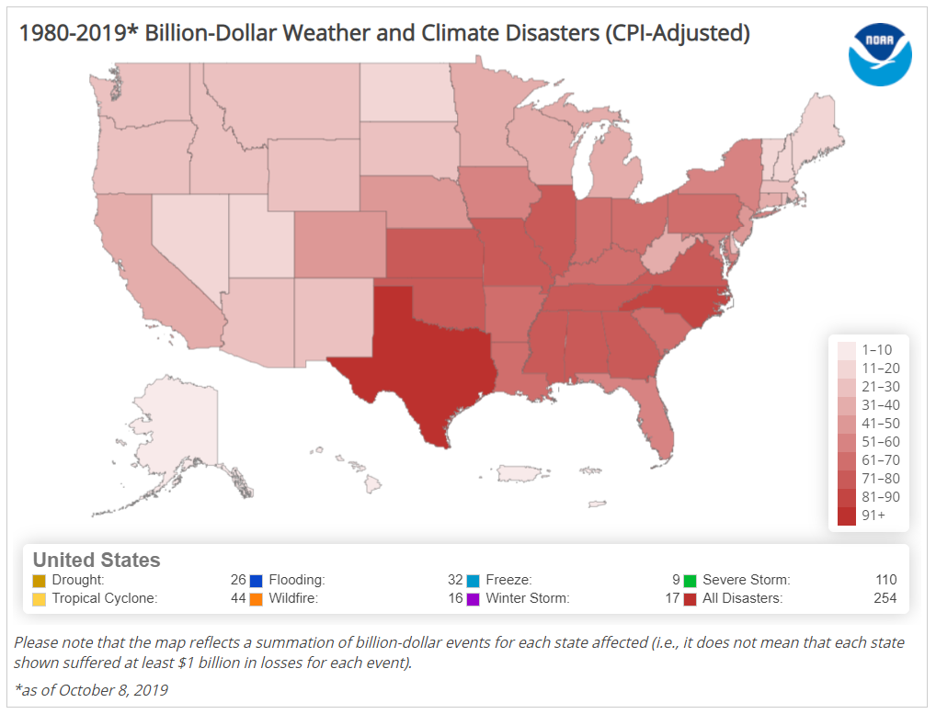
Extreme events are costly in many ways!
ncdc.noaa.gov/billions

Slide 4
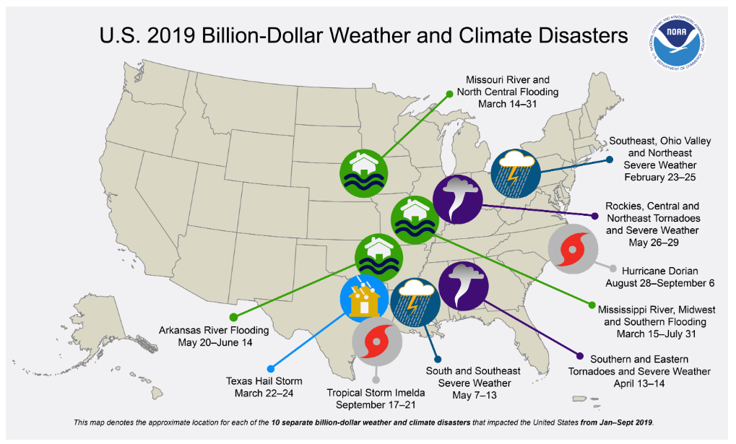
Extreme events come in many forms!
ncdc.noaa.gov/billions

Slide 5
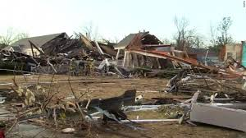
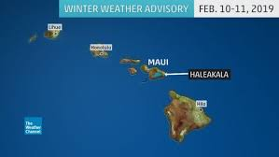

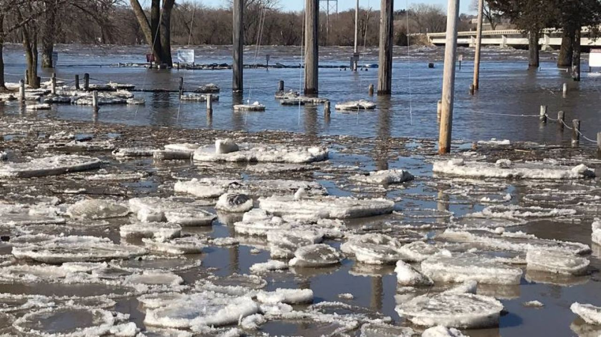
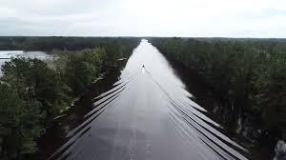
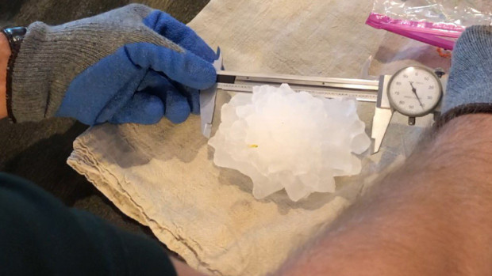

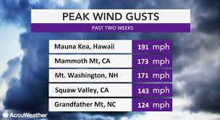
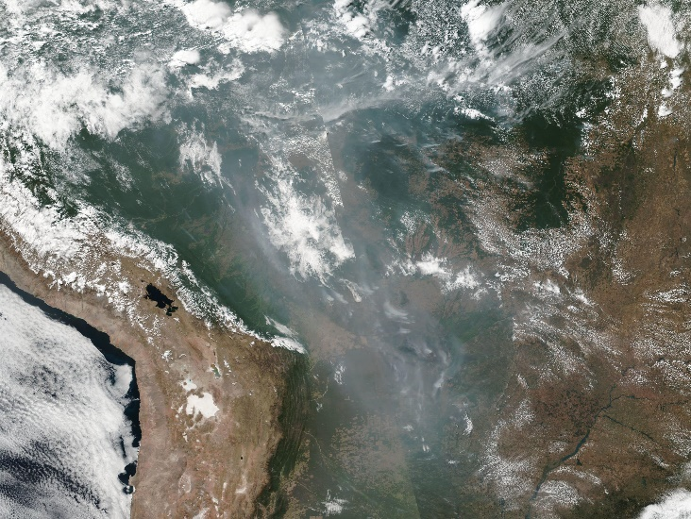
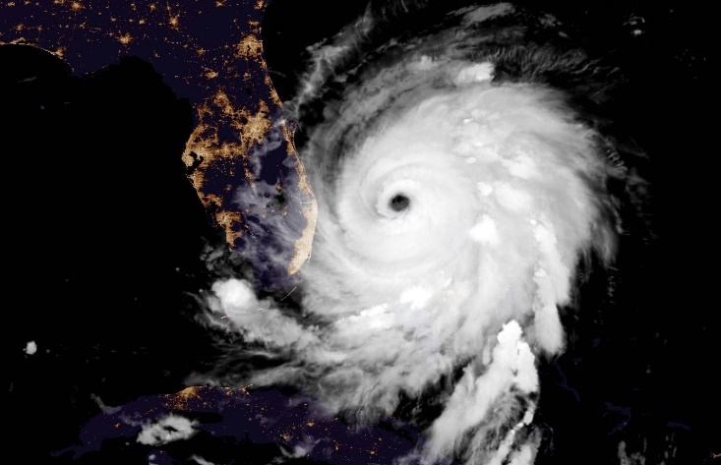
Extreme events are occurring more often!
Mile-Wide Alabama Tornado
3 Mar 2019 (CNN)
Record-Breaking Cold
in Hawai’i
10 Feb 2019 (The Weather Channel)
Houston Fireworks Fog
1 Jan 2019 (ABC13)
Omaha Ice Dam and Flood
17 Mar 2019 (AP)
I-40 after Hurricane Florence
18 Sept 2018 (AP)
Largest Hail in Colorado
13 Aug 2019 (CO Climate Ctr)
Cat 5
Hurricane Dorian
2 Sept 2019 (NOAA)
February
Winds
Anchorage, AK hits 90F for first time
5 Jul 2019 (NY Times)
Amazon Wildfires
22 Aug 2019 (NASA)

Slide 6
Can we simulate extreme events?
What extreme events can we simulate with WRF?
How important is horizontal grid spacing?
Can we characterize/quantify potential changes to extreme events?

Slide 7
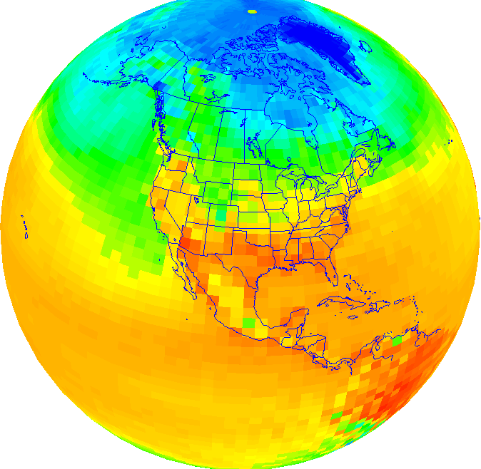
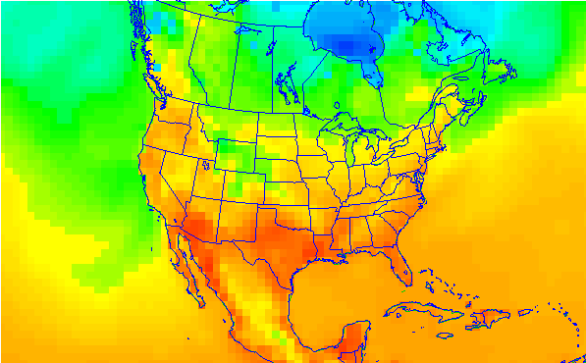
What is “dynamical downscaling”?
Global Climate
- Comprehensive science
- Emissions scenarios
- Multi-century data
- Coarse resolution
Regional (National or
Local) Impacts of
Climate Change
- Effects on human health,
air quality, and ecosystems
- Frequency and intensity of
extreme events
Dynamical Downscaling
Large, well-established
(external) programs
EPA’s interests
GCM
RCM

Slide 8
WRF Modeling Setup
WRFv3.9 with a “dynamical downscaling” configuration
  Long, continuous simulation
  Options differ from most EPA retrospective applications
  No additional observations included (emulates regional climate scenario)
Historical (verifiable) case: 1988—2010 (23-year period)
Forcing data from ERA-Interim (0.75° x 0.75°)
  Initial conditions
  Lateral boundary conditions
  Surface fields
  Large-scale nudging

Slide 9
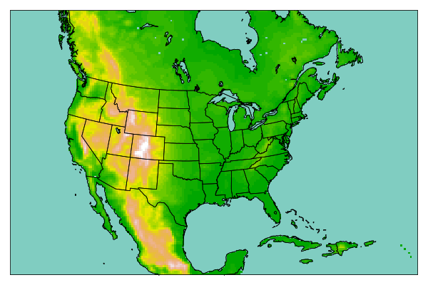
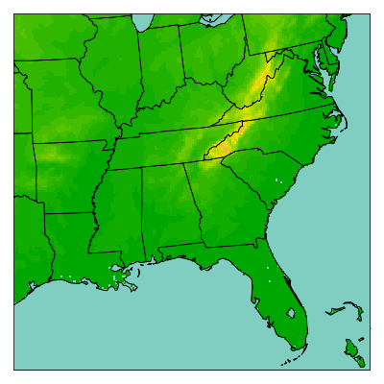
WRF Modeling Domains
36-km (210 x 140)
12-km (163 x 163)
34 hybrid sigma-pressure layers up to 50 hPa

Slide 10
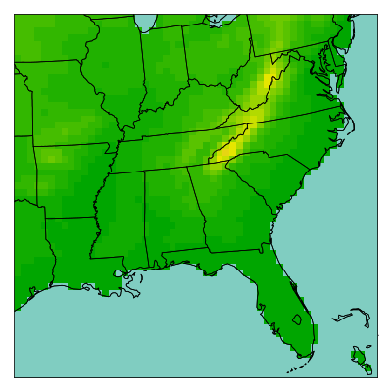
WRF Modeling Domains for Analysis
Cropped 36-km (55 x 55)
12-km (163 x 163)

Slide 11
WRF Model Options
Description | Option Used
Longwave & Shortwave Radiation | RRTMG
Microphysics | WSM6
Subgrid Convection | Kain-Fritsch + radiative feedbacks | MSKF
PBL Scheme | ACM2 | YSU
Land-Surface Model | NOAH
Land Use Classification | NLCD-MODIS
Nudging | Spectral nudging above PBL only potential temperature horizontal wind components geopotential water vapor mixing ratio

Slide 12
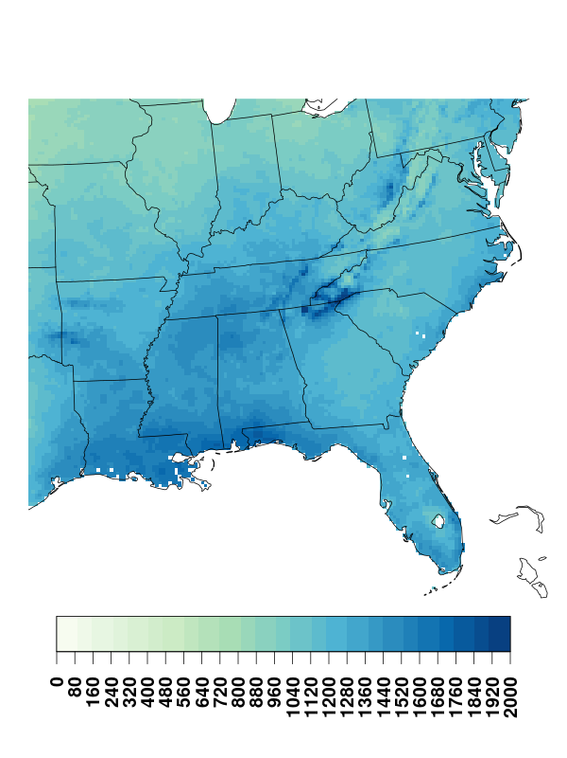
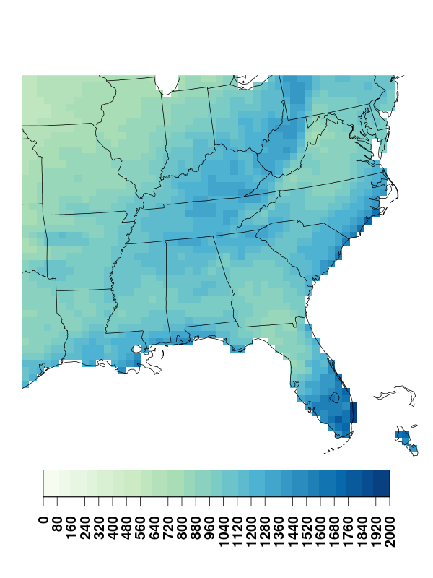
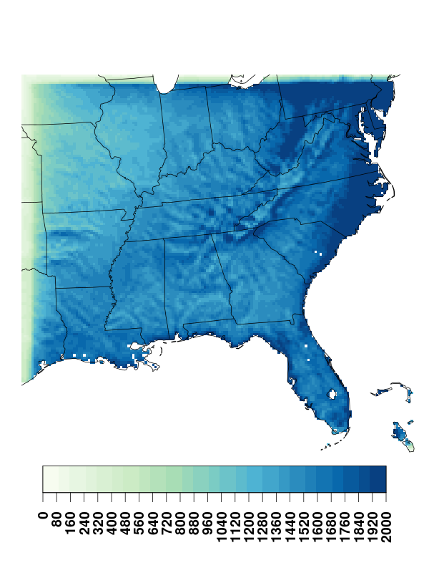
Annual Average Precipitation (mm)
PRISM
36-km WRF
12-km WRF (KF-rad)

Slide 13
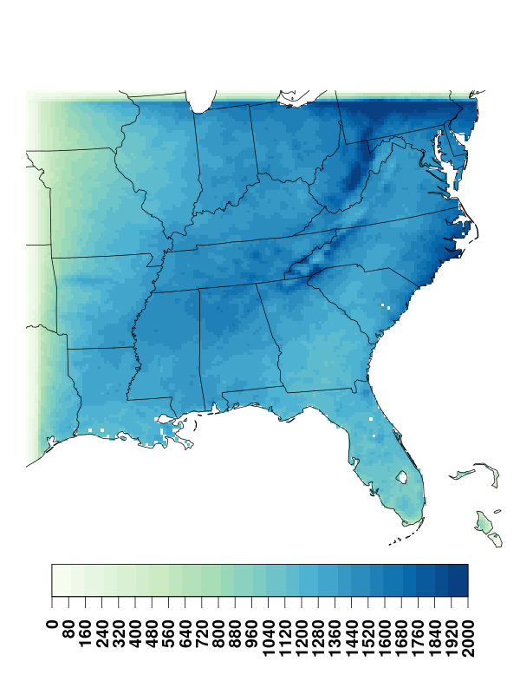
Annual Average Precipitation (mm)
PRISM
36-km WRF
12-km WRF (MSKF)

Slide 14
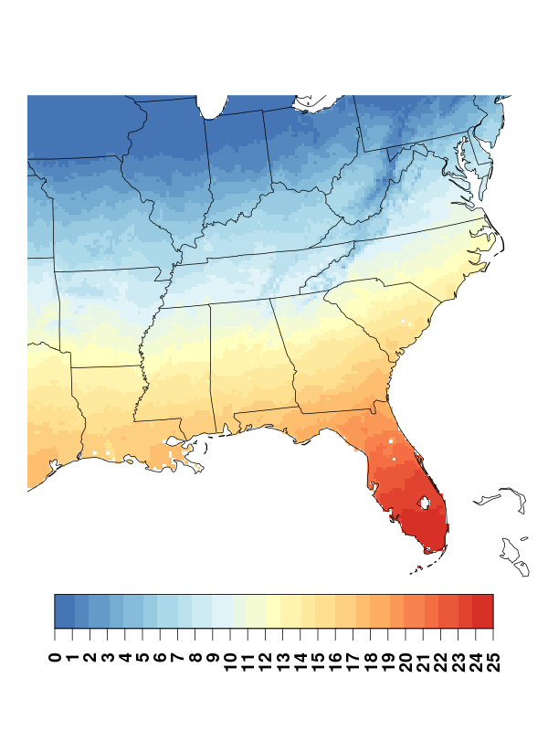
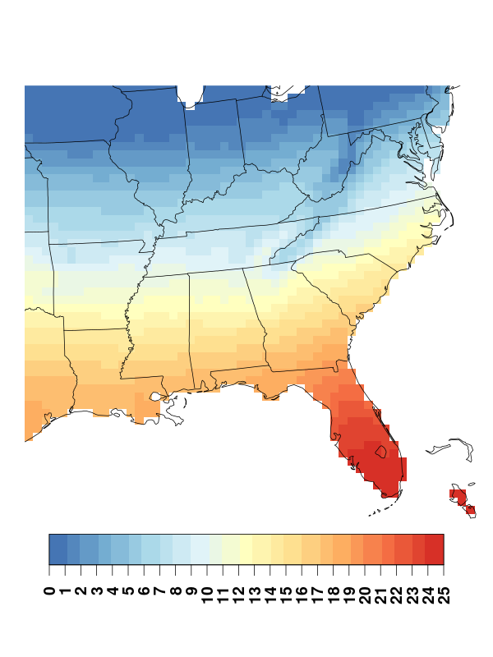

January Average Max Temperature (°C)
PRISM
36-km WRF
12-km WRF (MSKF)

Slide 15
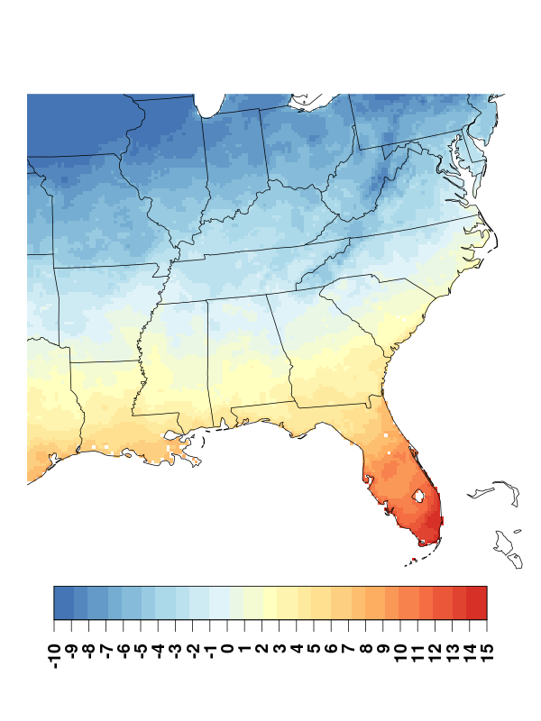
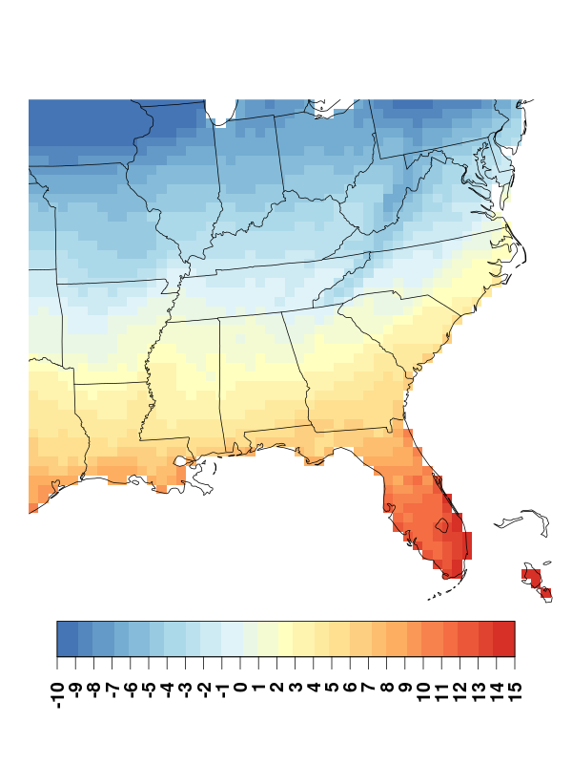
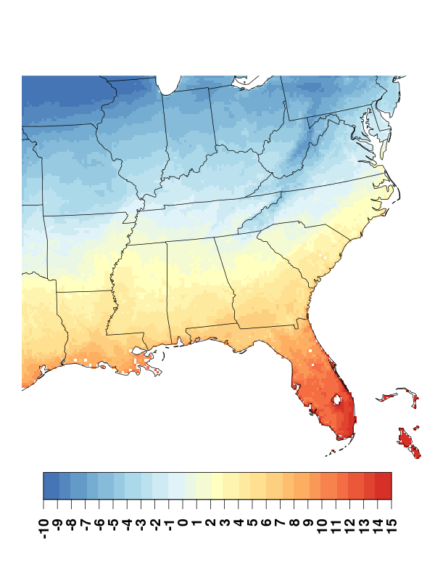
January Average Min Temperature (°C)
PRISM
36-km WRF
12-km WRF (MSKF)

Slide 16
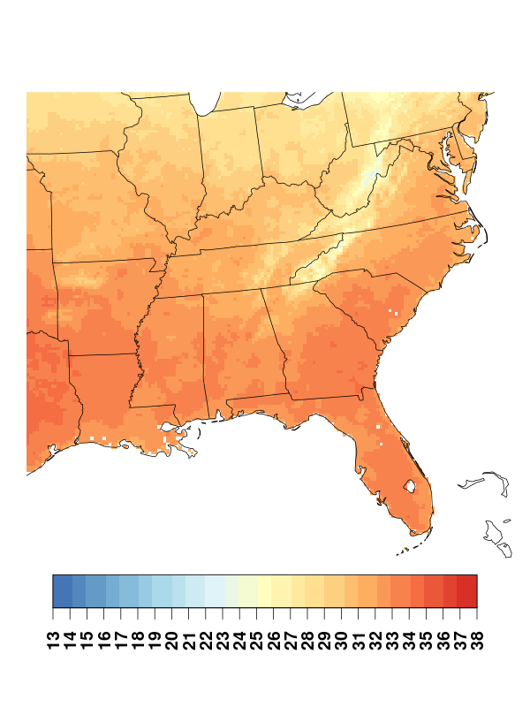
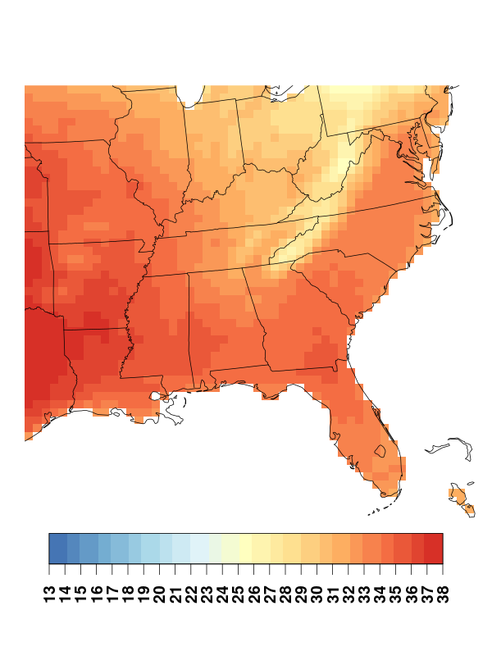
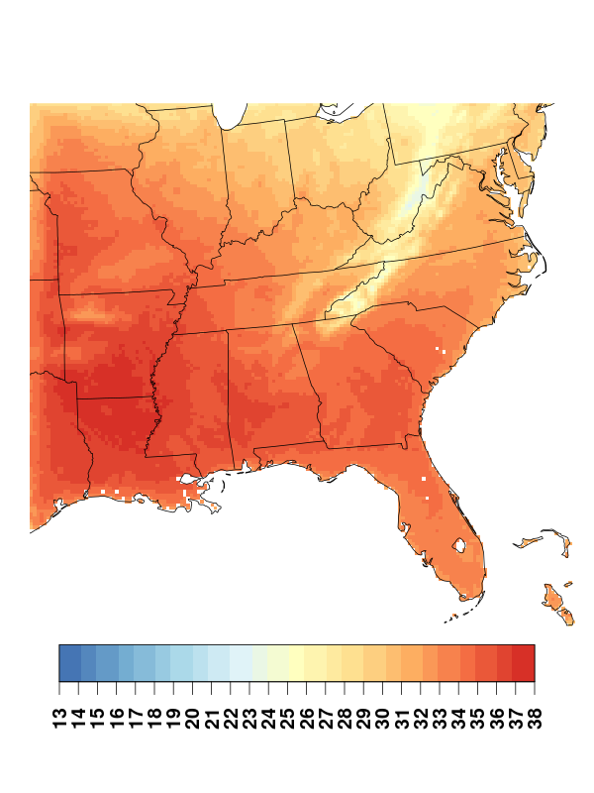
July Average Max Temperature (°C)
PRISM
36-km WRF
12-km WRF (MSKF)

Slide 17
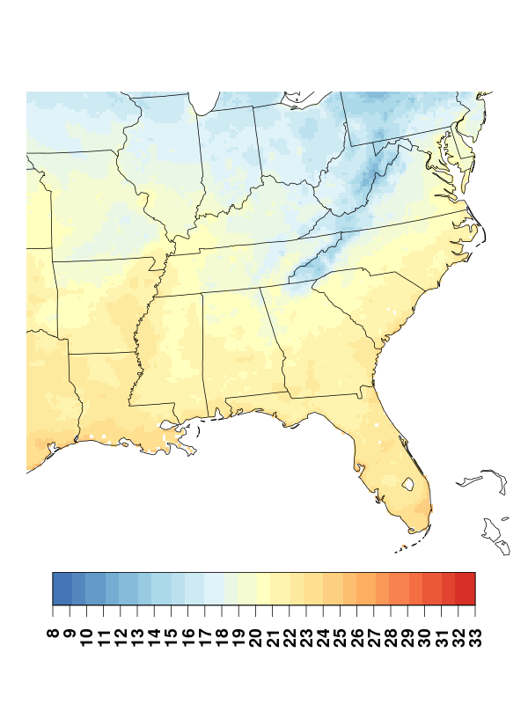
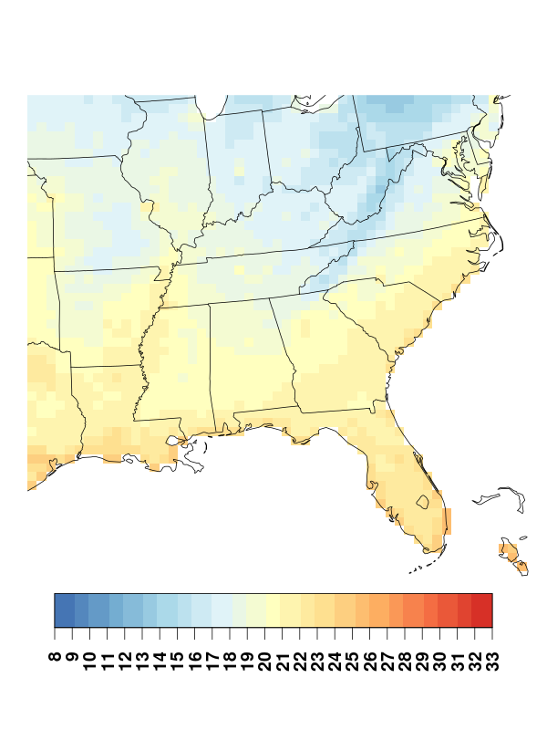
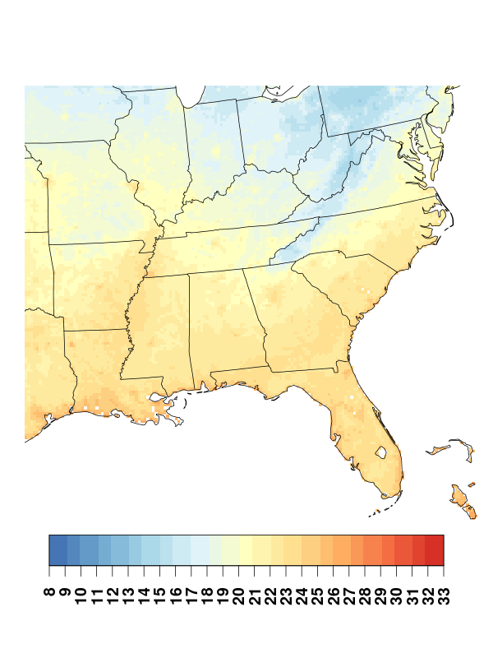
July Average Min Temperature (°C)
PRISM
36-km WRF
12-km WRF (MSKF)

Slide 18
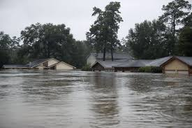
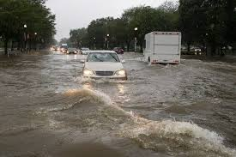
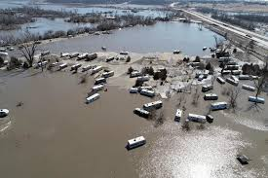
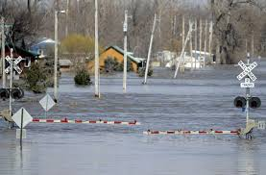
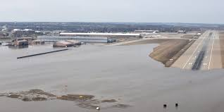
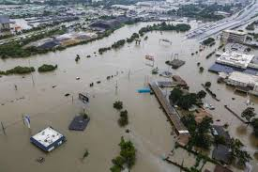
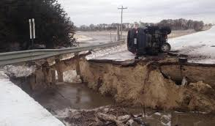
Examining a water application…
Heavy rain events (intense thunderstorms, tropical cyclones, stalled fronts) can have tremendous impacts on human health, the environment, and the economy.
Excess water can lead to decreased water quality (runoff, contamination), increased disease in people and animals (through multiplying and spreading pathogens, increase in mosquitoes, etc.), and increased property damage.
Infrastructure must be designed to handle intense precipitation!

Slide 19
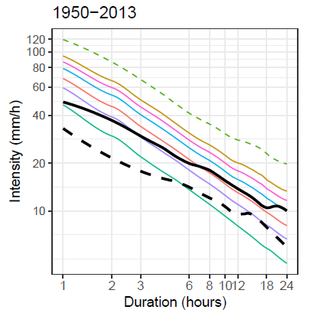
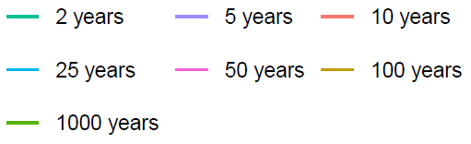
What are IDF Curves ?
IDF curves for Wilmington, NC
IDF curves graphically represent the probability that an extreme event of particular INTENSITY at particular DURATION will occur.
At least 20-30 years of precipitation data.
Annual Maximum Series (AMS).
Fitting probability functions.
Calculating probability distributions.
Frequency
Intensity (mm/h)
Frequency
Hurricanes
Matthew
Duration (hours)
Florence
Notes:
Used in the design of urban storm-water systems, farm-terrace and drainage systems, highway and railway culverts, municipal storm-sewer systems, and other engineering works that must care for storm runoff.
EXPLAIN IDF CURVES WELL, EXPLAIN WILMINGTON, NC

Slide 20
Additional Analysis for Selected Cities
Cincinnati, OH
Raleigh, NC
Wilmington, NC
Atlanta, GA
New Orleans, LA

Slide 21
Precipitation IDF Curves
Precipitation Intensity (mm/h)
Jalowska & Spero
(in review)

Slide 22
Precipitation Annual Maximum Series

Slide 23
Preliminary Conclusions
Some extreme events can be modeled with WRF by dynamical downscaling
Increasing resolution can sometimes improve simulation of extreme events
  High-intensity, short-duration precipitation cannot be captured at 36-km
  Decreasing grid spacing to 12-km is usually in the right direction
But increasing resolution does not guarantee an improved simulation!
  Need appropriate model options (physics and nudging)
  Improvements may be incremental…is it worth it? (Point of diminishing returns)
Higher resolution is required for some mesoscale interactions
  In steep and complex terrain
  Land/water boundaries and coastal flows
  Urban/suburban interactions

