Slide 1
Relaxed Energy Policy, Climate Change, and Attainability of U.S. Ozone Standards
Huizhong Shen, Yilin Chen, Yufei Li, Armistead Russell, Yongtao Hu, Lucas R.F. Henneman, Mehmet Talât Odman, Jhih-Shyang Shih, Dallas Burtraw, Shuai Shao, Haofei Yu, Momei Qin, Zhihong Chen, Abiola S. Lawal, Gertrude K. Pavur, Marilyn A. Brown, Charles T. Driscoll
Speaker: Huizhong Shen

Slide 2
Relaxed Energy Policies
Power plants
CPP: Clean Power Plan (CPP) → Affordable Clean Energy (ACE) rule
 | CPP (2015) | ACE (2019)
EPA’s role | entire energy sector | upgrades to coal plants
fuel impacts | switching coal to renewables and natural gas | cleaner and more efficient coal plants; no fuel switching
Federal and state | Single federal standard | Individual state standards
Vehicles
CAFE: Corporate Average Fuel Economy (CAFE) standards → Safer Affordable Fuel Efficient (SAFE) Vehicles Rule
Relax fuel economy standard for light duty vehicles of MY2022-2025: ~50 MPG to ~35 MPG
Notes:
CPP first proposed in 2014. Supply and demand sides

Slide 3
Climate Change and O₃
Meteorology
Temperature-dependent photochemical reactions for O₃ formation;
Temperature-dependent PAN reservoir of NO_{X}.
Biogenic emissions of volatile organic compounds (BVOC emissions) and NO_{X}
Meteorology: temperature
CO₂ elevation: inhibition (Wilkinson et al., 2009)
Increase in leaf area index (LAI, one-sided green leaf area per unit ground surface area):
Direct impact: proportionally increasing the multiplier (LAI);
Indirect impact: reducing emission factor by reducing temperature and photosynthetically active radiation.
Notes:
CO2 elevation: the direct interactions of carbon assimilation with the chloroplastic biochemistry of isoprene precursors

Slide 4
Study Design
Energy policy (EP) scenarios: EP-CONT and EP-RELX
Both EP scenarios assume unchanged implementation of laws, regulations, and international protocols that are in place as of the end of 2017
Scenario | Supply | Demand
EP-CONT | Extension of CPP and PTC/ITC through 2050 | Increasingly stringent efficiency standards
EP-RELX | CPP elimination, early sunset of PTC/ITC | No new efficiency requirement
PTC/ITC: production tax credit and investment tax credit
Notes:
CPP elimination: CPP is permanently voided and is not replaced by other controls on power sector CO₂ emissions
Explain how PTC/ITC make impacts

Slide 5
Study Design
Modeling framework
Meteorology downscaling:
WRF v3.8.1
Climate projection: Output from CESM1
O₃ standards: 0.070, 0.060 ppm
Biogenic emissions: BEIS v3.6.1 (updated)
Air quality modeling: CMAQv5.0.2-HDDM
Energy policy: Output from NEMS 2018
CMAQ-HDDM: Community Multiscale Air Quality Model with High-order Decoupled Direct Method;
NEMS: National Energy Modeling System;
CSEM: NCAR's Community Earth System Model;
BEIS: Biogenic Emission Inventory System;
WRF: Weather Research and Forecasting model
Notes:
EIA: Energy Information Administration

Slide 6
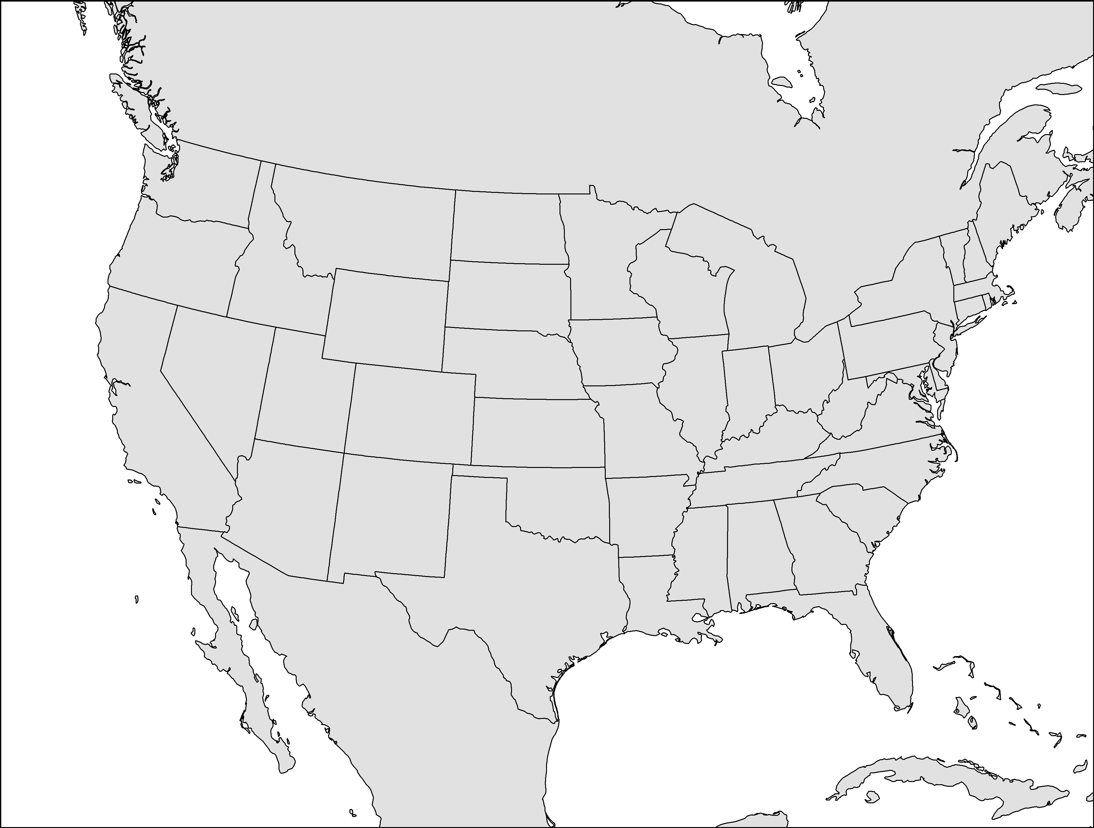
Study Design
Modeling framework
Model domain: Contiguous U.S. on a 36 km spatial resolution
Climate projections: Representative Concentration Pathways (RCPs)
RCP4.5: a climate scenario with moderate temperature increase
RCP8.5: a climate scenario with intense temperature increase
2010
2020
2030
2040
2050
Anthropogenic emissions
Consecutive years
Climate, Biogenic emissions
2008-2012
2048-2052
Air quality modeling
2008-2012
2048-2052
Notes:
Compute-intensive

Slide 7
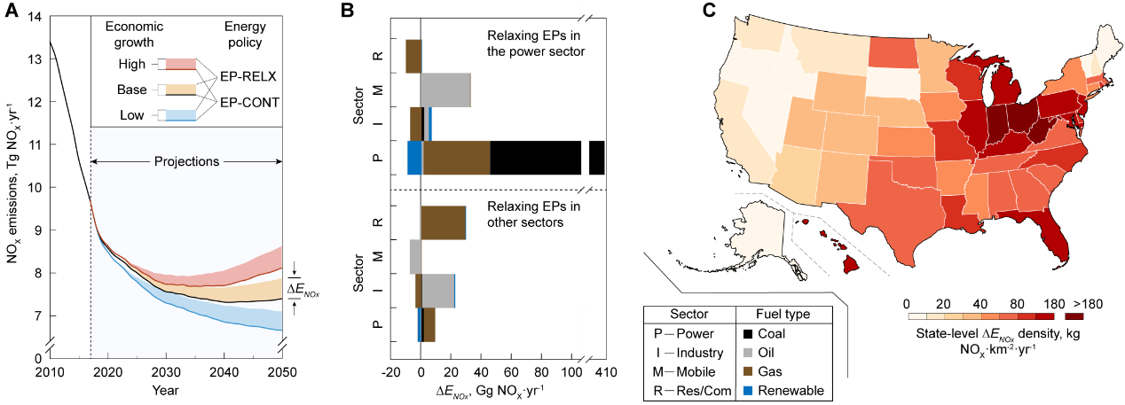
Impacts of EP Relaxation on Anthropogenic Emissions
NO_{X} emission projection:
A continuously decreasing trend before 2040
EP relaxation increase NO_{X} emissions by 6.5%
Coal combustion in power sector contributes the most.

Slide 8
Impacts of EP Relaxation on Anthropogenic Emissions
Sensitivity tests:
Assumptions | EP-RELX, Gg/year | EP-CONT, Gg/year | ∆E_{NOx}, Gg/year | ∆E_{NOx}/EP-CONT
Baseline | 7,860 | 7,380 | 480 | 6.5%
High economic growth | 8,660 | 8,130 | 530 | 6.6%
Low economic growth | 6,980 | 6,580 | 400 | 6.2%
High oil price | 7,280 | 6,840 | 440 | 6.4%
Low oil price | 8,410 | 7,920 | 490 | 6.2%
High oil and gas resource and technology | 7,690 | 7,350 | 340 | 4.7%
Low oil and gas resource and technology | 7,830 | 7,390 | 440 | 5.9%

Slide 9
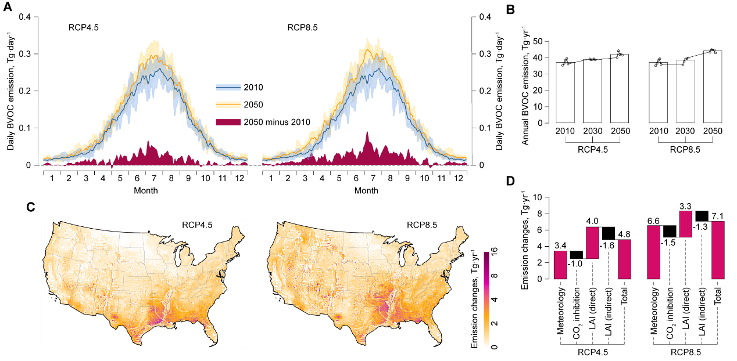
Projections of BVOC Emissions
Increase in total BVOC emissions between 2010 and 2050 :
▪ +13% under RCP4.5 ▪ +19% under RCP8.5

Slide 10
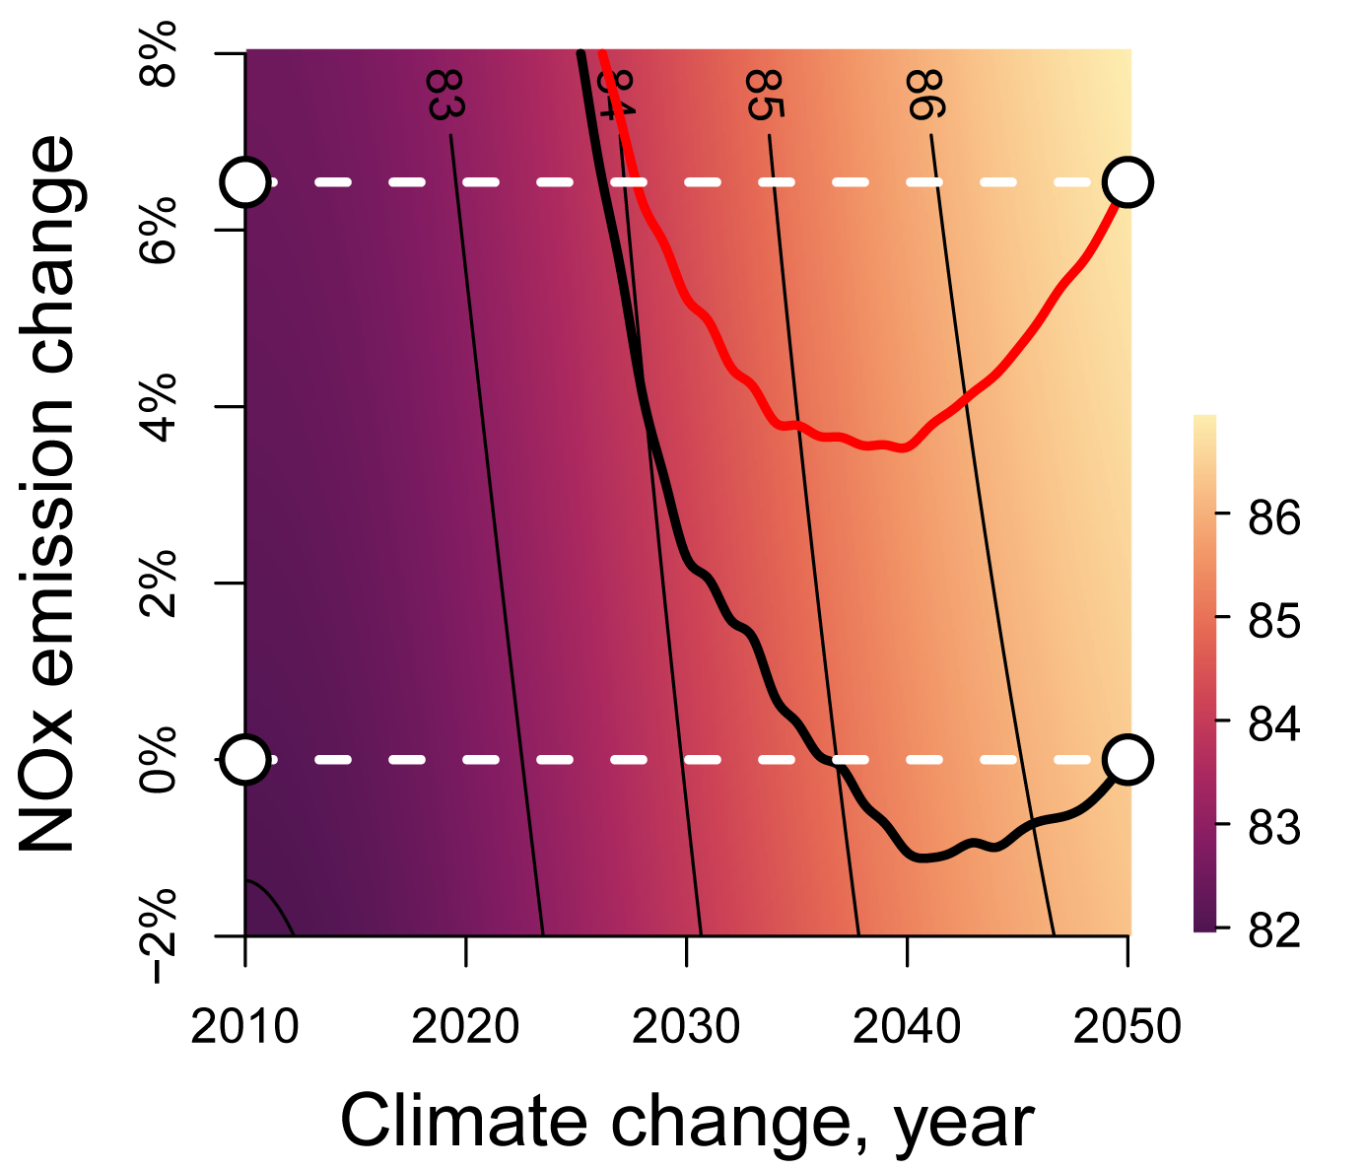
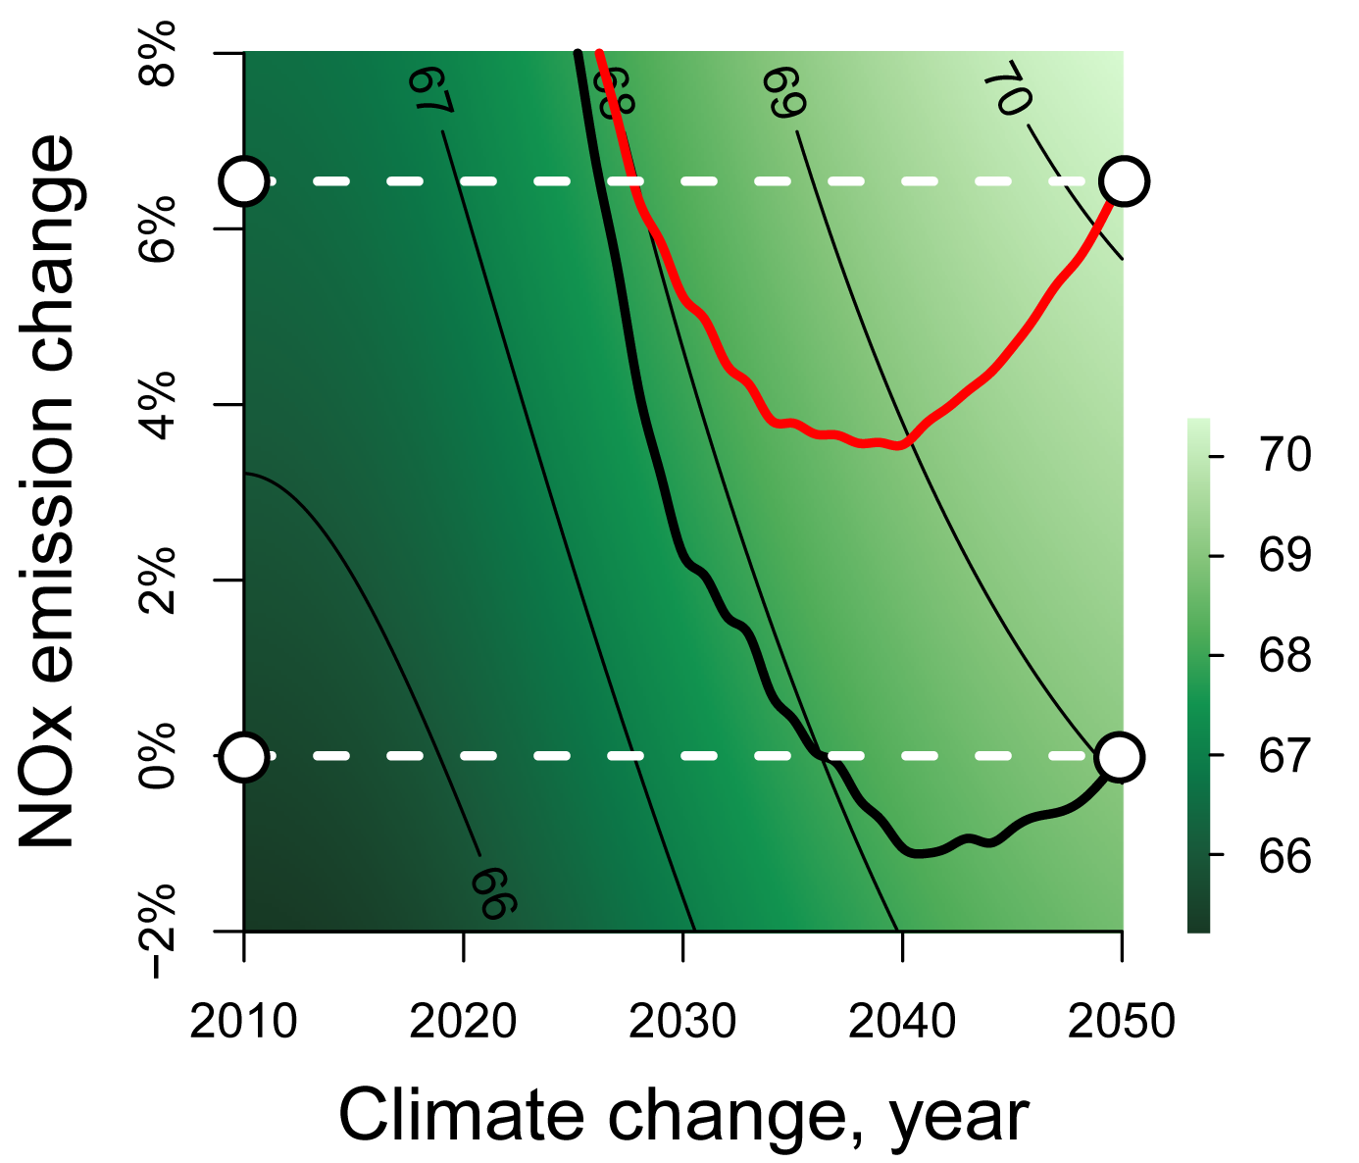
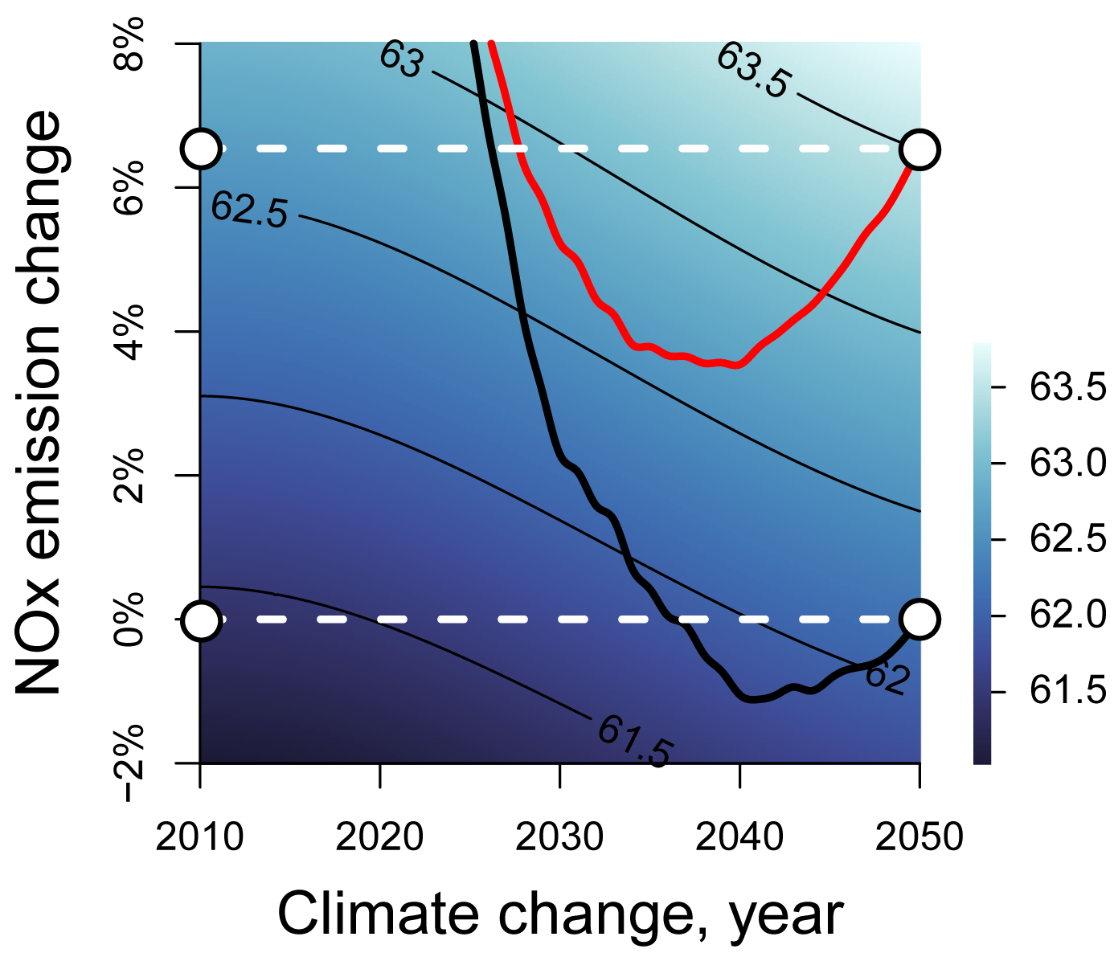
EP Relaxation, Climate Change, and Ground-level O₃
County profile:
O₃ design value (as isopleths): Annual fourth-highest daily maximum 8-hr O₃ concentration, averaged over each period.
More sensitive to climate change
More sensitive to EP relaxation
Los Angeles
New York
Fulton, Atlanta
EP-RELX 2050
O₃, ppb
O₃, ppb
O₃, ppb
EP-CONT 2050
EP-RELX
EP-CONT
Notes:
heterogeneous

Slide 11
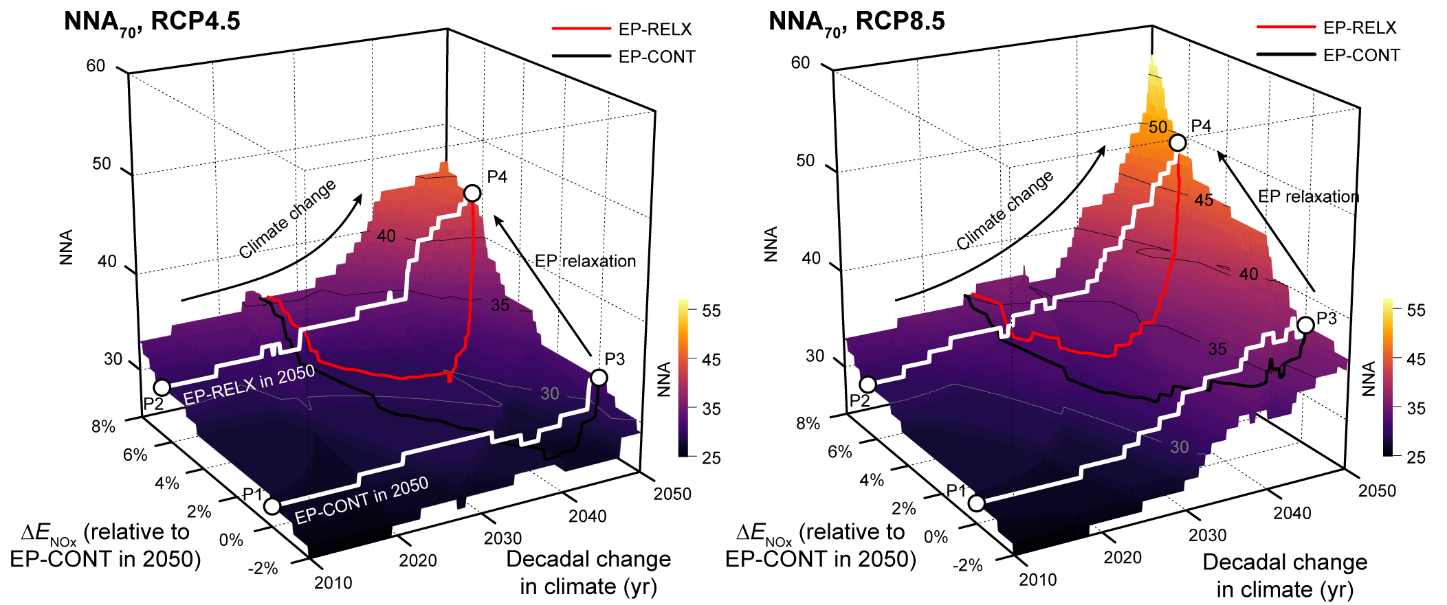
EP Relaxation, Climate Change, and Ground-level O₃
Isopleths of number of non-attainment counties that exceed 0.070-ppm standard (NNA₇₀).
∆T=1.4 °C
∆T=2.0 °C

Slide 12
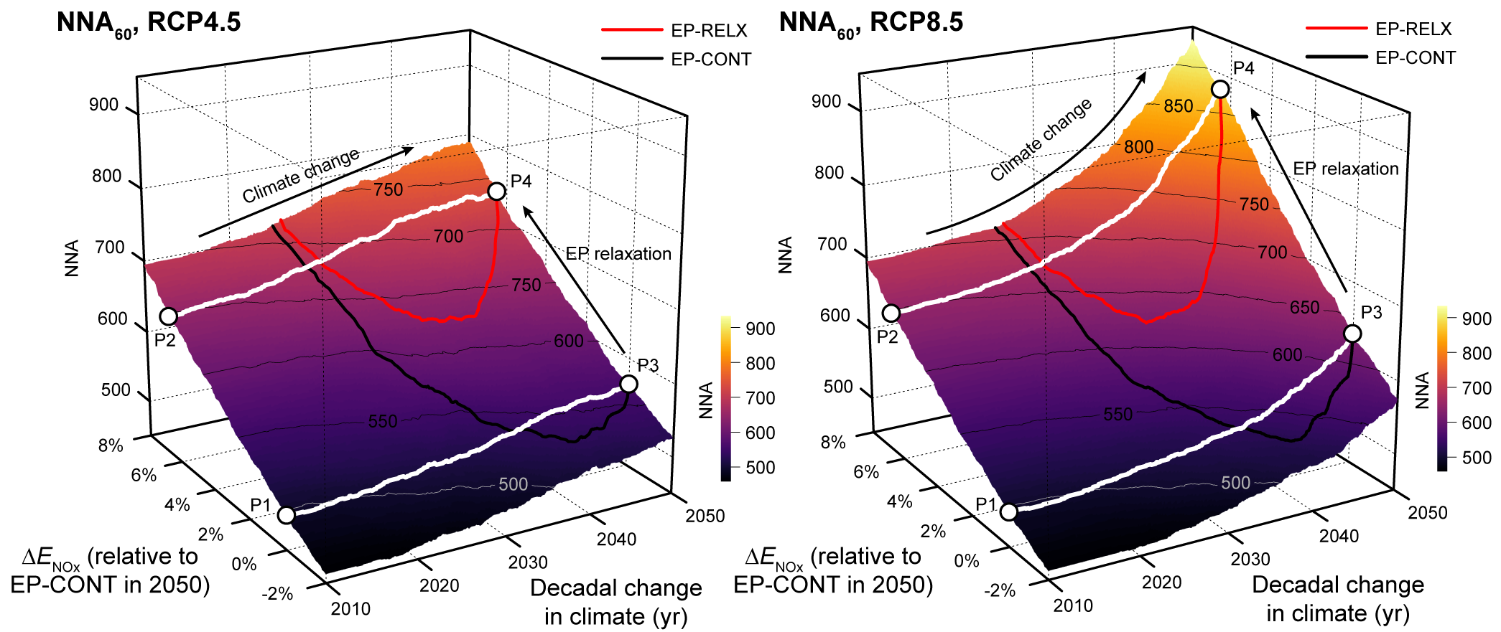
EP Relaxation, Climate Change, and Ground-level O₃
Isopleths of NNA₆₀
Synergistic effect

Slide 13
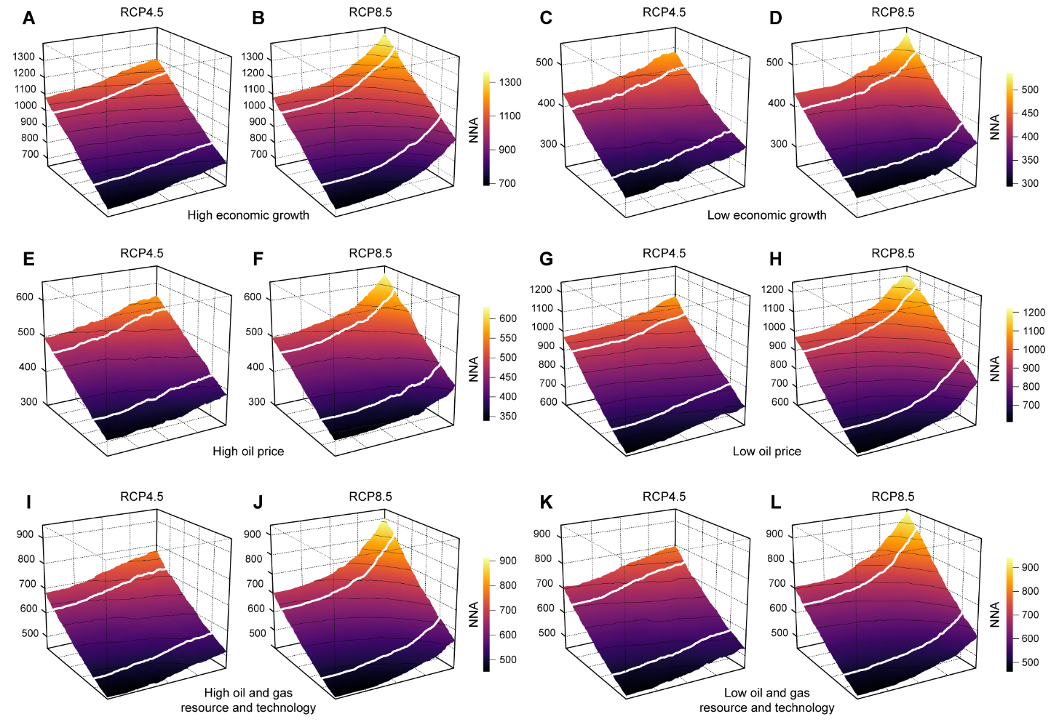
Impacts of EP Relaxation on Anthropogenic Emissions
Sensitivity tests: results hold
High economic growth (A, B)
Low economic growth (C, D)
High oil price (E, F)
Low oil price (G, H)
High oil and gas resource and technology (I, J)
Low oil and gas resource and technology (K, L)

Slide 14
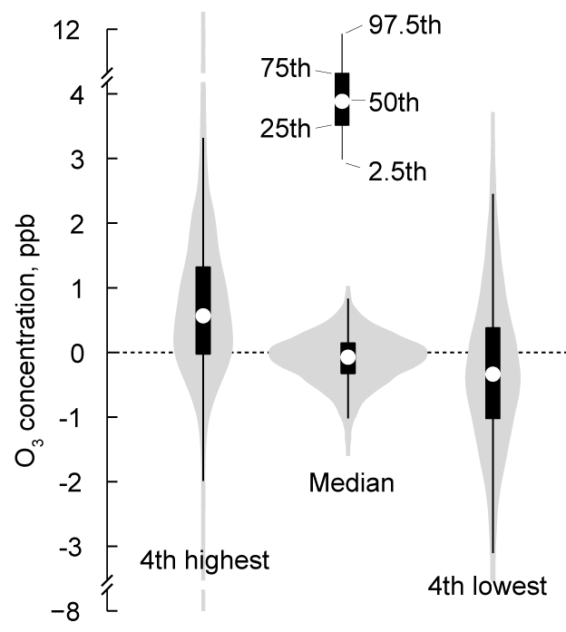
EP Relaxation, Climate Change, and Ground-level O₃
Isopleths of NNA₆₀
O₃ level change due to climate change
Leveraging effect
O₃ production efficiency (OPE) increases by 11% due to the RCP8.5 climate change.
S_{O3,NOx}: sensitivity of O₃ to NOx emissions;
S_{NO2,NOx}: sensitivity of NO₂ to NOx emission;
S_{NOz,NOx}: sensitivity of NOz to NOx emissions.
or DVs.

Slide 15
EP Relaxation, Climate Change, and Ground-level O₃
The continuing decline in ground-level O₃ may be reversed by relaxed EPs and climate change.
Nonattainment counties at P1
Additional nonattainment counties at P4

Slide 16
Conclusions
Climate
Energy policy
Health
Non-GHGs emission
Relaxed energy policies coupled with climate change will undermine efforts to attain U.S. O₃ standards.
There are synergistic effects between changes in emissions and climate on O₃ compliance (33–69% more NNA).
(One Earth, in press. DOI: 10.1016/j.oneear.2019.09.006)

Slide 17
Acknowledgement
EPA grant number R835880
Thank you
This presentation was made possible in part by USEPA. Its contents are solely the responsibility of the grantee and do not necessarily represent the official views of the funding sources and those sources do not endorse the purchase of any commercial products or services mentioned in the publication.
R835880

Slide 18
Questions about air quality modeling:
hshen73@gatech.edu
Questions about energy policies:
yufei.li@gatech.edu

Slide 19
The National Ambient Air Quality Standards (NAAQS) for ozone (O₃)
First set in 1971
The form since the 1997 standard: Annual fourth-highest daily maximum 8-hr O₃ concentration, averaged over 3 years
Year | Indicator | Averaging time | Level, ppm | Form
1971 | Total photochemical oxidants | 1 hour | 0.08 | No more than one hour (1971) or day (1979)
1979 | O₃ |  | 0.12
1997 |  | 8 hours | 0.08 | Fourth-highest
2008 |  |  | 0.075
2015 |  |  | 0.070
(www.epa.gov/ground-level-ozone-pollution)

