Slide 1
An Uncertainty for Clean Air: Air Quality Modeling Implications of Underestimating VOC Emissions in Urban Inventories
Shupeng Zhuª, Michael Mac Kinnon^{b}, Brendan P. Shaffer^{b}, G.S. Samuelsen^{b}, Jacob Brouwer^{b}, Donald Dabdubª
ª Computational Environmental Sciences Laboratory, University of California, Irvine, CA 92697, USA
^{b} Advanced Power and Energy Program, University of California, Irvine, CA 92697, USA
Notes:
Today, I am going to talk about our study about the air quality modeling implications of underestimated VOC emissions in Urban Inventories. This is a cooperative work between our group and the advanced power and energy program lead by professor scot Samuelsen.

Slide 2
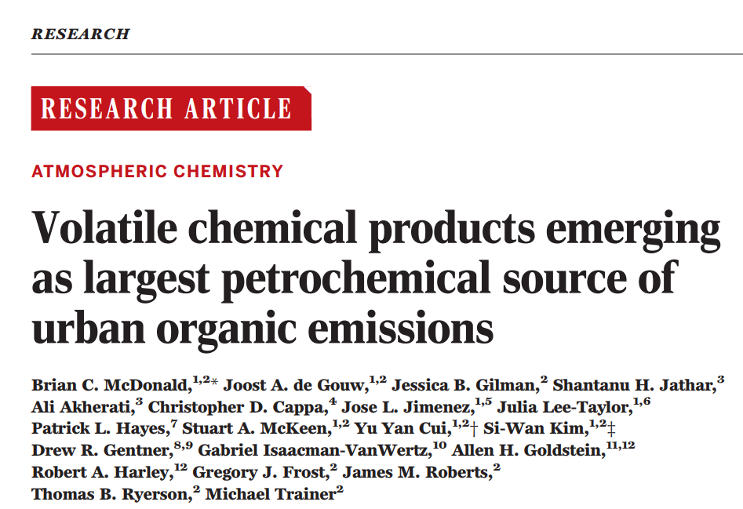
Introduction
Volatile Organic Compounds (VOC) are precursor for Ozone (O₃) and Secondary Organic Aerosols (SOA).
Underestimated VOC emissions from Volatile Chemical Products (VCP) (McDonald et al. Science 2018)
What’s the implication for Air quality modeling and prediction in California?
Pesticides, coatings, printing inks, adhesives,
cleaning agents, personal care products
Notes:
As we all know that volatile organic compounds (also known as VOC) are important precursor for air pollutants such as Ozone and Secondary organic Aerosols.
Early this year Professor McDonald’s group published a paper on Science, which points out that due to restricted regulations on the traffic emissions, volatile chemical products has emerged as largest petrochemical source of urban organic emissions. While they also found that such change has not been reflected by current inventory and the voc emissions from those products has been largely underestimated. This figure here shows some example of volatile chemical products, such as pesticides, coatings, cleaning agents and personal care products.
Motivated by McDonald’s results, we conduct this primary study to investigate the implication for air quality modeling and prediction in California due to this underestimation on voc emissions.

Slide 3
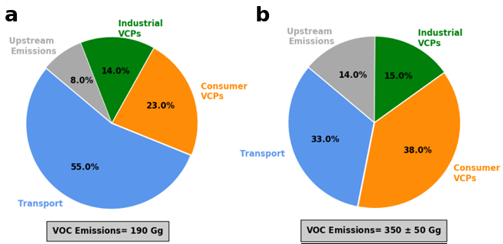
Methods
CARB 2012
McDonald et al.
Baseline:
2012 California Air Resource Board emission inventory (CARB 2012)
Low Case:
VOC scaled to 300 Gg
Medium Case:
VOC scaled to 350 Gg
High Case:
VOC scaled to 400 Gg
VCP Case:
Only the VOC emissions of VCP are scaled based on the 350 Gg estimation
Limitation:
Scaled only on existing sources, no new source sare added.
Scaling factors applied to CARB 2012
Case | Petrochemical Total | Consumer VCPs | Industrial VCPs | Upstream | Transportation
Low (VCPL) | 1.58 | 2.61 | 1.69 | 2.76 | 0.95
Medium (VCPM) | 1.84 | 3.04 | 1.99 | 3.22 | 1.10
High (VCPH) | 2.11 | 3.48 | 2.26 | 3.68 | 1.26
VCP only (VCPO) | 1.61 | 3.04 | 1.99 | 1.00 | 1.00
Notes:
The basic idea here is to scale the baseline VOC inventory (which is the CARB 2012) to match up the referenced inventory in McDonald’s paper. These two pie figures here show the difference in sector-based inventory composition between the CARB 2012 and McDonald’s result. As we can see here, transportation accounts for more than a half of petrochemical sources in current inventory, where it only accounts for one third of the total emissions in McDonald’s result. While emissions from consumer VCPs is even larger than the transportation sector based on McDonald’s study. And the total VOC emission is also largely underestimated in current inventory between 190 and 300 to 400 Gaga grams (year). As there is 50 Gaga grams uncertainty in McDonald’s estimation, we designed four alternative scenarios. For the low, medium and high case, VOC emissions are scaled to 300, 350, and 400 gg accordingly. While in the VCP case, only the VOC emissions of VCP are scaled based on the medium estimation. The right table here presents the scaling factor used in each scenario for each sector. Form which we can see that emissions from consumer and upstream sector increased by more than three times.

Slide 4
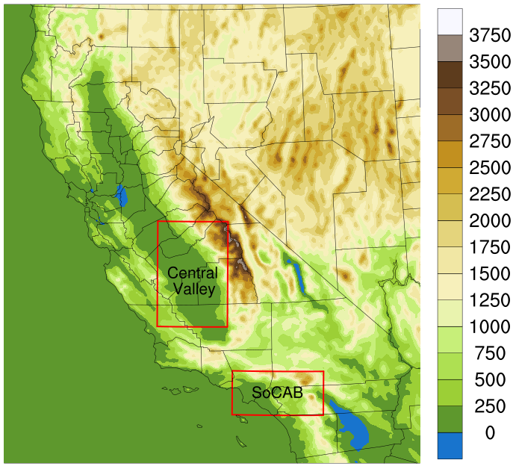
Air Quality Modeling
Emissions: SMOKE V4.0 (Sparse Matrix Operator Kernel Modeling System)
Anthropogenic Emission: CARB 2012 inventory.
Biogenic Emission: Model of Emissions of Gases and Aerosols from Nature (MEGAN, v2.1).
Meteorology: WRF V3.7 (Weather Research and Forecasting Model)
Operational Global Analysis data (year 2012)
Air quality: CMAQ V5.2 (Community Multiscale Air Quality Modeling System)
Boundary condition: Model for Ozone and Related Chemical Tracers (Mozart v4.0).
Photochemistry: SAPRC-07 chemical mechanism
Aerosol dynamics: AERO6
Simulation domain: California (4 km x 4 km)
Simulation periods: Winter (Jan. 1st- Jan. 15th ) & Summer (Jul. 8th – Jul. 22th)
Notes:
First, the SMOKE model is used to implement the scaling factors and generate emissions files for each scenario, with biogenic emission calculated from MEGAN. And the metrological conditions are downscaled from the operational global analysis data using WRF for the year 2012. CMAQ 5.2 is used for air quality simulation, with boundary conditions calculated from Mozart 4, and SAPR-07 chemical mechanism for photochemistry. The horizontal resolution is 4x4 km. And we simulated two weeks in winter and two weeks in summer.

Slide 5
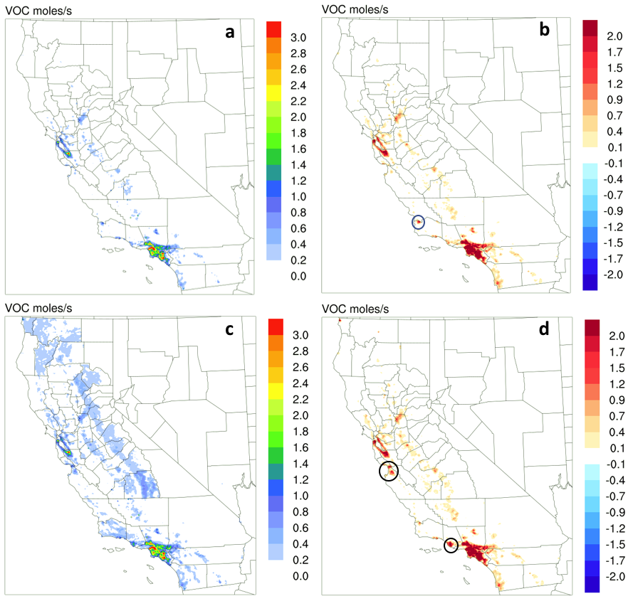
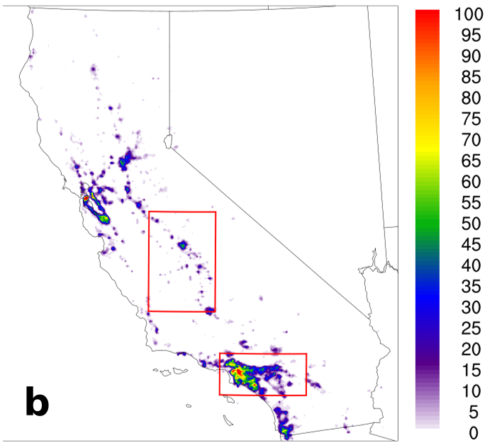
VOC Emission Changes
Base Case
High - Base Case
Winter
Winter
Larger difference in highly populated urban regions.
Peak differences:
11.68 moles/s in winter
11.75 moles/s in summer
Seasonal difference is small.
Differences in circles are caused by the usage of non-methyl bromide pesticides.
Summer
Summer
Population density
Notes:
The first column of this figure shows voc emissions from base case, where we can see a wider spread of VOC emissions in the summer, those difference is mainly cased by biogenic sources. The second column shows the difference between the high case and base case. We can see the difference map is highly correlated to population density. The largest difference can be found in large metropolitan regions such as the south coast and the bay area. The peak difference is quite similar between two seasons. While we also found some seasonal spatial difference as marked by those circles. Those differences are mainly caused by the usage of non-methyl bromide pesticides.

Slide 6
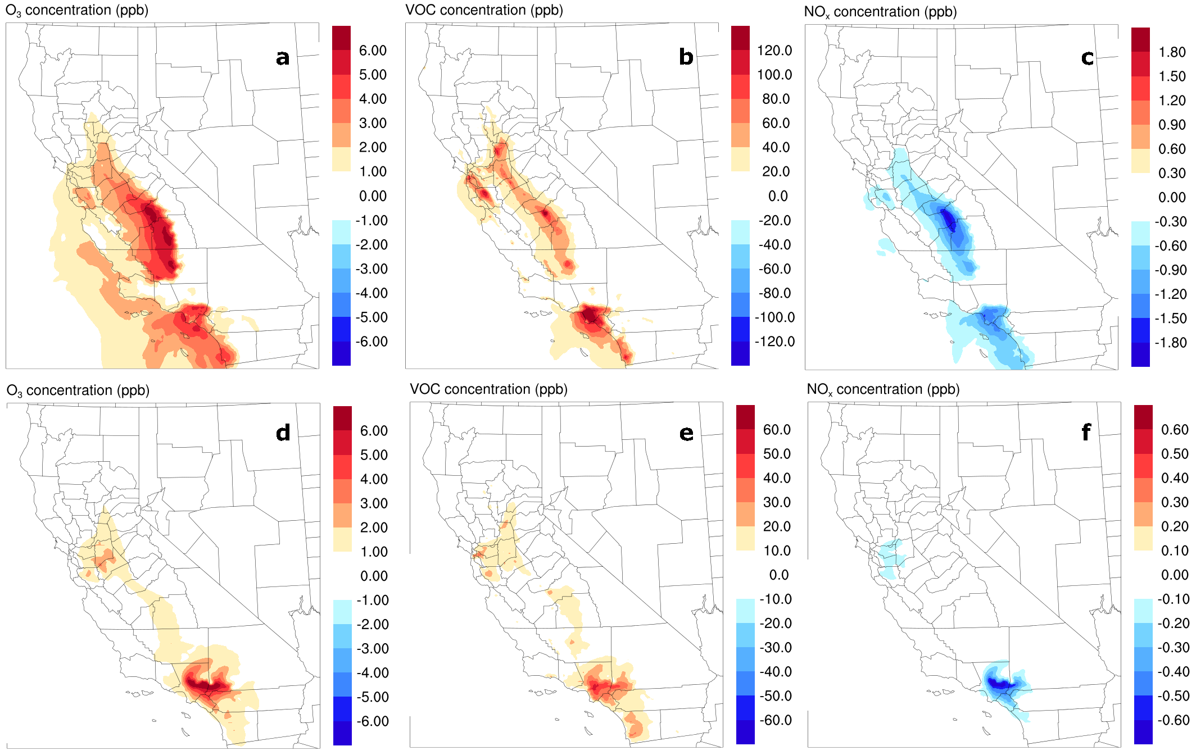
Impact on Ozone
Between high case and base case
Peak Difference
Averaged Difference
8 hour daily maximum O₃
VOC limited
Afternoon Hours (12:00 - 8:00 PM) O₃
More HNO₃
Wide-Spread
Winter
Concentrate in SoCAB
Summer
15.6 ppb
17.4 ppb
Notes:
Here are our results. First, we found large impact on 8 hour daily maximum O3. The peak difference could be as high as 15 ppb in the winter, and 17.4 ppb in the summer, which is quite significant. This shows the difference of averaged concentration in afternoon hours. We can see the difference is wider spread in winter, and for summer period, the difference concentrated in socab region. The following two columns shows the corresponding difference of VOC and NOx concentrations, we can see the VOC increase and NOx decrease in corresponding region which indicates a VOC limited conditions in those regions.

Slide 7
Impact on maximum 8-hr averaged Ozone concentration
Solid lines: Domain averaged.
Dash lines: Peak difference.
Proportional impact as VOC emissions increase.
Highest peak difference happened in summer SoCAB.
Winter
Summer
Notes:
Here are timeseries of maximum 8 hr ozone in two subdomains for different scenarios. The solid lines represent domain wide average, while the dash lines represent the peak difference within the subdomain. We can see a proportional impact as VOC emissions increase. And the highest peak impact happened in SoCAB during the summer period, although impacts are relatively higher in the winter. However, all winter days are far away from the regulation limit, and the only impact on the nonattainment days evaluation happens in the summer.

Slide 8
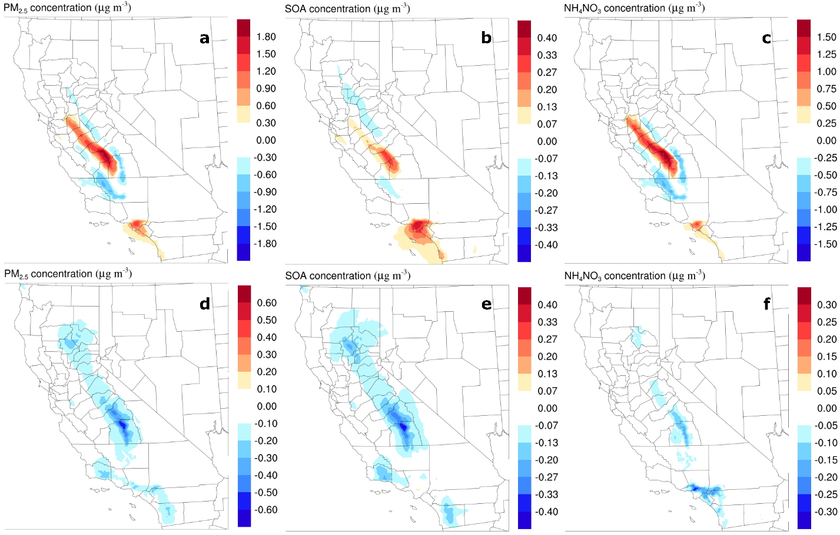
Impact on PM_{2.5}
Between high case and base case
Peak Difference
Averaged Difference
24 hour daily maximum PM_{2.5}
Larger Impact
Increase in
Winter
Decrease in
Summer
Main contributor
7.5 µg/m³
80%
67%
NOx -> PAN?
-1.1 µg/m³
Notes:
We also investigate the impact on PM2.5. We found a much higher peak difference in the winter, with large increase observed within central valley and socab region. The peak increase could be as high as 7.5 micro grams per cubic meter. And further analysis shows that such difference is mainly derived by the increase of NH4NO3, which contribute to 80% of increase in central valley and 67% in SoCAB. The SOA also increased as the VOC emission increase. The impact on summer PM is much smaller, however on an opposite direction. SOA contribute most of the decrease in the sierra nevada mountains, while the decrease of NH4NO3 contribute most of the impact over the socab. We think that more NOx is transformed into PAN, as PAN concentration is found increase in those region

Slide 9
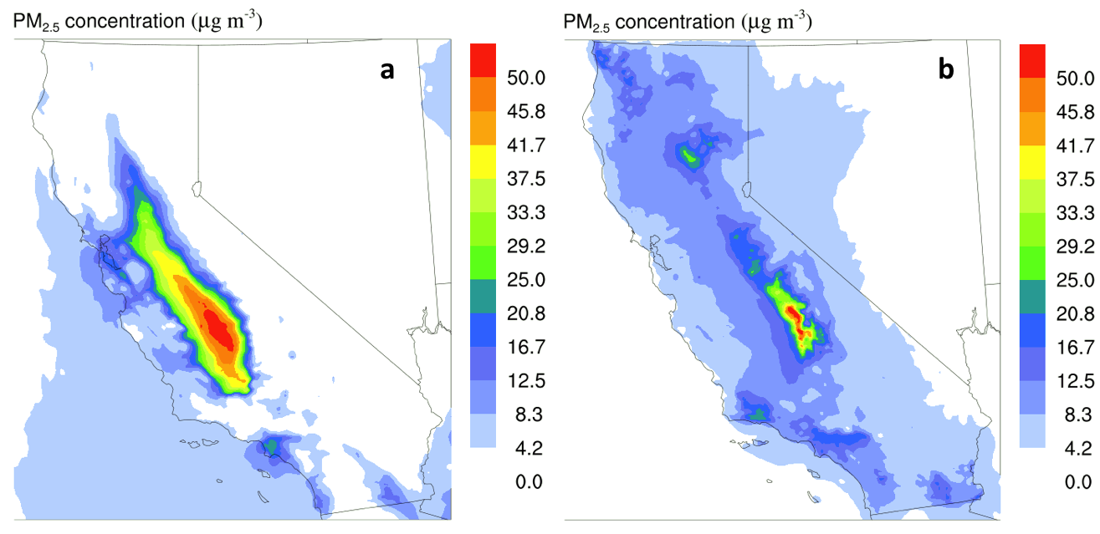
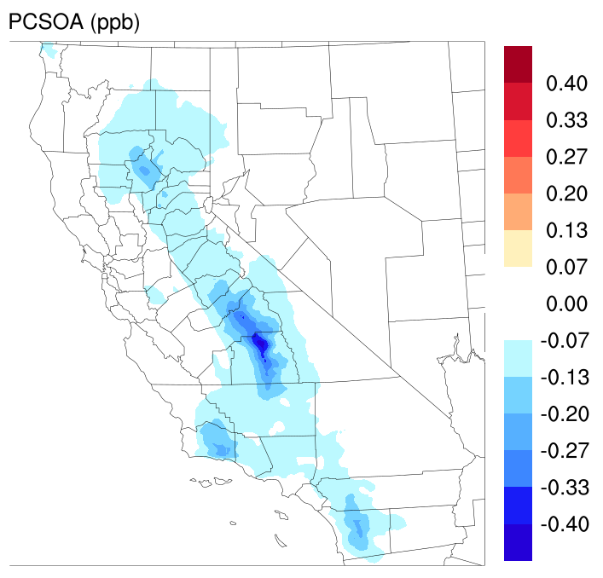
Impact on PM_{2.5}
Peak differences coincide with peak concentrations
PCSOA contribute to most of the SOA
Winter
Summer
Summer
Averaged concentration (Base Case)
PCSOA- Potential Combustion-origin SOA (Murphy et al., 2017):
SOA from anthropogenic combustion sources that could be missing from current chemical transport model predictions
Between high case and base case
Notes:
The two figures on the right shows the averaged PM concentration of the base case, we can find that the location of peak impact is coincide with peak concentrations. And we also further investigated the cause of SOA decrease, we found that the main contributor is a species called PCSOA, which is newly integrated into CMAQv5.2 to represent potential combustion-origin SOA. The reason for its decrease could be its gas precursor is more latent during ageing compares to other fresh added VOC emissions. But as it is not a real species, this impact could be somewhat artificial.

Slide 10
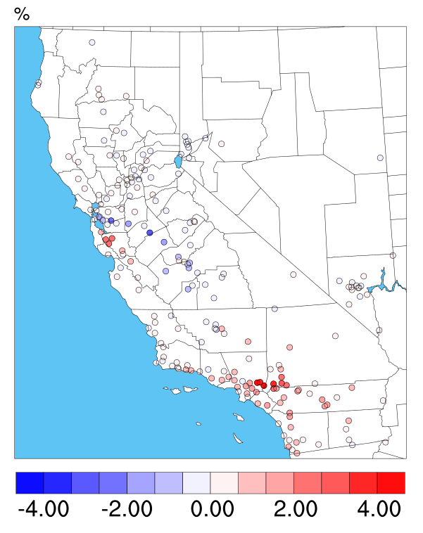
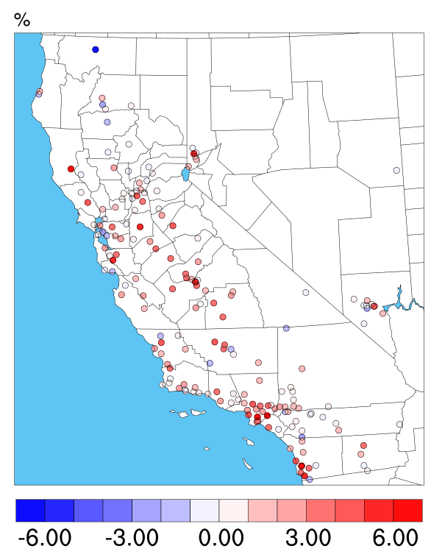
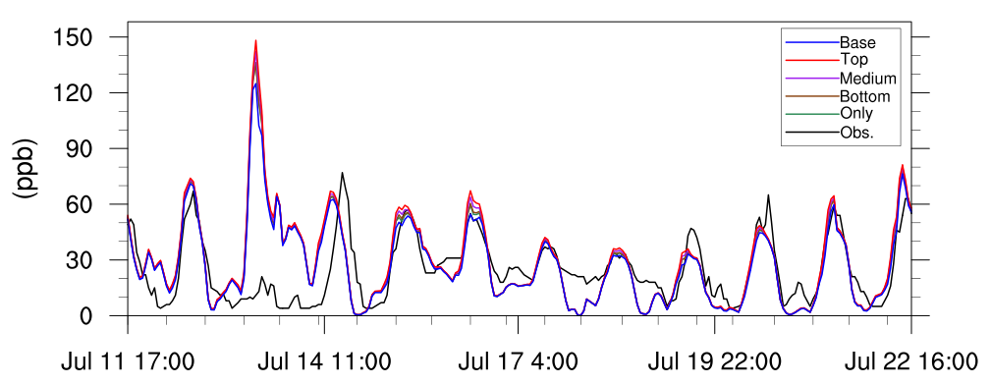
Impact on Model performance: Ozone
Summer
Winter
Observation: AQS network (EPA)
Performance is only improved in North California Summer time.
Increased the overestimation in most observation sites.
Change in model errors: Improved (Blue), Degraded (Red)
Normalized mean error (NME) | $$\frac{\sum_{i=1}^{n}{{|o}_{i}−c_{i}|}}{\sum_{i=1}^{n}{O_{i}}}$$
o_{i} and c_{i} are the observed and the simulated concentrations at time and location i, respectively. n is the number of data
Between high case and base case
No peak in the measurement?
Notes:
We also investigated how the increase of VOC emissions could impact model performance. We used the observation data obtained from the AQS network to calculate model performance matrix. The upper two figures shows the change in Normalized mean error of model performance for Ozone. The blue color here indicates a decrease of model errors, which means the performance is improved. On the contrary, the red color indicates a degraded in model performance. In the summer period, the model performance is found improved in the north part of the state. While, for the socab region, the model performance is found degraded due to increased overestimation. While, in the winter, the overall model performance is also decreased. This timeseries here shows the comparison between simulation results and observation at one observation site in downtown LA. In general, most of the difference happens in the peak. And not peak is found in the measurement is Jul 13 when the model predicted a super high concentration. I am not sure if it is due to mistakes in measurement data or inaccurate metrological conditions.

Slide 11
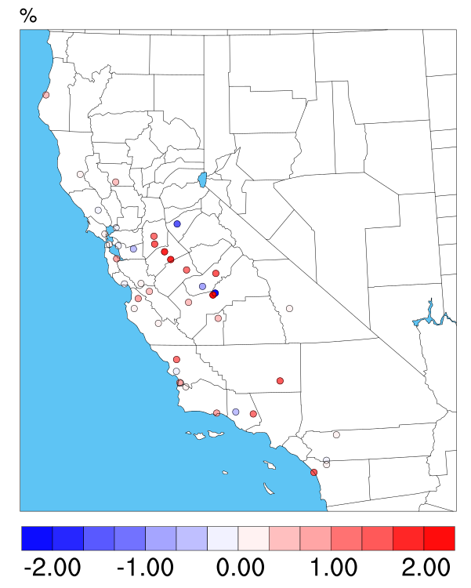
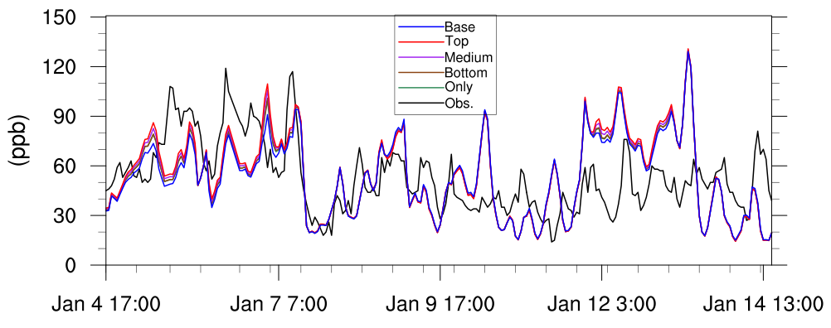
Impact on Model performance: PM_{2.5}
Winter
Winter
Summer
Observation: AQS network (EPA)
Performance improved in most sites during Summer.
The increase in central valley increased the overestimation during winter.
Change in model errors: Improved (Blue), Degraded (Red)
Normalized mean error (NME) | $$\frac{\sum_{i=1}^{n}{{|o}_{i}−c_{i}|}}{\sum_{i=1}^{n}{O_{i}}}$$
o_{i} and c_{i} are the observed and the simulated concentrations at time and location i, respectively. n is the number of data
Between high case and base case
Notes:
For PM predictions. We found that performance is improved in most sites during the summer. Although the level of improvement is quite small. However, in winter, the model performance is not improved in majority of the site. Here is one example site located with the central valley region, where usually experienced high pollution episode in the winter. We can see the increase in VOC emission help reduced the underestimation in the first couple days, while also increased the overestimation between Jan 12 and 13.

Slide 12
Conclusion
Ozone increase proportionally as VOC emission scales up.
PM_{2.5} increase in winter while decrease in summer due to additional VOC emissions.
Model performance improved in North California for summer Ozone and through out the state for summer PM_{2.5}.
The overestimation in the Central Valley on winter PM_{2.5} is amplified.
New emissions sources need to be developed and added to represent the underestimated VCP emissions.
Notes:
Here are our conclusions. First ozone is found to be increase proportionally as VOC emission scales up. PM2.5

Slide 13
Thank You!
Questions?

Slide 15
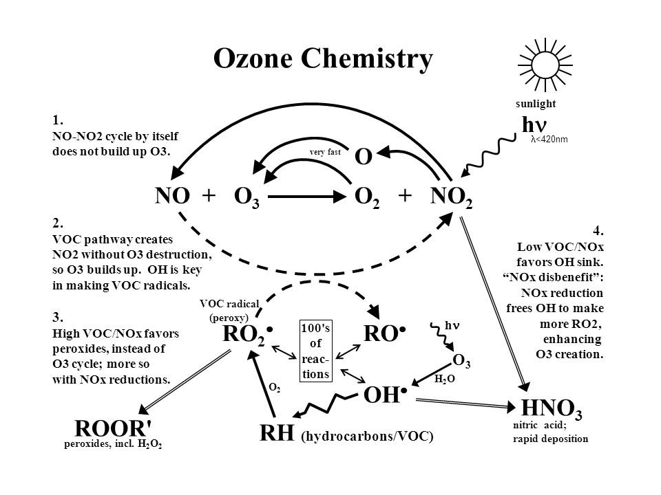
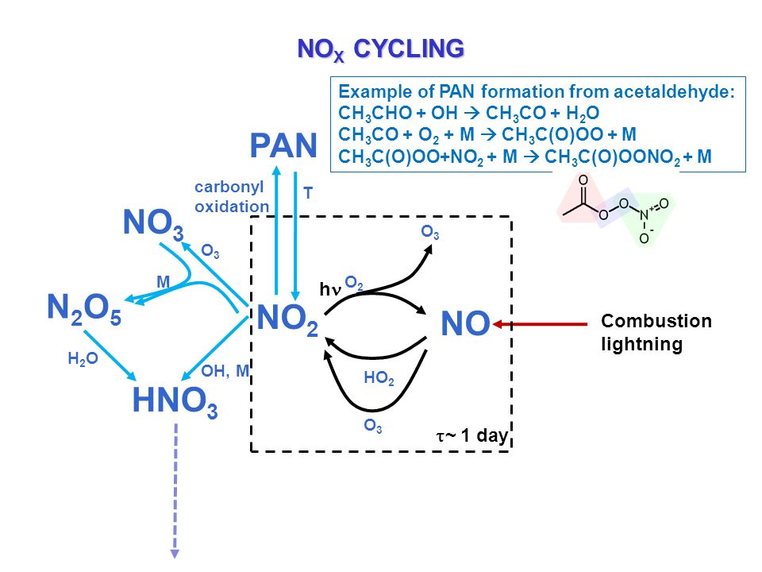
Changes in HNO₃ and PAN
Winter
Summer
Between high case and base case

Slide 16
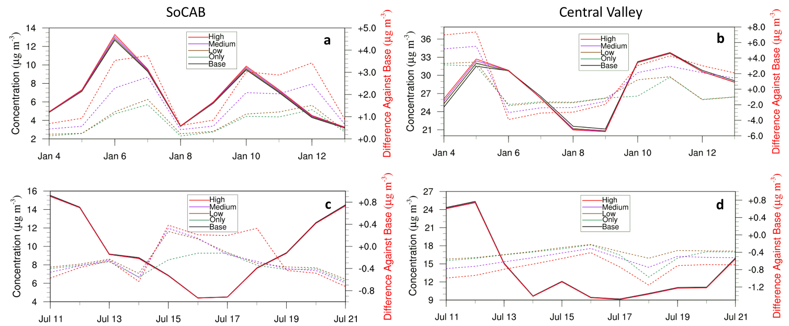
Impact on daily 24-hr averaged Ozone concentration
Solid lines: Domain averaged.
Dash lines: Peak difference.
Non-proportional impact as VOC emissions increase.
Highest peak difference happened in summer Central Valley.
Winter
Summer

Slide 17
Impact on Model performance: All Sites
WINTER
SUMMER
O₃
PM_{2.5}

