Slide 1
Coupling MOVES-based Mobile Emissions Modeling with Air Quality Modeling System
B.H. Baek, Rizzieri Pedruzzi, and Carlie Coats
UNC at Chapel Hill, USA
Notes:
What is SMOKE simple way
Not a model like air quality models but a processor to convert monthly/annual county-level inventory pollutants to air quality modeling needs
History of SMOKE system and inventory data evolution … does not fit into a single pathway like area, mobile, point and biogenic
New way of thinking to process them and meets the need of air quality model with the continuous support from inventory group in OAQPS at EPA
Over the last 11 years, I have mada a few siginifcant updates…like SMOKE-MOVES integration tool in 2010. Now we are making another move forward movement to the future to meet the needs of global air quality modeling community.
2013 CARB also wants us to update the system to meet their CARB modeling system and developing the one integrated system without many sysytem

Slide 2
Background
SMOKE-MOVES Integration Tool Released on 2010
Latest SMOKE-MOVES2014b Integration Tool
Enhanced the meteorology dependency on mobile emissions for air quality modeling system
Technical Challenges:
Slow and Most Computationally Expensive!
Big size of ASCII-format MOVES Emissions Factors Lookup Table files
Processing the limited numbers of Reference County-specific Lookup Tables
MOVES
SMOKE-MOVES Integration Tool
SMOKE

Slide 3
SMOKE-MOVES Integration Tool
RatePerDistance [grams/miles]
Exhaust and most evaporative emissions that happen on real roadtypes
Sorted By SCC (=vehicle/road/process), 16 Speed Bins and Ambient Temperature Bins
RatePerVehicle [grams/vehicle/hour]
Exhaust and most evaporative emissions that occur off-network
Sorted By SCC, Hour of day and Ambient Temperature Bins
RatePerProfile [grams/vehicle/hour]
Vapor venting evaporative emissions that occur off-network
Sorted By SCC, Hour of day and Min/Max Temperatures
RatePerHour [grams/hour]
APU operation and extended idling processes
Sorted By SCC, Ambient Temperature
Notes:
Before we get into SMOKE-MOVES2014 integration tool, I would like to quickly explain what is SMOKE-MOVES integration tool first for your better understanding of this presentation.
As you already know, previous MOVES2010 can develop emissions in two different methods. First one is “Inventory Mode” which allows you to develop annual/monthly county total emissions inventory. And the other method is called “Emissions Rate” mode which allows you to develop on-road and off-network emission rates outputs from three different modes.
RPD which represents exhaust and most evaporative on-read emissions from real road types. Because these are EF in unit of g/mile, we need to apply hourly VMT activity inventory to compute hourly emissions from onroad sources.
RPV which represents
RPP
As some of you already know SMOKE is emission processor that creates hourly spatially gridded emissions input files for air quality models like CMAQ and CAMx. To develop these kind of hourly gridded chemically speciated emissions files for air quality model, we have developed the SMOKE-MOVES tool.
This tool will allow users to apply real time hourly on-road and off-network emissions using hourly meteorological input data, these emissions rates from MOVES and mobile activity inventories (VMT and VPOP)

Slide 4
Current SMOKE-MOVES Integration Runs
304 Reference Counties for Continental U.S. Modeling Domains with Two Fuel Months per Each Reference County (Based on NEI 2014 Modeling Platform)
Size of MOVES Lookup Tables:
RPD: 85-150MB, RPV: 45-95MB, PRP: 15-50MB, PRH: Less than 1MB
Processing Optimization: Processing 7 consecutive days at a time.
Faster processing but requires more RAM memory
Processing 1 days at at time, much slower processing time
Tagging or source grouping options: much more memory and slower processing time
More Grid Cells and more reference counties = more memory and slower processing time
Sectors | Computing Time | RAM Memory Usages
RPD | 4 hours | 10-20 GB
RPV | 1.5 hours | 5-10 GB
RPP | 30 minutes | < 1 GB
RPH | 5 minutes | 2 GB

Slide 5
Solutions
Current/Possible Solutions:
Computational Optimization of the SMOKE-MOVES Integration tool
Reduce the size and numbers of MOVES EF lookup tables:
Aggregated Processes (Less than 15 processes)
Aggregated Vehicle and Road Types
Reduced optimized temperature increments
Limited numbers of reference counties.
Convert current ASCII-formatted MOVES EF lookup tables into NetCDF format
Proposed Solutions:
Parameterization of Current ASCII-format MOVES EF Lookup Tables into Polynomial Algorithms using Best-Fitted Curve Algorithms (BFCA)
Store the algorithms in NetCDF format to eliminate I/O bottlenecks
Coupling with SMOKE and AQ models including forecasting AQ

Slide 6
RatePerDistance (RPD)
Reference County:
Baltimore County, MD (24005)
Vehicle Types:
Passenger Vehicle
Transit Buses
Processes:
All Exhaust, Evaporative, Brake and Tire [81]
Refueling [62]
Pollutants: TOG, NOx, PM2.5

Slide 7
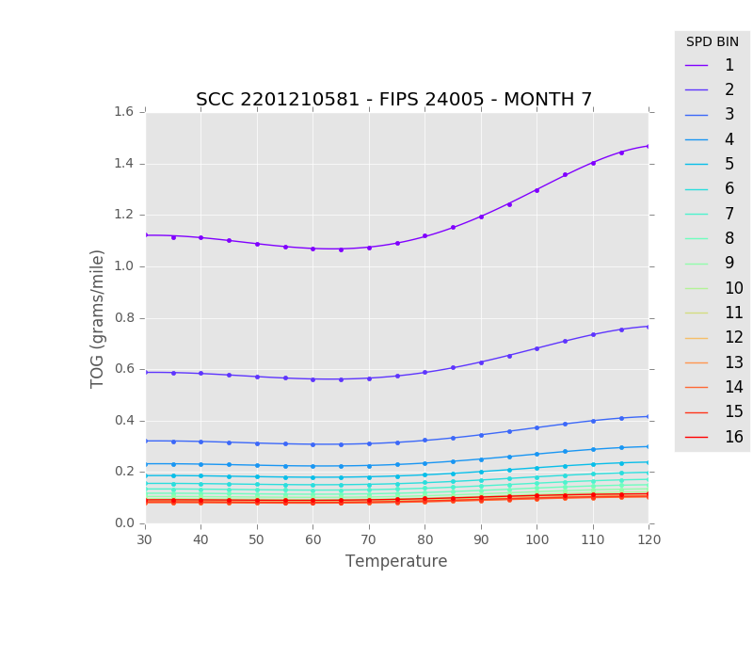
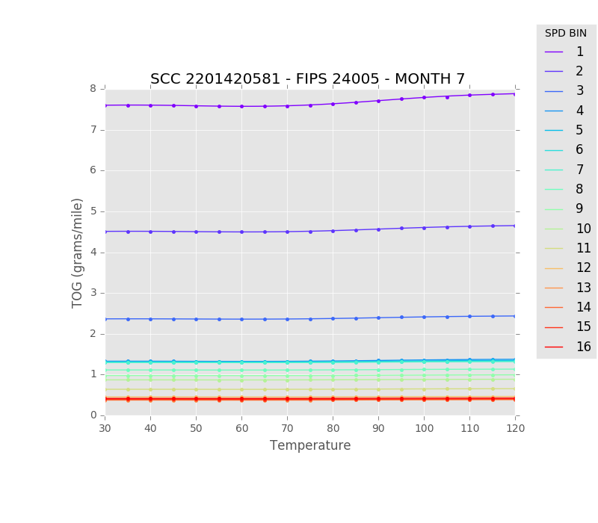
TOG: Gasoline-Passenger Car(left) and Buses (Right) Urban Unrestricted Access All Exhaust, Evaporative, Brake and Tire [81]

Slide 8
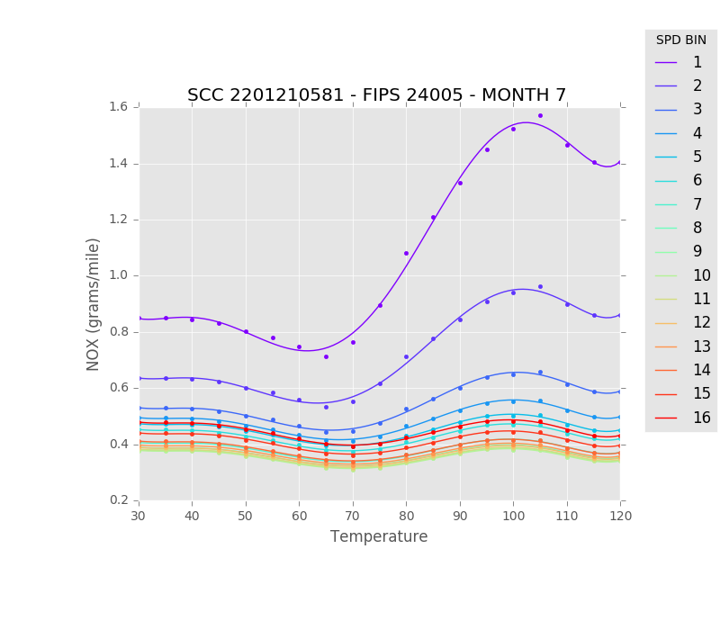
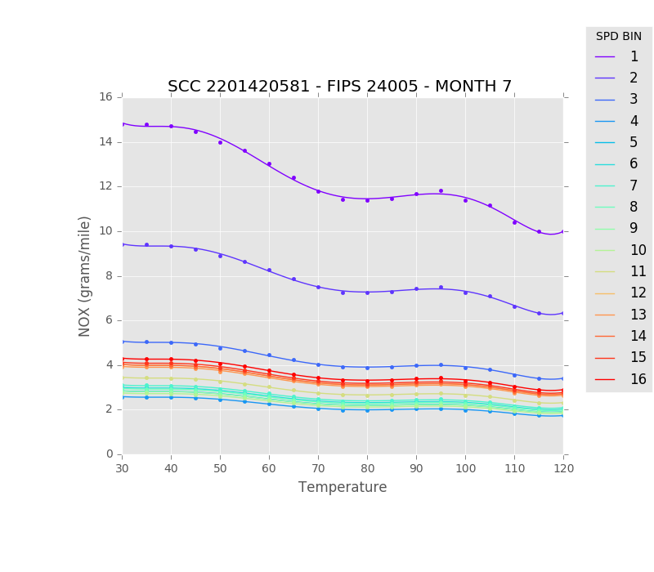
NOx: Gasoline-Passenger Car(left) and Buses (Right) Urban Unrestricted Access All Exhaust, Evaporative, Brake and Tire [81]

Slide 9
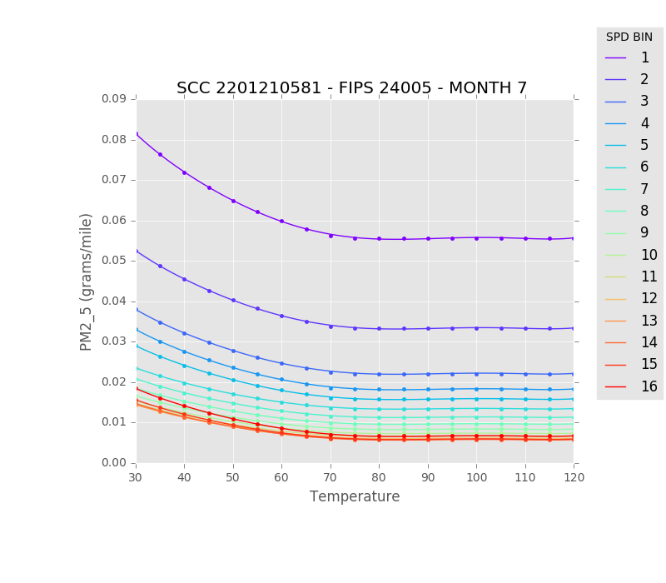
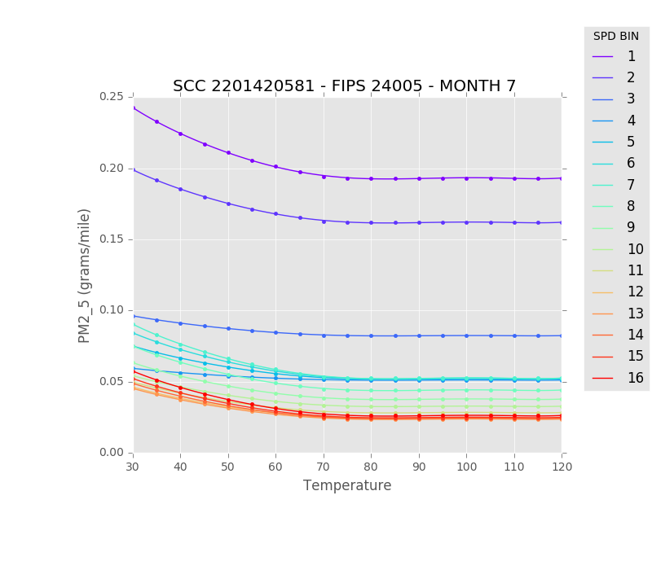
PM2.5: Gasoline-Passenger Car(left) and Buses (Right) Urban Unrestricted Access Refueling [62] and All Exhaust, Evaporative, Brake and Tire [81]

Slide 10
Rate Per Vehicle (RPV)

Slide 11
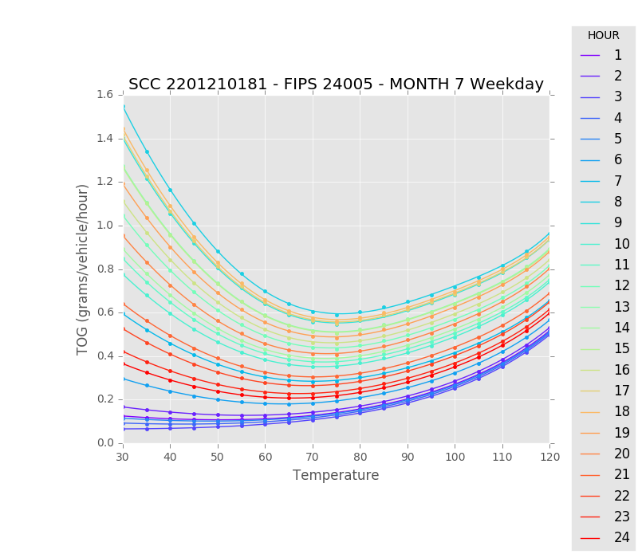
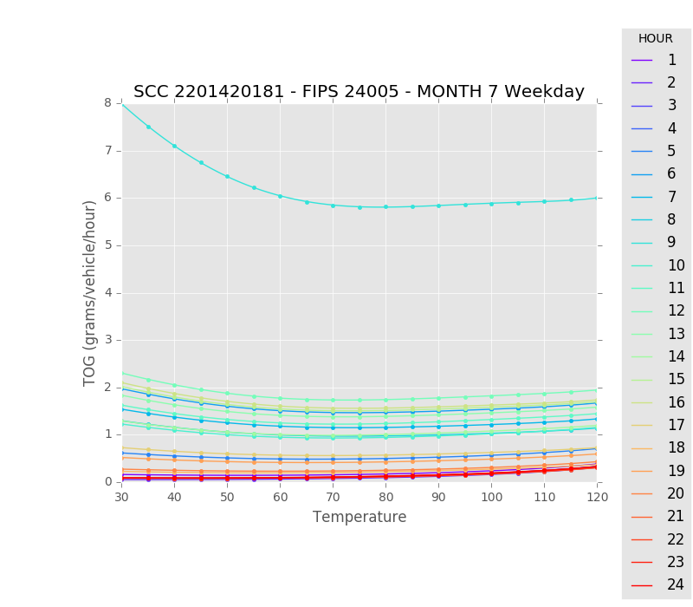
TOG: Gasoline-Passenger Car(left) and Buses (Right) Off-network All Exhaust, Evaporative, Brake and Tire [81]

Slide 12
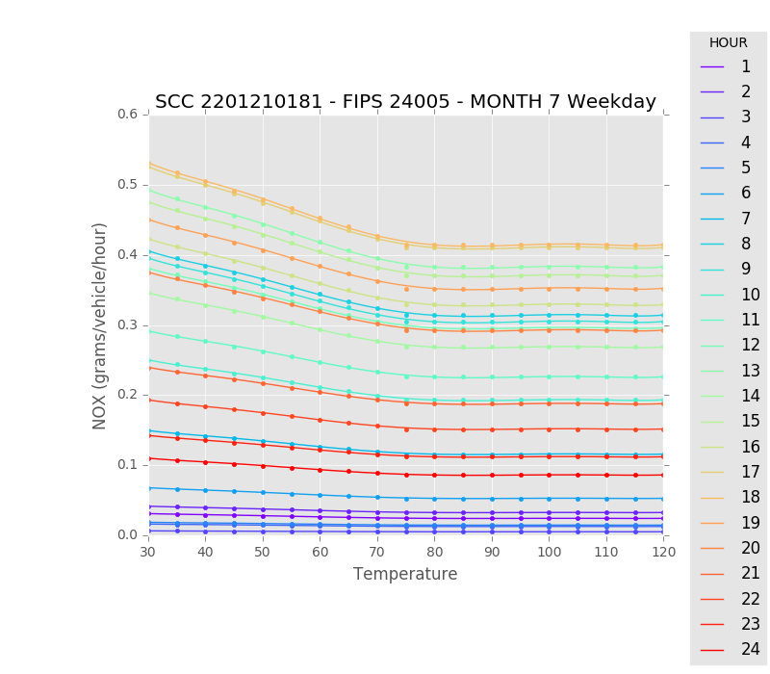
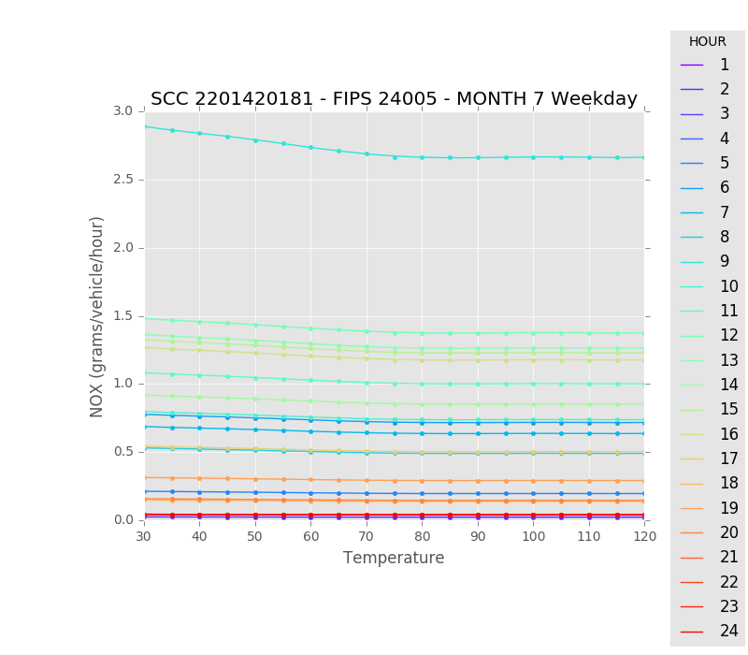
NOx: Gasoline-Passenger Car(left) and Buses (Right) Off-network All Exhaust, Evaporative, Brake and Tire [81]

Slide 13
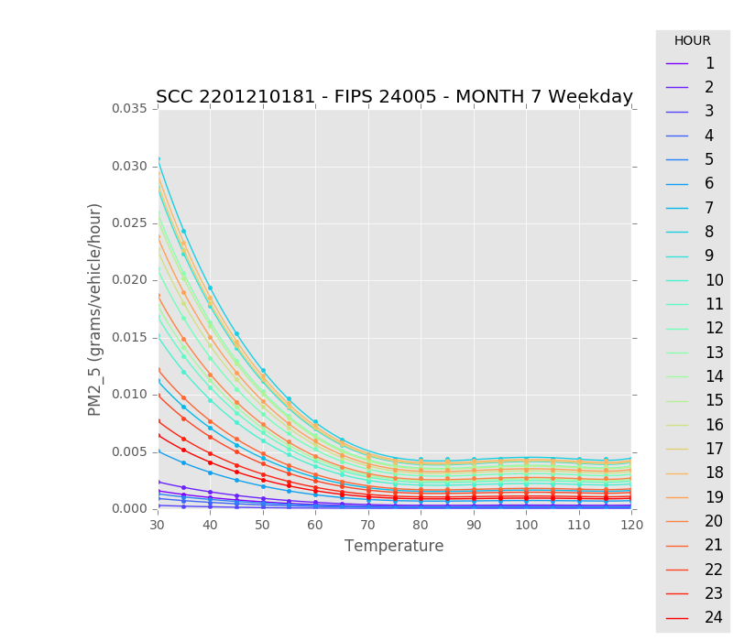
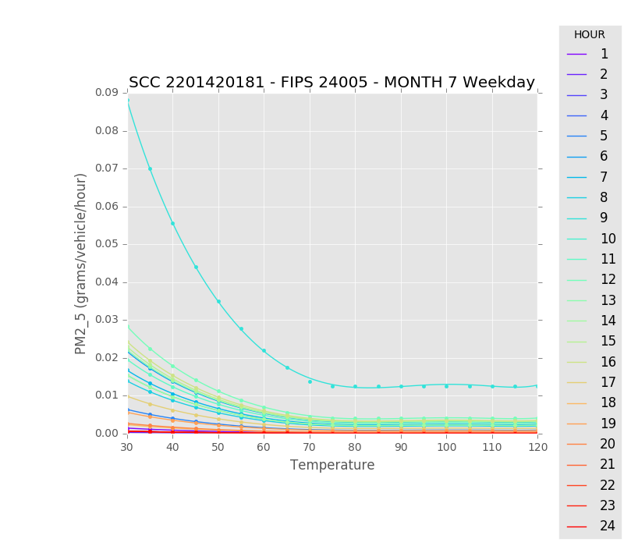
PM2.5: Gasoline-Passenger Car(left) and Buses (Right) Off-network All Exhaust, Evaporative, Brake and Tire [81]

Slide 14
Polynomial Algorithms Using BCFA Method
$y=ax^{6}+bx^{5}$ $+cx^{4}$ $+dx^{3}$ $+ex^{2}+fx$ $+g$
MOVES BCFA NetCDF formatted Emissions Factors Lookup Table File:
Days of Week = 7
No of Pollutatns : 30
No of SCC : 320
No of Speed Bin (for RPD) : 16 Bins
No of Hours (for RPV and RPP) : 24 hours
Minimum Temperature for all reference Counties
Minimum Temperature for all reference Counties
No of Polynomial Coefficients and intercept : 7 (a, b, c, d, e, f, and g)
Sectors | ASCII (MB) | CSV* (MB) | NetCDF* (MB)
RPD | 95-150 (77*) | 18 | 4.1
RPV | 45-100 (55*) | 11 | 2.1
RPH | <1MB (.65*) | 0.11 | 0.04

Slide 15
Performances
The size of NetCDF-format MOVES BCFA Lookup Table File : ~2.5G
Fuel Months = 2 (i.e., January and July)
No of Reference Counties : 304
Significant improvement on SMOKE-MOVES computational processing time and memory usages:
Small Test Case: US12km 66*59 Domain with a Single Reference County
Current: 15 Seconds vs. BCFA: 5 Seconds (5 times Faster!)
Med. Test Case: US12km 66*59 Domain with Two Reference Counties
Current: 509 Seconds vs. BCFA: 20 Seconds (25 time Faster!)
U.S. EPA NEI Modelign Platform Case: 12US1_459X299 with full Ref. Counties
Current: 4165 Seconds vs. BCFA: 49 Seconds (85 times Faster!)
The more no of reference counties, the better speed up of SMOKE-MOVES

Slide 16
Coupled AQ Modeling System
Emissions
Coupled Inline Emissions
Biogenic
NH₃ Bi-directional
Lightning NOx
Sea salt
Windblown Dust
Plume Rise for Point sources
Meteorology
Air Quality
Develop the prove of concept for coupling MOVES-based mobile emissions with air quality modeling system that can reflects the meteorology feedbacks to MOVES-based emissions for a better air quality simulation near metropolitan areas

Slide 17
Questions?

Slide 18
Acknowledgement
National Strategic Project-Fine Particle:
(NRF-2017M3D8A1092022)
National Research Foundation of Korea (NRF)
Ministry of Science and ICT(MSIT)
Ministry of Environment(ME)
Ministry of Health and Welfare(MOHW)

