Slide 1
Potential Performance differences of the National Air Quality Forecasting Capability when upgrading the Chemical Transport Model
Pius Lee¹, Youhua Tang^{1,2}, Jeff McQueen³, Ivanka Stajner^{3,4}, Daniel Tong^{1,2,5},
Barry Baker^{1,2}, Hyuncheol Kim^{1,2}, Jianping Huang^{3,6}, Ho-Chun Huang^{4,6},
Li Pan^{3,6}, and Jose Tirado-Delgado⁷
¹NOAA Air Resources Laboratory; ² UMD Cooperative Institute for Climate and Satellites, ³ NOAA National Centers for Environmental Prediction (NCEP); ⁴ NOAA NWS Office for Science and Technology Integration; ⁵ Center for Spatial Information Science and Systems, George Mason University; ⁶ I.M. Systems Group Inc., Rockville; ⁷Eastern Research Group (ERG), Arlington,
17th CMAS, Oct 22-24 2018

Slide 2
Talk Outline
Current NAQFC & CMAQ5.2 strengths in NAQFC-γ;
Long range transport of Smoke and Dust plumes;
Time-varying LBCs in NAQFC using GEOS-Chem & NGAC input;
Time-varying LBCs in NAQFC-γ using hemispheric CMAQ input;
Investigated to include halogen chemistry (reduction in coastal O₃).
17th CMAS, Oct 22-24 2018

Slide 3
Current Operations over CONUS
CMAQ5.0.2 (155 species) : major improvement since last upgrade
Explicitly modeling NTR by various alkyl nitrates species
Improved dust and PM modeling by adding 17 mineral species
Exploring CMAQ5.2 with developmental runs:
SOA module with enhanced summer time production of SOA;
CB6 and aero6 – 228 species: Advancement VOC chemistry & Combustion PM;
Photolysis rate attenuation from aerosol diming;
Account gas-chemistry by adopting EPA smoke-2-cmaq chemical profile;
LBC from operational NGAC for intruding smoke plume species;
Dynamic boundary condition from hemispheric CMAQ simulation;
Halogen chemistry: Cl, Br, and I.
17th CMAS, Oct 22-24 2018

Slide 4
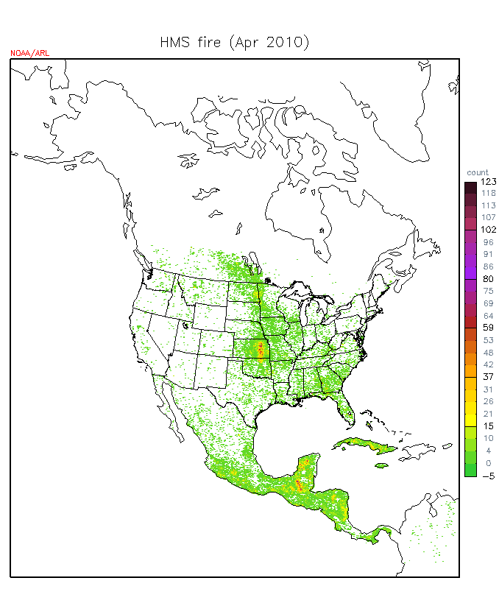
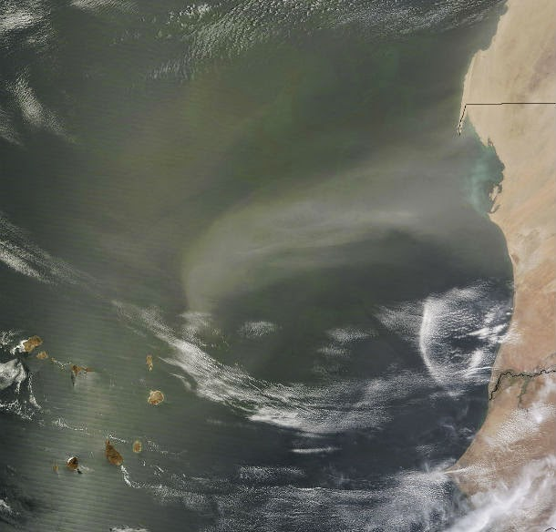
Account for Exo-domain emitted pollution intruded into CONUS via BCs
Courtesy: LANCE Rapid response team,
NASA
Dust storm plume transported from West Africa
A typical monthly hot-spot fire count in April
17th CMAS, Oct 22-24 2018

Slide 5
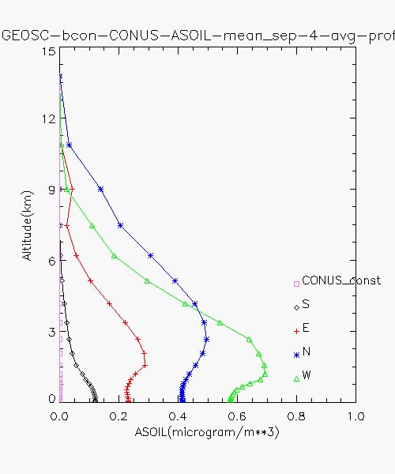
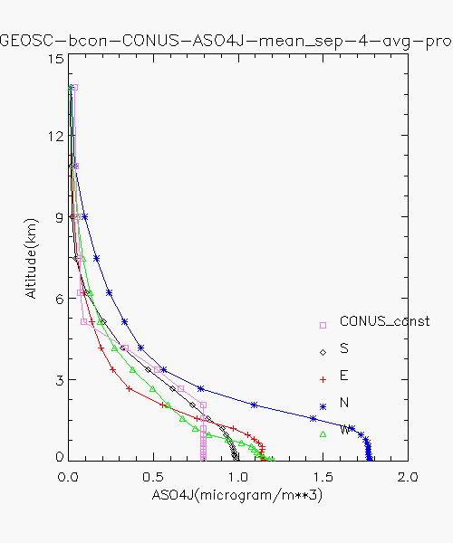
Current ops: PM components are modified by NGAC
Static LBC
Monthly averaged vertical profiles from GEOS-CHEM 2006
(a) ASOIL
(b) ASO4J
17th CMAS, Oct 22-24 2018

Slide 6
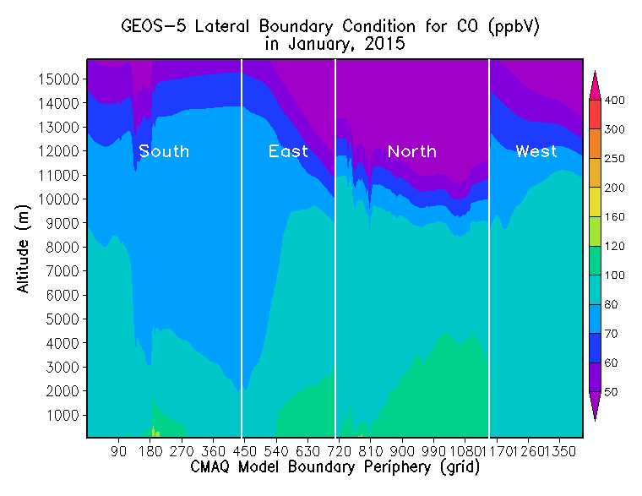
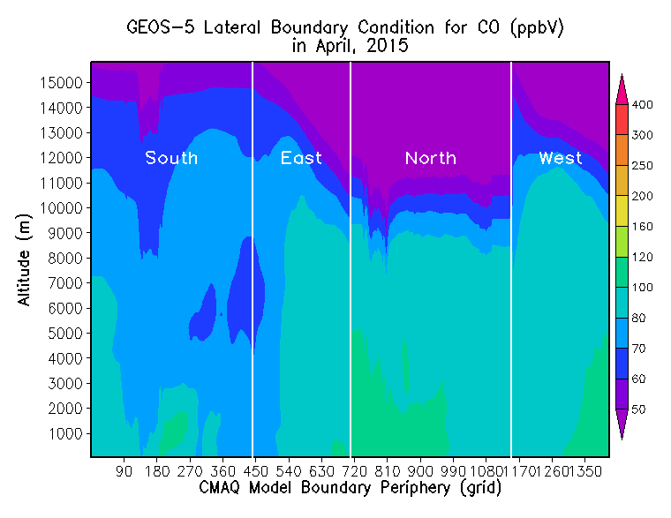
Seasonality of chemical lateral boundary conditions
(a) Geos5 2015 January monthly averaged CO
(b) Geos5 2015 April monthly averaged CO
17th CMAS, Oct 22-24 2018

Slide 7
Modify static Chemical LBC with NGAC 3-hourly output
Dynamic BC data are fed into CMAQ
Speciation mapping between NGAC and CMAQ speices
NGAC species | CMAQ species (multiplicative factor)
Dust | A25J | 1.0, 0.42; respectively (R.)
Dust | ASOIL | 0.58,1.0,0.76; (R.)
Sea salt | ANAJ | 0.39,0.27; (R.)
Sea salt | ACLJ | 0.61,0.42(R.)
Sea salt | ANAK | 0.12,0.39; (R.)
Sea salt | ACLK | 0.18,0.61; (R.)
SO2 | SO2 | 1.0
CO | CO | 1.0
SO4 | ASO4J | 1.0
bcphobic | AECJ | 1.0
bcphilic | AECJ | 1.0
ocphobic | AORGPAJ | 1.0
ocphilic | AORGPAJ | 1.0
17th CMAS, Oct 22-24 2018

Slide 8
Sensitivity cases for exploring CMAQ5.2 to include Halogens
Case | CTM | Dynamic LBC | Halogen emission | Remark
V5.2_Base | CMAQ5.2 | NGAC no gaseous species | none | 17 species
V5.2_LBC_A | CMAQ5.2 | Derived from hemispheric CMAQ | none | 230 species
V5.2_LBC_B | CMAQ5.2 | Derived from hemispheric CMAQ | Parameterized based on chlorophyll-a concentration | 230 species
Courtesy : Sarwar Golam
17th CMAS, Oct 22-24 2018

Slide 9
Unraveled LBC along perimeter of CMAQ-CONUS domain
CMAQ species can be strongly modified by corresponding species in NGAC
(a) Static from climatology
(b) Overridden by NGAC
17th CMAS, Oct 22-24 2018
Notes:
(Q) What & specificity, result of pre-implementation test Phase I

Slide 10
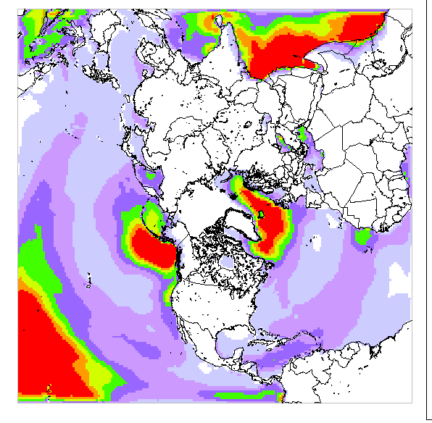
Derive dynamic LBC from Hemispheric CMAQ5.2 simulation
Polar stereographic projection
with 44 layer & model top at 50 mb
Lambert Conformal Conic projection with 35 layer & model top at 50 mb
Courtesy : Sarwar Golam
17th CMAS, Oct 22-24 2018

Slide 11
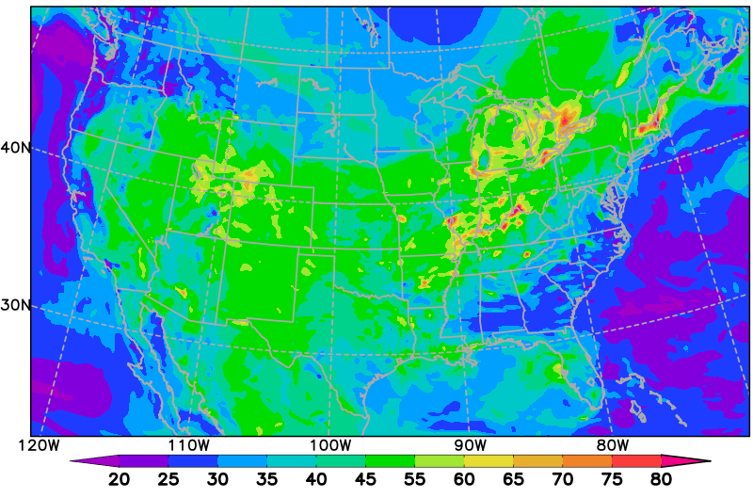
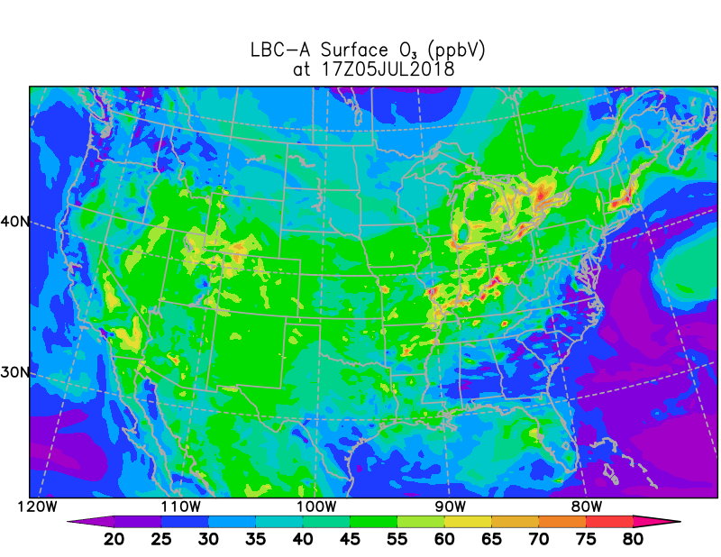
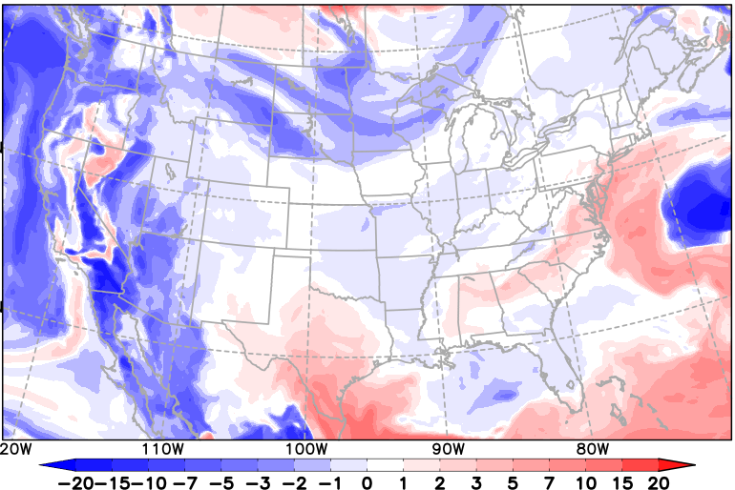
Surface O₃ valid 20180705 17Z
V5.2_Base -- LBC no gaseous species
V5.2_LBC_A -- LBC hemispheric CMAQ but
no CHLO based Cl,Br, I emission
V5.2_LBC_B minus V5.2_LBC_A
17th CMAS, Oct 22-24 2018

Slide 12
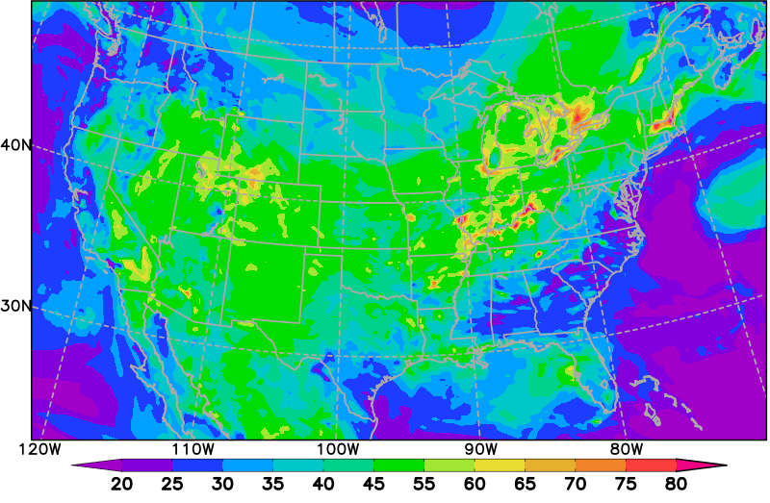
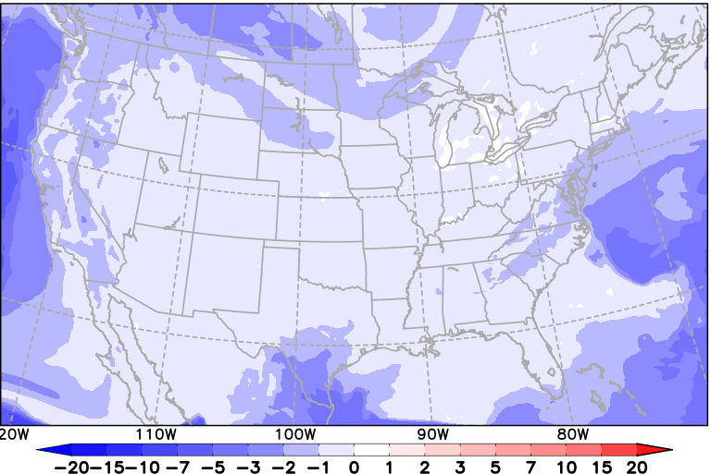
Surface O₃ valid 20180705 17Z
V5.2_LBC_B -- LBC hemispheric CMAQ and
with CHLO based Cl,Br, I emission
V5.2_LBC_A -- LBC hemispheric CMAQ but
no CHLO based Cl,Br, I emission
V5.2_LBC_B minus V5.2_LBC_A
17th CMAS, Oct 22-24 2018

Slide 13
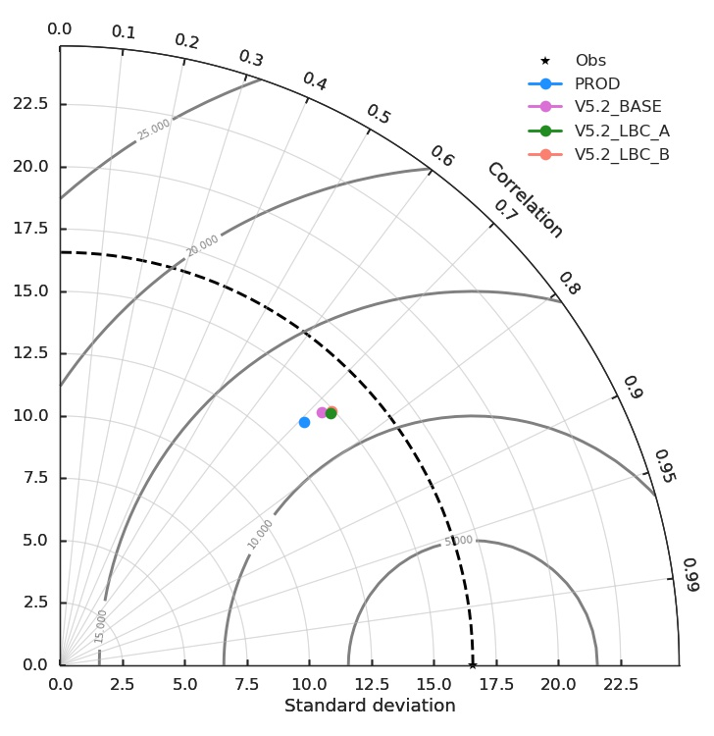
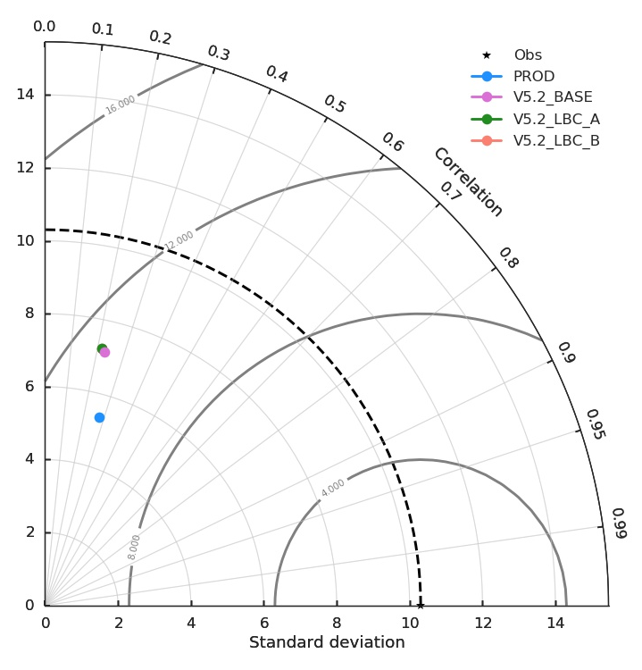
O₃
Variability for V5.2_LBC_B and
V5.2_LBC_A cases are comparable and better than current NAQFC.
PM_{2.5}
17th CMAS, Oct 22-24 2018

Slide 14
MDA8 O₃ performance for CMAQ5.2 configurations in 7/1-7/11
 |  | N | obs | mean | Bias | RMSE | Coeff corr | FAR | IOA
 | 5.2 NGAC | 271300 | 33.0 | 38.25 | 5.25 | 12.94 | 0.71 | 0.72 | 0.82
 | N_CHLO |  |  | 38.87 | 5.87 | 12.98 | 0.73 | 0.71 | 0.82
 | CHLO |  |  | 38.42 | 5.42 | 12.83 | 0.73 | 0.71 | 0.83
NE | 5.2 NGAC | 39500 | 34.8 | 39.20 | 4.40 | 13.05 | 0.75 | 0.64 | 0.85
 | N_CHLO |  |  | 40.15 | 5.35 | 13.04 | 0.77 | 0.62 | 0.85
 | CHLO |  |  | 39.78 | 4.98 | 12.94 | 0.77 | 0.62 | 0.86
S E | 5.2 NGAC | 45300 | 26.0 | 34.28 | 8.28 | 13.84 | 0.67 | 0.92 | 0.73
 | N_CHLO |  |  | 34.82 | 8.82 | 13.85 | 0.69 | 0.92 | 0.75
 | CHLO |  |  | 34.53 | 8.53 | 13.71 | 0.69 | 0.92 | 0.76
SC | 5.2 NGAC | 39000 | 35.8 | 39.96 | 4.16 | 14.03 | 0.71 | 0.65 | 0.65
 | N_CHLO |  |  | 40.56 | 4.76 | 14.66 | 0.70 | 0.65 | 0.65
 | CHLO |  |  | 39.67 | 3.87 | 14.42 | 0.70 | 0.65 | 0.65
CONUS
17th CMAS, Oct 22-24 2018

Slide 15
24 h PM_{2.5} performance for CMAQ5.2 configurations in 7/1-7/11
 |  | N | obs | mean | Bias | RMSE | Coeff corr | FAR | IOA
 | 5.2 NGAC | 183530 | 8.9 | 9.20 | 0.30 | 11.13 | 0.23 | 1.0 | 0.44
 | N_CHLO |  |  | 9.32 | 0.42 | 11.55 | 0.22 | 1.0 | 0.42
 | CHLO |  |  | 9.32 | 0.42 | 11.55 | 0.22 | 1.0 | 0.42
NE | 5.2 NGAC | 25300 | 10.0 | 11.58 | 1.58 | 8.68 | 0.46 | 1.0 | 0.66
 | N_CHLO |  |  | 11.86 | 1.86 | 8.89 | 0.44 | 1.0 | 0.65
 | CHLO |  |  | 11.85 | 1.85 | 8.89 | 0.44 | 1.0 | 0.65
S E | 5.2 NGAC | 23500 | 8.6 | 9.26 | 0.66 | 7.90 | 0.20 | 1.0 | 0.45
 | N_CHLO |  |  | 9.36 | 0.76 | 8.47 | 0.18 | 1.0 | 0.42
 | CHLO |  |  | 9.36 | 0.76 | 8.47 | 0.18 | 1.0 | 0.42
SC | 5.2 NGAC | 43800 | 7.9 | 6.53 | -1.37 | 9.32 | 0.31 | 0.99 | 0.47
 | N_CHLO |  |  | 6.72 | -1.18 | 9.24 | 0.30 | 0.99 | 0.47
 | CHLO |  |  | 6.71 | -1.19 | 9.24 | 0.31 | 0.99 | 0.47
CONUS
17th CMAS, Oct 22-24 2018

Slide 16
Tested CMAQ5.2 configurations for NAQFC-γ
Current NAQFC & CMAQ5.2 strengths in NAQFC-γ
Long range transport of Smoke and Dust plumes;
Time-varying LBCs in NAQFC using GOES-Chem & NGAC input;
Time-varying LBCs in NAQFC-γ using hemispheric CMAQ input;
Investigated to include halogen chemistry (reduction in coastal O₃?)
Improved variability characteristics of surface O₃ and PM_{2.5};
Reduced over-predictions in coastal O₃.
Other NAQFC presentations: Mon_3.10: Kim et al. NO2 down-scaling
PI (18) Tang et al., Hawaii volcano eruption; Wed_1.00: Tong et al., Dust emission
PI (23) Baker et al., Evaluation Toolkit (MONET); Wed_4.10: Stajner et al., NAQFC
PII (5) Kim et al., Top-down NO2; : Chai et al., Smoke inverse modeling
17th CMAS, Oct 22-24 2018

