Slide 1

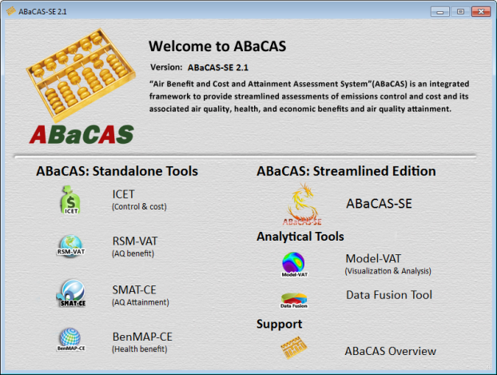
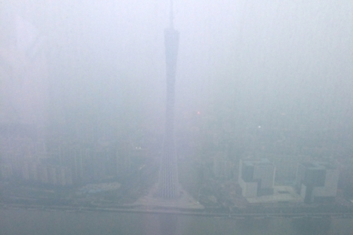



Overview of “ABaCAS”: A New-Generation Integrated Air Quality Decision Support System
Air Pollution
(PM2.5 & O3)
ABaCAS
Cost/Benefit & Attainment
Emissions Control & Cost
Health & Economic
Benefit
AQ
Benefit & Attainment
Science
Policy
Actions
Carey Jang
Office of Air Quality Planning & Standards, U.S.EPA
CMAS Conference, 10/22/2018

Slide 2
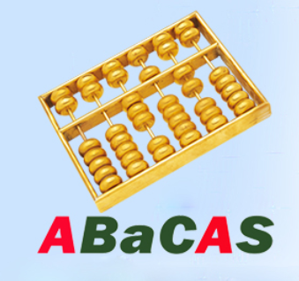





Outline
Air Benefit & Cost and Attainment Assessment System:
  “ABaCAS ”: An integrated decision support system developed by a team of international scientists; key components including:
    “ICET”: Control Cost Estimate Tool
    “RSM/CMAQ”: Air Quality Assessment Tool
    “SMAT-CE”: Attainment Assessment Tool
    “BenMAP-CE”: Health & Economic Benefit Tool
    “LE-CO”: Least Cost Optimizer Tool (prototype)
Evolution & Recent Development:
  1. ABaCAS Prototype (2015): Cost/Benefit & Attainment Assessment
  2. ABaCAS 1.0 (2016): Connected under One Integrated Platform
  3. ABaCAS 2.0 (2017): ABaCAS Streamlined Edition (ABaCAS-SE)
  4. ABaCAS 3.0 (2018): ABaCAS Optimized Edition (ABaCAS-OE)

Slide 3
What is ABaCAS ?
ABaCAS is an “user-friendly” and “open-source” air quality decision support system
  “User-friendly” for policy-makers and common users with free and easy-to-use GUI and visualization & analysis functions
  “Open-source” environment for scientists and advanced users to develop, enhance and expand functions and modules
ABaCAS is an integrated framework to provide assessment of air pollution control and its associated AQ, health, and attainment benefits
  Provide effective assessment of AQ and health/economic benefits, benefit/cost analysis & optimization, and attainment assessment under various control strategies/scenarios

Slide 4




ABaCAS
Prototype
ABaCAS 1.0
ABaCAS 2.0
ABaCAS 3.0
(prototype)
Four Key Tools:
Cost estimate
AQ Benefit
AQ Attainment
Health Benefit
Integrated
Platform
Integrated cost/benefit assessment
International applications
ABaCAS website
ABaCAS training & User’s Guides
Streamlined Edition
“ABaCAS-SE”
Streamlined cost/benefit assessment
China & USA pilot cases
Model-VAT Visual Tool
Data Fusion Tool
Optimized Edition
“ABaCAS-OE”
Optimized (least-cost) control strategy
Polynomial Functions “pf-RSM” and “i-RSM”
Least Cost Optimizer “LE-CO”
ICET
ICET
RSM-VAT
SMAT-CE
BenMAP-CE
2015
2016
2017
2018

Slide 5
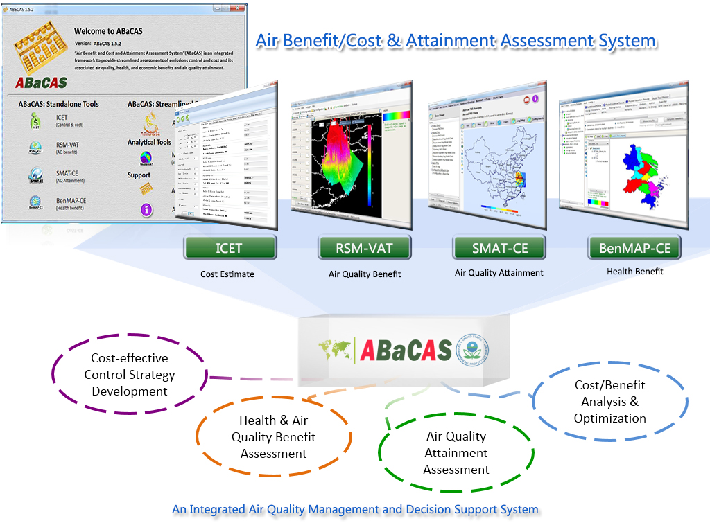
ABaCAS : Air Benefit and Cost & Attainment Assessment System
Integrated AQ Decision Support System (http://www.abacas-dss.com)
“ABaCAS 1.0”
2015-2016
Integrated
Cost/Benefit
& Attainment
Assessment
Control
& Cost
Estimate
Real-time
Air Quality
Benefit
Air Quality
Attainment
Assessment
Health &
Economic
Benefit

Slide 6
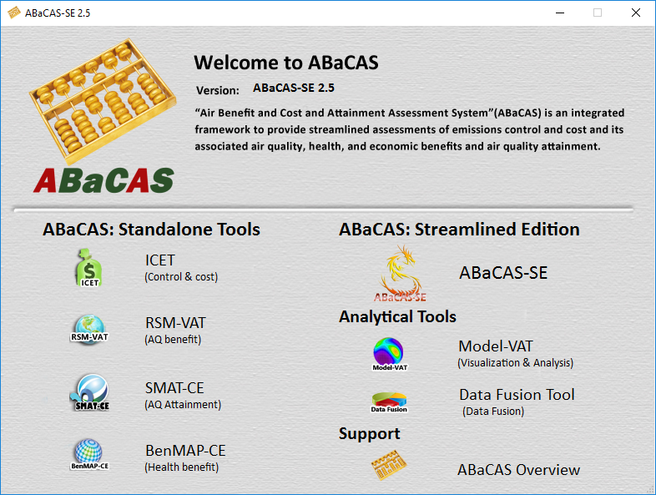
“ABaCAS”: Air Benefit and Cost & Attainment Assessment System
An integrated AQ Decision Support System
Developed for “Scientists” and “Policy Makers”
6

Slide 7
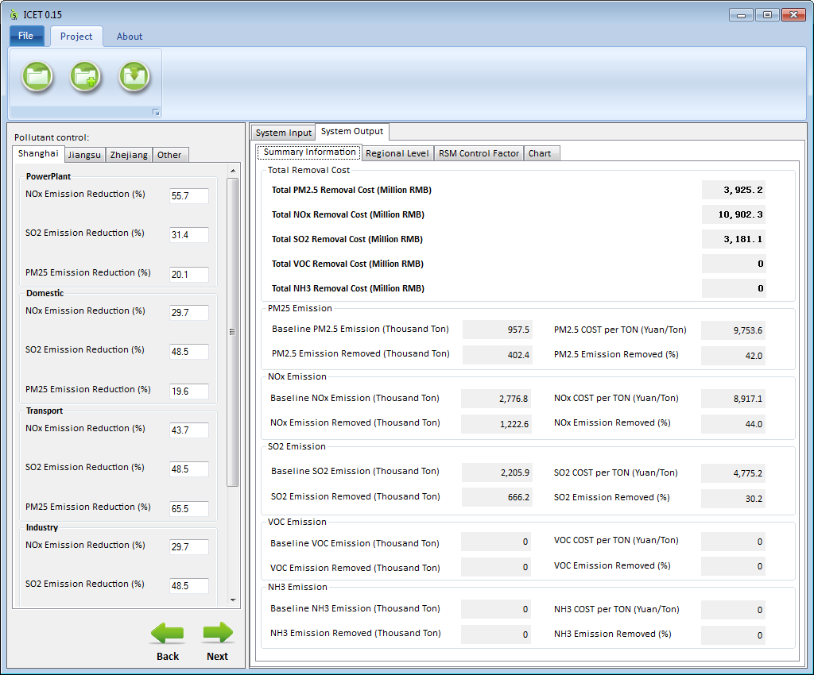
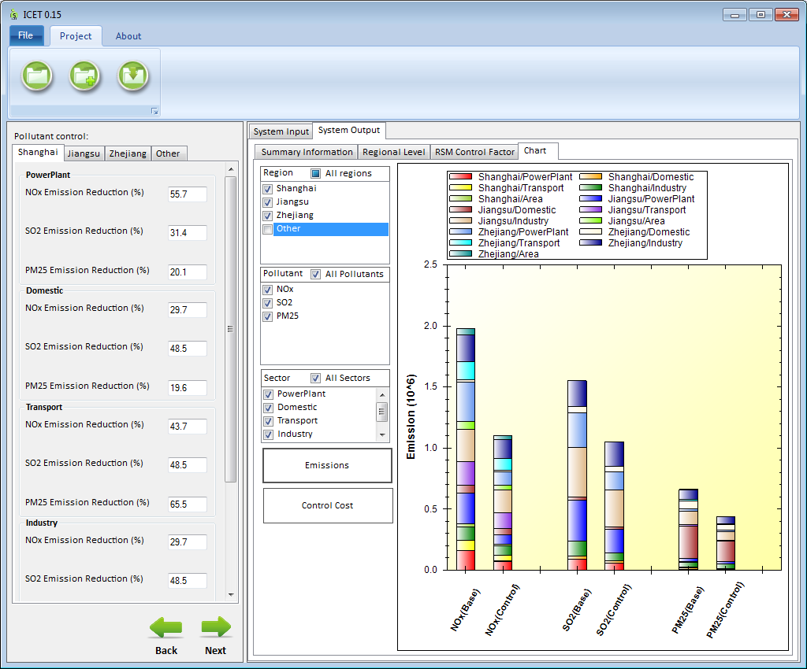
ICET: International Control cost Estimate Tool
ICET
(International Emissions Control Cost Interface Tool)
Provide Control Cost Analysis and Estimate : A flexible & modular control & cost estimate tool to give an estimate of control cost and link to RSM/CMAQ & BenMAP-CE for control cost/benefit assessment
Notes:
Comment: This is an important slide, but needs to be improved. Consider to use animations to highlight the key features & differences

Slide 8
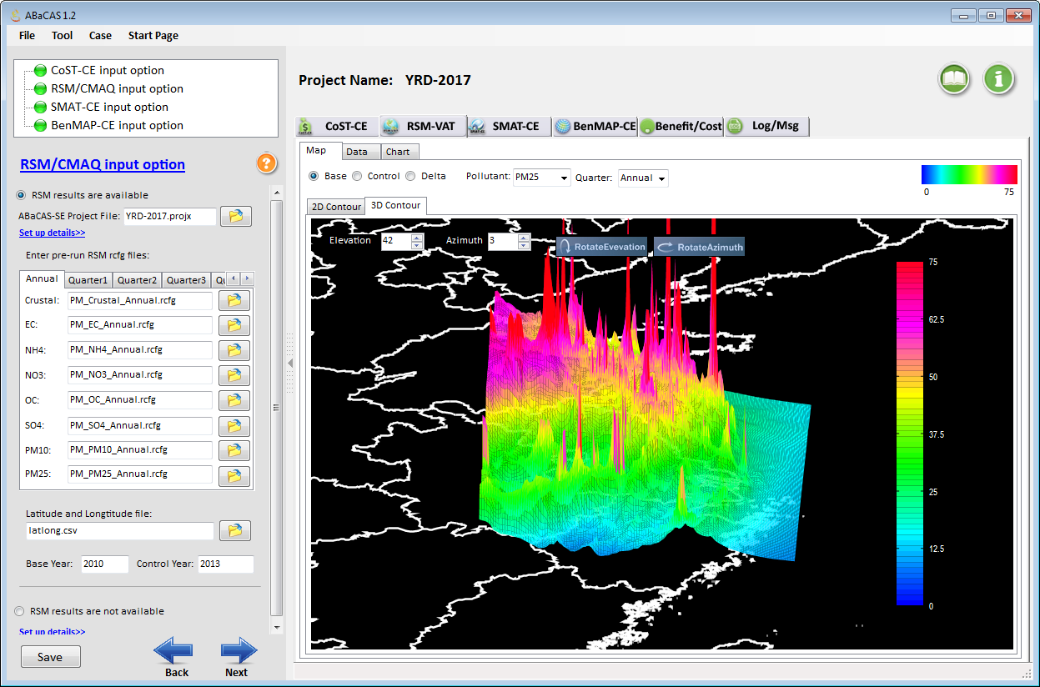
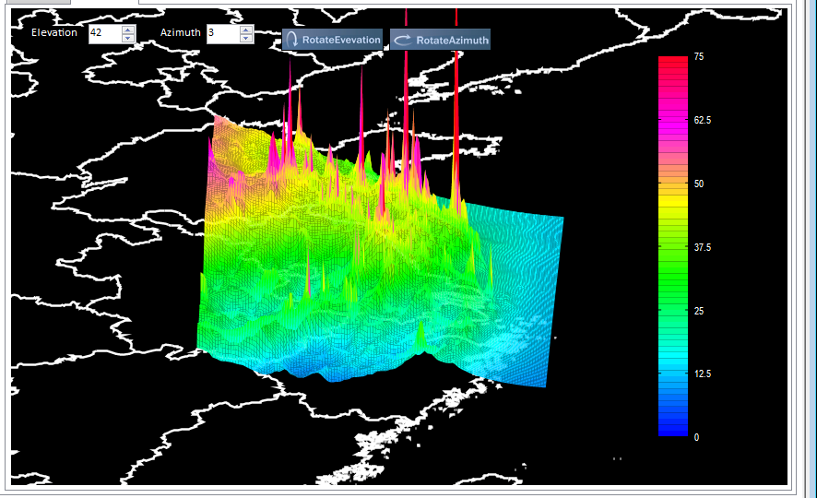
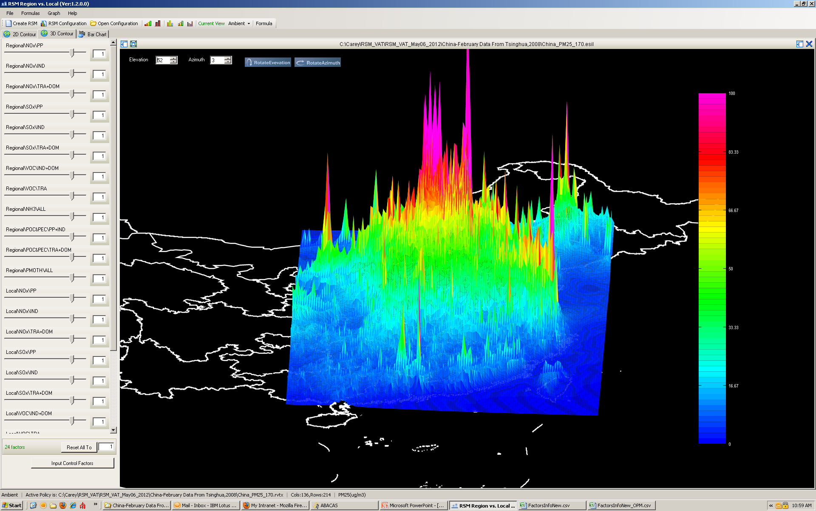
RSM: Response Surface Model
RSM/CMAQ
Base
Control
RSM-VAT:
(RSM Visualization &
Analysis Tool)
Provide Real-time AQ Response of Emissions Control:
A cutting-edge tool developed by USEPA & Chinese Scientists to provide real-time response of AQ concentrations to changes in emission sources
Notes:
Comment: This is an important slide, but needs to be improved. Consider to use animations to highlight the key features & differences

Slide 9
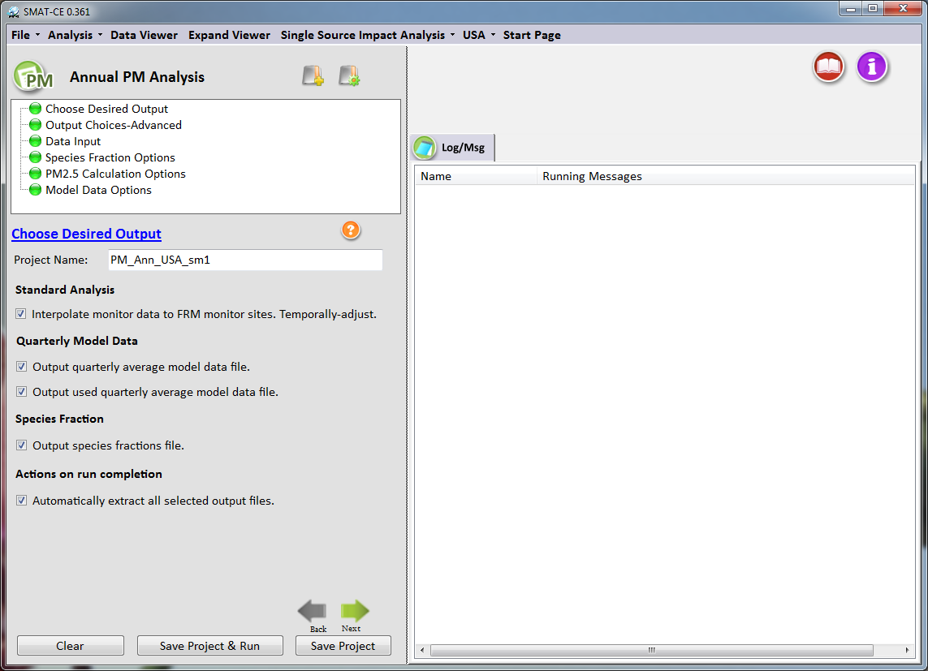
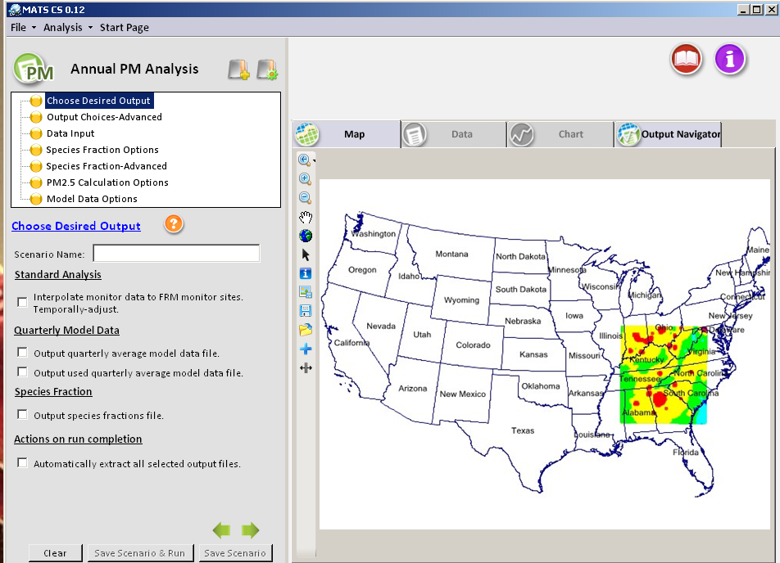
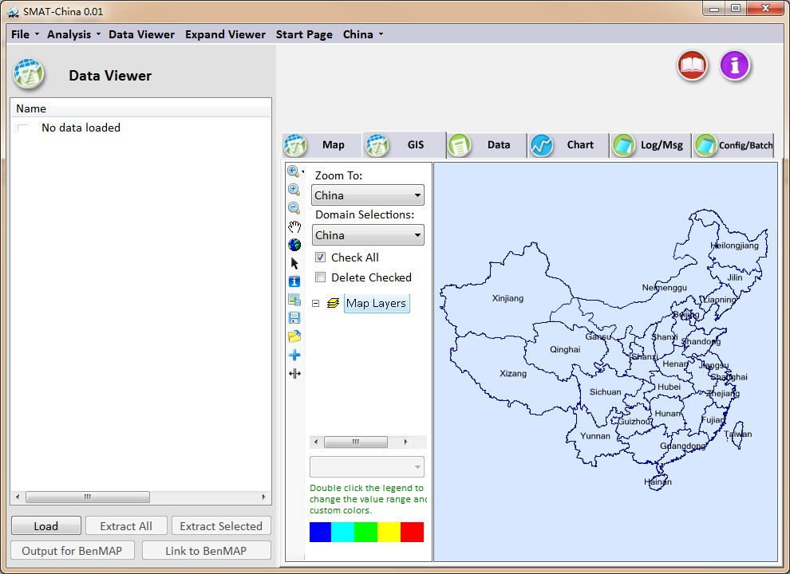
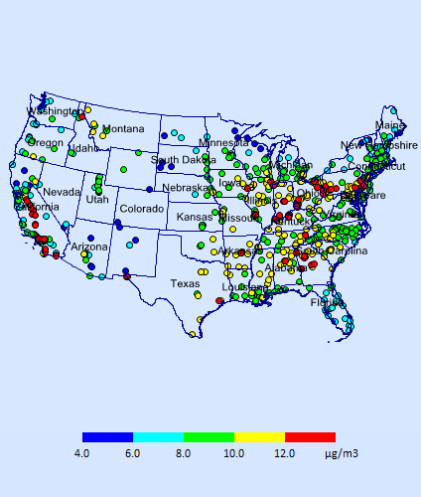
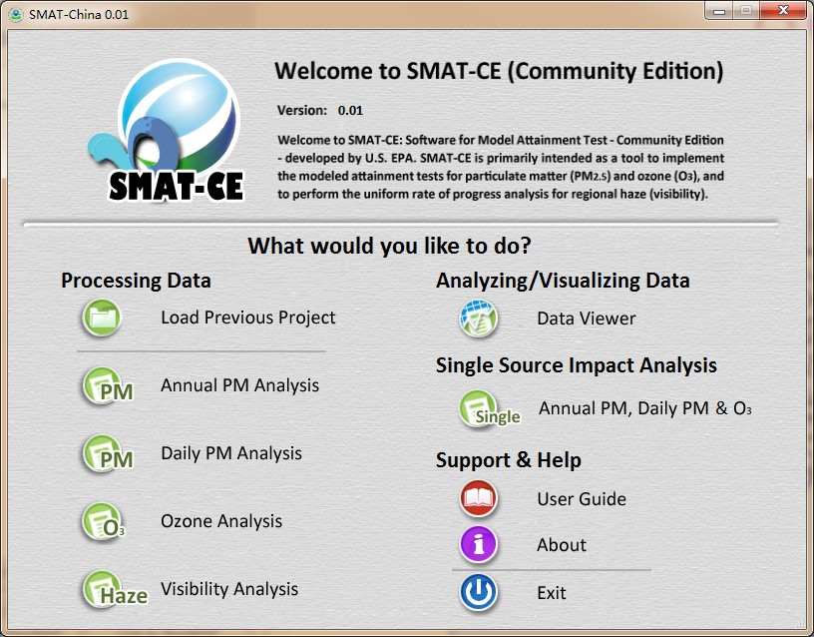
SMAT-CE: Software for Model Attainment Test
(Community Edition)
SMAT-CE
(Community Edition)
Developed by EPA and “ABaCAS” team to perform attainment assessment for EPA’s national rules and SIPs on PM2.5, O3 & Visibility
Use monitoring data as base and model data as projection
Notes:
Comment: This is an important slide, but needs to be improved. Consider to use animations to highlight the key features & differences

Slide 10
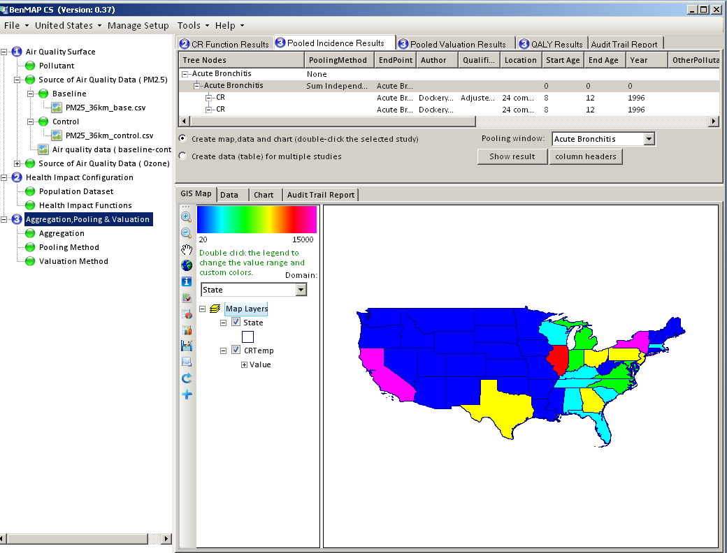
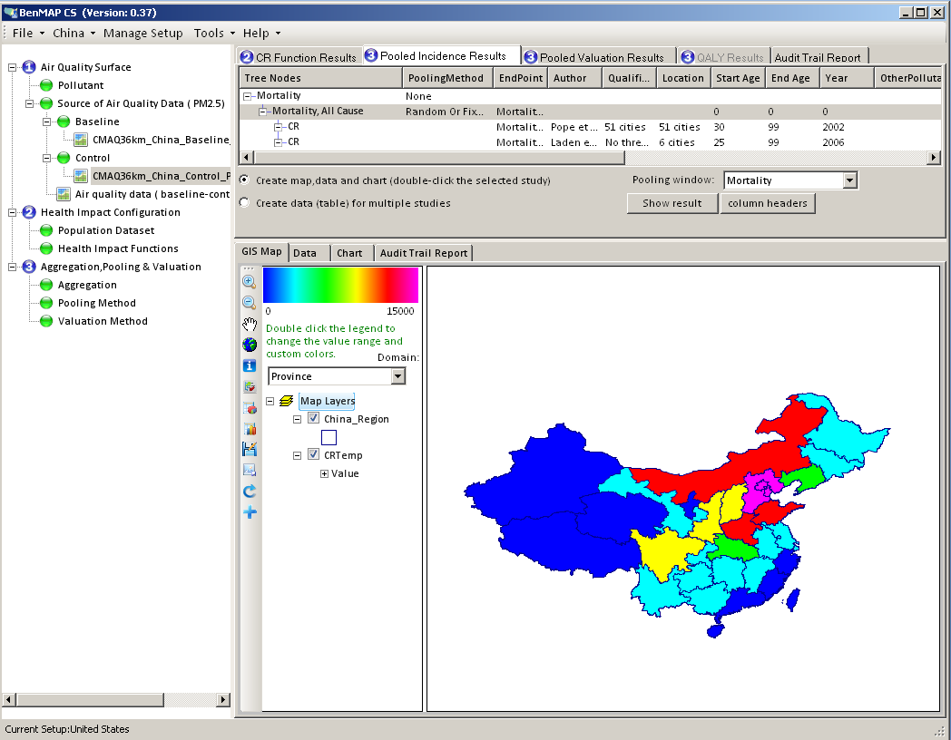
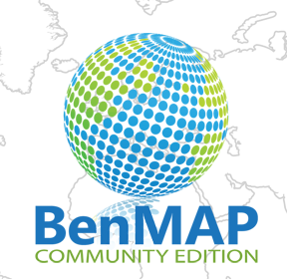
BenMAP-CE: Environmental Benefit Mapping & Analysis (Community Edition)
BenMAP-CE
BenMAP-CE
(Community Edition to
Replace Legacy BenMAP)
Provide Health Impacts & Economic Benefits Estimate:
Developed by EPA and ABaCAS team to estimate health & environmental impacts and economic benefits occurring changes in air quality
Notes:
Comment: This is an important slide, but needs to be improved. Consider to use animations to highlight the key features & differences

Slide 11
“ABaCAS-SE”: ABaCAS “Streamlined Edition”
Developed for “Scientists” and “Policy Makers”

Slide 12

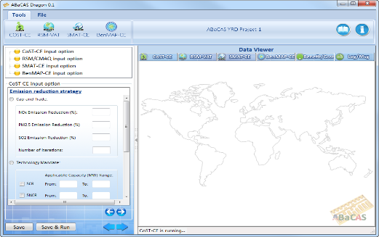

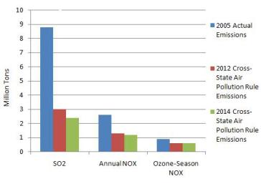
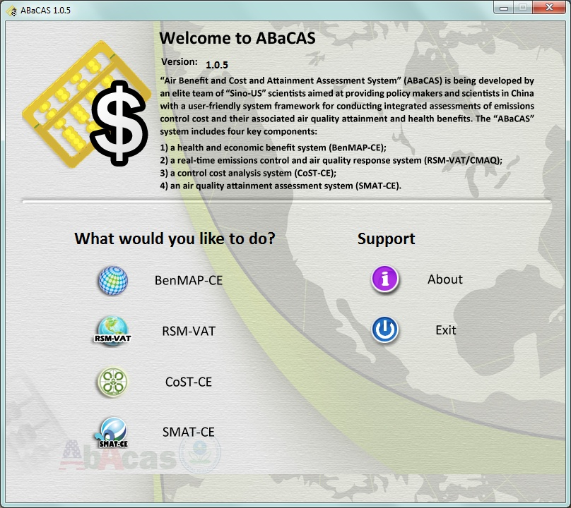
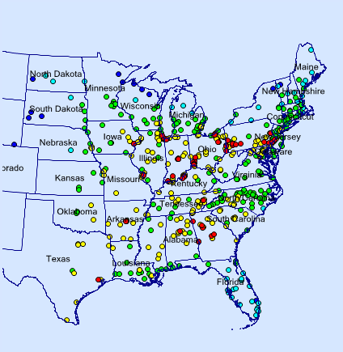
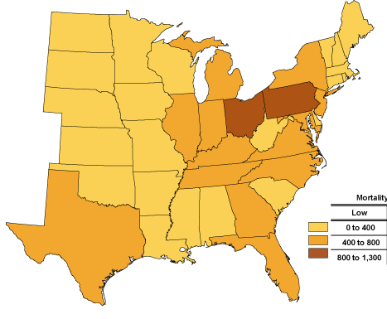
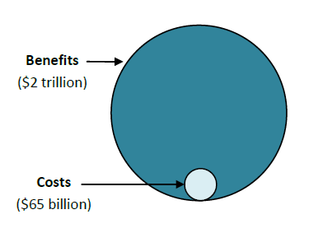
“ABaCAS-SE”:
(Streamlined Edition”, 2016-2017)
Control Policy Scenarios
Control Strategy
A
Control Strategy
B
Control Strategy
C
……………
ABaCAS-SE
ABaCAS-SE Master Script
Cost estimate ($$)
ICET
ICET script
ICET
AQ Benefit (ug/m³)
RSM-VAT
RSM-VAT script
> 12 ug/m³ (non-attainment)
SMAT-CE
SMAT-CE script
Attainment (DVs)
BenMAP-CE
BenMAP-CE script
BenMAP-CE
Health Benefit ($$)
Benefit/Cost = ~20
Streamlined Assessment
Benefit ($$)/Cost ($$)
Notes:
spatial field: A Spatial Field refers to air pollution estimates made at the center of each grid cell in a specified modeling domain. For example, MATS might calculate ozone design values for each grid cell in the modeling domain. Several types of Spatial Fields can be calculated for ozone and PM.
利用环境监测数据、模型数据（主要是CMAQ模拟的结果）作为模型输入，并利用优化的数理统计技术对大气复合污染状况进行模拟，实现对环境空气质量标准的达标评估。其中包括point estimate和spatial field estimate。

Slide 13
ABaCAS-SE
Cost/Benefit
Attainment
ICET
SMAT-CE
BenMAP-CE
Emissions
Control & Cost
RSM/CMAQ
Health/Economic Benefit
AQ Benefit
$$ (cost)
AQ (benefit)
$$ (benefit)
Tons (emis)
Tons (emis)
AQ (benefit)
AQ (benefit)
$$ (benefit)
$$ (cost)
$$ (cost)
“abacas-dss.com”

Slide 14
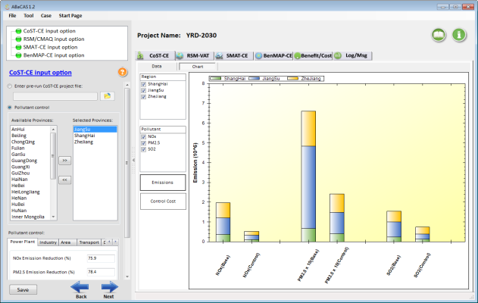
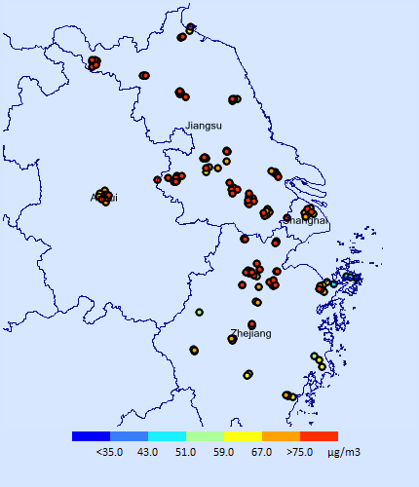
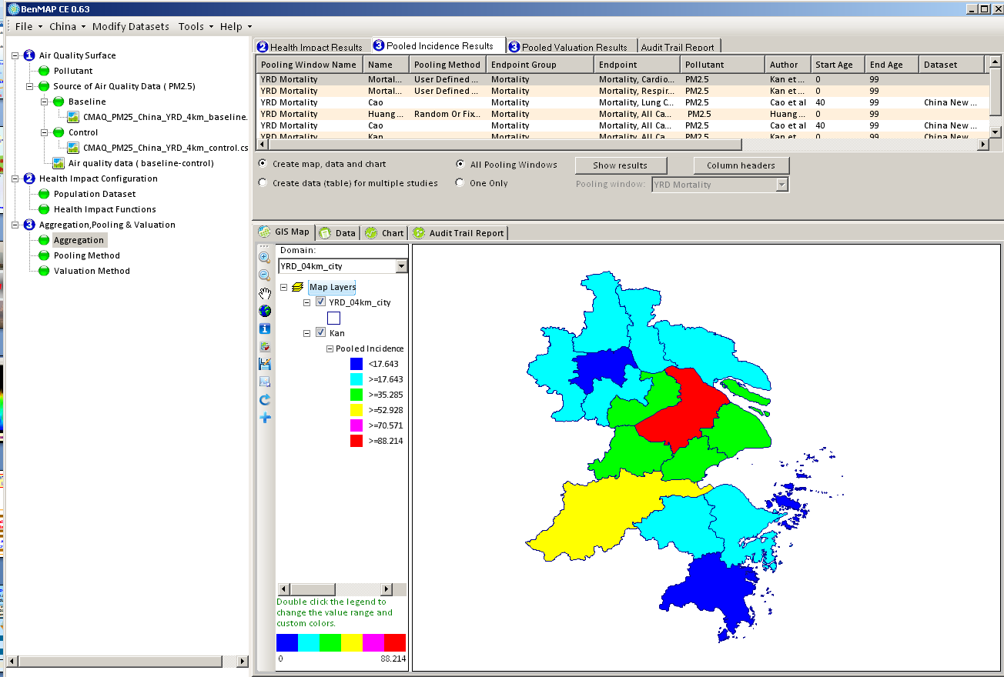
ABaCAS-SE：China YRD/Shanghai Case Study
China National Air Pollution Control Plan (2013)
Region | Annual PM_{2.5}
BJ-TJ-Hebei | 25% ↓
YRD/Shanghai (Yangtze River Delta) | 20% ↓
PRD/Guangzhou | 15% ↓
Beijing | 60 ug/m³
Other Cities (333 cities) | 10% ↓ (PM₁₀)
ICET
Emissions Control & Cost
RSM/CMAQ
AQ Response to Emissions Control
AQ Attainment in YRD:
2017: PM2.5 20% ↓
2030: Attain China NAAQS
SMAT-CE
AQ Attainment
BenMAP-CE
Health and Economic Benefits

Slide 15
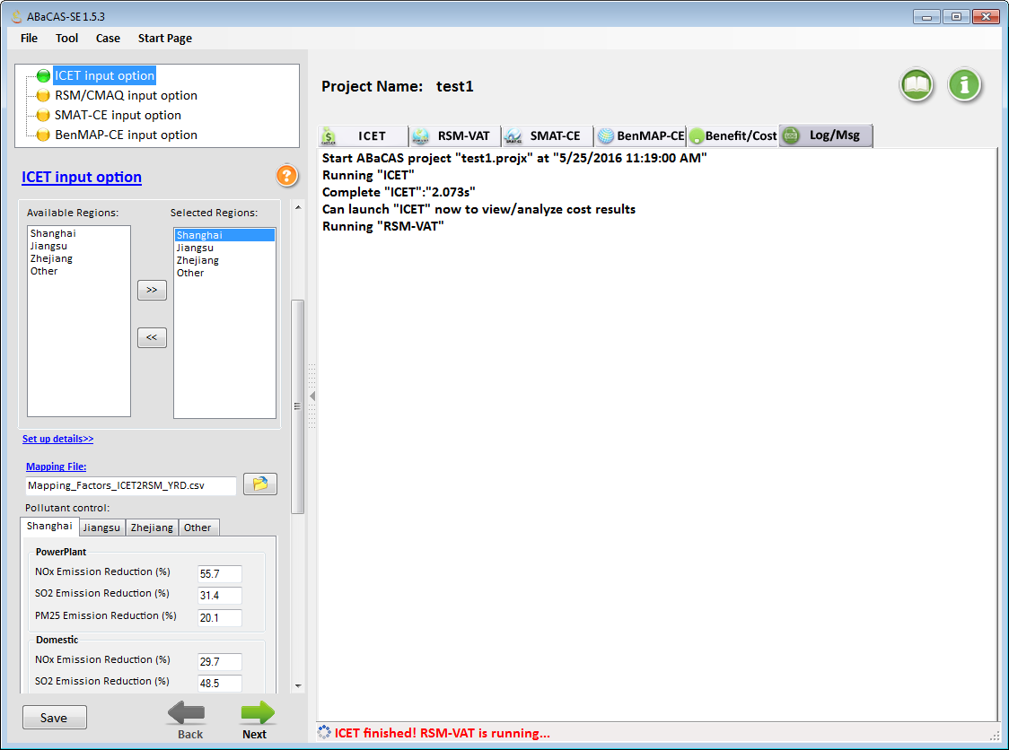
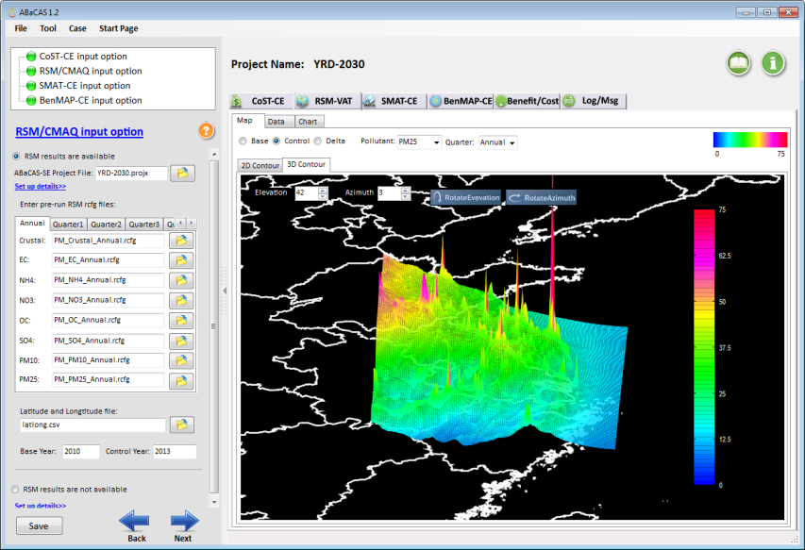
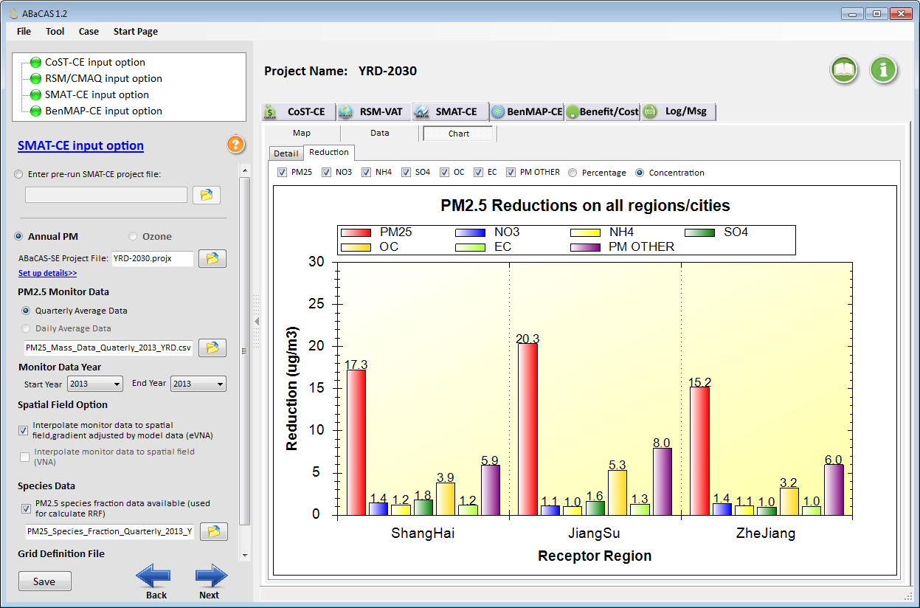
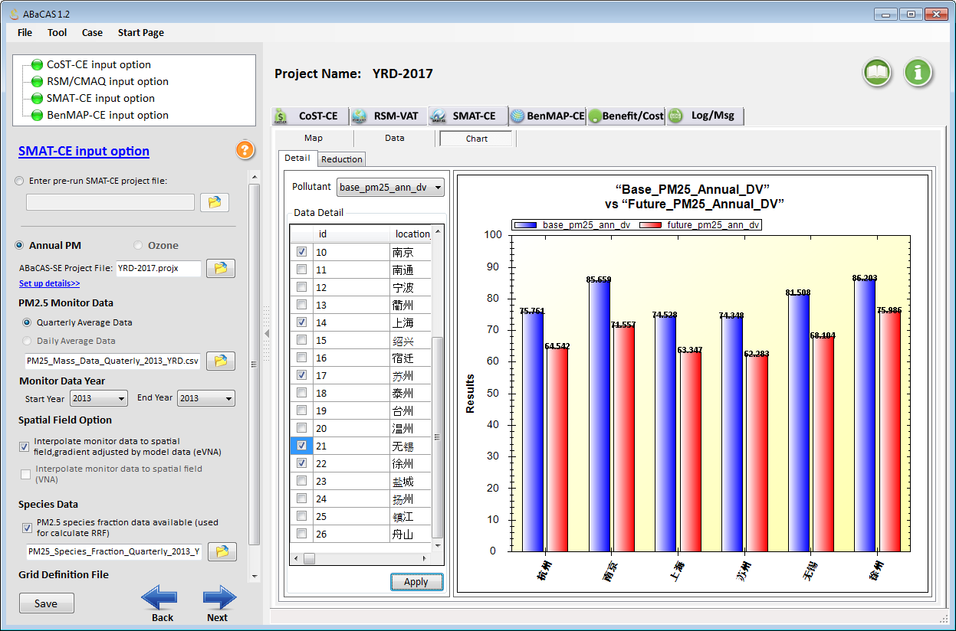
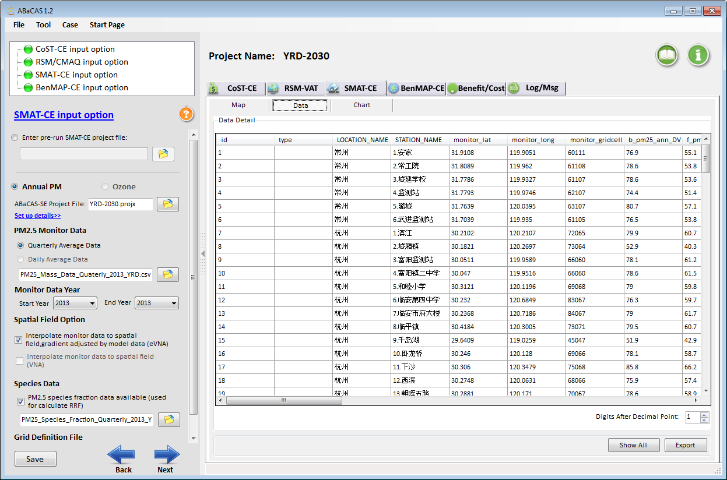
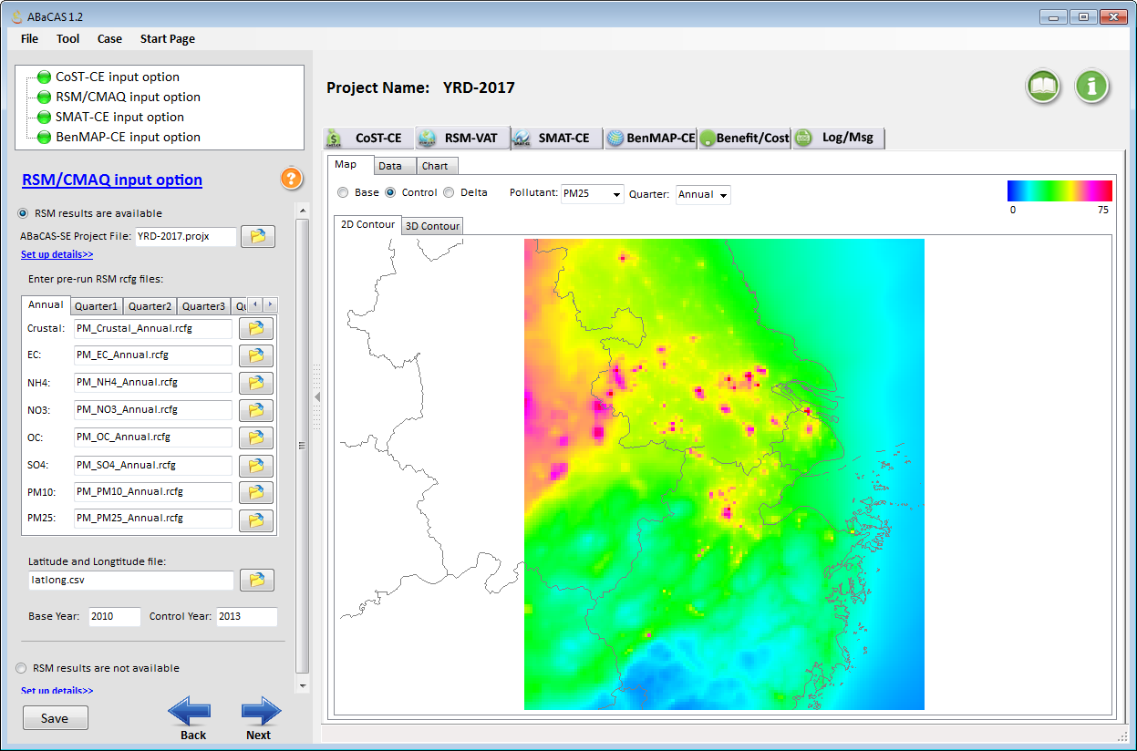
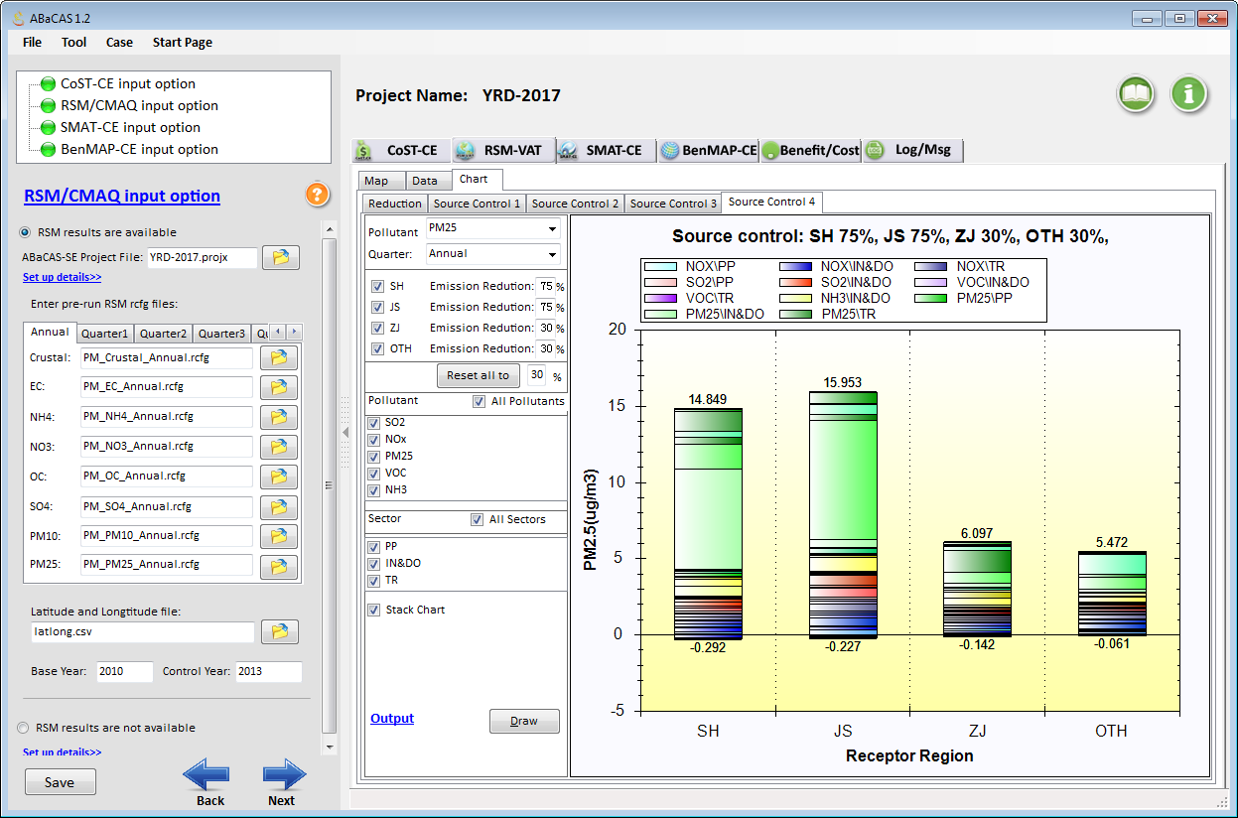
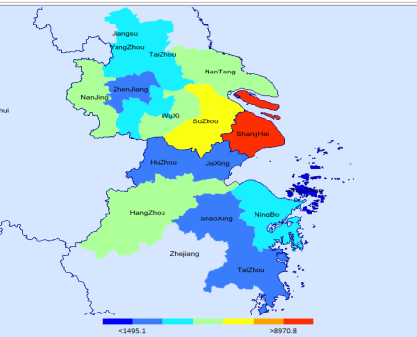
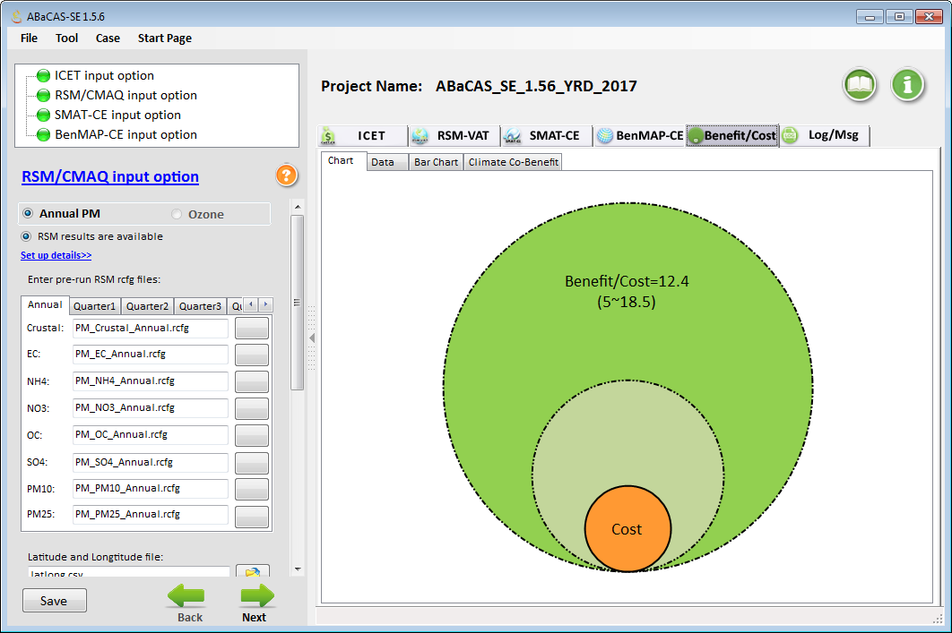
“ABaCAS-SE” (Streamlined Edition):
Developed for Policy-Making and Analysis
ABaCAS-SE “YRD 2017 case”:
5~10 minutes to complete a run
Benefit/Cost =
~12.5
ABaCAS-SE

Slide 16


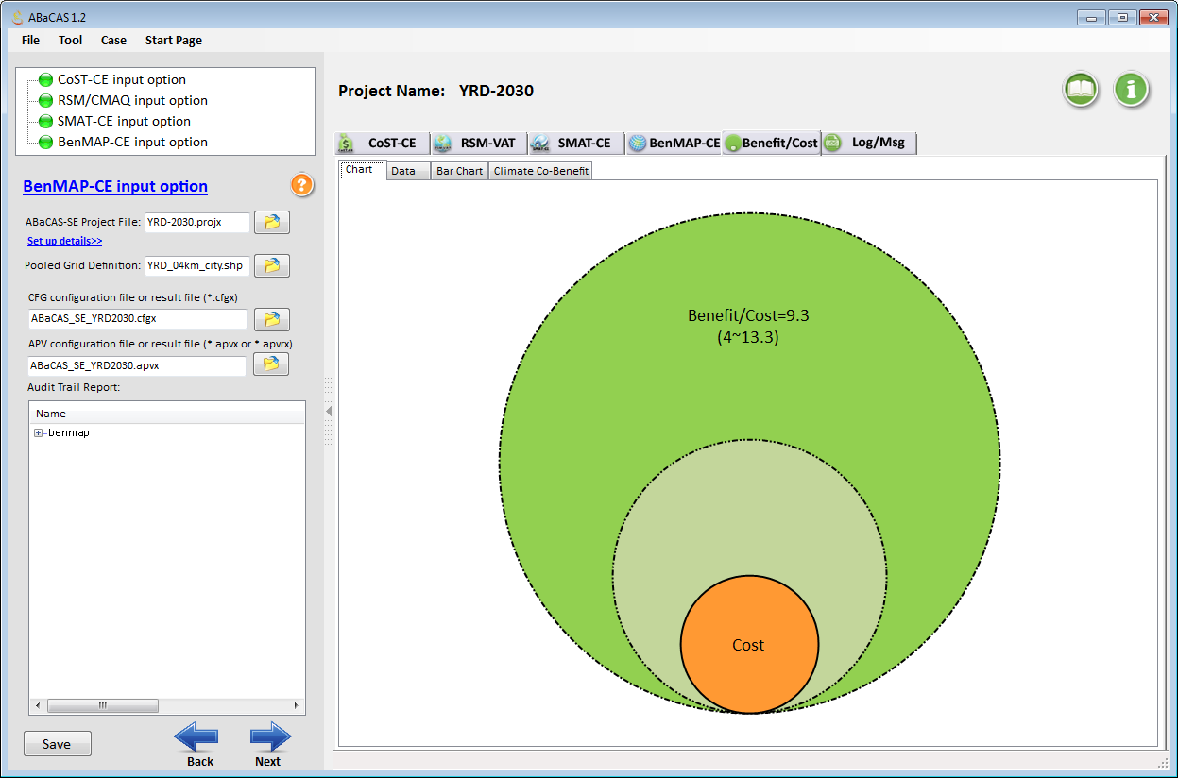
China YRD “2030” PM2.5 Case
RSM/CMAQ
(5~10 minutes to run)
SMAT-CE
BenMAP-CE
Benefit/Cost
Benefit/Cost =~ 9

Slide 17
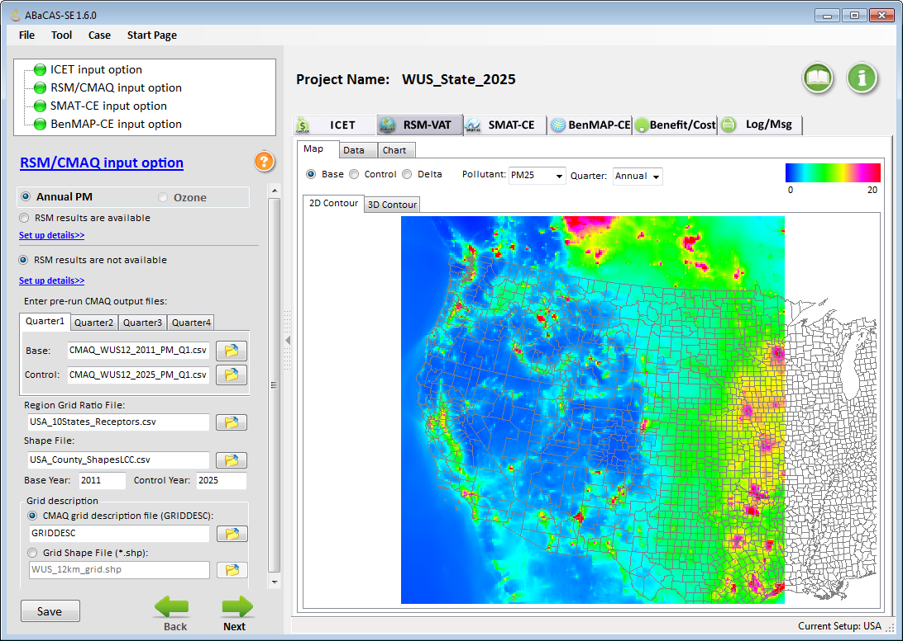
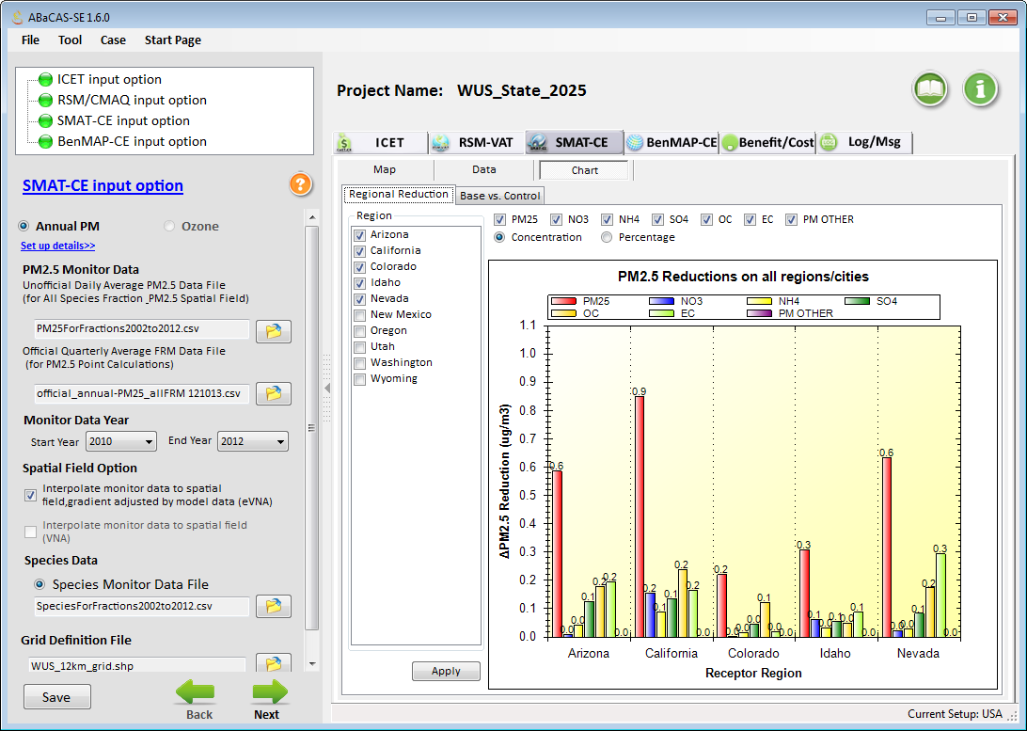
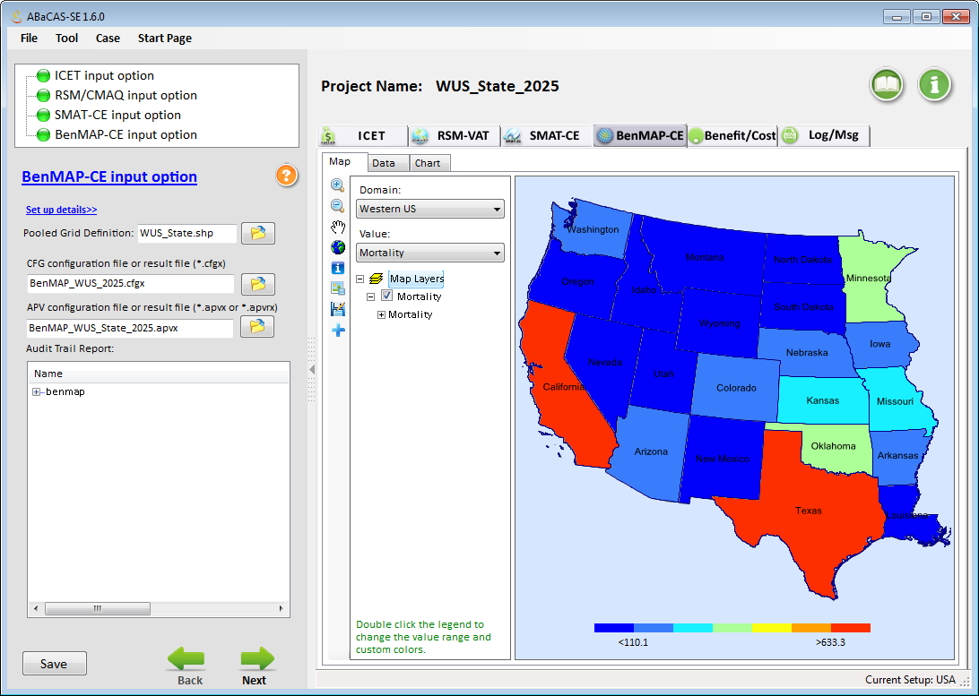
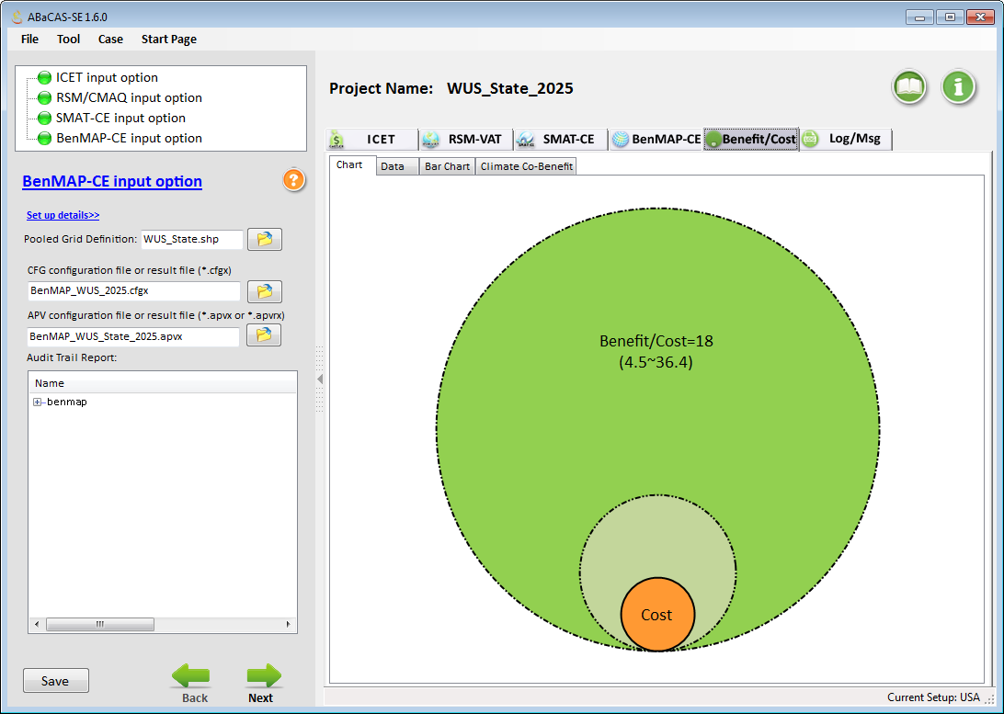
Western U.S. Case Study (ABaCAS-SE)
CMAQ (no-RSM)
(PI: UNC-IE)
SMAT-CE
BenMAP-CE
Benefit/Cost
Benefit/Cost =~ 18

Slide 18
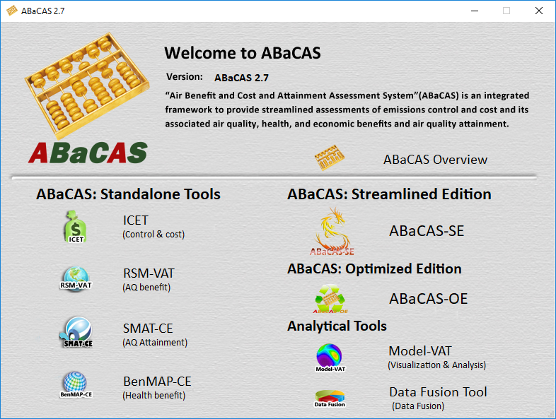
“ABaCAS-OE”:
Optimized Edition (2018 Prototype)
Developed for “Scientists” and “Policy Makers”
18

Slide 19
“ABaCAS 3.0”: Work Plan (2018-2019)
  “ABaCAS-OE”: Optimized Edition
  for developing optimized (least cost) control strategies
    “pf-RSM”: New-generation RSM w/ polynomial functions
      Significantly reduce # of model runs and increase accuracy of RSM predictions
      Provide multi-pollutant (e.g., PM2.5 & O3) and temporal (e.g., daily) RSM results
    “LE-CO”: LEast COst control strategy optimizer tool
      Link with “ICET” and “pf-RSM” to calculate optimized emissions control & cost for attaining AQ goals
    Model-VAT: Model visualization & analysis tools
    Data Fusion Tool: Fuse monitoring & model data

Slide 20


“ABaCAS-OE ” (2018)
(Optimized Edition”: under “ABaCAS 3.0”)
Attainment Goals
Pollutant A: PM2.5
attains 35 ug/m³ (annual)
Pollutant B: O3
attains 80 ppb (MDA8)
ABaCAS-OE
> 12 ug/m³ (non-attainment)
Attainment
Target
SMAT-CE
LE-CO
Control Cost
Optimizer
Optimized Control & Cost for Attaining AQ Goals
ICET
pf-RSM
Air Quality
Benefit
Control &
Cost Estimate
Health Benefit ($$)
BenMAP-CE
Optimized Control Strategy
Benefit/Cost = ~20
Benefit ($$)/Cost ($$)
Notes:
spatial field: A Spatial Field refers to air pollution estimates made at the center of each grid cell in a specified modeling domain. For example, MATS might calculate ozone design values for each grid cell in the modeling domain. Several types of Spatial Fields can be calculated for ozone and PM.
利用环境监测数据、模型数据（主要是CMAQ模拟的结果）作为模型输入，并利用优化的数理统计技术对大气复合污染状况进行模拟，实现对环境空气质量标准的达标评估。其中包括point estimate和spatial field estimate。

Slide 21
Recent RSM Development: “pf-RSM”
Region A
Pollutant A (PM)
Pollutant A (PM)
Air
Air
Air
Pollutant A (PM)
pollutant
pollutant
Region B
Pollutant B (O3)
Pollutant B (O3)
Pollutant B (O3)
•
Chemistry
RSM w/
Temporal
Polynomial
Functions
•
Transport
•
Indirect
Real-time pollutant responses
to emissions change
Real-time pollutant responses
Multi-pollutant responses
Single scenario
to multi-region sources
based on polynomial functions
Region A
Emis./Reg. A
Emissions
Emissions
Change
Region B
Emis./Reg. B
Region C
Emis./Reg. C
AQM
RSM
ERSM
Pf-RSM
Air Quality Model
(CMAQ, CAMx, etc.)
U.S.EPA
Response Surface
Model
U.S.EPA
Multi-Region
Extended RSM
Tsinghua U.
RSM with
Polynomial Functions
Tsinghua U./SCUT

Slide 22
“pf-RSM” Methodology
Polynomial Functions
Chemistry:
Degree of
Non-linearity
Chemistry:
Term of
Interactions
Model:
Only 3rd step involved in training samples (i.e., model runs), and thus significantly reduces
# of model runs required for accuracy
“pf-RSM”: Response Surface Model based on Polynomial Functions
(Temporal & multi-region RSM)
Xing et. al., 2018,
Atmos. Chem. & Phys.
10/22 (Mon) 1:00 pm by Jia XING : “pf-RSM” presentation

Slide 23
“pf-RSM” Validation : PM 2.5
CMAQ
&
ΔCMAQ
(response)
pf-RSM
&
Δpf-RSM
(response)
Xing et. al., 2018, Atmos. Chem. & Phys.

Slide 24
“i-RSM”(2018-2019 under development)
“i-RSM”: “Indicator-based”pf-RSM
Use
pre-defined
“Indicators”
for
PM2.5 (18)
and O3 (16)
to predict
nonlinearities
of species
and their interactions
# of model runs needed for maintaining RSM accuracy in predicting control responses for each selected study region
Traditional RSM | pf-RSM | i-RSM
>100 | 30~40 | 5~10
10/22 (Mon) 1:00 pm by Jia XING : “pf-RSM” presentation
Xing et. al., 2019,
in preparation

Slide 25
LE-CO: Least-Cost Control Strategy Optimizer
Target
Optimize
Attainment
LEast
-
COst
Emissions
control cost
goals
control strategy
optimization
LE-CO
Response surface
International
cost
model (RSM)
estimate tool (ICET)
pf-RSM
ICET
Real-time AQ responses
Marginal Cost Curves
Control effectiveness
Control strategies
SMAT-CE
Optimized/cost-efficient strategy to meet attainment goals
Xing et. al., 2018, Submitted to JEM

Slide 26
LE-CO: Beijing Case Study
Control region
Optimized
control cost
for attaining
both AQ goals
PM2.5
& O3
Optimized
control cost
for attaining
PM2.5 goal
PM2.5
Optimized
control cost
for attaining
O3 goal
O3
Xing et. al., 2018, Submitted to JEM

Slide 27
“ABaCAS”: Air Benefit and Cost & Attainment Assessment System
Analytical Tools added in “ABaCAS 2.7” (2017-2018)
New Analytical Tools: “Model-VAT” & Data Fusion Tool

Slide 28
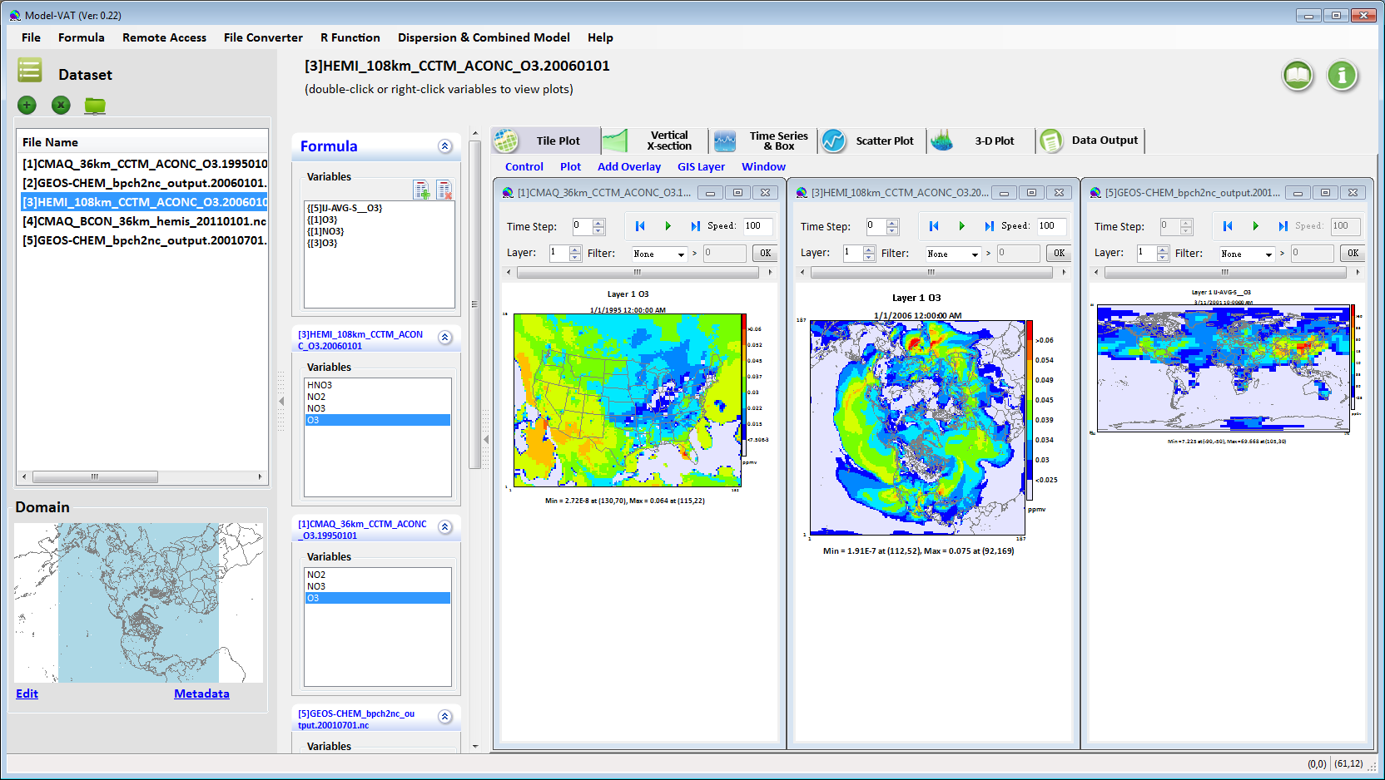
Model-VAT:
Multi-Scale Model Visualization & Analysis Tool
CMAQ/ CAMx
(regional)
GOES-Chem
(global)
H-CMAQ
(hemispheric)
(Easy Map Transformation)
User-Friendly V/A & Eval. Tool for Photochemical & Dispersion Models

Slide 29
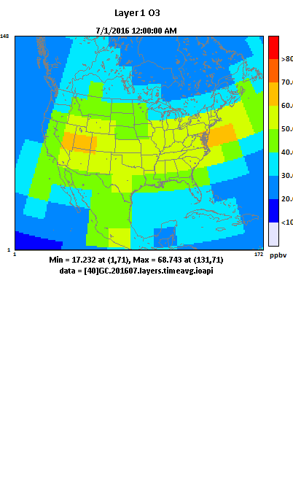
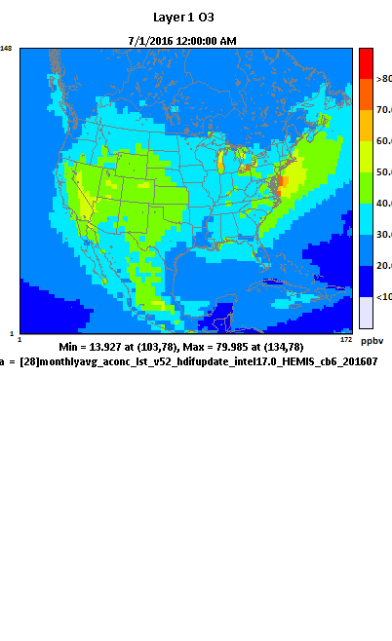
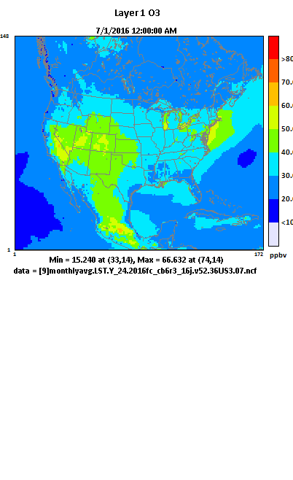
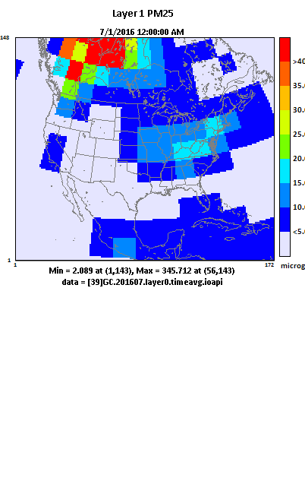
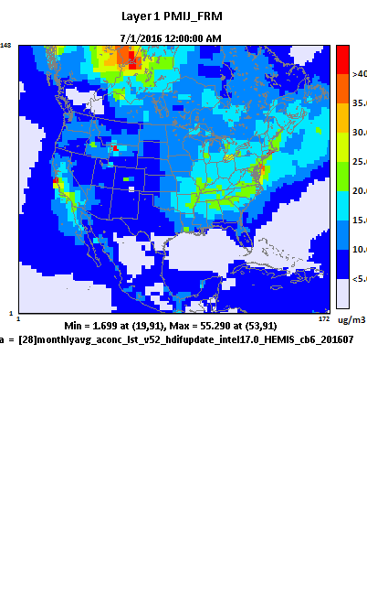
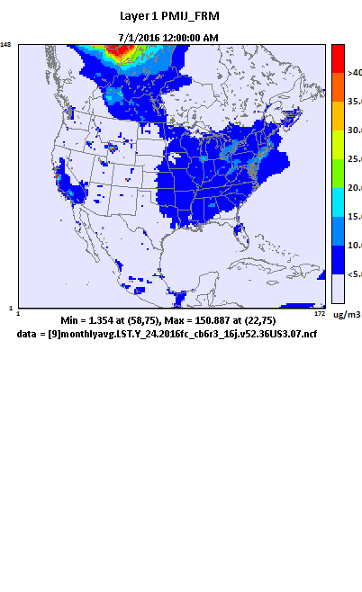
Model-VAT: Multi-Scale Model V/A Tool
GEOS-Chem (4ºx5º)
H-CMAQ (108km)
CMAQ (36-km)
O3 (July 2016)
PM2.5 (July 2016)

Slide 30
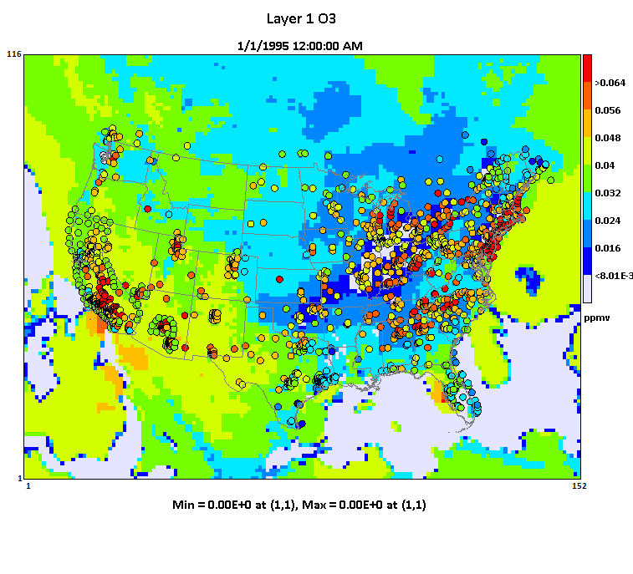








Model-VAT: Model Analysis & Evaluation
Link to “R”
Flexible
Data
Output
Remote File Access

Slide 31
“Data Fusion” Tool
(Fusing Model and Monitor and/or other data)
Inputs:
Model & Monitor or other data
(dispersion model, satellite data, LUR, etc.)
Spatial: grid & non-grid (census)
Temporal: annual/monthly/daily
Techniques:
eVNA, VNA,
Downscaler, etc.
Data
Fusion
Open-Source & User-Friendly
Cross-Validation
(QA, Multi-fold, Leave-one-out, etc)
Method Development, Evaluation & Research
Regulatory Assessment
(PM & O3 RIA, REA)
BenMAP-CE
Health Studies
SMAT-CE
Attainment Test
Notes:
In a simple team, DFT. An important last step of regulatory modeling and other assessment

Slide 32







“Data Fusion” Tool: Main GUI
(ABaCAS website download: Data Fusion Tool v.1.5)
2. DF Technique Option
eVNA/VNA/Downscaler
1. Data Input Option
Model data
Monitor data
Other
3. Spatial & Temporal Option
Spatial DF option
Temporal DF option
4. Receptor Option
Grid (model)
Non-grid (GIS shape file)
Data Viewer
5. Cross-Validation Option
Multi-fold (% of random or cluster withholding)
Leave-one-out
Leave-group-out

Slide 33

Annual Average 2015 PM_{2.5} Fields
10/24 (Wed) 8:50 am by Dr. Jim KELLY:
“Data Fusion Tool” application for PM2.5 spatial fields
A System for Developing and Projecting PM_{2.5} Spatial Fields to Correspond to Just Meeting National Ambient Air Quality Standards

Slide 34

“GCAM-ABaCAS”: Conceptual Framework
Integrated Climate-AQ Benefit/cost Assessment
ABaCAS
(CPP, Paris Agreement, etc.)
Climate/AQ Policies
Input Data
Air Pollutant
Emissions
Reduction
RSM/CMAQ
SMAT-CE
ICET
BenMAP-CE
Control cost
AQ Benefit
Attainment Benefit
Health/Econ. Benefit
GCAM
Output Data
GHG
Emissions
Reduction
Radiative Forcing & Global mean temp
Global Change
Assessment Model
Climate benefit/Cost
assessment
AQ benefit/Cost
assessment
Social Cost of Carbon
Climate & AQ co-benefit/cost Assessment
Development Plan for 2018-2019, Lead: Prof. Jia Xing, Tsinghua Univ.

Slide 35

“ABaCAS” Website (www.abacas-dss.com)

Slide 36

“ABaCAS System” & Tools: Overview &UG

Slide 37

“ABaCAS Download” Page: www.abacas-dss.com

Slide 38


“ABaCAS Publications”: Recent Published Paper

Slide 39
2018 Papers/Publications and
2018 CMAS Conference Presentations
“pf-RSM”: “Quantification of the enhanced effectiveness of NOx control from simultaneous reductions of VOC and NH3 for reducing air pollution in the Beijing–Tianjin–Hebei region, China”, Xing, et al., June, 2018, Atmos. Chem. & Phys.
“LE-CO”: “Least-cost control strategy optimization for air quality attainment: A case study of PM_{2.5} and O₃ in China’s Beijing–Tianjin–Hebei region”, Xing, et al., submitted to J. of Environ. Management
“i-RSM”: “An efficient way in quantifying the nonlinear response of air pollution to emission changes with the indicator-based response surface model ”, Xing, et al., in preparation
“DFT & BenMAP-CE”: “Health Benefit Assessment of PM_{2.5} Reduction in Pearl River Delta region of China using a Model-Monitor Data Fusion Approach”, Li, et al., Submitted to J. of Environ. Management
“DFT”: “Projecting PM_{2.5} Spatial Fields to Correspond to Just Meeting National Ambient Air Quality Standards”, Kelly, et al., in preparation
10/22 (Mon) 9:40 am by Carey JANG : “ABaCAS Overview” presentation
10/22 (Mon) 1:00 pm by Jia XING : “pf-RSM” presentation
10/23 (Tue) 11:40 am by Younha KIM : “RSM” application in Korean “GUIDE”
10/24 (Wed) 8:50 am by Jim KELLY: “Data Fusion Tool” for PM2.5 spatial fields
“Poster Session 1” by Xinyi Dong : “RSM” application in Taiwan

Slide 40

“ABaCAS” Conferences/Workshops

Slide 41


2018 ABaCAS/CMAS Conference/Training Workshop (Beijing, 5/21-23)
2016 ABaCAS Conference/Training Workshop (Shanghai, 6/14-16)

Slide 42

“ABaCAS” Project Team

Slide 43

www.ABaCAS-dss.com
THANK YOU!
Carey Jang, U.S. EPA, Jang.carey@epa.gov

