Slide 1
Evaluation and Intercomparison of CMAQ-Simulated Ozone and PM_{2.5} Trends Over the United States
Christian Hogrefe, Kristen M. Foley, K. Wyat Appel, Shawn J. Roselle, Donna Schwede, Jesse O. Bash, and Rohit Mathur
Computational Exposure Division, National Exposure Research Laboratory, U.S. Environmental Protection Agency, RTP, NC, US
17th Annual CMAS Conference, Chapel Hill, NC
October 22-24, 2018
Office of Research and Development
National Exposure Research Laboratory, Computational Exposure Division
Notes:
(1) While “arial” is used in this example, other fonts may be used. Please strive for consistency in font type and size.
(2) While a blue background is shown here, other colors noted on the EPA/ORD intranet site may be used.
(3) A picture may be added if desired.
--- The goal is to promote our CED “brand” and maintain some degree of consistency among CED presentations.

Slide 2
Disclaimer: The views expressed in this presentation are those of the authors and do not necessarily reflect the views or policies of the U.S. EPA.
Office of Research and Development
National Exposure Research Laboratory , Computational Exposure Division
Office of Research and Development
National Exposure Research Laboratory, Computational Exposure Division
Notes:
Disclaimer may be placed elsewhere in the presentation (such as the title slide or the “final” slide); however, it should be clearly legible.

Slide 3
Motivation and Scope
Long-term regional air quality model simulations have become more feasible
Dynamic evaluation (examining trends) may inform planning applications
Trends in means vs. extremes
Dependency of modeled trends on inputs (emissions, boundary conditions)
Such datasets may also be applied for other problems, e.g. health impact studies
Must provide guidance on strength and limitations of the data (systematic biases, modeled variability, species composition etc.)
We are in the initial stages of this work, the presentation provides examples of the analyses we are pursuing

Slide 4
Overview of Long-Term Model Simulations
 | 1990 – 2010 Simulations (“DOE”) | 2002 – 2014 Simulations (“ECODEP”)
Model | WRF3.4 / CMAQ5.0.2 two-way, no Bidi | 2002-2012: WRF3.4 / CMAQ5.0.2 offline, Bidi 2013: WRF3.7 / CMAQ5.1 offline, Bidi 2014: WRF3.8 / CMAQ5.2 two-way, Bidi
Grid Spacing | 36km | 12km
Emissions | Xing et al. (2013) MOBILE6 mobile sources Climatological fires scaled by year-specific activity No marine vessel emissions | Various NEI / Modeling Platforms MOVES mobile sources Year-specific wildfires Emissions from marine vessels included
Boundary Conditions | Hourly H-CMAQ (Xing et al., 2015) | 2002-2004: Monthly median values from 2005 simulation of GEOS-Chem v9-01-02 (incorrect boundary conditions were used for Jan-June 2004) 2005 – 2012: Hourly GEOS-Chem v8-03-02 2013: Hourly GEOS-Chem v9-01-02 2014: Hourly GEOS-Chem v10-1
References | Gan et al., 2015, 2016; Astitha et al., 2016 | Zhang et al., JGR, 2018, under review
For this study, focus on the 2002 – 2010 overlap period

Slide 5
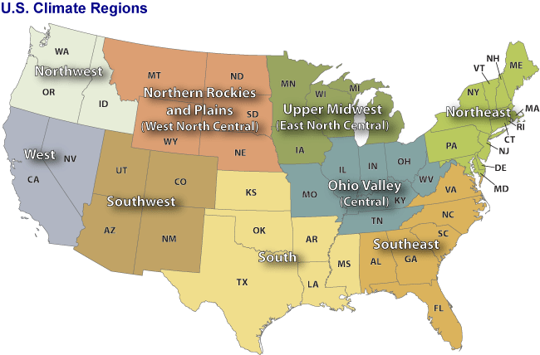
Analysis Approach
Observations: Maximum Daily Average 8-hr (MDA8) O₃ calculated from hourly AQS O₃ values, PM_{2.5} and species from AQS, CSN, and IMPROVE
Emissions: Sum of all anthropogenic source categories calculated from model-ready input files
Boundary Conditions: averaged along each of the four domain boundaries
Temporal aggregation: seasonal (March – May, June – August, September – November, December – February) and annual
Spatial aggregation: NOAA climate regions
Source: https://www.ncdc.noaa.gov/monitoring-references/maps/images/us-climate-regions.gif

Slide 6
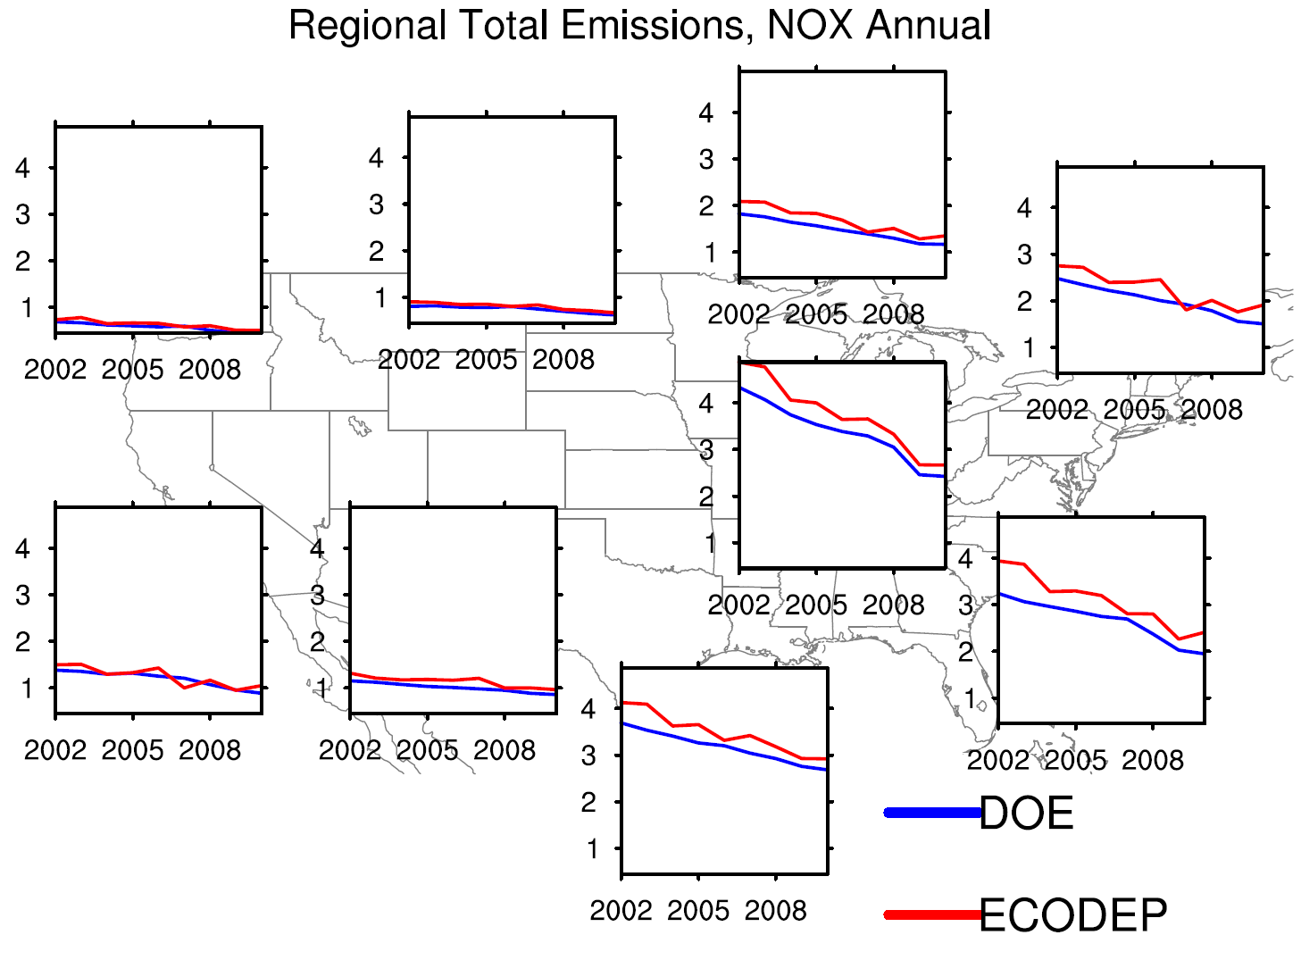
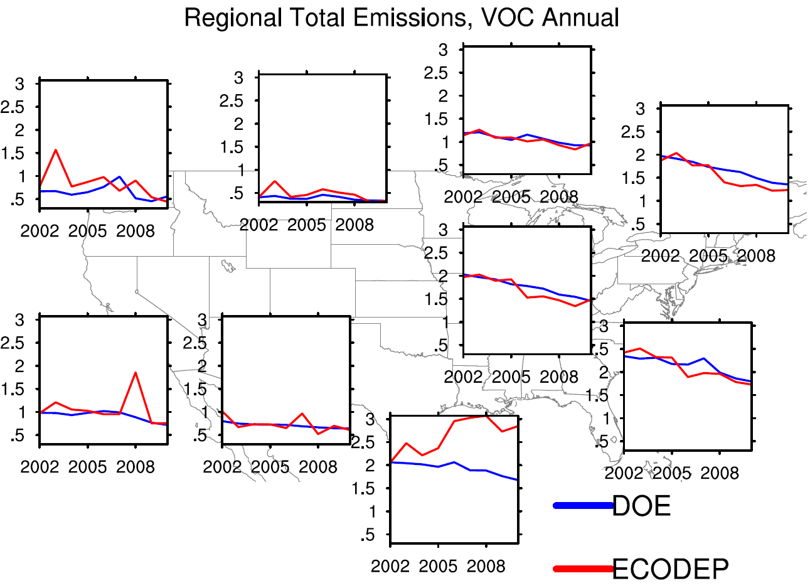
Anthropogenic NO_{x} and VOC Emission Time Series
Annual Total NO_{x} Emissions (Tg/yr)
Annual Total VOC Emissions (TgC/yr)
Similar emission trends in most regions
DOE NO_{x} tends to be lower than ECODEP NO_{x} (use of MOBILE6 for DOE)
More year-to-year variability in ECODEP emissions (use of different NEIs)

Slide 7
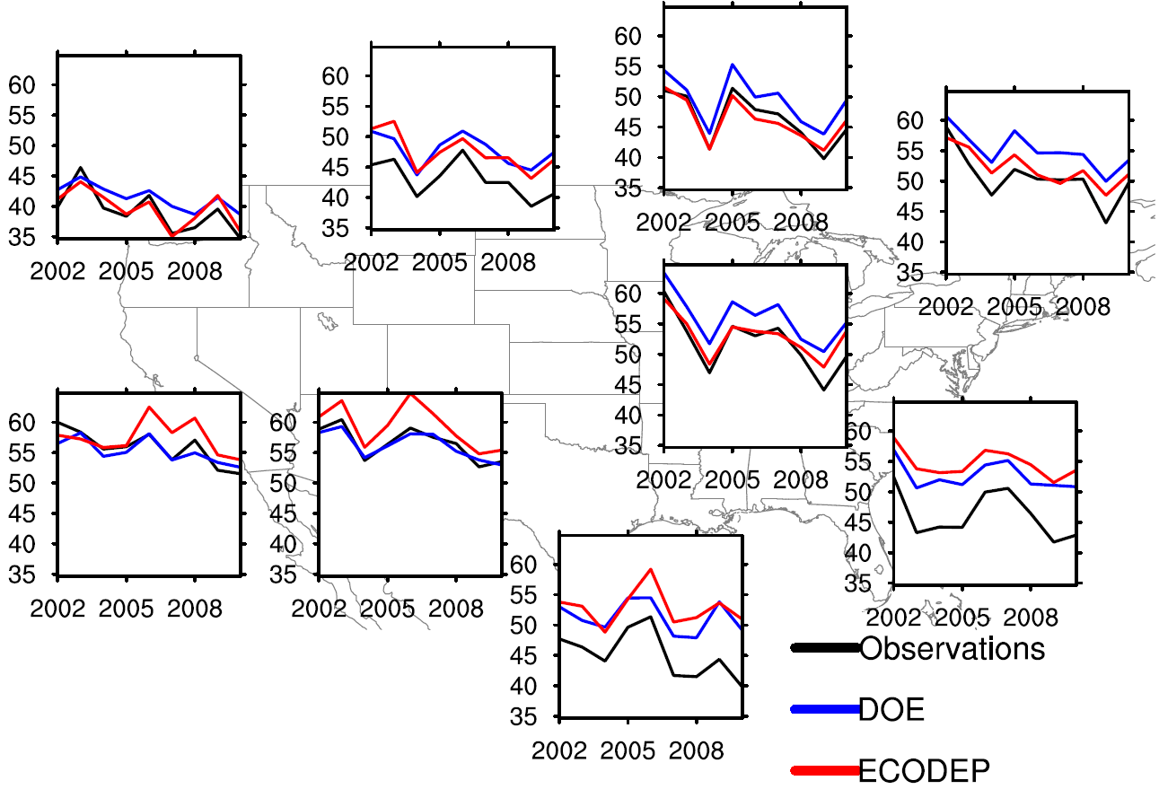
Trends in MDA8 O₃ Summer Averages
Regional Average Time Series
Observations
DOE
ECODEP
Downward trends in 2002 – 2010 summer average MDA8 O₃ in all regions and at most stations
Observed trends often are more negative than modeled trends
ECODEP trends tend to be more negative than DOE trends in the western portion of the domain

Slide 8
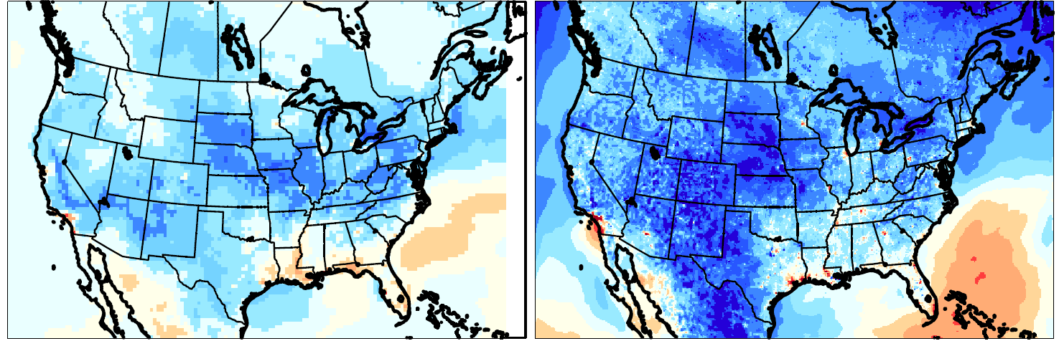
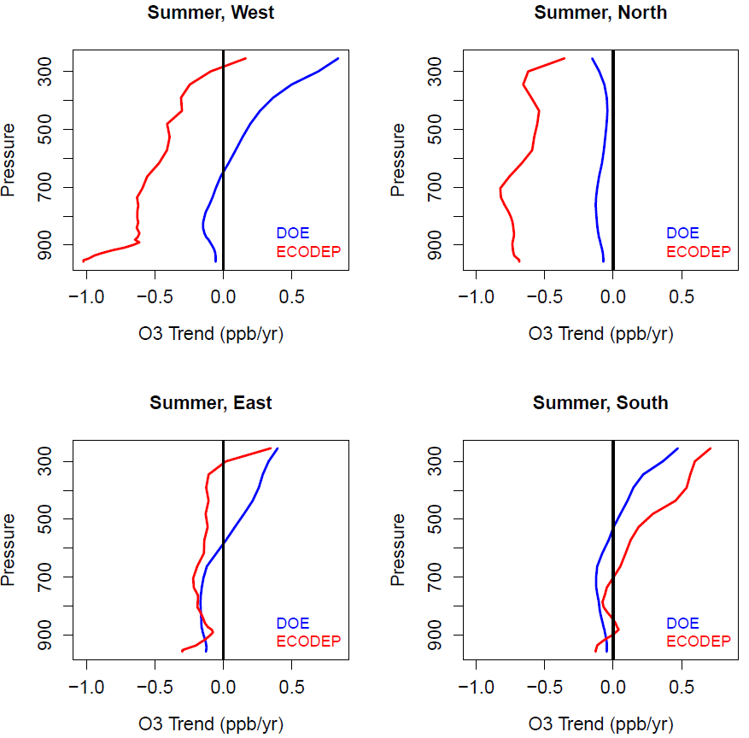
Trends in Modeled O₃ Concentrations and Boundary Conditions, Summer
Trends DOE
Trends ECODEP
Trends Boundary Conditions
ppb/yr
Stronger downward trends in the ECODEP western and northern boundary conditions likely cause the stronger downward trends in surface ozone over the western portion of the domain

Slide 9
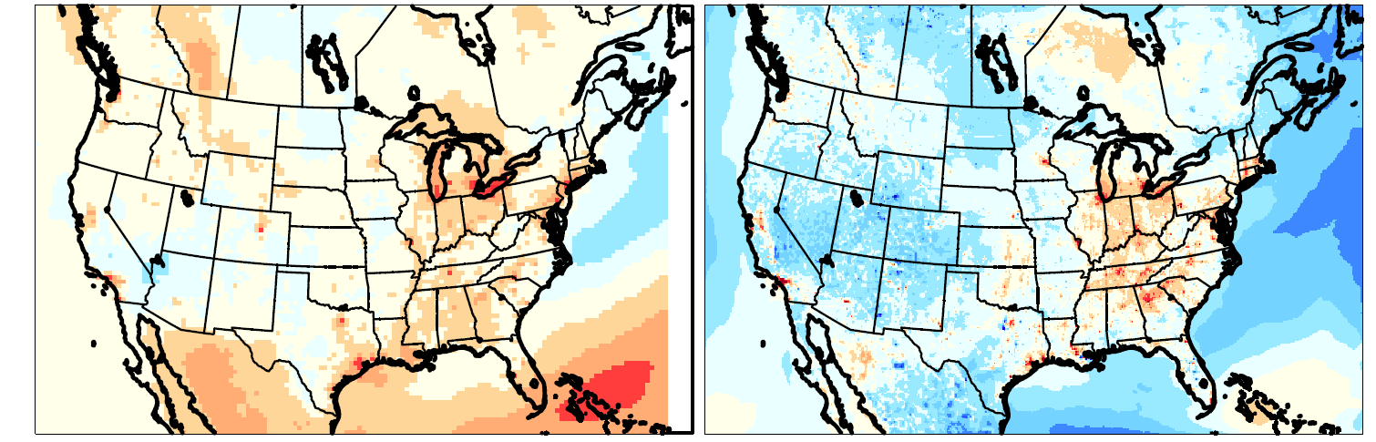
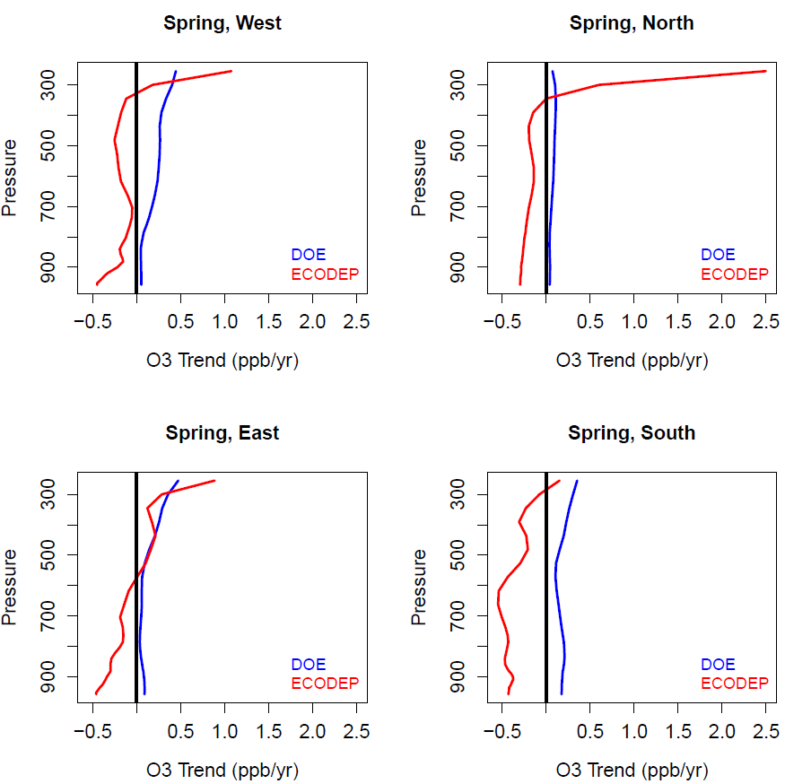
Trends in Modeled O₃ Concentrations and Boundary Conditions, Spring
Trends DOE
Trends ECODEP
Trends Boundary Conditions
ppb/yr
Differences in the directionality of spring ozone boundary condition trends likely are a key reason for the divergence in the sign of surface ozone trends over the western portion of the domain

Slide 10
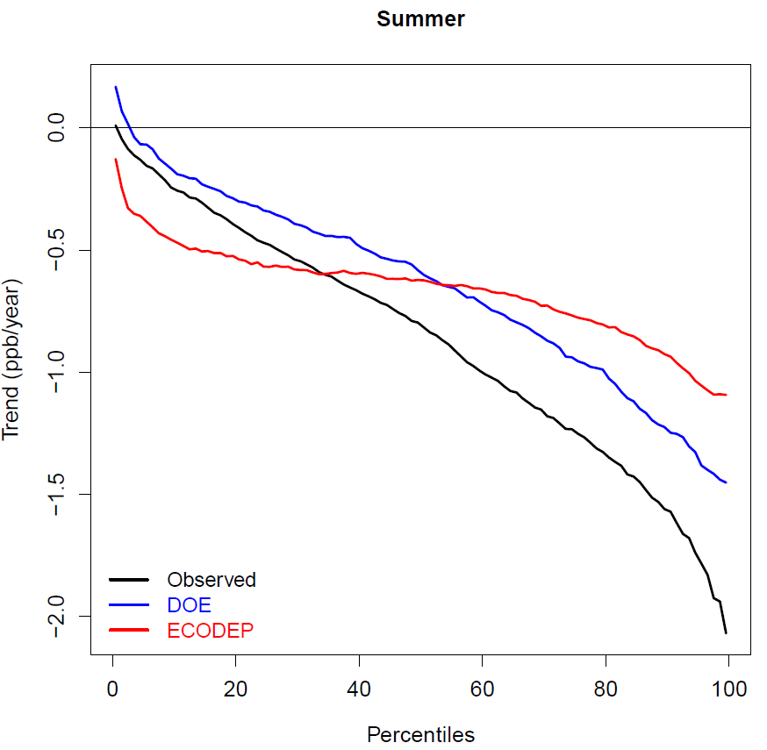
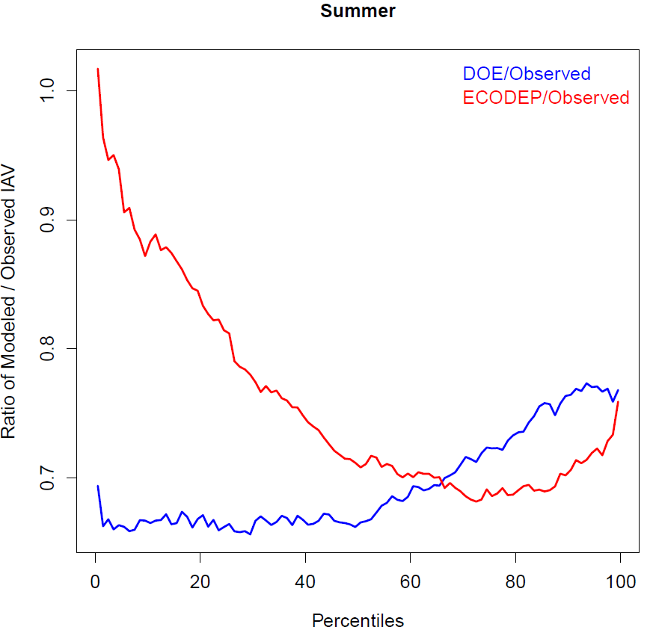
Observed and Modeled Summer MDA8 O₃ Trends and Interannual Variability by Percentile
Observed and Modeled Trends
Modeled / Observed Interannual Variability
Rate of summer MDA8 O₃ decrease generally underestimated by both simulations across all percentiles
ECODEP trends are less variable across percentiles
Interannual variability is underestimated, especially by the DOE runs

Slide 11
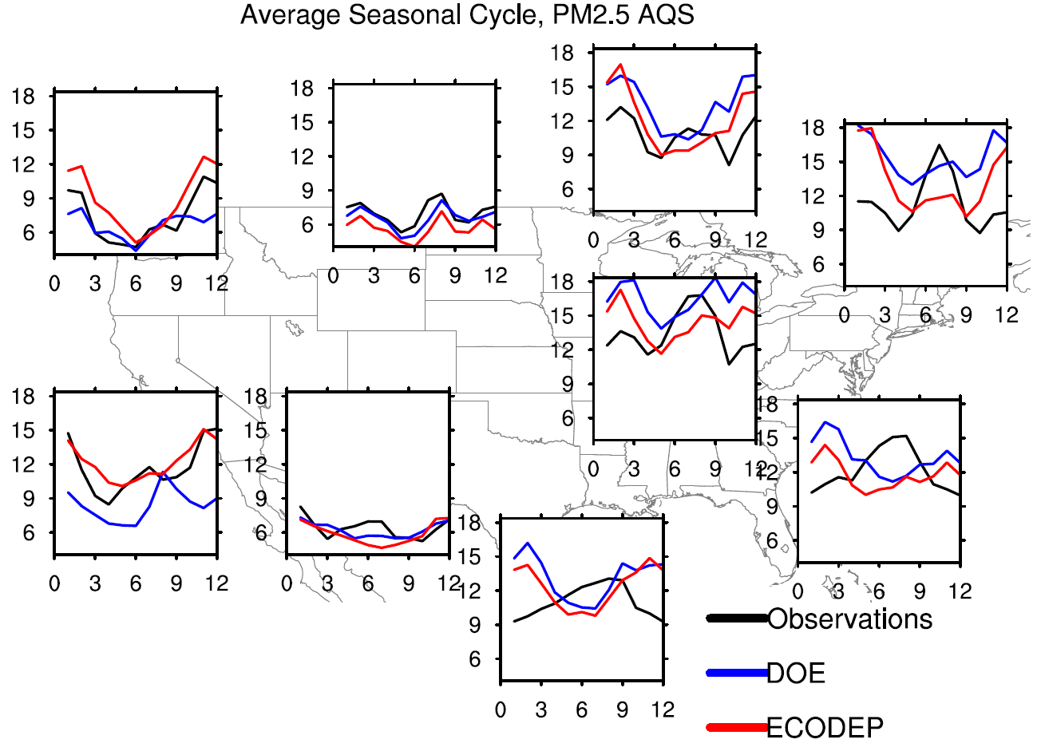
PM_{2.5} Seasonal Variability and Bias
Observed and Modeled Average Seasonal Cycles
Summer
Winter
µg/m³
Both simulations tend to reverse the observed seasonal cycle across the East
This manifests itself in negative summer biases and positive winter biases
Newer model versions likely would show improved performance due to updates for organic aerosols

Slide 12
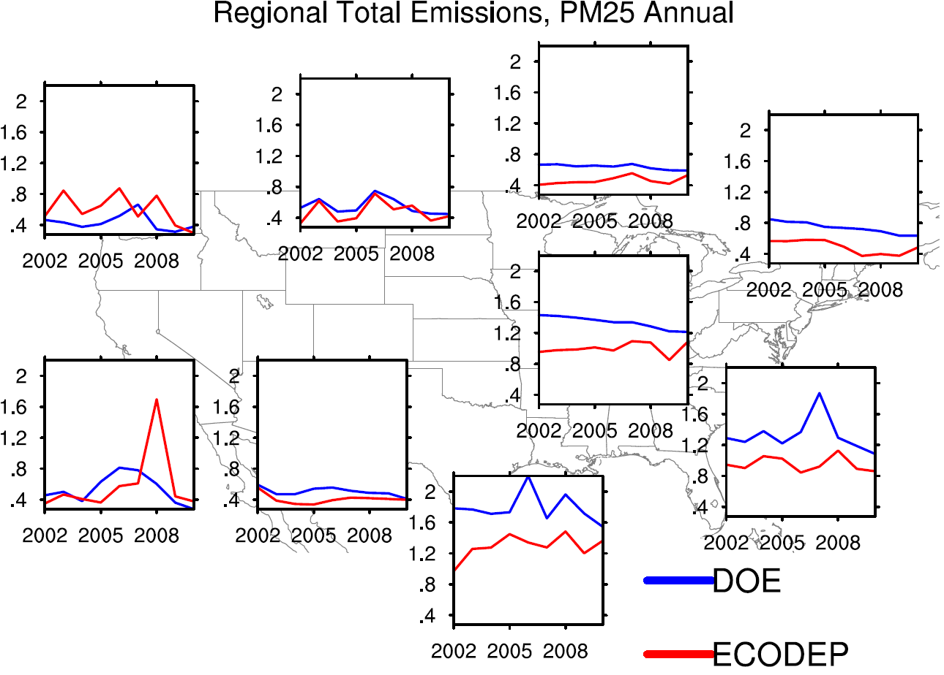
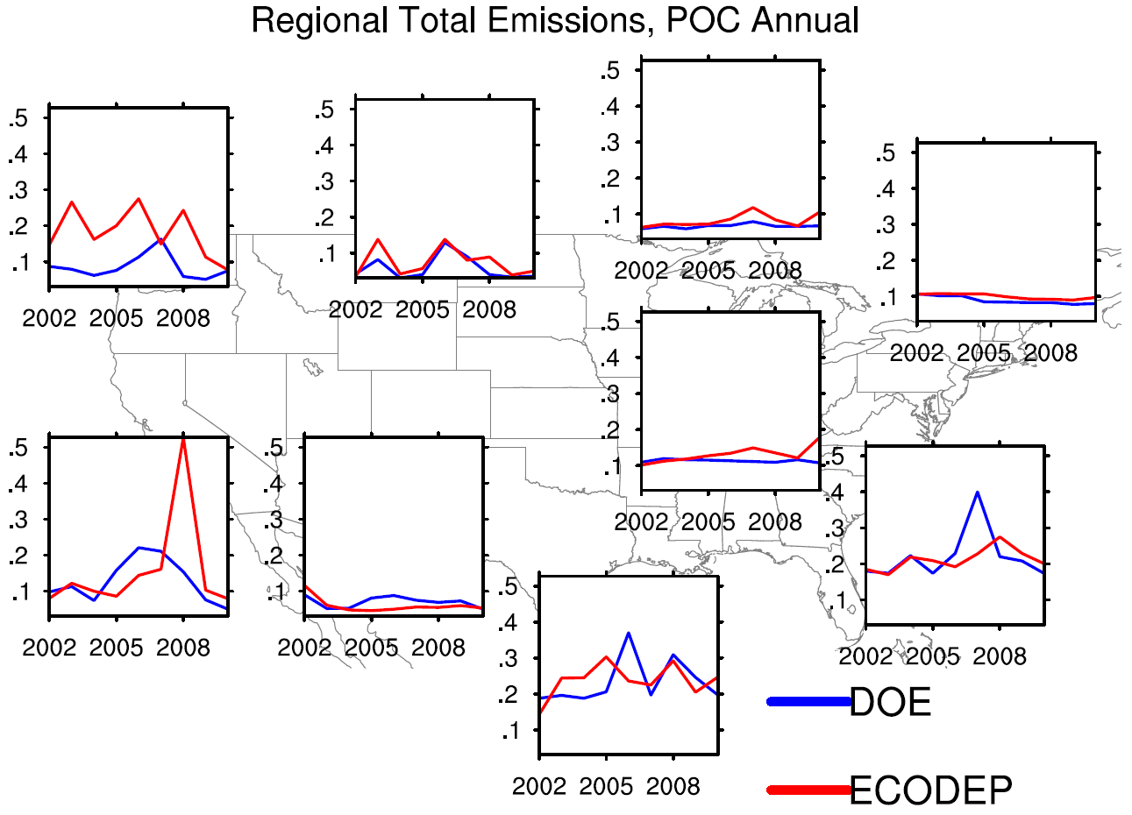
Anthropogenic PM_{2.5} and Primary Organic Carbon (POC) Emission Time Series
Annual Total PM₂₅ Emissions (Tg/yr)
Annual Total POC Emissions (Tg/yr)
DOE has higher primary PM_{2.5} emissions than ECODEP in the East, likely explaining the higher winter PM_{2.5} concentration bias
ECODEP tends to have a higher POC emission loading and larger year-to-year variability, especially in the West (use of year-specific fire emissions)

Slide 13
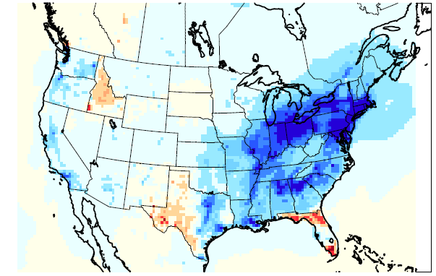
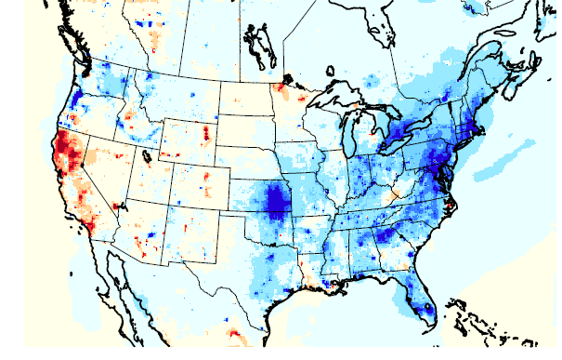
PM_{2.5} Annual Average Model Trends
Trends DOE
Trends ECODEP
µg/m³/yr
DOE shows stronger downward trends in the East
Divergence in the direction of trends in parts of the West
State outlines are visible in some PM_{2.5} concentration trends, likely driven by state-specific assumptions in the processing of primary PM_{2.5} emissions

Slide 14
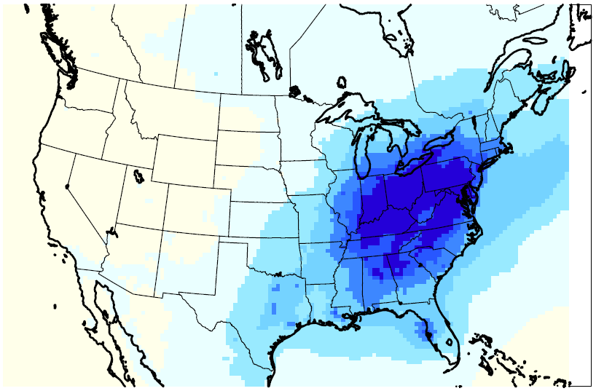
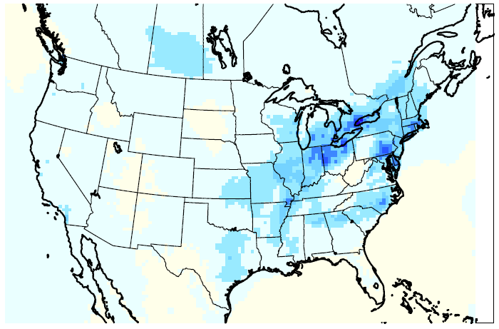
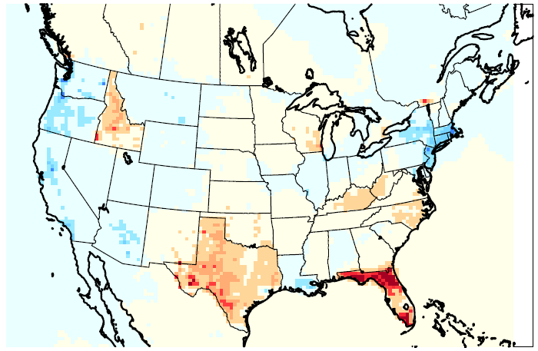
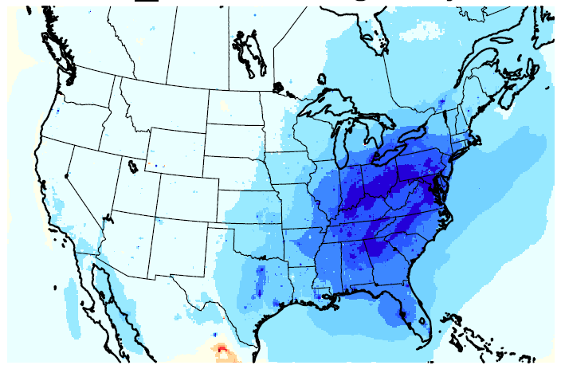
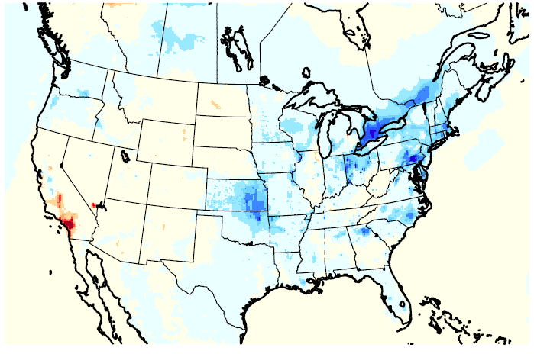
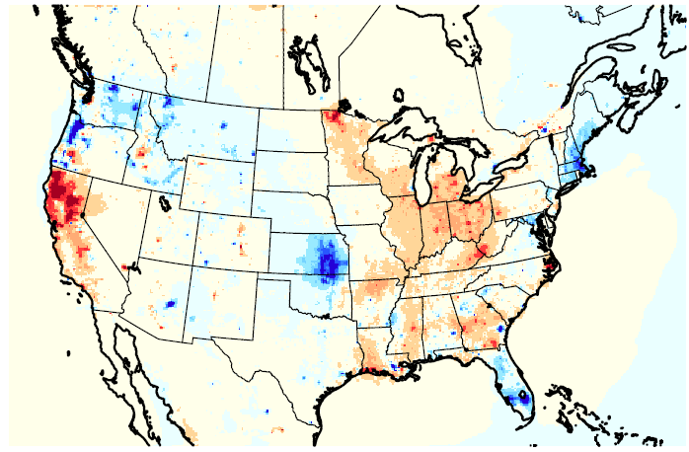
PM_{2.5} Species Annual Average Model Trends
SO₄ DOE
NO₃ DOE
OC DOE
SO₄ and NO₃ trends are similar for most of the domain
OC trends show differences between the simulations, likely due to differences in emissions processing
SO₄ ECODEP
NO₃ ECODEP
OC ECODEP
µg/m³/yr

Slide 15
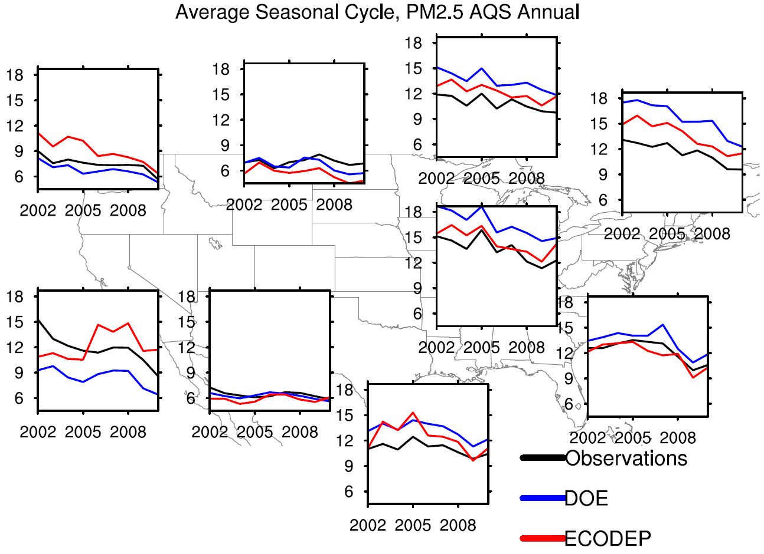
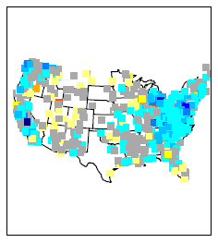
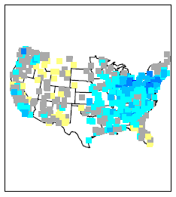
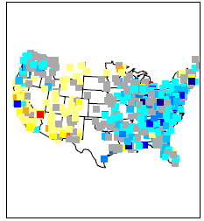
Trends in AQS PM_{2.5} Annual Averages
Regional Average Time Series
Observations
DOE
ECODEP
Generally good agreement of both models with observed PM_{2.5} trends in the East
ECODEP does not capture downward trends in CA

Slide 16
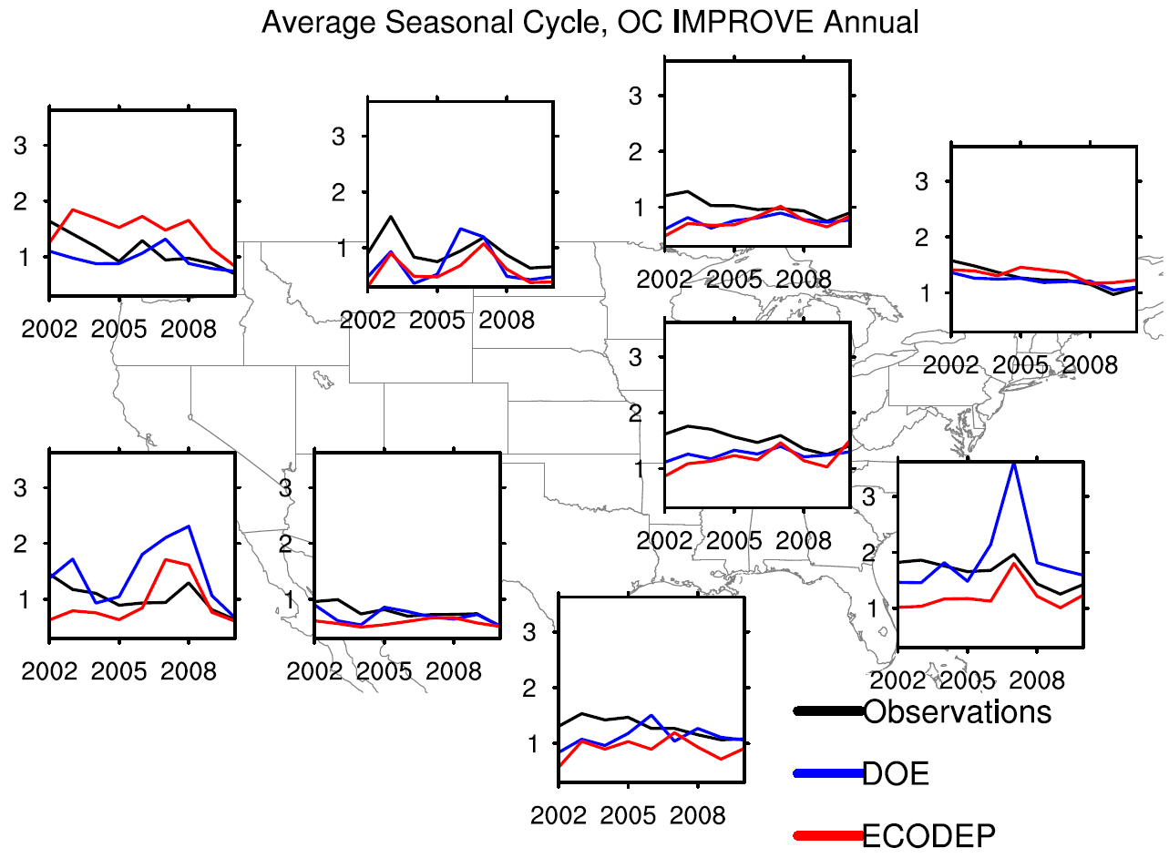
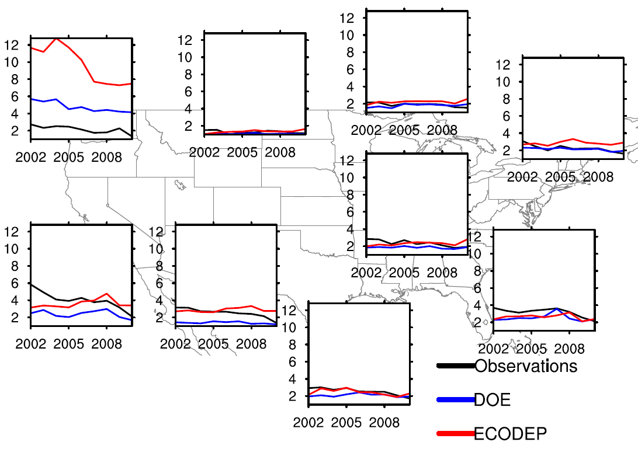
Trends in IMPROVE and CSN OC Annual Averages
Regional Average Time Series, IMPROVE
Regional Average Time Series, CSN
Neither model tends to capture downward OC trends in the central regions

Slide 17
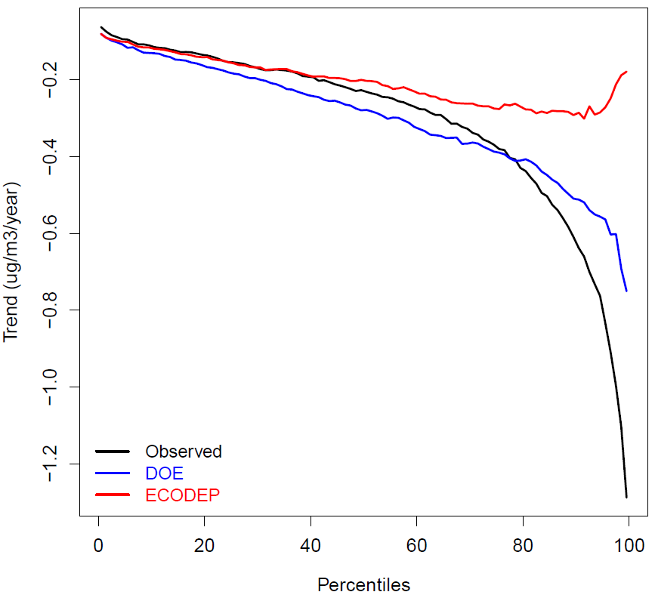
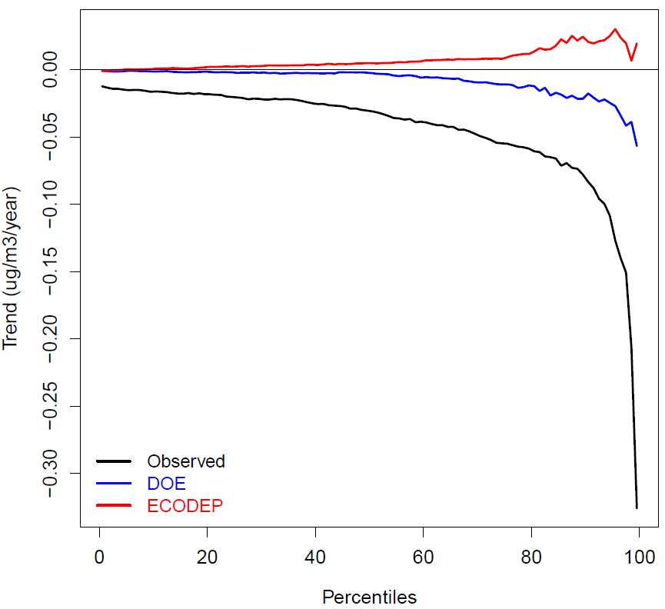
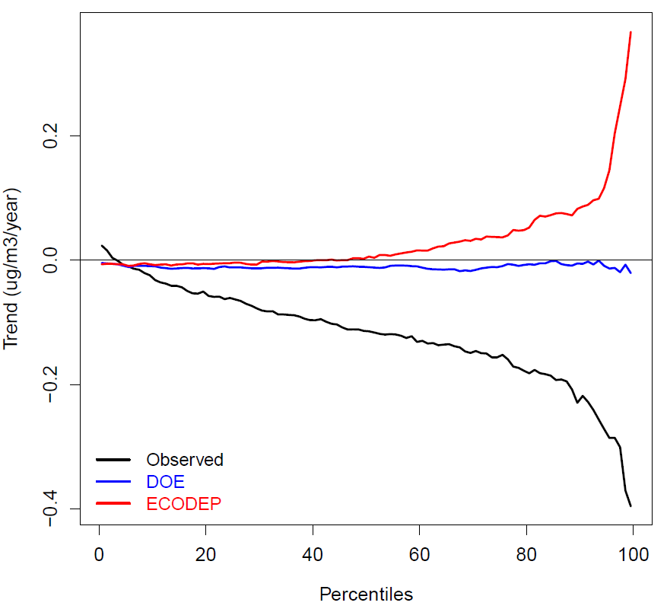
Observed and Modeled Trends in Annual AQS PM_{2.5}, IMPROVE OC, and CSN OC by Percentile
AQS PM_{2.5}
IMPROVE OC
CSN OC
Good agreement between observed and modeled PM_{2.5} trends at 0 – 75th percentiles
Disagreement between observed and modeled OC trends across percentiles, likely resulting both from assumptions in emissions processing and outdated model treatment of organic aerosol processes in these CMAQv5.0.2 simulations

Slide 18
Summary
Trends in O₃ boundary conditions appear to affect trends in modeled surface ozone concentrations
Observed summer O₃ trends often are more negative than modeled trends
Modeled interannual variability in MDA8 O₃ tends to be less than observed
The CMAQv5.0.2 simulations analyzed in this study tend to reverse the observed PM_{2.5} seasonal cycle across the East
Modeled PM_{2.5} concentration trends are sensitive to the processing of primary PM_{2.5} emissions, especially POC
Disagreement between observed and modeled OC trends across percentiles, likely resulting both from assumptions in emissions processing and outdated model treatment of organic aerosol processes in these CMAQv5.0.2 simulations
While this presentation focused on trends and variability, future work will also consider biases and consider speciated PM_{2.5} data in greater detail

