Slide 1
Atmospheric Nitrogen Deposition Modeling of the Chesapeake Bay: Current Applications and Future Directions
Jesse O. Bash¹, Lew Linker², Patrick Campbell³, Kristen Foley¹, Gopal Bhatt⁴,
Gary Shenk⁵, Joseph Zhang⁶, Tanya Spero¹
1. EPA National Exposure Research Laboratory, RTP, NC, US
2. EPA Chesapeake Bay Program Office, Annapolis, MD
3. University of Maryland, College Park, MD
4. Penn State Chesapeake Bay Program Office, Annapolis, MD
5. USGS Virginia and West Virginia Water Science Center, Richmond, VA
6. Virginia Institute of Marine Science, Gloucester Point, VA
17th Annual CMAS Conference, Chapel Hill, NC
October 22-24, 2018
Office of Research and Development
National Exposure Research Laboratory, Computational Exposure Division
Notes:
(1) While “arial” is used in this example, other fonts may be used. Please strive for consistency in font type and size.
(2) While a blue background is shown here, other colors noted on the EPA/ORD intranet site may be used.
(3) A picture may be added if desired.
--- The goal is to promote our CED “brand” and maintain some degree of consistency among CED presentations.

Slide 2
Disclaimer: The views expressed in this presentation are those of the authors and do not necessarily reflect the views or policies of the U.S. EPA.
Office of Research and Development
National Exposure Research Laboratory , Computational Exposure Division
Office of Research and Development
National Exposure Research Laboratory, Computational Exposure Division
Notes:
Disclaimer may be placed elsewhere in the presentation (such as the title slide or the “final” slide); however, it should be clearly legible.

Slide 3
Motivation and Scope
The Chesapeake Bay Watershed
Progress and Trends
The Chesapeake Bay Model
Stake Holder Engagement
Future Directions
Application Driven Development

Slide 4

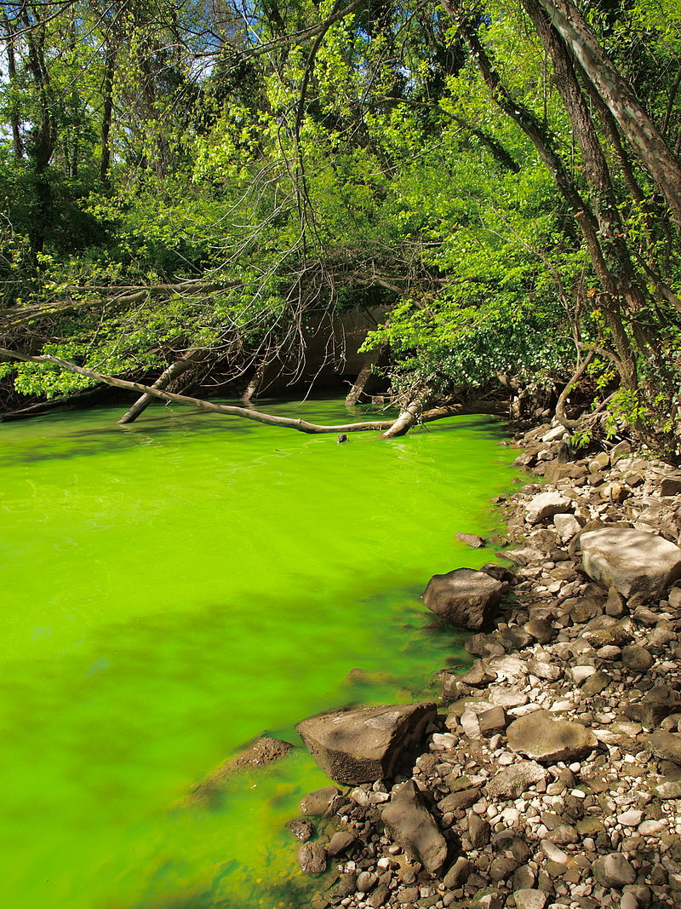
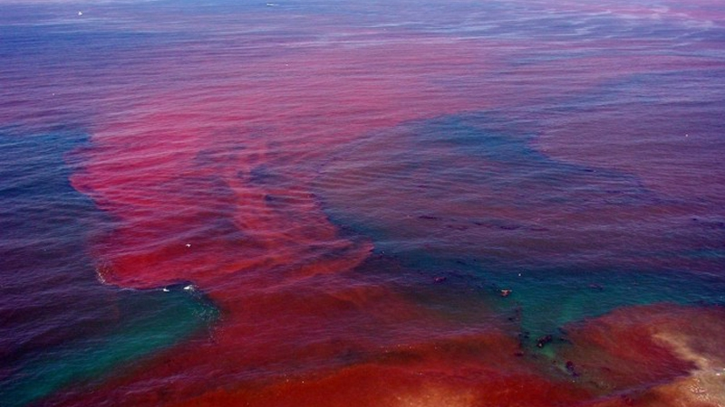
Application Driven Development
Measurements and Detailed Field Scale Modeling
Design of field experiments
Application Driven Model Development
Adapted models to meet partner needs
Model Application and Evaluation
Chesapeake Bay
Identification of Model and Measurement Needs
Feedback from research partners
Green Infrastructure
Climate Scenarios
Total Deposition Maps
Lessons from model evaluation
Development and application of detailed field scale models
Generalization of field scale modeling
Emissions Development
For many pollutants, the exchange between air and vegetation, soil, and/or water can greatly impact biodiversity, water quality and the ambient concentration most relevant to human exposure.
https://scied.ucar.edu/blog/how-does-ozone-damage-plants
One Biosphere modeling develops innovative responses to complex environmental challenges through better understanding of natural and man-made system interactions.
http://www.noaa.gov/what-is-harmful-algal-bloom
https://en.wikipedia.org/wiki/Chesapeake_Bay
https://en.wikipedia.org/wiki/Eutrophication
Notes:
Here we define application driven model development as using the model biases and environmental assessment needs to drive the experimentation and development processes.
Once a bias or modeling need is identified we engage the measurement community to acquire data or develop modeling and measurement experiments to constrain model processes
The data collected in this phase of development is then generalized to processes that can be modeled on regional and/or global scales
Once a new model is developed, the application process ideally involves multiple decades of simulations and the assessment of the model biases and short comings

Slide 5
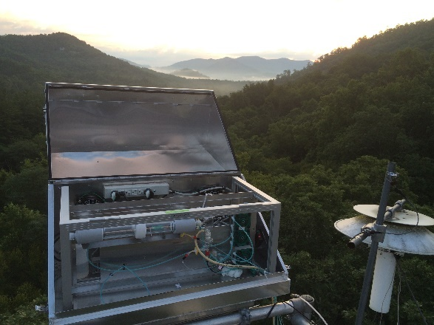
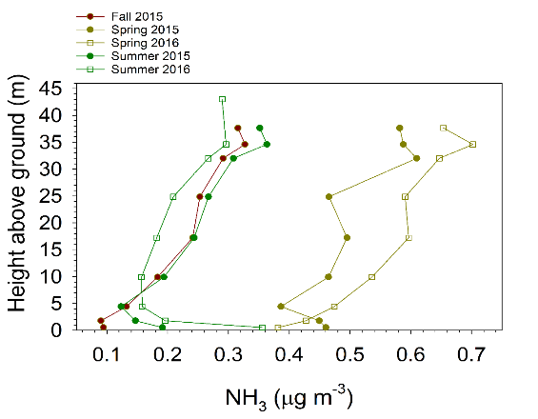
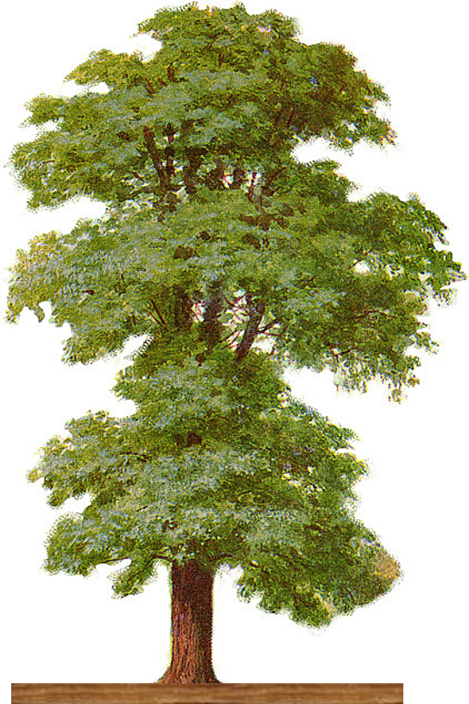
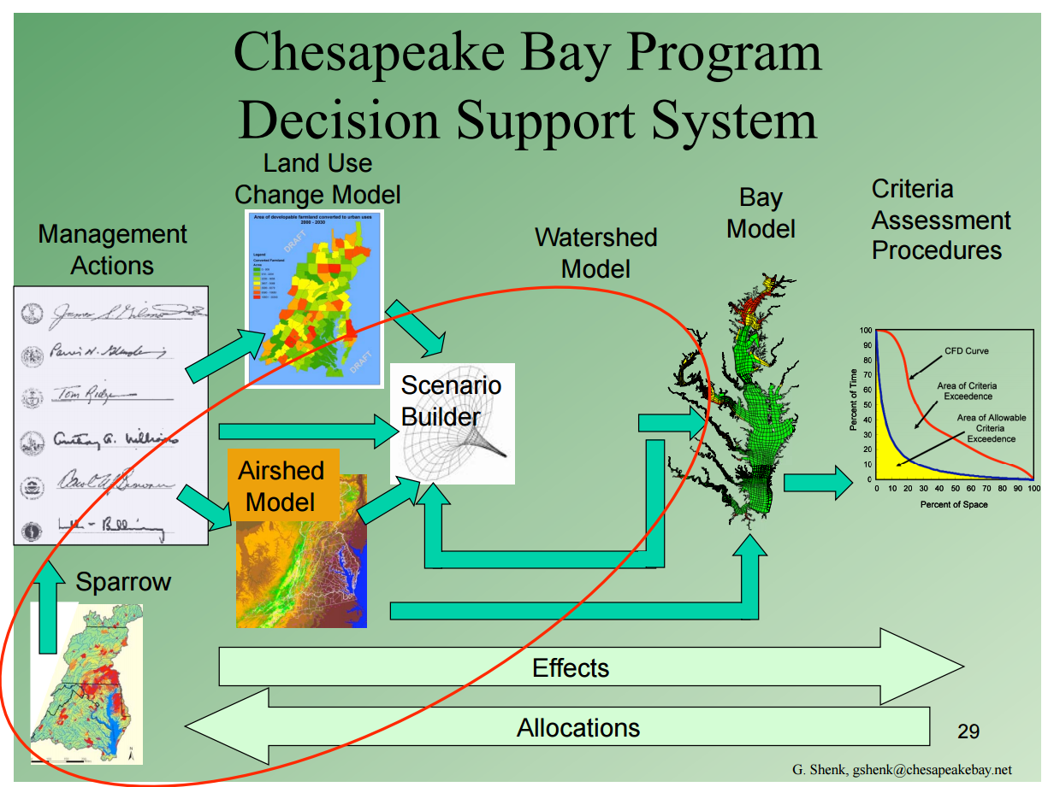
Ecosystem Relevant Science Questions and Goals
How does air pollution impact ecosystem health?
  What processes need to be captured in models?
How do we model processes on a regional scale without a robust network of measurements?
How do we estimate atmospheric loading for scenarios or climate?
  No observations are available
  May be outside of the parameterization space of empirical models
A process-level model is needed to credibly assess the impact that emissions, land use change, and agricultural practices have on air quality and ecosystem health
CMAQ
WRF
Notes:
This is a general list of ecosystem relevant science questions and goals
Many processes important to air quality and ecosystem health do not have continuous observations
Scenarios involving the future, land use, climate, emissions reductions, and development do not have observations but are necessary to consider

Slide 6
Application Driven Development
Agency Needs
  National Ambient Air Quality Standards (NAAQS)
  Secondary NAAQS
  Supports Total Maximum Daily Load (TMDL) assessments
  Critical Loads
  Regional Haze
  National Emissions Inventory
  Emerging contaminants and environmental stressors
  Climate and scenarios
  Support for regional and local environmental managers
CMAQ
WRF
Notes:
Agency needs
This in not a comprehensive list
Only applies to the atmospheric relevant processes of many applications
The impact of the atmosphere on the environment via climate, air quality or nitrogen deposition is important
Application needs are growing
Presents a challenge for model development with finite resources.

Slide 7
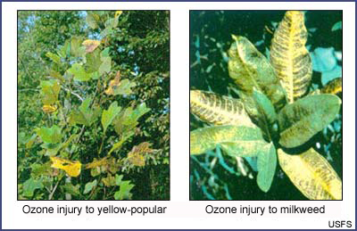
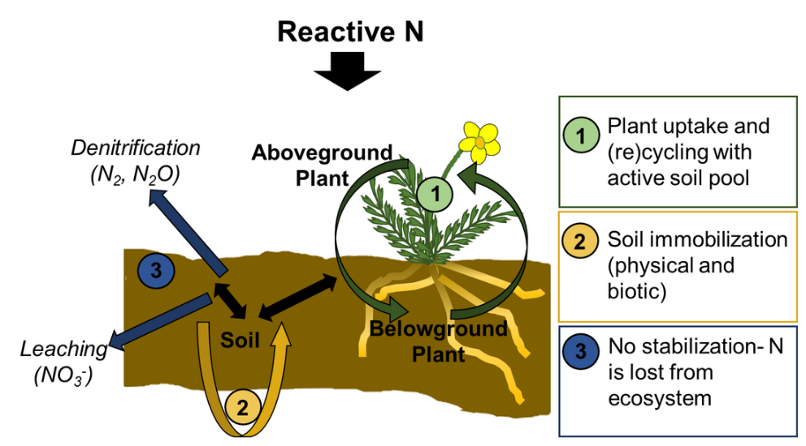
Application Driven Development
Model uncertainties
  Where do pollutants deposit
    Plant surfaces, soils, vegetation uptake, etc.
  Emerging chemicals
  Air-ecosystem feedbacks
  Air pollution and climate stressors on ecosystems
Modeling needs
  Land use specific deposition
  Agricultural air quality
  Air, Land Use, Energy and Hydrology connections

Slide 8
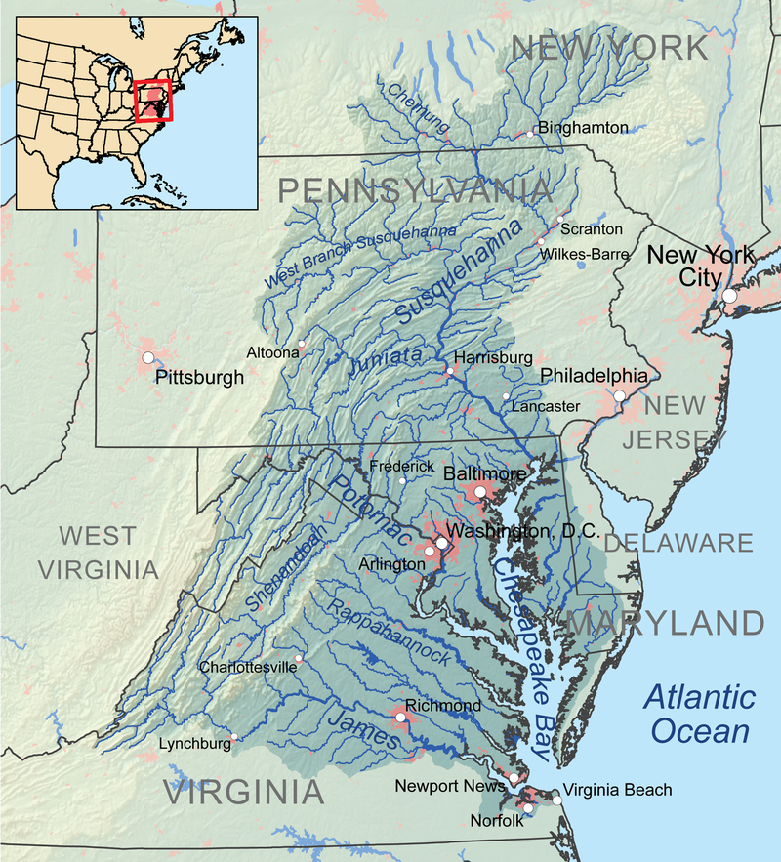
The Chesapeake Bay Watershed
Approximately 164,000 square kilometers and home to more than 18 million people
  Largest estuary in the United States
  Population increasing by about 150,000 people per year
Encompasses parts of six states and Washington D.C.
Land-to-water ratio of 14:1
  The largest of any coastal water body in the world
  Sensitive to atmospheric deposition
https://en.wikipedia.org/wiki/Chesapeake_Bay
Notes:
Land use, emissions and population are not static
Future will likely include additional development pressures
Need resilience to future environmental stressors as well as nutrient reductions

Slide 9
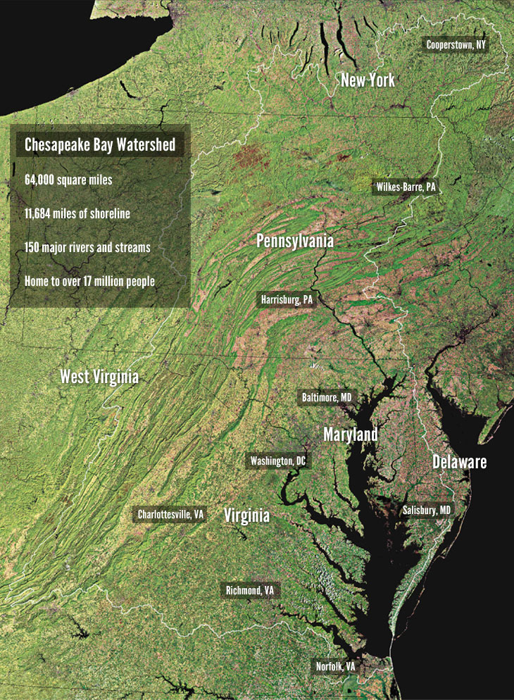
The Chesapeake Bay Watershed
Recreation and fisheries are important to the economy in the Chesapeake Bay
  Clean water and healthy habitats are necessary to support these activities
Chesapeake Bay Program (CBP) established in 1983 as a federal, state, and local/regional partnership
Water point sources, atmospheric deposition and agriculture are the largest sources of nitrogen loading to the Chesapeake Bay watershed
https://www.chesapeakebay.net/discover/watershed
Notes:
The Chesapeake Bay Program engages the community in water quality issues and to understand what ‘Bay restoration’ means to the general public.

Slide 10
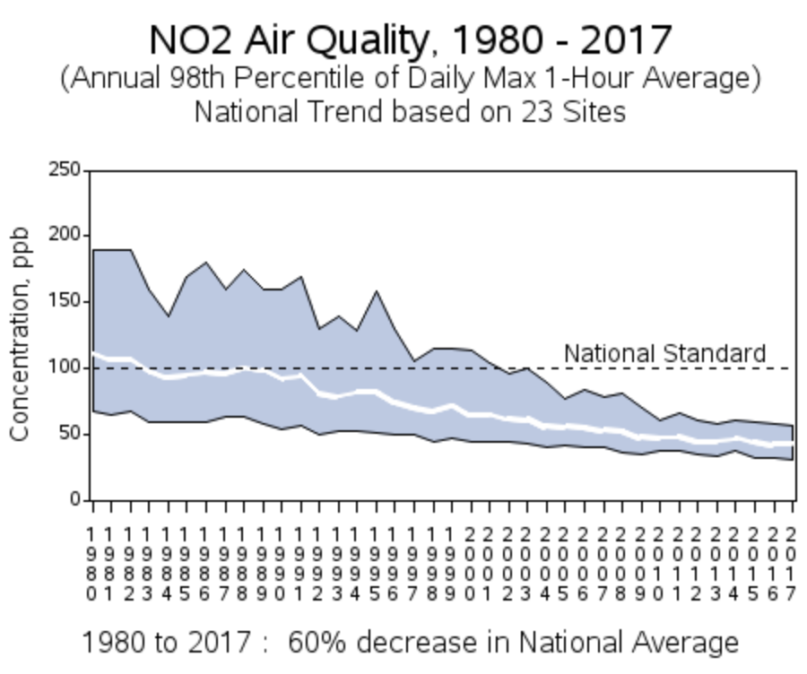
The Chesapeake Bay TMDL
Set by the EPA in 2010
  Largest TMDL developed by EPA
Sets nutrients loading limits
Atmospheric deposition of total nitrogen is rapidly reducing and contributes to about 1/3 of the nitrogen loading to the Chesapeake Bay watershed
  Large reductions due to Clean Air Act regulations
Atmospheric oxidized nitrogen reductions from NOx regulation
Reduced nitrogen deposition relatively constant
https://www.epa.gov/air-trends/nitrogen-dioxide-trends
Notes:
Reductions in atmospheric nitrogen loading has been one of the success stories
However the nitrogen reductions have not been consistent across sectors or species
Clean air act reductions of NOx has reduced combustion sources but agricultural emissions have remained relatively constant
Reductions in other pollutants have changed the transport and fate atmospheric nitrogen

Slide 11
Water Quality Progress and Trends
Late summer anoxic volume normalized to flow (bottom panel) showing a pronounced decrease from 1985 to 2016
  Despite increasing trends in precipitation, water temperature, development and population growth
Progress in point source reductions and atmospheric deposition reductions being observed
Changes in development, population and climate are additional stressors
Notes:
Dissolved oxygen is the most relevant metric for water quality improvements. Sensitive to both phosphorus and nitrogen
Reductions in nitrogen loading has resulted in water quality improvements.
Improvements have not been bay wide. Some areas are more sensitive to deposition.
Year to year variability in precipitation, wind speed and temperature drive total volume of anoxic waters but the Bay appears to be becoming more resilient to large dissolved oxygen events over the past 30 years.

Slide 12
The Chesapeake Bay Model
Cumulative Flow Diagram
Approximately 1496 continuous
sites from 1984 to present
Notes:
The Chesapeake Bay Mode consists of a system of linked dynamic models. Connecting atmospheric emissions all the way to ecosystem models for sea grass and crabs.
These models include WRF, CMAQ, land cover land change models, watershed runoff models, hydrodynamic models, criteria assessment models.
Best management sensitivities, model input and output, and observational data are used for a reduced form static model that can quickly assess first order impacts that can be simulated by local and regional managers

Slide 13
Atmospheric Nitrogen Deposition Modeling
Retrospective (2002-2012)
  Projections from the nearest national emissions inventory with continuous emissions monitoring data for NOx and SOx
Near Term Projections (2017-2028)
  Projected emissions including emission reductions and meteorology held constant at 2011 values
Long Term Projections (2045-2054)
  WRF dynamically downscaled Community Earth System Model (CESM) historical (1995-2004) and future (2045-2054) simulations under the global RCP 4.5 emissions scenario with projected regional emissions including emission reductions and projected economic growth

Slide 14
WRF and CMAQ Modifications for Long Term Projections
WRF used for dynamic downscaling of projected meteorology requires modifications to be more consistent with the input data expected by the CMAQ model
Vegetation properties updated in WRF based on satellite data:
  Updating model properties rather than using satellite data allows the model to incorporate land use changes
Soil hydraulic properties updated using observations
WRF-Noah modified to output variables needed by CMAQ for atmospheric chemistry simulations
MCIP 4.5, WRF 4.0 and CMAQ v5.3 will support these options

Slide 15
Nitrogen Cycling in CMAQ
Nitrogen is transported across multiple media
CMAQ can be coupled to an agro-ecosystem model
  USDA’s Environmental Policy Integrated Climate (EPIC) model
Considers multimedia gradients and biogeochemical processes when calculating model NH₃ fluxes
Cooter et al. 2012
Notes:
These simulations used CMAQ with bidirectional NH3 exchange. This includes EPIC simulations for the agricultural sectors.

Slide 16
Nitrogen Concentration and Deposition Trends
Trends (2002-2012) in ambient oxidized nitrogen concentrations are captured well
  Gives confidence that dry deposition is captured well
Underestimating the reduced N wet deposition trends in the Midwest
  Ambient NH₃ measurements do not cover a sufficient amount of time for trends
  Mid Atlantic trends captured well
Zhang et al. in review
Notes:
Trends and magnitude in ambient total nitrate and ammonium and nitrate wet deposition captured well in the Mid-Atlantic
Gives confidence in the model results
Modeled results in the west did not perform as well.

Slide 17
Trends in Modeled Atmospheric Deposition
Climate + Emissions Changes lead to:
Overall decreasing trend in Total N deposition to the CBW.
Decreases in the proportion of dry and wet deposition of Oxidized N.
Increases in the proportion of dry and wet deposition of NH_{x}.
Results comparable to both retrospective and “on-the-books” projections to 2030 that used meteorological data assimilation
Set by the EPA in 2010
  Largest TMDL developed by EPA
Sets nutrients loading limits
Atmospheric deposition is rapidly reducing and contributes to about 33% of the nitrogen loading to the Chesapeake watershed
  Most rapid reduction of any nitrogen source
  Reductions due to Clean Air Act regulations
Atmospheric N reductions are largely been from NOx regulation
NH₃ and NH₄ deposition relatively constant
Blue points: Campbell et al.
Other points: Zhang et al.
Campbell et al. in review
Notes:
The future simulations matched the retrospective simulations remarkably well given the difference in WRF simulations and land use
Total nitrogen deposition shifts from oxidized nitrogen to reduced nitrogen deposition over this time period in agreement with recent observations.
The climate impact appears to be largely driven by changes in precipitation and is on the order of 4% as apposed to the 40% reduction due to emissions

Slide 18
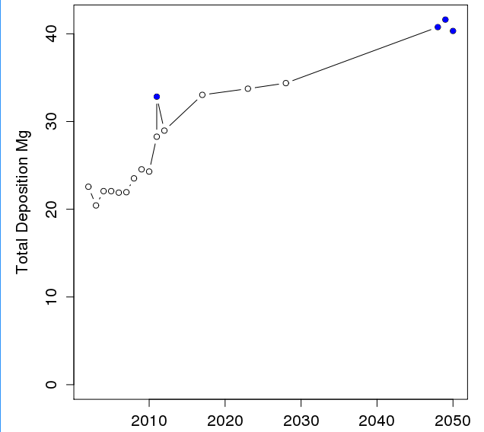
Trends in Modeled NH₃ Atmospheric Deposition
Year | Changes in Total N Deposition | Changes in NH₃ Dry Deposition
2002-2004 | 0% | 0%
2017 | -32% | 80%
2028 | -40% | 92%
2048-2050 | -42% | 122%
Significant decrease in total N deposition
  Largely due to NOx reductions
Increase in NH₃ deposition
  Aerosol chemistry and NOx/SOx reductions
  Relatively constant NH₃ emissions
Notes:
Dry NH3 deposition is increasing due to SOx and NOx reductions.
PM reductions have resulted in higher ambient NH3 concentrations, in agreement with AIRS satellite observations over the same time frame
NH3 deposits faster than aerosol ammonium resulting in less long range transport, more local deposition.

Slide 19
The Chesapeake Bay Model
The watershed model is a simple coefficient model that relies on multiple process models, statistical models, data analysis and literature reviews.
Calibrated to observed data using dynamical model and sensitivities
  Limited to a specific modeling system
Improved engagement with local and regional managers
Reliant on the full dynamic models
  Cannot replace dynamic models
Best management Practices
http://cast.chesapeakebay.net/Documentation/ModelDocumentation
Notes:
Returning to the reduced form mode.
The bay model is now a simple steady state reduced form model derived from sensitivities and scenario simulations in the dynamic modeling system and observations
Dependent on the full form dynamic models and limited to the application of those models
Allows first order simulations and best management practices simulations via a web interface

Slide 20
Implications of a Reduced Form Model
State and local water quality managers like it
  Allows managers to run scenarios consistent with the dynamic simulations
Improved communication with stake holders
  Managers become familiar with the general model responses to nutrient loading
  Improved engagement with stakeholders
http://cast.chesapeakebay.net/Documentation/ModelDocumentation
Notes:
The figure on the right shows the connections to the dynamic model, research and data

Slide 21
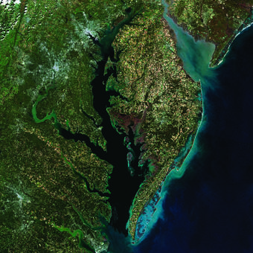
Future Directions: Land Use
Represent land use change in the CMAQ modeling system
  Connected to emissions
Better characterize agricultural and forest dynamics
Incorporate consequences of climate change under different scenarios
Enhance representation of land use change drivers
Chesapeake Bay and surrounding lands as
seen in a mosaic of Landsat images from 2014.
Credit: NOAA/USGS
Notes:
Land use being developed at 1 m for the historical period and 30 m consistent with IPCC scenarios for future scenarios
Historical data is derived from aircraft multispectral and lidar observations
BMP implementation is at the field scale and finer resolution is needed to better capture the impacts
Future scenarios built on existing transportation and development planning to about 2030 and the IPCC scenarios after that.
It will be a challenge to bring these changes into the WRF and CMAQ modeling system

Slide 22
Future Directions: Hydrology
Fine scale models for priority watersheds
  Needed to resolve key features, source areas, etc.
Unstructured hydrodynamics and watershed models
Develop complementary monitoring system
Need meteorological and air quality linkages
SCHISM hydrodynamics model
Notes:
Hydrology and an hydrodynamic models moving to fine scale to better capture the impact of BMPs
Moving from about 1km resolution to 30 to 200 meter resolution using unstructured meshes
Presents difficulties in linking with meteorological and air-quality models
Example is from SCHISM which was developed from the MPAS ocean model

Slide 23
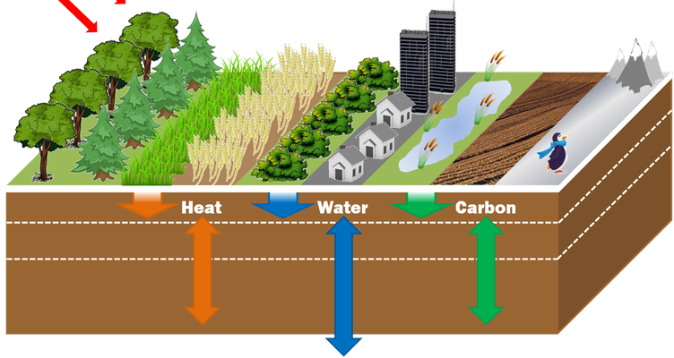
Future Directions: Air-Quality
Land use and hydrology models will have <1 km resolution
  Not feasible for air-quality and meteorology
Land use and future scenario capability needed
  Cannot constrain with observations
  Better coupling with WRF Noah LSM
Transport and fate of nutrients in terrestrial models differ by land use
  Land use specific dry deposition model for CMAQ v5.3
CMAQ STAGE
Dry Deposition
Notes:
Achieving 30m resolution in meteorological and air quality models difficult
Need land use specific data for BMP implementation, e.g. how does a riparian buffer change dry deposition
This can be done on the grid scale for air-quality models but land use specific output is needed to better interface with higher resolution hydrological and land use models
Not a substitution for higher resolution as the ambient concentrations are still modeled at the model grid resolution. Currently working on sensitivities to quantify the impact of resultion.

Slide 24
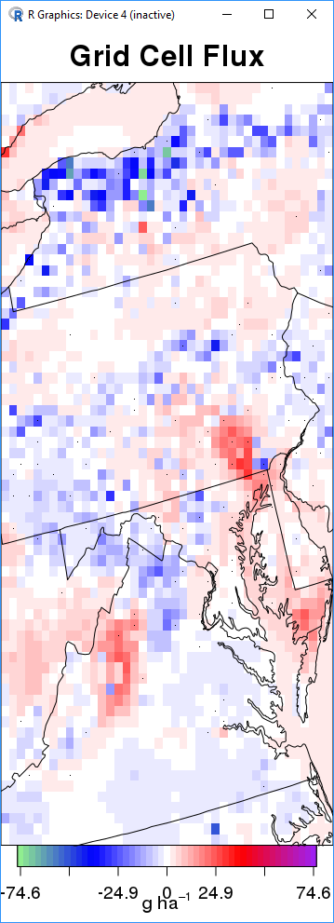
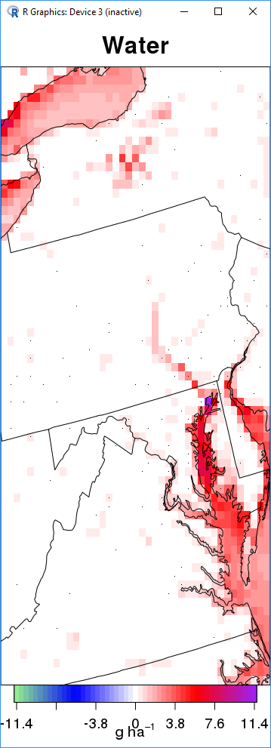
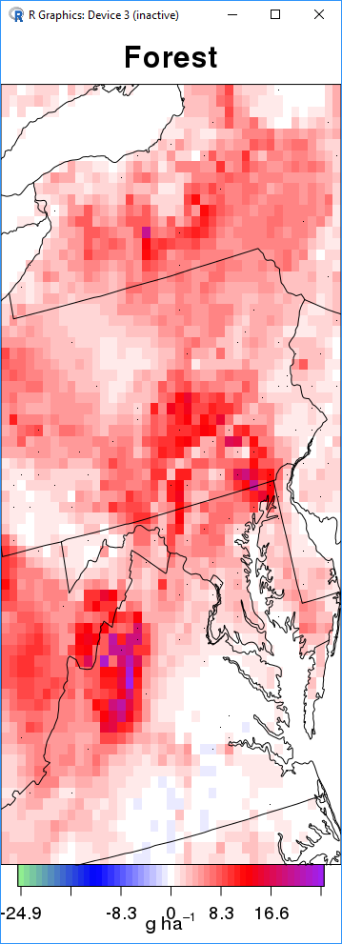
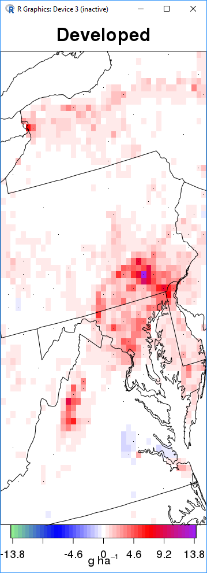
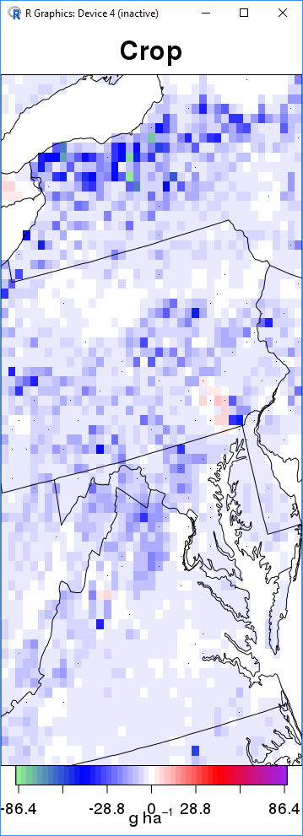
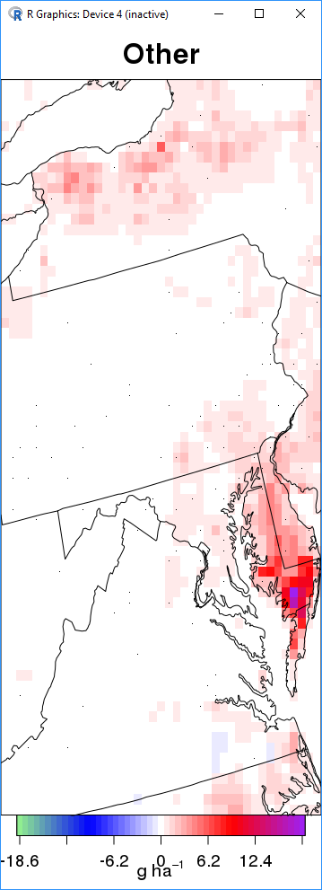
Future Directions: Air-Quality
NH₃ dry deposition example

Slide 25
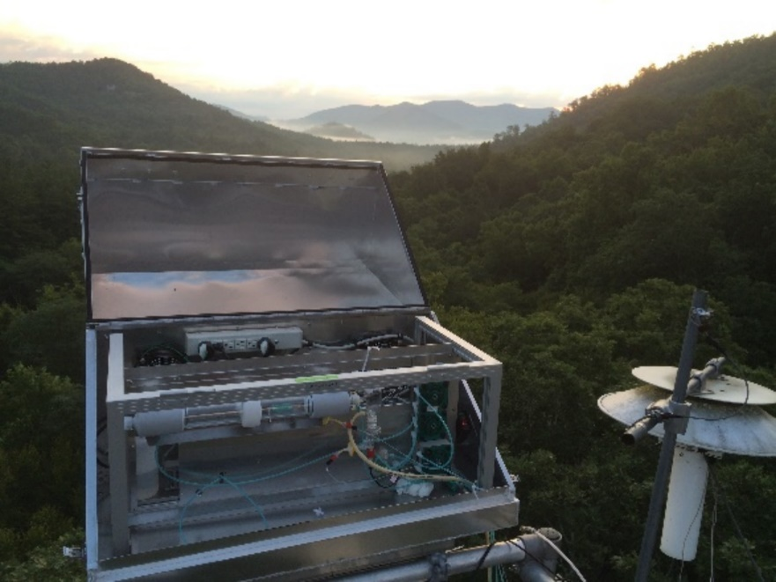

Computational Needs
Big data and collaboration
  How to best make large input and output files available?
Airshed models need large parallel computational environments
Each modeling system has its own computational environment
  Containers and cloud computing?
How to best couple or link modeling systems?
  Library of models and modules?
  How can common datasets be leveraged across models, e.g. land use?
Notes:
Computational needs needed to drive individual models but also to connect these models to each other and observations.
Need to adapt models to better utilize common datasets for system applications

Slide 26
Data Needs
Dry deposition measurements exist only for a small number of species for a limited number of sites and times
  Existing measurements are not housed in a common location or format
Model intercomparison studies needed
  Do other modeling systems exhibit the similar sensitivities?
What can we learn from reduced form models or machine learning?
    Would a loosely constrained system produce similar environmental drivers?

Slide 27
Summary
Atmospheric deposition of nitrogen to the Chesapeake Bay watershed is about 1/3 of the total nitrogen load
NOx reductions due to the Clean Air Act have resulted in a large reduction in nitrogen loading to the watershed
CMAQ simulations capture the trends in wet deposition and ambient NOx well in Chesapeake Bay area
The reduced nitrogen fraction of deposition is increasing although the total nitrogen deposition is decreasing
  Due to NOx and SOx reductions and near constant NH₃ emissions
Modeling is moving towards finer scales more in line with local water quality managers

