Slide 1
Examining Changes in Ozone over the Western United States via Assimilation of Satellite Ozone Products in a Chemistry-Transport Model
2017 CMAS Meeting
October 25, 2017
Gregory Osterman¹, Jessica Neu¹, Thomas Walker¹, Dejian Fu¹, Susan Kulawik^{1,2}, and Kevin Bowman¹
¹Jet Propulsion Laboratory/California Institute of Technology
²Bay Area Environmental Research Institute

Slide 2
Changes in Emissions During the Satellite Period
2005-2016 Changes in Emissions based on OMI NO₂ and MOPITT CO
2005-2016 Trend
Figures courtesy of K. Miyazaki
% Difference from 2005
Complex, non-monotonic changes in emissions have occurred during the satellite period, particularly in Asia. What impact have these changes had on tropospheric ozone?

Slide 3
Overview of Verstraeten et al., 2015 analysis
Conclusions
Rapid increase in tropospheric O₃ over China (7% in six years) observed by TES
Model simulations reproduce the observed O₃ increase within uncertainties (taking into account changes in emissions and stratospheric/troposperic exchange)
Domestic reductions in emissions should have decreased free tropospheric O₃ over the Western US
Effect is offset by changes in STE and increased transport of O₃ and precursors from Asia.
Data/Models Used
Tropospheric Emission Spectrometer (TES) – tropospheric O₃
Ozone Monitoring Instrument (OMI) – NO₂ tropospheric column
Microwave Limb Sounder (MLS) – stratospheric O₃
Tracer Model 5 (TM5) chemistry/transport model
Top down emissions estimated from OMI NO₂
Limitations of Analysis
Time period limited to 2005-2010 by TES observations
No analysis of surface data
Focus on a broad area of Western US

Slide 4
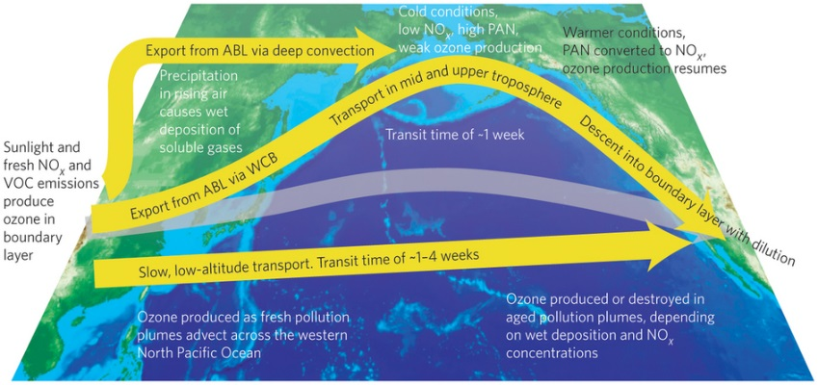
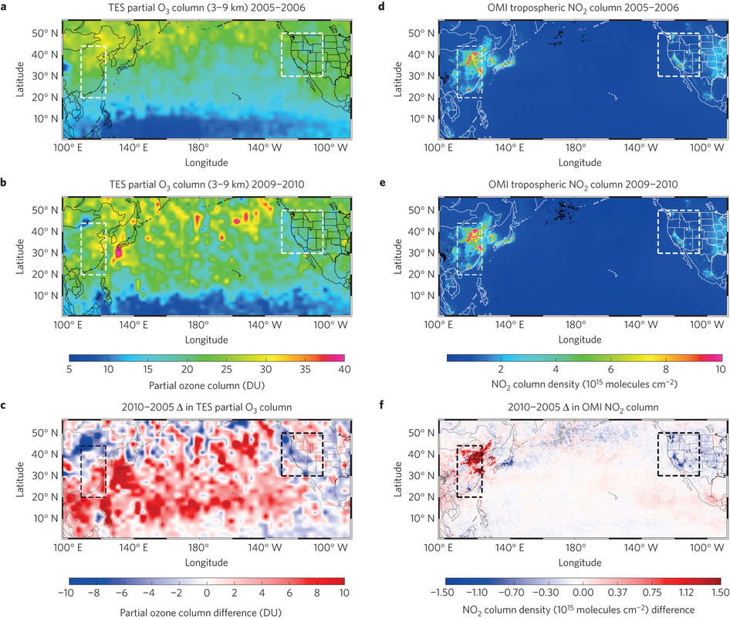
Drivers of Regional Tropospheric Ozone Changes: 2005-2010
Mid-tropospheric ozone is largely controlled by a combination of emissions, long-range transport, and downward transport from the stratosphere.
Half of the increase in mid-tropospheric ozone over Eastern China from 2005-2010 can be attributed to increasing NO_{x} emissions, while the other half was associated with natural variability in stratospheric transport.
Drivers of Regional Ozone Changes
MLS: Temporary increase in downward transport from the stratosphere partly due to 2009-2010 El Nino.
Explains 50% of the ozone increase
Offset 57% of expected ozone decrease
TES: 7% Increase in mid-tropospheric ozone
TES: No change in mid-tropospheric ozone
Transport from China offset 43% of expected decrease
OMI: 21% increase in NO_{x} emissions. Explains 50% of the ozone increase.
OMI: 21% decrease in NO_{x} emissions. Should have given a 2% decrease in ozone
Verstraeten et al., 2015; Doherty, 2015

Slide 5
Updated Analysis (2017)
Neu ET al. – HAQAST Proposal
Data/Models Used in 2015 Analysis
Tropospheric Emission Spectrometer (TES) – tropospheric O₃, 2005-2010 only
Ozone Monitoring Instrument (OMI) – NO₂ tropospheric column
Microwave Limb Sounder (MLS) – stratospheric O₃
Tracer Model 5 (TM5) chemistry/transport model
Top down emissions estimated from OMI NO₂
Data/Models Used in 2017 Analysis
Tropospheric ozone from combined AIRS/OMI retrievals (2005 – 2015)
Ozone Monitoring Instrument (OMI) – NO₂ tropospheric column
Microwave Limb Sounder (MLS) – stratospheric O₃
GEOS-Chem with satellite data assimilation (MLS stratospheric O₃)
Updated emissions estimated from satellite data (OMI NO₂)
Surface ozone data from Western US and Asia

Slide 6
Updated Analysis:
GEOS-Chem Model Set Up
GEOS-Chem, v9-01-02 with additional data assimilation capabilities.
    MLS ozone profiles in stratosphere
    Uses 3DVAR assimilation approach
2° x 2.5° resolution, 47 vertical levels.
Dynamics driven by MERRA-2 meteorological fields.
Tropospheric NO_{x}-HO_{x}-VOC chemistry.
LINOZ stratosphere.
Anthropogenic NO_{x} emissions as described on following slide
Other emissions generally from EDGAR v3, overwritten with regional inventories.
Biomass burning emissions from GFED2.

Slide 7
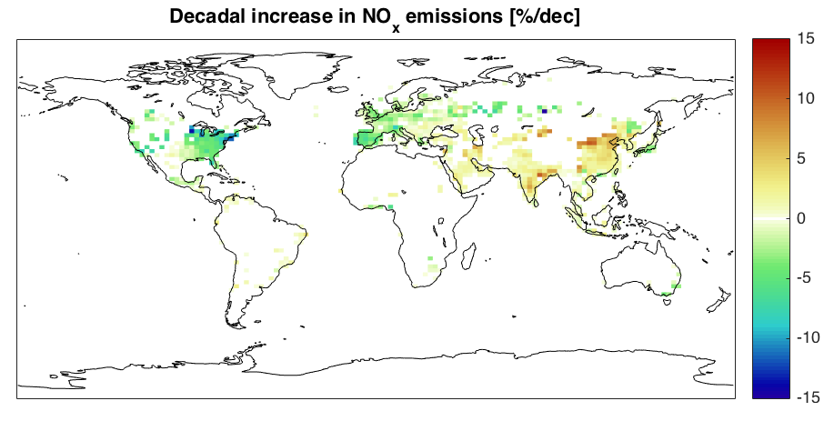
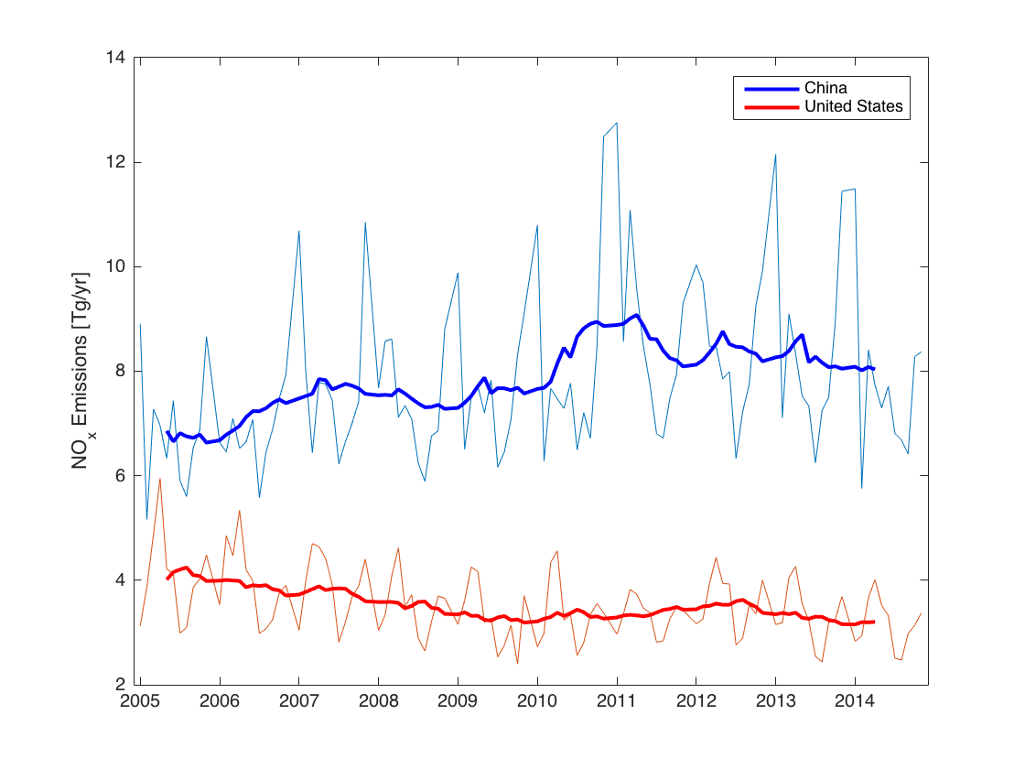
No_{x} Emissions
Obtained from mass balance inversion of OMI NO₂ columns and GEOS-Chem (similar to Verstraeten et al. 2015).
Decreases in North America and Europe.
Top plot shows linear trends over 2005-2015 in % per decade.
  China shows an upward trend: However, emissions in China peak in 2011 and begin to decrease.

Slide 8
Planned Model Runs (2005 – 2015)
Baseline
    Mass balance emissions
    MLS assimilation
Global constant emissions
    Constant 2005 emissions globally
    MLS assimilation
China constant emissions
    Constant 2005 emissions over China
    MLS assimilation
China extrapolated emissions
    Mass balance emissions + extrapolated trend over China
    MLS assimilation
Constant stratosphere
    Mass balance emissions
    Repeated 2005 meteorology and 2005 MLS assimilation

Slide 9
NEW Satellite o₃ Products:
Characteristics and Diagnostics of Retrievals
JPL MUSES (MUlti-SpEctra, MUlti-SpEcies, Multi-SEnsors Retrievals of Trace Gases) algorithm delivers both retrieved trace gas concentration profiles and observation operators needed for trend analysis, climate model evaluation, and data assimilation.
Based on TES retrieval algorithm – consistent set of sensitivity metrics and error estimates.

Slide 10
Joint AIRS/OMI O₃ Retrievals
The AIRS/OMI O₃ retrievals have been configured in two modes.
  Global survey mode
    Provides profile data with a spatial sampling similar to TES global survey
    22-month data have been processed including
      2006 Jun – Aug
      2009 Jan – Jul, Oct – Dec
      2010 Jan – May
      2016 Mar – Jun
    December 2017, an estimated release date of AIRS/OMI ozone v1 data
  Regional mapping mode
    Processes all available measurements for flight campaigns including
      KORUS-AQ, Apr – Jun 2016
      ORACLES, Aug, Sept 2016
      POSIDON, Sept, Oct 2016
  Data products have been saved in Hierarchical Data Format, a common format used in the NASA Earth Observation System level 2 products

Slide 11
AIRS/OMI Vs. TES v5 GS O₃ Profile Data on August 2006
AIRS/OMI O₃ VMR
TES O₃ v5 VMR
a priori
ppb
316
mbar
510
mbar
750
mbar
Tropospheric
DOFS

Slide 12
Joint AIRS/OMI vs. TES GS O₃ During Summer 2006
316 mbar
510 mbar
750 mbar
Relative bias < 2-5%. Standard deviation of the differences < the estimated uncertainty.
Correlation Coefficient (r)
Mean Diff. (Joint-TES) | ppb
100 x (Joint-TES)/TES | %
Standard Deviation of Diff. | ppb
100 x (Joint-TES)/TES | %
AIRS/OMI Total Uncertainty | %
TES v5 Total Uncertainty | %
316 mbar |  |  | 510 mbar |  |  | 750 mbar
Jun | Jul | Aug | Jun | Jul | Aug | Jun | Jul | Aug
0.85 | 0.85 | 0.84 | 0.83 | 0.82 | 0.80 | 0.81 | 0.77 | 0.75
-7.4 | -6.2 | -4.0 | -3.4 | -3.3 | -2.9 | -1.8 | -1.5 | -1.8
-4.8 | -4.4 | -3.8 | -1.9 | -2.1 | -2.7 | -0.8 | -0.4 | -1.6
20.5 | 17.7 | 14.3 | 10.9 | 10.0 | 8.5 | 7.6 | 7.3 | 7.0
24.6 | 22.5 | 19.5 | 21.0 | 19.7 | 16.8 | 19.6 | 19.4 | 17.9
27.8 | 27.8 | 27.6 | 22.5 | 22.5 | 22.3 | 24.1 | 23.9 | 23.5
22.0 | 22.0 | 22.2 | 19.5 | 19.5 | 19.7 | 23.9 | 23.9 | 23.5

Slide 13
Comparisons to WOUDC Ozonesondes
 | 316 mbar |  | 510 mbar |  | 750 mbar |  | # of Sites | # of Pairs
 | Mean | RMS | Mean | RMS | Mean | RMS
 | 100 x (Satellite - Sonde_AppliedAK)/Sonde_AppliedAK
AIRS/OMI | 1.9 | 15.8 | 4.0 | 18.3 | -0.7 | 17.9 | 21 | 93
TES | 6.6 | 22.6 | 7.3 | 17.9 | 6.6 | 22.6 | 30 | 171
Coincidence criteria
Passed retrieval quality check
Distance within 300 km
Time diff. within 4 hours
June, July, August 2006
13

Slide 14
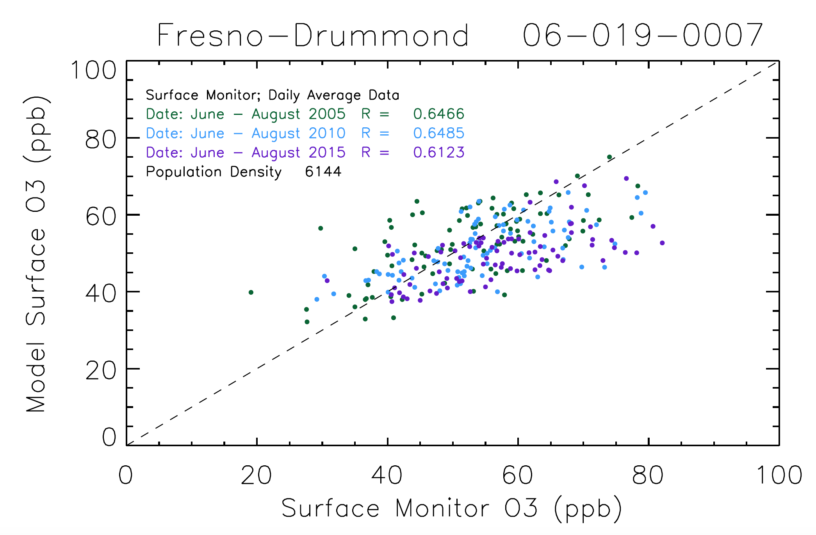
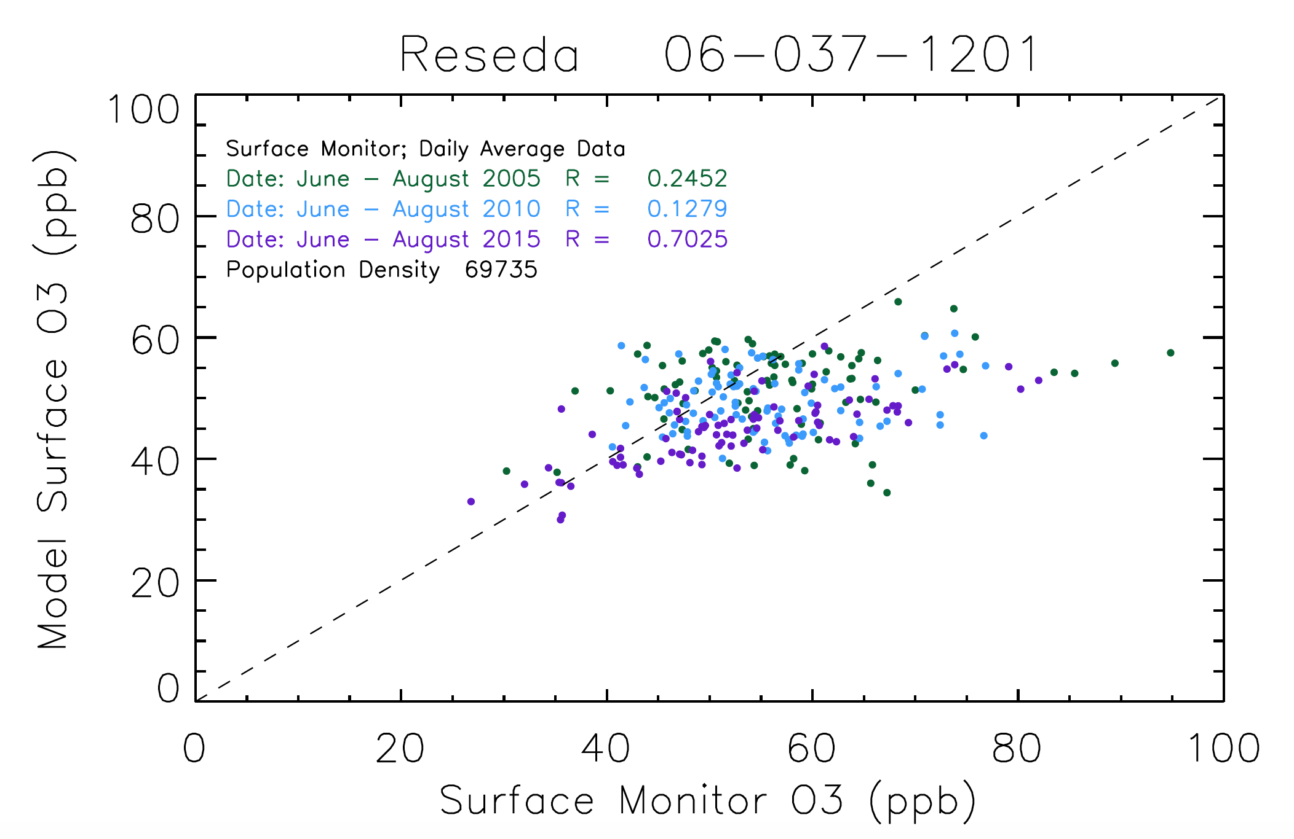
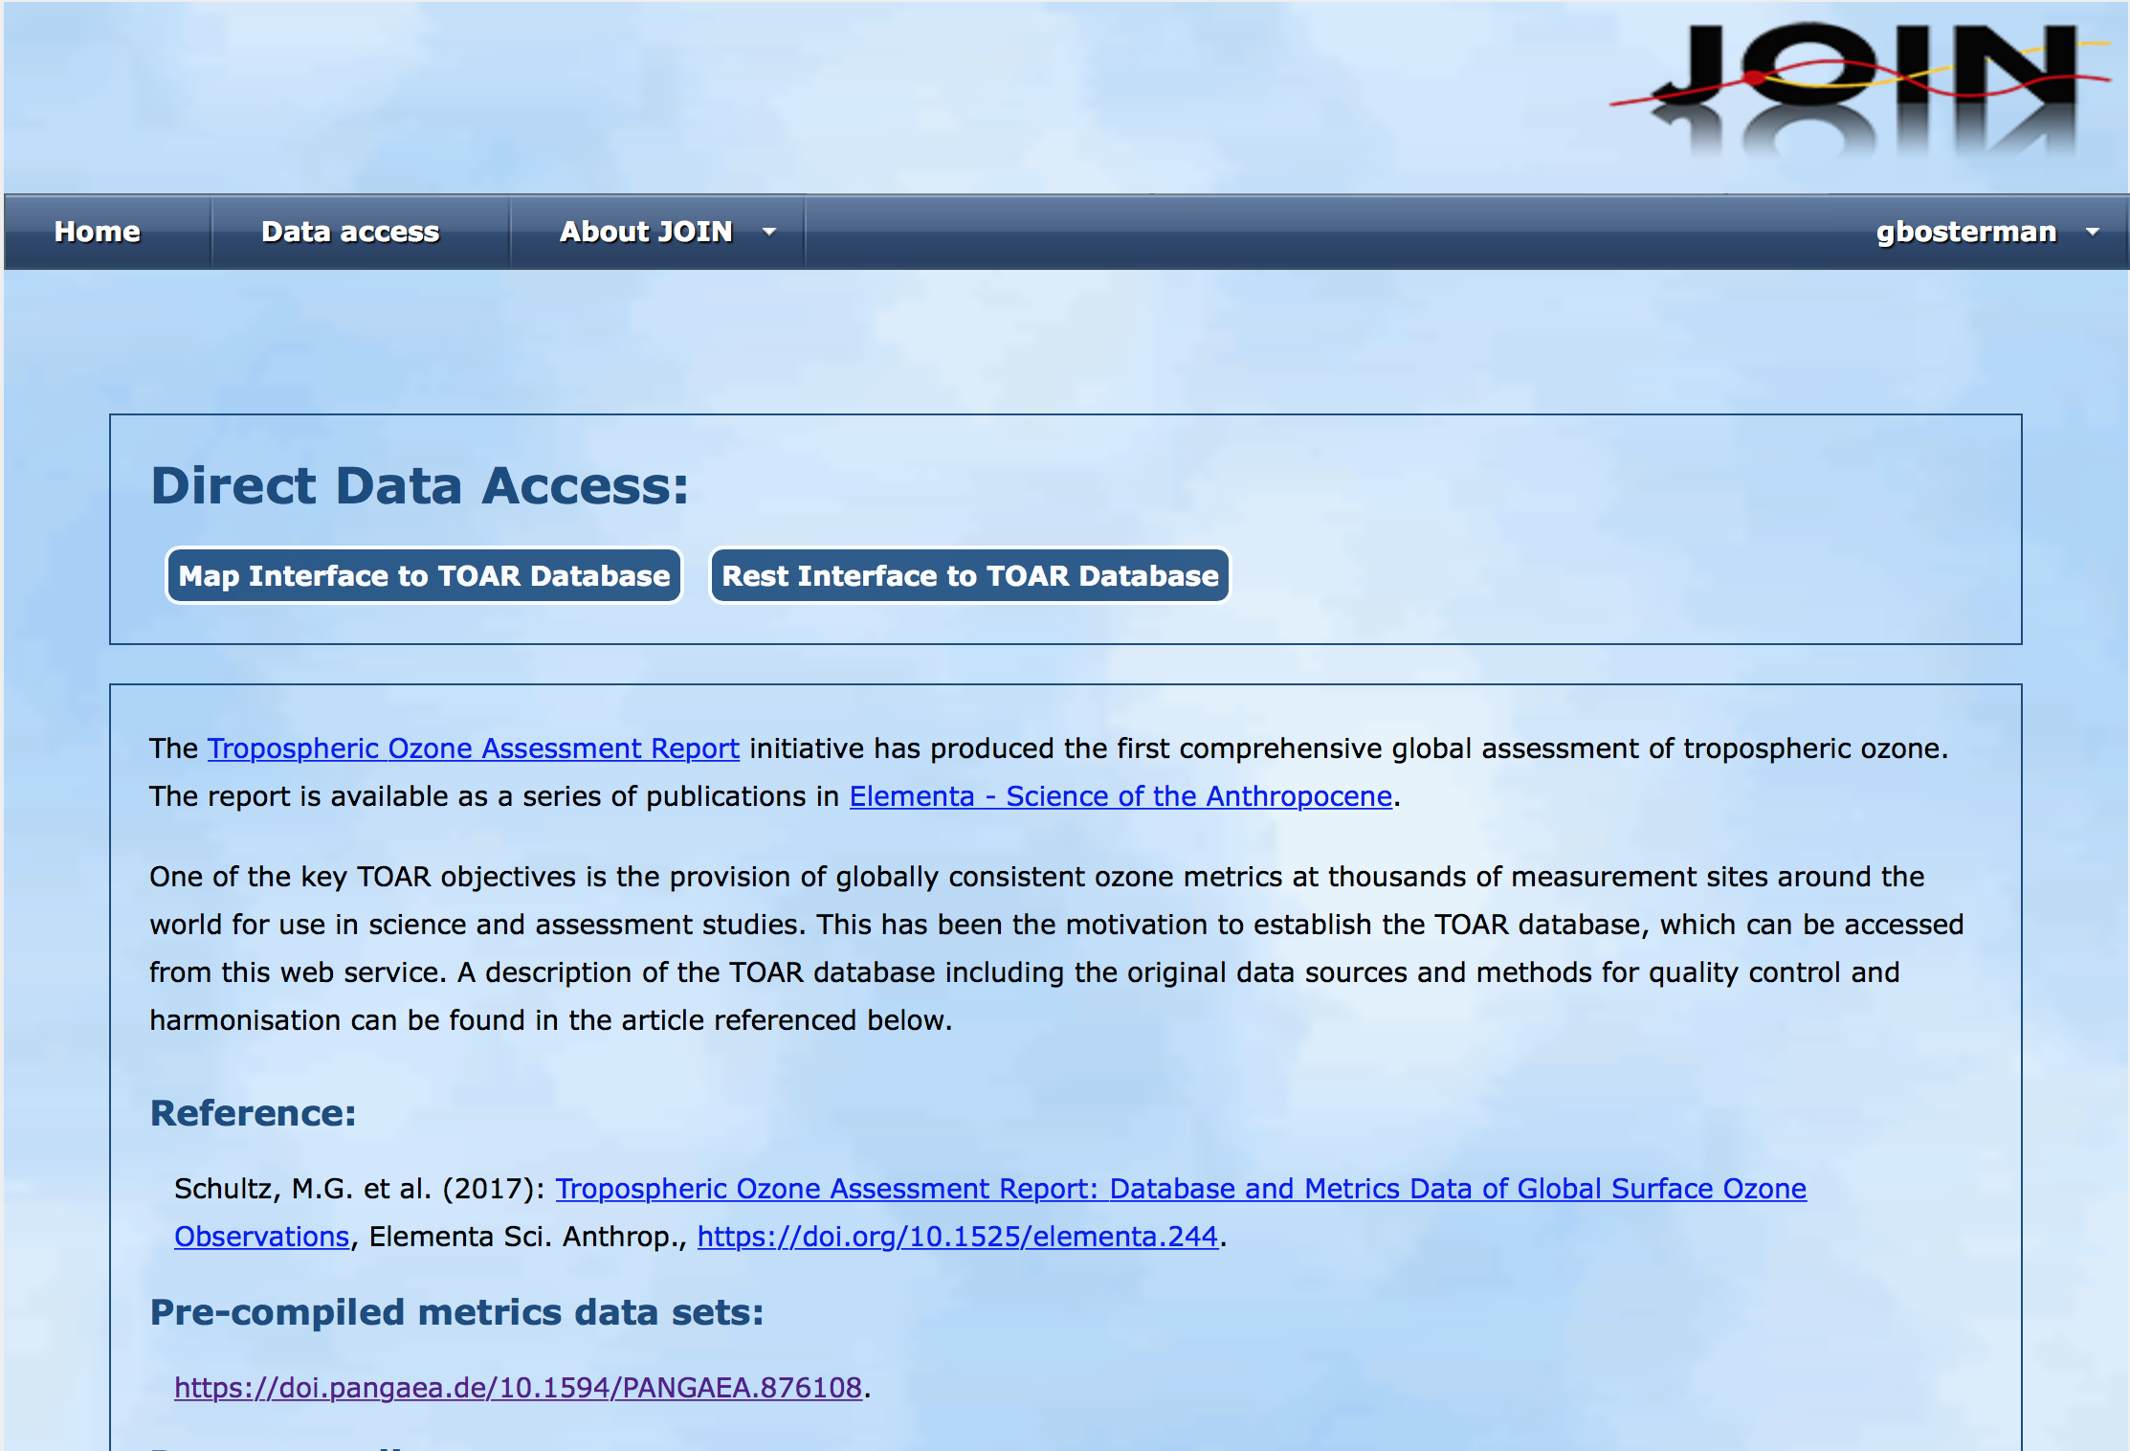
Surface Data Comparisons
Getting ready to start surface data analysis
Using the TOAR surface monitor database
Schultz MG, Schröder S, Lyapina O, Cooper O, Galbally I, Petropavlovskikh I, et al.. Tropospheric Ozone Assessment Report: Database and Metrics Data of Global Surface Ozone Observations. Elem Sci Anth. 2017. DOI: http://doi.org/10.1525/elementa.244

Slide 15
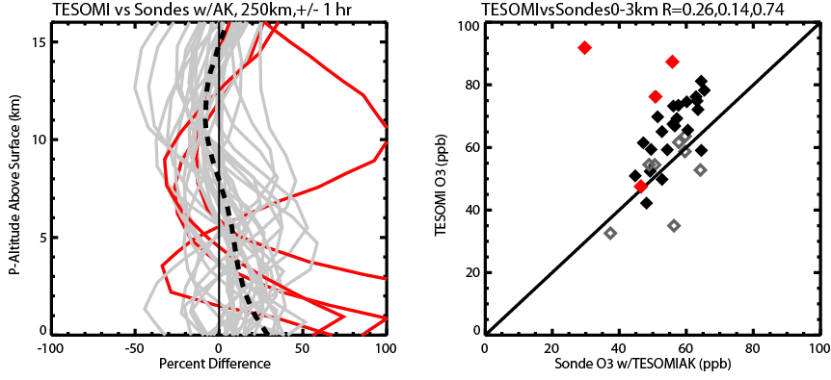
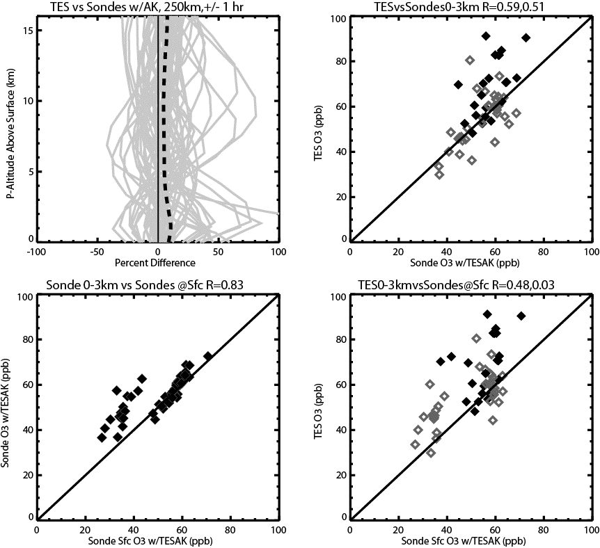
TES/OMI Retrievals
Another multispectral retrieval product that we can utilize is a combination of TES/OMI radiances
TES/OMI retrievals have shown improved sensitivity to O₃ in the lowest troposphere over single instrument retrievals
Provide additional lower tropospheric O₃ information for the 2005-2010 time period
Validation analysis and paper are currently underway
TES/OMI vs Sondes: R=0.74
TES vs Sondes: R=0.51

Slide 16
Examining Changes in Ozone over the Western United States via Assimilation of Satellite Ozone Products in a Chemistry-Transport Model
Currently producing GEOS-Chem model runs for analysis
Validation analysis of combined AIRS/OMI retrievals show that the data can resolve upper and lower tropospheric ozone (similar to TES)
  The AIRS/OMI data will allow us the ability to extend the Verstraeten et al., 2015 analysis beyond the TES time period
Utilizing surface data in the analysis to examine how changes in mid-tropospheric ozone affect surface ozone in the model
Future results:
  HAQAST Meeting in November 2017
  AMS Meeting in January 2018

