Slide 1
Update on 2016 Emissions Modeling Platform Development
A. Eyth, J. Vukovich, G. Pouliot, M. Strum U.S. EPA Office of Air Quality Planning and Standards
C. Allen, J. Beidler - CSRA
October 24, 2017

Slide 2
Why are we Preparing an Emissions Platform for 2016?
The 2014 National Emissions Inventory (NEI), Version 1 was released in fall, 2016
EPA typically prepares a modeling platform based on the most recent NEI or another close year (e.g., 2007/2008)
2014 was a cool summer in much of the country without many air quality issues
A collaborative process was undertaken with states, regional, and local organizations to select a modeling base year for analyses based on the 2014 NEI
2016 was identified as first choice, 2015 was second choice
A 2016 emissions modeling platform will provide a building block for State Implementation Plans:
Regional Haze (with 2028 future year)
Ozone (with 2023 future year)

Slide 3
Improvements in the 2014NEIv2 coming in December
Updates to PM emissions from ag. tilling, ag. dust, construction dust, mining and quarrying, road dust
Corrections to spatial distribution of livestock NH₃ and the addition of VOC for agricultural livestock
Residential fuel combustion updates
Updates to oil and gas emissions
Locomotive emissions and offshore oil platforms updated to year 2014
Refinements to point sources (e.g., stack parameters, locations, hazardous air pollutants)
Updates to onroad input data including age distributions, speeds, fuels, and activity data (e.g., vehicle miles traveled and populations)
Updates to nonroad emissions in some states
Limited updates to fire and biogenic emissions

Slide 4
Preliminary and Upcoming Versions of the 2016 Platform
EPA prepared a preliminary 2016 emissions based on the version 1 of the 2014 NEI to perform initial runs
This will be superseded in early 2018 by updated data from the 2014NEIv2
Continued 2016 platform development during 2018
Collaborative effort between states, multi-jurisdictional organizations (MJOs), and EPA based on 2014NEIv2 data
2016 data at least for fires, onroad, nonroad, biogenics, and point sources
Will include 2016, 2023 for ozone, and 2028 for regional haze
Zac Adelman of LADCO and Alison Eyth are co-coordinators
MJO/State and EPA sector co-leads will improve sectors

Slide 5
Overview of the Preliminary 2016 Platform Development
For many sectors, data from Version 1 of the 2014 National Emissions Inventory were used in full or as the starting point
Point and nonpoint oil and gas emissions adjusted to 2016
Onroad mobile source emissions were developed using 2014NEIv1 inputs projected to 2016 (including fuels)
Nonroad mobile source emissions were developed using inputs developed for 2014NEIv1 but run for 2016
2016 data were used for electric generating units (EGUs) with Continuous Emissions Monitoring Systems (CEMS)
Wild and prescribed fire emissions were developed for 2016
Agricultural fire emissions estimated for 2016
Incorporated latest inventory from Environment Canada (2013)

Slide 6
Annual Emissions Changes by Sector from 2011 to Preliminary 2016
All units in tons/yr

Slide 7
Preliminary 2016 EGU Emissions
Started with 2014NEIv1 emissions
For EGUs matched to Continuous Emissions Monitoring System (CEMS) data, updated annual emissions to 2016 CEMS totals
Identified pre-2016 closures based on NEI and U.S. Energy Information Administration (EIA) data
Added new units for which stack parameters and locations were available from EIS
Derived 2016-based temporal profiles to be used for units without CEMS
Assigned flat temporal profiles to municipal waste combustors and co-generation units
Processed all EGUs as elevated point sources for inline processing

Slide 8
Preliminary 2016 non-EGU Point Sources
Started with 2014NEIv1
Updated with fall 2016 state-submitted control data
Incorporated pre-2016 closures but did not add new sources
Point source oil and gas updates:
Projected 2014NEIv1 to 2016 using state-specific factors
Annual production data for desired years for most states based on Energy Information Administration (EIA’s) Natural Gas and Crude Oil Production summaries
If data was not available for a state, Annual Energy Outlook (AEO) 2015/2016 production information for Supply Region was used
Moved offshore sources to the “pt_oilgas” sector from the other point (“othpt”) sector from previous platforms

Slide 9
Preliminary 2016 Fires
Wild and prescribed fires: based on SMARTFIRE2 and Bluesky
Inputs from Hazard Mapping System, ICS-209, GeoMAC
Excluded agricultural fires
Flaming separated from residual smoldering (heat flux puts residual smoldering into layer 1)
Large fires > 20K acres split into two or more 12km cells
Agricultural fires: satellite-based day-specific point source fires emitted into layer 1
Pouliot, G., V. Rao, J. L. McCarty, and A. Soja (2017), Development of the crop residue and rangeland burning in the 2014 National Emissions Inventory using information from multiple sources, Journal of the Air & Waste Management Association, 67(5), 613-622
Canada and Mexico fires: based on Fire Inventory from NCAR (FINN) with estimated heat flux added

Slide 10
2016 Annual PM 2.5 from Wild and Prescribed Fires
400

Slide 11
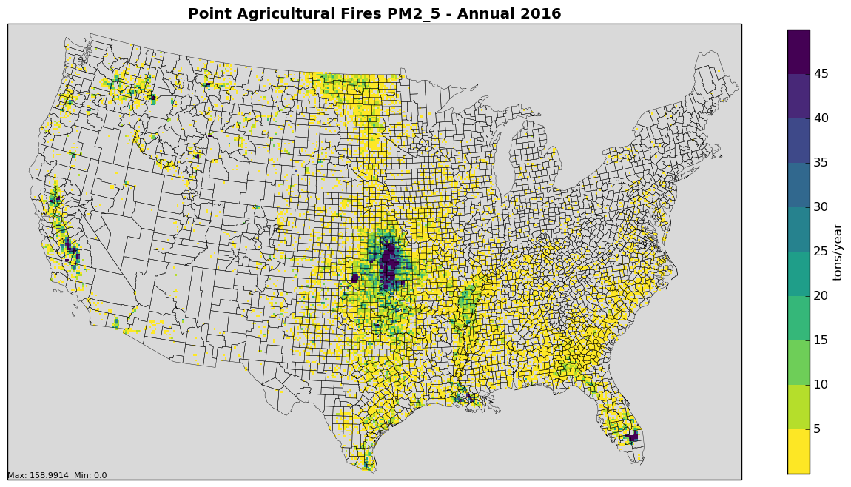
2014 vs. 2016 Ptagfire Annual PM_{2.5}
State | 2014 PM2.5 | 2016 PM2.5 | % diff
Arkansas | 1,706 | 2,745 | 61%
California | 3,596 | 5,689 | 58%
Florida | 3,632 | 3,676 | 1%
Georgia | 2,090 | 1,587 | -24%
Kansas | 10,861 | 18,385 | 69%
Missouri | 1,640 | 2,368 | 44%
North Dakota | 1,969 | 3,241 | 65%
Oklahoma | 6,124 | 9,545 | 56%
Texas | 4,401 | 5,815 | 32%
Washington | 1,694 | 1,334 | -21%
2014 PM_{2.5}
2016 PM_{2.5}

Slide 12
Preliminary 2016 Nonpoint sectors
Area Fugitive: use 2014NEIv1 unadjusted dust emissions with 2016 met-adjustments
Agricultural NH₃: 2014NEIv1 or livestock with 2016 hourly temporalization and 2016 fertilizer emissions
Nonpoint oil and gas: 2014NEIv1 adjusted to 2016 using state-specific oil and gas factors
Nonpoint: 2014NEIv1 inventory with speciation updates for Vinyl/Fabric/Leather/Polycarb coatings and agricultural VOCs
Residential Wood Combustion: 2014NEIv1 with 2016 temporalization
Rail: locomotive data consistent with 2014NEIv2 values
Biogenics: generated with BELD 4.1 and 2016 met. data

Slide 13
Preliminary 2016 Non-US Sectors
Other point: new 2013 Canada inventory and 2014 Mexico projected from 2008
Other area (nonpoint): new 2013 Canada inventory and 2014 Mexico projected from 2008
New spatial surrogates for Canada
Other fugitive dust: new 2013 Canada inventory
Met adjustments based on 2016
Onroad Canada: new monthly 2013 Canada inventory with new surrogates
Onroad Mexico: 2014 MOVES-Mexico inventory with updated spatial surrogate for human population

Slide 14
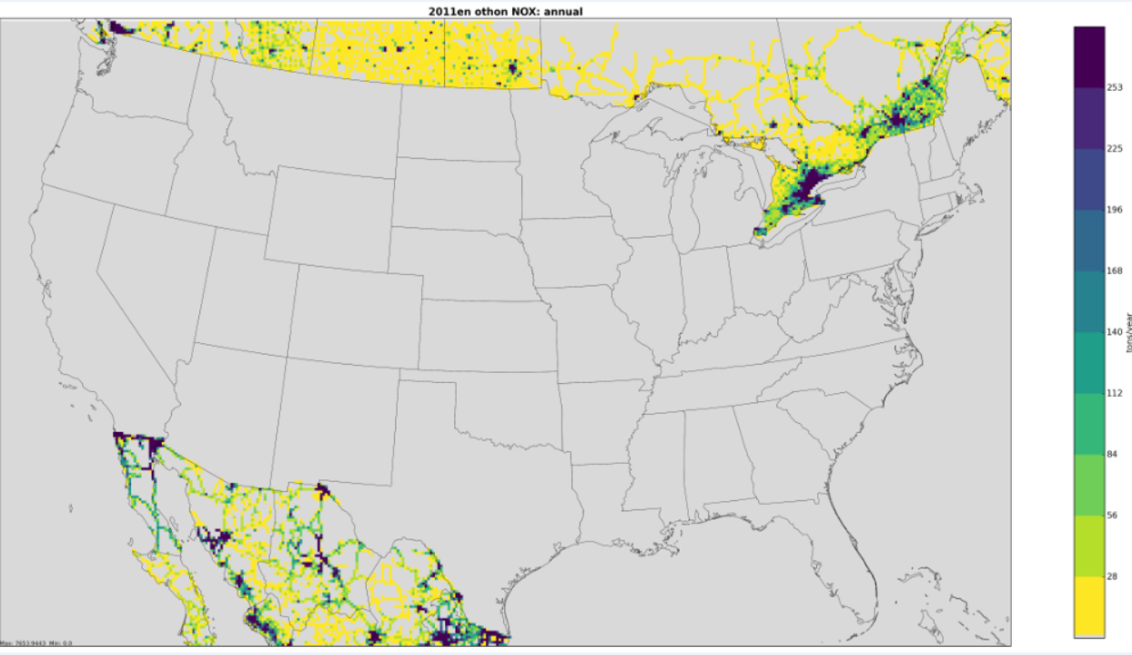
Onroad NOx in Canada and Mexico: Base and Changes
New 2013 inventory in Canada plus
new surrogates
Emissions move out of cities
New population surrogate in Mexico
Emissions move into cities
2011 emissions shown here

Slide 15
Preliminary 2016 Commercial Marine Vessel Emissions
CMV emissions are now separated from the off-shore oil and gas platform emissions
cmv_c3 is a point sector with plume rise for the larger Category 3 sources and follows shipping lanes
Projected to 2016 due to SO2 regulation (resulted in a large SO2 decrease, other pollutants adjusted slightly)
cmv_c1c2 is a nonpoint sector (emissions in layer 1)
Uses a new spatial surrogate based on 2013 https://www.marinecadastre.gov/data/
Farther offshore emissions are now in the same sectors as their near-shore emissions in state waters

Slide 16
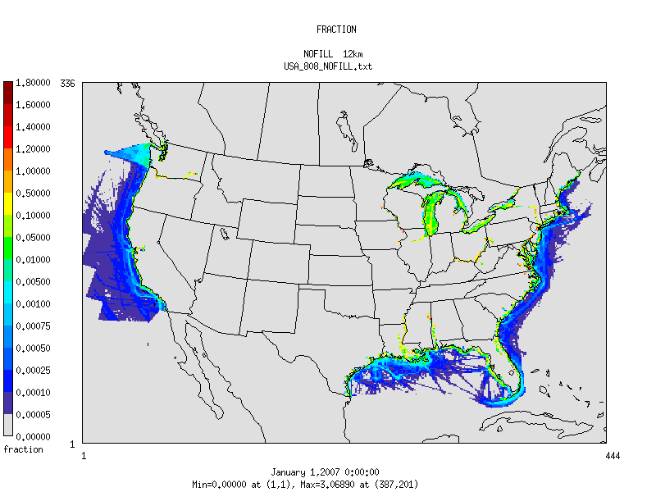
New 12km CMV Spatial Surrogate

Slide 17
Preliminary 2016 Onroad Emissions
2014NEIv1 MOVES inputs projected to 2016 and run through MOVES2014a for year 2016
Activity data from 2014NEIv2 projected to 2016 using Annual Energy Outlook 2016 & 2017
California emissions adjusted to 2016 by interpolation between 2014 and 2017 by county and pollutant
Spatial surrogates from 2014 platform used
More resolved roadway activity data for on-network
Used National Land Cover Database (NLCD) land development categories for off-network emissions

Slide 18
Preliminary 2016 Nonroad Emissions
MOVES 2014a run used to develop 2016 nonroad emissions including 2016 meteorology
California emissions adjusted to 2016 by interpolation between 2014 and 2017 by county and pollutant
2014 platform spatial surrogates used
Greater use of National Land Cover Database (NLCD) land development categories
Temporal profiles adjusted for construction, agriculture, and lawn and garden sources

Slide 19
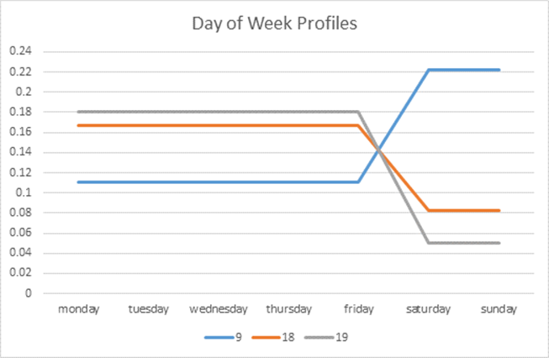
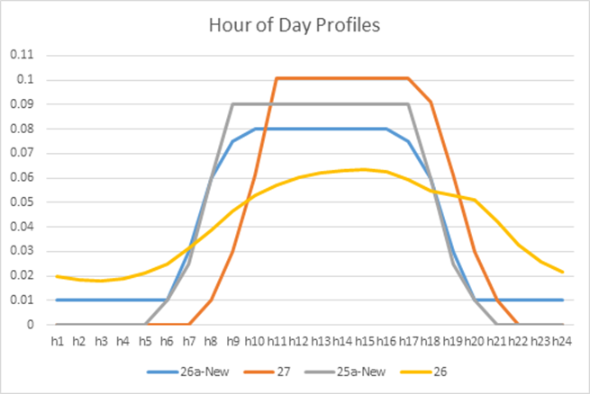
Nonroad Temporal Profile Updates
Non-Road Category | Old Day of Week | New Day of Week | Old Hour of day | New Hour of Day
Construction | 18 | 19 | 26 | 26a
Commercial Lawn and Garden | 18 | 19 | 26 | 25a
Residential Lawn and Garden | 9 | 9 | 26 | 27
Agriculture | 18 | 18 | 26 | 25a
Commercial L&G, Constr., Ag.
Old
Residential L&G
New
Res. Lawn & garden
Commerical, Ag.
Construction
Old

Slide 20
Conclusion
A preliminary 2016 emissions modeling platform based on 2014NEIv1 was developed
In the coming year, collaborative workgroups will form to develop a 2016 platform based on 2014NEIv2
Emissions modeling improvements (spatial, temporal, speciation) will continue to be used
The new platform will include a 2016 base year and future years that support ozone and regional haze analyses
Questions?

Slide 21
Extra Slides

Slide 22
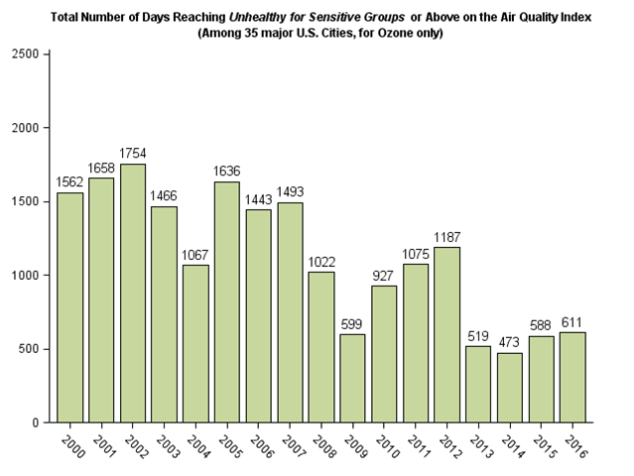
Ozone Unhealthy for Sensitive Groups Since 2000
There are many factors involved in selecting a base year: availability of inputs, representativeness of meteorology, some instances of poor AQ but not an unrepresentable number
O₃ rebounded a bit from the lower seasons of 2014 and 2015, thereby making it easier to study ozone events (source: AirNow)

Slide 23
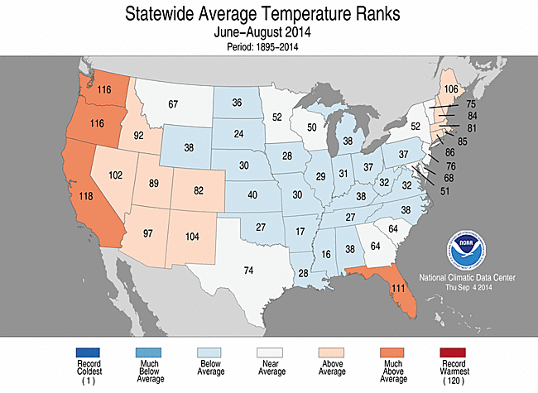
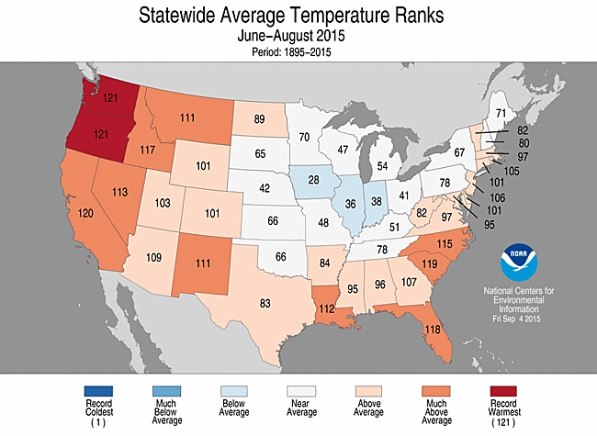
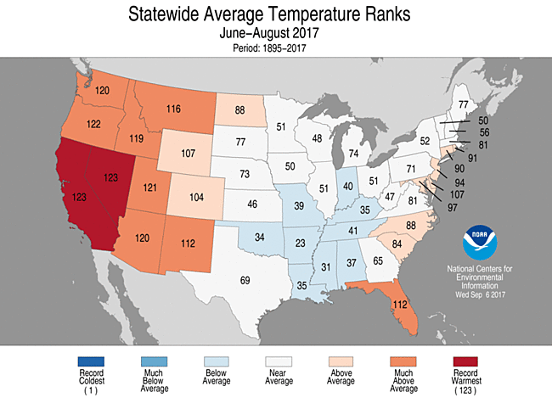
Recent Summer Temperature Ranks

Slide 24
Preliminary 2016 Platform Sectors
Point and non-US Sectors | Nonpoint Sectors
ptegu – Electric generating units | ag – agricultural ammonia (=2014v1 livestock)
pt_oilgas – Point oil and gas | afdust_adj – fugitive dust (= 2014v1)
ptnonipm – Non-EGU point (= 2014v1) | beis – biogenic
ptagfire – Point agricultural fires | cmv_c1c2 – C1&C2 (small to mid-size engine) Commercial Marine Vessels (=2014v1)
ptfire – Wild and prescribed fires | cmv_c3 – C3 Commercial Marine (=2014v1)
ptfire_mxca – Canada & Mexico fires | nonpt – Other nonpoint (= 2014v1)
othpt – Canada & Mexico point | np_oilgas – Nonpoint oil and gas
othafdust – Canada fugitive dust | nonroad – Nonroad mobile
othar – Canada & Mexico nonpoint | onroad – Onroad mobile
onroad_can – Canada onroad | rail – locomotive (= 2014v2)
onroad_mex – Mexico onroad | rwc – Residential Wood Combustion (= 2014v1)

Slide 25
Percent Changes by Sector from 2011 to 2016
Sector | NH3 % change | NOx % change | PM10 % change | PM2.5 % change | SO2 % change | VOC % change
Fugitive Dust (=2014) |  |  | 7% | 9%
Ag. Fires | 2319% | -60% | -37% | -33% | -68% | -55%
C1C2 CMV (=2014) | -34% | -21% | -38% | -38% | -46% | -42%
C3 CMV (=2014) | -56% | -10% | -58% | -57% | -54% | 7%
Nonpoint (=2014) | 21% | 10% | 45% | 41% | 9% | -3%
Nonpoint Oil and Gas |  | 19% | 16% | 24% | 119% | 25%
Nonroad | -15% | -15% | -13% | -14% | -22% | -19%
Onroad | -15% | -19% | -6% | -16% | 0% | -20%
Wild and Prescr. Fires | -17% | -26% | -20% | -20% | -22% | -16%
Electric Generating Units | 3% | -16% | -17% | -12% | -31% | -7%
Non-EGU Point (=2014) | -2% | -2% | 10% | -9% | -17% | 3%
Point Oil and Gas* | -94% | -22% | -20% | -20% | -37% | -19%
Rail (=2011+state data) | 5% | -1% | -3% | -3% | -12% | -2%
Res. Wood (=2014) | -18% | -7% | -13% | -13% | -10% | -21%
Continental U.S. | -15% | -13% | 1% | -7% | -26% | -8%
* Selection criteria for point oil and gas sources changed for the 2016 platform

Slide 26
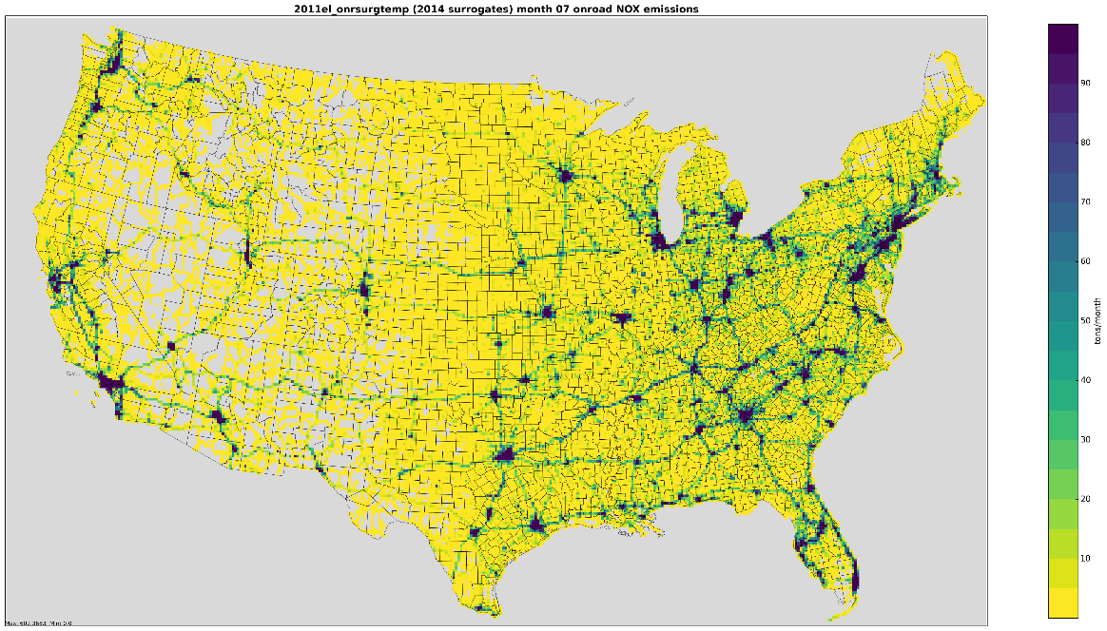
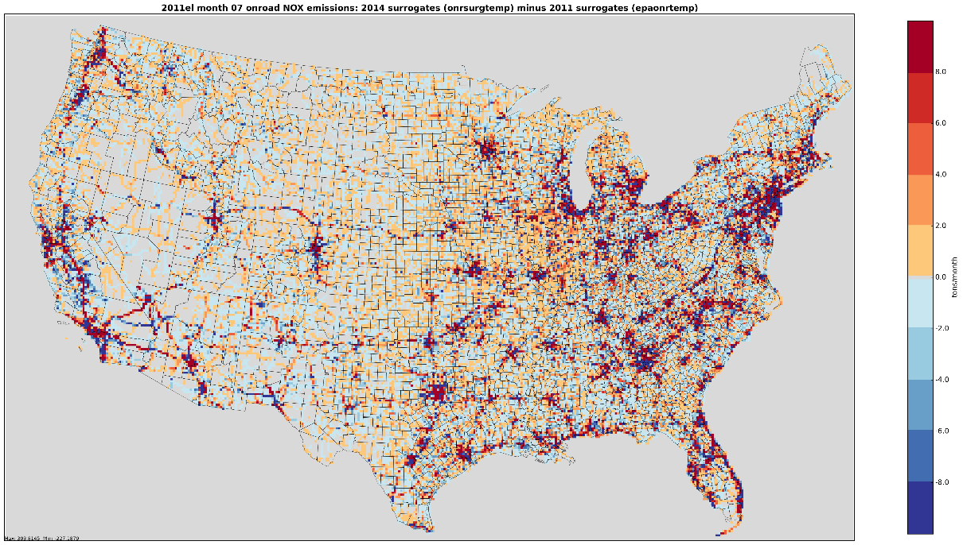
Impacts of new Spatial Surrogates on Onroad NOx Emissions
2011 surrogates
2014 surrogates
Difference between 2011 and 2014 surrogates

