Slide 1
Projections of Atmospheric Nutrient Deposition to the Chesapeake Bay Watershed
Patrick C. Campbell¹, Jesse O. Bash¹, Chris Nolte¹, Tanya L. Spero¹,
Ellen J. Cooter¹, Kyle Hinson², and Lewis Linker²
¹National Exposure Research Laboratory, U.S. Environmental Protection Agency, Research Triangle Park, NC, USA
²Chesapeake Bay Program, Annapolis, MD, USA
2017 CMAS Conference
October 25, 2017
Notes:
Discuss impacts of climate and emissions changes on …
Acknowledge co-authors both from the U.S. EPA and the Chesapeake Bay program.

Slide 2
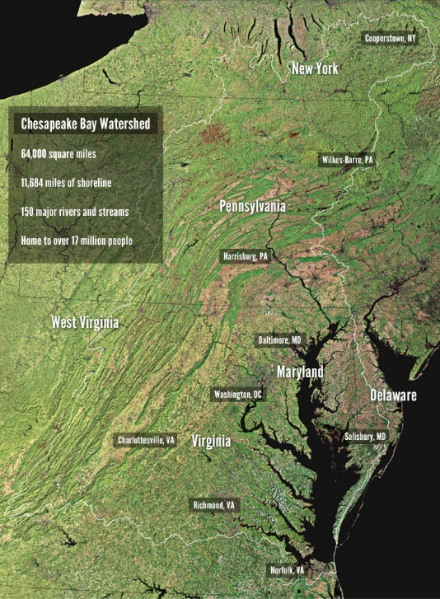
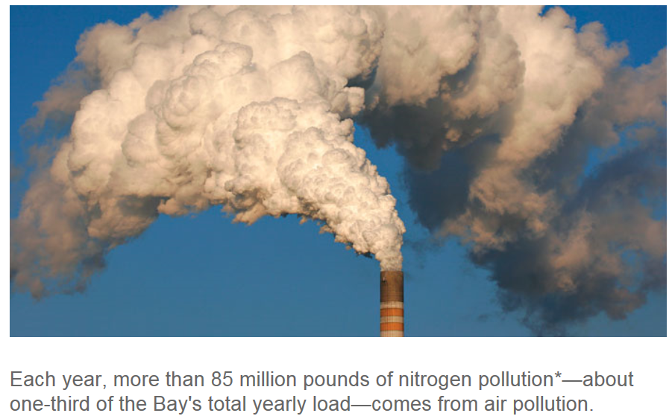
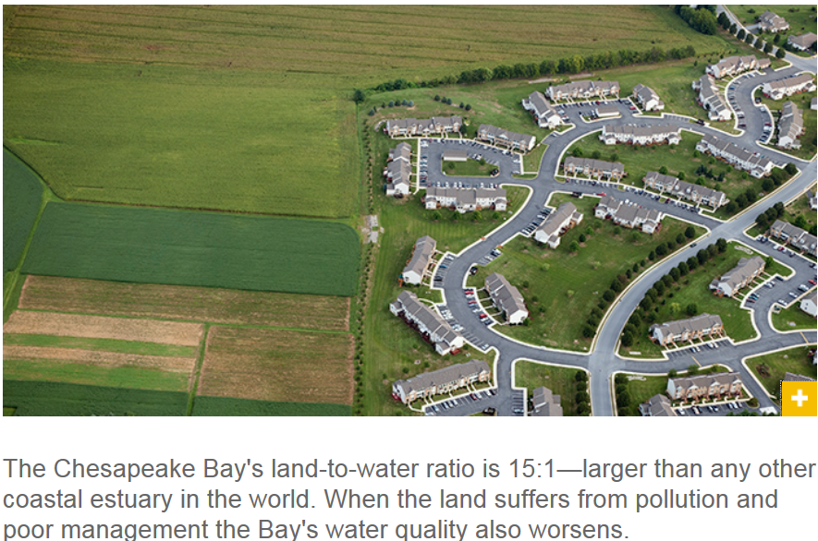
Introduction
Chesapeake
Bay Watershed
Nitrogen loading to the Chesapeake
Bay watershed
5%
Climate
25%
70%
Emissions
Linker et al. (2013)
Atmospheric nitrogen loading is the second largest source of nitrogen in the watershed
Point and agriculture loading presented here are direct loading to the watershed
A bridge through the marsh, Tangier Island
Land Use
Land Use
Key scientific question: How do changes in climate, land use, and emissions impact regional meteorological drivers and atmospheric nutrient deposition loading important to the Chesapeake Bay’s water quality and ecosystem health?
Notes:
Largest estuary in the United States - Encompasses parts of six states and is 64,000 sq. miles - Home to more than 18 million people - Land-to-water ratio of 15:1 - The largest of any coastal water body in the world - Sensitive to future climate, emissions, and land use changes that serve to alter its atmospheric inputs
Modeling results indicate that a 23% reduction in atmospheric nitrogen loading has been achieved through air quality regulations from 2002 to 2012
But changes in climate systems are expected to alter key variables and processes within the Watershed and should be examined in concurrence with land use changes that will interact with and potentially exacerbate climate impacts”
Besides damage to an already sensitive ecosystem, another aspect is that recreation and fisheries are important to the economy in the Chesapeake Bay, and thus clean water and healthy habitats are necessary to support these activities
Chesapeake Bay restoration efforts are improving water quality, habitat and fisheries according the 2016 State of the Bay assessment
There are sill areas in need of further improvement
Particularly nutrient loading and oyster and shad fisheries
The composition of atmospheric reactive nitrogen deposition is shifting from oxidized (fossil fuel combustion) to reduced (largely agricultural) over the past decade
Controls of emissions differ
Fossil fuel combustion emissions regulated under Clean Air Act
Agricultural best management practices are largely voluntary
Ecosystem impacts differ

Slide 3
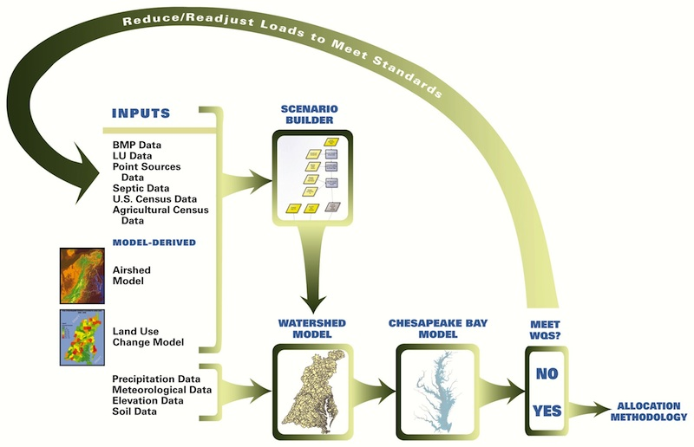
Chesapeake Bay Program
Chesapeake Bay Program (CBP) Model Framework
Linked modeling system to assess current and proposed watershed management on changes in water quality and ecosystem health of the Chesapeake Bay
Includes simulations of the airshed, watershed, land-use, estuary, ecosystem, and climate
The linked Weather Research and Forecasting (WRF) and Community Multiscale Air Quality (CMAQ) models are integral parts of the CBP model framework
https://www.chesapeakebay.net/who/group/modeling_team
https://www.epa.gov/restoration-chesapeake-bay
Notes:
Recognizing the need to improve water quality in the Bay, the Chesapeake Bay Program was established in 1983 as a federal, state and local partnership, including non-profits and academic institutions.
EPA ORD has been providing atmospheric nitrogen loading estimates for more than two decades.
EPA works with federal and state agencies, non-profit organizations and academic institutions to coordinate restoration of the Chesapeake Bay and its watershed through the Chesapeake Bay Program. On December 29, 2010, the EPA established the Chesapeake Bay Total Maximum Daily Load (TMDL). The TMDL is a historic and comprehensive "pollution diet" to restore clean water in the Chesapeake Bay and the region's streams, creeks, and rivers.
The TMDL is the largest ever developed by EPA, encompassing a 64,000-square-mile watershed. The TMDL identifies the necessary pollution reductions from major sources of nitrogen, phosphorus and sediment across the Bay jurisdictions and sets pollution limits necessary to meet water quality standards. Bay jurisdictions include Delaware, Maryland, New York, Pennsylvania, Virginia, West Virginia and the District of Columbia.
Specifically, the TMDL set Bay watershed limits of 185.9 million pounds of nitrogen, 12.5 million pounds of phosphorus and 6.45 billion pounds of sediment per year. This equates to a 25 percent reduction in nitrogen, 24 percent reduction in phosphorus and 20 percent reduction in sediment

Slide 4
WRF-CMAQ Simulation Design
Paired simulations:
Current (CURR)
01 Jan 1995 –
31 Dec 2004
Future (FUT)
01 Jan 2045 –
31 Dec 2054
RCP4.5: stabilized radiative forcing at 4.5 W m⁻² by 2100
(Thomson et al., 2011)
IPCC AR5 RCP4.5
Global mean temp. change ~ +1.4°C
http://ar5-syr.ipcc.ch/
Details on the RCP4.5 Scenario
Developed by GCAM model at PNNL/JGCRI
Stabilization scenario
Notes:
In this work we advance and apply a dynamically downscaling method, which I will not delve into detail here, but just say that the coarser resolution global model, based on CESM1.0 provides the ICONs and BCONs to the finer scale regional WRF-CMAQ-EPIC model, in this case 36x36 km, so we can represent the impacts of global climate change on regional meteorology and air quality in the future.
The modified WRF-CMAQ system is also coupled to EPIC (Environmental Policy Integrated Climate) → models agricultural cropping management and soil biogeochemical processes for input to CMAQ for improved nutrient modeling (e.g., NH3 emissions and NH4 fate)
This model design is a relative optimistic future, where the global CESM model is driven by Representative Concentration Pathway scenario 4.5 emissions, and the regional CMAQ simulation applies future projections to 2040 based on federal and state regulations and predicted measures to 2040.
Two downscaled CESM RCP4.5 periods, a current period of 1995 - 2004 and a future period 2045 – 2054.
The radiative forcing pathway of the RCP4.5 scenario is comparable to a number of climate policy scenarios and several low-emissions reference scenarios in the literature, such as the IPCC SRES B1 scenario. Stabilizes anthropogenic forcing at 4.5 W m2 by 2100. 3-month spin-up period for WRF to drive CMAQ.

Slide 5
Modifications to WRF and CMAQ
Both offline and coupled WRFv3.8.1-CMAQv5.2 has been modified to have more consistent physical parameterizations for climate-air quality-deposition studies:
WRF/Noah LSM canopy resistance, i.e., bulk stomatal resistance (R_{c}) used as input to WRF-CMAQ
R_{c} modifications to sub-grid scale mosaic/tiling land cover composition approach in WRF/Noah LSM (Li et al., 2013)
Updated vegetation data tables in WRF/Noah with land use specific MODIS-regressed Leaf Area Index (LAI)
Updated soil data tables values adapted from Kishne et al. (2017), which is based on a detailed study using the USDA - National Cooperative Soil Characterization Database (USDA-NRCS)
Revised soil O₃ resistance based on Meszaros et al. (2009)
WRF/Noah top soil layer depth is modified from 10 to 1 cm for improved consistency with CMAQ processes
More details found in our 2017 WRF User’s Workshop presentation: (http://www2.mmm.ucar.edu/wrf/users/workshops/WS2017/oral_presentations/5.2.pdf); also in upcoming manuscript: Campbell et al. (2017).
In this work, we apply a modified offline WRFv3.8.1-CMAQv5.2 model system
Notes:
1 and 2 improve the consistency between CMAQ and WRF-Noah, uses a key parameter for CMAQ deposition (additional canopy moisture content correction)
3 Addresses the differences between outdated default Noah Vegetation Table, and the satellite derived vegetation
4 Addresses inconsistencies in the significantly outdated (> 25 years) hydraulic properties in the Noah soil table – and values used within CMAQ LSM_MOD.F
5 Addresses western O3 biases that are masked in PX simulations by exaggerated vegetation fractions → increases O3 DDEP to soil, especially in drier soil regions of the west
6 Improves the consistency between Noah soil simulations with EPIC and CMAQ for wind blown dust and bidirectional NH3 exchange applications
Note that I will not provide the typical slide on all model configurations used here, as it has been shown and discussed at length here and other conferences, but we can discuss further if you’d like. I’d rather jump right into the results and discussion.

Slide 6
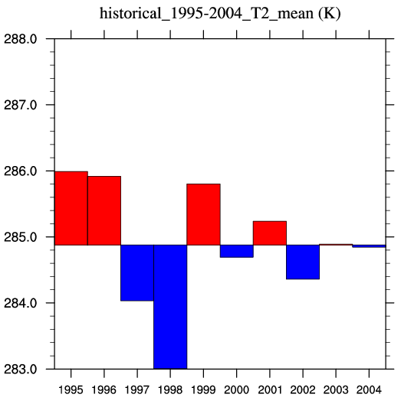
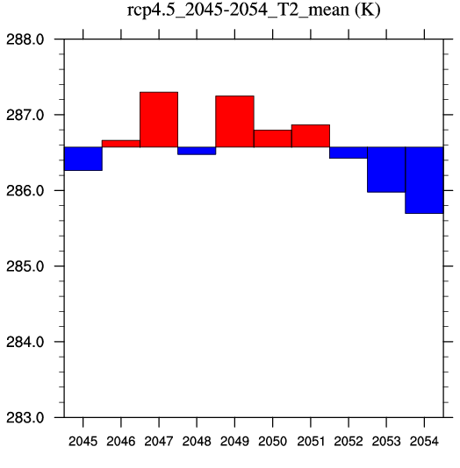
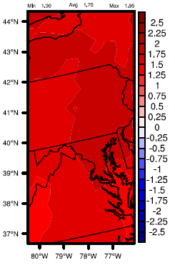
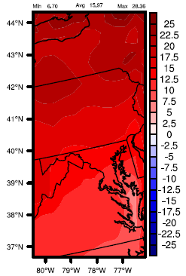
Climate Changes (T2)
10-yr and Annual Mean 2-m Temperature (K) (T2)
10-yr Seasonal Mean T2
CURR
FUT
Chesapeake Bay Watershed
Red: Above 10-yr mean
Blue: Below 10-yr mean
10-yr Annual
Mean T2 →
Abs.
(°C)
Rel.
(%)
Annual
Min: +1.3 °C (+6.8%)
Max: +2.0 °C (+28.4%)
Mean: +1.7°C (+16.0%)
Annual
Annual
Notes:
Looking at climate changes, the 10 year annual mean 2-meter temperature (T2 – top left bar charts) shows clear increase over Chesapeake Bay, where all annual warmer and cooler years compared to the 10-year mean in the future are warmer than the current period.
While the warming is widespread across the U.S., there are clear spatial and seasonal differences (right spatial plots), with some of the greatest warming found in the west, west-northwest, and central U.S.
The 10-year annual mean T2 (lower plots) shows mean increases over the Chesapeake Bay watershed of about 1.7C, with a max near 2.0C.
(+2.0° C for CONUS; Yahya et al., 2017-Downscaled RCP4.5 with fully coupled chemistry WRF-Chem model)
Decadal application of WRF/chem for regional air quality and climate modeling over the U.S. under the representative concentration pathways scenarios. Part 2: Current vs. future simulations

Slide 7
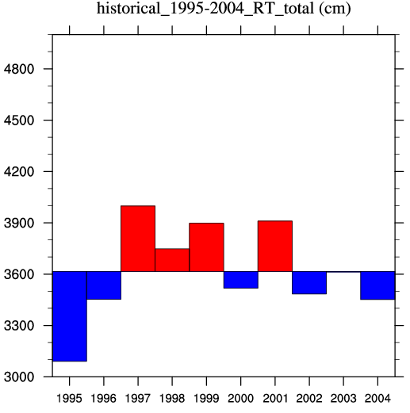
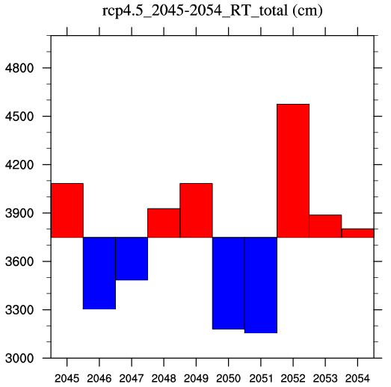
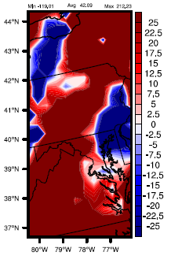
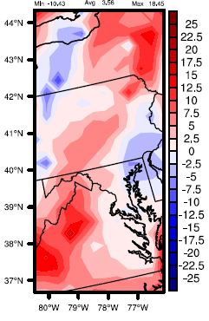
Climate Changes (PRECIP)
10-yr and Annual Total Precipitation (cm) (PRECIP)
10-yr Seasonal Mean PRECIP
Chesapeake Bay Watershed
Red: Above 10-yr mean
Blue: Below 10-yr mean
CURR
FUT
10-yr Annual
Total PRECIP →
Abs. (cm)
Rel.
(%)
Min: -119.0 cm (-10.4%)
Max: +212.2 cm (+18.5%)
Mean: +42.1 cm (+3.6%)
Annual
Annual
Notes:
Similar plots for precip expectedly show a more complex story given the complex interactions on precipitation formation, but the 10-year annual total precipitation over the Chesapeake Bay shows a slightly wetter 10 year mean, with more interannual variability
Seasonal and spatial differences over the whole U.S. in the changes, but typically drier west, and more variable eastern U.S. changes (plenty more discussion on this).
Overall for the 10 year annual total precipitation changes over the Chesapeake Bay watershed there are on average increased precipitation of about 42 cm, but the range in minimum and maximum changes is large.

Slide 8
Climate Reanalysis Evaluation
CURR and FUT downscaled WRF simulation compared to NCEP’s North American Regional Reanalysis (NARR) dataset for precipitation (3-hourly) and Climate Forecast System Reanalysis (CFSR) dataset for 2-m temperature (hourly)
10-yr Average Monthly T2
10-yr Average Monthly PRECIP
Green: NARR/CFSR Reanalysis
Blue: CURR
Red: FUT
Notes:
We cannot compare historical CESM RCP4.5 downscaled runs to direct observations as the climate run is just a climate scenario driven forecast, not necessarily representative of any specific point in space/time. Thus we should only compare climatological averages, and comparisons against reanalysis datasets are well suited for such comparisons.
Precipitation on top, and 2-m temperature on bottom. 10 year average monthly precipitation for each month for Jan – Dec on left, and cumulative distribution analyses for each season on right.
CURR Temperature agrees well with CFSR (slight systematic warm bias), and overall warmer atmosphere in future with monthly FUT averages above CURR, and shift of CDF to the right for daily average temperatures.
Precipitation more interesting. Good agreement with NARR, except in summer, where precipitation is overpredicted in Chesapeake Bay (especially at the higher precip rates). Consistently wetter average FUT winter and early spring, but more variable FUT changes in late spring, summer, and fall.
Overall, good representation of the current climate by downscaled CESM to WRF against the reanalysis.

Slide 9
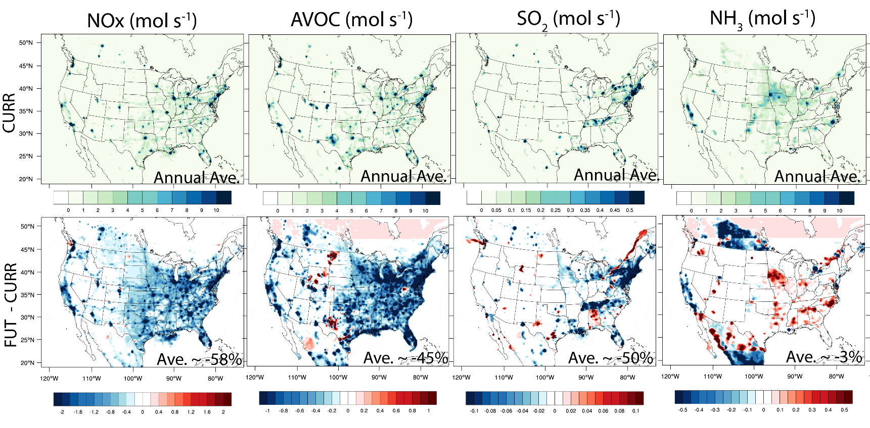
Emission Projections
CURR: EPA’s 2011v6.2 (EPA, 2015) based on 2011NEIv2
FUT: Includes federal and state regulations in place before Aug 2015 and projected to 2040 (EPA, 2016)
Percentages are approximate domain-wide % emission changes relative to 2011v6.2
Notes:
Highly comprehensive future emissions dataset are projected from the 2011 NEI base case either by running models to estimate future year emissions from specific types of emission sources (e.g., EGUs, and onroad and nonroad mobile sources), or for other types of sources by adjusting the base year emissions according to the best estimate of changes expected to occur in the intervening years (e.g., non-EGU point and nonpoint sources).
Examples:
EGU Point Sources: Unit-specific estimates from IPM version 5.15, including the Clean Power Plan (CPP), Cross State Air Pollution Rule (CSAPR), Final Mercury and Air Toxics Standards (MATS), Regional Haze rule, and Cooling Water Intakes Rule.
Mobile On-Road and Non-Road: MOVES2014 model was used with year-specific information about fuel mixtures, activity data, and the impacts of national and state-level rules and control programs . 2030 data for California were provided by the California Air Resources Board. Texas data were projected from the 2011 inventory provided by TCEQ.
Ag: Year 2030 projection factors for livestock estimates based on expected changes in animal population from 2005 USDA data, updated according to EPA experts in July 2012
Area fugitive dust sector (afdust): For livestock PM emissions, projection factors for dust categories related to livestock estimates based on expected changes in animal population. For unpaved and paved road dust, county-level Vehicle Miles Traveled (VMT) projections to 2040 were considered.

Slide 10
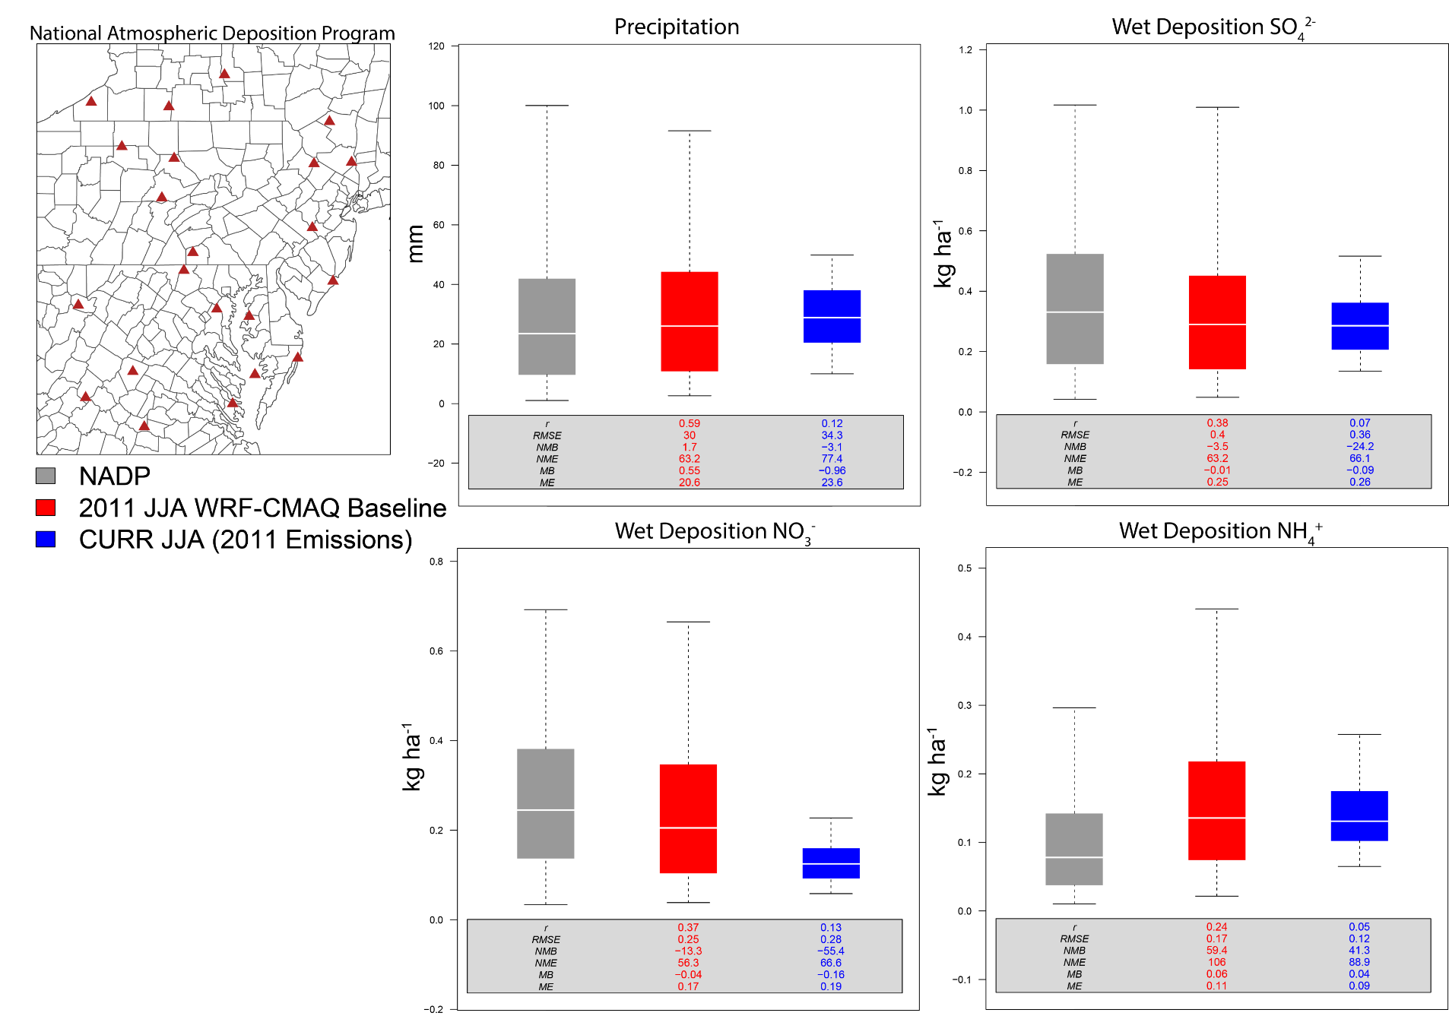
Wet Deposition Evaluation
Gray: Bi-weekly JJA NADP
observations
Red: 2011 JJA baseline
WRF-CMAQ (similar model)
Re-analysis ICONs/BCONs
Blue: CURR period average
(1995 – 2004) JJA simulation
2011 NEIv2 emissions
Notes:
Overall good agreement in overall median (white lines) and interquartile range for the box plot comparisons and statistics, but max/min is much lower for averaged CURR JJA period compared to 2011 baseline run (as these are 10 year averages compared against 2011).

Slide 11
Future Nitrogen Deposition
Preliminary Climate + Emission Impacts:
CURR (1995–2004)
FUT (2045–2054)
Chesapeake Bay Watershed
16 to 29% reduction in total nitrogen atmospheric deposition
Clear benefits from air-quality
standards under a changing climate
Largely dominated by reductions
in OxN deposition (40 to 47%)
Increases in total reduced (NH_{x})
deposition (up to +19 %)
Notes:
Spatial plots of current and future total nitrogen deposition within the Chesapeake Bay Watershed.
Largely unregulated NH3 emissions compared to NOx
Although REDN deposition only increases by 3%, recent observations suggest that REDN ~ 65 % total inorganic nitrogen deposition budget (Li et al., 2016)
Approximate contributions to total deposition:
Dry Deposition ~ 60 %
Wet Deposition ~ 40 %
Overall N deposition has decreased due to air quality standards
Ratio of oxidized to reduced N deposition is changing
Oxidized N deposition is decreasing faster than total N deposition
In response to controls on combustion sources
Reduced N deposition is increasing
In response to changes in atmospheric composition and a lack of controls on NH₃ emissions

Slide 12
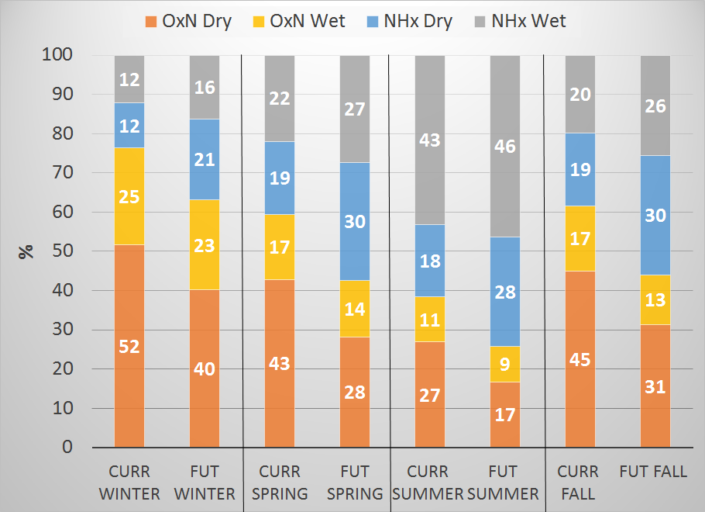
Nitrogen Deposition Budget
Ratio of oxidized to reduced species is important!
Analysis suggests a shift toward relative increases in reduced nitrogen (NHx) deposition.
Chesapeake Bay
Watershed
Notes:
Stacked bar chart comparison of seasonal current to future changes in proportions of wet and dry, and oxidized and reduced nitrogen, to the total nitrogen deposition budget.
Brown and yellow is dry and wet deposition of oxidized nitrogen decreases, while blue and grey are dry and wet deposition of reduced nitrogen increases. Largest increases in NHx dry as this is mostly NH3 gas dry deposition, which deposits much faster than the NH4+ aerosol in NHx wet.

Slide 13
Preliminary Findings
Improved simulation of nitrogen budget in WRF-CMAQ, which is critical for simulating Chesapeake Bay under various environmental futures.
The downscaled WRF-CMAQ climate and wet deposition simulations capture the seasonal and regional variability well against NCEP reanalysis and NADP data, respectively.
Reduction in future total atmospheric nitrogen deposition, due to decreased oxidized nitrogen, and apparent shift towards increased reduced nitrogen proportion.
NH₃ dry deposition increases are larger than increases in emissions, due to a reduction of ambient NH₄⁺ aerosols from SOx and NOx controls.
Gaseous NH₃ deposits much faster than aerosol NH₄⁺.

Slide 14
Further Work
How can we independently characterize the roles of changing weather and emissions on atmospheric nutrient deposition to the Chesapeake Bay watershed?
If changes to land use are also holistically considered, how could the atmospheric nutrient deposition be altered?
How does increasing model resolution impact the atmospheric deposition changes?
Notes:
Bullet One:
Bullet Two:
ICLUS methods of redistributing population, housing development, and impervious surface change—incorporate LU change in both WRF and CMAQ emissions
Bullet Three:
One-way nesting down to 12 and 4 km over eastern U.S. and Chesapeake Bay watershed, better representation of interaction of complex terrain/flow and convective precipitation impacts on wet deposition.

Slide 15
References
Campbell, P., J. O. Bash, and T. L. Spero (2017), Improvements to the Noah Land Surface Model in WRF-CMAQ, in preparation.
EPA (2015), Preparation of Emission Inventories for the 2011v6.2 Emissions Modeling Platform. Available at: https://www.epa.gov/air-emissions-modeling/2011-version-62-technical-support-document.
EPA (2016), Emissions Inventory for Air Quality Modeling Technical Support Document: Heavy-Duty Vehicle Greenhouse Gas Phase 2 Final Rule, EPA-420-R-008, August 2016.
Kishné, A.S., Y. T. Yimam, C. L. S. Morgan, and B. C. Dornblaser (2017), Evaluation and improvement of the default soil hydraulic parameters for the Noah Land Surface Model, Geoderma, 285, 247 – 259.
Li, D., E. Bou-Zeid, M. Barlage, F. Chen, and J. A. Smith (2013), Development and evaluation of a mosaic approach in the WRF-Noah framework, J. Geophys. Res. Atmos., 118, 11,918–11,935, doi:10.1002/2013JD020657.
Linker, Lewis C., Robin Dennis, Gary W. Shenk, Richard A. Batiuk, Jeffrey Grimm, and Ping Wang (2013), Computing Atmospheric Nutrient Loads to the Chesapeake Bay Watershed and Tidal Waters. Journal of the American Water Resources Association (JAWRA) 1-17. DOI: 10.1111/jawr.12112
Meszaros, R., D. Szinyei, C. Vincze, I. Lagzi, T. Turanyi, L. Haszpra, and A. S. Tomlin (2009), Effect of the soil wetness state on the stomatal ozone fluxes over Hungary, Int. J. Environment and Pollution, 36, 180 – 194.
Thomson, A. M., K. V. Calvin, S. J. Smith, G. P. Kyle, A. Volke, P. Patel, S. Delgado-Arias, B. Bond-Lamberty, M. A. Wise, L. E. Clarke, and J. A. Edmonds (2011), RCP4.5: a pathway for stabilization of radiative forcing by 2100, Climate Change, 109, 77 -94.

Slide 16
WRF-CMAQ Configuration
Model Domain and Time Periods
Model | Variant of Offline WRFv3.8.1-CMAQv5.2
Period and Domain | 1995-2004 & 2045-2054; North America, CONUS Centered
Horiz. And Vert. Resolution | 36×36 km & 35 layers up to 50 h Pa
Inputs
Land Use | USGS28
Chemical ICONs/BCONs | GEOS-Chem (identifies inland water cells)
Meteorological ICONs/BCONs | Downscaled 0.875°×1.25°Community Earth System Model version 1.0 w/ spectral nudging – treatment of inland water bodies Spero et al., (2016)
Emissions | Current Anthropogenic: EPA’s 2011v6.2 platform Future Anthropogenic: “On-the-books” 2040 reference case CMAQ in-line BEISv3.6.1 for biogenic, bi-directional NH₃ (EPIC), updated windblown dust, and sea-salt mask
WRF Physics and CMAQ Chemistry
Radiation | Rapid Radiative Transfer Model for GCMs (RRTMG)
LSM, Sfclay, and PBL | Modified Noah (Campbell et al., 2017), MO, and YSU
Cumulus | Kain-Fritsch (KF)
Microphysics | Morrison Double Moment
Gas-Phase/Aqueous-Phase/Aerosol Mech. | CB05-TUCL/AQChem Updates/AERO6-3 modes
Photolysis | CMAQ in-line photolysis
Notes:
Similar configuration as to the modified and coupled test runs in Part I, but with a few differences highlighted in blue.
Also new in this work is dynamically changing the GHG concentrations in WRF (not just CESM) year-by-year based on previous global CAM RCP4.5 scenario simulations. This has definitive impacts on the RRTMG radiation through changing GHGs, and effectively alter the future regional temperature, while indirectly impacting the O3 concentration in CMAQ. Also, in CMAQ, we set the prescribed CO2 and CH4 concentrations based on average 1995-2005 and 2045-2055 values from CAM RCP4.5. The change in CH4 will directly impact the O3 levels in the historical and future cases.
Spectral Nudging is a new upper-air nudging option since Version 3.1. This selectively
nudges the coarser scales only, but is otherwise set up the same way as grid-nudging.
This option also nudges geopotential height. The wave numbers defined here are the
number of waves contained in the domain, and the number is the maximum one that is
nudged.
Spectral nudging preserves large scale atmospheric motions from CESM, and allows WRF to provide the more detailed regional scale dynamics

